Slide 1
Assigned Wheel Hub – GD&T
A STEP BY STEP WALKTHROUGH

Slide 2
What you will need…
Assigned part drawings for reference
Wheel Hub
Review material on GD&T from CAD course

Slide 3
Wheel Hub
The following slides walk you through the GD&T dimensioning process on the assigned wheel hub.
NOTE: The following drawings are provided to illustrate one way to properly dimension the wheel hub using GD&T, not the only way.

Slide 4
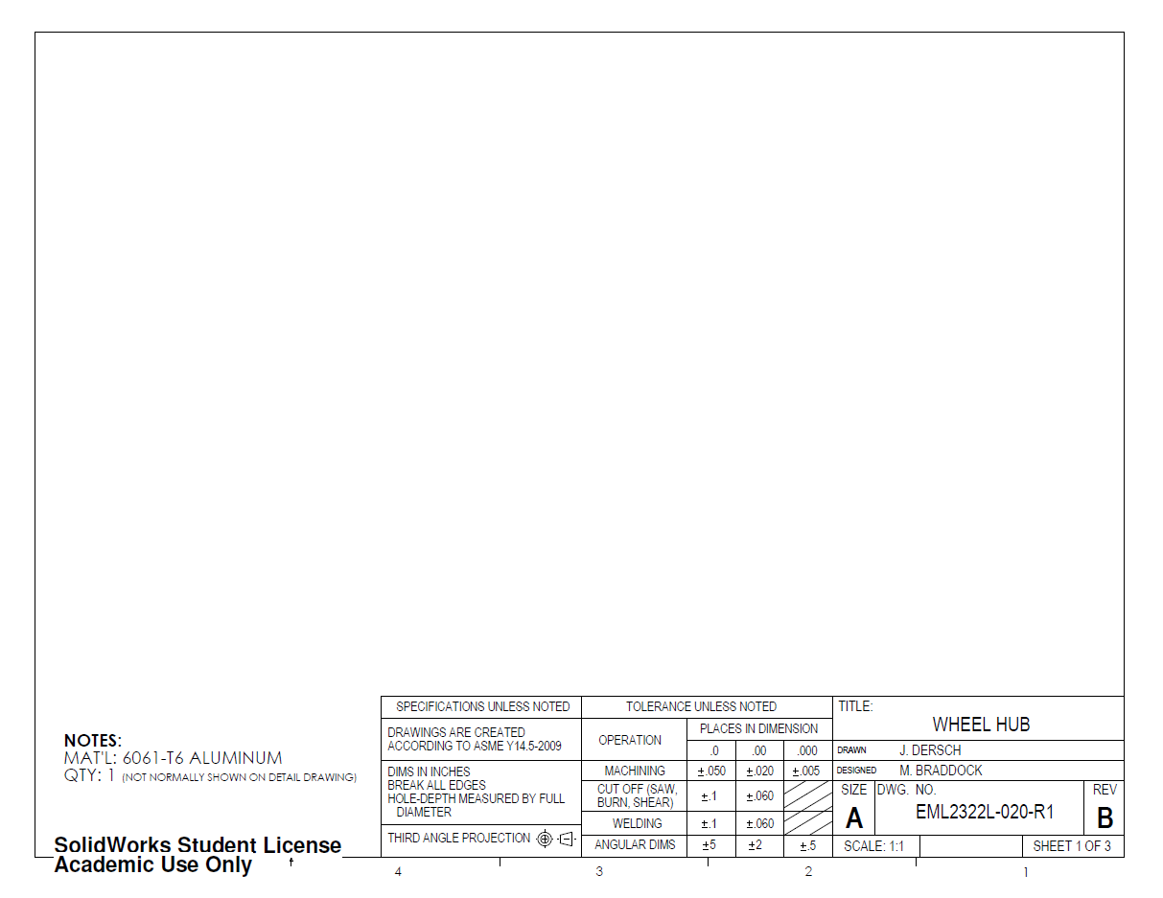
Use a similar title block as in Traditional Dimensioning and Tolerancing (TD&T)
Requires standard notes:
- material
- units
- deburring Instructions
Finish notes are not included since finish is specified differently on GD&T drawings
ADDITIONALLY:
Specify this drawing uses GD&T
Note how views are projected (see graphic beside note)
Define where hole depth is measured (Alternatively, hole-depth can be measured by the drill’s point)

Slide 5
In lab, we have always specified a quantity on the detail drawing in order to simplify the lab.
HOWEVER, in industry, the quantity is usually specified in the BOM and rarely shown on detail drawings (TD&T or GD&T).
Quantity is shown here to match the TD&T wheel hub drawings.

Slide 6
In this case, the same views that are used in TD&T can be
used for GD&T. Add these views to the page…

Slide 7
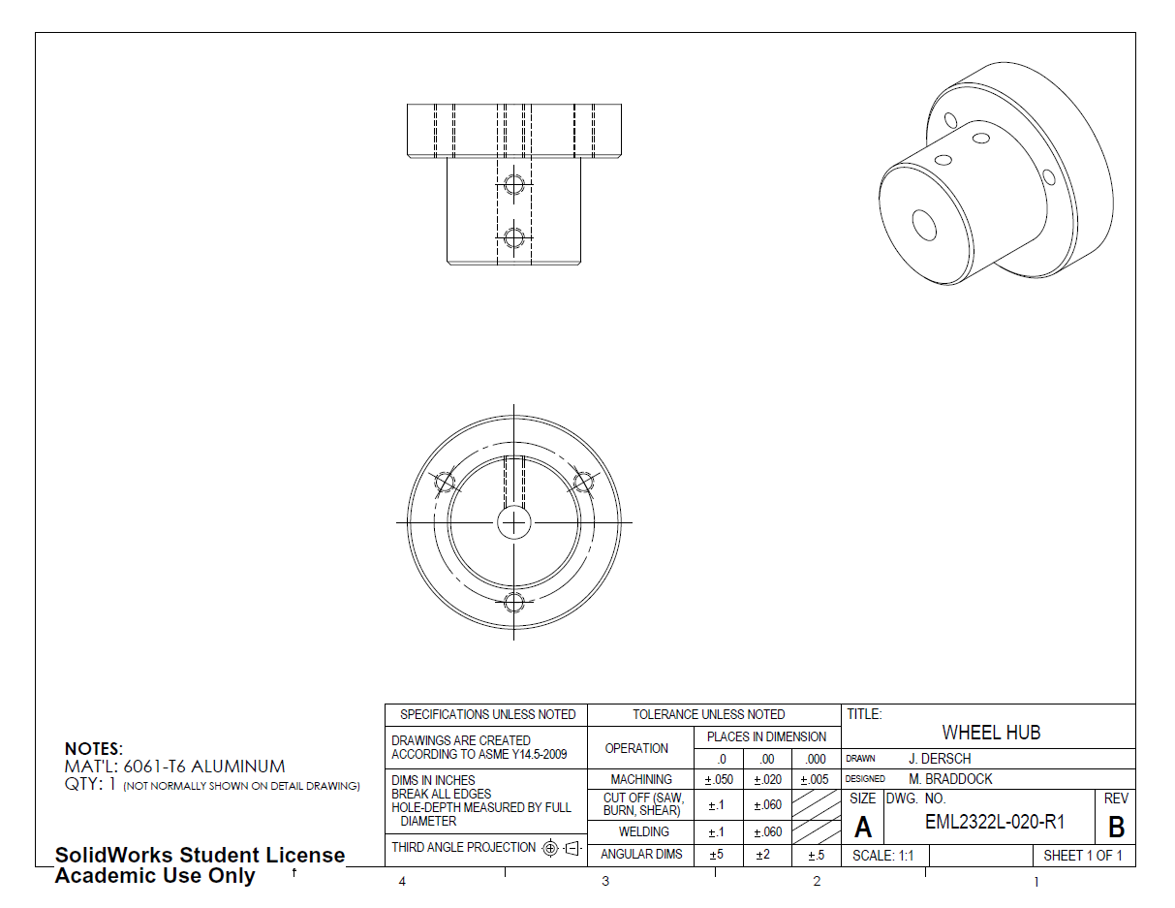
In this case, the same views that are used in TD&T can be
used for GD&T. Add these views to the page…

Slide 8
Now, define datums and control frames.

Slide 9
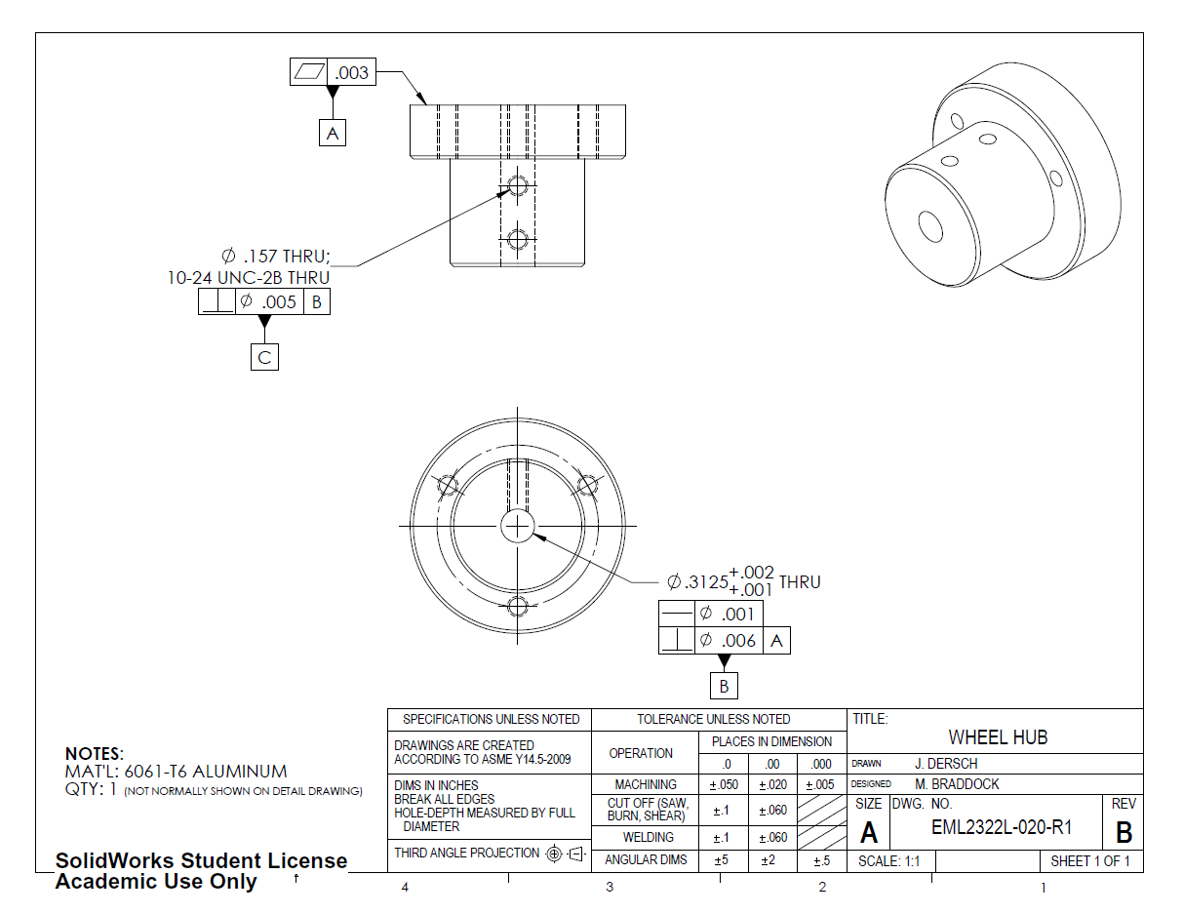
Datum Feature
Symbols

Slide 10
Feature Control
Frames (FCF)

Slide 11
This reads: “This feature is flat to within three-thousandths of an inch and defines datum plane A.”
The most critical datum is defined as Datum A. For this part, the face that touches the wheel is the most important since poor flatness results in wheel wobble.

Slide 12
This surface must be contained within an envelope three-thousandths of an inch wide.
This reads: “This feature is flat to within three-thousandths of an inch and defines datum plane A.”
In the TD&T drawing, all surfaces were specified to be finished, but did not include geometric (flatness) specifications. GD&T allows flatness requirements to be easily specified on any part surface.

Slide 13
Indicates this feature is Datum A

Slide 14
Specifies Flatness control

Slide 15
Defines Envelope Width

Slide 16
Datum A
Three-thousandths inch wide envelope (not to scale) in which every point on the top surface must be contained.
NOTE: Datum A is the outermost surface of the part. The three-thousandths of an inch envelope extends into the part. This is a result of the datum placement and is NOT normally the case for ‘flatness’.
Normally, the specified envelope width is centered on that plane. If this surface was not defined as a datum, then the envelope would extend 1.5 thousandths on either side of the ‘perfect’ location.

Slide 17
This reads: “This feature…
The thru hole is defined as a very close clearance hole for the 5/16 shaft.

Slide 18
This reads: “This feature is straight to within one-thousandths of an inch diameter…
This means that the axis of the feature (in this case, hole) must fit in a cylinder of infinite length and a diameter of one-thousandths of an inch.

Slide 19
This reads: “This feature is straight to within one-thousandths of an inch diameter and perpendicular to Datum A within six-thousandths of an inch diameter…
This means that the axis of the feature (in this case, hole) must fit in a cylinder of infinite length and a diameter of six-thousandths of an inch whose axis is perpendicular to Datum A.

Slide 20
This reads: “This feature is straight to within one-thousandths of an inch diameter and perpendicular to Datum A within six-thousandths of an inch diameter and defines datum line B.”
Since datum feature B is attached to the feature control frame, it is defined by the perfect feature: a line perpendicular to Datum A.

Slide 21
The defined hole’s axis must not only be perpendicular, but also straight! Both feature control frames contribute to defining the acceptable geometry of this hole.
Datum A
.001
.006
Datum B
Side View
Axis

Slide 22
The tapped hole is defined as in the assigned part drawing.
This reads: “This feature is perpendicular to Datum B within five-thousandths of an inch and defines datum line C.”
Datum C is perpendicular to the line defined as Datum B (no orientation is prescribed, however, other features will have their orientations defined using Datum C).

Slide 23
Now, begin dimensioning the shoulder…

Slide 24
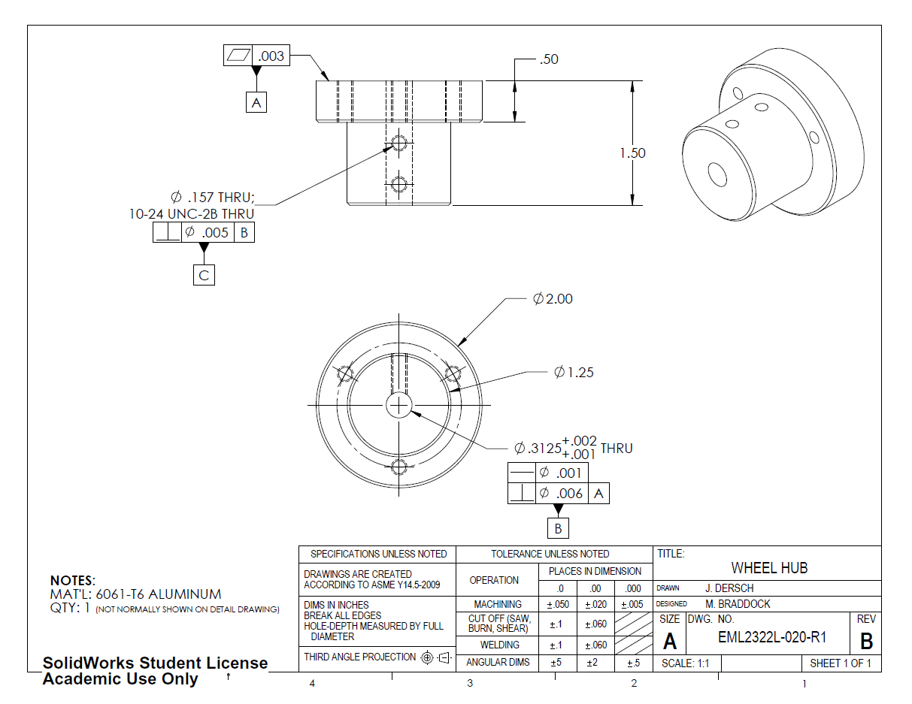
Now, begin dimensioning the shoulder…
Apply dimensions as in TD&T assigned part drawing as shown here.

Slide 25
For example, this face must measure between .48 and .52 from Datum A at EVERY point on the surface.
These dimensions define a nominal tolerance window within which the features must fall.

Slide 26
Next, add feature control frames to ensure the cylindrical features have finished surfaces and are truly cylindrical…

Slide 27
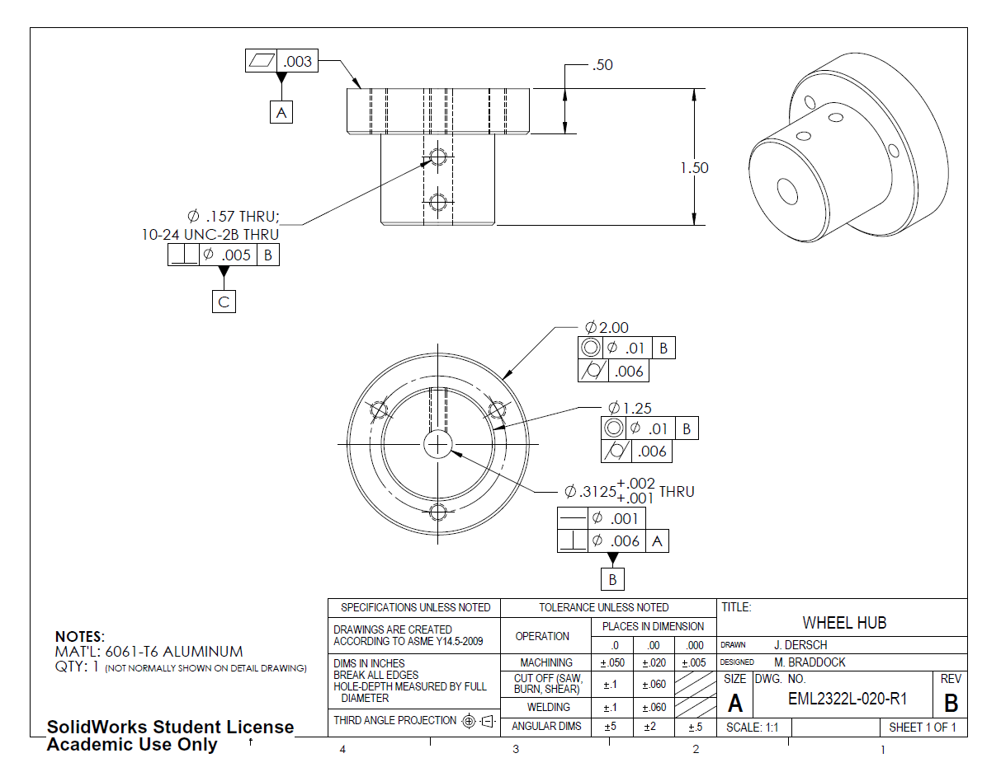
Next, add feature control frames to ensure the cylindrical features have finished surfaces and are truly cylindrical…

Slide 28
These read: “This feature is…

Slide 29
These read: “This feature is concentric with Datum B to within ten-thousandths of an inch diameter …
Cross-section
This means that at each slice of the cylinder, the center point of the resulting circle (average of all points) falls within a circle about Datum B with a diameter of ten-thousandths of an inch.
Ø .01

Slide 30
These read: “This feature is concentric with Datum B to within ten-thousandths of an inch and is cylindrical to within six-thousandths
of an inch.
While the toleranced diameter provides an ‘acceptable’ window for feature size, cylindricity specifies the allowable deviation from a perfect cylinder. (see Dr. Crane’s lecture 7)

Slide 31
The concentricity FCF ensures the part remains centered about the primary axis as intended in the TD&T drawing.
The cylindricity FCF matches the TD&T surface finish requirement.

Slide 32
Now dimension the set screw holes…

Slide 33
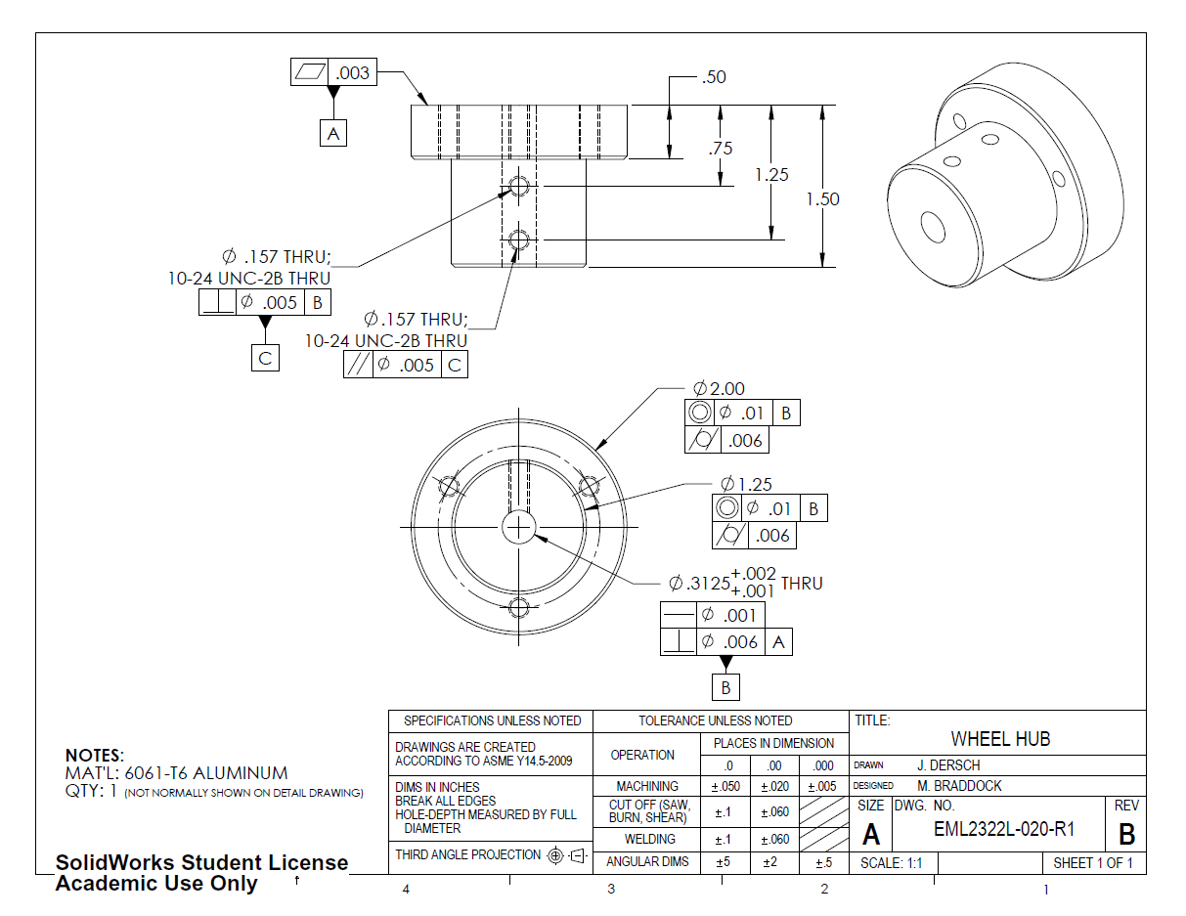
Now dimension the set screw holes…
Apply remaining dimensions as in TD&T assigned part drawing as shown here.

Slide 34
Hole callouts are the same in GD&T and TD&T
NOTE: Normally, holes such as these would be specified as 2x (2 Places) rather than noted twice. In this case, it was necessary to specify the holes separately so that Datum C was properly defined. (see Dr. Crane’s notes on defining datums using two holes)

Slide 35
These dimensions locate the holes relative to Datum A according to the Tolerance Table.

Slide 36
Note that the holes’ locations relative to the part’s centerline are defined by Datum C (rather than the 1.00" locating dimension in the TD&T drawing).

Slide 37
This reads: “This feature is parallel to Datum C to within five-thousandths of an inch diameter.
The axis of this hole must lie within a cylinder whose axis is parallel to Datum C and whose diameter is five-thousandths of an inch.

Slide 38
Of interest, these feature control frames result in EXACTLY the same tolerance envelope (shifted .5").

Slide 39
Now that the set screw holes are dimensioned, add dimensions for the 3-hole bolt pattern…

Slide 40
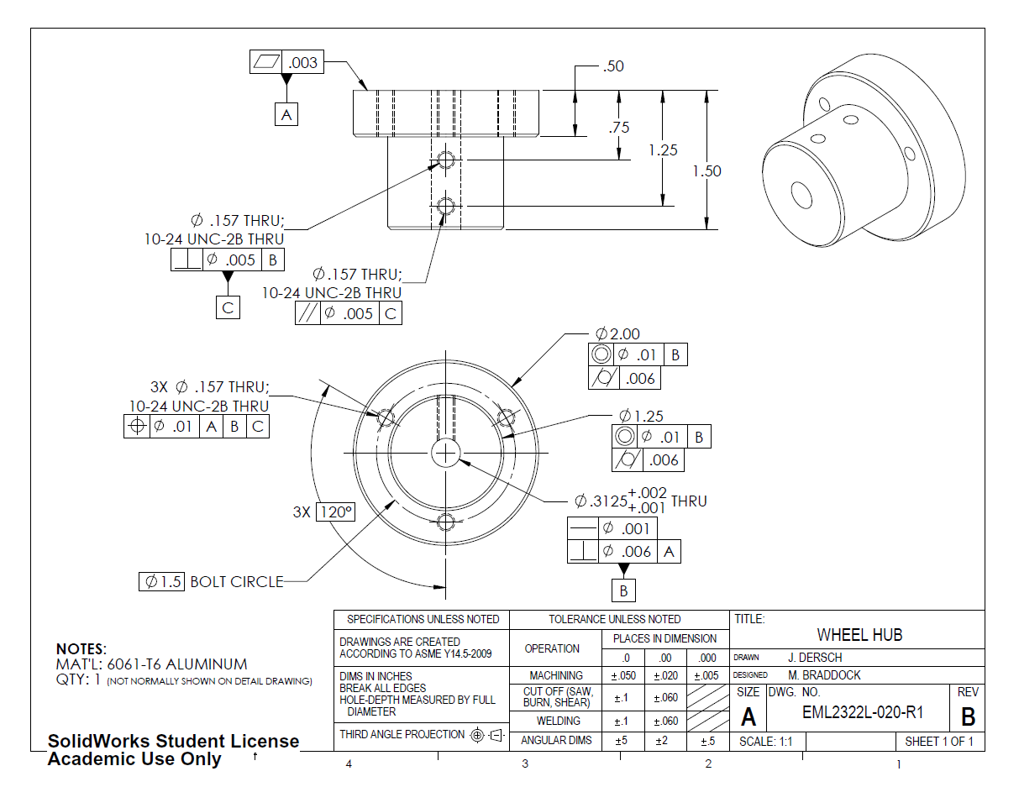
Now that the set screw holes are dimensioned, add dimensions for the 3-hole bolt pattern…

Slide 41
This specifies that there exists a perfect circle on which holes should fall.
NOTE: Boxed dimensions indicate theoretically perfect dimensions and are called basic dimensions. Features located by basic dimensions are always modified by feature control frames.

Slide 42
This specifies that the 120° dimension occurs three times (in a chain).
NOTE: Boxed dimensions indicate theoretically perfect dimensions and are called basic dimensions. Features located by basic dimensions are always modified by feature control frames.

Slide 43
Hole callouts are the same in GD&T and TD&T
NOTE: 3X is used rather than 3 Places

Slide 44
This reads: “This feature is located to within ten-thousandths of an inch diameter with respect to Datum A, Datum B and Datum C.
NOTE: This is equivalent to stating that these holes are parallel to Datum B EXCEPT that the design intent is clearer. The holes positions are the focus rather than their straightness or orientation (although these are both implicitly constrained).

Slide 45
Add specifications for the chamfers and surface finish requirements (“finish all surfaces”).

Slide 46
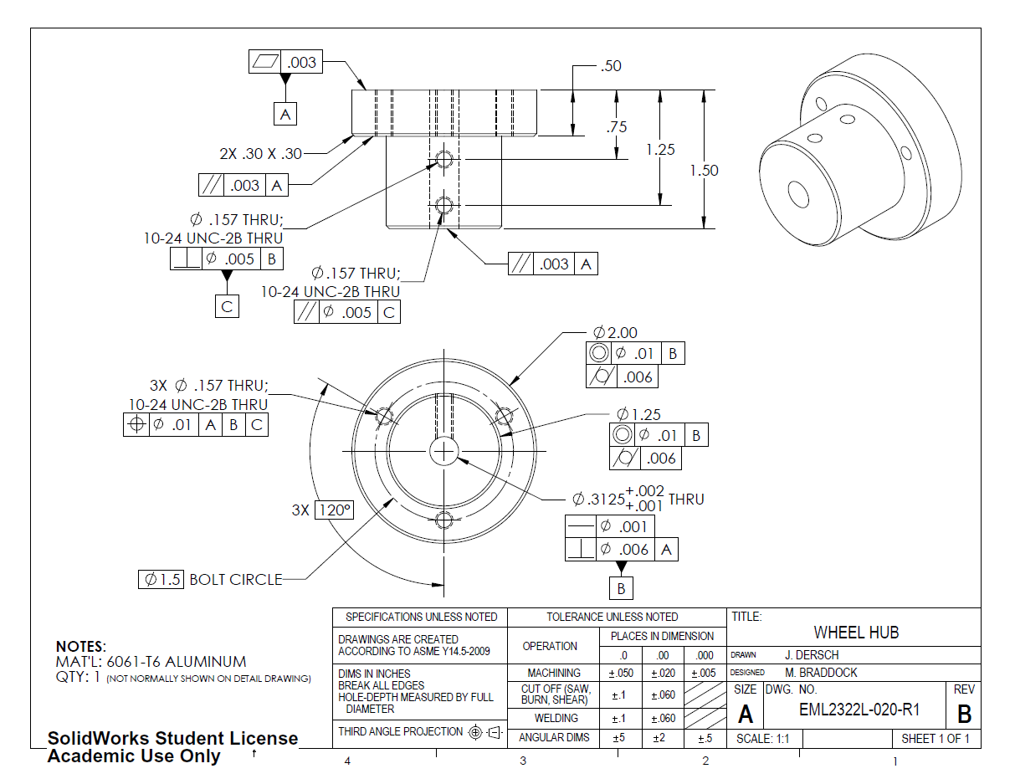
Add final specifications for the chamfers and surface finish requirements (“finish all surfaces”).

Slide 47
The chamfer is specified the same in GD&T and TD&T. (note that further geometric requirements could be added if desired)

Slide 48
This reads: “This feature is parallel to Datum A to within three-thousandths of an inch.

Slide 49
By requiring a tight parallelism requirement, the manufacturer will need to finish these surfaces.
NOTE: A flatness requirement could also be used effectively. Parallelism is a stronger requirement than flatness.

Slide 50
Now check your work…
Are all surfaces finished (as specified in TD&T)?
Are all features completely defined
Position (dimensions, location, etc.)
Orientation (parallelism, perpendicularity, angles, etc.)
Size (with tolerances)
Quality (flatness, circularity, cylindricity, etc.)

Slide 52
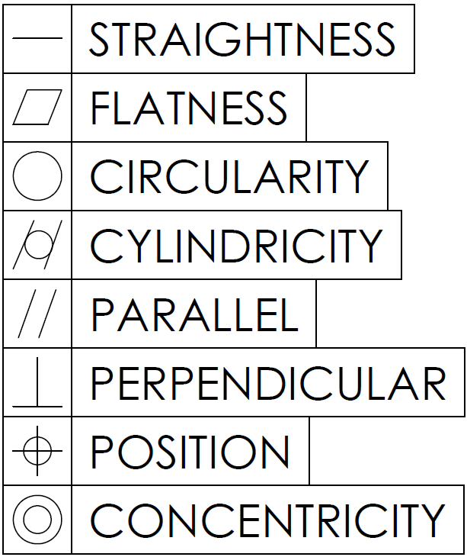
Common GD&T Symbols
Additional Links:
Sigmetrix
Tec-Ease, Inc.
Wikipedia

