Slide 1
Introduction to Nonlinear Finite Element Analysis
Nam-Ho Kim
2nd Edition

Slide 2
CHAP 1
Continuum Mechanics and
Linear Finite Element Analysis
Instructor: Nam-Ho Kim (nkim@ufl.edu)
Web: https://www.mae.ufl.edu/nkim/INFEM/

Slide 3
Table of Contents
1.1. Introduction
1.2. Vector and Tensor Calculus
1.3. Stress and Strain
1.4. Mechanics of Continuous Bodies
1.5. Finite Element Analysis of Linear Systems

Slide 4
Introduction
1.1

Slide 5
Background
Finite Element Method (FEM):
  a powerful tool for solving partial differential equations and integro-differential equations
Linear FEM:
  methods of modeling and solution procedure are well established
Nonlinear FEM:
  different modeling and solution procedures based on the characteristics of the problems → complicated
  many textbooks in the nonlinear FEMs emphasize complicated theoretical parts or advanced topics
This book:
  to simply introduce the nonlinear finite element analysis procedure and to clearly explain the solution procedure
  detailed theories, solution procedures, and implementation using MATLAB for only representative problems

Slide 6
Chapter Outline
Vector and Tensor Calculus
  Preliminary to understand mathematical derivations in other chapters
Stress and Strain
  Review of mechanics of materials and elasticity
Mechanics of Continuous Bodies
  Energy principles for structural equilibrium (principle of minimum potential energy)
  Principle of virtual work for more general non-potential problems
Linear Finite Element Method
  Discretization of continuum equations and approximation of solution using piecewise polynomials
  Introduction to MATLAB program ELAST2D and ELAST3D

Slide 7
Vector and tensor calculus
1.2

Slide 8
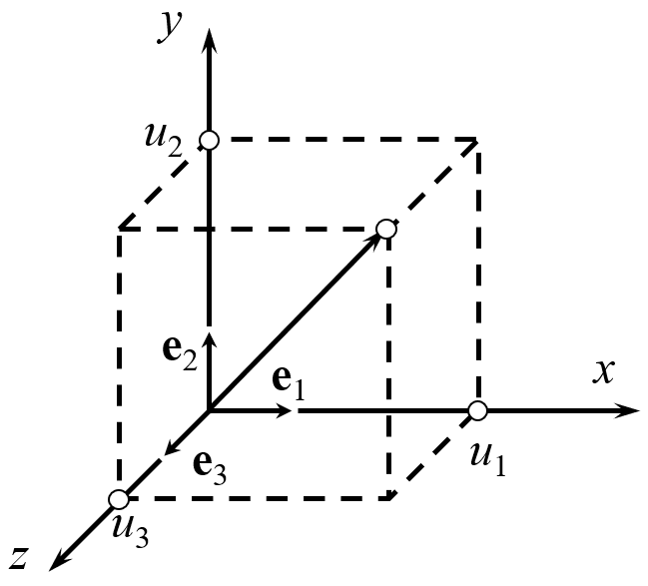
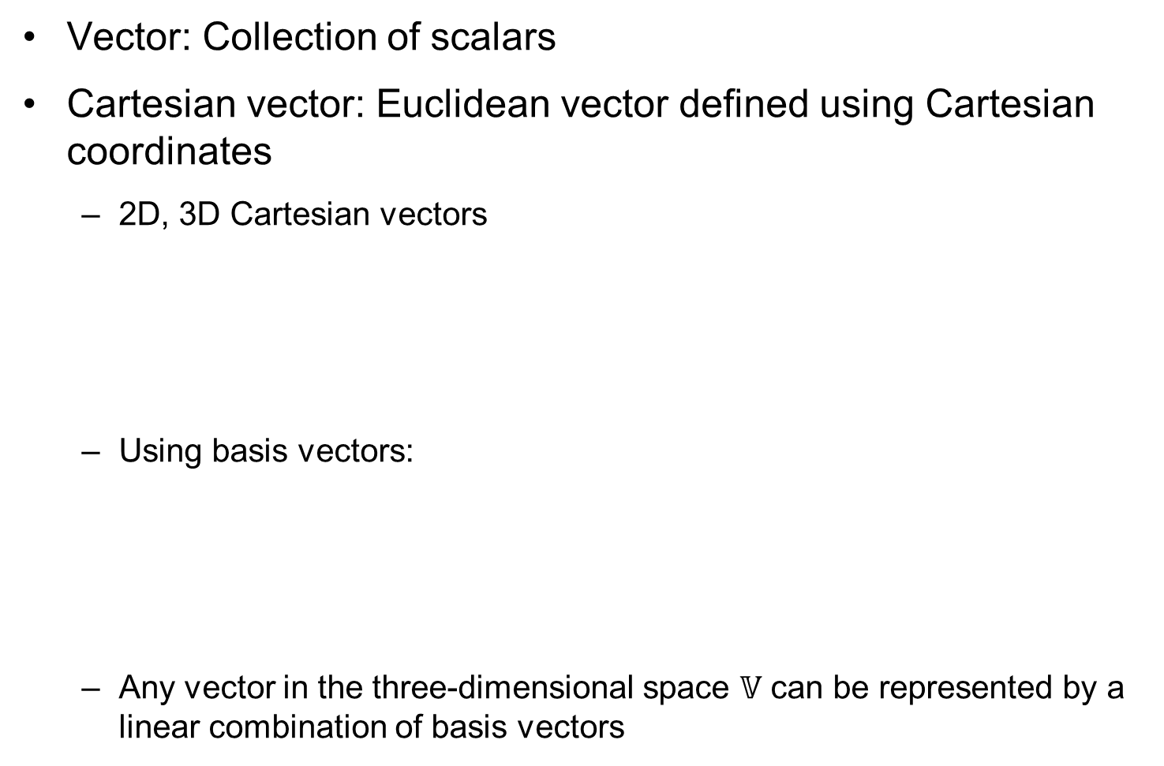

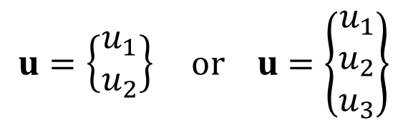
Vector and Tensor
Vector: Collection of scalars
Cartesian vector: Euclidean vector defined using Cartesian coordinates
  2D, 3D Cartesian vectors
  Using basis vectors:
  Any vector in the three-dimensional space $𝕍$ can be represented by a linear combination of basis vectors
$$u=\left\{\begin{matrix}u_{1} \\ u_{2}\end{matrix}\right\} or u=\left\{\begin{matrix}u_{1} \\ u_{2} \\ u_{3}\end{matrix}\right\}$$
$$e1 = \left\{1, 0, 0\right\}T, e2 = \left\{0, 1, 0\right\}T, e3 = \{0, 0, 1\}T$$
$$u=u_{1}e_{1}+u_{2}e_{2}+u_{3}e_{3}$$

Slide 9
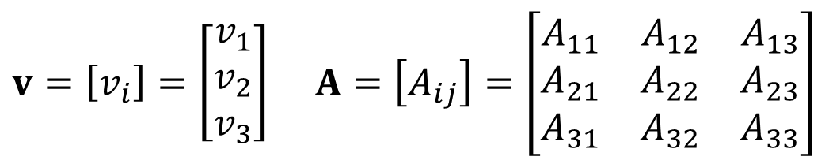
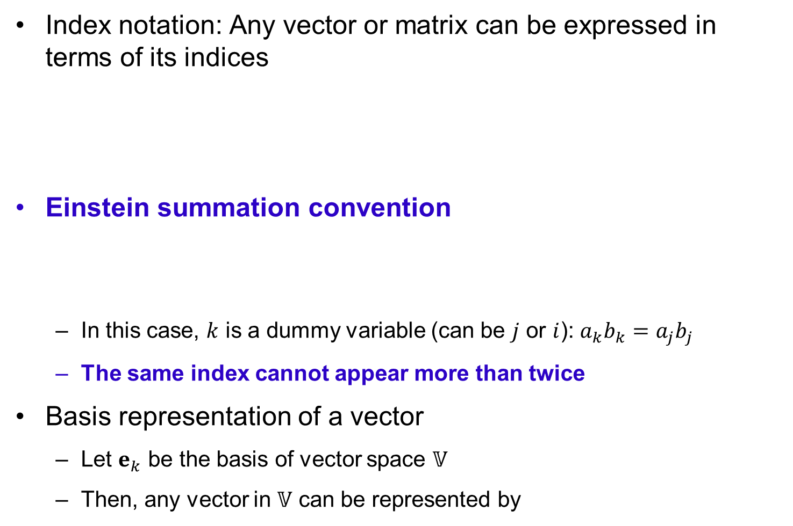


Index Notation and Summation Rule
Index notation: Any vector or matrix can be expressed in terms of its indices
Einstein summation convention
  In this case, $k$ is a dummy variable (can be $j$ or $i$): $a_{k}b_{k}=a_{j}b_{j}$
  The same index cannot appear more than twice
Basis representation of a vector
  Let $e_{k}$ be the basis of vector space $𝕍$
  Then, any vector in $𝕍$ can be represented by
$$v=\left[v_{i}\right]=\left[\begin{matrix}v_{1} \\ v_{2} \\ v_{3}\end{matrix}\right] A=\left[A_{ij}\right]=\left[\begin{matrix}A_{11} & A_{12} & A_{13} \\ A_{21} & A_{22} & A_{23} \\ A_{31} & A_{32} & A_{33}\end{matrix}\right]$$
$$\sum_{k=1}^{3}{a_{k}b_{k}}=a_{k}b_{k}$$
Repeated indices mean summation!!
$$w=\sum_{k=1}^{3}{w_{k}e_{k}}=w_{k}e_{k}$$

Slide 10

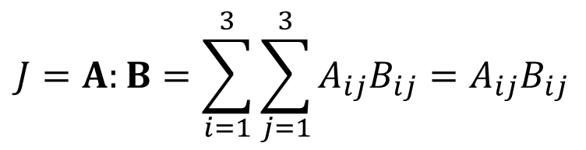

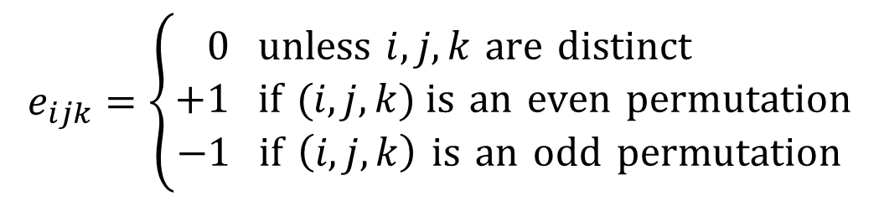

Index Notation and Summation Rule cont.
Examples
  Matrix multiplication:
  Trace operator:
  Dot product:
  Cross product:
  Contraction: double dot product
$$C=A⋅B C_{ij}=A_{ik}B_{kj}$$
$$\text{tr}\left(A\right)=A_{11}+A_{22}+A_{33}=A_{kk}$$
$$u⋅v=u_{1}v_{1}+u_{2}v_{2}+u_{3}v_{3}=u_{k}v_{k}$$
$$u×v=u_{j}v_{k}\left(e_{j}×e_{k}\right)=e_{ijk}u_{j}v_{k}e_{i}$$
$$e_{ijk}=\left\{\begin{matrix}0 \text{unless} i,j,k \text{are} \text{distinct} \\ +1 \text{if} (i,j,k) \text{is} \text{an} \text{even} \text{permutation} \\ −1 \text{if} \left(i,j,k\right) \text{is} \text{an} \text{odd} \text{permutation} \end{matrix}\right.$$
Permutation
symbol
$$J=A:B=\sum_{i=1}^{3}{\sum_{j=1}^{3}{A_{ij}B_{ij}}}=A_{ij}B_{ij}$$

Slide 11

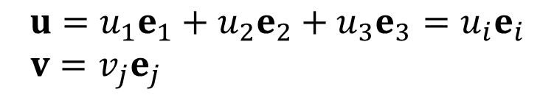

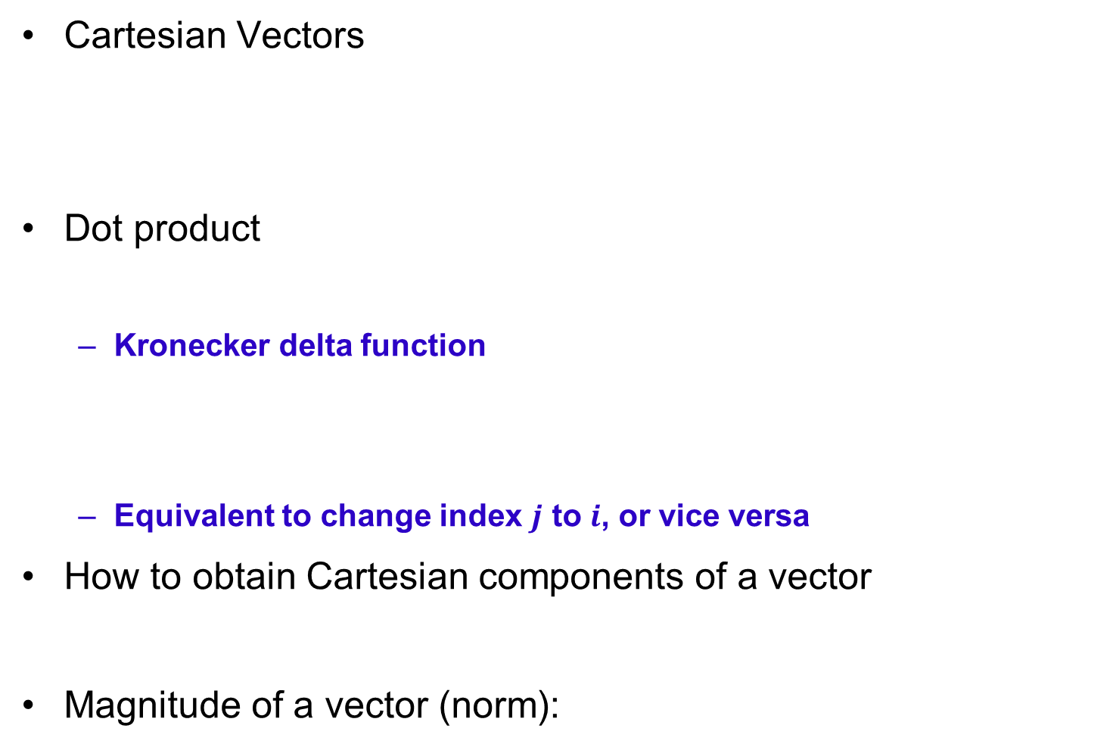


Cartesian Vector
X₃
Cartesian Vectors
Dot product
  Kronecker delta function
  Equivalent to change index $j$ to $i$, or vice versa
How to obtain Cartesian components of a vector
Magnitude of a vector (norm):
u
$$\begin{matrix}u=u_{1}e_{1}+u_{2}e_{2}+u_{3}e_{3}=u_{i}e_{i} \\ v=v_{j}e_{j} \end{matrix}$$
v
e₃
e₁
X₂
e₂
X₁
$$u⋅v=\left(u_{i}e_{i}\right)⋅\left(v_{j}e_{j}\right)=u_{i}v_{j}\left(e_{i}⋅e_{j}\right)=u_{i}v_{j}δ_{ij}=u_{i}v_{i}$$
$$δ_{ij}=\left\{\begin{matrix}1 \text{if} i=j \\ 0 \text{if} i≠j\end{matrix}\right.$$
$$δ_{jj}=δ_{11}+δ_{22}+δ_{33}=3$$
$$e_{i}⋅v=e_{i}⋅\left(v_{j}e_{j}\right)=v_{j}δ_{ij}=v_{i}$$
Projection
$$\left\|v\right\|=\sqrt{v⋅v}$$

Slide 12
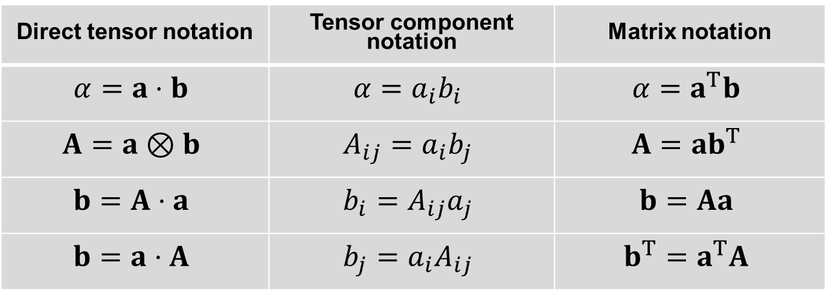
Notation Used Here
Direct tensor notation | Tensor component notation | Matrix notation
$$α=a⋅b$$ | $$α=a_{i}b_{i}$$ | $$α=a^{T}b$$
$$A=a⊗b$$ | $$A_{ij}=a_{i}b_{j}$$ | $$A=ab^{T}$$
$$b=A⋅a$$ | $$b_{i}=A_{ij}a_{j}$$ | $$b=Aa$$
$$b=a⋅A$$ | $$b_{j}=a_{i}A_{ij}$$ | $$b^{T}=a^{T}A$$

Slide 13
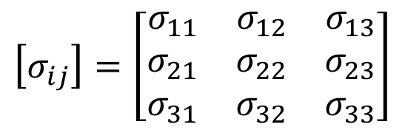
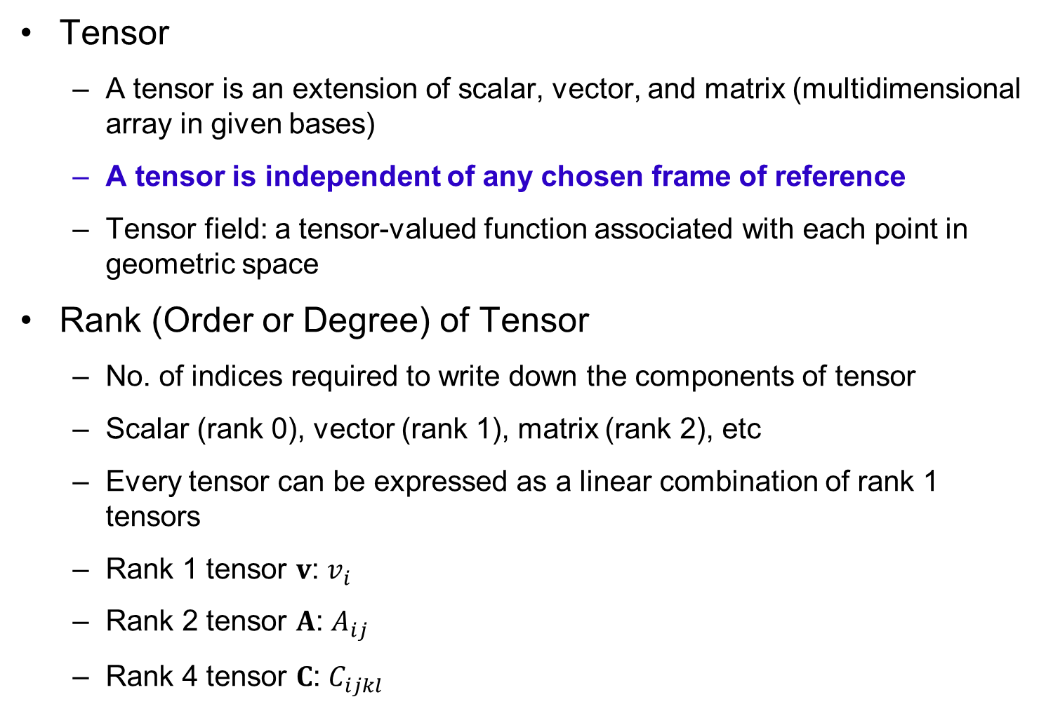
Tensor and Rank (Order or Degree)
Tensor
  A tensor is an extension of scalar, vector, and matrix (multidimensional array in given bases)
  A tensor is independent of any chosen frame of reference
  Tensor field: a tensor-valued function associated with each point in geometric space
Rank (Order or Degree) of Tensor
  No. of indices required to write down the components of tensor
  Scalar (rank 0), vector (rank 1), matrix (rank 2), etc
  Every tensor can be expressed as a linear combination of rank 1 tensors
  Rank 1 tensor $v$: $v_{i}$
  Rank 2 tensor $A$: $A_{ij}$
  Rank 4 tensor $C$: $C_{ijkl}$
$$\left[σ_{ij}\right]=\left[\begin{matrix}σ_{11} & σ_{12} & σ_{13} \\ σ_{21} & σ_{22} & σ_{23} \\ σ_{31} & σ_{32} & σ_{33}\end{matrix}\right]$$
Rank-2
stress
tensor

Slide 14







Tensor Operations
Basic rules for tensors
  Tensor (dyadic) product: increase rank
Rank-4 tensor: $D=D_{ijkl}e_{i}⊗e_{j}⊗e_{k}⊗e_{l}$
Different notations
$$\begin{matrix}\left(TS\right)R=T\left(SR\right) \\ T\left(S+R\right)=TS+TR \\ α\left(TS\right)=\left(αT\right)S=T\left(αS\right) \\ 1T=T1=T \end{matrix}$$
$$TS=T⋅S$$
Identity tensor
$$1=\left[δ_{ij}\right]$$
$$A=u⊗v=u_{i}v_{j}e_{i}⊗e_{j} A_{ij}=u_{i}v_{j}$$
$$A^{T}=A_{ji}e_{i}⊗e_{j}$$
$$\begin{matrix}\begin{aligned}\left(αu\right)⊗v=α\left(u⊗v\right) \\ \left(u⊗v\right)⋅w=u\left(v⋅w\right) \end{aligned} \\ w⋅\left(u⊗v\right)=v\left(w⋅u\right) \\ \left(u⊗v\right)\left(w⊗x\right)=\left(v⋅w\right)u⊗x\end{matrix}$$
$$u⊗v≠v⊗u$$

Slide 15

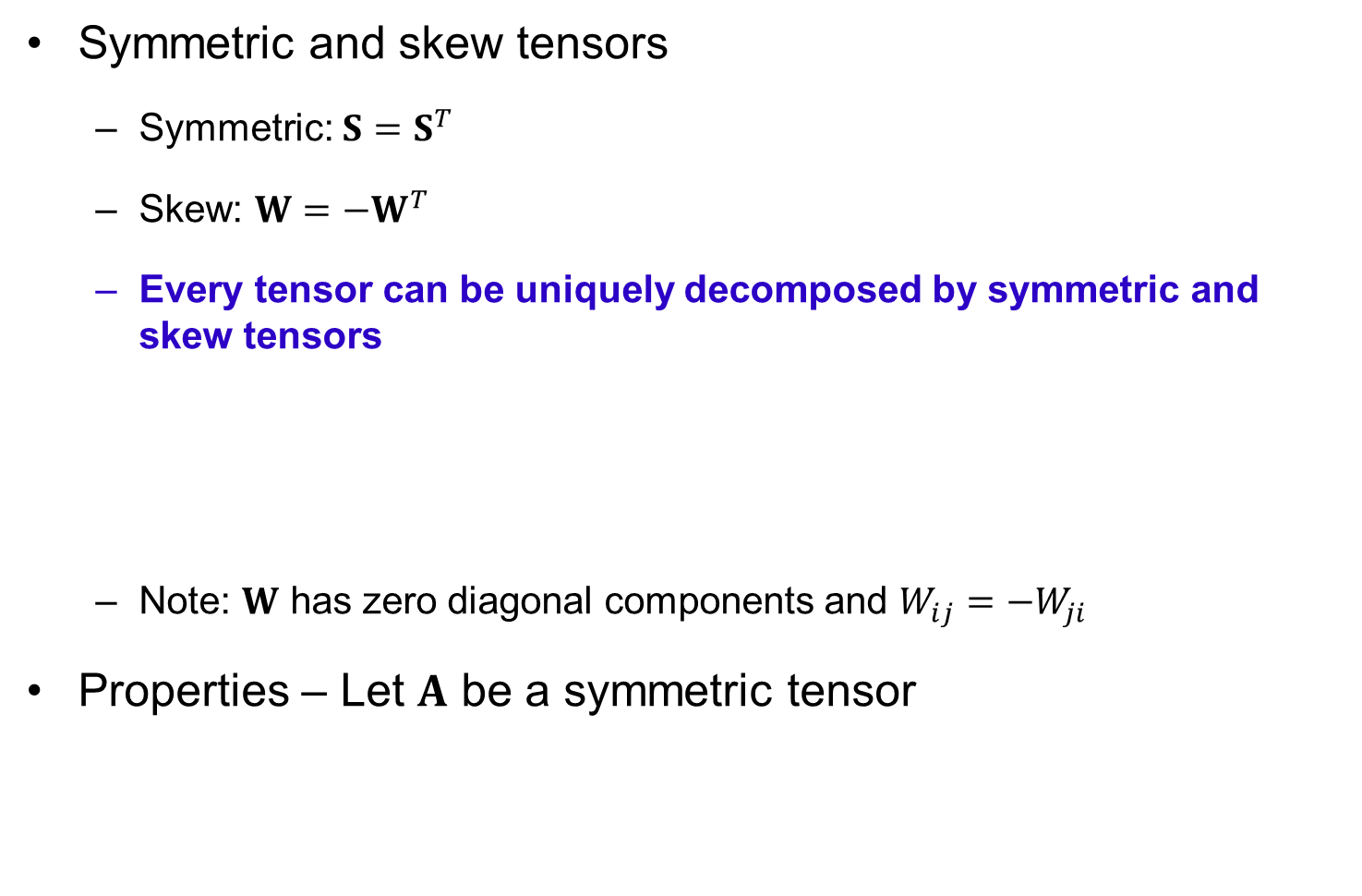


Tensor Operations cont.
Symmetric and skew tensors
  Symmetric: $S=S^{T}$
  Skew: $W=−W^{T}$
  Every tensor can be uniquely decomposed by symmetric and skew tensors
  Note: $W$ has zero diagonal components and $W_{ij}=−W_{ji}$
Properties – Let $A$ be a symmetric tensor
$$\begin{matrix}S=\frac{1}{2}\left(T+T^{T}\right) \\ W=\frac{1}{2}\left(T−T^{T}\right)\end{matrix}$$
$$T=S+W$$
$$\begin{matrix}A:W=0 \\ A:T=A:S\end{matrix}$$

Slide 16
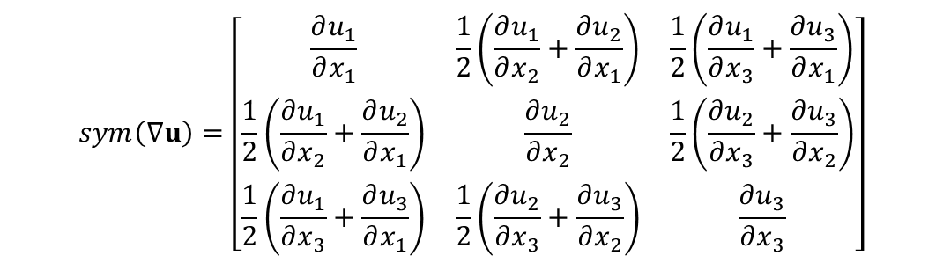

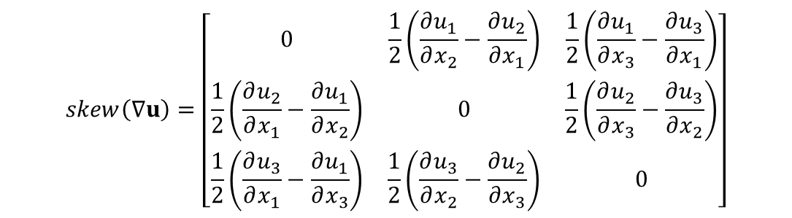
Example
Displacement gradient can be considered a tensor (rank 2)
$$∇u=\left[\frac{∂u}{∂x}\right]=\left[\begin{matrix}\frac{∂u_{1}}{∂x_{1}} & \frac{∂u_{1}}{∂x_{2}} & \frac{∂u_{1}}{∂x_{3}} \\ \frac{∂u_{2}}{∂x_{1}} & \frac{∂u_{2}}{∂x_{2}} & \frac{∂u_{2}}{∂x_{3}} \\ \frac{∂u_{3}}{∂x_{1}} & \frac{∂u_{3}}{∂x_{2}} & \frac{∂u_{3}}{∂x_{3}}\end{matrix}\right]$$
$$sym\left(∇u\right)=\left[\begin{matrix}\frac{∂u_{1}}{∂x_{1}} & \frac{1}{2}\left(\frac{∂u_{1}}{∂x_{2}}+\frac{∂u_{2}}{∂x_{1}}\right) & \frac{1}{2}\left(\frac{∂u_{1}}{∂x_{3}}+\frac{∂u_{3}}{∂x_{1}}\right) \\ \frac{1}{2}\left(\frac{∂u_{1}}{∂x_{2}}+\frac{∂u_{2}}{∂x_{1}}\right) & \frac{∂u_{2}}{∂x_{2}} & \frac{1}{2}\left(\frac{∂u_{2}}{∂x_{3}}+\frac{∂u_{3}}{∂x_{2}}\right) \\ \frac{1}{2}\left(\frac{∂u_{1}}{∂x_{3}}+\frac{∂u_{3}}{∂x_{1}}\right) & \frac{1}{2}\left(\frac{∂u_{2}}{∂x_{3}}+\frac{∂u_{3}}{∂x_{2}}\right) & \frac{∂u_{3}}{∂x_{3}}\end{matrix}\right]$$
Strain tensor
$$skew\left(∇u\right)=\left[\begin{matrix}0 & \frac{1}{2}\left(\frac{∂u_{1}}{∂x_{2}}−\frac{∂u_{2}}{∂x_{1}}\right) & \frac{1}{2}\left(\frac{∂u_{1}}{∂x_{3}}−\frac{∂u_{3}}{∂x_{1}}\right) \\ \frac{1}{2}\left(\frac{∂u_{2}}{∂x_{1}}−\frac{∂u_{1}}{∂x_{2}}\right) & 0 & \frac{1}{2}\left(\frac{∂u_{2}}{∂x_{3}}−\frac{∂u_{3}}{∂x_{2}}\right) \\ \frac{1}{2}\left(\frac{∂u_{3}}{∂x_{1}}−\frac{∂u_{1}}{∂x_{3}}\right) & \frac{1}{2}\left(\frac{∂u_{3}}{∂x_{2}}−\frac{∂u_{2}}{∂x_{3}}\right) & 0\end{matrix}\right]$$
Spin tensor

Slide 17




Contraction and Trace
Contraction of rank-2 tensors
  contraction operator reduces four ranks from the sum of ranks of two tensors
magnitude (or, norm) of a rank-2 tensor
Constitutive relation between stress and strain
Trace: part of contraction
  In tensor notation
$$a:b=a_{ij}b_{ij}=a_{11}b_{11}+a_{12}b_{12}+…+a_{32}b_{32}+a_{33}b_{33}$$
$$\left\|a\right\|=\sqrt{a:a}$$
$$σ=D:\text{ε}, σ_{ij}=D_{ijkl}ε_{kl}$$
$$tr\left(A\right)=A_{ii}=A_{11}+A_{22}+A_{33}$$
$$tr\left(A\right)=A:1=1:A$$

Slide 18










Orthogonal Tensor
In two different coord.
Direction cosines
Change basis
e₃
e₃*
$$u=u_{i}e_{i}=u_{j}^{∗}e_{j}^{∗}$$
e₁*
e₂
e₁
e₂*
$$β=\left[β_{ij}\right]=\left[e_{i}^{∗}⋅e_{j}\right], e_{i}^{∗}=β_{ij}e_{j}$$
We can also show
$$e_{j}={\text{β}}_{ij}e_{i}^{∗} u^{∗}=βu$$
$$\begin{matrix}u=u_{j}e_{j}=u_{i}^{∗}e_{i}^{∗} \\ =u_{i}^{∗}{\text{β}}_{ij}e_{j} \end{matrix}$$
$$u={\text{β}}^{T}u^{∗}={\text{β}}^{T}\left(\text{β}u\right)=\left({\text{β}}^{T}\text{β}\right)u$$
$$β^{−1}=β^{T}$$
$$u_{j}={\text{β}}_{ij}u_{i}^{∗}$$
$$β^{T}β=ββ^{T}=1 det\left(β\right)=±1$$
Orthogonal tensor
$$u=β^{T}u^{∗}$$
Rank-2 tensor transformation
$$T^{∗}=βTβ^{T}, T_{ij}^{∗}=β_{ik}T_{kl}β_{jl}$$

Slide 19

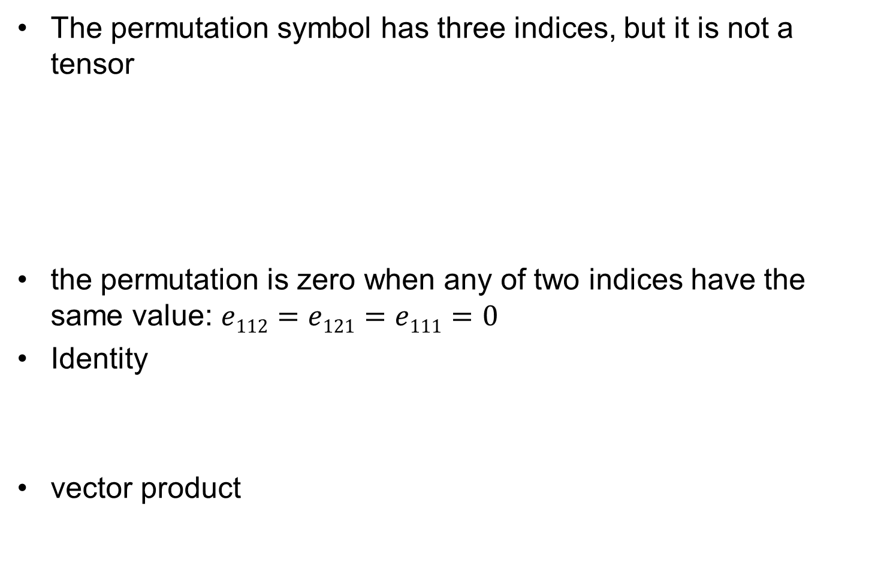
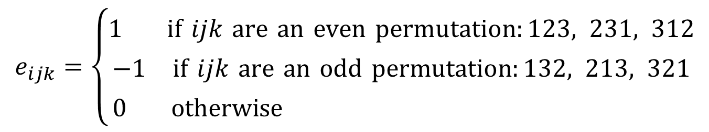

Permutation
The permutation symbol has three indices, but it is not a tensor
the permutation is zero when any of two indices have the same value: $e112=e121=e111=0$
Identity
vector product
$$e_{ijk}=\left\{\begin{matrix}1 \text{if} ijk \text{are} \text{an} \text{even} \text{permutation}:123, 231, 312 \\ −1 \text{if} ijk \text{are} \text{an} \text{odd} \text{permutation}:132, 213, 321 \\ 0 \text{otherwise} \end{matrix}\right.$$
$$e_{ijk}e_{lmk}=δ_{il}δ_{jm}−δ_{im}δ_{jl}$$
$$u×v=e_{i}e_{ijk}u_{j}v_{k}$$

Slide 20

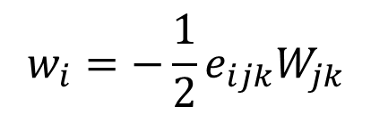


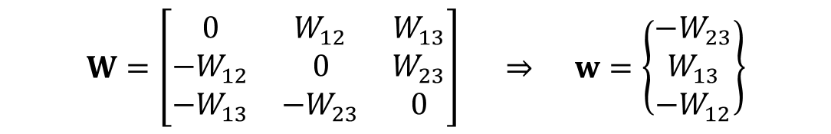
Dual Vector
For any skew tensor $W$ and a vector $u$
  $Wu$ and $u$ are orthogonal
Let $W_{ij}=−e_{ijk}w_{k}$
Then, $W_{ij}u_{j}=−e_{ijk}w_{k}u_{j}=e_{ikj}w_{k}u_{j}$
$$u⋅Wu=u⋅W^{T}u=−u⋅Wu=0$$
$$W=\left[\begin{matrix}0 & W_{12} & W_{13} \\ −W_{12} & 0 & W_{23} \\ −W_{13} & −W_{23} & 0\end{matrix}\right] ⇒ w=\left\{\begin{matrix}−W_{23} \\ W_{13} \\ −W_{12}\end{matrix}\right\}$$
$$Wu=w×u$$
Dual vector of skew tensor $W$
$$w_{i}=−\frac{1}{2}e_{ijk}W_{jk}$$

Slide 21





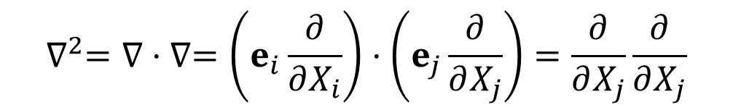



Vector and Tensor Calculus
Gradient
  Gradient is considered a vector
  We will often use a simplified notation:
Laplace operator
Gradient of a scalar field $φ(X)$: vector
$$φ(X)$$
$$∇=\frac{∂}{∂X}=e_{i}\frac{∂}{∂X_{i}}$$
$$Ω$$
$$Γ$$
$$v_{i,j}=\frac{∂v_{i}}{∂X_{j}}$$
$$∇^{2}=∇⋅∇=\left(e_{i}\frac{∂}{∂X_{i}}\right)⋅\left(e_{j}\frac{∂}{∂X_{j}}\right)=\frac{∂}{∂X_{j}}\frac{∂}{∂X_{j}}$$
$$\frac{∂^{2}}{∂X_{1}^{2}}+\frac{∂^{2}}{∂X_{2}^{2}}+\frac{∂^{2}}{∂X_{3}^{2}}$$
$$∇φ\left(X\right)=e_{i}\frac{∂φ}{∂X_{i}}$$

Slide 22
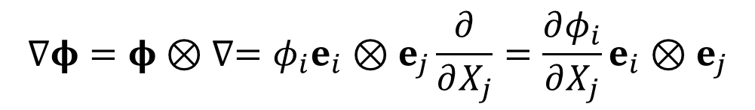


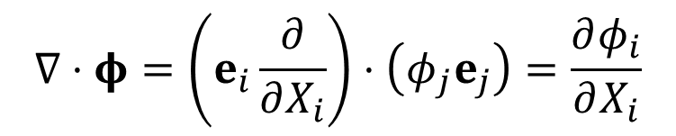
Vector and Tensor Calculus
Gradient of a Tensor Field (increase rank by 1)
Divergence (decrease rank by 2)
  Ex) $∇⋅σ=σ_{jk,j}e_{k}$
Curl
$$∇φ=φ⊗∇=φ_{i}e_{i}⊗e_{j}\frac{∂}{∂X_{j}}=\frac{∂φ_{i}}{∂X_{j}}e_{i}⊗e_{j}$$
$$∇⋅φ=\left(e_{i}\frac{∂}{∂X_{i}}\right)⋅\left(φ_{j}e_{j}\right)=\frac{∂φ_{i}}{∂X_{i}}$$
$$∇×v=e_{i}e_{ijk}v_{k,j}$$

Slide 23

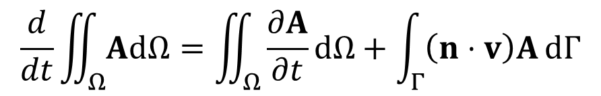

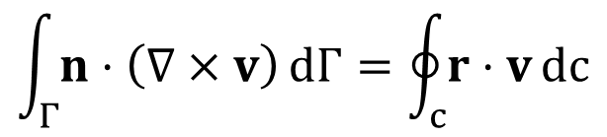
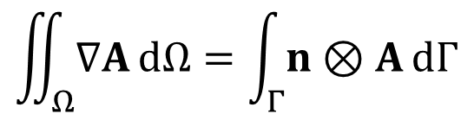
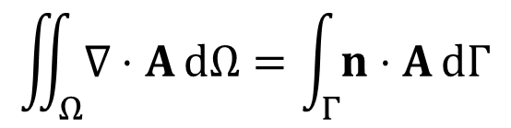
Integral Theorems
Divergence Theorem
Gradient Theorem
Stokes Theorem
Reynolds Transport Theorem
$$\iint_{Ω}{∇⋅A \text{d}Ω}=\int_{Γ}{n⋅A \text{d}Γ}$$
$n$: unit outward normal vector
$$\iint_{Ω}{∇A \text{d}Ω}=\int_{Γ}{n⊗A \text{d}Γ}$$
c
$$\int_{Γ}{n⋅\left(∇×v\right) \text{d}Γ}=\oint_{c}{r⋅v \text{d}c}$$
$$Γ$$
r
$$\frac{d}{dt}\iint_{Ω}{A\text{d}Ω}=\iint_{Ω}{\frac{∂A}{∂t}\text{d}Ω}+\int_{Γ}{\left(n⋅v\right)A \text{d}Γ}$$

Slide 24
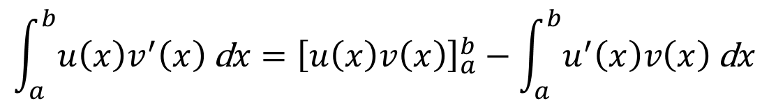

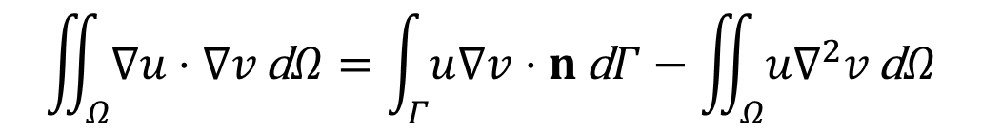
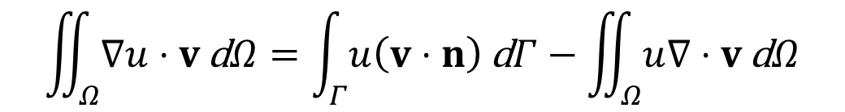
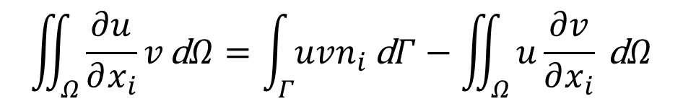
Integration-by-Parts
$u(x)$ and $v(x)$ are continuously differentiable functions
1D
2D, 3D
For a vector field v(x)
Green’s identity
$$\int_{a}^{b}{u\left(x\right)v^{′}\left(x\right) \text{d}x}={\left[u\left(x\right)v\left(x\right)\right]}_{a}^{b}−\int_{a}^{b}{u^{′}\left(x\right)v\left(x\right) \text{d}x}$$
$$\iint_{Ω}{\frac{∂u}{∂x_{i}}v \text{d}Ω}=\int_{Γ}{uvn_{i} \text{d}Γ}−\iint_{Ω}{u\frac{∂v}{∂x_{i}} \text{d}Ω}$$
$$\iint_{Ω}{∇u⋅v \text{d}Ω}=\int_{Γ}{u\left(v⋅n\right) \text{d}Γ}−\iint_{Ω}{u∇⋅v \text{d}Ω}$$
$$\iint_{Ω}{∇u⋅∇v \text{d}Ω}=\int_{Γ}{u∇v⋅n \text{d}Γ}−\iint_{Ω}{u∇^{2}v \text{d}Ω}$$

Slide 25


Example: Divergence Theorem
S: unit sphere $(x2+y2+z2=1), F=2xi+y2j+z2k$
Integrate $\int_{S}{F⋅n dS}$
$$\begin{matrix}\int_{S}{F⋅n \text{d}S}=\iint_{Ω}{∇⋅F \text{d}Ω} \\ =2\iint_{Ω}{\left(1+y+z\right) \text{d}Ω} \\ =2\iint_{Ω}{ \text{d}Ω}+2\iint_{Ω}{y \text{d}Ω}+2\iint_{Ω}{z \text{d}Ω} \\ =2\iint_{Ω}{ \text{d}Ω} \\ =\frac{8π}{3} \end{matrix}$$

Slide 26


Exercise
A symmetric rank four tensor is defined by
where $1=[dij]$ is a unit tensor of rank-two and
$I=\frac{1}{2}\left[δ_{ik}δ_{jl}+δ_{il}δ_{jk}\right]$ is a symmetric unit tensor of rank-four. When $E$ is an arbitrary symmetric rank-two tensor, calculate $S=D:E$ in terms of $E$.
$$D=λ1⊗1+2μI$$

Slide 27
Stress and strain
1.3

Slide 28



Surface Traction (Stress)
Surface traction (Stress)
  The entire body is in equilibrium with external forces ($f1 \sim f6$)
  The imaginary cut body is in equilibrium due to external forces ($f1, f2, f3$) and internal forces
  Internal force acting at a point P
  on a plane whose unit normal is n:
  The surface traction depends on the unit normal direction $n$.
  Surface traction will change as $n$ changes.
  unit = force per unit area (pressure)
$$t^{\left(n\right)}=\lim_{ΔA→0}\frac{ΔF}{ΔA}$$
$$t^{(n)}=t_{1}e_{1}+t_{2}e_{2}+t_{3}e_{3}$$

Slide 29


Cartesian Stress Components
Surface traction changes according to the direction of the surface.
Impossible to store stress information for all directions.
Let’s store surface traction parallel to the three coordinate directions.
Surface traction in other directions can be calculated from them.
Consider the x-face of an infinitesimal cube
$$t^{\left(x\right)}=t_{1}^{\left(x\right)}e_{1}+t_{2}^{\left(x\right)}e_{2}+t_{3}^{\left(x\right)}e_{3}$$
Δx
$$t^{\left(x\right)}=σ_{11}e_{1}+σ_{12}e_{2}+σ_{13}e_{3}$$
Δz
σ₁₃
z
ΔF
Normal
stress
Shear
stress
σ₁₁
σ₁₂
Δy
x
y

Slide 30


Stress Tensor
  First index is the face and the second index is its direction
  When two indices are the same, normal stress, otherwise shear stress.
  Continuation for other surfaces.
  Total nine components
  Same stress components are defined for the negative planes.
Rank-2 Stress Tensor
Sign convention
$$σ=σ_{ij}e_{i}⊗e_{j}$$
σ₃₃
Δx
σ₃₁
σ₃₂
Δz
$$\begin{matrix}sgn\left(σ_{11}\right)=sgn\left(n\right)×sgn\left(ΔF_{x}\right) \\ sgn\left(σ_{12}\right)=sgn\left(n\right)×sgn\left(ΔF_{y}\right)\end{matrix}$$
σ₁₃
σ₂₃
z
σ₁₁
σ₁₂
σ₂₁
σ₂₂
Δy
x
y

Slide 31



Symmetry of Stress Tensor
  Stress tensor should be symmetric
  9 components 6 components
  Equilibrium of the angular moment
  Similarly for all three directions:
  Let’s use vector notation:
$$\begin{matrix}\sum{M}=Δ𝓁\left(σ_{12}−σ_{21}\right)=0 \\ ⇒σ_{12}=σ_{21}\end{matrix}$$
$$σ_{12}=σ_{21}, σ_{23}=σ_{32}, σ_{13}=σ_{31}$$
$$\left\{σ\right\}=\left\{\begin{matrix}σ_{11} \\ σ_{22} \\ σ_{33} \\ σ_{12} \\ σ_{23} \\ σ_{13}\end{matrix}\right\}$$
$$\left[σ_{ij}\right]=\left[\begin{matrix}σ_{11} & σ_{12} & σ_{13} \\ σ_{12} & σ_{22} & σ_{23} \\ σ_{13} & σ_{23} & σ_{33}\end{matrix}\right]$$
Cartesian components
of stress tensor

Slide 32



Stress in Arbitrary Plane
  If Cartesian stress components are known, it is possible to determine the surface traction acting on any plane.
  Consider a plane whose normal is n.
  Surface area (ΔABC = A)
  The surface traction
  Force balance
y
B
$$ΔPAB=An_{3}; ΔPBC=An_{1}; ΔPAC=An_{2}$$
n
σ₃₁
σ₃₃
t^{(n)}
σ₁₃
$$t^{\left(n\right)}=t_{1}^{\left(n\right)}e_{1}+t_{2}^{\left(n\right)}e_{2}+t_{3}^{\left(n\right)}e_{3}$$
σ₁₁
σ₃₂
σ₁₂
P
σ₂₃
A
x
σ₂₁
σ₂₂
z
C
$$\sum{F_{1}}=t_{1}^{\left(n\right)}A−σ_{11}An_{1}−σ_{21}An_{2}−σ_{31}An_{3}=0$$
$$t_{1}^{\left(n\right)}=σ_{11}n_{1}+σ_{21}n_{2}+σ_{31}n_{3}$$

Slide 33




Cauchy’s Lemma
All three-directions
Tensor notation
  stress tensor; completely characterize the state of stress at a point
Cauchy’s Lemma
  the surface tractions acting on opposite sides of the same surface are equal in magnitude and opposite in direction
$$t_{1}^{\left(n\right)}=σ_{11}n_{1}+σ_{21}n_{2}+σ_{31}n_{3}$$
$$\begin{matrix}t_{2}^{\left(n\right)}=σ_{12}n_{1}+σ_{22}n_{2}+σ_{32}n_{3} \\ t_{3}^{\left(n\right)}=σ_{13}n_{1}+σ_{23}n_{2}+σ_{33}n_{3}\end{matrix}$$
$$t^{\left(n\right)}=n⋅\text{σ} ⇒ t^{\left(n\right)}=\text{σ}⋅n$$
$$t^{\left(n\right)}=−t^{\left(−n\right)}$$

Slide 34







Projected Stresses
Normal stress $σ\left(n\right)=t^{n}⋅n=n⋅σ⋅n=σ_{ij}n_{i}n_{j}$
Shear stress $τ\left(n\right)=\sqrt{{\left\|t^{n}\right\|}^{2}−σ^{2}\left(n\right)}, τ\left(n\right)=t^{n}−nσ\left(n\right)$
Principal stresses $t^{n}∥n ⇒ σ_{1},σ_{2},σ_{3}$
Mean stress (hydrostatic pressure)
Stress deviator
$$p=σ_{m}=\frac{1}{3}tr\left(σ\right)=\frac{1}{3}\left(σ_{11}+σ_{22}+σ_{33}\right)$$
$$I_{ijkl}=\frac{1}{2}\left(δ_{ik}δ_{jl}+δ_{il}δ_{jk}\right)$$
$$s=σ−σ_{m}1=I_{dev}:σ$$
Rank-4 identity tensor
$$I_{dev}=I−\frac{1}{3}1⊗1$$
$$\begin{matrix} \\ s=\left[\begin{matrix}σ_{11}−σ_{m} & σ_{12} & σ_{13} \\ σ_{12} & σ_{11}−σ_{m} & σ_{23} \\ σ_{13} & σ_{23} & σ_{11}−σ_{m}\end{matrix}\right]\end{matrix}$$
Rank-4 deviatoric identity tensor
$$I_{dev}:1=0, I_{dev}:s=s$$

Slide 35




Principal Stresses
Normal & shear stress change as n changes
  Is there a plane on which the normal (or shear)stress becomes the maximum?
There are at least three mutually perpendicular planes on which the normal stress attains an extremum
  Shear stresses are zero on these planes → Principal directions
  Traction t^{(n)} is parallel to surface normal n
Eigenvalue problem
$$t^{\left(n\right)}=σ_{n}n$$
$$σ⋅n=σ_{n}n$$
Principal
stress
Principal
direction
$$\left[σ−σ_{n}1\right]⋅n=0$$
$$\left[\begin{matrix}σ_{11}−σ_{n} & σ_{12} & σ_{13} \\ σ_{12} & σ_{22}−σ_{n} & σ_{23} \\ σ_{13} & σ_{23} & σ_{33}−σ_{n}\end{matrix}\right]\left\{\begin{matrix}n_{1} \\ n_{2} \\ n_{3}\end{matrix}\right\}=\left\{\begin{matrix}0 \\ 0 \\ 0\end{matrix}\right\}$$

Slide 36




Eigenvalue Problem for Principal Stresses
The eigenvalue problem has non-trivial solution if and only if the determinant is zero:
The above equation becomes a cubic equation:
Three roots are principal stresses
$$\left|\begin{matrix}σ_{11}−σ_{n} & σ_{12} & σ_{13} \\ σ_{12} & σ_{22}−σ_{n} & σ_{23} \\ σ_{13} & σ_{23} & σ_{33}−σ_{n}\end{matrix}\right|=0$$
$$σ_{n}^{3}−I_{1}σ_{n}^{2}+I_{2}σ_{n}^{ }−I_{3}=0$$
$$\begin{matrix}I_{1}=σ_{11}+σ_{22}+σ_{33} \\ I_{2}=σ_{11}σ_{22}+σ_{22}σ_{33}+σ_{33}σ_{11}−σ_{12}^{2}−σ_{23}^{2}−σ_{13}^{2} \\ I_{3}=\left|\text{σ}\right|=σ_{11}σ_{22}σ_{33}+2σ_{12}σ_{23}σ_{13}−σ_{11}σ_{23}^{2}−σ_{22}σ_{13}^{2}−σ_{33}σ_{12}^{2}\end{matrix}$$
$$σ_{1}≥σ_{2}≥σ_{3}$$

Slide 37


Principal Directions
Stress Invariants: $I1, I2, I3$
  independent of the coordinate system
Principal directions
  Substitute each principal stress to the eigenvalue problem to get n
  Since the determinant is zero, an infinite number of solutions exist
  Among them, choose the one with a unit magnitude
Principal directions are mutually perpendicular
$${\left\|n^{i}\right\|}^{2}={\left(n_{1}^{i}\right)}^{2}+{\left(n_{2}^{i}\right)}^{2}+{\left(n_{3}^{i}\right)}^{2}=1, i=1,2,3$$
$$n^{i}⋅n^{j}=0, i≠j$$

Slide 38

Principal Directions
There are three cases for principal directions:
  $σ1$, $σ2$, and $σ3$ are distinct ⇒ principal directions are three unique mutually orthogonal unit vectors.
  $σ1=σ2$ and $σ3$ are distinct ⇒ $n3$ is a unique principal direction, and any two orthogonal directions on the plane that is perpendicular to $n3$ are principal directions.
  $σ1=σ2=σ3$ ⇒ any three orthogonal directions are principal directions. This state of stress corresponds to a hydrostatic pressure.
n³

Slide 39

Strains (Simple Version)
  Strain is defined as the elongation per unit length
  Tensile (normal) strains in x₁- and x₂-directions
  Strain is a dimensionless quantity. Positive for elongation and negative for compression
Δu₂
Δx₂
P
Δx₁
P
Δu₁
$$\begin{matrix}ε_{11}=\lim_{Δx_{1}→0}\frac{Δu_{1}}{Δx_{1}}=\frac{∂u_{1}}{∂x_{1}} \\ ε_{22}=\lim_{Δx_{2}→0}\frac{Δu_{2}}{Δx_{2}}=\frac{∂u_{2}}{∂x_{2}}\end{matrix}$$
Textbook has different, but
more rigorous derivations

Slide 40



Shear Strain
  Shear strain is the tangent of the change in angle between two originally perpendicular axes
  Shear strain (change of angle)
  Positive when the angle between two positive (or two negative) faces is reduced and negative when the angle is increased.
  Valid for small deformation
Δu₁
$$\begin{matrix}θ_{1}\sim tanθ_{1}=\frac{Δu_{2}}{Δx_{1}} \\ θ_{2}\sim tanθ_{2}=\frac{Δu_{1}}{Δx_{2}}\end{matrix}$$
θ₂
Δx₂
π/2 – γ₁₂
θ₁
Δu₂
P
Δx₁
$$γ_{12}=θ_{1}+θ_{2}=\lim_{Δx_{1}→0}\frac{Δu_{2}}{Δx_{1}}+\lim_{Δx_{2}→0}\frac{Δu_{1}}{Δx_{2}}=\frac{∂u_{2}}{∂x_{1}}+\frac{∂u_{1}}{∂x_{2}}$$
$$ε_{12}=\frac{1}{2}γ_{12}=\frac{1}{2}\left(\frac{∂u_{2}}{∂x_{1}}+\frac{∂u_{1}}{∂x_{2}}\right)$$

Slide 41



Strains (Rigorous Version)
Strain: a measure of deformation
  Normal strain: change in length of a line segment
  Shear strain: change in angle between two perpendicular line segments
Displacement of $P=(u1,u2,u3)$
Displacement of $Q$ & $R$
$$\begin{matrix}u_{1}^{Q}=u_{1}+\frac{∂u_{1}}{∂x_{1}}Δx_{1} \\ u_{2}^{Q}=u_{2}+\frac{∂u_{2}}{∂x_{1}}Δx_{1} \\ u_{3}^{Q}=u_{3}+\frac{∂u_{3}}{∂x_{1}}Δx_{1}\end{matrix}$$
$$\begin{matrix}u_{1}^{R}=u_{1}+\frac{∂u_{1}}{∂x_{2}}Δx_{2} \\ u_{2}^{R}=u_{2}+\frac{∂u_{2}}{∂x_{2}}Δx_{2} \\ u_{3}^{R}=u_{3}+\frac{∂u_{3}}{∂x_{2}}Δx_{2}\end{matrix}$$
R'
Q'
R
P'(x₁+u₁, x₂+u₂, x₃+u₃)
Δx₂
x₂
Δx₁
P(x₁,x₂,x₃)
Q
x₁
x₃

Slide 42


Displacement Field
Coordinates of P, Q, and R before and after deformation
Length of the line segment P'Q'
$\begin{matrix}P:\left(x_{1} , x_{2} , x_{3}\right) \\ Q:\left(x_{1} , + , Δx_{1}x_{2}x_{3}\right) \\ R:\left(x_{1} , x_{1} , +Δx_{2}x_{3}\right) \\ P^{′}:\left(x_{1} , + , u_{1}^{P}x_{2}+u_{2}^{P}x_{3}+u_{3}^{P}\right)=\left(x_{1} , + , u_{1}x_{2}+u_{2}x_{3}+u_{3}\right) \\ Q^{′}:\left(x_{1} , + , Δx_{1}+u_{1}^{Q}x_{2}+u_{2}^{Q}x_{3}+u_{3}^{Q}\right) \\ =\left(x_{1} , + , Δx_{1}+u_{1}+\frac{∂u_{1}}{∂x_{1}}Δx_{1}x_{2}+u_{2}+\frac{∂u_{2}}{∂x_{1}}Δx_{1}x_{3}+u_{3}+\frac{∂u_{3}}{∂x_{1}}Δx_{1}\right) \\ R^{′}:\left(x_{1} , + , u_{1}^{R}x_{2}+Δx_{2}+u_{2}^{R}x_{3}+u_{3}^{R}\right) \\ =\left(x_{1} , + , u_{1}+\frac{∂u_{1}}{∂x_{2}}Δx_{2}x_{2}+Δx_{2}+u_{2}+\frac{∂u_{2}}{∂x_{2}}Δx_{2}x_{3}+u_{3}+\frac{∂u_{3}}{∂x_{2}}Δx_{2}\right)\end{matrix}$
$$P^{′}Q^{′}=\sqrt{{\left(x_{1}^{P^{′}}−x_{1}^{Q^{′}}\right)}^{2}+{\left(x_{2}^{P^{′}}−x_{2}^{Q^{′}}\right)}^{2}+{\left(x_{3}^{P^{′}}−x_{3}^{Q^{′}}\right)}^{2}}$$

Slide 43




Deformation Field
Length of the line segment P'Q'
Linear normal strain
$$\begin{matrix}P^{′}Q^{′}=Δx_{1}\sqrt{{\left(1+\frac{∂u_{1}}{∂x_{1}}\right)}^{2}+{\left(\frac{∂u_{2}}{∂x_{1}}\right)}^{2}+{\left(\frac{∂u_{3}}{∂x_{1}}\right)}^{2}} \\ =Δx_{1}{\left(1+2\frac{∂u_{1}}{∂x_{1}}+{\left(\frac{∂u_{1}}{∂x_{1}}\right)}^{2}+{\left(\frac{∂u_{2}}{∂x_{1}}\right)}^{2}+{\left(\frac{∂u_{3}}{∂x_{1}}\right)}^{2}\right)}^{1/2} \\ ≈Δx_{1}\left(1+\frac{∂u_{1}}{∂x_{1}}+\frac{1}{2}{\left(\frac{∂u_{1}}{∂x_{1}}\right)}^{2}+\frac{1}{2}{\left(\frac{∂u_{2}}{∂x_{1}}\right)}^{2}+\frac{1}{2}{\left(\frac{∂u_{3}}{∂x_{1}}\right)}^{2}\right)\end{matrix}$$
$$≈Δx\left(1+\frac{∂u_{1}}{∂x_{1}}\right)$$
Linear
Nonlinear
Ignore H.O.T. when displacement
gradients are small
$$ε_{11}=\frac{P^{′}Q^{′}−PQ}{PQ}=\frac{∂u_{1}}{∂x_{1}}$$
$$ε_{22}=\frac{∂u_{2}}{∂x_{2}}, ε_{33}=\frac{∂u_{3}}{∂x_{3}}$$

Slide 44









Deformation Field
Shear strain $γ_{xy}$
  change in angle between two lines originally parallel to x– and y–axes
$$θ_{1}=\frac{x_{2}^{Q^{′}}−x_{2}^{Q}}{Δx_{1}}=\frac{∂u_{2}}{∂x_{1}}$$
$$θ_{2}=\frac{x_{1}^{R^{′}}−x_{1}^{R}}{Δx_{2}}=\frac{∂u_{1}}{∂x_{2}}$$
$$γ_{12}=θ_{1}+θ_{2}=\frac{∂u_{1}}{∂x_{2}}+\frac{∂u_{2}}{∂x_{1}}$$
$$\begin{matrix}γ_{23}=\frac{∂u_{2}}{∂x_{3}}+\frac{∂u_{3}}{∂x_{2}} \\ γ_{13}=\frac{∂u_{3}}{∂x_{1}}+\frac{∂u_{1}}{∂x_{3}}\end{matrix}$$
Engineering shear strain
Different notations
$$\begin{matrix}ε_{12}=\frac{1}{2}\left(\frac{∂u_{1}}{∂x_{2}}+\frac{∂u_{2}}{∂x_{1}}\right) \\ ε_{23}=\frac{1}{2}\left(\frac{∂u_{2}}{∂x_{3}}+\frac{∂u_{3}}{∂x_{2}}\right) \\ ε_{13}=\frac{1}{2}\left(\frac{∂u_{3}}{∂x_{1}}+\frac{∂u_{1}}{∂x_{3}}\right)\end{matrix}$$
$$ε_{ij}=\frac{1}{2}\left(\frac{∂u_{i}}{∂x_{j}}+\frac{∂u_{j}}{∂x_{i}}\right)$$
$$ε_{ij}=\frac{1}{2}\left(u_{i,j}+u_{j,i}\right)$$
$$ε=sym\left(∇u\right)$$

Slide 45



Strain Tensor
Strain Tensor
Cartesian Components
Vector notation
$$ε=ε_{ij}e_{i}⊗e_{j}$$
$$\left[ε_{ij}\right]=\left[\begin{matrix}ε_{11} & ε_{12} & ε_{13} \\ ε_{12} & ε_{22} & ε_{23} \\ ε_{13} & ε_{23} & ε_{33}\end{matrix}\right]$$
$$\left\{ε\right\}=\left\{\begin{matrix}ε_{11} \\ ε_{22} \\ ε_{33} \\ 2ε_{12} \\ 2ε_{23} \\ 2ε_{13}\end{matrix}\right\}=\left\{\begin{matrix}ε_{11} \\ ε_{22} \\ ε_{33} \\ γ_{12} \\ γ_{23} \\ γ_{13}\end{matrix}\right\}$$

Slide 46




Volumetric and Deviatoric Strain
Volumetric strain (from small strain assumption)
Deviatoric strain
$$ε_{V}=\frac{V−V_{0}}{V_{0}}=\left(1+ε_{11}\right)\left(1+ε_{22}\right)\left(1+ε_{33}\right)−1≈ε_{11}+ε_{22}+ε_{33}$$
$$ε_{V}=ε_{11}+ε_{22}+ε_{33}=ε_{kk}$$
x₃
$$e=ε−\frac{1}{3}ε_{V}1 e_{ij}=ε_{ij}−\frac{1}{3}ε_{V}δ_{ij}$$
e₂₂
e₃₃
1
$$e=I_{dev}:ε$$
x₂
1
1
e₁₁
x₁
Exercise: Write $I_{dev}$ in matrix-vector notation

Slide 47
Stress-Strain Relationship
Applied Load shape change (strain) stress
There must be a relation between stress and strain
Linear Elasticity: Simplest and most commonly used
σ
Ultimate stress
Fracture
Yield stress
Proportional limit
Young’s modulus
ε
Strain hardening
Necking

Slide 48




Generalized Hooke’s Law
$$σ=D:ε, σ_{ij}=D_{ijkl}ε_{kl}$$
Linear elastic material
  In general, $D_{ijkl}$ has 81 components
  Due to symmetry in $σ_{ij}$, $D_{ijkl}=D_{jikl}$
  Due to symmetry in $ε_{kl}$, $D_{ijkl}=D_{ijlk}$
  from definition of strain energy, $D_{ijkl}=D_{klij}$
Isotropic material (no directional dependence)
  Most general 4-th order isotropic tensor
  Have only two independent coefficients
  (Lame’s constants: $λ$ and $μ$)
21 independent coeff
$$\begin{matrix}D_{ijkl}=λδ_{ij}δ_{kl}+μδ_{ik}δ_{jl}+μδ_{il}δ_{jk} \\ =λδ_{ij}δ_{kl}+μ\left(δ_{ik}δ_{jl}+δ_{il}δ_{jk}\right)\end{matrix}$$
$$D=λ1⊗1+2μI$$

Slide 49



Generalized Hooke’s Law cont.
Stress-strain relation
  Volumetric strain: $ε_{kk}=ε_{11}+ε_{22}+ε_{33}=ε_{v}$
  Off-diagonal part: $σ_{12}=2με_{12}=μγ_{12}$
  Bulk modulus $K$: relation b/w volumetric stress & strain
  Substitute $λ=K−\frac{2}{3}μ$ so that we can separate volumetric part
Total deform. = volumetric + deviatoric deform.
$$σ_{ij}=D_{ijkl}ε_{kl}=\left[λδ_{ij}δ_{kl}+μ\left(δ_{ik}δ_{jl}+δ_{il}δ_{jk}\right)\right]ε_{kl}=λε_{kk}δ_{ij}+2με_{ij}$$
$μ$ is the shear modulus
$$I_{1}=3σ_{m}=σ_{jj}=λε_{kk}δ_{jj}+2με_{jj}=\left(3λ+2μ\right)ε_{kk}$$
$$p=σ_{m}=\left(λ+\frac{2}{3}μ\right)ε_{kk}=Kε_{v}$$
Bulk modulus

Slide 50





Generalized Hooke’s Law cont.
Stress-strain relation cont.
$$\begin{matrix}σ_{ij}=\left(K−\frac{2}{3}μ\right)ε_{kk}δ_{ij}+2με_{ij} \\ =Kε_{kk}δ_{ij}+2με_{ij}−\frac{2}{3}με_{kk}δ_{ij} \\ =Kδ_{ij}δ_{kl}ε_{kl}+2μ\left[δ_{ik}δ_{jl}−\frac{1}{3}δ_{ij}δ_{kl}\right]ε_{kl} \\ =\left[Kδ_{ij}δ_{kl}+2μ{\left(I_{dev}\right)}_{ijkl}\right]ε_{kl} \end{matrix}$$
$$⇒σ=\left[K1⊗1+2μI_{dev}\right]:ε$$
$$e=I_{dev}:ε$$
Deviatoric part
Volumetric part
Deviatoric strain
$$\begin{matrix}⇒σ=Kε_{v}1+2μe \\ σ= σ_{m}1 + s \end{matrix}$$
$$s=I_{dev}:σ$$
Deviatoric stress
Important for plasticity; plastic deformation only occurs in deviatoric part
volumetric part is always elastic

Slide 51



Generalized Hooke’s Law cont.
Vector notation
  The tensor notation is not convenient for computer implementation
  Thus, we use Voigt notation
  Strain (6×1 vector), Stress (6×1 vector), and C (6×6 matrix)
2nd-order tensor  vector
4th-order tensor  matrix
$$ε=\left[\begin{matrix}ε_{11} \\ ε_{22} \\ ε_{33} \\ 2ε_{12} \\ 2ε_{23} \\ 2ε_{13}\end{matrix}\right]=\left[\begin{matrix}u_{1,1} \\ u_{2,2} \\ u_{3,3} \\ u_{1,2}+u_{2,1} \\ u_{2,3}+u_{3,2} \\ u_{1,3}+u_{3,1}\end{matrix}\right]$$
$$σ=\left[\begin{matrix}σ_{11} \\ σ_{22} \\ σ_{33} \\ σ_{12} \\ σ_{23} \\ σ_{13}\end{matrix}\right]=Dε$$
$$ε_{12}+ε_{21}=2ε_{12}$$
You don’t need 2 here

Slide 52





3D Solid Element cont.
Elasticity matrix
Relation b/w
Lame’s constants
and Young’s modulus
and Poisson’s ratio
$$I_{dev}=\left[\begin{matrix}\frac{2}{3} & −\frac{1}{3} & −\frac{1}{3} & 0 & 0 & 0 \\ −\frac{1}{3} & \frac{2}{3} & −\frac{1}{3} & 0 & 0 & 0 \\ −\frac{1}{3} & −\frac{1}{3} & \frac{2}{3} & 0 & 0 & 0 \\ 0 & 0 & 0 & \frac{1}{2} & 0 & 0 \\ 0 & 0 & 0 & 0 & \frac{1}{2} & 0 \\ 0 & 0 & 0 & 0 & 0 & \frac{1}{2}\end{matrix}\right]$$
$$D=K1⊗1+2μI_{dev}$$
$$1=\left\{\begin{matrix}1 \\ 1 \\ 1 \\ 0 \\ 0 \\ 0\end{matrix}\right\}$$
$$\begin{matrix}ν=\frac{λ}{2\left(λ+μ\right)},E=\frac{μ\left(3λ+2μ\right)}{λ+μ} \\ λ=\frac{Eν}{\left(1+ν\right)\left(1−2ν\right)},μ=\frac{E}{2\left(1+ν\right)}\end{matrix}$$
$$D=\left[\begin{matrix}λ+2μ & λ & λ & 0 & 0 & 0 \\ λ & λ+2μ & λ & 0 & 0 & 0 \\ λ & λ & λ+2μ & 0 & 0 & 0 \\ 0 & 0 & 0 & μ & 0 & 0 \\ 0 & 0 & 0 & 0 & μ & 0 \\ 0 & 0 & 0 & 0 & 0 & μ\end{matrix}\right]$$
Textbook has a definition of $D$ in terms of $E$ and $ν$

Slide 53



Plane Stress
Thin plate–like components parallel to the xy–plane
The plate is subjected to forces in its in-plane only
$σ13=σ23=σ33=0$
$ε13=ε23=0$, but $ε33≠0$
$ε33$ can be calculated from the condition of $σ33=0$:
$$\left\{σ\right\}=\left\{\begin{matrix}σ_{11} \\ σ_{22} \\ σ_{12}\end{matrix}\right\}=\frac{E}{1−ν^{2}}\left[\begin{matrix}1 & ν & 0 \\ ν & 1 & 0 \\ 0 & 0 & \frac{1}{2}\left(1−ν\right)\end{matrix}\right]\left\{\begin{matrix}ε_{11} \\ ε_{22} \\ γ_{12}\end{matrix}\right\}$$
$$ε_{33}=−\frac{ν}{1−ν}\left(ε_{11}+ε_{22}\right)$$

Slide 54



Plane Strain
Strains with a $z$ subscript are all zero: $ε13=ε23=ε33=0$
Deformation in the $z$-direction is constrained, (i.e., $u3=0$)
can be used if the structure is infinitely long in the $z$-direction
$σ13=σ23=0$, but$σ33≠0$
$σ33$ can be calculated from the condition of $ε33=0$:
$$\left\{σ\right\}=\left\{\begin{matrix}σ_{11} \\ σ_{22} \\ σ_{12}\end{matrix}\right\}=\frac{E}{\left(1+ν\right)\left(1−2ν\right)}\left[\begin{matrix}1−ν & ν & 0 \\ ν & 1−ν & 0 \\ 0 & 0 & \frac{1}{2}−ν\end{matrix}\right]\left\{\begin{matrix}ε_{11} \\ ε_{22} \\ γ_{12}\end{matrix}\right\}$$
$$σ_{33}=\frac{Eν}{\left(1+ν\right)\left(1−2ν\right)}\left(ε_{11}+ε_{22}\right)$$

Slide 55
Mechanics of continuous bodies
1.4

Slide 56

Governing Equations for Equilibrium
Governing differential equations for structural equilibrium
  Three laws of mechanics: conservation of mass, conservation of linear momentum and conservation of angular momentum
Boundary-valued problem: satisfied at every point in $Ω$
  Governing D.E. + Boundary conditions
  Solutions: $C2$-continuous for truss & solid, $C4$-continuous for beam
  Unnecessarily requirements for higher-order continuity
Energy-based method
  For conservative system, structural equilibrium when the potential energy has its minimum: Principle of minimum potential energy
  If the solution of BVP exists, then that solution is the minimizing solution of the potential energy
  When no solution exists in BVP, PMPE may have a natural solution
Principle of virtual work
  Equilibrium of the work done by both internal and external forces with small arbitrary virtual displacements

Slide 57







Balance of Linear Momentum
Balance of linear momentum
Stress tensor (rank 2):
Surface traction
Cauchy’s Lemma
$$\iint_{Ω}{f^{b} dΩ}+\int_{Γ}{t^{n} dΓ}=\iint_{Ω}{ρa dΩ}$$
$fb$: body force
$tn$: surface traction
0 for static problem
$$\left[σ_{ij}\right]=\left[\begin{matrix}σ_{11} & σ_{12} & σ_{13} \\ σ_{21} & σ_{22} & σ_{23} \\ σ_{31} & σ_{32} & σ_{33}\end{matrix}\right]$$
$$σ=σ_{ij}e_{i}⊗e_{j}$$
Γ
Ω
$$t^{n}=n⋅σ$$
X
X₃
$$t^{n}=−t^{−n}$$
e₃
e₁
X₂
n
e₂
$$t^{n}=n⋅σ t^{−n}=−n⋅σ$$
X₁
t^{n}

Slide 58






Balance of Linear Momentum cont
Balance of linear momentum
  For a static problem
Balance of angular momentum
$$\iint_{Ω}{\left(f^{b}−ρa\right) dΩ}=−\int_{Γ}{n⋅σ dΓ}=−\iint_{Ω}{∇⋅σ dΩ}$$
$$\iint_{Ω}{\left[∇⋅σ+\left(f^{b}−ρa\right)\right] dΩ}=0$$
Divergence Theorem
$$∇⋅σ+\left(f^{b}−ρa\right)=0$$
$$∇⋅σ+f^{b}=0 σ_{ij,i}+f_{j}^{b}=0$$
$$\iint_{Ω}{x×f^{b} dΩ}+\int_{Γ}{x×t^{n} dΓ}=\iint_{Ω}{ρx×a dΩ}$$
$$σ=σ^{T} σ_{ij}=σ_{ji}$$

Slide 59



Boundary-Valued Problem
We want to determine the state of a body in equilibrium
The equilibrium state (solution) of the body must satisfy
  local momentum balance equation
  boundary conditions
Strong form of BVP
  Given body force $f^{b}$, and traction t
  on the boundary, find u such that
  and
Solution space
Γ
Ω
X
f^{b}
X₃
$$∇⋅σ+f^{b}=0$$
(1)
(2)
(3)
e₃
e₁
X₂
n
e₂
$u=0$ on $Γ^{h}$ essential BC
$t=n∙σ$ on $Γ^{s}$ natural BC
X₁
t
$$D_{A}=\{u∈{\left[C^{2}\left(Ω\right)\right]}^{3}| u=0 on x∈Γ^{h},t=n∙σ \text{on} x∈Γ^{s}\}$$

Slide 60
Boundary-Valued Problem cont.
How to solve BVP
  To solve the strong form, we want to construct trial solutions that automatically satisfy a part of BVP and find the solution that satisfy remaining conditions.
  Statically admissible stress field: satisfy (1) and (3)
  Kinematically admissible displacement field: satisfy (2) and have piecewise continuous first partial derivative
  Admissible stress field is difficult to construct. Thus, admissible displacement field is used often

Slide 61



Principle of Minimum Potential Energy (PMPE)
Deformable bodies generate internal forces by deformation against externally applied forces
Equilibrium: balance between internal and external forces
For elastic materials, the concept of force equilibrium can be extended to energy balance
Strain energy: stored energy due to deformation (corresponding to internal force)
For elastic material, $U\left(u\right)$ is only a function of total displacement $u$ (independent of path)
$$U\left(u\right)≡\frac{1}{2}\iint_{Ω}{σ\left(u\right):ε\left(u\right) dΩ}$$
$$σ\left(u\right)=D:ε\left(u\right)$$
Linear elastic material

Slide 62



PMPE cont.
Work done by applied loads (conservative loads)
$U\left(u\right)$ is a quadratic function of $u$, while $W\left(u\right)$ is a linear function of $u$.
Potential energy
$$W\left(u\right)=\iint_{Ω}{u⋅f^{b} dΩ}+\int_{Γ^{s}}{u⋅t dΓ}$$
Γ^{g}
u₃
f ^{b}
u₁
u₂
x₃
Γ^{h}
Ω
f ^{s}
x₂
x₁
$$\begin{matrix}Π\left(u\right)=U\left(u\right)−W\left(u\right) \\ =\frac{1}{2}\iint_{Ω}{σ\left(u\right):ε\left(u\right) dΩ}−\iint_{Ω}{u⋅f^{b} dΩ}−\int_{Γ^{s}}{u⋅t dΓ}\end{matrix}$$

Slide 63



PMPE cont.
PMPE: for all displacements that satisfy the boundary conditions, known as kinematically admissible displacements, those which satisfy the boundary-valued problem make the total potential energy stationary on $DA$
But the potential energy is well defined in the space of kinematically admissible displacements
No need to satisfy traction BC (it is a part of potential)
Less requirement on continuity
The solution is called a generalized (natural) solution
$ℤ=$ $\left\{u∈{\left[H^{1}\left(Ω\right)\right]}^{3} \left| u=0 on x∈Γ^{h}\right.\right\}$
$H1$: first-order derivatives are integrable

Slide 64






Example – Uniaxial Bar
Strong form
Integrate twice: $EAu\left(x\right)=c_{1}x+c_{2}$
Apply two BCs:
PMPE with assumed solution $u(x)=c1x+c2$
To satisfy KAD space, $u(0)=0, → u(x)=c1x$
Potential energy:
$$\begin{matrix}EAu^{″}=0 x∈\left[0 , L\right] \\ u=0 x=0 \\ EAu^{′}\left(L\right)=F x=L\end{matrix}$$
x
F
L
$$u\left(x\right)=\frac{Fx}{EA}$$
Solution of BVP
$$\begin{matrix}U=\frac{1}{2}\int_{0}^{L}{EA{\left(u^{′}\right)}^{2} dx}=EALc_{1}^{2} \\ W=Fu\left(L\right)=FLc_{1}\end{matrix}$$
$$\frac{dΠ}{dc_{1}}=\frac{d}{dc_{1}}\left(U−W\right)=EALc_{1}−FL=0$$
$$c_{1}=\frac{F}{EA}⇒u\left(x\right)=\frac{Fx}{EA}$$

Slide 65


Virtual Displacement
Virtual displacement is not experienced but only assumed to exist so that various possible equilibrium positions may be compared to determine the correct one
Let mass m and springs are in equilibrium at the current position
Then, a small arbitrary perturbation, $δr$, can be assumed
  Since $δr$ is so small, the member forces are assumed unchanged
The work done by virtual displacement is
If the current position is in force equilibrium, $δW=0$
$$δW=F_{1}⋅δr+F_{2}⋅δr+F_{3}⋅δr+F_{4}⋅δr=\left(F_{1}+F_{2}+F_{3}+F_{4}\right)⋅δr$$
F₂
F₃
δr
F₁
F₄

Slide 66





Virtual Displacement Field
Virtual displacement (Space $ℤ$)
  Small arbitrary perturbation (variation) of real displacement
  Let $\overline{u}$ be the virtual displacement, then $u+\overline{u}$ must be kinematically admissible, too
  Then, $\overline{u}$ must satisfy homogeneous displacement BC
  Space $ℤ$ only includes homogeneous
  essential BCs
Property of variation
$$δu=\lim_{τ→0}\frac{1}{τ}\left[\left(u+τη\right)−\left(u\right)\right]={\left.\frac{d}{dτ}\left(u+τη\right)\right|}_{τ=0}=η≡\overline{u}$$
$$u↦u+τ\overline{u}∈𝕍 ⇒ \overline{u}∈ℤ$$
ū
$$ℤ=\left\{\left.\overline{u}\right|\overline{u}∈{\left[H^{1}\left(Ω\right)\right]}^{3}, {\left.\overline{u}\right|}_{Γ^{h}}=0\right\}$$
u
In the literature, $δu$ is often used instead of $\overline{u}$
$$δ\left(\frac{du}{dx}\right)=\frac{d\left(δu\right)}{dx}$$

Slide 67






PMPE As a Variation
Necessary condition for minimum PE
  Stationary condition <--> first variation = 0
Variation of strain energy
$$δΠ\left(u ; \overline{u}\right)=\lim_{τ→0}\frac{1}{τ}\left[Π\left(u+τ\overline{u}\right)−Π\left(u\right)\right]={\left.\frac{d}{dτ}Π\left(u+τ\overline{u}\right)\right|}_{τ=0}=0$$
$$for all \overline{u}∈ℤ$$
$$δ\left(\frac{∂u}{∂x}\right)={\left.\frac{d}{dτ}\left(\frac{∂u+τ\overline{u}}{∂x}\right)\right|}_{τ=0}=\frac{∂\overline{u}}{∂x}$$
$$δε\left(u\right)=ε\left(\overline{u}\right)=\overline{ε}$$
$$σ=D:\overline{ε}$$
$$δU\left(u ; \overline{u}\right)=\frac{1}{2}\iint_{Ω}^{ }{[ε\left(\overline{u}\right):D:ε\left(u\right)+ε\left(u\right):D:ε\left(\overline{u}\right)] dΩ} \\ =\iint_{Ω}^{ }{ε\left(\overline{u}\right):D:ε\left(u\right)dΩ} \\ ≡a(u,\overline{u})$$
Energy bilinear form

Slide 68



PMPE As a Variation cont.
Variation of work done by applied loads
Thus, PMPE becomes
  Load form $𝓁\left(\overline{u}\right)$is linear with respect to $\overline{u}$
  Energy form $a(u,\overline{u})$ is symmetric, bilinear w.r.t. $u$ and $\overline{u}$
  Different problems have different $a(u,\overline{u})$ and $𝓁\left(\overline{u}\right)$, but they share the same property
How can we satisfy “for all $\overline{u}∈ℤ$” requirement?
Can we test an infinite number of $\overline{u}$?
$$δW\left(u ; \overline{u}\right)=\iint_{Ω}{\overline{u}⋅f^{b} dΩ}+\int_{Γ^{s}}{\overline{u}⋅t dΓ}≡𝓁\left(\overline{u}\right)$$
Load linear form
$$δΠ\left(u ; \overline{u}\right)=δU\left(u ; \overline{u}\right)−δW\left(u ; \overline{u}\right)=0$$
$$a(u,\overline{u}) =𝓁\left(\overline{u}\right), ∀\overline{u}∈ℤ$$

Slide 69




Example – Uniaxial Bar
Assumed displacement $u(x)=cx$ → $\overline{u}\left(x\right)=\overline{c}x$
  virtual displacement is in the same space with u(x):
Variation of strain energy
Variation of applied load
PMPE
$$\begin{matrix}δU=\frac{d}{dτ}{\left[\frac{1}{2}\int_{0}^{L}{EA{\left[\left(u+τ\overline{u}{\left.)\right.}^{′}\right.\right]}^{2} dx}\right]}_{τ=0}=\frac{1}{2}{\left.\int_{0}^{L}{2EA\left(u+τ\overline{u}{\left.)\right.}^{′}{\overline{u}}^{′} dx\right.}\right|}_{τ=0} \\ =\int_{0}^{L}{EAu^{′}{\overline{u}}^{′} dx}=EALc\overline{c} \end{matrix}$$
$$δW=\frac{d}{dτ}{\left[F\left[u\left(L\right)+τ\overline{u}\left(L\right)\right]\right]}_{τ=0}=F\overline{u}\left(L\right)=FL\overline{c}$$
$$u\left(x\right)=cx=\frac{Fx}{EA}$$
$$δΠ=δU−δW=\overline{c}\left(EALc−FL\right)=0$$
Arbitrary $\overline{u}\left(x\right)$ → arbitrary $\overline{c}$ → coefficient of $\overline{c}$ must be zero

Slide 70


Principle of Virtual Work
Instead of solving the strong form directly, we want to solve the equation with relaxed requirement (weak form)
Virtual work – Work resulting from real forces acting through a virtual displacement
Principle of virtual work – when a system is in equilibrium, the forces applied to the system will not produce any virtual work for arbitrary virtual displacements
  Balance of linear momentum is force equilibrium $∇⋅σ+ρf^{b}=0$
  Thus, the virtual work can be obtained by multiplying the force equilibrium equation with a virtual displacement
  If the above virtual work becomes zero for arbitrary $\overline{u}$, then it satisfies the original equilibrium equation in a weak sense
$$\overline{W}=\iint_{Ω}{\left(∇⋅σ+f^{b}\right)⋅\overline{u} dΩ}$$

Slide 71







Principle of Virtual Work cont
$$\iint_{Ω}{\left(σ_{ij,i}+f_{j}^{b}\right){\overline{u}}_{j} dΩ}=0 ∀\overline{u}∈ℤ$$
PVW
  Integration-by-parts
  Divergence Theorem
  The boundary is decomposed by $Γ=Γ^{h}∪Γ^{s}$
$$=\iint_{Ω}{σ_{ij,i}{\overline{u}}_{j} dΩ}+\iint_{Ω}{f_{j}^{b}{\overline{u}}_{j} dΩ}$$
$$=\iint_{Ω}{\left[{\left(σ_{ij}{\overline{u}}_{j}\right)}_{,i}−σ_{ij}{\overline{u}}_{j,i}\right] dΩ}+\iint_{Ω}{f_{j}^{b}{\overline{u}}_{j} dΩ}$$
$$=\int_{Γ}{n_{i}σ_{ij}{\overline{u}}_{j} dΓ}−\iint_{Ω}{σ_{ij}{\overline{u}}_{j,i} dΩ}+\iint_{Ω}{f_{j}^{b}{\overline{u}}_{j} dΩ}$$
$${\overline{u}}_{j}=0 on Γ^{h} and n_{i}σ_{ij}=t_{j} on Γ^{s}$$
$$\begin{matrix}=\int_{Γ^{S}}{t_{j}{\overline{u}}_{j} dΓ}−\iint_{Ω}{σ_{ij}{\overline{u}}_{j,i} dΩ}+\iint_{Ω}{f_{j}^{b}{\overline{u}}_{j} dΩ} \\ =0 ∀\overline{u}∈ℤ \end{matrix}$$

Slide 72








Principle of Virtual Work cont
Since $σ_{ij}$ is symmetric
Weak Form of BVP
  Internal virtual work = external virtual work
  Starting point of FEM
Symbolic expression
  Energy form:
  Load form:
$$sym\left({\overline{u}}_{i,j}\right)=\frac{1}{2}\left(\frac{∂{\overline{u}}_{i}}{∂X_{j}}+\frac{∂{\overline{u}}_{j}}{∂X_{i}}\right)={\overline{ε}}_{ij}$$
$$σ_{ij}{\overline{u}}_{j,i}=σ_{ij}sym\left({\overline{u}}_{j,i}\right)=σ_{ij}{\overline{ε}}_{ij}$$
$$\iint_{Ω}{σ_{ij}{\overline{ε}}_{ij} dΩ}=\iint_{Ω}{f_{j}^{b}{\overline{u}}_{j} dΩ}+\int_{Γ^{s}}{t_{j}{\overline{u}}_{j} dΓ} ∀\overline{u}∈ℤ$$
$$a(u,\overline{u})=𝓁\left(\overline{u}\right) ∀\overline{u}∈ℤ$$
$$\left[K\right]\left\{d\right\}=\left\{F\right\}$$
FE equation
$$a(u,\overline{u})=\iint_{Ω}{σ:\overline{ε} dΩ}$$
$$𝓁\left(\overline{u}\right)=\iint_{Ω}{ρ\overline{u}⋅f^{b} dΩ}+\int_{Γ^{s}}{\overline{u}⋅t dΓ}$$

Slide 73




Example – Heat Transfer Problem
Steady-State Differential Equation
Boundary conditions
Space of kinematically admissible temperature
Multiply by virtual temperature, integrate by part, and apply boundary conditions
T = T₀
$$\frac{∂}{∂x}\left(k_{x}\frac{∂T}{∂x}\right)+\frac{∂}{∂y}\left(k_{y}\frac{∂T}{∂y}\right)+Q=0$$
domain A
S_{T}
q_{n}
S_{q}
Q
$$\left\{\begin{matrix}T=T_{0} on S_{T} \\ q_{n}=n_{x}k_{x}\frac{dT}{dx}+n_{y}k_{y}\frac{dT}{dy} on S_{q}\end{matrix}\right.$$
n = {n_{x}, n_{y}}^{T}
$$ℤ=\left\{\left.\overline{T}∈H^{1}\left(Ω\right)\right|\overline{T}\left(x\right)=0, ∀x∈S_{T}\right\}$$
$$\int_{Ω}{\left(k_{x}\frac{∂T}{∂x}\frac{∂\overline{T}}{∂x}+k_{y}\frac{∂T}{∂y}\frac{∂\overline{T}}{∂y}\right) dΩ}=\int_{Ω}{\overline{T}Q dΩ}+\int_{S_{q}}{\overline{T}q_{n} dS_{q}}, ∀\overline{T}∈ℤ$$

Slide 74




Example – Beam Problem
f(x)
Governing DE
Boundary conditions for cantilevered beam
Space of kinematically admissible displacement
Integrate-by-part twice, and apply BCs
$$EI\frac{d^{4}v}{dx^{4}}=f\left(x\right), x∈\left[0 , L\right]$$
x
L
$$v\left(0\right)=\frac{dv}{dx}\left(0\right)=\frac{d^{2}v}{dx^{2}}\left(L\right)=\frac{d^{3}v}{dx^{3}}\left(L\right)=0$$
$$ℤ=\left\{\left.\overline{v}∈H^{2}\left[0 , L\right]\right|\overline{v}\left(0\right)=\frac{d\overline{v}}{dx}\left(0\right)=0\right\}$$
$$\int_{0}^{L}{EI\frac{d^{2}\overline{v}}{dx^{2}}\frac{d^{2}v}{dx^{2}} dx}=\int_{0}^{L}{f\overline{v} dx}, ∀\overline{v}∈ℤ$$

Slide 75


Difference b/w Strong and Weak Solutions
The solution of the strong form needs to be twice differentiable
The solution of the weak form requires the first-order derivatives are integrable  bigger solution space than that of the strong form
If the strong form has a solution, it is the solution of the weak form
If the strong form does not have a solution, the weak form may have a natural solution
$$\frac{∂}{∂x}\left(k_{x}\frac{∂T}{∂x}\right)+\frac{∂}{∂y}\left(k_{y}\frac{∂T}{∂y}\right)+Q=0$$
$$\int_{Ω}{\left(k_{x}\frac{∂T}{∂x}\frac{∂\overline{T}}{∂x}+k_{y}\frac{∂T}{∂y}\frac{∂\overline{T}}{∂y}\right) dΩ}$$
F

Slide 76
Finite element method
1.5

Slide 77

Finite Element Approximation
Difficult to solve a variational equation analytically
Approximate solution
  Linear combination of trial functions
  Smoothness & accuracy depend on
  the choice of trial functions
  If the approximate solution is expressed in the entire domain, it is difficult to satisfy kinematically admissible conditions
Finite element approximation
  Approximate solution in simple sub-domains (elements)
  Simple trial functions (low-order polynomials) within an element
  Kinematically admissible conditions only for elements on the boundary
$$u\left(x\right)=\sum_{i=1}^{n}{c_{i}φ_{i}\left(x\right)}$$
u(x)
Nodes
Approximate solution
Piecewise-
linear
approximation
x
Finite elements
Exact solution

Slide 78

Finite Elements
Types of finite elements
1D 2D 3D
Variational equation is imposed on each element.
Linear
Quadratic
$$\int_{0}^{1}{\boxed{} dx}=\int_{0}^{0.1}{\boxed{} dx}+\int_{0.1}^{0.2}{\boxed{} dx}+⋯+\int_{0.9}^{1}{\boxed{} dx}$$
One element

Slide 79


Trial Solution
  Solution within an element is approximated using simple polynomials.
  i-th element is composed of two nodes: $x_{i}$ and $x_{i+1}$. Since two unknowns are involved, linear polynomial can be used:
  The unknown coefficients, $a_{0}$ and $a_{1}$, will be expressed in terms of nodal solutions $u\left(x_{i}\right)$ and $u\left(x_{i+1}\right)$.
$$u\left(x\right)=a_{0}+a_{1}x, x_{i}≤x≤x_{i+1}$$

Slide 80





Trial Solution cont.
  Substitute two nodal values
  Express a₀ and a₁ in terms of $u_{i}$ and $u_{i+1}$. Then, the solution is approximated by
  Solution for Element $e$:
  $N_{1}(x)$ and $N_{2}(x)$: Shape Function or Interpolation Function
$$\left\{\begin{matrix}u\left(x_{i}\right)=u_{i}=a_{0}+a_{1}x_{i} \\ u\left(x_{i+1}\right)=u_{i+1}=a_{0}+a_{1}x_{i+1}\end{matrix}\right.$$
$$u\left(x\right)=\frac{x_{i+1}−x}{L^{\left(e\right)}}u_{i}+\frac{x−x_{i}}{L^{\left(e\right)}}u_{i+1}$$
$$N_{1}(x)$$
$$N_{2}(x)$$
$$u\left(x\right)=N_{1}\left(x\right)u_{i}+N_{2}\left(x\right)u_{i+1}, x_{i}≤x≤x_{i+1}$$

Slide 81



Trial Solution cont.
Observations
  Solution $u(x)$ is interpolated using its nodal values $u_{i}$ and $u_{i+1}$.
  $N_{1}\left(x\right)=1$ at node $x_{i}$, and $=0$ at node $x_{i+1}$.
  The solution is approximated by piecewise linear polynomials and its gradient is constant within an element.
  Stress and strain (derivative) are often averaged at the node.
$$N_{1}\left(x\right)$$
$$N_{2}\left(x\right)$$
x_{i}
x_{i+1}

Slide 82





1D Finite Elements
1D BVP
Use PVW
Integration-by-parts
  This variational equation also satisfies at individual element level
$$\begin{matrix}\frac{d^{2}u}{dx^{2}}+p\left(x\right)=0,0≤x≤1 \\ \left.\begin{matrix}u\left(0\right)=0 \\ \frac{du}{dx}\left(1\right)=0\end{matrix}\right\}Boundary conditions\end{matrix}$$
Space of kinematically
admissible displacements
$$\int_{0}^{1}{\left(\frac{d^{2}u}{dx^{2}}+p\right)\overline{u} dx}=0$$
$$ℤ=\left\{\left.\overline{u}∈H^{\left(1\right)}[0,1] \right|\overline{u}\left(0\right)=0\right\}$$
$${\left.\frac{du}{dx}\overline{u}\right|}_{0}^{1}−\int_{0}^{1}{\frac{du}{dx}\frac{d\overline{u}}{dx} dx}=−\int_{0}^{1}{p\overline{u} dx}$$
$$\int_{x_{i}}^{x_{j}}{\frac{du}{dx}\frac{d\overline{u}}{dx} dx}=\int_{x_{i}}^{x_{j}}{p\overline{u} dx} ∀\overline{u}∈ℤ$$
(1)

Slide 83




1D Interpolation Functions
Finite element approximation for one element (e) at a time
Satisfies interpolation condition
Interpolation of displacement variation (same with u)
Derivative of $u(x)$: differentiating interpolation functions
$$u^{\left(e\right)}\left(x\right)=u_{i}N_{1}\left(x\right)+u_{i+1}N_{2}\left(x\right)=N^{\left(e\right)}⋅d^{\left(e\right)}$$
$$d^{\left(e\right)}=\left\{\begin{matrix}u_{i} \\ u_{i+1}\end{matrix}\right\}N^{\left(e\right)}=\left\lfloor \begin{matrix}N_{1} & N_{2}\end{matrix}\right\rfloor$$
$$\begin{matrix}u^{\left(e\right)}\left(x_{i}\right)=u_{i} \\ u^{\left(e\right)}\left(x_{i+1}\right)=u_{i+1}\end{matrix}$$
$${\overline{u}}^{\left(e\right)}\left(x\right)={\overline{u}}_{i}N_{1}\left(x\right)+{\overline{u}}_{i+1}N_{2}\left(x\right)=N^{\left(e\right)}⋅{\overline{d}}^{\left(e\right)}$$
$$\frac{du^{\left(e\right)}}{dx}=\left\lfloor \begin{matrix}\frac{dN_{1}}{dx} & \frac{dN_{2}}{dx}\end{matrix}\right\rfloor \left\{\begin{matrix}u_{i} \\ u_{i+1}\end{matrix}\right\}=\left\lfloor \begin{matrix}−\frac{1}{L^{\left(e\right)}} & \frac{1}{L^{\left(e\right)}}\end{matrix}\right\rfloor \left\{\begin{matrix}u_{i} \\ u_{i+1}\end{matrix}\right\}=B^{\left(e\right)}⋅d^{\left(e\right)}$$

Slide 84




Element-Level Variational Equation
Approximate variational equation (1) for element (e)
  Must satisfied for all ${\overline{u}}^{\left(e\right)}\left(x\right)∈ℤ$
  If element (e) is not on the boundary, ${\overline{d}}^{\left(e\right)}$ can be arbitrary
Element-level variational equation
$${{\overline{d}}^{\left(e\right)}}^{T}\left[\int_{x_{i}}^{x_{j}}{{B^{\left(e\right)}}^{T}B^{\left(e\right)} dx}\right]d^{\left(e\right)}={{\overline{d}}^{\left(e\right)}}^{T}\int_{x_{i}}^{x_{j}}{{N^{\left(e\right)}}^{T}p\left(x\right) dx}+{{\overline{d}}^{\left(e\right)}}^{T}\left\{\begin{matrix}−\frac{du}{dx}\left(x_{i}\right) \\ +\frac{du}{dx}\left(x_{i+1}\right)\end{matrix}\right\}$$
$$\left[\int_{x_{i}}^{x_{j}}{{B^{\left(e\right)}}^{T}B^{\left(e\right)} dx}\right]d^{\left(e\right)}=\int_{x_{i}}^{x_{j}}{{N^{\left(e\right)}}^{T}p\left(x\right) dx}+\left\{\begin{matrix}−\frac{du}{dx}\left(x_{i}\right) \\ +\frac{du}{dx}\left(x_{i+1}\right)\end{matrix}\right\}$$
2x2 matrix
2x1 vector
$$\left[k^{\left(e\right)}\right]\left\{d^{\left(e\right)}\right\}=\left\{f^{\left(e\right)}\right\}+\left\{\begin{matrix}−\frac{du}{dx}\left(x_{i}\right) \\ +\frac{du}{dx}\left(x_{i+1}\right)\end{matrix}\right\}$$

Slide 85



Assembly
Need to derive the element-level equation for all elements
Consider Elements 1 and 2 (connected at Node 2)
Assembly
$${\left[\begin{matrix}k_{11}^{ } & k_{12}^{ } \\ k_{21}^{ } & k_{22}^{ }\end{matrix}\right]}^{\left(1\right)}\left\{\begin{matrix}u_{1} \\ u_{2}\end{matrix}\right\}={\left\{\begin{matrix}f_{1} \\ f_{2}\end{matrix}\right\}}^{\left(1\right)}+\left\{\begin{matrix}−\frac{du}{dx}\left(x_{1}\right) \\ +\frac{du}{dx}\left(x_{2}\right)\end{matrix}\right\}$$
$${\left[\begin{matrix}k_{11}^{ } & k_{12}^{ } \\ k_{21}^{ } & k_{22}^{ }\end{matrix}\right]}^{\left(2\right)}\left\{\begin{matrix}u_{2} \\ u_{3}\end{matrix}\right\}={\left\{\begin{matrix}f_{2} \\ f_{3}\end{matrix}\right\}}^{\left(2\right)}+\left\{\begin{matrix}−\frac{du}{dx}\left(x_{2}\right) \\ +\frac{du}{dx}\left(x_{3}\right)\end{matrix}\right\}$$
Vanished
unknown term
$$\left[\begin{matrix}k_{11}^{\left(1\right)} & k_{12}^{\left(1\right)} & 0 \\ k_{21}^{\left(1\right)} & k_{22}^{\left(1\right)}+k_{11}^{\left(2\right)} & k_{12}^{\left(2\right)} \\ 0 & k_{21}^{\left(2\right)} & k_{22}^{\left(2\right)}\end{matrix}\right]\left\{\begin{matrix}u_{1} \\ u_{2} \\ u_{3}\end{matrix}\right\}=\left\{\begin{matrix}f_{1}^{\left(1\right)} \\ f_{2}^{\left(1\right)}+f_{2}^{\left(2\right)} \\ f_{3}^{\left(2\right)}\end{matrix}\right\}+\left\{\begin{matrix}−\frac{du}{dx}\left(x_{1}\right) \\ 0 \\ \frac{du}{dx}\left(x_{3}\right)\end{matrix}\right\}$$

Slide 86



Assembly cont.
Assembly of $NE$ elements $(ND=NE+1)$
Coefficient matrix $\left[K\right]$ is singular; it will become non-singular after applying boundary conditions
$$\underset{\left(N_{D}×N_{D}\right)}{\left[\underset{}{\begin{matrix}k_{11}^{\left(1\right)} & k_{12}^{\left(1\right)} & 0 & … & 0 \\ k_{21}^{\left(1\right)} & k_{22}^{\left(1\right)}+k_{11}^{\left(2\right)} & k_{12}^{\left(2\right)} & ⋯ & 0 \\ 0 & k_{221}^{\left(2\right)} & k_{22}^{\left(2\right)}+k_{11}^{\left(2\right)} & ⋯ & 0 \\ ⋮ & ⋮ & ⋮ & ⋱ & ⋮ \\ 0 & 0 & 0 & k_{21}^{\left(N_{E}\right)} & k_{22}^{\left(N_{E}\right)}\end{matrix}}\right]}\underset{\left(N_{D}×1\right)}{\left\{\begin{matrix}u_{1}^{ } \\ u_{2} \\ u_{3} \\ ⋮ \\ u_{N}\end{matrix}\right\}}=\underset{\left(N_{D}×1\right)}{\left\{\begin{matrix}f_{1}^{\left(1\right)} \\ f_{2}^{\left(1\right)}+f_{2}^{\left(2\right)} \\ f_{3}^{\left(2\right)}+f_{3}^{\left(3\right)} \\ ⋮ \\ f_{N}^{\left(N_{E}\right)}\end{matrix}\right\}}+\underset{\left(N_{D}×1\right)}{\left\{\begin{matrix}−\frac{du}{dx}\left(x_{1}\right) \\ 0 \\ 0 \\ ⋮ \\ +\frac{du}{dx}\left(x_{N}\right)\end{matrix}\right\}}$$
$$\left[K\right]\left\{d\right\}=\left\{F\right\}$$

Slide 87



Example
Use three equal-length elements
All elements have the same coefficient matrix
RHS (p(x) = x)
$$\frac{d^{2}u}{dx^{2}}+x=0,0≤x≤1u\left(0\right)=0, u\left(1\right)=0$$
$${\left[k^{\left(e\right)}\right]}_{2×2}=\frac{1}{L^{\left(e\right)}}\left[\begin{matrix}1 & −1 \\ −1 & 1\end{matrix}\right]=\left[\begin{matrix}3 & −3 \\ −3 & 3\end{matrix}\right], (e=1,2,3)$$
$$\begin{matrix}\left\{f^{\left(e\right)}\right\}=\int_{x_{i}}^{x_{i+1}}{p\left(x\right)\left\{\begin{matrix}N_{1}\left(x\right) \\ N_{2}\left(x\right)\end{matrix}\right\}dx}=\frac{1}{L^{\left(e\right)}}\int_{x_{i}}^{x_{i+1}}{\left\{\begin{matrix}x\left(x_{i+1}−x\right) \\ x\left(x−x_{i}\right)\end{matrix}\right\}dx} \\ =L^{\left(e\right)}\left\{\begin{matrix}\frac{x_{i}}{3}+\frac{x_{i+1}}{6} \\ \frac{x_{i}}{6}+\frac{x_{i+1}}{3}\end{matrix}\right\}, \left(e=1,2,3\right) \end{matrix}$$

Slide 88




Example cont.
$$\left\{\begin{matrix}f_{1}^{\left(1\right)} \\ f_{2}^{\left(1\right)}\end{matrix}\right\}=\frac{1}{54}\left\{\begin{matrix}1 \\ 2\end{matrix}\right\}, \left\{\begin{matrix}f_{2}^{\left(2\right)} \\ f_{3}^{\left(2\right)}\end{matrix}\right\}=\frac{1}{54}\left\{\begin{matrix}4 \\ 5\end{matrix}\right\}, \left\{\begin{matrix}f_{3}^{\left(3\right)} \\ f_{4}^{\left(3\right)}\end{matrix}\right\}=\frac{1}{54}\left\{\begin{matrix}7 \\ 8\end{matrix}\right\}$$
RHS cont.
Assembly
Apply boundary conditions
  Deleting 1st and 4th rows and columns
$$\left[\begin{matrix} 3 & −3 & 0 & 0 \\ −3 & 3+3 & −3 & 0 \\ 0 & −3 & 3+3 & −3 \\ 0 & 0 & −3 & 3\end{matrix}\right]\left\{\begin{matrix}u_{1}^{ } \\ u_{2}^{ } \\ u_{3}^{ } \\ u_{4}^{ }\end{matrix}\right\}=\left\{\begin{matrix}\frac{1}{54}−\frac{du}{dx}\left(0\right) \\ \frac{2}{54}+\frac{4}{54} \\ \frac{7}{54}+\frac{5}{54} \\ \frac{8}{54}+\frac{du}{dx}\left(1\right)\end{matrix}\right\}$$
Element 1
Element 2
Element 3
$$\begin{matrix}u_{2}=\frac{4}{81} \\ u_{3}=\frac{5}{81}\end{matrix}$$
$$\left[\begin{matrix}6 & −3 \\ −3 & 6\end{matrix}\right]\left\{\begin{matrix}u_{2} \\ u_{3}\end{matrix}\right\}=\frac{1}{9}\left\{\begin{matrix}1 \\ 2\end{matrix}\right\}$$

Slide 89


EXAMPLE cont.
Approximate solution
Exact solution
  Three element solutions are poor
  Need more elements
$$u\left(x\right)=\left\{\begin{matrix}\frac{4}{27}x, & 0≤x≤\frac{1}{3} \\ \frac{4}{81}+\frac{1}{27}\left(x−\frac{1}{3}\right), & \frac{1}{3}≤x≤\frac{2}{3} \\ \frac{5}{81}−\frac{5}{27}\left(x−\frac{2}{3}\right), & \frac{2}{3}≤x≤1\end{matrix}\right.$$
$$u\left(x\right)=\frac{1}{6}x\left(1−x^{2}\right)$$

Slide 90



3D Solid Element
Isoparametric mapping
  Build interpolation functions on the reference element
  Jacobian: mapping relation between physical and reference elem.
Interpolation and mapping
$$u\left(ξ\right)=\sum_{I=1}^{8}{N_{I}\left(ξ\right)u_{I}}$$
$$x\left(ξ\right)=\sum_{I=1}^{8}{N_{I}\left(ξ\right)x_{I}}$$
Same for mapping
and interpolation
$$N_{I}\left(ξ\right)=\frac{1}{8}\left(1+ξξ_{I}\right)\left(1+ηη_{I}\right)\left(1+ζζ_{I}\right)$$
ζ
x⁸
x⁷
(–1, –1,1)
(–1,1,1)
x⁵
(1, –1,1)
(1,1,1)
x⁶
η
x⁴
x³
(–1,1,–1)
x¹
(1, –1,–1)
x₃
ξ
(1,1,–1)
x²
x₂
x₁
(a) Finite Element
(b) Reference Element

Slide 91





3D Solid Element cont.
Jacobian matrix
Derivatives of shape functions
  Jacobian should not be zero anywhere in the element
  Zero or negative Jacobian: mapping is invalid (bad element shape)
$$J_{3×3}=\frac{∂x}{∂ξ}=\sum_{I=1}^{8}{x_{I}\frac{∂N_{I}\left(ξ\right)}{∂ξ}}$$
$\left|J\right|$: Jacobian
$$\left\{\begin{matrix}\frac{∂N_{I}}{∂ξ} & \frac{∂N_{I}}{∂η} & \frac{∂N_{I}}{∂ζ}\end{matrix}\right\}=\left\{\begin{matrix}\frac{∂N_{I}}{∂x_{1}} & \frac{∂N_{I}}{∂x_{2}} & \frac{∂N_{I}}{∂x_{3}}\end{matrix}\right\}\left[\begin{matrix}\frac{∂x_{1}}{∂ξ} & \frac{∂x_{1}}{∂η} & \frac{∂x_{1}}{∂ζ} \\ \frac{∂x_{2}}{∂ξ} & \frac{∂x_{2}}{∂η} & \frac{∂x_{2}}{∂ζ} \\ \frac{∂x_{3}}{∂ξ} & \frac{∂x_{3}}{∂η} & \frac{∂x_{3}}{∂ζ}\end{matrix}\right]$$
$$\frac{∂N_{I}}{∂ξ}=\frac{∂N_{I}}{∂x}⋅J$$
$$\frac{∂N_{I}}{∂x}=\frac{∂N_{I}}{∂ξ}⋅J^{−1}$$

Slide 92




3D Solid Element cont.
Displacement-strain relation
$$ε\left(u\right)=\sum_{I=1}^{8}{B_{I}u_{I}}$$
$$B_{I}=\left[\begin{matrix}N_{I,1} & 0 & 0 \\ 0 & N_{I,2} & 0 \\ 0 & 0 & N_{I,3} \\ N_{I,2} & N_{I,1} & 0 \\ 0 & N_{I,3} & N_{I,2} \\ N_{I,3} & 0 & N_{I,1}\end{matrix}\right]$$
$$\overline{ε}=\overline{ε}\left(\overline{u}\right)=\sum_{I=1}^{8}{B_{I}{\overline{u}}_{I}}$$
$$N_{I,i}=\frac{∂N_{i}}{∂x_{i}}$$

Slide 93




3D Solid Element cont.
Transformation of integration domain
Energy form
Load form
Discrete variational equation
$$\iiint_{Ω}{dΩ}=\int_{−1}^{1}{\int_{−1}^{1}{\int_{−1}^{1}{\left|J\right|dξdηdζ}}}$$
$$a(u,\overline{u})=\sum_{I=1}^{8}{\sum_{J=1}^{8}{ {\overline{u}}_{I}^{T} \left[\int_{−1}^{1}{\int_{−1}^{1}{\int_{−1}^{1}{ B_{I}^{T}DB_{J}\left|J\right| dξdηdζ}}}\right]u_{J}}}≡{\left\{\overline{d}\right\}}^{T}\left[k\right]\left\{d\right\}$$
$$𝓁\left(\overline{u}\right)=\sum_{J=1}^{8}{ {\overline{u}}_{I}^{T} \left[\int_{−1}^{1}{\int_{−1}^{1}{\int_{−1}^{1}{ N_{I}\left(ξ\right)f^{b}\left|J\right| dξdηdζ}}}\right]}={\left\{\overline{d}\right\}}^{T}\left\{f\right\}$$
$${\left\{\overline{d}\right\}}^{T}\left[k\right]\left\{d\right\}={\left\{\overline{d}\right\}}^{T}\left\{f\right\}, ∀\left\{\overline{d}\right\}∈ℤ_{h}$$

Slide 94


Numerical Integration
For bar and beam, analytical integration is possible
For plate and solid, analytical integration is difficult, if not impossible
Gauss quadrature is most popular in FEM due to simplicity and accuracy
1D Gauss quadrature
  NG: No. of integ. points; $ξ_{i}$: integ. point; $ω_{i}$: integ. weight
  $ξ_{i}$ and $ω_{i}$ are chosen so that the integration is exact
  for (2*NG – 1)-order polynomial
  Works well for smooth function
  Integration domain is $[−1, 1]$
$$\int_{−1}^{1}{f\left(ξ\right) dξ}≈\sum_{i=1}^{NG}{ω_{i}f\left(ξ_{i}\right)}$$

Slide 95


Numerical Integration cont.
Multi-dimensions
$$\int_{−1}^{1}{\int_{−1}^{1}{f\left(ξ , η\right) dξdη}}=\sum_{i=1}^{NG}{\sum_{j=1}^{NG}{ω_{i}ω_{j}f\left(ξ_{i} , η_{j}\right)}}$$
$$\int_{−1}^{1}{\int_{−1}^{1}{\int_{−1}^{1}{f(ξ,η,ζ) dξdηdζ}}}=\sum_{i=1}^{NG}{\sum_{j=1}^{NG}{\sum_{k=1}^{NG}{ω_{i}ω_{j}ω_{k}f(ξ_{i},η_{j},ζ_{k}) }}}$$
η
NG | Integration Points (ξ_{i}) | Weights (ω_{i})
1 | 0.0 | 2.0
2 | ±.5773502692 | 1.0
3 | ±.7745966692 0.0 | .5555555556 .8888888889
4 | ±.8611363116 ±.3399810436 | .3478546451 .6521451549
5 | ±.9061798459 ±.5384693101 0.0 | .2369268851 .4786286705 .5688888889
ξ
η
(a) 1×1
η
ξ
ξ
(b) 2×2
(c) 3×3

Slide 96
ELAST3D.m
A module to solve linear elastic problem using NLFEA.m
Input variables for ELAST2D.m
Textbook and companion website also have ELAST3D.m
Variable | Array size | Meaning
ETAN | (6,6) | Elastic stiffness matrix Eq. (1.81)
NE | Integer | Total number of elements
NDOF | Integer | Dimension of problem (3)
XYZ | (3,NNODE) | Coordinates of all nodes
LE | (8,NE) | Element connectivity
DYNF | Real | Dynamic factor (=1 for static)

Slide 97








How to Solve Linear Problem in Nonlinear Code
Linear matrix solver
  Construct stiffness matrix and force vector
  Use LU decomposition to solve for unknown displacement {d}
Nonlinear solver (iterative solver)
  Assume the solution at iteration n is known, and n+1 is unknown
$$\left[K\right]\left\{d\right\}=\left\{F\right\}$$
$$\{fint\}=\{fext\}$$
$$\{f\}=\{fext\}−\{fint\}=\{0\}$$
$$\left\{d^{n+1}\right\}=\left\{d^{n}\right\}+\left\{Δd\right\}$$
For linear problem, $\{dn\}=\{0\}$
$$\left\{f^{n+1}\right\}=\left\{f^{n}\right\}+\left[\frac{∂f}{∂d}\right]\left\{Δd\right\}≈\left\{0\right\}$$
$$\left\{F\right\}−\left[K\right]\left\{d^{n}\right\}−\left[K\right]\left\{Δd\right\}=0$$
$$\left[K\right]\left\{Δd\right\}=\left\{F\right\}$$
Only one iteration!!

Slide 98
1 function ELAST2D(ETAN,NE,NDOF,XYZ,LE,DYNF)
2 %******************************************************************************
3 % COMPUTE STIFFNESS & RESIDUAL FOR 2D PLANE-STRAIN LINEAR ELASTIC MATERIAL %
4 %******************************************************************************
5 %% %
6 global LTAN UPDATE DISPTD FORCE GKF SIGMA % Global variables
7 XG=[-1/sqrt(3), 1/sqrt(3)]; WGT=[1.0, 1.0]; % Integration points & weights
8 INTN=0; % Index for history variables (each integration pt)
9 for IE=1:NE % Loop over elements. Assemble K and F
10 ELXY=XYZ(LE(IE,:),:); % Element nodal coordinates
11 IDOF=zeros(1,NDOF*size(LE,2)); % Local to global DOF mapping index
12 for I=1:size(LE,2) % Loop for element nodes
13 IDOF(I*NDOF+[-1 0])=LE(IE,I)*NDOF+[-1 0]; % DOF mapping index
14 end % End of element nodes loop
15 DSP=reshape(DISPTD(IDOF),NDOF,4); % NDOFxNENODE element total displacement
16 for LX=1:2, for LY=1:2 % Loop for integration points
17 E1=XG(LX); E2=XG(LY); % Integration point
18 INTN=INTN+1; % Integration point sequential index
19 [~,SHPD,DET]=SHAPEL([E1 E2], ELXY); % Det & shape function derivatives
20 FAC=WGT(LX)*WGT(LY)*DET; % Integration weights
21 DEPS=DSP*SHPD'; % Calculate strain
22 DDEPS=[DEPS(1,1) DEPS(2,2) 0 DEPS(1,2)+DEPS(2,1) 0 0]'; % Strain vector
23 STRESS = ETAN*DDEPS; % Calculate stress
24 if UPDATE, SIGMA(:,INTN)=STRESS; continue; end % Store stresses
25 BM=zeros(4,8); % displacement-strain matrix
26 for I=1:4 % Loop for B matrix
27 COL=I*NDOF+[-1 0]; % Colum indices for B matrix
28 BM(:,COL)=[SHPD(1,I) 0; 0 SHPD(2,I); 0 0; SHPD(2,I) SHPD(1,I)]; %
29 end % End of B matrix loop
30 FORCE(IDOF) = FORCE(IDOF)-FAC*BM'*STRESS(1:4); % Residual internal forces
31 if LTAN % Calculate tangent stiffness
32 EKF = BM'*ETAN(1:4,1:4)*BM; % Element tangent stiffness
33 GKF(IDOF,IDOF)=GKF(IDOF,IDOF)+DYNF*FAC*EKF; % Assemble to global K
34 end % End of tangent stiffness branch
35 end, end % End of integration points loop
36 end % End of element loop
37 end %

Slide 99
1 function [SF,GDSF,DET]=SHAPEL(XI,ELXY)
2 %******************************************************************************
3 % COMPUTING SHAPE FUNCTION, DERIVATIVES, AND DETERMINANT AT INTEGRATION POINTS%
4 %******************************************************************************
5 %% %
6 XNODE=[-1 1 1 -1 -1 1 1 -1; % Nodal coordinates of parent element
7 -1 -1 1 1 -1 -1 1 1; %
8 -1 -1 -1 -1 1 1 1 1]; %
9 [NNODE, NDOF]=size(ELXY); A=1/NNODE; ID=1:NDOF; % Define # of Nodes and DOF
10 SF=zeros(NNODE*NDOF,NDOF); DSF=zeros(NDOF,NNODE); % Shape fns and derivative
11 for I=1:NNODE % Loop for element nodes
12 XP=XNODE(1:NDOF,I)'; % I-th column of XNODE matrix
13 XI0=ones(1,NDOF)+XI.*XP; % Terms in each coordinate direction
14 SF(NDOF*(I-1)+1:NDOF*I,1:NDOF)=A*prod(XI0)*eye(NDOF); % Shape fn. matrix
15 for J=1:NDOF % Loop for each DOF
16 DSF(J,I)=A*XP(J)*prod(XI0(setdiff(ID,J))); % Derivative of shape functions
17 end % End of DOF loop
18 end % End of element nodes loop
19 GJ=DSF*ELXY; % Jacobian matrix
20 DET=det(GJ); % Determinant of Jacobian matrix
21 GDSF=GJ\DSF; % Derivatives of shape functions w.r.t. spatial coordinates
22 end %

Slide 100
One Element Tension Example
x₃
10kN
10kN
10kN
5
10kN
8
6
7
1
4
x₂
2
x₁
3
% Example 1.16: One element example
XYZ=[0 0 0;1 0 0;1 1 0;0 1 0;0 0 1;1 0 1;1 1 1;0 1 1]; % Nodal coordinates (mm)
LE=[1 2 3 4 5 6 7 8]; % Element connectivity
EXTFORCE=[5 3 100; 6 3 100; 7 3 100; 8 3 100]; % Applied forces [N, DOF, Value]
SDISPT=[1 1 0;1 2 0;1 3 0;2 2 0;2 3 0;3 3 0;4 1 0;4 3 0]; % Fixed displacements
MID=0; PROP=[206.9E3, 0.3]; % Linear elastic material PROP=[E, NU]
TIMS=[0.0 1.0 1.0 0.0 1.0]'; % Load increments [t0 T Dt f0 fL]
PARAM=struct('ITRA',30,'ATOL',1.0E5,'NTOL',6,'TOL',1E-6,'TIMS',TIMS); %
clc; NOUT=fopen('output.txt','w'); % Output file
NLFEA(PARAM,NOUT,MID,PROP,EXTFORCE,SDISPT,XYZ,LE,[],[]); % Calling NLFEA
fclose(NOUT); %

Slide 101
One Element Output
Command line output
Time Time step Iter Residual
1.00000 1.000e+00 2 5.45697e-12
Contents in output.txt
TIME = 1.000e+00
Nodal Displacements
Node U1 U2 U3
1 0.000e+00 0.000e+00 0.000e+00
2 -5.607e-08 0.000e+00 0.000e+00
3 -5.607e-08 -5.607e-08 0.000e+00
4 0.000e+00 -5.607e-08 0.000e+00
5 -5.494e-23 1.830e-23 1.933e-07
6 -5.607e-08 4.061e-23 1.933e-07
7 -5.607e-08 -5.607e-08 1.933e-07
8 -8.032e-23 -5.607e-08 1.933e-07
Element Stress
S11 S22 S33 S12 S23 S13
Element 1
0.000e+00 1.091e-11 4.000e+04 -2.322e-13 6.633e-13 -3.317e-12
0.000e+00 0.000e+00 4.000e+04 -3.980e-13 1.327e-13 -9.287e-13
-3.638e-12 7.276e-12 4.000e+04 -1.592e-12 -2.123e-12 -3.317e-12
0.000e+00 0.000e+00 4.000e+04 2.653e-13 -2.123e-12 5.307e-13
0.000e+00 0.000e+00 4.000e+04 5.638e-13 3.449e-12 -1.327e-12
0.000e+00 0.000e+00 4.000e+04 -1.194e-12 4.776e-12 1.061e-12
0.000e+00 0.000e+00 4.000e+04 -7.960e-13 2.919e-12 -3.449e-12
3.638e-12 3.638e-12 4.000e+04 -5.307e-13 3.715e-12 1.061e-12
*** Successful end of program ***

Slide 102
Appendix

Slide 103



(True vs. Engineering) Stress & Strain
Material behavior: Stress-strain curve (from testing)
Metallic material: Uniaxial tention test
  Test measures force (not stress) and divided by the cross-sectional area of the specimen to calculate engineering stress
  Test measured elongation (not strain) and divided by the initial length of the specimen to calculate engineering strain
$$σ_{eng}=\frac{P}{A_{0}}$$
$$ε_{eng}=\frac{ΔL}{L_{0}}$$

Slide 104



True Stress and True Strain
Finite element analysis programs use true stress-true strain relationship
How to convert engineering stress & strain to true stress & strain?
$$σ_{true}=σ_{eng}\left(1+ε_{eng}\right)$$
$$ε_{true}=ln\left(1+ε_{eng}\right)$$

Slide 105

True Stress and True Strain
The conversion is valid until the ultimate strength (UTS)
  Beyonf UTS, necking (localized strain) occurs, and the true cross-section needs to be measured during the experiment directly
Plastic strain calculation
  Plastic strain = total strain – elastic strain
$$ε_{ln}^{plastic}=ln\left(1+ε_{eng}\right)−\frac{σ_{true}}{E}$$

