Slide 1
CHAP 2
Nonlinear Finite Element Analysis Procedures
Nam-Ho Kim

Slide 2
Goals
What is a nonlinear problem?
How is a nonlinear problem different from a linear one?
What types of nonlinearity exist?
How to understand stresses and strains
How to formulate nonlinear problems
How to solve nonlinear problems
When does nonlinear analysis experience difficulty?

Slide 3
Introduction to Nonlinear Systems in Solid Mechanics
2.1

Slide 4



Nonlinear Structural Problems
What is a nonlinear structural problem?
  Everything except for linear structural problems
  Need to understand linear problems first
What is linearity?
Example: fatigue analysis
$$A\left(αu+βw\right)=αA\left(u\right)+βA\left(w\right)$$
Input x
(load, heat)
$$y=ax$$
Output y
(displ, temp)
x₁
y₁
x₁
x₂
x₂
y₂
$$y=ax$$
2x₁
2y₁
Y
2x₁ +3x₂
2y₁+3y₂

Slide 5
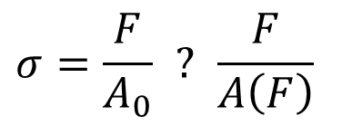
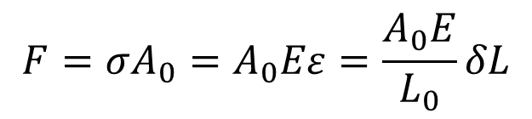
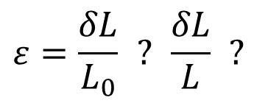
What is a linear structural problem?
Global
Local
Local
Global
Force
Linear
Stress
Linear
Strain
Linear
Displacement
A₀
A
σ
σ = Eε
F/2
L₀
δL
F/2
L
$$σ=\frac{F}{A_{0}} ? \frac{F}{A\left(F\right)}$$
E
ε
$$ε=\frac{δL}{L_{0}} ? \frac{δL}{L} ?$$
$$F=σA_{0}=A_{0}Eε=\frac{A_{0}E}{L_{0}}δL$$
Linearity is an approximation
Assumptions:
  Infinitesimal strain (<0.2%)
  Infinitesimal displacement
  Small rotation
  Linear stress-strain relation

Slide 6
Observations in linear problems
Which one will happen?
Will this happen?
M
M
Truss
Truss
F

Slide 7

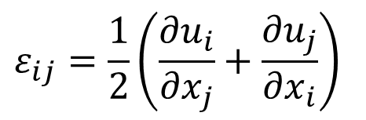
Linear vs. Nonlinear Problems
Linear Problem:
  Infinitesimal deformation:
  Linear stress-strain relation:
  Constant displacement BCs
  Constant applied forces
Nonlinear Problem:
  Everything except for linear problems!
  Geometric nonlinearity: nonlinear strain-displacement relation
  Material nonlinearity: nonlinear constitutive relation
  Kinematic nonlinearity: Non-constant displacement BCs, contact
  Force nonlinearity: follow-up loads
$$ε_{ij}=\frac{1}{2}\left(\frac{∂u_{i}}{∂x_{j}}+\frac{∂u_{j}}{∂x_{i}}\right)$$
$$σ=D:ε$$
Undeformed coord.
Constant

Slide 8
Nonlinearities in Structural Problems
Displacement
Strain
Stress
Nonlinear
displacement-strain
Nonlinear
stress-strain
Nonlinear displ. BC
Nonlinear force BC
Prescribed
displacement
Applied
force
More than one nonlinearity can exist at the same time

Slide 9
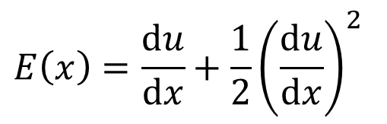



Geometric Nonlinearity
Relations among kinematic quantities (i.e., displacement, rotation and strains) are nonlinear
Displacement-strain relation
  Linear:
  Nonlinear:
Tip displacement
8.
6.
4.
2.
0.
C₁
C₂
C₀
C₃
0.0 0.2 0.4 0.6 0.8 1.0
Normalized couple
When du/dx is small
$$ε\left(x\right)=\frac{du}{dx}$$
$${\left(\frac{du}{dx}\right)}^{2}≪\frac{du}{dx}$$
$$E\left(x\right)=\frac{du}{dx}+\frac{1}{2}{\left(\frac{du}{dx}\right)}^{2}$$
H.O.T. can be ignored
$$ε\left(x\right)≈E\left(x\right)$$

Slide 10
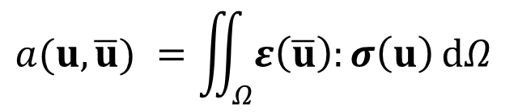

Geometric Nonlinearity cont.
Displacement-strain relation
  E has a higher-order term
  $(du/dx)≪1 → ε(x)\sim E(x)$.
Domain of integration
  Undeformed domain Ω₀
  Deformed domain Ω_{x}
0.35
0.30
0.25
0.20
0.15
0.10
0.05
0
E
Strain
e
0 0.05 0.10 0.15 0.20 0.25 0.30
du/dx
$$a(u,\overline{u}) =\iint_{Ω}{ε\left(\overline{u}\right):σ\left(u\right) dΩ}$$
Deformed domain is unknown

Slide 11


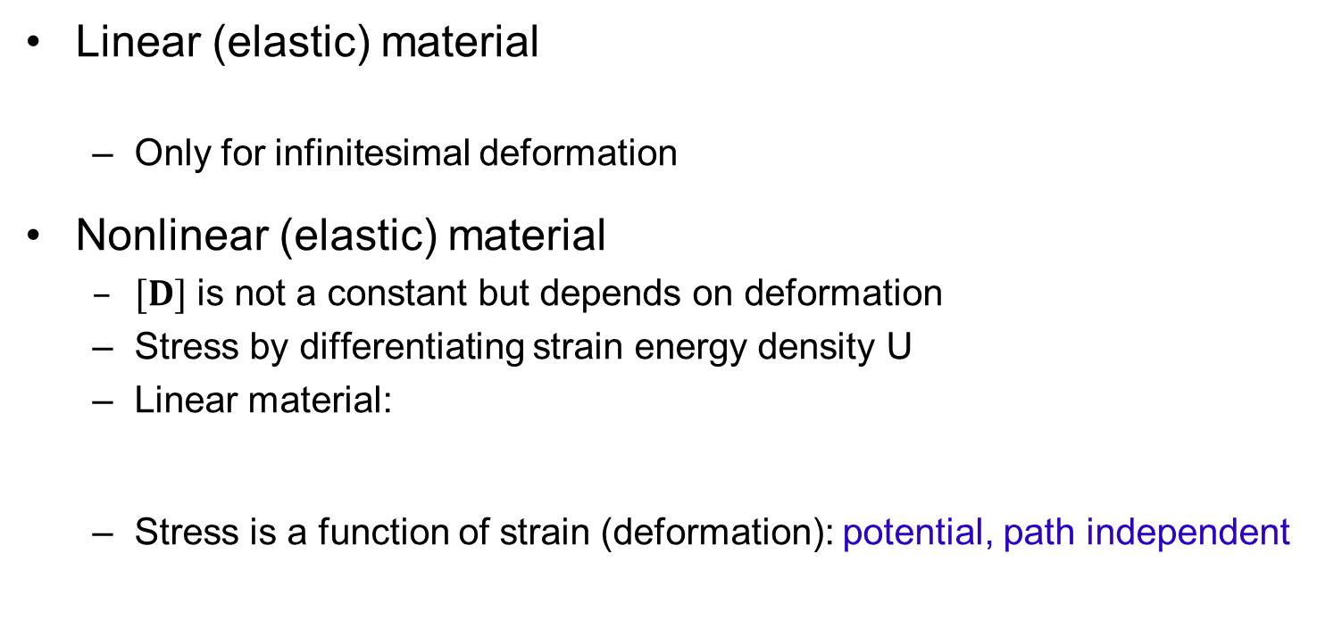
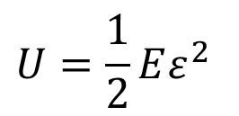


Material Nonlinearity
Linear (elastic) material
  Only for infinitesimal deformation
Nonlinear (elastic) material
  $[D]$ is not a constant but depends on deformation
  Stress by differentiating strain energy density U
  Linear material:
  Stress is a function of strain (deformation): potential, path independent
$$\left\{σ\right\}=\left[D\right]\left\{ε\right\}$$
More generally, $\{σ\} = \{f(ε)\}$
$$σ=\frac{dU}{dε}$$
$$U=\frac{1}{2}Eε^{2}$$
$$σ=\frac{dU}{dε}=Eε$$
σ
Nonlinear spring
E
σ
1
ε
E
Linear spring
ε
Linear and nonlinear elastic spring models

Slide 12
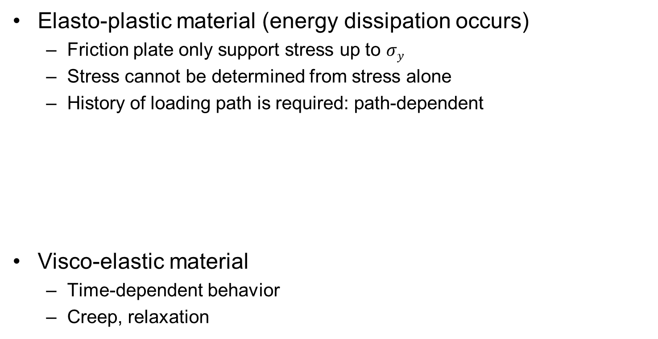
Material Nonlinearity cont.
Elasto-plastic material (energy dissipation occurs)
  Friction plate only support stress up to $σy$
  Stress cannot be determined from stress alone
  History of loading path is required: path-dependent
Visco-elastic material
  Time-dependent behavior
  Creep, relaxation
σ
E
σ_{Y}
s_{Y}
σ
E
ε
Elasto-plastic spring model
η
σ
E
Eε
σ
time
Visco-elastic spring model

Slide 13
Boundary and Force Nonlinearities
Nonlinear displacement BC (kinematic nonlinearity)
  Contact problems, displacement dependent conditions
Nonlinear force BC (Kinetic nonlinearity)
d_{max}
Force
Contact boundary
Displacement

Slide 14
Mild vs. Rough Nonlinearity
Mild Nonlinear Problems
  Continuous, history-independent nonlinear relations between stress and strain
  Nonlinear elasticity, Geometric nonlinearity, and deformation-dependent loads
Rough Nonlinear Problems
  Equality and/or inequality constraints in constitutive relations
  History-dependent nonlinear relations between stress and strain
  Elastoplasticity and contact problems

Slide 15


Nonlinear Finite Element Equations
Equilibrium between internal and external forces
Kinetic and kinematic nonlinearities
  Appears on the boundary
  Handled by displacements and forces (global, explicit)
  Relatively easy to understand (Not easy to implement though)
Material & geometric nonlinearities
  Appears in the domain
  Depends on stresses and strains (local, implicit)
Linear problems
$$P\left(d\right)=F\left(d\right)$$
$$\left[K\right]\left\{d\right\}=\left\{F\right\}$$
Stress
Strain
Loads

Slide 16
Solution Procedure for Nonlinear Algebraic Equations
2.2

Slide 17
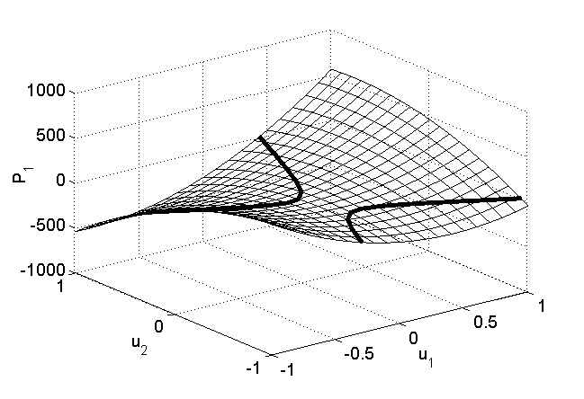
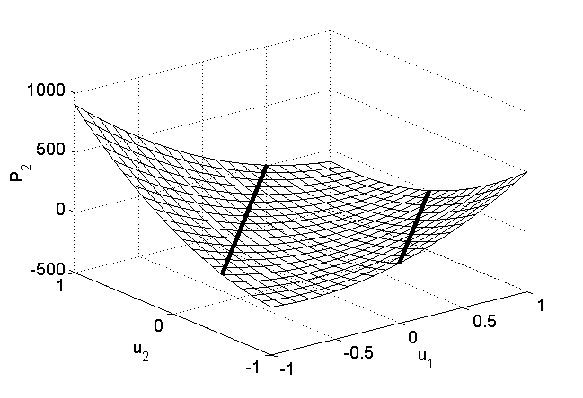
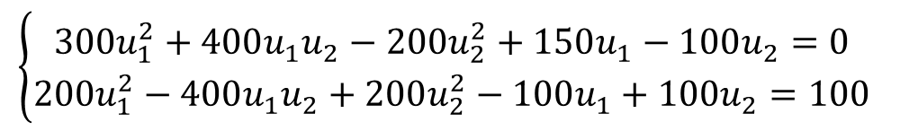

Example – Nonlinear Springs
k₁
k₂
Spring constants
  $k1 = 50 + 500u$
  $k2 = 100 + 200u$
Governing equation
  Solution is in the intersection between two zero contours
  Multiple solutions may exist
  No solution exists in a certain situation
F
u₁
u₂
$$\left\{\begin{matrix}300u_{1}^{2}+400u_{1}u_{2}−200u_{2}^{2}+150u_{1}−100u_{2}=0 \\ 200u_{1}^{2}−400u_{1}u_{2}+200u_{2}^{2}−100u_{1}+100u_{2}=100\end{matrix}\right.$$
P₁
P₂

Slide 18



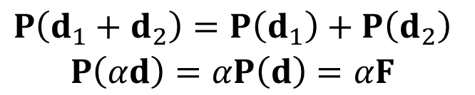
Solution Procedure
Linear Problems
  Stiffness matrix $K$ is constant
  If the load is doubled, displacement is doubled, too
  Superposition is possible
Nonlinear Problems
  How to find $d$ for a given $F$?
$$K⋅d=F or P\left(d\right)=F$$
2F
K
F
$$\begin{matrix}P\left(d_{1}+d_{2}\right)=P\left(d_{1}\right)+P\left(d_{2}\right) \\ P\left(αd\right)=αP\left(d\right)=αF\end{matrix}$$
d
2d
$$P\left(d\right)=F, P\left(2d\right)≠2F$$
F
K_{T}
Incremental Solution Procedure
d^{i}
d

Slide 19


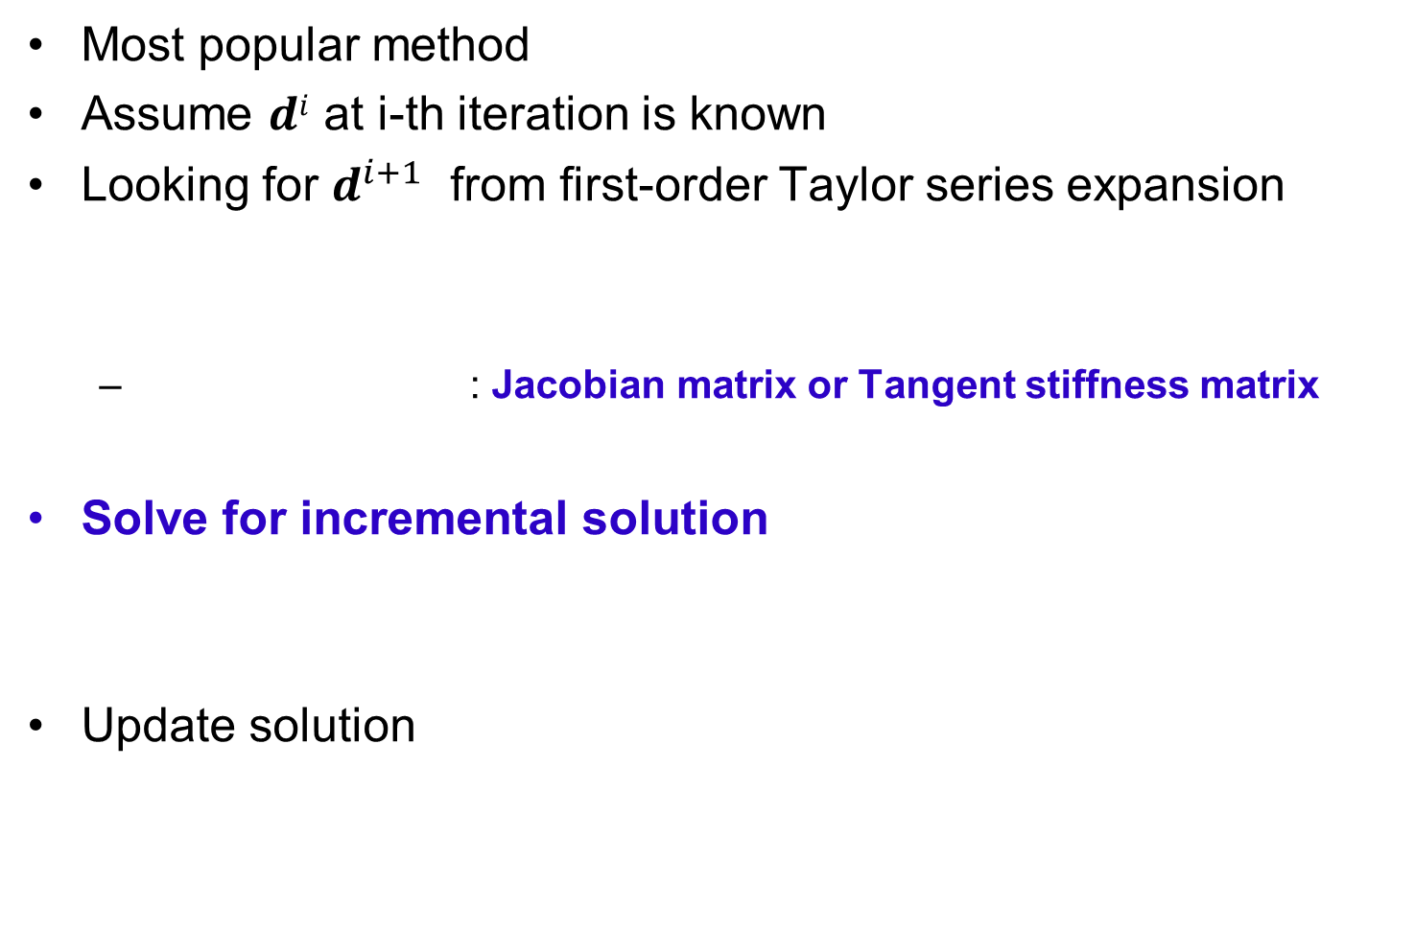


Newton-Raphson Method
Most popular method
Assume $di$ at i-th iteration is known
Looking for $d^{i+1}$ from first-order Taylor series expansion
  : Jacobian matrix or Tangent stiffness matrix
Solve for incremental solution
Update solution
$$P\left(d^{i+1}\right)≈P\left(d^{i}\right)+K_{T}^{i}\left(d^{i}\right)⋅Δd^{i}=F$$
$$K_{T}^{i}\left(d^{i}\right)≡{\left(\frac{∂P}{∂d}\right)}^{i}$$
$$K_{T}^{i}Δd^{i}=F−P\left(d^{i}\right)$$
F
P(d)
Solution
P(d^{i+1})
$$d^{i+1}=d^{i}+Δd^{i}$$
P(d^{i})
Δd^{i+1}
d^{i}
d^{i+1}
d^{i+2}
d^{n}
d

Slide 20
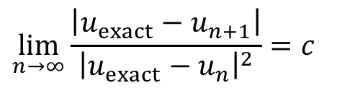
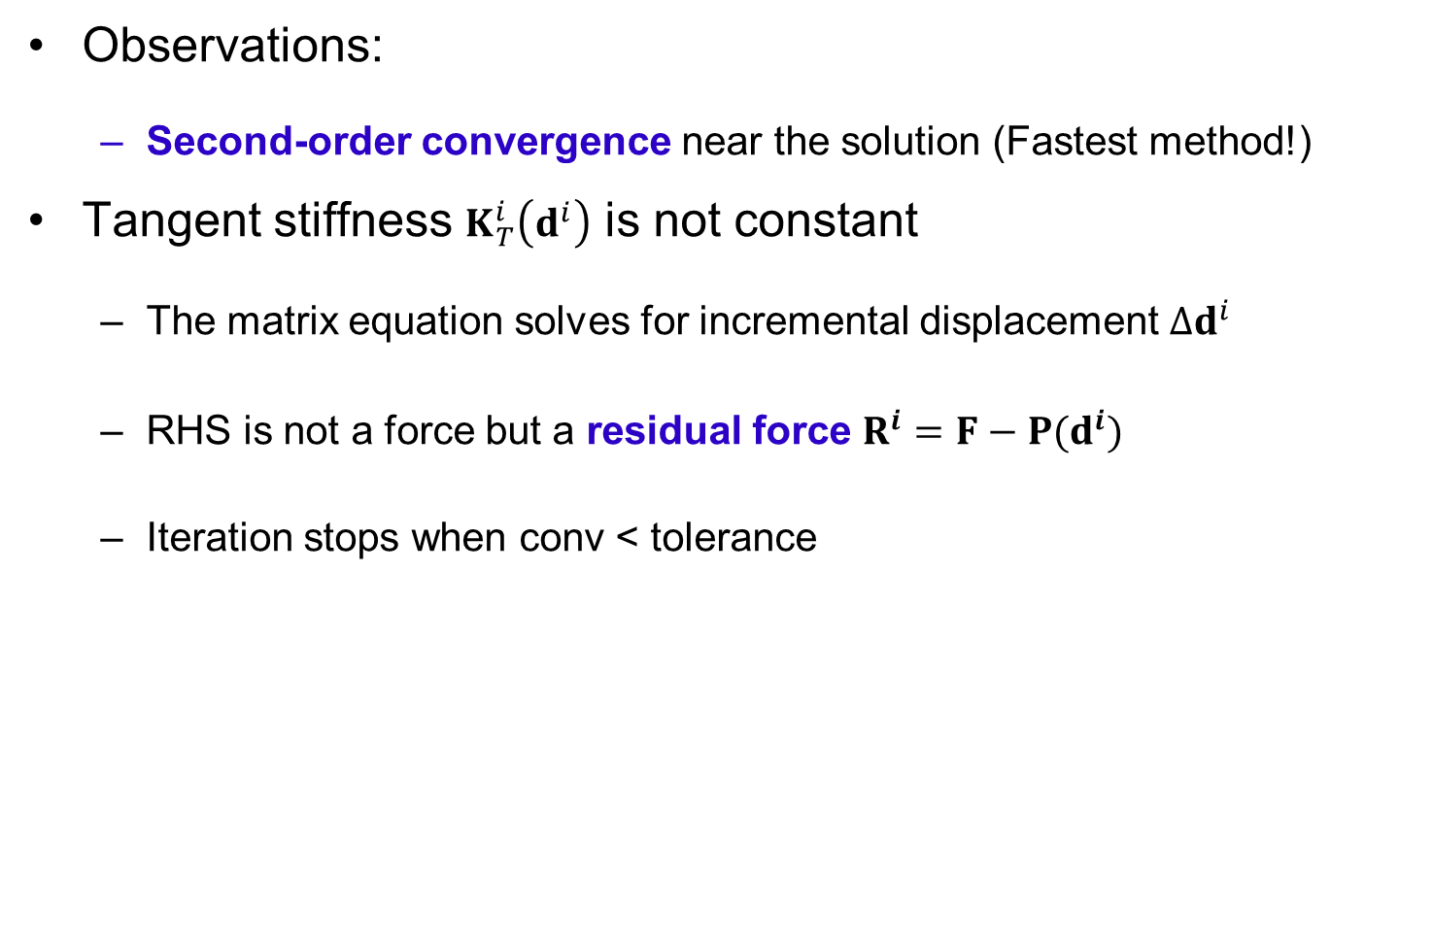


N-R Method cont.
$$\lim_{n→∞}\frac{\left|u_{exact}−u_{n+1}\right|}{{\left|u_{exact}−u_{n}\right|}^{2}}=c$$
Observations:
  Second-order convergence near the solution (Fastest method!)
Tangent stiffness $K_{T}^{i}\left(d^{i}\right)$ is not constant
  The matrix equation solves for incremental displacement $Δd^{i}$
  RHS is not a force but a residual force $R^{i}=F−P(d^{i})$
  Iteration stops when conv < tolerance
$$conv=\frac{\sum_{j=1}^{n}{{\left(R_{j}^{i+1}\right)}^{2}}}{1+\sum_{j=1}^{n}{{\left(F_{j}\right)}^{2}}}$$
$$conv=\frac{\sum_{j=1}^{n}{{\left(Δu_{j}^{i+1}\right)}^{2}}}{1+\sum_{j=1}^{n}{{\left(Δu_{j}^{0}\right)}^{2}}}$$
Or,

Slide 21
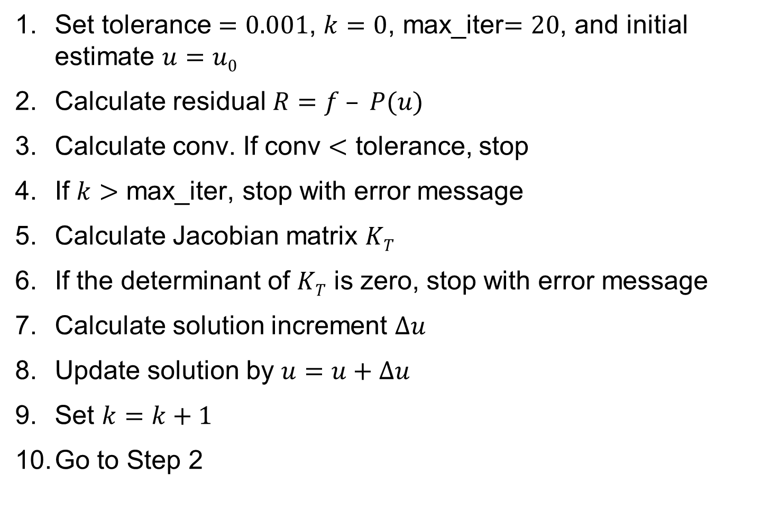
N-R Algorithm
Set tolerance $=0.001$, $k=0$, max_iter$=20$, and initial estimate $u=u0$
Calculate residual $R=f – P(u)$
Calculate conv. If conv $<$ tolerance, stop
If $k>$ max_iter, stop with error message
Calculate Jacobian matrix $KT$
If the determinant of $KT$ is zero, stop with error message
Calculate solution increment $Δu$
Update solution by $u=u+Δu$
Set $k=k+1$
Go to Step 2

Slide 22
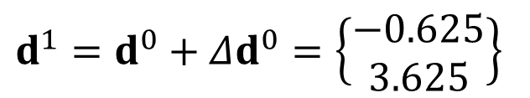
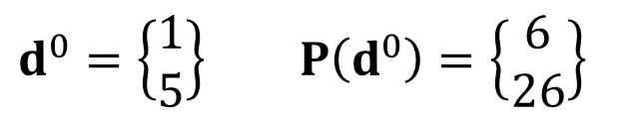
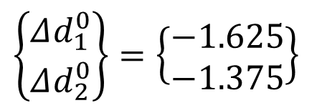
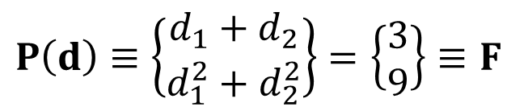
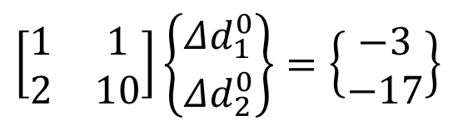
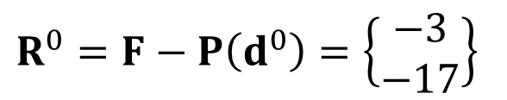
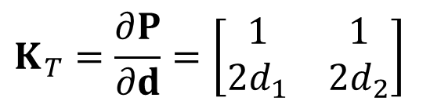
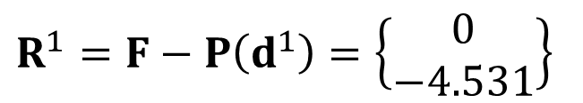
Example – N-R Method
$$P\left(d\right)≡\left\{\begin{matrix}d_{1}+d_{2} \\ d_{1}^{2}+d_{2}^{2}\end{matrix}\right\}=\left\{\begin{matrix}3 \\ 9\end{matrix}\right\}≡F$$
$$d^{0}=\left\{\begin{matrix}1 \\ 5\end{matrix}\right\} P\left(d^{0}\right)=\left\{\begin{matrix}6 \\ 26\end{matrix}\right\}$$
$$K_{T}=\frac{∂P}{∂d}=\left[\begin{matrix}1 & 1 \\ 2d_{1} & 2d_{2}\end{matrix}\right]$$
$$R^{0}=F−P\left(d^{0}\right)=\left\{\begin{matrix}−3 \\ −17\end{matrix}\right\}$$
Iteration 1
$$\left[\begin{matrix}1 & 1 \\ 2 & 10\end{matrix}\right]\left\{\begin{matrix}Δd_{1}^{0} \\ Δd_{2}^{0}\end{matrix}\right\}=\left\{\begin{matrix}−3 \\ −17\end{matrix}\right\}$$
$$\left\{\begin{matrix}Δd_{1}^{0} \\ Δd_{2}^{0}\end{matrix}\right\}=\left\{\begin{matrix}−1.625 \\ −1.375\end{matrix}\right\}$$
$$d^{1}=d^{0}+Δd^{0}=\left\{\begin{matrix}−0.625 \\ 3.625\end{matrix}\right\}$$
$$R^{1}=F−P\left(d^{1}\right)=\left\{\begin{matrix}0 \\ −4.531\end{matrix}\right\}$$

Slide 23
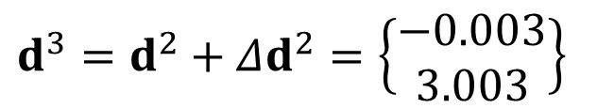
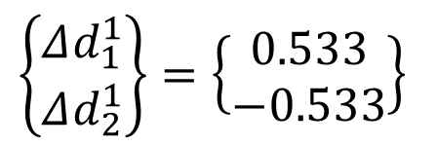
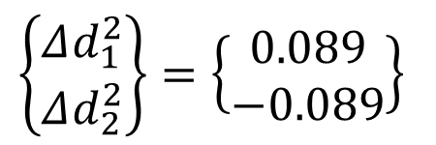
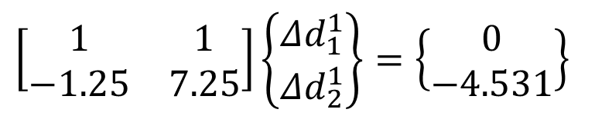
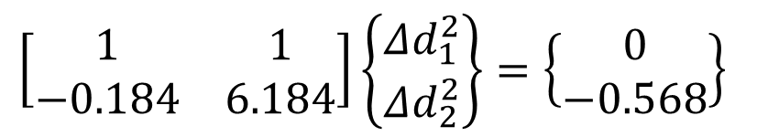
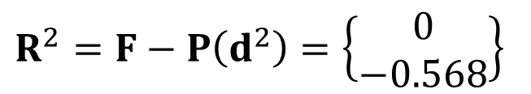
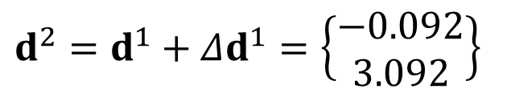
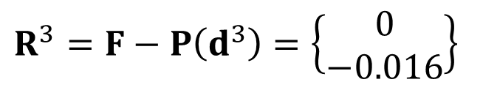
Example – N-R Method cont.
Iteration 2
Iteration 3
$$\left[\begin{matrix}1 & 1 \\ −1.25 & 7.25\end{matrix}\right]\left\{\begin{matrix}Δd_{1}^{1} \\ Δd_{2}^{1}\end{matrix}\right\}=\left\{\begin{matrix}0 \\ −4.531\end{matrix}\right\}$$
$$\left\{\begin{matrix}Δd_{1}^{1} \\ Δd_{2}^{1}\end{matrix}\right\}=\left\{\begin{matrix}0.533 \\ −0.533\end{matrix}\right\}$$
$$d^{2}=d^{1}+Δd^{1}=\left\{\begin{matrix}−0.092 \\ 3.092\end{matrix}\right\}$$
$$R^{2}=F−P\left(d^{2}\right)=\left\{\begin{matrix}0 \\ −0.568\end{matrix}\right\}$$
$$\left[\begin{matrix}1 & 1 \\ −0.184 & 6.184\end{matrix}\right]\left\{\begin{matrix}Δd_{1}^{2} \\ Δd_{2}^{2}\end{matrix}\right\}=\left\{\begin{matrix}0 \\ −0.568\end{matrix}\right\}$$
$$\left\{\begin{matrix}Δd_{1}^{2} \\ Δd_{2}^{2}\end{matrix}\right\}=\left\{\begin{matrix}0.089 \\ −0.089\end{matrix}\right\}$$
$$d^{3}=d^{2}+Δd^{2}=\left\{\begin{matrix}−0.003 \\ 3.003\end{matrix}\right\}$$
$$R^{3}=F−P\left(d^{3}\right)=\left\{\begin{matrix}0 \\ −0.016\end{matrix}\right\}$$

Slide 24
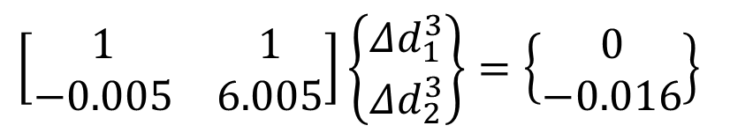
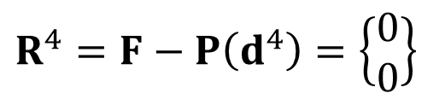
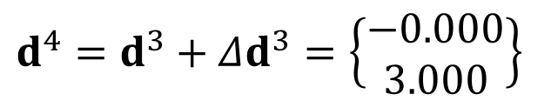

Example – N-R Method cont.
Iteration 4
$$\left[\begin{matrix}1 & 1 \\ −0.005 & 6.005\end{matrix}\right]\left\{\begin{matrix}Δd_{1}^{3} \\ Δd_{2}^{3}\end{matrix}\right\}=\left\{\begin{matrix}0 \\ −0.016\end{matrix}\right\}$$
$$\left\{\begin{matrix}Δd_{1}^{3} \\ Δd_{2}^{3}\end{matrix}\right\}=\left\{\begin{matrix}0.003 \\ −0.003\end{matrix}\right\}$$
$$d^{4}=d^{3}+Δd^{3}=\left\{\begin{matrix}−0.000 \\ 3.000\end{matrix}\right\}$$
$$R^{4}=F−P\left(d^{4}\right)=\left\{\begin{matrix}0 \\ 0\end{matrix}\right\}$$
Residual
Iter | ||R||
0 | 17.263
1 | 4.531
2 | 0.568
3 | 0.016
4 | 0.0
Iteration
Quadratic convergence

Slide 25



When N-R Method Does Not Converge
Difficulties
  Convergence is not always guaranteed
  Automatic load step control and/or line search techniques are often used
  Difficult/expensive to calculate $K_{T}^{i}\left(d^{i}\right)$
$$\frac{∂P}{∂d}$$
Solution
P(d)
F
$$\frac{∂P}{∂d}$$
d^{i+2}
d^{i}
d^{n}
d^{i+1}
d

Slide 26
When N-R Method Does Not Converge cont.
Convergence difficulty occurs when
  Jacobian matrix is not positive-definite
  Bifurcation & snap-through require a special algorithm
P.D. Jacobian: in order to increase displ., force must be increased
F
F_{C}
C
B
A
F_{B}
B
D
Force
C
D
E
A
E
Displacement

Slide 27
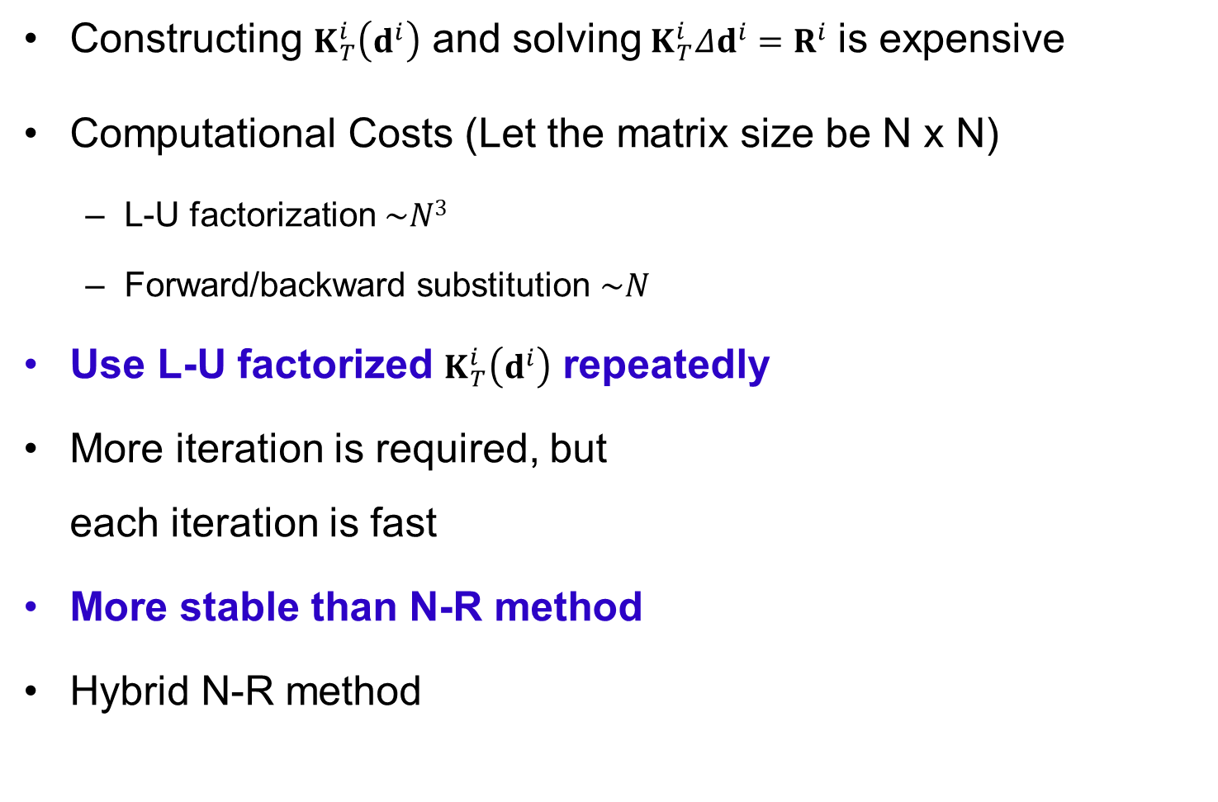
Modified N-R Method
Constructing $K_{T}^{i}\left(d^{i}\right)$ and solving$K_{T}^{i}Δd^{i}=R^{i}$ is expensive
Computational Costs (Let the matrix size be N x N)
  L-U factorization $\sim N3$
  Forward/backward substitution $\sim N$
Use L-U factorized $K_{T}^{i}\left(d^{i}\right)$ repeatedly
More iteration is required, but
each iteration is fast
More stable than N-R method
Hybrid N-R method
F
P(d)
Solution
d^{i}
d^{i+1}
d^{n}
d

Slide 28
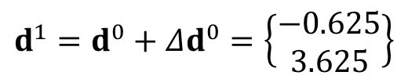







Example – Modified N-R Method
Solve the same problem using modified N-R method
$$P\left(d\right)≡\left\{\begin{matrix}d_{1}+d_{2} \\ d_{1}^{2}+d_{2}^{2}\end{matrix}\right\}=\left\{\begin{matrix}3 \\ 9\end{matrix}\right\}≡F$$
$$d^{0}=\left\{\begin{matrix}1 \\ 5\end{matrix}\right\} P\left(d^{0}\right)=\left\{\begin{matrix}6 \\ 26\end{matrix}\right\}$$
$$K_{T}=\frac{∂P}{∂d}=\left[\begin{matrix}1 & 1 \\ 2d_{1} & 2d_{2}\end{matrix}\right]$$
$$R^{0}=F−P\left(d^{0}\right)=\left\{\begin{matrix}−3 \\ −17\end{matrix}\right\}$$
Iteration 1
$$\left[\begin{matrix}1 & 1 \\ 2 & 10\end{matrix}\right]\left\{\begin{matrix}Δd_{1}^{0} \\ Δd_{2}^{0}\end{matrix}\right\}=\left\{\begin{matrix}−3 \\ −17\end{matrix}\right\}$$
$$\left\{\begin{matrix}Δd_{1}^{0} \\ Δd_{2}^{0}\end{matrix}\right\}=\left\{\begin{matrix}−1.625 \\ −1.375\end{matrix}\right\}$$
$$d^{1}=d^{0}+Δd^{0}=\left\{\begin{matrix}−0.625 \\ 3.625\end{matrix}\right\}$$
$$R^{1}=F−P\left(d^{1}\right)=\left\{\begin{matrix}0 \\ −4.531\end{matrix}\right\}$$

Slide 29




Example – Modified N-R Method cont.
Iteration 2
$$\left[\begin{matrix}1 & 1 \\ 2 & 10\end{matrix}\right]\left\{\begin{matrix}Δd_{1}^{1} \\ Δd_{2}^{1}\end{matrix}\right\}=\left\{\begin{matrix}0 \\ −4.531\end{matrix}\right\}$$
$$\left\{\begin{matrix}Δd_{1}^{1} \\ Δd_{2}^{1}\end{matrix}\right\}=\left\{\begin{matrix}0.566 \\ −0.566\end{matrix}\right\}$$
$$d^{2}=d^{1}+Δd^{1}=\left\{\begin{matrix}−0.059 \\ 3.059\end{matrix}\right\}$$
$$R^{2}=F−P\left(d^{2}\right)=\left\{\begin{matrix}0 \\ −0.358\end{matrix}\right\}$$
Residual
Iter | ||R||
0 | 17.263
1 | 4.5310
2 | 0.3584
3 | 0.0831
4 | 0.0204
5 | 0.0051
6 | 0.0013
7 | 0.0003
Iteration

Slide 30


Incremental Secant Method
Secant matrix
  Instead of using tangent stiffness, approximate it using the solution from the previous iteration
  At i-th iteration
  The secant matrix satisfies
  Not a unique process in high dimension
Start from initial K_{T} matrix, iteratively update it
  Rank-1 or rank-2 update
  The textbook has Broyden’s algorithm (Rank-1 update)
  Here we will discuss BFGS method (Rank-2 update)
F
P(d)
$$K_{s}^{i}Δd^{i}=F−P\left(d^{i}\right)$$
Solution
$$K_{s}^{i}⋅\left(d^{i}−d^{i−1}\right)=P\left(d^{i}\right)−P\left(d^{i−1}\right)$$
Secant stiffness
d⁰
d¹
d²
d³
d^{n}
d

Slide 31



Incremental Secant Method cont.
BFGS (Broyden, Fletcher, Goldfarb and Shanno) method
  Stiffness matrix must be symmetric and positive-definite
  Instead of updating K, update H (saving computational time)
Become unstable when the No. of iterations is increased
$$Δd^{i}={\left[K_{s}^{i}\right]}^{−1}\left\{F−P\left(d^{i}\right)\right\}≡\left[H_{s}^{i}\right]\left\{F−P\left(d^{i}\right)\right\}$$
$$H_{s}^{i}=\left(I+w^{i}{v^{i}}^{T}\right)H_{s}^{i−1}\left(I+w^{i}{v^{i}}^{T}\right)$$
$$v^{i}=R^{i−1}\left(1−\frac{{\left(Δd^{i−1}\right)}^{T}\left(R^{i−1}−R^{i}\right)}{{\left(Δd^{i}\right)}^{T}R^{i−1}}\right)−R^{i}$$
$$w^{i}=\frac{Δd^{i−1}}{{\left(Δd^{i−1}\right)}^{T}\left(R^{i−1}−R^{i}\right)}$$

Slide 32

Incremental Force Method
N-R method converges fast if the initial estimate is close to the solution
Solid mechanics: initial estimate = undeformed shape
Convergence difficulty
occurs when the applied
load is large
(deformation is large)
IFM: apply loads in
increments. Use the
solution from the
previous increment
as an initial estimate
  Commercial programs
  call it “Load Increment”
  or “Time Increment”

Slide 33
Incremental Force Method cont.
Load increment does not have to be uniform
  Critical part has smaller increment size
Solutions in the intermediate load increments
  History of the response can provide insight into the problem
  Estimating the bifurcation point or the critical load
  Load increments greatly affect the accuracy in path-dependent problems

Slide 34


Load Increment in Commercial Software
Use “Time” to represent load level
  In a static problem, “Time” means a pseudo-time
  Required Starting time, (T_{start}), Ending time (T_{end}) and increment
  Load is gradually increased from zero at T_{start} and full load at T_{end}
  Load magnitude at load increment T^{n}:
Automatic time stepping
  Increase/decrease next load increment based on the number of convergence iteration at the current load
  User provide initial load increment, minimum increment, and maximum increment
  Bisection of load increment when not converged
$$F^{n}=\frac{T^{n}−T_{start}}{T_{end}−T_{start}}F$$
$$T^{n}=n×ΔT≤T_{end}$$

Slide 35
Force Control vs. Displacement Control
Force control: gradually increase applied forces and find equilibrium configuration
Displ. control: gradually increase prescribed displacements
  Applied load can be calculated as a reaction
  More stable than force control.
  Useful for softening, contact, snap-through, etc.
F
F
P(u)
F_{n}
F_{C}
P(u)
F₃
F_{B}
F₂
F₁
F_{A}
u
u
u₁
u₂
u₃
u_{n}
u_{A}
u_{B}
u_{C}
u_{D}

Slide 36
Steps in the Solution of Nonlinear Finite Element Analysis
2.3

Slide 37





Nonlinear Solution Steps
Initialization:
Residual Calculation
Convergence Check (If converged, stop)
Linearization
  Calculate tangent stiffness
Incremental Solution:
  Solve
State Determination
  Update displacement and stress
Go To Step 2
$$d^{0}=0; i=0$$
$$R^{i}=F−P\left(d^{i}\right)$$
$$K_{T}^{i}\left(d^{i}\right)$$
$$K_{T}^{i}\left(d^{i}\right)Δd^{i}=R^{i}$$
$$\begin{matrix}d^{i+1}=d^{i}+Δd^{i} \\ σ^{i+1}=σ^{i}+Δσ^{i}\end{matrix}$$

Slide 38






Nonlinear Solution Steps cont.
State determination
  For a given displ d^{k}, determine current state (strain, stress, etc)
  Sometimes, stress cannot be determined using strain alone
Residual calculation
  Applied nodal force − Nodal forces due to internal stresses
$$u^{k}\left(x\right)=N\left(x\right)⋅d^{k}$$
$$ε^{k}=B⋅d^{k}$$
$$σ^{k}=f\left(ε^{k}\right)$$
$$\iiint_{Ω}{ε{\left(\overline{u}\right)}^{T}σ dΩ}=\iint_{Γ_{s}}{{\overline{u}}^{T}t dΓ}+\iiint_{Ω}{{\overline{u}}^{T}f^{b} dΩ}, ∀\overline{u}∈ℤ$$
Weak form:
$${\overline{d}}^{T}\left(\iiint_{Ω}{B^{T}σ dΩ}=\iint_{Γ_{s}}{N^{T}t dΓ}+\iiint_{Ω}{N^{T}f^{b} dΩ}\right), ∀\overline{d}∈ℤ_{h}$$
Discretization:
$$R^{k}=\iint_{Γ_{s}}{N^{T}t dΓ}+\iiint_{Ω}{N^{T}f^{b} dΩ}−\iiint_{Ω}{B^{T}σ^{k} dΩ}$$
Residual:

Slide 39









Example – Linear Elastic Material
Governing equation (Scalar equation)
Collect
Residual: $R=F−P\left(d\right)$
Linear elastic material
$$\overline{u}=N⋅\overline{d}$$
$$\iiint_{Ω}{ε{\left(\overline{u}\right)}^{T}σ dΩ}=\iint_{Γ_{s}}{{\overline{u}}^{T}t dΓ}+\iiint_{Ω}{{\overline{u}}^{T}f^{b} dΩ}$$
$$ε\left(\overline{u}\right)=B⋅\overline{d}$$
$${\overline{d}}^{T}\left(\iiint_{Ω}{B^{T}σ dΩ}=\iint_{Γ_{s}}{N^{T}t dΓ}+\iiint_{Ω}{N^{T}f^{b} dΩ}\right)$$
$$P\left(d\right)$$
$$F$$
F
$$σ=D⋅ε=D⋅B⋅d$$
K_{T}
$$K_{T}=\frac{∂P\left(d\right)}{∂d}=\iiint_{Ω}{B^{T}DB dΩ}$$
d

Slide 40





Example – Nonlinear Bar
Rubber bar $σ=E\tan^{−1}\left(mε\right)$
Discrete weak form ${\overline{d}}^{T}\int_{0}^{L}{B^{T}σA dx}={\overline{d}}^{T}F$
Scalar equation
$$\overline{d}=\left\{\begin{matrix}{\overline{d}}_{1} \\ {\overline{d}}_{2}\end{matrix}\right\}$$
$$\begin{matrix} R=F−\int_{0}^{L}{\frac{σA}{L} dx} \\ ⇒R=F−σ\left(d\right)A\end{matrix}$$
$$F=\left\{\begin{matrix}R \\ F\end{matrix}\right\}$$
$$B=\frac{1}{L}\left\lfloor \begin{matrix}−1 & 1\end{matrix}\right\rfloor$$
120
100
80
60
40
20
0
Stress
1
2
F = 10kN
x
L = 1m
0 0.01 0.02 0.03 0.04 0.05
Strain

Slide 41






Example – Nonlinear Bar cont.
Jacobian
N-R equation
Iteration 1
Iteration 2
$$\frac{dP}{dd}=\frac{dσ\left(d\right)}{dd}A=\frac{dσ}{dε}\frac{dε}{dd}A=\frac{1}{L}mAE\cos^{2}\left(\frac{σ}{E}\right)$$
$$\left[\frac{1}{L}mAE\cos^{2}\left(\frac{σ^{k}}{E}\right)\right]Δd^{k}=F−σ^{k}A$$
$$\begin{matrix}d^{1}=d^{0}+Δd^{0}=0.025m \\ ε^{1}={d^{1}}/L=0.025 \\ σ^{1}=Etan^{−1}\left(mε^{1}\right)=78.5MPa\end{matrix}$$
$$\frac{mAE}{L}Δd^{0}=F$$
$$\left[\frac{mAE}{L}\cos^{2}\left(\frac{σ^{1}}{E}\right)\right]Δd^{1}=F−σ^{1}A$$
$$\begin{matrix}d^{2}=d^{1}+Δd^{1}=0.0357m \\ ε^{2}={d^{2}}/L=0.0357 \\ σ^{2}=Etan^{−1}\left(mε^{2}\right)=96MPa\end{matrix}$$

Slide 42
N-R or Modified N-R?
It is always recommended to use the Incremental Force Method
  Mild nonlinear: ~10 increments
  Rough nonlinear: 20 ~ 100 increments
  For rough nonlinear problems, analysis results depends on increment size
Within an increment, N-R or modified N-R can be used
  N-R method calculates K_{T} at every iteration
  Modified N-R method calculates K_{T} once at every increment
  N-R is better when: mild nonlinear problem, tight convergence criterion
  Modified N-R is better when: computation is expensive, small increment size, and when N-R does not converge well
Many FE programs provide automatic stiffness update option
  Depending on convergence criteria used, material status change, etc

Slide 43

Accuracy vs. Convergence
Nonlinear solution procedure requires
  Internal force P(d)
  Tangent stiffness
  They are often implemented in the same routine
Internal force P(d) needs to be accurate
  We solve equilibrium of P(d) = F
Tangent stiffness K_{T}(d) contributes to convergence
  Accurate K_{T}(d) provides quadratic convergence near the solution
  Approximate K_{T}(d) requires more iteration to converge
  Wrong K_{T}(d) causes lack of convergence
$$K_{T}\left(d\right)=\frac{∂P}{∂d}$$

Slide 44

Convergence Criteria
Most analysis programs provide three convergence criteria
  Work, displacement, load (residual)
  Work = displacement * load
  At least two criteria needs to be converged
Traditional convergence criterion is load (residual)
  Equilibrium between internal and external forces
Use displacement criterion for load insensitive system
$$P\left(d\right)=F\left(d\right)$$
Force
Use load
criterion
Use displacement
criterion
Displacement

Slide 45

Solution Strategies
Load Step (subcase or step)
  Load step is a set of loading and boundary conditions to define an analysis problem
  Multiple load steps can be used to define a sequence of loading conditions
Load
LS1
LS2
Time
NASTRAN
SPC = 1
SUBCASE 1
LOAD = 1
SUBCASE 2
LOAD = 2

Slide 46
Solution Strategies
300
Load Increment (substeps)
  Linear analysis concerns max load
  Nonlinear analysis depends on
  load path (history)
  Applied load is gradually increased
  within a load step
  Follow load path, improve accuracy,
  and easy to converge
Convergence Iteration
  Within a load increment, an iterative
  method (e.g., NR method) is used to
  find nonlinear solution
  Bisection, linear search, stabilization, etc
250
Loading
200
150
Force
100
50
0
-50
Unloading
-100
0
0.2
0.4
0.6
0.8
1
Displacement
F
Fª
4
5
3
2
1
u

Slide 47
Solution Strategies cont.
Automatic (Variable) Load Increment
  Also called Automatic Time Stepping
  Load increment may not be uniform
  When convergence iteration diverges, the load increment is halved
  If a solution converges in less than 4 iterations, increase time increment by 25%
  If a solution converges in more than 8 iterations, decrease time increment by 25%
Subincrement (or bisection)
  When iterations do not converge at a given increment, analysis goes back to previously converged increment and the load increment is reduced by half
  This process is repeated until max number of subincrements

Slide 48


When nonlinear analysis does not converge
NR method assumes a constant curvature locally
When a sign of curvature changes around the solution, NR method oscillates or diverges
Often the residual changes sign between iterations
Line search can help to converge
$$P\left(u\right)=u+\tan^{−1}\left(5u\right)$$
$$\frac{dP}{du}=1+5\cos^{2}\left(\tan^{−1}\left(5u\right)\right)$$

Slide 49
When nonlinear analysis does not converge
Displacement-controlled vs. force-controlled procedure
  Almost all linear problems are force-controlled
  Displacement-controlled procedure is more stable for nonlinear analysis
  Use reaction forces to calculate applied forces
F
C
F_{C}
B
A
F_{B}
B
D
Force
C
D
E
A
E
Displacement

Slide 50


When nonlinear analysis does not converge
Mesh distortion
  Most FE programs stop analysis when mesh is distorted too much
  Initial good mesh may be distorted during a large deformation
  Many FE programs provide remeshing capability, but it is still inaccurate or inconvenient
  It is best to make mesh in such a way that the mesh quality can be maintained after deformation (need experience)
Initial mesh

Slide 51
NLFEA - MATLAB Code for Nonlinear FEA
2.4

Slide 52
NLFEA.m
Nonlinear finite element analysis program
  Incremental force method with N-R method
  Bisection method when N-R is failed to converge
  Can solve for linear elastic, hyperelastic and elasto-plastic material nonlinearities with large deformation
Global arrays
Name | Dimension | Contents
GKF | NEQ x NEQ | Tangent matrix
FORCE | NEQ x 1 | Residual vector
DISPTD | NEQ x 1 | Displacement vector
DISPDD | NEQ x 1 | Displacement increment
ACC | NEQ x 1 | Acceleration vector for dynamic analysis
SIGMA | 6 x 8 x NE | Stress at each integration point
XQ | 7 x 8 x NE | History variable at each integration point

Slide 53
Input data
Update history variables
FLAG10
Time Increment
Print stress & displacement
T = T + ΔT
Bisection control
Final time?
Yes
Stop
FLAG11
Bisection
No
Increase load & BC
T = T – ΔT
ΔT = ΔT/2
ITER = 0
Calculate R & K
Displacement BC
Converged?
Yes
No
Yes
Max ITER?
No
ITER=ITER + 1
Solve ΔU = K\R
FLAG20
Convergence
iteration
U = U + ΔU

Slide 54
NLFEA.m cont.
Nodal coordinates and element connectivity
  the node numbers are in sequence
  nodal coordinates in XYZ(NNODE , 3)
  eight-node hexahedral elements LE(NELEN, 8)
Applied forces and prescribed displacements
  EXTFORCE(NFORCE, 3): [node, DOF, value] format
  SDISPT(NDISPT, 3)
Load steps and increments
  TIMS(NTIME,5): [T_{start}, T_{end}, T_{inc}, LOAD_{init}, LOAD_{final}] format
Material properties
  Mooney-Rivlin hyperelasticity (MID = -1), PROP = [A10, A01, K]
  infinitesimal elastoplasticity (MID = 1), PROP = [LAMBDA, MU, BETA, H, Y0]

Slide 55
NLFEA.m cont.
Control parameters
  ITRA: maximum number of convergence iterations
  if residual > ATOL, then solution diverges, bisection starts
  The total number of bisections is limited by NTOL
  The convergence iteration converges when residual < TOL
  Program prints out results to NOUT after convergence
PARAM: Matlab structure for control parameters
  PARAM=struct('ITRA',70,'ATOL',1.0E5,'NTOL',6,'TOL',1E-6,'TIMS',TIMS)
function NLFEA(PARAM,MID,PROP,EXTFORCE,SDISPT,XYZ,LE,[],[])
%***********************************************************************
% MAIN PROGRAM FOR HYPERELASTIC/ELASTOPLASTIC ANALYSIS
%***********************************************************************

Slide 56
NLFEA.m
Global variables:
  DISPDD: Incremental displacement vector
  DISPTD: Total displacement vector
  FORCE: Global force vector
  GKF: Global tangent stiffness matrix
Material models (MID)
  MID = 0: Linear elastic material
  MID > 0: Elastoplastic materials (1, 11, 21)
  MID < 0: Hyperelastic materials (Mooney-Rivlin)

Slide 57
Extension of a Single Element Example
%
% Extension of single element example
XYZ=[0 0 0;1 0 0;1 1 0;0 1 0;0 0 1;1 0 1;1 1 1;0 1 1]; % Nodal coordinates (mm)
LE=[1 2 3 4 5 6 7 8]; % Element connectivity
EXTFORCE=[5 3 10; 6 3 10; 7 3 10; 8 3 10]; % External forces [Node, DOF, Value]
SDISPT=[1 1 0;1 2 0;1 3 0;2 2 0;2 3 0;3 3 0;4 1 0;4 3 0]; % Fixed displacements
TIMS=[0 0.5 0.1 0 0.5;0.5 1 0.1 0.5 1]'; % Load increments [t0 T Dt f0 fL]
MID=1; PROP=[206.9, 0.29, 0.0, 5., 35.0]; % Elastoplastic [E NU BETA H Y0]
PARAM=struct('ITRA',20,'ATOL',1.0E5,'NTOL',5,'TOL',1E-6,'TIMS',TIMS); %
clc; NOUT=fopen('output.txt','w'); % Open output file
NLFEA(PARAM,NOUT,MID,PROP,EXTFORCE,SDISPT,XYZ,LE,[],[]); % Calling NLFEA
fclose(NOUT); % Close output file

Slide 58

Tension of Elastoplastic Bar Example
Material properties
x₃
11kN
11kN
$$E$$ | $$ν$$ | $$σY$$ | $$H$$
206.9 GPa | 0.29 | 400 MPa | 100 MPa
9
11kN
11kN
12
10
11
Uniaxial stress condition s₃₃ ≠ 0
When F_{i} = 10 kN, σ = 400 MPa (Elastic limit)
Elastoplastic when F_{i} = 10 ~ 11kN
5
8
6
7
%
% Two-element example
%
% Nodal coordinates
XYZ=[0 0 0; 1 0 0; 1 1 0; 0 1 0;
0 0 1; 1 0 1; 1 1 1; 0 1 1;
0 0 2; 1 0 2; 1 1 2; 0 1 2]*0.01;
%
% Element connectivity
LE=[1 2 3 4 5 6 7 8;
5 6 7 8 9 10 11 12];
%
% Prescribed displacements [Node, DOF, Value]
SDISPT=[1 1 0;1 2 0;1 3 0;2 2 0;2 3 0;3 3 0;4 1 0;4 3 0];
1
4
x₂
2
x₁
3
x₂
u=w=0
w=0
4
3
1
2
x₁
u=v=w=0
v=w=0

Slide 59
Tension of Elastoplastic Bar Example
%
% External forces [Node, DOF, Value]
EXTFORCE=[9 3 10.0E3; 10 3 10.0E3; 11 3 10.0E3; 12 3 10.0E3];
%
% Load increments [Start End Increment InitialFactor FinalFactor]
TIMS=[0.0 0.8 0.4 0.0 0.8; 0.8 1.1 0.1 0.8 1.1]';
%
% Material properties PROP=[LAMDA MU BETA H Y0]
MID=1;
PROP=[206.9E9 0.29 0 1E8 4E8];
%
% Set program parameters
PARAM=struct('ITRA',70,'ATOL',1.0E5,'NTOL',6,'TOL',1E-6,'TIMS',TIMS);;
%
% Calling main function
clc; NOUT=fopen('output.txt','w');
NLFEA(PARAM,NOUT,MID,PROP,EXTFORCE,SDISPT,XYZ,LE,[],[]);
fclose(NOUT);
Force (kN)
10kN * 1.1 = 11kN
11
10
9
8
4
0
0.4
Time
0.8
0.9
1
1.1

Slide 60
Tension of Elastoplastic Bar Example
Convergence iteration outputs (output.txt)
Time Time step Iter Residual
0.40000 4.000e-01 2 3.80851e-12
Time Time step Iter Residual
0.80000 4.000e-01 2 4.32010e-12
Time Time step Iter Residual
0.90000 1.000e-01 2 3.97904e-12
Time Time step Iter Residual
1.00000 1.000e-01 2 3.63798e-12
Time Time step Iter Residual
1.10000 1.000e-01 2 6.66390e+02
3 1.67060e-09
Linear elastic region
Elastoplastic region
Load factor | u_{5z} | u_{9z} | S₃₃ Elem1 | S₃₃ Elem2 | State
0.4 | 7.73×10⁻⁶ | 1.55×10⁻⁵ | 160 MPa | 160 MPa | Elastic
0.8 | 1.55×10⁻⁵ | 3.09×10⁻⁵ | 320 MPa | 320 MPa | Elastic
0.9 | 1.74×10⁻⁵ | 3.48×10⁻⁵ | 360 MPa | 360 MPa | Elastic
1.0 | 1.93×10⁻⁵ | 3.87×10⁻⁵ | 400 MPa | 400 MPa | Elastic
1.1 | 4.02×10⁻³ | 8.04×10⁻³ | 440 MPa | 440 MPa | Plastic

Slide 61

Postprocessing NLFEA Analysis Results
W=0.1; H=0.1; L=0.4; F=250; % Dimensions of the beam and applied load
XYZ=[W 0 0;W L 0;0 L 0;0 0 0; % Nodal coordinates
W 0 H;W L H;0 L H;0 0 H; %
W 2*L 0;0 2*L 0;W 2*L H;0 2*L H; %
W 3*L 0;0 3*L 0;W 3*L H;0 3*L H; %
W 4*L 0;0 4*L 0;W 4*L H;0 4*L H; %
W 5*L 0;0 5*L 0;W 5*L H;0 L H]; %
LE=[ 1 2 3 4 5 6 7 8; 2 9 10 3 6 11 12 7; % Element connectivity
9 13 14 10 11 15 16 12; 13 17 18 14 15 19 20 16; %
17 21 22 18 19 23 24 20]; %
FORCE=[21 3 F; 22 3 F; 23 3 F; 24 3 F]; % Applied forces [Node,DOF,Value]
SDISPT=[1 1 0;1 2 0;1 3 0;4 1 0;4 2 0;4 3 0; % Prescribed displacements
5 1 0;5 2 0;5 3 0;8 1 0;8 2 0;8 3 0]; % [Node, DOF, Value]
TIMS=[0.0 1.0 1.0 0 1.0]'; % One-step linear elastic analysis
MID=0; PROP=[200E9 0.33]; % Linear elastic material
PARAM=struct('ITRA',20,'ATOL',1.0E5,'NTOL',5,'TOL',1E-6,'TIMS',TIMS); %
clc; NOUT = fopen('output.txt','w'); % Output file
NLFEA(PARAM,NOUT,MID,PROP,FORCE,SDISPT,XYZ,LE,[],[]); % Calling NLFEA
fclose(NOUT); % Closing output file
[SMAX,SMIN]=PLOTELEM(XYZ,LE,'output.txt',1.0,2,[]) % Plot stress S22 contour

Slide 62
Appendix

Slide 63






Line Search
Iterative solution using Newton-Raphson method
When the potential energy is not convex locally, N-R method can diverge
Line search: determines the local minimum point in a given direction $di$
  Determine α such that
Line search based on energy error
Linear search stops when
$$u^{i+1}=u^{i}+αd^{i}$$
$$K_{T}^{i}d^{i}=R^{i}$$
Residual error
Inc. displacement
Tangent stiffness
Line search parameter
$${R^{i}}^{T}d^{i}=0$$
$$E_{k}=\frac{{R_{k}^{i}}^{T}d^{i}}{E_{0}}$$
$$−LSTOL≤E_{k}≤LSTOL$$

Slide 64
Line Search Algorithm
E_{k}
Initial
1st line search
2nd line search
Divergence
1
Doubling scheme
LSTOL
No linear search
0
α
1
-LSTOL
Linear interpolation
-1
Divergence

