Slide 1
CHAP 4
FEA for Elastoplastic Problems
Nam-Ho Kim

Slide 2
Introduction
Elastic material: a strain energy is differentiated by strain to obtain stress
  History-independent, potential exists, reversible, no permanent deformation
Elatoplastic material:
  Permanent deformation for a force larger than elastic limit
  No one-to-one relationship between stress and strain
  Constitutive relation is given in terms of the rates of stress and strain (Hypo-elasticity)
  Stress can only be calculated by integrating the stress rate over the past load history (History-dependent)
Important to separate elastic and plastic strain
  Only elastic strain generates stress

Slide 3
Table of Contents
4.2. 1D Elastoplasticity
4.3. Multi-dimensional Elastoplasticity
4.4. Finite Rotation with Objective Integration
4.5. Finite Deformation Elastoplasticity with Hyperelastcity
4.6. Mathematical Formulation from Finite Elasticity
4.7. MATLAB Code for Elastoplastic Material Model
4.8. Elastoplasticity Analysis Using Commercial Programs
4.9. Summary
4.10. Exercises

Slide 4
1D Elastoplasticity
4.2

Slide 5
Goals
Understand difference between elasticity and plasticity
Learn basic elastoplastic model
Learn different hardening models
Understand different moduli used in 1D elastoplasticity
Learn how to calculate plastic strain when total strain increment is given
Learn state determination for elastoplastic material

Slide 6
Plasticity
Elasticity – A material deforms under stress, but then returns to its original shape when the stress is removed
Plasticity - deformation of a material undergoing non-reversible changes of shape in response to applied forces
  Plasticity in metals is usually a consequence of dislocations
  Rough nonlinearity
Found in most metals, and in general is a good description for a large class of materials
Perfect plasticity – a property of materials to undergo irreversible deformation without any increase in stresses or loads
Hardening - need increasingly higher stresses to result in further plastic deformation

Slide 7

Behavior of a Ductile Material
Terms | Explanation
Proportional limit | The greatest stress for which the stress is still proportional to the strain
Elastic limit | The greatest stress without resulting in any permanent strain on release of stress
Young’s Modulus | Slope of the linear portion of the stress-strain curve
Yield stress | The stress required to produce 0.2% plastic strain
Strain hardening | A region where more stress is required to deform the material
Ultimate stress | The maximum stress the material can resist
Necking | Cross section of the specimen reduces during deformation
$$σ$$
Ultimate stress
Fracture
Yield stress
Proportional limit
Young’s modulus
$$ε$$
Strain hardening
Necking

Slide 8


Elastoplasticity
Most metals have both elastic and plastic properties
  Initially, the material shows elastic behavior
  After yielding, the material becomes plastic
  By removing loading, the material becomes elastic again
We will assume small (infinitesimal) deformation case
  Elastic and plastic strain can be additively decomposed by
  Strain energy density exists in terms of elastic strain
  Stress is related to the elastic strain, not the plastic strain
The plastic strain will be considered as an internal variable, which evolves according to plastic deformation
$$ε=ε_{e}+ε_{p}$$
$$U_{0}=\frac{1}{2}E{\left(ε_{e}\right)}^{2}$$

Slide 9
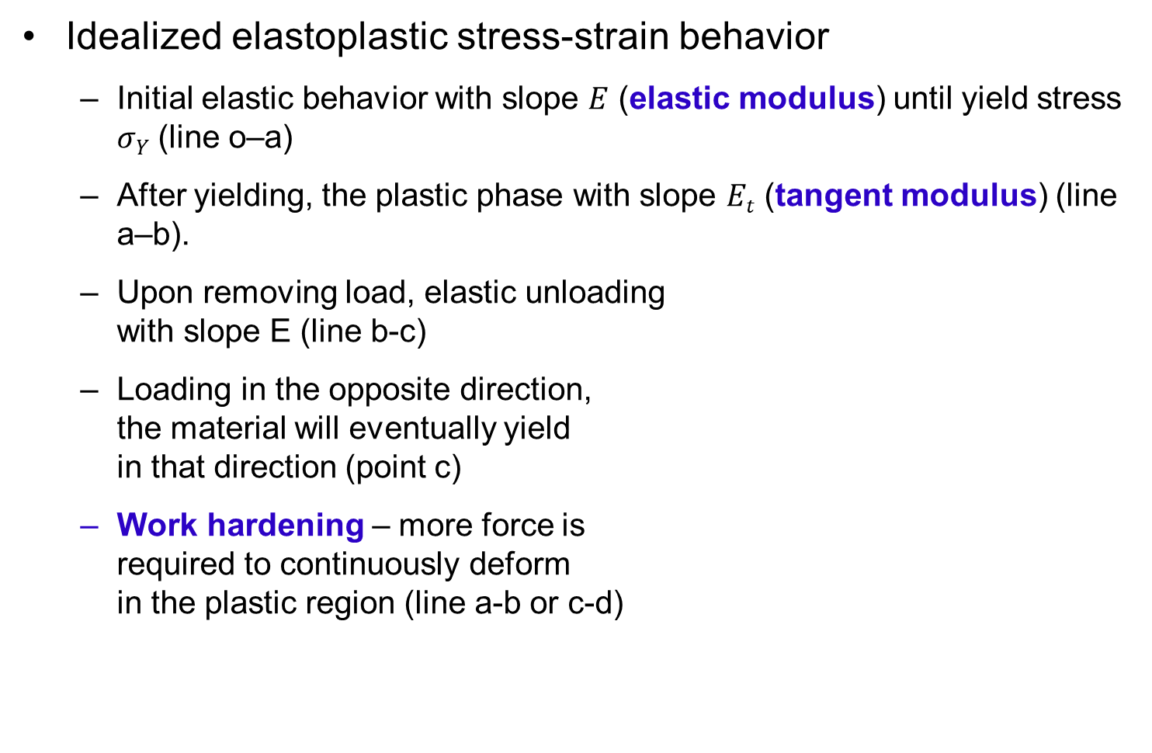
1D Elastoplasticity
Idealized elastoplastic stress-strain behavior
  Initial elastic behavior with slope $E$ (elastic modulus) until yield stress $σY$ (line o–a)
  After yielding, the plastic phase with slope $Et$ (tangent modulus) (line a–b).
  Upon removing load, elastic unloading
  with slope E (line b-c)
  Loading in the opposite direction,
  the material will eventually yield
  in that direction (point c)
  Work hardening – more force is
  required to continuously deform
  in the plastic region (line a-b or c-d)
σ
b
e
a
E_{t}
E
o
ε
c
d

Slide 10
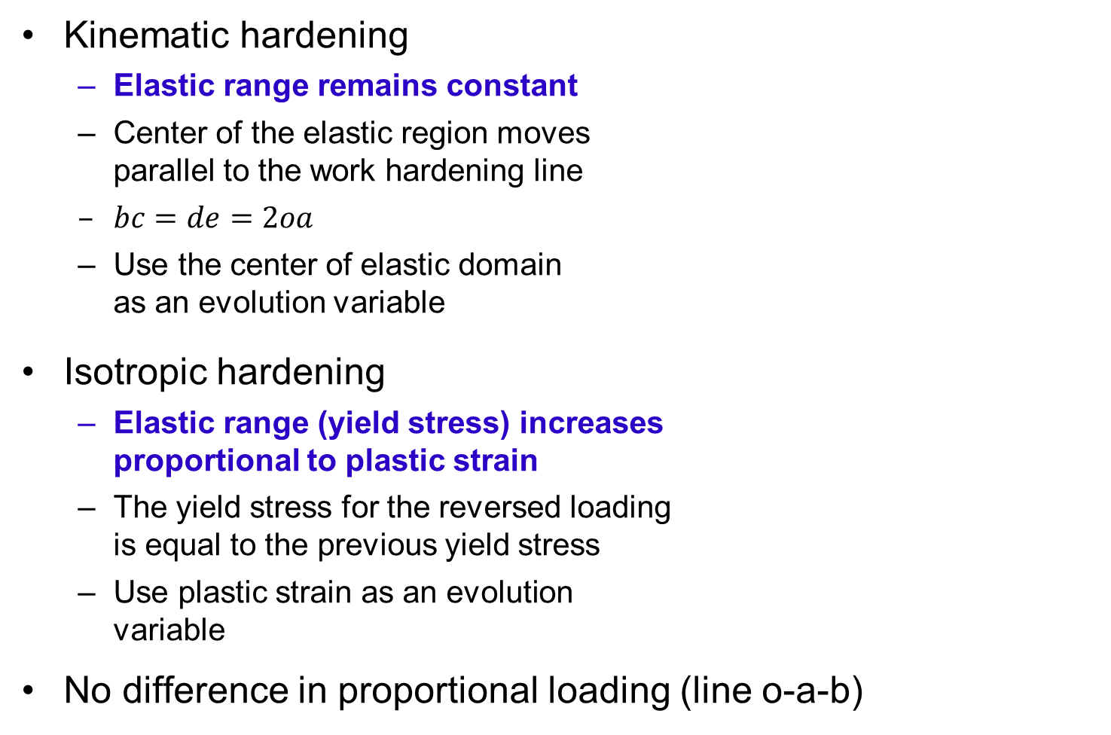
Work Hardening Models
σ
b
a
e
Kinematic hardening
  Elastic range remains constant
  Center of the elastic region moves
  parallel to the work hardening line
  $bc=de=2oa$
  Use the center of elastic domain
  as an evolution variable
Isotropic hardening
  Elastic range (yield stress) increases
  proportional to plastic strain
  The yield stress for the reversed loading
  is equal to the previous yield stress
  Use plastic strain as an evolution
  variable
No difference in proportional loading (line o-a-b)
o
ε
c
d
σ
e
a
b
h
o
ε
h
c
d

Slide 11


Elastoplastic Analysis
Additive decomposition
  Only elastic strain contributes to stress (but we don’t know how much of the total strain corresponds to the elastic strain)
  Let’s consider an increment of strain:
  Elastic strain increases stress by
  Elastic strain disappears upon removing loads or changing direction
$$Δε=Δε_{e}+Δε_{p}$$
$$Δσ=EΔε_{e}$$
σ
σ
Strain hardening slope, E_{t}
Initial loading
Δσ
Elastic
slope, E
σ_{Y}
E
E
Reloading
E
Δε_{e}
Δε_{p}
Unloading
ε_{Y}
ε
ε
Δε

Slide 12
Elastoplastic Analysis cont.
Additive decomposition (continue)
  Plastic strain remains constant during unloading
  The effect of load-history is stored in the plastic strain
  The yield stress is determined by the magnitude of plastic strain
  Decomposing elastic and plastic part of strain is an important part of elastoplastic analysis
For given stress σ, strain cannot be determined.
  Complete history is required (path- or history-dependent)
  History is stored in evolution variable (plastic strain)
σ
o
ε

Slide 13

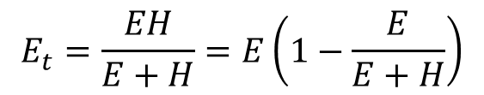


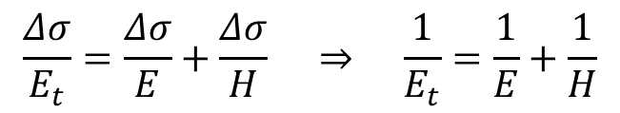

Plastic Modulus
Strain increment $Δε=Δε_{e}+Δε_{p}$
Stress increment $Δσ=EΔε_{e}$
Plastic modulus
Relation between moduli
Both kinematic and isotropic hardenings have the same plastic modulus
σ
Strain hardening slope, E_{t}
$$H=\frac{Δσ}{Δε_{p}}$$
Δσ
σ_{Y}
E
Δε_{e}
Δε_{p}
$$Δσ=EΔε_{e}=HΔε_{p}=E_{t}Δε$$
ε_{Y}
ε
Δε
$$\frac{Δσ}{E_{t}}=\frac{Δσ}{E}+\frac{Δσ}{H} ⇒ \frac{1}{E_{t}}=\frac{1}{E}+\frac{1}{H}$$
E_{t}
$$H=\frac{EE_{t}}{E−E_{t}}$$
$$E_{t}=\frac{EH}{E+H}=E\left(1−\frac{E}{E+H}\right)$$
H
Δε_{e}
Δε_{p}

Slide 14
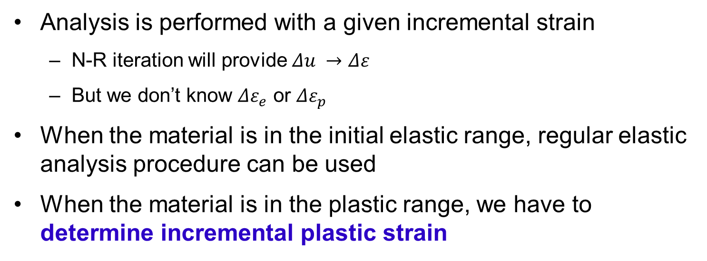
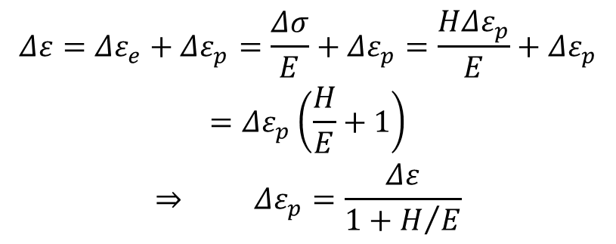
Analysis Procedure
Analysis is performed with a given incremental strain
  N-R iteration will provide $Δu →Δε$
  But we don’t know $Δε_{e}$ or $Δε_{p}$
When the material is in the initial elastic range, regular elastic analysis procedure can be used
When the material is in the plastic range, we have to determine incremental plastic strain
σ
$$\begin{matrix}Δε=Δε_{e}+Δε_{p}=\frac{Δσ}{E}+Δε_{p}=\frac{HΔε_{p}}{E}+Δε_{p} \\ =Δε_{p}\left(\frac{H}{E}+1\right) \\ ⇒ Δε_{p}=\frac{Δε}{1+H/E}\end{matrix}$$
Δσ
σ_{Y}
E
Δε_{e}
Δε_{p}
Only when the material is on the plastic curve!!
ε_{Y}
ε
Δε

Slide 15
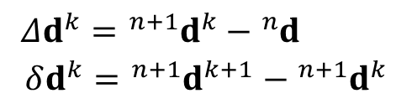
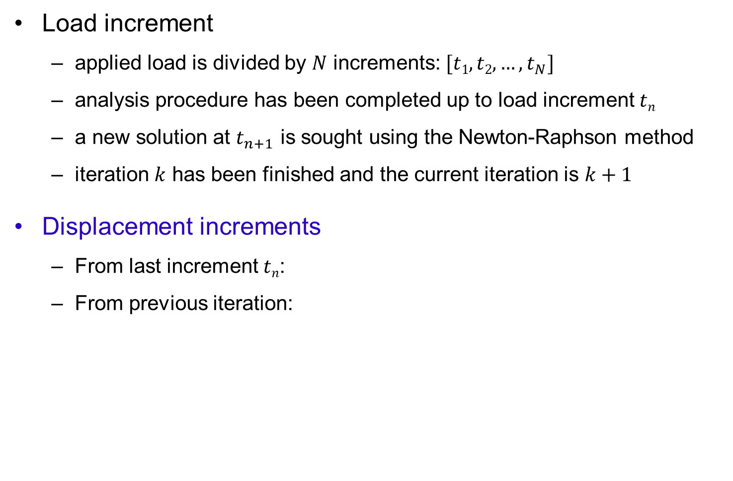

1D Finite Element Formulation
Load increment
  applied load is divided by $N$ increments: $[t1, t2, …, t_{N}]$
  analysis procedure has been completed up to load increment $tn$
  a new solution at $t_{n+1}$ is sought using the Newton-Raphson method
  iteration $k$ has been finished and the current iteration is $k+1$
Displacement increments
  From last increment $tn$:
  From previous iteration:
$$\begin{matrix}Δd^{k}={{}_{ }^{n+1}d}^{k}−{}_{ }^{n}d \\ δd^{k}={}_{ }^{n+1}{d^{k+1}}−{{}_{ }^{n+1}d}^{k}\end{matrix}$$
$$d=\left\{\begin{matrix}u_{1} \\ u_{2}\end{matrix}\right\}$$
u₁
u₂
P₁
P₂
x₁
x₂
L

Slide 16


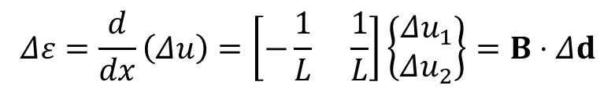
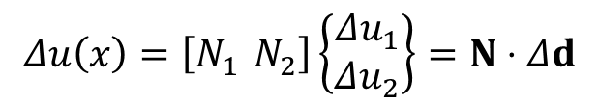
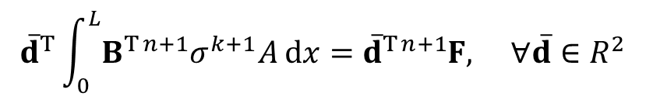
1D FE Formulation cont.
Interpolation
Weak form (1 element)
  Internal force = external force
$$Δu\left(x\right)=\left[N_{1} N_{2}\right]\left\{\begin{matrix}Δu_{1} \\ Δu_{2}\end{matrix}\right\}=N⋅Δd$$
$$\begin{matrix}δu=N⋅δd \\ δε=B⋅δd\end{matrix}$$
$$Δε=\frac{d}{dx}\left(Δu\right)=\left[−\frac{1}{L} \frac{1}{L}\right]\left\{\begin{matrix}Δu_{1} \\ Δu_{2}\end{matrix}\right\}=B⋅Δd$$
$${\overline{d}}^{T}\int_{0}^{L}{B^{T}{{}_{ }^{n+1}σ}^{k+1}A dx}={\overline{d}}^{T}{}_{ }^{n+1}F, ∀\overline{d}∈R^{2}$$
$$\overline{d}=\left\{\begin{matrix}{\overline{u}}_{1} \\ {\overline{u}}_{2}\end{matrix}\right\}$$

Slide 17
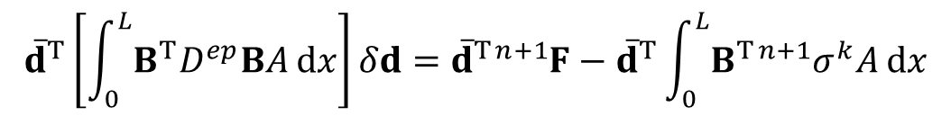
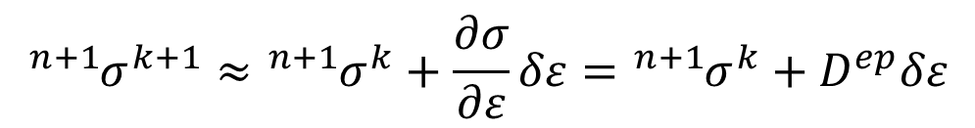
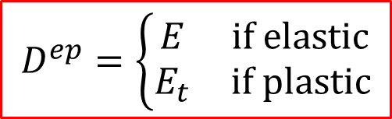
1D FE Formulation cont.
Stress-strain relationship (Incremental)
  Elastoplastic tangent modulus
Linearization of weak form
$${{}_{ }^{n+1}σ}^{k+1}≈{{}_{ }^{n+1}σ}^{k}+\frac{∂σ}{∂ε}δε={{}_{ }^{n+1}σ}^{k}+D^{ep}δε$$
$$D^{ep}=\left\{\begin{matrix}E & if elastic \\ E_{t} & if plastic\end{matrix}\right.$$
$${\overline{d}}^{T}\left[\int_{0}^{L}{B^{T}D^{ep}BA dx}\right]δd={\overline{d}}^{T}{}_{ }^{n+1}F−{\overline{d}}^{T}\int_{0}^{L}{B^{T}{{}_{ }^{n+1}σ}^{k}A dx}$$
Tangent stiffness
Residual

Slide 18

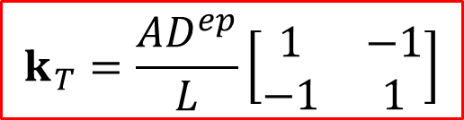
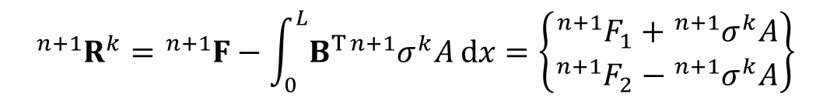

1D FE Formulation cont.
Tangent Stiffness
Residual
State Determination:
Incremental Finite Element Equation
  N-R iteration until the residual vanishes
$$k_{T}=\frac{AD^{ep}}{L}\left[\begin{matrix}1 & −1 \\ −1 & 1\end{matrix}\right]$$
$${{}_{ }^{n+1}R}^{k}={}_{ }^{n+1}F−\int_{0}^{L}{B^{T}{{}_{ }^{n+1}σ}^{k}A dx}=\left\{\begin{matrix}{{}_{ }^{n+1}F}_{1}+{{}_{ }^{n+1}σ}^{k}A \\ {{}_{ }^{n+1}F}_{2}−{{}_{ }^{n+1}σ}^{k}A\end{matrix}\right\}$$
$${{}_{ }^{n+1}σ}^{k}=f({}_{ }^{n}σ,{{}_{ }^{n}ε}_{p},Δε^{k},⋯)$$
Will talk about next slides
$$k_{T}⋅δd^{k}={{}_{ }^{n+1}R}^{k}$$

Slide 19

Isotropic Hardening Model
Yield strength gradually increases proportional to the plastic strain
  Yield strength is always positive for both tension or compression
  Plastic strain is always positive and continuously accumulated even in cycling loadings
Total plastic strain
$$σ_{Y}^{n}=σ_{Y}^{0}+Hε_{p}^{n}$$
Initial yield stress
σ
σ
E
E
ε_{p}
ε
ε_{p}
ε_{e}
ε

Slide 20








State Determination (Isotropic Hardening)
How to determine stress
  Given: strain increment ($Δε$) and all variables in load step $n$
Computer current yield stress (point d)
Elastic predictor (point c)
Check yield status
$$\left(E , H , σ_{Y}^{0} , σ^{n} , ε_{p}^{n}\right)$$
$$σ_{Y}^{n}=σ_{Y}^{0}+Hε_{p}^{n}$$
σ
σ^{tr}
c
Δε_{p}
$$Δσ^{tr}=EΔε$$
$$σ^{tr}=σ^{n}+Δσ^{tr}$$
σ^{n+1}
Δσ^{tr}
d
e
RΔσ^{tr}
E
Δε_{ep}= (1–R)Δε
Trial yield function (c – e)
σ^{n}
a
b
f
$$f^{tr}=\left|σ^{tr}\right|−σ_{Y}^{n}$$
Δε
ε
$$f^{tr}=\left(1−R\right)EΔε$$
$R$: Fraction of $Δσ^{tr}$ to the yield stress

Slide 21

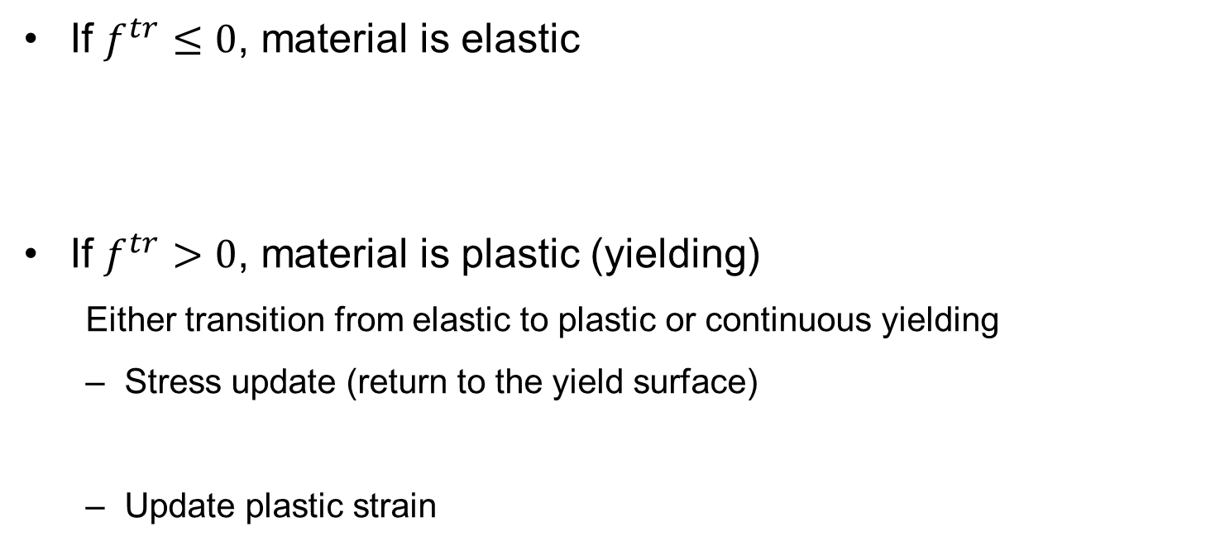



State Determination (Isotropic Hardening) cont.
If $f^{tr}≤0$, material is elastic
If $f^{tr}>0$, material is plastic (yielding)
  Either transition from elastic to plastic or continuous yielding
  Stress update (return to the yield surface)
  Update plastic strain
$$σ^{n+1}=σ^{tr}$$
Either initial elastic region or unloading
$$σ^{n+1}=σ^{tr}−sgn\left(σ^{tr}\right)EΔε_{p}$$
σ
Initial loading
$$ε_{p}^{n+1}=ε_{p}^{n}+Δε_{p}$$
E
Unloading
Reloading
Plastic strain increment is unknown
ε
$$Δε=Δε_{e}+Δε_{p}$$
For a given strain increment, how much is elastic and plastic?

Slide 22
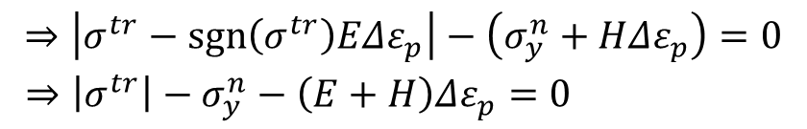


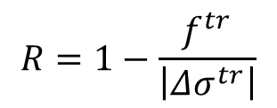
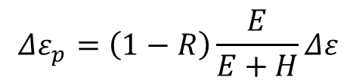
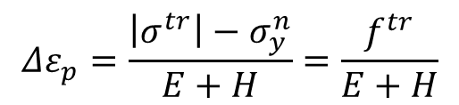
State Determination (Isotropic Hardening) cont.
Plastic consistency condition
  to determine plastic strain increment
  Stress must be on the yield surface after plastic deformation
$$f^{n+1}=\left|σ^{n+1}\right|−σ_{y}^{n+1}=0$$
$$\begin{matrix}⇒\left|σ^{tr}−sgn\left(σ^{tr}\right)EΔε_{p}\right|−\left(σ_{y}^{n}+HΔε_{p}\right)=0 \\ ⇒\left|σ^{tr}\right|−σ_{y}^{n}−\left(E+H\right)Δε_{p}=0 \end{matrix}$$
σ
σ^{tr}
c
Δε_{p}
$$Δε_{p}=\frac{\left|σ^{tr}\right|−σ_{y}^{n}}{E+H}=\frac{f^{tr}}{E+H}$$
σ^{n+1}
Δσ
d
e
RΔσ
E
Δε_{ep}= (1–R)Δε
$$Δε_{p}=\left(1−R\right)\frac{E}{E+H}Δε$$
σ^{n}
a
b
f
$$R=1−\frac{f^{tr}}{\left|Δσ^{tr}\right|}$$
Δε
ε
%Note: $Δε_{p}$ is always positive!!

Slide 23
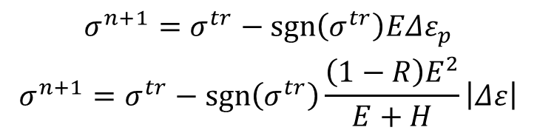
State Determination (Isotropic Hardening) cont.
Update stress
Algorithm
  Elastic trial
  Plastic return mapping
  No iteration is required in linear hardening models
$$\begin{matrix}σ^{n+1}=σ^{tr}−sgn\left(σ^{tr}\right)EΔε_{p} \\ σ^{n+1}=σ^{tr}−sgn\left(σ^{tr}\right)\frac{\left(1−R\right)E^{2}}{E+H}\left|Δε\right|\end{matrix}$$
σ
σ^{tr}
c
Δε_{p}
σ^{n+1}
Δσ
d
e
Elastic trial
Plastic compensation
(return mapping)
RΔσ
E
Δε_{ep}= (1–R)Δε
σ^{n}
a
b
f
Δε
ε

Slide 24
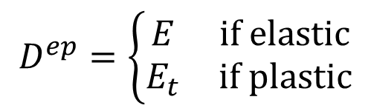
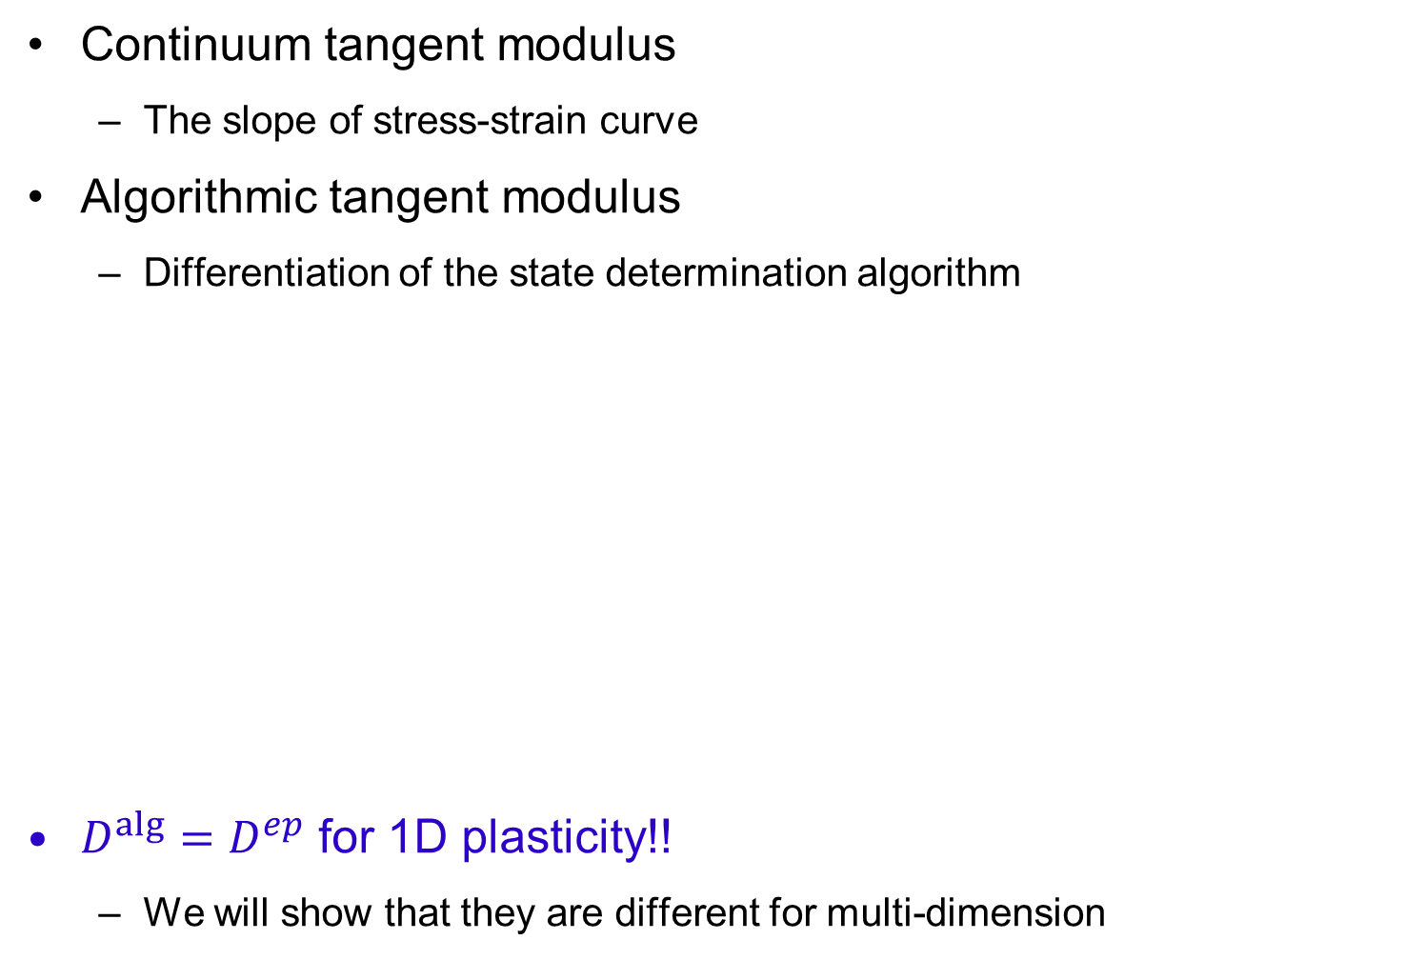
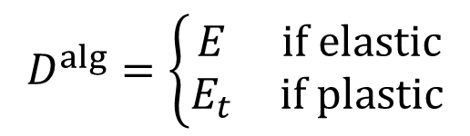
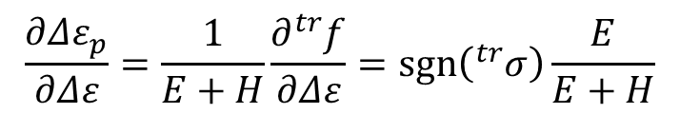
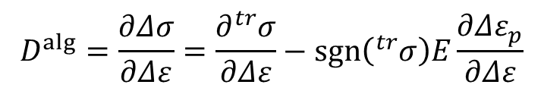
Algorithmic Tangent Stiffness
Continuum tangent modulus
  The slope of stress-strain curve
Algorithmic tangent modulus
  Differentiation of the state determination algorithm
$D^{alg}=D^{ep}$ for 1D plasticity!!
  We will show that they are different for multi-dimension
$$D^{ep}=\left\{\begin{matrix}E & if elastic \\ E_{t} & if plastic\end{matrix}\right.$$
$$D^{alg}=\frac{∂Δσ}{∂Δε}=\frac{∂{}_{ }^{tr}σ}{∂Δε}−sgn\left({}_{ }^{tr}σ\right)E\frac{∂Δε_{p}}{∂Δε}$$
$$\frac{∂Δε_{p}}{∂Δε}=\frac{1}{E+H}\frac{∂{}_{ }^{tr}f}{∂Δε}=sgn\left({}_{ }^{tr}σ\right)\frac{E}{E+H}$$
$$D^{alg}=\left\{\begin{matrix}E & if elastic \\ E_{t} & if plastic\end{matrix}\right.$$

Slide 25





Algorithm for Isotropic Hardening
Given: $Δε, E, H, σ_{Y}^{0}, σ^{n}, ε_{p}^{n}$
Trial state
If $f^{tr}≤0$ (elastic)
  Remain elastic: $σ^{n+1}=σ^{tr}, ε_{p}^{n+1}=ε_{p}^{n}$ ; exit
If $f^{tr}>0$ (plastic)
  Calculate plastic strain:
  Update stress and plastic strain (store them for next increment)
$$\begin{matrix}σ^{tr}=σ^{n}+EΔε \\ σ_{Y}^{n}=σ_{Y}^{0}+Hε_{p}^{n} \\ f^{tr}=\left|σ^{tr}\right|−σ_{Y}^{n}\end{matrix}$$
$$Δε_{p}=\frac{f^{tr}}{E+H}$$
$$σ^{n+1}=σ^{tr}−sgn\left(σ^{tr}\right)EΔε_{p}$$
$$ε_{p}^{n+1}=ε_{p}^{n}+Δε_{p}$$

Slide 26
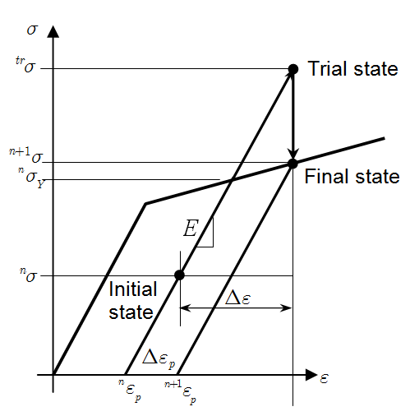


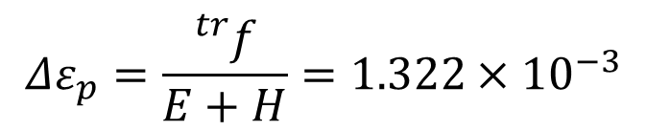
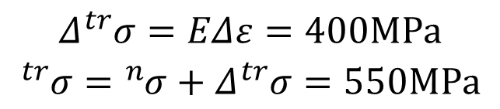
Ex) Elastoplastic Bar (Isotropic Hardening)
$E=200GPa, H=25GPa, 0σy=250MPa$
$nσ=150MPa, nep=0.0001,Δε=0.002$
Yield stress: ${{}_{ }^{n}σ}_{Y}={{}_{ }^{0}σ}_{Y}+H{{}_{ }^{n}ε}_{p}=252.5MPa$
  Material is elastic at $tn$
Trial stress:
Plastic consistency condition
State update
$$\begin{matrix}Δ{}_{ }^{tr}σ=EΔε=400MPa \\ {}_{ }^{tr}σ={}_{ }^{n}σ+Δ{}_{ }^{tr}σ=550MPa\end{matrix}$$
Now material is plastic
$$Δε_{p}=\frac{{}_{ }^{tr}f}{E+H}=1.322×{10}^{−3}$$
$${}_{ }^{n+1}σ={}_{ }^{tr}σ−sgn\left({}_{ }^{tr}σ\right)EΔε_{p}=285.6MPa$$
$${{}_{ }^{n+1}ε}_{p}={{}_{ }^{n}ε}_{p}+Δε_{p}=1.422×{10}^{−3}$$

Slide 27


Kinematic Hardening Model
Yield strength remains constant, but the center of elastic region moves parallel to the hardening curve
Effective stress is defined using the shifted stress
Use the center of elastic domain as an evolution variable
$$η=σ−α$$
$$α^{n+1}=α^{n}+sgn\left(η\right)HΔε_{p}$$
Back stress
σ
σ
E
E
2ε_{p}
ε
ε_{p}
ε_{e}
ε

Slide 28




State Determination (Kinematic Hardening)
Given: Material properties and state at increment $n$:
Elastic predictor
Check yield status
If$f^{tr}≤0$, material is elastic
If $f^{tr}>0$, material is plastic (yielding)
($Δε,E,H,σ_{Y}^{0},σ^{n},α^{n},ε_{p}^{n})$
$$σ^{tr}=σ^{n}+EΔε, α^{tr}=α^{n}, η^{tr}=σ^{tr}−α^{tr}$$
σ
σ^{tr}
c
Trial yield function
σ^{n+1}
d
e
$$f^{tr}=\left|η^{tr}\right|−σ_{Y}^{0}$$
η^{tr}
E
σ^{n}
a
b
$$σ^{n+1}=σ^{tr}$$
α^{n+1}
g
α^{n}
Either initial elastic region or unloading
f
ε
Δε
  Either transition from elastic to plastic or continuous yielding

Slide 29

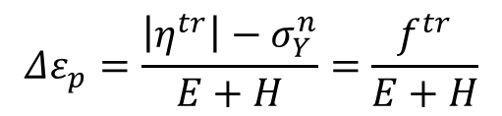

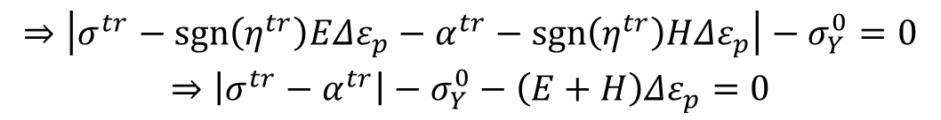


State Determination (Kinematic Hardening) cont.
Updating formulas for stress, back stress & plastic strain
Plastic consistency condition
  To determine unknown plastic strain increment
  Stress must be on the yield surface during plastic loading
$$σ^{n+1}=σ^{tr}−sgn\left(η^{tr}\right)EΔε_{p}$$
$$α^{n+1}=α^{tr}+sgn\left(η^{tr}\right)HΔε_{p}$$
$$ε_{p}^{n+1}=ε_{p}^{n}+Δε_{p}$$
$$f^{n+1}=\left|η^{n+1}\right|−σ_{Y}^{0}=0$$
$$\begin{matrix}⇒\left|σ^{tr}−sgn\left(η^{tr}\right)EΔε_{p}−α^{tr}−sgn\left(η^{tr}\right)HΔε_{p}\right|−σ_{Y}^{0}=0 \\ ⇒\left|σ^{tr}−α^{tr}\right|−σ_{Y}^{0}−\left(E+H\right)Δε_{p}=0\end{matrix}$$
$$Δε_{p}=\frac{\left|η^{tr}\right|−σ_{Y}^{n}}{E+H}=\frac{f^{tr}}{E+H}$$
%Note: the same formula with
isotropic hardening model!!

Slide 30


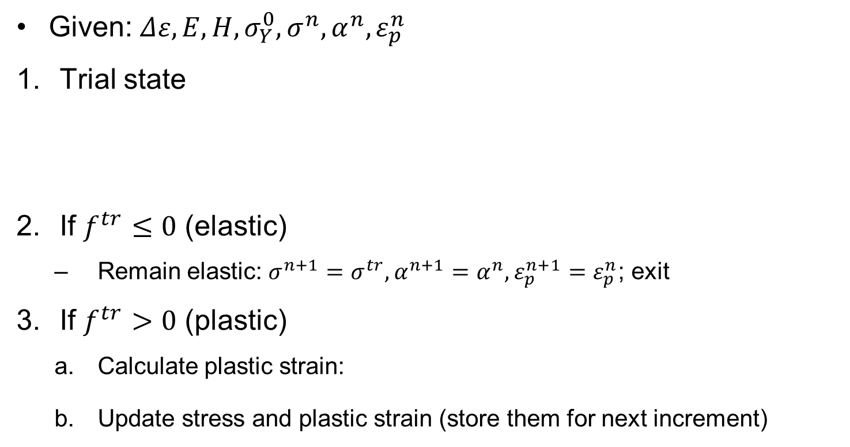



Algorithm for Kinematic Hardening
Given: $Δε,E,H,σ_{Y}^{0},σ^{n},α^{n},ε_{p}^{n}$
Trial state
If $f^{tr}≤0$ (elastic)
  Remain elastic: $σ^{n+1}=σ^{tr}, α^{n+1}=α^{n},ε_{p}^{n+1}=ε_{p}^{n}$; exit
If $f^{tr}>0$ (plastic)
  Calculate plastic strain:
  Update stress and plastic strain (store them for next increment)
$$\begin{matrix}σ^{tr}=σ^{n}+EΔε \\ α^{tr}=α^{n} \\ η^{tr}=σ^{tr}−α^{tr} \\ f^{tr}=\left|η^{tr}\right|−σ_{Y}^{0}\end{matrix}$$
$$Δε_{p}=\frac{f^{tr}}{E+H}$$
$$σ^{n+1}=σ^{tr}−sgn\left(η^{tr}\right)EΔε_{p}$$
$$α^{n+1}=α^{n}+sgn\left(η^{tr}\right)HΔε_{p}$$
$$ε_{p}^{n+1}=ε_{p}^{n}+Δε_{p}$$

Slide 31
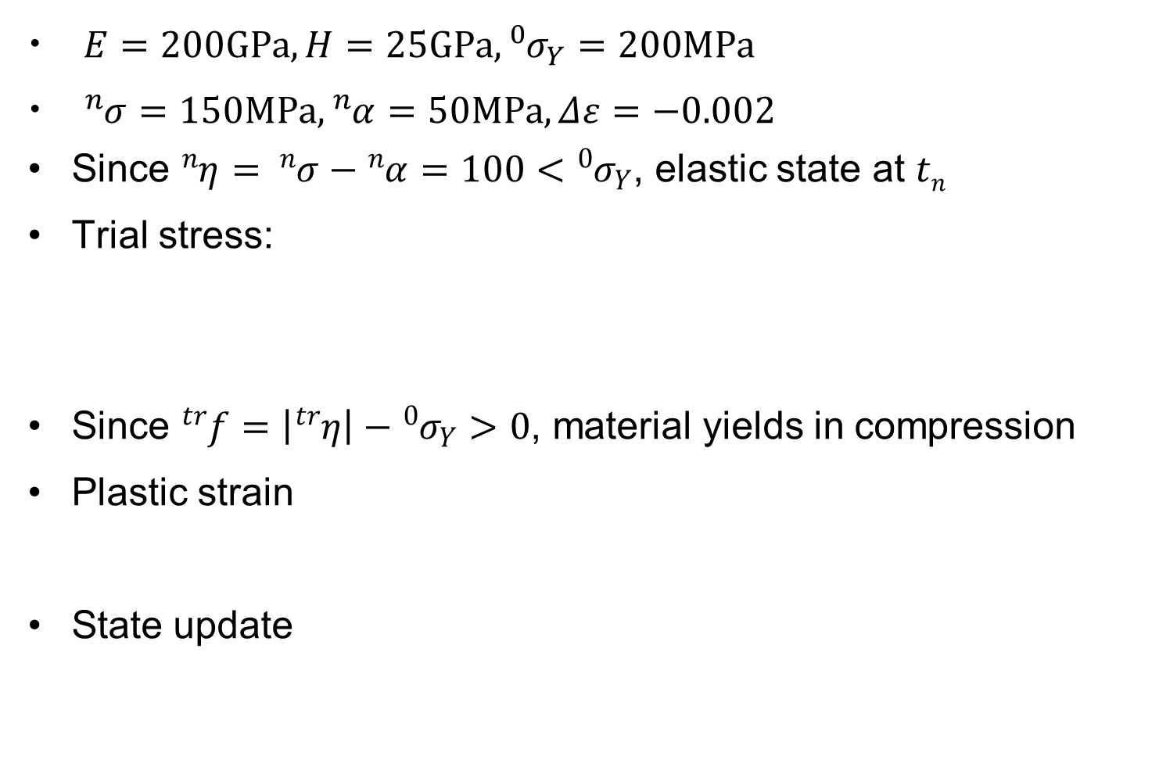
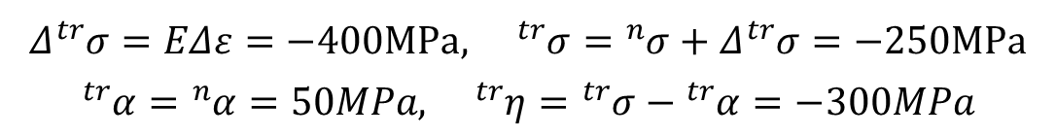
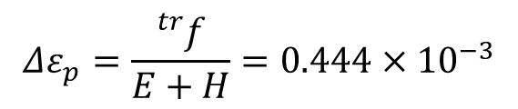
Ex) Elastoplastic Bar (Kinematic Hardening)
$E=200GPa, H=25GPa,{{}_{ }^{0}σ}_{Y}=200MPa$
${}_{ }^{n}σ=150MPa,{}_{ }^{n}α=50MPa,Δε=−0.002$
Since ${}_{ }^{n}η= {}_{ }^{n}σ−{}_{ }^{n}α=100<{{}_{ }^{0}σ}_{Y}$, elastic state at $tn$
Trial stress:
Since ${}_{ }^{tr}f=\left|{}_{ }^{tr}η\right|−{{}_{ }^{0}σ}_{Y}>0$, material yields in compression
Plastic strain
State update
$$\begin{matrix}Δ{}_{ }^{tr}σ=EΔε=−400MPa, {}_{ }^{tr}σ={}_{ }^{n}σ+Δ{}_{ }^{tr}σ=−250MPa \\ {}_{ }^{tr}α={}_{ }^{n}α=50MPa, {}_{ }^{tr}η={}_{ }^{tr}σ−{}_{ }^{tr}α=−300MPa\end{matrix}$$
$$Δε_{p}=\frac{{}_{ }^{tr}f}{E+H}=0.444×{10}^{−3}$$
$${}_{ }^{n+1}σ={}_{ }^{tr}σ−sgn\left({}_{ }^{tr}η\right)EΔε_{p}=−161.1MPa$$
$${}_{ }^{n+1}α={}_{ }^{tr}α−sgn\left({}_{ }^{tr}η\right)HΔε_{p}=38.9MPa$$

Slide 32

Ex) Elastoplastic Bar (Kinematic Hardening)

Slide 33




Combined Hardening Model
Baushinger effect
  conditions where the yield strength of a metal decreases when the direction of strain is changed
  Common for most polycrystalline metals
  Related to the dislocation structure in the cold worked metal. As deformation occurs, the dislocations will accumulate at barriers and produce dislocation pile-ups and tangles.
Numerical modeling of Baushinger effect
  Modeled as a combined kinematic and isotropic hardening
$$σ_{Y}^{n+1}=σ_{Y}^{n}+\left(1−β\right)HΔε_{p}$$
$$α^{n+1}=α^{n}+sgn\left(η\right)βHΔε_{p}$$
$$0≤β≤1$$
$β=0$: isotropic hardening
$β=1$: kinematic hardening

Slide 34



Combined Hardening Model cont.
Trial state
Stress update
Show that the plastic increment is the same
$$\begin{matrix}σ^{tr}=σ^{n}+EΔε \\ α^{tr}=α^{n} \\ η^{tr}=σ^{tr}−α^{tr} \\ f^{tr}=\left|η^{tr}\right|−σ_{Y}^{n}\end{matrix}$$
$$\begin{matrix}σ^{n+1}=σ^{tr}−sgn\left(η^{tr}\right)EΔε_{p} \\ α^{n+1}=α^{tr}+sgn\left(η^{tr}\right)βHΔε_{p} \\ σ_{Y}^{n+1}=σ_{y}^{n}+\left(1−β\right)HΔε_{p} \end{matrix}$$
$$Δε_{p}=\frac{f^{tr}}{E+H}$$

Slide 35
MATLAB Program combHard1D
function [stress,alpha,ep]=COMBHARD1D(mp,deps,stressN,alphaN,epN)
%******************************************************************************
% 1D Linear combined isotropic/kinamtic hardening model %
% Inputs: %
% mp = [E, beta, H, Y0]; %
% deps = strain increment %
% stressN = stress at load increment N %
% alphaN = back stress at load increment N %
% epN = plastic strain at load increment N %
% Outputs: %
% stress = stress at load increment N+1 %
% alpha = back stress at load increment N+1 %
% ep = plastic strain at load increment N+1 %
%******************************************************************************
%% %
E=mp(1); beta=mp(2); H=mp(3); Y0=mp(4); % material properties
ftol = Y0*1E-6; % tolerance for yield
stresstr = stressN + E*deps; % trial stress
etatr = stresstr - alphaN; % trial shifted stress
fyld = abs(etatr) - (Y0+(1-beta)*H*epN); % trial yield function
if fyld < ftol % yield test
stress = stresstr; alpha = alphaN; ep = epN; % trial states are final
return; % Retrn to the main program
else % Plastic deformation occurs
dep = fyld/(E+H); % plastic strain increment
end % End of yield test branch
stress = stresstr - sign(etatr)*E*dep; % updated stress
alpha = alphaN + sign(etatr)*beta*H*dep; % updated back stress
ep = epN + dep; % updated plastic strain
end %

Slide 36
Ex) Two bars in parallel
  Bar 1: A = 0.75, E = 10000, E_{t} = 1000, ⁰σ_{Y} = 5, kinematic
  Bar 2: A = 1.25, E = 5000, E_{t} = 500, ⁰σ_{Y} = 7.5, isotropic
E1=10000; Et1=1000; sY1=5;E2=5000; Et2=500; sY2=7.5; % Material properties
A1=0.75; L1=100; A2=1.25; L2=100; % Geometric parameters
tol=1.0E-5; u=0; P=15; iter=0; % Initialize variables
nS1=0; nAlp1=0; nep1=0; nS2=0; nAlp2=0; nep2=0; % Initialize variables
mp1=[E1, 1, E1*Et1/(E1-Et1), sY1]; % Bar1 material properties
mp2=[E2, 0, E2*Et2/(E2-Et2), sY2]; % Bar2 material properties
Res=P-nS1*A1-nS2*A2; % Initial residual
Dep1=E1; Dep2=E2; % Initial tangent stiffness
conv=Res^2/(1+P^2); % Convergence criterion
fprintf('\niter u S1 S2 Alpha1 Alpha2'); % Print head
fprintf(' ep1 ep2 Residual'); % Print head
fprintf('\n %3d %7.4f %7.3f %7.3f %7.3f %7.3f %8.6f %8.6f %10.3e',... %
iter,u,nS1,nS2,nAlp1,nAlp2,nep1,nep2,Res); % Print results
while conv>tol && iter<20 % Newton-Raphson iteration loop
delu=Res/(Dep1*A1/L1 + Dep2*A2/L2); % Calculate displacement increment
delE=delu/L1; u=u+delu; % Strain increment and update displacement
[S1,Alp1,ep1]=COMBHARD1D(mp1,delE,nS1,nAlp1,nep1); % State determination
[S2,Alp2,ep2]=COMBHARD1D(mp2,delE,nS2,nAlp2,nep2); % State determination
Res=P-S1*A1-S2*A2; % Residual
conv=Res^2/(1+P^2); % Convergence criterion
iter=iter+1; % Move to next iteration
Dep1=E1; if ep1>nep1; Dep1=Et1; end % Tangent stiffness
Dep2=E2; if ep2>nep2; Dep2=Et2; end % Tangent stiffness
nS1=S1; nAlp1=Alp1; nep1=ep1; % Update state variables
nS2=S2; nAlp2=Alp2; nep2=ep2; % Update state variables
fprintf('\n %3d %7.4f %7.3f %7.3f %7.3f %7.3f %8.6f %8.6f %10.3e',... %
iter,u,nS1,nS2,nAlp1,nAlp2,nep1,nep2,Res); % Print results
end %

Slide 37
Ex) Two bars in parallel cont.
Bar1
Rigid
15
Bar2
Iteration | u | s₁ | s₂ | e_{p1} | e_{p2} | Residual
0 | 0.0000 | 0.000 | 0.000 | 0.000000 | 0.000000 | 1.50E+1
1 | 0.1091 | 5.591 | 5.455 | 0.000532 | 0.000000 | 3.99E+0
2 | 0.1661 | 6.161 | 7.580 | 0.001045 | 0.000145 | 9.04E1
3 | 0.2318 | 6.818 | 7.909 | 0.001636 | 0.000736 | 0.00E+0

Slide 38
Summary
Plastic deformation depends on load-history and its information is stored in plastic strain
Stress only depends on elastic strain
Isotropic hardening increases the elastic domain, while kinematic hardening maintains the size of elastic domain but moves the center of it
Major issue in elastoplastic analysis is to decompose the strain into elastic and plastic parts
Algorithmic tangent stiffness is consistent with the state determination algorithm
State determination is composed of (a) elastic trial and (b) plastic return mapping

Slide 39
1D Elastoplastic Analysis Using ABAQUS
Material Card
  *MATERIAL,NAME=ALLE
  *ELASTIC
  200.E3,.3
  *PLASTIC
  200.,0.
  220.,.0009
  220.,.0029
Plastic strain
Yield stress

Slide 40
1D Elastoplastic Analysis Using ABAQUS
*HEADING
UniaxialPlasticity
*NODE,NSET=ALLN
1,0.,0.,0.
2,1.,0.,0.
3,1.,1.,0.
4,0.,1.,0.
5,0.,0.,1.
6,1.,0.,1.
7,1.,1.,1.
8,0.,1.,1.
*ELEMENT,TYPE=C3D8,ELSET=ALLE
1,1,2,3,4,5,6,7,8
*SOLID SECTION,ELSET=ALLE,MATERIAL=ALLE
*MATERIAL,NAME=ALLE
*ELASTIC
200.E3,.3
*PLASTIC
200.,0.
220.,.0009
220.,.0029
*BOUNDARY
1,PINNED
2,2
5,2
6,2
4,1
5,1
8,1
2,3
3,3
4,3
*STEP,INC=20
*STATIC,DIRECT
1.,20.
*BOUNDARY
7,3,,.004
5,3,,.004
6,3,,.004
8,3,,.004
*EL PRINT,FREQ=1
S,
E,
EP,
*NODE PRINT
U,RF
*END STEP

Slide 41

Stress History
Stress Curve

Slide 42
Multi-Dimensional Elastoplastic Analysis
4.3

Slide 43
Goals
Understand failure criteria, equivalent stress, and effective strain
Understand how 1D tension test data can be used for determining failure of 3D stress state
Understand deviatoric stress and strain
Understand the concept of elastic domain and yield surface
Understand hardening models
Understand evolution of plastic variables along with that of the yield surface

Slide 44

Multi-Dimensional Elastoplasticity
How can we generalize 1D stress state ($σ11$) to 3D state (6 components)?
  Need scalar measures of stress and strain to compare with 1D test
  Equivalent stress & effective strain
  Key ingredients: yield criteria, hardening model, stress-strain relation
We will assume small (infinitesimal) strains
Rate independent elastoplasticity- independent of strain rate
Von Mises yield criterion with associated hardening model is the most popular

Slide 45


Failure Criteria
Material yields due to relative sliding in lattice structures
Sliding preserves volume  plastic deformation is related to shear or deviatoric part
Tresca (1864, max. shear stress)
  Material fails when max. shear stress reaches that of tension test
  Tension test: yield at $σ1=σY,σ2=σ3=0$
  Yielding occurs when $τ_{max}=τ_{Y}$
σ₂
Safe region
$$τ_{max}=\frac{σ_{1}−σ_{3}}{2}≤τ_{Y}=\frac{σ_{Y}}{2}$$
σ_{Y}
Failure region
–σ_{Y}
σ_{Y}
σ₁
–σ_{Y}

Slide 46








Failure Criteria cont.
Distortion Energy Theory (von Mises)
  Material fails when distortion energy reaches that of tension test
  We need preliminaries before deriving $U_{d}$
Volumetric stress and mean strain
Deviatoric stress and strain
$$U_{d}≤U_{d}\left(tension test\right)$$
$$σ_{m}=\frac{1}{3}tr\left(σ\right)=\frac{1}{3}\left(σ_{11}+σ_{22}+σ_{33}\right)$$
$$ε_{m}=\frac{1}{3}tr\left(ε\right)=\frac{1}{3}ε_{v}=\frac{1}{3}\left(ε_{11}+ε_{22}+ε_{33}\right)$$
$$s=σ−σ_{m}1=I_{dev}:σ$$
$$I_{ijkl}={\left(δ_{ik}δ_{jl}+δ_{il}δ_{jk}\right)}/2$$
$$e=ε−ε_{m}1=I_{dev}:ε$$
$$I_{dev}=I−\frac{1}{3}1⊗1$$

Slide 47






Failure Criteria cont.
Example: Linear elastic material
Distortion energy density
$$σ=\left[λ1⊗1+2μI\right]:ε≡D:ε$$
$$σ=λ\left(3ε_{m}\right)1+2μ\left(e+ε_{m}1\right) \\ =\left(3λ+2μ\right)ε_{m}1+2μe$$
$$\begin{matrix}σ_{m}=\left(3λ+2μ\right)ε_{m} \\ s=2μe\end{matrix}$$
volumetric
deviatoric
Bulk modulus
$$K=\frac{3λ+2μ}{3}$$
$$U=\frac{1}{2}σ:ε=\frac{1}{2}\left(σ_{m}1+s\right):\left(ε_{m}1+e\right)=\frac{3}{2}σ_{m}ε_{m}+\frac{1}{2}s:e$$
$$U_{d}=\frac{1}{2}s:e=\frac{1}{4μ}s:s$$

Slide 48






Failure Criteria cont.
$$σ_{11}=σ σ_{m}=\frac{1}{3}σ s=σ\left[\begin{matrix}\frac{2}{3} & 0 & 0 \\ 0 & −\frac{1}{3} & 0 \\ 0 & 0 & −\frac{1}{3}\end{matrix}\right]$$
1D Case
Material yields when
Let’s define an equivalent stress
Then, material yields when
Stress can increase from zero to $σ_{Y}$, but cannot increase beyond that
$${\left.U_{d}\right|}_{1D}=\frac{1}{4μ}s:s=\frac{1}{4μ}\frac{2}{3}σ^{2}=\frac{1}{6μ}σ^{2}$$
$$U_{d}=\frac{1}{4μ}s:s=\frac{1}{6μ}σ_{Y}^{2}={\left.U_{d}\right|}_{1D}$$
$$σ_{e}=\sqrt{\frac{3}{2}s:s}$$
von Mises stress
$$σ_{e}=σ_{Y}$$

Slide 49



Equivalent Stress and Effective Strain
Equivalent stress is the scalar measure of 3D stress state that can be compared with 1D stress from tension test
Effective strain is the scalar measure of 3D strain state that makes conjugate with equivalent stress
$$U_{d}=\frac{1}{2}s:e=\frac{1}{2}σ_{e}e_{e}$$
$$U_{d}=\frac{1}{4μ}s:s=\frac{1}{6μ}σ_{e}^{2}=\frac{1}{2}σ_{e}e_{e}$$
Effective strain
$$e_{e}=\frac{1}{3μ}σ_{e}=\frac{1}{3μ}\sqrt{\frac{3}{2}s:s}=\frac{1}{3μ}\sqrt{\frac{3}{2}2μe:2μe}=\sqrt{\frac{2}{3}e:e}$$

Slide 50




Equivalent Stress and Effective Strain cont.
1D Case cont.
$$ε_{11}=ε ε_{22}=ε_{33}=−νε ε_{m}=\frac{1−2ν}{3}ε$$
$$e=\frac{\left(1+ν\right)ε}{3}\left[\begin{matrix}2 & 0 & 0 \\ 0 & −1 & 0 \\ 0 & 0 & −1\end{matrix}\right]$$
$$e:e=6{\left(\frac{\left(1+ν\right)ε}{3}\right)}^{2}$$
$$e_{e}=\sqrt{\frac{2}{3}e:e}=\frac{2\left(1+ν\right)}{3}ε$$
Effective strain for 1D tension
ε
ε

Slide 51





Von Mises Criterion
Material yields when $σ_{e}=σ_{Y}$
Yield criterion
  1D test data $σ_{Y}$ can be used for
  multi-dimensional stress state
  Often called $J_{2}$ plasticity model
$$J_{2}=\frac{1}{2}s:s$$
$$σ_{e}=\sqrt{\frac{3}{2}s:s}=\sqrt{3J_{2}}$$
2nd invariant of s
$$J_{2}=\frac{1}{6}\left[{\left(σ_{x}−σ_{y}\right)}^{2}+{\left(σ_{y}−σ_{z}\right)}^{2}+{\left(σ_{z}−σ_{x}\right)}^{2}\right]+τ_{xy}^{2}+τ_{yz}^{2}+τ_{zx}^{2}$$
$$J_{2}=\frac{1}{6}\left[{\left(σ_{1}−σ_{2}\right)}^{2}+{\left(σ_{2}−σ_{3}\right)}^{2}+{\left(σ_{3}−σ_{1}\right)}^{2}\right]$$
In terms of principal stresses
σ₂
$$σ_{e}^{2}−σ_{Y}^{2}≡3J_{2}−σ_{Y}^{2}=0$$
Elastic
σ₁
Yield surface

Slide 52






Von Mises Criterion cont.
$J_{2}$: second invariant of $s$
Von Mises yield function
$$J_{2}=\frac{1}{2}\left[s:s−tr{\left(s\right)}^{2}\right]=\frac{1}{2}s:s$$
Impossible
state
Elastic
state
s₂
$$3J_{2}−σ_{Y}^{2}=0$$
Material
yields
$$⇒ \frac{3}{2}s:s−σ_{Y}^{2}=0$$
s₁
$$⇒ \sqrt{s:s}−\sqrt{\frac{2}{3}}σ_{Y}=0$$
$$⇒ \left\|s\right\|−\sqrt{\frac{2}{3}}σ_{Y}=0$$
radius
Yield function
Yield surface is circular in
deviatoric stress space

Slide 53




Example
Pure shear stress $τ$ to yield
  Yield surface:
  Failure in max. shear stress theory
  Safe in distortion energy theory
  Von Mises is more accurate, but
  Tresca is more conservative
x₂
τ
$$σ=\left[\begin{matrix}0 & τ & 0 \\ τ & 0 & 0 \\ 0 & 0 & 0\end{matrix}\right]=s$$
τ
τ
x₁
$$\left\|s\right\|=\sqrt{s:s}=\sqrt{τ^{2}+τ^{2}}=τ\sqrt{2}$$
τ
$$\sqrt{2}τ=\sqrt{\frac{2}{3}}σ_{Y} ⇒ τ=\frac{1}{\sqrt{3}}σ_{Y}$$
Safe region
σ₂
C
σ₁
D

Slide 54



Example
Uniaxial tensile test
  Yield surface
$$σ=\left[\begin{matrix}σ & 0 & 0 \\ 0 & 0 & 0 \\ 0 & 0 & 0\end{matrix}\right] s=\left[\begin{matrix}\frac{2}{3}σ & 0 & 0 \\ 0 & −\frac{1}{3}σ & 0 \\ 0 & 0 & −\frac{1}{3}σ\end{matrix}\right]$$
$$\left\|s\right\|=\sqrt{\frac{4}{9}σ^{2}+\frac{1}{9}σ^{2}+\frac{1}{9}σ^{2}}=\sqrt{\frac{2}{3}}σ$$
$$\sqrt{\frac{2}{3}}σ−\sqrt{\frac{2}{3}}σ_{Y}=0 ⇒ σ=σ_{Y}$$
Consistent with uniaxial
tension test
σ
σ

Slide 55
Hardening Model
For many materials, the yield surface increases proportional to plastic deformation  strain hardening
Isotropic hardening: Change in radius
Kinematic hardening: Change in center
Isotropic hardening
Kinematic hardening
σ₂
σ₂
σ₁
σ₁
Initial yield surface
Initial yield surface

Slide 56





Hardening Model cont.
Isotropic hardening model (linear)
  $H=0$: elasto-perfectly-plastic material
Kinematic hardening model (linear)
  The center of yield surface : back stress $α$
  Shifted stress: $η=s−α$
  $α$ moves proportional to $ep$
$$\begin{matrix}H=\frac{Δσ}{Δe_{p}} \\ e_{p} \\ σ_{Y}^{0}\end{matrix}$$
$$σ_{Y}=σ_{Y}^{0}+He_{p}$$
Plastic modulus
Effective plastic strain
Initial yield stress
s₂
s
α
s₁
$$\left\|η\right\|−\sqrt{\frac{2}{3}}σ_{Y}=0$$
Radial
direction
$$\dot{α}=\sqrt{\frac{2}{3}}H{\dot{e}}_{p}\frac{η}{\left\|η\right\|}$$

Slide 57



Hardening Model cont.
Combined Hardening
  Many materials show both isotropic and kinematic hardenings
  Introduce a parameter $β[0,1]$ to consider this effect
  Baushinger effect: The yield stress increases in one directional loading. But it decreases in the opposite directional load.
  This is caused by dislocation pileups and tangles (back stress). When strain direction is changed, this makes the dislocations easy to move
  Isotropic hardening: $β=0$
  Kinematic hardening: $β=1$
$$\left\|η\right\|−\sqrt{\frac{2}{3}}\left[σ_{Y}^{0}+\left(1−β\right)He_{p}\right]=0$$
$$\dot{α}=\sqrt{\frac{2}{3}βH{\dot{e}}_{p}\frac{η}{\left\|η\right\|}}$$

Slide 58








Ex) Uniaxial Bar with Hardening
  Calculate uniaxial stress $σ$ when $ep=0.1$, initial$σ_{Y}^{0}=400$ MPa and $H=200$ MPa (a) isotropic, (b) kinematic and (c) combined hardening with $β=0.5$
    Isotropic hardening
    Kinematic hardening
$$σ=\left[\begin{matrix}σ & 0 & 0 \\ 0 & 0 & 0 \\ 0 & 0 & 0\end{matrix}\right] s=\left[\begin{matrix}\frac{2}{3}σ & 0 & 0 \\ 0 & −\frac{1}{3}σ & 0 \\ 0 & 0 & −\frac{1}{3}σ\end{matrix}\right]$$
$$\left\|s\right\|=\sqrt{\frac{2}{3}}σ$$
$$\left\|s\right\|−\sqrt{\frac{2}{3}}\left(σ_{Y}^{0}+He_{p}\right)=\sqrt{\frac{2}{3}}σ−\sqrt{\frac{2}{3}}\left(400+200×0.1\right)=0$$
$$σ=420 MPa$$
$$\left\|s−α\right\|−\sqrt{\frac{2}{3}}σ_{Y}^{0}=0$$
$$⇒\left\|s\right\|−\left\|α\right\|−\sqrt{\frac{2}{3}}σ_{Y}^{0}=\sqrt{\frac{2}{3}}σ−\sqrt{\frac{2}{3}}He_{p}−\sqrt{\frac{2}{3}}σ_{Y}^{0}=0$$
$$σ=420 MPa$$

Slide 59

Ex) Uniaxial Bar with Hardening
  Combined hardening
$$\begin{matrix} \left\|s−α\right\|−\sqrt{\frac{2}{3}}\left[σ_{Y}^{0}+\left(1−β\right)He_{p}\right] \\ =\left\|s\right\|−\left\|α\right\|−\sqrt{\frac{2}{3}}\left[σ_{Y}^{0}+\left(1−β\right)He_{p}\right] \\ =\sqrt{\frac{2}{3}}σ−\sqrt{\frac{2}{3}}βHe_{p}−\sqrt{\frac{2}{3}}σ_{Y}^{0}−\sqrt{\frac{2}{3}}\left(1−β\right)He_{p} \\ =0 \end{matrix}$$
$$σ=σ_{Y}^{0}+He_{p}=\left(400+200×0.1\right)=420MPa$$
All three models yield the same stress (proportional loading)

Slide 60







Rate-Independent Elastoplasticity
Additive decomposition
Strain energy (linear elastic)
Stress (differentiating W w.r.t. strain)
$$ε=ε^{e}+ε^{p} \dot{ε}={\dot{ε}}^{e}+{\dot{ε}}^{p}$$
From small deformation assumption
$$W\left(ε^{e}\right)=\frac{1}{2}ε^{e}:D:ε^{e}=\frac{1}{2}\left(ε−ε^{p}\right):D:\left(ε−ε^{p}\right)$$
$$σ=\frac{∂W}{∂ε^{e}}=D:ε^{e}=D:\left(ε−ε^{p}\right)$$
$$\dot{σ}=D:\left(\dot{ε}−{\dot{ε}}^{p}\right)$$
$$\begin{matrix}ε^{p}:plastic strain tensor \\ e^{p}:deviatoric plastic strain tensor \\ e_{p}:effective plastic strain \left(scalar\right)\end{matrix}$$
$$D=λ1⊗1+2μI$$
$$D=\left(λ+\frac{2}{3}μ\right)1⊗1+2μI_{dev}$$
Why we separate volumetric part
from deviatoric part?

Slide 61





Rate-Independent Elastoplasticity cont.
Stress cont.
  Volumetric stress:
  Deviatoric stress:
Yield function
  We will use von Mises, pressure insensitive yield function
  $κ(e_{p})$: Radius of elastic domain
  $e_{p}$: effective plastic strain
Elastic domain (smooth, convex)
$$σ_{m}=\frac{1}{3}tr\left(\dot{σ}\right)=\left(λ+\frac{2}{3}μ\right)tr(\dot{ε})=\left(3λ+2μ\right){\dot{ε}}_{m}$$
$$\dot{s}=2μ\left(\dot{e}−{\dot{e}}^{p}\right)$$
Why isn’t this
an elastic strain?
$$f\left(η , e_{p}\right)=\left\|η\right\|−\sqrt{\frac{2}{3}}κ(e_{p})≤0$$
σ_{tr}
σ_{n+1}
σ_{n}
σ_{tr}
$$E=\left\{\left.(η,e_{p}) \right|f(η,e_{p})≤0\right\}$$
σ_{n}
σ_{n+1}
E, f<0

Slide 62




Rate-Independent Elastoplasticity cont.
Flow rule (determine evolution of plastic strain)
  Plastic consistency parameter $γ$: $γ>0$ (plastic), $γ=0$ (elastic)
Flow potential $g(σ,ξ)$
  Plastic strain increases in the normal direction to the flow potential
$${\dot{ε}}^{p}=γr(σ,ξ)$$
$$ξ=(α,e_{p})$$
Plastic variables
$$r=\frac{∂g(σ,ξ) }{∂σ} ⇒ {\dot{ε}}^{p}=γ\frac{∂g(σ,ξ) }{∂σ}$$
g₃
g₂
g₁

Slide 63




Rate-Independent Elastoplasticity cont.
Associative flow rule
  Flow potential = yield function
$${\dot{ε}}^{p}=γ\frac{∂f(η,ξ) }{∂η}$$
Unit deviatoric tensor
normal to the yield surface
$$\frac{∂f}{∂η}=\frac{∂\left\|η\right\|}{∂η}=\frac{∂\sqrt{η:η}}{∂η}=\frac{η}{\sqrt{η:η}}=\frac{η}{\left\|η\right\|}=N$$
$$⇒ {\dot{ε}}^{p}=γ\frac{∂f}{∂η}=γ\frac{η}{\left\|η\right\|}=γN$$
N determines the direction of plastic strain rate
and $γ$ determines the magnitude

Slide 64







Rate-Independent Elastoplasticity cont.
Evolution of plastic variables (hardening model)
Back stress α
Effective plastic strain
  Note: plastic deformation only occurs in deviatoric components
$$\dot{α}=H_{α}\left(e_{p}\right)γ\frac{∂f(η,e_{p}) }{∂η}=H_{α}\left(e_{p}\right)γN$$
Plastic modulus for
kinematic hardening
$${\dot{e}}_{p}=\sqrt{\frac{2}{3}{\dot{e}}^{p}:{\dot{e}}^{p}}=\sqrt{\frac{2}{3}}\left\|{\dot{e}}^{p}\right\|$$
$${\dot{ε}}^{p}={\dot{e}}^{p}$$
$$\left\|{\dot{ε}}^{p}\right\|=\left\|γN\right\|=γ$$
$$ξ=\left(α,e_{p}\right)$$
$${\dot{e}}_{p}=\sqrt{\frac{2}{3}} γ$$
$$⇒\dot{ξ}=γh\left(σ,ξ\right)$$

Slide 65







Rate-Independent Elastoplasticity cont.
Kuhn-Tucker conditions
  The plastic consistency parameter must satisfy
Within elastic domain:
On the yield surface
  Elastic unloading
  Neutral loading
  Plastic loading (process attempt to violate $f≤0$)
$$γ≥0 γf=0 f≤0$$
$$f<0 γ=0 ⇒γf=0$$
$$\dot{f}<0 γ=0 ⇒γ\dot{f}=0$$
$$\dot{f}=0 γ=0 ⇒γ\dot{f}=0$$
f = 0
$$\dot{f}=0 γ>0 ⇒γ\dot{f}=0$$
f = 0
⇒ Equivalent to
$$γ\dot{f}=0$$

Slide 66







Classical Elastoplasticity
Elastoplasticity boils down to how to calculate plasticity consistency parameter
Classical plasticity uses the rate form of evolution relations to calculate it
Plastic consistency condition
  $γ$ is only non-zero when continues plastic deformation
$$γ\dot{f}=0$$
$$γ>0 \dot{f}(σ,ξ)=0$$
$$\begin{matrix}\dot{σ}=D:\left(\dot{ε}−{\dot{ε}}^{p}\right) \\ \dot{ξ}=γh(σ,ξ)\end{matrix}$$
$$\dot{f}(σ,ξ)=\frac{∂f}{∂σ}:\dot{σ}+\frac{∂f}{∂ξ}⋅\dot{ξ}=0$$
$$\frac{∂f}{∂σ}:D:\left(\dot{ε}−{\dot{ε}}^{p}\right)+\frac{∂f}{∂ξ}⋅γh=0$$
$$\frac{∂f}{∂σ}:D:\dot{ε}−\frac{∂f}{∂σ}:D:γr+\frac{∂f}{∂ξ}⋅γh=0$$
Solve for plastic
consistency parameter

Slide 67








Classical Elastoplasticity cont.
Plastic consistency parameter
$$γ=\frac{〈\frac{∂f}{∂σ}:D:\dot{ε}〉}{\frac{∂f}{∂σ}:D:r−\frac{∂f}{∂ξ}⋅h}$$
Assume the denominator is positive
$$〈x〉=\left\{\begin{matrix}x if x>0 \\ 0 if x≤0\end{matrix}\right.$$
$$γ>0 ⇒ \frac{∂f}{∂σ}:D:\dot{ε}>0$$
$$cosθ=\frac{\frac{∂f}{∂σ}:D:\dot{ε}}{\left\|\frac{∂f}{∂σ}\right\|\left\|D:\dot{ε}\right\|}$$
E
$$\frac{∂f}{∂σ} normal$$
$$θ$$
$θ<90°$ : plastic loading
$θ=90°$ : neutral loading
$θ>90°$ : elastic unloading
$$D:\dot{ε} trial stress rate$$

Slide 68





Classical Elastoplasticity cont.
Elastoplastic tangent stiffness (when $γ>0$)
$$\dot{σ}=D:\left(\dot{ε}−{\dot{ε}}^{p}\right)$$
$$\dot{σ}=D:\dot{ε}−D:γr=D:\dot{ε}−D:r\frac{〈\frac{∂f}{∂σ}:D:\dot{ε}〉}{\frac{∂f}{∂σ}:D:r−\frac{∂f}{∂ξ}⋅h}$$
$$\dot{σ}=\left[D−\frac{〈D:r⊗\frac{∂f}{∂σ}:D〉}{\frac{∂f}{∂σ}:D:r−\frac{∂f}{∂ξ}⋅h}\right]:\dot{ε}$$
$$D^{ep}=D−\frac{〈D:r⊗\frac{∂f}{∂σ}:D〉}{\frac{∂f}{∂σ}:D:r−\frac{∂f}{∂ξ}⋅h}$$
Continuum elastoplastic
tangent operator
In general, it is not symmetric, but for associative flow rule, it is

Slide 69

Nonlinear Hardening Models
Nonlinear kinematic hardening model
Nonlinear isotropic hardening model
$$\dot{α}=H\left(e_{p}\right){\dot{e}}^{p}, H\left(e_{p}\right)=H_{0}exp\left(−\frac{e_{p}}{e_{p}^{∞}}\right)$$
Saturated hardening
$$κ\left(e_{p}\right)=σ_{Y}^{0}+\left(σ_{Y}^{∞}−σ_{Y}^{0}\right)\left[1−exp\left({−e_{p}}/{e_{p}^{∞}}\right)\right]$$

Slide 70





Example: Linear hardening model
Linear combined hardening model, associative flow rule
5 params: 2 elastic $(λ, μ)$ and 3 plastic $(β, H, σ_{Y}^{0})$ variables
Plastic consistency parameter
$$κ\left(e_{p}\right)=σ_{Y}^{0}+\left(1−β\right)He_{p} \dot{α}=\frac{2}{3}βH​{\dot{e}}^{p}$$
$$f\left(s,α,e_{p}\right)=\left\|s−α\right\|−\sqrt{\frac{2}{3}}\left[σ_{Y}^{0}+\left(1−β\right)He_{p}\right]=0$$
$$\dot{f}=\frac{∂f}{∂s}:\dot{s}+\frac{∂f}{∂α}:\dot{α}+\frac{∂f}{∂e_{p}}{\dot{e}}_{p}=N:\dot{s}−N:\dot{α}−\sqrt{\frac{2}{3}}\left(1−β\right)H{\dot{e}}_{p}=0$$
$$\begin{matrix}\dot{s}=2μ\left(\dot{e}−{\dot{e}}^{p}\right)=2μ\dot{e}−2μγN \\ \dot{α}=\frac{2}{3}βH{\dot{e}}^{p}=\frac{2}{3}βHγN \\ {\dot{e}}_{p}=\sqrt{\frac{2}{3}}γ \end{matrix}$$

Slide 71








Example: Linear hardening model cont.
Plastic consistency parameter cont.
  No iteration is required
Elastoplastic tangent stiffness
$$\dot{f}=2μN:\dot{ε}−2μγN:N−\frac{2}{3}βHγN:N−\frac{2}{3}\left(1−β\right)Hγ=0$$
$$γ=\frac{2μN:\dot{ε}}{2μ+\frac{2}{3}H}$$
$$\begin{matrix}N:N=1 \\ N:\dot{e}=N:\dot{ε}\end{matrix}$$
$$D=\left(λ+\frac{2}{3}μ\right)1⊗1+2μI_{dev}$$
$$\dot{σ}=D:\dot{ε}−D:{\dot{ε}}^{p}=D:\dot{ε}−γD:N$$
$$D:N=2μN$$
$$\dot{σ}=D:\dot{ε}−2μN\frac{2μN:\dot{ε}}{2μ+\frac{2}{3}H}=\left[D−\frac{4μ^{2}}{2μ+\frac{2}{3}H}N⊗N\right]:\dot{ε}$$
$$Dep$$

Slide 72




Ex) Plastic Deformation of a Bar
$$E$$ | $$μ$$ | $ν$ | $$σ_{Y}$$ | $$H$$ | $$β$$
2.4GPa | 1.0GPa | 0.2 | 300MPa | 100MPa | 0.3
At $tn$: purely elastic, $σ11=300$ MPa
At $t_{n+1}$: $Δε11=0.1$, determine stress and plastic variables
At $tn$:
Strain increments
$$σ=\left[\begin{matrix}300 & 0 & 0 \\ 0 & 0 & 0 \\ 0 & 0 & 0\end{matrix}\right]MPa, s=\left[\begin{matrix}200 & 0 & 0 \\ 0 & −100 & 0 \\ 0 & 0 & −100\end{matrix}\right]MPa$$
$$Δε=\left[\begin{matrix}0.1 & 0 & 0 \\ 0 & −0.02 & 0 \\ 0 & 0 & −0.02\end{matrix}\right], Δe=\left[\begin{matrix}0.08 & 0 & 0 \\ 0 & −0.04 & 0 \\ 0 & 0 & −0.04\end{matrix}\right]$$

Slide 73



Ex) Plastic Deformation of a Bar
Purely elastic at $tn: nα=0, nep=0, nη=ns–nα=ns$
Trial states:
Yield function
$${}_{ }^{tr}η={}_{ }^{tr}s={}_{ }^{n}s+2μΔe=\left[\begin{matrix}360 & 0 & 0 \\ 0 & −180 & 0 \\ 0 & 0 & −180\end{matrix}\right]MPa$$
$$\left\|{}_{ }^{tr}η\right\|=\sqrt{{360}^{2}+{180}^{2}+{180}^{2}}=180\sqrt{6}MPa$$
$$N=\frac{{}_{ }^{tr}η}{\left\|{}_{ }^{tr}η\right\|}=\frac{1}{\sqrt{6}}\left[\begin{matrix}2 & 0 & 0 \\ 0 & −1 & 0 \\ 0 & 0 & −1\end{matrix}\right]$$
$$f\left({}_{ }^{tr}η , {{}_{ }^{tr}e}_{p}\right)=\left\|{}_{ }^{tr}η\right\|−\sqrt{\frac{2}{3}}κ\left({{}_{ }^{n}e}_{p}\right)=180\sqrt{6}−300\sqrt{\frac{2}{3}}=80\sqrt{6}>0$$
Plastic state!

Slide 74




Ex) Plastic Deformation of a Bar
Plastic consistency parameter
Update stress and plastic variables
$$γ=\frac{2μN:Δε}{2μ+\frac{2}{3}H}=0.0948$$
$${}_{ }^{n+1}σ={}_{ }^{n}σ+D:Δε−2μγN=\left[\begin{matrix}385.2 & 0 & 0 \\ 0 & 77.4 & 0 \\ 0 & 0 & 77.4\end{matrix}\right]MPa$$
$${}_{ }^{n+1}α={}_{ }^{n}α+\frac{2}{3}βHγN=\left[\begin{matrix}1.54 & 0 & 0 \\ 0 & −0.77 & 0 \\ 0 & 0 & −0.77\end{matrix}\right]MPa$$
No
equilibrium!!
$${{}_{ }^{n+1}e}_{p}={{}_{ }^{n}e}_{p}+\sqrt{\frac{2}{3}}γ=0.0774$$

Slide 75




Numerical Integration
Plastic evolution is given in the rate form
We will use backward Euler method to integrate it
Assumptions
  We assume that all variables are known at load step n: $σ^{n},ξ^{n}$
  At the current time $n+1$, $Δu$ or $Δε$ is given
We will use 2-step procedure
  Predictor: elastic trial
  Corrector: plastic return mapping (projection onto the yield surface)
$$\dot{y}=f\left(t , y\right) \frac{y_{n+1}−y_{n}}{Δt}=f\left(t_{n+1}+y_{n+1}\right)$$
$$y_{n+1}=y_{n}+Δt⋅f\left(t_{n+1}+y_{n+1}\right)$$
A-stable
Stable for all $Δt$

Slide 76

Numerical Integration cont.
Elastic predictor
  Shifted stress: $η^{tr}=s^{tr}−α^{tr}$
  Yield function: $f\left(η^{tr} , e_{p}^{n}\right)=\left\|η^{tr}\right\|−\sqrt{\frac{2}{3}}κ\left(e_{p}^{n}\right)$
Plastic corrector
  If $f<0$ (within the elastic domain)
  Exit
$$s^{tr}=s^{n}+2μΔe α^{tr}=α^{n} e_{p}^{tr}=e_{p}^{n}$$
dev. inc. strain
No plasticity
$$s^{n+1}=s^{tr} α^{n+1}=α^{tr} e_{p}^{n+1}=e_{p}^{tr}$$

Slide 77









Numerical Integration cont.
Plastic corrector cont.
  If $f>0$ (return mapping to yield surface)
Trial direction is parallel to final direction
$$s^{n+1}=s^{tr}−2μ Δε_{p}$$
unknown
$$Δε_{p}=ΔγN$$
$$s^{n+1}=s^{tr}−2μΔγN$$
$$α^{n+1}=α^{tr}−H_{α}ΔγN$$
$$η^{n+1}=s^{n+1}−α^{n+1}=η^{tr}−\left(2μ+H_{α}\right)ΔγN$$
So far, unknowns are $Δγ$ and $N={\left\|η^{n+1}\right\|}/{η^{n+1}}$
$$η^{n+1}=η^{tr}+φ η^{n+1} ⇒ η^{tr}∥η^{n+1}$$
$$N=\frac{η^{n+1}}{\left\|η^{n+1}\right\|}=\frac{η^{tr}}{\left\|η^{tr}\right\|}$$
Known from trial state
So, everything boils down to $Δγ$

Slide 78


Numerical Integration cont.
Plastic corrector cont.
  Now the plastic consistency parameter is only unknown!!
  How to compute: stress must stay on the yield surface
  While projecting the trial stress,
  the yield surface also varies
  But both happen in the same
  direction N
$$f\left(η^{n+1} , e_{p}^{n+1}\right)=0$$
s^{n}
α^{n}
s^{n+1}
s^{tr}
α^{n+1}
$$f\left(η^{n+1} , e_{p}^{n+1}\right)=\left\|η^{n+1}\right\|−\sqrt{\frac{2}{3}}κ\left(e_{p}^{n+1}\right)=0$$
$$\left\|η^{n+1}\right\|=\left\|η^{tr}−\left(2μ+H_{α}\right)ΔγN\right\|=\left\|η^{tr}\right\|−\left(2μ+H_{α}\right)Δγ$$

Slide 79






Numerical Integration cont.
Plastic corrector cont.
  Plastic consistency condition
  Nonlinear (scalar) equation w.r.t. $Δγ$
  Use Newton-Raphson method (start with $Δγ=0$ and $e_{p}^{n+1}=e_{p}^{n}$)
  Stop when $f \sim 0$
$$\left\|η^{tr}\right\|−\left(2μ+H_{α}\left(e_{p}^{n+1}\right)\right)Δγ−\sqrt{\frac{2}{3}}κ\left(e_{p}^{n+1}\right)=0$$
$$f=\left\|η^{tr}\right\|−\left(2μ+H_{α}\left(e_{p}^{n+1}\right)\right)Δγ−\sqrt{\frac{2}{3}}κ\left(e_{p}^{n+1}\right)$$
$$\frac{df}{dγ}=−\left(2μ+H_{α}\right)−\sqrt{\frac{2}{3}}\frac{dH_{α}}{de_{p}}Δγ−\frac{2}{3}\frac{dκ}{de_{p}}$$
$$Δγ=Δγ−\frac{f}{df/dγ}$$
$$e_{p}^{n+1}=e_{p}^{n+1}+\sqrt{\frac{2}{3}}Δγ$$

Slide 80





Numerical Integration cont.
When N-R iteration is converged, update stress
$$s^{n+1}=s^{n}+2μΔe−2μΔγN$$
$$α^{n+1}=α^{n}+H_{α}ΔγN$$
$$e_{p}^{n+1}=e_{p}^{n}+\sqrt{\frac{2}{3}}Δγ$$
$$σ^{n+1}=σ^{n}+D:Δε−2μΔγN$$
$$D^{ep}:Δε$$
Tangent operator

Slide 81




Example
Linear combined hardening
Consistency condition
$$\begin{matrix}H_{α}\left(e_{p}^{n+1}\right)=\frac{2}{3}βH H_{α,e_{p}}=0 \\ κ\left(e_{p}^{n+1}\right)=σ_{Y}^{0}+\left(1−β\right)He_{p}^{n+1}=κ\left(e_{p}^{n}\right)+\sqrt{\frac{2}{3}}\left(1−β\right)HΔγ\end{matrix}$$
$$f=\left\|η^{tr}\right\|−\left(2μ+\frac{2}{3}βH\right)Δγ−\sqrt{\frac{2}{3}}\left(κ\left(e_{p}^{n}\right)+\sqrt{\frac{2}{3}}\left(1−β\right)HΔγ\right)=0$$
$$⇒ Δγ=\frac{\left\|η^{tr}\right\|−\sqrt{\frac{2}{3}}κ\left(e_{p}^{n}\right)}{2μ+\frac{2}{3}H}=\frac{f^{tr}}{2μ+\frac{2}{3}H}$$
No iteration is required
$$\frac{1}{A}=2μ+\frac{2}{3}H$$

Slide 82



Difference from the Rate Form
Rate form (linear hardening)
Incremental form
Two formulations are equivalent when
  The material is in the plastic state at $t_{n}$
  $Δe$ is parallel to $η^{tr}$
When time increment is very small, these two requirements are satisfied
$$γ=\frac{2μN:\dot{ε}}{2μ+\frac{2}{3}H}$$
f(^{n}h,^{n}e_{p}) = 0
^{n}s
2mDe
^{tr}s
f(^{tr}h,^{tr}e_{p})
^{n}a
$$Δγ=\frac{\left\|η^{tr}\right\|−\sqrt{\frac{2}{3}}κ\left(e_{p}^{n}\right)}{2μ+\frac{2}{3}H}$$
2mN:De

Slide 83



Consistent Tangent Operator
Consistent tangent operator – tangent operator that is consistent with numerical integration algorithm
Differentiate stress update equation
$$D^{ep}=\frac{∂\dot{σ}}{∂\dot{ε}} D^{alg}=\frac{∂Δσ}{∂Δε}$$
Continuum tangent operator
Consistent tangent operator
$$Δσ=D:Δε−2μΔγN$$
$$\frac{∂Δσ}{∂Δε}=D−2μN⊗\frac{∂Δγ}{∂Δε}−2μΔγ\frac{∂N}{∂Δε}$$
(1)
(2)

Slide 84











Consistent Tangent Operator cont
$$⇒ \frac{∂f}{∂Δε}=0$$
Term (1)
$$f\left(η^{n+1} , e_{p}^{n+1}\right)=f\left(η^{n} , e_{p}^{n}\right)=0$$
$$\frac{∂f}{∂Δε}=\frac{∂}{∂Δε}\left[\left\|η^{tr}\right\|−\left(2μ+H_{α}\left(e_{p}^{n+1}\right)\right)Δγ−\sqrt{\frac{2}{3}}κ\left(e_{p}^{n+1}\right)\right]=0$$
$$\frac{∂\left\|η^{tr}\right\|}{∂Δε}=\frac{∂{\left(η^{tr}:η^{tr}\right)}^{1/2}}{∂Δε}=\frac{1}{2}\frac{1}{\left\|η^{tr}\right\|}2η^{tr}:\frac{∂η^{tr}}{∂Δε}$$
$$\frac{∂\left\|η^{tr}\right\|}{∂Δε}=\frac{η^{tr}}{\left\|η^{tr}\right\|}:\frac{∂η^{tr}}{∂Δε}=2μN$$
$$\frac{∂η^{tr}}{∂Δε}=\frac{∂\left(s^{tr}−α^{n}\right)}{∂Δε}=2μI_{dev}$$
$$\frac{∂f}{∂Δε}=2μN−\left(2μ+H_{α}\left(e_{p}^{n+1}\right)\right)\frac{∂Δγ}{∂Δε}−\frac{∂H_{α}}{∂e_{p}}\frac{∂e_{p}}{∂Δε}Δγ−\sqrt{\frac{2}{3}}\frac{∂κ}{∂e_{p}}\frac{∂e_{p}}{∂Δε}=0$$
$$2μN−\left(2μ+H_{α}\left(e_{p}^{n+1}\right)+\sqrt{\frac{2}{3}}H_{α,e_{p}}Δγ+\frac{2}{3}κ_{,e_{p}}\right)\frac{∂Δγ}{∂Δε}=0$$
$$\sqrt{\frac{2}{3}}\frac{∂Δγ}{∂Δε}$$
$$\frac{∂Δγ}{∂Δε}=2μA N$$
$$\frac{1}{A}=2μ+H_{α}\left(e_{p}^{n+1}\right)+\sqrt{\frac{2}{3}}H_{α,e_{p}}Δγ+\frac{2}{3}κ_{,e_{p}}$$

Slide 85







Consistent Tangent Operator cont
Term (2):
Consistent tangent operator
$$\frac{∂N}{∂Δε}=\frac{∂N}{∂η^{tr}}:\frac{∂η^{tr}}{∂Δε}$$
$$\frac{∂η^{tr}}{∂Δε}=\frac{∂}{∂Δε}\left(s^{n}+2μΔe−α^{n}\right)=2μI_{dev}$$
$$\frac{∂N}{∂η^{tr}}=\frac{∂}{∂η^{tr}}\left(\frac{∂η^{tr}}{∂\left\|η^{tr}\right\|}\right)=\frac{I}{\left\|η^{tr}\right\|}−\frac{η^{tr}⊗η^{tr}}{{\left\|η^{tr}\right\|}^{3}}=\frac{1}{\left\|η^{tr}\right\|}\left[I−N⊗N\right]$$
$$\frac{∂N}{∂Δε}=\frac{1}{\left\|η^{tr}\right\|}\left[I−N⊗N\right]:2μI_{dev}=\frac{2μ}{\left\|η^{tr}\right\|}\left[I_{dev}−N⊗N\right]$$
$$D^{alg}=\frac{∂Δσ}{∂Δε}=D−2μN⊗\left(2μA N\right)−2μΔγ\frac{2μ}{\left\|η^{tr}\right\|}\left[I_{dev}−N⊗N\right]$$
$$D^{alg}=D−4μ^{2}A N⊗N−\frac{4μ^{2}Δγ}{\left\|η^{tr}\right\|}\left[I_{dev}−N⊗N\right]$$
Not existing in $Dep$

Slide 86




Variational Equation
Variational equation
  The only nonlinearity is from stress (material nonlinearity)
  Small strain, small rotation
Linearization
Update displacement
$$a({}_{ }^{n}ξ;{}_{ }^{n+1}u,\overline{u})=𝓁\left(\overline{u}\right), ∀\overline{u}∈ℤ$$
$$a({}_{ }^{n}ξ;{}_{ }^{n+1}u,\overline{u})≡\iint_{Ω}{ε\left(\overline{u}\right):{}_{ }^{n+1}σ dΩ}$$
$$a^{∗}({}_{ }^{n}ξ,{{}_{ }^{n+1}u}^{k};δu^{k},\overline{u})=𝓁\left(\overline{u}\right)−a({}_{ }^{n}ξ;{{}_{ }^{n+1}u}^{k},\overline{u}), ∀\overline{u}∈ℤ$$
$$a^{∗}({}_{ }^{n}ξ,{}_{ }^{n+1}u;δu,\overline{u}) ≡\iint_{Ω}{ε\left(\overline{u}\right):D^{alg}:ε\left(δu\right) dΩ}$$
$${{}_{ }^{n+1}u}^{k+1}={{}_{ }^{n+1}u}^{k}+δu^{k}$$

Slide 87

Implementation of Elastoplasticity
We will explain for a 3D solid element at a Gauss point
Voigt notation
Inputs
$$\left\{σ\right\}={\left[σ_{11} σ_{22} σ_{33} σ_{12} σ_{23} σ_{13}\right]}^{T}$$
$$\left\{Δε\right\}={\left[Δε_{11} Δε_{22} Δε_{33} 2Δε_{12} 2Δε_{23} 2Δε_{13}\right]}^{T}$$
$$Δd_{I}={\left\{\begin{matrix}Δd_{I1} & Δd_{I2} & Δd_{I3}\end{matrix}\right\}}^{T}$$
$$σ^{n}={\left\{\begin{matrix}σ_{11}^{n} & σ_{22}^{n} & σ_{33}^{n} & σ_{12}^{n} & σ_{23}^{n} & σ_{13}^{n}\end{matrix}\right\}}^{T}$$
$$ξ^{n}={\left\{\begin{matrix}α_{11}^{n} & α_{22}^{n} & α_{33}^{n} & α_{12}^{n} & α_{23}^{n} & α_{13}^{n} & e_{p}^{n}\end{matrix}\right\}}^{T}$$
ζ
x⁸
x⁷
(–1, –1,1)
(–1,1,1)
x⁵
(1, –1,1)
(1,1,1)
x⁶
η
x⁴
x³
(–1,1,–1)
x¹
(1, –1,–1)
x₃
(1,1,–1)
x²
ξ
x₂
x₁
(a) Finite Element
(b) Reference Element

Slide 88






Implementation of Elastoplasticity cont.
Displacement
  $ξ=\{ξ, η, ζ\}T$ is the natural coordinates at an integration point
Strain
Update
$$Δu=\sum_{I=1}^{8}{N_{I}\left(ξ\right)Δd_{I}}$$
$$B_{I}=\left[\begin{matrix}N_{I,1} & 0 & 0 \\ 0 & N_{I,2} & 0 \\ 0 & 0 & N_{I,3} \\ N_{I,2} & N_{I,1} & 0 \\ 0 & N_{I,3} & N_{I,2} \\ N_{I,3} & 0 & N_{I,1}\end{matrix}\right]$$
$$Δε=\sum_{I=1}^{8}{B_{I}Δu_{I}}$$
$${}_{ }^{n+1}u={}_{ }^{n}u+Δu$$
$$\left\{{}_{ }^{n+1}ε\right\}=\left\{{}_{ }^{n}ε\right\}+\left\{Δε\right\}$$

Slide 89





Return Mapping Algorithm
Elastic predictor
  Unit tensor
  Trial stress
  Trace of stress
  Shifted stress
  Norm
  Yield function
$$1={\left[\begin{matrix}1 & 1 & 1 & 0 & 0 & 0\end{matrix}\right]}^{T}$$
$$σ^{tr}=σ^{n}+D⋅Δε$$
$$tr\left(σ\right)=σ_{11}^{tr}+σ_{22}^{tr}+σ_{33}^{tr}$$
$$η^{tr}=σ^{tr}−\frac{1}{3}tr\left(σ\right)1−α^{n}$$
$$\left\|η^{tr}\right\|=\sqrt{{\left(η_{11}^{tr}\right)}^{2}+{\left(η_{22}^{tr}\right)}^{2}+{\left(η_{33}^{tr}\right)}^{2}+2\left[{\left(η_{12}^{tr}\right)}^{2}+{\left(η_{23}^{tr}\right)}^{2}+{\left(η_{13}^{tr}\right)}^{2}\right]}$$
$$f=\left\|η^{tr}\right\|−\sqrt{\frac{2}{3}}\left[σ_{Y}^{0}+\left(1−β\right)He_{p}^{n}\right]$$

Slide 90


Return Mapping Algorithm cont.
Check yield status
  If $f<0$, then the material is elastic
  Exit
Consistency parameter: $Δγ=f/{\left(2μ+\frac{2}{3}H\right)}$
Unit deviatoric tensor: $N={η^{tr}}/{\left\|η^{tr}\right\|}$
Update stress: $σ^{n+1}=σ^{tr}−2μΔγN$
Update back stress: $α^{n+1}=α^{n}+\frac{2}{3}βHΔγN$
Update plastic strain: $e_{p}^{n+1}=e_{p}^{n}+\sqrt{\frac{2}{3}}Δγ$
Calculate consistent tangent matrix
$$σ^{n+1}=σ^{tr} D^{alg}=D$$

Slide 91






Implementation of Elastoplasticity cont.
$$I^{dev}=\left[\begin{matrix}\frac{2}{3} & −\frac{1}{3} & −\frac{1}{3} & 0 & 0 & 0 \\ −\frac{1}{3} & \frac{2}{3} & −\frac{1}{3} & 0 & 0 & 0 \\ −\frac{1}{3} & −\frac{1}{3} & \frac{2}{3} & 0 & 0 & 0 \\ 0 & 0 & 0 & \frac{1}{2} & 0 & 0 \\ 0 & 0 & 0 & 0 & \frac{1}{2} & 0 \\ 0 & 0 & 0 & 0 & 0 & \frac{1}{2}\end{matrix}\right]$$
Consistent tangent matrix
Internal force and tangent stiffness matrix
Solve for incremental displacement
The algorithm repeats until the residual reduces to zero
Once the solution converges, save stress and plastic variables and move to next load step
$$c_{1}=\frac{4μ^{2}}{2μ+\frac{2}{3}H} c_{2}=\frac{4μ^{2}Δγ}{\left\|η^{tr}\right\|}$$
$$D^{alg}=D−\left(c_{1}−c_{2}\right)NN^{T}−c_{2}I_{dev}$$
$$f^{int}=\sum_{I=1}^{8}{\sum_{K=1}^{NG}{{\left(B_{I}^{T}σ^{n+1}\left|J\right|\right)}_{K}ω_{K}}}$$
$$K_{T}=\sum_{I=1}^{8}{\sum_{J=1}^{8}{\sum_{K=1}^{NG}{{\left(B_{I}^{T}D^{alg}B_{J}\left|J\right|\right)}_{K}ω_{K}}}}$$
$$\left[K_{T}\right]\left\{Δu\right\}=\left\{f^{ext}\right\}−\left\{f^{int}\right\}$$

Slide 92
Program COMBHARD.m
1 function [STR,ALP,EP,D]=COMBHARD(MP,D,DEPS,STRN,ALPN,EPN,LTAN)
2 %******************************************************************************
3 % Linear combined isotropic/kinamtic hardening plasticity model %
4 %******************************************************************************
5 %% %
6 IDEN = [1 1 1 0 0 0]'; TWO3=2/3; STWO3=sqrt(TWO3); % Identity tensor & const.
7 MU=MP(2); BETA=MP(3); H=MP(4); Y0=MP(5); % Material properties
8 STRTR=STRN + D*DEPS; % Trial stress
9 I1=sum(STRTR(1:3)); % Trace(sigmatr)
10 STR=STRTR - I1*IDEN/3; % Deviatoric stress
11 ETA=STR - ALPN; % Shifted stress
12 ETAT=sqrt(ETA(1)^2+ETA(2)^2+ETA(3)^2+2*(ETA(4)^2+ETA(5)^2+ETA(6)^2)); % Norm
13 FYLD=ETAT - STWO3*(Y0+(1-BETA)*H*EPN); % Trial yield function
14 if FYLD<Y0*1E-6, STR=STRTR; ALP=ALPN; EP=EPN; return; end % Elastic state
15 GAMMA=FYLD/(2*MU + TWO3*H); % Plastic consistency param
16 N=ETA/ETAT; % Unit vector normal to f
17 EP=EPN + GAMMA*STWO3; % Updated eff. plastic strain
18 STR=STRTR - 2*MU*GAMMA*N; % Updated stress
19 ALP=ALPN + TWO3*BETA*H*GAMMA*N; % Updated back stress
20 if LTAN % Algorithmic tangent stiffness for plasticity
21 V1=4*MU^2/(2*MU+TWO3*H); V2=4*MU^2*GAMMA/ETAT; % Coefficients
22 D=D - (V1-V2)*(N*N') + V2*(IDEN*IDEN')/3; % Tangent stiffness
23 D(1,1)=D(1,1)-V2; D(2,2)=D(2,2)-V2; D(3,3)=D(3,3)-V2; % From 4th-order I
24 D(4,4)=D(4,4)-.5*V2; D(5,5)=D(5,5)-.5*V2; D(6,6)=D(6,6)-.5*V2; %
25 end % End of tangent stiffness branch
26 end %

Slide 93

Summary
1D tension test data are used for 2D or 3D stress state using failure theories
  All failure criteria are independent of coordinate system (must defined using invariants)
Yielding of a ductile material is related to shear stress or deviatoric stress
Kinematic hardening shift the center of elastic domain, while isotropic hardening increase the radius of it
For rate-independent $J2$ plasticity, elastic predictor and plastic correct algorithm is used
Return mapping occurs in the radial direction of deviatoric stress
During return mapping, the yield surface also changes

Slide 94
Elastoplasticity with Finite Rotation
4.4

Slide 95
Goals
Understand the concept of objective rate and frame-indifference (why do we need objectivity?)
Learn how to make a non-objective rate to objective one
Learn different objective stress rates
Learn how to maintain objectivity at finite rotation
Understand midpoint configuration
Understand how to linearize the energy form in the updated Lagrangian formulation
Understand how to implement update Lagrangian frame

Slide 96



Elastoplasticity with Finite Rotation
We studied elastoplasticity with infinitesimal deformation
  Infinitesimal deformation means both strain and rotation are small
We can relax this limitation by allowing finite rotation
However, the engineering strain changes in rigid-body rotation (We showed in Chapter 3)
How can we use engineering strain
for a finite rotation problem?
Instead of using $X$, we can use $xn$ as a reference (Body-fixed coordinate, not Eulerian but Lagrangian)
Can the frame of reference move?
$$∇u=sym\left(∇u\right)+skew\left(∇u\right)$$
strain
rotation
$$ε=\left[\begin{matrix}cosα−1 & 0 & 0 \\ 0 & cosα−1 & 0 \\ 0 & 0 & 0\end{matrix}\right]$$

Slide 97



Objective Tensor
We want to take care of the issues related to the moving reference frame $xn$ (rotation and translation) using objectivity
Objective tensor: any tensor that is not affected by superimposed rigid body translations and rotations of the spatial frame
Rotation of a body is equivalent to rotation of coordinate frame in opposite direction
Consider two frames in the figure
(rotation + translation)
x
$$\overline{x}=Q\left(t\right)⋅x+c\left(t\right)$$
P
$x$ and $\overline{x}$ are different by rigid-body motion,
by relative motion between observers

Slide 98




Objective Tensor cont.
Frame indifference (objectivity)
  Quantities that depend only on $Q$ and not on the other aspects of the motion of the reference frame (e.g., translation, velocity and acceleration, angular velocity and angular acceleration)
Objective scalar
Objective vector
Objective tensor
In order to use a moving reference, we must use objective quantities
$$\overline{f}=f$$
$$\overline{v}=Q⋅v$$
$$\overline{T}=Q⋅T⋅Q^{T}$$

Slide 99


Example
Deformation gradient
  $F$ transforms like a vector
Right C-G deformation tensor
  Material tensors are not affected by rigid-body motion
Left C-G deformation tensor
Objectivity only applies to a spatial tensor, not material tensor
Deformation gradient transforms like a vector because it has one spatial component and one material component
$$\overline{F}=\frac{∂\overline{x}}{∂X}=\frac{∂}{∂X}\left(Q\left(t\right)⋅x+c\left(t\right)\right)=Q\left(t\right)⋅\frac{∂x}{∂X}=Q\left(t\right)⋅F$$
$$\overline{C}={\overline{F}}^{T}\overline{F}={\left(QF\right)}^{T}\left(QF\right)=F^{T}Q^{T}QF=F^{T}F=C$$
$$\overline{b}=\overline{F}{\overline{F}}^{T}=\left(QF\right)\left(F^{T}Q^{T}\right)=QFF^{T}Q^{T}=QbQ^{T}$$
Objective
tensor

Slide 100






Velocity Gradient
In two different frames
Time differentiate of $\overline{x}=Q⋅x$
Spatial differentiation of $\overline{v}$
Velocity gradient is related to incremental
displacement gradient in finite time step
$$L=\frac{∂v}{∂x}, \overline{L}=\frac{∂\overline{v}}{∂\overline{x}}$$
$$LΔt≈\frac{∂Δu}{∂x}$$
$$\dot{\overline{x}}=Q⋅v+\dot{Q}⋅x$$
$$\overline{v}=Q⋅v+\dot{Q}Q^{T}\overline{x}$$
Velocity is not objective
$$\begin{matrix}\overline{L}=\frac{∂\overline{v}}{∂\overline{x}} \\ =Q⋅\frac{∂v}{∂x}⋅\frac{∂x}{∂\overline{x}}+\dot{Q}⋅Q^{T}⋅\frac{∂\overline{x}}{∂\overline{x}} \\ =Q⋅L⋅Q^{T}+\dot{Q}⋅Q^{T} \end{matrix}$$
Velocity gradient is not objective

Slide 101






Rate of Deformation and Spin Tensor
Rate of Deformation
Spin tensor
$$d=sym\left(L\right) \overline{d}=sym\left(\overline{L}\right)$$
$$\overline{d}=sym\left(\overline{L}\right)=\frac{1}{2}\left(Q⋅L⋅Q^{T}+Q⋅L^{T}⋅Q^{T}+\dot{Q}⋅Q^{T}+Q⋅{\dot{Q}}^{T}\right)$$
$$Q⋅Q^{T}=1 ⇒ \dot{Q}⋅Q^{T}+Q⋅{\dot{Q}}^{T}=0$$
$$\overline{d}=Q⋅\frac{1}{2}\left(L+L^{T}\right)⋅Q^{T}=Q⋅d⋅Q^{T}$$
Objective
This is incremental stain
$$W=\frac{1}{2}(L−L^{T}) \overline{W}=\frac{1}{2}(\overline{L}−{\overline{L}}^{T})$$
$$\left.\overline{W}=\frac{1}{2}\left(\overline{L}−{\overline{L}}^{T}\right)=\frac{1}{2}(Q⋅L⋅Q^{T}−Q⋅L^{T}⋅Q^{T}+\dot{Q}⋅Q^{T}−Q⋅{\dot{Q}}^{T}\right)$$
$$\overline{W}=Q⋅W⋅Q^{T}+\frac{1}{2}\left(\dot{Q}⋅Q^{T}−Q⋅{\dot{Q}}^{T}\right)$$
Depends on the spin of rotating frame
Not Objective

Slide 102





Cauchy Stress Is an Objective Tensor
Proof from the relation between stresses
Proof from coordinate transformation of stress tensor
  Coordinate transformation is opposite to rotation
$$σ=\frac{1}{J}FSF^{T}$$
$$\overline{σ}=\frac{1}{J}\overline{F}\overline{S}{\overline{F}}^{T}=\frac{1}{J}QFSF^{T}Q^{T}=Q\left(\frac{1}{J}FSF^{T}\right)Q^{T}=QσQ^{T}$$
$$\overline{S}=S$$
$${\left[\begin{matrix}T^{\left(b^{1}\right)} & T^{\left(b^{2}\right)} & T^{\left(b^{3}\right)}\end{matrix}\right]}_{xyz}={\left[σ\right]}_{xyz}\left[\begin{matrix}b^{1} & b^{2} & b^{3}\end{matrix}\right]={\left[σ\right]}_{xyz}\left[Q\right]$$
$${\left[σ\right]}_{x^{′}y^{′}z^{′}}={\left[Q\right]}^{T}{\left[σ\right]}_{xyz}\left[Q\right]$$
$${\left[\overline{σ}\right]}_{xyz}=\left[Q\right]{\left[σ\right]}_{xyz}{\left[Q\right]}^{T}$$

Slide 103


Objective Rate
If $T$ is an objective tensor, will its rate be objective, too?
  This is important because in plasticity the constitutive relation is given in terms of stress rate
Differentiate an objective tensor $\overline{T}=Q⋅T⋅Q^{T}$
  Not objective due to $\dot{Q}$ and ${\dot{Q}}^{T}$
Remove non-objective terms using $\overline{L}=Q⋅L⋅Q^{T}+\dot{Q}⋅Q^{T}$
$$\dot{\overline{T}}=\dot{Q}⋅T⋅Q^{T}+Q⋅\dot{T}⋅Q^{T}+Q⋅T⋅{\dot{Q}}^{T}$$
$$\dot{Q}=\overline{L}⋅Q−Q⋅L {\dot{Q}}^{T}=Q^{T}⋅{\overline{L}}^{T}−L^{T}⋅Q^{T}$$
$$\begin{matrix}\dot{\overline{T}}=\left(\overline{L}Q−QL\right)TQ^{T}+Q\dot{T}Q^{T}+QT\left(Q^{T}{\overline{L}}^{T}−L^{T}Q^{T}\right) \\ =\overline{L}QTQ^{T}−QLTQ^{T}+Q\dot{T}Q^{T}+QTQ^{T}{\overline{L}}^{T}−QTL^{T}Q^{T} \\ =\overline{L}\overline{T}−QLTQ^{T}+Q\dot{T}Q^{T}+\overline{T}{\overline{L}}^{T}−QTL^{T}Q^{T} \end{matrix}$$

Slide 104




Objective Rate cont.
Objective rate
Thus, $\dot{T}−LT−TL^{T}$ is an objective rate (Truesdell rate)
Co-rotational rate (Jaumann rate)
Convected rate
These objective rates are different, but perform equally
When $T$ is stress, they are objective stress rate
$$\dot{\overline{T}}=\overline{L}\overline{T}−QLTQ^{T}+Q\dot{T}Q^{T}+\overline{T}{\overline{L}}^{T}−QTL^{T}Q^{T}$$
$$\dot{\overline{T}}−\overline{L}\overline{T}−\overline{T}{\overline{L}}^{T}=Q\left(\dot{T}−LT−TL^{T}\right)Q^{T}$$
$$\dot{T}−W⋅T+T⋅W$$
$$\dot{T}+L^{T}⋅T+T⋅L$$

Slide 105





Finite Rotation and Objective Rate
Since constitutive relation should be independent of the reference frame, it has to be given in terms of objective rate
Cauchy stress is an objective tensor, but Cauchy stress rate is not objective rate
Instead of rate, we will use increment (from previous converged load step to the current iteration)
Consider a unit vector $ej$ in spatial Cartesian coordinates under rigid body rotation from material vector $Ej$
$$W=\frac{1}{2}\left(\frac{∂Δu}{∂x}−{\frac{∂Δu}{∂x}}^{T}\right)=ΔQ⋅Q^{T}$$
$$e_{j}=Q⋅E_{j}$$
$$Δe_{j}=ΔQ⋅E_{j}=W⋅Q⋅E_{j}=W⋅ e_{j}$$
$W$: spin tensor
$Q$: rotation tensor

Slide 106




Finite Rotation and Objective Rate cont.
Cauchy stress in Cartesian coordinates
Incremental Cauchy stress
Constitutive relation
$$σ=σ_{ij}e_{i}⊗e_{j}$$
$$\begin{matrix}Δσ=Δσ_{ij} e_{i}⊗e_{j}+σ_{ij} Δe_{i}⊗e_{j}+σ_{ij} e_{i}⊗Δe_{j} \\ =Δσ_{ij}^{J} e_{i}⊗e_{j}+W⋅\left(σ_{ij} e_{i}⊗e_{j}\right)+\left(σ_{ij} e_{i}⊗e_{j}\right)⋅W^{T} \\ =\left(Δσ_{ij}^{J}+W_{ik}σ_{kj}−σ_{ik}W_{kj}\right) e_{i}⊗e_{j} \end{matrix}$$
Effect of rigid body rotation
Jaumann or co-rotational Cauchy stress increment
Objective rate in the rotating frame
Only accurate for small, rigid body rotations
$$Δσ^{J}=D^{alg}:Δε$$
$$Δσ^{J}=Δσ−Wσ+σW$$

Slide 107





Finite Rotation and Objective Rate cont.
For finite rotation, the spin tensor $W$ is not constant throughout the increment
Preserving objectivity for large rotational increments using midpoint configuration
Instead of $n+1$, calculate strain increment and spin at $n+½$
Midpoint configuration
  We want to rotation stress into the midpoint configuration
$$Δε_{ij}=\frac{1}{2}\left(\frac{∂Δu_{i}}{∂x_{j}^{n+1/2}}+\frac{∂Δu_{j}}{∂x_{i}^{n+1/2}}\right)$$
$$W_{ij}=\frac{1}{2}\left(\frac{∂Δu_{i}}{∂x_{j}^{n+1/2}}−\frac{∂Δu_{j}}{∂x_{i}^{n+1/2}}\right)$$
How to calculate these?
$$x^{n+1/2}=\frac{1}{2}\left(x^{n+1}+x^{n}\right)=x^{n}+\frac{1}{2}Δu=x^{n+1}−\frac{1}{2}Δu$$
$$\frac{∂Δu}{∂x^{n+1/2}}=\frac{∂Δu}{∂x^{n}}⋅\frac{∂x^{n}}{∂x^{n+1/2}}, \frac{∂x^{n+1/2}}{∂x^{n}}=1+\frac{1}{2}\frac{∂Δu}{∂x^{n}}$$

Slide 108






Finite Rotation and Objective Rate cont.
Rotational matrix to the midpoint configuration
Rotation of stress and back stress
Now, return mapping with these stresses
  Exactly same as small deformation plasticity
$$\frac{R_{n+1}−R_{n}}{Δt}≈W\left(\dot{u}\right)⋅R_{n+\frac{1}{2}}≈W\left(\dot{u}\right)⋅\frac{R_{n+1}+R_{n}}{2}$$
$$\frac{dR}{dt}=W⋅R$$
$$W\left(Δu\right)=ΔtW\left(\dot{u}\right)$$
$$⇒ R={\left(1−\frac{1}{2}W\right)}^{−1}\left(1+\frac{1}{2}W\right)=1+{\left(1−\frac{1}{2}W\right)}^{−1}W$$
$$R_{n}=1$$
$${\overline{σ}}^{n}=R∙σ^{n}∙R^{T}$$
$${\overline{α}}^{n}=R∙α^{n}∙R^{T}$$
This takes care of rigid body rotation

Slide 109
Program ROTATESTRESS.m
function [STRESS,ALPHA]=ROTATESTRESS(L,S,A)
%******************************************************************************
% Rotate stress and back stress to the mid-configuration L = [dui/dxj] %
%******************************************************************************
%% %
STR=[S(1) S(4) S(6);S(4) S(2) S(5);S(6) S(5) S(3)]; % Stress matrix
ALP=[A(1) A(4) A(6);A(4) A(2) A(5);A(6) A(5) A(3)]; % Back stress matrix
R = L*inv(eye(3) - 0.5*L); % Displacement gradient at midpoint
W = .5*(R-R'); % Spin tensor at midpoint
R = eye(3) + inv(eye(3) - 0.5*W)*W; % Rotation to the midpoint
STR = R*STR*R'; % Rotate stress
ALP = R*ALP*R'; % Rotate back stress
STRESS=[STR(1,1) STR(2,2) STR(3,3) STR(1,2) STR(2,3) STR(1,3)]'; % Voigt form
ALPHA =[ALP(1,1) ALP(2,2) ALP(3,3) ALP(1,2) ALP(2,3) ALP(1,3)]'; % Voigt form
end %

Slide 110


Variational Principle for Finite Rotation
Total Lagrangian is inconvenient
  We don’t know how 2nd P-K stress evolves in plasticity
  plastic variables is directly related to the Cauchy stress
Thus, we will use the updated Lagrangian formulation
Assume the problem has been solved up to $n$ load step, and we are looking for the solution at load step $n+1$
Since load form is straightforward, we will ignore it
Energy form
  Since the Cauchy stress is symmetric, it is OK to use $∇_{n+1}\overline{u}$
  Both $Ω_{n+1}$ and $σ^{n+1}$ are unknown
  Nonlinear in terms of $u$
$$a\left({}_{ }^{n}ξ;u_{ }^{n+1},\overline{u}\right)≡\iint_{Ω_{n+1}}{ ∇_{n+1}\overline{u}:σ^{n+1} dΩ}$$

Slide 111


Variational Principle for Finite Rotation cont.
Energy form cont.
  Since the current configuration is unknown (depends on displace-ment) , let’s transform it to the undeformed configuration $Ω_{0}$
  Integral domain can be changed by $\iint_{Ω_{n+1}}{dΩ}=\iint_{Ω_{0}}{J dΩ} J=det\left(F\right)$
  This is only for convenience in linearization. Eventually, we will come back to the deformed configuration and integrate at there
  The integrand is identical to $T:\overline{F}$ where $T=JF^{−1}σ$ is the
  first P-K stress
  Nonlinearity comes from (a) constitutive relation (hypoelasticity), (b) spatial gradient (deformation gradient), and (c) Jacobian of deformation gradient (domain change)
$$a\left({}_{ }^{n}ξ;u_{ }^{n+1},\overline{u}\right)=\iint_{Ω_{n+1}}{ ∇_{n+1}\overline{u}:σ^{n+1} dΩ}=\iint_{Ω_{0}}{(∇_{0}\overline{u}F^{−1}):σ^{n+1}J dΩ}$$

Slide 112




Linearization
Increment of deformation gradient
Increment of Jacobian
$$ΔF=\frac{∂}{∂ω}{\left[\frac{∂\left(x+ωΔu\right)}{∂X}\right]}_{ω=0}=\frac{∂Δu}{∂X}=∇_{0}Δu$$
$$FF^{−1}=1 ⇒ ΔF^{−1}=−F^{−1}∇_{0}ΔuF^{−1}=−F^{−1}∇_{n+1}Δu$$
$$ΔJ=Δ\left|F\right|=J div\left(Δu\right)$$
$$\left|F_{mn}\right|=\frac{1}{6}e_{ijk}e_{rst}F_{ir}F_{js}F_{kt}$$
$$e_{ijk}e_{ijr}=2δ_{kr}$$

Slide 113


Linearization cont.
Linearization of energy form
$Δ\iint_{Ω_{0}}{\left(∇_{0}\overline{u}F^{−1}\right):σJ dΩ}$
$=\iint_{Ω_{0}}{\left[\left(∇_{0}\overline{u}ΔF^{−1}\right):σJ+\left(∇_{0}\overline{u}F^{−1}\right):ΔσJ+\left(∇_{0}\overline{u}F^{−1}\right):σΔJ\right] dΩ}$
$=\iint_{Ω_{0}}{\left[−∇_{0}\overline{u}F^{−1}∇_{n+1}Δu:σ+∇_{0}\overline{u}F^{−1}:Δσ+∇_{0}\overline{u}F^{−1}:σdiv\left(Δu\right)\right] JdΩ}$
$=\iint_{Ω_{n+1}}{\left[−∇_{n+1}\overline{u}∇_{n+1}Δu:σ+∇_{n+1}\overline{u}:Δσ+∇_{n+1}\overline{u}:σdiv\left(Δu\right)\right] dΩ}$
$=\iint_{Ω_{n+1}}{∇_{n+1}\overline{u}:\left[Δσ+σdiv\left(Δu\right)−σ{\left(∇_{n+1}Δu\right)}^{T}\right] dΩ}$
$$AB:C=A:CB^{T} A_{ik}B_{kj}C_{ij}=A_{ik}C_{ij}B_{kj}$$
Use Jaumann objective rate

Slide 114






Linearization cont.
Linearization of energy form cont.
  Express inside of [ ] in terms of $∇_{n+1}Δu$
  Constitutive relation: $Δσ^{J}=D^{alg}:Δε=D^{alg}:\left(∇_{n+1}Δu\right)$
  Spin term
$L\left[a\left({}_{ }^{n}ξ;u_{ }^{n+1},\overline{u}\right)\right]=\iint_{Ω_{n+1}}{∇_{n+1}\overline{u}:\left[Δσ+σdiv\left(Δu\right)−σ{\left(∇_{n+1}Δu\right)}^{T}\right] dΩ}$
$=\iint_{Ω_{n+1}}{∇_{n+1}\overline{u}:\left[Δσ^{J}+Wσ−σW+σdiv\left(Δu\right)−σ{\left(∇_{n+1}Δu\right)}^{T}\right] dΩ}$
$$\begin{matrix}W_{im}σ_{mj}=\frac{1}{2}\left(\frac{∂Δu_{i}}{∂x_{m}}−\frac{∂Δu_{m}}{∂x_{i}}\right)σ_{mj}=\frac{1}{2}σ_{mj}\left(δ_{ik}δ_{ml}−δ_{mk}δ_{il}\right)\frac{∂Δu_{k}}{∂x_{l}} \\ =\frac{1}{2}\left(σ_{lj}δ_{ik}−σ_{kj}δ_{il}\right){\left.\left.[\right.∇_{n+1}Δu]\right.}_{kl} \end{matrix}$$
$$−σ_{im}W_{mj}=\frac{1}{2}\left(σ_{il}δ_{jk}−σ_{ik}δ_{jl}\right){\left[∇_{n+1}Δu\right]}_{kl}$$
$$σ_{ij}\frac{∂Δu_{k}}{∂x_{k}}=σ_{ij}δ_{kl}{\left[∇_{n+1}Δu\right]}_{kl}$$
$$−σ_{im}\frac{∂Δu_{j}}{∂x_{m}}=−σ_{il}δ_{jk}{\left[∇_{n+1}Δu\right]}_{kl}$$

Slide 115



Linearization cont.
Linearization of energy form cont.
  Initial stiffness term (we need to separate this term)
  Define
$$L\left[a\left(u , \overline{u}\right)\right]=\iint_{Ω_{n+1}}{∇_{n+1}\overline{u}:\left[Δσ^{J}+Wσ−σW+σdiv\left(Δu\right)−σ{\left(∇_{n+1}Δu\right)}^{T}\right] dΩ}$$
$$\frac{1}{2}\left(σ_{jl}δ_{ik}−σ_{jk}δ_{il}−σ_{il}δ_{jk}−σ_{ik}δ_{jl}\right)+σ_{ij}δ_{kl}$$
$$\begin{matrix}σ:sym\left(∇_{n+1}{\overline{u}}^{T}∇_{n+1}Δu\right)=σ:η\left(Δu , \overline{u}\right) \\ σ_{rs}\frac{1}{2}\left(\frac{∂{\overline{u}}_{m}}{∂x_{r}}\frac{∂Δu_{m}}{∂x_{s}}+\frac{∂{\overline{u}}_{m}}{∂x_{r}}\frac{∂Δu_{m}}{∂x_{s}}\right)=\frac{∂{\overline{u}}_{i}}{∂x_{j}}σ_{jl}δ_{ik}\frac{∂Δu_{k}}{∂x_{l}}\end{matrix}$$
$$−D_{ijkl}^{∗}=σ_{ij}δ_{kl}−\frac{1}{2}\left(σ_{il}δ_{jk}+σ_{jl}δ_{ik}+σ_{ik}δ_{jl}+σ_{jk}δ_{il}\right)$$
Rotational effect of Cauchy stress tensor

Slide 116

Linearization cont.
Linearization of energy form cont.
N-R iteration
$$L\left[a\left({}_{ }^{n}ξ;u_{ }^{n+1},\overline{u}\right)\right]=\iint_{Ω_{n+1}}^{ }{\left[ ∇_{n+1}\overline{u}:\left(D^{alg}−D^{∗}\right):∇_{n+1}Δu+σ:η ( Δu , \overline{u} )\right]}dΩ \\ =a^{∗}\left({}_{ }^{n}ξ,u_{ }^{n+1};Δu_{ },\overline{u}\right)$$
$$a^{∗}\left({}_{ }^{n}ξ,u_{k}^{n+1};Δu_{k+1},\overline{u}\right)=𝓁_{n+1}\left(\overline{u}\right)−a\left({}_{ }^{n}ξ;u_{k}^{n+1},\overline{u}\right), ∀\overline{u}∈ℤ$$
History-dependent
(implicit)
Bilinear

Slide 117

Implementation
We will explain using a 3D solid element at a Gauss point using updated Lagrangian form
The return mapping and consistent tangent operator will be the same with infinitesimal plasticity
Voigt Notation
Inputs
$$\left\{σ\right\}={\left[σ_{11} σ_{22} σ_{33} σ_{12} σ_{23} σ_{13}\right]}^{T}$$
$$\left\{Δε\right\}={\left[Δε_{11} Δε_{22} Δε_{33} 2Δε_{12} 2Δε_{23} 2Δε_{13}\right]}^{T}$$
$$Δd_{I}={\left\{\begin{matrix}Δd_{I1} & Δd_{I2} & Δd_{I3}\end{matrix}\right\}}^{T}$$
$$σ^{n}={\left\{\begin{matrix}σ_{11}^{n} & σ_{22}^{n} & σ_{33}^{n} & σ_{12}^{n} & σ_{23}^{n} & σ_{13}^{n}\end{matrix}\right\}}^{T}$$
$$ξ^{n}={\left\{\begin{matrix}α_{11}^{n} & α_{22}^{n} & α_{33}^{n} & α_{12}^{n} & α_{23}^{n} & α_{13}^{n} & e_{p}^{n}\end{matrix}\right\}}^{T}$$

Slide 118

Implementation cont.
In the updated Lagrangian, the derivative is evaluated at the current configuration (unknown yet)
Let the current load step is $n+1$ (unknown) and $k+1$ N-R iteration
Then, we use the configuration at the previous iteration $(n+1, k)$ as a reference
This is not ‘true’ updated Lagrangian, but when the N-R iteration converges, $k$ is almost identical to $k+1$
Caution: we only update stresses at the converged load step, not individual iteration
All derivatives and integration in updated Lagrangian must be evaluated at $(n+1, k)$ configuration
Displacement increment $Δu$ is from $(n+1,0)$ to $(n+1,k)$

Slide 119





Implementation cont.
Stress-displacement matrix (Two approaches)
  Mapping between current ($n+1, k$) and reference configurations
  Mapping between undeformed and reference configurations
$$J=\left[\begin{matrix}\frac{∂x_{1}}{∂ξ} & \frac{∂x_{2}}{∂ξ} & \frac{∂x_{3}}{∂ξ} \\ \frac{∂x_{1}}{∂η} & \frac{∂x_{2}}{∂η} & \frac{∂x_{3}}{∂η} \\ \frac{∂x_{1}}{∂ζ} & \frac{∂x_{2}}{∂ζ} & \frac{∂x_{3}}{∂ζ}\end{matrix}\right]$$
$$\left[\begin{matrix}\frac{∂}{∂x_{1}} \\ \frac{∂}{∂x_{2}} \\ \frac{∂}{∂x_{3}}\end{matrix}\right]=J^{−1}\left[\begin{matrix}\frac{∂}{∂ξ} \\ \frac{∂}{∂η} \\ \frac{∂}{∂ζ}\end{matrix}\right]$$
$$\left[\begin{matrix}\frac{∂}{∂x_{1}} \\ \frac{∂}{∂x_{2}} \\ \frac{∂}{∂x_{3}}\end{matrix}\right]=F^{−1}\left[\begin{matrix}\frac{∂}{∂X_{1}} \\ \frac{∂}{∂X_{2}} \\ \frac{∂}{∂X_{3}}\end{matrix}\right]$$
$$∇_{n+1}u=F^{−1}∇_{0}u$$
Use this for B matrix

Slide 120




Implementation cont.
Obtain midpoint configuration (between $k$ and $k+1$)
Rotation matrix: $R=1+{\left(1−\frac{1}{2}W\right)}^{−1}W$
Rotate stresses: ${\overline{σ}}^{n}=R∙σ^{n}∙R^{T}$ ${\overline{α}}^{n}=R∙α^{n}∙R^{T}$
Return mapping with ${\overline{σ}}^{n}$ and ${\overline{α}}^{n}$
  This part is identical to the classical return mapping
  Calculate stresses: $σ_{k+1}^{n+1},α_{k+1}^{n+1}$
  Calculate consistent tangent operator $Dalg$
$$\frac{∂x^{n}}{∂x^{n+1/2}}={\left[1+\frac{1}{2}\frac{∂Δu}{∂x^{n}}\right]}^{−1}$$
$$\frac{∂Δu}{∂x^{n+1/2}}=\frac{∂Δu}{∂x^{n}}⋅\frac{∂x^{n}}{∂x^{n+1/2}}$$
$$Δε=sym\left(∇_{n+\frac{1}{2}}Δu\right) W=skew\left(∇_{n+\frac{1}{2}}Δu\right)$$

Slide 121






Implementation cont.
Internal force
Tangent stiffness matrix
Initial stiffness matrix
$$f^{int}=\sum_{I=1}^{8}{\sum_{K=1}^{NG}{{\left(B_{I}^{T}σ_{k+1}^{n+1}\left|J\right|\right)}_{K}ω_{K}}}$$
This summation is similar to
assembly (must be added to the
corresponding DOFs)
$$D^{∗}=\left[\begin{matrix}−σ_{11} & σ_{11} & σ_{11} & −σ_{12} & 0 & −σ_{13} \\ σ_{22} & −σ_{22} & σ_{22} & −σ_{12} & −σ_{23} & 0 \\ σ_{33} & σ_{33} & −σ_{33} & 0 & −σ_{23} & −σ_{13} \\ −σ_{12} & −σ_{12} & 0 & −\frac{1}{2}\left(σ_{11}+σ_{22}\right) & −\frac{1}{2}σ_{13} & −\frac{1}{2}σ_{23} \\ 0 & −σ_{23} & −σ_{23} & −\frac{1}{2}σ_{13} & −\frac{1}{2}\left(σ_{22}+σ_{33}\right) & −\frac{1}{2}σ_{12} \\ −σ_{13} & 0 & −σ_{13} & −\frac{1}{2}σ_{23} & −\frac{1}{2}σ_{12} & −\frac{1}{2}\left(σ_{11}+σ_{33}\right)\end{matrix}\right]$$
$$K_{T}=\sum_{I=1}^{8}{\sum_{J=1}^{8}{\sum_{K=1}^{NG}{{\left[B_{I}^{T}\left(D^{alg}−D^{∗}\right)B_{J}\left|J\right|\right]}_{K}ω_{K}}}}$$
$$\left[B_{I}^{G}\right]=\left[\begin{matrix}N_{I,1} & 0 & 0 \\ N_{I,2} & 0 & 0 \\ N_{I,3} & 0 & 0 \\ 0 & N_{I,1} & 0 \\ 0 & N_{I,2} & 0 \\ 0 & N_{I,3} & 0 \\ 0 & 0 & N_{I,1} \\ 0 & 0 & N_{I,2} \\ 0 & 0 & N_{I,3}\end{matrix}\right]$$
$$K_{S}=\sum_{I=1}^{8}{\sum_{J=1}^{8}{\sum_{K=1}^{NG}{{\left[B_{I}^{G^{T}}ΣB_{J}^{G}\left|J\right|\right]}_{K}ω_{K}}}}$$
$$\left[Σ\right]={\left[\begin{matrix}σ & 0 & 0 \\ 0 & σ & 0 \\ 0 & 0 & σ\end{matrix}\right]}_{9x9}$$

Slide 122


Implementation cont.
Solve for incremental displacement
Update displacements
When N-R iteration converges
  Stress and history dependent variables are stored (updated) to the global array
  Move on to the next load step
$$\left[K_{T}+K_{S}\right]\left\{δd_{k+1}\right\}=\left\{f^{ext}\right\}−\left\{f^{int}\right\}$$
$$\begin{matrix}d_{k+1}^{n+1}=d_{k}^{n+1}+δd_{k+1} \\ Δd_{k+1}=Δd_{k+1}+δd_{k+1}\end{matrix}$$

Slide 123
Program PLAST3D
1 function PLAST3D(MID,PROP,ETAN,NE,NDOF,XYZ,LE,DYNF)
2 %******************************************************************************
3 % MAIN PROGRAM COMPUTING GLOBAL STIFFNESS MATRIX RESIDUAL FORCE FOR %
4 % PLASTIC MATERIAL MODELS %
5 %******************************************************************************
6 %% %
7 global LTAN UPDATE DISPDD DISPTD FORCE GKF SIGMA XQ % Global variables
8 XG=[-1/sqrt(3), 1/sqrt(3)]; WGT=[1.0, 1.0]; % Integration points & weights
9 INTN=0; % Index for history variables (each integration pt)
10 for IE=1:NE % Loop over elements. Assemble K and F
11 ELXY=XYZ(LE(IE,:),:); % Element nodal coordinates
12 IDOF=zeros(1,NDOF*size(LE,2)); % Local to global DOF mapping index
13 for I=1:size(LE,2) % Loop for element nodes
14 IDOF(I*NDOF+[-2 -1 0])=LE(IE,I)*NDOF+[-2 -1 0]; % DOF mapping index
15 end % End of element nodes loop
16 DSP=reshape(DISPTD(IDOF),NDOF,8); % NDOFxNENODE element total displacement
17 DSPD=reshape(DISPDD(IDOF),NDOF,8); % element incremental displacement
18 for LX=1:2, for LY=1:2, for LZ=1:2 % LOOP OVER INTEGRATION POINTS
19 E1=XG(LX); E2=XG(LY); E3=XG(LZ); % Integration point
20 INTN = INTN + 1; % Integration point sequential index
21 [~,SHPD,DET]=SHAPEL([E1 E2 E3], ELXY); % Det & shape function derivatives
22 FAC=WGT(LX)*WGT(LY)*WGT(LZ)*DET; % Integration weights
23 if MID>20, NALPHA=3; STRESSN=SIGMA(7:12,INTN); % Restore converged stress
24 else, NALPHA=6; STRESSN=SIGMA(1:6,INTN); end % from previous time
25 ALPHAN=XQ(1:NALPHA,INTN); % Restore back stress
26 EPN=XQ(NALPHA+1,INTN); % Restore effective plastic strain
27 if MID>10, F=DSP*SHPD'+eye(3); SHPD=inv(F)'*SHPD; end % Updated Lagrangian
28 DEPS=DSPD*SHPD'; % Incremental strain
29 DDEPS=[DEPS(1,1) DEPS(2,2) DEPS(3,3) ... % Voigt notation
30 DEPS(1,2)+DEPS(2,1) DEPS(2,3)+DEPS(3,2) DEPS(1,3)+DEPS(3,1)]'; %

Slide 124
Program PLAST3D cont.
31 if MID==1 % Infinitesimal plasticity
32 [STRESS,ALPHA,EP,DTAN]=COMBHARD(PROP,ETAN,DDEPS,STRESSN,ALPHAN,EPN,LTAN); %
33 elseif MID==11 % Finite rotation plasticity
34 FAC=FAC*det(F); % updated Lagrangian integration
35 [STRESSN,ALPHAN]=ROTATESTRESS(DEPS,STRESSN,ALPHAN); % Rotate stress
36 [STRESS,ALPHA,EP,DTAN]=COMBHARD(PROP,ETAN,DDEPS,STRESSN,ALPHAN,EPN,LTAN); %
37 elseif MID==21 % Multiplicative plasticity
38 [STRESS,B,ALPHA,EP,DTAN]=MULPLAST(PROP,ETAN,DEPS,STRESSN,ALPHAN,EPN,LTAN);%
39 end % End of plasticity model branch
40 if UPDATE % Update plastic variables
41 SIGMA(1:6,INTN)=STRESS; % Store stress
42 XQ(:,INTN)= [ALPHA; EP]; % Store back stress & effective plastic strain
43 if MID>20, SIGMA(7:12,INTN)=B; end % Store right Cauchy-Green tensor
44 continue; % Do not calculate F and K
45 end % End of update branch
46 BM=zeros(6,24); BG=zeros(9,24); % displacement-strain matrix
47 for I=1:8 % Element nodes loop
48 COL=(I-1)*NDOF+1:(I-1)*NDOF+NDOF; % Node DOFs
49 BM(:,COL)=[SHPD(1,I) 0 0; 0 SHPD(2,I) 0; 0 0 SHPD(3,I); % Displacement-
50 SHPD(2,I) SHPD(1,I) 0; 0 SHPD(3,I) SHPD(2,I); % strain matrix
51 SHPD(3,I) 0 SHPD(1,I)]; %
52 BG(:,COL)=[SHPD(1,I) 0 0; SHPD(2,I) 0 0; SHPD(3,I) 0 0; % Nonlinear
53 0 SHPD(1,I) 0; 0 SHPD(2,I) 0; 0 SHPD(3,I) 0; % Displacement-
54 0 0 SHPD(1,I); 0 0 SHPD(2,I); 0 0 SHPD(3,I)]; % strain matrix
55 end % End of element node loop
56 FORCE(IDOF) = FORCE(IDOF) - FAC*BM'*STRESS; % Residual internal forces

Slide 125
Program PLAST3D cont.
57 if LTAN % Calculate tangent stiffness
58 SIG=[STRESS(1) STRESS(4) STRESS(6); % Stress tensor
59 STRESS(4) STRESS(2) STRESS(5); %
60 STRESS(6) STRESS(5) STRESS(3)]; %
61 if MID == 1 % Infinitesimal plasticity
62 EKF = BM'*DTAN*BM; % Calculate tangent stiffness
63 elseif MID == 11 % Finite rotation plasticity
64 CTAN=[-STRESS(1) STRESS(1) STRESS(1) -STRESS(4) 0 -STRESS(6); % Tangent
65 STRESS(2) -STRESS(2) STRESS(2) -STRESS(4) -STRESS(5) 0; % stiffness
66 STRESS(3) STRESS(3) -STRESS(3) 0 -STRESS(5) -STRESS(6); % from
67 -STRESS(4) -STRESS(4) 0 -0.5*(STRESS(1)+STRESS(2)) ... % objective
68 -0.5*STRESS(6) -0.5*STRESS(5); % stress
69 0 -STRESS(5) -STRESS(5) -0.5*STRESS(6) ... % rate
70 -0.5*(STRESS(2)+STRESS(3)) -0.5*STRESS(4); %
71 -STRESS(6) 0 -STRESS(6) -0.5*STRESS(5) ... %
72 -0.5*STRESS(4) -0.5*(STRESS(1)+STRESS(3))]; %
73 SHEAD=kron(eye(3),SIG); % Initial stiffness matrix
74 EKF = BM'*(DTAN+CTAN)*BM + BG'*SHEAD*BG; % Calculate tangent stiffness
75 elseif MID == 21 % Multiplicative plasticity
76 SHEAD=kron(eye(3),SIG); % Initial stiffness matrix
77 EKF = BM'*DTAN*BM + BG'*SHEAD*BG; % Calculate tangent stiffness
78 end % End of plasticity model branch
79 GKF(IDOF,IDOF)=GKF(IDOF,IDOF)+DYNF*FAC*EKF; % Assemble to global K
80 end % End of LTAN branch
81 end, end, end % End of integration points loop
82 end % End of element loop
83 end %

Slide 126


Ex) Simple Shear Deformation
Plane-strain square with the velocity gradient at each load step
$$\left[\frac{∂Δu}{∂x}\right]=\left[\begin{matrix}0 & 0.024 & 0 \\ −0.02 & 0 & 0 \\ 0 & 0 & 0\end{matrix}\right]$$
$$\begin{matrix}E=24GPa, ν=0.2, \\ H=1.0GPa, σ_{Y}^{0}=200\sqrt{3}MPa\end{matrix}$$
% Example 4.16 Shear deformation of elastoplastic square
E=24000; NU=0.2; MU=E/2/(1+NU); LAMBDA=NU*E/((1+NU)*(1-2*NU)); % Material prop.
MP = [LAMBDA MU 0 1000 200*sqrt(3)]; % Elastoplastic material properties
IDEN=[1 1 1 0 0 0]'; % 2nd-order identity matrix
D=MU*diag([2 2 2 1 1 1]) + LAMBDA*(IDEN*IDEN'); % Elastivity matrix
STRESS=zeros(6,1); ALPHA=zeros(6,1); EP=0; % Initialize history variables
DEPS= [0 0 0 0.004 0 0]'; % Strain increment
X=zeros(1,15); Y=zeros(1,16); % Strain-stress data
for i=2:16 % Load increment loop
[STRESS,ALPHA,EP]=COMBHARD(MP,D,DEPS,STRESS,ALPHA,EP,false);% Elastoplasticity
X(i)=(i-1)*DEPS(4); Y(i)=STRESS(4); % Store strain & stress history
end % End of load increment loop
plot(X,Y,'-o'); % Plot the strain-stress graph

Slide 127

Ex) Simple Shear Deformation
250
200
150
100
50
0
Shear stress (MPa)
Small strain
Finite rotation
0 0.01 0.02 0.03 0.04 0.05 0.06
Shear strain
$$\begin{matrix}stress={\left.\left.[\right.\begin{matrix}0 & 0 & 0 & 212.9 & 0 & 0\end{matrix}]\right.}^{T} \\ stressR={\left.\left.[\right.\begin{matrix}43.4 & −43.4 & 0 & 208.2 & 0 & 0\end{matrix}]\right.}^{T}\end{matrix}$$

Slide 128
Summary
Finite rotation elastoplasticity is formulated using updated Lagrangian (reference frame moves with body)
Finite rotation elastoplasticity is fundamentally identical to the classical plasticity. Only rigid-body rotation is taken into account using objective stress rate and integration
We must use an objective stress rate to define the constitutive relation because the material response should be independent of coordinate system
Objectivity only applies for spatial vectors and tensors
In the finite rotation, the midpoint configuration is used to reduce errors involved in non-uniform rotation and spin
Linearization is performed after transforming to the undeformed configuration

Slide 129
Finite Deformation Elastoplasticity with Hyperelasticity
4.5

Slide 130
Goals
Understand the difference between hypoelasticity and hyperelasticity
Learn the concept of multiplicative decomposition and intermediate configuration
Understand the principle of maximum dissipation
Understand the plastic evolution in strain space and stress space
Learn J₂ plasticity in principal stress space

Slide 131
Finite Deformation Plasticity
So far, we used small strain elastoplasticity theory
Finite rotation has been taken care of using the deformed configuration with an objective rate
However, still, the strain should be small enough so that the elastic and plastic strains are decomposed additively
This is fundamental limitation of hypoelasticity
How can we handle large strain problem?
On the other hand, hyperelasticity can handle large strain
However, it is not easy to describe plastic evolution in 2nd P-K stress. It is given in the current configuration (Cauchy stress)
How can we handle it?
Transformation between references

Slide 132




Intermediate Configuration
Let’s take one step back and discuss different references
Lee (1967) proposed that the deformation gradient can be multiplicatively decomposed
  Remember deformation gradient maps between deformed and undeformed configurations
  Instead of moving directly from $Ω0$ to $Ωn$, the deformation moves to an intermediate configuration ($Ωp$) first and then goes to $Ωn$
  The intermediate configuration is an imaginary one and can be arbitrary
$$F\left(X\right)=F_{e}\left(X\right)F_{p}\left(X\right)$$
$$FdX=F_{e}\left(F_{p}dX\right)=F_{e}dx_{p}$$
Additive decomposition:
$$ε=ε_{e}+ε_{p}$$

Slide 133

Intermediate Configuration cont.
$Fp(X)$: deformation through the intermediate configuration (related to the internal plastic variables)
$F_{e}^{−1} (X)$: local, stress-free, unloaded process
Decomposition of $F(X)$ into the intermediate configuration followed by elastic deformation
F
Undeformed
Configuration
Current
Configuration
F_{p}
F_{e}
Elastic
Deformation
Intermediate Configuration

Slide 134


Kirchhoff Stress – Matter of Convenience
Kirchhoff stress
  This is different from 1st and 2nd P-K stress
  It is defined using Cauchy stress with Jacobian effect ($J=|F|$)
  When deformation is small, $J≈1 ⇒ τ≈σ$
  We assume the constitutive relation is given in terms of $τ$
Why do we use different stress measure?
  By including J into stress, we don’t have to linearize it
  We can integrate the energy form in $Ω0$
  But, still all integrands are defined in $Ωn$
$$τ=Jσ$$

Slide 135




Elastic Domain and Free Energy
Elastic domain
  $q$: stress-like internal variables (hardening properties)
  Isotropy: the yield function is independent of orientation of $τ$ and $q$ (objectivity)
Free energy function (similar to strain energy density)
  Elastic left C-G deformation tensor: $b_{e}=F_{e}F_{e}^{T}$
  strain-like internal variables vector:
  Free energy only depends on $F_{e}$, and due to isotropy, $b_{e}$
$$E≡\left\{\left.\left(τ , q\right) \right| f\left(τ , q\right)≤0\right\}$$
$$ψ=ψ\left(b_{e} , ξ\right)$$
$$q=−\frac{∂ψ}{∂ξ}$$

Slide 136



Dissipation Function
Dissipation function (ignoring thermal part)
  Rate of stress work – rate of free energy change
  Rate of deformation $d=sym(L)$, where velocity gradient $L=\dot{F}F^{−1}$
  Dissipation is energy loss due to plastic deformation (irreversible)
Rate of elastic left C-G tensor
  We can’t differentiate $be$ because its reference is $Ωp$
  Transform to $Ω0$ using $F=FeFp$ relation
$$D≡τ:d−\frac{d}{dt}ψ\left(b_{e} , ξ\right)≥0$$
$$b_{e}=F_{e}F_{e}^{T}=\left(FF_{p}^{−1}\right)\left(F_{p}^{−T}F^{T}\right)=F\left(F_{p}^{−1}F_{p}^{−T}\right)F^{T}=FC_{p}^{−1}F^{T}$$
$${\dot{b}}_{e}=\dot{F}C_{p}^{−1}F^{T}+FC_{p}^{−1}{\dot{F}}^{T}+F\frac{d}{dt}\left(C_{p}^{−1}\right)F^{T}$$

Slide 137






Rate of Elastic Left C-G Tensor
Rate of elastic left C-G tensor cont.
  Lie derivative: $F\frac{d}{dt}\left(C_{p}^{−1}\right)F^{T}=L_{v}b_{e}$ pulling $be$ back to the undeformed configuration, and after taking a time derivative, pushing forward to the current configuration (plastic deformation)
Thus, we have
$${\dot{b}}_{e}=\dot{F}C_{p}^{−1}F^{T}+FC_{p}^{−1}{\dot{F}}^{T}+F\frac{d}{dt}\left(C_{p}^{−1}\right)F^{T}$$
$$\frac{∂v}{∂X}F_{p}^{−1}F_{p}^{−T}F^{T}=\frac{∂v}{∂x}FF_{p}^{−1}F_{p}^{−T}F^{T}=LF_{e}F_{e}^{T}=Lb_{e}$$
$$b_{e}L^{T}$$
$Cp$: plastic right C-G
deformation tensor
$${\dot{b}}_{e}=Lb_{e}+b_{e}L^{T}+L_{v}b_{e}$$
Elastic
Plastic

Slide 138


Dissipation Function cont.
Dissipation function cont.
$$\begin{matrix}D=τ:d−\frac{d}{dt}ψ\left(b_{e} , ξ\right) \\ \begin{aligned}=τ:d−\frac{∂ψ}{∂b^{e}}:{\dot{b}}_{e}−\frac{∂ψ}{∂ξ}⋅\dot{ξ} \\ =τ:d−\frac{∂ψ}{∂b^{e}}:\left(Lb_{e}+b_{e}L^{T}+L_{v}b_{e}\right)+q⋅\dot{ξ} \\ =τ:d−2\frac{∂ψ}{∂b_{e}}b_{e}:L+\left(2\frac{∂ψ}{∂b_{e}}b_{e}\right):\left[−\frac{1}{2}\left(L_{v}b_{e}\right)b_{e}^{−1}\right]+q⋅\dot{ξ} \\ =\left(τ−2\frac{∂ψ}{∂b_{e}}b_{e}\right):d+\left(2\frac{∂ψ}{∂b_{e}}b_{e}\right):\left[−\frac{1}{2}\left(L_{v}b_{e}\right)b_{e}^{−1}\right]+q⋅\dot{ξ}≥0\end{aligned}\end{matrix}$$
For symmetric tensors, $A:BC = AC:B$
For a symmetric $S$ and general $L$, $S:L = S:sym(L)$

Slide 139



Principle of Maximum Dissipation
Principle of Maximum Dissipation
  For all admissible stresses and internal variables, the inequality must satisfy
  If we consider the material is elastic, then no plastic variable will change $L_{V}b_{e}=\dot{ξ}=0$
  In order to satisfy the inequality for any $d$ (especially $d1=−d2$)
  Total form: constitutive relation is given in terms of stress, not stress increment
  In addition, we have $\frac{∂ψ}{∂b_{e}}=\frac{1}{2}τ⋅b_{e}^{−1}$
$$D=\left(τ−2\frac{∂ψ}{∂b_{e}}b_{e}\right):d+\left(2\frac{∂ψ}{∂b_{e}}b_{e}\right):\left[−\frac{1}{2}\left(L_{v}b_{e}\right)b_{e}^{−1}\right]+q⋅\dot{ξ}≥0$$
$$τ=2\frac{∂ψ}{∂b_{e}}b_{e}$$
Constitutive relation

Slide 140





Principle of Maximum Dissipation cont.
Reduced dissipation function
Principle of Maximum Dissipation
  Plastic deformation occurs in the direction that maximizes $D$
  In classical associative plasticity
$$\left(2\frac{∂ψ}{∂b_{e}}b_{e}\right):\left[−\frac{1}{2}\left(L_{v}b_{e}\right)b_{e}^{−1}\right]+q⋅\dot{ξ}≥0$$
$$⇒ τ:\left[−\frac{1}{2}\left(L_{v}b_{e}\right)b_{e}^{−1}\right]+q⋅\dot{ξ}≥0$$
Plastic
dissipation
$$D=σ:\dot{ε}+q∙\dot{ξ}≥0$$
$$ε_{p}∥\frac{∂f}{∂σ} ⇒ {\dot{ε}}_{p}=\dot{γ}\frac{∂f}{∂σ}$$

Slide 141

Principle of Maximum Dissipation cont.
Principle of Maximum Dissipation cont.
  For given rates $\{L_{V}b_{e},\dot{ξ}\}$, state variables $\{τ,q\}$ maximize the dissipation function $D$
  For classical variational inequality, the dissipation inequality satisfies if and only if the coefficients are in the normal direction of the elastic domain (defined by yield function)
Geometric interpretation
  All $τ^{∗}$ should reside inside of $E$
  Thus, the angle θ should be greater
  than or equal to 90º
  In order to satisfy for all $τ^{∗}$, $−\frac{1}{2}\left(L_{v}b_{e}\right)b_{e}^{−1}$
  should be normal to yield surface
$$D=\left(τ−τ^{∗}\right):\left[−\frac{1}{2}\left(L_{v}b_{e}\right)b_{e}^{−1}\right]+\left(q−q^{∗}\right)⋅\dot{ξ}≥0, ∀\left\{τ^{∗},q^{∗}\right\}∈E$$
θ
E
τ∗
τ

Slide 142




Principle of Maximum Dissipation cont.
Evolution equations for multiplicative decomposition
  Plastic evolution is still in a rate form
  Stress is hyperelastic (total form)
  Plastic evolution is given in terms of strain ($be$ and $ξ$)
  We need to integrate these equations
$$−\frac{1}{2}L_{v}b_{e}=\dot{γ}\frac{∂f\left(τ , q\right)}{∂τ}b_{e}$$
$$\dot{ξ}=\dot{γ}\frac{∂ f\left(τ , q\right)}{∂q}$$
$$\dot{γ}≥0, f\left(τ , q\right)≤0, \dot{γ}f\left(τ , q\right)=0.$$

Slide 143








Time Integration
Given: $\left\{\begin{matrix}F^{n} & b_{e}^{n} & ξ^{n}\end{matrix}\right\} and Δu$
Relative deformation gradient
First-order evolution equations
f
F^{n}
Ω_{n}
Ω_{n+1}
$$f\left(x\right)=\frac{∂x^{n+1}}{∂x^{n}}=1+∇_{n}Δu$$
Ω₀
$$F^{n+1}=f⋅F^{n}$$
$$\dot{f}=\frac{∂\dot{u}}{∂x^{n}}=\frac{∂\dot{u}}{∂x^{n+1}}\frac{∂x^{n+1}}{∂x^{n}}=Lf$$
$${\dot{b}}_{e}=\left[Lb_{e}+b_{e}L^{T}\right]−2\dot{γ}\frac{∂ f\left(τ , q\right)}{∂τ}b_{e}$$
Initial conditions
$$\dot{ξ}=\dot{γ}\frac{∂ f\left(τ , q\right)}{∂q}$$
$${\left.\left\{f , b_{e} , ξ\right\}\right|}_{t=t_{n}}=\left\{1 , b_{e}^{n} , ξ^{n}\right\}$$
$$\dot{γ}≥0, f\left(τ , q\right)≤0, \dot{γ}f\left(τ , q\right)=0$$
Strain-based evolution

Slide 144




Time Integration cont.
Constitutive law
  The constitutive relation is hyperelastic
  Once $be$ is found, stress can be calculated by differentiating the free energy function. Same for the internal variables
Elastic predictor (no plastic flow)
  Similar to classical plasticity, we will use elastic predictor and plastic corrector algorithm
  For given incremental displacement, eliminate plastic flow and push the elastic, left C-G tensor forward to the current configuration
$$τ=2\frac{∂ψ}{∂b_{e}}b_{e}$$
$$q=−\frac{∂ ψ\left(b_{e} , ξ\right)}{∂ ξ}$$
$$f^{tr}=f ⇒ F_{e}^{tr}=f⋅F_{e}^{n} F_{p}^{tr}=F_{p}^{n}$$

Slide 145





Time Integration cont.
Elastic predictor cont.
Check for yield status
  If $τ^{tr}<f$, trial state is final state and stop
$$b_{e}^{tr}=F_{e}^{tr}⋅{F_{e}^{tr}}^{T}=f⋅F_{e}^{n}⋅{F_{e}^{n}}^{T}⋅f^{T}=fb_{e}^{n}f^{T}$$
$$f^{tr}=f b_{e}^{tr}=fb_{e}^{n}f^{T} ξ^{tr}=ξ^{n}$$
$$τ^{tr}=2\frac{∂ψ}{∂b_{e}^{tr}}b_{e}^{tr}$$
$$q^{tr}=−\frac{∂ ψ\left(b_{e}^{tr} , ξ^{tr}\right)}{∂ ξ^{tr}}$$
$$\begin{matrix}b_{e}^{n+1}=b_{e}^{tr} ξ^{n+1}=ξ^{tr} \\ τ^{n+1}=τ^{tr} q^{n+1}=q^{tr}\end{matrix}$$

Slide 146






Time Integration cont.
Plastic corrector (in the fixed current configuration)
  The solution of $\dot{y}=Ay$ is $y=y0exp⁡(At)$
  First-order accuracy and unconditional stability
  return-mapping algorithms for the left Cauchy-Green tensor
$${\dot{b}}_{e}=Lb_{e}+b_{e}L^{T}−2\dot{γ}\frac{∂f}{∂ τ}b_{e}$$
Elastic
Plastic
$$b_{e}^{n+1}=b_{e}^{tr}exp\left[−2Δγ\frac{∂f\left(τ , q\right)}{∂ τ}\right]$$
$$ξ^{n+1}=ξ^{tr}+Δγ\frac{∂f\left(τ , q\right)}{∂ q}$$
$$Δγ=\dot{γ}Δt$$
$$Δγ≥0, f\left(τ , q\right)≤0, Δγ f\left(τ , q\right)=0$$

Slide 147










Spectral Decomposition
Objective: want to get a similar return mapping algorithm with classical plasticity
Return-mapping algorithm for principal Kirchhoff stress
For isotropic material, the principal direction of τ is parallel to that of $be$
Spectral decomposition
$$b_{e}=\sum_{i=1}^{3}{λ_{i}^{2} {\hat{n}}^{i}⊗{\hat{n}}^{i}}$$
$$τ=\sum_{i=1}^{3}{τ_{pi} {\hat{n}}^{i}⊗{\hat{n}}^{i}}$$
$$b_{e}^{n+1}=b_{e}^{tr}exp\left[⋯\right]$$
$$λ_{i}$$
: principal stretch
: principal Kirchhoff stress
: spatial eigenvector
: material eigenvector
$be$ and $b_{e}^{tr}$ have the
same eigenvectors!!
$$τ_{pi}$$
$${\hat{n}}^{i}$$
Do you remember that
$η∥ηtr$ in classical plasticity?
$${\hat{N}}^{i}$$

Slide 148






Return Mapping in Principal Stress Space
Principal stress vector $τ_{p}={[τ_{p1},τ_{p2},τ_{p3}]}^{T}$
Logarithmic elastic principal strain vector
Free energy for $J2$ plasticity
Constitutive relation in principal space
  Linear relation between principal Kirchhoff stress and logarithmic elastic principal strain
$$e={\left[\begin{matrix}e_{1} & e_{2} & e_{3}\end{matrix}\right]}^{T}={\left[\begin{matrix}logλ_{1} & logλ_{2} & logλ_{3}\end{matrix}\right]}^{T}$$
Good for large elastic strain
$$ψ\left(e , ξ\right)=\frac{1}{2}λ{\left[e_{1}+e_{2}+e_{3}\right]}^{2}+μ\left[e_{1}^{2}+e_{2}^{2}+e_{3}^{2}\right]+\hat{K}\left(ξ\right)$$
$$τ_{p}=\frac{∂ψ}{∂e}=c^{e}⋅e$$
$$c^{e}=(λ+\frac{2}{3}μ) \hat{1}⊗\hat{1}+2μ1_{dev}$$
$$1_{dev}=1−\frac{1}{3}\left(\hat{1}⊗\hat{1}\right)$$
$$\hat{1}={\left[1,1,1\right]}^{T}$$

Slide 149









Return Mapping in Principal Stress Space cont.
Take log on return mapping for $be$ and pre-multiply with $ce$
$$b_{e}=\sum_{i=1}^{3}{λ_{i}^{2} {\hat{n}}^{i}⊗{\hat{n}}^{i}}$$
$$⇒log\left(b_{e}\right)=\sum_{i=1}^{3}{2log\left(λ_{i}\right) {\hat{n}}^{i}⊗{\hat{n}}^{i}}=\sum_{i=1}^{3}{2e_{i} {\hat{n}}^{i}⊗{\hat{n}}^{i}}$$
$$b_{e}^{n+1}=b_{e}^{tr}exp\left[−2Δγ\frac{∂f\left(τ^{e} , q\right)}{∂ τ}\right]$$
$$⇒ log\left(b_{e}^{n+1}\right)=log\left(b_{e}^{tr}\right)+logexp\left[−2Δγ\frac{∂f\left(τ , q\right)}{∂ τ}\right]$$
$$⇒ \frac{∂f}{∂τ}=\sum_{i=1}^{3}{\frac{∂\hat{f}}{∂τ_{pi}}{\hat{n}}^{i}⊗{\hat{n}}^{i}}$$
$$f\left(τ , q\right)=\hat{f}\left(τ_{p} , q\right)$$
$$⇒ 2e^{n+1}=2e^{tr}−2Δγ\frac{∂\hat{f}\left(τ_{p} , q\right)}{∂τ_{p}}$$
$$⇒ c^{e}⋅e^{n+1}=c^{e}⋅e^{tr}−Δγc^{e}⋅\frac{∂\hat{f}\left(τ_{p} , q\right)}{∂τ_{p}}$$

Slide 150





Return Mapping in Principal Stress Space cont.
Plastic evolution in principal stress space
  Fundamentally the same with classical plasticity: Classical plasticity [$σ(6×1)$ and $C(6×6)$], but here [$τp(3×1)$ and $ce(3×3)$]
  During the plastic evolution, the principal direction remains constant (fixed current configuration)
  Only principal stresses change
$$τ_{p}=τ_{p}^{tr}−Δγ c^{e}⋅\frac{∂\hat{f}\left(τ_{p} , q\right)}{∂τ_{p}}$$
$$τ_{p}^{tr}=c^{e}⋅e^{tr}$$
$$ξ^{n+1}=ξ^{n}+Δγ \frac{∂\hat{f}\left(τ_{p} , q\right)}{∂q}$$
$$Δγ≥0, \hat{f}\left(τ_{p} , q\right)≤0, Δγ \hat{f}\left(τ_{p} , q\right)=0$$

Slide 151









Return Mapping Algorithm
Deviatoric principal stress
Yield function
Return mapping
$$s=τ_{p}−\frac{1}{3}\left(τ_{p}⋅\hat{1}\right)\hat{1}=1_{dev}⋅τ_{p}$$
$$f(η,e_{p}) =\left\|η\right\|−\sqrt{\frac{2}{3}}κ\left(e_{p}\right)≤0$$
$$η=s−α$$
$$e_{p}=\int_{0}^{t}{\sqrt{2/3}\left\|{\dot{e}}_{p}\left(t\right)\right\|dt}$$
$$τ_{p}^{tr}=c^{e}⋅e^{tr}$$
$$τ_{p}^{n+1}=τ_{p}^{tr}−2μΔγN$$
$$\begin{matrix}α^{tr}=α^{n} \\ e_{p}^{tr}=e_{p}^{n} \\ N=\frac{η^{n+1}}{\left\|η^{n+1}\right\|}=\frac{η^{tr}}{\left\|η^{tr}\right\|}\end{matrix}$$
$$α^{n+1}=α^{tr}+ΔγH_{α}N$$
$$e_{p}^{n+1}=e_{p}^{tr}+\sqrt{2/3}Δγ$$
Identical to the classical plasticity

Slide 152





Return Mapping Algorithm cont.
Plastic consistency parameter
  Solve for $Δγ$ using N-R iteration, or directly for linear hardening
  Derivative
Recovery
  Once return mapping converged, recover stress and strain
$$\begin{matrix}f\left(η^{n+1} , e_{p}^{n+1}\right)=\left\|η^{n+1}\right\|−\sqrt{\frac{2}{3}}κ\left(e_{p}^{n+1}\right) \\ =\left\|η^{tr}\right\|−\left(2μ+H_{α}\right)Δγ−\sqrt{\frac{2}{3}}κ\left(e_{p}^{n+1}\right)=0\end{matrix}$$
$$\frac{∂f}{∂Δγ}=−(2μ+H_{α}+\sqrt{\frac{2}{3}}H_{α,e_{p}}Δγ+\frac{2}{3}κ_{,e_{p}}) =−\frac{1}{A}$$
$$τ^{n+1}=\sum_{i=1}^{3}{τ_{pi}^{n+1} {\hat{n}}^{i}⊗{\hat{n}}^{i}}=\sum_{i=1}^{3}{τ_{pi}^{n+1} m^{i}} m^{i}={\hat{n}}^{i}⊗{\hat{n}}^{i}$$
$$b_{e}^{n+1}=\sum_{i=1}^{3}{exp\left(2e_{i}^{n+1}\right)m^{i}} e^{n+1}=e^{tr}−ΔγN$$

Slide 153




Ex) Incompressible Elastic Cube
Elastic deformation: $x_{1}=αX_{1},x_{2}=βX_{2},x_{3}=βX_{3}$
Deformation gradient
Incompressibility: $det⁡(F)=1⇒β=1/{\sqrt{α}}$
Eigenvalues and eigenvectors:
Logarithmic stretches:
$$F=\left[\begin{matrix}α & 0 & 0 \\ 0 & β & 0 \\ 0 & 0 & β\end{matrix}\right], b=FF^{T}=\left[\begin{matrix}α^{2} & 0 & 0 \\ 0 & β^{2} & 0 \\ 0 & 0 & β^{2}\end{matrix}\right]$$
$$\begin{matrix}λ_{1}=α^{2}, n^{1}={\left.\left.[\right.\begin{matrix}1 & 0 & 0\end{matrix}]\right.}^{T} \\ λ_{2}=α^{−1}, n^{2}={\left.\left.[\right.\begin{matrix}0 & 1 & 0\end{matrix}]\right.}^{T} \\ λ_{3}=α^{−1}, n^{3}={\left.\left.[\right.\begin{matrix}0 & 0 & 1\end{matrix}]\right.}^{T}\end{matrix}$$
$$e={\left\{\begin{matrix}2logα & −logα & −logα\end{matrix}\right\}}^{T}$$

Slide 154


Ex) Incompressible Elastic Cube
Stress-strain relation (principal space)
Kirchhoff stress
$$τ^{p}=\left[\begin{matrix}λ+2μ & λ & λ \\ λ & λ+2μ & λ \\ λ & λ & λ+2μ\end{matrix}\right]\left\{\begin{matrix}2logα \\ −logα \\ −logα\end{matrix}\right\}=\left\{\begin{matrix}4μlogα \\ −2μlogα \\ −2μlogα\end{matrix}\right\}$$
$$τ=\sum_{i=1}^{3}{τ_{i}^{p}n^{i}⊗n^{i}}=2μlogα\left[\begin{matrix}2 & 0 & 0 \\ 0 & −1 & 0 \\ 0 & 0 & −1\end{matrix}\right]$$

Slide 155






Consistent Tangent Operator
Relation b/w material and spatial tangent operators
  $F_{ir}F_{js}$: transform stress to material frame $τ=FSFT$
  $F_{km}F_{ln}$: differentiate w.r.t. $E$ and then transform to spatial frame
But,
Let $τ^{n+1}=\sum_{i=1}^{3}{τ_{pi}^{n+1} m^{i}}$
We want $c={∂τ}/{∂ε}$, but we have
$$D=\frac{∂S}{∂E}$$
$$⇒ \overline{E}:D:ΔE=\left[F^{T}ε\left(\overline{u}\right)F\right]:D:\left[F^{T}ε\left(Δu\right)F\right]=ε\left(\overline{u}\right):c:ε\left(Δu\right)$$
$$c_{ijkl}=F_{ir}F_{js}F_{km}F_{ln}D_{rsmn}=F_{ir}F_{js}F_{km}F_{ln}\frac{∂S_{rs}}{∂E_{mn}}$$
$$c_{ijkl}≠\frac{∂τ_{ij}}{∂ε_{kl}}$$
$$\frac{∂w}{∂ε}=F\frac{∂w}{∂E}F^{T}$$
$$\frac{∂τ_{p}}{∂e}=c^{alg}=c^{e}−4μ^{2}AN⊗N−\frac{4μ^{2}Δγ}{\left\|η^{tr}\right\|}\left[1_{dev}−N⊗N\right]$$

Slide 156




Consistent Tangent Operator cont.
How to obtain $c={∂τ}/{∂ε}$ using $c^{alg}={∂τ_{p}}/{∂e}$?
Remember ${∂τ_{p}}/{∂e}$contains all plasticity
Since intermediate frame is reference, we have to use $Fe$
Start from stress expression
$$τ^{n+1}=\sum_{i=1}^{3}{τ_{pi}^{n+1} m^{i}}$$
$$c=\frac{∂τ}{∂ε}=\frac{∂}{∂ε}\left(\sum_{i=1}^{3}{τ_{pi}^{n+1} m^{i}}\right)=\sum_{i=1}^{3}{\left[\frac{∂τ_{pi}^{n+1}}{∂ε}⊗m^{i}+τ_{pi}^{n+1}\frac{∂m^{i}}{∂ε}\right]}$$
$$c=\sum_{i=1}^{3}{\left[\sum_{j=1}^{3}{\frac{∂τ_{pi}^{n+1}}{∂e_{j}^{tr}}\frac{∂e_{j}^{tr}}{∂ε}}⊗m^{i}+τ_{pi}^{n+1}\frac{∂m^{i}}{∂ε}\right]}$$
(1)
(2)
(3)

Slide 157




Consistent Tangent Operator cont.
Using (1), (2), and (3),
$$\left(1\right) \frac{∂τ_{p}}{∂e^{tr}}=c^{alg}$$
consistent tangent operator in principal stress
Same as classical return mapping (3×3)
$$\left(2\right) \frac{∂e_{j}^{tr}}{∂ε}=2F_{e}\frac{∂e_{j}^{tr}}{∂C_{e}}F_{e}^{T}=m^{j}$$
These are elastic
$$\left(3\right) \frac{∂m^{i}}{∂ε}=2F_{e}\frac{∂m^{i}}{∂C_{e}}F_{e}^{T}=2{\hat{c}}^{i}$$
$$c=\frac{∂τ}{∂ε}=\sum_{i=1}^{3}{\sum_{j=1}^{3}{c_{ij}^{alg}m^{i}⊗m^{j}}}+\sum_{i=1}^{3}{2τ_{pi}{\hat{c}}^{i}}$$

Slide 158


Incremental Variational Principle
Energy form (nonlinear)
Linearization
N-R iteration
$$\begin{matrix}a({}_{ }^{n}ξ;u,\overline{u}) =\iint_{Ω_{n}}{σ:ε\left(\overline{u}\right) dΩ}=\iint_{Ω_{0}}{σ:ε\left(\overline{u}\right)J dΩ} \\ =\iint_{Ω_{0}}{τ:ε\left(\overline{u}\right) dΩ} \end{matrix}$$
$$a^{∗}({}_{ }^{n}ξ,{{}_{ }^{n}b}^{e};Δu,\overline{u}) ≡\iint_{{}_{ }^{0}Ω}{\left[ε\left(\overline{u}\right):c:ε\left(Δu\right)+τ:η(Δu,\overline{u}) \right] dΩ}$$
$$a^{∗}({}_{ }^{n}ξ,{{}_{ }^{n+1}u}^{k+1};Δu^{k+1},\overline{u})=𝓁_{n+1}\left(\overline{u}\right)−a({}_{ }^{n}ξ;{{}_{ }^{n+1}u}^{k+1},\overline{u}), ∀\overline{u}∈ℤ$$

Slide 159
MATLAB Code MULPLAST
1 function [STRESS,BU,ALPHA,EP,D]=MULPLAST(MP,D,L,B,ALPHA,EP,LTAN)
2 %******************************************************************************
3 % Multiplicative plasticity with linear combined hardening %
4 %******************************************************************************
5 %% %
6 IDEN=[1 1 1]'; TWO3=2/3; STWO3=sqrt(TWO3); EPS=1E-12*[0 1 2]'; % Constants
7 MU=MP(2); BETA=MP(3); H=MP(4); Y0=MP(5); % Material properties
8 R=inv(eye(3)-L); % Inc. deformation gradient
9 BM=[B(1) B(4) B(6);B(4) B(2) B(5);B(6) B(5) B(3)]; % Previous left C-G tensor
10 BM=R*BM*R'; % Trial elastic left C-G tensor
11 B=[BM(1,1) BM(2,2) BM(3,3) BM(1,2) BM(2,3) BM(1,3)]'; % Voigt notation
12 [V,P]=eig(BM); % Eigenvalues & eigenvectors
13 EIGEN=[P(1,1); P(2,2); P(3,3)]+EPS; % Square of principal stretches
14 M=[V(1,:).^2; V(2,:).^2; V(3,:).^2; % Eigenvector matrices M = N*N'
15 V(1,:).*V(2,:); V(2,:).*V(3,:); V(1,:).*V(3,:)]; %
16 DEPS=0.5*log(EIGEN); % Logarithmic principal strains
17 SIGTR=D*DEPS; % Trial principal stress
18 ETA=SIGTR - ALPHA - sum(SIGTR)*IDEN/3; % Shifted stress
19 ETAT=norm(ETA); % Norm of shifted stress
20 FYLD=ETAT - STWO3*(Y0+(1-BETA)*H*EP); % trial yield function
21 if FYLD<Y0*1E-6 % Material is elastic
22 SIG=SIGTR; % Updated principal stress
23 STRESS=M*SIG; % Updated Cauchy stress
24 BU=B; % Updated elastic left C-G tensor
25 else % Material is plastic
26 GAMMA=FYLD/(2*MU + TWO3*H); % Plastic consistency param
27 EP=EP + GAMMA*STWO3; % Updated eff. plastic strain
28 N=ETA/ETAT; % Unit vector normal to f
29 DEPS=DEPS - GAMMA*N; % Updated elastic strain
30 SIG=SIGTR - 2*MU*GAMMA*N; % Updated principal stress
31 ALPHA=ALPHA + TWO3*BETA*H*GAMMA*N; % Updated back stress
32 STRESS=M*SIG; % Updated Cauchy stress
33 BU=M*exp(2*DEPS); % Updated elastic left C-G tensor

Slide 160
34 if LTAN % Tangent stiffness in principal stress space
35 V1=4*MU^2/(2*MU+TWO3*H); V2=4*MU^2*GAMMA/ETAT; % Coefficients
36 D=D-(V1-V2)*(N*N')+V2*((IDEN*IDEN')/3-eye(3,3)); % Tangent stiffness
37 end % End of LTAN branch
38 end % End of plastic branch
39 if LTAN % Calculate tangent stiffness
40 J1 = sum(EIGEN); J3 = prod(EIGEN); % Invariants
41 I2=[1 1 1 0 0 0]'; % Rank-2 identity tensor (Voigt notation)
42 I4=eye(6);I4(4,4)=.5;I4(5,5)=.5;I4(6,6)=.5; % Rank-4 identity tensor
43 IBB=[0,B(4)^2-B(1)*B(2),B(6)^2-B(1)*B(3),0,B(4)*B(6)-B(1)*B(5),0; %
44 B(4)*B(4)-B(1)*B(2),0,B(5)^2-B(2)*B(3),0,0,B(4)*B(5)-B(2)*B(6); %
45 B(6)^2-B(1)*B(3),B(5)^2-B(2)*B(3),0,B(5)*B(6)-B(3)*B(4),0,0; %
46 0,0,B(5)*B(6)-B(3)*B(4),(B(1)*B(2)-B(4)^2)/2,... %
47 (B(2)*B(6)-B(4)*B(5))/2,(B(1)*B(5)-B(4)*B(6))/2; %
48 B(4)*B(6)-B(1)*B(5),0,0,(B(2)*B(6)-B(4)*B(5))/2,... %
49 (B(2)*B(3)-B(5)^2)/2,(B(3)*B(4)-B(5)*B(6))/2; %
50 0,B(4)*B(5)-B(2)*B(6),0,(B(1)*B(5)-B(4)*B(6))/2,... %
51 (B(3)*B(4)-B(5)*B(6))/2,(B(1)*B(3)-B(6)^2)/2]; %
52 D1=1/((EIGEN(2)-EIGEN(1))*(EIGEN(3)-EIGEN(1))); % Coefficients
53 D2=1/((EIGEN(3)-EIGEN(2))*(EIGEN(1)-EIGEN(2))); %
54 D3=1/((EIGEN(1)-EIGEN(3))*(EIGEN(2)-EIGEN(3))); %
55 T11=-J3*D1/EIGEN(1); T12=-J3*D2/EIGEN(2); T13=-J3*D3/EIGEN(3); % Coefficients
56 T21=D1*EIGEN(1); T22=D2*EIGEN(2); T23=D3*EIGEN(3); %
57 T31=T21*(J1-4*EIGEN(1));T32=T22*(J1-4*EIGEN(2));T33=T23*(J1-4*EIGEN(3)); %
58 C1=D1*IBB+T11*(I4-(I2-M(:,1))*(I2-M(:,1))')+T21*(B*M(:,1)'+M(:,1)*B')... %
59 +T31*M(:,1)*M(:,1)'; %
60 C2=D2*IBB+T12*(I4-(I2-M(:,2))*(I2-M(:,2))')+T22*(B*M(:,2)'+M(:,2)*B')... %
61 +T32*M(:,2)*M(:,2)'; %
62 C3=D3*IBB+T13*(I4-(I2-M(:,3))*(I2-M(:,3))')+T23*(B*M(:,3)'+M(:,3)*B')... %
63 +T33*M(:,3)*M(:,3)'; %
64 D = M*D*M' + 2*(C1*SIG(1)+C2*SIG(2)+C3*SIG(3)); % Tangent stiffness
65 end % End of LTAN branch
66 end %

Slide 161
Ex) Shear Deformation of a Square
E=24000; NU=0.2; MU=E/2/(1+NU); LAMBDA=NU*E/((1+NU)*(1-2*NU)); % Material prop.
MP = [LAMBDA MU 0 1000 200*sqrt(3)]; % Elastoplastic material properties
IDEN=[1 1 1 0 0 0]'; % 2nd-order identity matrix
D=MU*diag([2 2 2 1 1 1]) + LAMBDA*(IDEN*IDEN'); % Elasticity matrix
DM=2*MU*eye(3) + LAMBDA*[1 1 1]'*[1 1 1]; % Elasticity matrix (principal space)
L=[0 0.024 0;-0.02 0 0;0 0 0]; % Velocity gradient
DEPS= [0 0 0 0.004 0 0]'; % Strain increment
STRN=zeros(6,1); ALPN=zeros(6,1); EPN=0; % Initialize small strain variables
STRR=STRN; ALPR=ALPN; EPR=EPN; % Initialize large rotation variables
STRM=STRN; ALPM=[0 0 0]';EPM=EPN; % Initialize finite deformation variables
BM=[1 1 1 0 0 0]'; % Elastic Cauchy-Green deformation tensor
X=zeros(1,16);Y1=zeros(1,16);Y2=zeros(1,16);Y3=zeros(1,16);% Strain-stress data
for i=2:16 % Load increment loop
[STRR,ALPR]=ROTATESTRESS(L,STRR,ALPR); % Rotate stress
[STRR,ALPR,EPR]=COMBHARD(MP,D,DEPS,STRR,ALPR,EPR,false); % Elastoplasticity
[STRN,ALPN,EPN]=COMBHARD(MP,D,DEPS,STRN,ALPN,EPN,false); % Elastoplasticity
[STRM,BM,ALPM,EPM]=MULPLAST(MP,DM,L,BM,ALPM,EPM,false); % Elastoplasticity
X(i)=(i-1)*DEPS(4);Y1(i)=STRN(4);Y2(i)=STRR(4);Y3(i)=STRM(4); % Store data
end % End of load increment loop
plot(X,Y1,'k-',X,Y2,'k-o',X,Y3,'k--'); % Plot the strain-stress graph
250
200
150
100
50
0
Shear stress (MPa)
Small strain
Finite rotation
Large strain
0 0.01 0.02 0.03 0.04 0.05 0.06
Shear strain

Slide 162
Summary
In multiplicative decomposition, the effect of plasticity is modeled by intermediate configuration
The total form stress-strain relation is given by hyperelasticity between intermediate and current configuration
We studied principle of max dissipation to derive constitutive relation and plastic evolution
Similar to classical plasticity, the return mapping algorithm is used in principal Kirchhoff stress and principal logarithmic elastic strain
It is assumed that the principal direction is fixed during plastic return mapping

