Slide 1
CHAP 5 Finite Element Analysis of Contact Problem
Nam-Ho Kim

Slide 2
Introduction
Contact is boundary nonlinearity
The graph of contact force versus displacement becomes vertical
Both displacement and contact force are unknown in the interface
Objective of contact analysis
Whether two or more bodies are in contact
Where the location or region of contact is
How much contact force or pressure occurs in the interface
If there is a relative motion after contact in the interface
Finite element analysis procedure for contact problem
Find whether a material point in the boundary of a body is in contact with the other body
If it is in contact, the corresponding contact force must be calculated

Slide 3
Introduction
Equilibrium of elastic system:
finding a displacement field that minimizes the potential energy
Contact condition (constrained minimization)
the potential is minimized while satisfying the contact constraint
Convert to unconstrained optimization
Can be solved using either the penalty method or Lagrange multiplier method
Contact-target concept for contact implementation
the nodes on the contact boundary cannot penetrate the surface elements on the target boundary

Slide 4
Goals
Learn the computational difficulty in boundary nonlinearity
Understand the concept of variational inequality and its relationship with the constrained optimization
Learn how to impose contact constraint and friction constraints using penalty method
Understand difference between Lagrange multiplier method and penalty method
Learn how to integrate contact constraint with the structural variational equation
Learn how to implement the contact constraints in finite element analysis
Understand collocational integration

Slide 5
1D Contact Examples
5.2

Slide 6
Contact Problem – Boundary Nonlinearity
Contact problem is categorized as boundary nonlinearity
Body 1 cannot penetrate Body 2 (impenetrability)
Why nonlinear?
Both contact boundary and contact stress are unknown!!!
Abrupt change in contact force (difficult in NR iteration)
Body 2
Body 1
Contact stress (compressive)
Contact boundary
Contact force
Penetration

Slide 7
Why are contact problems difficult?
Unknown boundary
Contact boundary is unknown a priori
It is a part of solution
Candidate boundary is often given
Abrupt change in force
Extremely discontinuous force profile
When contact occurs, contact force cannot be determined from displacement
Similar to incompressibility (Lagrange multiplier or penalty method)
Discrete boundary
In continuum, contact boundary varies smoothly
In numerical model, contact boundary varies node to node
Very sensitive to boundary discretization
Body 1
Body 2
Contact force
Penetration

Slide 8
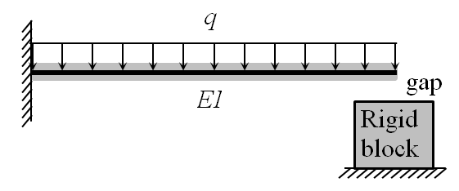

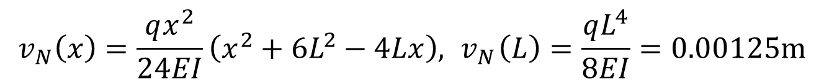
Contact of a Cantilever Beam with a Rigid Block
$q=1 kN/m, L=1 m, EI=105 N∙m2, initial gap δ=1 mm$
Trial-and-error solution
First assume that the deflection is smaller than the gap
Since $v_{N}(L)>δ$, the assumption is wrong, the beam will be in contact
$$v_{N}\left(x\right)=\frac{qx^{2}}{24EI}\left(x^{2}+6L^{2}−4Lx\right),{ v}_{N}\left(L\right)=\frac{qL^{4}}{8EI}=0.00125m$$

Slide 9
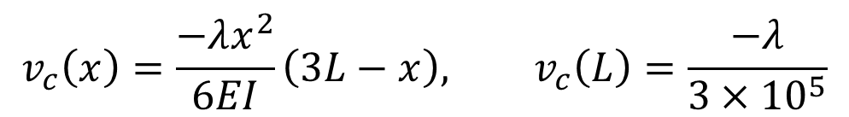

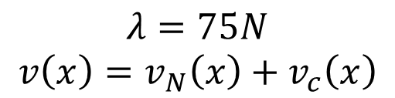
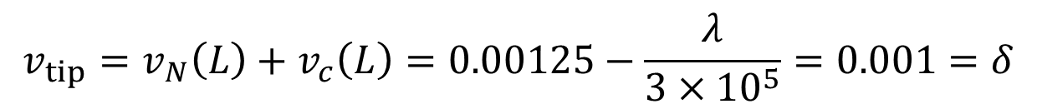
Cantilever Beam Contact with a Rigid Block cont.
Trial-and-error solution cont.
Now contact occurs. Contact in one-point (tip).
Contact force, $λ$, to prevent penetration
Determine the contact force from tip displacement = gap
$$v_{c}\left(x\right)=\frac{−λx^{2}}{6EI}\left(3L−x\right), v_{c}\left(L\right)=\frac{−λ}{3×{10}^{5}}$$
$$v_{tip}=v_{N}\left(L\right)+v_{c}\left(L\right)=0.00125−\frac{λ}{3×{10}^{5}}=0.001=δ$$
$$\begin{matrix}λ=75N \\ v\left(x\right)=v_{N}\left(x\right)+v_{c}\left(x\right)\end{matrix}$$

Slide 10
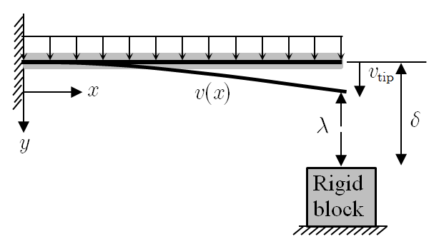


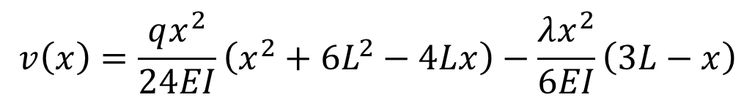
Cantilever Beam Contact with a Rigid Block cont.
Solution using contact constraint
Treat both contact force and gap as unknown and add constraint
When $λ=0$, no contact. Contact occurs when $λ>0$. $λ<0$ impossible
Gap condition:
$$v\left(x\right)=\frac{qx^{2}}{24EI}\left(x^{2}+6L^{2}−4Lx\right)−\frac{λx^{2}}{6EI}\left(3L−x\right)$$
$$g=δ−v_{tip}≥0$$

Slide 11

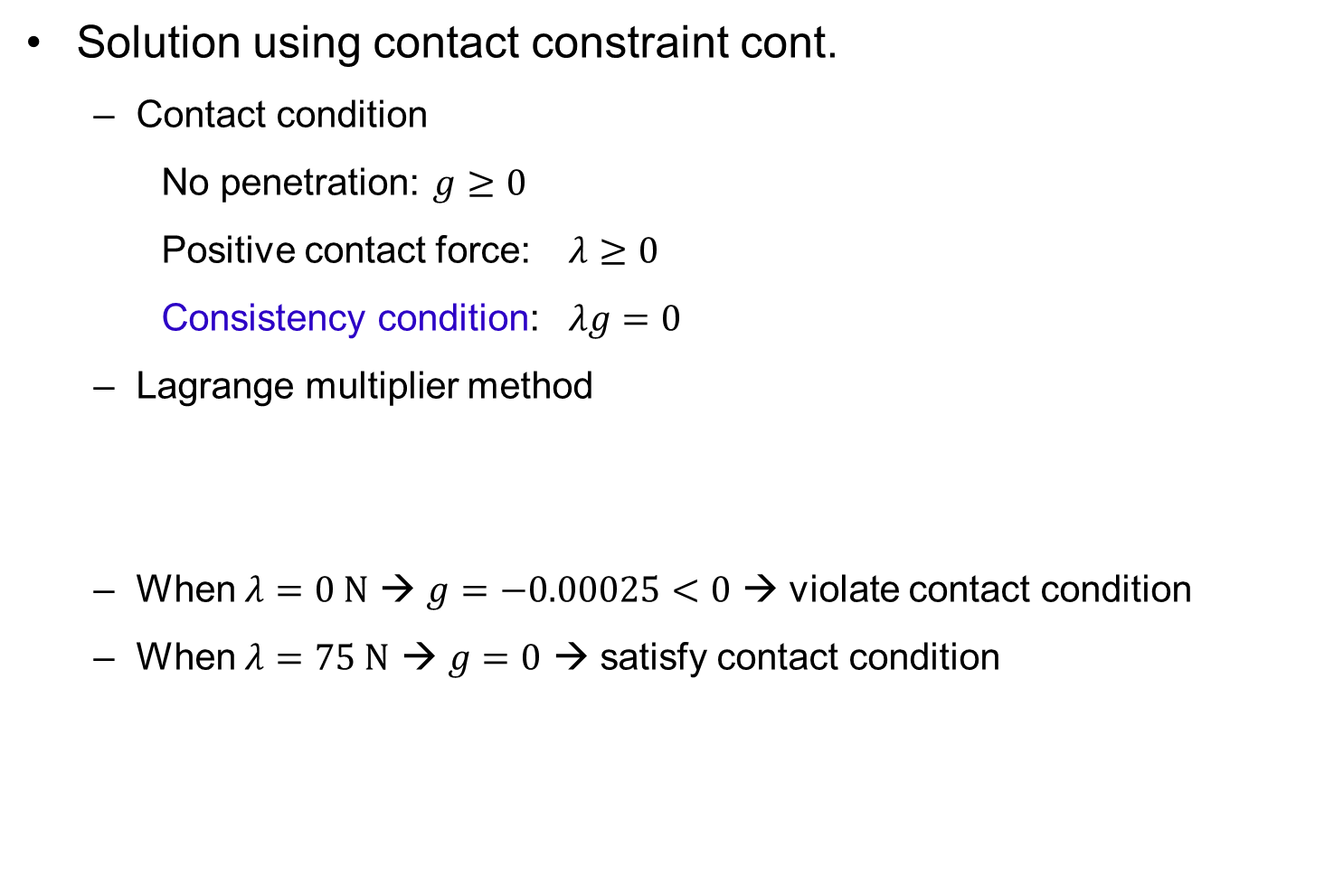
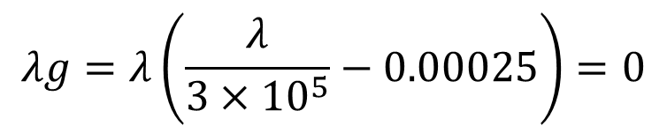
Cantilever Beam Contact with a Rigid Block cont.
Solution using contact constraint cont.
Contact condition
No penetration: $g≥0$
Positive contact force: $λ≥0$
Consistency condition: $λg=0$
Lagrange multiplier method
When $λ=0 N$ → $g=−0.00025<0$ → violate contact condition
When $λ=75 N$ → $g=0$ → satisfy contact condition
$$λg=λ\left(\frac{λ}{3×{10}^{5}}−0.00025\right)=0$$
Lagrange multiplier, $λ$, is the contact force

Slide 12


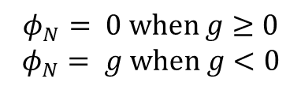
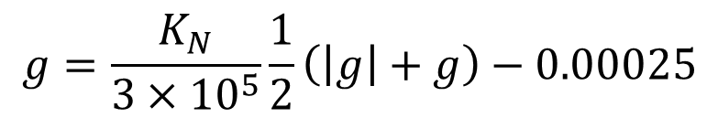

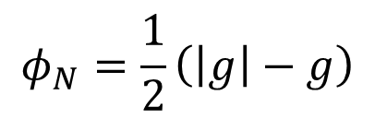
Cantilever Beam Contact with a Rigid Block cont.
Penalty method
Small penetration is allowed, and contact force is proportional to it
Penetration function
Contact force
From
Gap depends on penalty parameter
$$φ_{N}=\frac{1}{2}\left(\left|g\right|−g\right)$$
$$φ_{N}= 0 when g≥0$$
$$φ_{N}= g when g<0$$
$$λ=K_{N}φ_{N}$$
$KN$: penalty parameter
$$g=δ−v_{tip}≥0$$
$$g=\frac{K_{N}}{3×{10}^{5}}\frac{1}{2}\left(\left|g\right|+g\right)−0.00025$$

Slide 13
Cantilever Beam Contact with a Rigid Block cont.
Penalty method cont.
Large penalty allows small penetration
Penalty parameter | Penetration (m) | Contact force (N)
3×10⁵ | 1.25×10⁻⁴ | 37.50
3×10⁶ | 2.27×10⁻⁵ | 68.18
3×10⁷ | 2.48×10⁻⁶ | 74.26
3×10⁸ | 2.50×10⁻⁷ | 74.92
3×10⁹ | 2.50×10⁻⁸ | 75.00

Slide 14
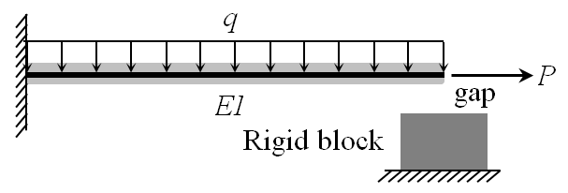
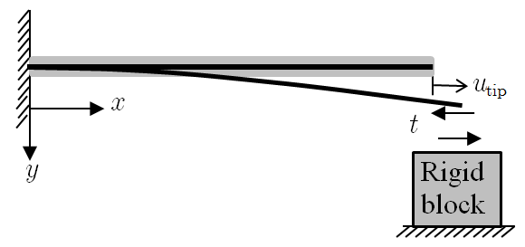



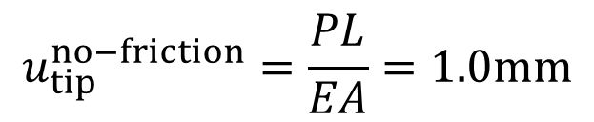


Beam Contact with Friction
Sequence: $q$ is applied first, followed by the axial load $P$
Assume no friction ($P=100N$, 1D bar deformation)
Frictional constraint ($μ=0.5$)
Stick condition:
Slip condition:
Consistency condition:
$$u_{tip}^{no−friction}=\frac{PL}{EA}=1.0mm$$
$$t−μλ<0, u_{tip}=0$$
$t$: tangential friction force
$$t−μλ=0, u_{tip}>0$$
$$u_{tip}\left(t−μλ\right)=0$$

Slide 15
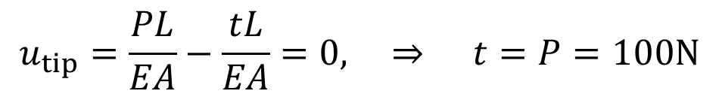

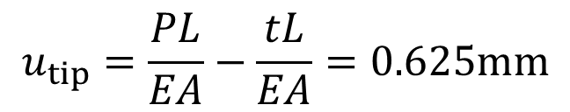
Beam Contact with Friction cont.
Trial-and-error solution
First assume stick condition (need to satisfy $t−μλ<0$)
Violate: $t−μλ<0$
Next, try slip condition $t=μλ=37.5N$ (need to satisfy $u_{tip}>0$)
Satisfies $u_{tip}>0$, therefore, valid
$$u_{tip}=\frac{PL}{EA}−\frac{tL}{EA}=0, ⇒ t=P=100N$$
$$u_{tip}=\frac{PL}{EA}−\frac{tL}{EA}=0.625mm$$

Slide 16
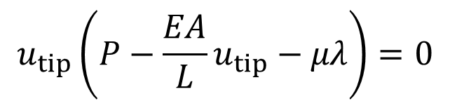
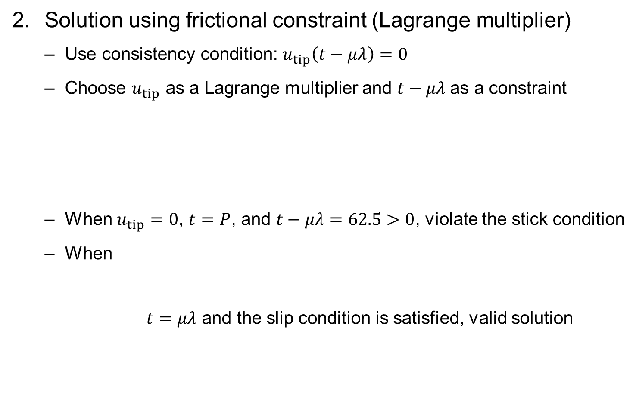
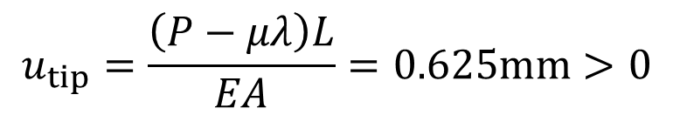
Beam Contact with Friction cont.
Solution using frictional constraint (Lagrange multiplier)
Use consistency condition: $u_{tip}\left(t−μλ\right)=0$
Choose $u_{tip}$ as a Lagrange multiplier and $t−μλ$ as a constraint
When $u_{tip}=0$, $t=P$, and $t−μλ=62.5>0$, violate the stick condition
When
$t=μλ$ and the slip condition is satisfied, valid solution
$$u_{tip}\left(P−\frac{EA}{L}u_{tip}−μλ\right)=0$$
$$u_{tip}=\frac{\left(P−μλ\right)L}{EA}=0.625mm>0$$

Slide 17




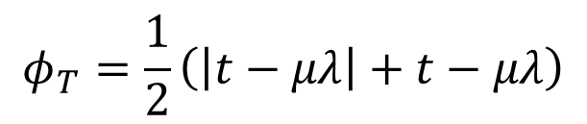
Beam Contact with Friction cont.
Penalty method
Penalize when $t−μλ>0$
Slip displacement and frictional force
When $t−μλ<0$ (stick), $u_{tip}=0$ (no penalization)
When $t−μλ>0$ (slip), penalize to stay close $t=μλ$
Friction force (in terms of $u_{tip}$)
$$φ_{T}=\frac{1}{2}\left(\left|t−μλ\right|+t−μλ\right)$$
$$u_{tip}=K_{T}φ_{T}$$
$K_{T}$: penalty parameter for tangential slip
$$t=P−\frac{EA}{L}u_{tip}$$

Slide 18
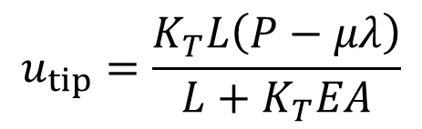

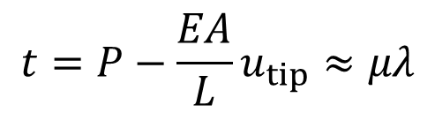
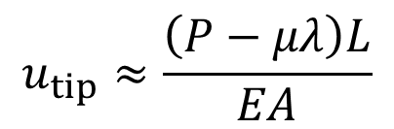
Beam Contact with Friction cont.
Penalty method cont.
Tip displacement
For large $K_{T}$,
$$u_{tip}=\frac{K_{T}L\left(P−μλ\right)}{L+K_{T}EA}$$
$$u_{tip}≈\frac{\left(P−μλ\right)L}{EA}$$
$$t=P−\frac{EA}{L}u_{tip}≈μλ$$
Slip condition
Penalty parameter | Tip displacement (m) | Frictional force (N)
1×10⁻⁴ | 5.68×10⁻⁴ | 43.18
1×10⁻³ | 6.19×10⁻⁴ | 38.12
1×10⁻² | 6.24×10⁻⁴ | 37.56
1×10⁻¹ | 6.25×10⁻⁴ | 37.50
1×10⁰ | 6.25×10⁻⁴ | 37.50

Slide 19
Observations
Due to unknown contact boundary, contact point should be found using either direct search (trial-and-error) or nonlinear constraint equation
Both methods requires iterative process to find contact boundary and contact force
Contact function replace the abrupt change in contact condition with a smooth but highly nonlinear function
Friction force calculation depends on the sequence of load application (Path-dependent)
Friction function regularizes the discontinuous friction behavior to a smooth one

Slide 20
General Formulation FOR 2D Contact Problems
5.3

Slide 21
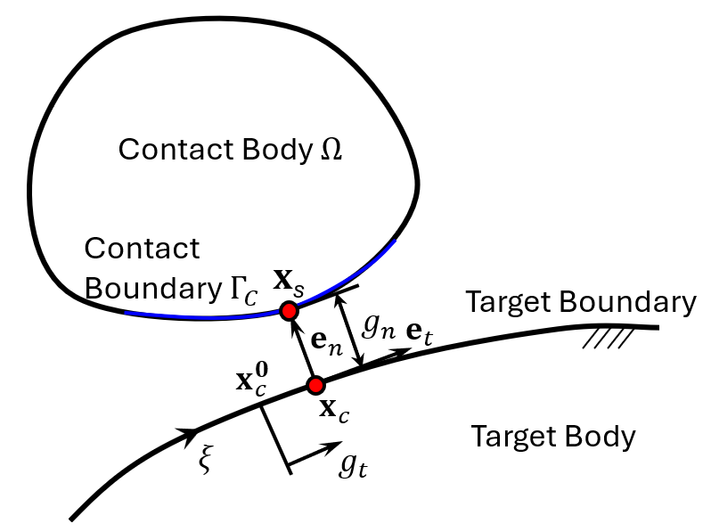




General Contact Formulation
Contact between a flexible body and a rigid body
Point $x∈Ω$ contacts to $x_{c}∈$ rigid surface (param $ξ$)
How to find $x_{c}\left(ξ\right)$
Closest projection onto the rigid surface
$$x_{c}=x_{c}\left(ξ_{c}\right)$$
$$e_{t}=\frac{t}{\left\|t\right\|}=\frac{x_{c,ξ}}{\left\|x_{c,ξ}\right\|}$$
$$φ\left(ξ_{c}\right)={\left(x_{s}−x_{c}\left(ξ_{c}\right)\right)}^{T}e_{t}\left(ξ_{c}\right)=0$$
Unit tangent vector

Slide 22



Contact Formulation cont.
Gap function
Impenetrability condition
Tangential slip function
$$g_{n}={\left(x_{s}−x_{c}\left(ξ_{c}\right)\right)}^{T}e_{n}\left(ξ_{c}\right)$$
$$g_{n}≥0, x_{s}∈Γ_{c}$$
boundary that has a possibility of contact
$$g_{t}≡\left\|t^{0}\right\|\left(ξ_{c}−ξ_{c}^{0}\right)$$
Parameter at the previous contact point

Slide 23
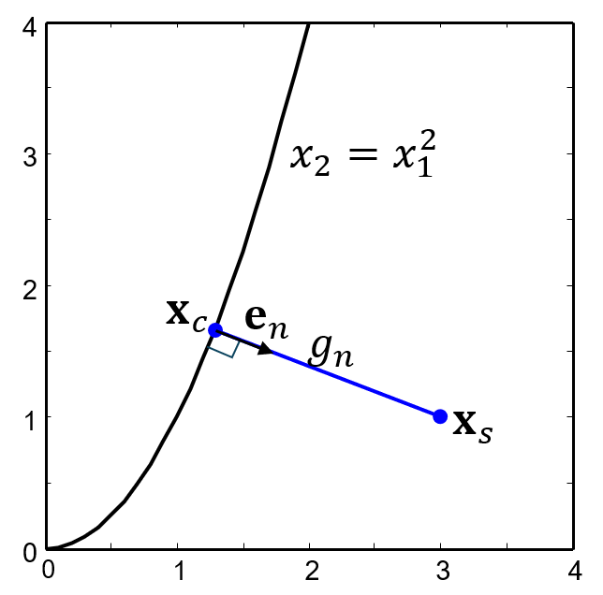

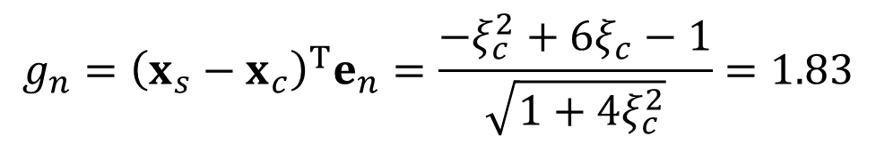

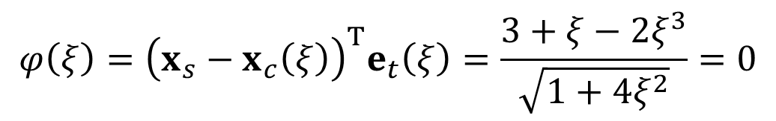
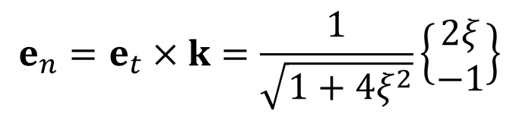
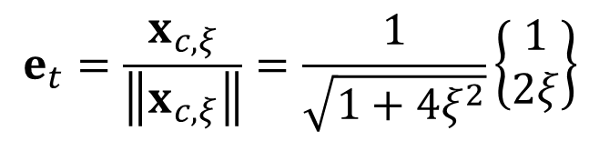
Ex) Project to a Parabola
Projection of $x_{s}=\{3, 1\}$ to $x_{2}=x_{1}^{2}$
Let $xc=\{ξ, ξ2\}T$
Projection point
Gap
$$e_{t}=\frac{x_{c,ξ}}{\left\|x_{c,ξ}\right\|}=\frac{1}{\sqrt{1+4ξ^{2}}}\left\{\begin{matrix}1 \\ 2ξ\end{matrix}\right\}$$
$$e_{n}=e_{t}×k=\frac{1}{\sqrt{1+4ξ^{2}}}\left\{\begin{matrix}2ξ \\ −1\end{matrix}\right\}$$
$$φ\left(ξ\right)={\left(x_{s}−x_{c}\left(ξ\right)\right)}^{T}e_{t}\left(ξ\right)=\frac{3+ξ−2ξ^{3}}{\sqrt{1+4ξ^{2}}}=0$$
$$ξc = 1.29$$
$$xc = \{1.29, 1.66\}$$
$$g_{n}={\left(x_{s}−x_{c}\right)}^{T}e_{n}=\frac{−ξ_{c}^{2}+6ξ_{c}−1}{\sqrt{1+4ξ_{c}^{2}}}=1.83$$

Slide 24


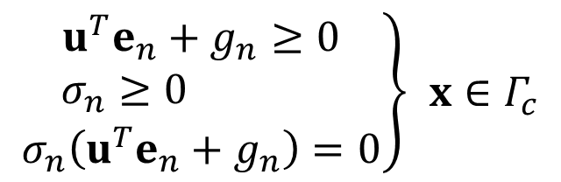
Variational Inequality
Governing equation
Contact conditions (small deformation)
Contact set $𝕂$ (convex)
$$\left\{\begin{matrix}∇⋅σ+f^{b}=0 x∈Ω \\ u=0 x∈Γ^{g} \\ σn=f^{s} x∈Γ^{s}\end{matrix}\right.$$
$$\left.\begin{matrix}u^{T}e_{n}+g_{n}≥0 \\ σ_{n}≥0 \\ σ_{n}\left(u^{T}e_{n}+g_{n}\right)=0\end{matrix}\right\} x∈Γ_{c}$$
$$𝕂=\left\{\left.w∈{\left[H^{1}\left(Ω\right)\right]}^{N}\right|{\left.w\right|}_{Γ^{g}}=0 and w^{T}e_{n}+g_{n}≥0 on Γ_{c}\right\}$$
satisfies all kinematic constraints (displacement conditions)

Slide 25
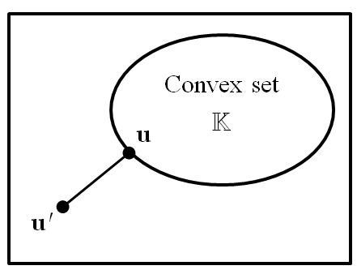
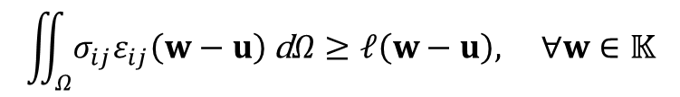
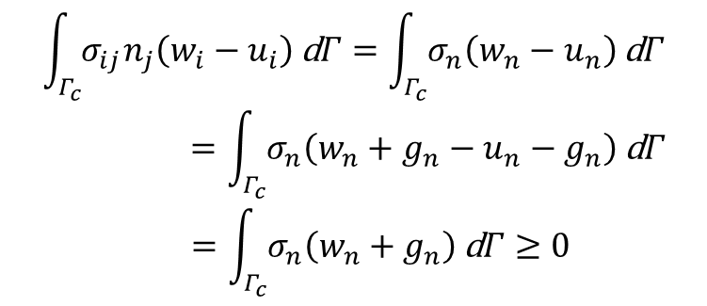
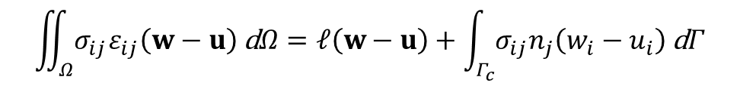

Variational Inequality cont.
Variational equation with $\overline{u}=w–u$ (i.e., $w$ is arbitrary)
$$\iint_{Ω}{σ_{ij}ε_{ij}\left(w−u\right) \text{d}Ω}=−\iint_{Ω}{σ_{ij,j}\left(w_{i}−u_{i}\right) \text{d}Ω}+\int_{Γ^{s}∪Γ_{c}}{σ_{ij}n_{j}\left(w_{i}−u_{i}\right) \text{d}Γ}$$
$$σ_{ij,j}=−f_{i}^{b} \left(x∈Ω\right), σ_{ij}n_{j}=f_{i}^{s} \left(x∈Γ^{s}\right)$$
$$\iint_{Ω}{σ_{ij}ε_{ij}\left(w−u\right) \text{d}Ω}=𝓁\left(w−u\right)+\int_{Γ_{c}}{σ_{ij}n_{j}\left(w_{i}−u_{i}\right) \text{d}Γ}$$
$$\begin{matrix}\int_{Γ_{c}}{σ_{ij}n_{j}\left(w_{i}−u_{i}\right) \text{d}Γ}=\int_{Γ_{c}}{σ_{n}\left(w_{n}−u_{n}\right) \text{d}Γ} \\ =\int_{Γ_{c}}{σ_{n}\left(w_{n}+g_{n}−u_{n}−g_{n}\right) \text{d}Γ} \\ =\int_{Γ_{c}}{σ_{n}\left(w_{n}+g_{n}\right) \text{d}Γ}≥0\end{matrix}$$
Since it is arbitrary, we don’t know the value, but it is non-negative
$$\iint_{Ω}{σ_{ij}ε_{ij}\left(w−u\right) \text{d}Ω}≥𝓁\left(w−u\right), ∀w∈𝕂$$
Variational inequality for contact problem

Slide 26
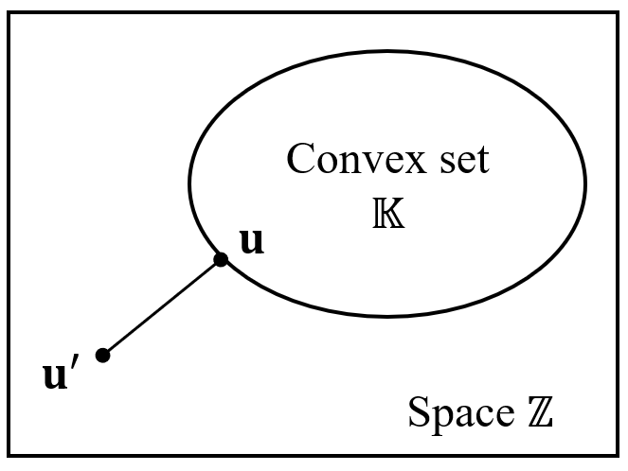



Illustration of Projection
$$a(u,w−u) ≥𝓁\left(w−u\right), ∀w∈𝕂$$
If the solution $u′$ is out of set $𝕂$, it is projected to $u$ on $𝕂$
Beam deflection example (rigid block with initial gap of 1mm)
$v′(x)$: beam deflection without rigid block $v^{′}∈ℤ$
Contact condition is violated (penetration to the block)
$v(x)$: projection of $v′(x)$ onto convex set $𝕂$
by applying the contact force

Slide 27
Variational Inequality cont.
For large deformation problem
Variational inequality is not easy to solve directly
We will show that V.I. is equivalent to constrained optimization of total potential energy
The constraint will be imposed using either penalty method or Lagrange multiplier method
$𝕂=${$w∈{\left[H^{1}\left(Ω\right)\right]}^{N}\}|$ ${\left.w\right|}_{Γ^{g}}=0 and {\left(x−x_{c}\left(ξ_{c}\right)\right)}^{T}e_{n}≥0 on Γ_{c}$}

Slide 28



Potential Energy and Directional Derivative
Potential energy
Directional derivative
Directional derivative of potential energy
For variational inequality
$$Π\left(u\right)=\frac{1}{2}a(u,u) −𝓁\left(u\right)$$
$$\begin{matrix}{\left.\frac{d}{dτ}\left[Π\left(u+τv\right)\right]\right|}_{τ=0}={\left.\frac{d}{dτ}\left[\frac{1}{2}a(u+τv,u+τv) −𝓁\left(u+τv\right)\right]\right|}_{τ=0} \\ \\ =\frac{1}{2}a(u,v)+\frac{1}{2}a(v,u)−𝓁\left(v\right) \\ =a(u,v)−𝓁\left(v\right) \end{matrix}$$
$$〈DΠ\left(u\right),v〉=a(u,v)−𝓁\left(v\right)$$
$$a(u,w−u) ≥𝓁\left(w−u\right)⇔〈DΠ\left(u\right),w−u〉≥0, ∀w∈𝕂$$

Slide 29



Equivalence
V.I. is equivalent to constrained optimization
For arbitrary $w∈𝕂$
Thus, $Π\left(u\right)$ is the smallest potential energy in $𝕂$
Unique solution if and only if $Π\left(w\right)$ is a convex function and set $𝕂$ is closed convex
$$\begin{matrix}Π\left(w\right)−Π\left(u\right)=\frac{1}{2}a(w,w) −𝓁\left(w\right)−\frac{1}{2}a(u,u)+𝓁\left(u\right)+a(u,w−u)−a(u,w−u) \\ =a(u,w−u)−𝓁\left(w−u\right)+\frac{1}{2}a(w,w)−a(u,w)+\frac{1}{2}a(u,u) \\ =〈\text{D}Π\left(u\right),w−u〉+\frac{1}{2}a\left(w−u,w−u\right) \end{matrix}$$
non-negative
$$⇒ Π\left(w\right)≥Π\left(u\right)+〈DΠ\left(u\right),w−u〉 ∀w∈𝕂$$
$$Π\left(u\right)=\min_{w∈𝕂}Π\left(w\right)=\min_{w∈𝕂}\left[\frac{1}{2}a(w,w)−𝓁\left(w\right)\right]$$

Slide 30



Constrained Optimization
PMPE minimizes the potential energy in the kinematically admissible space
Contact problem minimizes the same potential energy in the contact constraint set $𝕂$
The constrained optimization problem can be converted into unconstrained optimization problem using the penalty method or Lagrange multiplier method
If $g_{n}<0$, penalize $Π\left(u\right)$ using
$$𝕂=\left\{\left.w∈{\left[H^{1}\left(Ω\right)\right]}^{N}\right|{\left.w\right|}_{Γ^{g}}=0 and {\left(x−x_{c}\right)}^{T}e_{n}≥0 on Γ_{c}\right\}$$
$$g_{n}≥0 \text{on} Γ_{c}$$
$$P=\frac{1}{2}ω_{n}\int_{Γ_{C}}{g_{n}^{2} dΓ}+\frac{1}{2}ω_{t}\int_{Γ_{C}}{g_{t}^{2} dΓ}$$
penalty parameter

Slide 31

Constrained Optimization cont.
Penalized unconstrained optimization problem
$$Π\left(u\right)=\min_{w∈𝕂}Π\left(w\right)=\min_{w∈ℤ}\left[Π\left(w\right)+P\left(w\right)\right]$$
constrained
unconstrained
Solution space w/o contact 
😐
Contact force
u
u_{NoContact}

Slide 32




Ex) Beam Deflection with Rigid Block
$q=1 kN/m, L=1 m, EI=105 N∙m2, initial gap δ = 1 mm$
Assumed deflection: $v\left(x\right)=a_{2}x^{2}+a_{3}x^{3}+a_{4}x^{4}$
Penalty function:
Penalized potential energy
$$P=\frac{1}{2}ω_{n}g_{n}^{2}$$
$$g_{n}=δ−v_{tip}=δ−a_{2}−a_{3}−a_{4}$$
$$Π_{a}=Π+P=\frac{1}{2}\int_{0}^{L}{EI{\left(v_{,xx}\right)}^{2} dx}−\int_{0}^{L}{qv dx}+\frac{1}{2}ω_{n}g_{n}^{2}$$

Slide 33



Ex) Beam Deflection with Rigid Block
Stationary condition
Penetration: $a2+a3+a4−δ$
Contact force:$−ω_{n}g_{n}$
$$\left[\begin{matrix}4EI+ω_{n} & 6EI+ω_{n} & 8EI+ω_{n} \\ 6EI+ω_{n} & 12EI+ω_{n} & 18EI+ω_{n} \\ 8EI+ω_{n} & 18EI+ω_{n} & \frac{144}{5}EI+ω_{n}\end{matrix}\right]\left\{\begin{matrix}a_{2} \\ a_{3} \\ a_{4}\end{matrix}\right\}=\left\{\begin{matrix}\frac{1}{3}q+ω_{n}δ \\ \frac{1}{4}q+ω_{n}δ \\ \frac{1}{5}q+ω_{n}δ\end{matrix}\right\}$$
$$\frac{∂Π_{a}}{∂a_{i}}=0$$
Penalty parameter | a₁ | a₂ | a₃ | Penetration (m) | Contact force (N)
3×10⁵ | 2.31×10⁻³ | -1.60×10⁻³ | 4.17×10⁻⁴ | 1.25×10⁻⁴ | 37.50
3×10⁶ | 2.16×10⁻³ | -1.55×10⁻³ | 4.17×10⁻⁴ | 2.27×10⁻⁵ | 68.18
3×10⁷ | 2.13×10⁻³ | -1.54×10⁻³ | 4.17×10⁻⁴ | 2.48×10⁻⁶ | 74.26
3×10⁸ | 2.13×10⁻³ | -1.54×10⁻³ | 4.17×10⁻⁴ | 2.50×10⁻⁷ | 74.92
3×10⁹ | 2.13×10⁻³ | -1.54×10⁻³ | 4.17×10⁻⁴ | 2.50×10⁻⁸ | 75.00
True value | 2.13×10⁻³ | -1.54×10⁻³ | 4.17×10⁻⁴ | 0.0 | 75.00

Slide 34





Variational Equation
Structural Equilibrium
Variational equation
$$δΠ(u;\overline{u})+δP(u;\overline{u})=0$$
$$a(u,\overline{u})−𝓁\left(\overline{u}\right)+δP(u;\overline{u})=0$$
$$\begin{matrix}δP(u;\overline{u})=ω_{n}\int_{Γ_{C}}{g_{n}{\overline{g}}_{n} dΓ}+ω_{t}\int_{Γ_{C}}{g_{t}{\overline{g}}_{t} dΓ}≡ b(u,\overline{u}) \\ b_{N}(u,\overline{u}) b_{T}(u,\overline{u})\end{matrix}$$
need to express in terms of $u$ and $\overline{u}$
$$a(u,\overline{u})+b(u,\overline{u})=𝓁\left(\overline{u}\right), ∀\overline{u}∈ℤ$$

Slide 35




Frictionless Contact Formulation
Variation of the normal gap
Normal contact form
Contact force: $−ω_{n}g_{n}$
positive contact force is in the same direction with $e_{n}$, that is, a compressive force
Displacement variation: ${\overline{u}}_{n}={\overline{u}}^{T}e_{n}$
$$g_{n}={\left(x−x_{c}\left(ξ\right)\right)}^{T}e_{n}$$
$${\overline{g}}_{n}={\overline{u}}^{T}e_{n}$$
$$b_{N}(u,\overline{u})=ω_{n}\int_{Γ_{c}}{g_{n}{\overline{u}}^{T}e_{n} dΓ}$$

Slide 36



Linearization
It is clear that $b_{N}$ is independent of energy form
The same $b_{N}$ can be used for elastic or plastic problem
It is nonlinear with respect to $u$ (need linearization)
Increment of gap function
We assume that the contact boundary is straight line $Δe_{n}=0$
This is true for linear finite elements
Refer to the book for the case when $Δe_{n}≠0$
$$Δg_{n}=Δ\left[{\left(x−x_{c}\left(ξ\right)\right)}^{T}e_{n}\right]=Δu^{T}e_{n}+{\left(x−x_{c}\left(ξ\right)\right)}^{T}Δe_{n}$$
$$Δg_{n}\left(u ; Δu\right)=Δu^{T}e_{n}$$
$$\begin{matrix}Δe_{n}∥e_{t} \\ x−x_{c}∥e_{n}\end{matrix}$$
Rigid surface

Slide 37


Linearization cont.
Linearization of contact form
N-R iteration
$$b_{N}(u,\overline{u})=ω_{n}\int_{Γ_{c}}{g_{n}{\overline{u}}^{T}e_{n} dΓ}$$
$$b_{N}^{∗}(u,Δu,\overline{u})=ω_{n}\int_{Γ_{c}}{{\overline{u}}^{T}e_{n}e_{n}^{T}Δu dΓ}$$
$$a^{∗}(u,Δu,\overline{u})+b_{N}^{∗}(u,Δu,\overline{u})=𝓁\left(\overline{u}\right)−a(u,\overline{u})−b_{N}(u,\overline{u}), ∀\overline{u}∈ℤ$$

Slide 38




Ex) Frictionless Contact of a Block
Calculate displacement, penetration and contact force at the contact interface.
$EA={10}^{5}N, ν=0, q=1.0 kN/m$
Plane strain: $u={\{u_{x},u_{y}\}}^{T}$, $\overline{u}={\{{\overline{u}}_{x},{\overline{u}}_{y}\}}^{T}$
Contact boundary: $e_{n}={\left\{0,1\right\}}^{T}$
Gap function: $g_{n}={(x−x_{c})}^{T}e_{n}=u_{y}(0)$
Contact form:
Penalized potential energy
y
q
Contact boundary
Elastic body
0
1
x
$$ξ=x, x_{c}={\{ξ_{c},0\}}^{T}, x={\{ξ_{c},u_{y}\}}^{T}$$
Rigid body
$$b_{N}(u,\overline{u})=ω_{n}\int_{0}^{1}{{\left.u_{y}{\overline{u}}_{y}\right|}_{y=0} dx}$$
$$Π+P=\frac{1}{2}\iint_{A}{ε^{T}Dε dA}−\int_{0}^{1}{{\left.\left(−q\right)u_{y}\right|}_{y=1} dx}+\frac{1}{2}ω_{n}\int_{0}^{1}{{\left.g_{n}^{2}\right|}_{y=0} dx}$$

Slide 39







Ex) Frictionless Contact of a Block cont.
From $ν=0$, $D$ becomes a diagonal matrix, decoupled x & y
Since load is only y-direction, $ε_{xx}=γ_{xy}=0$
Linear displacement in y-direction
Penalized potential
Need to satisfy for arbitrary ${\overline{a}}_{0},{\overline{a}}_{1}$
$$u_{y}=a_{0}+a_{1}y {\overline{u}}_{y}={\overline{a}}_{0}+{\overline{a}}_{1}y$$
$$\overline{Π}+\overline{P}=\iint_{A}{Ea_{1}{\overline{a}}_{1} dA}−\int_{0}^{1}{\left(−q\right)\left({\overline{a}}_{0}+{\overline{a}}_{1}\right) dx}+ω_{n}\int_{0}^{1}{a_{0}{\overline{a}}_{0} dx}=0$$
$$a_{0}=−\frac{q}{ω_{n}}, a_{1}=−\frac{q}{EA}$$
$$u_{y}=−\frac{q}{ω_{n}}−\frac{q}{EA}y, 0≤y≤1$$
As $ω_{n}$ increases, penetration decreases but
contact force remains constant
$$−ω_{n}g_{n}={\left.−ω_{n}u_{y}\right|}_{y=0}=q$$

Slide 40

Ex) Frictionless Contact of a Block cont.
The product of penetration and penalty parameter remains constant
Penalty parameter | Displacement | Penetration (m) | Contact force (N)
$${10}^{5}$$ | $$−1×{10}^{−2}−1×{10}^{−2}y$$ | $$1×{10}^{−2}$$ | $${10}^{3}$$
$${10}^{6}$$ | $$−1×{10}^{−3}−1×{10}^{−2}y$$ | $$1×{10}^{−4}$$ | $${10}^{3}$$
$${10}^{7}$$ | $$−1×{10}^{−4}−1×{10}^{−2}y$$ | $$1×{10}^{−4}$$ | $${10}^{3}$$
$${10}^{8}$$ | $$−1×{10}^{−5}−1×{10}^{−2}y$$ | $$1×{10}^{−5}$$ | $${10}^{3}$$
True value | $$−1×{10}^{−2}y$$ | 0.0 | $${10}^{3}$$

Slide 41





Frictional Contact Formulation
frictional contact depends on load history
Frictional interface law – regularization of Coulomb law
Friction form
$$b_{T}(u,\overline{u})=ω_{t}\int_{Γ_{C}}{g_{t}{\overline{g}}_{t} dΓ}$$
$${\overline{g}}_{t}=\left\|t^{0}\right\|{\overline{ξ}}_{c}=ν{\overline{u}}^{T}e_{t}$$
$$\begin{matrix}α=e_{n}^{T}x_{c,ξξ} \\ β=e_{t}^{T}x_{c,ξξ} \\ γ=e_{n}^{T}x_{c,ξξξ} \\ c={\left\|t\right\|}^{2}−g_{n}α \\ ν={\left\|t\right\|\left\|t^{0}\right\|}/c\end{matrix}$$
$$b_{T}(u,\overline{u}) =ω_{t}\int_{Γ_{c}}{νg_{t}{\overline{u}}^{T}e_{t} dΓ}$$

Slide 42



Friction Force
During stick condition, $f_{T}{=ω_{t}g}_{t}$($ω_{t}$: regularization param.)
When slip occurs, $\left|νω_{t}g_{t}\right|=−μω_{n}g_{n}$
Modified friction form
$$νω_{t}g_{t}≤\left|μω_{n}g_{n}\right|$$
$$b_{T}(u,\overline{u})=\left\{\begin{matrix}ω_{t}\int_{Γ_{c}}{νg_{t}{\overline{u}}^{T}e_{t} dΓ}, if \left|νω_{t}g_{t}\right|≤\left|μω_{n}g_{n}\right| \\ −μω_{n}sgn\left(g_{t}\right)\int_{Γ_{c}}{νg_{n}{\overline{u}}^{T}e_{t} dΓ}, otherwise\end{matrix}\right.$$

Slide 43



Linearization of Stick Form
Increment of slip
Increment of tangential vector
Incremental slip form for the stick condition
$$Δg_{t}\left(u ; Δu\right)=\left\|t^{0}\right\|Δξ_{c}=ν e_{t}^{T}Δu$$
$$Δe_{t}=−e_{3}×Δe_{n}=\frac{α}{c}e_{n}\left(e_{t}^{T}Δu\right)$$
$$\begin{matrix}b_{T}^{∗}(u,Δu,\overline{u})=ω_{t}\int_{Γ_{c}}{ν^{2}{\overline{u}}^{T}e_{t}e_{t}^{T}Δu dΓ} \\ +ω_{t}\int_{Γ_{c}}{\frac{ανg_{t}}{c}{\overline{u}}^{T}\left(e_{n}e_{t}^{T}+e_{t}e_{n}^{T}\right)Δu dΓ} \\ +ω_{t}\int_{Γ_{c}}{\frac{νg_{t}}{c^{2}}\left(\left(γ\left\|t\right\|−2αβ\right)g_{n}−β{\left\|t\right\|}^{2}\right) {\overline{u}}^{T}e_{t}e_{t}^{T}Δu dΓ}\end{matrix}$$

Slide 44



Linearization of Slip Form
Parameter for slip condition: $ω_{t}=−μω_{n}sgn\left(g_{t}\right)$
Friction form:
Linearized slip form (not symmetric!!)
$$b_{T}\left(u,\overline{u}\right)=ω_{t}\int_{Γ_{c}}{ν g_{n}{\overline{u}}^{T}e_{t} dΓ}$$
$$\begin{matrix}b_{T}^{∗}(u;Δu,\overline{u})=ω_{t}\int_{Γ_{c}}{ν{\overline{u}}^{T}e_{t}e_{n}^{T}Δu dΓ} \\ + ω_{t}\int_{Γ_{c}}{\frac{ανg_{n}}{c}{\overline{u}}^{T}\left(e_{n}e_{t}^{T}+e_{t}e_{n}^{T}\right)Δu dΓ} \\ + ω_{t}\int_{Γ_{c}}{\frac{νg_{n}}{c^{2}}\left(\left(γ\left\|t\right\|− 2αβ\right)g_{n}−β{\left\|t\right\|}^{2}\right){\overline{u}}^{T}e_{t}e_{t}^{T}Δu dΓ}\end{matrix}$$

Slide 45


Linearization
Let contact form $b\left(u,\overline{u}\right)=b_{N}\left(u,\overline{u}\right)+b_{T}(u,\overline{u})$
Linearization $b^{∗}\left(u,Δu,\overline{u}\right)=b_{N}^{∗}\left(u,Δu,\overline{u}\right)+b_{T}^{∗}(u,Δu,\overline{u})$
N-R iteration
Let $n$ be current load increment and $k+1$ be the current iteration counter
Contact form is independent of structural form
Can be applied to different material models.
$$\begin{aligned}&a^{∗}\left({}_{ }^{n}{u^{k}};Δu^{k+1},\overline{u}\right)+b^{∗}\left({}_{ }^{n}{u^{k}};Δu^{k+1},\overline{u}\right) \\ & =𝓁\left(\overline{u}\right)−a\left({}_{ }^{n}{u^{k}} , \overline{u}\right)−b\left({}_{ }^{n}{u^{k}} , \overline{u}\right), ∀\overline{u}∈Z\end{aligned}$$

Slide 46



Ex) Frictional Slip of a Cantilever Beam
Distributed load $q$ → axial load $P$, $ω_{t}={10}^{6}, μ=0.5$
Contact force: $F_{c}=–ω_{n}g_{n}=75 N$
Penalized potential energy (axial alone)
$$Π_{a}=\int_{0}^{L}{EA{\left(u_{,x}\right)}^{2} dx}−Pu\left(L\right)+{\left.\frac{1}{2}ω_{t}g_{t}^{2}\right|}_{x=L}$$
$${\overline{Π}}_{a}=\int_{0}^{L}{EAu_{,x}{\overline{u}}_{,x} dx}−P\overline{u}\left(L\right)+{\left.ω_{t}g_{t}{\overline{g}}_{t}\right|}_{x=L}=0, ∀\overline{u}∈ℤ$$
P=100N

Slide 47






Ex) Frictional Slip of a Cantilever Beam
Linear axial displacement field: $u(x)=a0+a1x$
Tangential slip in terms of displacement
Parametric coordinate $ξ$ has an origin at $x=L$, and it has the same length as the x-coordinate
Assume the stick condition: $ω_{t}g_{t}≤\left|μω_{n}g_{n}\right|$
$$u\left(0\right)=0 ⇒ u\left(x\right)=a_{1}x u_{,x}=a_{1} {\overline{u}}_{,x}={\overline{a}}_{1}$$
$$\left\|x_{c,ξ}\right\|=\left\|t\right\|=\left\|t^{0}\right\|=1$$
$$ξ_{c}^{0}=0$$
$$g_{t}=ξ_{c}=u\left(L\right)=a_{1}$$
$${\overline{a}}_{1}\left(EAa_{1}+ω_{t}a_{1}−P\right)=0, ∀{\overline{a}}_{1}∈ℝ$$
$$u\left(x\right)=\frac{Px}{EA+ω_{t}}=9.09×{10}^{−5}x$$
$$ω_{t}g_{t}=90.9>37.5=\left|μω_{n}g_{n}\right|$$
The assumption is violated!!

Slide 48




Ex) Frictional Slip of a Cantilever Beam
Assume the slip condition:
With contact force $=70N$, $−μω_{n}g_{n}=37.5N$
$${\overline{Π}}_{a}=\int_{0}^{L}{EAu_{,x}{\overline{u}}_{,x} dx}−P\overline{u}\left(L\right)−{\left.μω_{n}sgn\left(g_{t}\right)g_{n}{\overline{g}}_{t}\right|}_{x=L}=0,∀\overline{u}∈ℤ$$
$${\overline{a}}_{1}\left(EAa_{1}−P+37.5\right)=0, ∀{\overline{a}}_{1}∈ℝ$$
$$a_{1}=62.5×{10}^{−5}$$
$$u_{tip}=0.625mm$$

Slide 49
Finite Element Formulation of Contact Problems
5.4

Slide 50


Flexible-Rigid Body Contact
$Γ_{C}$: a portion of the contact boundary where the contact body penetrates the target body
Contact between a contact node ($x_{s}$) and a straight target segment ($x_{1}$ and $x_{2}$)
Contact pair: $\hat{x}={\{x_{s},x_{1},x_{2}\}}^{T}$
Approaches:
(1) to find if the contact pair is in contact or in separation
(2) to calculate the contact force and penetration if it is in contact

Slide 51


Finite Element Formulation
Contact-Target contact
The rigid body has fixed or prescribed displacement
Point $x$ is projected onto the piecewise linear segments of the rigid body with $xc(ξ=ξc)$ as the projected point
Unit normal and tangent vectors
$$t=x_{2}−x_{1}, e_{t}=\frac{t}{\left\|t\right\|}, e_{n}=e_{3}×e_{t}$$
Contact body
x_{s}
g
ξ⁰
e_{n}
x₁
x_{c}⁰
x₂
ξ
x_{c}
e_{t}
Target body
L

Slide 52




Finite Element Formulation cont.
Parameter at contact point
Gap function
Contact occurs when $g_{n}≤0$ and $0≤ξ_{c}≤1$
Contact forces
$h$: integration weight (length of element)
Contact force is in the direction of $e_{n}$
$$ξ_{c}=\frac{1}{\left\|t\right\|}{\left(x_{s}−x_{1}\right)}^{T}e_{t}$$
$$g_{n}={\left(x_{s}−x_{1}\right)}^{T}e_{n}≥0$$
Impenetrability condition
$$f_{c}^{n}=−ω_{n}g_{n}he_{n}$$

Slide 53


Collocation Integral
Contact form $b_{N}(u,\overline{u})$ is the integral along the boundary $Γ_{C}$
Collocation integral: Numerical integration at node location
Discrete contact form
Gauss quadrature is difficult because integration point $≠$ node
Collocation integral: integration points = node, weights = $h$
Weight $h$ represents the domain that an integration point covers
calculating integration weight for general elements is difficult
$h$ can be included in the gap $g_{n}$ by putting $h=1$ for all contact nodes
can cause confusion interpreting the physical meaning of the gap
$$b_{N}(u,\overline{u}) ≈\sum_{I=1}^{NC}{{\left[{\overline{u}}_{s}^{T}\left(ω_{n}g_{n}he_{n}\right)\right]}_{I}}=\sum_{I=1}^{NC}{{\left[{\overline{u}}_{s}^{T}\left(−f_{c}^{n}\right)\right]}_{I}}≡{\overline{d}}_{g}^{T}\left(−F_{c}^{n}\right)$$

Slide 54


Linearization
Discrete incremental form
Tangent stiffness: $k_{c}^{n}=ω_{n}he_{n}e_{n}^{T}$
Assembled contact stiffness: $K_{c}^{n}$
N-R iteration
Residual force $F_{res}=F^{ext}−F^{int}$
$$b_{N}^{∗}(u;Δu,\overline{u}) =\sum_{I=1}^{NC}{{\left(ω_{n}h{\overline{u}}_{s}^{T}e_{n}e_{n}^{\text{T}}Δu_{s}\right)}_{I}}=\sum_{I=1}^{NC}{{\left({\overline{u}}_{s}^{T}k_{c}^{n}Δu_{s}\right)}_{I}}≡{\overline{d}}_{g}^{T}K_{c}^{n}Δd_{g}$$
$${\overline{d}}_{g}^{T}\left[K_{g}+K_{c}^{n}\right]Δd_{g}={\overline{d}}_{g}^{T}\left\{F_{res}+F_{c}^{n}\right\}, {\overline{d}}_{g}∈ℤ_{h}$$

Slide 55





Ex) Collocation Integration
Single element: $e_{n}={\left\{0,1\right\}}^{T}$
when integration weight is ignored, i.e., $h=1$, $f_{1}^{c}=f_{2}^{c}=500 \text{N}$
When $h=l/2=0.5$
Analytical solution (slide 40): with $ω_{n}={10}^{5}$: $g_{n}=u_{y}\left(0\right)=−q/ω_{n}=−0.01$
$$g_{n1}=−\frac{f_{1}^{c}}{ω_{n}}=−0.005, g_{n2}=−\frac{f_{2}^{c}}{ω_{n}}=−0.005$$
$$g_{n1}=−\frac{f_{1}^{c}}{hω_{n}}=−0.01, g_{n2}=−\frac{f_{2}^{c}}{hω_{n}}=−0.01$$
$$q=1.0 kN/m$$

Slide 56



Ex) Collocation Integration
Four elements:
when integration weight is ignored, uniform contact stress $→$ contact force is equally distributed two nodes $→$ $f_{1}^{c}=f_{3}^{c}=250 \text{N}$, $f_{2}^{c}=500 \text{N}$
When $h=l/2=0.25$: $h_{1}=h_{3}=0.25$, $h_{2}=2×0.25=0.5$
Therefore, including integration weights is correct
If integration weights are not used, gap $g_{n}$ includes integration weights
$$g_{n1}=g_{n3}=−\frac{f_{1}^{c}}{ω_{n}}=−0.0025, g_{n2}=−\frac{f_{2}^{c}}{ω_{n}}=−0.005$$
$$g_{n1}=g_{n3}=−\frac{f_{1}^{c}}{h_{1}ω_{n}}=−0.01, g_{n2}=−\frac{f_{2}^{c}}{h_{2}ω_{n}}=−0.01$$

Slide 57



Frictional Slip
Frictional slip
Friction force and tangent stiffness (stick condition)
Friction force and tangent stiffness (slip condition)
$$g_{t}=l^{0}\left(ξ_{c}−ξ_{c}^{0}\right)$$
$$f_{c}^{t}=−ω_{t}g_{t}he_{t}, if \left|ω_{t}g_{t}\right|<\left|μω_{n}g_{n}\right|$$
$$k_{t}^{c}=ω_{t}he_{t}e_{t}^{T}$$
$$f_{t}^{c}=μω_{n}sgn\left(g_{t}\right)g_{n}he_{t}, if \left|ω_{t}g_{t}\right|≥\left|μω_{n}g_{n}\right|$$
$$k_{t}^{c}=μω_{n}hsgn\left(g_{t}\right)e_{t}e_{n}^{T}$$

Slide 58



Frictional Slip cont.
Tangential form
Linearized tangential form
N-R iteration
Contact stiffness: $K_{c}=K_{c}^{n}+K_{c}^{t}$
Contact force: $F_{c}=F_{c}^{n}+F_{c}^{t}$
$$b_{T}(u,\overline{u})≈\sum_{I=1}^{NC}{{\left[{\overline{u}}_{s}^{T}(−f_{c}^{t})\right]}_{I}}≡{\overline{d}}_{g}^{T} (−F_{c}^{t})$$
$$b_{T}^{∗}(u;Δu,\overline{u})≈\sum_{I=1}^{NC}{{\left({\overline{u}}_{s}^{T}k_{c}^{t}Δu_{s}\right)}_{I}}≡{\overline{d}}_{g}^{T}K_{c}^{t}Δd_{g}$$
$${\overline{d}}_{g}^{T}\left[K_{g}+K_{c}\right]Δd_{g}={\overline{d}}_{g}^{T}\{F_{res}+F_{c}\}, {\overline{d}}_{g}∈ℤ_{h}$$

Slide 59



Flexible-Flexible Contact
Both contact and target bodies are deformable
Equal and opposite contact force is applied at contact node and target segment $→$ need interpolate contact force at target segment
Let contact force $f_{n}^{c}$ at a contact node
Contact forces at target nodes are $[f_{c1}^{n}, f_{c2}^{n}]=[−(1−ξ_{c})f_{c}^{n}, −ξ_{c}f_{c}^{n}]$
Contact forces at contact pair $\hat{x}={\{x_{s},x_{1},x_{2}\}}^{\text{T}}$
$${\hat{f}}_{c}^{n}={\left\{f_{c}^{n} , , −\left(1−ξ_{c}\right)f_{c}^{n} −ξ_{c}f_{c}^{n}\right\}}^{T}$$
$$x_{c}\left(ξ_{c}\right)=\left(1−ξ_{c}\right)x_{1}+ξ_{c}x_{2}$$
Contact body
x_{s}
$$u_{c}\left(ξ_{c}\right)=\left(1−ξ_{c}\right)u_{1}+ξ_{c}u_{2}$$
g
ξ⁰
e_{n}
x₁
x_{c}⁰
x₂
ξ
x_{c}
e_{t}
Target body
L

Slide 60





Flexible-Flexible Contact cont.
Variations of normal gap and tangential slip
Contact form and tangential form
Define augmented vectors
$${\overline{g}}_{n}={\left({\overline{u}}_{s}−{\overline{u}}_{c}\right)}^{T}e_{n}$$
$${\overline{g}}_{t}=\left\|t^{0}\right\|{\overline{ξ}}_{c}=ν{\left({\overline{u}}_{s}−{\overline{u}}_{c}\right)}^{T}e_{t}+\frac{g_{n}\left\|t^{0}\right\|}{c}{\overline{u}}_{c,ξ}^{T}e_{n}$$
$$b_{N}(u,\overline{u})=ω_{n}\int_{Γ_{c}}{g_{n}e_{n}^{T}({\overline{u}}_{s}−{\overline{u}}_{c}) \text{d}Γ}$$
Additional term due to deformable target body
$$b_{T}(u,\overline{u})=ω_{t}\int_{Γ_{c}}{g_{t}\left(νe_{t}^{T}({\overline{u}}_{s}−{\overline{u}}_{c})+\frac{g_{n}\left\|t^{0}\right\|}{c}e_{n}^{T}{\overline{u}}_{c,ξ}\right) \text{d}Γ}$$
$$\begin{aligned}\hat{u}=\left[\begin{aligned}u_{s} \\ u_{1} \\ u_{2}\end{aligned}\right], N=\left[\begin{aligned}e_{n} \\ −(1−ξ_{c})e_{n} \\ −ξ_{c}e_{n}\end{aligned}\right], T=\left[\begin{aligned}e_{t} \\ −(1−ξ_{c})e_{t} \\ −ξ_{c}e_{t}\end{aligned}\right], P=\left[\begin{aligned}0 \\ −e_{n} \\ e_{n}\end{aligned}\right], Q=\left[\begin{aligned}0 \\ −e_{t} \\ e_{t}\end{aligned}\right] \\ C_{n}=N−\frac{g_{n}l^{0}}{l^{2}}Q, C_{t}=T+\frac{g_{n}l^{0}}{l^{2}}P\end{aligned}$$

Slide 61




Flexible-Flexible Contact cont.
Contact form
Linearization
Stick condition
Slip condition
$$\begin{aligned}b\left(u,\overline{u}\right)=b_{N}\left(u,\overline{u}\right)+b_{T}\left(u,\overline{u}\right)≈\sum_{I=1}^{NC}{{\left[{\hat{\overline{u}}}^{T}\left(ω_{n}g_{n}hN\right)\right]}_{I}}+\sum_{I=1}^{NC}{{\left[{\hat{\overline{u}}}^{T}\left(ω_{t}g_{t}hC_{t}\right)\right]}_{I}}≡{\overline{d}}_{g}^{T}\left(−F_{c}\right) \\ \end{aligned}$$
$$b_{N}^{∗}(u;Δu,\overline{u})=\sum_{I=1}^{NC}{{\left(ω_{n}h{\hat{\overline{u}}}^{T}\left[C_{n}C_{n}^{T}\right]Δ\hat{u}\right)}_{I}}≡{\overline{d}}_{g}^{T}K_{c}^{n}Δd_{g}$$
$$\begin{aligned}b_{T}^{∗}(u;Δu,\overline{u})=\sum_{I=1}^{NC}{{\left(ω_{t}h{\hat{\overline{u}}}^{T}[C_{t}C_{t}^{T}+\frac{2g_{t}}{l}\left(sym(C_{n}P^{T})−sym(C_{t}Q^{T})\right)]Δ\hat{u}\right)}_{I}≡{\overline{d}}_{g}^{T}K_{c}^{t}Δd_{g}} \\ \end{aligned}$$
$$\begin{aligned}b_{T}^{∗}(u;Δu,\overline{u})=\sum_{I=1}^{NC}{{\left(ω_{t}h{\hat{\overline{u}}}^{T}[C_{t}N^{T}+\frac{2g_{N}}{l}\left(sym(C_{n}P^{T})−sym(C_{t}Q^{T})\right)]Δ\hat{u}\right)}_{I}} \\ \end{aligned}≡{\overline{d}}_{g}^{T}K_{c}^{t}Δd_{g}$$

Slide 62

MATLAB Code for Contact Analysis
Define contact problem
%******************************************************************************
XYZC=[1.1 2; -0.1 2]; % Rigid body coordinates
CNODE=[5 6]; % Contact nodes
LEC=[7 8]; % Target segments
CDISP=[7 2 -0.2;8 2 -0.2]; % Prescribed displ. of rigid nodes
CONTPARM=[1E8 1E7 0.4]; % Contact parameters [wN, wT, friction coefficient]
CONTACT=struct('XYZC',XYZC,'XYZP',XYZC,'CDISP',CDISP,'CNODE',CNODE,... %
'LEC',LEC,'PARM',CONTPARM); % Contact structure
$$⋮$$
NLFEA(PARAM,NOUT,MID,PROP,[],SDISPT,XYZ,LE,CONTACT,[]); % Calling NLFEA
%******************************************************************************
Rigid nodes: defined in XYZC
Contact nodes: defined in CNODE
Target segments: defined in LEC
Prescribed displacements of rigid nodes: defined in CDISP
Contact parameters: defined in CONTPARM $(ω_{n}, ω_{t},μ)$
Send to NLFEA using a structure: defined in CONTACT

Slide 63

MATLAB Code for Contact Analysis cont.
Contact pair: defined using contact nodes & target segments
NLFEA calls CNTELM to calculate the global contact stiffness matrix and contact force vector
CNTELM calls CNTELM2D or ENTELM3D to calculate contact force and contact stiffness for each pair
$$\text{ELXY}=\left[\begin{matrix}x_{s} & x_{1} & x_{2} \\ y_{s} & y_{1} & y_{2}\end{matrix}\right]$$

Slide 64
1 function CNTELM(CNT,XYZ,CDISP,NUMNP,LTAN)
2 %******************************************************************************
3 % COMPUTE CONTACT STIFFNESS & FORCE AND ASSEMBLE TO GLOBAL STIFFNESS & FORCE %
4 %******************************************************************************
5 %% %
6 global DISPTD FORCE GKF % Global variables
7 NCNT=size(CNT.CNODE,2); NTARG=size(CNT.LEC,1); % No. of contact pairs
8 NDOF=size(XYZ,2); NETARG=2^(NDOF-1); % Dimensions
9 ELXY=zeros(NDOF,NTARG+1); % Coordinates of contact pairs
10 ELXYP=zeros(NDOF,NTARG+1); % Coordinates at previous time
11 for ICNT=1:NCNT % Loop for contact nodes
12 IDOF=NDOF*(CNT.CNODE(ICNT)-1)+(1:NDOF); % Contact node DOFs
13 ELXY(:,1)=XYZ(CNT.CNODE(ICNT),:)+DISPTD(IDOF)';% Coordinates of contact nodes
14 ELXYP(:,1)=XYZ(CNT.CNODE(ICNT),:)+CDISP(IDOF)';% Coordinates at previous time
15 for ITARG=1:NTARG % Loop for target segments
16 if CNT.LEC(ITARG,1)>NUMNP % Target nodes are rigid
17 for i=1:NETARG % Loop for all nodes in current target segment
18 ELXY(:,i+1)=XYZ(CNT.LEC(ITARG,i),:); % Coordinates of target nodes
19 ELXYP(:,i+1)=CNT.XYZP(CNT.LEC(ITARG,i)-NUMNP,:); % Coord. at previous time
20 end % End of for i loop
21 else % Target nodes are flexible
22 for i=1:NETARG % Loop for all nodes in current target segment
23 JDOF=NDOF*(CNT.LEC(ITARG,i)-1)+(1:NDOF); % DOF of flexible target nodes
24 ELXY(:,i+1)=XYZ(CNT.LEC(ITARG,i),:)+DISPTD(JDOF)'; % Current coordinates
25 ELXYP(:,i+1)=XYZ(CNT.LEC(ITARG,i),:)+CDISP(JDOF)'; % Previous coordinates
26 IDOF=[IDOF JDOF]; % Accumulated DOFs of flexible nodes
27 end % End of for i loop
28 end % End of if CNT.LEC(ITARG,1)>NUMNP loop
29 NFLEX=size(IDOF,2); % No of flexible DOFs in contact pair
30 if NDOF == 2 % 2D contact branch
31 [F,KC]=CNTELM2D(ELXY,ELXYP,CNT.PARM); % 2D contact force and stiffness
32 else % 3D contact branch
33 [F,KC]=CNTELM3D(ELXY,ELXYP,CNT.PARM); % 3D contact force and stiffness
34 end % End of if NDOF branch
35 if ~isempty(F) % F & KC are non-empty when contact occurs
36 FORCE(IDOF)=FORCE(IDOF)+F(1:NFLEX); % Assemble contact force
37 if LTAN, GKF(IDOF,IDOF)=GKF(IDOF,IDOF)+KC(1:NFLEX,1:NFLEX); end % stiffness
38 break; % Stop checking other target segments. One target per contact node
39 end % End of if ~isempty(F) branch
40 IDOF=NDOF*(CNT.CNODE(ICNT)-1)+(1:NDOF); % Contact node DOFs
41 end % End of target segment loop
42 end % End of contact node loop
43 end % End of function

Slide 65
45 function [F,KC]=CNTELM2D(ELXY,ELXYP,PARM)
46 %******************************************************************************
47 % COMPUTE CONTACT STIFFNESS AND FORCE FOR 2D CONTACT PAIR %
48 %******************************************************************************
49 %% %
50 F=[]; KC=[]; % Return null when no contact
51 XT=ELXY(:,3)-ELXY(:,2); XLEN=norm(XT); % Tangent target segment
52 if XLEN < 1E-6, return; end % Error in target segment definition
53 XTP=ELXYP(:,3)-ELXYP(:,2); XLENP = norm(XTP); % Tangent at previous time
54 XT=XT/XLEN; % Unit tangent vector
55 XTP=XTP/XLENP; % Unit tangent at previous time
56 XN=[-XT(2); XT(1)]; % Unit normal vector
57 GN=(ELXY(:,1)-ELXY(:,2))'*XN; % Gap b/w contact and target
58 ALPHA=(ELXY(:,1)-ELXY(:,2))'*XT/XLEN; % Parametric coordinate
59 ALPHA0=((ELXYP(:,1)-ELXYP(:,2))'*XTP)/XLENP; % Param. coord. at previous time
60 if (ALPHA>1.05)||(ALPHA<-0.05)||(GN>=0)||(GN<=-XLEN), return; end %
61 XLAMBN=-PARM(1)*GN; % Normal contact force
62 GT=(ALPHA-ALPHA0)*XLENP; % Tangential slip
63 XLAMBT=-PARM(2)*GT; % Tangential force for stick cond.
64 FRTOL=PARM(3)*XLAMBN; % Criterion for stick/slip condition
65 NN=[XN; -(1-ALPHA)*XN; -ALPHA*XN]; % Augmented normal vector
66 TT=[XT; -(1-ALPHA)*XT; -ALPHA*XT]; % Augmented tangential vector
67 if abs(XLAMBT)>FRTOL % Slip condition
68 XLAMBT=-FRTOL*sign(GT); % Tangential force for slip condition
69 KC=PARM(1)*(NN*NN')-PARM(3)*PARM(1)*sign(GT)*(TT*NN'); % Contact stiffness
70 else % Stick condition
71 KC=PARM(1)*(NN*NN')+PARM(2)*(TT*TT'); % Contact stiffness
72 end % End of stick/slip branch
73 F= XLAMBN*NN+XLAMBT*TT; % Contact force
74 end % End of function
Refer to the book for detailed explanations of the codes

Slide 66


Ex) Contact Compression of Two Elements
Two plane-strain elements are under contact with a rigid wall on the top. The rigid wall moves down by $0.2 m$ $ω_{n}={10}^{8}$, $ω_{t}={10}^{7}$, $μ=0.4$, $E=2×{10}^{6} Pa$ and $ν=0.3$
%******************************************************************************
% Two-element contact example 2D plane strain %
%******************************************************************************
XYZ=[0 0; 1 0; 0 1; 1 1; 0 2; 1 2]; % Nodal coordinates
LE=[1 2 4 3;3 4 6 5]; % Element connectivity
SDISPT=[1 1 0;1 2 0;2 2 0;3 1 0;5 1 0]; % Prescribed displ. [Node, DOF, Value]
TIMS=[0.0 1.0 0.2 0.0 1.0]'; % Load increments [Start End Increment IF FF]
MID=0; PROP=[2E6 0.3]; % Linear elastic material PROP=[E NU]
XYZC=[-0.1 2; 1.1 2]; % Rigid body coordinates
CNODE=[5 6]; % Contact nodes
LEC=[8 7]; % Target segments
CDISP=[7 2 -0.2;8 2 -0.2]; % Prescribed displ. of rigid nodes
CONTPARM=[1E8 1E7 0.4]; % Contact parameters [wN, wT, friction coefficient]
CONTACT=struct('XYZC',XYZC,'XYZP',XYZC,'CDISP',CDISP,'CNODE',CNODE,... %
'LEC',LEC,'PARM',CONTPARM); % Contact structure
PARAM=struct('ITRA',70,'ATOL',1.0E5,'NTOL',6,'TOL',1E-6,'TIMS',TIMS); % Param.
NOUT=fopen('output.txt','w'); % Output file
NLFEA(PARAM,NOUT,MID,PROP,[],SDISPT,XYZ,LE,CONTACT,[]); % Calling NLFEA
%******************************************************************************

Slide 67
TIME = 1.000e+00
Nodal Displacements
Node U1 U2
1 0.000e+00 0.000e+00
2 4.522e-02 0.000e+00
3 1.631e-18 -1.066e-01
4 4.508e-02 -9.968e-02
5 0.000e+00 -1.989e-01
6 1.055e-02 -1.988e-01
Element Stresses
S11 S22 S33 S12 S23 S13
Element 1
3.329e+02 -2.310e+05 -6.919e+04 1.107e+03 0.000e+00 0.000e+00
1.199e+02 -2.311e+05 -6.928e+04 4.193e+03 0.000e+00 0.000e+00
4.962e+03 -2.202e+05 -6.456e+04 1.046e+03 0.000e+00 0.000e+00
4.749e+03 -2.203e+05 -6.465e+04 4.132e+03 0.000e+00 0.000e+00
Element 2
-6.453e+03 -2.088e+05 -6.458e+04 -1.375e+03 0.000e+00 0.000e+00
-6.013e+04 -2.318e+05 -8.759e+04 -4.396e+03 0.000e+00 0.000e+00
-1.099e+04 -2.194e+05 -6.911e+04 -1.671e+04 0.000e+00 0.000e+00
-6.466e+04 -2.424e+05 -9.212e+04 -1.973e+04 0.000e+00 0.000e+00
Contact Forces
Node F1 F2
5 0.000e+00 -1.056e+05
6 -3.302e+04 -1.200e+05
*** Successful end of program ***
Nodal displacements
Element stresses
Contact forces

Slide 68
3D Contact Analysis
5.5

Slide 69





3D Contact Formulation
Two tangent vectors: $t_{α}=x_{c,α}, α=1,2$
Two parameters: $ξ=\{ξ_{1},ξ_{2}\}$
$x_{c,α}=∂x_{c}/∂ξ_{α}, α=1,2$
Use FE shape functions
Consistency condition (closest projection)
Need local N-R method to find $ξ^{c}=\{ξ_{1}^{c},ξ_{2}^{c}\}$
$$t_{α}=\sum_{I=1}^{4}{\frac{∂N_{I}(ξ)}{∂ξ_{α}}x_{I}}, α=1,2$$
$$e_{n}=\frac{t_{1}×t_{2}}{\left\|t_{1}×t_{2}\right\|}$$
$$φ_{α}={(x_{s}−x_{c}(ξ))}^{T}t_{α}(ξ)=0, α=1,2$$
$$\left[\begin{matrix}\frac{∂φ_{1}}{∂ξ_{1}} & \frac{∂φ_{1}}{∂ξ_{2}} \\ \frac{∂φ_{2}}{∂ξ_{1}} & \frac{∂φ_{2}}{∂ξ_{2}}\end{matrix}\right]\left\{\begin{aligned}Δξ_{1} \\ Δξ_{2}\end{aligned}\right\}=\left\{\begin{aligned}−φ_{1} \\ −φ_{2}\end{aligned}\right\}$$

Slide 70


3D Contact Formulation cont.
Contact search
Contact occurs in this target element if$\left|ξ_{α}\right|≤1$ and $g_{n}≤0$
Gap $g_{n}={(x_{s}−x_{c})}^{T}e_{n}$
Contact force and tangent stiffness only for violated pairs
Contact force $f_{c}^{n}=−ω_{n}g_{n}e_{n}$
Tangent stiffness $k_{c}^{n}=ω_{n}e_{n}e_{n}^{T}$
Tangential slip with friction
Tangential slip: $g_{t}=\left\|x_{c}\left(ξ_{c}\right)−x_{c}(ξ_{c}^{0})\right\|$
Tangent vector
Previous contact point
$$e_{t}=\frac{x_{c}\left(ξ_{c}\right)−x_{c}(ξ_{c}^{0})}{\left\|x_{c}\left(ξ_{c}\right)−x_{c}(ξ_{c}^{0})\right\|}$$
This is not in the parametric direction but the slip direction

Slide 71




3D Contact Formulation cont.
Contact force and tangent stiffness
Matlab implementation
Contact pair (1 contact node, 4 target nodes)
Augmented arrays
$$f_{c}^{t}=\left\{\begin{matrix}−ω_{t}g_{t}e_{t} & if \left|ω_{t}g_{t}\right|<\left|μω_{n}g_{n}\right| \\ μω_{n}g_{n}e_{t} & otherwise \end{matrix}\right.$$
$$k_{c}^{t}=\left\{\begin{matrix}ω_{t}e_{t}e_{t}^{T} & if \left|ω_{t}g_{t}\right|<\left|μω_{n}g_{n}\right| \\ −μω_{n}e_{t}e_{n}^{T} & otherwise \end{matrix}\right.$$
$$\text{ELXY}=\left[\begin{matrix}x_{s} & x_{1} & x_{2} & x_{3} & x_{4} \\ y_{s} & y_{1} & y_{2} & y_{3} & y_{4} \\ z_{s} & z_{1} & z_{2} & z_{3} & z_{4}\end{matrix}\right]$$
$$[1, −N_{1}\left(ξ\right), −N_{2}\left(ξ\right), −N_{3}\left(ξ\right), −N_{4}\left(ξ\right)]$$

Slide 72
CNTELM3D
1 function [F,KC]=CNTELM3D(ELXY,ELXYP,PARM)
2 %******************************************************************************
3 % COMPUTE CONTACT STIFFNESS AND FORCE FOR 3D CONTACT PAIR %
4 %******************************************************************************
5 %% %
6 F=[]; KC=[]; % Return null when no contact
7 [T1,T2,XC,XS,~]=CUTL(0,0,ELXY); % Two tangent vectors and contact nodes
8 XN=cross(T1,T2); XN=XN/norm(XN); % Unit normal vector at the center
9 XI=(XS'*T1)/(norm(T1)^2); % Parametric coord. along T1 dir.
10 ETA=(XS'*T2)/(norm(T2)^2); % Parametric coord. along T2 dir.
11 GN=XN'*XS; % Gap in the normal dir.
12 XX=(ELXY(:,1)-ELXY(:,2)+ELXY(:,3)-ELXY(:,4))/4; % 2nd-derivative of Xc
13 if((abs(XI)>1.2)||(abs(ETA)>1.2)||GN>0.1), return; end % No contact occurs
14 for ICOUNT=1:20 % NR iteration to find contact point
15 [T1,T2,XC,XS,AN] = CUTL(XI,ETA,ELXY); % Two tangent vectors and contact nodes
16 A=[-T1'*T1, XS'*XX-T2'*T1; XS'*XX-T2'*T1, -T2'*T2]; % Jacobian of NR
17 B=[-XS'*T1; -XS'*T2]; % Residual of NR
18 DXI=A\B; % Incremental parametric coordinates
19 XI=XI+DXI(1); ETA=ETA+DXI(2); % Update parametric coordinates
20 if(norm(DXI)<1.E-6), break; end % Converged NR iteration
21 end % End of local N-R loop
22 XN=cross(T1,T2); XN=XN/norm(XN); % Unit normal vector at contact point
23 GN=XN'*XS; % Gap in the normal dir.
24 if((abs(XI)>1.05)||(abs(ETA)>1.05)||GN>0), return; end % No contact occurs
25 XX=(ELXYP(:,1)-ELXYP(:,2)+ELXYP(:,3)-ELXYP(:,4))/4; % 2nd-derivative of Xc
26 XIP=XI; ETAP=ETA; % Previous parametric coordinates
27 for ICOUNT=1:20 % NR iteration to find contact point
28 [T1P,T2P,~,XSP,~] = CUTL(XIP,ETAP,ELXYP); % Tangent vectors & contact nodes
29 A=[-T1P'*T1P, XSP'*XX-T2P'*T1P; XSP'*XX-T2P'*T1P, -T2P'*T2P];% Jacobian of NR
30 B=[-XSP'*T1P; -XSP'*T2P]; % Residual of NR
31 DXIP=A\B; % Incremental parametric coordinates
32 XIP=XIP+DXIP(1); ETAP=ETAP+DXIP(2); % Update parametric coordinates
33 if(norm(DXIP)<1.E-6), break; end % Converged NR iteration
34 end % End of local N-R loop

Slide 73
CNTELM3D cont.
35 [~,~,XCP,~,~] = CUTL(XIP,ETAP,ELXY); % Previous contact point
36 GT=XC-XCP; XT=GT/norm(GT); % Tangential slip & unit vector
37 if norm(GT)<1E-10, XT=(T1+T2)/norm(T1+T2); end % Tangent vector with zero slip
38 NN=XN*AN; NN=reshape(NN,[],1); % Augmented normal vector
39 TT=XT*AN; TT=reshape(TT,[],1); % Augmented tangential vector
40 TT1=T1/norm(T1)*AN; TT1=reshape(TT1,[],1); % Augmented tangent 1 vector
41 TT2=T2/norm(T2)*AN; TT2=reshape(TT2,[],1); % Augmented tangent 2 vector
42 XLAMBN=-PARM(1)*GN; % Normal contact force
43 XLAMBT=-PARM(2)*norm(GT); % Tangential force for stick cond.
44 if abs(XLAMBT)>PARM(3)*XLAMBN % Slip condition
45 XLAMBT=-PARM(3)*XLAMBN; % Tangential force for slip condition
46 KC=PARM(1)*(NN*NN')-PARM(3)*PARM(1)*(TT*NN'); % Contact stiffness
47 else % Stick condition
48 KC=PARM(1)*(NN*NN')+PARM(2)*(TT1*TT1'+TT2*TT2'); % Contact stiffness
49 end % End of if abs(XLAMBT)>PARM(3)*XLAMBN
50 F= XLAMBN*NN+XLAMBT*TT; % Contact force
51 end %
52 %
53 function [T1,T2,XC,XS,AN] = CUTL(XI,ETA,ELXY)
54 %******************************************************************************
55 % COMPUTE COORD. OF CENTEROID AND TWO TANGENT VECTORS %
56 %******************************************************************************
57 %% %
58 XN=[-1 1 1 -1; -1 -1 1 1]; % Parametric coordinates of 4 nodes
59 T1=zeros(3,1); T2=T1; XC=T1; XS=T1; % Definition of vectors
60 for J = 1:3 % Loop for coord. dir.
61 T1(J)=sum(XN(1,:).*(1+ETA*XN(2,:)).*ELXY(J,2:5)./4); % Tangent 1 vector
62 T2(J)=sum(XN(2,:).*(1+XI *XN(1,:)).*ELXY(J,2:5)./4); % Tangent 2 vector
63 XC(J)=sum((1+XI*XN(1,:)).*(1+ETA*XN(2,:)).*ELXY(J,2:5)./4); % Contact point
64 XS(J)=ELXY(J,1)-XC(J); % Relative contact node location
65 end % End of coord. dir. loop
66 AN=[1 -(1+XI*XN(1,:)).*(1+ETA*XN(2,:))/4]; % Augmented shape function vector
67 end %

Slide 74


Ex) Contact Compression of Two 3D Elements
Rigid wall moves down by $0.2 m$, $ω_{n}={0.5×10}^{8}$, $ω_{t}={0.5×10}^{7}$, $μ=0.4$, $E=2×{10}^{6} Pa$ and $ν=0.3$
%******************************************************************************
% Two-element contact example 3D %
%******************************************************************************
XYZ=[0 0 0; 1 0 0; 0 1 0; 1 1 0; 0 2 0; 1 2 0; % Nodal coordinates
0 0 1; 1 0 1; 0 1 1; 1 1 1; 0 2 1; 1 2 1]; %
LE=[1 2 4 3 7 8 10 9; % Element connectivity
3 4 6 5 9 10 12 11]; %
SDISPT=[1 1 0;1 2 0;1 3 0;2 2 0;2 3 0;3 1 0;3 3 0; % Prescribed displacements
4 3 0;5 1 0;5 3 0;6 3 0;7 1 0;7 2 0;7 3 0; %
8 2 0;8 3 0;9 1 0;9 3 0;10 3 0;11 1 0;11 3 0;12 3 0]; %
TIMS=[0.0 1.0 0.2 0.0 1.0]'; % Load increments [Start End Increment IF FF]
MID=0; PROP=[2E6, 0.3]; % Linear elastic material PROP=[E NU]
XYZC=[-0.1 2 -0.1; 1.1 2 -0.1; -0.1 2 1.1; 1.1 2 1.1]; % Rigid body coordinates
CNODE=[5 6 11 12]; % Contact nodes
CDISP=[13 2 -0.2;14 2 -0.2;15 2 -0.2;16 2 -0.2]; % Displacementd of rigid nodes
LEC=[13 14 16 15]; % Target element
CONTPARM=[0.5E8 0.5E7 0.4]; % Contact parameters [wN, wT, friction coeff.]
CONTACT=struct('XYZC',XYZC,'XYZP',XYZC,'CDISP',CDISP,'CNODE',CNODE,... %
'LEC',LEC,'PARM',CONTPARM); % Contact structure
PARAM=struct('ITRA',70,'ATOL',1.0E5,'NTOL',6,'TOL',1E-6,'TIMS',TIMS); % Param.
NOUT=fopen('output.txt','w'); % Output file
NLFEA(PARAM,NOUT,MID,PROP,[],SDISPT,XYZ,LE,CONTACT,[]); % Calling NLFEA
%******************************************************************************

Slide 75
Contact Analysis Procedure and Modeling Issues
5.6

Slide 76
Types of Contact Interface
Weld contact
A contact node is bonded to the target segment (no relative motion)
Conceptually same with rigid-link or MPC
For contact purpose, it allows a slight elastic deformation
Decompose forces in normal and tangential directions
Rough contact
Similar to weld, but the contact can be separated
Stick contact
The relative motion is within an elastic deformation
Tangent stiffness is symmetric,
Slip contact
The relative motion is governed by Coulomb friction model
Tangent stiffness become unsymmetric

Slide 77
Contact Search
Easiest case
User can specify which contact node will contact with which target segment
This is only possible when deformation is small and no relative motion exists in the contact surface
Contact and target nodes are often located at the same position and connected by a compression-only spring (node-to-node contact)
Works for very limited cases
General case
User does not know which contact node will contact with which target segment
But, user can specify candidates
Then, the contact algorithm searches for contacting target segment for each contact node
Time consuming process, because this needs to be done at every iteration

Slide 78

Contact Search cont.
Node-to-surface contact search
Surface-to-surface contact search

Slide 79
Contact-Target Contact
Theoretically, there is no need to distinguish Body 1 from Body 2
However, the distinction is often made for numerical convenience
One body is called a contact body, while the other body is called a target body
Contact condition: the contact body cannot penetrate into the target body
The target body can penetrate into the contact body (physically not possible, but numerically it’s not checked)
Master
Slave

Slide 80

Contact-Target Contact cont.
Contact condition between a contact node and a target segment
In 2D, contact pair is often given in terms of $\{x, x1, x2\}$
Contact node $x$ is projected onto the piecewise linear segments of the target segment with $xc(ξ=ξc)$ as the projected point
Gap: $g=\left(x−x_{1}\right)⋅e_{n}≥0$
$g>0$: no contact
$g<0$: contact
Contact
x_{s}
ξ⁰
g
x₁
e_{n}
x_{c}⁰
x₂
ξ
x_{c}
e_{t}
L
Target

Slide 81
Contact Formulation (Two-Step Procedure)
Search nodes/segments that violate contact constraint
Apply contact force for the violated nodes/segments (contact force)
Body 1
Violated nodes
Contact candidates
Body 2
Contact force

Slide 82


Contact Tolerance and Load Increment
Contact tolerance
Minimum distance to search for contact (1% of element length)
Load increment and contact detection
Too large load increment may miss contact detection
Out of contact
Within tolerance
Out of contact

Slide 83


Contact Force
For those contacting pairs, penetration needs to be corrected by applying a force (contact force)
More penetration needs more force
Penalty-based contact force (compression-only spring)
Penalty parameter ($K_{n}$): Contact stiffness
It allows a small penetration ($g<0$)
It depends on material stiffness
The bigger $K_{n}$, the less allowed penetration
$$F_{C}=K_{n}〈−g〉$$
x₁
x_{c}
x₂
g < 0
x
F_{C}

Slide 84

Contact Stiffness
Contact stiffness depends on the material stiffness of contacting two bodies
Large contact stiffness reduces penetration, but can cause problem in convergence
Proper contact stiffness can be determined from allowed penetration (need experience)
Normally expressed as a scalar multiple of material’s elastic modulus
Start with small initial SF and increase it gradually until reasonable penetration
$$K_{n}=SF⋅E SF≈1.0$$

Slide 85



Lagrange Multiplier Method
In penalty method, the contact force is calculated from penetration
Contact force is a function of deformation
Lagrange multiplier method can impose contact condition exactly
Contact force is a Lagrange multiplier to impose impenetrability condition
Contact force is an independent variable
Complimentary condition
Stiffness matrix is positive semi-definite
Contact force is applied in the normal direction to the master segment
$$\begin{matrix}〈−g〉=0 F_{C}>0 contact \\ 〈−g〉>0 F_{C}=0 no contact\end{matrix}$$
$$F_{C}〈−g〉=0$$
$$\left[\begin{matrix}K & A \\ A^{T} & 0\end{matrix}\right]\left\{\begin{matrix}d \\ F_{C}\end{matrix}\right\}=\left\{\begin{matrix}F \\ 0\end{matrix}\right\}$$

Slide 86

Observations
Contact force is an internal force at the interface
Newton’s 3rd law: equal and opposite forces act on interface
Due to discretization, force distribution can be different, but the resultants should be the same
F
$$F=\sum_{i=1}^{N_{p}}{p_{ci}}=\sum_{i=1}^{N_{q}}{q_{ci}}$$
p_{C1}
p_{C2}
q_{C1}
q_{C2}
q_{C2}
F

Slide 87


Contact Formulation
Add contact force as an external force
Ex) Linear elastic materials
Contact force depends on displacement (nonlinear, unknown)
F
$$\left[K\right]\left\{d\right\}=\left\{F\right\}−\left\{F_{C}\left(d\right)\right\}$$
p_{C1}
p_{C2}
Internal force
External force
Contact force
q_{C1}
q_{C2}
q_{C2}
F
$$\left[K+K_{C}\right]\left\{Δd\right\}=\left\{F\right\}−\left\{F_{C}\left(d\right)\right\}−\left[K\right]\left\{d\right\}$$
Residual
Tangent stiffness
$$\left[K_{C}\right]=\left[\frac{∂F_{C}}{∂d}\right]$$
Contact stiffness

Slide 88

Friction Force
So far, contact force is applied to the normal direction
It is independent of load history (potential problem)
Friction force is produced by a relative motion in the interface
Friction force is applied to the parallel direction
It depends on load history (path dependent)
Coulomb friction model
$$\begin{matrix}F_{f}<μF_{C} Stick \\ =μF_{C} Slip\end{matrix}$$
Body 1
Friction force
Friction force
Contact force
Relative motion

Slide 89




Friction Force cont.
Coulomb friction force is indeterminate when two bodies are stick (no unique determination of friction force)
In reality, there is a small elastic deformation before slip
Regularized friction model
Similar to elasto-perfectly-plastic model
$$\begin{matrix}F_{f}=K_{t}s Stick \\ =μF_{C} Slip\end{matrix}$$
$K_{t}$: tangential stiffness
Friction force
$$μF_{C}$$
$$K_{t}$$
Relative motion

Slide 90





Tangential Stiffness
Tangential stiffness determines the stick case
It is related to shear strength of the material
Contact surface with a large $K_{t}$ behaves like a rigid body
Small $K_{t}$ elongate elastic stick condition too much (inaccurate)
$$\begin{matrix}F_{f}=K_{t}s Stick \\ =μF_{C} Slip\end{matrix}$$
$$K_{t}=SF⋅E SF≈0.5$$
Friction force
$$μF_{C}$$
$$K_{t}$$
Relative motion

Slide 91
Selection of Target and Contact Surfaces
Contact constraint
A contact node CANNOT penetrate the target segment
A target node CAN penetrate the contact segment
There is not much difference in a fine mesh, but the results can be quite different in a coarse mesh
How to choose target and contact
Rigid surface to a target
Convex surface to a contact
Fine mesh to a contact
Master
Slave
Slave
Master

Slide 92
Selection of Target and Contact Surfaces
How to prevent penetration?
Can define contact-target pair twice by changing the role
Some surface-to-surface contact algorithms use this
Careful in defining contact-target pairs
Contact-target pair 2
Contact-target pair 1

Slide 93

Flexible or Rigid Bodies?
Flexible-Flexible Contact
Body1 and Body2 have a similar stiffness and both can deform
Flexible-Rigid Contact
Stiffness of Body2 is significantly larger than that of Body1
Body2 can be assumed to be a rigid body (no deformation but can move)
Rubber contacting to steel
Why not flexible-flexible?
When two bodies have a large difference in stiffness, the matrix becomes ill-conditioned
Enough to model contacting surface only for Body2
Friction in the interface
Friction makes the contact analysis path-dependent
Careful in the order of load application
$$\left[\begin{matrix}{10}^{7} & & & \\ & {10}^{7} & & \\ & & 1 & \\ & & & 1\end{matrix}\right]$$

Slide 94
Effect of discretization
Contact stress (pressure) is high on the edge
Contact stress is sensitive to discretization
Uniform pressure
Contact body
Non-uniform contact stress

Slide 95
Rigid-Body Motion
Contact constraint is different from displacement BC
Contact force is proportional to the penetration amount
A contact body between two rigid-bodies can either fly out or oscillate between two surfaces
Always better to remove rigid-body motion without contact
Rigid target
Rigid target
Rigid target
Rigid target

Slide 96
Rigid-Body Motion
When a body has rigid-body motion, an initial gap can cause singular matrix (infinite/very large displacements)
Same is true for initial overlap
Rigid target
Rigid target

Slide 97




Rigid-Body Motion
Removing rigid-body motion
A small, artificial bar elements can be used to remove rigid-body motion without affecting analysis results much
Contact stress at bushing due to shaft bending

Slide 98
Convergence Difficulty at a Corner
Convergence iteration is stable when a variable (force) varies smoothly
The slope of finite elements are discontinuous along the curved surface
This can cause oscillation in residual force (not converging)
Need to make the corner smooth using either higher-order elements or many linear elements
About 10 elements in 90 degrees, or use higher-order elements

Slide 99
Curved Contact Surface
Curved surface
Contact pressure is VERY sensitive to the curvature
Linear elements often yield unsmooth contact pressure distribution
Less quadratic elements is better than many linear elements
Linear elements
Quadratic elements

Slide 100
Summary
Contact condition is a rough boundary nonlinearity due to discontinuous contact force and unknown contact region
Both force and displacement on the contact boundary are unknown
Contact search is necessary at each iteration
Penalty method or Lagrange multiplier method can be used to represent the contact constraint
Penalty method allows a small penetration, but easy to implement
Lagrange multiplier method can impose contact condition accurately, but requires additional variables and the matrix become positive semi-definite
Numerically, contact-target concept is used along with collocation integration (at contact nodes)
Friction makes the contact problem path-dependent
Discrete boundary and rigid-body motion makes the contact problem difficult to solve

