Slide 1
CHAP 6
Finite Element Analysis for Time-Dependent Problems
Nam-Ho Kim

Slide 2
Introduction
So far, we only handled quasi-static problems
  Static equilibrium under gradual application of loads
Structural dynamics – Dynamic equilibrium
  Time-varying loads, inertial forces, forced vibration, transient response
  Overall dynamic response of a structure is sought rather than relatively local response, such as shock propagation
This chapter would not handle rigid-body dynamics, multi-body dynamics, natural vibration, random vibration, frequency response, etc.

Slide 3
Introduction
Nonlinear dynamics
  inertial terms are always linear due to the conservation of mass
  Nonlinear dynamic analysis: when structural response is a nonlinear function of displacements
  Nonlinearity comes from structural static response, not from inertial effects
  Rigorous theoretical studies in linear dynamics can still be applicable for nonlinear dynamics
Ordinary DE for time-domain, partial DE for space-domain
  Space domain: integro-differential equation using variational principle and finite element method
  Time domain: finite difference methods
  Dynamic response is obtained by direct time integration of all of the DOFs of the finite element model

Slide 4
Goals
Understand the derivation of dynamic equation of motion using Hamilton’s principle
Understand how to calculate consistent and lumped mass matrices and their characteristics
Understand various time integration methods and their characteristics, in terms of stability
  Understand the difference between implicit and explicit time integration methods
  Understand Newmark family methods with different parameter values
Understand the difference between time integration methods of linear and nonlinear problems

Slide 5
Dynamic Analysis of Linear Systems
6.2

Slide 6
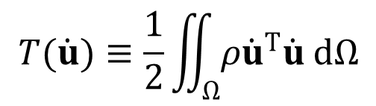


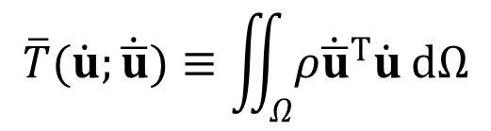
Hamilton’s Principle of Dynamic Systems
Remove time
Hamilton’s principle Variational principle
Kinetic energy
  Requirement of virtual displacements $\overline{u}(x,0)=\overline{u}(x,t_{T})=0$
Integration by parts
$$T(\dot{u})≡\frac{1}{2}\iint_{Ω}{ρ{\dot{u}}^{T}\dot{u} dΩ}$$
Variation
$$\overline{T}(\dot{u};\dot{\overline{u}})≡\iint_{Ω}{ρ{\dot{\overline{u}}}^{T}\dot{u} dΩ}$$
$$\begin{aligned}\int_{0}^{t_{T}}{\overline{T}(\dot{u};\dot{\overline{u}}) dt}=\int_{0}^{t_{T}}{\left(\iint_{Ω}{ρ{\dot{\overline{u}}}^{T}\dot{u} dΩ}\right)dt} \\ =\iint_{Ω}{ρ {\left.({\overline{u}}^{T}\dot{u})\right|}_{0}^{t_{T}} dΩ}−\int_{0}^{t_{T}}{\left(\iint_{Ω}{ρ{\overline{u}}^{T}\ddot{u} dΩ}\right)dt} \\ =−\int_{0}^{t_{T}}{\left(\iint_{Ω}{ρ{\overline{u}}^{T}\ddot{u} dΩ}\right)dt} \\ ≡−\int_{0}^{t_{T}}{d\left(\ddot{u},\overline{u}\right) dt} \end{aligned}$$
Kinetic energy form

Slide 7

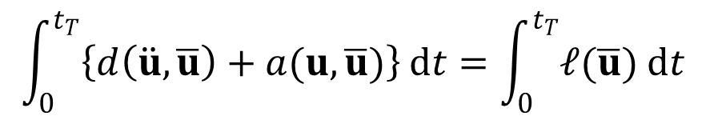
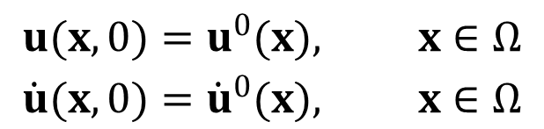
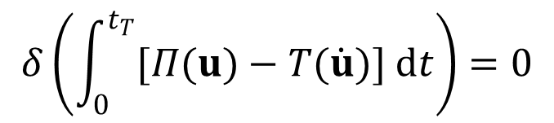
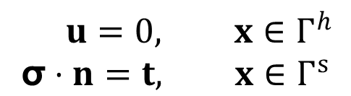

Hamilton’s Principle cont.
Hamilton’s principle: stationary condition
The same Hamilton’s principle can be obtained from the principle of virtual work
$$δ\left(\int_{0}^{t_{T}}{[Π(u)−T(\dot{u})] dt}\right)=0$$
$$\int_{0}^{t_{T}}{\left\{d\left(\ddot{u},\overline{u}\right)+a(u,\overline{u})\right\} dt}=\int_{0}^{t_{T}}{𝓁(\overline{u}) dt}$$
$$∀\overline{u}∈ℤ$$
$$ρ\ddot{u}+C\dot{u}+A\left(u\right)=f^{b}(x,t), x∈Ω$$
Differential operator
$$\begin{matrix} u=0, x∈Γ^{h} \\ \text{σ}⋅n=t, x∈Γ^{s}\end{matrix}$$
$$A\left(u\right)=−∇∙σ(u)$$
$$\begin{aligned}u(x,0)=u^{0}(x), x∈Ω \\ \dot{u}(x,0)={\dot{u}}^{0}(x), x∈Ω\end{aligned}$$

Slide 8
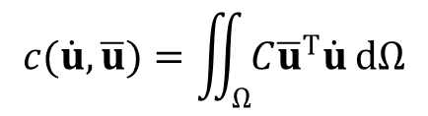

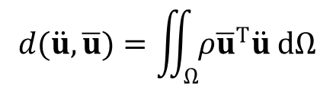

Hamilton’s Principle cont.
$×\overline{u}$ and integrating over both space and time
  Integrating-by-parts for ${\overline{u}}^{T}A(u)$
  Space integration: finite elements
  Time integration: numerical time integration $[0,t_{1},t_{2},⋯,t_{n},⋯,t_{T}]$
  Then, weak form needs to satisfy at discrete time
$$\int_{0}^{t_{T}}{\iint_{Ω}{[ρ{\overline{u}}^{T}\ddot{u}+C {\overline{u}}^{T}\dot{u}] dΩ}dt}+\int_{0}^{t_{T}}{\iint_{Ω}{{\overline{u}}^{T}A(u) dΩ}dt}=\int_{0}^{t_{T}}{\iint_{Ω}{{\overline{u}}^{T}f^{b} dΩ}dt}$$
$$\int_{0}^{t_{T}}{\left\{\iint_{Ω}{[ρ{\overline{u}}^{T}\ddot{u}+C {\overline{u}}^{T}\dot{u}] dΩ}+a(u,\overline{u})\right\}dt}=\int_{0}^{t_{T}}{\left\{\iint_{Ω}{{\overline{u}}^{T}f dΩ}+\int_{Γ^{s}}{{\overline{u}}^{T}t \text{d}Γ}\right\}dt}$$
$$d\left(\ddot{u},\overline{u}\right)+c(\dot{u},\overline{u})+a(u,\overline{u})=𝓁(\overline{u}), ∀\overline{u}∈ℤ$$
$$d(\ddot{u},\overline{u})=\iint_{Ω}{ρ{\overline{u}}^{T}\ddot{u} dΩ}$$
$$c(\dot{u},\overline{u})=\iint_{Ω}{C{\overline{u}}^{T}\dot{u} dΩ}$$

Slide 9
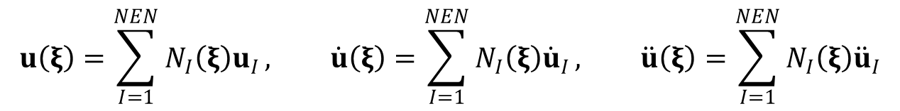




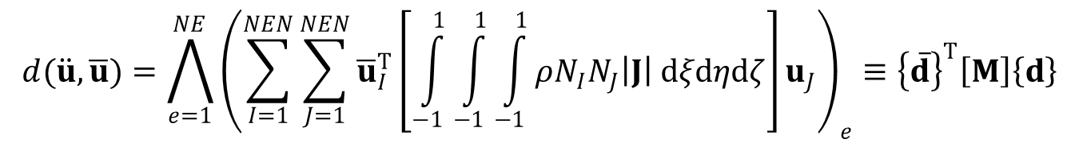
Finite Element Formulation
Interpolation
Assembly: $a\left(u,\overline{u}\right)≈{\{\overline{d}\}}^{T}[K]\{d\}$ and $𝓁(\overline{u})≈{\{\overline{d}\}}^{T}\{F\}$
Rayleigh damping matrix
Finite element equation of Hamilton’s principle
$$u\left(ξ\right)=\sum_{I=1}^{NEN}{N_{I}\left(ξ\right)u_{I}}, \dot{u}\left(ξ\right)=\sum_{I=1}^{NEN}{N_{I}\left(ξ\right){\dot{u}}_{I}}, \ddot{u}\left(ξ\right)=\sum_{I=1}^{NEN}{N_{I}\left(ξ\right){\ddot{u}}_{I}}$$
$$d(\ddot{u},\overline{u})=\bigwedge_{e=1}^{NE}{{\left(\sum_{I=1}^{NEN}{\sum_{J=1}^{NEN}{{\overline{u}}_{I}^{T}\left[\int_{−1}^{1}{\int_{−1}^{1}{\int_{−1}^{1}{ρN_{I}N_{J}\left|J\right| dξdηdζ}}}\right]u_{J}}}\right)}_{e}}≡{\left\{\overline{d}\right\}}^{T}\left[M\right]\left\{d\right\}$$
Mass matrix
$$\left[C\right]=c_{1}\left[M\right]+c_{2}[K]$$
Initial conditions
$$M\ddot{d}\left(t\right)+C\dot{d}\left(t\right)+Kd\left(t\right)=F(t)$$
$$\begin{matrix}d\left(t=0\right)=d_{0} \\ \dot{d}\left(t=0\right)={\dot{d}}_{0}\end{matrix}$$

Slide 10
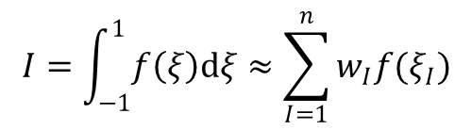
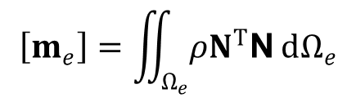
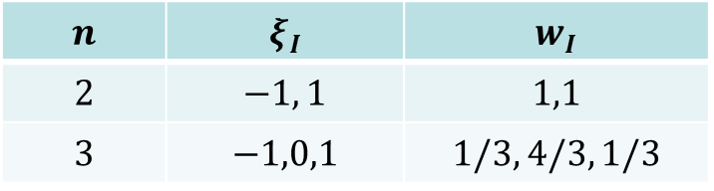
Consistent Mass vs. Lumped Mass
Consistent mass matrix – Integrate FE shape functions
  Computationally expensive for time integration (need inverse matrix)
Lumped mass matrix – Make diagonal mass matrix
Lobatto quadrature rule
  extension of Gauss quadrature to locate the integration points at nodes
  2-point for linear element (trapezoidal integration rule)
  3-point for quadratic element (Simpson’s integration rule)
$$\left[m_{e}\right]=\iint_{Ω_{e}}{ρN^{T}\text{N} dΩ_{e}}$$
$$I=\int_{−1}^{1}{f\left(ξ\right)dξ}≈\sum_{I=1}^{n}{w_{I}f(ξ_{I})}$$
$$n$$ | $$ξ_{I}$$ | $$w_{I}$$
$$2$$ | $$−1, 1$$ | $$1,1$$
$$3$$ | $$−1,0,1$$ | $$1/3, 4/3, 1/3$$

Slide 11
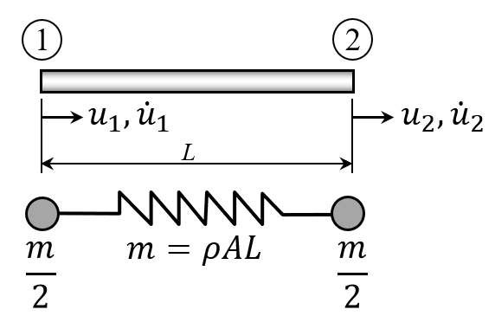


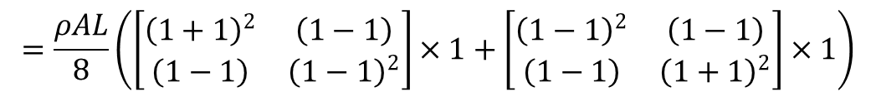
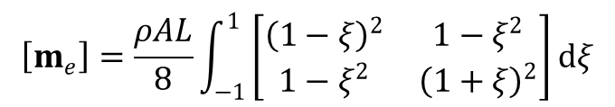
Ex) Consistent Mass vs. Lumped Mass
Consistent mass
  $N_{1}\left(ξ\right)=(1−ξ)/2$, $N_{2}\left(ξ\right)=(1+ξ)/2$
Lumped mass
$$\left[m_{e}\right]=ρA\int_{x_{1}}^{x_{2}}{N^{T}N}dx=\frac{ρAL}{2}\int_{−1}^{1}{N^{T}\text{N}}dξ=\frac{ρAL}{8}\int_{−1}^{1}{\left[\begin{matrix}{\left(1−ξ\right)}^{2} & 1−ξ^{2} \\ 1−ξ^{2} & {\left(1+ξ\right)}^{2}\end{matrix}\right]}dξ=\frac{ρAL}{6}\left[\begin{matrix}2 & 1 \\ 1 & 2\end{matrix}\right]$$
$$\left[m_{e}\right]=\frac{ρAL}{8}\int_{−1}^{1}{\left[\begin{matrix}{\left(1−ξ\right)}^{2} & 1−ξ^{2} \\ 1−ξ^{2} & {\left(1+ξ\right)}^{2}\end{matrix}\right]}dξ$$
$$=\frac{ρAL}{8}\left(\left[\begin{matrix}{\left(1+1\right)}^{2} & \left(1−1\right) \\ \left(1−1\right) & {\left(1−1\right)}^{2}\end{matrix}\right]×1+\left[\begin{matrix}{\left(1−1\right)}^{2} & \left(1−1\right) \\ \left(1−1\right) & {\left(1+1\right)}^{2}\end{matrix}\right]×1\right)$$
$$=\frac{ρAL}{2}\left[\begin{matrix}1 & 0 \\ 0 & 1\end{matrix}\right]$$

Slide 12
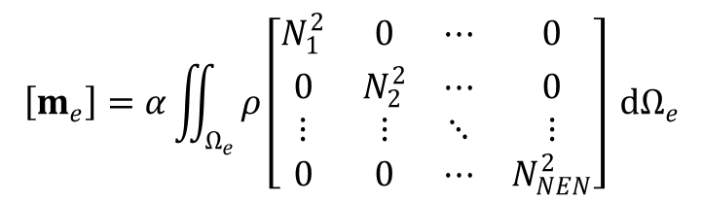
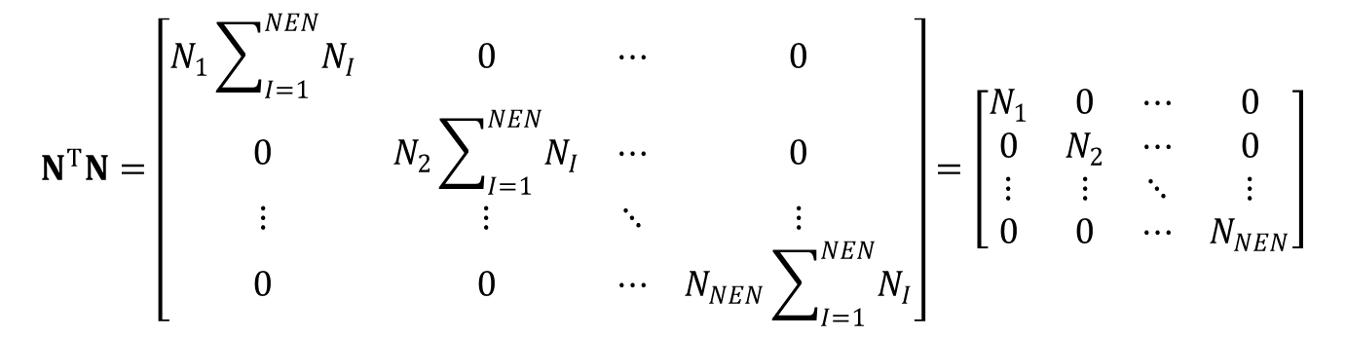

Lumped Mass Matrix
Row-sum mass matrix
  Diagonal term = sum of the row of the consistent mass matrix
Hinton’s method: keep positive definiteness
$$N^{T}N=\left[\begin{matrix}N_{1}\sum_{I=1}^{NEN}{N_{I}} & 0 & ⋯ & 0 \\ 0 & N_{2}\sum_{I=1}^{NEN}{N_{I}} & ⋯ & 0 \\ ⋮ & ⋮ & ⋱ & ⋮ \\ 0 & 0 & ⋯ & N_{NEN}\sum_{I=1}^{NEN}{N_{I}}\end{matrix}\right]=\left[\begin{matrix}N_{1} & 0 & ⋯ & 0 \\ 0 & N_{2} & ⋯ & 0 \\ ⋮ & ⋮ & ⋱ & ⋮ \\ 0 & 0 & ⋯ & N_{NEN}\end{matrix}\right]$$
$$\left[m_{e}\right]=α\iint_{Ω_{e}}{ρ\left[\begin{matrix}N_{1}^{2} & 0 & ⋯ & 0 \\ 0 & N_{2}^{2} & ⋯ & 0 \\ ⋮ & ⋮ & ⋱ & ⋮ \\ 0 & 0 & ⋯ & N_{NEN}^{2}\end{matrix}\right] dΩ_{e}}$$
$$α=\frac{\iint_{Ω_{e}}{ρ dΩ_{e}}}{\sum_{I=1}^{NEN}{\iint_{Ω_{e}}{ρN_{I}^{2} dΩ_{e}}}}$$

Slide 13
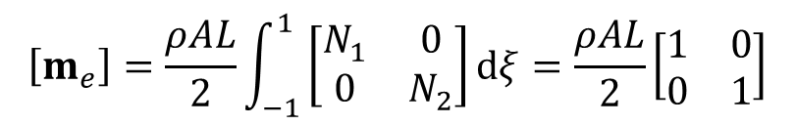
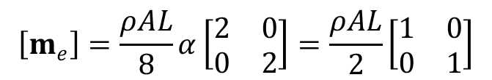

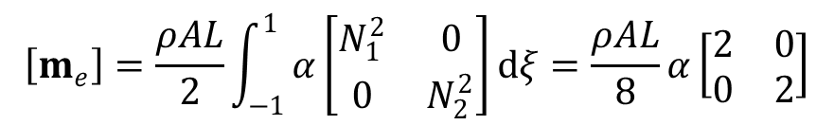
Ex) Consistent Mass vs. Lumped Mass
Row-sum
Hinton’s method
$$\left[m_{e}\right]=\frac{ρAL}{2}\int_{−1}^{1}{\left[\begin{matrix}N_{1} & 0 \\ 0 & N_{2}\end{matrix}\right]}dξ=\frac{ρAL}{2}\left[\begin{matrix}1 & 0 \\ 0 & 1\end{matrix}\right]$$
$$\left[m_{e}\right]=\frac{ρAL}{2}\int_{−1}^{1}{α\left[\begin{matrix}N_{1}^{2} & 0 \\ 0 & N_{2}^{2}\end{matrix}\right]}dξ=\frac{ρAL}{8}α\left[\begin{matrix}2 & 0 \\ 0 & 2\end{matrix}\right]$$
$$α=\frac{ρAL}{\left(\frac{1}{4}+\frac{1}{4}\right)ρAL}=2$$
$$\left[m_{e}\right]=\frac{ρAL}{8}α\left[\begin{matrix}2 & 0 \\ 0 & 2\end{matrix}\right]=\frac{ρAL}{2}\left[\begin{matrix}1 & 0 \\ 0 & 1\end{matrix}\right]$$

Slide 14
Numerical Time Integration of Linear Systems
6.3

Slide 15

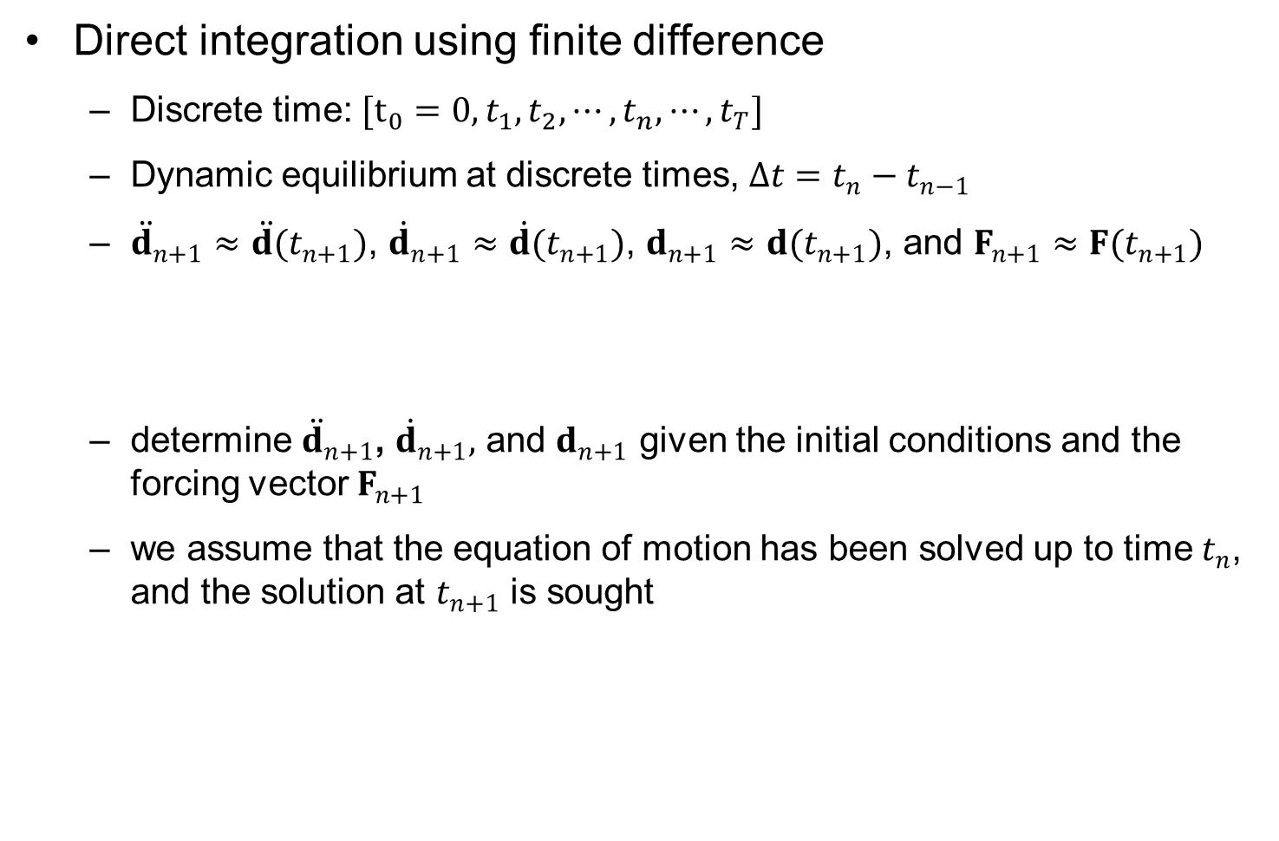
Numerical Time Integration
Direct integration using finite difference
  Discrete time: $[t_{0}=0,t_{1},t_{2},⋯,t_{n},⋯,t_{T}]$
  Dynamic equilibrium at discrete times, $Δt=t_{n}−t_{n−1}$
  ${\ddot{d}}_{n+1}≈\ddot{d}(t_{n+1})$, ${\dot{d}}_{n+1}≈\dot{d}(t_{n+1})$, $d_{n+1}≈d(t_{n+1})$, and $F_{n+1}≈F(t_{n+1})$
  determine ${\ddot{d}}_{n+1}$, ${\dot{d}}_{n+1},$ and $d_{n+1}$ given the initial conditions and the forcing vector $F_{n+1}$
  we assume that the equation of motion has been solved up to time $t_{n}$, and the solution at $t_{n+1}$ is sought
$$M{\ddot{d}}_{n+1}+C{\dot{d}}_{n+1}+Kd_{n+1}=F_{n+1}$$

Slide 16

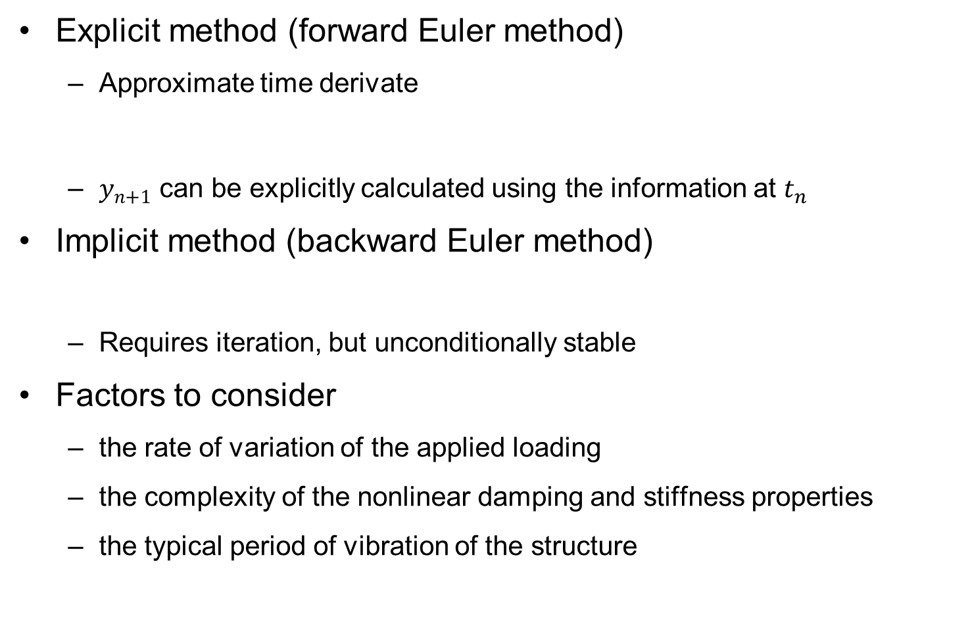

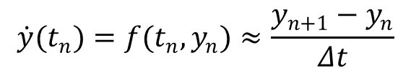

Implicit versus Explicit Methods
Explicit method (forward Euler method)
  Approximate time derivate
  $y_{n+1}$ can be explicitly calculated using the information at $t_{n}$
Implicit method (backward Euler method)
  Requires iteration, but unconditionally stable
Factors to consider
  the rate of variation of the applied loading
  the complexity of the nonlinear damping and stiffness properties
  the typical period of vibration of the structure
$$\dot{y}(t_{n})=f(t_{n},y_{n})≈\frac{y_{n+1}−y_{n}}{Δt}$$
$$\dot{y}=f(t,y(t)), y(t_{0})=y_{0}$$
$$y_{n+1}=y_{n}+Δt⋅f(t_{n},y_{n})$$
$$y_{n+1}=y_{n}+Δt⋅f(t_{n+1},y_{n+1})$$

Slide 17
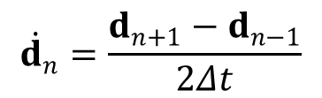
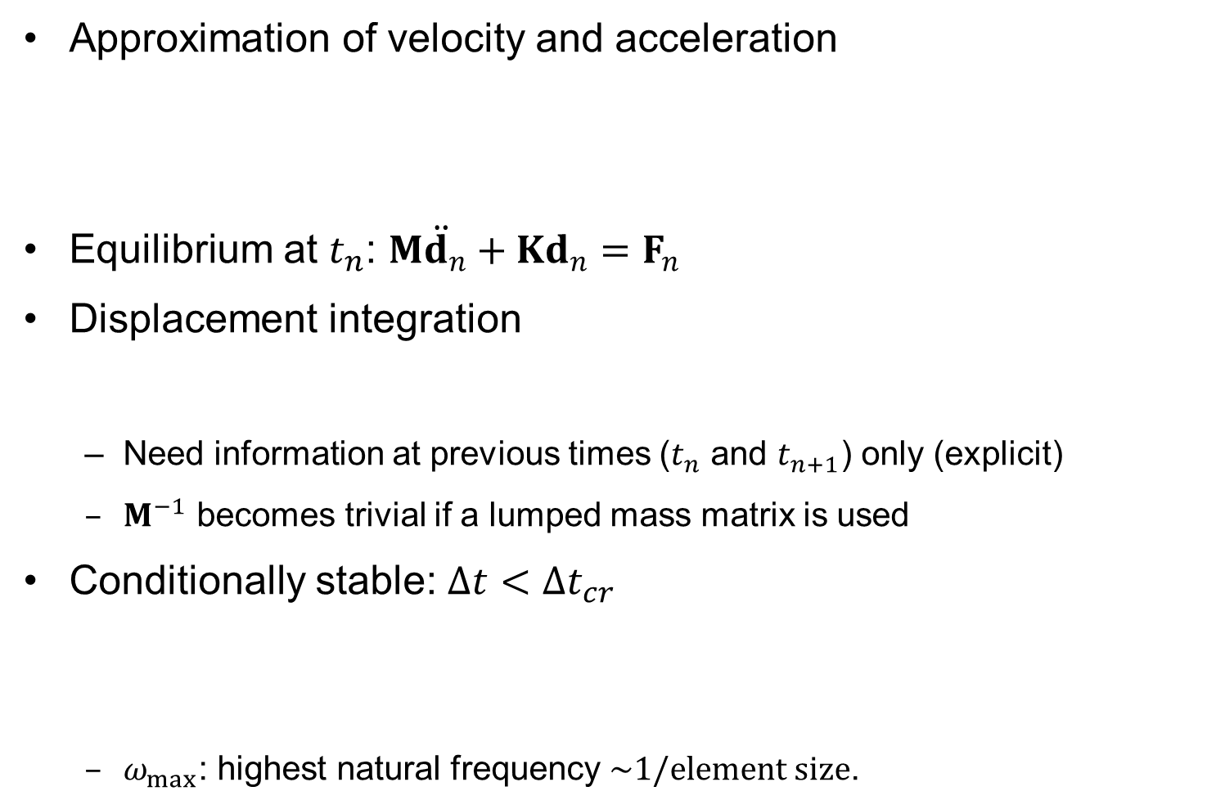
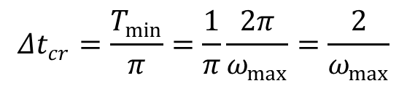
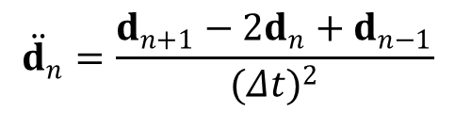
Central Difference Method (Explicit)
Approximation of velocity and acceleration
Equilibrium at $t_{n}$: $M{\ddot{d}}_{n}+Kd_{n}=F_{n}$
Displacement integration
  Need information at previous times ($t_{n}$ and $t_{n+1}$) only (explicit)
  $M^{−1}$ becomes trivial if a lumped mass matrix is used
Conditionally stable: $Δt<Δt_{cr}$
  $ω_{max}$: highest natural frequency $\sim 1/element size$.
$${\dot{d}}_{n}=\frac{d_{n+1}−d_{n−1}}{2Δt}$$
$${\ddot{d}}_{n}=\frac{d_{n+1}−2d_{n}+d_{n−1}}{{(Δt)}^{2}}$$
$$d_{n+1}=2d_{n}−d_{n−1}+{(Δt)}^{2}M^{−1}\left(F_{n}−Kd_{n}\right)$$
$$Δt_{cr}=\frac{T_{min}}{π}=\frac{1}{π}\frac{2π}{ω_{max}}=\frac{2}{ω_{max}}$$

Slide 18


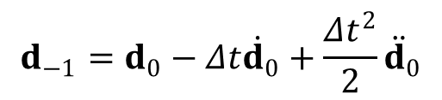
CDM Flowchart
Initial acceleration
Taylor series expansion
Set $i=0$, integrate displacement
Increase $i=i+1$, go to step 3
$${\ddot{d}}_{0}=M^{−1}\left(F_{0}−Kd_{0}\right)$$
$$d_{−1}=d_{0}−Δt{\dot{d}}_{0}+\frac{Δt^{2}}{2}{\ddot{d}}_{0}$$
$$d_{i+1}=2d_{i}−d_{i−1}+{\left(Δt\right)}^{2}M^{−1}\left(F_{i}−Kd_{i}\right)$$

Slide 19
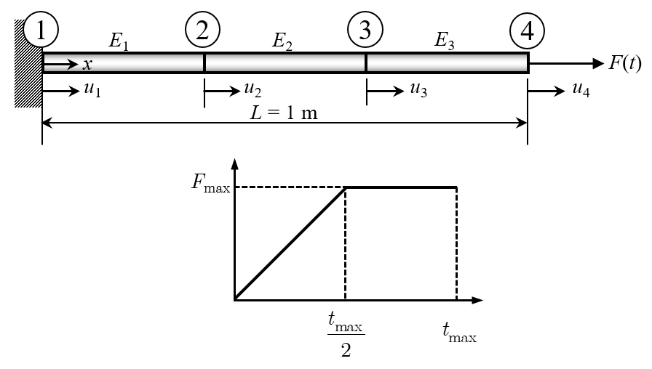
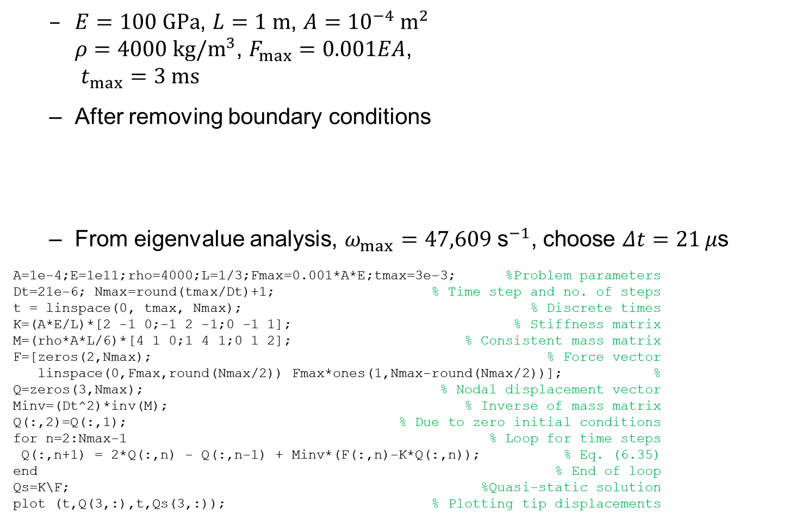
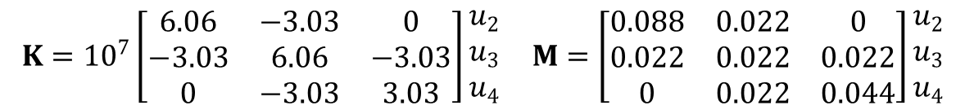
Ex) Dynamic Response of a Uniaxial Bar
  $E=100 GPa$, $L=1 m$, $A={10}^{−4} m^{2}$
  $ρ=4000 kg/m^{3}$, $F_{max}=0.001EA$,
  $t_{max}=3 ms$
  After removing boundary conditions
  From eigenvalue analysis, $ω_{max}=47,609 {\text{s}}^{−1}$, choose $Δt=21 μ\text{s}$
A=1e-4;E=1e11;rho=4000;L=1/3;Fmax=0.001*A*E;tmax=3e-3; %Problem parameters
Dt=21e-6; Nmax=round(tmax/Dt)+1; % Time step and no. of steps
t = linspace(0, tmax, Nmax); % Discrete times
K=(A*E/L)*[2 -1 0;-1 2 -1;0 -1 1]; % Stiffness matrix
M=(rho*A*L/6)*[4 1 0;1 4 1;0 1 2]; % Consistent mass matrix
F=[zeros(2,Nmax); % Force vector
linspace(0,Fmax,round(Nmax/2)) Fmax*ones(1,Nmax-round(Nmax/2))]; %
Q=zeros(3,Nmax); % Nodal displacement vector
Minv=(Dt^2)*inv(M); % Inverse of mass matrix
Q(:,2)=Q(:,1); % Due to zero initial conditions
for n=2:Nmax-1 % Loop for time steps
Q(:,n+1) = 2*Q(:,n) - Q(:,n-1) + Minv*(F(:,n)-K*Q(:,n)); % Eq. (6.35)
end % End of loop
Qs=K\F; %Quasi-static solution
plot (t,Q(3,:),t,Qs(3,:)); % Plotting tip displacements
$$K={10}^{7}\left[\begin{matrix}6.06 & −3.03 & 0 \\ −3.03 & 6.06 & −3.03 \\ 0 & −3.03 & 3.03\end{matrix}\right]\begin{aligned}u_{2} \\ u_{3} \\ u_{4}\end{aligned} M=\left[\begin{matrix}0.088 & 0.022 & 0 \\ 0.022 & 0.022 & 0.022 \\ 0 & 0.022 & 0.044\end{matrix}\right]\begin{aligned}u_{2} \\ u_{3} \\ u_{4}\end{aligned}$$

Slide 20
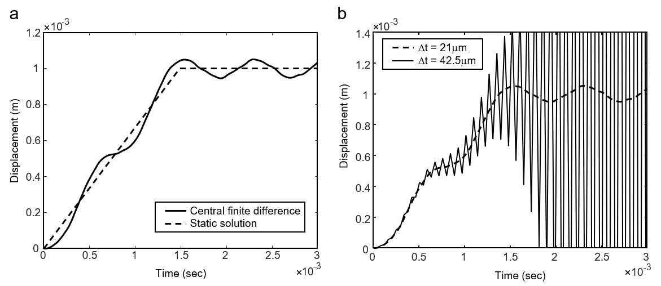

Ex) Dynamic Response of a Uniaxial Bar
Period of vibration: $T=\frac{2π}{ω}=0.791×{10}^{−3}sec$
The solution diverges when $Δt=42.5 μ\text{s}$

Slide 21

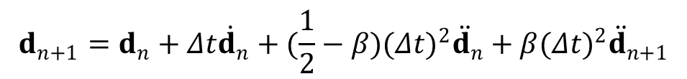



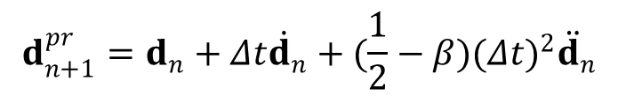

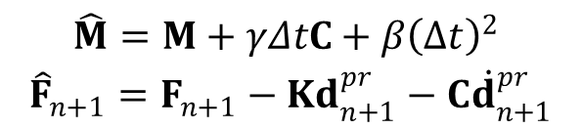
Newmark Method (Implicit)
Velocity and Displacement
Predictor & corrector split
  Predictor (Known variables)
  Solve for acceleration
  Corrector
$${\dot{d}}_{n+1}={\dot{d}}_{n}+(1−γ)Δt{\ddot{d}}_{n}+γΔt{\ddot{d}}_{n+1}$$
$$d_{n+1}=d_{n}+Δt{\dot{d}}_{n}+(\frac{1}{2}−β){(Δt)}^{2}{\ddot{d}}_{n}+β{(Δt)}^{2}{\ddot{d}}_{n+1}$$
$${\dot{d}}_{n+1}^{pr}={\dot{d}}_{n}+(1−γ)Δt{\ddot{d}}_{n}$$
$$d_{n+1}^{pr}=d_{n}+Δt{\dot{d}}_{n}+(\frac{1}{2}−β){(Δt)}^{2}{\ddot{d}}_{n}$$
$$\hat{M}{\ddot{d}}_{n+1}={\hat{F}}_{n+1}$$
$$\begin{aligned}\hat{M}=M+γΔtC+β{\left(Δt\right)}^{2} \\ {\hat{F}}_{n+1}=F_{n+1}−Kd_{n+1}^{pr}−C{\dot{d}}_{n+1}^{pr}\end{aligned}$$
$${\dot{d}}_{n+1}={\dot{d}}_{n+1}^{pr}+γΔt{\ddot{d}}_{n+1}$$
$$d_{n+1}=d_{n+1}^{pr}+β{(Δt)}^{2}{\ddot{d}}_{n+1}$$

Slide 22



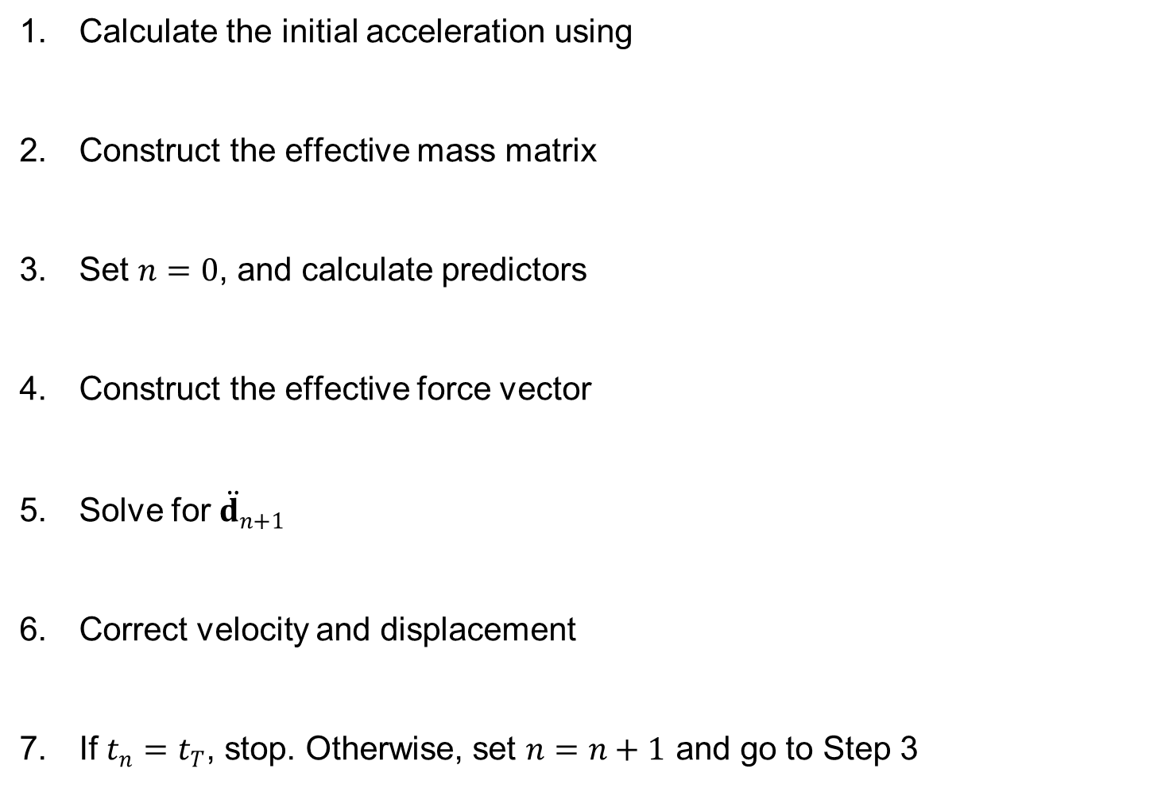
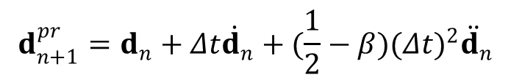




Newmark Method (Implicit) cont.
Calculate the initial acceleration using
Construct the effective mass matrix
Set $n=0$, and calculate predictors
Construct the effective force vector
Solve for ${\ddot{d}}_{n+1}$
Correct velocity and displacement
If $t_{n}=t_{T}$, stop. Otherwise, set $n=n+1$ and go to Step 3
$${\ddot{d}}_{0}=M^{−1}\left(F_{0}−Kd_{0}−C{\dot{d}}_{0}\right)$$
$$\hat{M}=M+γΔtC+β{(Δt)}^{2}K$$
$${\dot{d}}_{n+1}^{pr}={\dot{d}}_{n}+\left(1−γ\right)Δt{\ddot{d}}_{n}$$
$$d_{n+1}^{pr}=d_{n}+Δt{\dot{d}}_{n}+(\frac{1}{2}−β){(Δt)}^{2}{\ddot{d}}_{n}$$
$${\hat{F}}_{n+1}=F_{n+1}−Kd_{n+1}^{pr}−C{\dot{d}}_{n+1}^{pr}$$
$$\hat{M}{\ddot{d}}_{n+1}={\hat{F}}_{n+1}$$
$${\dot{d}}_{n+1}={\dot{d}}_{n+1}^{pr}+γΔt{\ddot{d}}_{n+1}$$
$$d_{n+1}=d_{n+1}^{pr}+β{(Δt)}^{2}{\ddot{d}}_{n+1}$$

Slide 23
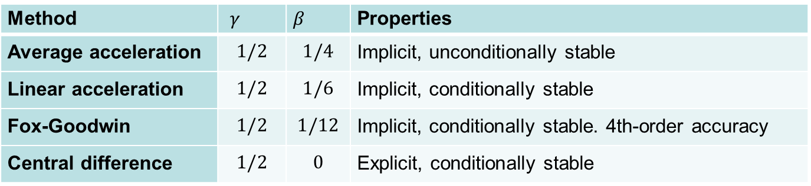





Newmark Method (Implicit) cont.
Newmark parameter $γ$ and $β$: accuracy, stability, and dissipation
Method | $γ$ | $β$ | Properties
Average acceleration | $$1/2$$ | $$1/4$$ | Implicit, unconditionally stable
Linear acceleration | $$1/2$$ | $$1/6$$ | Implicit, conditionally stable
Fox-Goodwin | $$1/2$$ | $$1/12$$ | Implicit, conditionally stable. 4th-order accuracy
Central difference | $$1/2$$ | $$0$$ | Explicit, conditionally stable
$$Unconditionally stable: γ≥\frac{1}{2}, β≥\frac{1}{2}γ$$
$$Conditionally stable: γ≥\frac{1}{2}, β<\frac{1}{2}γ$$
$$ω_{max}Δt_{cr}=\frac{1}{\sqrt{\frac{1}{2}γ−β}}$$
For conditionally stable algorithms,
time step must be $≤Δt_{cr}$

Slide 24

Ex) Dynamic Response of a Uniaxial Bar
Newmark’s method with $Δt=42μ\text{sec}$ and $Δt=75μ\text{sec}$
  $γ=2β=1/2$ for average acceleration method
  $γ=3β=1/2$ for linear acceleration
% Example 6.4 Newmark method
A=1e-4;E=1e11;rho=4000;L=1/3;Fmax=0.001*A*E;tmax=3e-3; %Problem parameters
gamma=0.5;beta=0.25;Dt=42e-6;Nmax=round(tmax/Dt)+1; % Newmark parameters & time
t = linspace(0, tmax, Nmax); % Discrete times
K=(A*E/L)*[2 -1 0;-1 2 -1;0 -1 1]; % Stiffness matrix
M=(rho*A*L/6)*[4 1 0;1 4 1;0 1 2]; % Consistent mass matrix
F=[zeros(2,Nmax); % Force vector
linspace(0,Fmax,round(Nmax/2)) Fmax*ones(1,Nmax-round(Nmax/2))]; %
Minv=inv(M+(beta*Dt^2)*K); % Inverse of effective mass matrix
Q=zeros(3,Nmax);V=zeros(3,Nmax);A=zeros(3,Nmax); % Displ., vel., acc. vectors
for n=1:Nmax-1 % Loop for time steps
Vpr = V(:,n)+(1- gamma)*Dt*A(:,n); % Velocity predictor
Qpr = Q(:,n)+Dt*V(:,n)+(0.5-beta)*Dt^2*A(:,n); % Displacement predictor
A(:,n+1)=Minv*(F(:,n+1)-K*Qpr); % Calculate acceleration
V(:,n+1)=Vpr + gamma*Dt*A(:,n+1); % Velocity corrector
Q(:,n+1)=Qpr + (beta*Dt^2)*A(:,n+1); % Displacement corrector
end % End of time step loop
Qs=K\F; % Static solution
plot (t,Q(3,:),t,Qs(3,:)); % Plotting tip displacements

Slide 25



Ex) Dynamic Response of a Uniaxial Bar cont.
For linear acceleration
$$ω_{max}Δt_{cr}=\frac{1}{\sqrt{\frac{1}{2}γ−β}}=3.464$$
$$Δt_{cr}=\frac{3.464}{ω_{max}}=72.7μsec$$

Slide 26
Dynamic Analysis of Nonlinear Systems
6.4

Slide 27

Nonlinear Dynamics Analysis
Nonlinear dynamics: dynamic analysis of nonlinear systems
Kinetic energy form $d\left(\ddot{u},\overline{u}\right)$ is identical to linear systems
  integration can be carried out at the undeformed configuration
Main difference: solves increments of displacements and accelerations
  the structural form $a(u,\overline{u})$ needs to be linearized so that $a^{∗}(u;Δu,\overline{u})$ is used in Newton-Raphson convergence iteration
  kinetic energy form $d(\ddot{u},\overline{u})$ and damping form $c(\dot{u},\overline{u})$ are already linear and do not need linearization
  $[M]$ and $[C]$ remain constant throughout the analysis
  Instead of $[K]$, tangent stiffness matrix $[K_{T}]$ needs to be used

Slide 28




Newmark Method: Acceleration Form
Dynamic equation at $t_{n+1}$ increment and $k+1$ iteration
Incremental form of Newmark method
  Total displacement $u_{n+1}^{k+1}=u_{n+1}^{k}+Δu^{k+1}$ with $u_{n+1}^{0}=u_{n+1}^{pr}$
Linearized incremental equation of motion
Acceleration form (solve for incremental acceleration)
$$d\left({\ddot{u}}_{n+1}^{k+1},\overline{u}\right)+a(u_{n+1}^{k+1},\overline{u})=𝓁_{n+1}(\overline{u}), ∀\overline{u}∈ℤ$$
$$Δu^{k+1}=β{(Δt)}^{2}Δ{\ddot{u}}^{k+1}$$
$$Δ{\dot{u}}^{k+1}=γΔtΔ{\ddot{u}}^{k+1}$$
$$d\left(Δ{\ddot{u}}^{k+1},\overline{u}\right)+a^{∗}\left(u_{n+1}^{k};Δu^{k+1},\overline{u}\right) =𝓁_{n+1}(\overline{u})−a(u_{n+1}^{k},\overline{u})−d({\ddot{u}}_{n+1}^{k},\overline{u}),∀\overline{u}∈ℤ$$
$$\left[M+β{\left(Δt\right)}^{2}K_{n+1}^{k}\right]Δ{\ddot{d}}^{k+1}=F_{n+1}^{ext}−F^{int}(d_{n+1}^{k})−M{\ddot{d}}_{n+1}^{k}$$
Tangent stiffness

Slide 29





Newmark Method: Displacement Form
Time integration of acceleration
Predictor
Linearized incremental equation of motion
  Update total displacement $d_{n+1}^{k+1}=d_{n+1}^{k}+Δd^{k+1}$ with $d_{n+1}^{0}=d_{n+1}^{pr}$
$${\ddot{d}}_{n+1}={\ddot{d}}_{n+1}^{pr}+\frac{1}{β{\left(Δt\right)}^{2}}d_{n+1}$$
$$Δ{\ddot{d}}^{k+1}=\frac{1}{β{\left(Δt\right)}^{2}}Δd^{k+1}$$
$${\ddot{d}}_{n+1}^{pr}=−\frac{1}{β{\left(Δt\right)}^{2}}\left(d_{n}+Δt{\dot{d}}_{n}+(\frac{1}{2}−β){(Δt)}^{2}{\ddot{d}}_{n}\right)$$
$$\left[\frac{1}{β{\left(Δt\right)}^{2}}M+K_{n+1}^{k}\right]Δd^{k+1}=F_{n+1}^{ext}−F^{int}(d_{n+1}^{k})−M{\ddot{d}}_{n+1}^{k}$$

Slide 30



Explicit Time Integration
$β=0$: very efficient with a diagonal mass matrix
Displacement: $d_{n+1}=d_{n}+Δt{\dot{d}}_{n}+\frac{1}{2}{(Δt)}^{2}{\ddot{d}}_{n}$
Equation of motion: $M{\ddot{d}}_{n+1}=F_{n+1}^{ext}−F^{int}(d_{n+1})$
  Decoupled equation with lumped mass matrix
Velocity update: ${\dot{d}}_{n+1}={\dot{d}}_{n}+(1−γ)Δt{\ddot{d}}_{n}+γΔt{\ddot{d}}_{n+1}$
Intermediate time-step to update velocity
$${\dot{d}}_{n+1/2}={\dot{d}}_{n−1/2}+Δt_{n}{\ddot{d}}_{n}$$
$$d_{n+1}= d_{n}+\frac{1}{2}(Δt_{n}+Δt_{n+1}){\dot{d}}_{n+1/2}$$

Slide 31


FE Implementation of Dynamic Analysis
A single code for static and dynamic analyses
Matrices and vectors for both analyses
  add $[M]$, multiply $β{\left(Δt\right)}^{2}$ to $[K]$, and subtract $M{\ddot{d}}_{n+1}^{k}$
Analysis type | Left-hand side | Solution | Right-hand side
Static analysis | $$\left[K_{n+1}^{k}\right]$$ | $$Δd^{k+1}$$ | $$F_{n+1}^{ext}−F^{int}(d_{n+1}^{k})$$
Dynamic analysis | $$\left[M+β{\left(Δt\right)}^{2}K_{n+1}^{k}\right]$$ | $$Δ{\ddot{d}}^{k+1}$$ | $$F_{n+1}^{ext}−F^{int}(d_{n+1}^{k})−M{\ddot{d}}_{n+1}^{k}$$

Slide 32
MASS2D function
1 function MASS2D(NE,NDOF,XYZ,LE,DYN)
2 %******************************************************************************
3 % MAIN PROGRAM COMPUTING MASS MATRIX AND INERTIAL VECTOR FOR %
4 % 2D PLANE-STRAIN QUADRILATERAL ELEMENTS %
5 %******************************************************************************
6 %% %
7 global ACC FORCE GKF % Global variables
8 XG=[-1/sqrt(3), 1/sqrt(3)]; WGT=[1.0, 1.0]; % Integration points & weights
9 for IE=1:NE % Loop over elements. Assemble K and F
10 ELXY=XYZ(LE(IE,:),:); % Element nodal coordinates
11 IDOF=zeros(1,NDOF*size(LE,2)); % Local to global DOF mapping index
12 for I=1:size(LE,2) % Loop for element nodes
13 IDOF(I*NDOF+[-1 0])=LE(IE,I)*NDOF+[-1 0]; % DOF mapping index
14 end % End of element nodes loop
15 for LX=1:2, for LY=1:2 %LOOP OVER INTEGRATION POINTS
16 E1=XG(LX); E2=XG(LY); % Integration point
17 [SHP,~,DET]=SHAPEL([E1 E2], ELXY); % Det & shape functions
18 FAC=DYN.RHO*WGT(LX)*WGT(LY)*DET; % Integraton weights
19 FORCE(IDOF) = FORCE(IDOF)-FAC*SHP*(SHP'*ACC(IDOF)); % Sbtract Ma term
20 GKF(IDOF,IDOF)=GKF(IDOF,IDOF)+FAC*(SHP*SHP'); % Mass Matrix
21 end, end % End of integration points loop
22 end % End of element loop
23 end %
Refer to the book for detailed explanations

Slide 33

Ex) Dynamic Analysis Using NLFEA
3D version of 1D bar example
1 % Example 6.5 3D uniaxil bar %
2 XYZ=[0 0 0; 0 0.01 0; 0 0.01 0.01; 0 0 0.01; % Nodal coordinates
3 1/3 0 0;1/3 0.01 0;1/3 0.01 0.01;1/3 0 0.01; %
4 2/3 0 0;2/3 0.01 0;2/3 0.01 0.01;2/3 0 0.01; %
5 1 0 0; 1 0.01 0; 1 0.01 0.01; 1 0 0.01]; %
6 LE=[1 2 3 4 5 6 7 8; 5 6 7 8 9 10 11 12;9 10 11 12 13 14 15 16]; % Elements
7 EXTFORCE=[13 1 2500;14 1 2500;15 1 2500;16 1 2500]; % External forces
8 SDISPT=[1 1 0;1 2 0;1 3 0;2 1 0;2 3 0;3 1 0;4 1 0;4 2 0]; % Fixed displacements
9 tmax=3E-3; Dt=42E-6; % Maximum time and time increment
10 TIMS=[0 tmax/2 Dt 0 1; tmax/2 tmax Dt 1 1]'; % Load increments [t0 T Dt f0 fL]
11 MID=0; PROP=[1E11 0.0]; % Elastic material [E NU]
12 PARAM=struct('ITRA',50,'ATOL',1.0E6,'NTOL',6,'TOL',1E-5,'TIMS',TIMS); %
13 DYN=struct('B',0.25,'G',0.5,'RHO',4000,'IV',[]); % Dynamic parameters
14 clc; NOUT=fopen('output.txt','w'); % Open output file
15 NLFEA(PARAM,NOUT,MID,PROP,EXTFORCE,SDISPT,XYZ,LE,[],DYN); % Calling NLFEA
16 fclose(NOUT); % Close output file

Slide 34

Ex) Dynamic Analysis Using NLFEA cont.
Tip displacement time history
Average acceleration method
Linear acceleration method

Slide 35
Summary
Dynamic equations are derived using Hamilton’s principle
Consistent mass and lumped mass are derived
  Lumped mass matrix has computational efficiency when used with an explicit time integration method
Kinetic form can be separated from constitutive models
  Independent treatment of dynamic analysis can be possible
  Inertial term is linear even if constitutive models are nonlinear
Explicit time integration methods are conditionally stable
  Stable time step size is proportional to the smallest element size
Implicit time integration can be formulated either acceleration form or displacement form

