Slide 1
Finite Element Analysis Using Abaqus
Instructor: Nam-Ho Kim (nkim@ufl.edu)

Slide 2
Abaqus Basics
Preprocessing
Abaqus/CAE
Interactive Mode
Input file (text):
Job.inp
Analysis Input file
Simulation
Abaqus/Standard
FEM Solver
Output file:
Job.odb, job.dat
Postprocessing
Abaqus/CAE

Slide 3
Methods of Analysis in ABAQUS
Interactive mode
Create an FE model and analysis using GUI
Advantage: Automatic discretization and no need to remember commands
Disadvantage: No automatic procedures for changing model or parameters
Python script
All GUI user actions will be saved as Python script
Advantage: Users can repeat the same command procedure
Disadvantage: Need to learn Python script language

Slide 4
Methods of Analysis in ABAQUS
Analysis input file
ABAQUS solver reads an analysis input file
Possible to manually create an analysis input file
Advantage: Users can change model directly without GUI
Disadvantage: Users have to discretize model and learn ABAQUS input file grammar

Slide 5
Components in ABAQUS Model
Geometry modeling (define geometry)
Creating nodes and elements (discretization)
Element section properties (area, moment of inertia, etc)
Material data (linear/nonlinear, elastic/plastic, isotropic/orthotropic, etc)
Loads and boundary conditions (nodal force, pressure, gravity, fixed displacement, joint, relation, etc)
Analysis type (linear/nonlinear, static/dynamic, etc)
Output requests

Slide 6
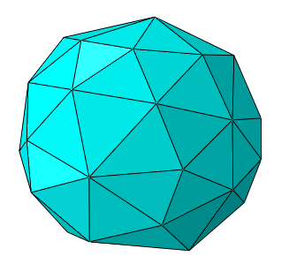
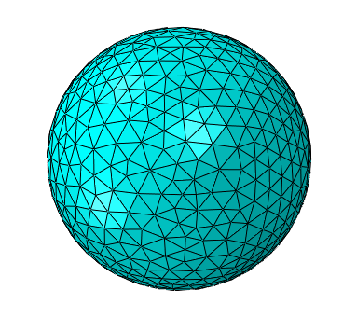
FEM Modeling

Slide 7
FEM Modeling
Pressure
Beam element
Which analysis type?
Which element type?
Section properties
Material properties
Loads and boundary conditions
Output requests
Solid element

Slide 8
FEM Modeling
Line (Beam element)
- Assign section properties (area, moment of inertia)
- Assign material properties
Volume (Solid element)
- Assign section properties
- Assign material properties

Slide 9
FEM Modeling
fixed BC
Line (Beam element)
- Apply distributed load “on the line”
- Apply fixed BC “at the point”
fixed BC
Volume (Solid element)
- Apply distribution load “on the surface”
- Apply fixed BC “on the surface”

Slide 10
FEM Modeling
Line (Beam element)
- Discretized geometry with beam element
- Discretized BC and load on nodes
Volume (Solid element)
- Discretized geometry with solid element
- Discretized BC and load on nodes

Slide 11
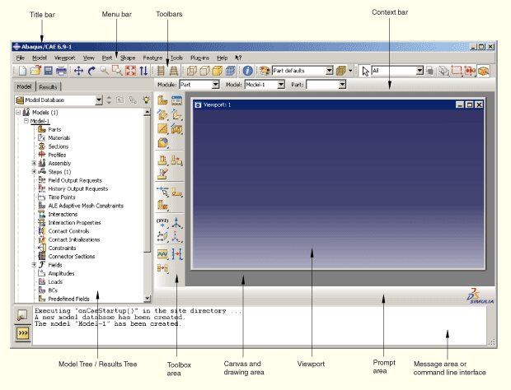
Start Abaqus/CAE
Startup window

Slide 12
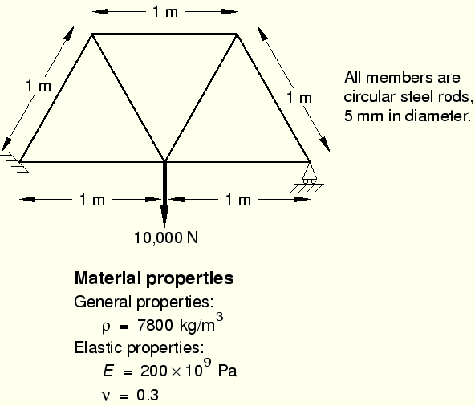
Example: Overhead Hoist

Slide 13
Units
Quantity | SI | SI (mm) | US Unit (ft) | US Unit (inch)
Length | m | mm | ft | in
Force | N | N | lbf | lbf
Mass | kg | tonne (10³ kg) | slug | lbf s²/in
Time | s | s | s | s
Stress | Pa (N/m²) | MPa (N/mm²) | lbf/ft² | psi (lbf/in²)
Energy | J | mJ (10^{–3} J) | ft lbf | in lbf
Density | kg/m³ | tonne/mm³ | slug/ft³ | lbf s²/in⁴
Abaqus does not have built-in units
Users must use consistent units

Slide 14
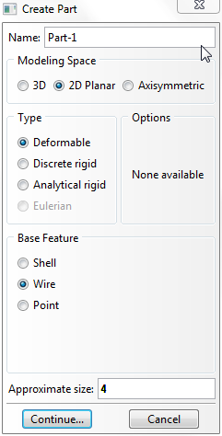
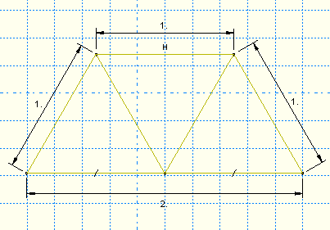
Create Part
Parts
Create 2D Planar, Deformable, Wire, Approx size = 4.0
Provide complete constrains and dimensions
Merge duplicate points

Slide 15
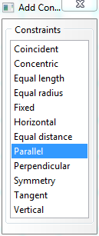
Geometry Constraint
Define exact geometry
Add constraints
Add dimension
Over constraint warning

Slide 16
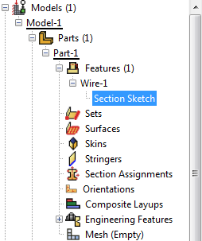
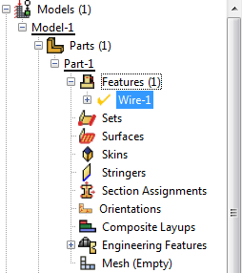
Geometry Modification
Modify geometry modeling
1. Go back to the sketch
2. Update geometry

Slide 17
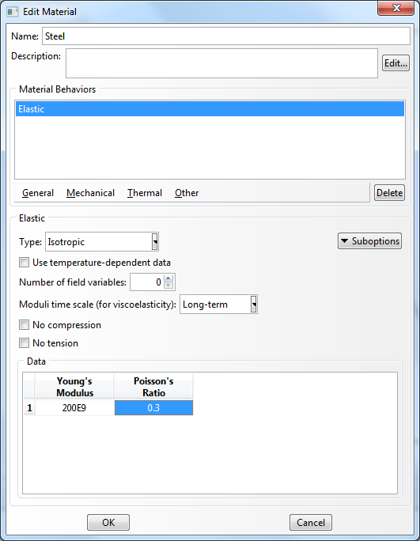
Define Material Properties
Materials
Name: Steel
Mechanical Elasticity Elastic

Slide 18
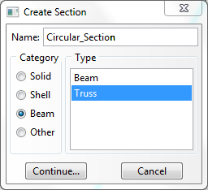
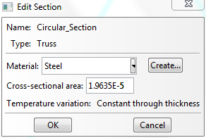
Define Section Properties
Calculate cross-sectional area using CLI (diameter = 5mm)
Sections
Name: Circular_Section
Beam, Truss
Choose material (Steel)
Write area

Slide 19
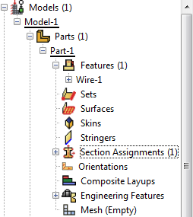
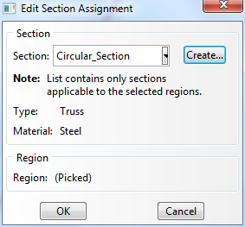
Define Section Properties
Assign the section to the part
Section Assignments
Select all wires
Assign Circular_Section

Slide 20
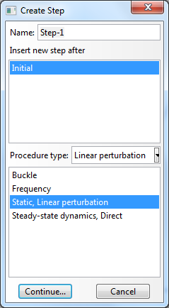
Assembly and Analysis Step
Different parts can be assembled in a model
Single assembly per model
Assembly
Instances: Choose the frame wireframe
Analysis Step
Configuring analysis procedure
Steps
Name: Apply Load
Type: Linear perturbation
Choose Static, Linear perturbation

Slide 21
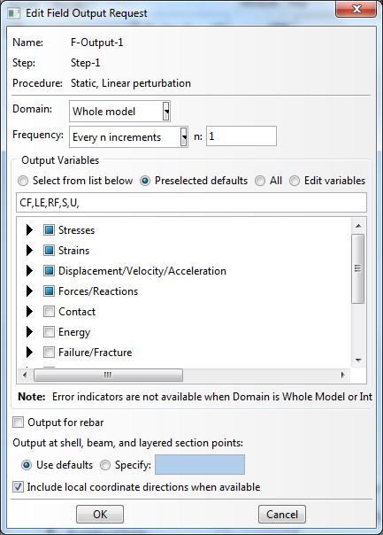
Assembly and Analysis Step
Examine Field Output Request (automatically requested)
User can change the request

Slide 22
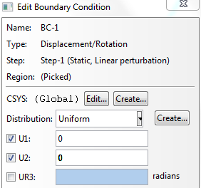
Boundary Conditions
Boundary conditions: Displacements or rotations are known
BCs
Name: Fixed
Step: Initial
Category: Mechanical
Type: Displacement/Rotation
Choose lower-left point
Select U1 and U2
Repeat for lower-right corner
Fix U2 only

Slide 23
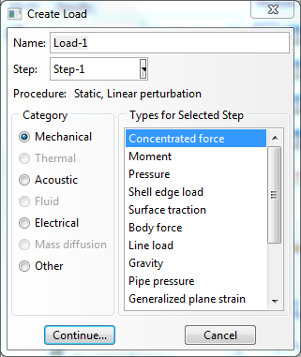
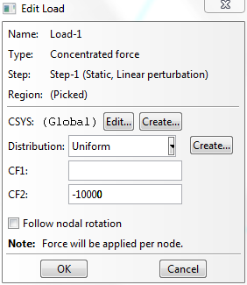
Applied Loads
Loads
Name: Force
Step: Applied Load
Category: Mechanical
Type: Concentrated force
Choose lower-center point
CF2 = -10000.0

Slide 24
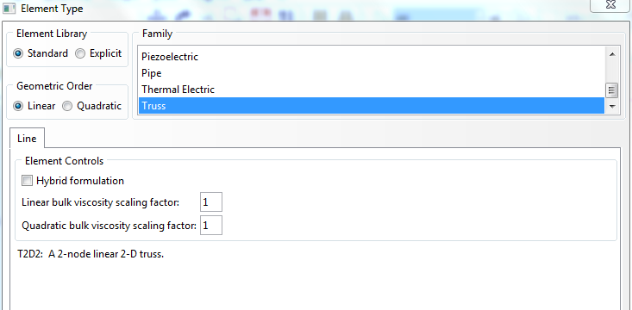
Meshing the Model
Parts
Part-1, Mesh
Menu Mesh, Element Types (side menu )
Select all wireframes
Library: Standard
Order: Linear
Family: Truss
T2D2: 2-node linear 2-D truss

Slide 25
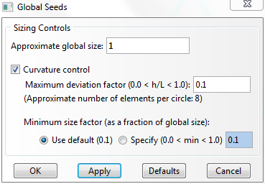
Meshing the Model
Seed a mesh
Control how to mesh (element size, etc)
Menu Seed, Part (side menu )
Global size = 1.0
Menu Mesh, Part, Yes (side menu )
Menu View, Part Display Option
Label on

Slide 26
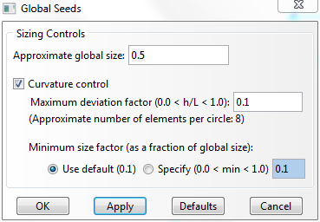
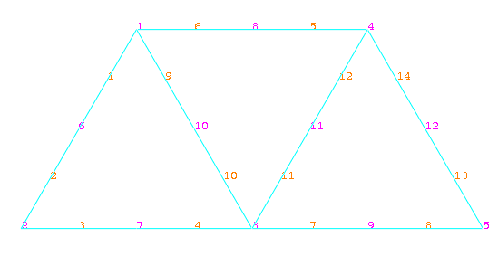
Mesh Modification
Menu Seed, Part (side menu )
Change the seed size (Global size) 1.0 to 0.5
Delete the previous mesh
Menu Mesh, Part, Yes (side menu )

Slide 27
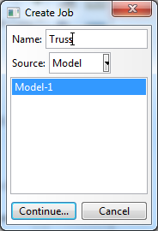
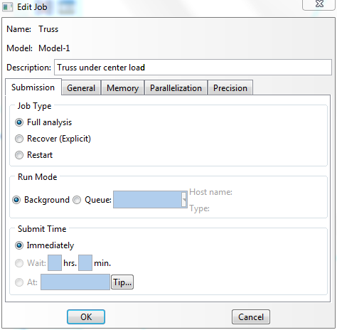
Creating an Analysis Job
Jobs
Jobs, Truss
Data Check
Monitor
Continue (or, submit)

Slide 28
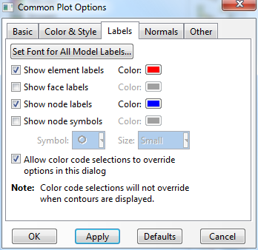
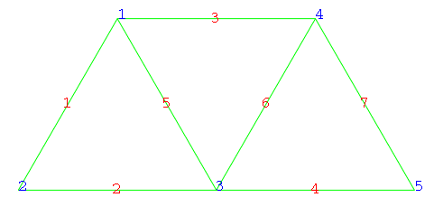
Postprocessing
Change “Model” tab to “Results” tab
Menu File, Open Job.odb file
Common Plot Option (side menu ), click on the Labels tab
(Show element labels, Show node labels)
Set Font for All Model Labels…

Slide 29
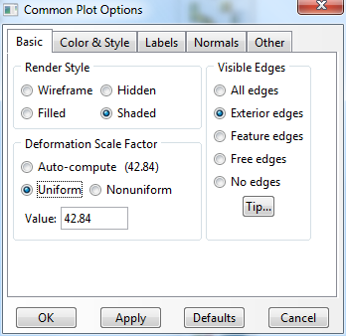
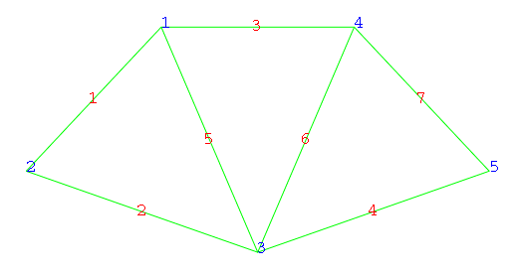
Postprocessing
Deformation scale
Common Plot Option (side menu ), click on the Basic tab, Deformation Scale Factor area

Slide 30
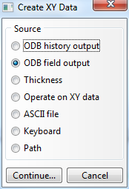
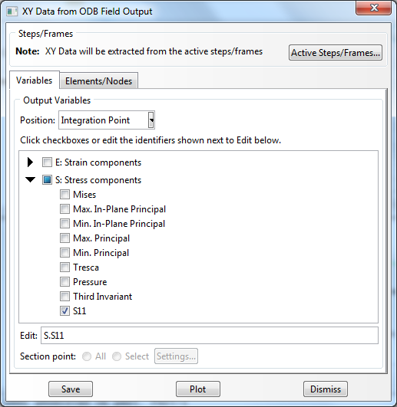
Postprocessing
Tools, XY Data, Manager
Position: Integration Point
Stress components, S11 (Try with displacements and reaction)

Slide 31
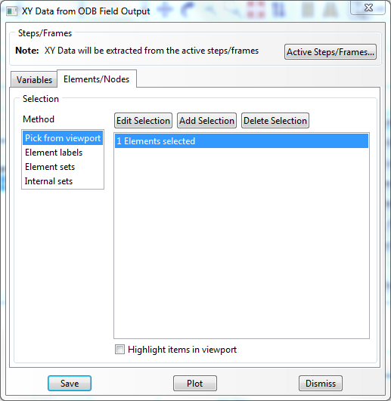
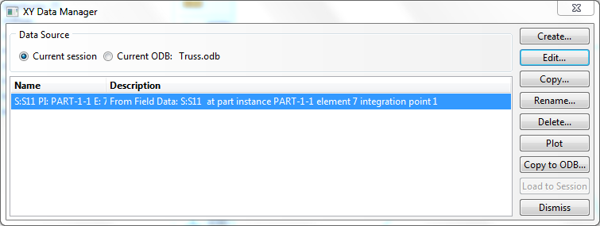
Postprocessing
Click on the Elements/Nodes tab
Select Element/Nodes you want to see result and save
Click Edit… to see the result

Slide 32
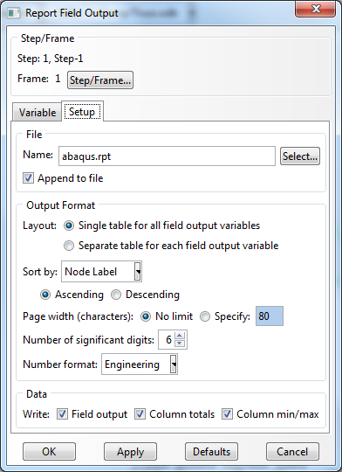
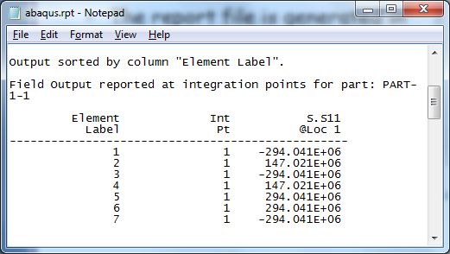
Postprocessing
Report, Field Output
Position: Integration Point
Stress components, S11 (Try with displacements and reaction)
Default report file name is “abaqus.rpt”
The report file is generated in “C:\temp” folder

Slide 33
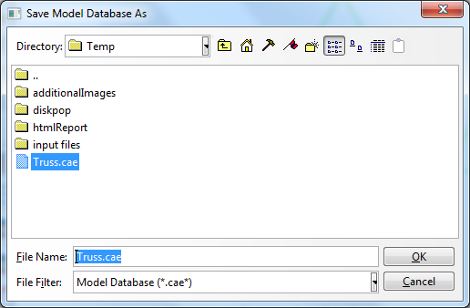
Save
Save job.cae file
Menu, File, Save As…
- job.cae file is saved
- job.jnl file is saved as well (user action history, python code)

