Slide 1
Tutorial 3: Plane Beam

Slide 2
CLAMPED-CLAMPED BEAM
E = 100 MPa,
Circular section with r = 20mm
Plot bending moment and shear force diagrams
y
1 m
1 m
1
2
3
x
q = 30 N/m

Slide 3
CLAMPED-CLAMPED BEAM
Classification of Beam Elements
Dimension (2D / 3D)
Formulation type (Mindlin-2node / Mindlin-3node / Euler)
Additional information (OS (open section) / H (hybrid) / OSH)
B23H
Hybrid formulation
Cubic polynomial
2D

Slide 4
CLAMPED-CLAMPED BEAM
Degree of freedoms for a beam element
2D/3D (2D beam is a special case of the 3D beam)
With translation (from the truss element)
Do not confuse sign convention for displacements and forces
θ₃₂
u₃₂
θ₁₂
u₁₂
θ₃₁
u₂₂
u₃₁
θ₂₂
u₃₂
u₁₂
3D Beam
u₁₁
u₂₁
θ₁₁
θ₂₂
θ₂₁
u₃₁
2D Beam
u₁₁
θ₂₁

Slide 5
CLAMPED-CLAMPED BEAM
Parts
2D Planar, Deformable, Wire, App Size = 4
Create lines: (-1, 0), (1, 0)
Materials
Mechanical, Elasticity, Elastic
Young’s modulus = 100E6, Poisson’s ratio = 0.3
Profiles
Circular, r = 0.02
Sections
Beam
Assign the section “Beam” to the part

Slide 6
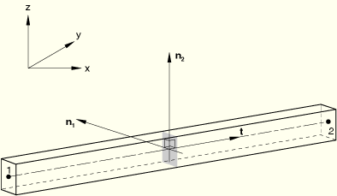
CLAMPED-CLAMPED BEAM
Beam cross section needs orientation (ex. Second moment of inertia)
n1 vector is (0, 0, -1) for plane beam (may not be modified for plane beam)
Tangent direction vector t is dependent to the direction of wire geometry

Slide 7
CLAMPED-CLAMPED BEAM
CASE 1
Direction of wire geometry (t)
Assigned beam orientation
(n1)
V
1 (t)
M
M
V
2 (n2)
CASE 2
Direction of wire geometry (t)
Assigned beam orientation
2 (n2)
V
(n1)
M
M
1 (t)
V

Slide 8
CLAMPED-CLAMPED BEAM
Assembly, Instance
Steps
Linear perturbation, Static
Field output request
Check SF, Section forces and moments
BCs
Initial, Encastre (clamped)
Loads
Mechanical, Pressure (force/length for beam) or Line load (force/length), select upward, Uniform, 30
Mesh
Element type, “Classical beam theory” or Euler beam theory, Cubic polynomial, (B23), Global element size = 0.2

Slide 9
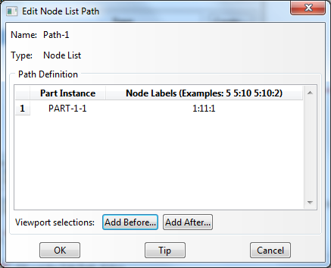
CLAMPED-CLAMPED BEAM
Analysis, Create Job, Data Check, Submit
Results
Deformed plot, Stress plots
Field output, Section points, Top or Bottom
Paths, Node list (first node #, last node #, inc)

Slide 10
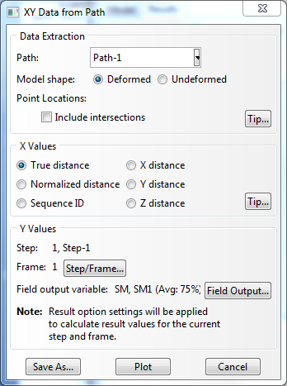
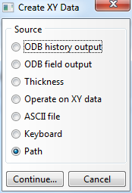
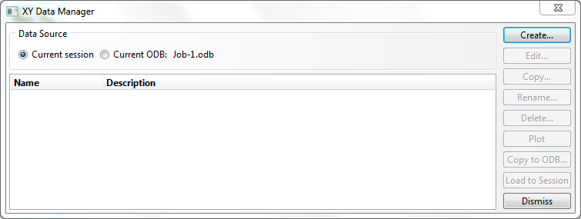
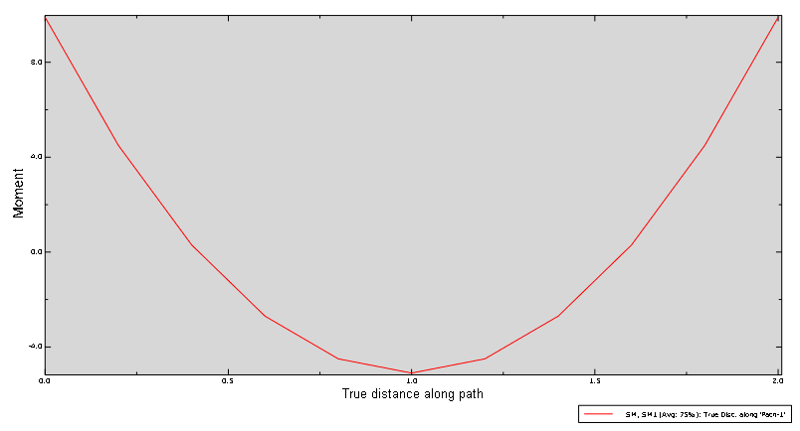
CLAMPED-CLAMPED BEAM
XYData, path, X Values = Sequence ID
Field output, SM1
To adjust font size of the XYData plot
Double click object to open a dialog box to adjust its properties (ex: double click the legend box to enlarge its font size)

Slide 11
CLAMPED-CLAMPED BEAM
Sign Convention for force and moment
Must not be confused with sign convention for displacements
Users must make sure which sign convention is used in a FEA software
Shear force and bending moment sign convention of ABAQUS for beam diagram
y
V
M
x
M
V
y
2 m
1
2
3
x
q = 30 N/m

Slide 12
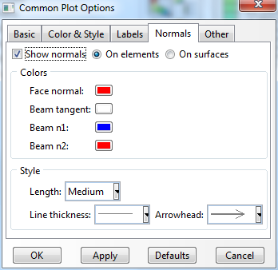
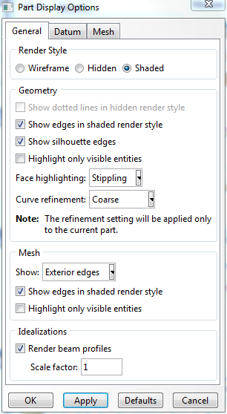
CLAMPED-CLAMPED BEAM
Common Plot Options
Normals, check “Show normals”, “On element”
Module part, View, Part Display Options
check “Render Beam Profile”

Slide 13
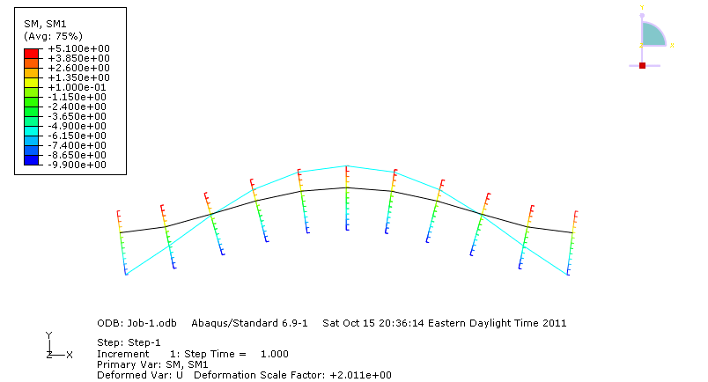
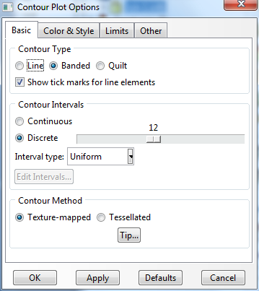
CLAMPED-CLAMPED BEAM
Result
Field output, SM1
Shear force output (SF2) is not available for B23 element
Contour Plot Options
Check “Show tick masks for line elements”

Slide 14
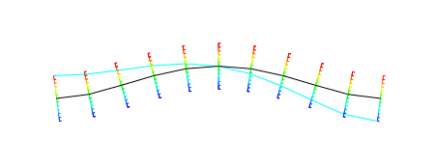
CLAMPED-CLAMPED BEAM
Change element type
Element type, “Timoshenko beam theory” or Mindling beam theory, Shear flexible, (B21), Global element size = 0.2
Field Output
Shear force output (SF2) is available

