Slide 1
Tutorial 4: 2D Plane (CST/Q4)

Slide 2
CANTILEVER BEAM
E = 200 GPa, ν=0.3
Thickness t = 0.01 m
1m
100 kN-m
5m

Slide 3
CANTILEVER BEAM (CST)
Parts
2D Planar, Deformable, Shell, App Size = 10
Create lines (rectangle): (0, 0), (5, 1)
Materials
Mechanical, Elasticity, Elastic
Young’s modulus = 200E9, Poisson’s ratio = 0.3
Sections
Solid, Homogeneous
Set plane stress/strain thickness to 0.01 m
Assign the section to the part

Slide 4
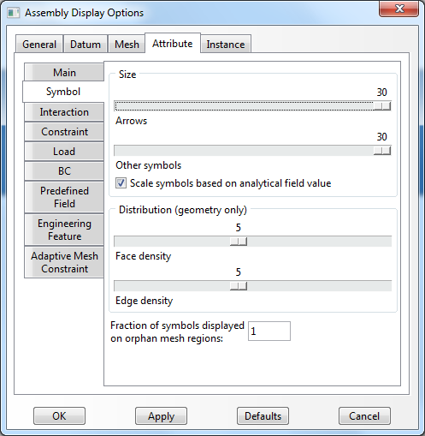
CANTILEVER BEAM (CST)
Assembly, Instance
Steps
Linear perturbation, Static
BCs
Initial, Encastre + Displacement/Rotation, U2
Tip
To change BC symbols: View, Assembly Display Options, Attribute
U2
Encastre

Slide 5
CANTILEVER BEAM (CST)
Loads
Mechanical, Pressure, select upward, Uniform, 30
Mesh
Assign Mesh Controls, Tri (Tri only)
Global element size = 1
Mesh control
Edit Mesh, Element, Swap diagonal
100 kN-m
1m
100 kN-m
1m
100 kN-m

Slide 6

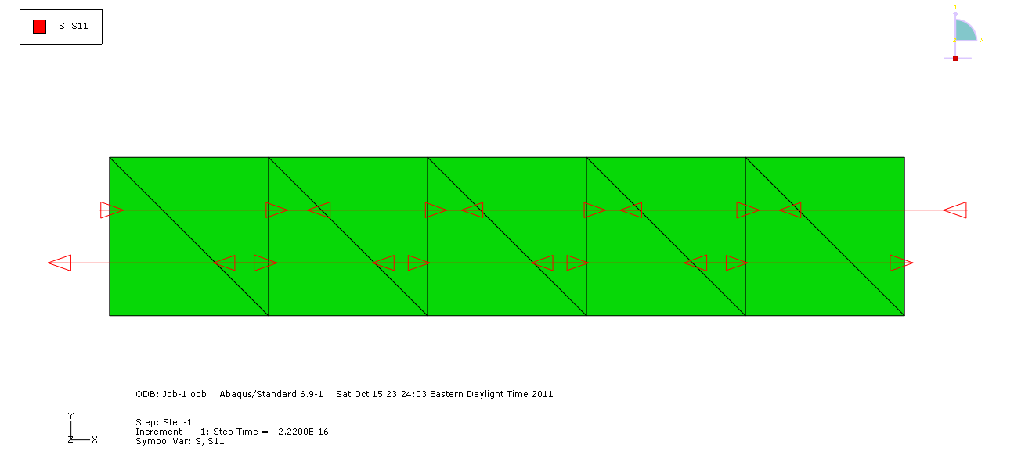
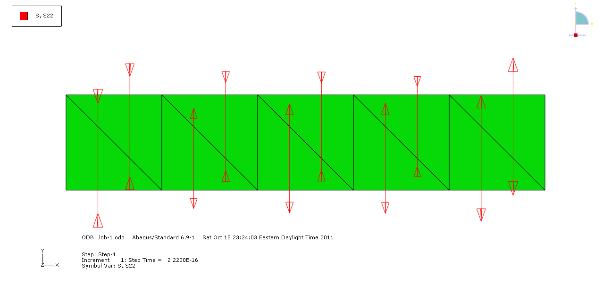
CLAMPED-CLAMPED BEAM (CST)
Analysis, Create Job, Data Check, Submit
Results
Deformed plot, Stress plots
Field output, Mises, S11, S22, S12
Field output, U, U2
Plot symbols
Plot stress direction
Make sure the “Field output tool box”
S11
S22

Slide 7
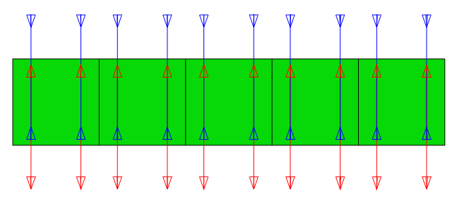
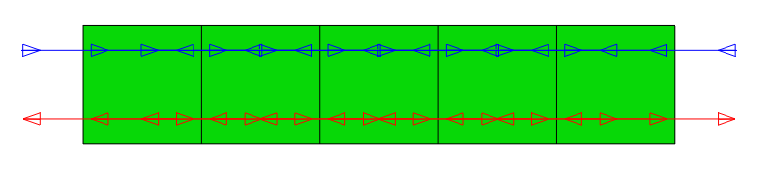
CANTILEVER BEAM (Q4)
The same procedures of Parts to Loads as CST
Mesh
Assign Mesh Controls, Quad (Quad only)
Element Type, Quad tap, uncheck “Reduced integration”
Global element size = 1
Analysis, Create Job, Data Check, Submit
Results
Plot symbols
S11
S22

