Slide 1
Tutorial 5-1: Part Sketch / Geometric Constraints

Slide 2
A BRACKET ANALYSIS
A bracket with a shaft hole
E=210 Gpa, Poison ratio 0.3
Thickness t=0.1 m
R0.1
R0.05
100kN
Fillet
R0.02
150kN
0.15
0.15
0.05
FIXED BC

Slide 3
PART MODULE (SKETCH)
Sketch
Draw outlines of the bottom of the bracket
Tip
Starting and ending point of a circle is recognized as a dividing point
Case 1
Case 2
Delete the bottom half
One geometric object
Delete the bottom half
Two geometric objects

Slide 4
PART MODULE (SKETCH)
Sketch
Menu/Edit/Auto-Trim, delete half of the outer circle
Menu/Add/Fillet, add two fillets, radius of those fillets is 0.02
Fillet center point
Auto trim
Fillet radius = 0.02
Add two fillets

Slide 5
PROPERTY / ASSEMBLY / STEPS MODULES
Materials
Mechanical, Elasticity, Elastic
Young’s modulus = 210E9, Poisson’s ratio = 0.3
Sections
Solid, Homogeneous
Set plane stress/strain thickness to 0.1 m
Assign the section to the part
Assembly, Instance
Steps
Linear perturbation, Static

Slide 6
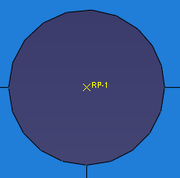
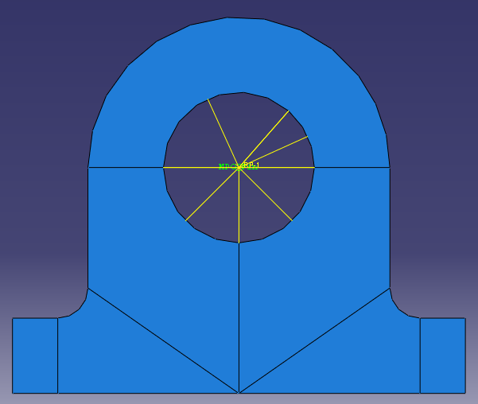
INTERACTION MODULE (MPC)
How to apply loads at the center of shaft hole?
Side tool bar/Create a reference point (RP) at the center of the shaft hole
Menu/Constraint/Create/MPC Constraint MPC (Multiple point constraints)
Select the RP as the MPC control point (master node)
Select the circumference of the hole shaft as the slave nodes
MPC type select as of Beam
Reference Point
Applied Beam type MPCs

Slide 7
MPC Types
Beam type
Provide a rigid beam between the master node and slave nodes
Constraint the “displacement” and “rotation” of the master node to the “displacement” and “rotation” of the slave nodes.
Distant between the master and slave nodes remain the same
Pin type
Constraint equal global displacements between the master node and slave nodes
Constraint the “displacement” of the master node to the “displacement” of the slave nodes.

Slide 8
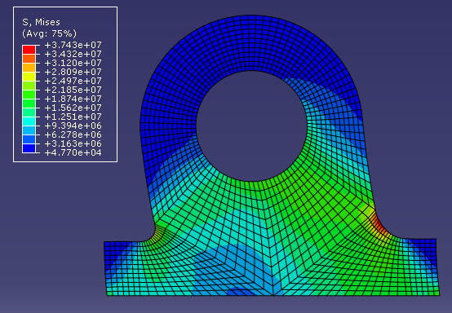
LOADS / JOB / VISUALIZATION MODULES
Loads
Mechanical, Concentrated force, Uniform, CF1 = -200kN CF2 = 150kN
BCs
Step1, ENCASTRE
Analysis, Create Job, Data Check, Submit
Results
Max Von Mises 37 MPa
FIXED BC

Slide 9
A BRACKET DESIGN
A bracket design
Maximum stress is of 50MPa
Find optimum size of the outer radius (R_{out})
0.07 m ≤ R_{out} ≤ 0.1 m
R0.1
R0.05
100kN
Fillet
R0.02
150kN
0.15
0.15
0.05
FIXED BC

Slide 10
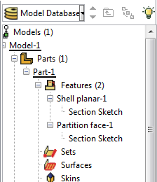
PART MODULE
Modify the current design
Modify part to modify the current design
Model tree / expand “Parts” / expand your part (default name: “Part-1”) / expand “Features” / expand your sketch (default name: “Shell planar”) / double click “Section Sketch”
Menu/Edit/Dimension
Set the outer radius dimension to 0.07 as a trial and error process

Slide 11
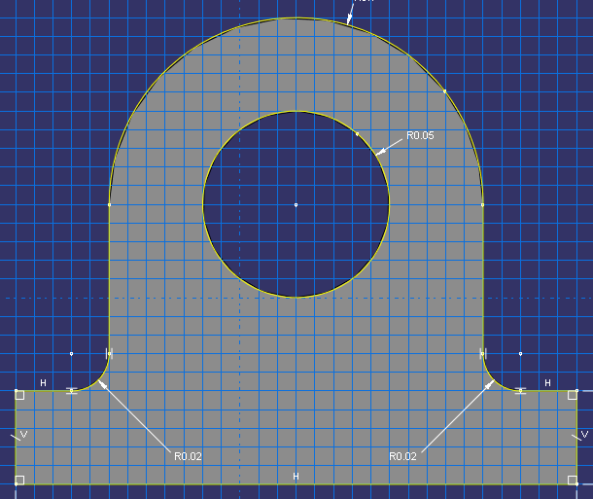
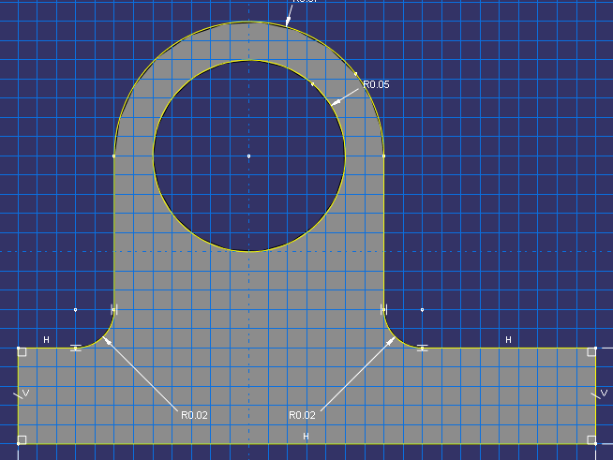
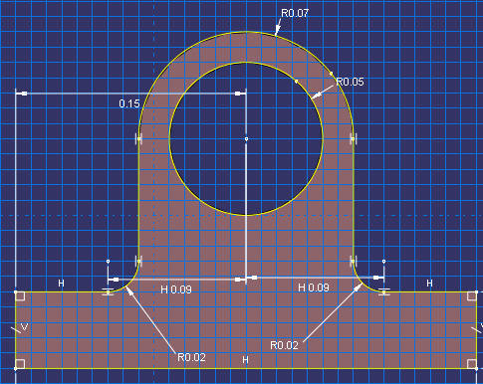
GEOMETRIC CONSTRAINTS
What happens?
Un desirable design perturbation (unsymmetric design)
Proper geometric constraints are needed
Add dimension from the shaft center and the edge at the bottom left to restrict the model remains symmetric as design parameter (the radius of the outer circle) is perturbed.

Slide 12
GEOMETRIC CONSTRAINTS
After design perturbation
Max Von Mises stress increased to 69 Mpa (Violation of the maximum stress constraint)
Repeat the other trials to find optimum design while satisfying the maximum stress constraint

Slide 13
Tutorial 5-2: 2D Plane (basic modeling technique)

Slide 14
PANEL WITH A HOLE
A panel with a hole - E = 200 GPa, ν=0.3 - Thickness t = 0.01 m
2m
R=0.25
50 kPa
50 kPa
5m

Slide 15
PANEL WITH A HOLE
E = 200 GPa, ν=0.3
Thickness t = 0.01 m
2.5m
U1=UR2
=UR3=0
(XSYMM)
1m
50 kPa
R=0.25
U2=UR1=UR3=0 (YSYMM)

Slide 16
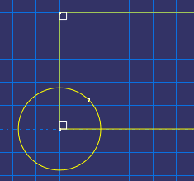
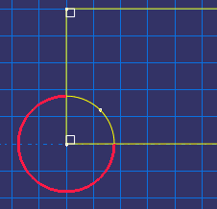
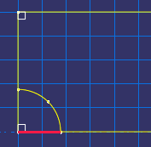
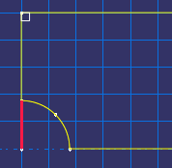
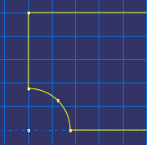
PARTS MODULE
Parts
2D Planar, Deformable, Shell, App Size = 10
Create lines (rectangle): (0, 0), (2.5, 1)
Create circle (center and perimeter): (0, 0), (0.25, 0)
Auto trim
Tip
Even a circle has a starting point and ending point on circumference

Slide 17
PROPERTY / ASSEMBLY / STEPS MODULES
Materials
Mechanical, Elasticity, Elastic
Young’s modulus = 200E9, Poisson’s ratio = 0.3
Sections
Solid, Homogeneous
Set plane stress/strain thickness to 0.01 m
Assign the section to the part
Assembly, Instance
Steps
Linear perturbation, Static

Slide 18
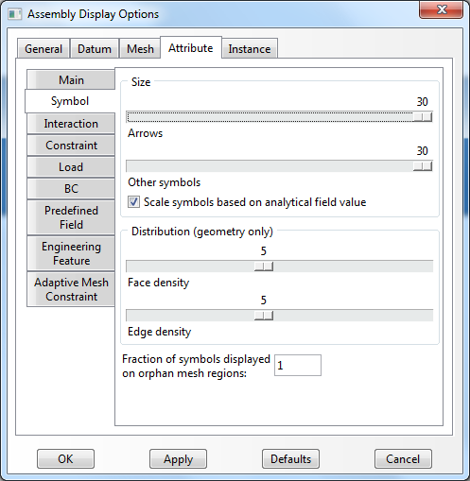
LOADS MODULE
BCs
Step1, Symmetric, XSYMM and YSYMM
Tip
To change BC symbols: View, Assembly Display Options, Attribute
Loads
Mechanical, Pressure, Uniform, -50000 (-50 kPa)
U1=UR2
=UR3=0
(XSYMM)
U2=UR1=UR3=0 (YSYMM)

Slide 19
MESH MODULE (MESHING TECHNIQUE)
Structured mesh
Follows predefined mesh patterns (Rule based meshing)
Predictable mesh shape
Not applicable for every geometry domain (If geometry domain is not affordable for structured mesh, a warning message and reasons will appear)
For 2D/Quad-dominated mesh, the geometry domain better have 4 edges
Free mesh
No predefined mesh patterns
Flexibility
Impossible to predict a free mesh pattern

Slide 20
MESH MODULE (PARTITION FACE)
Mesh
Menu: Tool/Partition/Partition Face/Sketch (sketch mode)
Draw 3 lines
Menu/Edit/Auto-trim, delete the red line
Assign Mesh Controls, Quad (Quad only), Structured
Global seed, size 0.1
0.5m
0.5m
Auto trim

Slide 21
MESH MODULE (SEED MESH)
Seed
Menu: Seed/Edge biased
Select lines, Bias ratio of 3, # of elements along the edge of 5
Tip
When you select the edges, pick near the end where the mesh must be denser (red arrow shows mesh density direction)
Bias ratio: the ratio of size of a starting and ending element
EX) Bias ratio of 3, # of elements along the edge of 3
a
3a

Slide 22
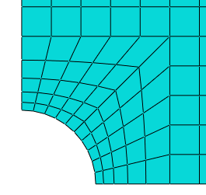
MESH / JOB / VISUALIZATION MODULES
Seed
Menu: Seed/Edge by number
Select lines, # of elements along the edge of 5
Mesh part
Analysis, Create Job, Data Check, Submit
Results
Deformed plot, Stress plots
Field output, Mises

