Slide 1
Tutorial 6-1: 3D Modeling

Slide 2
CANTILEVER BEAM
3D cantilever beam
E=210 Gpa, Poison ratio 0.3
Thickness t = 0.5 m
1m
100 kN-m
5m

Slide 3
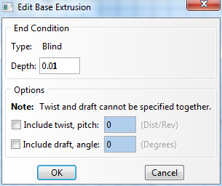
CANTILEVER BEAM
Parts
3D Planar, Deformable, Solid, Extrusion, App Size = 10
Create lines (rectangle): (0, 0), (5, 1)
Depth = 0.01
Materials
Mechanical, Elasticity, Elastic
Young’s modulus = 200E9, Poisson’s ratio = 0.3
Sections
Solid, Homogeneous
Assign the section to the part

Slide 4
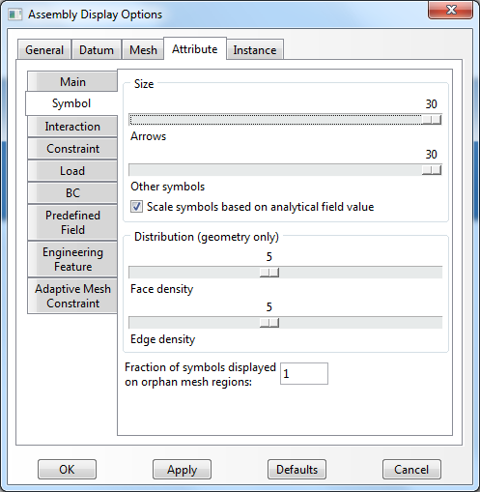
CANTILEVER BEAM
Assembly, Instance
Steps
Linear perturbation, Static
BCs
Initial, Encastre + Displacement/Rotation, U2
U1
Encastre

Slide 5
CANTILEVER BEAM
Loads
Mechanical, Pressure, select upward, Uniform, 30
Mesh
Hexa - structured mesh is default setting as it is possible
Global element size = 1
Cantilever beam with 8-node solid
Max v = 1.872 × 10⁻⁴ (Exact 1.5 × 10⁻⁴)
0.5m
-50 kN-m
1m
100 kN-m
-50 kN-m
1m
50 kN-m
50 kN-m

Slide 6
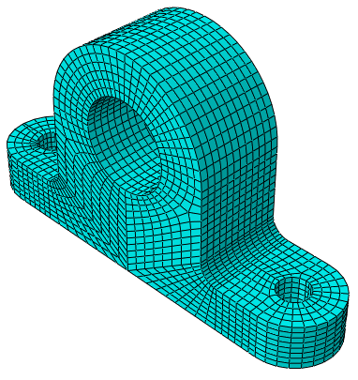
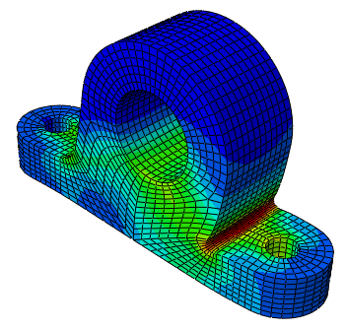
BRACKET ANALYSIS
A bracket with a shaft hole
E=210 Gpa, Poison ratio 0.3
3D geometry modeling
8-node hexa element with structure mesh

Slide 7
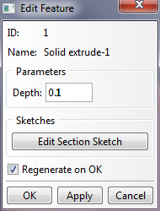
PART MODULE
Parts
Create Part-1
3D, Extrude, Depth 0.1
R0.1
R0.05
Fillet
R0.02
0.15
0.25
0.05

Slide 8
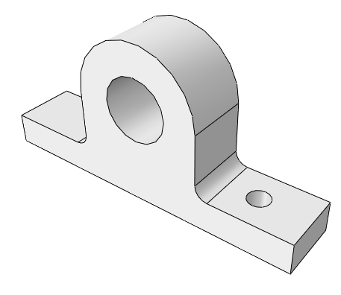
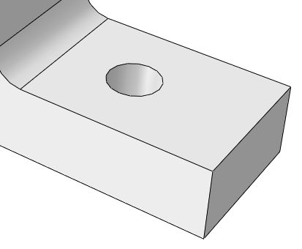
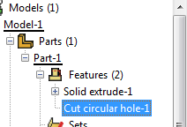
PART MODULE
Parts
Create Cut / Circular Hole
Dist. from Edge1 = 0.05 , Dist. from Edge2 = 0.05, Diameter 0.035
Do it again for the opposite side
Tip
Create a hole then edit those parameters (the cut circular hole is categorized as a feature of a part)
R0.035
0.05
0.05

Slide 9
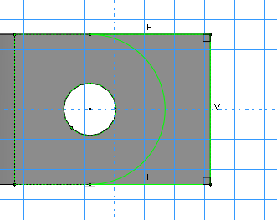
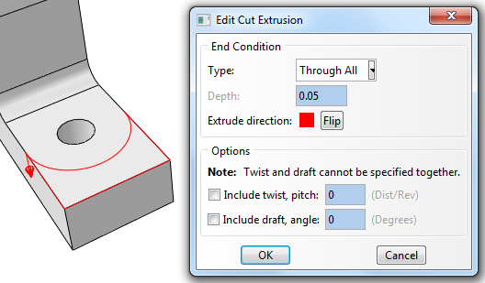
PART MODULE
Parts
Create Cut / Extrude
Select a planar, select an edge
Make a circle and three edges, click “done” button
Do it again for the opposite side

Slide 10
PROPERTY / ASSEMBLY / STEPS MODULES
Materials
Mechanical, Elasticity, Elastic
Young’s modulus = 210E9, Poisson’s ratio = 0.3
Sections
Solid, Homogeneous
Assign the section to the part
Assembly, Instance
Steps
Linear perturbation, Static

Slide 11
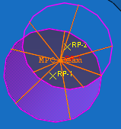
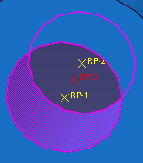
INTERACTION MODULE (MPC)
How to apply loads at the center of shaft hole?
Side tool bar/Create a reference point (RP-3) at the center of the shaft hole (RP-1 and RP-2 are the center of circles) Note: We need only one reference point RP-1 and RP-2 were made to show where they are
Menu/Constraint/Create/MPC Constraint MPC (Multiple point constraints)
Select the RP-3 as the MPC control point (master node)
Select the surface (magenta area) of the hole shaft as the slave nodes
MPC type select as of Beam
Applied Beam type MPCs
Reference Points

Slide 12
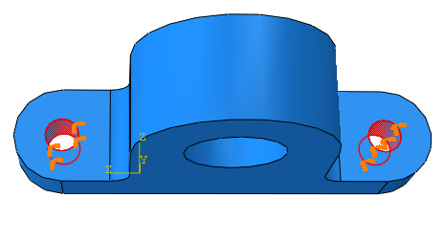
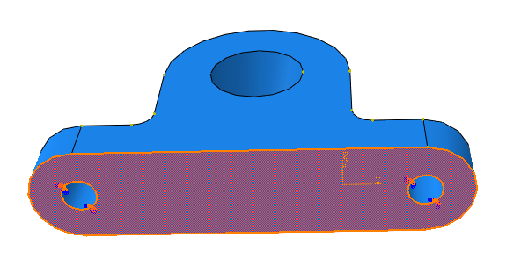
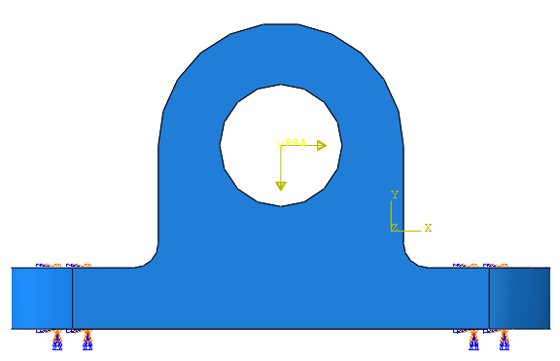
LOADS MODULE
BCs
Step1, ENCASTRE
Step1, Displacement/Rotation, y-dir
Loads
Step1, CF1 = 1000 N, CF2 = -1000 N on the master node of the MPC
1000 N
-1000 N

Slide 13
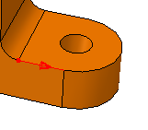
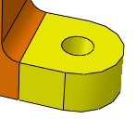
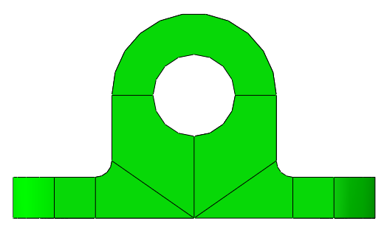
MESH MODULE
Mesh (Partitioning)
Partition Cell
Select Point & Normal, Click “Done”
Tip
A color of a volume indicates the best meshing method
If a color of a volume is dark orange, the volume can not be meshed that partitioning is needed
If the structured mesh is applicable for a volume, the color will be green

Slide 14
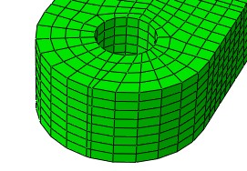
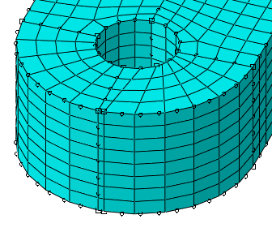
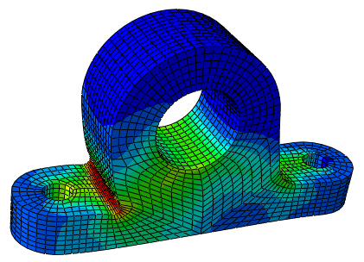
MESH MODULE
Mesh
Hexa - structured mesh is default setting as it is possible
Global element size = 0.08
Tip
Mesh shape can be distorted by geometric modeling: The rectangle represents start/end point of the circle
Analysis, Create Job, Data Check, Submit
Results

Slide 15
Tutorial 6-2: Heat Transfer

Slide 16
HEAT CONDUCTION
Fire in the subway tunnel (Heat Deterioration)
Aluminum alloy
Thermal conductivity Concrete: k=1.7 W/(m·K) Soil: k=1.5 W/(m·K)
Heat flux
250 W/m²
Temperature
5 °C (41 °F)
Concrete
Soil
1m
1m

Slide 17
HEAT CONDUCTION
Parts
Create Part-1
3D, Extrude, Depth 1 m
Materials
Thermal, Conductivity
Concrete: 1.7 W/(m·K), Soil: 1.5 W/(m·K)
Sections
Solid, Homogeneous
Concrete section, Soil section
Assign the section to the part
Assembly, Instance

Slide 18
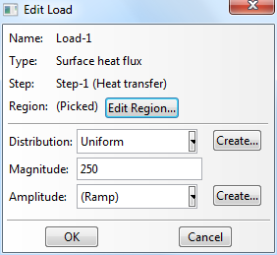
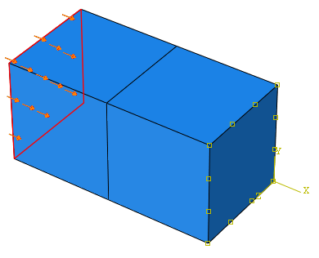
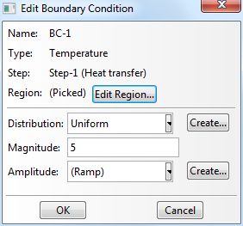
HEAT CONDUCTION
Steps
General, Heat transfer
Loads
Surface heat flux
BCs
Temperature
Heat flux
250 W/m²
Temperature: 5 °C (41 °F)

Slide 19
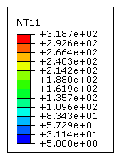
HEAT CONDUCTION
Mesh
Assign Element Type, Heat Transfer
Global seed, 1 m
Analysis, Create Job, Data Check, Submit
Results
HFL: Heat flux
NT: Nodal temperature
RFL: Residual flux

