Slide 1
CHAP 8 STRUCTURAL DESIGN USING FINITE ELEMENTS
FINITE ELEMENT ANALYSIS AND DESIGN
Nam-Ho Kim

Slide 2
INTRODUCTION
FEA: determining the response of a given structure for a given set of loads and boundary conditions
Geometry, material properties, BCs and loads are well defined
Engineering design: a process of synthesis in which parts are put together to build a structure that will perform a given set of functions satisfactorily
Analysis is systematic and can be taught easily; design is an iterative process
Creative design: creating a new structure or machine that does not exist
Adaptive design: modifying an existing design (evolutionary process)

Slide 3
INTRODUCTION – STRUCTURAL DESIGN
Structural design: a procedure to improve or enhance the performance of a structure by changing its parameters
Performance: a measurable quantity (constraint and goal)
the weight, stiffness or compliance; the fatigue life; noise and vibration levels; safety
Constraint: As long as the performance satisfies the criterion, its level is not important
Ex: the maximum stress should be less than the allowable stress
Goal: the performance that the engineer wants to improve as much as possible
Design variables: system parameters that can be changed during the design process
Plate thickness, cross-sectional area, shape, etc

Slide 4
SAFETY MARGIN
Factor of Safety (stress performance)
Structures should satisfy a constraint:
σ_{i}(x): the calculated stress at a point x in the i-th component
σ_{allowable}: allowable stress from material strength (failure strength)
Factor of safety: effect of material variability, experimental errors, etc
For general type of performance, use response and capacity
Response R_{i}: calculated value of performance
Capacity C_{i}: allowed value of performance
When multiple loads are applied simultaneously

Slide 5
SAFETY MARGIN cont.
Safety Margin: the excess capacity compared with the response
The member can afford additional Z_{i} stress before it fails
Sufficiency Factor S_{i}: ratio of the allowable capacity to the response
Normalized in terms of the capacity

Slide 6
LOAD FACTOR
Instead of dividing the capacity by S_{F}, increase applied loads
Load factor λ: the factor by which the applied loads must be multiplied just enough to cause the structure to fail
Let a set of loads be F = {F₁, F₂, …, F_{N}}^{T}. For a given failure strength C_{i}, the load factor is defined by
For proportional loading with linear system
Load factor is the ratio between capacity and response
The structure should be designed in order to satisfy a given level of load factor

Slide 7
EXAMPLE
Design the height h of cantilevered beam with S_{F} = 1.5
E = 2.9×10⁴ ksi, w = 2.25 in.
Allowable tip deflection D_{allowable} = 2.5 in. (No need S_{F})
FE equation after applying BCs
FE solution
L = 100 in
h
w
F = 2,000 lb

Slide 8
EXAMPLE cont.
Failure strength = 40 ksi (Need S_{F})
Supporting moment at the wall
Maximum stress at the wall
Height calculation with the factor of safety

Slide 9
FULLY-STRESSED DESIGN
For complex structure with different failure criteria needs an iterative process to find the best design – Intuitive design
Fully-Stressed Design: Very useful with stress and minimum gage constraints
From the observation that all members will be in the allowable stress level unless they reach the minimum gage
It is based on an assumption that the effect of adding or removing material from a member is to change the stresses in that member
Works well with statically determinate structure (member force does not change when the cross-section increases)
For the best design, each member of the structure that is not at its minimum gage is fully stressed under at least one of the design load conditions

Slide 10
FSD cont.
Assume the loads carried by members remained constant
Stress in each member is calculated
Member is resized to bring the stress to the allowable value
Truss example (member force F = σ·A)
If member forces are constant (statically determinant system), one iteration to come up FSD
Repeated calculations are required when member forces vary
If A_{new} is less than the minimum gage, choose min. gage

Slide 11
FSD cont.
Beam element: Use section modulus
Maximum bending stress
Update section modulus
If M remains constant, one iteration yields FSD
The section modulus in beam corresponds to cross-sectional area in truss
Section modulus

Slide 12
FSD EXAMPLE – CANTILEVERED BEAM
Initial w = 2.25, h = 3.5 in. Determine new height using FSD
Section modulus and max. stress at the initial design
New section modulus using stress ratio resizing
Only one iteration for FSD
L = 100 in
h
w
F = 2,000 lb

Slide 13
DESIGN PARAMETERS
Selecting design variables – easy for beam and truss, but more complicated for plane or 3D solids
Material property design variable
Varying material properties to find the best material
Not common, but useful for designing composite materials
Sizing design variable
Geometric parameters as design (parametric design variable)
Appears as a parameter in FEM
Thickness of plate/shell, cross-sectional geometry of truss/beam, etc
t
b
b
r
b
r
t
h
h
h
t
w
w

Slide 14
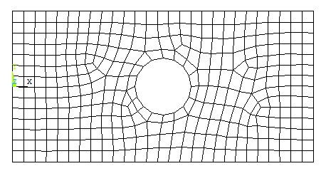
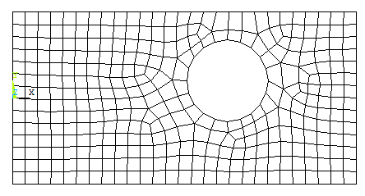
DESIGN PARAMETERS cont.
Shape design variable
Related to the structure’s geometry, which does not appear explicitly as a parameter
Beam cross-section is a geometry, but it appears as a moment of inertia
C_{x}, C_{y}, and r determine the size and location of the hole
Shape design variables change FE mesh
Design variables must be limited so that the hole remains inside of the plate
C_{x}
r
C_{x}
r
C_{y}
C_{y}
(a) Initial design
(b) Perturbed design

Slide 15
DESIGN PARAMETERS cont.
Shape design variable cont.
Shape design variable describe the movement of boundary
Mesh inside of structure must move accordingly
Iso-parametric mapping method
Works well with mapped mesh, maintaining topological mesh
Convenient on tracking the same elements and nodes
Possible mesh distortion for large shape-changing design
r
r
(a) Initial mesh
(b) Perturbed mesh

Slide 16
PARAMETER STUDY – SENSITIVITY ANALYSIS
Parameter study
Effect of a design variable on performance (gradual change of DV)
Cantilevered beam example:
w (in) | h (in) | σ_{max} (ksi)
2.0 | 4.0 | 37.5
2.0 | 4.5 | 29.6
2.0 | 5.0 | 24.0
2.5 | 4.0 | 30.0
2.5 | 4.5 | 23.7
2.5 | 5.0 | 19.2
3.0 | 4.0 | 25.0
3.0 | 4.5 | 19.8
3.0 | 5.0 | 16.0
Allowable stress
Acceptable region

Slide 17
SENSITIVITY ANALYSIS
Parameter study becomes too expensive with many DVs
Unable to capture rapid change in performance locally
Design sensitivity analysis computes the rate of performance change with respect to design variables
Sensitivity analysis calculates gradient of performance for optimization
Explicit dependence
Analytical relationship exists between performance and DVs
Weight of circular cross-section beam
Sensitivity w.r.t. r:

Slide 18
SENSITIVITY ANALYSIS cont.
Implicit dependence
Performance depends on DVs through state variable (displacement)
Sensitivity of stress:
How to calculate displacement sensitivity?
Differentiate finite element equation:
[dK/db] and {dF/db} can be evaluated using either their analytical expression or numerical differentiation
Difficult to calculate, time consuming
Easy to calculate from given expression of stress

Slide 19
SENSITIVITY ANALYSIS cont.
Sensitivity equation must be solved for each design variable
Sensitivity equation uses the same stiffness matrix with the original finite element analysis
Consider RHS as a pseudo-force vector
Similar to finite element analysis with multiple load cases
Thus, solving sensitivity equation is very inexpensive using factorized stiffness matrix
General form of performance
Sensitivity
Implicit dependent term
Explicit dependent term

Slide 20
FINITE DIFFERENCE SENSITIVITY
Easiest way to compute sensitivity information of the performance
Calculate performance at two different designs
Forward difference method
Central difference method
Consider FEA as a black-box
Sensitivity computation cost becomes high for many design variables
n+1 analyses for forward FDM
2N+1 analyses for central FDM

Slide 21
FINITE DIFFERENCE SENSITIVITY cont.
Accuracy of finite difference sensitivity
Accurate results can be expected when Δb approaches zero
For nonlinear performances, a large perturbation yields completely inaccurate results
Numerical noise becomes dominant for a too-small perturbation size
Η
(dΗ/db)₄
(dΗ/db)₃
(dΗ/db)₂
(dΗ/db)₁
b₀
b₁
b₂
b₃
b₄
b

Slide 22
EXAMPLE – CANTILEVERED BEAM
At optimum design (w=2.25 in, h=4.47 in), calculate sensitivity of tip displacement w.r.t. h
Exact sensitivity:
Differentiate [K]
Pseudo load vector

Slide 23
EXAMPLE – CANTILEVERED BEAM cont.
Sensitivity equation:
Same way of applying BC
Sensitivity of nodal DOFs
Same with the exact sensitivity

Slide 24
STRUCTURAL OPTIMIZATION
What Is Design Optimization?
To find the best design parameters that meet the design goal and satisfies constraints.
Design Parameters: Anything the Designer Can Change
Thickness of a plate
Cross-sectional geometry of a beam or truss
Geometric dimensions
Design Goal: Objective Function
Design criterion that will be minimized (or maximized)
Mass, Stress, Displacement, Natural Frequency, ETC
Constraint: Conditions that the system must satisfy
Stress, Displacement, ETC
Note: Design parameters must affect the design goal and constraints.

Slide 25
OPTIMIZATION FLOW CHART
Physical engineering problem
Structural modeling
Design parameterization
Performance definition (cost, constraints)
Structural analysis (FEM, BEM, CFD…)
Structural model update
Design sensitivity analysis
Optimized?
No
Yes
Stop

Slide 26
THREE-STEP PROBLEM FORMULATION
w
Design Parameterization
Clear identification
Independence of designs
Objective Function
Must be a function of design parameters
Minimization ( –Maximization)
Constraint Functions
Inequality constraints
Equality constraints
Equality constraints must be less than the number of design parameters
t₁
t₂
h

Slide 27
STANDARD FORM
Standard form of design optimization
Feasible set: the set of designs that satisfy constraints

Slide 28
BEER CAN EXAMPLE
Design the beer can size so that the minimum amount of sheet metal can be used (minimize manufacturing cost)
Constraints
It is required to hold at least 400 ml of fluid.
The diameter of the can should be no more than 8 cm. In addition, it should not be less than 3.5 cm (shipping & handling).
The height of the can should be no more than 18 cm and no less than 8 cm.
D
H

Slide 29
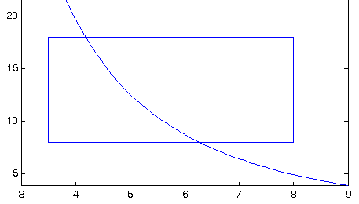
BEER CAN EXAMPLE cont.
Standard Form
Feasible Domain
S

Slide 30
GLOBAL OPTIMIZATION
Global Optimum
A point b* is called a global minimum for f(b) if
There is no mathematical method to find the global minimum
Weierstrass theorem: Existence of global minimum
If f(b) is continuous and the set S is closed and bounded, then there is a global minimum
Local Optimum
A point b* is called a local minimum for f(b) if
for all b∈S in a small neighborhood of b*
Global optimum: b₃
Local optima: b₁, b₃, b₅
f(b)
Feasible set
b₁
b₂
b₃
b₄
b₅
b₆
b

Slide 31
GRAPHICAL OPTIMIZATION
Graphical methods can be used to solve the optimization problem when it has only one or two design variables
Graphical methods are expensive but help to visualize the design space and to understand the nature of design problem
Draw the design space (lower- & upper-bounds of DVs)
Plot constraints on the graph (feasible set)
Plot contour lines of objective function
Find the optimum point (the objective function has the lowest value within the feasible set)

Slide 32
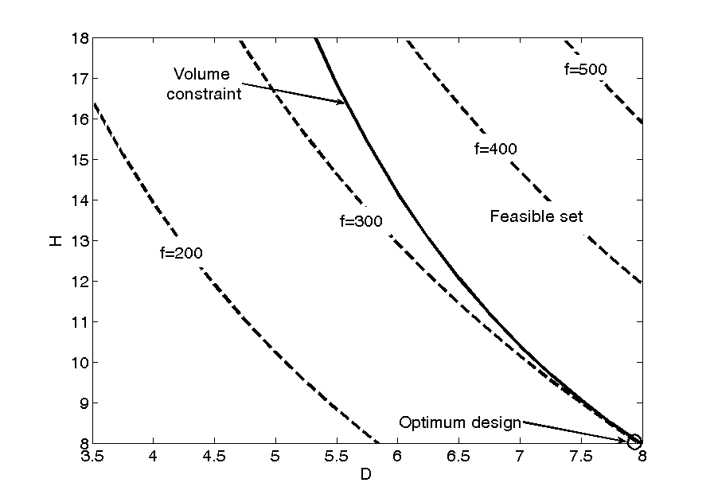
EXAMPLE – BEER CAN OPTIMIZATION

Slide 33
NUMERICAL METHODS
In FEA, we don’t know the explicit relationship, f(b), between design parameters and objective (or constraint) function.
But, we can calculate f(b) for a given b by solving the finite element equation.
Then, how can we find the optimum design?
Use Numerical Method
Numerical Method
From the current design, find the next design that can reduce the objective function and satisfy constraints.
Repeat the search until there is no way to improve the objective function further.

Slide 34
NUMERICAL METHOD cont.
Basic Algorithm
Start with b^{(K)} and K = 0.
Initial design must be given
Evaluate function values and their gradients.
Using finite element analysis
Using information from Step 2, determine ∆b^{(K)}.
Design change
Check for termination.
Stop if the problem is converged.
Update design
Increase K = K + 1 and go to Step 2.
Design iteration (cycle)

Slide 35
NUMERICAL METHOD cont.
Change in Design
α_{K}: Step size
d^{(K)}: Search direction vector
Design change means the determination of search direction and step size.

Slide 36
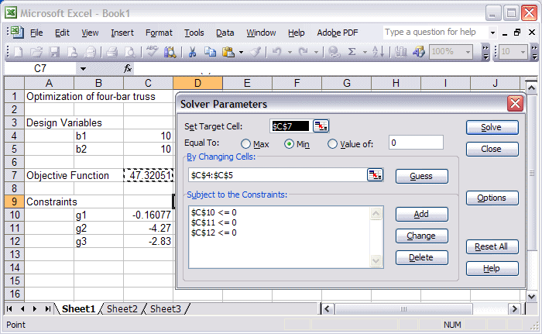
OPTIMIZATION USING EXCEL SOLVER
Four-bar truss optimization
1
L
1
3
L
2
2
F
3
4
4
2F

