Slide 1
160
140
A-basis
120
100
B-basis
80
60
40
20
0
420
440
460
480
500
520
540
560
580
Failure strength (MPa)
6.5
6.0
5.5
Knockdown factor
5.0
4.5
3.41
4.0
3.5
2.36
3.0
1.93
1.78
2.5
2.0
1.5
0
5
10
15
20
25
30
35
40
45
50
Number of coupons
L = 100 in
w
h
F = 2,000 lb

Slide 2
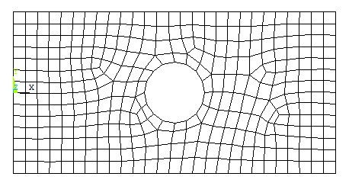
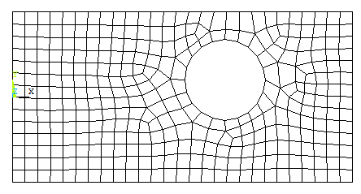
3
y
x
L
3
2
1
1
2
L
1,000 N
r
b
r
t
b
t
b
h
h
h
t
w
w
(a) (b) (c) (d) (e)
C_{x}
r
C_{x}
r
C_{y}
C_{y}
(a) Initial design
(b) Perturbed design
r
r
(a) Initial mesh
(b) Perturbed mesh

Slide 3
Allowable stress
Acceptable region
H
(dH/db)₄
(dH/db)₃
(dH/db)₂
(dH/db)₁
b₀
b₁
b₂
b₃
b₄
b
Physical engineering problem
Structural modeling
Design parameterization
Performance definition
(objective, constraints)
Structural analysis
(FEM, BEM, CFD…)
Structural model update
Design sensitivity analysis
Optimized?
No
Yes
Stop

Slide 4
w
w
t₁
t₁
t₂
h
b
t₂
h
(a) Independent designs
(b) Dependent designs
D
H
f(b)
Feasible set
b₁
b₂
b₃
b₄
b₅
b₆
b
18
Volume
f=500
16
constraint
f=400
H
14
f=300
Feasible set
12
f=200
10
Optimum
design
8
3.5
4
4.5
5
5.5
6
6.5
7
7.5
8
D

Slide 5
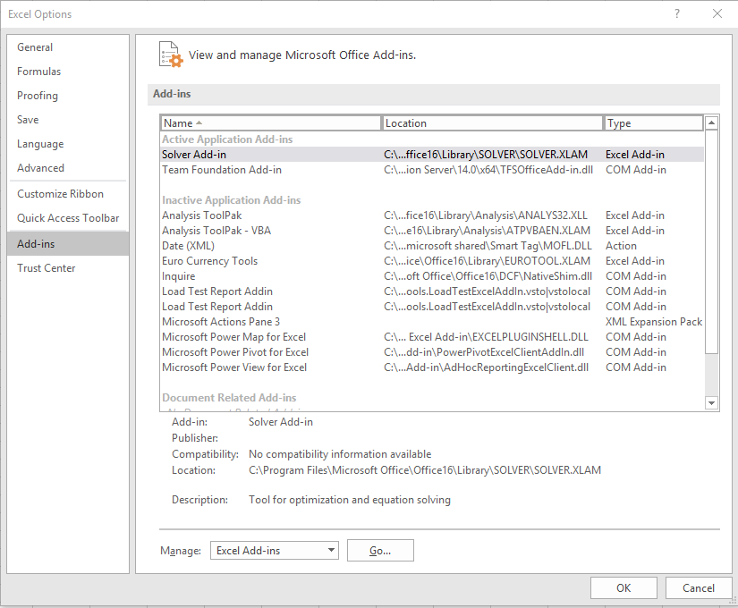
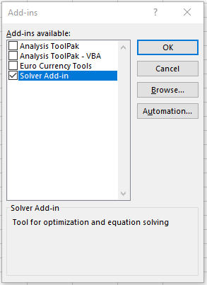
1
L
1
3
L
2
2
F
3
4
4
2F

Slide 6
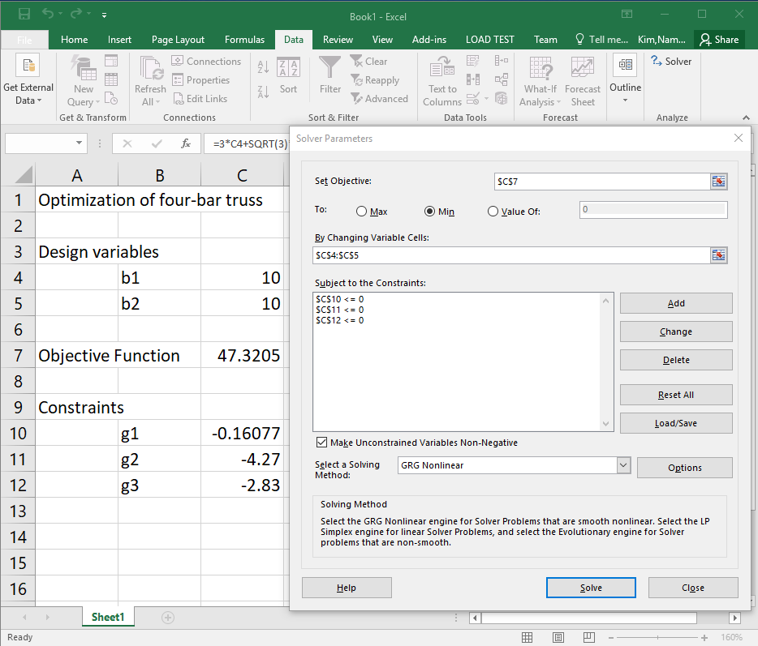
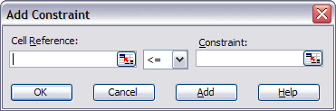
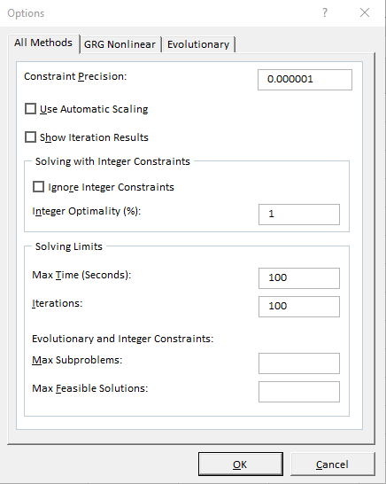

Slide 7
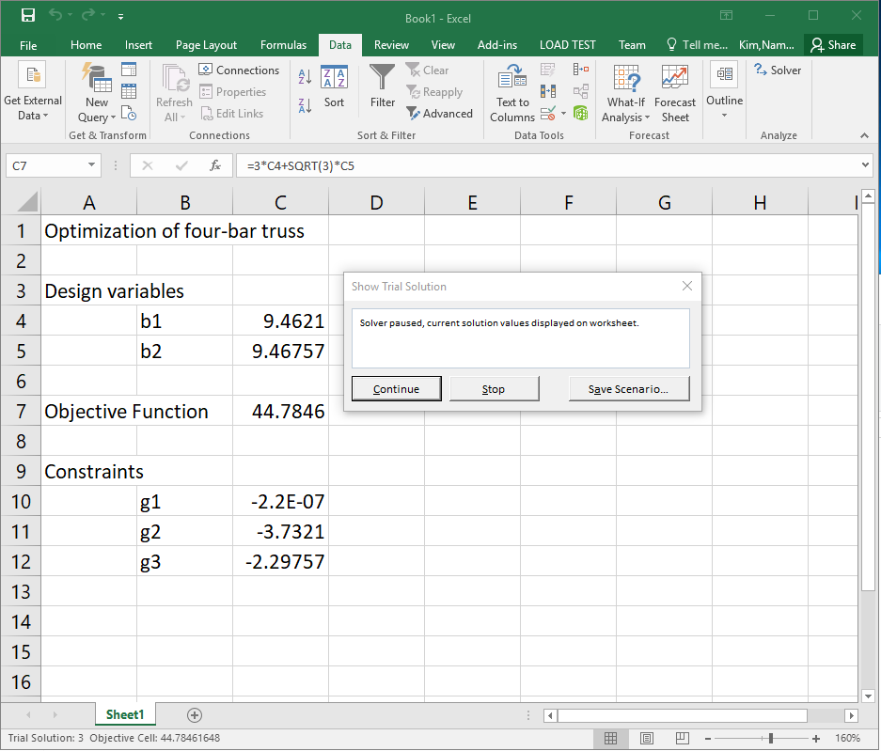
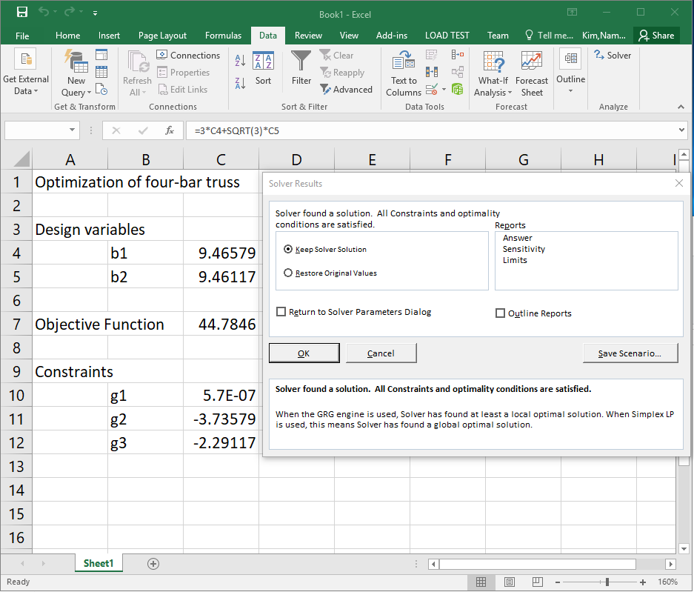

Slide 8
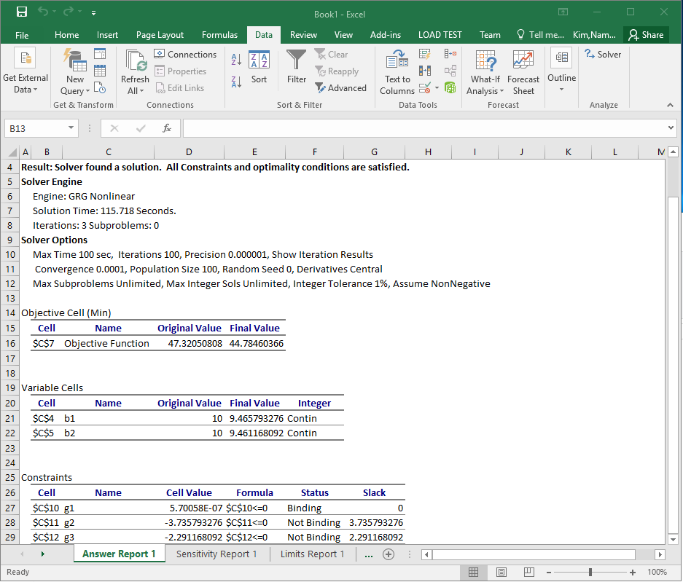
5
b
3
b
1
1
2
8
10
y
5
9
6
b
7
3
4
6
x
4
2
P₁
P₂

Slide 9
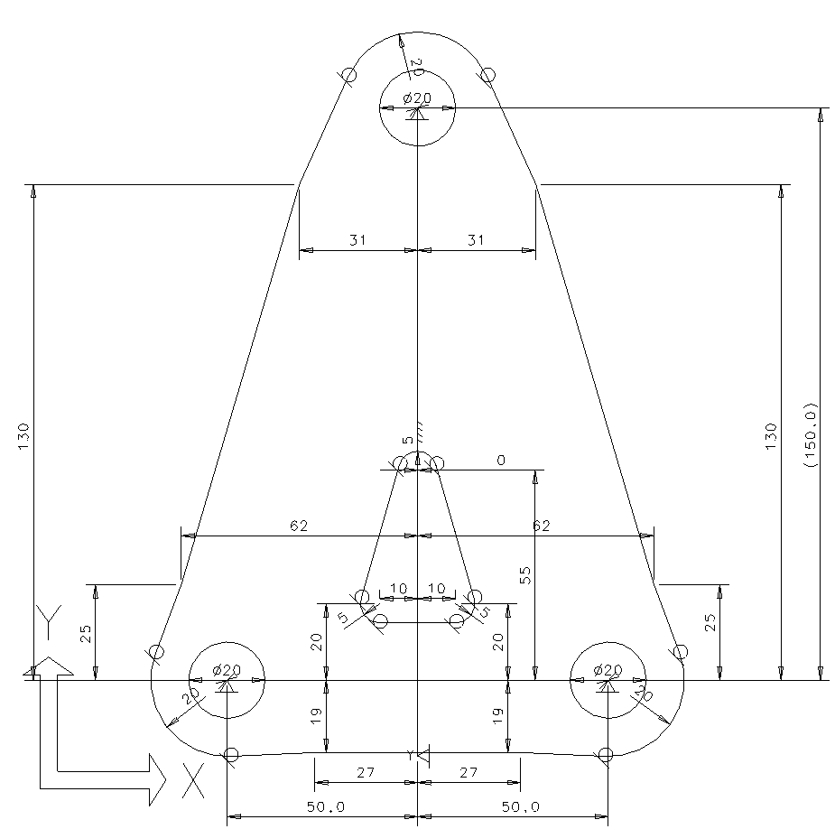
F_{x}
b₇
b₆
b₉
b₈
b₅
b₄
b₁
b₃
b₂
b₁₁
b₁₀
60 kN
2
Pin joint
9 cm
Roller support
1
3
12 cm
y
x
1
2
3
1
2
2L
F₂
L
F₃
p₀ = 120 N/m
C = –50 N-m
1
2
C
P
E, I, L

Slide 10
5
6
400 lb
9'
1
2
3
4
12'
12'
12'
1,200 lb
A
B
C
R_{L}
F
R_{R}
0.25 m
0.4 m
y
1,500 lb
1
E, I₁
2
E, I₂
3
x
10 in
25 in
p₀
E,I,L
w
t₁
t₂
h

