Slide 1
Figure 1.1
F₂
F₄
1
2
2
3
6
1
5
4
5
4
3
F₃
Figure 1.2
e
i
j
Figure 1.3
3
F₃
p(x)
F
x
Figure 1.4
Statically indeterminate
p(x)
F
Statically determinate

Slide 2
Figure 1.5
f_{i}^{(e)}
i
k^{(e)}=EA/L
j
f_{j}^{(e)}
u_{i}
Element e
u_{j}
Figure 1.6
F_{i}
Element e
f_{i}^{(e)}
f_{i}^{(e+1)}
Element e+1
Node i
Figure 1.7
A
B
C
R_{L}
F
R_{R}
0.25 m
0.4 m
Figure 1.8
k⁽²⁾
F₁
k⁽¹⁾
Element 2
Element 1
k⁽³⁾
x
Element 3
Figure 1.9
k⁽²⁾
3
F₃
F₁
1
k⁽¹⁾
2
u₂
u₃
4
F₄
u₁
k⁽³⁾
u₄

Slide 3
Figure 1.10
k⁽²⁾
12 N
F₁ = 40N
k⁽¹⁾
0.4 cm
1.2 cm
28 N
k⁽³⁾
Figure 1.11
50 N
8 cm
12 cm
Figure 1.12
y
Local coordinates
φ
2
1
Global coordinates
x
Figure 1.13
y
2
Element 2
Element 1
φ_{A}
1
3
x

Slide 4
Figure 1.14
y
k
φ
2
1
x
Figure 1.15
2
50 N
Element 1
8 cm
Element 2
1
3
12 cm
Figure 1.16
y
k⁽¹⁾
φ₁
2
φ₁ = tan^{–1}(8/12) = 33.7º
E = 30 x 10⁶ N/cm²
A = πr² = 0.049 cm²
L = 14.4 cm
1
x
Figure 1.17
y
2
φ₂ = –90º
E = 30 x 10⁶ N/cm²
A = πr² = 0.049 cm²
L = 8 cm
φ₂
k⁽²⁾
3
x

Slide 5
Figure 1.18
–60.2 N
60.2 N
1
2
Figure 1.19
2
Elem 2
F
45°
Elem 3
1
Elem 1
4
3
Figure 1.20
y
φ_{y}
K
2
φ_{x}
φ_{z}
1
x
z
Figure 1.21
z
3
2
E₃
E₂
y
E₁
4
1
10,000N
x

Slide 6
Figure 1.22
L
L
ΔL
No stress, no strain
No stress, thermal strain
Thermal stress, no strain
(a) at T = T_{ref}
(b) at T = T_{ref} + ΔT
Figure 1.23
AEαΔT
AEαΔT
1
2
ΔT
3
ΔT
1
2
L
y
30°
3
L
L
30°
x
4
AEαΔT
AEαΔT
(a)
(b)
(c)
Figure 1.24
6,000 N
3,464 N
3,464 N
y
x
4
Figure 1.25
3
z
5
E₄
E₃
2
E₂
4
y
1
E₁
10,000N
x

Slide 7
Figure 1.26
R₁
y
4
3in
3
3
F₁
3in
10in
2
2
F₂
1
1
x
R₂
Figure 1.27
(a) Clamped bar (b) Finite element model
y
x
1
2
3
20in
Copper
Steel
Copper
10in
10in
Rigid body
4
5
6
4000lb
4000lb
(a) Support Structure (b) Finite element model
Figure 1.28
y
a
1
x
3
30º
1
2
L=15ft
2
d
F = 5000lb

Slide 8
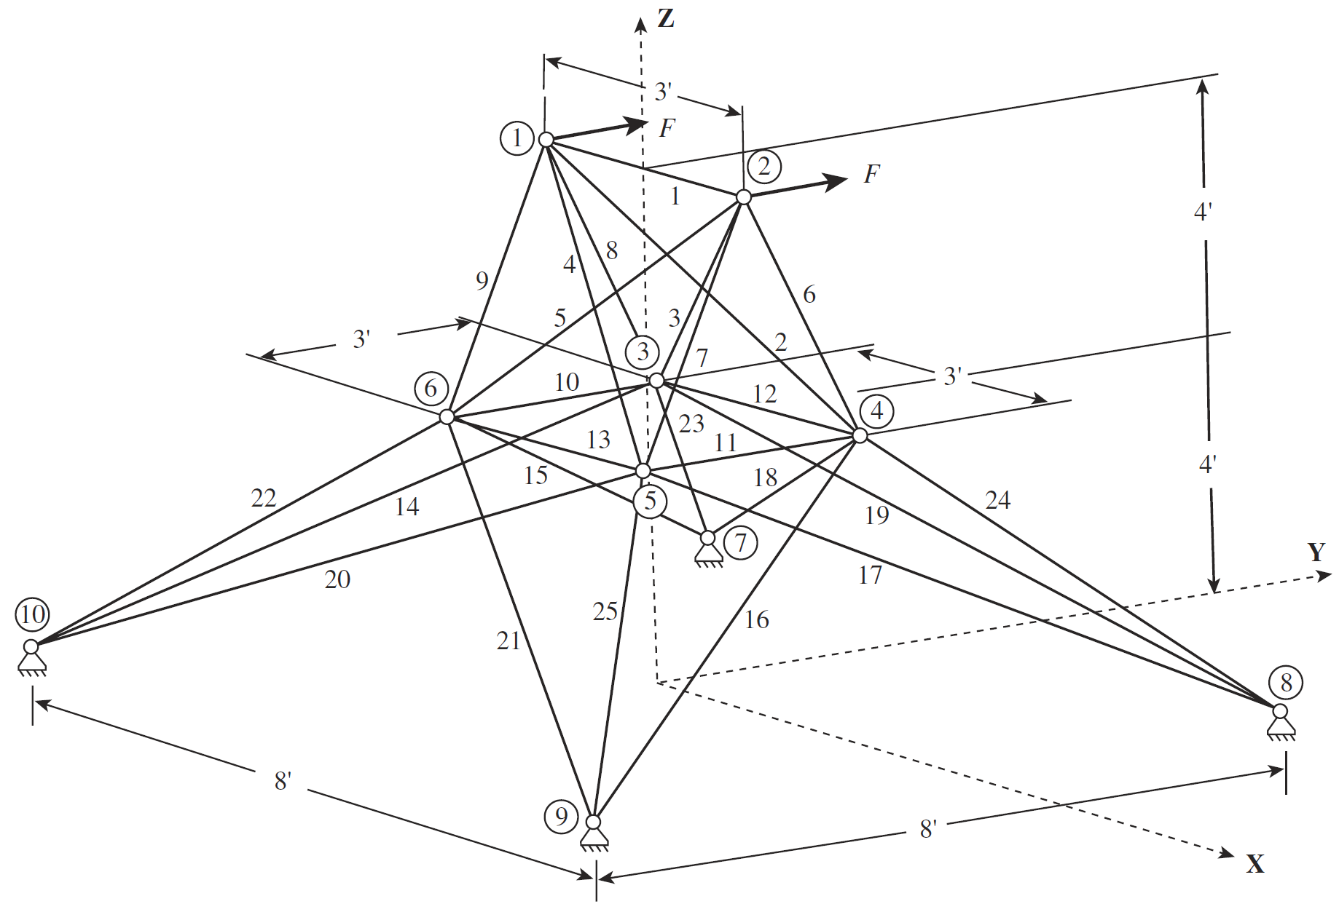
Figure 1.29
Figure 1.30
1 m
E₁
9 mm
12 mm
E₂
1
2 m
F
2
7
4
8
6
9
8
10
10
11
12
12
14
y
20
21
22
23
24
25
Figure 1.31
x
13
14
15
16
17
18
19
26
27
28
29
30
31
1
1
3
2
5
3
7
4
9
5
11
6
13
Figure 1.32
5
b
3
b
1
1
2
8
10
y
5
9
6
b
7
3
4
6
x
4
2
P₁
P₂

Slide 9
E₁
F
E₂
1
2
3
k⁽¹⁾
k⁽²⁾
1
x
2
3
u₁
u₂
u₃
1
u₂
2
2
u₄
1
3
4
4
x
u₃
F₄
3
1
u₂
2
u₄
2
3
6
1
u₃
4
5
3
5
4
F₃
1
3
u₃
2
F₁
2
4
1
4
x
3
u₁
F₁ =50 N
k⁽¹⁾=50 N/cm
k⁽²⁾=60 N/cm
1
2
3
x

Slide 10
k⁽¹⁾
k⁽²⁾
3
F₃
F₁
1
k⁽³⁾
u₃
k⁽⁴⁾
2
F₂
u₁
u₂
F₂
u₂
u₃
F₃
1
2
3
u₁
10 N
u₂
u₃
1
Element 1
k₁ = 200 N/m
2
Element 2
k₂ = 300 N/m
3
3
x
1
g
3
1
2
2
A
B
C
R_{L}
F
R_{R}
0.25 m
0.4 m

Slide 11
F = 10,000N
L = 1 m
R_{L}
F
R_{R}
0.3 m
0.4 m
0.3 m
500 lb/in
3
1
2000 lb/in
2
400 lb
500 lb/in
4
Element 1
Element 2
3
5 kN
1
2
2 kN
1 m
1 m
F
1
2
3
4
1 m
1 m
1 m
F
1
2
3
4
1 m
1 m
1 m

Slide 12
Q₁
1
1
3
3
4
4
6
Q₂
2
2
5
6
7
5
7
8
2
Elem 1
1
45º
F
Elem 2
3
F
2
Elem 2
3
1 m
Elem 1
1 m
1
2
60 N
Pin joint
9 cm
1
3
Roller support
12 cm

Slide 13
v₂
u₂
v₃
u₃
2
3
v₁
v₄
1
u₁
4
u₄
2
3
50 N
9 cm
1
4
12 cm
1
F
1
E, A, L
2
E, A, L
2
45º
3
y
F
1
1
x
2
2
3

Slide 14
1
y
L
1
x
2
2
4
L
L
3
10,000 N
3
F
3
45º
L
1
1
2
L
y
45º
x
2
1
E1
F
30º
3
E2
2
y
E3
x
3
2
E2
E1
4
45º
E3
1
F

Slide 15
3
y
3
x
L
3
2
L
3
2
1
1
2
1
1
2
L
L
1,000 N
1,000 N
400 lb
9'
Material: Steel rod
Diameter: 2"
12'
12'
12'
1,200 lb
b
Y
2
a
8 kN
a = b = 10 cm
6 m
3
1
3 m
X
Z
5 m
4
6 m
y
x
1
z
4
4
1
5
2
3
3
10,000 N
2

Slide 16
1
2
5,000 N
A, E, L
20,000 N
1
2
20000N
1
1 m
2
1 m
3
9500N
10500N
Node 2
2
y
E2
x
3
45º
1
F_{x}
E1
F_{y}
2
L, ΔT
2
3
ΔT
2
ΔT
2
10,000 N
5
4
5
4
L 1
4
3
1
3
1
3
1
(a)
4
(b)
(c)
4
3
3
4
3
3
4
5
2
4
6
2
1
2
5
1
2
1
1

Slide 17
1
2
F
1
y
2
x
3
F₂
2
F₃
3
2
5
4
1
3
y
4
x
1
L
L
1
2
3
y
E₁
L
E₂
E₃
x
4

Slide 18
1
u₂
2
u₄
2
3
1
3
4
F₄
4
Element 1
Element 2
1
5 kN
2
3
2 kN
1 m
1 m
1
y
L
1
x
2
2
4
L
10,000 N
L
3
3
Element 1
Element 2
1
2
3
L
L

Slide 19
5
b
3
b
1
1
2
11
8
13
10
y
5
9
6
b
12
7
14
3
4
6
x
4
2
P₁
P₂
Element 1
Element 2
2 kN
3
5 kN
1
2
1 m
1 m
y
1
1
F
x
2
2
3

Slide 20
Element 1
Element 2
1
5 kN
2
3
1 m
1 m
1
45º
2
y
E, A, L
E, A, L
3
x
F

