Slide 1
y
y
Neutral axis
x
z
L
F
F
A
y(dv/dx)
y
θ = dv/dx
v(x)
+M
y
+V_{y}
+M
+P
x
+P
+V_{y}
y
p(x)
x
C₁
C₂
C₃
F₁
F₂
F₃
Free-body diagram
p₀
E,I,L

Slide 2
1.0
0.8
0.6
v(x)/v_{max}
0.4
v_exact
0.2
v_approx.
0.0
0
0.2
0.4
0.6
0.8
1
x
0.00
x
0
0.2
0.4
0.6
0.8
1
M(x)
-0.04
-0.08
-0.12
M_exact
M_approx
0.6
V_exact
0.4
V_approx
V(x)
0.2
0.0
-0.2
-0.4
-0.6
0
0.2
0.4
0.6
0.8
1
x
–p₀
C
E,I,L
F
Notes:
%
% Figure 3.5
x=0:0.1:1;
v_approx=sin(pi*x);
M_approx=-(4/pi^3).*sin(pi*x);
Vy_approx=(4/pi^2).*cos(pi*x);
v_exact=16*(x - 2.*x.^3 + x.^4)/5;
M_exact=(-x + x.^2)./2;
Vy_exact=0.5 - x;
plot(x,v_exact,'k','LineWidth',2); hold on;
plot(x,v_approx,'k--','LineWidth',2,'MarkerSize',10);
legend('v_{exact}','v_{approx}');
figure;
plot(x,M_exact,'k','LineWidth',2); hold on;
plot(x,M_approx,'k--','LineWidth',2,'MarkerSize',10);
legend('M_{exact}','M_{approx}');
figure;
plot(x,Vy_exact,'k','LineWidth',2); hold on;
plot(x,Vy_approx,'k--','LineWidth',2,'MarkerSize',10);
legend('Vy_{exact}','Vy_{approx}');

Slide 3
0.02
v(x)
0.015
0.01
0.005
v_exact
v_approx.
0
0
0.1
0.2
0.3
0.4
0.5
0.6
0.7
0.8
0.9
1
(a)
x
500
M_exact
400
M_approx.
M(x)
300
200
100
0
0.1
0.2
0.3
0.4
0.5
0.6
0.7
0.8
0.9
1
(b)
x
500
V_{y}(x)
400
300
V_{y}_exact
V_{y}_approx.
200
0
0.1
0.2
0.3
0.4
0.5
0.6
0.7
0.8
0.9
1
(c)
x
F₁
F₂
C₁
x
C₂
p(x)
v₁
v₂
θ₁
x
θ₂
x₁
s = 0
L
x₂
s = 1

Slide 4
1.0
0.8
N₁
N₃
0.6
0.4
0.2
N₂/L
0.0
0
0.2
0.4
0.6
N₄/L
0.8
1
-0.2
v₁
v₂
θ₁
L
θ₂
y
p(x)
C₁
x
C₂
C₃
C₄
C₅
1
2
3
4
5
F₁
F₂
F₃
F₄
F₅
y
x
2EI
EI
3
1
2
2L
F₂
L
F₃

Slide 5
p
Equivalent
pL/2
pL/2
pL²/12
pL²/12
y
x
1
2
3
1 m
1 m
F₂ = 240 N
p₀ = 120 N/m
EI = 1000 N-m²
C = –50 N-m

Slide 6
0.000
FEM
-0.002
Exact
v
-0.004
-0.006
-0.008
-0.010
0
0.2
0.4
0.6
0.8
1
x
0.000
FEM
-0.005
Exact
-0.010
θ
-0.015
-0.020
-0.025
-0.030
0
0.2
0.4
0.6
0.8
1
x
10
FEM
0
Exact
-10
M
-20
-30
-40
-50
-60
0
0.2
0.4
0.6
0.8
1
x
120
FEM
100
Exact
80
Vy
60
40
20
0
0
0.2
0.4
0.6
0.8
1
x

Slide 7
p
L
0.35
0.30
v_analytical
0.25
v_FEA
v(s)
0.20
0.15
0.10
0.05
0.00
0.0
0.2
0.4
0.6
0.8
1.0
s
0.00
-0.05
M_Analytical
M_FEA
M(s)
-0.10
-0.15
-0.20
-0.25
-0.30
0
0.2
0.4
0.6
0.8
1
s
1.00
Vy_Analytical
0.80
Vy_FEA
0.60
0.40
Vy(s)
0.20
0.00
-0.20
-0.40
-0.60
-0.80
-1.00
0
0.2
0.4
0.6
0.8
1
s

Slide 8
p
F
2
1
3
2
3
1
4
Local coordinates
φ
2
y
1
x
Global coordinates
2
F
1
a
y
2
1
45º
3
x
a

Slide 9
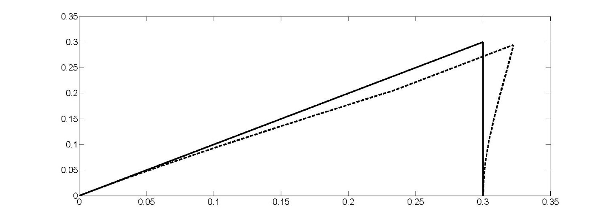
0.12N
1390N
981N
2
1.15Nm
1.15Nm
18.3N
2
1.11Nm
1
18.3N
4.33Nm
1390N
0.12N
3
981N
1000N
983N
18N
1.11Nm
4.33Nm
981N
981N

Slide 10
1
F_{z2}
1
2
2
y
2
2
x
z
3
3
y
C
x
L
P
C
P
C
P
M(x)
δ
P
δ
x
v(x)
x
Δ
dx
dΔ
θ
x
dx
x
dx

Slide 11
7
6
Exact tip deflection
Approx. tip deflection
5
P < 0
Tip Deflection
4
3
2
1
0
P > 0
0
0.2
0.4
0.6
0.8
1
1.2
1.4
1.6
λL
Notes:
M=[ -1.6 0 6.814217183
-1.5 0 3.99880036
-1.4 4.983153148 2.884071848
-1.3 3.240632103 2.289780937
-1.2 2.44403278 1.922899425
-1.1 1.991081634 1.675864369
-1 1.701631435 1.499925004
-0.9 1.503026693 1.369812349
-0.8 1.360388124 1.271151969
-0.7 1.254935754 1.195195791
-0.6 1.175712858 1.136348141
-0.5 1.115951419 1.090899174
-0.4 1.071305355 1.056332077
-0.3 1.038924479 1.030924647
-0.2 1.016942247 1.013512144
-0.1 1.00418368 1.003344146
0 1 1
0.1 0.995850209 0.996678072
0.2 0.983600118 0.986843404
0.3 0.96382418 0.970876614
0.4 0.937406851 0.949371896
0.5 0.905448928 0.923084024
0.6 0.869162847 0.892866709
0.7 0.829773633 0.859610923
0.8 0.788437756 0.824190315
0.9 0.746186071 0.787418315
1 0.703891453 0.75001875]
plot(M(3:27,1),M(3:27,2),M(:,1),M(:,3),'-')

Slide 12
y
x
P
P
2m
1m
1m

Slide 13
Local coordinates
f
2
y
1
x
Global coordinates
P
P
2
3
2
1
3
1
4
1.0
1.0
0.5
0.5
0
0
0.5
1.0
0
0
0.5
1.0

Slide 14
w
w
z
h
a
L
a
y
1
2
3
4
x
1
2
3
4
5
0.2
0.1
1
2
3
4
5
Deflection
0
-0.1
v = 0.18246in
-0.2
-0.3
-0.4
-0.5
0
5
10
15
20
25
30
35
40
X
Notes:
L=120;
s=0:0.1:1;
x=0:0.1:4;
x=10.*x;
N1=1 - 3.*s.^2 + 2.*s.^3;
N2=L.*(s - 2.*s.^2 + s.^3);
N3=3.*s.^2 - 2.*s.^3;
N4=L.*(-s.^2 + s.^3);
v1=-0.48274; q1=0.40547E-2; v2=0.0; q2=0.30411E-02;
v=v1.*N1 + q1.*N2 + v2.*N3 + q2.*N4;
V=v;
%
v1=0.0; q1=0.30411E-02; v2=0.18246; q2=0.0;
v=v1.*N1 + q1.*N2 + v2.*N3 + q2.*N4;
V=[V v(2:11)];
%
v1=0.18246; q1=0.0; v2=0.0; q2=-0.30411E-02;
v=v1.*N1 + q1.*N2 + v2.*N3 + q2.*N4;
V=[V v(2:11)];
%
v1=0.0; q1=-0.30411E-02; v2=-0.48274; q2=-0.40547E-02;
v=v1.*N1 + q1.*N2 + v2.*N3 + q2.*N4;
V=[V v(2:11)];
Plot(x,V)

Slide 15
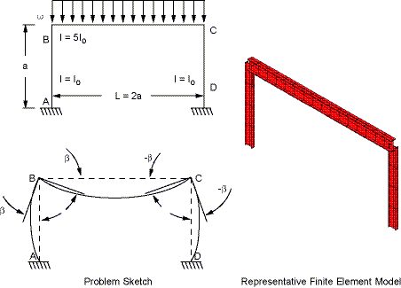
16.655"
1.68"
0.945"
Centroid
36.74"
1.68"
y
y
F
10
11
9
10
L/2
x
L/2
3
3
2
2
F
1
1
x

Slide 16
20
2
500
1
Seat
400
325
3
20
y
Unit: mm
x
400
20
4
825
Pedal
6
5
50
1,000 N
L = 1 m
p₀
y
x
C
L
p₀
y
x
C
L

Slide 17
0.5 m
1,000 N
1 m
k
A
C
2h
L
B
b
F₂
F₂
C₂
1
C₂
1
2
1
E, I
2
L
P
q
L_{T}
f
L = 1 m
EI = 0.15 N⋅m²
f = 1 N/m
1
L
2
p₀
1
2
3
p₀
F
L
L

Slide 18
F
E, I, L
k
1
C = 100 N-m
E, I
2
1 m
k
3
F
1
E, I
2
L
k
3
1
θ
2
L
10,000N
1
2
3
1mm
0.1m
0.1m

Slide 19
q₀
F₁
F₂
y
L
M₁
M₂
x
P
F₁
F₂
y
L
M₁
M₂
x
0.5 m
B
1 m
1 m
1,000 N
C₂
1 m
1 m
1
2
3
1
P
2
1
E, I, L
2
E, I, L
3
1
E, I
2
3
L
F
L
y
F = 60 N
x
1 m
1 m

Slide 20
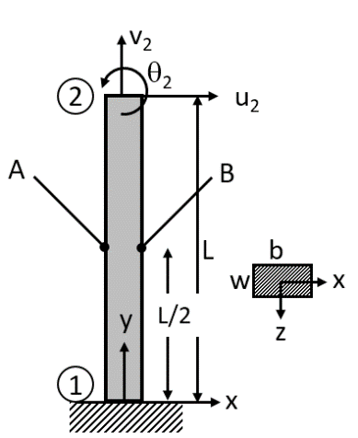
1
2
C
P
E, I, L
q
E=100
L=1
q=1
A=0.1
I=0.01
y
x
45º
F
10 mm
y
R = 100 mm
x
10 mm
F
F/2
y
R
x

Slide 21
2
E₂
3
E₁
E₃
1
4
2m
1m
y
1m
2m
q
x
1
2
1
2
45º
3
P
Q
r = 0.05
1,000 N
0.025
0.025
R
S

Slide 22
y
2
1
x
P
3
2m
1m
y
2
1
x
P
3
1m
1m
y
k_{T}
3
1
1
x
2
k_{L}
2
L
3
P
2
2
3
P
1
3
1
4

Slide 23
q
1
x
E, I
2
L
F
1
E, I
2
L
1
$$−C$$
$$C$$
2
s
1

