Slide 1
T_{high}
T_{high}
q_{x}
T_{low}
q_{x}
T_{low}
(a)
(b)
Q_{s}
Q_{g}
A
dx
T(0) = T₀
Q_{g}
q_{x}(L) = q_{L}
x
A
Q_{s}
1
2
N
Q₁
Q₂
Q₃
Q_{N}
i
e
j
x_{i}
T_{i}
L^{(e)}
T_{j}
x_{j}

Slide 2
Q₂
1
3
Element 1
2
Element 2
Q₄ = –200W
200 °C
T₁
T₂
T₃
T₄
T₅
x
1
2
3
4
Q₁
Q₂ = 500W
Q₃ = 0
Q₅ = 0
100W
3
2
4
50 °C
1
1
2
3
4
5
5
x
200W
Q = 0
Q = 0
Wall
200 °C
Insulated
No heat flow
x
1 m
No heat flow
200 °C
x
T₁
T₂
T₃
T₄
T₅
1
2
3
4

Slide 3
208
207
FEM
206
Exact
205
T
204
203
202
201
200
0
0.2
0.4
0.6
0.8
1
x
Ceramic foam
Metal foam
1,000 K
k_{c} = 0.05 W/m/K
Q_{g} = –1,000 W/m³
k_{m} = 0.025 W/m/K
Insulated
No heat flow
x
0.1 m
0.1 m
No heat flow
1,000 K
x
T₁
T₂
T₃
T₄
1
2
3
1000
FEM
900
Exact
T
800
700
600
0
0.05
0.1
0.15
0.2
x

Slide 4
T₁
T₂
T₃
h₁
1
2
h₃
Firebrick
Insulating brick
T_{f} = 1,500 °C
T_{a} = 20 °C
h_{i}
x
h_{o}
0.25 m
0.12 m
Convection boundary
No heat flow
Convection boundary
1,500 °C
x
20 °C
T_{f}
T₁
T₂
T₃
T_{a}
h_{i}
1
2
h_{o}
Fluid T ∞
Convection
b
h
i
j
x_{i}
Convection
x_{j}

Slide 5
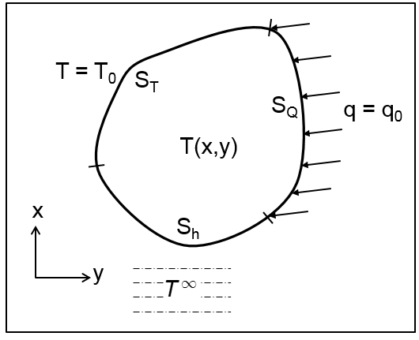
Convection
T ∞ = 30 °C
160 mm
1.25 mm
330 °C
x
Insulated
120 mm
T₁
T₂
T₃
T₄
1
2
3
350
250
T(x)
150
50
0
0
40
80
120
x

Slide 6
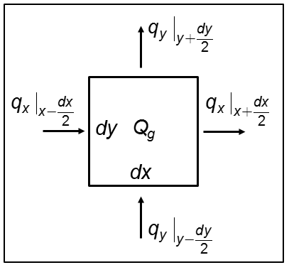
y
3
T₃
T₁
1
T₂
2
x
N₁
y
T₃
3
T₁
1
T₂
2
x
2
3
s
1

Slide 7
10mm
5mm
Heat flux boundary
Convection boundary
y
1
3
5
2
4
5
1
3
2
4
6
x
5
5

Slide 8
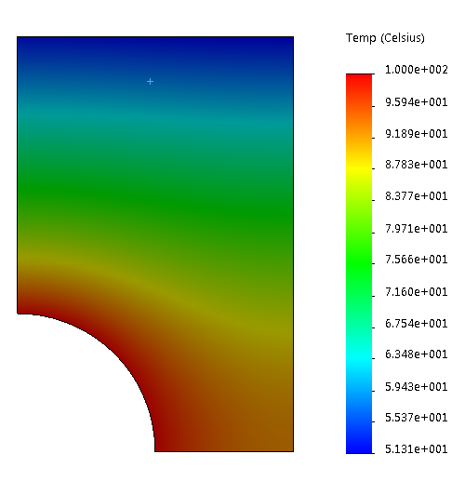
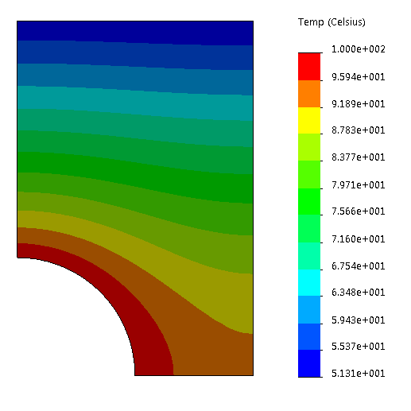
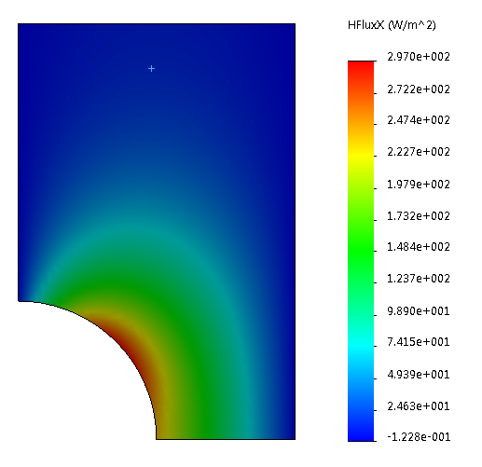
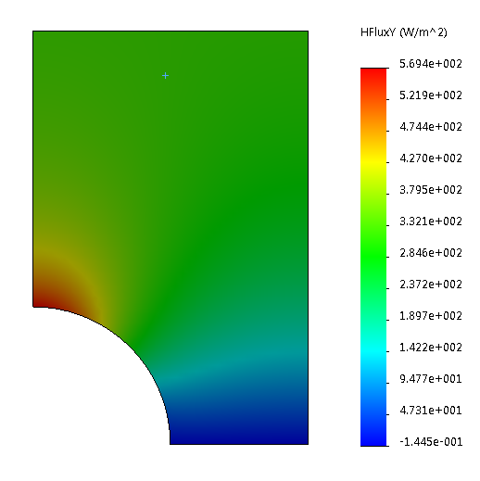
Convection
100ºC
100ºC
100ºC
t_{h}
100ºC
(a)
(b)
Figure 4.28
(a)
(b)
Figure 4.29

Slide 9
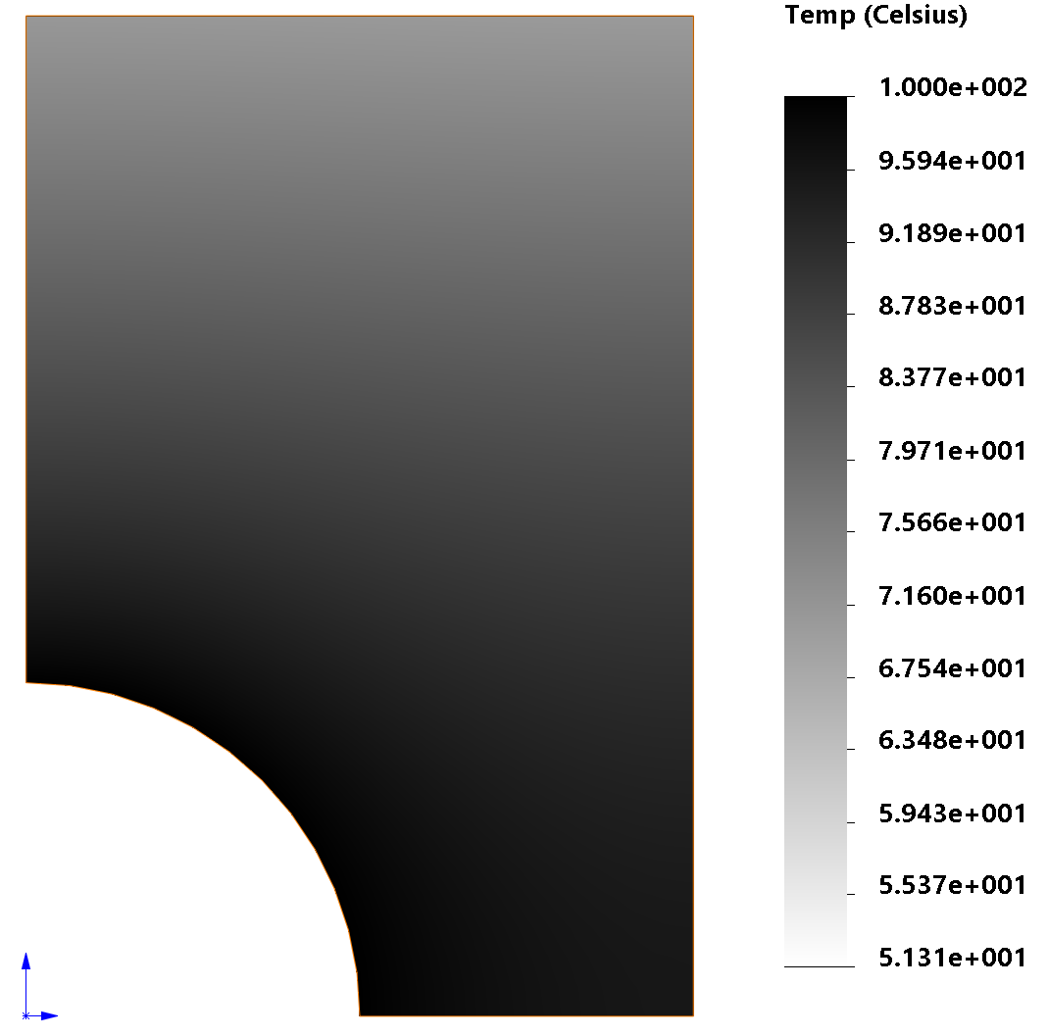
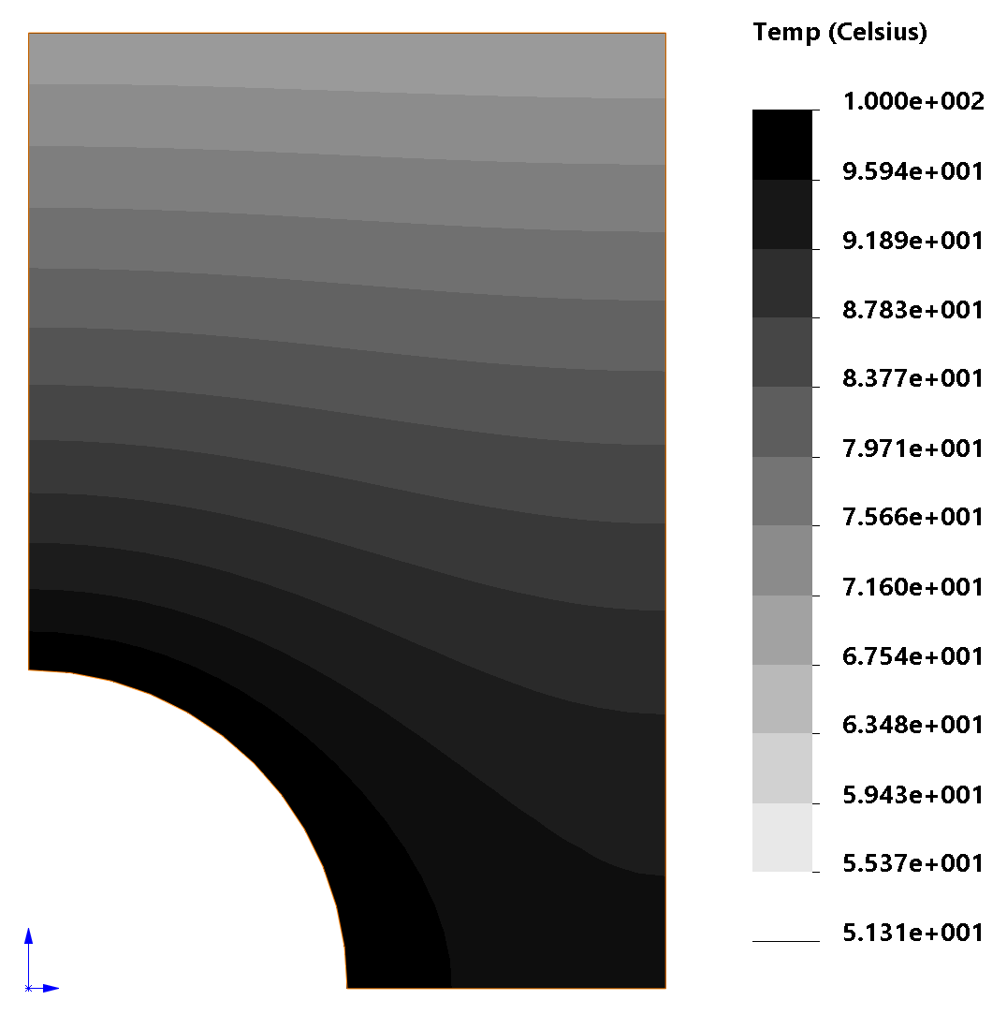
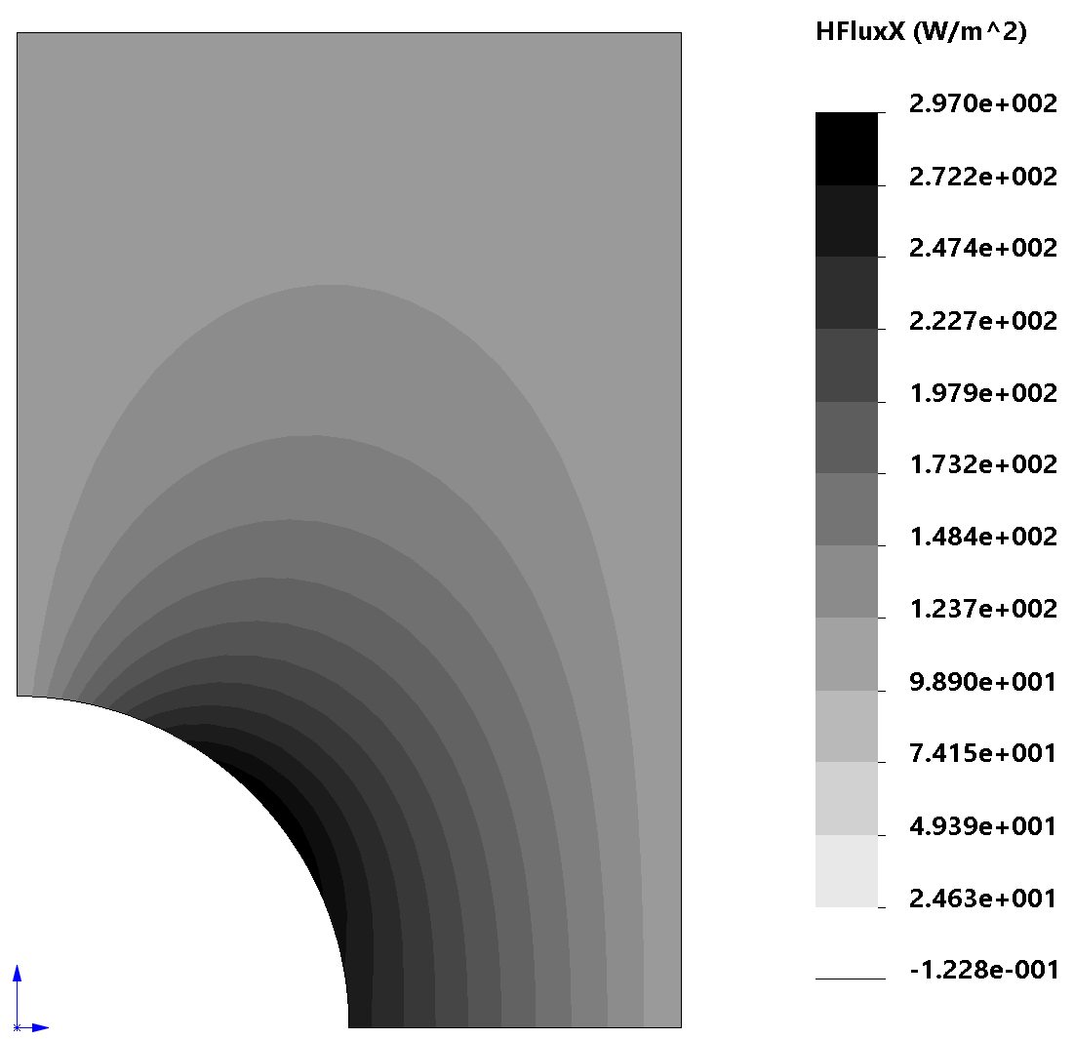
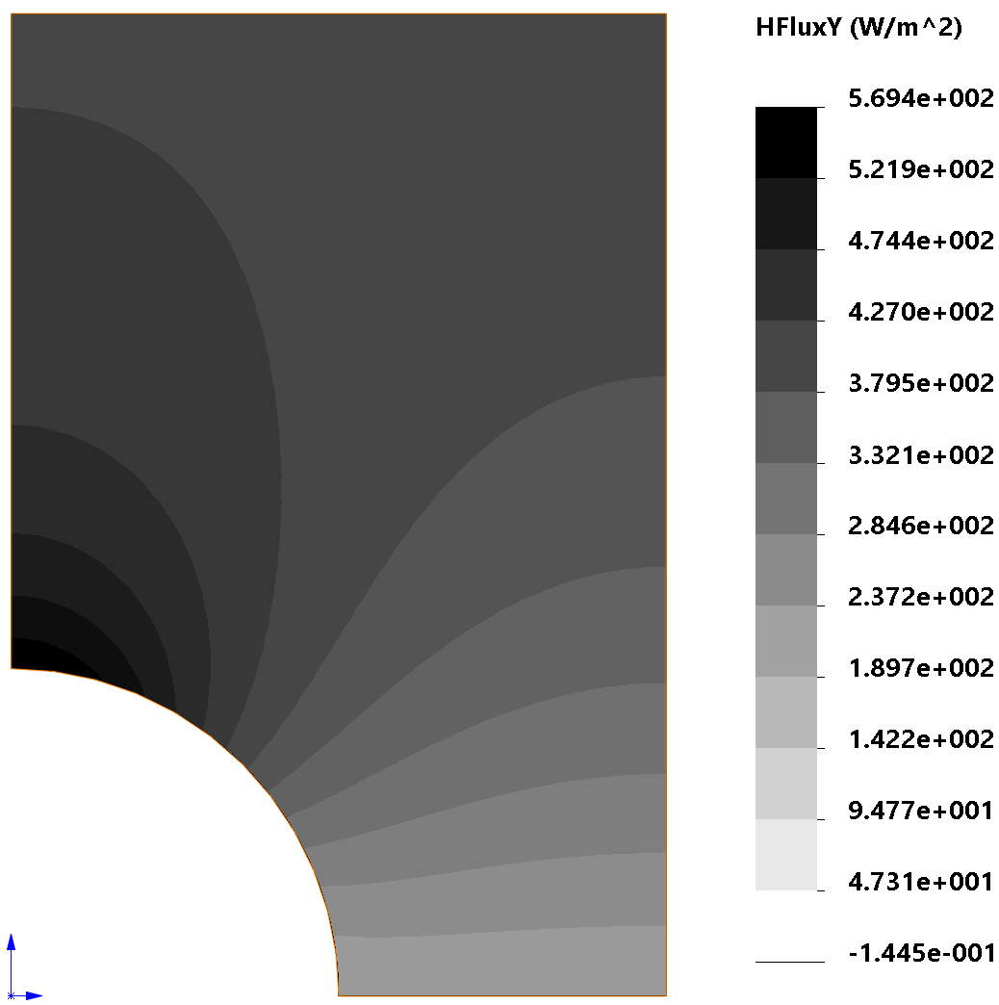
Figure 4.28
(a)
(b)
Figure 4.29

Slide 10
Insulated
T = 0ºC
x
Q_{g} = 10 W/m³
T = 0ºC
Insulated
1 m
T = 300ºC
Insulated
T_{f} = 30ºC
20 m
T₁
T₂
T₃
0.5
0.5
T₁ = 0ºC
T₂ = 100ºC
T₃ = 50ºC

Slide 11
Insulated
A = 1 m²
x
T₁
0.5 m
T₂
0.5 m
T₃
No heat flow
1
20°C
x
T₁
T₂
T₃
T_{R}
z
3
insulated
y
2
h, T_{f}
L
1
x
h
0.12m
T_{f}
Q_{g}
T_{f}
k
h

Slide 12
z
T_{w}
y
Air h, T_{a}
L
x
B
Area 0.1 m²
q
A
D
T = 66ºC
T = 370ºC
C
2.5cm
7.5cm
5cm
T_{o}
Concrete
Insulation
Concrete
T_{i}
h_{o}
h_{i}
0.07m
0.1m
0.1m

Slide 13
1
3
2
Parametric Space
x = 0
x₁
x₃
x₂
x = L
Physical Space
Plate thickness = 10mm
y
1
P
A₂
A₃
(x, y)
A₁
3
2
x

