Slide 1
Figure 5.1
f₆
ΔF
f₁
f₅
f₁
n
P
ΔA
f₂
f₄
f₂
z
f₃
f₃
x
y
(a)
(b)
F
F
Figure 5.2
F
θ
T^{(n)}
S
n
T^{(n)}
σ_{n}
Figure 5.3
n
τ_{n}
P
Δx
σ_{zz}
Δz
τ_{zx}
τ_{zy}
Figure 5.4
ΔF
τ_{xz}
τ_{yz}
z
σ_{xx}
τ_{xy}
τ_{yx}
σ_{yy}
y
Δy
x

Slide 2
Figure 5.5
y
B
n
τ_{xz}
τ_{zx}
σ_{zz}
T^{(n)}
σ_{xx}
P
τ_{zy}
τ_{xy}
τ_{yz}
A
x
τ_{yx}
z
C
σ_{yy}
A
τ_{yx}
B
y
Figure 5.6
τ_{xy}
Δl
O
x
τ_{xy}
C
Δl
D
τ_{yx}
y′
y
x′
Figure 5.7
b²
b¹
b³
x
z
z′
y′
y
x′
Figure 5.8
45º
x
z, z′

Slide 3
Figure 5.9
τ
τ_{max}
σ₃
σ₂
σ₁
σ
R'
Q'
R
P'(x+u,y+v,z+w)
Figure 5.10
Δy
y
P(x,y,z)
Δx
Q
x
z
Figure 5.11
Δa(1+ε₃)
Δa
Δa(1+ε₂)
y
Δa
Δa
Δa(1+ε₁)
x
z
Figure 5.12
F
F

Slide 4
Figure 5.13
σ
Ultimate stress
Fracture
Yield stress
Proportional limit
Young’s modulus
Strain hardening
Necking
ε
Figure 5.14
y
x
t_{y}
n
t
Figure 5.15
σ_{xx}
t_{x}
τ_{xy}
y
σ_{yy}
x
Figure 5.16
Applied loads
{σ} = [C] {ε}
Boundary condition

Slide 5
Figure 5.17
y
P
L
x
Figure 5.18
A
h
z
S_{T}
y
{T_{x},T_{y}}
x
Figure 5.19
σ
Figure 5.20
E
σ_{i}
U
Strain energy
ε_{i}
ε
σ₃
Figure 5.21
A
Safe region
σ₁
B
Material failure

Slide 6
Figure 5.22
σ₃
Safe region
Failure in max. shear stress theory
Safe in distortion energy theory
C
D
σ₁
Figure 5.23
Max. shear
stress theory
σ₃
Distortion energy theory
σ₁
Principal stress theory
Figure 5.24
A
l
Rod
y
Rigid arm
T
z
Figure 5.25
F
a
x
F
A
Figure P5.1
C
45°
B
l
F

Slide 7

Figure P5.4
σ_{yy}
τ_{xy}
n
τ_{xy}
σ_{xx}
θ
σ_{xx}
τ_{xy}
τ_{xy}
σ_{yy}
21 MN/m²
Figure P5.6
y
x
σ_{xx}
56 MN/m²
z
m³
P
m²
Figure P5.10
y
x
m¹
Figure P5.11
⋅ A
P
T
Figure P5.20
y
y
P
b
x
P
z
t
L

Slide 8
Figure P5.23
B
C
y
x
A
Figure P5.24
A
y
120º
120º
B
C
x
B
120º
Figure P5.25
y
C
A
120º
x
Figure P5.26
y
b
A
a
a
B
x
Figure P5.35
M_{z}
T
y
M_{z}
N
N
x
T

Slide 9
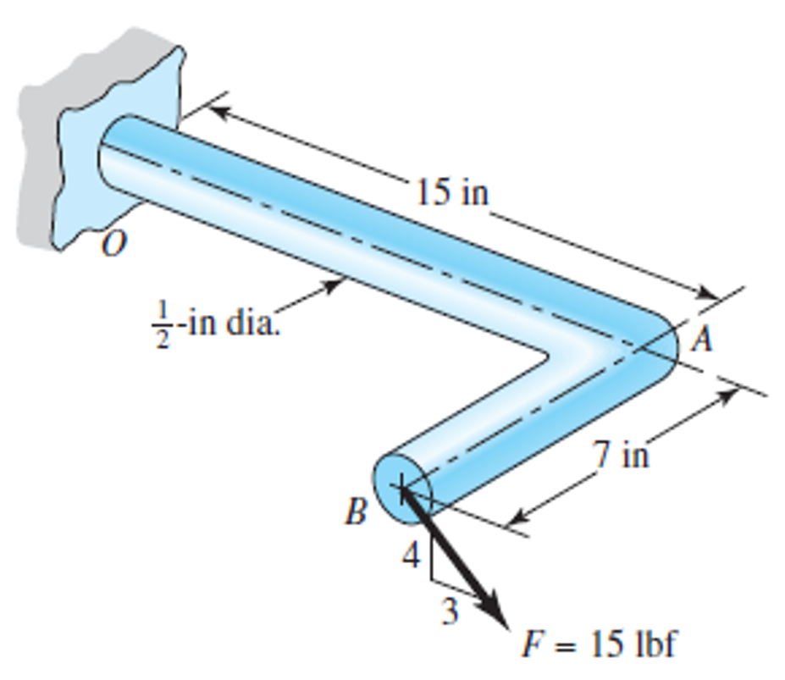
Figure P5.36
M_{z}
T
y
M_{z}
P
P
x
T
z
x
Figure P5.37
A
T_{z}
B
D
x
y
C
M_{x}
y
Rigid punch
Rigid punch
Plastic
Figure P5.38
Rigid die
Plastic
F
Rigid die
y
y
A
z
x
z
B
D
C

Slide 10
B
A
l
Rod
x
Rigid arm
y
F
a
z

