Slide 1
CHAP 6 FINITE ELEMENTS FOR PLANE SOLIDS
FINITE ELEMENT ANALYSIS AND DESIGN
Nam-Ho Kim

Slide 2
INTRODUCTION
Plane Solids
All engineering problems are 3-D. It is the engineer who approximates the problem using 1-D (beam or truss) or 2-D (plane stress or strain).
Stress and strain are either zero or constant in the direction of the thickness.
System of coupled second-order partial differential equation
Plane stress and plane strain: different constraints imposed in the thickness direction
Plane stress: zero stresses in the thickness direction (thin plate with in-plane forces)
Plane strain: zero strains in the thickness direction (thick solid with constant thickness, gun barrel)
Main variables: u (x-displacement) and v (y-displacement)

Slide 3
TYPES OF 2D PROBLEMS
Governing D.E.
Definition of strain
Stress-Strain Relation
Since stress involves first-order derivative of displacements, the governing differential equation is the second-order
b_{y}
b_{x}

Slide 4
TYPES OF 2D PROBLEMS cont.
Boundary Conditions
All differential equations must be accompanied by boundary conditions
S_{g} is the essential boundary and S_{T} is the natural boundary
g: prescribed (specified) displacement (usually zero for linear problem)
T: prescribed (specified) surface traction force
Objective: to determine the displacement fields u(x, y) and v(x, y) that satisfy the D.E. and the B.C.

Slide 5
PLANE STRESS PROBLEM
Plane Stress Problem:
Thickness is much smaller than the length and width dimensions
Thin plate or disk with applied in-plane forces
z-directional stresses are zero at the top and bottom surfaces
Thus, it is safe to assume that they are also zero along the thickness
Non-zero stress components: σ_{xx}, σ_{yy}, τ_{xy}
Non-zero strain components: ε_{xx}, ε_{yy}, ε_{xy}, ε_{zz}

Slide 6
PLANE STRESS PROBLEM cont.
Stress-strain relation
Even if ε_{zz} is not zero, it is not included in the stress-strain relation because it can be calculated from the following relation:
How to derive plane stress relation?
Solve for ε_{zz} in terms of ε_{xx} and ε_{yy} from the relation of σ_{zz} = 0 and Eq. (1.57)
Write σ_{xx} and σ_{yy} in terms of ε_{xx} and ε_{yy}

Slide 7
PLANE STRAIN PROBLEM
Plane Strain Problem
Thickness dimension is much larger than other two dimensions.
Deformation in the thickness direction is constrained.
Strain in z-dir is zero
Non-zero stress components: σ_{xx}, σ_{yy}, τ_{xy}, σ_{zz}.
Non-zero strain components: ε_{xx}, ε_{yy}, ε_{xy}.

Slide 8
PLANE STRAIN PROBLEM cont.
Plan Strain Problem
Stress-strain relation
Even if σ_{zz} is not zero, it is not included in the stress-strain relation because it can be calculated from the following relation:

Slide 9
EQUIVALENCE
A single program can be used to solve both the plane stress and plane strain problems by converting material properties.
From → To | E | ν
Plane strain → Plane stress
Plane stress → Plane strain

Slide 10
PRINCIPLE OF MINIMUM POTENTIAL ENERGY
Strain Energy
energy that is stored in the structure due to the elastic deformation
h: thickness, [C] = [C_{σ}] for plane stress, and [C] = [C_{ε}] for plane strain.
stress and strain are constant throughout the thickness.
The linear elastic relation {σ} = [C]{ε} has been used in the last relation.

Slide 11
PRINCIPLE OF MINIMUM POTENTIAL ENERGY cont.
Potential Energy of Applied Loads
Force acting on a body reduces potential to do additional work.
Negative of product of the force and corresponding displacement
Concentrated forces
F_{i} and q_{i} are in the same direction
Reaction force does not have any potential (because q_{i} = 0)
Distributed forces (pressure load) acting on the edge
A
h
z
S_{T}
y
{T_{x},T_{y}}
x

Slide 12
PRINCIPLE OF MINIMUM POTENTIAL ENERGY cont.
Total Potential Energy
Net energy contained in the structure
Sum of the strain energy and the potential energy of applied loads
Principle of Minimum Potential Energy
The structure is in equilibrium status when the potential energy has a minimum value.
Finite Element Equation

Slide 13
CST ELEMENT
Constant Strain Triangular Element
Decompose two-dimensional domain by a set of triangles.
Each triangular element is composed by three corner nodes.
Each element shares its edge and two corner nodes with an adjacent element
Counter-clockwise or clockwise node numbering
Each node has two DOFs: u and v
displacements interpolation using the shape functions and nodal displacements.
Displacement is linear because three nodal data are available.
Stress & strain are constant.
y
v₃
3
u₃
v₁
1
u₁
v₂
u₂
2
x

Slide 14
CST ELEMENT cont.
Displacement Interpolation
Since two-coordinates are perpendicular, u(x,y) and v(x,y) are separated.
u(x,y) needs to be interpolated in terms of u₁, u₂, and u₃, and v(x,y) in terms of v₁, v₂, and v₃.
interpolation function must be a three term polynomial in x and y.
Since we must have rigid body displacements and constant strain terms in the interpolation function, the displacement interpolation must be of the form
The goal is how to calculate unknown coefficients α_{i} and β_{i}, i = 1, 2, 3, in terms of nodal displacements.

Slide 15
CST ELEMENT cont.
Displacement Interpolation
x-displacement: Evaluate displacement at each node
In matrix notation
Is the coefficient matrix singular?
v₃
3
u₃
v₁
u₁
v₂
1
u₂
2

Slide 16
CST ELEMENT cont.
Displacement Interpolation
where
Area:

Slide 17
CST ELEMENT cont.
Insert to the interpolation equation
N₁(x,y)
N₂(x,y)
N₃(x,y)

Slide 18
CST ELEMENT cont.
Displacement Interpolation
A similar procedure can be applied for y-displacement v(x, y).
N₁, N₂, and N₃ are linear functions of x- and y-coordinates.
Interpolated displacement changes linearly along the each coordinate direction.
Shape Function

Slide 19
CST ELEMENT cont.
Displacement Interpolation
Matrix Notation
[N]: 2×6 matrix, {q}: 6×1 vector.
For a given point (x,y) within element, calculate [N] and multiply it with {q} to evaluate displacement at the point (x,y).

Slide 20
CST ELEMENT cont.
Strain Interpolation
differentiating the displacement in x- and y-directions.
differentiating shape function [N] because {q} is constant.

Slide 21
CST ELEMENT cont.
Strain Interpolation
[B] matrix is a constant matrix and depends only on the coordinates of the three nodes of the triangular element.
the strains will be constant over a given element

Slide 22
CST ELEMENT cont.
Property of CST Element
Since displacement is linear in x and y, the triangular element deforms into another triangle when forces are applied.
an imaginary straight line drawn within an element before deformation becomes another straight line after deformation.
Consider a local coordinate ξ such that ξ = 0 at Node 1 and ξ = a at Node 2.
Displacement on the edge 1-2:
Since the variation of displacement is linear, the displacements should depend only on u₁ and u₂, and not on u₃.
3
1
a
ξ
2

Slide 23
CST ELEMENT cont.
3
Property of CST Element
Inter-element Displacement Compatibility
Displacements at any point in an element can be computed from nodal displacements of that particular element and the shape functions.
Consider a point on a common edge of two adjacent elements, which can be considered as belonging to either of the elements.
Then the nodes of either triangle can be used in interpolating the displacements of this point.
However, one must obtain a unique set of displacements independent of the choice of the element.
This can be true only if the displacements of the points depend only on the nodes common to both elements.
Element 1
1
a
1
x
2
Element 2
3
2

Slide 24
EXAMPLE - Interpolation
nodal displacements {u₁, v₁, u₂, v₂, u₃, v₃, u₄, v₄} = {−0.1, 0, 0.1, 0, −0.1, 0, 0.1, 0}
Element 1: Nodes 1-2-4
y
(0,1)
(1,1)
4
3
2
1
1
2
x
(0,0)
(1,0)

Slide 25
EXAMPLE – Interpolation cont.
y
Element 2: Nodes 2-3-4
(0,1)
(1,1)
4
3
2
1
1
2
x
(0,0)
(1,0)
Strains are discontinuous along the element boundary

Slide 26
CST ELEMENT cont.
Strain Energy:
Element Stiffness Matrix:
Different from the truss and beam elements, transformation matrix [T] is not required in the two-dimensional element because [k] is constructed in the global coordinates.
The strain energy of the entire solid is simply the sum of the element strain energies
assembly

Slide 27
CST ELEMENT cont.
Potential energy of concentrated forces at nodes
Potential energy of distributed forces along element edges
Surface traction force {T} = [T_{x}, T_{y}]^{T} is applied on the element edge 1-2
y
3
T_{y}
1
s
T_{x}
2
x
{T}={T_{x},T_{y}}

Slide 28
CST ELEMENT cont.
Rewrite with all 6 DOFs
Constant surface traction
Work-equivalent nodal forces
Equally divided to two nodes

Slide 29
CST ELEMENT cont.
3
3
hlT_{y}/2
T_{y}
1
1
hlT_{x}/2
hlT_{y}/2
S
T_{x}
2
hlT_{x}/2
2
Potential energy of distributed forces of all elements

Slide 30
CST ELEMENT cont.
Potential energy of body forces
distributed over the entire element (e.g. gravity or inertia forces).
Potential energy of body forces for all elements

Slide 31
CST ELEMENT cont.
Total Potential Energy
Principle of Minimum Potential Energy
Assembly and applying boundary conditions are identical to other elements (beam and truss).
Stress and Strain Calculation
Nodal displacement {q^{(e)}} for the element of interest needs to be extracted
Finite Element Matrix Equation for CST Element
Stress and strain are constant for CST element

Slide 32
EXAMPLE 8.1
20
N₄
Cantilevered Plate
Thickness h = 0.1 in, E = 30×10⁶ psi and ν = 0.3.
Element 1
Area = 0.5×10×10 = 50.
15
N₃
50,000 lbs
E₂
10
E₁
5
N₂
50,000 lbs
N₁
10

Slide 33
EXAMPLE 8.1 cont.
Matrix [B]
Plane Stress Condition

Slide 34
EXAMPLE 8.1 cont.
Stiffness Matrix for Element 1
Element 2: Nodes 1-3-4

Slide 35
EXAMPLE 8.1 cont.
Matrix [B]
Stiffness Matrix

Slide 36
EXAMPLE 8.1 cont.
Assembly
R_{x1}, R_{y1}, R_{x4}, and R_{y4} are unknown reactions at nodes 1 and 4
displacement boundary condition u₁ = v₁ = u₄ = v₄ = 0
Symmetric

Slide 37
EXAMPLE 8.1 cont.
Reduced Matrix Equation and Solution

Slide 38
EXAMPLE 8.1 cont.
Element Results
Element 1

Slide 39
EXAMPLE 8.1 cont.
Element Results
Element 2

Slide 40
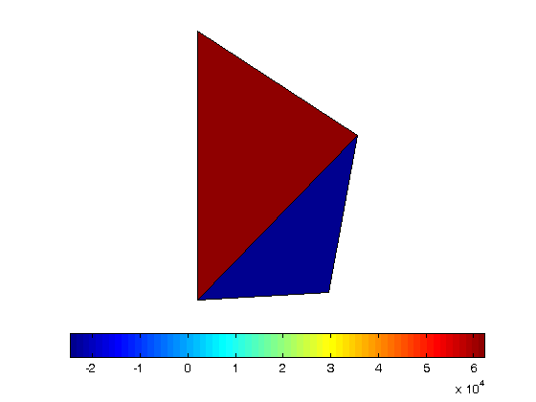
DISCUSSION
These stresses are constant over respective elements.
large discontinuity in stresses across element boundaries

Slide 41
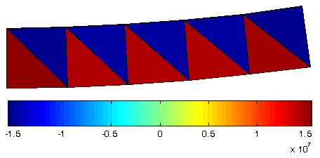
BEAM BENDING EXAMPLE
-F
2
4
6
8
10
5
1 m
1
3
7
9
5 m
F
Max v = 0.0018
σ_{xx} is constant along the x-axis and linear along y-axis
Exact Solution: σ_{xx} = 60 MPa
Max deflection v_{max} = 0.0075 m
σ_{xx}
x

Slide 42
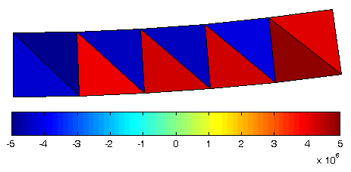
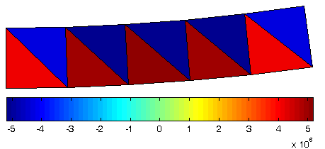
BEAM BENDING EXAMPLE cont.
y-normal stress and shear stress are supposed to be zero.
σ_{yy} Plot
τ_{xy} Plot

Slide 43
CST ELEMENT cont.
Discussions
CST element performs well when strain gradient is small.
In pure bending problem, σ_{xx} in the neutral axis should be zero. Instead, CST elements show oscillating pattern of stress.
CST elements predict stress and deflection about ¼ of the exact values.
Strain along y-axis is supposed to be linear. But, CST elements can only have constant strain in y-direction.
CST elements also have spurious shear strain.
3
v₂
1
2
How can we improve accuracy?
What direction?
u₂

Slide 44
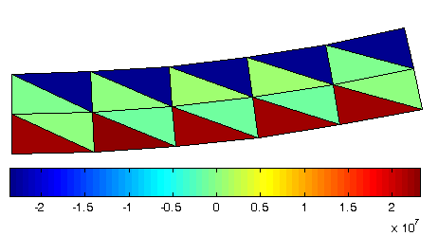
CST ELEMENT cont.
Two-Layer Model
σ_{xx} = 2.32 × 10⁷
v_{max} = 0.0028

Slide 45
RECTANGULAR ELEMENT
Each edge is parallel to the coordinate direction (not practical)
Lagrange interpolation for shape function calculation
Interpolation:
4
3
y
?
1
2
x

Slide 46
LAGRANGE INTERPOLATION
Interpolation
x₁
u₁
x
u(x)
x₂
u₂

Slide 47
RECTANGULAR ELEMENT cont.
u_{II}
Lagrange Interpolation
Along edge 1-2, y = y₁ (constant)
Along edge 4-3, y = y₃ (constant)
4
3
y
1
u_{I}
2
x

Slide 48
RECTANGULAR ELEMENT cont.
u_{II}
Lagrange Interpolation
Y-direction
Combine together
4
3
y
1
u_{I}
2
x

Slide 49
RECTANGULAR ELEMENT cont.
Lagrange Interpolation

Slide 50
RECTANGULAR ELEMENT cont.
Shape functions for rectangular elements are product of Lagrange interpolations in the two coordinate directions.
Note that N₁(x, y) is:
1 at node 1 and 0 at other nodes.
Linear function of x along edge 1-2 and linear function of y along edge 1-4.
Zero along edge 2-3 and 3-4.
Other shape functions have similar behavior.
N₁
4
3
1
2

Slide 51
RECTANGULAR ELEMENT cont.
Displacement interpolation
Same interpolation for both u and v.

Slide 52
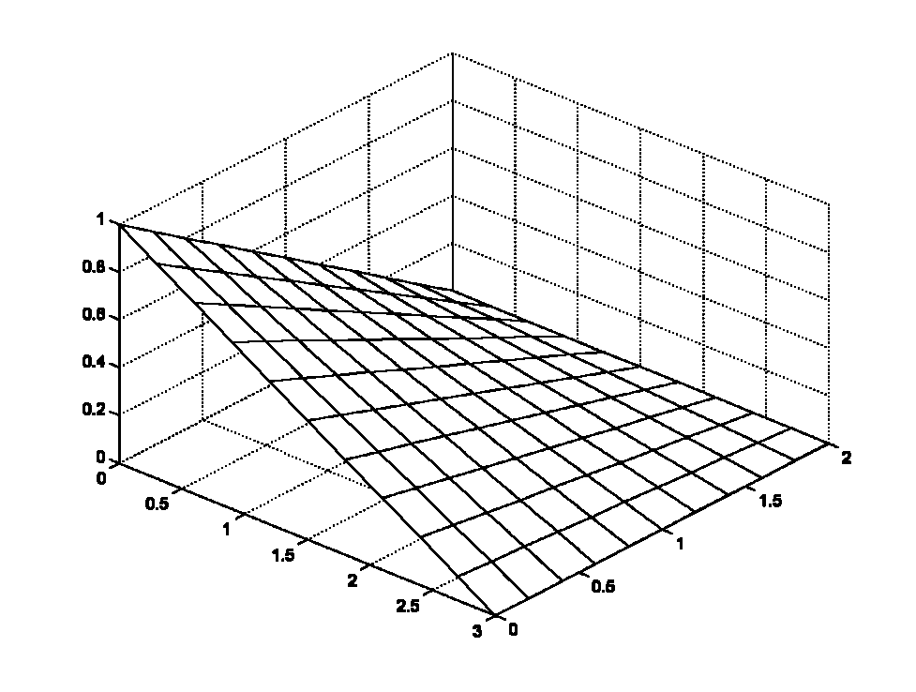
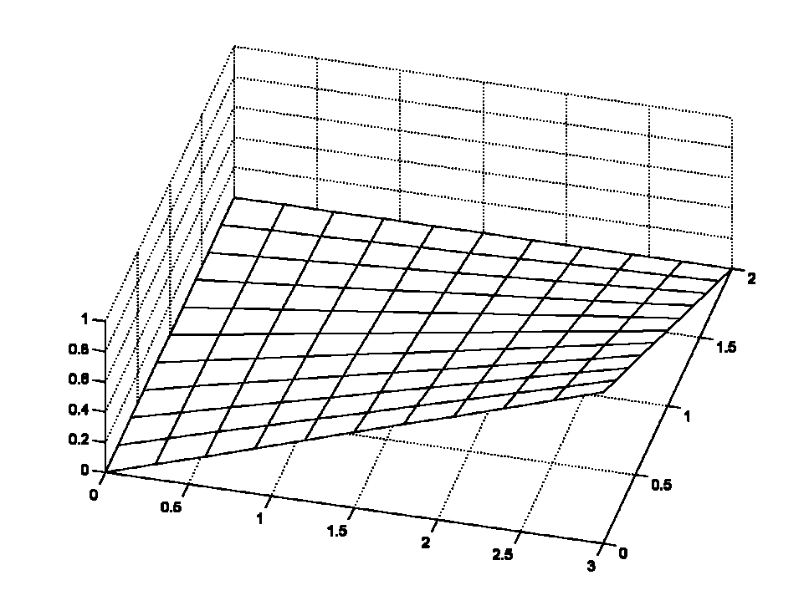
EXAMPLE 8.2
Shape Functions
y
4 (0,2)
3 (3,2)
x
1 (0,0)
2 (3,0)
N₁
N₂

Slide 53
RECTANGULAR ELEMENT cont.
Strain-displacement relation
Similar to CST element
[B] is a linear function of x and y.
Strain will change linearly within the element (not completely linear in both directions)

Slide 54
RECTANGULAR ELEMENT cont.
Element stiffness matrix (from strain energy)
Generally needs numerical integration
A square, plane-stress, rectangular element:

Slide 55
RECTANGULAR ELEMENT cont.
Nodal and distributed forces are the same with CST element
Body force (constant body force b = {b_{x}, b_{y}}^{T})
Equally divide the total magnitude of the body force to the four nodes

Slide 56
EXAMPLE – SIMPLE SHEAR
y
E = 10 GPa, v = 0.25, h=0.1m
F = 100 kN/m2
{Q_{s}} = {u₁, v₁, u₂, v₂, u₃, v₃, u₄, v₄}^{T}.
Non-zero DOFs: u₃ and u₄.
Stiffness matrix
FEM equation (after applying BC)
Nodal displacements
4
f
3
1 m
1 m
1
2
x

Slide 57
EXAMPLE – SIMPLE SHEAR cont.
Strain & Stress
Deformed shape
Undeformed shape

Slide 58
EXAMPLE – PURE BENDING
y
Couple M = 100 kN.m
Analytical solution
FEM solution
Non-zero DOFs: u₂, v₂, u₃, and v₃.
f
4
3
1 m
1 m
1
2
f
x

Slide 59
EXAMPLE – PURE BENDING cont.
Strain & Stress
Undeformed shape
Unable to make curvature
Trapezoidal shape -> non-zero shear stress
(σ_{xx})_{max} /(σ_{xx})_{exact} = 4.364/6.0 (73%)
Deformed shape

Slide 60
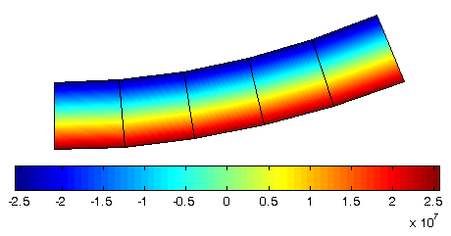
BEAM BENDING PROBLEM cont.
Sxx Plot
Stress is constant along the x-axis (pure bending)
linear through the height of the beam
Deflection is much higher than CST element. In fact, CST element is too stiff. However, stress is inaccurate.
Max v = 0.0051

Slide 61
BEAM BENDING PROBLEM cont.
Caution:
In numerical integration, we did not calculate stress at node points. Instead, we calculate stress at integration points.
Let’s calculate stress at the bottom surface for element 1 in the beam bending problem.
Nodal Coordinates:1(0,0), 2(1,0), 3(1,1), 4(0,1)
Nodal Displacements:
u = [0, 0.0002022, -0.0002022, 0]
v = [0, 0.0002022, 0.0002022, 0]
Shape functions and derivatives
4(0,1)
3(1,1)
1(0,0)
2(1,0)

Slide 62
BEAM BENDING PROBLEM cont.
4
3
At bottom surface, y = 0
Strain
Stress:
1
2
u = [0, 0.0002022, -0.0002022, 0]
v = [0, 0.0002022, 0.0002022, 0]

Slide 63
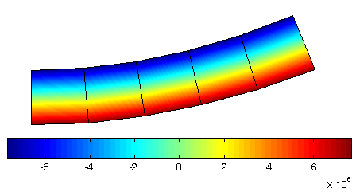
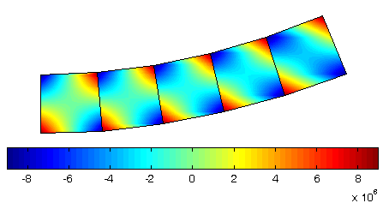
RECTANGULAR ELEMENT
y-normal stress and shear stress are supposed to be zero.
σ_{yy} Plot
τ_{xy} Plot
ε_{xx} is a linear function of y alone
ε_{yy} is a linear function of x alone
γ_{xy} is a linear function of x and y

Slide 64
RECTANGULAR ELEMENT
Discussions
Can’t represent constant shear force problem because ε_{xx} must be a linear function of x.
Even if ε_{xx} can represent linear strain in y-direction, the rectangular element can’t represent pure bending problem accurately.
Spurious shear strain makes the element too stiff.
Exact
Rectangular element

Slide 65
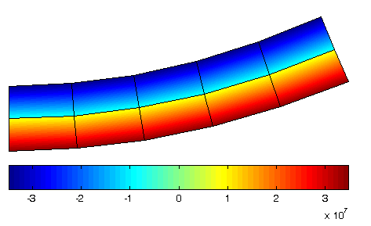
RECTANGULAR ELEMENT
Two-Layer Model
σ_{xx} = 3.48×10⁷
v_{max} = 0.0053

Slide 66
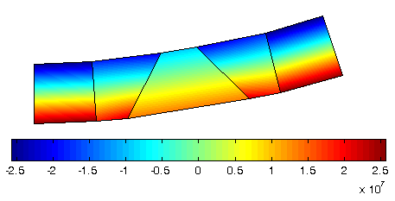
BEAM BENDING PROBLEM cont.
Distorted Element
As element is distorted, the solution is not accurate any more.
Max v = 0.004

Slide 67
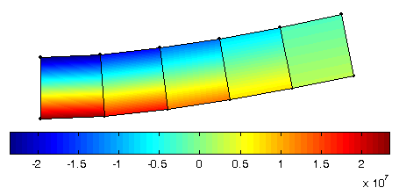
BEAM BENDING PROBLEM cont.
Constant Shear Force Problem
Sxx is supposed to change linearly along x-axis. But, the element is unable to represent linear change of stress along x-axis. Why?
Exact solution: v = 0.005 m and σ_{xx} = 6e7 Pa.
Max v = 0.0035

Slide 68
BEAM BENDING PROBLEM cont.
4
7
3
Higher-Order Element?
8-Node Rectangular Element
Strain
Can this element accurately represent pure bending and constant shear force problem?
8
6
1
5
2

Slide 69
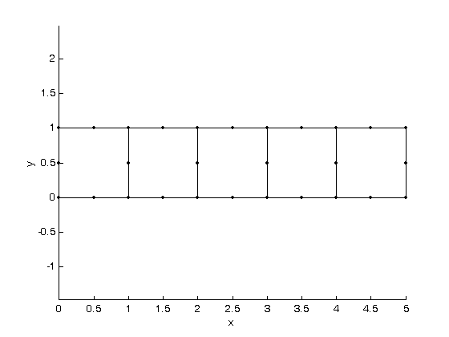
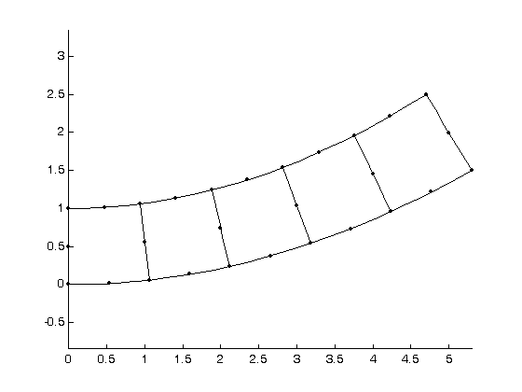
BEAM BENDING PROBLEM cont.
8-Node Rectangular Elements
Tip Displacement = 0.0075 m, Exact!

Slide 70
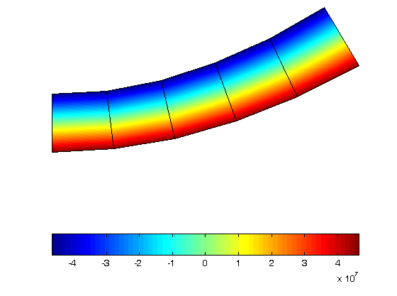
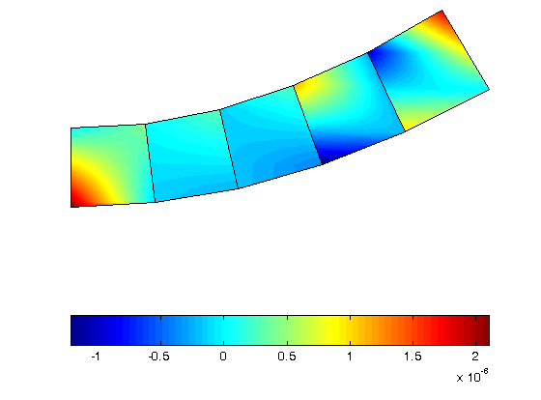
BEAM BENDING PROBLEM cont.
If the stress at the bottom surface is calculated, it will be the exact stress value.
Sxx
Syy

Slide 71
ISOPARAMETRIC ELEMENT
Quadrilateral Shape
Most commonly used element (irregular shape)
Generalization of rectangular element
Use mapping to transform into a square (Reference element).
The relationship between (x, y) and (s, t) must be obtained.
All formulations are done in the reference element.
v₃
y
v₄
t
3
u₃
4 (-1,1)
4
u₄
3 (1,1)
v₁
s
1
u₁
v₂
u₂
1 (-1,-1)
2 (1,-1)
2
x
Actual Element (x, y)
Parent Element (s, t)

Slide 72
ISOPARAMETRIC MAPPING
Definition
the same interpolation method is used for displacement and geometry.
Procedure
Construct the shape functions N₁, N₂, N₃, and N₄ at the reference element
t
4 (-1,1)
3 (1,1)
s
1 (-1,-1)
2 (1,-1)

Slide 73
ISOPARAMETRIC MAPPING cont.
y
t
3
4
4 (-1,1)
3 (1,1)
s
1
1 (-1,-1)
2 (1,-1)
2
x
Proportional mapping
For a given (x,y), find corresponding (s,t).
For a given (s,t), find corresponding (x,y).

Slide 74
ISOPARAMETRIC MAPPING cont.
Use the shape functions for interpolating displacement and geometry.
For a given value of (s,t) in the parent element, the corresponding point (x,y) in the actual element and displacement at that point can be obtained using the mapping relationship.
Displacement interpolation
Geometry interpolation

Slide 75
EXAMPLE
Find mapping point of A in the physical element
At point A, (s, t) = (0.5, 0.5)
Physical coord
y
t
3 (2,4)
4 (−1,1)
3 (1,1)
2 (4,4)
A (.5,.5)
B (1,2)
s
x
2 (1,−1)
4 (0,0)
1 (6,0)
1 (−1,−1)

Slide 76
EXAMPLE cont.
Find mapping point of B in the reference element
At point B, (x, y) = (1, 2)
Thus, (s, t) = (0, 1)

Slide 77
JACOBIAN OF MAPPING
Shape functions are given in (s,t). But, we want to differentiate w.r.t. (x,y) in order to calculate strain and stress. Use chain rule of differentiation.
In Matrix Form
Matrix [J] is called the Jacobian matrix of mapping.
How to calculate matrix [J]?

Slide 78
JACOBIAN OF MAPPING cont.
Derivatives of shape functions w.r.t. (x,y) coordinates:
Determinant |J|: Jacobian
What happen if |J| = 0 or |J| < 0?
shape function derivative cannot be obtained if the |J| = 0 anywhere in the element
Mapping relation between (x, y) and (s, t) is not valid if |J| = 0 or |J| < 0 anywhere in the element (–1 ≤ s, t ≤ 1).

Slide 79
JACOBIAN OF MAPPING cont.
Jacobian is an important criterion for evaluating the validity of mapping, as well as the quality of element
Every point in the reference element should be mapped into the interior of the physical element
When an interior point in (s, t) coord. is mapped into an exterior point in the (x, y) coord., the Jacobian becomes negative
If multiple points in (s, t) coordinates are mapped into a single point in (x, y) coordinates, the Jacobian becomes zero at that point
It is important to maintain the element shape so that the Jacobian is positive everywhere in the element

Slide 80
EXAMPLE (JACOBIAN)
Jacobian must not be zero anywhere in the domain (-1 ≤ s, t ≤ 1)
Nodal Coordinates
Iso-Parametric Mapping
Jacobian Matrix
y
3(2, 2)
4(0, 1)
x
1(0, 0)
2(1, 0)

Slide 81
EXAMPLE (JACOBIAN) cont.
Jacobian
It is clear that |J| > 0 for –1 ≤ s ≤ 1 and –1 ≤ t ≤ 1.
Constant s
t
4 (-1,1)
3 (1,1)
s
Constant t
1 (-1,-1)
2 (1,-1)

Slide 82
EXAMPLE (JACOBIAN) cont.
y
Nodal Coordinates
Mapping
Jacobian
4(0, 5)
3(5, 5)
2(1, 4)
1(0, 0)
x
|J| = 0 at 5 – 10s + 10t = 0; i.e., s – t = 1/2

Slide 83
EXAMPLE 8.3 (JACOBIAN) cont.
Constant s
In general the element geometry is invalid if the Jacobian is either zero or negative anywhere in the element.
Problems also arise when the Jacobian matrix is nearly singular either due to round-off errors or due to badly shaped elements.
To avoid problems due to badly shaped elements, it is suggested that the inside angles in quadrilateral elements be > 15˚ and < 165˚
Constant t
Invalid mapping
> 15º
< 165º

Slide 84
INTERPOLATION
Displacement Interpolation (8-DOF)
the interpolation is done in the reference coordinates (s, t)
The behavior of the element is similar to that of the rectangular element because both of them are based on the bilinear Lagrange interpolation

Slide 85
INTERPOLATION cont.
Strain

Slide 86
INTERPOLATION cont.
Strain cont.
The expression of [B] is not readily available because the matrix [A] involves the inverse of Jacobian matrix
The strain-displacement matrix [B] is not constant
Strain-displacement matrix

Slide 87
EXAMPLE
{u₁, v₁, u₂, v₂, u₃, v₃, u₄, v₄} = {0, 0, 1, 0, 2, 1, 0, 2}
Displacement and strain at (s,t)=(1/3, 0)?
Shape Functions
At (s,t)=(1/3, 0)
y
t
4 (0,2)
3 (3,2)
4 (-1,1)
3 (1,1)
s
x
1 (0,0)
2 (3,0)
1 (-1,-1)
2 (1,-1)

Slide 88
EXAMPLE cont.
Location at the Actual Element
Displacement at (s,t) = (1/3,0)

Slide 89
EXAMPLE cont.
Derivatives of the shape functions w.r.t. s and t.
But, we need the derivatives w.r.t. x and y. How to convert?

Slide 90
EXAMPLE cont.
Jacobian Matrix
Jacobian is positive, and the mapping is valid at this point
Jacobian matrix is constant throughout the element
Jacobian matrix only has diagonal components, which means that the physical element is a rectangle

Slide 91
EXAMPLE cont.
Derivative of the shape functions w.r.t. x and y.
Strain

Slide 92
FINITE ELEMENT EQUATION
Element stiffness matrix from strain energy expression
[k^{(e)}] is the element stiffness matrix
Integration domain is a general quadrilateral shape
Displacement–strain matrix [B] is written in (s, t) coordinates
we can perform the integration in the reference element

Slide 93
NUMERICAL INTEGRATION
Stiffness matrix and distributed load calculations involve integration over the domain
In many cases, analytical integration is very difficult
Numerical integration based on Gauss Quadrature is commonly used in finite element programs
Gauss Quadrature:
Integral is evaluated using function values and weights.
s_{i}: Gauss integration points, w_{i}: integration weights
f(s_{i}): function value at the Gauss point
n: number of integration points.

Slide 94
NUMERICAL INTEGRATION cont.
Constant Function: f(s) = 4
Use one integration point s₁ = 0 and weight w₁ = 2
The numerical integration is exact.
Linear Function: f(s) = 2s + 1
Use one integration point s₁ = 0 and weight w₁ = 2
The numerical integration is exact.
One-point Gauss Quadrature can integrate constant and linear functions exactly.

Slide 95
NUMERICAL INTEGRATION cont.
Quadratic Function: f(s) = 3s² + 2s + 1
Let’s use one-point Gauss Quadrature
One-point integration is not accurate for quadratic function
Let’s use two-point integration with w₁ = w₂ = 1 and -s₁ = s₂ =
Gauss Quadrature points and weights are selected such that n integration points can integrate (2n – 1)-order polynomial exactly.

Slide 96
NUMERICAL INTEGRATION cont.
Gauss Quadrature Points and Weights
n | Integration Points (s_{i}) | Weights (w_{i}) | Exact for polynomial of degree
1 | 0.0 | 2.0 | 1
2 | ±.5773502692 | 1.0 | 3
3 | ±.7745966692 0.0 | .5555555556 .8888888889 | 5
4 | ±.8611363116 ±.3399810436 | .3478546451 .6521451549 | 7
5 | ±.9061798459 ±.5384693101 0.0 | .2369268851 .4786286705 .5688888889 | 9

Slide 97
NUMERICAL INTEGRATION cont.
2-Dimensional Integration
multiplying two one-dimensional Gauss integration formulas
Total number of integration points = m×n.
t
t
t
s
s
s
(a) 1×1
(b) 2×2
(c) 3×3

Slide 98
NUMERICAL INTEGRATION EXAMPLE
Integrate the following polynomial:
One-point formula
Two-point formula

Slide 99
NUMERICAL INTEGRATION EXAMPLE cont.
3-point formula
4-point formula
4-point formula yields the exact solution. Why?

Slide 100
NUMERICAL INTEGRATION
Application to Stiffness Matrix Integral

Slide 101
PROJECT 2
Analysis and Design of Torque Arm
Material properties: E = 206.8 GPa, Poisson’s ratio = 0.29, thickness = 1.0 cm, mass density = 7850 kg/m³
Preliminary analysis: Knowledge from Mechanics of Materials
Convergence study on vertical displacement at the load application pt
Modify the shape of the torque arm to reduce weight
All dimensions in cm
2.5
4.2
4
1.0
2789N
Fixed
5
12
15
5066N
42

