Slide 1
f_{y}
y
f_{x}
x
Plane strain model
y
3
v₃
u₃
v₁
u₁
1
v₂
2
u₂
x
3
1
Element 1
a
1
x
2
Element 2
3
2

Slide 2
y
4
(0,1)
(1,1)
3
2
1
1
2
x
(0,0)
(1,0)
y
3
1
T_{y}
s
T_{x}
2
x
{T}={T_{x},T_{y}}^{T}
20
4
15
3
E2
50,000 lbs
10
5
E1
2
50,000 lbs
0
1
10
x

Slide 3
4
3
y
1
x
2
y
4 (0,2)
3 (3,2)
1 (0,0)
2 (3,0)
x
N₁
x
y
N₂
y
x

Slide 4
y
4
f
3
1 m
1 m
1
2
x
Undeformed shape
Deformed shape
y
f
4
3
1 m
1 m
1
2
f
x
Undeformed shape
Deformed shape

Slide 5
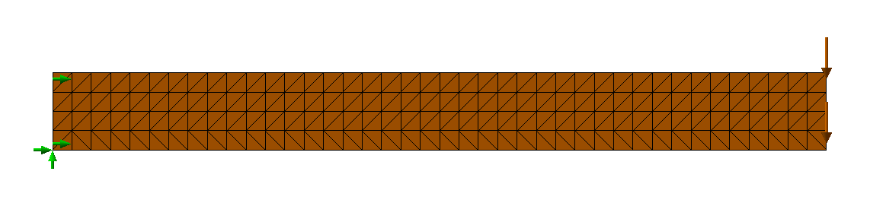
Axis
z
z\z
z
r
r
(a)
(b)
r
r + u_{r}
Axis
1
y
s
Element e
h
3
x
R_{i}
2
R_{o}
(a)
(b)

Slide 6
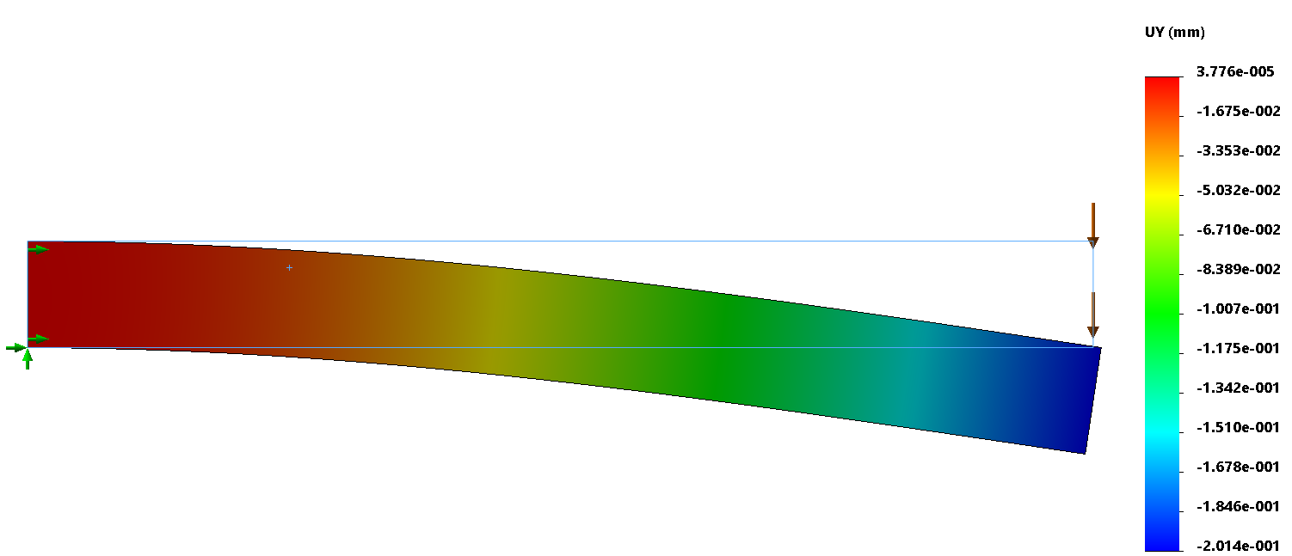
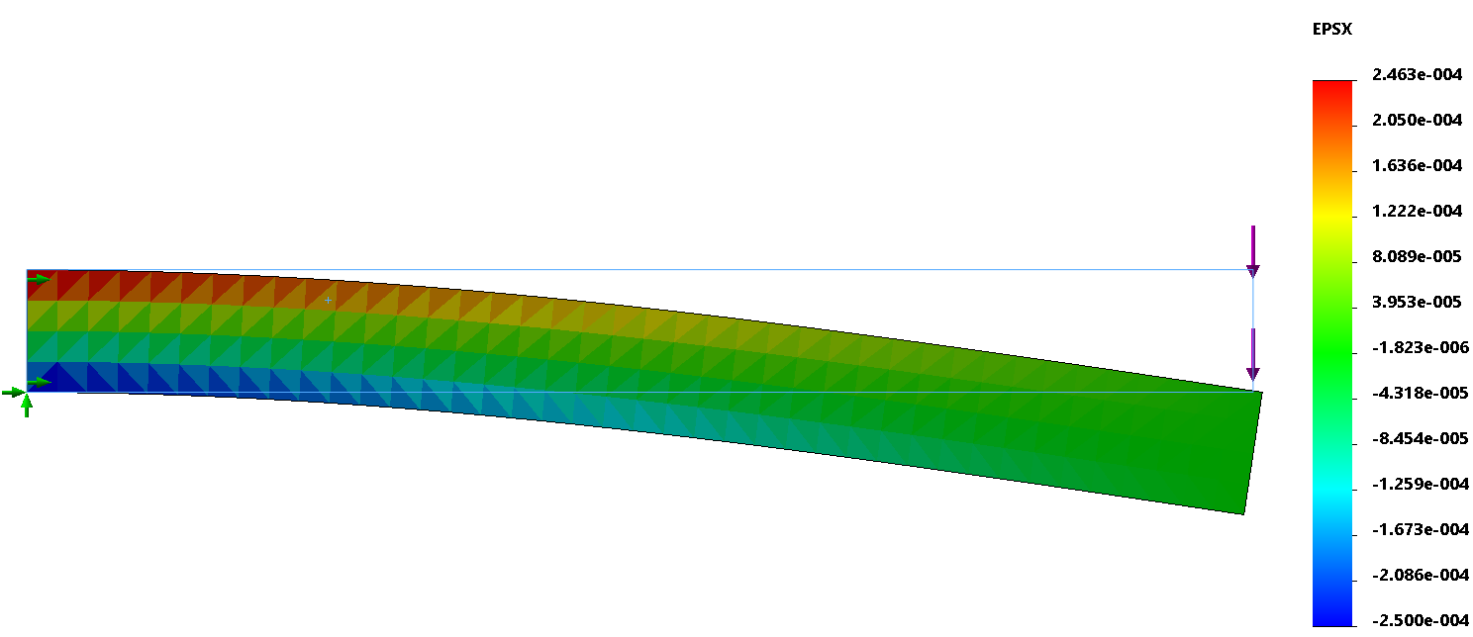
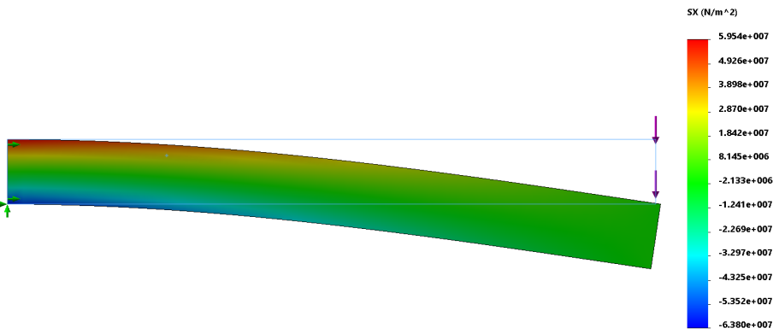
(a)
(b)
(c)

Slide 7
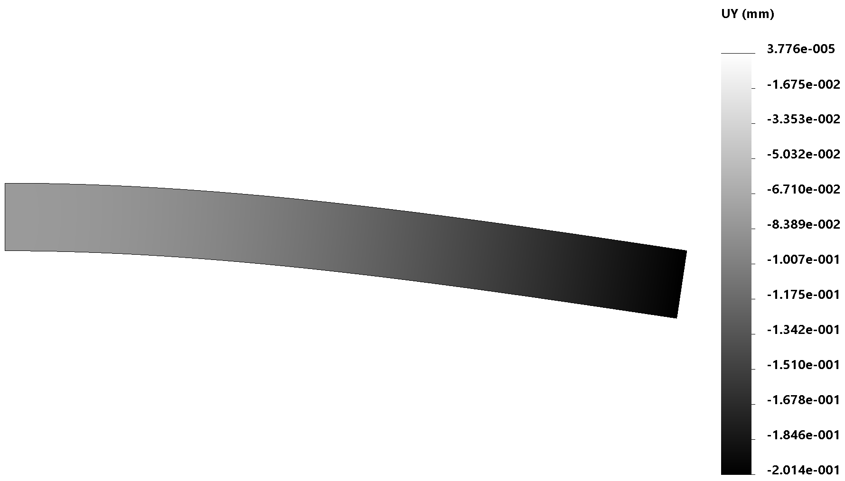
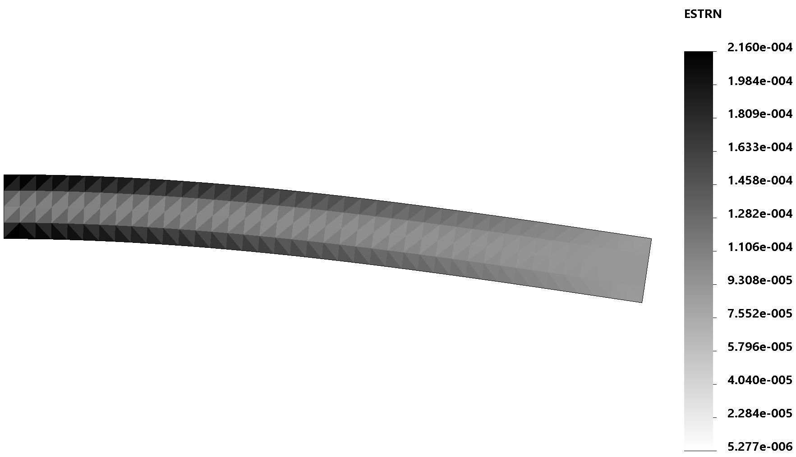
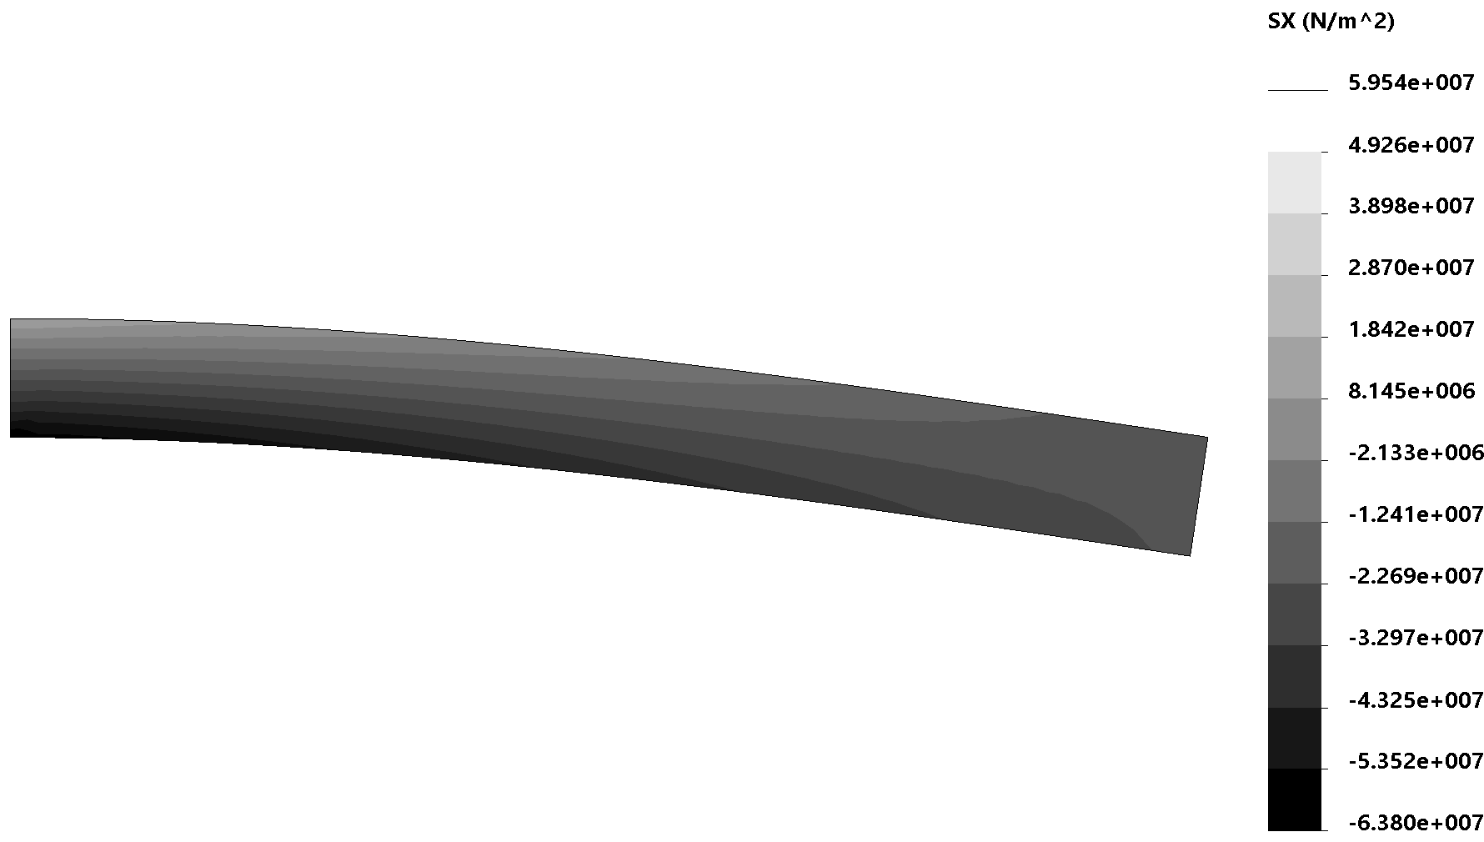
Figure 6.19: Beam deflection computed using CST elements
Figure 6.20: Computed normal strain component without smoothing
Figure 6.21: Normal stress component after smoothing

Slide 8
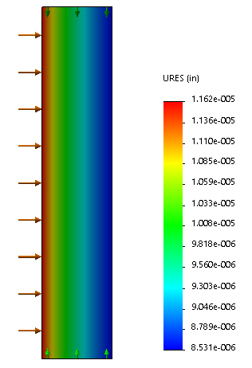
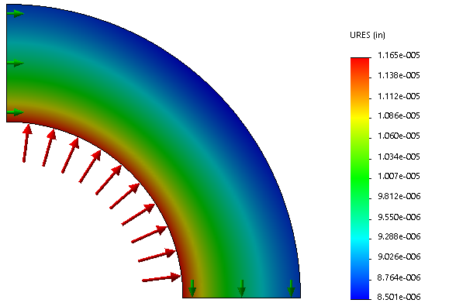
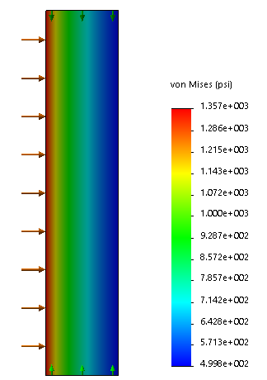
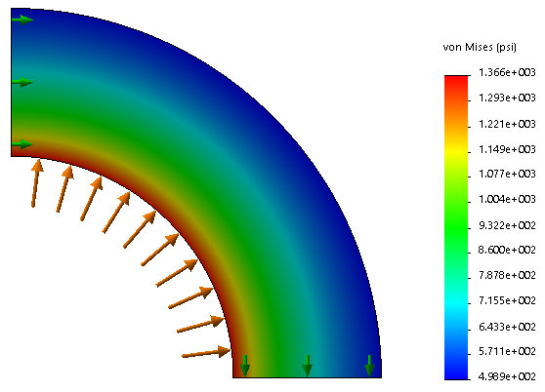
(a)
(b)
(c)
(d)
y
F₂
x
0.1 m
F₁
1 m

Slide 9
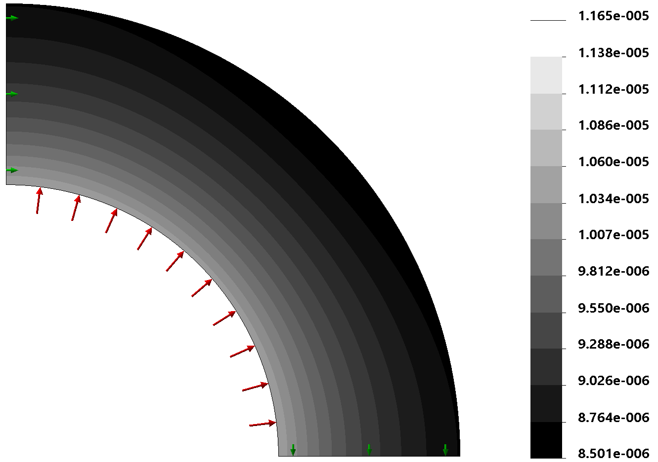
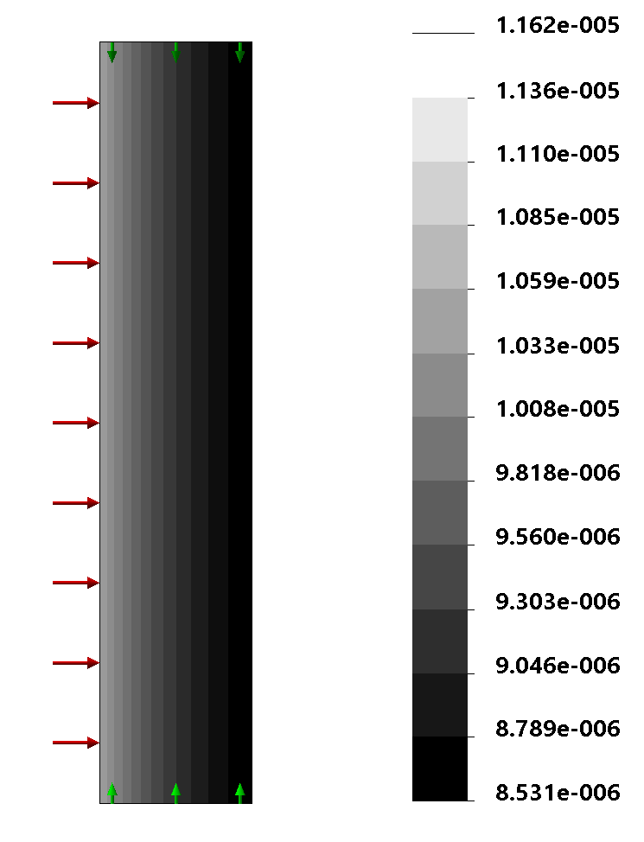

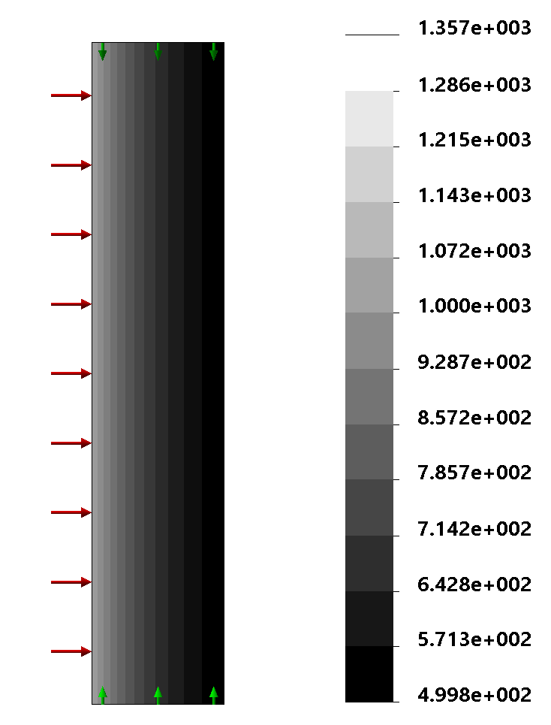
(a)
(b)
(c)
(d)
Figure 6.23: Comparison of results using Plane Strain and Axisymmetric models for the thick-walled cylinder; (a) Displacememtn magnitude with plane strain model, (b) Displacement magnitude with axisymmetric model, (c) Von Mises stress with plane strain model, (d) Von Mises stress with axisymmetric model

Slide 10
y
4
f
3
1 m
1
1 m
2
x
3 (0,20)
2 (10,10)
1 (0,0)
y
3 (0,1)
1 (0,0)
2 (1,0)
x
s_{yy} = 100 MPa
s_{yy} = 100 MPa
4
3
2 m
2
1 m
1
2
2 m
1
1 m
x
s_{yy} = 100 MPa

Slide 11
y
3 (0,4)
ξ
1 (0,0)
2 (3,0)
x
−F
2
4
6
8
10
1 m
1
3
5
7
9
5 m
F
y
4 (0,2)
3 (3,2)
1 (0,0)
2 (3,0)
x
y
4
5
6
E23
P
E24
x
1
2
3

Slide 12
y
2
4
6
E1
P
E2
x
1
3
5
(-1,1)
2
y
1
(1,1)
x
(-1,-1)
3
4
(1,-1)
y
4
3
g
1 m
1
2
x
y
2
3
p(t)
S
x
1
4

Slide 13
F
y
4 (0,2)
3 (3,2)
u₄
A
u₃
M
M
1 (0,0)
2 (3,0)
x
u₁
B
u₂
a
a
D
C
1 m
1 m
A
B
a
a = 1 mm
a
Original element
Deformed element
y
A
B
C
F
2c
x
L
L
F
−F
1
2
3
4
5
1 m
5 m
F

Slide 14
y
2 (-1,0)
x
1 (0,0)
3 (0,-1)
4
y
3
1 m
1 m
x
1
2
Original element
Deformed element
2 CST elements
4 Q4 elements
1 Q8 element
4 LST elements
f
f
f
f

Slide 15
q
q
1
2
3
1
2
3
y
x
L
L

