Slide 1
1
s
2
s = −1
s = 1
Parametric space
x = 0
x_{i}
x_{j}
x = L
Physical space
Element (e)
1
3
s
2
s = −1
s = 0
s = 1
Parametric space
x = 0
x_{i}
x_{k}
x_{j}
x = L
Physical space
Element (e)
1
3
2
s=−1
s=0
s=1
Reference element
1
3
2
x=0
x=1
x=2
Regular physical element
1
3
2
x=0
x=0.5
x=2
Irregular physical element

Slide 2
2
Mapping & Jacobian
1
Constant displacement
1.8
0.8
1.6
0.6
1.4
0.4
1.2
0.2
1
0
0.8
-0.2
0.6
-0.4
0.4
-0.6
0.2
-0.8
0
-1
-1
-0.8
-0.6
-0.4
-0.2
0
0.2
0.4
0.6
0.8
1
-1
-0.8
-0.6
-0.4
-0.2
0
0.2
0.4
0.6
0.8
1
1
Linear displacement
4
Quadratic displacement
1
3.5
1
3
2.5
1
2
1
1.5
1
1
0.5
1
0
-1
-0.8
-0.6
-0.4
-0.2
0
0.2
0.4
0.6
0.8
1
-1
-0.8
-0.6
-0.4
-0.2
0
0.2
0.4
0.6
0.8
1
2
Mapping & Jacobian
1
Constant displacement
1.8
0.8
1.6
0.6
1.4
0.4
1.2
0.2
1
0
0.8
-0.2
0.6
-0.4
0.4
-0.6
0.2
-0.8
0
-1
-1
-0.8
-0.6
-0.4
-0.2
0
0.2
0.4
0.6
0.8
1
-1
-0.8
-0.6
-0.4
-0.2
0
0.2
0.4
0.6
0.8
1
2
Linear displacement
6
Quadratic displacement
1.8
4
1.6
1.4
2
1.2
1
0
0.8
-2
0.6
0.4
-4
0.2
0
-6
-1
-0.8
-0.6
-0.4
-0.2
0
0.2
0.4
0.6
0.8
1
-1
-0.8
-0.6
-0.4
-0.2
0
0.2
0.4
0.6
0.8
1

Slide 3
T=100ºC
x
1
2
3
4
5
Element 1
Element 2
y
v₄
3
v₃
t
4
u₄
u₃
(−1,1)
(1,1)
v₁
4
3
s
1
u₁
v₂
1
2
2
u₂
(−1,−1)
(1,−1)
x
y
3
(2,4)
2
(4,4)
t
A (.5,.5)
B (1,2)
s
4
(0,0)
1
(6,0)
x
y
y
3
(2, 2)
4
(0, 5)
3
(5, 5)
4
(0, 1)
2
(1, 4)
1
(0, 0)
2
(1, 0)
1
(0, 0)
(a)
x
(b)
x

Slide 4
Constant s
Constant t
Constant s
Constant t
Invalid mapping
θ > 15º
θ < 165º
4
(0,2)
3
(3,2)
4
t
3
y
s
1
(0,0)
x
2
(3,0)
1
2

Slide 5
t
t
t
s
s
s
(a) 1×1
(b) 2×2
(c) 3×3
y
2 m
4
3
2 m
1
2
x
y
x
x-translation
y-translation
z-rotation
y
x
1
x y
x² xy y²
x³ x²y xy² y³
x⁴ x³y x²y² xy³ y⁴

Slide 6
t
4
7
3
(−1,1)
(1,1)
8
9
6
s
(−1,−1)
(1,−1)
1
5
2
t
4
7
3
(−1,1)
(1,1)
8
6
s
(−1,−1)
(1,−1)
1
5
2
4
3
8
1
5
2

Slide 7
8-node element
5-node element
4-node element
t
3
(61)
4
3
4
(−1,1)
(1,1)
E45
s
y
1
(51)
2
(57)
(−1,−1)
(1,−1)
x
1
2
Parametric space
Physical space
(−1,1)
y
(1,1)
2
1
3
x
(0,0)
s
(x₃,y₃)
(0,1)
2
(x₂,y₂)
3
1
r
(x₁,y₁)
(0,0)
(1,0)
Parametric Space
Physical Space

Slide 8
2
s
4
2
(0,1)
t
5
s
5
4
1
(0,0)
(1,0)
r
3
6
3
6
1
(0,1,0)
s
2
4
(0,0)
1
r
(1,0,0)
(0,0,1)
t
3
Parametric Space
Physical Space
s
(0,1,0)
2
5
6
9
4
8
1
r
(0,0)
(1,0,0)
10
7
(0,0,1)
3
t
Parametric Space
Real Space

Slide 9
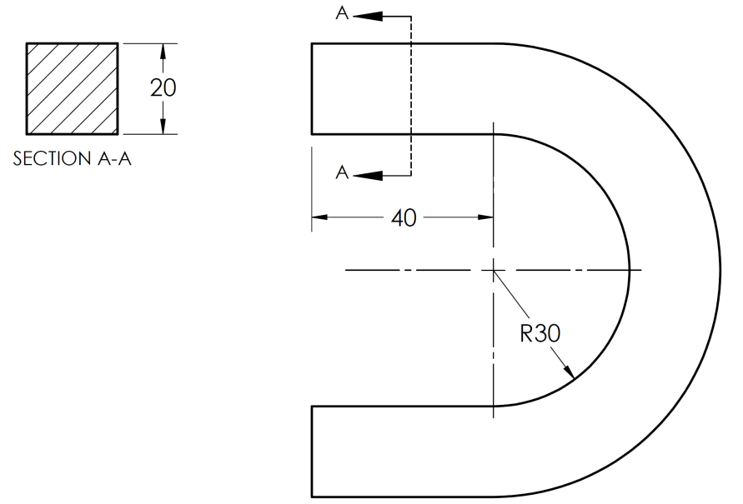
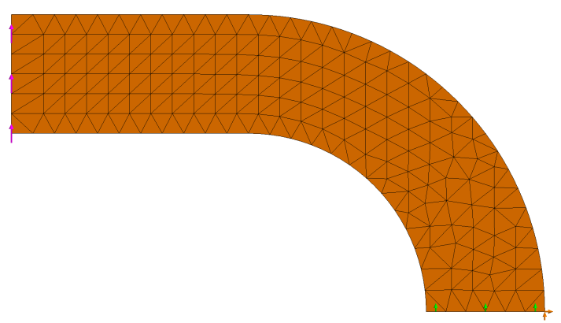
5
8
6
7
t
s
1
r
4
2
3
Parametric space
Physical space
P
P

Slide 10
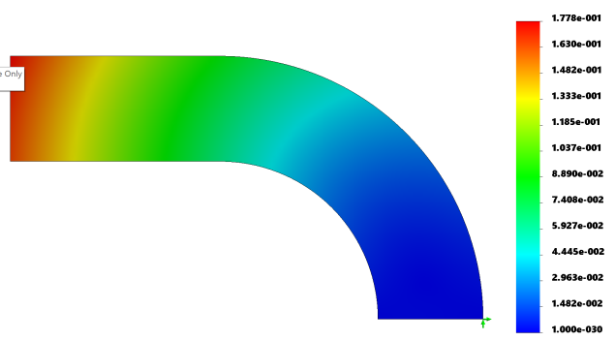
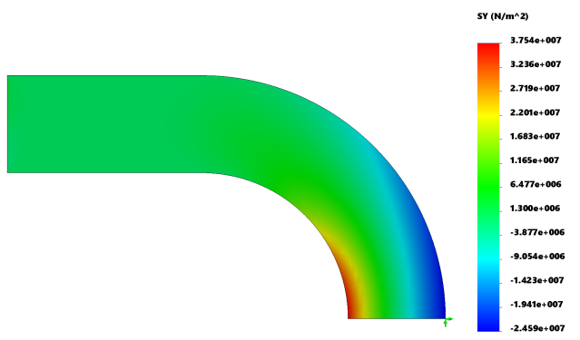
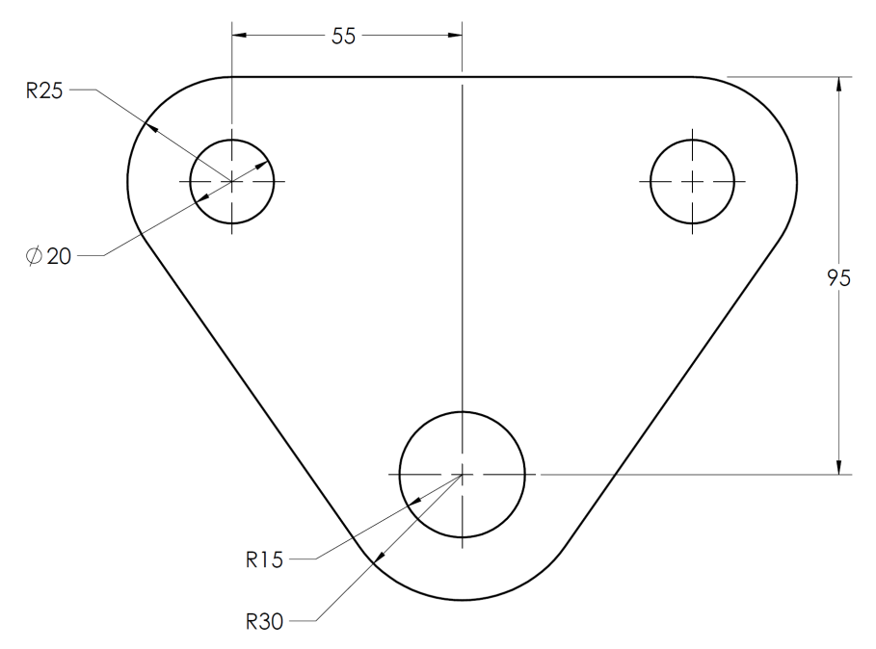
F
y
x

Slide 11
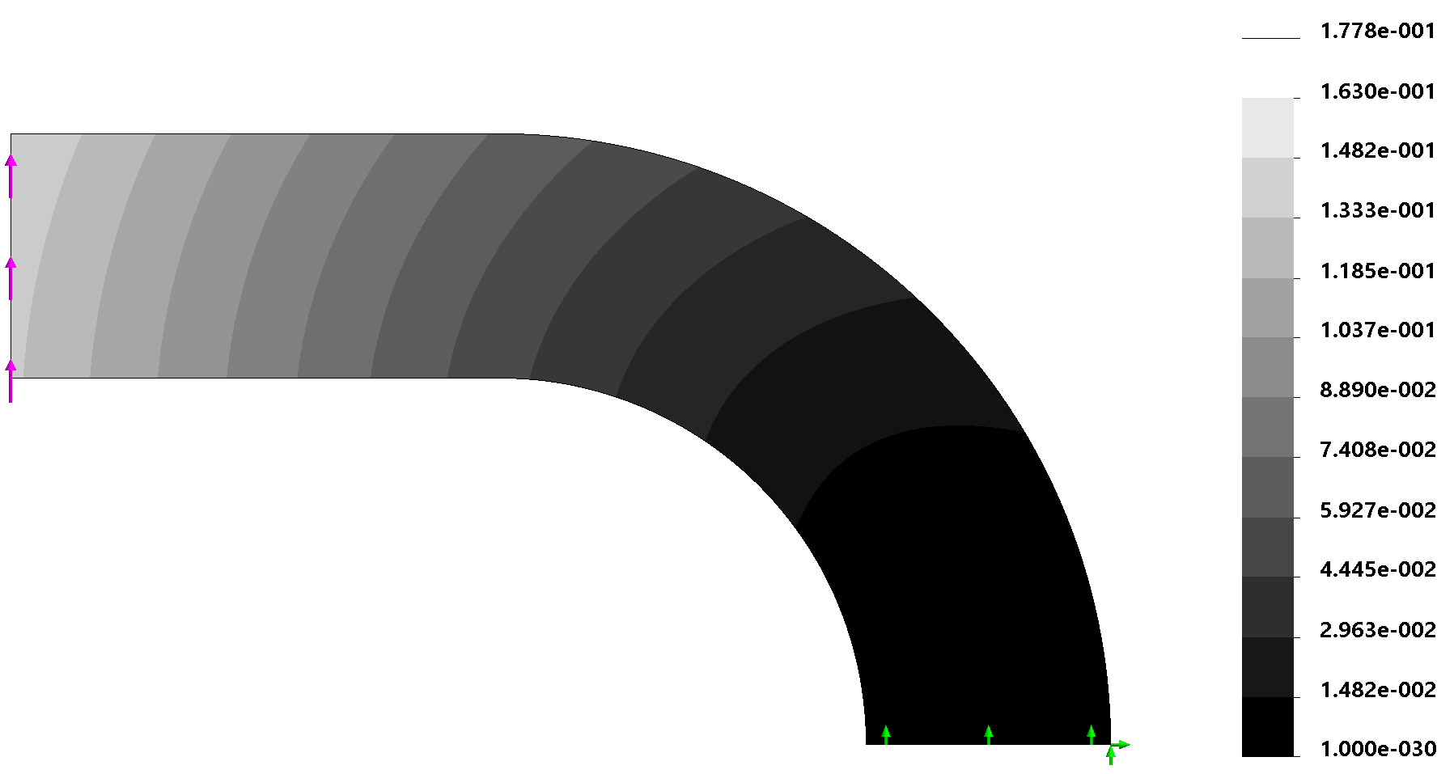
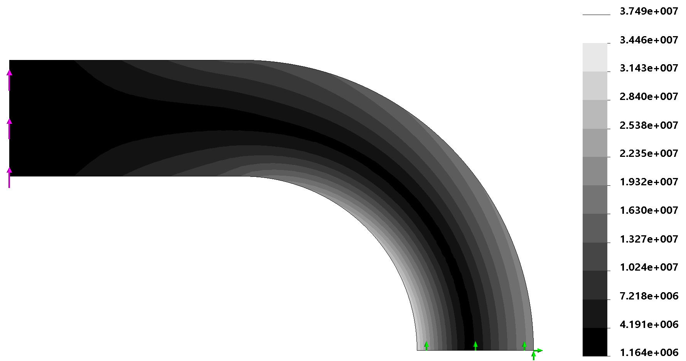
(a)
(b)
Figure 7.32: Deflection and stress distribution in U-shaped beam

Slide 12
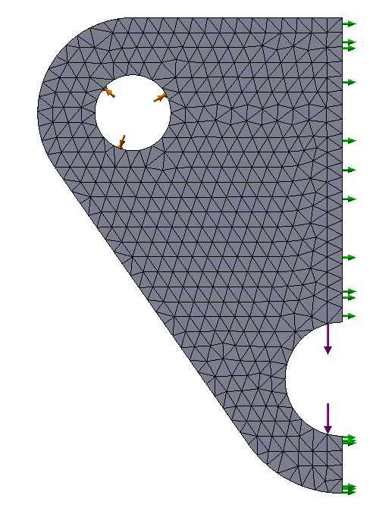
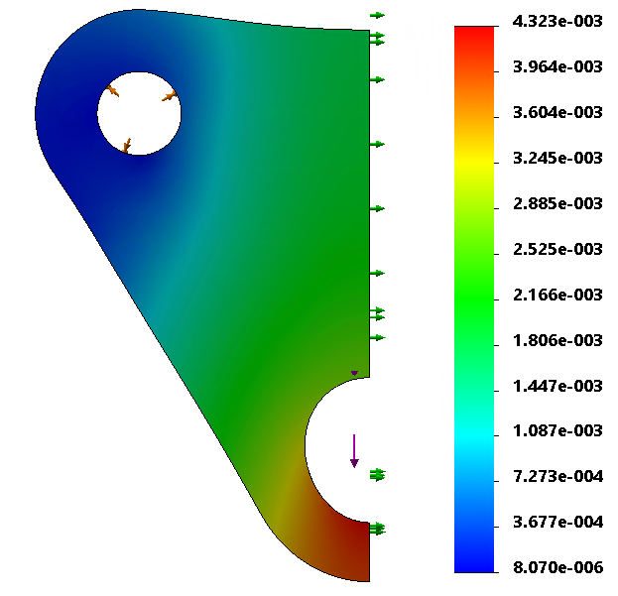
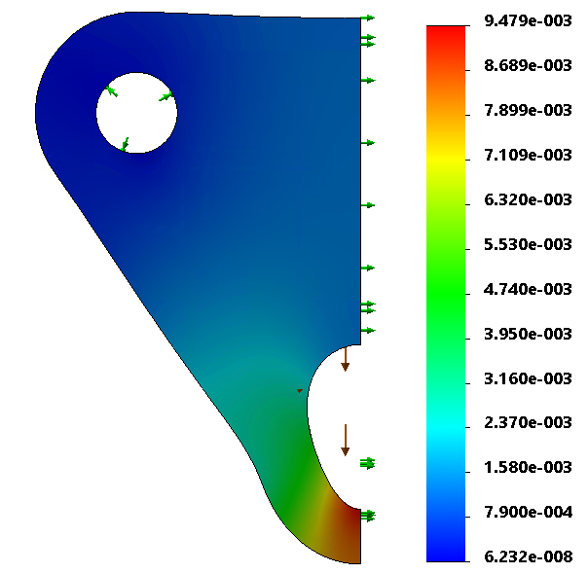
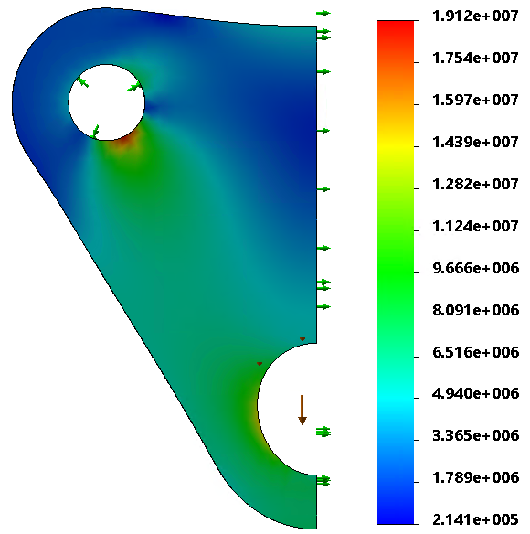
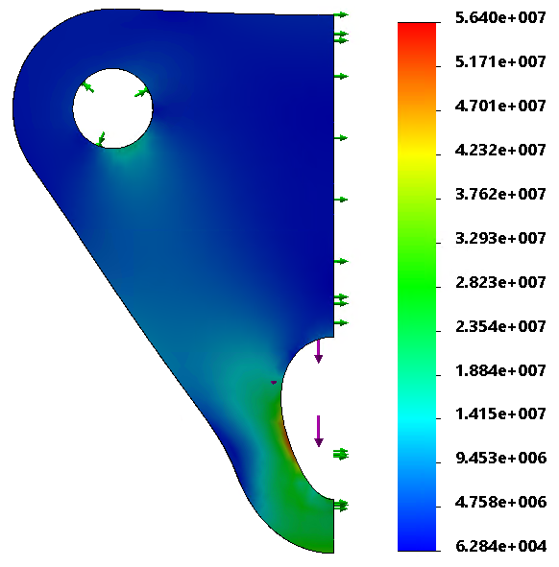

Slide 13
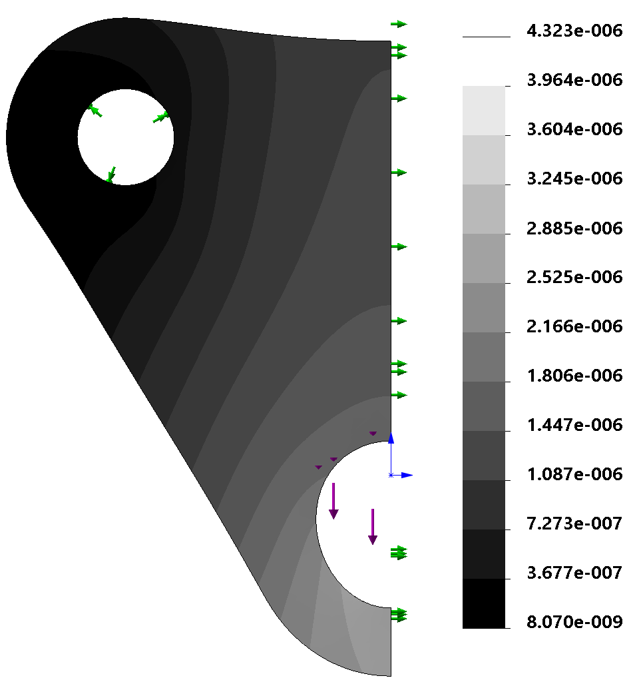
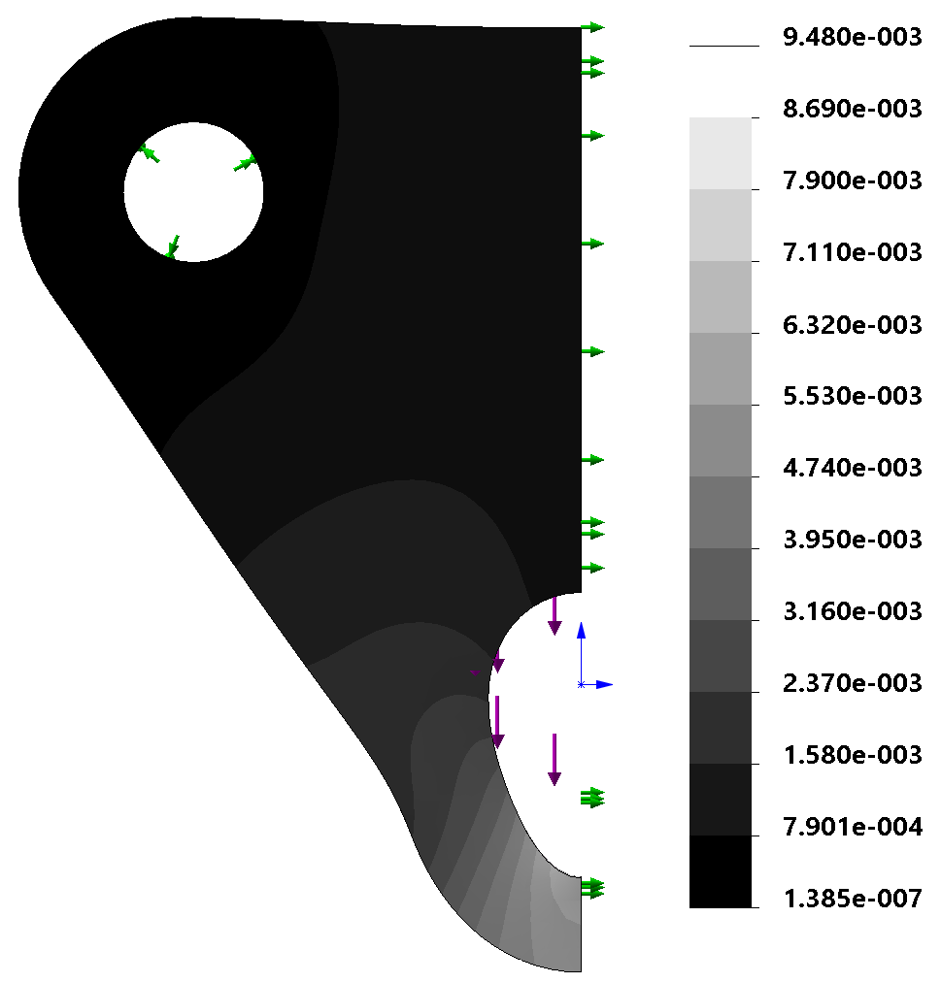
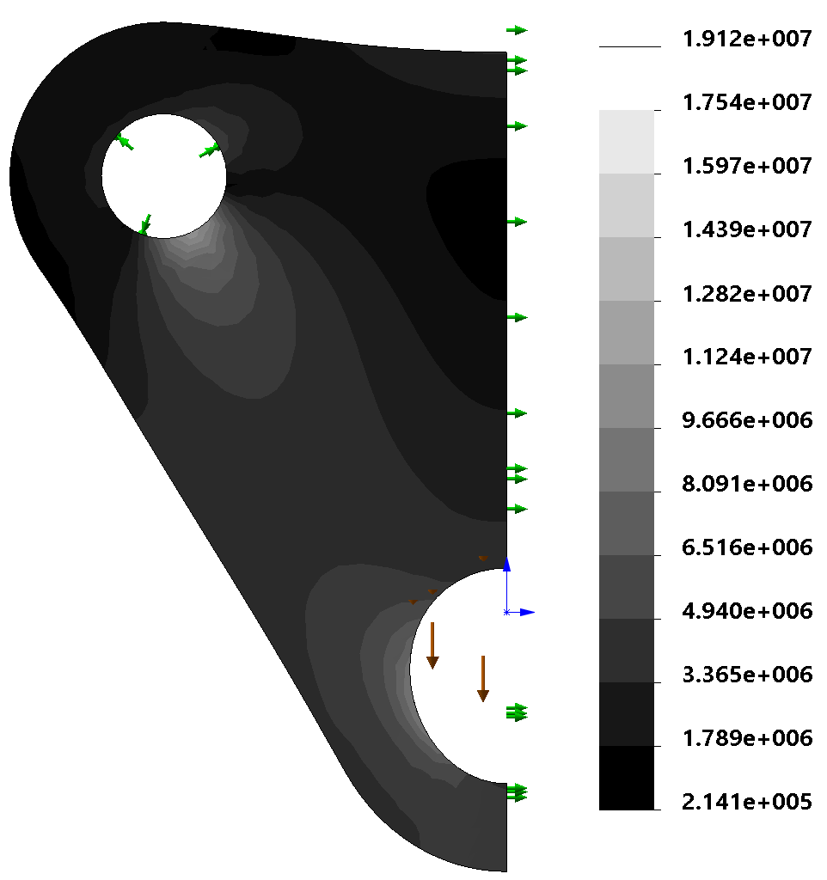
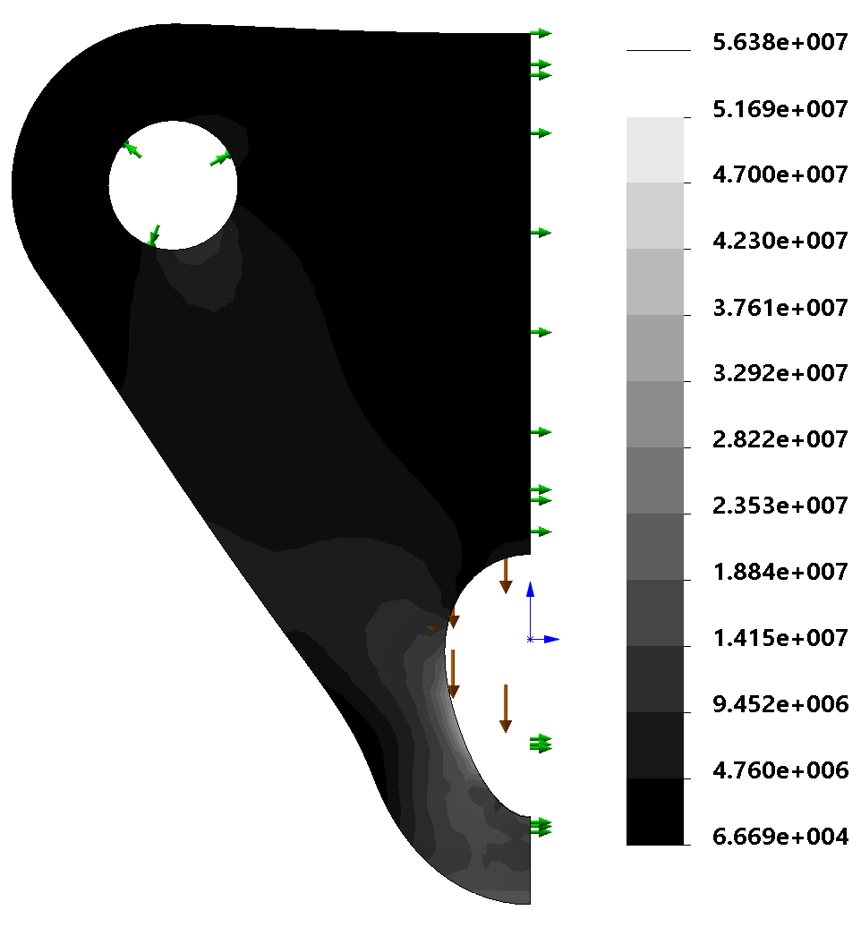
(a)
(b)
Figure 7.36: Deflection (mm) due to uniform load versus bearing load
(a)
(b)
Figure 7.37: Von Mises stress (N/m²) due to uniform load versus bearing load

Slide 14
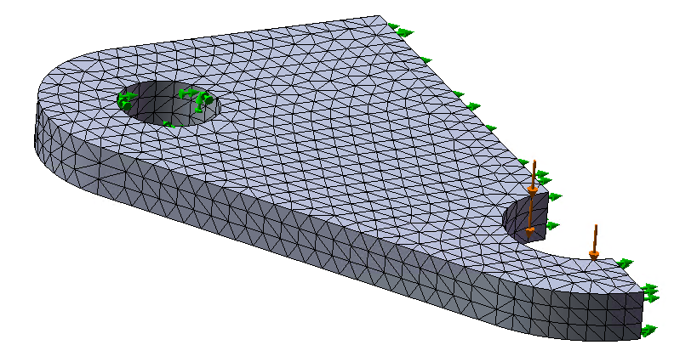
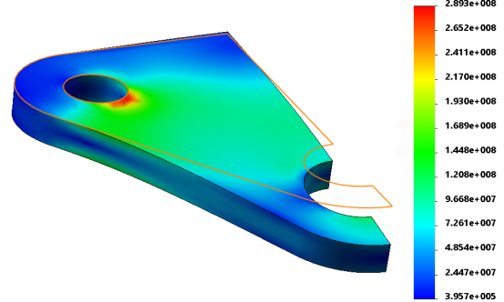
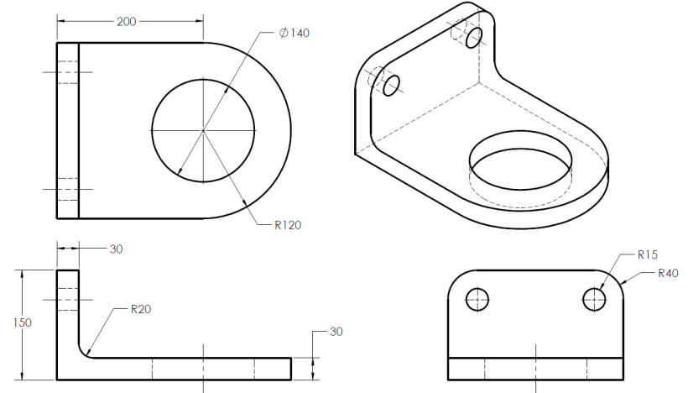
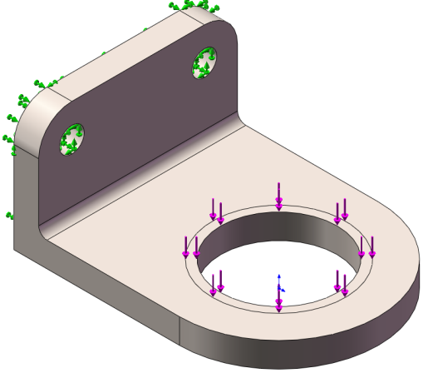

Slide 15
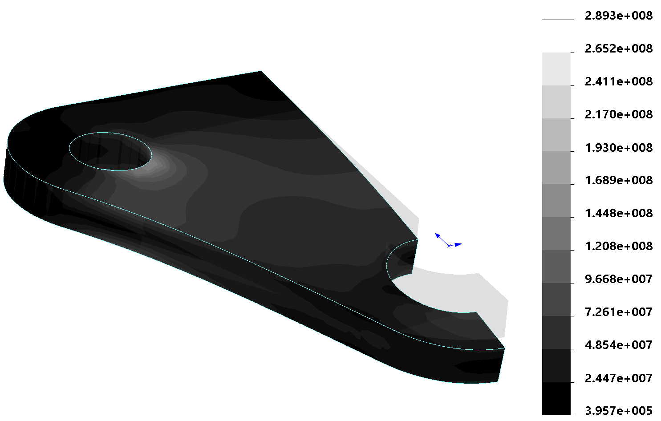
(b)
Figure 7.38: Plate with normal forces

Slide 16
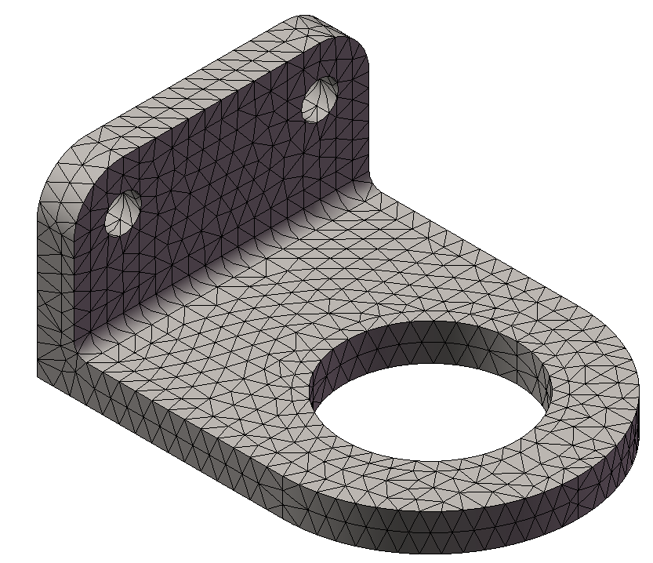
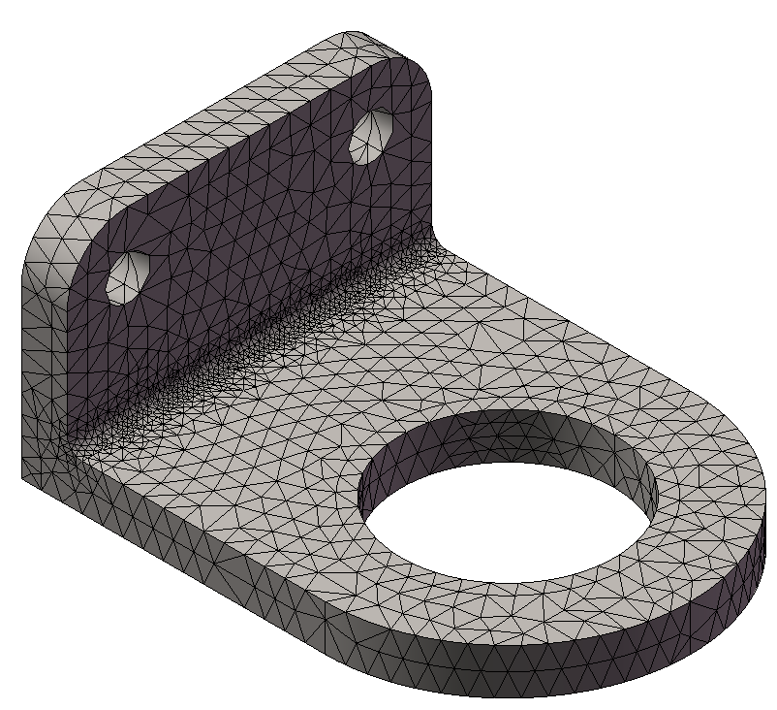
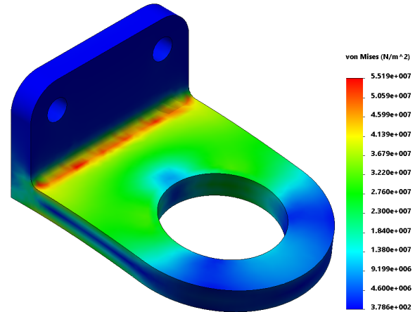
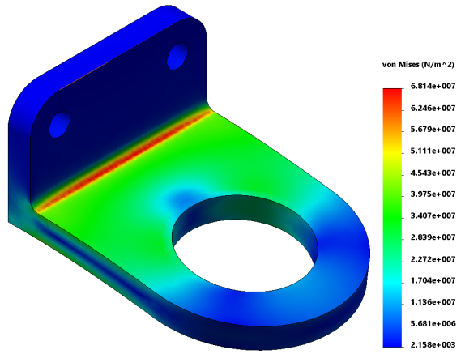
y
A
s
x
s
All dimensions in cm
4
1.0
2.5
4.2
Fixed
2789N
5
12
15
42
5066N

Slide 17
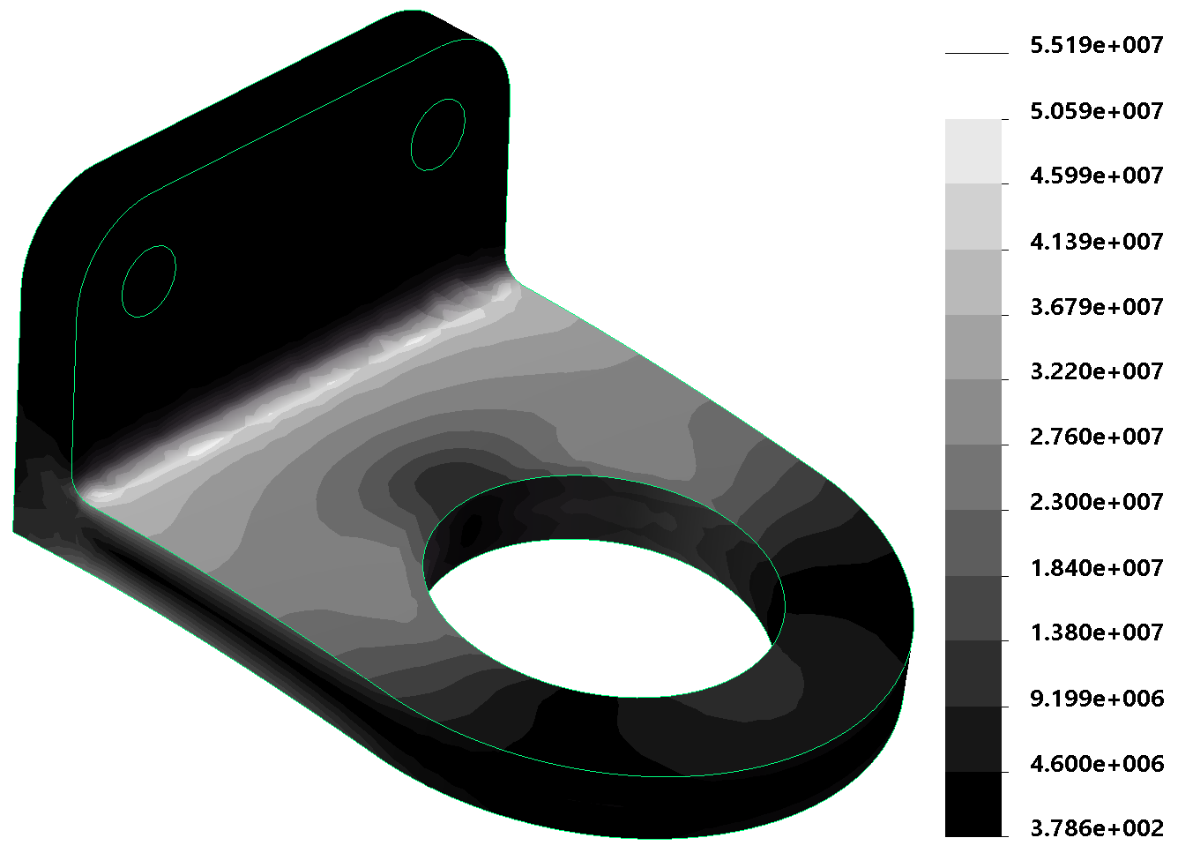
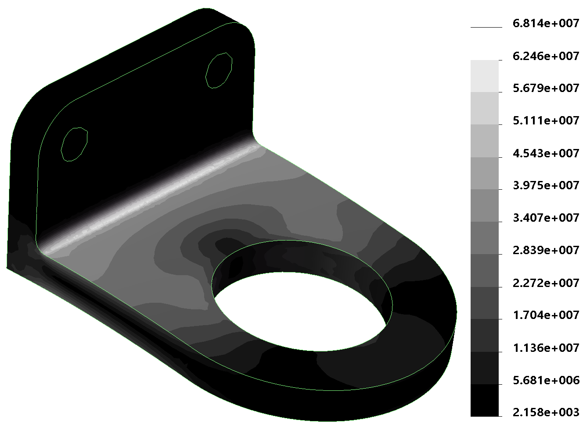

Slide 18
y
(0,3)
2
3
(1,1)
1
x
(0,0)
(3,0)
y
t
4
1
4
1
3
1
1
x
−1
1
s
−1
A
3
B
−1
2
1
−1
2
Physical element
Reference element
y
+1
4
1
2
3
x
−1
+1
y
(0,2)
(4,2)
4
3
1
2
x
(0,0)
(4,0)

Slide 19
(5,2)
4
t
1
3
y
16
(0,1)
14
−1
1
s
5
7
x
−1
(3,0)
1
2
Physical element
Reference element
y
3 (0,2)
4 (−1,1)
t
3 (1,1)
2 (1,1)
s
4 (0,0)
1 (1,0)
x
1 (−1,−1)
2 (1,−1)
y
64
(0,1)
(1,1)
63
51
(0,0)
(1,0)
52
x
t
4
3
L
1
2

Slide 20
2 (1,12)
1 (2,12)
2 (0,4)
1 (8,4)
3 (1,1)
4 (2,1)
3 (0,0)
4 (18,0)
y
2
1
x
1
y
4
6
3
1
5
2
x
2 (0,4)
1 (4,4)
3 (0,0)
x
4 (6,0)

Slide 21
y
T_{y} = 20 kPa
(0,0.4)
4
3
(0.5,0.4)
1
2
x
(0.8,0)
(−1,1)
y
t
(1,1)
4
1
3
2
1
−1
1
s
3
4
x
1
−1
2
(0,0)
Physical element
Reference element
t
4
7
3
(−1,1)
(1,1)
8
6
s
(−1,−1)
(1,−1)
1
5
2

Slide 22
y
y
2
4
1
x
3
2
2
x

