Slide 1
Figure 8.1
1
2
Figure 8.2
1
2
L
Figure 8.3
u
Figure 8.4
A
t
A
T

Slide 2
Figure 8.5
1
2
3
x
E₁
E₂
u₁
u₂
u₃
1 m
1 m
Figure 8.6
v₂
x
E₁
θ₂
E₂
1 m
1 m
1
2
3
6
4
2
Figure 8.7
v(x)
0
x
0
0.5
1
1.5
2
-2
-4
Mode 1
Mode 2
-6
1
2
Figure 8.8
2
3
6
1
5
4
5
4
3
Notes:
s=0:0.05:1;
v1=5.8*(3*s.^2 -2*s.^3);
v2=5.8*(1-3*s.^2 + 2*s.^3);
v_1=[v1 v2];
x=[s 1:0.05:2];
%
v1=36*(-s.^2 + s.^3);
v2=36*(s-2*s.^2 + s.^3);
v_2=[v1 v2];
plot(x,v_1,x,v_2)

Slide 3
Figure 8.9
1
E₁
2
E₂
3
E₃
4
x
u₄
F(t)
u₁
u₂
u₃
L = 1 m
F_{max}
1.2
10
-3
1
0.8
Displacement (m)
Figure 8.10
0.6
0.4
0.2
Central finite difference
Static solution
0
0
0.5
1
1.5
2
2.5
3
Time (sec)
10
-3

Slide 4
1.4
10
-3
Δt = 21μm
Δt = 42.5μm
Figure 8.11
1.2
1
Displacement (m)
0.8
0.6
0.4
0.2
0
0
0.5
1
1.5
2
2.5
3
Time (sec)
10
-3
1.2
10
-3
1
0.8
Displacement (m)
0.6
Figure 8.12
0.4
0.2
Central finite difference
Static solution
0
0
0.5
1
1.5
2
2.5
3
Time (sec)
10
-2

Slide 5
1.2
10
-3
1
0.8
Figure 8.13
Displacement (m)
0.6
0.4
Average accel.
Linear accel.
Static solution
0.2
0
0
0.5
1
1.5
2
2.5
3
Time (sec)
10
-3
1.2
10
-3
1
0.8
Displacement (m)
0.6
0.4
0.2
Average accel.
Linear accel.
Static solution
0
0
0.5
1
1.5
2
2.5
3
Time (sec)
10
-3

Slide 6
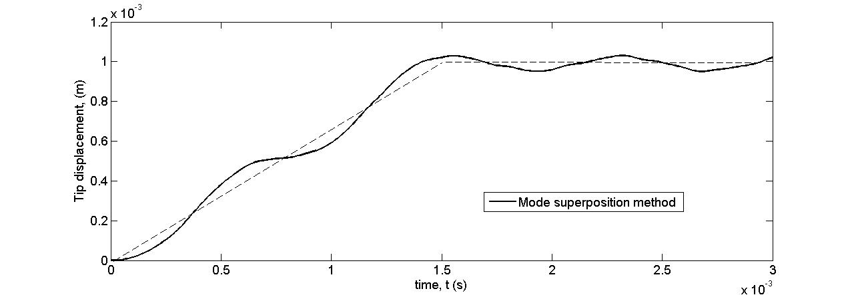
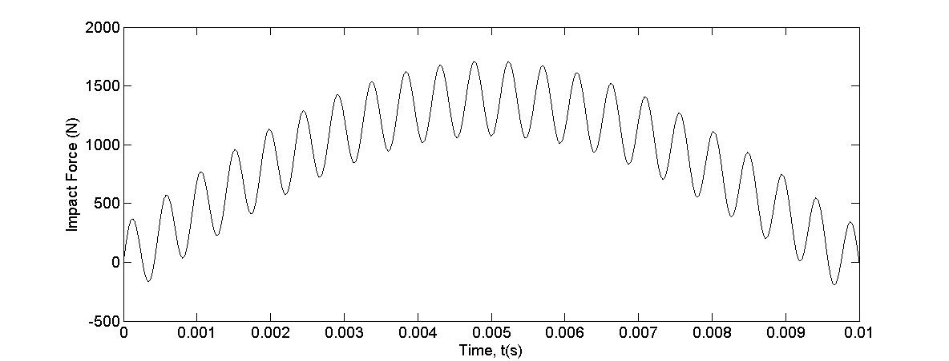
Figure 8.14
1
2
Figure 8.15
Figure 8.16
Figure 8.17

Slide 7
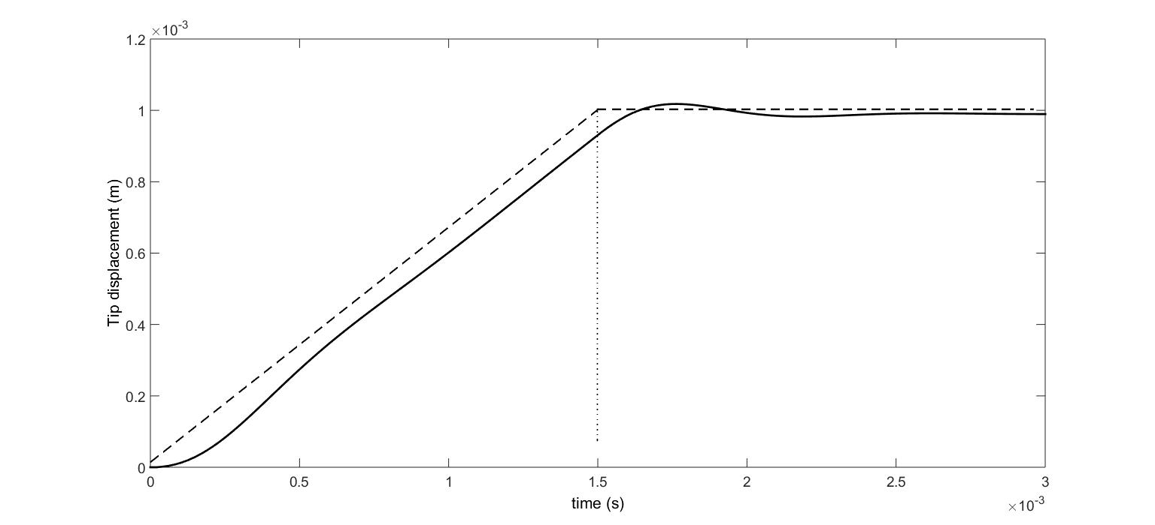
Figure 8.18
i
j
Figure 8.19
Figure 8.20
Figure 8.21

Slide 8
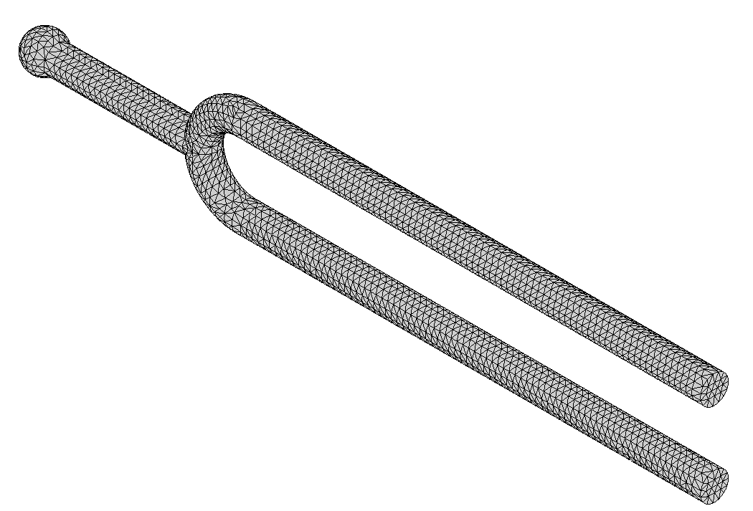
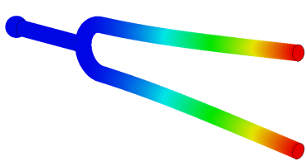
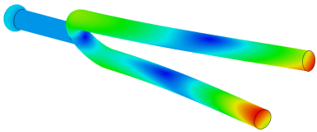
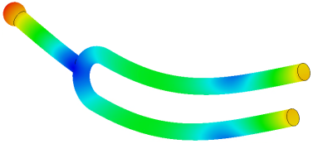
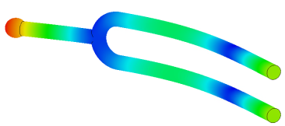
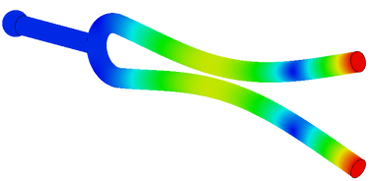
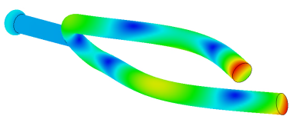
Figure 8.22
Figure 8.23
Figure 8.24
P
Figure 8.25
A
B
L = 1m

Slide 9
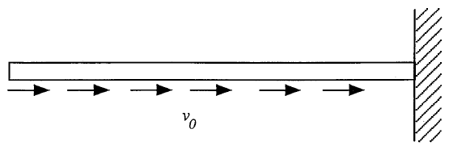

Slide 10
0.1
x = 0
x = 5
x = 10
0.08
0.06
0.04
0.02
Displacement
0
-0.02
-0.04
-0.06
-0.08
-0.1
0
0.1
0.2
0.3
0.4
0.5
0.6
0.7
0.8
0.9
1
Time
0.015
x = 0
x = 5
x = 10
0.01
0.005
Stress
0
-0.005
-0.01
-0.015
0
0.1
0.2
0.3
0.4
0.5
0.6
0.7
0.8
0.9
1
Time
Notes:
%Analytical solution
E=100;rho=0.01;a=sqrt(E/rho);l=10;
v0=1;x=[0 5 10]; t=linspace(0,1,200);
u=zeros(size(x,2),size(t,2));
s=zeros(size(x,2),size(t,2));
for n=1:60
bu=(2*(-1)^(n+1)*v0*l)/((n-0.5)^2*pi^2*a);
bs=-(2*(-1)^(n+1)*v0)/((n-0.5)*pi*a);
u = u + bu*cos((n-0.5)*pi*x/l)'*sin((n-0.5)*pi*a*t/l);
s = s + bs*sin((n-0.5)*pi*x/l)'*sin((n-0.5)*pi*a*t/l);
end
plot(t,u(1,:),t,u(2,:),t,u(3,:))
plot(t,s(1,:),t,s(2,:),t,s(3,:))

Slide 11
1.5
Elem 1
Elem 5
Elem 10
1
0.5
Stress
0
-0.5
-1
-1.5
0
0.1
0.2
0.3
0.4
0.5
0.6
0.7
0.8
0.9
1
Time
1.5
Dt = 0.01
Dt = 0.008
Dt = 0.005
1
0.5
Stress
0
-0.5
-1
-1.5
0
0.1
0.2
0.3
0.4
0.5
0.6
0.7
0.8
0.9
1
Time

Slide 12
1.5
Dt = 0.005
Dt = 0.01
Dt = 0.1
1
0.5
Stress
0
-0.5
-1
-1.5
0
0.1
0.2
0.3
0.4
0.5
0.6
0.7
0.8
0.9
1
Time
E, I, L
k
F₁ = 0
F₂ = 10
k₁
m₁
k₂
m₂
k₃

Slide 13
1
3
4
2
2
1
4
x
3
F₂
1
2
2
3
6
1
5
4
5
4
3
L/2
L/2
1
2
3
v₂
x
E₁
θ₂
E₂
1 m
1 m
1
2
3

