Slide 1
CHAP 7 FINITE ELEMENT PROCEDURE AND MODELING
FINITE ELEMENT ANALYSIS AND DESIGN
Nam-Ho Kim

Slide 2
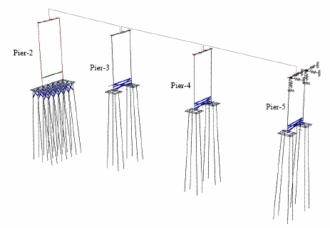
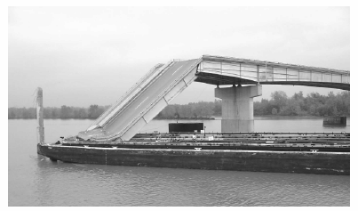
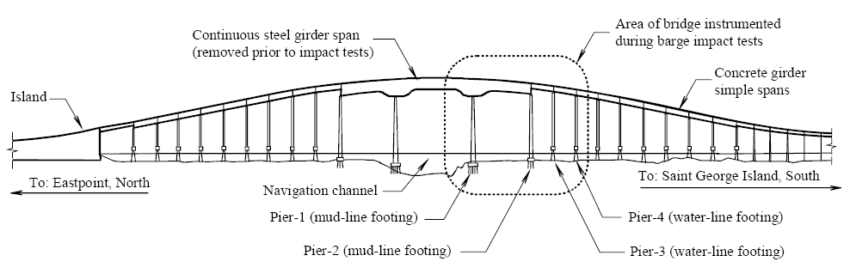
INTRODUCTION
When a physical problem statement is given, how can we model and solve it using FEA?
David Cowan (2007)

Slide 3
FINITE ELEMENT PROCEDURE
Discretization: dividing the structure into a set of simple-shaped, contiguous elements, connected by sharing nodes
Nodal displacements are unknown DOFs
Element level matrix equations are assembled to form global level equations
Specify displacement BC and applied loads
The global matrix equations are solved for the unknown DOFs
From the displacements at the nodes, calculate strains and then stresses in each element
Difficulties
How to model the problem using finite elements?
What kind of elements and how many elements should be used?
How the BCs and loads should be specified?
How to interpret the results?

Slide 4
FINITE ELEMENT PROCEDURE cont.
Preliminary analysis
Preprocessing
Correction/Refinement
Solving the problem
Postprocessing
Converged?
No
Yes
Stop

Slide 5
PRELIMINARY ANALYSIS
One of the most important steps in FEA procedure
Often ignored by many engineers
Provide an insight into the problem and predict behavior
Use analytical methods to estimate the expected solution (FBD, equilibriums, mechanics of materials, etc)
Simplify the problem using bars and beams
Predict level of displacement and stress as well as critical locations
Before FEA, engineers should know the range of expected solution and candidates of critical locations

Slide 6
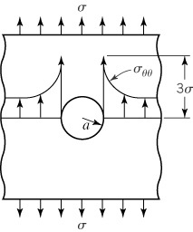
PRELIMINARY ANALYSIS EXAMPLE
Stress concentration on a plate with a hole
Nominal stress:
What would be the stress at the hole?
h=.25 in
300 lb
300 lb
2.0 in
φ .75 in

Slide 7
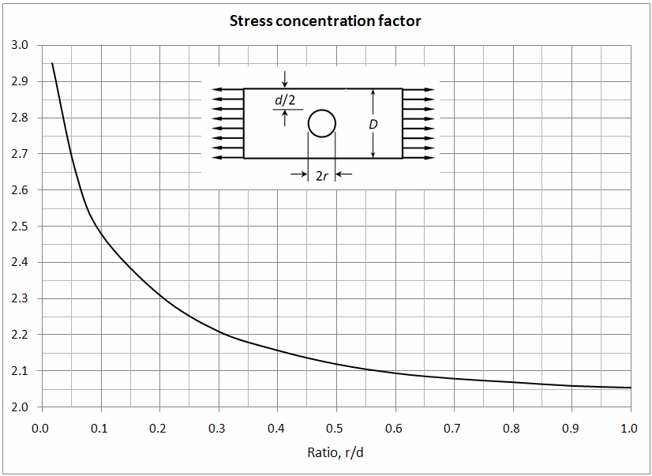
PRELIMINARY ANALYSIS EXAMPLE cont.
Stress concentration factor
Geometric factor: φ/D = .75/2 = 0.375
Stress concentration factor K = 2.17
Maximum stress

Slide 8
PREPROCESSING
preparing a model for finite element analysis
Modeling a physical problem using finite elements
Choosing types and number of elements
Applying displacement boundary conditions
Applying external loads
The finite element model is not a replication of the physical model, but a mathematical representation of the physical model
Finite element model can be different from physical model.
One or two beam elements for the complex space rocket system if the interest is in the max bending moment of the rocket.
The plate with a hole can be modeled using plane stress elements with the thickness

Slide 9
PREPROCESSING cont.
The behavior of FE model is different from that of physics
No stiffness in the vertical direction!
F
1
3
2

Slide 10
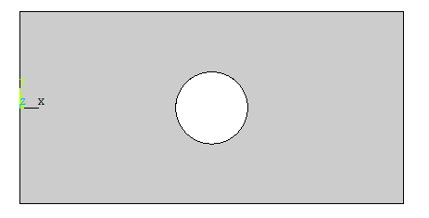
PREPROCESSING cont.
Units
STUPIDEST mistakes come from UNITS!
Consistent units must be used throughout FE procedure
In SI unit, order of deformation ~ 10⁻⁶m, order of stress ~ 10⁸Pa
Automatic mesh generation
Many commercial programs can automatically generate nodes and elements using GUI
Work with solid model

Slide 11
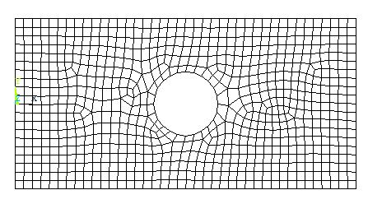
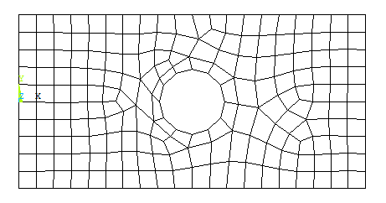
PREPROCESSING cont.
Mesh control
Provide mesh parameters that define the size and type of elements and other attributes
Global or local element size, curvature-based element size
Smaller element size for location of interest
Element size = 0.1 Element size = 0.2

Slide 12
PREPROCESSING cont.
Mesh quality
A good quality mesh is a recipe of success in finite element analysis
Element shape: Best for square element
Aspect ratio: Large aspect ratio elements should be avoided
Element size: Quick transition from small to large elements should be avoided
Smaller elements must be used where stresses change quickly
Rapid size change
160º
Distorted element
Large aspect ratio

Slide 13
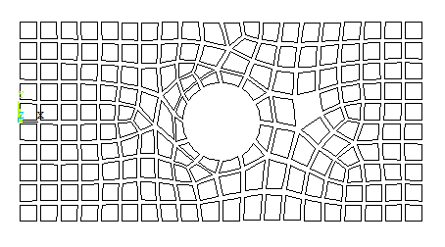
PREPROCESSING cont.
Checking the mesh
Duplicated nodes: Two nodes at the same location are associated with different elements; artificial crack in the model
Missing elements: Can be detected using shrink plot of elements
Mismatched boundary: Produce artificial crack
Missing element
1
4
6
E₂
7
E₁
5
E₃
2
3
8

Slide 14
PREPROCESSING cont.
Material properties
Isotropic, linear elastic material: Young’s modulus, shear modulus, Poisson’s ratio
Only two are independent
Sometimes, failure stress is required for estimating safety
Anisotropic material, composite material, elasto-plastic material, etc
Unit of material properties must be consistent with that of FE model

Slide 15
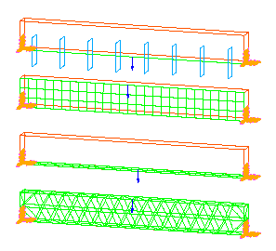
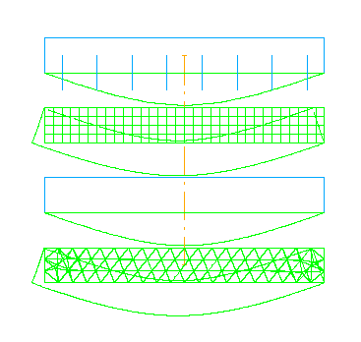
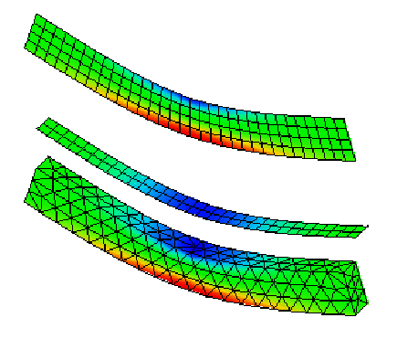
PREPROCESSING cont.
Choosing Element Type and Size
Different elements and models can be used for solving the same problem
Engineers should understand the capability of the elements and models so that proper elements should used

Slide 16
PREPROCESSING cont.
Solid element:
Can represent structural details, but computationally expensive
Shell/plate element
The sheet or plate can be represented using 2D plane with thickness
More efficient than solid element
Good for thin wall where bending and in-plane forces are important
Beam/frame element
Most efficient way of modeling
Good for predicting the overall deflection and bending moments of slender member
Limited to predicting local stress concentrations at the point of applied load or at junction

Slide 17
PREPROCESSING cont.
Element Types
Element | Name
 | 1D linear element
 | 2D triangular element
 | 2D rectangular element
 | 3D tetrahedral element
 | 3D hexahedral element

Slide 18
PREPROCESSING cont.
Element order
We only learned linear elements
Linear elements: 2-node bar, 3-node triangular, 4-node quadrilateral, 4-node tetrahedral, 8-node hexahedral elements
Parabolic elements: 3-node bar, 6-node triangular, 8-node quadrilateral, 10-node tetrahedral, 20-node hexahedral elements
Cubic elements: 4-node bar, 9-node triangular, 12-node quadrilateral, 16-node tetrahedral, 32-node hexahedral elements
Linear elements have two nodes along each edge, parabolic have three, and cubic have four.
A higher-order element is more accurate than a lower-order element

Slide 19
PREPROCESSING cont.
How to choose element size?
Critically important in obtaining good results
Preliminary analysis can help
Is the size proper? (Error analysis and convergence analysis)
Mesh refinement improves solution accuracy.
How small is good enough?
Stress or displacement
Exact value
Acceptable mesh size
Need mesh refinement
No. of elements

Slide 20
PREPROCESSING cont.
Convergence rate
Calculate the function of interest at three different meshes
Let h₁, h₂, and h₃ be the sizes of elements, ordered by h₁ > h₂ > h₃
Usually h₁ = 2h₂ = 4h₃
The ratio in difference
Convergence rate α: indicates how fast the solution will converge to the exact one

Slide 21
PREPROCESSING cont.
Applying displacement boundary conditions
FE model should be properly restrained so that it is not free to move in any direction even if there are no applied forces in that direction
Errors in BC will not disappear no matter how much you refine the model
Any unexplained high stress may be due to a wrong boundary condition
Fix center node
Plate
Plate
Rigid-bar elements
Fix all nodes
Not allowed to translate/rotate
Not allowed to translate

Slide 22
PREPROCESSING cont.
Example of error in BC
y
3
3
x
2
3
2
L
3
L
1
1
2
1
1
2
L
L
1,000 N
1,000 N
(a) Improper case
(b) Proper case

Slide 23
PREPROCESSING cont.
Applying external forces
Forces are applied through a complex mechanism
It is often simplified when the interest region is far from the load application location
FE results near the load application location are not accurate due to approximation involved in the force
Applying a concentrated force
Theoretically infinite stress (zero area)
Practically, all forces are distributed in a region
Concentrated force in FE is an idealization of distributed forces in a small region

Slide 24
PREPROCESSING cont.
(a) Concentrated force
(b) Distributed forces
Note that the distributed forces are converted to the equivalent nodal forces.
All applied forces must be converted to the equivalent nodal forces because the RHS of finite element matrix equations is the vector of nodal forces.

Slide 25
PREPROCESSING cont.
St. Venant’s principle
If the interest region is relatively far from the force location, the stress distribution may be assumed independent of the actual mode of application of the force
b
0.25b
0.5b
b
σ_{min} = 0.973σ_{ave} σ_{min} = 0.668σ_{ave} σ_{min} = 0.198σ_{ave} σ_{max} = 1.027σ_{ave} σ_{max} = 1.387σ_{ave} σ_{max} = 2.575σ_{ave}

Slide 26
PREPROCESSING cont.
Applying a couple to a plane solid
Applying a force through shaft
C
F
d
F
(a) Beam element
(b) Plane solid elements
Hole
Force
Plate
Plate
Bar elements
p_{max}

Slide 27
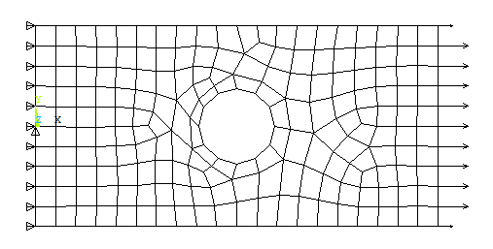
PREPROCESSING cont.
Plate with a hole example
All nodes on the left edge are fixed in x-direction
node at the center of the left edge is fixed both in x- and y-direction
uniform pressure 600 psi , which is equivalent to the 300 lb, is applied on the right edge

Slide 28
SOLVING PROBLEM
Element stiffness matrices and nodal force vectors are assembled and solved for unknown DOFs
Nodal DOF solutions – these are primary unknowns.
Derived solutions – stresses and strains of individual element
Static, buckling, heat transfer, potential flow, dynamics, nonlinear analysis, etc
Transparent to the user, but most failures in FEA procedures occur in this stage
Singularity in the global stiffness matrix
No solution or non-unique solution, zero determinant, no inverse matrix
Insufficient/wrong displacement boundary conditions
Negative values of material properties
Unconstrained joints
Coincident nodes causing cracks in the model
Large differences in components of stiffness matrix
Irregular node numbering

Slide 29
SOLVING PROBLEM cont.
Multiple load conditions
Ex: Bicycle design with (a) vertical bending and (b) horizontal impact load conditions
Most expensive LU decomposition can be done only once
Restarting solution
Adding additional load case
Efficient if decomposed stiffness matrix is saved

Slide 30
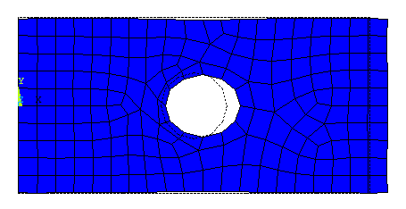
POSTPROCESSING
Review analysis results and evaluate the performance
Engineer must have a capability in interpreting FEA results
Requires knowledge and experience in mechanics
Engineer can check any discrepancy between the preliminary analysis results and the FEA results
Deformed shape display
Strong tool to understand the mechanism of structural behavior
Can verify if the displacement and forces are correctly applied
Deformation is often magnified such that it can be visible

Slide 31
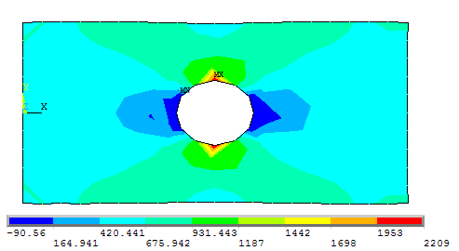
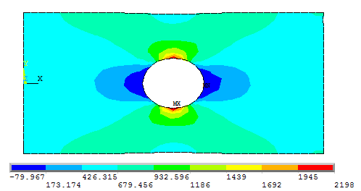
POSTPROCESSING cont.
Contour display
Understand the distribution of the stress in the structure and identify the most critical locations
Max stress 2,209 psi is 6% higher than that from preliminary analysis results (2,083 psi)
Accurate stress values at Gauss integration points are extrapolated to nodes
Refined model has 2,198 psi (.5% change from the initial model)
Size = 0.2"
Size = 0.1"

Slide 32
POSTPROCESSING cont.
Stress averaging
Contour-plotting algorithms are based on nodal values
Stress is discontinuous at nodes
Extrapolated stresses are averaged at nodes -> Cause error
Difference b/w actual and averages stress values are often used as criterion of accuracy
Stress at integration point
Stress
Averaged nodal stress
Elem 1
Elem 2
Elem 3

Slide 33
ESTIMATING ERRORS
Error estimation
Check accuracy of current analysis
Criterion for mesh refinement
Gauss point stress σ, averaged nodal stress σ*
Difference in stresses
Strain energies
Error estimation
the current mesh size is considered to be appropriate, if η ≈ 0.05

Slide 34
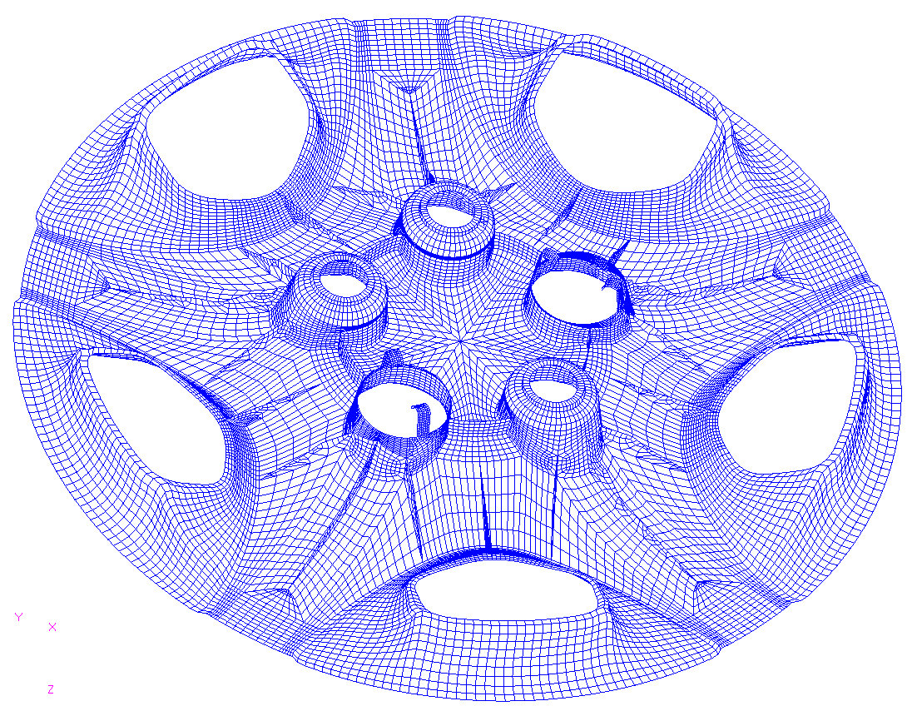
FINITE ELEMENT MODELING TECHNIQUES
Model abstraction
FE model can be different from the physical model
It would be better to gain insight from several simple models than to spend time making a single detail model
Depending on intention, FE model should have different level of detail
Example of unnecessarily detail model (purpose: bending/torsional stiffness)

Slide 35
FE MODELING TECHNIQUES cont.
Free meshing vs. mapped meshing
Free meshing: the user provides a general guideline of meshing and the FE software will make the mesh according to it
Mapped meshing: the user provides detailed instructions of how the mesh should be created
In 2D, all surfaces are divided into topologically four-sided quadrilaterals
The user then specifies how many elements will be generated in each side of the quadrilateral
2
1-2-3
1
3
6
4
5
6
4
5
(a) Physical mesh
(b) Topological mesh

Slide 36
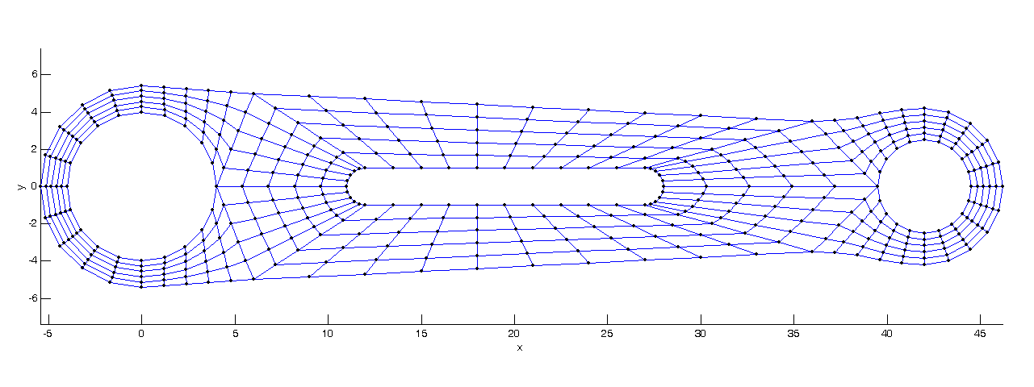
EXAMPLE OF MAPPED MESH
2
6
3
8
9
1
12
4
7
11
10
5
Fixed
BC
2789 N
5066 N

Slide 37
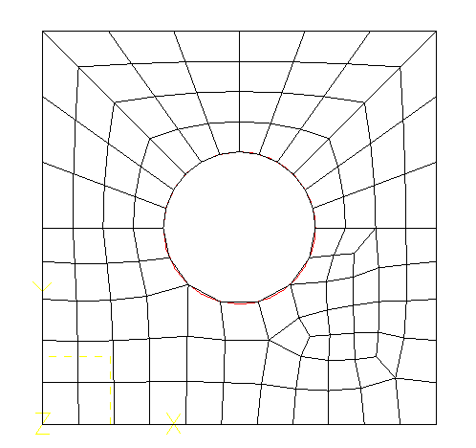
FE MODELING TECHNIQUES cont.
Free meshing vs. mapped meshing
More user action is required in mapped mesh
More complex computer algorithms need to be implemented in free meshing
The mapped mesh looks better because the grid looks more regular, but the quality of elements cannot be assured
Even if the mapped mesh looks more regular, the actual quality should be measured from the level of distortion
Mapped mesh
Free mesh

Slide 38
FE MODELING TECHNIQUES cont.
Using symmetry
Can reduce model size and save computation time
Can provide necessary boundary conditions
p
p
Symmetry plane
p
p
Modeled portion

Slide 39
FE MODELING TECHNIQUES cont.
Using symmetry
y
y
p
x
p
x
(a) One symmetric plane
(b) Two symmetric planes

Slide 40
FE MODELING TECHNIQUES cont.
Connecting beam with plane solids
Different elements have different nodal DOFs
Plane solid element
1
F
Constraint equation
Frame element
Plane solid element
Plane solid element
F
1
F
Constraint
2
h
Frame elements
Frame elements
3
(a) Extending to inside of solid
(b) Imposing a constraint

Slide 41
FE MODELING TECHNIQUES cont.
Modeling bolted joints
3D representations of bolts and parts and connecting them through a contact constraint
Huge model size
Nonlinear problem due to contact constraint
Rigid-body motion if an initial gap exists between the bolt and parts
Nodal coupling or rigid-link element
Plate 2
Plate 1
Plate 1
Plate 2
Nodal coupling
Rigid element

Slide 42
PATCH TEST
Will the FE solutions always converge to the exact solution as the mesh is refined?
Requirements for conforming or compatible element:
Compatibility: Displacements must be continuous across element boundaries—no gaps in materials
Completeness: The element should be able to represent rigid-body motions and constant strain conditions
When an element is conforming, the solution converges monotonically as the mesh is refined
A compatible element may become incompatible if a lower-order Gauss quadrature rule is used than necessary for numerical integration of stiffness matrix

Slide 43
PATCH TEST cont.
In order to guarantee the convergence of the solution, the element must pass a test, called patch test.
Rigid-body motion test
Displacements at boundary nodes are prescribed as a rigid-body motion
The inside node should have consistent displacement for rigid-body motion
Constant strain test
Linear displacements are applied at the boundary nodes
Generalized patch test
Minimum boundary condition to remove rigid-body motion
Equivalent constant stress loads are applied on the boundary
Can test implementation more thoroughly
y
(.5,1)
(0,1)
(1,1)
7
8
9
4
6
(1,.5)
(0,.4)
5
(.4,.3)
1
2
3
x
(0,0)
(.5,0)
(1,0)

