Slide 1
Preliminary analysis
Preprocessing
Correction/Refinement
Solving the problem
Postprocessing
Converged?
No
Yes
Stop
1.5 m
C
50 kN/m
A
D
2.5 m
250 mm
1.5 m
50 mm
B
4 m
2 m
16.45 kN
125 kN
21.93 kN
97.59 kN

Slide 2
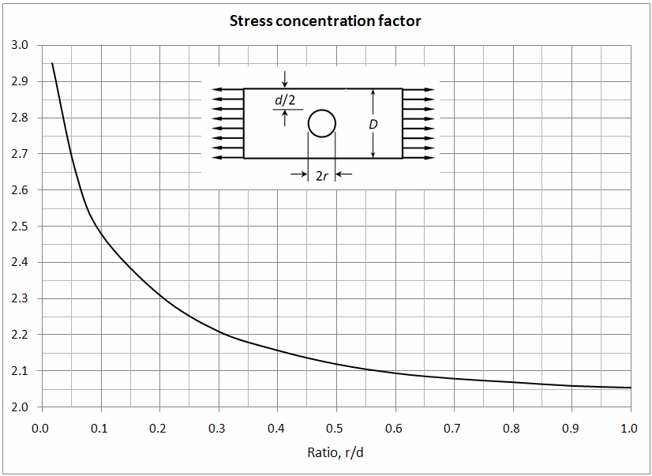
x
M
16.45 kN
N
21.93 kN
V
h=.25 in
300 lb
2.0 in
300 lb
φ .75 in

Slide 3
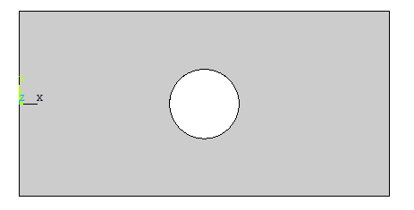
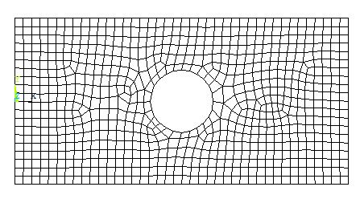
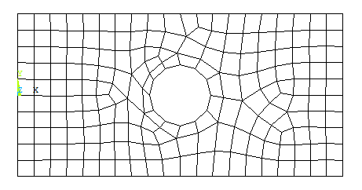
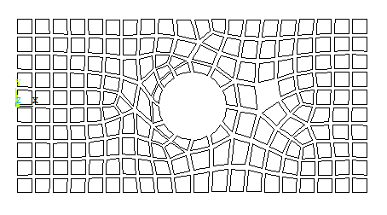
1
F
3
2
160º
Rapid size change
Missing element

Slide 4
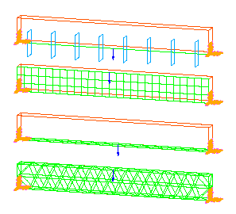
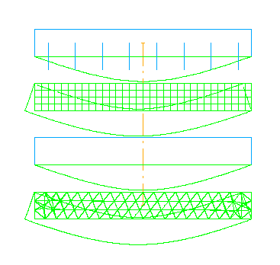
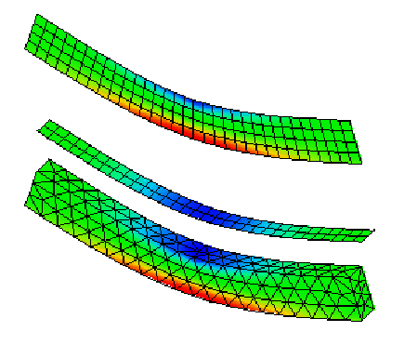
1
4
E₂
6
E₁
5
7
E₃
2
3
8
Beams
Plane solids
Shells
3D solids
Stress or displacement
Exact value
Acceptable mesh size
Need mesh refinement
No. of elements
Fix center node
Plate
Plate
Fix all nodes
Rigid-bar elements
3
y
3
x
L
3
2
L
3
2
1
1
2
1
1
2
L
L
1,000 N
1,000 N

Slide 5
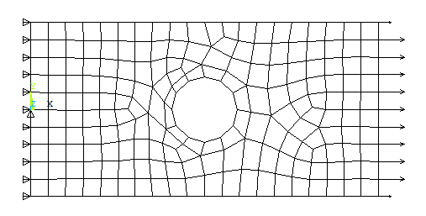
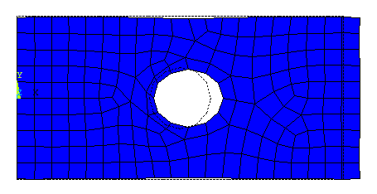
b
0.5b
0.25b
b
σ_{min} = 0.973σ_{ave} σ_{min} = 0.668σ_{ave} σ_{min} = 0.198σ_{ave} σ_{max} = 1.027σ_{ave} σ_{max} = 1.387σ_{ave} σ_{max} = 2.575σ_{ave}
C
F
d
F
Hole
Force
Plate
Plate
Bar elements
p_{max}

Slide 6
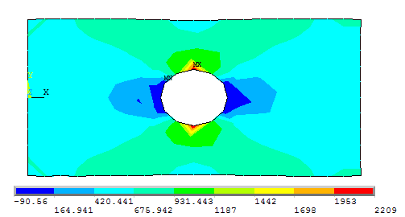
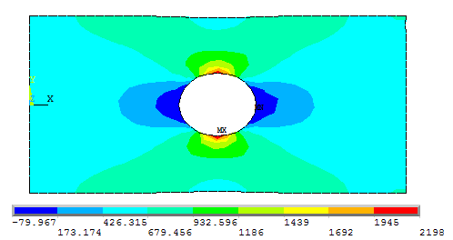
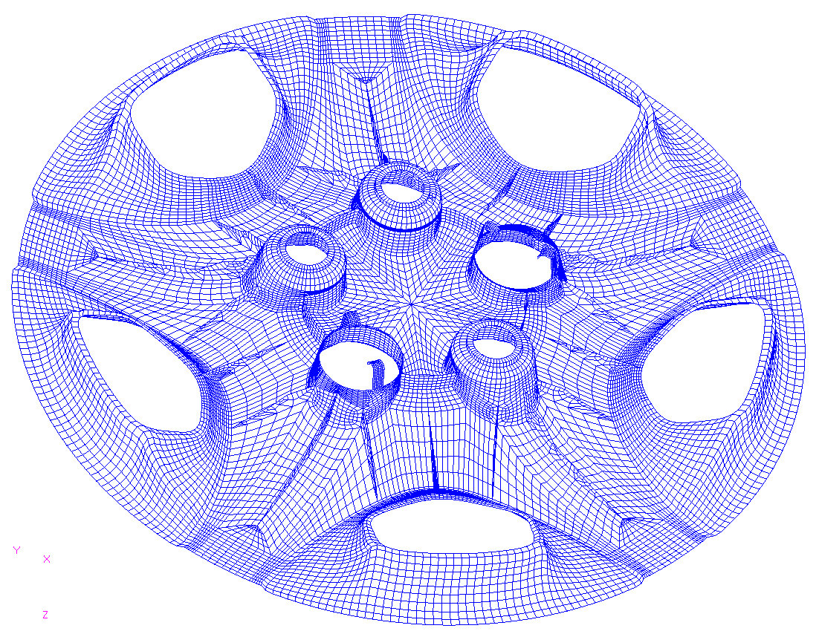
Stress at integration point
Stress
Averaged nodal stress
Elem 1
Elem 2
Elem 3

Slide 7
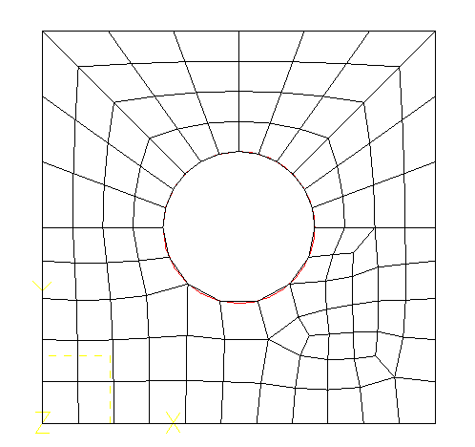
2
1-2-3
1
3
6
4
5
6
4
5
Mapped mesh
Free mesh
p
p
Symmetry plane
p
p
Modeled portion
y
y
p
x
p
x

Slide 8
Plane solid element
1
F
Frame element
Plane solid element
F
Plane solid element
1
F
Constraint
2
h
Frame elements
Frame elements
3
Plate 1
Plate 2
Plate 1
Plate 2
Nodal coupling
Rigid element
y
x
1 m
1 m
F₂ = 240 N
y
3
1
2
4
x
1 m
1 m

Slide 9
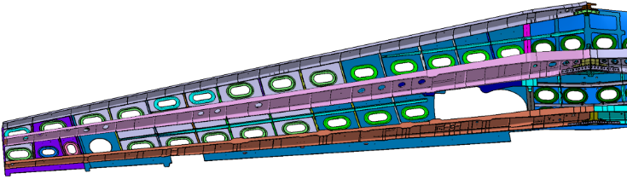
Input x
(load, heat)
y = ax
Output y
(displ, temp)
x₁
y = ax
y₁
x₁
x₂
x₂
y₂
2x₁
2y₁
y
2x₁ +3x₂
2y₁+3y₂
Global
Local
Local
Global
Force
Linear
Stress
Linear
Strain
Linear
Displacement
A₀
A
σ
σ = Eε
F/2
L₀
δL
F/2
E
L
ε
(a) (b) (c)
Load
Stress
time
time

Slide 10
y
(0,1)
(.5,1)
(1,1)
7
8
9
4
5
6
(1,.5)
(0,.4)
(.4,.3)
1
2
3
x
(0,0)
(.5,0)
(1,0)
y
E = 100 Pa, ν = 0.25
(0,1)
(.5,1)
(1,1)
7
8
9
(0,.4)
(1,.5)
4
5
6
σ_{xx} = 1 Pa
(.4,.3)
1
2
3
x
(0,0)
(.5,0)
(1,0)
1
2
3
x
0.5 m
1.0 m

Slide 11
Stress
Stress at integration point
Averaged nodal stress
1
2
3
4
Elem 1
Elem 2
Elem 3
Stress or displacement
Small change
Exact value
Large change
Acceptable mesh size
Need mesh refinement
Na
Nb
No. of elements

Slide 12
350 mm
200 mm
400 mm
10 kN
20 mm
1 m
20 mm
10 kN
20 mm
1 m
10 mm
10 kN
20 mm
1 m
20 mm
1 m
1 m
0.5 m
1 kN
1.3 m
1 kN
0.5 m
1 kN
1.3 m
1 kN

Slide 13
y
P
x
P
P
L
8 kN
400 mm
400 mm
400 mm
20 N/mm
400 mm
400 mm
400 mm
P_{y}
P_{x}
P_{x}
y
P_{y}
x
1
2
3
x
0.5 m
1.0 m

Slide 14
y
(0,3)
(2,2.5)
1
2
(4,2)
(0,1)
3
4
5
(1,1)
6
(4,1)
7
(0,0)
8
(2,0)
9
(4,0)
x
y
x
y
E = 100 Pa, ν = 0.25
(0,1)
(.5,1)
(1,1)
7
8
9
(0,.4)
(1,.5)
4
5
6
u = 0.01m
(.4,.4)
1
2
3
x
(0,0)
(.5,0)
(1,0)

Slide 15
(a) 4-Node Quadrilateral Plane stress elements
(b) 3-Node Triangular Plane stress elements
(c) A single 2-Node Hermite beam element
16
15
p
12
11
14
8
7
6
10
4
3
2
1
5
9
13

Slide 16
Fall 2019 Qualifying exam figures
P
P
P
y
P
x
7
6
5
11
Q4
10
F
8
Q8
4
Q4
1
2
3
9
y
E = 100 Pa, ν = 0.25
(0,1)
(.5,1)
(1,1)
7
8
9
(0,.4)
(1,.5)
4
5
6
u = 0.01m
(.4,.4)
1
2
3
x
(0,0)
(.5,0)
(1,0)

