Slide 1
Chapter 1
Introduction

Slide 2
1. Prognostics and Health Management

Slide 3
Prognostics and Health Management (PHM)
A new engineering approach that enables real-time health assessment
predict system’s future state based on up-to-date information by incorporating various disciplines including sensing technologies, failure physics, machine learning, modern statistics and reliability engineering
enable to turn data and health state into information that will improve our knowledge on the system and provide a strategy to maintain the system in its originally intended function
Condition-based maintenance (CBM)
  maintenance based on the actual condition of the equipment in contrast to scheduled maintenance
  a new maintenance strategy that can only repair/replace actually damaged parts, which can reduce the total life cycle costs
  consists of automated hardware and software systems that monitor, detect, isolate, and predict equipment performance and degradation
  prognostics is a key enabling technology for CBM

Slide 4
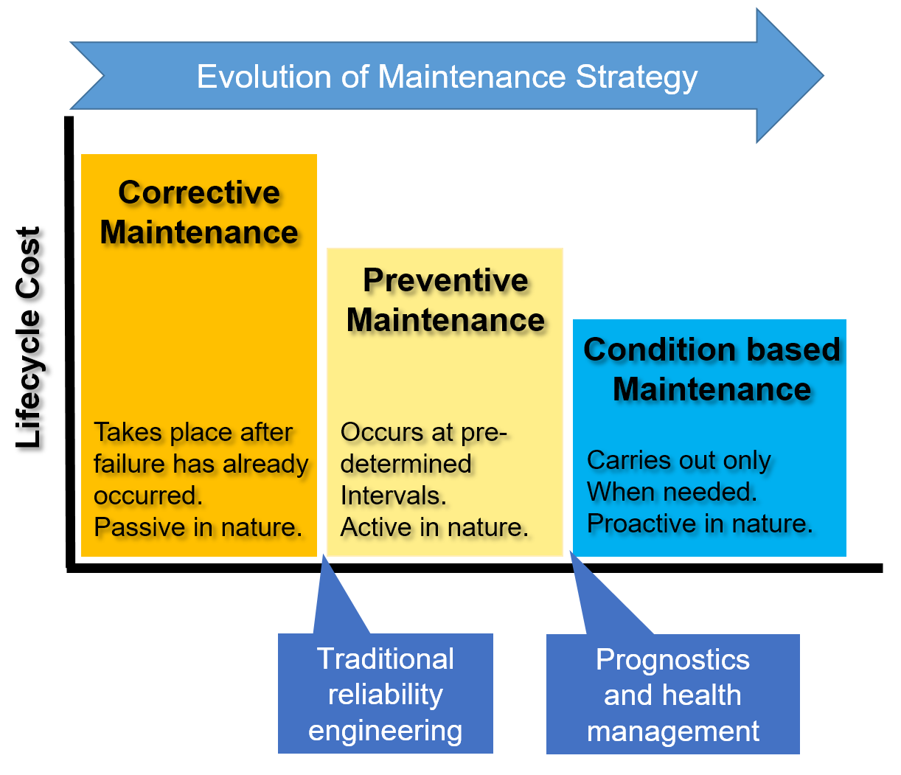
Evolution of Maintenance Strategy

Slide 5
Corrective Maintenance (1st generation)
Every system deteriorates its performance over time subject to the stress or load in operation
maintenance should be exercised to assure satisfactory level of reliability during the life of the system
Repair when a system breaks down (reactive, unplanned maintenance)
  Earliest method of repairing failure
No preparation time for maintenance
Unless replacement parts are already available, it takes the longest time for maintenance, and the forced outage cost is highest
the availability of the system is poor
it only replaces parts that are actually broken down, the number of replacement parts is the smallest

Slide 6
Preventive Maintenance (2nd generation)
Planned maintenance: periodic interval to prevent failures regardless of the health state of the system
uses the reliability prediction methods based on the handbook or historical field data
the most popular maintenance strategy where most replacements are prescheduled
the first outage cost may be low, but the scheduled outage cost can be high
cost is high because it replaces all parts even if many of them may not need to replace
this strategy is inefficient when only a small number of parts fail because this strategy enforces to replace many parts that are not going to be failed

Slide 7
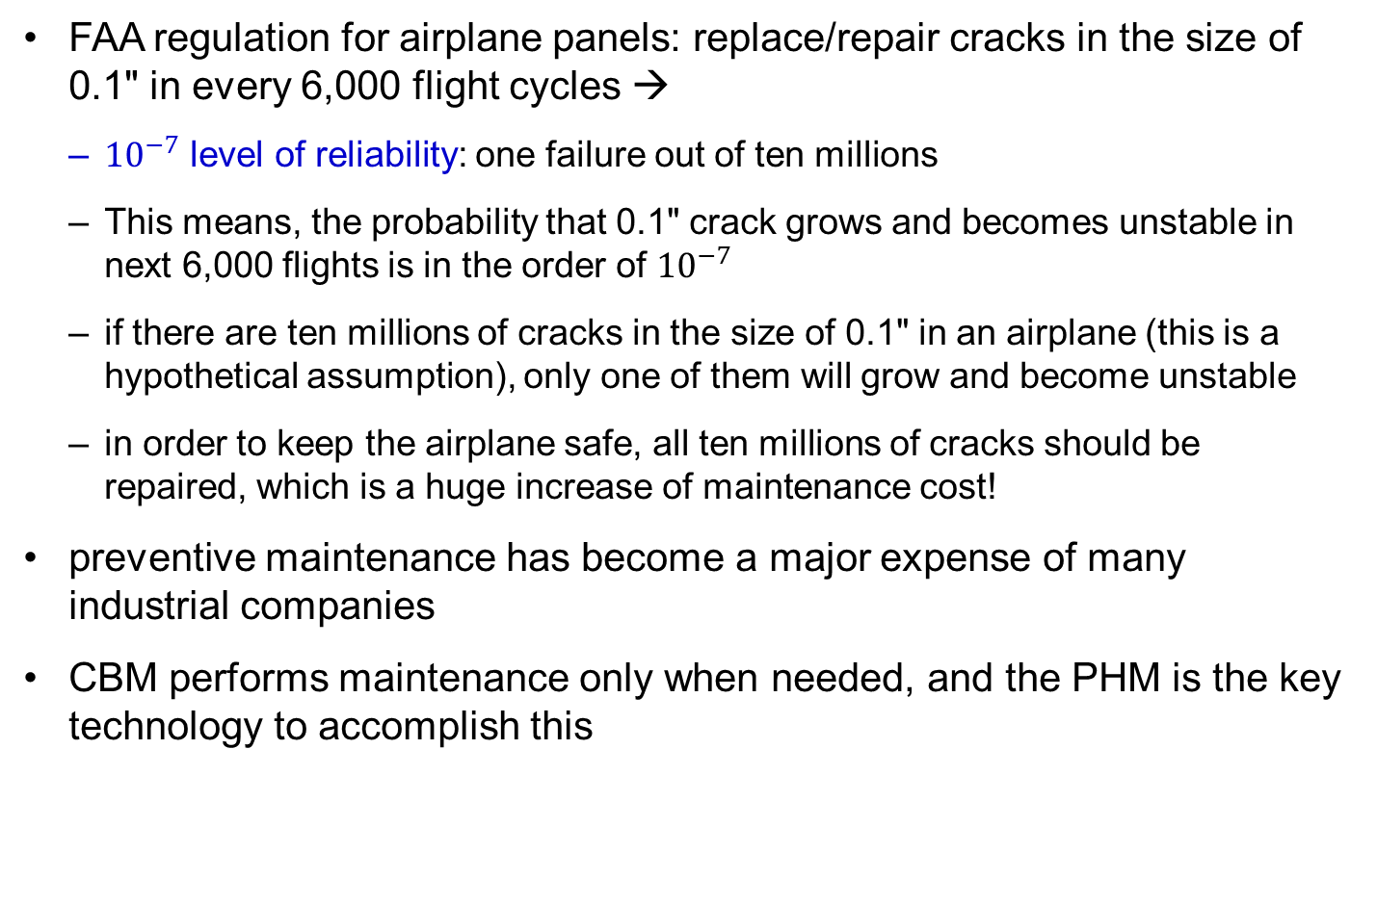
Why Preventive Maintenance Is Expensive
FAA regulation for airplane panels: replace/repair cracks in the size of 0.1" in every 6,000 flight cycles →
  ${10}^{−7}$ level of reliability: one failure out of ten millions
  This means, the probability that 0.1" crack grows and becomes unstable in next 6,000 flights is in the order of ${10}^{−7}$
  if there are ten millions of cracks in the size of 0.1" in an airplane (this is a hypothetical assumption), only one of them will grow and become unstable
  in order to keep the airplane safe, all ten millions of cracks should be repaired, which is a huge increase of maintenance cost!
preventive maintenance has become a major expense of many industrial companies
CBM performs maintenance only when needed, and the PHM is the key technology to accomplish this

Slide 8
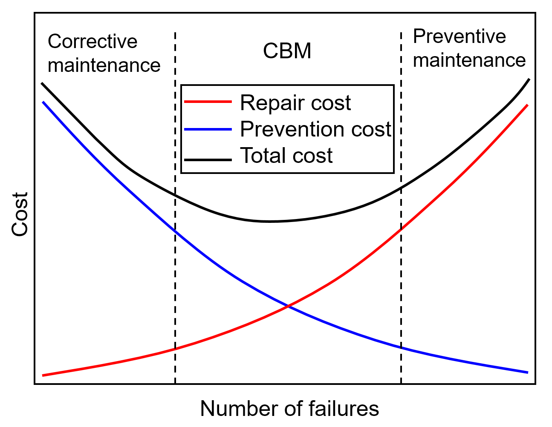
Maintenance Strategies vs. Cost

Slide 9
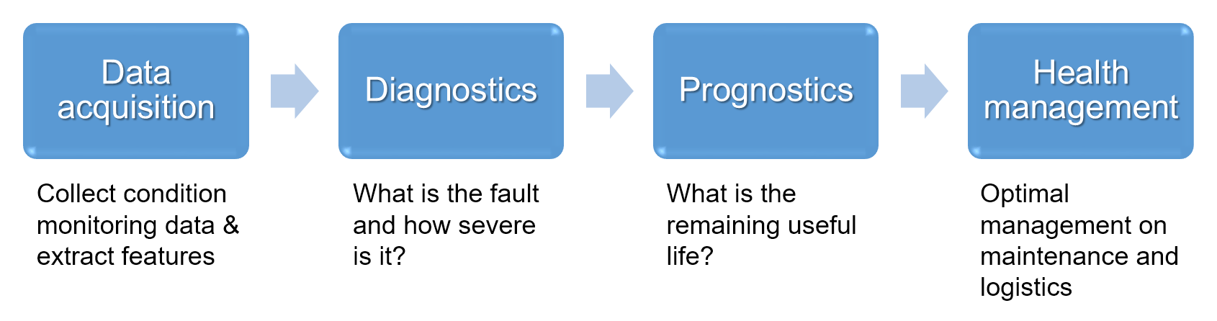
Four Main Steps of PHM

Slide 10
Four Main Steps of PHM
Data acquisition: collect measurement data from the sensors and process them to extract useful features for diagnosis
Diagnostics: the fault is detected for any anomaly, isolated to determine which component is failing and to identify how severe it is with respect to the failure threshold
Prognostics: predicts how long it will take until failure under the current operating condition
  Prognostics is the key enabler that permits the reliability of a system to be evaluated in its actual life cycle conditions
  predicts the time at which a system or a component will no longer perform its intended function, thus giving users the opportunity to mitigate system-level risks while extending its useful life
Health management: manage in optimum manner the maintenance scheduling and logistics support

Slide 11
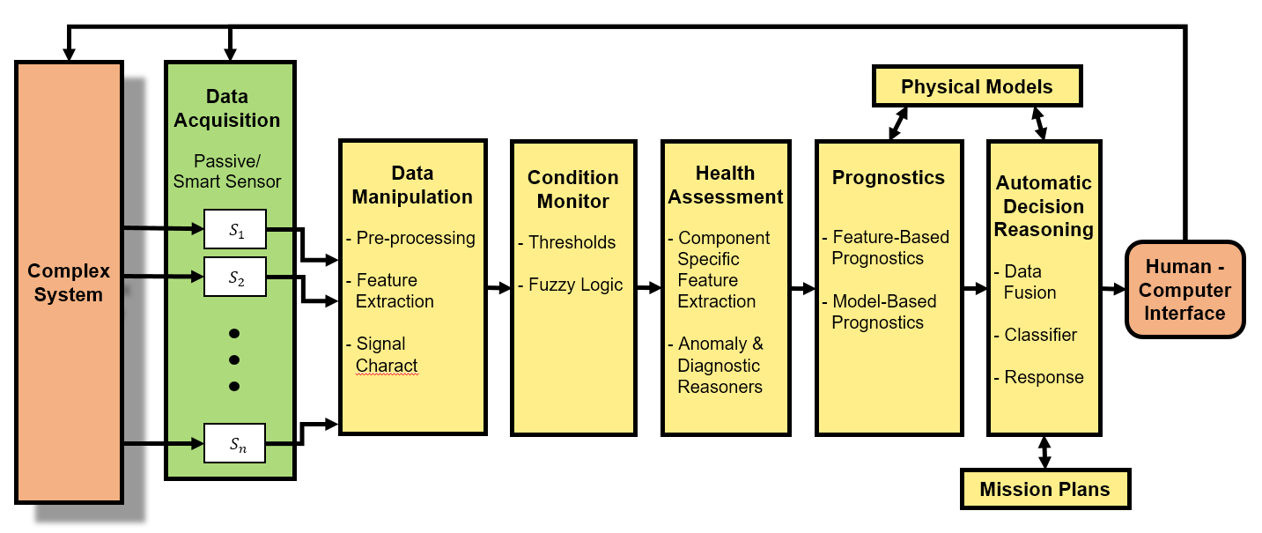
Prognostics Architecture (Callan et al. 2006)

Slide 12
2. Historical Background

Slide 13
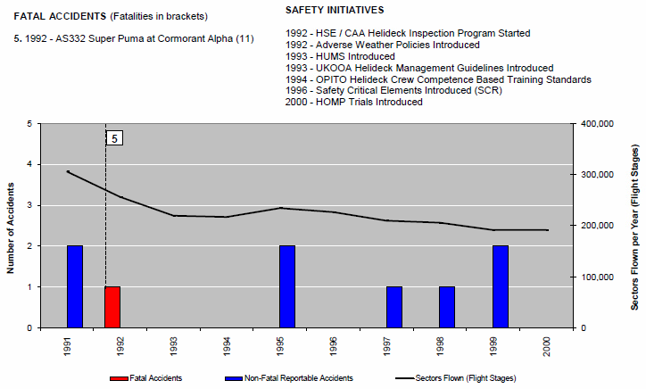
History of PHM
1980s: started to reduce a helicopter accident rate by the Civil Aviation Authority of UK
1990s: health and usage monitoring system (HUMS): measures health conditions and performance of helicopter

Slide 14
History of PHM cont.
1990s: NASA Vehicle Health Monitoring of outer space vehicle → replaced by a more universal word Integrated Vehicle Health Management (IVHM) to incorporate the prognostics of various systems
2000s: DARPA structural integrity prognosis system (SIPS) and conditioned-based maintenance plus (CBM+)
Prognostics and Health Management (PHM) was first adopted in the program for joint strike fighter development
  program managers shall optimize operational readiness through affordable, integrated, embedded diagnostics and prognostics, and embedded training and testing, serialized item management, automatic identification technology (AIT), and iterative technology refreshment

Slide 15
3. PHM Applications

Slide 16
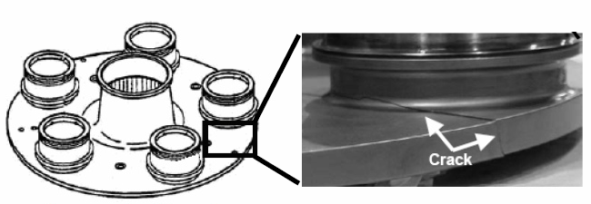
Aerospace and Defense Applications
pioneered by the aerospace and defense industry and propagated to other industry
Now applications are in defense, aerospace, wind power, civil infrastructure, manufacturing, and electronics
Pratt & Whitney: advanced PHM systems for the F135 multipurpose fighter
GE Aviation: monitored aircraft engines for over 15 years and provids diagnostic services to detect early symptoms of engine problems
Prognostics of crack on a planetary gear plate in
UH-60A helicopter (Vachtsevanos et al. 2006)

Slide 17
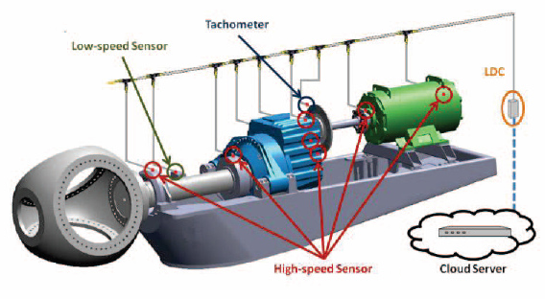
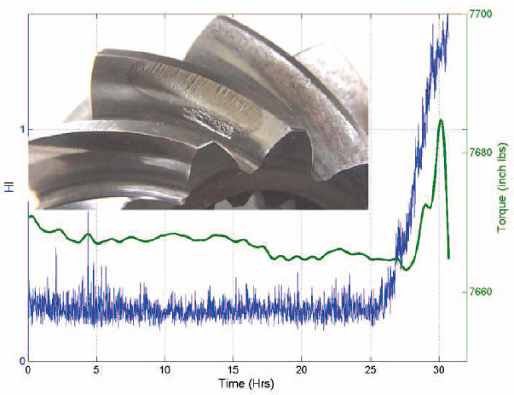
Heavy Machinery and Energy Industry
Rolls-Royce: gas turbine engines AVON 1535
Komatsu and Caterpillar: advanced data analysis algorithms to detect the vehicle problems at an early stage
Renewable energy: wind turbine drivetrain condition monitoring systems

Slide 18
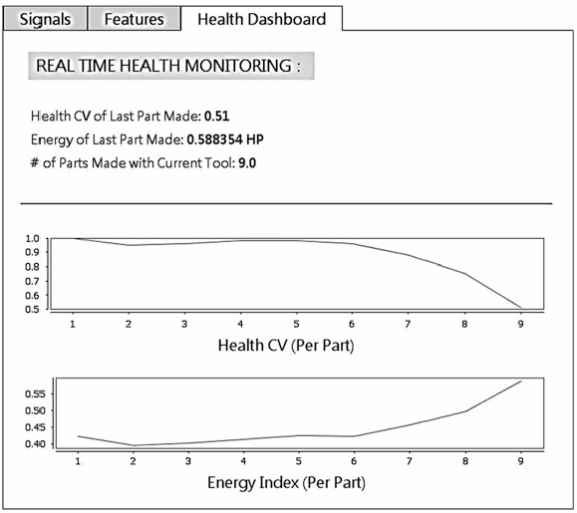
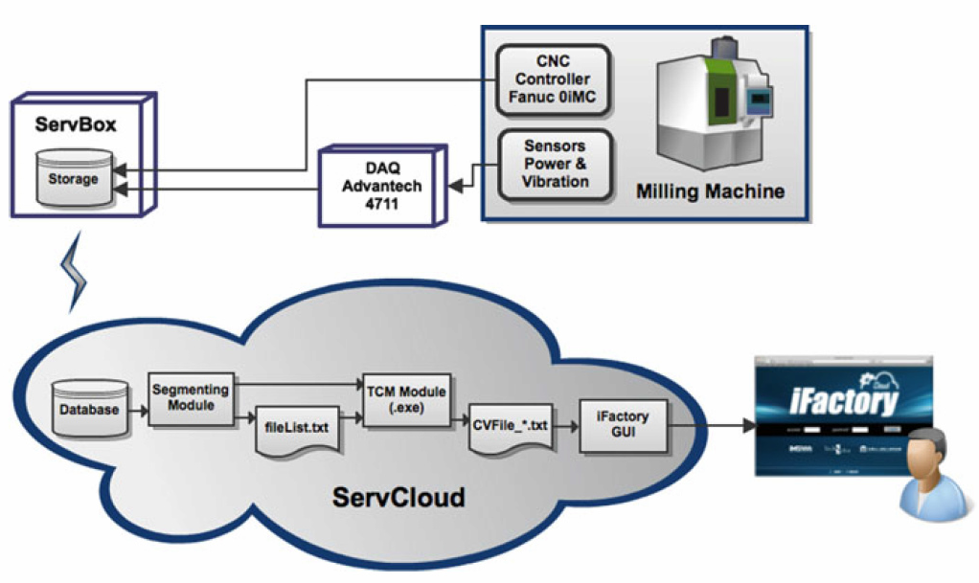
Manufacturing Industry
primary focus is on the reduced down time
spindle bearing of rotating machinery (Liao and Lee 2010)
machine tool wear (Kao et al. 2011)
surge for air compressors (Sodemann et al. 2006)
the fleet health of industrial robots

Slide 19
4. Review of Prognostics Algorithms

Slide 20
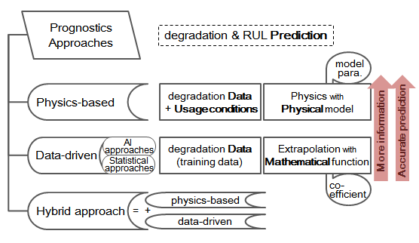
Category of Prognostics Methods

Slide 21
Physics-based Prognostics Methods
a physical model describing the behavior of degradation is available
combined with measured data and usage conditions to identify model parameters and to predict the future behavior
requires a detailed understanding of the problem
the results tend to be intuitive because they are based on modeled phenomenon.
Once a model is developed, it can be reused for different systems or different designs by tuning model parameters.
computationally efficient than the data-driven method
model development requires a thorough understanding of the system
missed physics can lead to failure of predicting degradation behavior
high-fidelity models, especially for numerical models, can be computationally intensive

Slide 22
Data-driven Prognostics Methods
use training data at current and previous usage conditions to identify the degradation state and to predict the future trend
conceptually an extrapolation with mathematical function
no guaranty that extrapolation is meaningful since failure progress from current state forward may be unrelated to prior failure progress
The success depends on collecting statistics of failures as a function of current state, which requires volumes of data
easy and fast to implement
off-the-shelf packages are available for data mining & machine learning
With enough data, it is possible to identify relationships that were not previously considered without any prejudice
requires a lot of data that include all possible modes of failure
outcome may be counterintuitive, and it is dangerous to accept a result without understand the cause of the problem
computationally intensive, both analysis and implementation

Slide 23
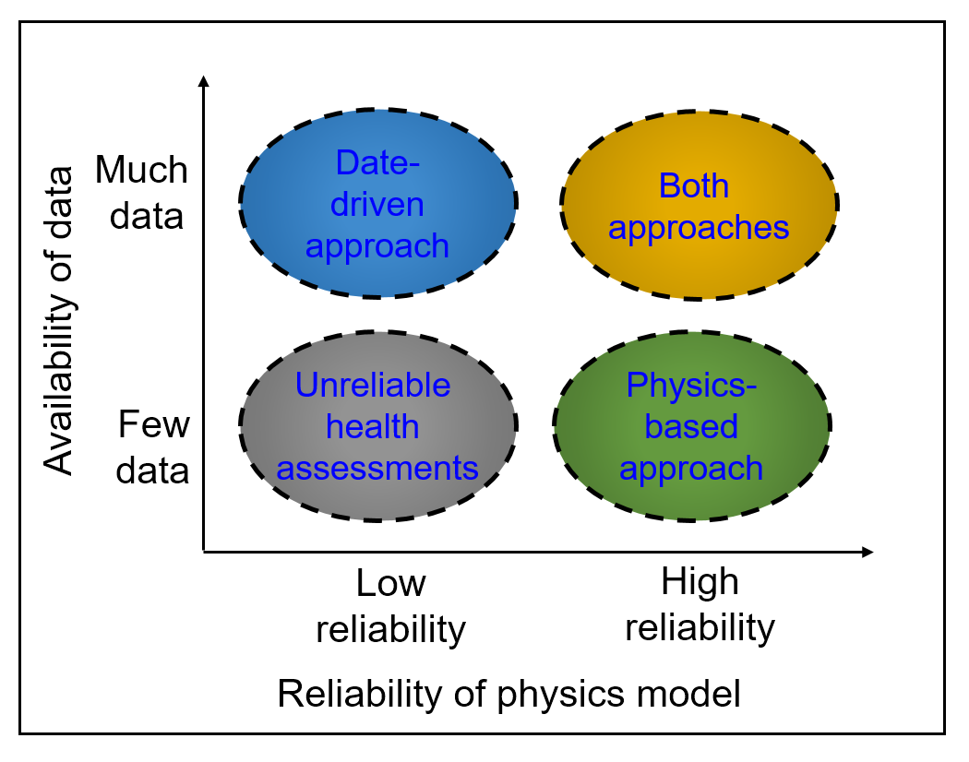
Application Domain of Prognostics Algorithms

Slide 24
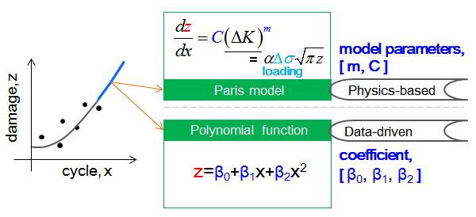
Difference between the Two Approaches cont.

Slide 25
Difference between the Two Approaches
availability of a physical model including usage conditions
  use of training data to identify the characteristics of the damage state
  more accurate and have long-term prediction
  Physical degradation models are very rare in practice
In data-driven approaches, it is not easy to obtain several sets of degradation data due to expensive time and costs
Hybrid approaches are to integrate advantages of both physics-based and da-ta-driven methods to improve the prediction capability
  the knowledge on physical behavior can be used to determine the mathematical model (e.g., determining the order of polynomial or exponential functions) in da-ta-driven method
  possible to use data-driven system model in conjunction with a physics-based fault model or vice-versa
  depends on a specific application domain

Slide 26
5. Benefits and Challenges for Prognostics

Slide 27
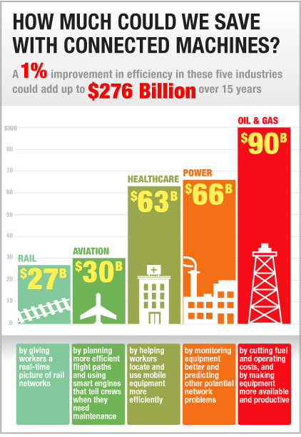
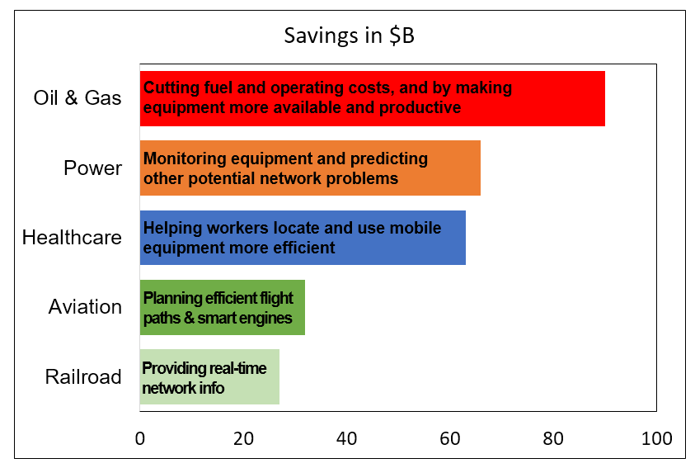
Reduced Operating Cost
through the CBM practices
through a more automated maintenance and logistics support system
GE claims that only 1% improvement in efficiency can make $276 billion in the five major industries

Slide 28
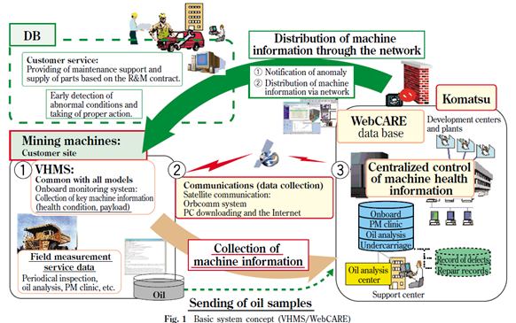
Increased Revenue
PHM can help indirectly to increase the revenue stream of a business
More reliable system can gain a larger market share
Not only selling a product, but also providing PHM services
Mining machines of
Komatsu company

Slide 29
Benefits in System Design and Development
Optimum system design
  Many tests in development stage including accelerated life tests (ALT)
  Prognostics provide data from the actual conditions, which can improve and optimize new design with much less cost
  PHM equipped system doesn’t have to be conservative in terms of safety and reliability because the faults are monitored and insured against failure
Improved reliability prediction
  Traditional handbook-based reliability methods are often proven to be misleading
  the data collected from PHM reflect the actual life cycle conditions of the system, which facilitates more accurate damage and RUL assessment
Improved logistics support system
  large-scale supply resources with scattered spare parts depots and their management are another big source of increased cost
  Accurate prediction of failure enables a significant reduction in the logistics

Slide 30
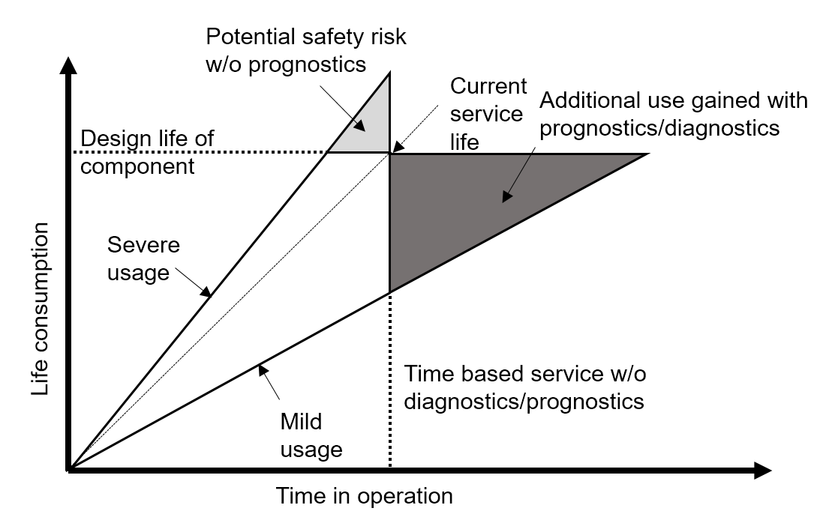
Other Benefits
Benefits in production
  Better process quality control
  Integrated maintenance development by OEMs
Benefits in system operation
  Increased system safety
  Improved operational reliability
Benefits in logistics support and maintenance
  Condition-based maintenance
  Improved fleet-wide decision support
  Optimum logistics supply chain
  Reduced maintenance-induced fault

Slide 31
Challenges in Prognostics
Implementing optimum sensor selection and localization
  requires sensors to measure the environmental, operational, and performance parameters
  Inaccurate measurements by improper sensor selection and location can degrade the prognostic performance
  sensor reliability and failures must also be considered
Feature extraction
  important to collect data that is directly related to damage
  Damage features need to be extracted from indirect data (vibration → crack)
  Need to overcome a small signal-to-noise ratio

Slide 32
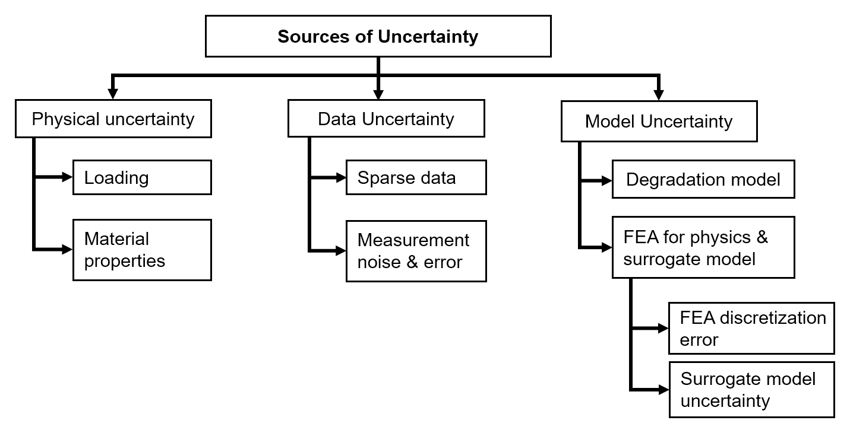
Addressing Prognostics Uncertainties
Need to handle real world uncertainties that lead to inaccurate predictions
uncertainties can lead to the significant deviation of prognostics results from the actual situation
Important to develop methods that can be used to describe the uncertainty bounds and confidence levels for prognosis

Slide 33
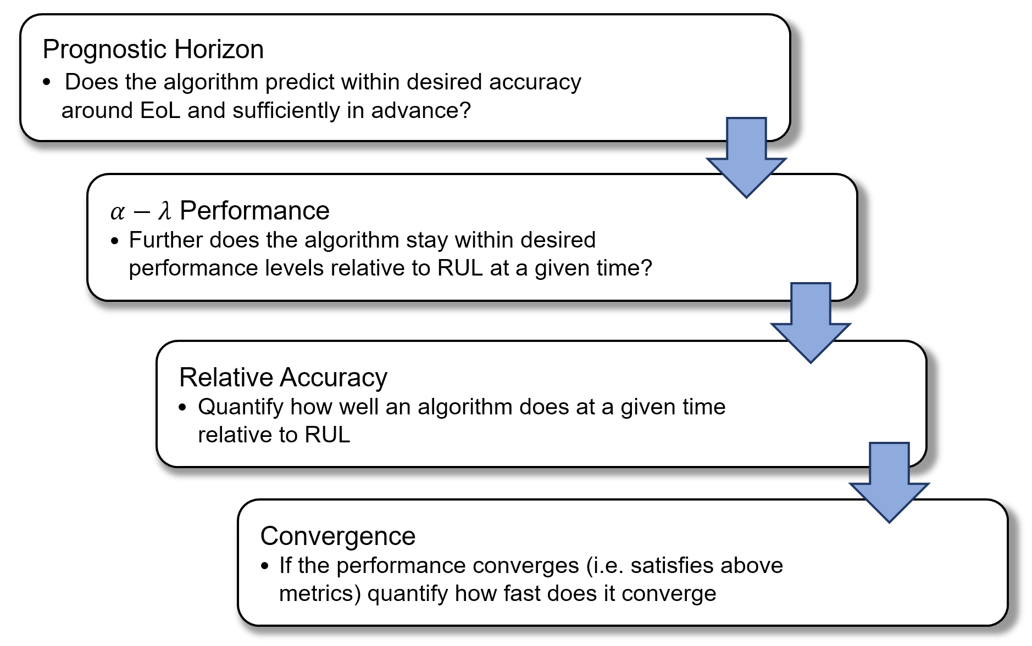
Prognostics Metrics

