Slide 1
Chapter 2
Tutorials for Prognostics

Slide 2
1. Introduction

Slide 3

System Performance Degradation
Lifecycle of engineering systems
  The performance is gradually degraded, and eventually, the systems fail under repeated usage conditions
  Ex) Fuselage panel under repeated pressurization loading (fatigue failure)
$$Structural Health ∝\frac{1}{Crack size}$$

Slide 4
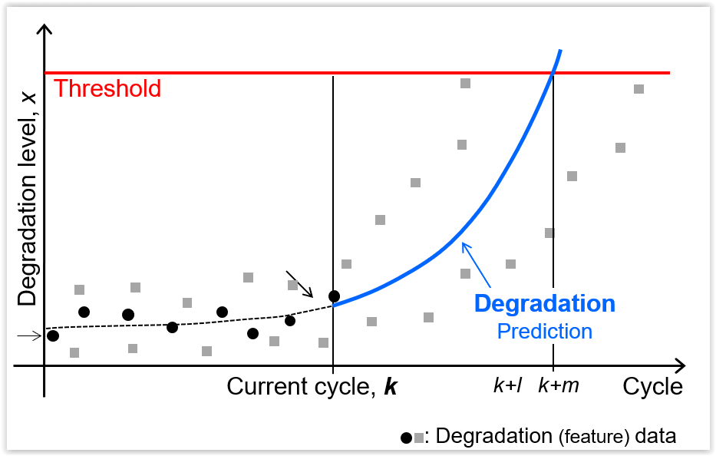
Damage Tolerance Design Concept
Allowed to have damage in the system as long as it can be monitored and controlled so that it may not cause a system level failure
Ex) cracks should be inspected and monitored, and panels are repaired or replaced before cracks grow beyond a certain level of threshold
Prognostics: predict remaining cycles before the damage grows beyond the threshold (remaining useful life, RUL)
Prognostics utilizes the
measured damage levels
up to the current cycle
Types of degradation:
crack size, wear volume
and spall size

Slide 5
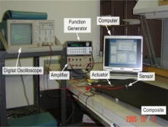

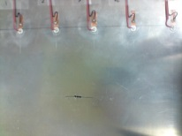
How to Measure Degradation?
Degradation data are difficult to measure directly
Health monitoring data are obtained from
sensors/actuators in the form of electrical or vibration
signals, acoustic waves, thermography, etc.
These signals are converted into degradation
data based on signal processing techniques
(featured data)
Ex) Crack size
  actual measurements are transient elastic waves
  using calibration against known crack sizes, it is possible
  to estimate the crack size from wave signals
σ
Sensors/
actuators
Damage
σ

Slide 6
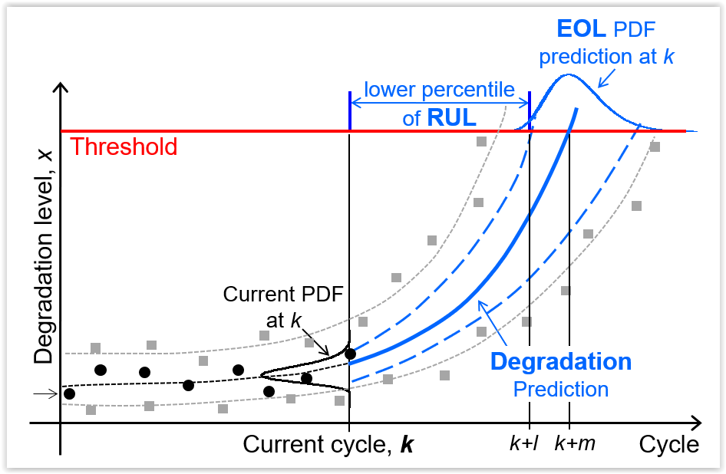
Uncertainty in Prognostics
The process of predicting the future behavior of degradation includes numerous sources of uncertainty
  variability in material properties, data measurement noise/bias, current/future loading conditions, and the predicting process itself
it is natural to consider the predicted degradation as a statistical distribution with the prediction interval
Even if degradation is measured as a single point at the current cycle, the degradation is represented as a distribution due to uncertainty

Slide 7

EOL vs RUL
System failure: when the degradation level goes beyond the threshold
The time to reach the threshold (end of life, EOL) is uncertain
  represented as a probability distribution
Probability of failure: the area under the distribution up to the given time
  The failure probability increases as cycle increases
EOL: when the degradation reaches to the threshold and the maintenance should be ordered for the system
RUL: the remaining time to the maintenance from the current time
  The lower bound of RUL: the maintenance time for a conservative purpose
Prognostics: to predict future behavior of degradation and the RUL of the system based on the measured data up to the current time
$$t_{RUL}=t_{EOL}−t_{k}$$

Slide 8
Types of Prognostics Methods
physics-based approaches and data-driven approaches
  Physics-based approaches: prediction based on degradation model
  Data-driven approaches: prediction based on the trend of data
Differences
  availability of a physical model that describes the behavior of damage,
  availability of field operating conditions
  damage degradation data from similar systems

Slide 9
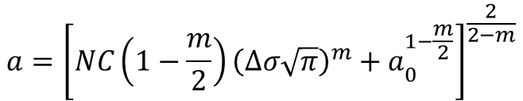

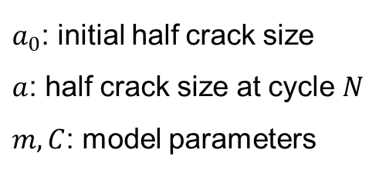
Physics-based Prognostics Methods
a physical model describing the behavior of degradation is available with usage conditions such as loading information
Ex) Fatigue crack growth model (Paris and Erdogan, 1963)
The model parameters can be identified based on measured crack sizes at certain interval of cycles with given loading information
The crack size at future cycles can be predicted by substituting the identified parameters to the Paris model with future loading conditions
Since identifying model parameters is the most important step, algorithms of physics-based approaches can be considered as a parameter estimation method.
$$\frac{da}{dN}=C{\left(Δσ\sqrt{πa}\right)}^{m}$$
$a_{0}$: initial half crack size
$a$: half crack size at cycle $N$
$m,C$: model parameters
$$a={\left[NC\left(1−\frac{m}{2}\right){\left(Δσ\sqrt{π}\right)}^{m}+a_{0}^{1−\frac{m}{2}}\right]}^{\frac{2}{2−m}}$$

Slide 10
Data-driven Prognostics Methods
When physical models are not available, or the failure phenomenon is too complex to be expressed as a model
Impossible to predict the future behavior without any information about degradation behavior
Therefore, several sets of run-to-failure data are usually required to identify the degradation characteristics in data-driven approaches, which is called training data
There are a great variety of data-driven methods to use information from training data

Slide 11
2. Prediction of Degradation Behavior

Slide 12
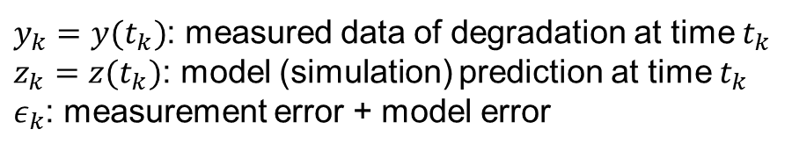
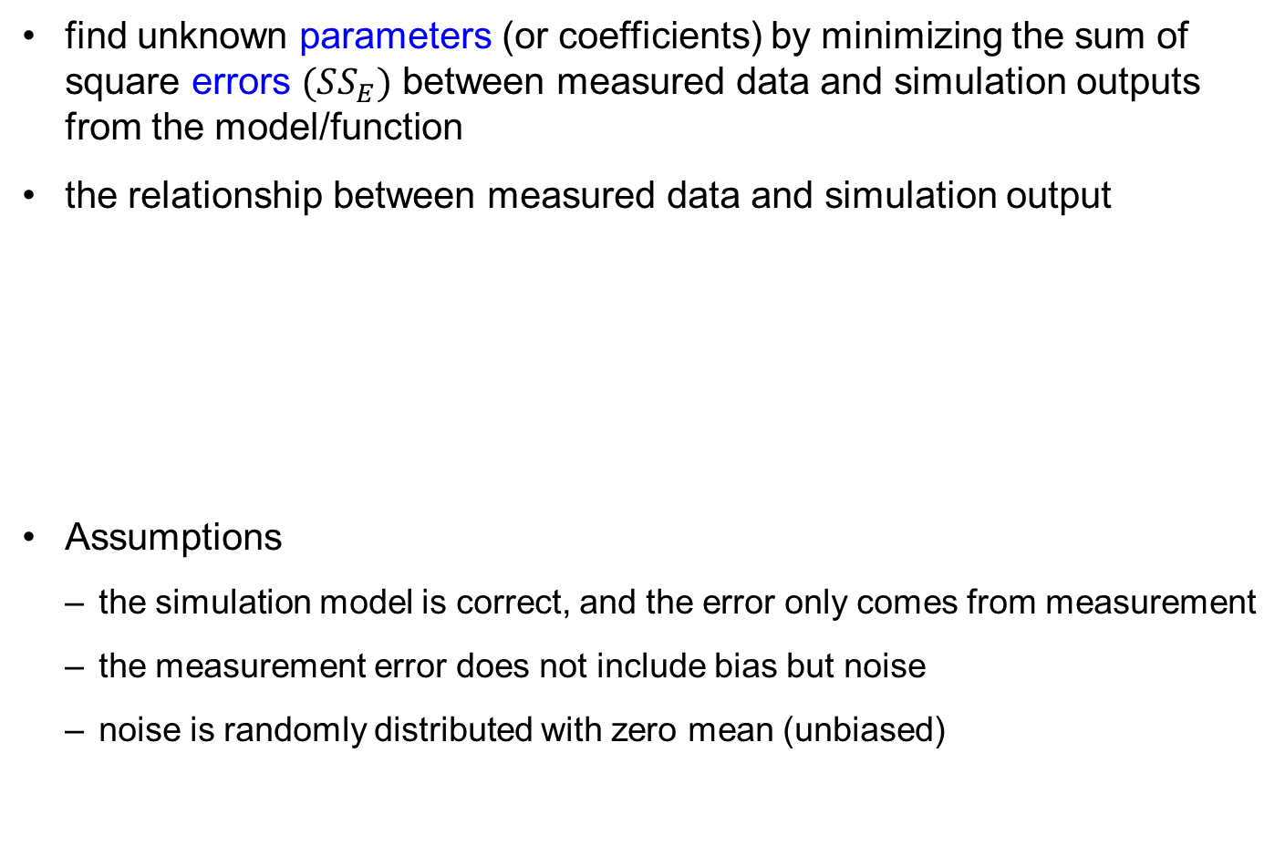

Least-squares Method
find unknown parameters (or coefficients) by minimizing the sum of square errors $(SS_{E})$ between measured data and simulation outputs from the model/function
the relationship between measured data and simulation output
Assumptions
  the simulation model is correct, and the error only comes from measurement
  the measurement error does not include bias but noise
  noise is randomly distributed with zero mean (unbiased)
$$y_{k}=z_{k}+ε_{k}$$
$y_{k}=y(t_{k})$: measured data of degradation at time $t_{k}$
$z_{k}=z(t_{k})$: model (simulation) prediction at time $t_{k}$
$ε_{k}$: measurement error + model error

Slide 13
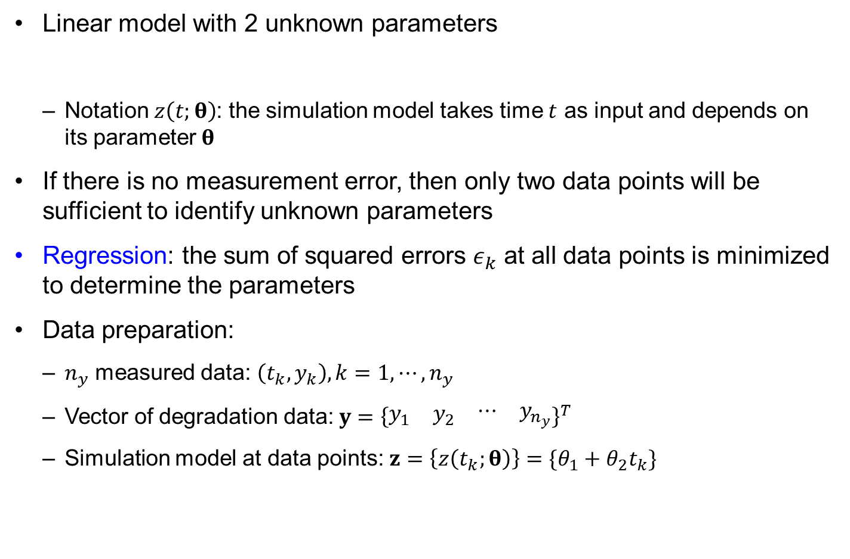
Linear Model
Linear model with 2 unknown parameters
  Notation $z\left(t;θ\right)$: the simulation model takes time $t$ as input and depends on its parameter $θ$
If there is no measurement error, then only two data points will be sufficient to identify unknown parameters
Regression: the sum of squared errors $ε_{k}$ at all data points is minimized to determine the parameters
Data preparation:
  $n_{y}$ measured data: $\left(t_{k},y_{k}\right), k=1,⋯,n_{y}$
  Vector of degradation data: $y={\left\{\begin{matrix}\begin{matrix}y_{1} & y_{2}\end{matrix} & \begin{matrix}⋯ & y_{n_{y}}\end{matrix}\end{matrix}\right\}}^{T}$
  Simulation model at data points: $z=\left\{z\left(t_{k};θ\right)\right\}=\{θ_{1}+θ_{2}t_{k}\}$
$$z\left(t;θ\right)=θ_{1}+θ_{2}t, θ={\left\{\begin{matrix}θ_{1} & θ_{2}\end{matrix}\right\}}^{T}$$

Slide 14
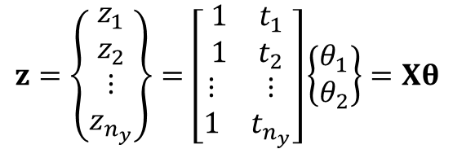

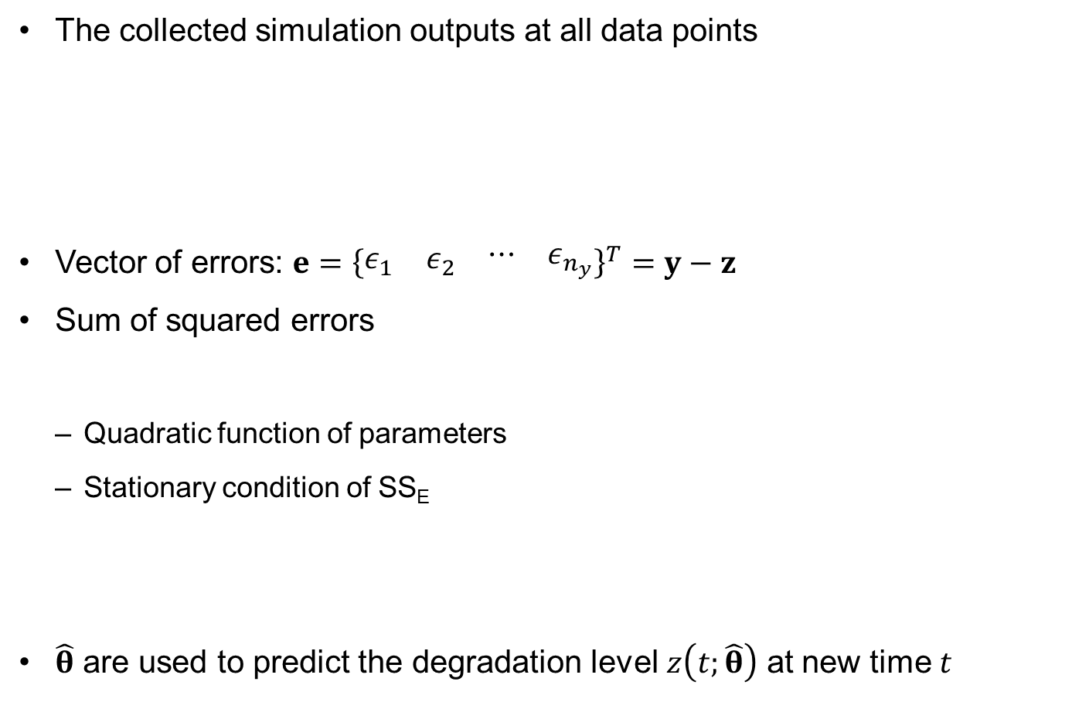

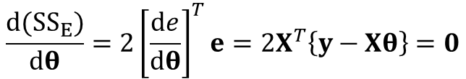
Regression in Linear Model
The collected simulation outputs at all data points
Vector of errors: $e={\left\{\begin{matrix}\begin{matrix}ε_{1} & ε_{2}\end{matrix} & \begin{matrix}⋯ & ε_{n_{y}}\end{matrix}\end{matrix}\right\}}^{T}=y−z$
Sum of squared errors
  Quadratic function of parameters
  Stationary condition of SS_{E}
$\hat{θ}$ are used to predict the degradation level $z\left(t;\hat{θ}\right)$ at new time $t$
$$z=\left\{\begin{matrix}\begin{matrix}z_{1} \\ z_{2}\end{matrix} \\ \begin{matrix}⋮ \\ z_{n_{y}}\end{matrix}\end{matrix}\right\}=\left[\begin{matrix}\begin{matrix}1 & t_{1} \\ 1 & t_{2}\end{matrix} \\ \begin{matrix}⋮ & ⋮ \\ 1 & t_{n_{y}}\end{matrix}\end{matrix}\right]\left\{\begin{matrix}θ_{1} \\ θ_{2}\end{matrix}\right\}=Xθ$$
$X$: design matrix
$$SS_{E}=e^{T}e={\left\{y−z\right\}}^{T}\left\{y−z\right\}={\left\{y−Xθ\right\}}^{T}\left\{y−Xθ\right\}$$
$$\frac{d(SS_{E})}{dθ}=2{\left[\frac{de}{dθ}\right]}^{T}e=2X^{T}\left\{y−Xθ\right\}=0$$
$$\hat{θ}={\left[X^{T}X\right]}^{−1}\left\{X^{T}y\right\}$$

Slide 15
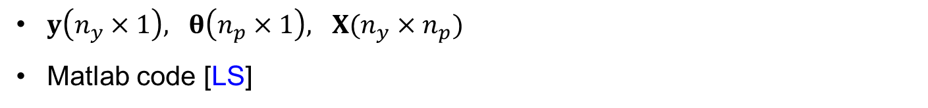
Generalization of Linear Regression
$y\left(n_{y}×1\right), θ\left(n_{p}×1\right), X(n_{y}×n_{p})$
Matlab code [LS]
%%Identify parameters (theta)
y=[ ]'; % a vector of measured data
x=[ ]'; % a vector/matrix of input
X=[ ]; % a design matrix, e.g., Eq.2.5
thetaH=(X'*X)\(X'*y) % Eq.2.8
% This is the same as: thetaH=regress(y,X);
%%Degradation prediction at xNew
xNew=[ ]';
XNew=[ ]; % same form as X, but use xNew instead of x
zH=XNew*thetaH; % Eq.2.4 or 2.5
%%RUL prediction
thres=[ ]; % threshold level
currt=[ ]; % current cycle
syms xEOL
XEOL=[ ]; % same form as X, but use xEOL instead of x
eolFuc=thres-XEOL*thetaH; % EOL func.
eol=double(solve(eolFuc,'Real',true));
rul=min(eol(eol>=0))-currt

Slide 16
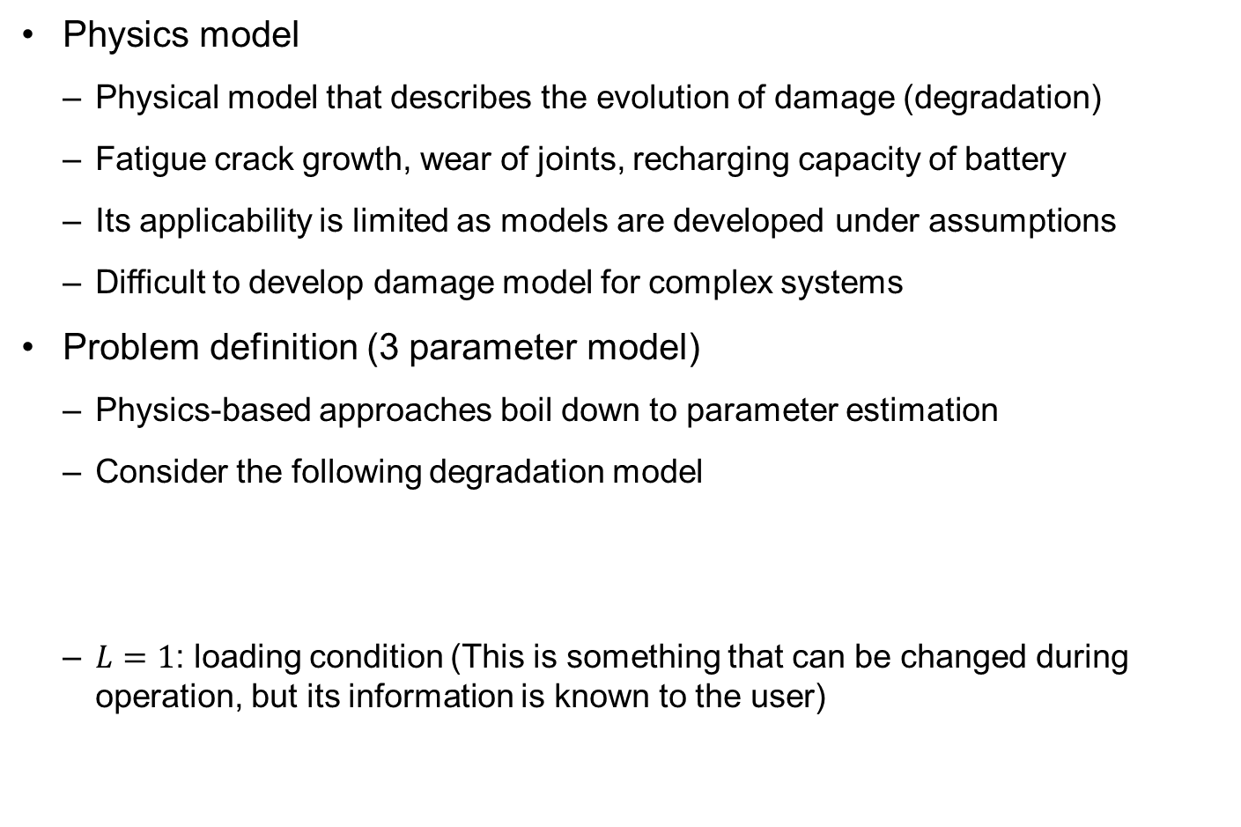
Physics-based Least-squares Method
Physics model
  Physical model that describes the evolution of damage (degradation)
  Fatigue crack growth, wear of joints, recharging capacity of battery
  Its applicability is limited as models are developed under assumptions
  Difficult to develop damage model for complex systems
Problem definition (3 parameter model)
  Physics-based approaches boil down to parameter estimation
  Consider the following degradation model
  $L=1$: loading condition (This is something that can be changed during operation, but its information is known to the user)
$$z\left(t;θ\right)=θ_{1}+θ_{2}Lt^{2}+θ_{3}t^{3}, θ={\left\{\begin{matrix}θ_{1} & θ_{2} & θ_{3}\end{matrix}\right\}}^{T}$$

Slide 17
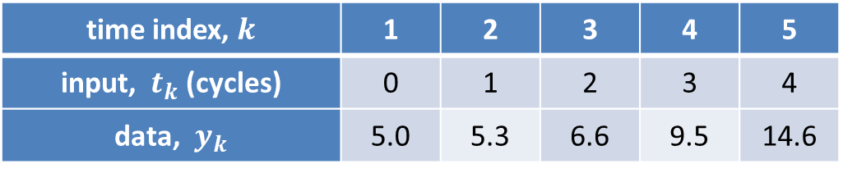
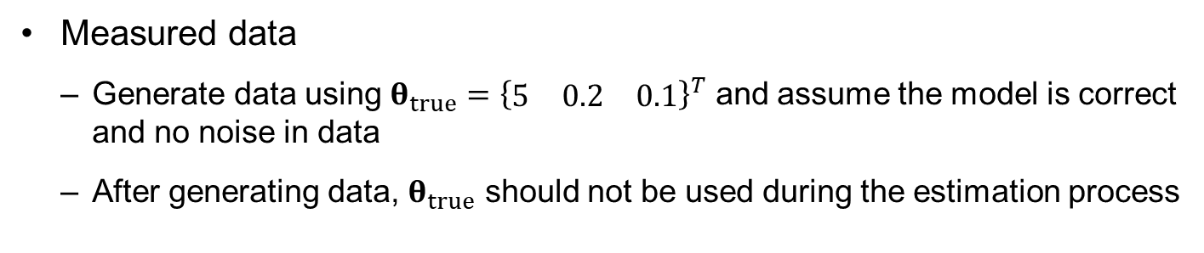
Physics-based Least-squares Method cont.
Measured data
  Generate data using $θ_{true}={\left\{\begin{matrix}5 & 0.2 & 0.1\end{matrix}\right\}}^{T}$ and assume the model is correct and no noise in data
  After generating data, $θ_{true}$ should not be used during the estimation process
time index, $k$ | 1 | 2 | 3 | 4 | 5
input, $t_{k}$ (cycles) | 0 | 1 | 2 | 3 | 4
data, $y_{k}$ | 5.0 | 5.3 | 6.6 | 9.5 | 14.6
set in [LS]
y=[5 5.3 6.6 9.5 14.6]';
x=[0 1 2 3 4]';

Slide 18

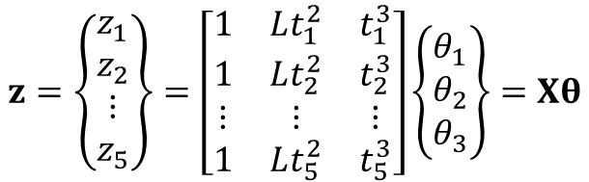
Physics-based Least-squares Method cont.
Parameter estimation
  Vector of degradation model
  Estimate unknown model parameters
  Finally, we obtain $\hat{θ}={\left\{\begin{matrix}5 & 0.2 & 0.1\end{matrix}\right\}}^{T}=θ_{true}$
$$z=\left\{\begin{matrix}\begin{matrix}z_{1} \\ z_{2}\end{matrix} \\ \begin{matrix}⋮ \\ z_{5}\end{matrix}\end{matrix}\right\}=\left[\begin{matrix}\begin{matrix}1 & Lt_{1}^{2} & t_{1}^{3} \\ 1 & Lt_{2}^{2} & t_{2}^{3}\end{matrix} \\ \begin{matrix}⋮ & ⋮ & ⋮ \\ 1 & Lt_{5}^{2} & t_{5}^{3}\end{matrix}\end{matrix}\right]\left\{\begin{matrix}θ_{1} \\ θ_{2} \\ θ_{3}\end{matrix}\right\}=Xθ$$
set in [LS]
L=1;
X=[ones(length(x),1) L*x.^2 x.^3];
in [LS]
thetaH=(X'*X)\(X'*y)

Slide 19

Physics-based Least-squares Method cont.
Degradation prediction
  once the model parameters are identified, it is trivial to predict the behavior of damage in the future by providing future time cycles to the model
  Prediction between $t=4$ and $t=15$
set in [LS]
xNew=[4:0.5:15]';
XNew=[ones(length(xNew),1) L*xNew.^2 xNew.^3];
zH=XNew*thetaH;
Exact prediction because
Data are exact
Model form is exact

Slide 20
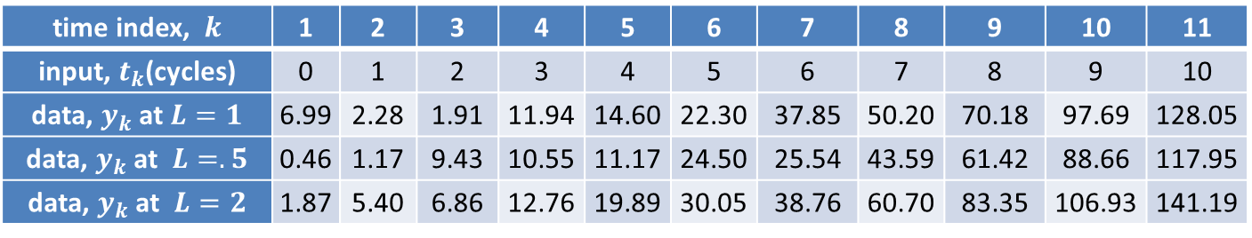
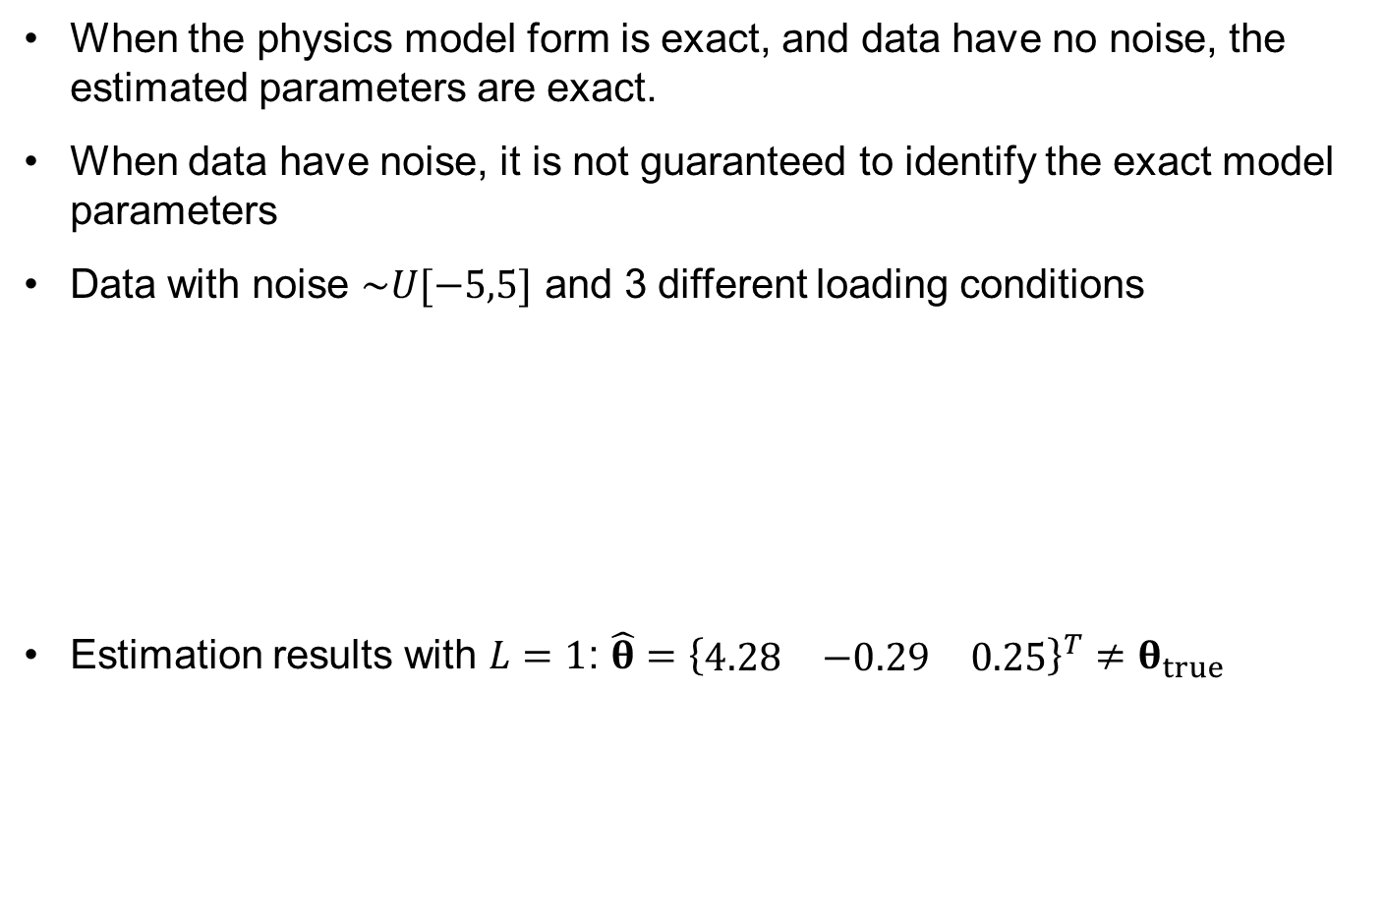
Effect of Noise in Data
When the physics model form is exact, and data have no noise, the estimated parameters are exact.
When data have noise, it is not guaranteed to identify the exact model parameters
Data with noise $\sim U[−5,5]$ and 3 different loading conditions
Estimation results with $L=1$: $\hat{θ}={\left\{\begin{matrix}4.28 & −0.29 & 0.25\end{matrix}\right\}}^{T}≠θ_{true}$
time index, $k$ | 1 | 2 | 3 | 4 | 5 | 6 | 7 | 8 | 9 | 10 | 11
input, $t_{k}$(cycles) | 0 | 1 | 2 | 3 | 4 | 5 | 6 | 7 | 8 | 9 | 10
data, $y_{k}$ at $L=1$ | 6.99 | 2.28 | 1.91 | 11.94 | 14.60 | 22.30 | 37.85 | 50.20 | 70.18 | 97.69 | 128.05
data, $y_{k}$ at $L=.5$ | 0.46 | 1.17 | 9.43 | 10.55 | 11.17 | 24.50 | 25.54 | 43.59 | 61.42 | 88.66 | 117.95
data, $y_{k}$ at $L=2$ | 1.87 | 5.40 | 6.86 | 12.76 | 19.89 | 30.05 | 38.76 | 60.70 | 83.35 | 106.93 | 141.19

Slide 21
Effect of Noise in Data cont.
Prediction curves
  Since the random noise has a mean of zero, the error in prediction can be reduced when more data are used
  Depending on random realization of noise, different results will happen every time
By repeating this process, it is possible to obtain a probability distribution of degradation level at a given time cycle
Using first 5 data
Using first 9 data

Slide 22
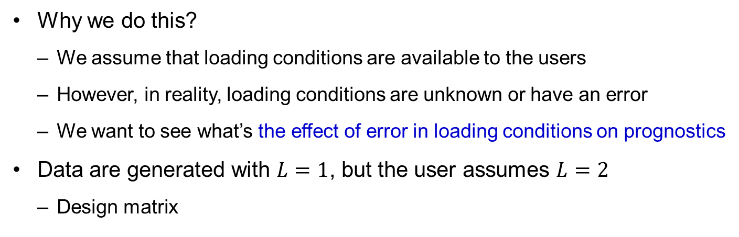
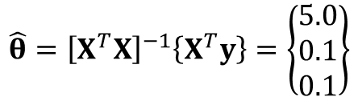
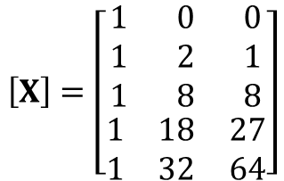
Parameter Estimation with Incorrect Loading
Why we do this?
  We assume that loading conditions are available to the users
  However, in reality, loading conditions are unknown or have an error
  We want to see what’s the effect of error in loading conditions on prognostics
Data are generated with $L=1$, but the user assumes $L=2$
  Design matrix
$$\left[X\right]=\left[\begin{matrix}\begin{matrix}1 & 0 & 0 \\ 1 & 2 & 1 \\ 1 & 8 & 8\end{matrix} \\ \begin{matrix}1 & 18 & 27 \\ 1 & 32 & 64\end{matrix}\end{matrix}\right]$$
$$\hat{θ}={\left[X^{T}X\right]}^{−1}\left\{X^{T}y\right\}=\left\{\begin{matrix}5.0 \\ 0.1 \\ 0.1\end{matrix}\right\}$$
Why are the two predictions the same?

Slide 23
Data-driven Prognostics Methods
Damage degradation phenomenon is too complicate, or it is difficult to directly measure the damage
Bearing damage example
  the cause of damage starts from small cracks in the race or in the rolling elements
  it is very difficult to measure the crack sizes directly
  Instead, the vibration of bearing assembly is measured using accelerometer, from which the level of damage is estimated
  the level of vibration is related to the level of damage, but it is difficult to make a physical relationship between the two because vibration can be caused by many different sources, such as misalignment or external excitations
Data-driven prognostics methods
  Predict the RUL without having physical model and/or without directly measuring damage degradation
  requires a large number of trend data to make a prediction

Slide 24

Mathematical Functions
Data-driven methods also need a model to predict
  However, the model does not have physical information
  It is mathematical model (meta model or surrogate)
  Mathematical model builds the relationship between inputs and degradation
Ex) Three functional relationships
The mathematical functions do not include loading conditions
  damage will evolve fast when the loading condition is severe
  If the loading condition is available, more accurate prediction is possible
  we only consider the case when the loading condition is not a part of mathematical functions
$$z^{(1)}=θ_{1}+θ_{2}t$$
$z^{(2)}=θ_{1}+θ_{2}t$ $+ θ_{3}t^{2}$
$$z^{(3)}=θ_{1}+θ_{2}t+θ_{3}t^{2}+θ_{4}t^{3}$$

Slide 25
Fitting Mathematical Functions
Fitting process estimate mathematical model parameters
  This part is the same with the physics-based model parameter estimation
Train the 3 mathematical functions with 5 data using LS code
  Quadratic & cubic models show decreasing degradation (non-physical)
  Linear model underpredict degradation in the future time

Slide 26
Evaluation of Mathematical Functions
hard to tell which function is better than the others
noise in data makes it difficult to predict the trend
When the degradation model is not available, it is difficult to select an appropriate mathematical function as well as to identify parameters accurately due to the influence of noise in data
The quality of prediction depends on
  function selection
  the number of training data
  the level of noise
How to choose an appropriate functional form?
  Based on the quality of fitting

Slide 27
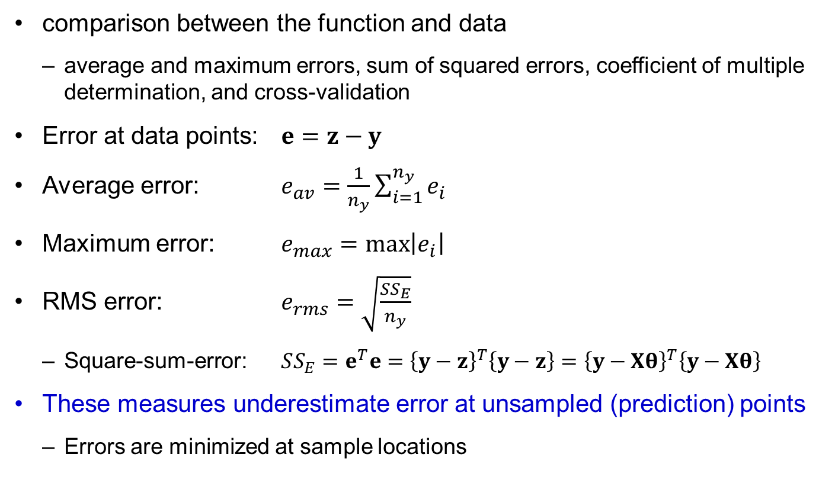
Measures of Quality of Fitting
comparison between the function and data
  average and maximum errors, sum of squared errors, coefficient of multiple determination, and cross-validation
Error at data points: $e=z−y$
Average error: $e_{av}=\frac{1}{n_{y}}\sum_{i=1}^{n_{y}}{e_{i}}$
Maximum error: $e_{max}=\max\left|e_{i}\right|$
RMS error: $e_{rms}=\sqrt{\frac{SS_{E}}{n_{y}}}$
  Square-sum-error: $SS_{E}=e^{T}e={\left\{y−z\right\}}^{T}\left\{y−z\right\}={\left\{y−Xθ\right\}}^{T}\left\{y−Xθ\right\}$
These measures underestimate error at unsampled (prediction) points
  Errors are minimized at sample locations

Slide 28
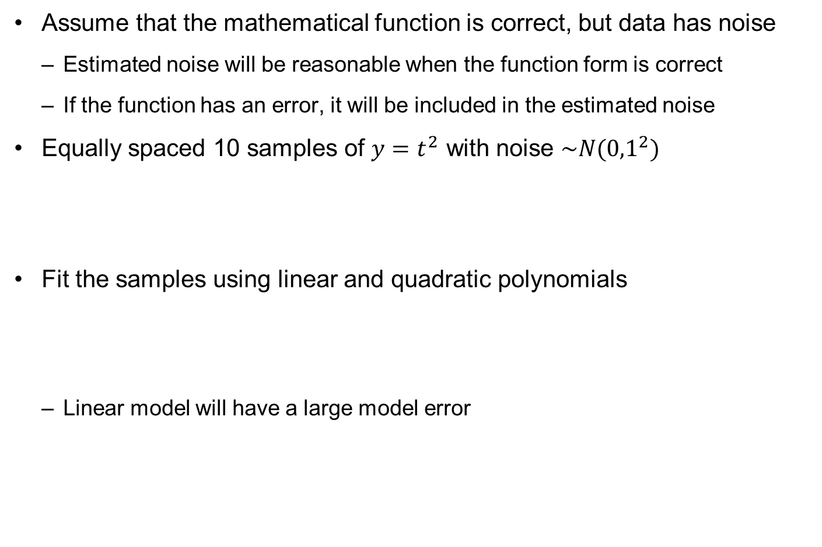
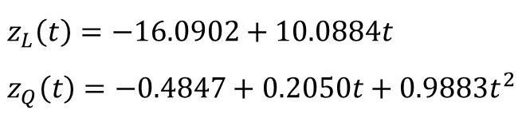
Ex) Estimated Noise versus Model Error
Assume that the mathematical function is correct, but data has noise
  Estimated noise will be reasonable when the function form is correct
  If the function has an error, it will be included in the estimated noise
Equally spaced 10 samples of $y=t^{2}$ with noise $\sim N({0,1}^{2})$
Fit the samples using linear and quadratic polynomials
  Linear model will have a large model error
x=linspace(0,10,20);
y=x.^2+randn(1,20);
$$z_{L}\left(t\right)=−16.0902+10.0884t \\ z_{Q}\left(t\right)=−0.4847+0.2050t+0.9883t^{2}$$
Notes:
x=linspace(0,10,20);
y=x.^2+randn(1,20);
p=polyfit(x,y,1)
e = y - polyval(p,x);
sigma = sqrt(e*e'/18)
%
p2=polyfit(x,y,2)
e = y - polyval(p2,x);
sigma2 = sqrt(e*e'/3)
%
xx=linspace(0,10,50);
f = polyval(p,xx);
f2 = polyval(p2,xx);
yy=xx.^2;
plot(x,y,'ko',xx,f,'k-',xx,f2,'r-',xx,yy,'b-');
legend('samples','linear polynomials','quadratic polynomials','true function');

Slide 29
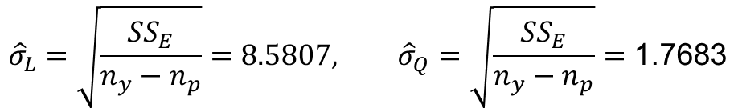
Ex) Estimated Noise versus Model Error cont.
Estimated noise (We will learn it later)
Since the functional form is
assumed to be correct, all
model error is included
in the estimated noise
  The pattern of errors is not
  random
$${\hat{σ}}_{L}=\sqrt{\frac{SS_{E}}{n_{y}−n_{p}}}=8.5807, {\hat{σ}}_{Q}=\sqrt{\frac{SS_{E}}{n_{y}−n_{p}}}=\text{1.7683}$$
Include model error
120
samples
100
linear polynomials
quadratic polynomials
80
true function
60
40
20
0
-20
0
2
4
6
8
10

Slide 30
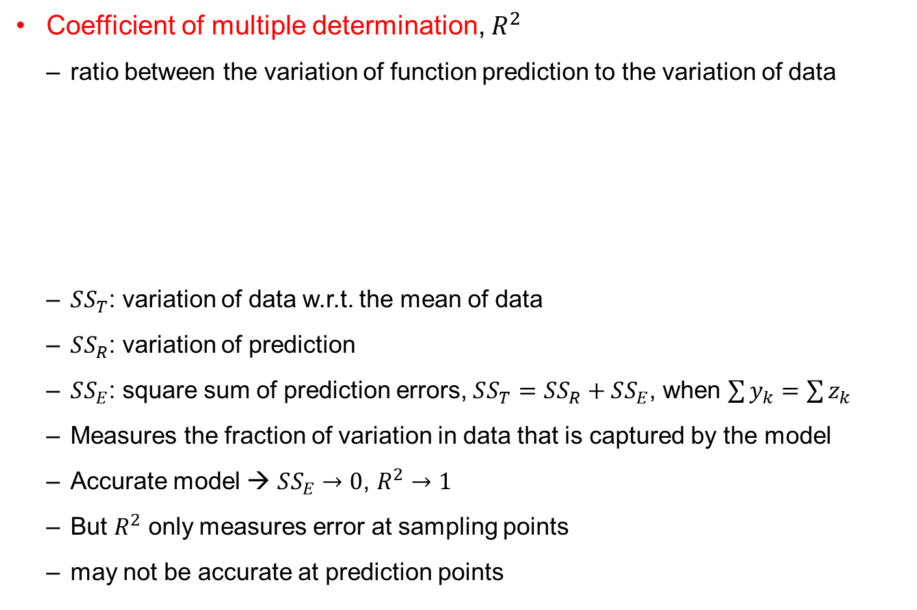
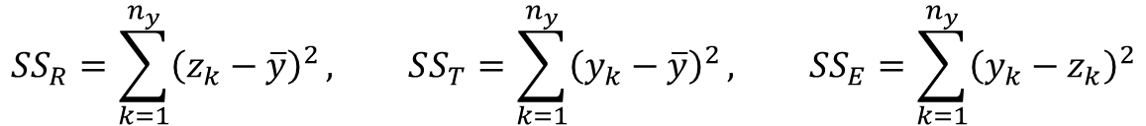

Coefficient of Multiple Determination, $R^{2}$
Coefficient of multiple determination, $R^{2}$
  ratio between the variation of function prediction to the variation of data
  $SS_{T}$: variation of data w.r.t. the mean of data
  $SS_{R}$: variation of prediction
  $SS_{E}$: square sum of prediction errors, $SS_{T}=SS_{R}+SS_{E}$, when $\sum{y_{k}}=\sum{z_{k}}$
  Measures the fraction of variation in data that is captured by the model
  Accurate model → $SS_{E}→0$, $R^{2}→1$
  But $R^{2}$ only measures error at sampling points
  may not be accurate at prediction points
$$R^{2}=\frac{SS_{R}}{SS_{T}}=1−\frac{SS_{E}}{SS_{T}}$$
$$SS_{R}=\sum_{k=1}^{n_{y}}{{\left(z_{k}−\overline{y}\right)}^{2}}, SS_{T}=\sum_{k=1}^{n_{y}}{{\left(y_{k}−\overline{y}\right)}^{2}}, SS_{E}=\sum_{k=1}^{n_{y}}{{\left(y_{k}−z_{k}\right)}^{2}}$$

Slide 31
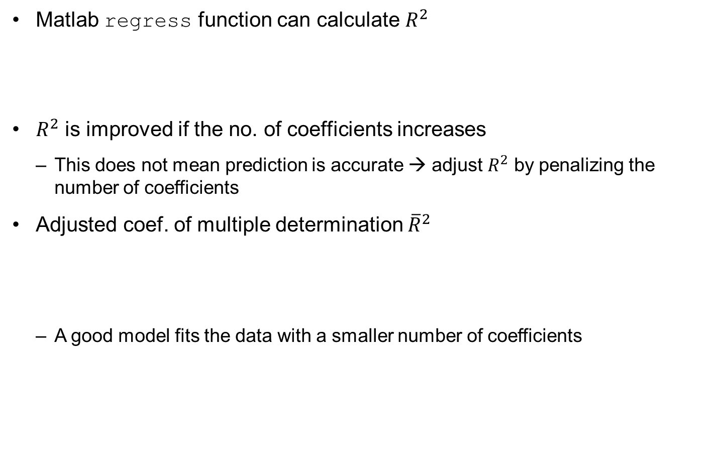
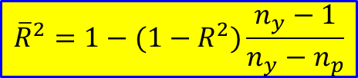
Adjusted Coef. of Multiple Determination, ${\overline{R}}^{2}$
Matlab regress function can calculate $R^{2}$
$R^{2}$ is improved if the no. of coefficients increases
  This does not mean prediction is accurate → adjust $R^{2}$ by penalizing the number of coefficients
Adjusted coef. of multiple determination ${\overline{R}}^{2}$
  A good model fits the data with a smaller number of coefficients
[thetaH,~,~,~,stats]=regress(y,X);
R2=stats(1)
$${\overline{R}}^{2}=1−(1−R^{2})\frac{n_{y}−1}{n_{y}−n_{p}}$$

Slide 32
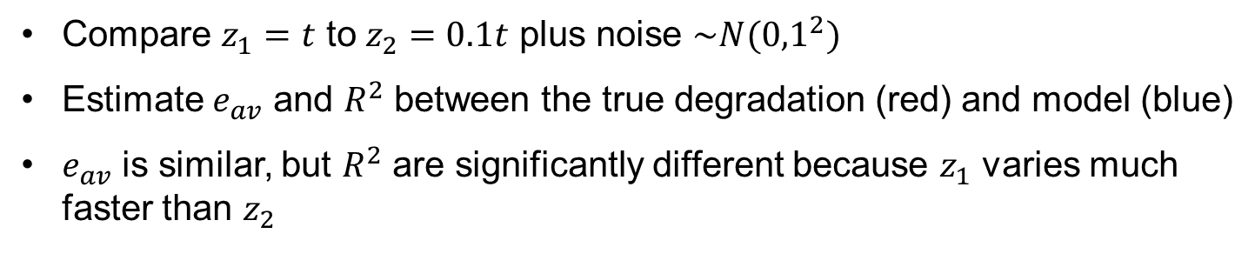


Ex) R² Does Not Reflect Prediction Accuracy
Compare $z_{1}=t$ to $z_{2}=0.1t$ plus noise $\sim N({0,1}^{2})$
Estimate $e_{av}$ and $R^{2}$ between the true degradation (red) and model (blue)
$e_{av}$ is similar, but $R^{2}$ are significantly different because $z_{1}$ varies much faster than $z_{2}$
35
5
$$z_{1}=0.598+0.997t \\ R^{2}=0.9785$$
$$z_{2}=0.598+0.097t \\ R^{2}=0.3016$$
30
4
25
3
20
2
z1
y2
15
1
10
0
5
-1
0
0
5
10
15
20
25
30
-2
t
0
5
10
15
20
25
30
x
Notes:
The coefficient of multiple determination does not necessarily reflect the accuracy. For the same level of error, if the function varies fast, R² will be larger than if the function varies slowly. This is illustrated in the two figures in the slide. In both we generate normally distributed random noise at 30 points using Matlab randn(1,30)
noise =
5.3767e-001 1.8339e+000 -2.2588e+000 8.6217e-001 3.1877e-001 -1.3077e+000 -4.3359e-001 3.4262e-001 3.5784e+000 2.7694e+000 -1.3499e+000 3.0349e+000 7.2540e-001 -6.3055e-002 7.1474e-001 -2.0497e-001 -1.2414e-001 1.4897e+000 1.4090e+000 1.4172e+000 6.7150e-001 -1.2075e+000 7.1724e-001 1.6302e+000 4.8889e-001 1.0347e+000 7.2689e-001 -3.0344e-001 2.9387e-001 -7.8728e-001
For the left figure we add the noise to the function y=x at x=1,2,…,30 ,and in the second we add it to y=0.1x at the same points. We fit the data with Matlab regress
xx=[ones(30,1),x']; [B,BINT,R,RINT,STATS] = regress(y',xx);
The fit of the data with y=x gives $\hat{y}$=0.5981+0.9970x with R²=0.9785, while the fit with y=0.1x gives $\hat{y}$=0.5981+0.0970x with R²=0.3016. Note that the errors from the true function (without the noise) are of similar magnitude even though the coefficients of multiple determination are very different. The figure on the right certainly looks much poorer than the one on the left, reflecting the fact that the noise to signal ratio is poor. The function y=0.1x changes by only 3 which is comparable to some of the noise values.

Slide 33
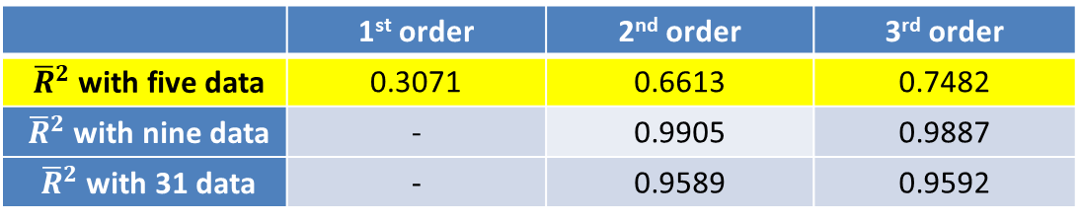

Test for $R^{2}$ and ${\overline{R}}^{2}$
Fitting 3 math models
  Quadratic function is comparable, but cubic function seems fit better
Future prediction (extrapolation)
  small difference in training region,
  but huge difference in prediction
  Cubic function shows the largest error
  in prediction region
  (negative degradation)
  Good training results $≠$ good prediction
  Long term prediction is dangerous
 | 1st order | 2nd order | 3rd order
${\overline{R}}^{2}$ with five data | 0.3071 | 0.6613 | 0.7482
${\overline{R}}^{2}$ with nine data | - | 0.9905 | 0.9887
${\overline{R}}^{2}$ with 31 data | - | 0.9589 | 0.9592

Slide 34
Overfitting
the number of data should be much larger than that of unknown coefficients
  Regression tends to compensate for the noise in data and try to find the mean trend of the function
Overfitting
  when the number of unknown coefficients increases, regression tends to fit the noise, not the trend
  a modeling error which occurs when the proposed function is overly complex so that it fits noisy data, and when the function has no conformability with the data shape
  Avoiding overfitting: cross-validation, regularization, early stopping and pruning
  penalize overly complex functions or test the capability of the function by evaluating its performance on a set of data not used for training
But these techniques do not guarantee the accuracy in future prediction

Slide 35

Ex) Fitting Noise
5 samples of $y=t$ with noise $\sim N({0,1}^{2})$
Fit the samples using 4-th order polynomials (5 coefficients)
Perfect fit for all data points
The model fits noise, not
the trend (no noise canceling)
t = [0, 2.5000, 5.0000, 7.5000, 10.0000]
y = [1.5326, 1.7303, 5.3714, 7.2744, 11.1174]
$$z\left(t\right)=1.5326−2.1864t+1.3397t^{2}−0.1970t^{3}+0.0094t^{4}$$
12
samples
10
4-th order polynomials
true function
8
6
4
2
0
0
2
4
6
8
10
Notes:
x=linspace(0,10,5);
y=x+randn(1,5);
p=polyfit(x,y,4)
xx=linspace(0,10,50);
f = polyval(p,xx);
yy=xx;
plot(x,y,'ko',xx,f,'k-',xx,yy,'b-');
legend('samples','4-th order polynomials','true function');

Slide 36
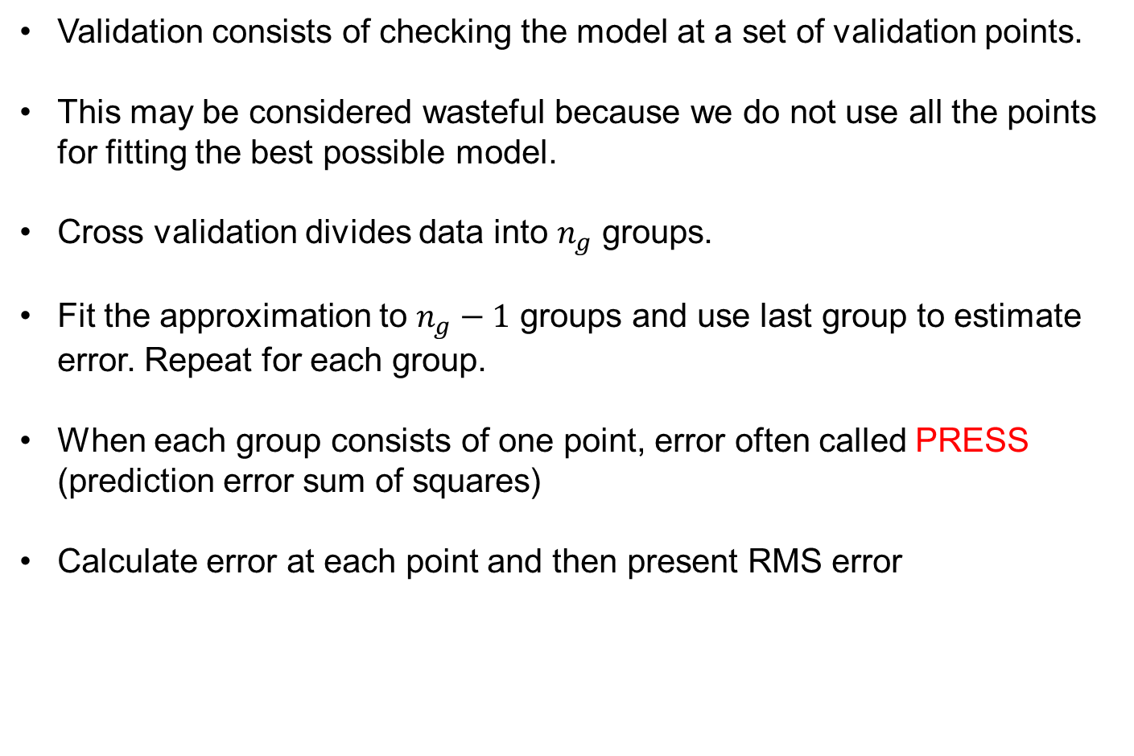
Cross Validation
Validation consists of checking the model at a set of validation points.
This may be considered wasteful because we do not use all the points for fitting the best possible model.
Cross validation divides data into $n_{g}$ groups.
Fit the approximation to $n_{g}−1$ groups and use last group to estimate error. Repeat for each group.
When each group consists of one point, error often called PRESS (prediction error sum of squares)
Calculate error at each point and then present RMS error
Notes:
The most straight forward method to estimate the accuracy of the surrogate is to compare it to the true function at a number of test points. This process is often called validation. It may be considered wasteful, because the extra points might as well be used to improve the accuracy of the surrogate. To get around this problem we use cross validation.
In simplest form of cross validation we leave one point out , fit the surrogate to the remaining points, and then check the error at the left out point. We repeat for each point, and so we end up with a cross validation error at each data point. The sum of the squares of these error is often called PRESS (prediction error sum of squares) and rms cross validation error is called the PRESS error.
When using linear regression, one can show that the ith cross validation errors $e_{pi}$ is $e_{pi}=\frac{e_{i}}{1−E_{ii}} where E=X{\left(X^{T}X\right)}^{−1}X^{T}$. However, the matrix E may be ill conditioned, in which case the equation for the cross validation errors may not be accurate. For most other surrogates there is no formula for the cross validation errors, and they most be calculated by successive refitting of the surrogate. When this is too expensive, it is possible to take a shortcut by leaving out several points at a time. For example, with 100 data points, we may divide the data into 20 groups of 5 and leave out one group, fitting the other 95 and calculating the errors at the 5 left out points. We then need to repeat the process only 20 times.

Slide 37
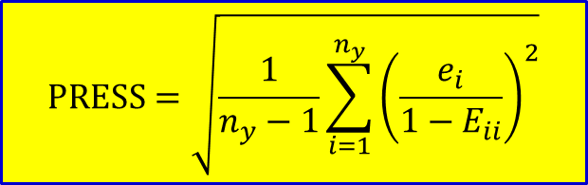
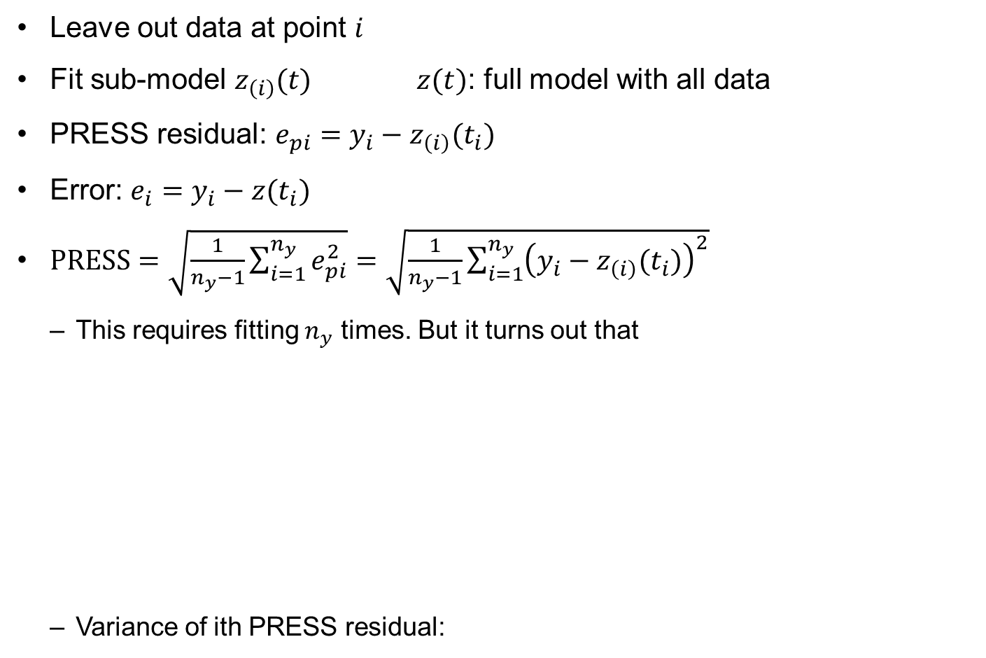
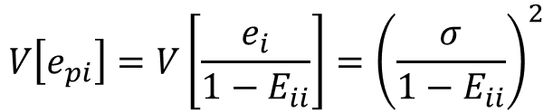

PRESS (prediction error sum of squares)
Leave out data at point $i$
Fit sub-model $z_{\left(i\right)}(t)$ $z(t)$: full model with all data
PRESS residual: $e_{pi}=y_{i}−z_{\left(i\right)}(t_{i})$
Error: $e_{i}=y_{i}−z(t_{i})$
$PRESS=\sqrt{\frac{1}{n_{y}−1}\sum_{i=1}^{n_{y}}{e_{pi}^{2}}}=\sqrt{\frac{1}{n_{y}−1}\sum_{i=1}^{n_{y}}{{\left(y_{i}−z_{\left(i\right)}(t_{i})\right)}^{2}}}$
  This requires fitting $n_{y}$ times. But it turns out that
  Variance of ith PRESS residual:
$$e_{pi}=\frac{e_{i}}{1−E_{ii}}, E=X{\left(X^{T}X\right)}^{−1}X^{T}$$
Idempotent matrix
$$PRESS=\sqrt{\frac{1}{n_{y}−1}\sum_{i=1}^{n_{y}}{{\left(\frac{e_{i}}{1−E_{ii}}\right)}^{2}}}$$
Scaled error with
1 – E_{ii} term
Requires one fitting
$$V\left[e_{pi}\right]=V\left[\frac{e_{i}}{1−E_{ii}}\right]={\left(\frac{σ}{1−E_{ii}}\right)}^{2}$$

Slide 38










PRESS (prediction error sum of squares) cont.
Property of the idempotent matrix $E$E
  Large $E_{ii}$: large PRESS residual → high influence point
The effect of change in data
  Column of $E_{ik}$ is the change of prediction due to a unit change in data $y_{k}$
$$z=X∙θ=X{\left(X^{T}X\right)}^{−1}X^{T}y=E∙y$$
Idempotent matrix $E$: map $y→z$
$$z+Δz=E∙\left(y+Δy\right)$$
$$Δz=E∙Δy$$
$\left\{\begin{matrix}\begin{matrix}{Δz}_{1} \\ {Δz}_{2}\end{matrix} \\ \begin{matrix}⋮ \\ {Δz}_{n_{y}}\end{matrix}\end{matrix}\right\}=\left[\begin{matrix}\begin{matrix}⋯ & ⋯ \\ ⋯ & ⋯\end{matrix} & \begin{matrix}E_{1k} & ⋯ \\ E_{2k} & ⋯\end{matrix} \\ \begin{matrix}⋮ & ⋮ \\ ⋯ & ⋯\end{matrix} & \begin{matrix}⋮ & ⋮ \\ E_{n_{y}k} & ⋯\end{matrix}\end{matrix}\right]$ $\left\{\begin{matrix}\begin{matrix}0 \\ 0\end{matrix} \\ \begin{matrix}⋮ \\ 1 \\ ⋮\end{matrix}\end{matrix}\right\}$
$$Δy_{k}$$
$$Δz_{i}$$
$$z\left(x\right)+Δz(x)$$
$$z(x)$$

Slide 39

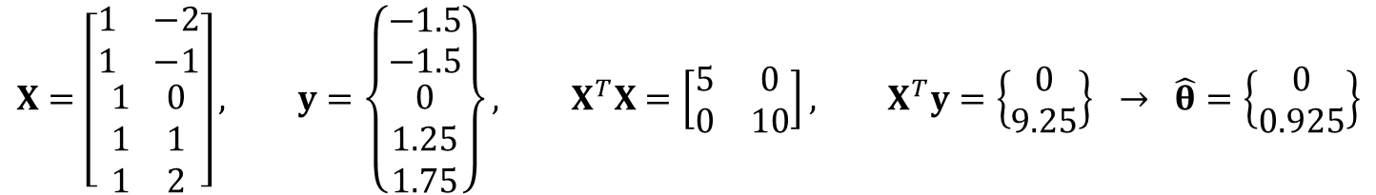
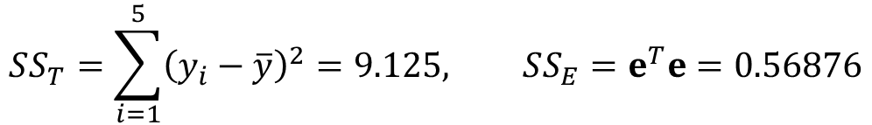
Ex) Linear Regression
True function: $y=t$
5 data: (-2,-1.5), (-1,-1.5), (1,1.25), (2,1.75), (0,0)
Linear fit: $z=θ_{1}+θ_{2}t$
Coefficient of multiple determination
$$X=\left[\begin{matrix}\begin{matrix}1 & −2 \\ 1 & −1\end{matrix} \\ \begin{matrix}1 & 0 \\ 1 & 1 \\ 1 & 2\end{matrix}\end{matrix}\right], y=\left\{\begin{matrix}\begin{matrix}−1.5 \\ −1.5\end{matrix} \\ \begin{matrix}0 \\ 1.25 \\ 1.75\end{matrix}\end{matrix}\right\}, X^{T}X=\left[\begin{matrix}5 & 0 \\ 0 & 10\end{matrix}\right], X^{T}y=\left\{\begin{matrix}0 \\ 9.25\end{matrix}\right\} → \hat{θ}=\left\{\begin{matrix}0 \\ 0.925\end{matrix}\right\}$$
$$z\left(t\right)=0.925t, e=\left\{\begin{matrix}\begin{matrix}0.35 & −0.575\end{matrix} & \begin{matrix}0 & 0.325 & −0.1\end{matrix}\end{matrix}\right\}$$
$$SS_{T}=\sum_{i=1}^{5}{{\left(y_{i}−\overline{y}\right)}^{2}}=9.125, SS_{E}=e^{T}e=0.56876$$
$$R^{2}=1−\frac{SS_{E}}{SS_{T}}=0.9377, {\overline{R}}^{2}=1−\left(1−0.9377\right)\frac{4}{3}=0.9169$$
Linear fit is satisfactory!!

Slide 40
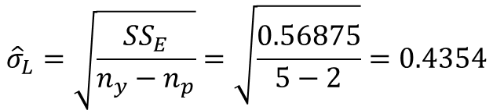


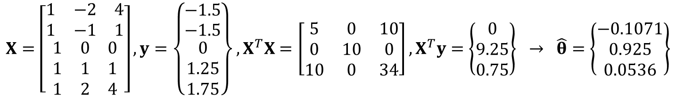
Ex) Linear Regression cont.
Error measures
  $e_{av}=\frac{1}{5}\sum_{i=1}^{5}{\left|e_{i}\right|}=0.27$, $e_{max}=\max\left\lceil e_{i}\right\rceil =0.575$, $e_{rms}=\sqrt{\frac{SS_{E}}{5}}=0.337$
Standard deviation of noise
Quadratic fit: $z\left(t\right)=θ_{1}+θ_{2}t+θ_{3}t^{2}$
$${\hat{σ}}_{L}=\sqrt{\frac{SS_{E}}{n_{y}−n_{p}}}=\sqrt{\frac{0.56875}{5−2}}=0.4354$$
$$σ=0.395$$
$$X=\left[\begin{matrix}\begin{matrix}1 & −2 & 4 \\ 1 & −1 & 1\end{matrix} \\ \begin{matrix}1 & 0 & 0 \\ 1 & 1 & 1 \\ 1 & 2 & 4\end{matrix}\end{matrix}\right], y=\left\{\begin{matrix}\begin{matrix}−1.5 \\ −1.5\end{matrix} \\ \begin{matrix}0 \\ 1.25 \\ 1.75\end{matrix}\end{matrix}\right\}, X^{T}X=\left[\begin{matrix}5 & 0 & 10 \\ 0 & 10 & 0 \\ 10 & 0 & 34\end{matrix}\right], X^{T}y=\left\{\begin{matrix}0 \\ 9.25 \\ 0.75\end{matrix}\right\} → \hat{θ}=\left\{\begin{matrix}−0.1071 \\ 0.925 \\ 0.0536\end{matrix}\right\}$$
$$z\left(t\right)=−0.1071+0.925t+0.05357t^{2}$$
$$e=\left\{\begin{matrix}\begin{matrix}−0.243 & 0.521\end{matrix} & \begin{matrix}−0.107 & −0.378 & 0.207\end{matrix}\end{matrix}\right\}$$
$$SS_{T}=9.125, SS_{E}=0.52857, R^{2}=0.9421, {\overline{R}}^{2}=0.8841$$
Improved
Deteriorated
$$e_{av}=0.921, e_{max}=0.521, e_{rms}=0.325, \hat{σ}=0.5141$$

Slide 41
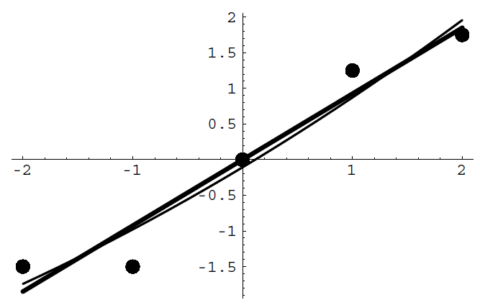
Ex) Linear Regression cont.
we have not gained any predictive capabilities by adding the quadratic terms

Slide 42



Prognosis with More Training Data
Possible remedy for overfitting in data-driven approaches
  the behavior of degradation is expressed with a simple function
  more information, such as more training data and usage conditions, is used for reliable prognostics results
Use 9 data to fit the quadratic and cubic models
  Similar ${\overline{R}}^{2}$ scores and similar prediction
  But noticeable error with the true function
$$z^{(2)}=5.83−3.59t+1.45t^{2} \\ z^{(3)}=5.99−3.93t+1.56t^{2}−0.01t^{3}$$
 | 2nd order | 3rd order
${\overline{R}}^{2}$ with five data | 0.6613 | 0.7482
${\overline{R}}^{2}$ with nine data | 0.9905 | 0.9887
${\overline{R}}^{2}$ with 31 data | 0.9589 | 0.9592

Slide 43
Challenges and Remedies of Data-driven Method
The selected function behaves similarly to the data for the training region, but not for the prediction region
This is a fundamental difficulty associated with an extrapolation
  The accuracy of five fitting functions in the training region is the same
  The accuracy is reasonable in short term prediction
  However, the function can be completely wrong in long term prediction
800
600
Training
region
Short term
prediction
Long term
prediction
400
z(x)
200
0
-200
0
1
2
3
4
x

Slide 44

Challenges and Remedies of Data-driven Method
How can data-driven approaches do long term prediction?
We need several run-to-fail data sets from identical or similar systems
  Degradation history up to failure can greatly improve the prediction accuracy
Assume 2 datasets $(L=0.5, 2)$ + 9 data of the current system available
  Good prediction because the degradation rate of the current system is in between the additional sets

Slide 45
3. Remaining Useful Life (RUL) Prediction

Slide 46



RUL Prediction
After training physical model or mathematical function, they are used to predict the remaining useful life (RUL)
  Need to determine the threshold of degradation (system is safe but needs maintenance)
Use physics model we already trained
  Estimation results with $L=1$: $\hat{θ}={\left\{\begin{matrix}4.28 & −0.29 & 0.25\end{matrix}\right\}}^{T}≠θ_{true}$
  Find RUL by solving implicit equation using Newton-Raphson method
Error in model parameters leads to the error in prediction
$$y_{threshold}−z\left(t_{EOL};\hat{θ}\right)=0$$
$$t_{RUL}=t_{EOL}−t_{current}$$
Data | Table 2.1 | Table 2.2
Parameters | [5.0, 0.2, 0.1] | [4.28, –0.29, 0.25]
Threshold | 150 | 150
EOL (cycles) | 10.7 | 8.7
RUL (cycles) | 6.7 | 4.7

Slide 47

RUL Prediction cont.
in [LS]
thres=150;
currt=4;
syms xEOL
L=1;
XEOL=[1 L*xEOL.^2 xEOL.^3];
eolFuc=thres-XEOL*thetaH; % EOL func.
eol=double(solve(eolFuc,'Real',true));
rul=min(eol(eol>=0))-currt
a symbolic solution of algebraic equation with xEOL for $t_{EOL}$
Monotonic degradation function should have a single solution
As cycle increases, prognostics becomes
more accurate
  True RUL is $−45°$ line in RUL-Cycles curve
  More training data are used to fit parameters

Slide 48

Ex) RUL Prediction When $L=2$
Physics model: $z\left(t;θ\right)=θ_{1}+θ_{2}Lt^{2}+θ_{3}t^{3}, θ={\left\{\begin{matrix}θ_{1} & θ_{2} & θ_{3}\end{matrix}\right\}}^{T}$
Use first 3 data to fit model parameters
RUL prediction: yH2(at t=2), yH3(at t=3)
  No RUL because prediction cannot reach the threshold
$$X=\left[\begin{matrix}1 & 0×2 & 0 \\ 1 & 1×2 & 1 \\ 1 & 4×2 & 8\end{matrix}\right], y=\left\{\begin{matrix}1.87 \\ 5.40 \\ 6.86\end{matrix}\right\}, → \hat{θ}={\left[X^{T}X\right]}^{−1}\left\{X^{T}y\right\}=\left\{\begin{matrix}1.87 \\ 2.91 \\ −2.28\end{matrix}\right\}$$
L=2;
y=[1.87 5.40 6.86 12.76 19.89 30.05 38.76 60.70 83.35 106.93 141.19]';
x=[0:1:10]';
X=[ones(length(x(1:3)),1) L*x(1:3).^2 x(1:3).^3];
thetaH=(X'*X)\(X'*y(1:3))
xNew=[0:0.1:12]';
XNew=[ones(length(xNew),1) L*xNew.^2 xNew.^3];
yH2=XNew*thetaH;
X=[ones(length(x(1:4)),1) L*x(1:4).^2 x(1:4).^3];
thetaH=(X'*X)\(X'*y(1:4))
yH3=XNew*thetaH;

Slide 49
Ex) RUL Prediction When $L=2$ cont.
the number of data is too small to have any meaningful prediction
Reliable RUL prediction after 7th cycle
cycle | 0, 1, 2, 3 | 4 | 5 | 6 | 7 | 8 | 9 | 10
RUL | N/A | 12.21 | 6.56 | 11.46 | 3.50 | 2.20 | 1.33 | 0.27

Slide 50
Ex) RUL Prediction When $L=2$ cont.
%RUL prediction
thres=150; % threshold level
rul=zeros(size(x));
syms xEOL
for i=4:11
currt=i-1;
X=[ones(length(x(1:i)),1) L*x(1:i).^2 x(1:i).^3];
thetaH=(X'*X)\(X'*y(1:i));
XEOL=[ones(length(xEOL),1) L*xEOL.^2 xEOL.^3];
eolFuc=thres-XEOL*thetaH; % EOL func.
eol=double(solve(eolFuc,'Real',true));
rul(i)=min(eol(eol>=0))-currt;
end
%
figure(2)
plot(x(4:11),rul(4:11),'.--r','markersize',25,'linewidth',2);
hold on; plot([0 10],[10 0],'k','linewidth',2);
axis([0 10 0 10]);
legend('Prediction','True');
xlabel('Cycles');ylabel('RUL');

Slide 51

Prognostics Metrics
We need measures to assess the performance of different prognostics algorithms
Most of them requires the true RUL
  They are useful to assess the performance of different algorithms
Prognostic horizon (PH)
  difference between the true EOL and the first time when the prediction result continuously resides in the $α$ accuracy zone
  The accuracy zone has a constant bound
  with a magnitude of $±α$ error with respect
  to true EOL

Slide 52


Prognostics Metrics cont.
$α−λ$ accuracy (true or false)
  determines whether a prediction result falls within the $α$ accuracy zone at a specific cycle $t_{λ}$
  $α$ accuracy zone: varies within $±α$ ratio to the true RUL (figure with $α=0.05$)
  Require more accuracy toward EOL
  $λ∈[0,1]$: parameter between starting and
  ending time
  For a given $λ$ (e.g., 0.5), if the prediction
  at $t_{λ}$ is within the $α$ accuracy zone, then
  it is true. Otherwise, false
$$t_{λ}=t_{S}+λ(EOL_{true}−t_{s})$$

Slide 53




Prognostics Metrics cont.
Relative accuracy (RA)
  the relative accuracy between the true and prediction RUL at $t_{λ}$
Cumulative relative accuracy (CRA)
  Average of RA from $t_{S}$ to $t_{E}$
Good algorithm = $RA→1, CRA→1$
$$Error(t_{λ})=\frac{\left|RUL_{true}(t_{λ})−RUL(t_{λ})\right|}{RUL_{true}(t_{λ})}$$
$$RA(t_{λ})=1−\frac{\left|RUL_{true}(t_{λ})−RUL(t_{λ})\right|}{RUL_{true}(t_{λ})}$$
$$CRA=1−\frac{1}{N}\sum_{k=1}^{N}{Error(k)}$$

Slide 54




Prognostics Metrics cont.
Convergence
  accuracy between the prediction and true RUL
  Euclidean distance between point $(t_{s},0)$ and the center of mass of the area under the error curve $(t_{C},E_{C})$
  The lower the distance is, the faster the convergence is
$$CoM=\sqrt{{\left(t_{C}−t_{S}\right)}^{2}+E_{C}^{2}}$$
$$t_{C}=\frac{1}{2}\frac{\sum_{k=S}^{E}{\left(t_{k+1}^{2}−t_{k}^{2}\right)E\left(k\right)}}{\sum_{k=S}^{E}{\left(t_{k+1}−t_{k}\right)E\left(k\right)}}$$
$$E_{C}=\frac{1}{2}\frac{\sum_{k=S}^{E}{\left(t_{k+1}−t_{k}\right)E^{2}\left(k\right)}}{\sum_{k=S}^{E}{\left(t_{k+1}−t_{k}\right)E\left(k\right)}}$$
PH $$(α=0.05)$$ | $α−λ$accuracy $$(α=0.05, λ=0.5)$$ | RA $$(λ=0.5)$$ | CRA | Convergence
3.6896 | False | 0.8310 | 0.7698 | 2.044

Slide 55

Metrics without Having the True RUL
So far, all prognostics metrics require the true RUL
In reality, we don’t know the true RUL, or it may not exist
How can we evaluate the performance of prognostics methods without having the true RUL?
Moving time window strategy
  Divide the measured data into $N_{f}$
  fitting data and $N_{v}$ validation data
  Training data: $1,⋯,N_{f}$
  Validation data: $N_{f}+1,⋯,N_{f}+N_{v}$
  Fit the degradation model using $N_{f}$
  data and evaluate the prediction
  performance using $N_{v}$ data
  More data can be used for fitting as
  time moves on

Slide 56



Metrics for Performance Evaluation
Notation
  True degradation ($y_{i}$), measured data with noise: (${\tilde{y}}_{i}$), degradation model: $z_{i}, i=1,⋯,N_{f}+N_{v}$
Mean-squared-error (MSE): integrated over the time window can be used to measure the accuracy of an algorithm (requires the true degradation information)
Mean-squared discrepancy (MSD): Compare the model prediction with measured data (including noise)
Question: Can MSD replace MSE?
$$MSE=\sum_{i=1}^{N_{v}}{{\left(y_{N_{f}+i}−z_{N_{f}+i}\right)}^{2}}$$
$$MSD=\sum_{i=1}^{N_{v}}{{\left({\tilde{y}}_{N_{f}+i}−z_{N_{f}+i}\right)}^{2}}$$

Slide 57


Correlation between MSE and MSD
Correlation between MSE and MSD is high (0.8 ~ 0.99)
  Consistently high for different algorithms
  High correlation means that MSD can replace with MSE
$$N_{f}=10, N_{v}=10$$
$$N_{f}=30, N_{v}=10$$

Slide 58
4. Uncertainty

Slide 59
Sources of Uncertainty in Prognostics
Uncertainty in prognostics is inevitable
sources of uncertainty:
  material variability
  data measurement noise/bias
  current/future loading conditions
  error in model form
  uncertainty in estimation algorithm
  prediction process
critically important to treat these sources of uncertainty properly in order to have reliable prognostics results
We will only consider noise in this chapter. Other sources will be considered later chapters

Slide 60

Noise in Measured Data
caused by measurement variability
random in nature, a statistical distribution is used to describe it
Gaussian noise: noise follows a normal distribution
white Gaussian noise: the values at any pair of times are identically distributed and statistically independent (and hence uncorrelated)
Goal: to estimate the level of uncertainty in estimated model parameters as well as the uncertainty in RUL due to noise in data
  Noise in data → uncertainty in model parameters → uncertainty in prediction
Assumption: $noise\sim N(0,σ^{2})$
  When the variance $σ^{2}$ is unknown, it should be included in the unknown model parameters; i.e., $n_{p}=n_{p}+1$
We will use the same process for model parameter estimation in the physics-based prognostics with $L=1$

Slide 61





Uncertainty in Regression
Unbiased estimate of variance of noise $\sim N(0,σ^{2})$
  If the model is correct, then the error after fit is related to the variance of noise
The derivation of uncertainty in model parameters is complicated
  Textbook (pp. 55-56) derives it for a linear model
Covariance matrix of model parameters $θ\sim N(\hat{θ},Σ_{\hat{θ}})$
  Diagonal of $Σ_{\hat{θ}}$: variance of $θ_{i}$
  Off-diagonal of $Σ_{\hat{θ}}$: correlation between $θ_{i}$ and $θ_{j}$
  Uncertainty in coefficients $∝$ uncertainty in noise
$${\hat{σ}}^{2}=\frac{SS_{E}}{n_{y}−n_{p}}$$
$$Σ_{\hat{θ}}=\left[θ−E\left(θ\right)\right]{\left[θ−E\left(θ\right)\right]}^{T}$$
$$Σ_{\hat{θ}}=σ^{2}{\left[X^{T}X\right]}^{−1}$$
Use $\hat{σ}$ instead

Slide 62



Confidence in Regression Coefficients
Standard deviation of $θ$ (square-root of diagonal terms of the covariance matrix)
Coefficient of variation of $θ$:
Large c.o.v., $c_{i}>1$:
  very little confidence on the coefficient
  the coefficient is difficulty to identify (insensitive to data)
  not affecting much on the prediction
Backward elimination: eliminate coefficient with the largest c.o.v.
$$se\left(θ_{i}\right)=s_{θ_{i}}=\hat{σ}\sqrt{{\left(X^{T}X\right)}_{ii}^{−1}}$$
$$c_{i}=\frac{s_{θ_{i}}}{\left|{\hat{θ}}_{i}\right|}$$

Slide 63
Ex) Eliminating Unimportant Terms
Important terms large magnitude of coefficients
Remove those coefficients whose values cannot be estimated accurately for given data
  These coefficients do not have much effect on the accuracy of the fit
  May reduce prediction quality in the region where these coefficients have a large effect
  We will have a systematic approach to identify unimportant terms
$$z\left(x_{1},x_{2}\right)=10.5+0.01x_{1}+9.87x_{2}−5x_{1}^{2}+7.6x_{1}x_{2}+0.02x_{2}^{2}$$
Linear x₁ term
is not important
Quadratic x₂ term
is not important
$$z\left(x_{1},x_{2}\right)=10.5+9.87x_{2}−5x_{1}^{2}+7.6x_{1}x_{2}$$

Slide 64



Ex) Backward elimination
Quadratic mathematical function
Coefficient of variation
Eliminate θ₁
Reduced quadratic model: $z=θ_{2}t+θ_{3}t^{2}$
$$\hat{σ}=0.5141 \\ {\overline{R}}^{2}=0.8841$$
$$z=−0.1071+0.925t+0.05357t^{2}$$
$${\left(X^{T}X\right)}^{−1}=\left[\begin{matrix}\frac{17}{35} & 0 & −\frac{1}{7} \\ 0 & \frac{1}{10} & 0 \\ −\frac{1}{7} & 0 & \frac{1}{14}\end{matrix}\right], Σ_{\hat{θ}}=\left[\begin{matrix}0.1284 & 0 & −0.03776 \\ 0 & 0.02643 & 0 \\ −0.03776 & 0 & 0.01888\end{matrix}\right]$$
$$c_{1}=\frac{\sqrt{0.1284}}{0.1071}=3.35, c_{2}=\frac{\sqrt{0.02643}}{0.925}=0.176, c_{3}=\frac{\sqrt{0.01888}}{0.05357}=2.56$$

Slide 65




Ex) Backward elimination cont.
Reduced quadratic model $z=θ_{2}t+θ_{3}t^{2}$, and fit again
Errors
  $e=\{−0.262, 0.597, 0, −0.3038, 0.188\}$
  $SS_{T}=9.125, SS_{E}=0.5522, R^{2}=0.9394, {\overline{R}}^{2}=0.9193$
Estimated variance of noise
$$X=\left[\begin{matrix}\begin{matrix}−2 & 4 \\ −1 & 1\end{matrix} \\ \begin{matrix}0 & 0 \\ 1 & 1 \\ 2 & 4\end{matrix}\end{matrix}\right], y=\left\{\begin{matrix}\begin{matrix}−1.5 \\ −1.5\end{matrix} \\ \begin{matrix}0 \\ 1.25 \\ 1.75\end{matrix}\end{matrix}\right\}, → b=\left\{\begin{matrix}0.925 \\ 0.02205\end{matrix}\right\}$$
$$z\left(t\right)=0.925t+0.02205t^{2}$$
Improved!
$${\hat{σ}}^{2}=\frac{SS_{E}}{n_{y}−n_{p}}=0.1841, \hat{σ}=0.429$$

Slide 66




Ex) Backward elimination cont.
Additional elimination
Fitting the linear model: $z\left(t\right)=θ_{1}t$
  $z\left(t\right)=0.925t$
  $\hat{σ}=0.4354, {\overline{R}}^{2}=0.9169$
  Therefore, it is better not to eliminate $θ_{2}$
$${\left(X^{T}X\right)}^{−1}=\left[\begin{matrix}\frac{1}{10} & 0 \\ 0 & \frac{1}{34}\end{matrix}\right], Σ_{\hat{θ}}=\left[\begin{matrix}0.0184 & 0 \\ 0 & 0.00541\end{matrix}\right]$$
$$c_{1}=\frac{\sqrt{0.0184}}{0.925}=0.147, c_{2}=3.33$$
eliminate $θ_{3}$
Slightly
decreased

Slide 67



Ex) Backward elimination cont.
Change (perturb) data y(1) = 1.35 (8% perturbation)
Quadratic fit
After eliminating $θ_{1}$
$$z=−0.1071+0.925t+0.05357t^{2}$$
$$z=−0.0729+0.935t+0.0465t^{2}$$
30% 1% 13% change
$$z\left(t\right)=0.925t+0.02205t^{2}$$
$$z\left(t\right)=0.935t+0.025t^{2}$$
1% 13% change

Slide 68
Prediction variance in linear regression
Assumptions on noise in linear regression allow us to estimate the prediction variance due to the noise at any point.
Prediction variance is usually large when the prediction point is far from a data point.
We distinguish between interpolation, when the prediction point is within the convex hull of the data points, and extrapolation when outside.
Extrapolation is associated with larger errors, and in high dimensions it usually cannot be avoided.
Notes:
When we fit a surrogate to data we typically calculate some measure of the overall accuracy of the fit, such as standard error or cross validation rms. However, when we use the surrogate for prediction, it is helpful to also have an idea of the expected accuracy at the prediction point.
In linear regression we typically assume that the data is contaminated with normally distributed noise. This means that if we generated the data again, we would get different data and a different fit. The assumptions on the noise will allow us to estimate the variance in the prediction of the fit at any given point. This is called prediction variance. The square root of the variance is an estimate of the standard deviation in the prediction at that point. Even if the error in the fit is not due to noise, or only to noise, the prediction variance often gives a good idea of the expected accuracy at a point. This is important because even if the fit is good overall, it may still have large errors at some points, especially at points that are far from data points. In general, we expect that in the convex hull of the data points (we’ll remind you of the definition of convex hull on Slide 5) the predictions will be more accurate than outside, or in other words, interpolation will be more accurate than extrapolation.

Slide 69



Prediction variance
Linear regression model: $z\left(t\right)=\sum_{i=1}^{n_{p}}{θ_{i}ξ_{i}(t)}$
Then $z\left(t\right)=ξ{\left(t\right)}^{T}θ$
Variance property:
Prediction variance:
Standard error (standard deviation) of prediction at time $t$
$$z=ax, V\left[x\right]=σ^{2} → V\left[z\right]=a^{2}V\left[x\right]=a^{2}σ^{2}$$
$$V\left[z\left(t\right)\right]=ξ^{T}Σ_{\hat{θ}}ξ={\hat{σ}}^{2}ξ^{T}{\left(X^{T}X\right)}^{−1}ξ$$
$$s_{z}\left(t\right)=\hat{σ}\sqrt{{ξ\left(t\right)}^{T}{\left(X^{T}X\right)}^{−1}ξ\left(t\right)}$$
Notes:
To estimate the variability in prediction at a point x we start with the linear regression model $\overset{}{\hat{y}}=\sum_{i=1}^{n_{β}}{b_{i}ξ_{i}(x),}$ and write it in vector form as $\overset{}{\hat{y}}=x^{\left(m)T\right.}b ,$ where the vector of coefficients b multiplies a vector of shape functions $\left.x_{i}^{\left(m\right)}=ξ_{i}(x\right)$.
Since the coefficients are linear functions of the data, and the data is normally distributed, the coefficients b are also normally distributed. From the equation for b (Slide 2) we can show that the covariance matrix of b is $\sum_{b}{}=σ^{2}{\left(X^{T}X\right)}^{−1}$ and then with some algebra it follows that
$$Var[\overset{}{\hat{y}}(x)]=x^{\left(m)T\right.}\sum_{b}{x^{\left(m\right)}}=σ^{2}x^{\left(m)T\right.}{\left(X^{T}X\right)}^{−1}x^{\left(m\right)}$$
Since we do not know the exact value of the noise $σ$ we substitute the estimate. And take the square root to get the standard error, which as usual, is the estimate of the standard deviation
$$s_{y}=\overset{}{\hat{σ}}\sqrt{x^{\left(m)T\right.}{\left(X^{T}X\right)}^{−1}x^{\left(m\right)}}$$

Slide 70


Data sensitivity
Data sensitivity: how much the prediction at $t$ will vary due to a change in data $y_{i}$?
Linear regression: $z\left(t\right)=ξ{\left(t\right)}^{T}θ=ξ{\left(t\right)}^{T}{\left(X^{T}X\right)}^{−1}X^{T}y$
Differentiate $z\left(t\right)$ with respect to ith component of $y$
  Sensitivity of prediction with respect to change in data
$$\frac{∂z(t)}{∂y_{i}}={\left\{ξ{\left(t\right)}^{T}{\left(X^{T}X\right)}^{−1}X^{T}\right\}}_{i}$$

Slide 71







Ex) Variance in the Linear Model
Linear model $z=θ_{1}+θ_{2}t$ with noisy data in Table 2.2
Square sum of error
Mean and variance of data
Covariance matrix of the coefficients
$$X=\left[\begin{matrix}\begin{matrix}1 & 0 \\ 1 & 1\end{matrix} \\ \begin{matrix}1 & 2 \\ 1 & 3 \\ 1 & 4\end{matrix}\end{matrix}\right], y=\left\{\begin{matrix}\begin{matrix}6.99 \\ 2.28\end{matrix} \\ \begin{matrix}1.91 \\ 11.94 \\ 14.60\end{matrix}\end{matrix}\right\} → \hat{θ}={\left[X^{T}X\right]}^{−1}\left\{X^{T}y\right\}=\left\{\begin{matrix}2.57 \\ 2.49\end{matrix}\right\}$$
$$SS_{E}={\left\{y−X\hat{θ}\right\}}^{T}\left\{y−X\hat{θ}\right\}=66.97$$
$${\hat{σ}}^{2}=\frac{SS_{E}}{n_{y}−n_{p}}=\frac{66.97}{5−2}=22.32$$
$$\hat{σ}=4.72$$
Noise $\sim U\left[−5,5\right], σ=2.88$
$$\overline{x}=2, V[x] =\sum_{i=1}^{n_{y}}{{\left(x_{i}−\overline{x}\right)}^{2}}=10$$
$$Σ_{\hat{θ}}=σ^{2}{\left[X^{T}X\right]}^{−1}=22.32\left[\begin{matrix}0.6 & −0.2 \\ −0.2 & 0.1\end{matrix}\right]=\left[\begin{matrix}13.39 & −4.46 \\ −4.46 & 2.23\end{matrix}\right]$$

Slide 72


Ex) Variance in the Linear Model cont.
Uncertainty in coefficients
  ${\hat{σ}}_{θ_{1}}=\sqrt{13.39}=3.66,{\hat{σ}}_{θ_{2}}=\sqrt{2.23}=1.49$
  $c_{1}=\frac{3.66}{2.57}=1.42, c_{2}=\frac{1.49}{2.49}=0.60$: better confidence in the slope
Prediction variance at a data point $t=2$ with $z\left(2\right)=7.55$
  $ξ\left(2\right)={\left\{1, 2\right\}}^{T} → s_{z}\left(2\right)=\hat{σ}\sqrt{{ξ\left(2\right)}^{T}{\left(X^{T}X\right)}^{−1}ξ\left(2\right)}=2.11$
Prediction variance at an extrapolation point $t=6$
  $ξ\left(6\right)={\left\{1, 6\right\}}^{T} → s_{z}\left(6\right)=\hat{σ}\sqrt{{ξ\left(6\right)}^{T}{\left(X^{T}X\right)}^{−1}ξ\left(6\right)}=6.33$
Data sensitivity at $t=2$ due to change in $y_{4}=10.94$
Fit the surrogate with $y_{4}=10.94$, and evaluate $z(2)$
  $z_{original}\left(2\right)=7.544, z_{perturbed}\left(2\right)=7.344, Δz\left(2\right)=−0.2$
$$Δz\left(2\right)=\frac{∂z(2)}{∂y_{4}}Δy_{4}={\left\{ξ{\left(2\right)}^{T}{\left(X^{T}X\right)}^{−1}X^{T}\right\}}_{4}×\left(−1\right)=−0.2$$

Slide 73


Review: Population vs. Samples
Let’s assume that samples are generated from a population $A\sim N(μ,σ^{2})$, but we do not know $μ$ and $σ$
Mean of samples, $\overline{A}=\frac{1}{n_{y}}\sum_{i=1}^{n_{y}}{a_{i}}$, is random
  $\overline{A}$ will be different from $μ$; but as $n_{y}→∞,\overline{A}→μ$
  Different sets of samples will have different $\overline{A}$ ; $\overline{A}\sim N\left(μ,\frac{σ^{2}}{n_{y}}\right)$
In practice, $μ \text{and} σ^{2}$ are unknown, and need to be estimated using mean $\overline{A}$ and standard deviation $s$ of samples
  Objective: estimate $μ \text{and} σ^{2}$ using $\overline{A}$ and $s$ of samples
  Opposite argument: when $\overline{A}$ and $s$ are given, $μ$ is random; $μ\sim N\left(\overline{A},\frac{σ^{2}}{n_{y}}\right)$
  Since $σ^{2}$ is unknown, $s$ is used instead → normalized $μ$ follows t-distribution with $n_{y}−1$ degree-of-freedom
$$\frac{μ−\overline{A}}{s/{\sqrt{n_{y}}}}\sim t_{n_{y}−1}$$

Slide 74



Distribution of Parameters
We can consider $\hat{θ}={\left[X^{T}X\right]}^{−1}\left\{X^{T}y\right\}$ and $Σ_{\hat{θ}}=σ^{2}{\left[X^{T}X\right]}^{−1}$ as sample mean and covariance
Unknown population mean and variance
  Use $Σ_{\hat{θ}}$ to generate samples
$\left(100−2α\right)\%$ confidence interval (CI)
  The bound between $α\%$ and $(100−α)\%$ of the distribution
  CI reflects the error caused by limited number of data
  As $n_{y}→∞,CI→0$
Prediction interval (PI)
  PI considers the measurement error (noise) of data, $\hat{σ}$
  PI is used to quantify the uncertainty in degradation level and RUL
$$\frac{θ_{i}−\hat{θ_{i}}}{σ_{\hat{θ_{i}}}}\sim t_{n_{y}−n_{p}}$$
$$θ_{i}\sim \hat{θ_{i}}+t_{n_{y}−n_{p}}σ_{\hat{θ_{i}}}$$

Slide 75





EX) Uncertainty in Physics Model
Use 5 noisy data to identify parameters and uncertainty in physics model $z\left(t\right)=5+θ_{2}Lt^{2}+θ_{3}t^{3}$ with $L=1$
With $θ_{1}=5$, modify the model form to $z^{∗}=z−5=θ_{2}t^{2}+θ_{3}t^{3}$
Regression
Noise estimate
Covariance
$$X=\left[\begin{matrix}\begin{matrix}0 & 0 \\ 1 & 1\end{matrix} \\ \begin{matrix}4 & 8 \\ 9 & 27 \\ 16 & 64\end{matrix}\end{matrix}\right], y^{∗}=y−5=\left\{\begin{matrix}\begin{matrix}1.99 \\ −4.28\end{matrix} \\ \begin{matrix}−4.91 \\ 6.94 \\ 9.60\end{matrix}\end{matrix}\right\}$$
$$\hat{θ}={\left[X^{T}X\right]}^{−1}\left\{X^{T}y\right\}=\left\{\begin{matrix}−0.58 \\ 0.31\end{matrix}\right\}$$
$${\hat{σ}}^{2}=\frac{SS_{E}}{n_{y}−n_{p}}=\frac{35.78}{5−2}=11.93$$
$$SS_{E}={\left\{y^{∗}−Xθ\right\}}^{T}\left\{y^{∗}−Xθ\right\}=35.78$$
Noise $\sim U\left[−5,5\right], σ=2.88, \hat{σ}=3.45$
$$Σ_{\hat{θ}}={\hat{σ}}^{2}{\left[X^{T}X\right]}^{−1}=\left[\begin{matrix}1.42 & −0.38 \\ −0.38 & 0.10\end{matrix}\right], σ_{\hat{θ}}^{2}=\left\{\begin{matrix}1.42 \\ 0.10\end{matrix}\right\}$$

Slide 76

EX) Uncertainty in Physics Model cont.
y=[6.99 2.28 1.91 11.94 14.60]';
ys=y-5;
x=[0 1 2 3 4]';
X=[x.^2 x.^3];
thetaH=(X'*X)\(X'*ys)
ny=length(y); % num. of data
np=size(X,2); % num. of unknown parameters
sse=(ys-X*thetaH)'*(ys-X*thetaH)
sigmaH2=sse/(ny-np)
thetaCov=sigmaH2*inv(X'*X) %covariance matrix using Eq. 2.21
sigTheta=sqrt(diag(thetaCov)) %Standard error of theta
Estimate median, 90% CI of parameters using 5000 samples
  Use mvtrnd function with $Σ_{\hat{θ}}$
ns=5000; % num. of samples
mvt=mvtrnd(thetaCov,ny-np,ns)';
thetaHat=repmat(thetaH,1,ns)+mvt.*repmat(sigTheta,1,ns);
alpha=0.05;
thetaCI=prctile(thetaHat',[alpha 0.5 1-alpha]*100)’
i=1; subplot(1,2,i); hist(thetaHat(i,:),30);
i=2; subplot(1,2,i); hist(thetaHat(i,:),30);
figure;
plot(thetaHat(1,:),thetaHat(2,:),'.','color',[0.5 0.5 0.5]);

Slide 77

EX) Uncertainty in Physics Model cont.
 | 5 percentile | median | 95 percentile
$$\hat{θ_{2}}$$ | -3.40 | -0.59 | 2.27
$$\hat{θ_{3}}$$ | -0.46 | 0.31 | 1.08
Predict the future damage growth and plot the median, 90% CI and PI
  Apply samples of parameters to the physics model to prediction future damage in the form of samples
$$\hat{z}=z^{∗}+5={\hat{θ}}_{2}t^{2}+{\hat{θ}}_{3}t^{3}+5$$

Slide 78
EX) Uncertainty in Physics Model cont.
xNew=[4:15]'; XNew=[xNew.^2 xNew.^3];
nn=length(xNew);
zHat=XNew*thetaHat +5*ones(nn,ns);
zHatCI=prctile(zHat',[alpha 0.5 1-alpha]*100)'; % nn x 3
zPredi= zHat+trnd(ny-np,nn,ns)*sqrt(sigmaH2);
zPrediPI=prctile(zPredi',[alpha 0.5 1-alpha]*100)';
Due to a small number of data,
uncertainty is large
CI and PI are close because the error
in data is small compared to the error
in parameters

Slide 79

EX) Uncertainty in Physics Model cont.
RUL prediction
  Line 6: find the first location where cycle $≥$ threshold.
  Line 7: when RUL is infinite (this case is not included in the RUL results)
  Line 8: when RUL is the same as the current cycle, i.e., RUL=0
k=5; % current time index
currt=x(k); % current cycle
thres=150; % threshold
i0=0;
for i=1:ns
loca=find(zPredi(:,i)>=thres,1);
if isempty(loca); i0=i0+1;
elseif loca==1; rul(k,i-i0)=0;
else
rul(k,i-i0)=interp1([zPredi(loca,i) zPredi(loca-1,i)], ...
[xNew(loca) xNew(loca-1)],thres)-currt;
end
end

Slide 80

Ex) RUL Prediction at Different Cycles
Degradation prediction with $k=7$ and $k=11$
RUL prediction at $k=3\sim 11$
(assume that samples of RUL are
stored in rul(11, ns)
k1=3; k2=11;alpha=0.05;
x=0:10;
eolTrue=10.69;
rulPct=prctile(rul',[alpha 0.5 1-alpha].*100)';

Slide 81

Ex) Prognostic Metrics
Prognostic horizon (PH)
  find the first cycle when more than 50% of samples continuously fall within the accuracy zone
$α−λ$ accuracy
RA & CRA
for i=1:size(rul,1)
loca=find(rulTrue(i)-alpha<rul(i,:) & rul(i,:)<rulTrue(i)+alpha);
probPH(i,:)=length(loca)/size(rul,2);
end
loca=find(probPH<beta,1,'last')+1;
ph=eolTrue-cycle(loca);
a=find( rul(idx_lam,:)>rulTrue(idx_lam)*(1-alpha) ...
& rul(idx_lam,:)<rulTrue(idx_lam)*(1+alpha) );
probAL=length(a)/size(rul,2);
if probAL<beta;
ra=1-abs(rulTrue(idx_lam)-median(rul(idx_lam,:)))/rulTrue(idx_lam);

Slide 82

Ex) Prognostic Metrics
PH $(α=0.05)$) | $α−λ$ accuracy $$(α=0.05,λ=0.5)$$ | RA $$(λ=0.5)$$ | CRA | Convergence
3.6896 | False | 0.7794 | 0.6969 | 2.4684

Slide 83
5. Issues in Practical Prognostics

Slide 84
Issues in Practical Prognostics
We only discussed regression-based prognostics with Gaussian noise
  More advanced algorithms, such as Bayesian methods, will be studied
Issue 1: noise and bias have an effect on the prognostics results
  Noise comes from various sources such as variable measurement environment and measurement variability
  Bias comes from calibration error in measurement equipment
Issue 2: Correlation
  Model parameters are correlated each other
  loading conditions can be correlated with the parameters
Issue 3: Lack of data in data-driven prognostics
  Data-driven approaches require many sets of degradation data, but degradation data are expensive time and costs
Issue 4: Indirect degradation data
  in most cases, degradation data need to be extracted from sensor signals

Slide 85
Summary
Prognostics identifies system’s performance degradation over time and predicts the remaining useful life to prepare for a maintenance
Physics-base prognostics algorithms fits degradation model parameters using measured data
Data-driven prognostics algorithms fits mathematical functions using many run-to-fail data
Prognostics metrics can be used to compare performance of different prognostics algorithms
Uncertainty makes it difficulty to fit model parameters and predict the future degradation
Other challenges include correlation between parameters, lack of run-to-fail data, and indirect measurements

