Slide 1
Chapter 3 Bayesian Statistics for Prognostics

Slide 2
1. Introduction to Bayesian Theory

Slide 3
Deterministic vs. Probabilistic Approaches
Physics-based prognostics methods estimate model parameters with the least-squares method using degradation measurement data
This process yields a set of deterministic model parameters that can represent measured degradation most closely
Identified model parameters are not accurate when measurement error and model form error exist
Parameters change with different sets of data
Make more sense to characterize model parameters probabilistically
how to interpret the probabilistic representation of model parameters
there is a true deterministic value of model parameters, but their values are unknown
With imperfect data and model, the estimated model parameters have uncertainty, which is represented by probability distribution
not random, but uncertain (lack of knowledge, epistemic uncertainty)

Slide 4
Model Parameter Estimation Methods
Least-squares method: regression-based method
Bayesian inference: identify unknown parameters and effectively reduce epistemic uncertainty in the identified parameters when more data are available
Bayes’ theorem (Bayes and Price 1763)
how to compute a distribution for the probability parameter of a binomial distribution using observed data
The concept of “degree of belief” was rejected for 100 yers because it is vague and subjective
Harold Jeffreys (Jeffreys 1961) rediscovered the Bayes’ theorem and made it a modern theory
Bayes’ theorem became practical in 1990s due to the rapid growth of computers

Slide 5
Purpose of Bayes’ Theorem in Prognostics
Bayesian inference is utilized here to probabilistically identify unknown model parameters
inference is a process of determining a value of parameter based on collected evidence
evidence = measured data using health monitoring systems
Bayesian inference is a statistical method to express degrees of belief on a certain event rather than a deterministic decision, which is based on information such as data and our knowledge using probability model (Gelman et al. 2004)
Here, it is used to update the probability distribution of unknown model parameters

Slide 6
Bayesian Inference Process
Building a prior distribution
the initial estimate of probability distribution of model parameters
a prior knowledge/information of the parameter before taking measurement
using expert’s opinion, previous experience or physical reasoning
non-informative prior: no prior information, constant for all range
Building a likelihood
represents the effect of measured data on the probability distribution
the probability to obtain the data with a given value of model parameter
Posterior distribution
The outcome of Bayesian inference
The product of the prior distribution and likelihood

Slide 7
Bayesian Inference for Prognostics
estimate and update unknown parameters based on measured degradation data using health monitoring systems
Unknown model parameters are represented as a probability density function (PDF), which is updated with more data and prior knowledge or information
The more data, the more accurate estimation (uncertainty reduction)
PDF represents epistemic uncertainty; the shape of knowledge
can be used to predict the remaining useful life (RUL) before the system fails
the RUL will also be in the form of PDF, and we take conservative value
With a large uncertainty, the conservative estimate of RUL would be very short (frequent maintenance)
With a lack of knowledge, frequent maintenance is required (important to reduce the uncertainty )
performance of prognostics method is determined based on the level of uncertainty in estimated model parameters

Slide 8
2. Aleatory versus Epistemic Uncertainty

Slide 9
Aleatory Uncertainty
also called as random variable, variability, type-A uncertainty or irreducible uncertainty
Inherent randomness which cannot be reduced by further data
Ex) the tensile strengths of different specimens from a same material are different
Variability in material properties, noise in measurement, and variability in applied loads can be considered as aleatory uncertainty
Generally expressed using PDF or CDF
For a random variable, it is often required to take a conservative estimate
Ex) when the failure strength is randomly distributed, it is safe to design based on a conservative value

Slide 10
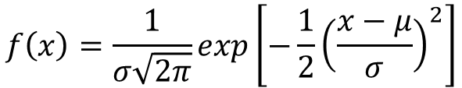

Ex) Normal Distribution
Failure strength with mean = 250 MPa and CoV = 10%
$CoV=\frac{σ}{μ}$, $σ=250×0.1=25MPa$
Failure strength $X\sim N(μ, σ^{2})$
PDF:
$$f\left(x\right)=\frac{1}{σ\sqrt{2π}}exp\left[−\frac{1}{2}{\left(\frac{x−μ}{σ}\right)}^{2}\right]$$
Probability density function
±3s (99%)
±2s (95%)
±1s (68%)
mean
150
200
250
300
350
Failure strength (MPa)

Slide 11
Probability density function (PDF)
Probability Density Function (PDF) of R.V.
Properties of PDF
f_{X}(x)
PDF of X
f_{X}(x)dx
x

Slide 12
Cumulative distribution function (CDF)
CDF = Integral of PDF
1
Experimental CDF from 500 samples shown in blue, compares well to exact CDF for normal distribution.
0.9
0.8
0.7
0.6
normal CDF
0.5
0.4
0.3
z=randn(1,500)
ecdf(z)
0.2
0.1
0
-4
-3
-2
-1
0
1
2
3
4
x
Notes:
The cumulative distribution function (CDF) is the probability of the random variable being less than x, and so may be obtained from an integral of the PDF
$$F(x)=P(X<x)=\int_{−∞}^{x}{f(t)dt}$$
Given a sample, the CDF at x can be estimated simply as the number of samples below x divided by the total number of samples. This so called ‘experimental CDF’ gives a much more accurate picture of the CDF than a histogram would give of the PDF with the same sample. This is illustrated in the figure with the normal distribution obtained with the following Matlab sequence
z=randn(1,500);
[f,x]=ecdf(z);
X=[-4:0.1:4];
p=normcdf(X,0,1);
plot(X,p,'r'); hold on; plot(x,f)
xlabel('x'); ylabel('normal CDF')

Slide 13
Cumulative distribution function (CDF)
Cumulative Distribution Function (CDF), F_{X}(x)
Properties of CDF
f_{X}(x)
PDF
x
x
Area = F_{X}(x)
1
F_{X}(x)
CDF of X
x

Slide 14
STATISTICAL MOMENTS
Moments of R.V.
Average value of g(X)
First moment – mean of X
Second moment – Variance of X
Standard deviation (SD)
Square root of variance = s_{X}
f_{X}(x)
PDF
f_{X}(x)dx
x
dx
g(X)

Slide 15
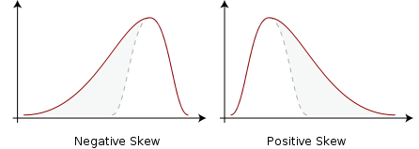
STATISTICAL MOMENTS cont.
Coefficient of variation
Third moment – Skewness
Skewness coefficient
Median: Value of X at CDF F_{X}(x) = 0.5
Mode: Value of X corresponding to the peak value of PDF

Slide 16
Epistemic Uncertainty
A variable may not be random, but the true value is unknown (uncertain)
For a random variable, if the exact distribution parameters are unknown, epistemic uncertainty exists (sampling uncertainty/statistical tolerance)
state of knowledge uncertainty, subjective uncertainty, type-B, or reducible uncertainty, lack of knowledge
Epistemic uncertainty can be reduced through better understanding physics, or collecting more relevant data
Different methods are used to represent the epistemic uncertainty
Probability theory
Non-probabilistic or imprecise probability approaches
Fuzzy sets or possibility theory
evidence theory

Slide 17
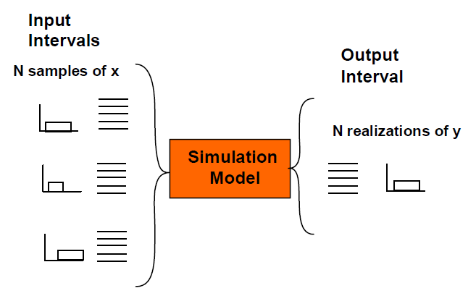
Interval analysis
Developed for rounding errors and measurement errors in mathematical computation
Simplest form to represent uncertainties
Uncertain variable is represented by its minimum and maximum possible values
Propagate the interval bounds through the computational model to get the bounds on the output variables
Optimization or sampling methods are used to find min/max
g_{max}
g_{min}
x_{min}
x_{max}

Slide 18
Probability-based method
Epistemic uncertainty is represented as a probability distribution
Two-level representation of uncertainty
Inner-loop for aleatory, outer-loop for epistemic uncertainty
Most common method, but different interpretation of epistemic and aleatory
Ex) a distribution is estimated by samples
Estimated mean has an epistemic uncertainty (statistical uncertainty)
For a given mean, the distribution has aleatory uncertainty (distribution)

Slide 19
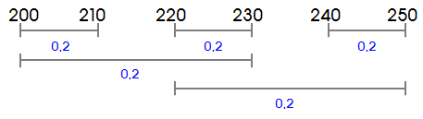
Evidence theory
Dempster-Shafer evidence theory measures uncertainty with belief and plausibility
Useful for epistemic uncertainty when the information is nonspecific, ambiguous, or conflicting
BPA: the level of likelihood that the input falls within the interval
Cumulative belief: lower-bound of probability
Cumulative plausibility: upper-bound of probability
Basic Probability Assignment (BPA)

Slide 20
Evidence theory (Dempster-Shafer theory)
measures uncertainty with belief (lower bound) and plausibility (upper bound) determined from the known evidence (information) for a proposition
Belief Bel(A): all the evidence supporting that the actual state belongs to A
Plausibility Pl(A): all the evidence that does not rule out that the actual state belongs to A
Each input is divided by intervals with basic probability assignment (BPA) at each interval
Cumulative belief function (CBF) and cumulative plausibility function (CPF): Similar to CDF in a distribution
Limited when inconsistent data sources – unreliable evidence combination

Slide 21
Evidence theory
BPA = 0.2 0.5 0.3
x₁
1.0
0.9
0.8
0.7
0.6
0.5
0.4
0.3
0.2
0.1
0.0
x₂
BPA = 0.3 0.7
Cell | Prob | Min | Max
(1,1) | 0.06 | 1.0 | 2.0
(1,2) | 0.14 | 2.0 | 4.0
(2,1) | 0.15 | 3.0 | 6.0
(2,2) | 0.35 | 4.0 | 6.0
(3,1) | 0.09 | 5.0 | 7.0
(3,2) | 0.21 | 5.0 | 8.0
CPF or CBF
CPF
CDF
CBF
0 1 2 3 4 5 6 7 8 9 10
Performance
Computationally expensive: N*M sets of interval analysis
CPF
CBF

Slide 22
Comparison of different methods

Slide 23
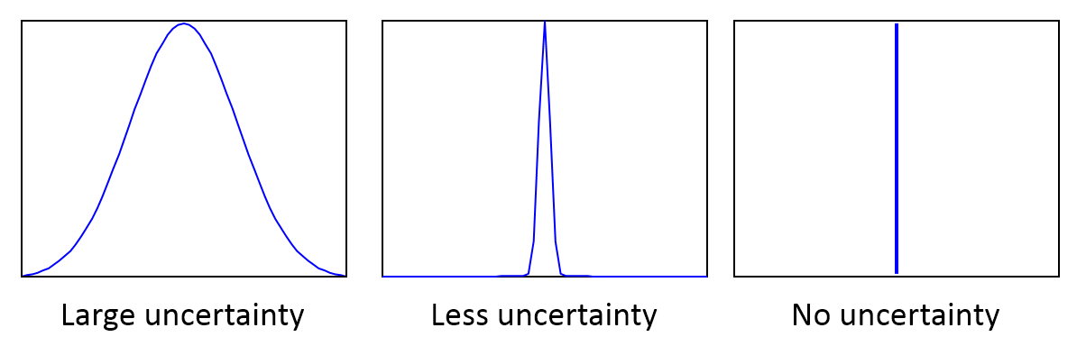
Probability Theory for Epistemic Uncertainty
Aleatory uncertainty
a large uncertainty means that samples are widely distributed
no uncertainty means that the variable or function is deterministic
Epistemic uncertainty
a large uncertainty means that the information related to a parameter or a quantity is ambiguous
the shape of PDF is the shape of information for the parameter
No uncertainty means that the information is fully known, and there is no need to improve any knowledge regarding the parameter

Slide 24
Epistemic Uncertainty in Model Parameters
Focus is on the epistemic uncertainty in degradation model parameters
lack of knowledge about the appropriate value to use for the model
This epistemic uncertainty is represented by a PDF
Ex) material handbooks show a lower & upper bound of material parameters
We may use a uniform distribution (this is the level of our knowledge)
This is the range of material properties in generic materials
a particular batch of a material may have a narrow range of distribution
if a specimen is taken from the same batch, a narrower range of material property can be found
We want to reduce the epistemic uncertainty using Bayesian inference when measurement data on degradation are available

Slide 25
Review: Population vs. Samples
Want to estimate statistics of population with samples
Sample mean and SD → population mean and SD
Different samples will have different mean and SD
Confidence interval: the range of errors the prediction of the population mean and SD
The quality will depend on the size of sample, uncertainty in RV and the confidence level
Population
Samples

Slide 26

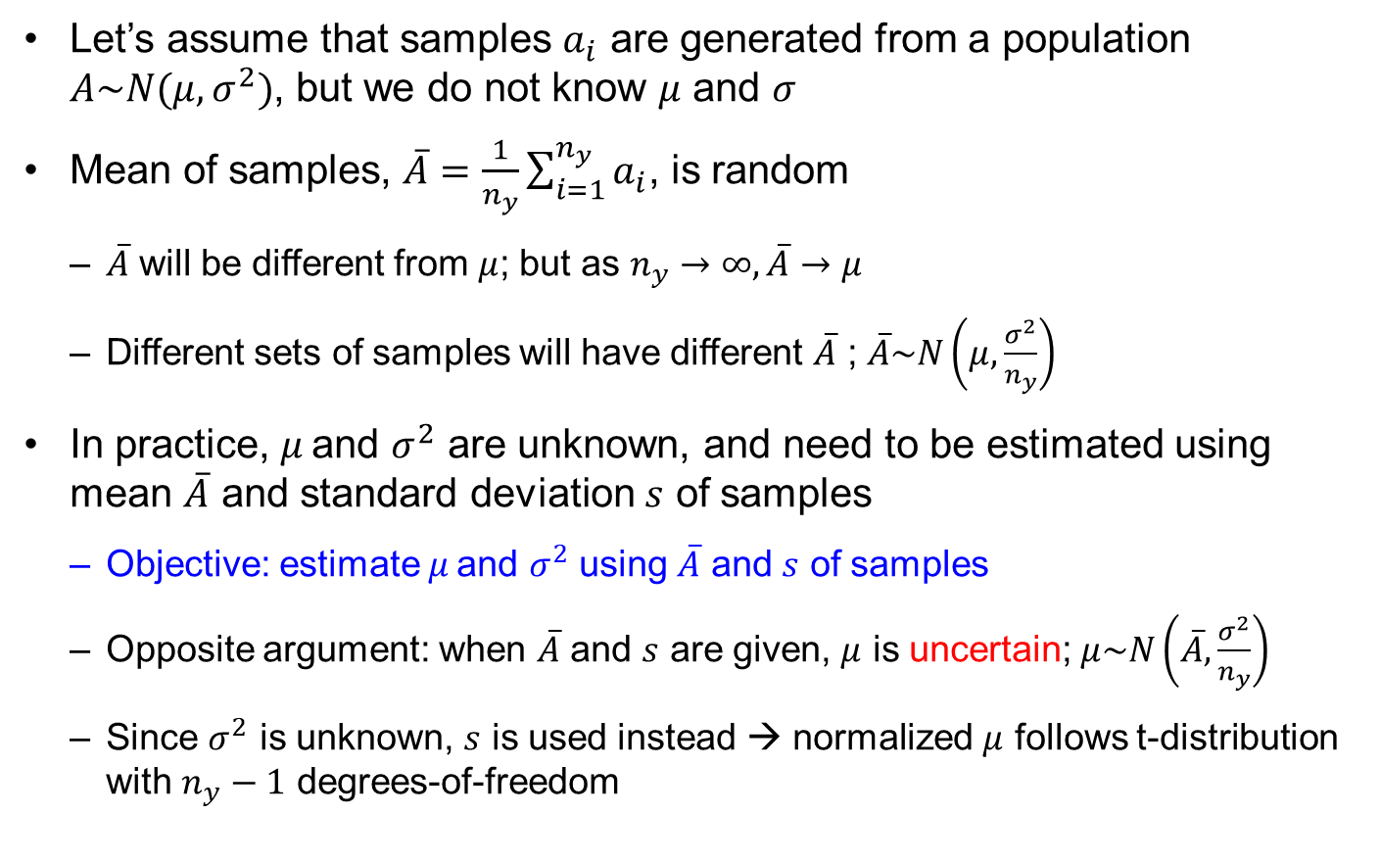
Review: Population vs. Samples cont.
Let’s assume that samples $a_{i}$ are generated from a population $A\sim N(μ,σ^{2})$, but we do not know $μ$ and $σ$
Mean of samples, $\overline{A}=\frac{1}{n_{y}}\sum_{i=1}^{n_{y}}{a_{i}}$, is random
$\overline{A}$ will be different from $μ$; but as $n_{y}→∞,\overline{A}→μ$
Different sets of samples will have different $\overline{A}$ ; $\overline{A}\sim N\left(μ,\frac{σ^{2}}{n_{y}}\right)$
In practice, $μ \text{and} σ^{2}$ are unknown, and need to be estimated using mean $\overline{A}$ and standard deviation $s$ of samples
Objective: estimate $μ \text{and} σ^{2}$ using $\overline{A}$ and $s$ of samples
Opposite argument: when $\overline{A}$ and $s$ are given, $μ$ is uncertain; $μ\sim N\left(\overline{A},\frac{σ^{2}}{n_{y}}\right)$
Since $σ^{2}$ is unknown, $s$ is used instead → normalized $μ$ follows t-distribution with $n_{y}−1$ degrees-of-freedom
$$\frac{μ−\overline{A}}{s/{\sqrt{n_{y}}}}\sim t_{n_{y}−1}$$

Slide 27
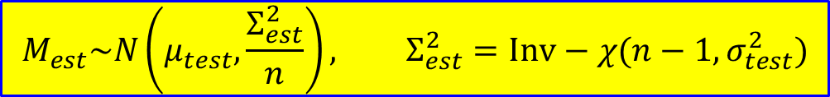
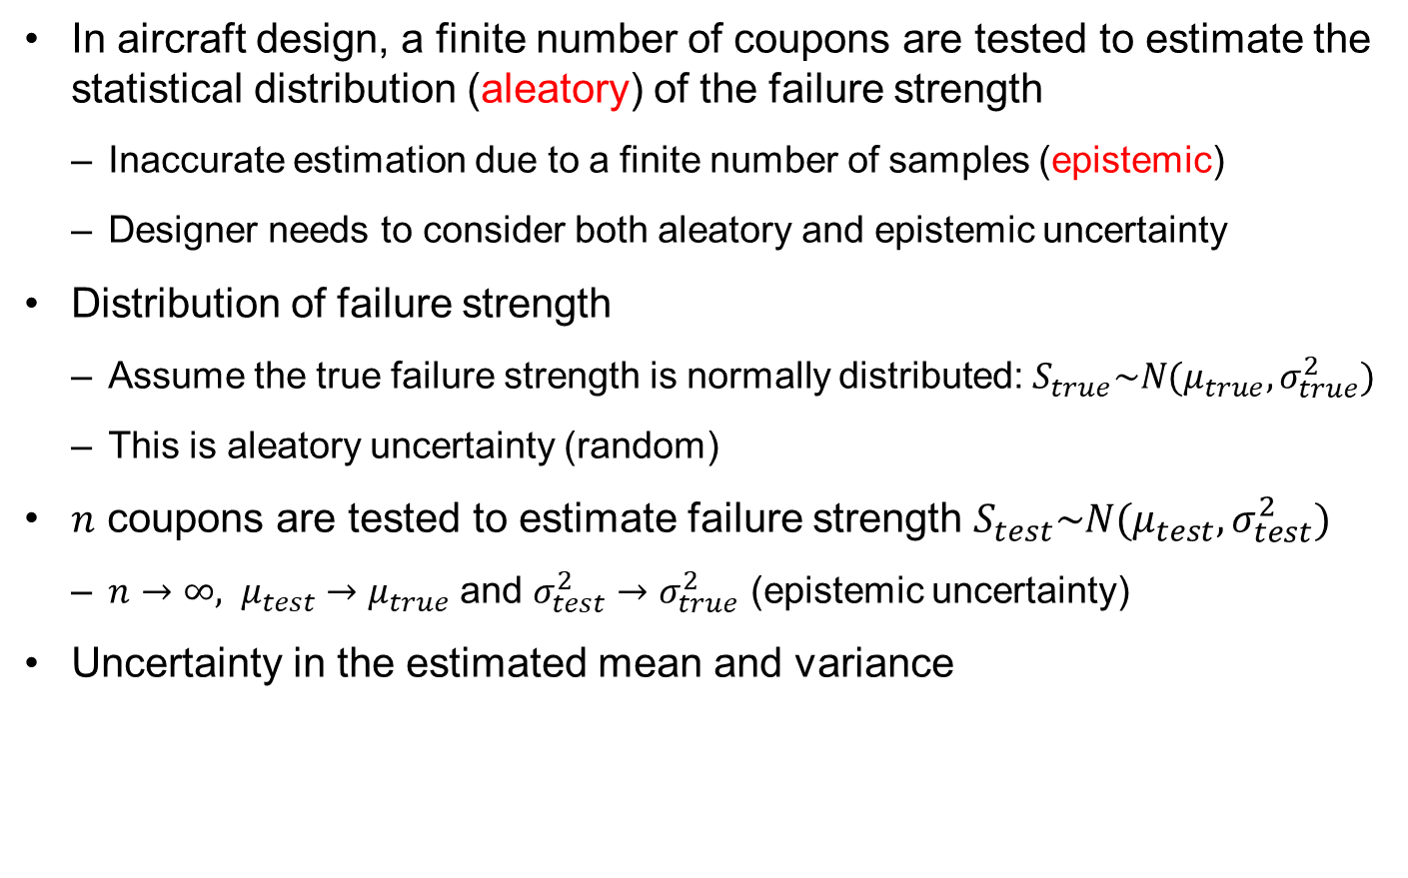

Sampling Uncertainty in Coupon Tests
In aircraft design, a finite number of coupons are tested to estimate the statistical distribution (aleatory) of the failure strength
Inaccurate estimation due to a finite number of samples (epistemic)
Designer needs to consider both aleatory and epistemic uncertainty
Distribution of failure strength
Assume the true failure strength is normally distributed: $S_{true}\sim N(μ_{true},σ_{true}^{2})$
This is aleatory uncertainty (random)
$n$ coupons are tested to estimate failure strength $S_{test}\sim N(μ_{test},σ_{test}^{2})$
${n→∞, μ}_{test}→μ_{true}$ and $σ_{test}^{2}→σ_{true}^{2}$ (epistemic uncertainty)
Uncertainty in the estimated mean and variance
$$M_{est}\sim N\left(μ_{test},\frac{Σ_{est}^{2}}{n}\right), Σ_{est}^{2}=Inv−χ(n−1,σ_{test}^{2})$$
scaled inverse chi-squared distribution of $n−1$ degrees-of-freedom

Slide 28
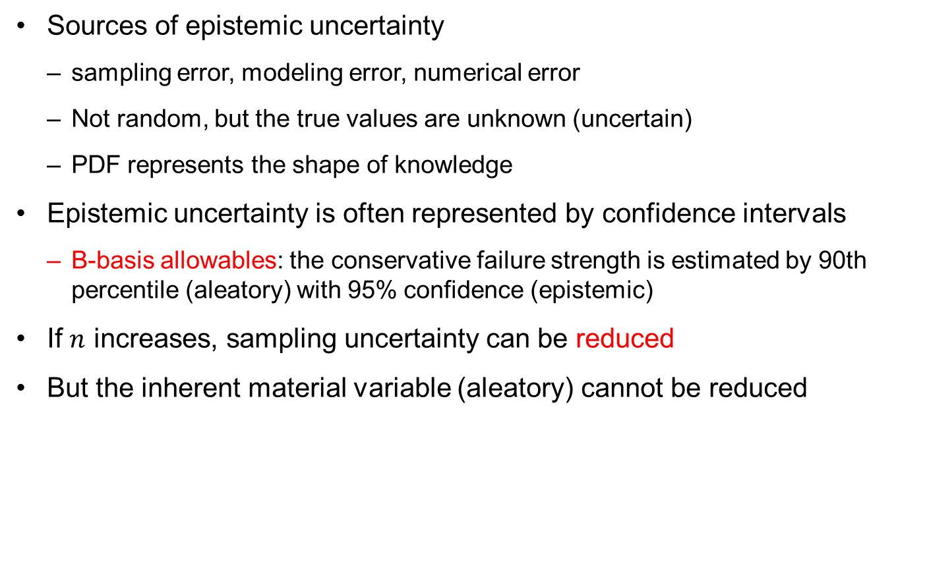
Sampling Uncertainty in Coupon Tests cont.
Sources of epistemic uncertainty
sampling error, modeling error, numerical error
Not random, but the true values are unknown (uncertain)
PDF represents the shape of knowledge
Epistemic uncertainty is often represented by confidence intervals
B-basis allowables: the conservative failure strength is estimated by 90th percentile (aleatory) with 95% confidence (epistemic)
If $n$ increases, sampling uncertainty can be reduced
But the inherent material variable (aleatory) cannot be reduced

Slide 29
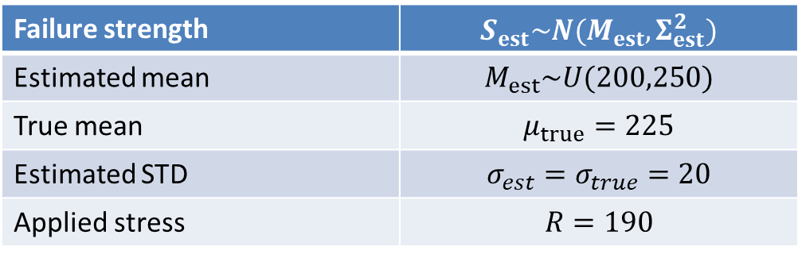
Ex) Failure Strength
Calculate the mean and 90th percentile of failure strength
Distribution type is known but distribution parameters are unknown
Double-loop Monte Carlo Simulation (MCS)
Failure strength | $$S_{est}\sim N(M_{est},Σ_{est}^{2})$$
Estimated mean | $$M_{est}\sim U(200,250)$$
True mean | $$μ_{true}=225$$
Estimated STD | $$σ_{est}=σ_{true}=20$$
Applied stress | $$R=190$$

Slide 30

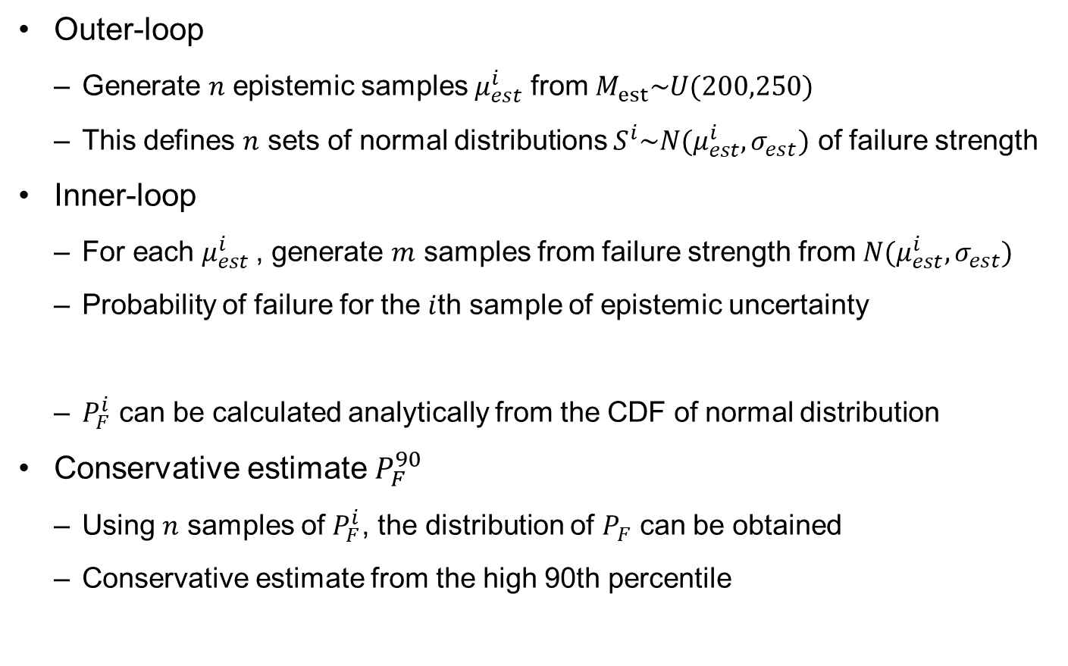
Double-loop MCS
Outer-loop
Generate $n$ epistemic samples $μ_{est}^{i}$ from $M_{est}\sim U(200,250)$
This defines $n$ sets of normal distributions $S^{i}\sim N(μ_{est}^{i},σ_{est})$ of failure strength
Inner-loop
For each $μ_{est}^{i}$, generate $m$ samples from failure strength from $N(μ_{est}^{i},σ_{est})$
Probability of failure for the $i$th sample of epistemic uncertainty
$P_{F}^{i}$ can be calculated analytically from the CDF of normal distribution
Conservative estimate $P_{F}^{90}$
Using $n$ samples of $P_{F}^{i}$, the distribution of $P_{F}$ can be obtained
Conservative estimate from the high 90th percentile
$$P_{F}^{i}=P[S^{i}≤R]$$

Slide 31
Distribution of $P_{F}$
m=1e5;sigma_est=20;
mu_est=50*rand(m,1)+200;
Pf=sort(cdf('norm',190,mu_est,sigma_est));
PDF=hist(Pf,50)/(m*max(Pf)/50);
x=linspace(0,max(Pf),50);
plot(x,PDF);
Pf_mean=mean(Pf)
Pf_90=Pf(90000)

Slide 32
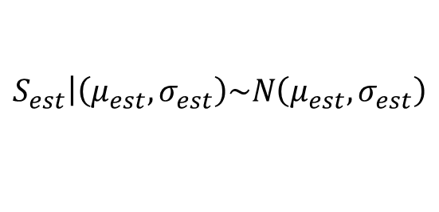
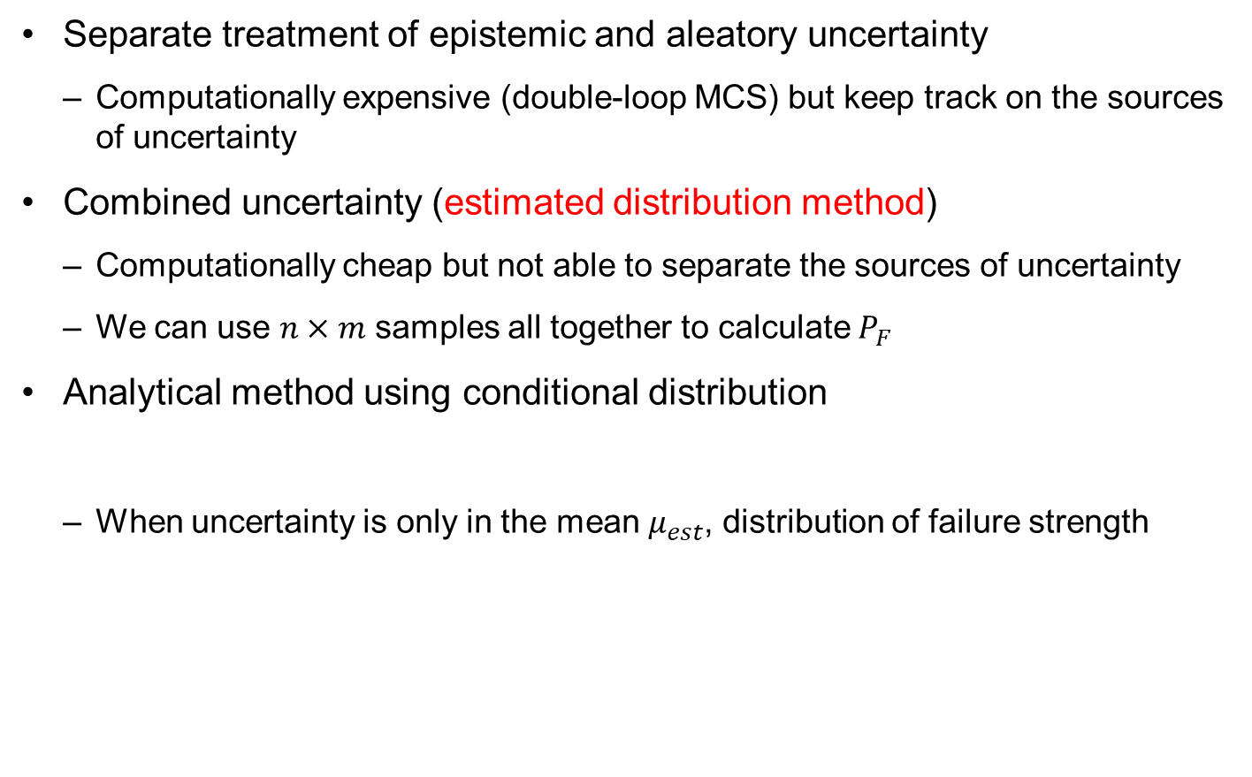

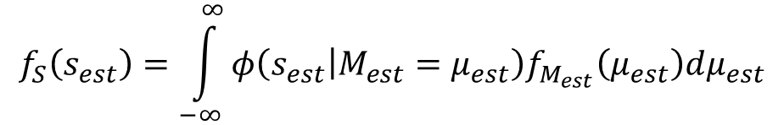
Can Epistemic and Aleatory Be Combined?
Separate treatment of epistemic and aleatory uncertainty
Computationally expensive (double-loop MCS) but keep track on the sources of uncertainty
Combined uncertainty (estimated distribution method)
Computationally cheap but not able to separate the sources of uncertainty
We can use $n×m$ samples all together to calculate $P_{F}$
Analytical method using conditional distribution
When uncertainty is only in the mean $μ_{est}$, distribution of failure strength
$$\left.S_{est}\right|\left(μ_{est},σ_{est}\right)\sim N\left(μ_{est},σ_{est}\right)$$
$$f_{S}\left(s_{est}\right)=\int_{−∞}^{∞}{φ\left(\left.s_{est}\right|M_{est}=μ_{est}\right)f_{M_{est}}\left(μ_{est}\right)dμ_{est}}$$
Normal PDF of failure strength with given $μ_{est}$
PDF of the mean (uniform dist)

Slide 33


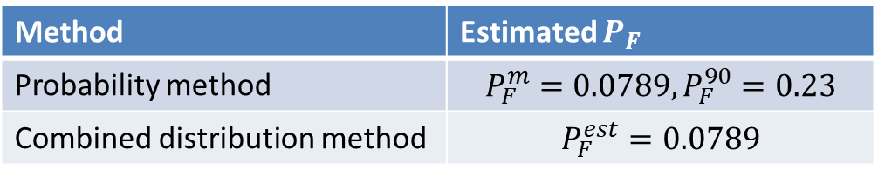
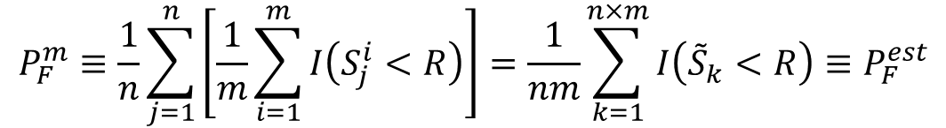
Can Epistemic and Aleatory Be Combined? cont.
Probability of failure
Single value of $P_{F}^{est}$ (combined uncertainty)
This is in fact the mean $P_{F}^{m}$ from the probability method (separated uncertainty)
This can be shown in the case of MCS
$$P_{F}^{est}=\int_{−∞}^{R}{f_{S}\left(s_{est}\right)ds_{est}}$$
$$P_{F}^{m}≡\frac{1}{n}\sum_{j=1}^{n}{\left[\frac{1}{m}\sum_{i=1}^{m}{I\left(S_{j}^{i}<R\right)}\right]=\frac{1}{nm}\sum_{k=1}^{n×m}{I\left({\tilde{S}}_{k}<R\right)}≡P_{F}^{est}}$$
Method | Estimated $P_{F}$
Probability method | $$P_{F}^{m}=0.0789, P_{F}^{90}=0.23$$
Combined distribution method | $$P_{F}^{est}=0.0789$$

Slide 34
Summary
It would be necessary to separate epistemic uncertainty from aleatory uncertainty
In the probability method, epistemic uncertainty is also represented using a probability distribution
However, the meaning of PDF should be understood in the context of the shape of knowledge
Epistemic uncertainty is reducible by having more samples or having additional tests
Double-loop MCS can be used to estimate the effect of aleatory and epistemic uncertainties

Slide 35
3. Conditional Probability and Total Probability

Slide 36
Emergency Car Depot
Three car sets
Sample space has 8 mutually exclusive outcomes.
Figure defines 4 other mutually exclusive events.
Random variable X is the number of good cars.

Slide 37
Set Notation
An event with no sample point is an impossible event or a null set
Give an example for car space?
The complement of an event E is denoted as
What is the complement of X=2?
Union of events denoted , intersection
The answer to the previous question may be written as
Events E₁ and E₂ both happening is written as E₁E₂ or

Slide 38
Venn Diagram
Intersection
Other relationships
Probability
Event
Notes:
Venn diagrams are used to illustrate the relationships between sets. For example, the top diagram shows two sets that have a non-empty intersection, while the bottom two diagrams shows sets that have empty intersections, so that the sets are mutually exclusive.
The top diagram and the bottom left diagram show sets that do not cover the entire space, while the bottom right shows a case where the two sets cover the entire space or are collectively exhaustive.

Slide 39
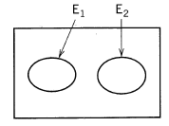
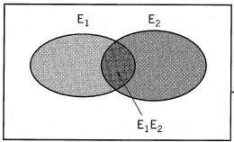
Axiom of Probability
P(E) ≥ 0: probability of an event E is non-negative.
Probability of certain event P(S)=1.
Probability of two mutually exclusive events
In general

Slide 40
Example
Numbers in Venn diagram represent the frequencies that each event occurs
Probability can be defined as the ratio between the frequency of an event and the total frequency
A
B
11
5
17
15

Slide 41
Conditional Probability
Key information is how to calculate
From the law of multiplication of probabilities
the probability that both A and B will occur is equal to the probability that A will occur multiplied by the conditional probability that B will occur given that A has occurred, P(B|A)
Therefore,
A
B
11
5
17
15

Slide 42
Statistically Independent Events
When the conditional probability of B given A is equal to the unconditional, or absolute, probability of B, the two events are said to be statistically independent
The occurrence of A does not alter the probability that B will occur
the conditional probability becomes identical to the unconditional probability

Slide 43
California Problem
A building can suffer structural damage by fire (event F) or strong earthquakes (event E). Let F and E denote the events, with corresponding probabilities 0.005 and 0.05, respectively. F and E are statistically independent events. Calculate the probability of structural damage to the building.
Are F,E mutually exclusive?
Calculate P(EUF)
Recall that

Slide 44
Bridge Damage Example
A bridge can be damaged by failure in the foundation (F) or in the superstructure (S). The corresponding failure probabilities for a particular bridge are estimated to be 0.05 and 0.01, respectively. Also, if there is foundation failure, then the probability that the superstructure will also suffer some damage is 0.50.
Draw Venn diagram
P(F U S) ? (0.01 is probability of S alone)
P(F U S) when F, S are independent ?
Which probability is higher ?, i.e., more conservative ?

Slide 45
Bridge Damage Answer
Divide space into F and its compliment
F
S
P(F)=0.05
P(S|F)=0.5

Slide 46
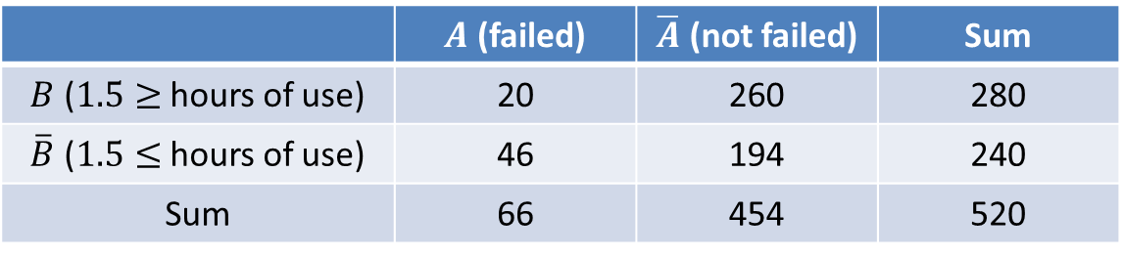
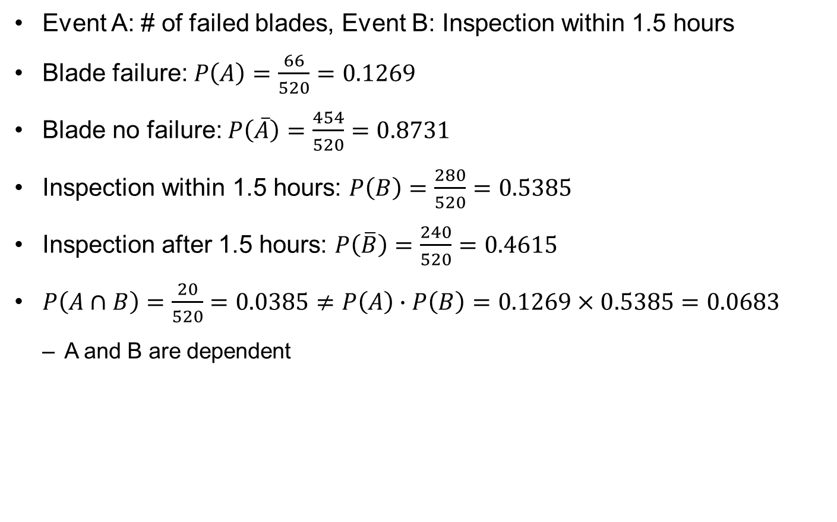
Ex) Failure Probability of Turbine Blades
Event A: # of failed blades, Event B: Inspection within 1.5 hours
Blade failure: $P\left(A\right)=\frac{66}{520}=0.1269$
Blade no failure: $P\left(\overline{A}\right)=\frac{454}{520}=0.8731$
Inspection within 1.5 hours: $P\left(B\right)=\frac{280}{520}=0.5385$
Inspection after 1.5 hours: $P\left(\overline{B}\right)=\frac{240}{520}=0.4615$
$P\left(A∩B\right)=\frac{20}{520}=0.0385≠P\left(A\right)∙P\left(B\right)=0.1269×0.5385=0.0683$
A and B are dependent
 | $A$ (failed) | $\overline{A}$ (not failed) | Sum
$B$ ($1.5≥$ hours of use) | 20 | 260 | 280
$\overline{B}$ ($1.5≤$ hours of use) | 46 | 194 | 240
Sum | 66 | 454 | 520

Slide 47
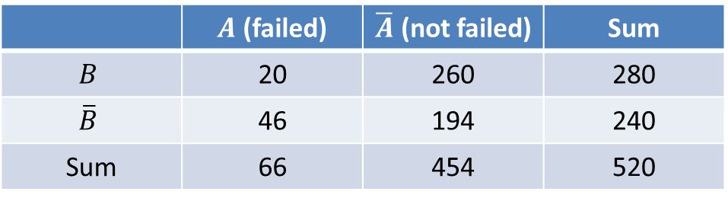
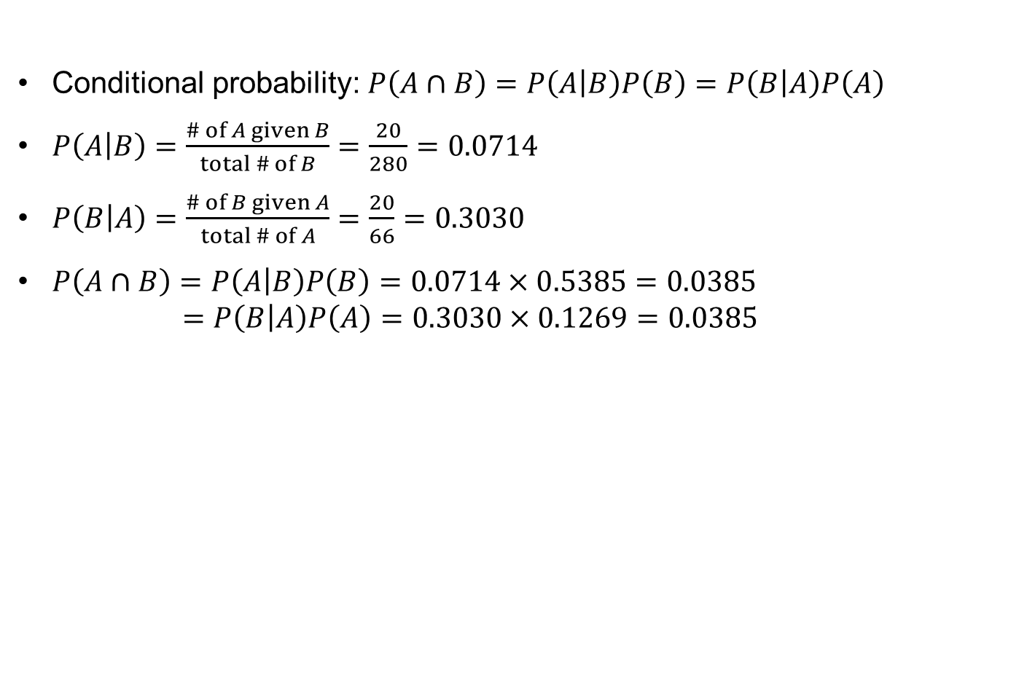
Ex) Failure Probability of Turbine Blades cont.
Conditional probability: $P\left(A∩B\right)=P\left(\left.A\right|B\right)P\left(B\right)=P\left(\left.B\right|A\right)P\left(A\right)$
$P\left(\left.A\right|B\right)=\frac{\# of A given B}{total \# of B}=\frac{20}{280}=0.0714$
$P\left(\left.B\right|A\right)=\frac{\# of B given A}{total \# of A}=\frac{20}{66}=0.3030$
$P\left(A∩B\right)=P\left(\left.A\right|B\right)P\left(B\right)=0.0714×0.5385=0.0385$ $=P\left(\left.B\right|A\right)P\left(A\right)=0.3030×0.1269=0.0385$
 | $A$ (failed) | $\overline{A}$ (not failed) | Sum
$$B$$ | 20 | 260 | 280
$$\overline{B}$$ | 46 | 194 | 240
Sum | 66 | 454 | 520
A
B
46
20
260
194

Slide 48

Ex) Proof Load Test
Tensile strength of aluminum: $S\sim N\left({350,50}^{2}\right)MPa$
Proof test shows that the aluminum is safe until $s^{∗}=350MPa$
Calculate the conditional probability of the strength given the proof test
Probability of strength being greater than $s$: $P(S>s)$
monotonically decreasing graph as a function of $s$
s=200:10:600;
P_ini=1-cdf('norm',s,350,50);
plot(s,P_ini,'b')
1
0.016
0.014
0.8
0.012
0.6
0.01
Probability
PDF
0.008
0.4
0.006
0.2
0.004
0.002
0
200
300
400
500
600
0
200
250
300
350
400
450
500
s
s

Slide 49
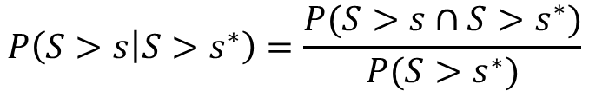

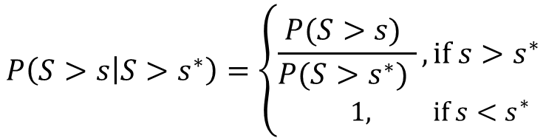
Ex) Proof Load Test cont.
1
Conditional probability
Event A: $S>s$, Event B: $S>s^{∗}$
When $s<s^{∗}$, $P\left(S>s∩S>s^{∗}\right)=P(S>s^{∗})$
When $s>s^{∗}$, $P\left(S>s∩S>s^{∗}\right)=P(S>s)$
Unknown material strength (epistemic uncertainty) is significantly changed due to the evidence
without proof test
with proof test
0.8
$$P\left(\left.S>s\right|S>s^{∗}\right)=\frac{P(S>s∩S>s^{∗})}{P(S>s^{∗})}$$
0.6
Probability
0.4
0.2
proof test
0
200
300
400
500
600
s
$$P\left(\left.S>s\right|S>s^{∗}\right)=\left\{\begin{aligned}\frac{P(S>s) }{P(S>s^{∗}) }, if s>s^{∗} \\ 1, if s<s^{∗}\end{aligned}\right.$$
0.016
0.014
0.012
0.01
PDF
0.008
0.006
0.004
0.002
0
200
250
300
350
400
450
500
s

Slide 50
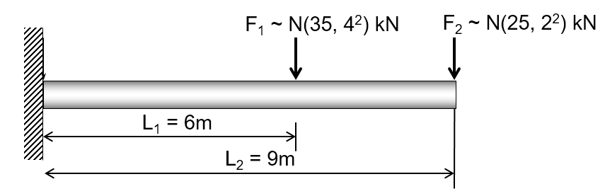
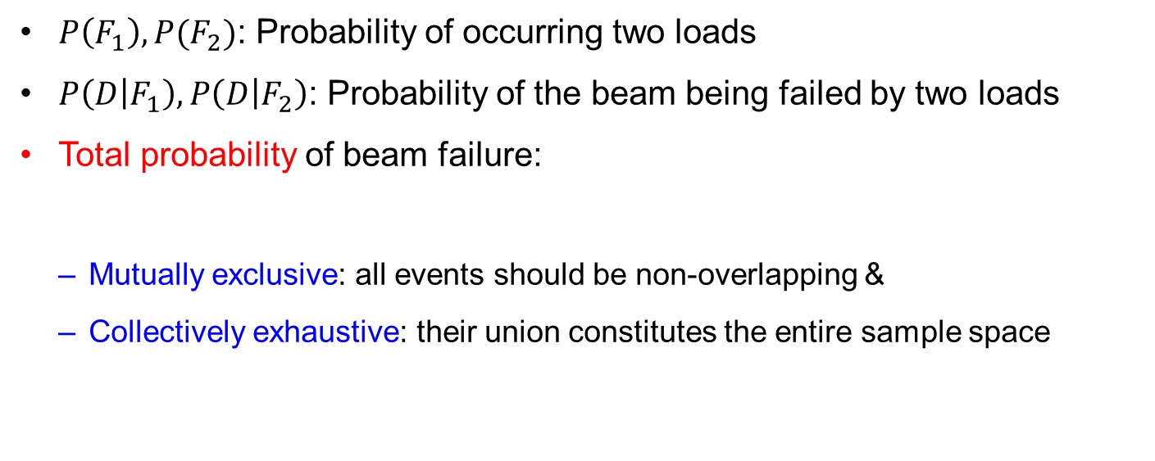
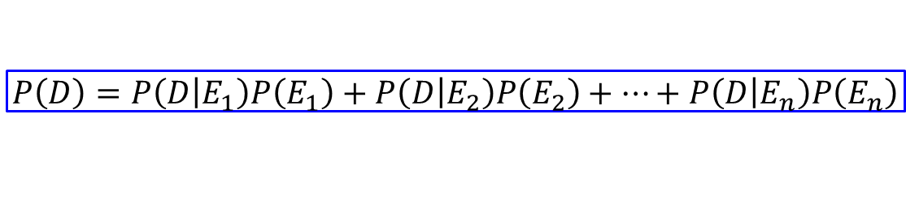
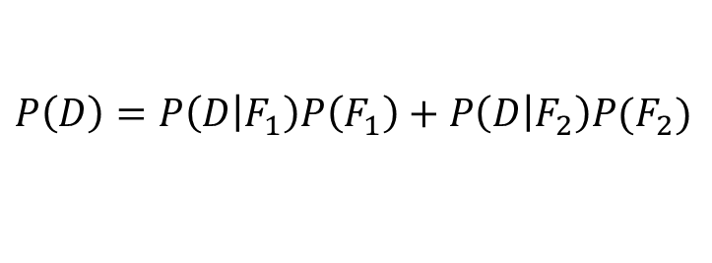
Total Probability
$P\left(F_{1}\right), P(F_{2})$: Probability of occurring two loads
$P\left(\left.D\right|F_{1}\right),P\left(\left.D\right|F_{2}\right)$: Probability of the beam being failed by two loads
Total probability of beam failure:
Mutually exclusive: all events should be non-overlapping &
Collectively exhaustive: their union constitutes the entire sample space
$$P\left(D\right)=P\left(\left.D\right|F_{1}\right)P\left(F_{1}\right)+P\left(\left.D\right|F_{2}\right)P(F_{2})$$
$$P\left(D\right)=P\left(\left.D\right|E_{1}\right)P\left(E_{1}\right)+P\left(\left.D\right|E_{2}\right)P\left(E_{2}\right)+⋯+P\left(\left.D\right|E_{n}\right)P\left(E_{n}\right)$$

Slide 51
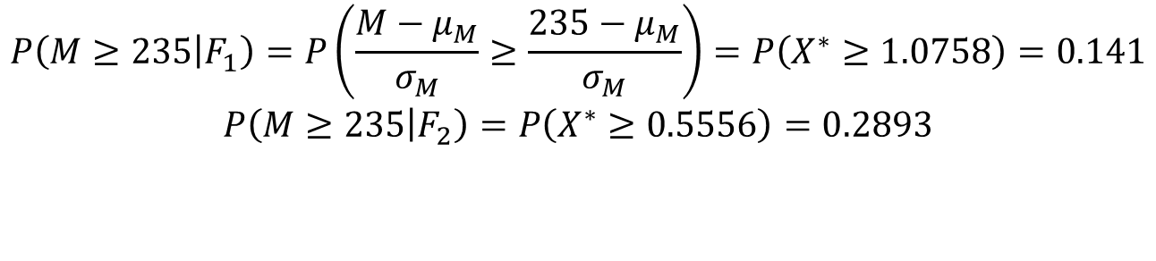
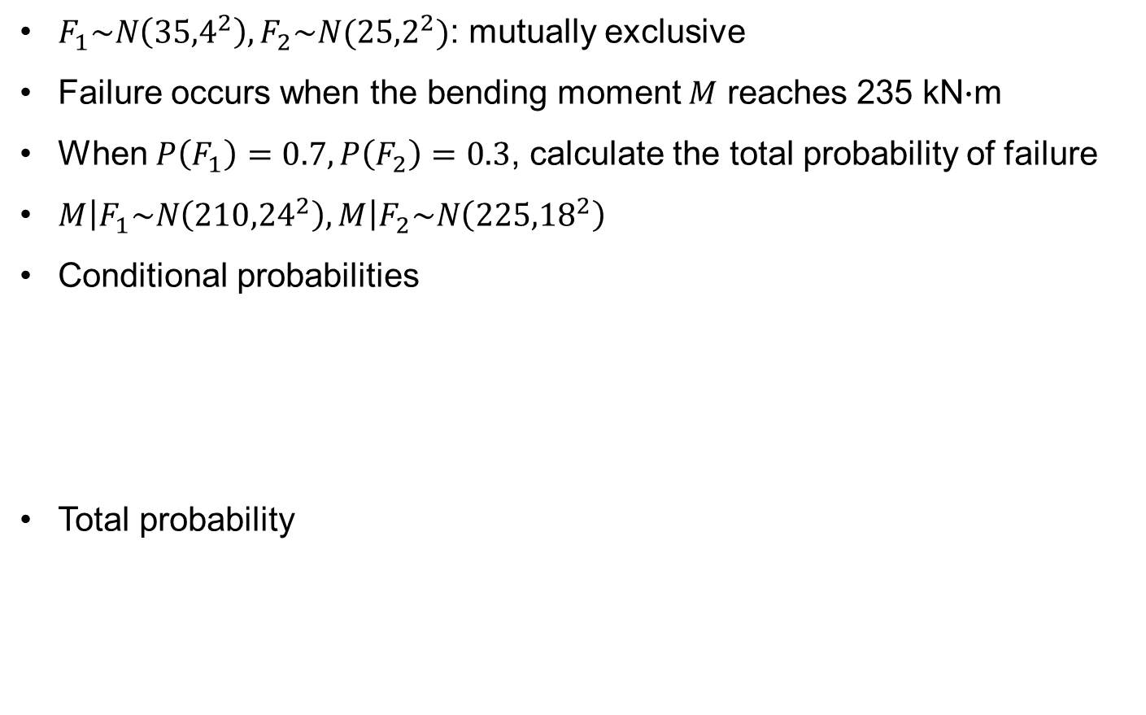
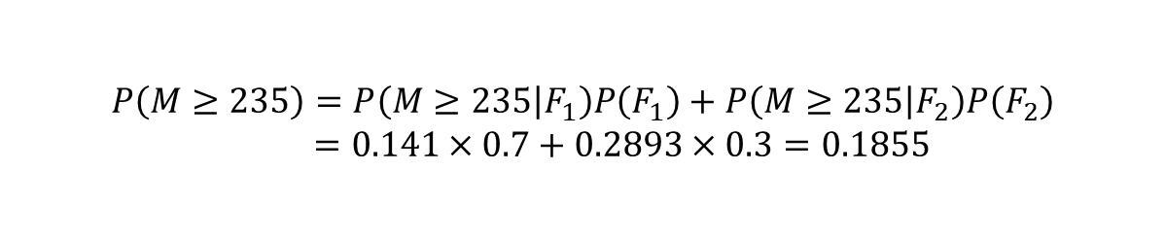
Ex) Total Probability
$F_{1}\sim N\left({35,4}^{2}\right), F_{2}\sim N({25,2}^{2})$: mutually exclusive
Failure occurs when the bending moment $M$ reaches 235 kN$∙$m
When $P\left(F_{1}\right)=0.7, P\left(F_{2}\right)=0.3$, calculate the total probability of failure
$\left.M\right|F_{1}\sim N\left({210,24}^{2}\right),\left.M\right|F_{2}\sim N\left({225,18}^{2}\right)$
Conditional probabilities
Total probability
$$P\left(\left.M≥235\right|F_{1}\right)=P\left(\frac{M−μ_{M}}{σ_{M}}≥\frac{235−μ_{M}}{σ_{M}}\right)=P\left(X^{∗}≥1.0758\right)=0.141$$
$$P\left(\left.M≥235\right|F_{2}\right)=P\left(X^{∗}≥0.5556\right)=0.2893$$
$$P\left(M≥235\right)=P\left(\left.M≥235\right|F_{1}\right)P\left(F_{1}\right)+P\left(\left.M≥235\right|F_{2}\right)P\left(F_{2}\right) \\ =0.141×0.7+0.2893×0.3=0.1855$$

Slide 52
4. Bayes' Theorem

Slide 53

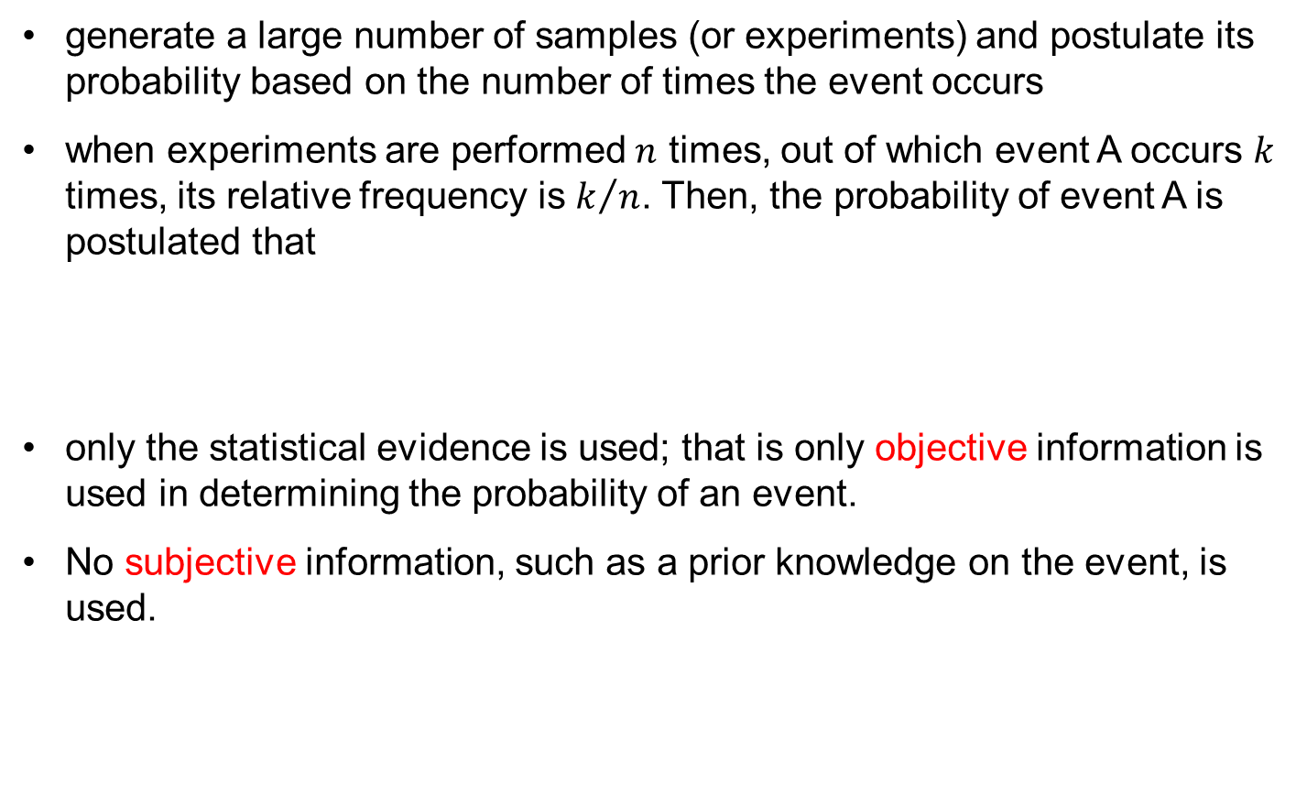
Frequentist’s Method
generate a large number of samples (or experiments) and postulate its probability based on the number of times the event occurs
when experiments are performed $n$ times, out of which event A occurs $k$ times, its relative frequency is $k/n$. Then, the probability of event A is postulated that
only the statistical evidence is used; that is only objective information is used in determining the probability of an event.
No subjective information, such as a prior knowledge on the event, is used.
$$P\left(A\right)=\lim_{n→∞}{\frac{k}{n}}$$

Slide 54
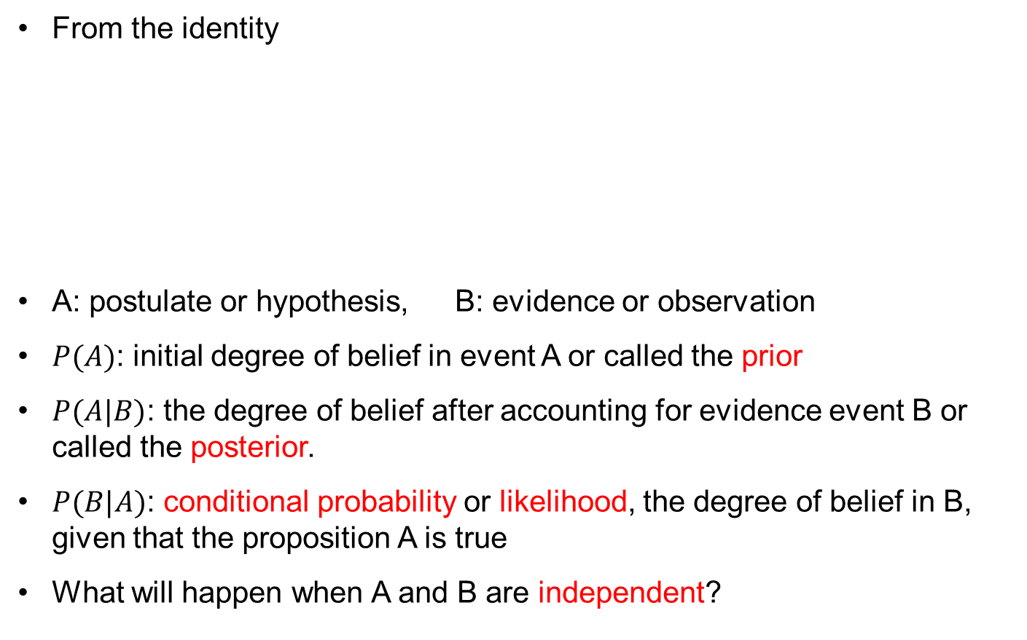

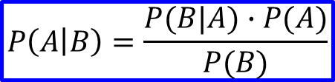
Bayes’ Rule (Bayes 1763)
From the identity
A: postulate or hypothesis, B: evidence or observation
$P(A)$: initial degree of belief in event A or called the prior
$P(A|B)$: the degree of belief after accounting for evidence event B or called the posterior.
$P(B|A)$: conditional probability or likelihood, the degree of belief in B, given that the proposition A is true
What will happen when A and B are independent?
$$P\left(A∩B\right)=P\left(A\right)∙P\left(B | A\right)=P(B)∙P(A|B)$$
$$P\left(A | B\right)=\frac{P(B|A)∙P(A)}{P(B)}$$
$$P\left(B\right)=P\left(B∩A\right)+P(B∩\overline{A})$$

Slide 55
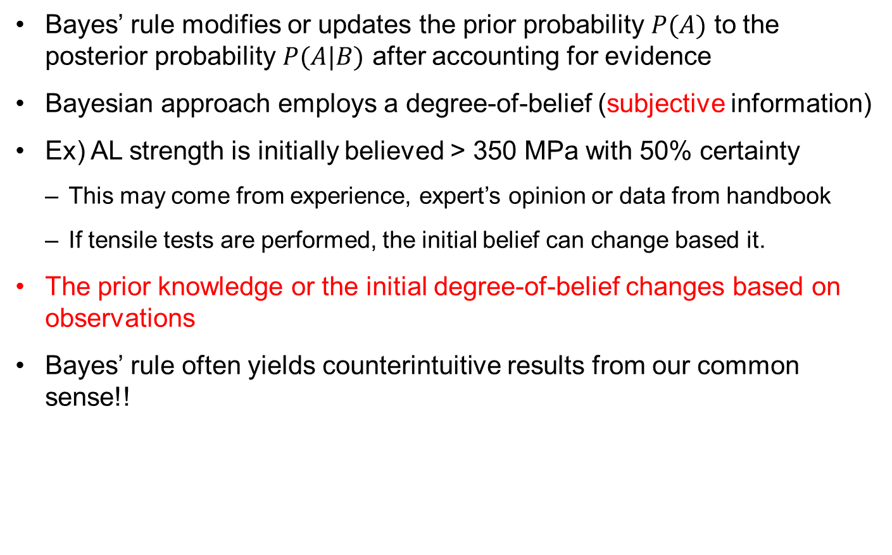
Understanding Bayes’ Rule
Bayes’ rule modifies or updates the prior probability $P(A)$ to the posterior probability $P(A|B)$ after accounting for evidence
Bayesian approach employs a degree-of-belief (subjective information)
Ex) AL strength is initially believed > 350 MPa with 50% certainty
This may come from experience, expert’s opinion or data from handbook
If tensile tests are performed, the initial belief can change based it.
The prior knowledge or the initial degree-of-belief changes based on observations
Bayes’ rule often yields counterintuitive results from our common sense!!

Slide 56


Bayes’ Rule Example
During an Ebola epidemic in Africa, it was estimated that a passenger arriving from Africa has ${10}^{−1}$ chance of being infected.
We have a test that is 99% accurate for detecting Ebola (1% of the time a positive result is false and 1% of the time a negative result is false).
Calculate the probability that a person testing positive is infected.
$$E_{1}=infected, E_{2}=tested positive \\ P\left(E_{1} | E_{2}\right)=P\left(E_{2} | E_{1}\right)∙\frac{P\left(E_{1}\right)}{P\left(E_{2}\right)} \\ P\left(E_{2} | E_{1}\right)=0.99, P\left(E_{1}\right)={10}^{−5} \\ P\left(E_{2}\right)=P\left(E_{2}∩E_{1}\right)+P\left(E_{2}∩{\overline{E}}_{1}\right) \\ =0.99×{10}^{−5}+0.01×\left(1−{10}^{−5}\right)=0.01001 \\ P\left(E_{1} | E_{2}\right)=0.99×\frac{{10}^{−5}}{0.01001}=0.000989$$
Why the probability of actually infected is so low even if the test shows positive?

Slide 57
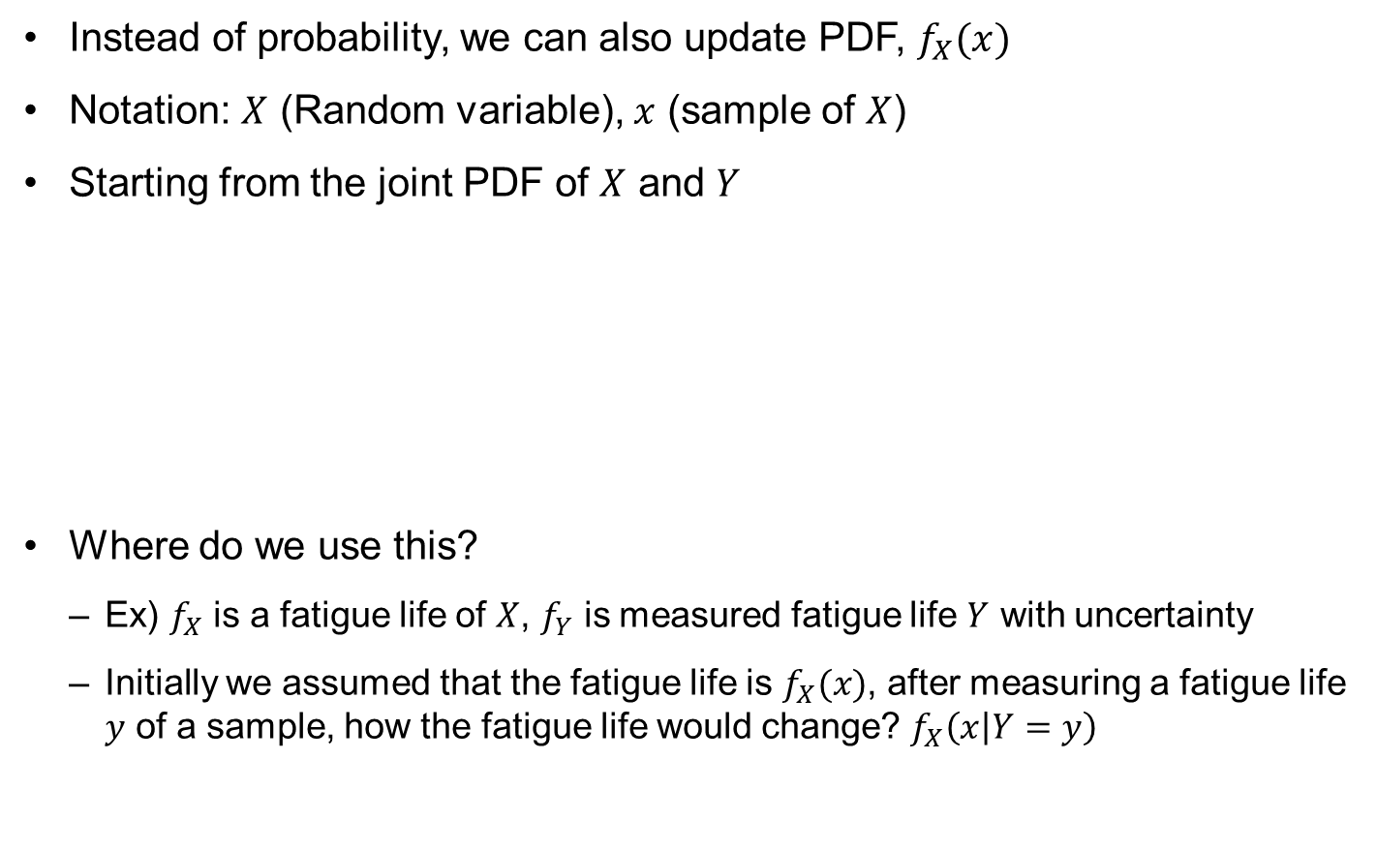
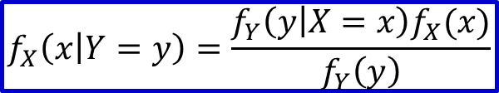
Bayes’ Rule for PDF
Instead of probability, we can also update PDF, $f_{X}(x)$
Notation: $X$ (Random variable), $x$ (sample of $X$)
Starting from the joint PDF of $X$ and $Y$
Where do we use this?
Ex) $f_{X}$ is a fatigue life of $X$, $f_{Y}$ is measured fatigue life $Y$ with uncertainty
Initially we assumed that the fatigue life is $f_{X}(x)$, after measuring a fatigue life $y$ of a sample, how the fatigue life would change? $f_{X}\left(x | Y=y\right)$
$$f_{XY}\left(x,y\right)=f_{X}\left(x | Y=y\right)f_{Y}\left(y\right)=f_{Y}\left(y | X=x\right)f_{X}(x)$$
$$f_{X}\left(x | Y=y\right)=\frac{f_{Y}\left(y | X=x\right)f_{X}(x)}{f_{Y}\left(y\right)}$$

Slide 58



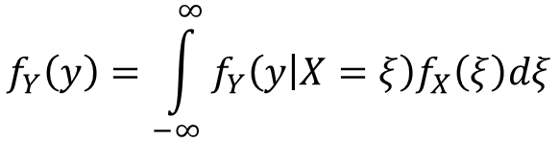
Bayes’ Rule for PDF cont.
Denominator: Marginal distribution
can be considered as a normalizing constant
Likelihood
the probability density value of test $Y$ given fatigue life $X=x$
$$f_{Y}\left(y\right)=\int_{−∞}^{∞}{f_{Y}\left(y | X=ξ\right)f_{X}\left(ξ\right)dξ}$$
$$f_{Y}\left(y | X=x\right)$$
We will use $L(y|x)$

Slide 59
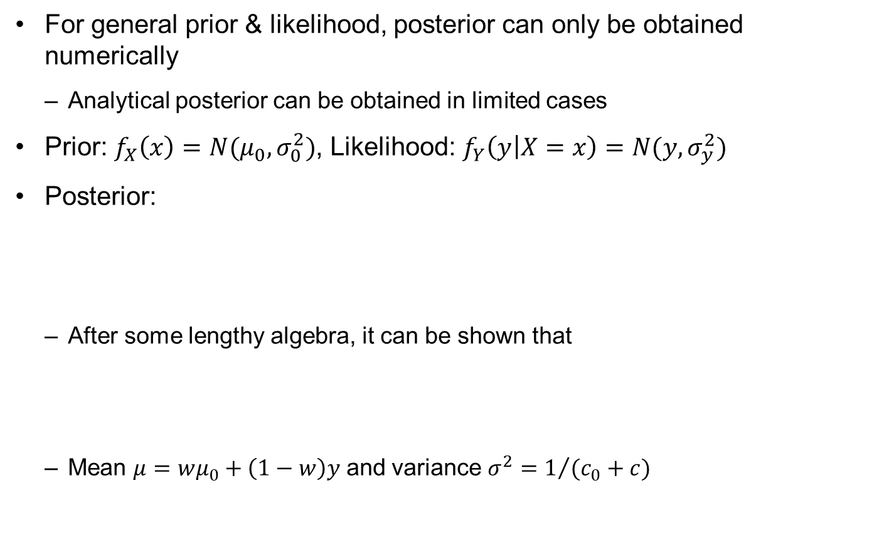
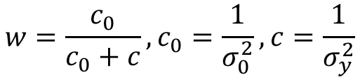
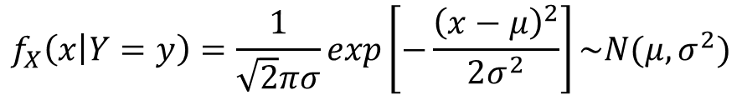
Analytical Posterior
For general prior & likelihood, posterior can only be obtained numerically
Analytical posterior can be obtained in limited cases
Prior: $f_{X}\left(x\right)=N(μ_{0},σ_{0}^{2})$, Likelihood: $f_{Y}\left(\left.y\right|X=x\right)=N(y,σ_{y}^{2})$
Posterior:
After some lengthy algebra, it can be shown that
Mean $μ=wμ_{0}+\left(1−w\right)y$ and variance $σ^{2}=1/{(c_{0}+c)}$
$$f_{X}\left(\left.x\right|Y=y\right)=\frac{f_{Y}\left(\left.y\right|X=x\right)f_{X}(x)}{f_{Y}(y)}\sim exp\left[−\frac{{\left(y−x\right)}^{2}}{2σ_{y}^{2}}−\frac{{\left(x−μ_{0}\right)}^{2}}{2σ_{0}^{2}}\right]$$
$$f_{X}\left(\left.x\right|Y=y\right)=\frac{1}{\sqrt{2}πσ}exp\left[−\frac{{\left(x−μ\right)}^{2}}{2σ^{2}}\right]\sim N(μ,σ^{2})$$
$$w=\frac{c_{0}}{c_{0}+c}, c_{0}=\frac{1}{σ_{0}^{2}}, c=\frac{1}{σ_{y}^{2}}$$

Slide 60



Ex) Independent Variables
$X$ and $Y$ are statistically independent
Bayes’ theorem for independent variables:
Having an observation in $Y$ cannot affect the knowledge in $X$
$$f_{XY}\left(x,y\right)=f_{X}(x)∙f_{Y}(y)$$
$$f_{X}\left(\left.x\right|Y=y\right)=\frac{f_{XY}\left(x,y\right)}{f_{Y}(y)}=\frac{f_{X}(x)∙f_{Y}(y)}{f_{Y}(y)}=f_{X}(x)$$

Slide 61



Ex) Bayes’ Theorem for Failure Strength
Tested failure strength of 570 MPa with test variability STD of 10 MPa
Non-informative prior), $f_{X}\left(x\right)=constant$ or ignore it (included in $K$)
Posterior distribution $\sim$ likelihood
Since the likelihood is a Gaussian distribution, the area under $\int_{−∞}^{∞}{f_{Y}\left(y=570 | x\right)dx}=1$. Therefore, $K=1$
The posterior is a normal distribution with STD = 10
$$f_{X}\left(x | Y=y\right)=\frac{1}{K}f_{Y}\left(y | X=x\right)f_{X}(x)$$
$$f_{X}\left(x | Y=570\right)=\frac{1}{K}f_{Y}\left(y=570 | X=x\right) \\ =\frac{1}{K10\sqrt{2π}}exp\left[−\frac{{\left(x−570\right)}^{2}}{200}\right]$$

Slide 62


Ex) Bayes’ Theorem for Failure Strength cont.
Repeat the example with known prior distribution of $f_{X}\left(x\right)=N({550,20}^{2})$
Conjugate distribution: when the product of prior and likelihood yield the same type of distribution with the prior
$w=\frac{c_{0}}{c_{0}+c}=0.2$: Large variance in the prior gives more weight on data
$μ=wμ_{0}+\left(1−w\right)y=566$MPa, $σ^{2}=1/{(c_{0}+c)}=80$MPa
m0=550; s0=20; y=570; sy=10; x=500:1:620;
c0=1/s0^2; c=1/sy^2; w=c0/(c0+c);
m=w*m0+(1-w)*y; s=sqrt(1/(c0+c));
pdf_pr=exp(-((x-m0).^2)./(2*s0^2))/(sqrt(2*pi)*s0);
pdf_li=exp(-((x-y).^2)./(2*sy^2))/(sqrt(2*pi)*sy);
pdf_po=exp(-((x-m).^2)./(2*s^2))/(sqrt(2*pi)*s);
plot(x,pdf_pr,'-b',x,pdf_li,'-g',x,pdf_po,'-r');
$$f_{X}\left(\left.x\right|Y=y\right)=\frac{1}{σ\sqrt{2π}}exp\left[−\frac{{\left(x−μ\right)}^{2}}{2σ^{2}}\right]\sim N(μ,σ^{2})$$

Slide 63

Ex) Bayes’ Theorem for Failure Strength cont.
Prior, likelihood and posterior distributions

Slide 64


Bayes’ Theorem with Multiple Data
Multiple data: $y=\left\{\begin{matrix}\begin{matrix}y_{1} & y_{2}\end{matrix} & \begin{matrix}⋯ & y_{N}\end{matrix}\end{matrix}\right\}$
Bayesian inference can be applied iteratively or all at once
Multiple, independent tests are available
likelihoods of individual tests are multiplied to build the total likelihood
Multiple tests can be updated one-by-one
Previous posterior $f_{X}^{\left(i−1\right)}\left(x\right)$ becomes prior in the following update
$$f_{X}\left(x | Y=y\right)=\frac{1}{K}\prod_{i=1}^{N}{\left[f_{Y}\left(y_{i} | X=x\right)\right]}f_{X}(x)$$
$$f_{X}^{(i)}\left(x | Y=y_{i}\right)=\frac{1}{K_{i}}f_{Y}\left(y_{i} | X=x\right)f_{X}^{\left(i−1\right)}\left(x\right), i=1,⋯,N$$

Slide 65

Bayes’ Theorem with Multiple Data cont.
Bayes' rule becomes identical to the maximum likelihood estimate when there is no prior information; i.e., $f_{X}\left(x\right)=constant$
The prior PDF can be applied either first or last. Update the posterior distribution without prior information and then to apply the prior PDF after the last update
Bayes' rule performs better than the least squares method and maximum likelihood estimate in a sense that it can estimate the uncertainty structure of the identified parameters
These uncertainty structures depend on the prior distribution and likelihood function.

Slide 66



Bayesian Updating Illustration
Let’s update a single parameter $(x)$ with measured data $(y1, y2, …)$
Initial prior is assumed to be uniformly distributed $fX(x) \sim U(xL, xU)$
Measured data $yi$ has uniformly distributed uncertainty $\sim U(−a, +a)$.
Likelihood $fY(y | X=x)$: when $X=x$ is given, what’s the probability to get measured data $y$. ($x$ is variable, not $y$)
f_{X}(x)
x
x_{L}
x_{U}
a
a
Since $y1$ is out of $fY(x)$, likelihood $= 0$
f_{Y}(x)
x
x₁
y₁
Since $y1$ is within $fY(x)$, likelihood $= fY$
x₂
y₁

Slide 67

Bayesian Updating Illustration cont.
Calculate Likelihood by changing $x$ in a range. In the case of uniform test uncertainty
a
a
f_{Y}(x)
Likelihood
x
y₁
f_{X}(x)
Prior
x
x_{L}
x_{U}
f_{X}(x|Y=y)
Posterior
x
x_{L}
x_{U}

Slide 68


Ex) Conjugate Distribution with Multiple Data
4 failure strength data: 558, 567, 573, 582 MPa, Prior $\sim N({550,20}^{2})$
Since both prior and likelihood are normal, the posterior will be normal
Data: mean $\overline{y}=570, {σ_{y}^{2}}/N={100}/4=25$
Weight: $w_{N}={c_{0}}/{\left(c_{0}+c_{N}\right)=0.0588}$
Mean of the posterior: $μ=w_{N}μ_{0}+\left(1−w_{N}\right)\overline{y}=568.8$MPa
Variance of the posterior: $σ^{2}=1/{(c_{0}+c_{N})}=23.5$
$$f_{X}\left(\left.x\right|Y=y\right)=\frac{1}{4.85\sqrt{2π}}exp\left[−\frac{{\left(x−568.8\right)}^{2}}{47}\right]$$

Slide 69

Ex) Conjugate Distribution with Multiple Data cont.

Slide 70
Bayes’ Theorem for Parameter Estimation
So far, it is assumed that the measured quantity is a same kind of uncertain variable
Measured quantity can be different from the quantity of interest
Measure natural frequency to estimate the change in stiffness due to damage
This is called calibration of parameters
most engineering computation requires model parameters, which need to be identified based on experimental observations
Estimation of model parameters is a key step in prognostics
Conventional regression can be used for identifying model parameters
Bayes’ theorem can provide more comprehensive information: not only the most likelihood value but also uncertainty associated with it

Slide 71



Bayesian Inference
Bayes’ theorem for model parameter estimation
$θ$ : vector of model parameters, $y$: measured data
Bayesian inference or Bayesian updating
the posterior is about model parameters, while the likelihood is measurement of a physical quantity
a physical model must be employed to relate the model parameters with measured data
Ex) Crack propagation using Paris model
Use Paris model calculate the likelihood; the probability to obtain measured crack size $y$ for given parameter values $θ$
Select different values of $θ$ and calculate the probability of getting $y$
$$f\left(θ | y\right)=\frac{f\left(y | θ\right)f(θ)}{f(y)}$$
$f\left(θ | y\right)∝$ $f\left(y | θ\right)f(θ)$

Slide 72
5. Bayesian Updating

Slide 73

Bayesian Updating
Posterior distribution = likelihood function $×$ prior distribution
Likelihood function is similar to probability density function, but it is different
overall Bayesian method: posterior distribution is obtained by multiplying likelihood of all data with the prior distribution
recursive Bayesian method:
Bayesian update is employed one data point at a time
the posterior distribution from the previous update is used as a prior distribution and likelihood includes only a single test data
Mathematically, these two Bayesian updating methods are equivalent and should yield the identical posterior distribution
They become different numerically, especially when a PDF is rep-resented by samples

Slide 74
Recursive Bayesian Update
Assume uniform prior and 2 data from uniform test variability

Slide 75

Recursive Bayesian Update cont.
the posterior distribution from the previous data is used as a prior distribution for the next data
$$f\left(θ | y_{1}\right)∝f\left(y_{1} | θ\right)f\left(θ\right) \\ f\left(θ | y_{1:2}\right)∝f\left(y_{2} | θ\right)f\left(θ | y_{1}\right) \\ ⋮ \\ f\left(θ | y_{1:k}\right)∝f\left(y_{k} | θ\right)f\left(θ | y_{1:k−1}\right)$$

Slide 76

Ex) Bayesian Updating of Failure Strength
Estimate the uncertainty of normalized failure strength given 3 test data
Prior distribution of failure strength is uniformly distributed $\sim U(0.9, 1.1)$
3 tensile tests yield measured failure strength of 1.05, 1.10, and 1.15
Test variability is uniformly distributed $\sim U\left(−0.15, 0.15\right)$
First data $y_{1}=1.05$
7
6
prior
5
Since the prior is within the likelihood, the posterior = the prior
4
Likelihood
3
2
1
0
0.9
0.95
1
1.05
1.1
1.15
1.2
(a) Initial distribution and first test result

Slide 77
Likelihood of Failure Strength
Representing test variability
Assume uniform distribution ~ U(test-0.15, test+0.15)
Likelihood L(test | x):
When true failure strength is x, the probability to get failure strength test
a
a
x=0.8:0.001:1.3; n=size(x,2);
likelihood=zeros(1,n);
prior=pdf('unif',x,0.9,1.1);
a=0.15;
test1=1.05;
for i=1:n
likelihood(i)=pdf('unif',test1,x(i)-a,x(i)+a);
end
posterior=prior.*likelihood;
area=sum(posterior)*0.001;
posterior=posterior/area;
plot(x,prior,x,likelihood,x,posterior);
f_{Y}(x)
x
x₁
y
x₂
y

Slide 78

Bayesian Updating of Failure Strength cont.
11
Use previous posterior as a new prior
11
10
10
Posterior
9
9
8
Posterior
8
prior
7
7
6
prior
6
5
Likelihood
5
4
4
Likelihood
3
3
2
2
1
1
0
0.9
0.95
1
1.05
1.1
1.15
1.2
0
0.9
0.95
1
1.05
1.1
1.15
1.2
(b) Before and after test 2
(c) Before and after test 3
Uncertainty in prior $\sim U(0.9, 1.1)$
Uncertainty in posterior $\sim U(1.0, 1.1)$
3 tests reduce uncertainty in failure strength by 50%

Slide 79

Lognormal Likelihood for Failure Strength
We will learn Bayesian updating for different types of prior, likelihood and multiple parameters in the next chapter
When test variability is lognormally distributed
Evolution of failure stress distribution, f(σ_{f}), with Bayesian updating.

Slide 80
Normal Likelihood
If the error is assumed to have a fixed standard deviation, the likelihood for this error will be calculated from pdf of normal distribution
In the same way as uniform, normal likelihood is constructed as follows
$$L\left(y | x\right)=p\left(y | x\right)=Normal_PDF(y|x,σ^{2})$$
7
Posterior
for i=1:n
likelihood(i)= ...
pdf(‘norm',test1,mean,std);
end
6
prior
5
4
Likelihood
3
2
1
0
0.8
0.85
0.9
0.95
1
1.05
1.1
1.15
1.2
1.25
1.3

Slide 81


Overall Bayesian Update
Posterior distribution = likelihood $×$ prior distribution
Likelihood function includes all data together
$$f\left(θ | y_{1:k}\right)∝f\left(y_{1} | θ\right)×f\left(y_{2} | θ\right)×⋯×f\left(y_{k} | θ\right)×f\left(θ\right) \\ =f\left(y_{1:k} | θ\right)f(θ)$$

Slide 82

Ex) Overall Bayesian Update
x=0.8:0.001:1.3;
prior=pdf('unif',x,0.9,1.1);
test=[1.05 1.10 1.15]; ny=length(test);
likelihood=1;
for k=1:ny
likelihood=pdf('unif',test(k),x-a,x+a).*likelihood;
end
areaL=sum(likelihood)*0.001;
likelihood=likelihood/areaL;
posterior=prior.*likelihood;
area=sum(posterior)*0.001;
posterior=posterior/area;
plot(x,prior,'r-',x,likelihood,'b--’,…
x,posterior,'m-');

Slide 83
6. Bayesian Parameter Estimation

Slide 84




Bayesian Estimation of Model Parameters
Illustration model: $z\left(t;θ\right)=θ_{1}+θ_{2}Lt^{2}+θ_{3}t^{3}$
Want to estimate the mean and STD of normal distribution
Normally distributed likelihood:
$μ$ becomes model output and $σ$ is the measurement variability
Measurement error $(μ−y)$ is normally distributed with zero mean and $σ$
Equivalent form:
Multiple data
$$f\left(y | μ,σ\right)=\frac{1}{σ\sqrt{2π}}exp\left(−\frac{{\left(μ−y\right)}^{2}}{2σ^{2}}\right)$$
$$f\left(y_{k} | θ\right)=\frac{1}{σ\sqrt{2π}}exp\left(−\frac{{\left(z_{k}−y_{k}\right)}^{2}}{2σ^{2}}\right)\sim N(z_{k},σ^{2})$$
$$z_{k}=θ_{1}+θ_{2}Lt_{k}^{2}+θ_{3}t_{k}^{3}, σ=θ_{4}$$
$$f\left(y_{1:n_{y}} | θ\right)=f\left(y_{1} | θ\right)×⋯×f\left(y_{n_{y}} | θ\right)=\frac{1}{{\left(σ\sqrt{2π}\right)}^{n_{y}}}exp\left(−\frac{\sum_{k=1}^{n_{y}}{{\left(z_{k}−y_{k}\right)}^{2}}}{2σ^{2}}\right)$$

Slide 85



Bayesian Estimation of Model Parameters cont.
Uniform prior distribution
Independent prior distribution with multiple parameters
Posterior = Likelihood $×$ Prior
$$f\left(θ\right)=U\left(a,b\right)=\left\{\begin{aligned}1/{(b−a)} for θ∈[a,b] \\ 0 otherwise\end{aligned}\right.$$
$$f\left(θ\right)=\prod_{i=1}^{n_{p}}{f(θ_{i})}=\prod_{i=1}^{n_{p}}{U(a_{i},b_{i})}$$

Slide 86

Ex) Bayesian Parameter Estimation
Assume $z\left(t;θ\right)=θ+0.2t^{2}+0.1t^{3}$ with $σ=2.9$ (single parameter)
Prior $f(θ)\sim U[0,10]$, Likelihood: normal distribution
Recursive Bayesian parameter estimation
as more data are used, the distribution becomes narrower
t=[0 1 2 3 4]; y=[5.0 5.3 6.6 9.5 14.6];
sigma=2.9; theta=-5:0.01:15; ng=length(theta);
prior=unifpdf(theta,0,10);
for k=1:5
z(k,:)=theta+0.2*t(k)^2+0.1*t(k)^3;
postS(k,:)=normpdf(y(k),z(k,:),sigma).*prior;
prior=postS(k,:);
end
plot(theta,postS./repmat(0.01*sum(postS,2),1,ng));

Slide 87
Ex) Bayesian Parameter Estimation cont.
Overall Bayesian parameter estimation
ny=length(y);
for i=1:ng
z=theta(i)+0.2*t.^2+0.1*t.^3;
prior=unifpdf(theta(i),0,10);
postO(1,i)=(sigma*sqrt(2*pi))^-ny* ...
exp(-0.5/sigma^2*(z-y)*(z-y)')*prior;
end
plot(theta,postO/(0.01*sum(postO)));

Slide 88

Ex) Bayesian Parameter Estimation 2
Model: $z\left(t;θ\right)=5+θ_{2}t^{2}+θ_{3}t^{3}$ with $σ=2.9$ and non-informative prior
Recursive Bayesian (2 parameters)
t=[0 1 2 3 4];
y=[6.99 2.28 1.91 11.94 14.60];
sigma=2.9;
ng=200;
th2B=[-10 10]; th3B=[-2 2];
[theta2 theta3]=meshgrid(linspace(th2B(1),th2B(2),ng)', ...
linspace(th3B(1),th3B(2),ng));
%%% Recursive
prior=1;
for k=1:5;
z(k,:)=5+theta2(:)*t(k)^2+theta3(:)*t(k)^3;
postS(k,:)=normpdf(y(k),z(k,:),sigma).*prior;
prior=postS(k,:);
C=sum(postS(k,:))* ...
(th2B(2)-th2B(1))/(ng-1)*(th3B(2)-th3B(1))/(ng-1);
contour(theta2,theta3,reshape(postS(k,:)/C,ng,ng)); hold on;
end
plot(0.2,0.1,'pk','markersize',18);

Slide 89
Ex) Bayesian Parameter Estimation 2 cont.
Overall Bayesian
%%% Overall
ny=length(y);
for i=1:ng; for j=1:ng
z=5+theta2(i,j)*t.^2+theta3(i,j)*t.^3;
postO(i,j)=(sigma*sqrt(2*pi))^-ny* ...
exp(-0.5/sigma^2*(z-y)*(z-y)');
end; end
C=sum(sum(postO))* ...
(th2B(2)-th2B(1))/(ng-1)*(th3B(2)-th3B(1))/(ng-1);
contour(theta2,theta3,postO/C); hold on;
plot(0.2,0.1,'pk','markersize',18);
Joint PDF with correlation

Slide 90
7. Generating Samples from Posterior Distribution

Slide 91
Generating Samples from Posterior PDF
So far, we studied how to obtain the posterior distribution (PDF)
We have analytical expression of the posterior PDF
Most of time, posterior PDF is not a standard distribution
How to estimate the distribution of degradation with posterior PDF of model parameters?
Samples of model parameters are generated based on the posterior PDF
These samples are substituted in the degradation model to generate the samples of degradation (i.e., samples of RUL)
Objective: How to generate samples that follow the posterior PDF?
Inverse CDF method
Grid approximation method
More general methods will follow in the next chapter

Slide 92


Inverse CDF Method
Use the CDF of posterior distribution to draw random samples
Integrate the posterior PDF to obtain CDF (numerically)
Generate a random sample $u\sim U(0,1)$ (in the vertical axis) and find the corresponding real sample $θ$ using the inverse of CDF
It means, generate random samples of CDF and find corresponding random parameter $θ$
Figure shows more samples near the high PDF
$$F\left(θ\right)=u↔F^{−1}\left(u\right)=θ$$

Slide 93

Ex) Inverse CDF Method
Generate 500 samples of $N({5,2.9}^{2})$ using the inverse CDF method and compared the histogram with exact PDF
ns=5000; % num. of samples
u=rand(1,ns);
thetaS=norminv(u,mu,sig); % samples by inv. CDF
[fre val]=hist(thetaS,30); bar(val,fre/ns/(val(2)-val(1)))
theta=linspace(-10,20,200);
pdf=normpdf(theta,mu,sig); %%% exact PDF
hold on; plot(theta,pdf,'r');

Slide 94


Grid Approximation Method: 1 parameter
When the closed expression of CDF is not available, it is approximated by piecewise linear polynomials at several grid points (numerical integration)
For a given random sample $u_{5}$,
$$θ_{5}=g_{1}+\frac{u_{5}−F(g_{1})}{F\left(g_{2}\right)−F(g_{1})}×(g_{2}−g_{1})$$

Slide 95

Procedure
Procedure
In order to generate samples following PDF $f(θ)$,
Construct approx. CDF $F(θ)$ which is the integral of $f(θ)$.
Draw random value $u$ from the uniform distribution on [0,1].
let $θ=F^{−1}(u)$. Then the value $θ$ will be a random draw from $f(θ)$.
Remarks
Effective only when we have knowledge of the range and we miss nothing outside their ranges.
Not good for higher-dimensional multivariate problems, where computing at every point in the multidimensional grid becomes prohibitively expensive.
Conclusion: this method is not used well in practice.
Notes:
Matlab code for practice
% grid method (try dx=0.1~2.)
p = @(x) 0.3*exp(-0.2*x.^2)+0.7*exp(-0.2*(x-10).^2); % this is target density.
dx=0.5; xx=-10:dx:20; nx=length(xx); fp=p(xx); plot(xx,fp)
F(1)=0; for i=2:nx; F(i)=sum(fp(1:i-1))*dx; end; % approximate cdf
N=1e4; U=rand(1,N)*(max(F)-min(F));
for i=1:N; i2=min(find(F>U(i))); i1=i2-1; X(i)=interp1(F(i1:i2),xx(i1:i2),U(i)); end;
nb=histc(X,xx); figure(2); bar(xx,nb/N/dx);
A=sum(fp)*dx; hold on; plot(xx,fp/A,'r') % for comparison

Slide 96
Matlab Practice (Normal Distribution)
mx=0; sx=1; dx=.01; xx=-3:dx:3; nx=length(xx);
pdfnorm=1/sqrt(2*pi)/sx*exp(-1/2*((xx-mx)./sx).^2);
plot(xx,pdfnorm); grid on; % normal pdf
% generate approximate cdf.
cdf(1)=0;
for i=2:length(xx);
cdf(i)=sum(pdfnorm(1:i-1))*dx;
end;
plot(xx,cdf);grid on; % approximate cdf
% grid method based on the approximate cdf.
N=1e4; u=rand(1,N)*(max(cdf)-min(cdf));
for i=1:N;
i2=min(find(cdf>u(i))); i1=i2-1;
xmc(i)=unifinv(u(i),xx(i1),xx(i2));
end;
nb=hist(xmc,-3:.2:3);
plot(xx,pdfnorm); hold on; bar(-3:.2:3,nb/N/.2);

Slide 97
Matlab Practice
% direct method #1 just for reference
u=rand(N,1);
xmc1=norminv(u,mx,sx);
nb1=hist(xmc1,-3:.2:3);
plot(xx,pdfnorm); hold on; bar(-3:.2:3,nb1/N/.2);
% direct method #2 just for reference too
xmc2=normrnd(mx,sx,N,1);
nb2=hist(xmc2,-3:.2:3);
plot(xx,pdfnorm); hold on; bar(-3:.2:3,nb2/N/.2);

Slide 98


Grid Approximation Method: 2 Parameters
Drawing samples from joint PDF (correlated)
Joint PDF:
Draw a sample from a marginal PDF of $A$ as the same way explained in the grid approximation method
Construct a PDF of $B$ conditional on the sample of $A$ in Step 1
Draw a sample from the PDF in Step 2 as the same way explained in the grid approximation method
Repeat Steps 1-3 $n_{s}$ times
$$f_{AB}\left(a,b\right)=f_{A}\left(a | B=b\right)f_{B}\left(b\right)=f_{B}\left(b | A=a\right)f_{A}(a)$$
$$f_{A}\left(a\right)=\int_{−∞}^{∞}{f_{AB}\left(a,b\right)db, } f_{B}\left(b\right)=\int_{−∞}^{∞}{f_{AB}\left(a,b\right)da }$$

Slide 99

Ex) Grid Approximation Method
Model: $z\left(t;θ\right)=5+θ_{2}t^{2}+θ_{3}t^{3}$ with $σ=2.9$ and non-informative prior
ng=50; ns=5000; % num. of grid & samples
t = [0 1 2 3 4];
y=[6.99 2.28 1.91 11.94 14.60]; ny=length(y);
sigma = 2.9;
thL=[-5; -1]; thU=[5; 2];
theta(1,:)=linspace(thL(1),thU(1),ng+1);
theta(2,:)=linspace(thL(2),thU(2),ng+1);
wt=(thU-thL)/ng; % grid width
thetaP=repmat(wt/2,1,ng)+theta(:,1:ng); % point for pdf
[thetaP2 thetaP3]=meshgrid(thetaP(1,:)',thetaP(2,:));
post=1; %%% joint PDF
for k=1:ny;
z=5+thetaP2(:)*t(k)^2+thetaP3(:)*t(k)^3;
post=normpdf(y(k),z,sigma).*post;
end
C=sum(post)*wt(1)*wt(2);
jPdf=reshape(post/C,ng,ng);

Slide 100
Ex) Grid Approximation Method cont.
mPdf2=sum(jPdf)*wt(2); %%% marginal PDF of theta 2
mCdf2(2:ng+1)=cumsum(mPdf2*wt(1));
for i=1:ns
u=rand;
loca=find(mCdf2>=u,1);
thetaS(1,i)=interp1([mCdf2(loca) mCdf2(loca-1)], ...
[theta(1,loca) theta(1,loca-1)],u); % Eq.
post=1; %%% PDF of theta 3 conditional on theta2
for k=1:ny;
z=5+thetaS(1,i)*t(k)^2+thetaP(2,:)*t(k)^3;
post=normpdf(y(k),z,sigma).*post;
end
C=sum(post)*wt(2);
mPdf3=post/C;
mCdf3(2:ng+1)=cumsum(mPdf3*wt(2));
u=rand;
loca=find(mCdf3>=u,1);
thetaS(2,i)=interp1([mCdf3(loca) mCdf3(loca-1)], ...
[theta(2,loca) theta(2,loca-1)],u); % Eq.
end

Slide 101






Ex) Grid Approximation Method cont.
figure; [fre val]=hist(thetaS(1,:),30);
bar(val,fre/ns/(val(2)-val(1)))
figure; [fre val]=hist(thetaS(2,:),30);
bar(val,fre/ns/(val(2)-val(1)))
figure; plot(thetaS(1,:),thetaS(2,:),'.')
$$θ_{2}, n_{g}=10$$
$$θ_{2}, n_{g}=50$$
$$n_{g}=10$$
$$θ_{3}, n_{g}=10$$
$$θ_{3}, n_{g}=50$$
$$n_{g}=50$$

Slide 102

Rejection Sampling
Procedure
In order to generate samples for pdf $p(x)$, introduce an arbitrary pdf $q(x)$ that has sampling capability, such that $Mq(x)$ bounds $p(x)$.
Sample $θ$ at random from the proposal pdf $q(θ)$.
With probability $p\left(θ | y\right)/(Mq\left(θ\right))$, accept $θ$ as a draw from $p$.
It means, generate a random number $u\sim U(0,1)$, and compare $u$ to the value $p\left(θ | y\right)/(Mq\left(θ\right))$. If $u$ is less than the value, it is accepted.
$M$ is just chosen such that $Mq$ exceeds $p$ at everywhere.
Pseudo-code & illustration

Slide 103

Triangular Distribution Example
Mq(x)
$p(x)=2x$for $x in [0,1]$
Select $q(x)=U[0,1]$
Then $M=3$ is large enough.
qsamp=rand(1,5) = 0.8147 0.9058 0.1270 0.9134 0.6324.
px=2*qsamp = 1.6294 1.8116 0.2540 1.8268 1.2647
paccept=px./(3*qsamp) = 0.6667 0.6667 0.6667 0.6667 0.6667
accepttest=rand(1,5)=0.0975 0.2785 0.5469 0.9575 0.9649
accept=sign(paccept-accepttest)= 1 1 1 -1 -1
p(x)
q(x)
0
1

Slide 104

Rejection Sampling
Practice with matlab
generate samples of this distribution.
Remarks
it is not always possible to bound $p/q$ with reasonable amount $M$ over the whole space. If $M$ is too large, the acceptance probability $P(x accepted) \sim 1/M$ is too small.
Notes:
% rejection sampling (try M=0.5, 1, 2, 1e3,¡¦)
p = @(x) 0.3*exp(-0.2*x.^2)+0.7*exp(-0.2*(x-10).^2); % this is target density.
mew=5; sig=10; q = @(x) normpdf(x,mew,sig); % this is proposal pdf.
dx=0.5; xx=-10:dx:20; fp=p(xx); plot(xx,fp)
fq=q(xx); hold on; plot(xx,fq,'r')
ratio=fp./fq; M=max(ratio)*2; plot(xx,M*fq,'m')
N=1e5; X=normrnd(mew,sig,1,N); % step 1
R=p(X)./q(X)/M; U=rand(1,N); ind=find(U<R); X=X(ind); N1=length(X); % step 2
nb=histc(X,xx); figure(2); bar(xx+dx/2,nb/N1/dx); % plot samples.
A=sum(fp)*dx; hold on; plot(xx,fp/A,'r') % compare.
[mean(X) var(X) prctile(X,50) prctile(X,2.5) prctile(X,97.5)]
[length(find(X<5))/N1 length(find(X<15))/N1]

Slide 105
Matlab Practice
p = @(x) 0.3*exp(-0.2*x.^2)+0.7*exp(-0.2*(x-10).^2);
mew=5; sig=10; q = @(x) normpdf(x,mew,sig);
dx=0.1; xx=-10:dx:20; yp=p(xx); A=sum(yp)*dx; yp=yp/A; plot(xx,yp)
yq=q(xx); plot(xx,[yp' yq'])
%
ratio=yp./yq; M=max(ratio)*5.0; plot(xx,[yp' M*yq'])
N=1e6; Xmc=normrnd(mew,sig,1,N); U=rand(1,N); % step 1
R=p(Xmc)./q(Xmc)/M; ind=find(R>U); X=Xmc(ind); N1=length(X); % step 2
nb=histc(X,xx); bar(xx,nb/N1/dx); hold on; plot(xx,yp)
%nb=histc(Xmc,xx); bar(xx,nb/N/dx); hold on; plot(xx,yq)

Slide 106
Matlab Practice cont.
$$p(x)$$
$$Mq(x)$$
$$q(x)$$
$$p(x)$$

Slide 107
8. Importance Sampling
Uncertainty is different from randomness
The future is completely uncertain…
…I am completely certain of this

Slide 108

Importance Sampling
Like rejection sampling, we will use a convenient distribution (proposal distribution) instead of actual one.
Why did we have the condition $Mq>p$ in rejection sampling?
Because we could not accept with probability greater than one.
If $M$ is too large, the acceptance probability $(\sim 1/M)$is too small
Importance sampling resolves this difficulty by allowing samples to have different weights.
This is particularly simple when we use the samples to calculate integrals.
We can now choose the proposal distribution not only for convenience, but also to emphasize regions that contribute a lot to the integral.

Slide 109



Calculation of Moment
Calculation of mean
Introduce an arbitrary pdf $q(x)$ that has sampling capability. In this case, $q(x)$ need not bound $p(x)$.
Then moment (or expectation) of an arbitrary function $f(x)$ becomes
It is a good idea to normalize the weight samples.
Practice with matlab
Calculate mean & variance of $p(x)$ using importance sampling.
$$I\left(f\right)=\int{f\left(x\right)p\left(x\right)dx}=\int{f\left(x\right)w\left(x\right)q\left(x\right)dx}, where w\left(x\right)=\frac{p(x)}{q(x)}$$
$${\hat{I}}_{N}\left(f\right)=\sum_{i=1}^{N}{f\left(x^{\left(i\right)}\right)w(x^{\left(i\right)})},$$
where x^{(i)} is the sample drawn from q(x).
$${\hat{I}}_{N}\left(f\right)=\sum_{i=1}^{N}{f(x^{\left(i\right)})\tilde{w}(x^{\left(i\right)})}, where\tilde{ w}\left(x^{\left(i\right)}\right)=\frac{w{(x}^{\left(i\right)})}{\sum_{k=1}^{N}{w{(x}^{\left(k\right)})}}$$
Notes:
% calculation of moment by importance sampling
p = @(x) 0.3*exp(-0.2*x.^2)+0.7*exp(-0.2*(x-10).^2); % this is target density.
mew=5; sig=10; q = @(x) normpdf(x,mew,sig); % this is proposal pdf.
% calculate mean and variance.
N=1e4; X=normrnd(mew,sig,1,N); W=p(X)./q(X); W=W/sum(W);
meanp=sum(X.*W); varp=sum((X-meanp).^2.*W); [meanp varp]

Slide 110
Triangular Distribution Example
p(x)=2x for x in [0,1]; Select q(x)=U[0,1]
qsamp=rand(1,5) = 0.8147 0.9058 0.1270 0.9134 0.6324.
px=2*qsamp = 1.6294 1.8116 0.2540 1.8268 1.2647
qx= rand(1,5) = 0.6792 0.0901 0.7432 0.1886 0.0559
meanimp=sum(qsamp.*px./qx)/sum(px./qx)=0.7862
For rejection sampling we chose M=3.
paccept=px./(3*qsamp) = 0.6667 0.6667 0.6667 0.6667 0.6667
accepttest=rand(1,5)=0.0975 0.2785 0.5469 0.9575 0.9649
accept=sign(paccept-accepttest)= 1 1 1 -1 -1
meanrej=sum(qsamp.*(accept+1))/sum(accept+1)=0.6158
Exact value 0.6667

Slide 111



Importance Sampling
Generation of samples
Recall that
Another meaning of this is that the distribution $p(x)$ has weight $w(xi)$at the sample points $xi$drawn by $q(x)$. This can be written as
Practice with matlab
Generate samples of this distribution.
$$I\left(f\right)=\int{f\left(x\right)p\left(x\right)dx}→{\hat{I}}_{N}\left(f\right)=\sum_{i=1}^{N}{f\left(x^{\left(i\right)}\right)w(x^{\left(i\right)})}, where w\left(x\right)=\frac{p(x)}{q(x)}$$
$${\hat{p}}_{N}\left(x\right)=\sum_{i=1}^{N}{\tilde{w}\left(x^{\left(i\right)}\right)δ_{x^{\left(i\right)}}(x)}$$

Slide 112
Matlab Practice
p = @(x) 0.3*exp(-0.2*x.^2)+0.7*exp(-0.2*(x-10).^2);
mew=5; sig=10; q = @(x) normpdf(x,mew,sig);
dx=0.1; xx=-10:dx:20; yp=p(xx); A=sum(yp)*dx; yp=yp/A;
yq=q(xx); plot(xx,[yp' yq'])
%
N=3e4; Xmc=normrnd(mew,sig,1,N); W0=p(Xmc)./q(Xmc);
Wpmf=W0/sum(W0);
for i=1:N; Wcmf(i)=sum(Wpmf(1:i)); end;
for i=1:N; ind=find(Wcmf>=rand); X(i)=Xmc(ind(1)); end;
nb=histc(X,xx); bar(xx,nb/N/dx); hold on; plot(xx,yp)
1
0.9
0.8
0.7
0.6
0.5
0.4
0.3
0.2
0.1
0
-40
-30
-20
-10
0
10
20
30
40
50
0.18
0.25
0.16
0.14
0.2
0.12
0.1
0.15
0.08
0.1
0.06
0.04
0.05
0.02
0
0
-10
-5
0
5
10
15
20
-15
-10
-5
0
5
10
15
20
25

Slide 113




Calculation of Probability of $g(x)≤0$
When we can draw samples from $p(x)$
Count # of x where $g≤0$, or sum all $Ig$.
In case that we can’t draw samples,
Sum all $Ig$ but with uneven weight where $Ig$ is 1 when $g≤0$.
Practice with matlab
Calculate $P[p(x)≤5]$using importance sampling.
$$p_{f}=\int_{g(x)≤0}{p\left(x\right)dx}=\int{I_{g}\left(x\right)p\left(x\right)dx}≈\frac{1}{N}\sum_{i=1}^{N}{I_{g}\left(x^{\left(i\right)}\right)}=\frac{n_{f}}{N}$$
$$p_{f}=\int{\left[I_{g}\left(x\right)w\left(x\right)\right]q\left(x\right)dx}≈\frac{1}{N}\sum_{i=1}^{N}{I_{g}\left(x^{\left(i\right)}\right)\tilde{w}\left(x^{\left(i\right)}\right)}$$

Slide 114


How Many Samples We Need?
Each sample is from binomial distribution with probability of “success” $θ$
The mean of $n$ samples is $nθ$, and the variance is $nθ(1−θ)$
With $y$ samples satisfying $g≤0$, estimate of the probability is $y/n$, with mean equal to $θ$, and variance$θ(1−θ)/n$
Estimated coefficient of variance (for small probability)
How many samples do we need to estimate probability of failure of 1% to two digits accuracy? That is, that we can distinguish between 0.99% and 1.00%.
$$c_{v}=\frac{σ}{μ}=\frac{\sqrt{{θ(1−θ)}/n}}{θ}=\frac{\sqrt{(1−θ) }}{nθ}≈\sqrt{\frac{1}{y}}$$

Slide 115
Tricky with Importance Sampling
With importance sampling the number of successful samples is more ambiguous because of weighting.
A more general method is bootstrapping where we sample the same sample again and again with replacement and observe its standard deviation.
For example, if we found 5 failures out of 100, and we now sample out of the 100, we can get repeated samples, and consequently more or less failures.

Slide 116

Reducing the Number of Samples
If we have some information on the region where $g≤0$ occurs, we can use a distribution that peaks around that region.
This will allow us to increase the number of samples that will satisfy $g≤0$ and increase our accuracy.

Slide 117
Practice
X and Y are jointly normally distributed random variables with marginal distributions that are standard and correlation coefficient of 0.8. You need to estimate the probability that X+Y>5. Estimate how many samples you need if you sample directly from their joint distribution for 5% accuracy of that probability. Verify by actual sampling.
Repeat by using a sampling distribution that is the same, but with the mean moved to (2.5,2.5)
Repeat by using a lognormal sampling distribution with X and Y independent, each with a mean of 2.5 and a standard deviation of 1.

Slide 118
9. Markov Chain Monte Carlo Simulation
Uncertainty is different from randomness
The future is completely uncertain…
…I am completely certain of this

Slide 119
Markov Simulation
Andrey Markov, Russian mathematician (1856-1922)
A method to generate a sequence of samples whose distribution converges to $p(θ|y)$
each sequence $θ^{t}$ is produced by starting at an arbitrary point $θ^{0}$, and drawing $θ^{t}$ from a transition distribution $T_{t}(θ^{t}|θ^{t−1})$
The transition probability distribution should be constructed so that the Markov chain converges to a stationary distribution $p(θ|y)$ which is the target of our concern

Slide 120
Markov Chain Monte Carlo (MCMC) simulation
MCMC is used when it is not possible (or not computationally efficient) to sample $θ$ directly from $p(θ|y)$
Instead, sample $θ$ iteratively in such a way that at each step of the process we expect to draw from a distribution that becomes closer and closer to $p(θ|y)$
This approach appears to be the easiest way to get reliable results
The key MCMC simulation is to create a Markov process whose stationary distribution is the specified $p(θ|y)$ and run the simulation long enough that the distribution for the current draws is close enough to the stationary distribution
Once the simulations are drawn, we have to check convergence of the sequence. The speed of the convergence is important.
Samples at the early stage should be removed from the samples (burn-in)

Slide 121
Markov Chain Monte Carlo
We will focus mostly on the Metropolis-Hastings version of MCMC.
Nicholas Metropolis, Greek American physicist (1915-1999), W. Keith Hastings, Canadian mathematician (1930- )
Recent survey places the Metropolis algorithm as one of the greatest ten algorithms of science and engineering development of 20th century.
MCMC algorithms have played a significant role in statistics, econometrics, physics and computing science over the last two decades.
This is the only known general approach for calculating the volume of a convex body in $d$ dimensions within a reasonable time

Slide 122
Weather Transition Matrix
Land of Oz has unique weather system (no 2 nice days in a row)
Weather tomorrow affected directly only by weather today, with $T_{ij}$ the probability of a state $j$ tomorrow given state $i$ today.
If rain today. What is the probability of snow tomorrow ?
Given row vector $p$ of probabilities for today, $pT$ to get probabilities for tomorrow
If today we have 50% chance of rain (rest is no precipitation) what are the probabilities tomorrow?
If N, likely to S and R the next day, not N again.
If R or S, 50% of the same the next day.
If changed, only half of this change to N.

Slide 123
Far Future Predictions
Given $p$ today, what will be the weather day after tomorrow? The day after that? In one month?
Day after tomorrow $\left(pT\right)T=pT^{2}$
Day after that $pT^{3}$
In a month $pT^{30}$
No matter what is the weather today, the probabilities for next month are 0.4, 0.2, 0.4
T=[0.5 0.25 0.25; 0.5 0 0.5; 0.25 0.25 0.5]
^{T^2 =}
^{0.4375 0.1875 0.3750}
^{0.3750 0.2500 0.3750}
^{0.3750 0.1875 0.4375}
^{T^3=}
^{0.4063 0.2031 0.3906}
^{0.4063 0.1875 0.4063}
^{0.3906 0.2031 0.4063}
^{T^30=}
^{0.4000 0.2000 0.4000}
^{0.4000 0.2000 0.4000}
^{0.4000 0.2000 0.4000}

Slide 124
Markov Chain and Long-Term Prediction
For a set of states $S=\left\{s_{1}, s_{2}, ⋯, s_{r}\right\}$, Markov chain is a process that a new state $s_{j}$ is determined by current state $s_{i}$ with probability $T_{ij}$.
$T_{ij}$ is called transition probabilities, denoted as $T\left(j | i\right)=T_{ij}$ The row vector, called probability vector (or distribution), sums to 1. $T_{ij}^{n}$ of the matrix $T^{n}$ gives the probability that we have state $s_{j}$, starting from state $s_{i}$, after $n$ steps.
As $n→∞,{ T}^{n}$ approaches limiting matrix $W$ with all rows the same vector $w$. $w$ is the left eigenvector of matrix $T$ corresponding to highest eigenvalue.
Let $p$ be arbitrary starting distribution. Then probability distribution after $n→∞$ steps is ${ pT}^{n}=w$, which means that regardless of initial $p$, one gets always the same distribution $w$ after many steps.
Notes:
Long range predictions and highest eigenvalue of matrix.
P=[0.5 0.25 0.25; 0.5 0 0.5; 0.25 0.25 0.5];
P^30 =
0.4000 0.2000 0.4000
0.4000 0.2000 0.4000
0.4000 0.2000 0.4000
[v,D]=eig(P')
v =
-0.6667 -0.7071 0.4082
-0.3333 -0.0000 -0.8165
-0.6667 0.7071 0.4082
D =
1.0000 0 0
0 0.2500 0
0 0 -0.2500
Note that the eigenvector corresponding to the largest eigenvalue (1) is [-2/3,-1/3,-2/3],. Matlab normalizes it to length 1. We need to renormalize to sum of the components equal to one, getting 0.4 0.2 0.4.

Slide 125
Matlab Practice
Transition probabilities
Left eigenvector
T=[0 1 0;0 .1 .9; .6 .4 0]; [V,D]=eig(T');
V(:,1)'= [ -0.3725 -0.6898 -0.6208]
V(:,1)'/sum(V(:,1)')=[ 0.2213 0.4098 0.3689]
Long term prediction

Slide 126
Markov Chain in Continuous Space
Transition matrix $T$ becomes the integral kernel $K$, and $p(x)$ becomes the corresponding eigenfunction
Continuous version of Markov chain algorithm
$K(x^{(i)}|x^{(i−1)})$: conditional density of $x^{(i)}$ given the value $x^{(i−1)}$
Posterior predictive distribution
Posterior predictive distribution is obtained by the random draws
Once posterior distribution $θ$ is available, $\tilde{y}$ is drawn for each given $θ$

Slide 127
Introduction to Markov Chain Monte Carlo
MCMC is a strategy for generating samples $x^{(i)}$ by using a Markov chain mechanism, such that the samples $x^{(i)}$ mimic samples drawn from the target distribution $p(x)$.
We sample iteratively such that at each step of the process we expect to draw from a distribution that becomes ever closer to $p(θ|y)$.
For a wide class of problems, this appears to be the easiest way to get reliable results.
Basic assumption: we cannot draw samples from $p(x)$ directly, but can evaluate $p(x)$ up to a normalizing constant

Slide 128
Markov Chain Monte Carlo
Forward process: Markov process
Given a transition matrix $T$, find equilibrium distribution $p$
Example:
Inverse process: MCMC process
Given a distribution $p$, construct transition matrix $T$ of Markov chain.
Then we obtain after Markov process, the target distribution $p$
Example:

Slide 129
Matlab Practice 3-Value Distribution
Use MH method to construct equilibrium distribution p = (5, 11, 2)/18
Let
Then
And
p=[5/18 11/18 2/18] = [0.2778, 0.6111, 0.1111];
Q=1/3*ones(3);
for i=1:3; for j=1:3; A(i,j)=min(1,p(j)/p(i)); end; end;
T=Q.*A; for i=1:3; T(i,i)=1-(sum(T(i,:))-T(i,i)); end;
Not practical for very large number of states

Slide 130

Introduction to the Metropolis-Hastings Algorithm
Most popular MCMC method. Other MCMC algorithms are interpreted as special cases or extensions of this algorithm.
Metropolis Algorithm
A transition distribution $q\left(x^{∗} | x\right)$ is introduced, often the normal distribution centered at $x$.
The MH step is to sample a new candidate $x^{∗}$ given the current $x$ based on $q\left(x^{∗} | x\right)$. Then the point is accepted with probability
Otherwise it remains at $x$.
By repeating these steps, one obtains in the end the samples of $p(x)$.

Slide 131
Flow Chart
Initialize $x^{(0)}$
For $i=0$ to $N−1$
Sample $u\sim U[0,1]$
Sample $x^{∗}\sim q(x^{∗}|x^{\left(i\right)})$
“accepting with a probability of A” If $u<A\left(x^{∗},x^{\left(i\right)}\right)=min\left\{1,\frac{p(x^{∗})q(x^{\left(i\right)}|x^{∗})}{p(x^{\left(i\right)})q(x^{∗}|x^{\left(i\right)})}\right\}$ $x^{\left(i+1\right)}=x^{∗}$ else $x^{\left(i+1\right)}=x^{\left(i\right)}$
$$q(x^{∗}|x^{\left(i\right)})$$
$$q(x^{\left(i\right)}|x^{∗})$$
PDF
$$x^{∗}$$
$$x^{(i)}$$
$$q\left(x^{∗} | x^{\left(i\right)}\right)\sim N\left(x^{\left(i\right)},σ^{2}\right) \\ q\left(x^{\left(i\right)} | x^{∗}\right)\sim N\left(x^{∗},σ^{2}\right)$$
For a symmetric distribution
$$q\left(x^{\left(i\right)} | x^{∗}\right)=q\left(x^{∗} | x^{\left(i\right)}\right)$$

Slide 132
Triangular Distribution Illustration
p=2x, x in [0,1]. Start at x=0.1, and use U[x-0.25,x+0.25] for q.
x0=0.1; x=x0+(rand-0.5)/2
x =0.0266
paccept=x/x0=0.2657
rand=0.4494 %reject
x=x0+(rand-0.5)/2=0.3318
paccept=x/x0=3.3177
rand=0.6712 % accept
x0=x; x=x0+(rand-0.5)/2=0.1029
paccept=x/x0=0.3102
rand= 0.9730% reject

Slide 133
Triangular Distribution
p=2x in [0,1]
Matlab realization
p=@(x) heaviside(x).*heaviside(1-x)*2.*x
xx=linspace(-1,2,301); fp=p(xx); plot (xx,fp)
Notes:
As a first step we implement the triangular distribution in Matlab using the Heaviside step function and plot it as a check.

Slide 134
Uniform Proposal Distribution
q(x)=U(x-0.25,x+0.25)
Sampling:
clear; X(1)=0; N=1e4; delta=0.25;
for i=1:N-1;
x=X(i); xs=x+2*(rand-0.5)*delta
u=rand
if u<min(1,p(xs)/(p(x)+1.e-10)); X(1+i)=xs; else; X(1+i)=x; end;
end
Plotting
N0=1; xx=linspace(0,1,26);dx=0.04; %It often pays to have larger N0
nb=histc(X(N0+1:N),xx); bar(xx+dx/2,nb/(N-N0)/dx);
Notes:
We define the transition (proposal) distribution as the uniform distribution centered around x with a bound of 0.25 to the left and to the right.
In the Matlab implementation we set the number of samples to 10,000 select the in initial sample to be at zero, and set the range of the uniform transition distribution as 0.25. Then we execute N-1 step. At each step we sample from the transition distribution and accept the new point with a probability given by the Metropolis formula. Note that we add 1e-10 to p(x) since it can be zero.
Once we sampled the 10,000 points we generate a histogram using histc, with 25 boxes. We see that we get something similar to the desired distribution.

Slide 135
Compare CDFs
ecdf(X); hold on
xx=linspace(0,1,101);
xx2=xx.^2;
plot(xx,xx2,'r')
legend('ecdf','exact')

Slide 136
10. Matlab MCMC
Uncertainty is different from randomness
The future is completely uncertain…
…I am completely certain of this

Slide 137
Introduction to the Metropolis-Hastings Algorithm
Most popular MCMC method. Other MCMC algorithms are interpreted as special cases or extensions of this algorithm.
Metropolis Algorithm
A transition distribution $q\left(x^{∗} | x\right)$ is introduced, often the normal distribution centered at $x$.
The MH step is to sample a new candidate $x^{∗}$ given the current $x$ based on $q\left(x^{∗} | x\right)$. Then the point is accepted with probability
Otherwise it remains at $x$.
By repeating these steps, one obtains in the end the samples of $p(x)$.

Slide 138
Metropolis-Hastings Algorithm
Let $x_{n}=i, x_{n+1}=j$ is determined in the following process
Generation step: Generate a candidate state $x^{∗}$ from $x_{n}$ with some distribution $q(x^{∗}|x_{n})$
$q(x^{∗}|x_{n})$: transition matrix of an irreducible Markov chain.
$q\left(x^{∗} | x_{n}\right)=0→q\left(x_{n} | x^{∗}\right)=0$ (Can’t go forward implies can’t go backward)
Acceptance step:
Generate probability sample $u\sim U[0,1]$
If $u<A\left(x^{∗},x_{n}\right)=min\left\{1,\frac{p(x^{∗})q(x_{n}|x^{∗})}{p(x_{n})q(x^{∗}|x_{n})}\right\}$ $x_{n+1}=x^{∗}$
Otherwise
$x_{n+1}=x_{n}$
Transition probabilities
$$P\left(x_{n+1} | x_{n}\right)=q\left(x_{n+1} | x_{n}\right)A\left(x_{n+1} | x_{n}\right) \\ T_{ij}=q_{ij}A_{ij}$$

Slide 139

MCMC sampling
Generating samples from posterior distribution

Slide 140
Triangular Distribution Illustration
p=2x, x in [0,1]. Start at x=0.1, and use U[x-0.25,x+0.25] for q.
x0=0.1; x=x0+(rand-0.5)/2
x =0.0266
paccept=(2*x)/(2*x0)=0.2657
rand=0.4494 %reject
x=x0+(rand-0.5)/2=0.3318
paccept=(2*x)/(2*x0)=3.3177% accept
x0=x; x=x0+(rand-0.5)/2=0.1029
paccept=(2*x)/(2*x0)=0.3102
rand= 0.9730% reject
N=10000; x=zeros(1,N); x(1)=0.5;
for i=1:N-1
xs=x(i)+0.5*(rand-0.5);
if xs<0 || xs>1, xs=0; end
if rand < min(1, xs/x(i)), x(i+1)=xs;
else, x(i+1)=x(i);
end
end
histogram(x);

Slide 141
Metropolis-Hastings Algorithm
Metropolis algorithm
A proposal distribution q(x*|x) is symmetric w.r.t x* and x. Then the ratio is simplified.
Example: normal pdf at x* with mean at x equals to the vice versa.
Practice with matlab
Generate samples of this distribution using a proposal pdf
As the random walk progresses, the number of samples are increased, and the distribution converges to the target distribution.
Notes:
This is Prof. Choi’s slide that summarizes the equations and results for the probability distribution given in the equation.
The first equation gives the Metropolis Hastings algorithm, which allows you to use a non-symmetric proposal (transition) distribution. If the transition distribution is symmetric the algorithm reduces to the Metropolis algorithm, which we will use for the triangular example.
In the Matlab practice for p(x), the code given in the notes to the previous slide uses the Metropolis Hastings formula, with the two q-terms. However, for the normal distribution, a distribution with a mean x evaluated at x* gives the same value as the distribution with a mean x* evaluated at , so the two terms cancel.
The figure show the results of the MCMC simulation with increasing number of samples.

Slide 142
Normal Proposal Distribution Example
Let’s sample from
with proposal distribution
N=1e4; xa=zeros(N,1);
p = @(x) 0.3*exp(-0.2*x.^2)+0.7*exp(-0.2*(x-10).^2);
for i=1:N-1;
u=rand(1); x=xa(i);
xs=normrnd(x,10); % sample from proposal pdf.
pxs=p(xs);px=p(x);
qxs=normpdf(xs,x,10);qx=normpdf(x,xs,10);
if u<min(1,pxs*qx/(px*qxs)); xa(1+i)=xs;
else xa(1+i)=x; end;
end;

Slide 143
Normal Proposal Distribution Example cont.
% compare pdf of the simulation result with true pdf.
clf; delta=.5; xx=-10:delta:20;
yy=p(xx); yyarea=sum(yy)*delta;
[nb,xout]=hist(xa,xx); plot(xx,yy*delta/yyarea);
hold on; bar(xout,nb/N,'w');
%
% Compare cdf with true cdf.
cdfmc=zeros(length(xx),1); cdfog=cdfmc;
for i=2:length(xx);
cdfmc(i)=cdfmc(i-1)+nb(i)/N;
cdfog(i)=cdfog(i-1)+yy(i)*delta/yyarea;
end;
clf; plot(xx,[cdfmc cdfog])
max(cdfmc-cdfog) % possible measure of accuracy.

Slide 144
Normal Proposal Distribution Example cont.
0.09
1
0.08
0.9
0.07
0.8
0.06
0.7
0.05
0.6
0.04
0.5
0.4
0.03
0.3
0.02
0.2
0.01
0.1
0
0
-15
-10
-5
0
5
10
15
20
25
-10
-5
0
5
10
15
20
max(cdfmc-cdfog) = 0.0375

Slide 145
Remarks
Independent sampler for proposal distribution: q(x*|x) = q(x*)
Similar to important sampling
Symmetric proposal: q(x*|x) = q(x|x*)
Acceptance ratio is simplified
MH does not need normalizing constant for the target distribution.
It is easy to simulate several independent chains in parallel.
Success or failure of the algorithm often hinges on the choice of proposal pdf

Slide 146
Trace of samples from MCMC sampling
Proper samples
Improper samples

Slide 147

Fatigue crack growth example
Paris model
$a$: half crack size
$N$: No. of cycles
$ΔK$: Range of stress intensity factor
$Δσ$: hoop stress range
$m,C$: damage growth model parameters
Crack size after $N_{i}$ cycles
σ
σ
[ Through-the-thickness crack in a fuselage panel ]

Slide 148
Measurement data
Measurement uncertainty model
synthetic measurement data
larger noise than lab measurement
useful for parameter study
synthetic data generation
assume: $m_{truth}=3.8, C_{true}=1.5×{10}^{−10}, a_{0}=10mm$
bias: $±2mm$
noise$\sim U\left(−u,u\right), u=0, 0.1, 1, 1mm$
three different levels of loading
for estimation: $Δσ=86.5 and 78.6 MPa$
for validation: $Δσ=70.8 MPa$
[ bias = +2mm and noise = 0mm ]
[ bias = +2mm and noise = 5mm ]

Slide 149
Damage growth parameters estimation
Bayesian inference for identifying model parameters
Bayes’ theorem
Likelihood function
Prior PDF
$θ$: unknown parameters
$a^{meas}$: observed crack size
$p(a^{meas}|θ)$: likelihood
$p(θ)$: prior PDF
$p(θ|a^{meas})$: posterior PDF
$σ$: STD of noise
$b$: bias
$$θ=\{m,C,a_{0},b,σ\}$$

Slide 150
Damage growth parameters estimation
Posterior distributions of correlated parameters with zero noise and bias=2mm
[ n =13 ]
[ n =17 ]

Slide 151
Damage growth parameter estimation
Posterior distributions of correlated parameters with zero noise
[ The median of identified parameters and the errors with the true values ]
 |  | n = 13 |  |  |  | n = 15 |  |  |  | n = 17
 |  | m | log(C) | a₀ | b | m | log(C) | a₀ | b | m | log(C) | a₀ | b
true values |  | 3.8 | -22.6 | 10 | ±2 | 3.8 | -22.6 | 10 | ±2 | 3.8 | -22.6 | 10 | ±2
b=+2mm | median | 3.82 | -22.8 | 10.6 | 1.37 | 3.81 | -22.7 | 10.4 | 1.53 | 3.82 | -22.7 | 10.4 | 1.52
 | error (%) | 0.49 | 0.57 | 5.67 | 31.7 | 0.32 | 0.37 | 4.00 | 23.6 | 0.47 | 0.44 | 3.84 | 24.2
b=-2mm | median | 3.78 | -22.5 | 9.50 | -1.44 | 3.78 | -22.5 | 9.51 | -1.41 | 3.78 | -22.5 | 9.49 | -1.35
 | error (%) | 0.40 | 0.50 | 4.96 | 28.0 | 0.40 | 0.48 | 4.94 | 29.5 | 0.55 | 0.55 | 5.11 | 32.7

Slide 152
Damage growth parameters estimation
Posterior distributions of correlated parameters with three different levels of noise
[ b = +2mm ]
[ b = -2mm ]

Slide 153
Damage propagation and RUL prediction
Prediction of crack growth with bias=+2mm
[ noise = 1mm ]
[ n = 13 ]
[ n = 17 ]
[ noise = 5mm ]
[ n = 13 ]
[ n = 17 ]

Slide 154
Damage propagation and RUL prediction
Prediction of RUL
[ noise = 0.1mm ]
[ noise = 1mm ]
[ noise = 5mm ]
[ bias = +2mm ]
[ bias =- 2mm ]

Slide 155

Correlation between two Paris model parameters
Posterior joint PDF of m and C

