Slide 1
Chapter 5 Data-driven Prognostics

Slide 2
1. Introduction to Data-driven Prognostics

Slide 3
Challenges in Physics-based Prognostics
physics-based prognostics approaches are a powerful tool for predicting the future behavior of damage degradation with a relatively small number of observed data
They are limited to the case when a physical model that describes the damage degradation behavior is available
the measured data must be directly related to the physical model
Physics-based prognostics may anticipate challenges when predicting failure of a complex system without well-defined physical model to describe degradation and when direct measurement of damage is impossible

Slide 4
Ex) Bearing Spall
spall phenomenon where the rolling elements or race surface is damaged due to surface cracks
An initial small surface crack quickly propagates into other regions of surface and gradually increases vibration of the shaft and system
The excessive vibration eventually leads to the system failure
For SHM, these surface cracks cannot be measured directly while the bearing is rotating
accelerometers are often installed in the stationary parts of the system to monitor the level of vibration
the damage degradation is measured indirectly through the level of vibration
there is no clear physical relationship between the degradation level and vibration level
Maintenance decision is made by the vibration level based on experience
Reliable decision requires many run-to-fail data of similar systems

Slide 5
Data-driven Prognostics
Data-driven approaches use information from observed data to identify the patterns of degradation progress and predict the future state without using a physical model
still use some sort of mathematical model that works only for a particular system under monitoring
can be considered as an extrapolation (prediction) method based on mathematical functions (degradation progress)
Training data
several sets of degradation data up to the end of life as well as the data from the current system are required to identify the degradation characteristics
used to make mathematical models learn the degradation behavior without a physical model
data-driven approaches are practical since physical degradation models are rare in practice

Slide 6
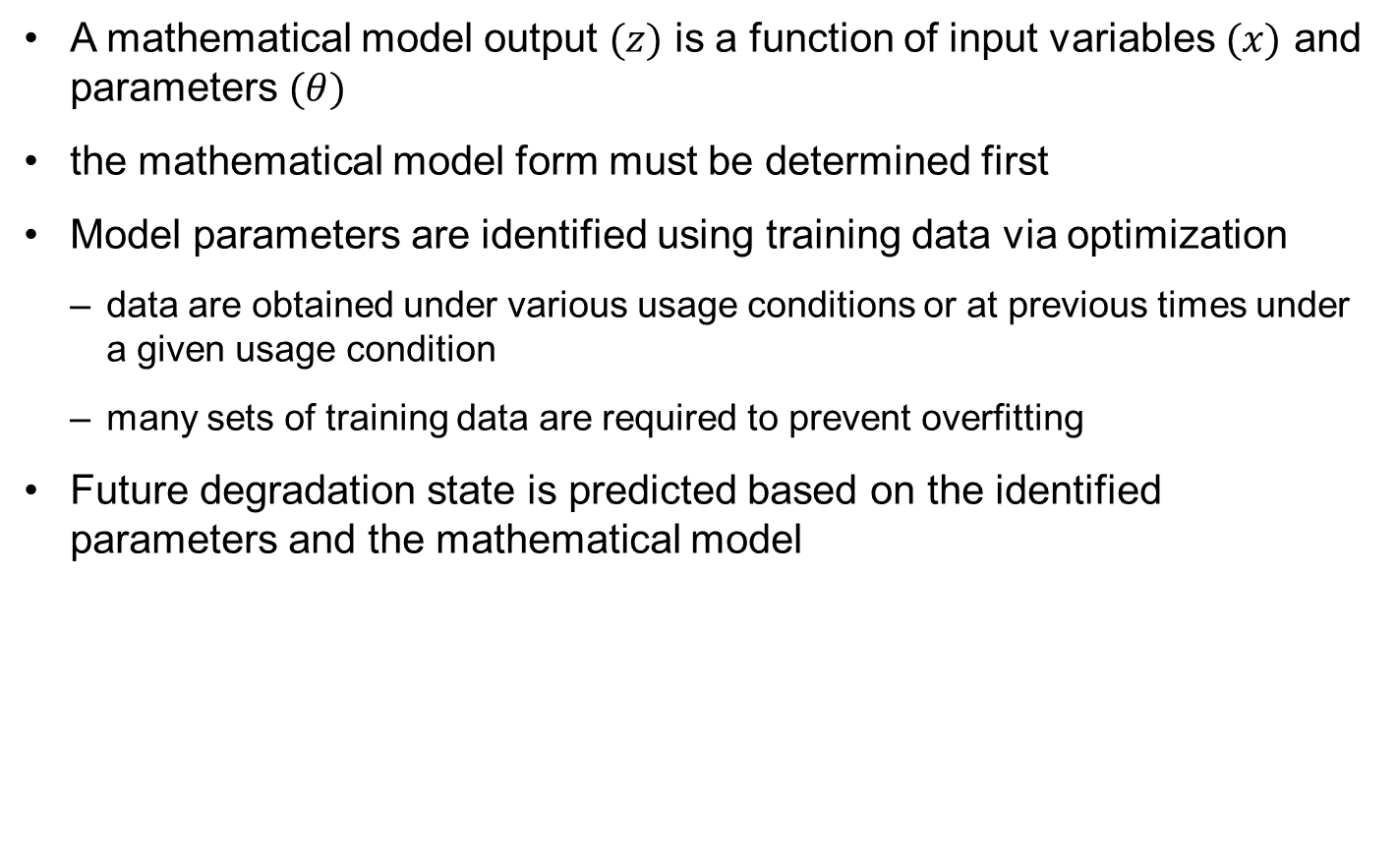
Review of Data-Driven Approaches
A mathematical model output $(z)$ is a function of input variables $(x)$ and parameters $(θ)$
the mathematical model form must be determined first
Model parameters are identified using training data via optimization
data are obtained under various usage conditions or at previous times under a given usage condition
many sets of training data are required to prevent overfitting
Future degradation state is predicted based on the identified parameters and the mathematical model

Slide 7
Data-Driven Prognostic Algorithms
Artificial intelligence approaches that include neural network (NN)
NN has been used in wide fields and applications, such as time series prediction, classification/pattern recognition and robotics/control
the most common algorithm used for prognostics
Statistical approaches including the Gaussian process (GP) regression
We will discuss GP and NN in this chapter

Slide 8
Data-Driven Prognostics Using Gaussian Process (GP) Regression

Slide 9
Surrogate Model and Extrapolation
Data-driven approaches fit the data using a mathematical function
fitting data with a mathematical function is referred to as a surrogate model
In the fitting process, accuracy is uttermost important criterion
If more data are available and if the surrogate model is flexible enough to follow all data, then an accurate surrogate model can be obtained
Once fitted, evaluating function values at different input values are extremely cheap
The main purpose is to reduce the computational time for numerous calculation of the quantity of interest (degradation) at different input values (time)
Surrogate modeling is popular in various engineering fields, such as engineering design and reliability assessment

Slide 10
Surrogate Model for Prognostics
In prognostics, the surrogate model is used for a different purpose
time is often used as an input variable (to predict the RUL of a system)
the main purpose of surrogate is not reducing computational time, but accurate prediction in the future time
Most applications usually predict the quantity of interest within the range of input data (interpolation )
In prognostics, it is to predict the degradation level in future time (extrapolation)
If degradation levels are measured up to the current time, they are used to fit a surrogate model to predict the degradation level in future time
a surrogate behaves quite different between interpolation and extrapolation region
A surrogate model with a good fit in interpolation region can miserably fail in predicting in the extrapolation region

Slide 11
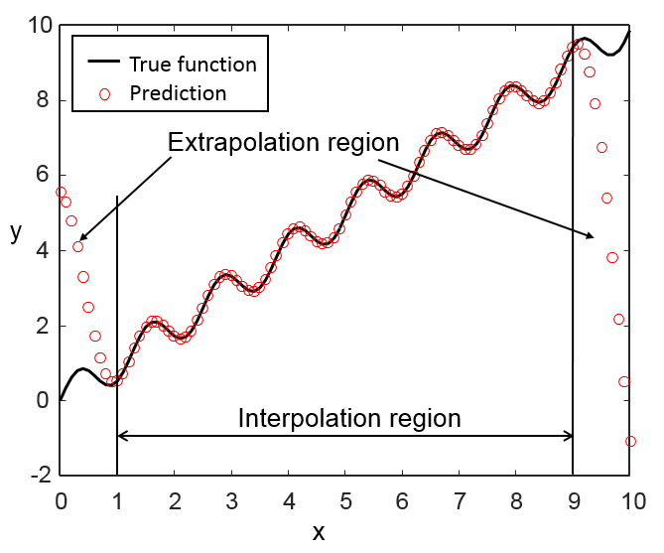

Interpolation vs. Extrapolation in Surrogate
Approximate $y\left(x\right)=x+0.5sin⁡(5x)$ using 21 equally-spaced samples in the range of [1, 9]
Fit the 21 samples using newrb (Matlab) radial-basis neural network in the range of [0, 10]
Surrogate fits are extremely accurate in [1, 9], but miserably failed in [0, 1] and [9, 10]
x=linspace(1,9,21); y=x+0.5*sin(5*x);
net=newrb(x,y);
xf=linspace(0,10,101); yf=xf+0.5*sin(5*xf);
ysim=sim(net,xf);
plot(xf,yf); hold on; plot(xf,ysim,'ro')

Slide 12
Surrogate for Extrapolation
it is important to evaluate surrogates for the perspective of extrapolation in prognostics
RBNN may not be a good surrogate as it does not carry the trend of degradation
Polynomial response surface may follow the trend relatively well, but it tends to change the curvature quickly in the extrapolation region
Gaussian process (GP) regression surrogate model turns out to be most robust in terms of extrapolation
In the surrogate community, GP is often called Kriging surrogate

Slide 13
Introduction to Kriging
Method invented in the 1950s by South African geologist Daniel G. Krige (1919-2013) for predicting distribution of minerals.
Formalized by French engineer, Georges Matheron in 1960.
Statisticians refer to a more general Gaussian Process regression.
Became very popular for fitting surrogates to expensive computer simulations in the 21st century.
It is one of the best surrogates available.
It probably became popular late mostly because of the high computer cost of fitting it to data.
Notes:
Kriging was invented in the 1950s by Daniel Krige (Professor at University of the Witwatersrand, Republic of South Africa), a South African geologist , for the purpose of predicting the distribution of minerals on the basis of samples. It became very popular for fitting surrogates to expensive computer simulations only about 40-50 years later. This is at least partly because it is an expensive surrogate in terms of computation, and it had to wait until computers became fast enough.
My experience is that of all currently popular surrogates, it has the highest chance of being the most accurate for a given problem. However, from my experience that chance is still less than 50%.
Krige, D. G. (1951). "A statistical approach to some basic mine valuation problems on the Witwatersrand". J. of the Chem., Metal. and Mining Soc. of South Africa 52 (6): 119–139.
Matheron, G., "Principles of geostatistics", Economic Geology, 58, pp 1246–1266, 1963

Slide 14
Kriging philosophy
We assume that the data is sampled from an unknown function that obeys simple correlation rules.
The value of the function at a point is correlated to the values at neighboring points based on their separation in different directions.
The correlation is strong to nearby points and weak with far away points, but strength does not change based on location, only separation between points.
Normally Kriging is used for noise free data so that it interpolates exactly the function values.
Notes:
For linear regression we normally assume that we know the functional shape (e.g. a polynomial) and the data is to be used to find the coefficients that will minimize the root mean square errors at the data points. Kriging takes a very different approach. It assumes that we don’t know much about the function, except for the form of correlation between the value of the function at nearby points. In particular, the correlation depends only on the separation between points and decays as they are further apart.
Kriging is a smooth predictor. If two points are close, then their Kriging estimates are close.
Kriging is usually used as an interpolator, so that if fits exactly the data, and we could not use the rms error as a way to find its parameters. That is, we assume that there is no noise in the data. There is a version of kriging with noise (often called kriging with a nugget).
Because of the correlation decay, kriging is a local surrogate with shape functions that are similar to those used for radial basis surrogates, except that the decay can be different in different directions.

Slide 15
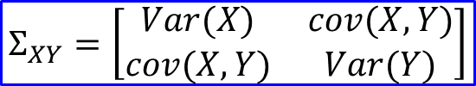
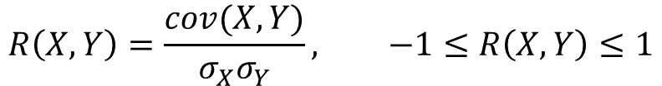
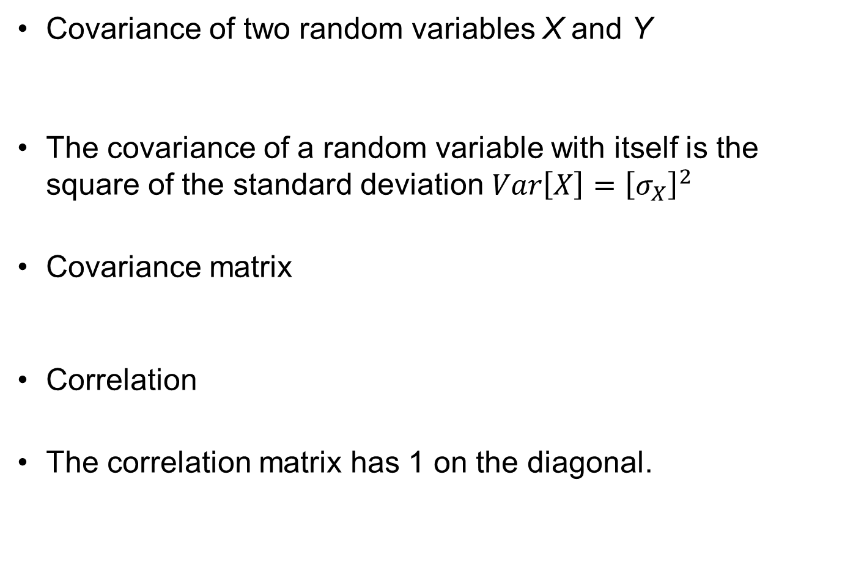
Reminder: Covariance and Correlation
Covariance of two random variables X and Y
The covariance of a random variable with itself is the square of the standard deviation $Var\left[X\right]={\left[σ_{X}\right]}^{2}$
Covariance matrix
Correlation
The correlation matrix has 1 on the diagonal.
$$cov\left(X,Y\right)=E\left[\left(X−μ_{x}\right)\left(Y−μ_{Y}\right)\right]=E\left[XY\right]−μ_{x}μ_{Y}$$
$$Σ_{XY}=\left[\begin{matrix}Var(X) & cov(X,Y) \\ cov(X,Y) & Var(Y)\end{matrix}\right]$$
$$R\left(X,Y\right)=\frac{cov(X,Y)}{σ_{X}σ_{Y}}, −1≤R\left(X,Y\right)≤1$$
Notes:
This is a reminder of the basic statistical quantities of covariance of pair of random variables and the important concept of correlation. Remember that the variance of a random variable, is the first moment around its mean, or the square of the standard deviation. The covariance of a pair of random variables is the mixed moment of the two variables.
Correlation measures their propensity to move together. So a correlation of 1 means that they increase and decrease in perfect synchrony. The most common case is when X=cY, where c is a positive constant.
Similarly a correlation of -1 also means perfect synchrony, but in the opposite direction, and X=cY, with c a negative constant is a common case. Finally, a correlation of 0 means that they are not related. The common case is when the random variables are independent, but not all uncorrelated variables are independent. Zero correlation relates to the first moment, but there may be dependence through higher order effects.
The correlation matrix is the matrix of correlation of the components of a vector. It has 1 on the diagonal, because each variable is perfectly correlated with itself.

Slide 16
Correlation between functions at near and far points
Generate 10 random samples, translate them by a bit (0.1), and by more (1.0)
x=10*rand(1,10);
xnear=x+0.1; xfar=x+1;
ynear=sin(xnear);
y=sin(x);
yfar=sin(xfar);
Compare corelations:
r=corrcoef(y,ynear) 0.9894; High correlation
rfar=corrcoef(y,yfar) 0.4229; Low correlation
Decay to about 0.4 over one sixth of the wavelength.
Wavelength on sine function is 2$π$~6
Notes:
The fitting process in kriging needs to estimate how fast the correlation between function values decays with distance. This depends on the wavelength of the function, with short wavelength corresponding to fast decay. In the example here, we check how fast the correlation decays for sin(x) that has a wave length of 2π.
To illustrate the values of correlations that are expected between function values, we generate random numbers between 0 and 10 and evaluate the sine function at these points. We also translate the points by a small amount compared to the wavelength (0.1) and a larger amount (1.0) and calculate the correlation coefficients between the function values in the original and translated sets.
The correlation coefficient is about 0.99 with the nearby points and 0.42 with the set further away. This reflects the change in function values, as illustrated by the pair of points marked in red.
In kriging, finding the rate of correlation decay is part of the fitting process. This example shows us that with a wavy function we can expect the correlation to decay to about 0.4 over one sixth of the wavelength.

Slide 17
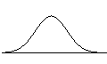



Universal Kriging approximation
Kriging is similar to PRS, but starting from statistical view
Ex) Linear global function
$ξ\left(x\right)=\left\{1,x\right\}, θ={\left\{a_{0},a_{1}\right\}}^{T}$
Measurement data
Predictions are exact at data points
Local departure
(random process)
$$z\left(x\right) = ξ\left(x\right)θ + s(x)$$
Trend function
Global function
(low-order polynomials)
z, y
Sampling data points
Trend Model
$$y_{k}=z\left(x_{k}\right) = ξ\left(x_{k}\right)θ + s(x_{k})$$
Systematic Departure
Mean of Kriging prediction
x

Slide 18


Universal Kriging Approximation cont.
Local departure
The difference between the prediction and global trend function
Kriging assumes that $s(x)$ follows a Gaussian process
$σ$: standard deviation of data w.r.t. the global function
$$s(x)\sim N(0,σ^{2})$$

Slide 19

Ordinary and simple Kriging
Ordinary Kriging: constant trend function
Simple Kriging: constant trend function is known (often 0)
Assumption: Systematic departures $s(x)$ are correlated.
Kriging prediction comes with a normal distribution of the uncertainty in the prediction
At the sample points, the uncertainty is zero
Notes:
The most general version of kriging is called universal kriging, and it includes a linear trend function and the deviation $\left.Z(x\right)$which includes the local contributions and is governed by the correlation function.
$$\hat{y}(x)=\sum_{i=1}^{N_{v}}{\left.β_{i}ξ_{i}(x\right)}+Z(x)$$
The trend function is composed of known shape functions $ξ_{i}\left(x\right)$ and coefficients $β_{i}$ to be determined. The shape functions are typically monomials, so that popular trend functions are linear and quadratic polynomials.
Here we will limit the description to a constant trend, a version of kriging known as ordinary kriging, with the constant estimated from the data. Another version of kriging, known as simple kriging is when the constant is assumed to be known.
As in linear regression, the kriging fit, shown in red in the figure, is only the mean of a normal distribution, and the distribution can be used to provide estimates of uncertainty in the kriging predictions, as well as guide the placements of further sampling points so as to reduce the uncertainty in the kriging prediction.
Caution: Note that the figure is misleading in that the uncertainty at the points where the data is given is zero when there is no noise. The uncertainty is larger in between data points.

Slide 20
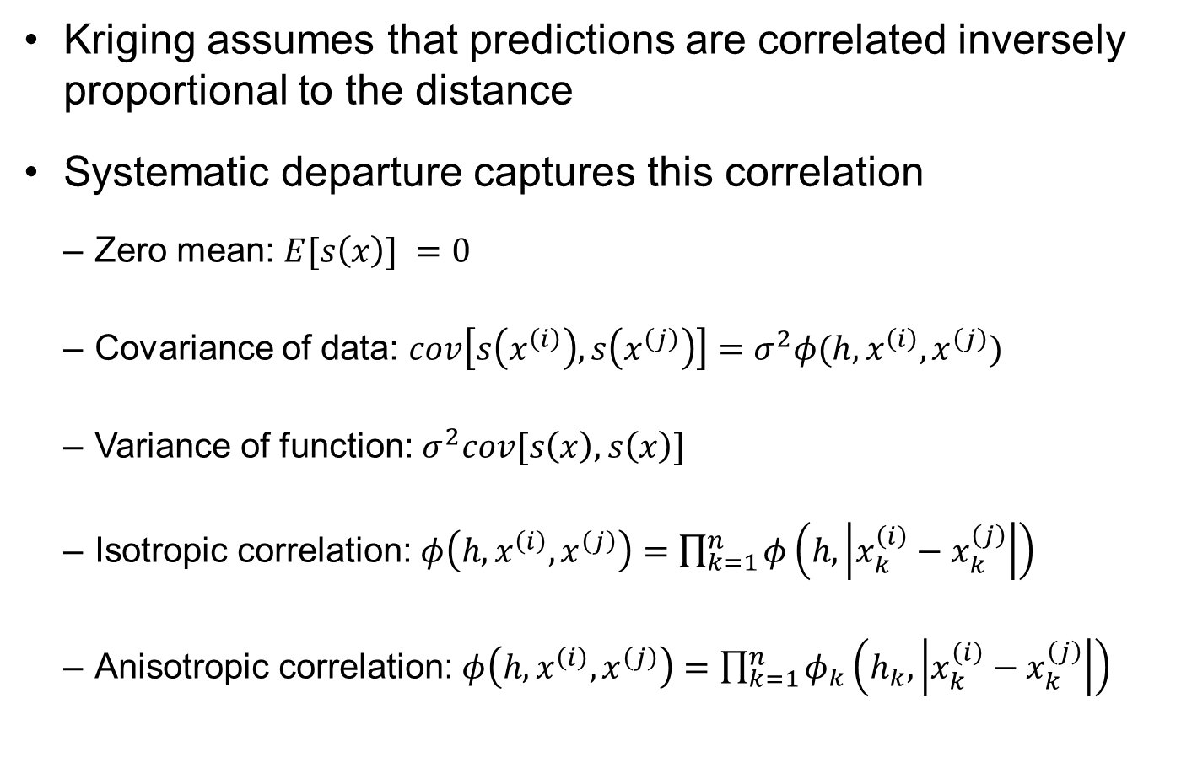
Correlation model
Kriging assumes that predictions are correlated inversely proportional to the distance
Systematic departure captures this correlation
Zero mean: $E[s\left(x\right)] =0$
Covariance of data: $cov\left[s\left(x^{\left(i\right)}\right),s\left(x^{\left(j\right)}\right)\right]=σ^{2}φ(h,x^{\left(i\right)},x^{\left(j\right)})$
Variance of function: $σ^{2}cov[s\left(x\right),s\left(x\right)]$
Isotropic correlation: $φ\left(h,x^{\left(i\right)},x^{\left(j\right)}\right)=\prod_{k=1}^{n}{φ\left(h,\left|x_{k}^{\left(i\right)}−x_{k}^{\left(j\right)}\right|\right)}$
Anisotropic correlation: $φ\left(h,x^{\left(i\right)},x^{\left(j\right)}\right)=\prod_{k=1}^{n}{φ_{k}\left(h_{k},\left|x_{k}^{\left(i\right)}−x_{k}^{\left(j\right)}\right|\right)}$

Slide 21
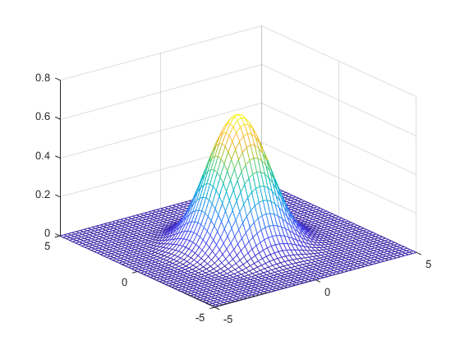
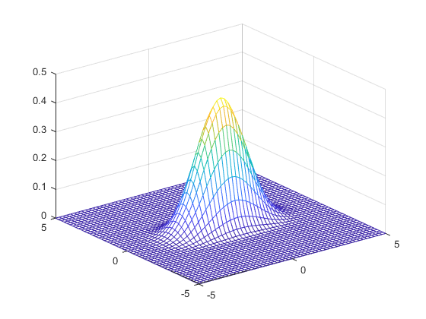
Isotropic vs. anisotropic correlation functions
(a) Isotropic correlation
(b) Anisotropic correlation

Slide 22
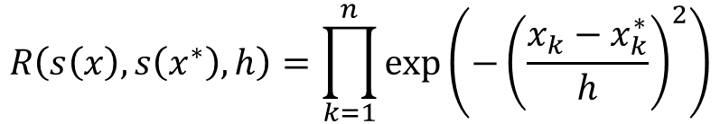
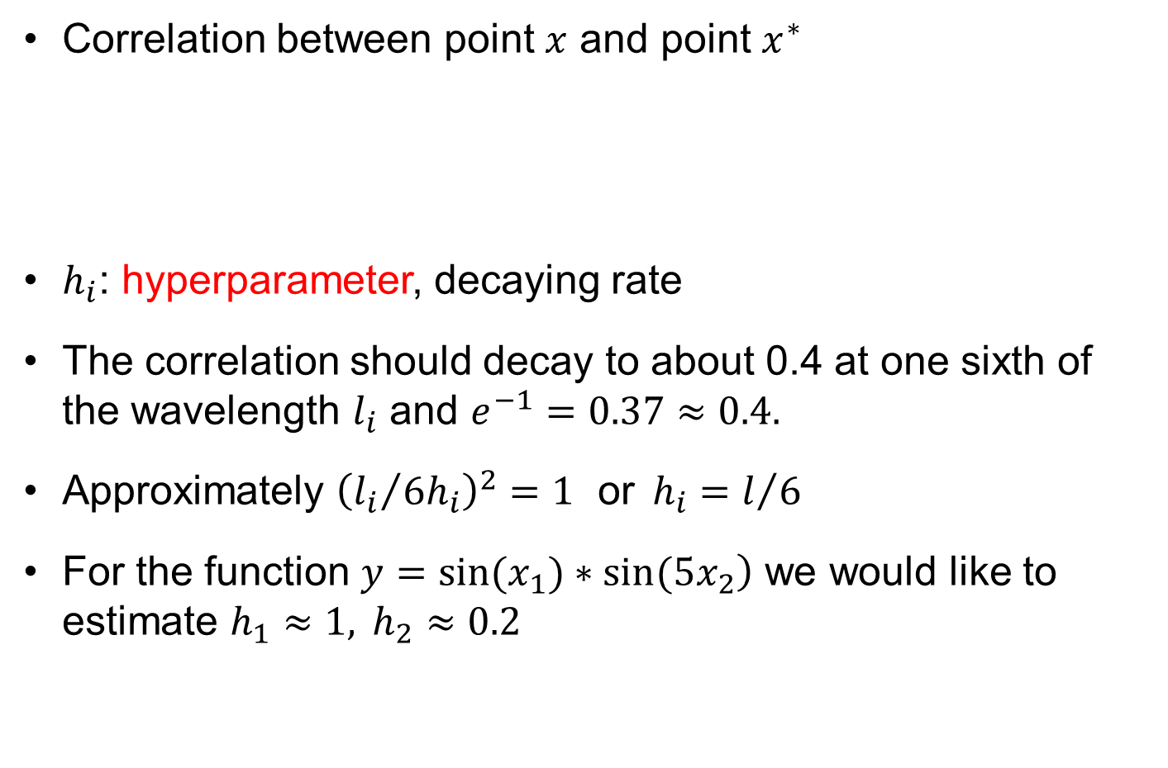
Gaussian correlation function
Correlation between point $x$ and point $x^{∗}$
$h_{i}$: hyperparameter, decaying rate
The correlation should decay to about 0.4 at one sixth of the wavelength $l_{i}$ and $e^{−1}=0.37≈0.4.$
Approximately ${\left({l_{i}}/{6h_{i}}\right)}^{2}=1 \text{or}{ h}_{i}=l/6$
For the function $\left.y=sin(x_{1})∗sin(5x_{2}\right)$ we would like to estimate $h_{1}≈1, h_{2}≈0.2$
$$R\left(s\left(x\right),s\left(x^{∗}\right),h\right)=\prod_{k=1}^{n}{\exp\left(−{\left(\frac{x_{k}−x_{k}^{∗}}{h}\right)}^{2}\right)}$$
Notes:
The most popular correlation decay function for kriging is Gaussian. Given two points x (with components $x_{i}$) and s we assume that the correlation of the unknown function Z at these two points is given as
$$C\left(Z(x),Z(s),θ\right)=\prod_{i=1}^{N_{v}}{exp\left(−θ_{i}{\left(x_{i}−s_{i}\right)}^{2}\right)}$$
Where the larger $θ_{i}$ is, the faster the decay of the correlation with distance. For $θ_{i}$=1, the decay in the ith direction is 1/e=0.37, which approximately corresponds to what we found for one sixth of the wavelength for the function sin(x). So if the wavelength in the ith direction is $l_{i}$, we should have approximately
$$θ_{i}{\left({l_{i}}/6\right)}^{2}=1 \text{or}{ θ}_{i}={36}/{l_{i}^{2}}$$
So for the function $\left.y=sin(x_{1})∗sin(5x_{2}\right)$ we have $l_{1}=2π≈6, l_{2}≈1.2$ ~(6/5) so we should use $θ_{1}≈1, θ_{2}≈25$.
The gaussian correlation function can also be generally referred to as gaussian kernel or basis functions.

Slide 23
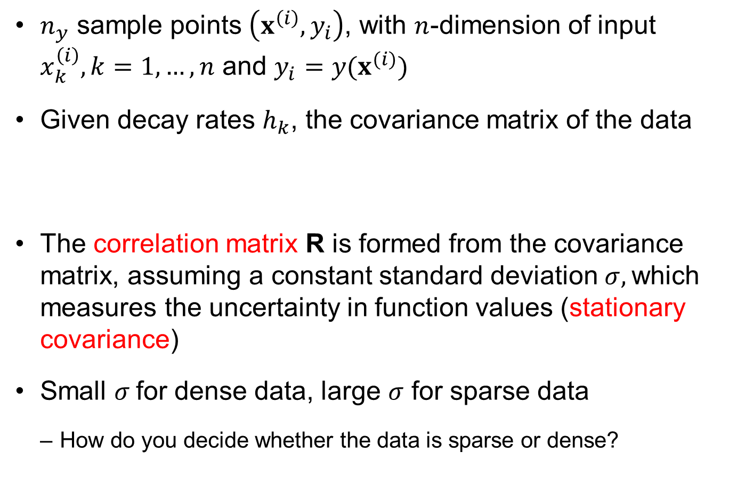
Notation
$n_{y}$ sample points $\left(x^{\left(i\right)},y_{i}\right)$, with $n$-dimension of input $x_{k}^{\left(i\right)}, k=1,…,n$ and $y_{i}=y(x^{(i)})$
Given decay rates $h_{k}$, the covariance matrix of the data
The correlation matrix R is formed from the covariance matrix, assuming a constant standard deviation $σ,$which measures the uncertainty in function values (stationary covariance)
Small $σ$for dense data, large $σ$ for sparse data
How do you decide whether the data is sparse or dense?
$cov\left(y_{i},y_{j}\right)=σ^{2}$ $\exp\left(−\sum_{k=1}^{n}{h{\left(x_{k}−x_{k}^{∗}\right)}^{2}}\right)=σ^{2}R_{ij}, i,j=1,⋯n_{y}$
Notes:
We use subscripts to denote components of a vector, and superscript to identify data points. We are in n dimensional space, and we have $n_{y}$ data points.
In the process of fitting the data, we will also need to estimate the decay rates $θ_{k}$ and the standard deviation $σ$. The standard deviation will be small when the data is dense. Dense means that we have more than enough points to describe the waviness of the function. That means that the distance from one point to the nearest one should be an order of magnitude less than the wavelength of the function.

Slide 24
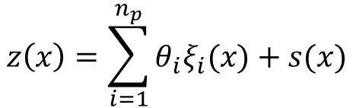
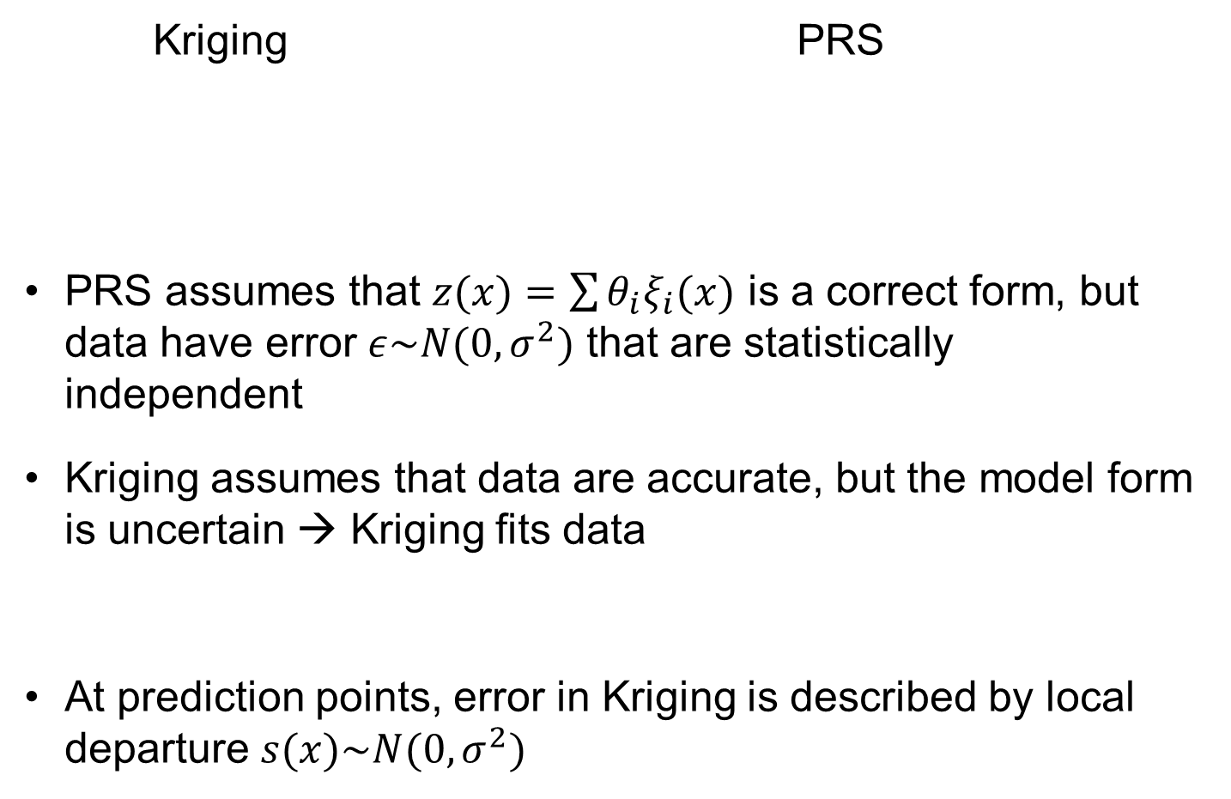
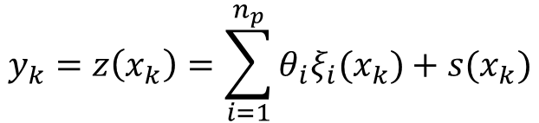
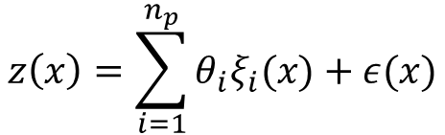
Kriging vs. PRS
Kriging PRS
PRS assumes that $z(x)=\sum{θ_{i}ξ_{i}(x)}$ is a correct form, but data have error $ε\sim N(0,σ^{2})$ that are statistically independent
Kriging assumes that data are accurate, but the model form is uncertain → Kriging fits data
At prediction points, error in Kriging is described by local departure $s(x)\sim N(0,σ^{2})$
$$z\left(x\right)=\sum_{i=1}^{n_{p}}{θ_{i}ξ_{i}(x)}+s(x)$$
$$z\left(x\right)=\sum_{i=1}^{n_{p}}{θ_{i}ξ_{i}(x)}+ε(x)$$
$$y_{k}=z\left(x_{k}\right)=\sum_{i=1}^{n_{p}}{θ_{i}ξ_{i}(x_{k})}+s(x_{k})$$

Slide 25
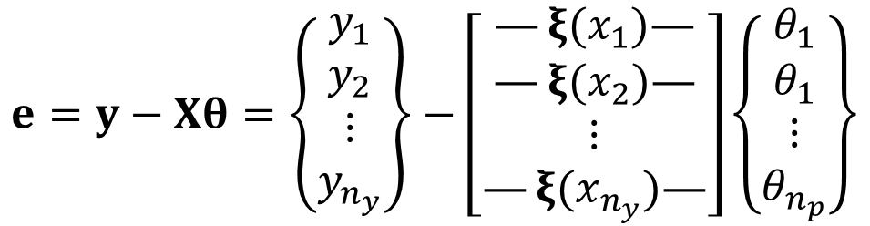

GP Simulation
GP simulation function is derived using measured data
Need to determine global function parameters, $θ$, and the variance of data w.r.t. global function, $σ^{2}$ using MLE
Local departure is calculated by minimizing the unbiased mean-squares-error
Error b/w data and global function
$$e=y−Xθ=\left\{\begin{matrix}\begin{matrix}y_{1} \\ y_{2}\end{matrix} \\ \begin{matrix}⋮ \\ y_{n_{y}}\end{matrix}\end{matrix}\right\}−\left[\begin{matrix}\begin{matrix}—ξ(x_{1})— \\ —ξ(x_{2})—\end{matrix} \\ \begin{matrix}⋮ \\ —ξ(x_{n_{y}})—\end{matrix}\end{matrix}\right]\left\{\begin{matrix}\begin{matrix}θ_{1} \\ θ_{1}\end{matrix} \\ \begin{matrix}⋮ \\ θ_{n_{p}}\end{matrix}\end{matrix}\right\}$$

Slide 26
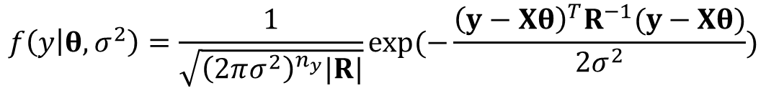
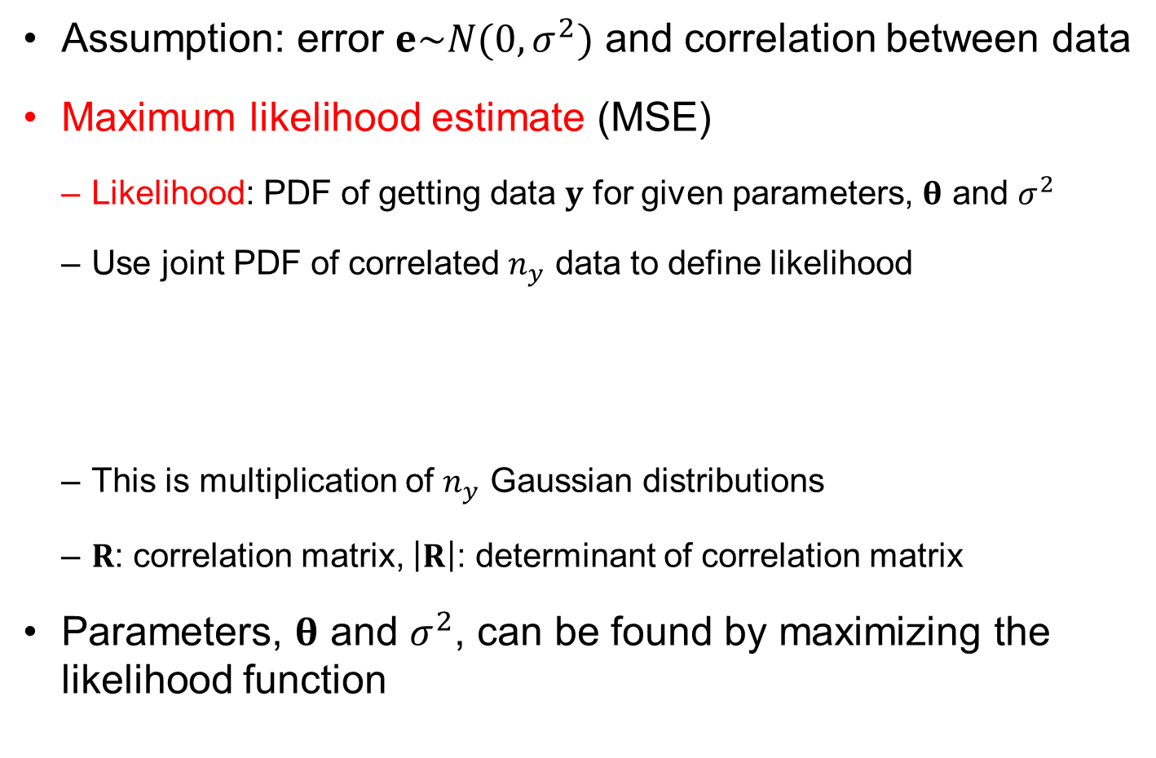
Determining the global function
Assumption: error $e\sim N(0,σ^{2})$ and correlation between data
Maximum likelihood estimate (MSE)
Likelihood: PDF of getting data $y$ for given parameters, $θ$ and $σ^{2}$
Use joint PDF of correlated $n_{y}$ data to define likelihood
This is multiplication of $n_{y}$ Gaussian distributions
$R$: correlation matrix, $\left|R\right|$: determinant of correlation matrix
Parameters, $θ$ and $σ^{2}$, can be found by maximizing the likelihood function
$$f\left(y | θ,σ^{2}\right)=\frac{1}{\sqrt{{\left(2πσ^{2}\right)}^{n_{y}}|R|}}\exp{(−\frac{{\left(y−Xθ\right)}^{T}R^{−1}(y−Xθ)}{2σ^{2}})}$$

Slide 27
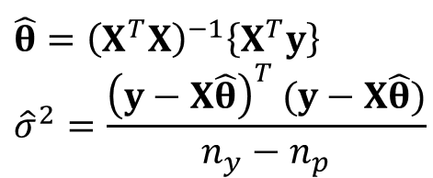

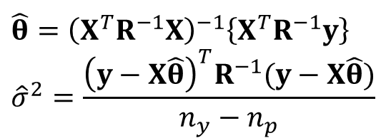
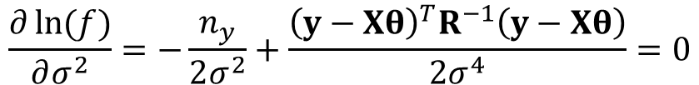
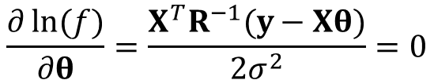
Maximum likelihood estimate (MLE)
Logarithmic likelihood (ignore $θ$ for now)
Stationary condition
Solve for $θ$ and $σ^{2}$
$$\ln{[f\left(y | θ,σ^{2}\right)]}=−\frac{n_{y}}{2}\ln\left(2πσ^{2}\right)−\frac{1}{2}\ln\left|R\right|−\frac{{\left(y−Xθ\right)}^{T}R^{−1}(y−Xθ)}{2σ^{2}}$$
$$\frac{∂\ln{(f)}}{∂θ}=\frac{X^{T}R^{−1}(y−Xθ)}{2σ^{2}}=0$$
$$\frac{∂\ln{(f)}}{∂σ^{2}}=−\frac{n_{y}}{2σ^{2}}+\frac{{\left(y−Xθ\right)}^{T}R^{−1}\left(y−Xθ\right)}{2σ^{4}}=0$$
PRS linear regression
$$\hat{θ}={\left(X^{T}R^{−1}X\right)}^{−1}\left\{X^{T}R^{−1}y\right\} \\ {\hat{σ}}^{2}=\frac{{\left(y−X\hat{θ}\right)}^{T}R^{−1}(y−X\hat{θ})}{n_{y}−n_{p}}$$
$$\hat{θ}={\left(X^{T}X\right)}^{−1}\left\{X^{T}y\right\} \\ {\hat{σ}}^{2}=\frac{{\left(y−X\hat{θ}\right)}^{T} (y−X\hat{θ})}{n_{y}−n_{p}}$$
For unbiased estimate

Slide 28
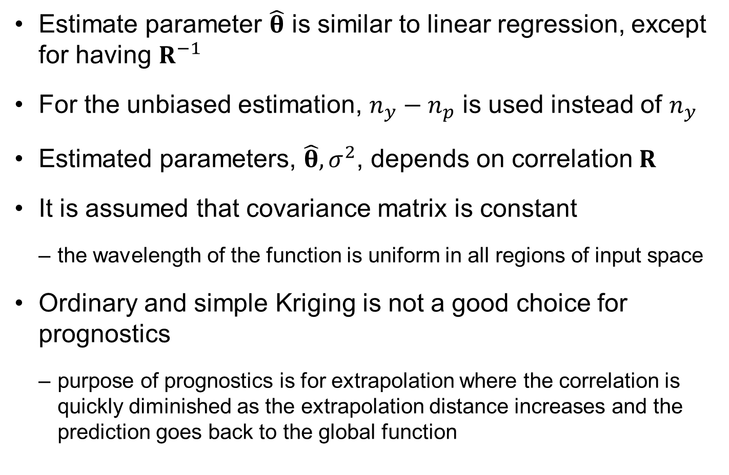
Maximum likelihood estimate (MLE)
Estimate parameter $\hat{θ}$ is similar to linear regression, except for having $R^{−1}$
For the unbiased estimation, $n_{y}−n_{p}$ is used instead of $n_{y}$
Estimated parameters, $\hat{θ}, σ^{2}$, depends on correlation $R$
It is assumed that covariance matrix is constant
the wavelength of the function is uniform in all regions of input space
Ordinary and simple Kriging is not a good choice for prognostics
purpose of prognostics is for extrapolation where the correlation is quickly diminished as the extrapolation distance increases and the prediction goes back to the global function

Slide 29

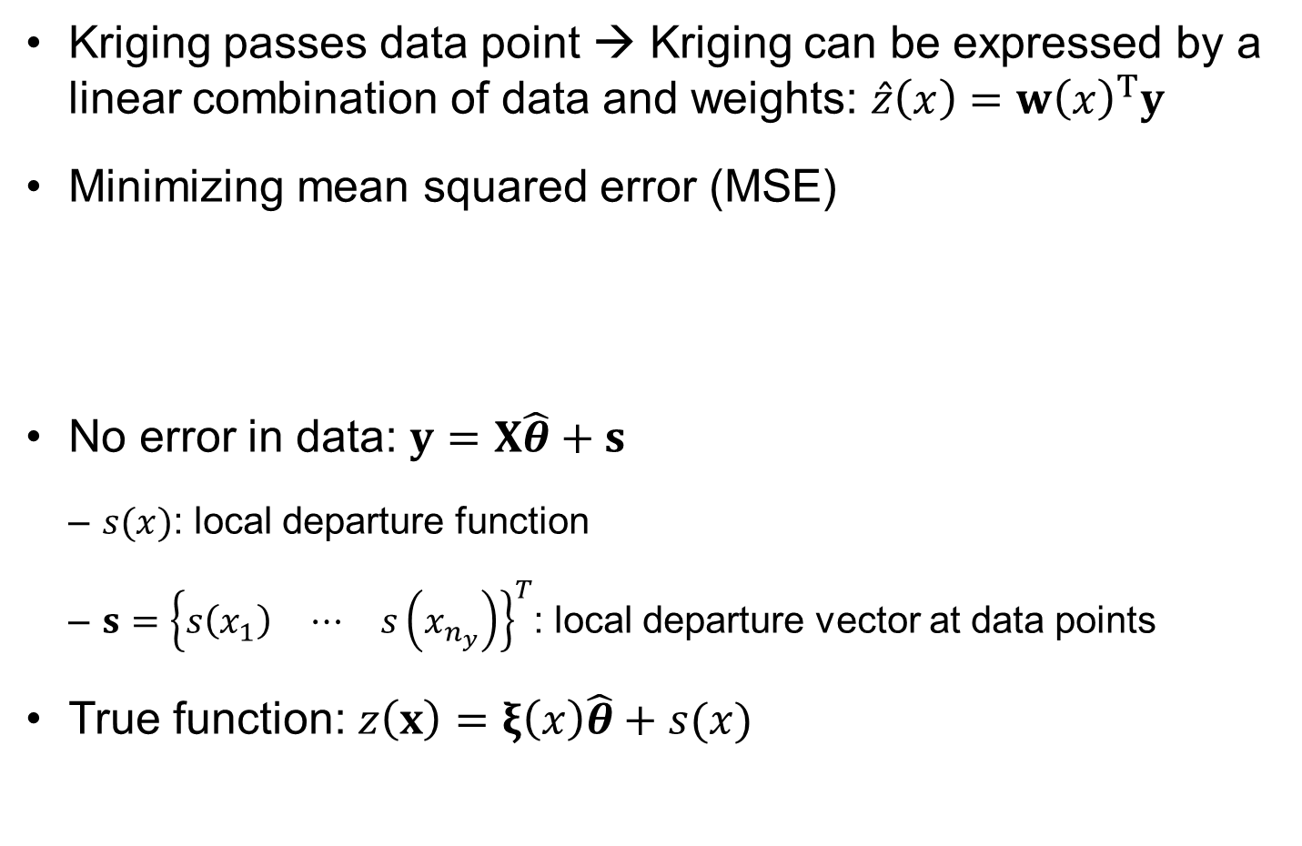
Local departure
Kriging passes data point → Kriging can be expressed by a linear combination of data and weights: $\hat{z}\left(x\right)=w{\left(x\right)}^{T}y$
Minimizing mean squared error (MSE)
No error in data: $y=X\hat{θ}+s$
$s(x)$: local departure function
$s={\left\{\begin{matrix}s\left(x_{1}\right) & ⋯ & s\left(x_{n_{y}}\right)\end{matrix}\right\}}^{T}$: local departure vector at data points
True function: $z\left(x\right)=ξ\left(x\right)\hat{θ}+s(x)$
$$ε\left(x\right)=\hat{z}\left(x\right)−z\left(x\right)=w{\left(x\right)}^{T}y−z(x)$$
Weight function

Slide 30
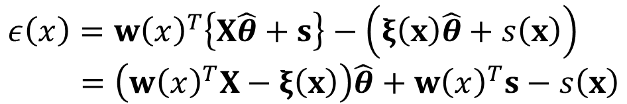

Error term
Goal: to determine the weight function that minimizes the error
Even if the GP simulation is shown in the form of $w{\left(x\right)}^{T}y$, this form will be expressed in terms of the global function and local departure
Error:
$$ε\left(x\right)=w{\left(x\right)}^{T}\left\{X\hat{θ}+s\right\}−\left(ξ\left(x\right)\hat{θ}+s\left(x\right)\right) \\ =\left(w{\left(x\right)}^{T}X−ξ\left(x\right)\right)\hat{θ}+w{\left(x\right)}^{T}s−s\left(x\right)$$
Global error
Departure error

Slide 31

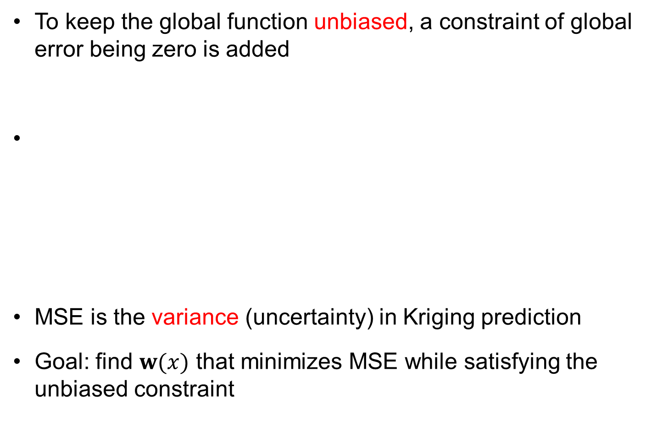
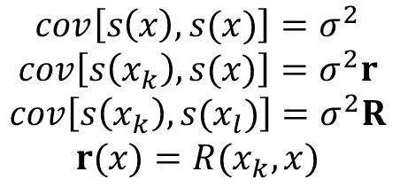
Minimize MSE
To keep the global function unbiased, a constraint of global error being zero is added
MSE is the variance (uncertainty) in Kriging prediction
Goal: find $w(x)$ that minimizes MSE while satisfying the unbiased constraint
$$w{\left(x\right)}^{T}X−ξ\left(x\right)=0$$
$$MSE=E\left[ε{\left(x\right)}^{2}\right]=E\left[{\left(w^{T}s−s\right)}^{2}\right]=E\left[w^{T}ss^{T}w−2w^{T}ss+s^{2}\right]$$
$$MSE=σ^{2}\left(w^{T}Rw−2w^{T}r+1\right)$$
$$cov\left[s\left(x\right),s(x)\right]=σ^{2}$$
$$cov\left[s\left(x_{k}\right),s(x)\right]=σ^{2}r$$
$$cov\left[s\left(x_{k}\right),s(x_{l})\right]=σ^{2}R$$
$$r(x)=R(x_{k},x)$$

Slide 32
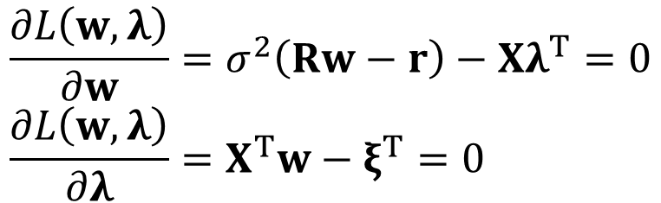

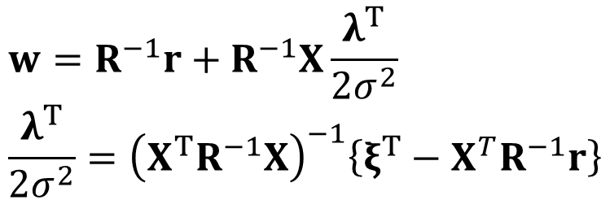
Lagrange function for constrained optimization
Lagrange function (min. MSE with constraint)
Stationary conditions (KKT)
$$L\left(w,λ\right)=σ^{2}\left(w^{T}Rw−2w^{T}r+1\right)−λ\left(X^{T}w−ξ^{T}\right)$$
Lagrange multiplier
$$\frac{∂L\left(w,λ\right)}{∂w}=σ^{2}\left(Rw−r\right)−Xλ^{T}=0 \\ \frac{∂L\left(w,λ\right)}{∂λ}=X^{T}w−ξ^{T}=0$$
$$w=R^{−1}r+R^{−1}X\frac{λ^{T}}{2σ^{2}} \\ \frac{λ^{T}}{2σ^{2}}={\left(X^{T}R^{−1}X\right)}^{−1}\left\{ξ^{T}−X^{T}R^{−1}r\right\}$$
$$\hat{z}\left(x\right)=w{\left(x\right)}^{T}y$$

Slide 33
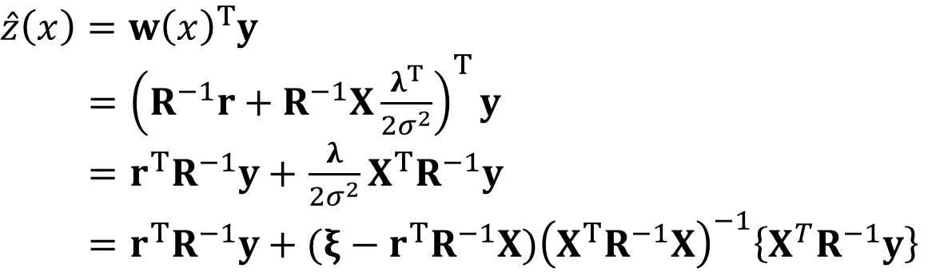


Kriging prediction
Kriging as linear combination of data and weight functions
Local departure term is the weighted sum of the trend function error $\left(y−X\hat{θ}\right)$ based on the correlation term $r{\left(x\right)}^{T}R^{−1}$
$$\hat{z}\left(x\right)=w{\left(x\right)}^{T}y$$
$={\left(R^{−1}r+R^{−1}X\frac{λ^{T}}{2σ^{2}}\right)}^{T}y$
$=r^{T}R^{−1}y+$ $\frac{λ}{2σ^{2}}X^{T}R^{−1}y$
$=r^{T}R^{−1}y+(ξ−r^{T}R^{−1}X){\left(X^{T}R^{−1}X\right)}^{−1}\left\{X^{T}R^{−1}y\right\}$
$$\hat{θ}$$
$$\hat{z}\left(x\right)=ξ\left(x\right)\hat{θ}+{r\left(x\right)}^{T}R^{−1}(y−X\hat{θ})$$
Global function
Local departure

Slide 34
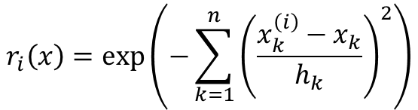
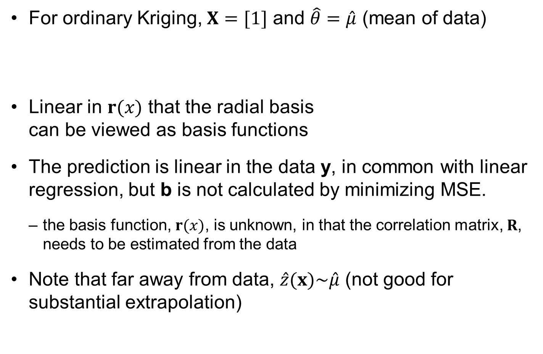
Simplification for ordinary Kriging
For ordinary Kriging, $X=[1]$ and $\hat{θ}=\hat{μ}$ (mean of data)
Linear in $r(x)$ that the radial basis can be viewed as basis functions
The prediction is linear in the data y, in common with linear regression, but b is not calculated by minimizing MSE.
the basis function, $r(x)$, is unknown, in that the correlation matrix, $R$, needs to be estimated from the data
Note that far away from data, $\hat{z}(x)\sim \hat{μ}$ (not good for substantial extrapolation)
$$\hat{z}\left(x\right)=\hat{μ}+{r\left(x\right)}^{T}R^{−1}\left(y−1\hat{μ}\right)=\hat{μ}+b^{T}r(x)$$
$$r_{i}\left(x\right)=\exp\left(−\sum_{k=1}^{n}{{\left(\frac{x_{k}^{\left(i\right)}−x_{k}}{h_{k}}\right)}^{2}}\right)$$
Notes:
The form of the surrogate for ordinary kriging is
$$\hat{y}(x)=\hat{μ}+r^{T}R^{−1}y=\hat{μ}+b^{T}r$$
Where $\hat{μ}$ is the constant, the estimated mean value. The vector b of coefficient is ${b=R}^{−1}y$, and the shape functions that it multiplies are the exponentials
$$r_{i}=exp\left(−\sum_{k=1}^{n}{θ_{k}{\left(x_{k}^{\left(i\right)}−x_{k}^{}\right)}^{2}}\right)$$
So kriging is similar to linear regression, which is a linear combination of unknown coefficients time known shape function. However, there are two important differences. First the shape functions are not known, in that the decay rates $θ_{k}$ will be estimated from the data (in the next slide). Second, the coefficients are not found by minimizing the rms error at the data points (which is zero, because the data is exactly interpolated).
Note that since the exponentials decay away from the data points, when we are far from all data points the prediction will be close to $\hat{μ}$ . So ordinary kriging is not good for substantial extrapolation. If we expect to need to extrapolate far from data points, we should use universal kriging with a trend.

Slide 35
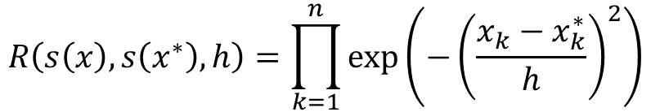
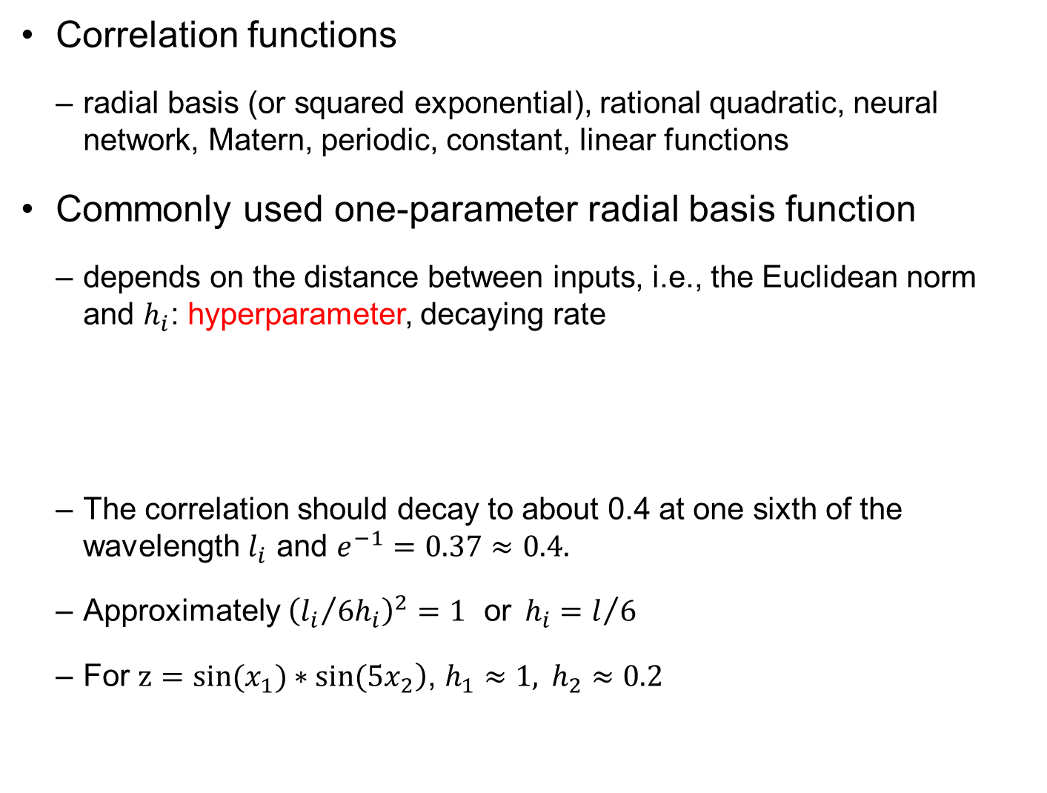
Correlation Function and Hyperparameters
Correlation functions
radial basis (or squared exponential), rational quadratic, neural network, Matern, periodic, constant, linear functions
Commonly used one-parameter radial basis function
depends on the distance between inputs, i.e., the Euclidean norm and $h_{i}$: hyperparameter, decaying rate
The correlation should decay to about 0.4 at one sixth of the wavelength $l_{i}$ and $e^{−1}=0.37≈0.4.$
Approximately ${\left({l_{i}}/{6h_{i}}\right)}^{2}=1 \text{or}{ h}_{i}=l/6$
For $\left.z=sin(x_{1})∗sin(5x_{2}\right)$, $h_{1}≈1, h_{2}≈0.2$
$$R\left(s\left(x\right),s\left(x^{∗}\right),h\right)=\prod_{k=1}^{n}{\exp\left(−{\left(\frac{x_{k}−x_{k}^{∗}}{h}\right)}^{2}\right)}$$

Slide 36

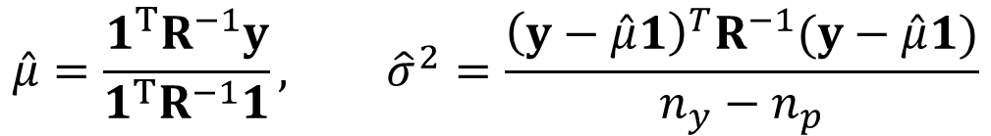

Estimating hyperparameters $h$
Estimating $\hat{θ}$ and $\hat{σ}$ depends on hyperparameter $h$ in R
Maximizing the log-likelihood that the data comes from a Gaussian process defined by $h_{k}$.
Once $h$ is found, the estimate of the mean and standard deviation is obtained as (ordinary Kriging)
$$\ln{[f\left(y | h,θ,σ^{2}\right)]}=−\frac{n_{y}}{2}\ln\left(2πσ^{2}\right)−\frac{1}{2}\ln\left|R\right|−\frac{{\left(y−Xθ\right)}^{T}R^{−1}(y−Xθ)}{2σ^{2}}$$
$$h=\arg{\max\left[\ln{[f\left(y | h,θ,σ^{2}\right)]}=−\frac{n_{y}}{2}\ln\left(σ^{2}\right)−\frac{1}{2}\ln\left|R\right|\right]}$$
$R^{−1}$ will be canceled with $$σ^{2}$$
$$h=\arg{\min\left[\ln\left(σ^{2(n_{y}−n_{p})}×\left|R\right|\right)\right]}$$
Equivalent
$$\hat{μ}=\frac{1^{T}R^{−1}y}{1^{T}R^{−1}1}, {\hat{σ}}^{2}=\frac{{\left(y−\hat{μ}1\right)}^{T}R^{−1}(y−\hat{μ}1)}{n_{y}−n_{p}}$$

Slide 37
Difficulty in MLE
Maximum likelihood is a tough optimization problem
the likelihood often varies slowly in a wide range of argument
Some Kriging codes minimize the cross-validation error instead
Cross-validation estimation
leaves out one of the points, fits the rest with the parameters, and calculates the error at the left-out point
repeated for every point to produce a total error measure
the set of parameters that yields the lowest cross-validation error is chosen
Optimization for parameters is often ill-conditioned
lead to either a poor fit or poor estimate of the prediction variance

Slide 38
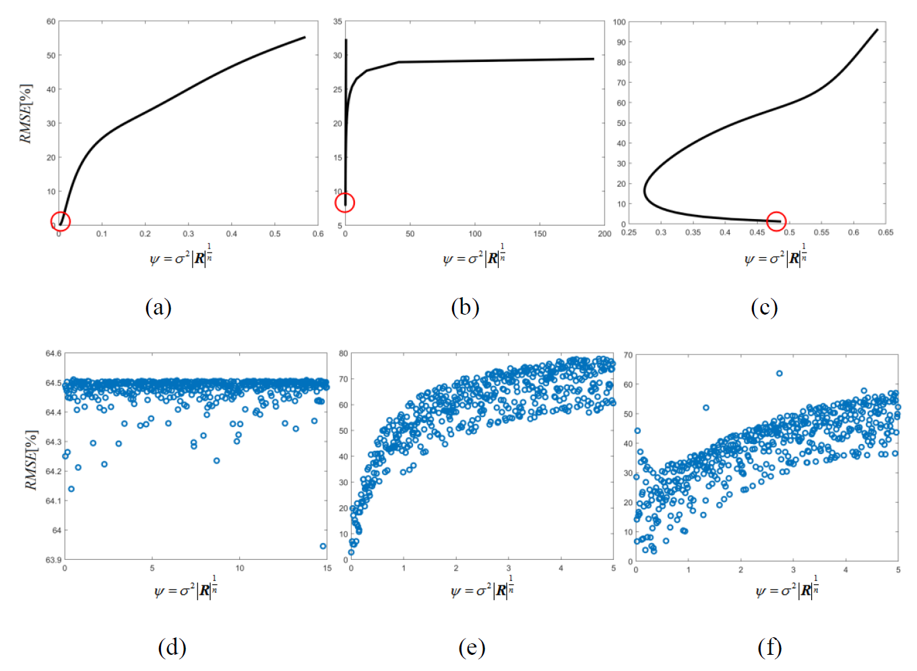
Comparison b/w RMSE and MLE
Discontinuous
MLE$≠$min RMSE
Good
More than 2 hyperparameters

Slide 39
Kriging fitting issues
MLE or cross-validation optimization problem solved to obtain the kriging fit is often ill-conditioned leading to poor fit, or poor estimate of the prediction variance.
Poor estimate of the prediction variance can be checked by comparing it to the cross validation error.
Poor fits are often characterized by the kriging surrogate having large curvature near data points.
It is recommended to visualize by plotting the kriging fit and its standard error.

Slide 40
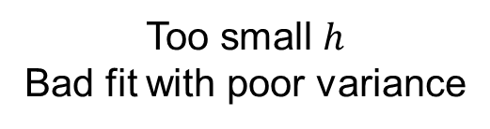
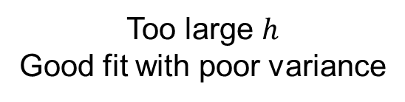
Ex) Quadratic function fit
Use 9 data and a constant global function $ξ\left(x\right)=0$ to fit a quadratic function $y\left(x\right)=x^{2}+5x−10$
Covariance $cov\left(x_{i},x_{j}\right)=exp⁡(−θ{(x_{i}−x_{j})}^{2})$
Too large $h$
Good fit with poor variance
Too small $h$
Bad fit with poor variance
Notes:
The example of fiting a quadratic function was used with several kriging packages, using the points shown in the figure or also additional points outside the range. The two cases shown on the next slide are extreme cases for this simple function, but they show the kind of behavior that is occasionally encountered and can be detected by plotting the kriging fit and bounds representing two standard errors.

Slide 41
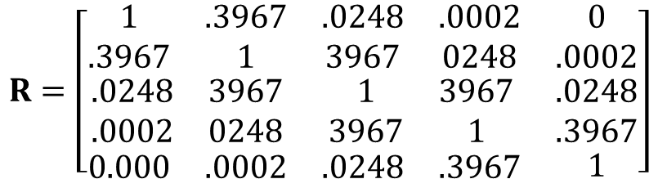
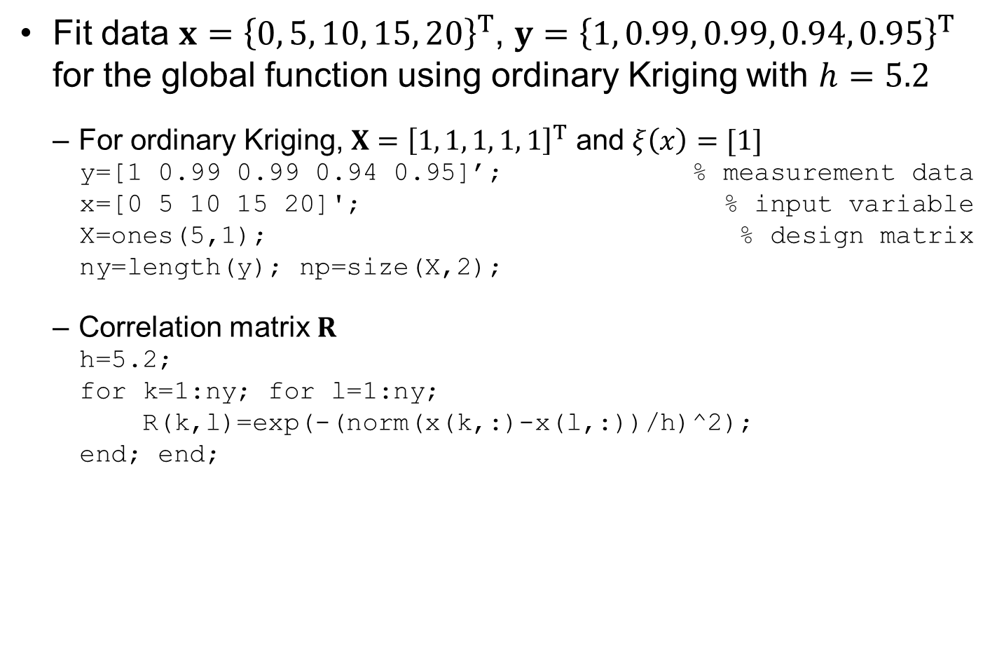
Ex) Kriging fit
Fit data $x={\left\{0, 5, 10, 15, 20\right\}}^{T}$, $y={\left\{1, 0.99, 0.99, 0.94, 0.95\right\}}^{T}$ for the global function using ordinary Kriging with $h=5.2$
For ordinary Kriging, $X={\left[1, 1, 1, 1, 1\right]}^{T}$ and $ξ\left(x\right)=[1]$
y=[1 0.99 0.99 0.94 0.95]’; % measurement data
x=[0 5 10 15 20]'; % input variable
X=ones(5,1); % design matrix
ny=length(y); np=size(X,2);
Correlation matrix $R$
h=5.2;
for k=1:ny; for l=1:ny;
R(k,l)=exp(-(norm(x(k,:)-x(l,:))/h)^2);
end; end;
$$R=\left[\begin{matrix}\begin{matrix}1 & .3967 \\ .3967 & 1\end{matrix} & \begin{matrix}.0248 & .0002 \\ 3967 & 0248\end{matrix} & \begin{matrix}0 \\ .0002\end{matrix} \\ \begin{matrix}.0248 & 3967 \\ .0002 & 0248\end{matrix} & \begin{matrix}1 & 3967 \\ 3967 & 1\end{matrix} & \begin{matrix}.0248 \\ .3967\end{matrix} \\ \begin{matrix}0.000 & .0002\end{matrix} & \begin{matrix}.0248 & .3967\end{matrix} & 1\end{matrix}\right]$$

Slide 42


Ex) Kriging fit cont.
Global function parameters
Rinv=inv(R);
thetaH=(X'*Rinv*X)\(X'* Rinv*y);
sigmaH=sqrt(1/(ny-np)*((y-X*thetaH)'*Rinv*(y-X*thetaH)));
Estimate the optimum hyperparameter
Instead of optimization the hyperparameter, we calculate it graphically
$h_{opt}=5.2$
We used this value in calculating $\hat{θ}$ and ${\hat{σ}}^{2}$
$$\hat{θ}={\left(X^{T}R^{−1}X\right)}^{−1}\left\{X^{T}R^{−1}y\right\}={3.0989}^{−1}×3.0226=0.9754 \\ {\hat{σ}}^{2}=\frac{{\left(y−X\hat{θ}\right)}^{T}R^{−1}(y−X\hat{θ})}{n_{y}−n_{p}}=7.28×{10}^{−4}, \hat{σ}=0.0270$$

Slide 43

Ex) Kriging fit cont.
Matlab code for the graph
Prediction at $x=10$ (this is a sample point)
Exact at the sample point !
h=zeros(20,1); Obj=zeros(20,1);
for i=1:20
h(i)=0.5*i;
for k=1:ny; for l=1:ny;
R(k,l)=exp(-(norm(x(k,:)-x(l,:))/h(i))^2);
end; end;
Rinv=inv(R);
thetaH=(X'*Rinv*X)\(X'* Rinv*y);
sigmaH=sqrt(1/(ny-np)*((y-X*thetaH)'*Rinv*(y-X*thetaH)));
Obj(i)=log(sigmaH^(2*(ny-np))*det(R));
end
plot(h,Obj,'linewidth',2); grid on;
$$r=\left\{R\left(x_{k},10\right)\right\}={\left\{0.0248, 0.3967, 1, 0.3967, 0.0248\right\}}^{T}$$
$$\hat{z}\left(10\right)=ξ\hat{θ}+r^{T}R^{−1}\left(y−X\hat{θ}\right)=0.9754+0.0146=0.99$$

Slide 44



Ex) Kriging fit cont.
Prediction at $x=14$ (prediction point)
xNew=10; %or xNew=14
for k=1:ny; r(k,1)=exp(-(norm(x(k,:)-xNew)/h)^2); end;
gpDepar=r'*Rinv*(y-X*thetaH);
$$r=\left\{R\left(x_{k},14\right)\right\}={\left\{0.0007, 0.05, 0.5534, 0.9637, 0.2641\right\}}^{T}$$
$$\hat{z}\left(14\right)=ξ\hat{θ}+r^{T}R^{−1}\left(y−X\hat{θ}\right)=0.9754−0.0272=0.9482$$
$$h=5.2$$
$$h=0.5$$

Slide 45



Prediction Variance
Square root of variance is called standard error.
The uncertainty at any $x$ is normally distributed.
$\hat{z}(x)$ represents the mean of Kriging prediction.
Notes:
Once we have fitted the kriging parameters, besides the surrogate estimate, $\left.\hat{y}(x\right)$, we also get a prediction variance or the variance of the estimate as
The square root of V is estimate of the standard deviation, called the standard error. It is often shown along the kriging fit by a shaded area as can be seen in the top right figure.
In general it is high far from data points and low near data points. It can be used to decide where to put additional data points in order to reduce the uncertainty in the kriging predictions (that is add points where V is maximal).
For some applications we take advantage that the distribution of uncertainty about the prediction is normal, with $\left.\hat{y}(x\right)$ being the mean and the standard error being the standard deviation, as shown in the left figure. This entire distribution is used for the Efficient Global Optimization in order to find points that have maximal expected improvement over the best sample value available so far.
For derivations one can refer to: Sacks, J., Welch, W.J., Mitchell, T.J. and Wynn, H.P. (1989), Design and analysis of computer experiments (with discussion), Statistical Science 4: 409–435.
45

Slide 46


Prediction uncertainty
Kriging prediction $\hat{z}\left(x\right)=ξ\left(x\right)\hat{θ}+{r\left(x\right)}^{T}R^{−1}(y−X\hat{θ})$ is the mean prediction and MSE is the variance
Kriging prediction is Gaussian distribution
This is an estimated uncertainty using data
When the # of data is small, use t-distribution
Ordinary Kriging
$$\hat{Z}\left(x\right)\sim N\left(ξ\left(x\right)\hat{θ}+{r\left(x\right)}^{T}R^{−1}\left(y−X\hat{θ}\right),σ^{2}\left(w^{T}Rw−2w^{T}r+1\right)\right)$$
$$\hat{Z}\left(x\right)\sim ξ\left(x\right)\hat{θ}+{r\left(x\right)}^{T}R^{−1}\left(y−X\hat{θ}\right)+t_{n_{y}−n_{p}}\hat{σ}\sqrt{w^{T}Rw−2w^{T}r+1}$$
$$V\left[\hat{Z}\left(x\right)\right]=σ^{2}\left[1−r^{T}R^{−1}r+\frac{{\left(1−1^{T}R^{−1}r\right)}^{2}}{1^{T}R^{−1}1}\right]$$

Slide 47





Prediction Variance at Data Points
prediction variance is zero at data points
Let $x=x_{k}$, at data point $x_{k}$
because $R^{−1}r\left(x_{k}\right)$is a unit vector whose $k$th component is one
$ξ(x_{k})$ is $k$th row of $X$
Therefore, Lagrange multiplier = 0
MSE
$${ξ(x_{k})}^{T}−X^{T}R^{−1}r\left(x_{k}\right)=0$$
$$\frac{λ^{T}}{2σ^{2}}={\left(X^{T}R^{−1}X\right)}^{−1}\left\{ξ^{T}−X^{T}R^{−1}r\right\}=0$$
$$w=R^{−1}r+R^{−1}X\frac{λ^{T}}{2σ^{2}}=R^{−1}r$$
a unit vector whose $k$th component is one
$$MSE=σ^{2}\left(w^{T}Rw−2w^{T}r+1\right)=0$$

Slide 48


Ex) Kriging fit cont.
90% confidence intervals at $x=14$
Standard error:${\hat{σ}}_{z}=\hat{σ}\sqrt{w^{T}Rw−2w^{T}r+1}$
xi=1;
w=Rinv*r+Rinv*X*((X'*Rinv*X)\(xi'-X'*Rinv*r));
zSigmaH=sigmaH*sqrt(w'*R*w-2*w'*r+1);
% using the inverse calculation
gpMean=0.9482; % from Example 5.2
PI=[ gpMean + tinv(0.05,ny-np)*zSigmaH, ...
gpMean + tinv(0.95,ny-np)*zSigmaH]
% using the random samples
ns=5e3;
tDist=trnd(ny-np,1,ns);
yHat=gpMean+tDist*zSigmaH;
PI=prctile(yHat,[5 95])
$$w=R^{−1}r+R^{−1}X\frac{λ^{T}}{2σ^{2}} \\ \frac{λ^{T}}{2σ^{2}}={\left(X^{T}R^{−1}X\right)}^{−1}\left\{ξ^{T}−X^{T}R^{−1}r\right\}$$
x_{new} | 5 percentile | 95 percentile | 90% P.I.
x = 10 | 0.99 | 0.99 | 0
x = 14 | 0.9394 | 0.9570 | 0.0176

Slide 49
Kriging with nuggets
Nuggets – refers to the inclusion of noise at data points.
The more general Gaussian Process surrogates or Kriging with nuggets can handle data with noise (e.g. experimental results with noise).

Slide 50
GP: Matlab code for Gaussian Process
function rul=GP(funcOrd,h0)
clear global; global DegraUnit ...
TimeUnit time y thres signiLevel ns ny nt xTrain yTrain X dof
%=== PROBLEM DEFINITION 1 (Required Variables) ==============
WorkName=' '; % work results are saved by WorkName
DegraUnit=' '; % degradation unit
TimeUnit=' '; % time unit (Cycles, Weeks, etc.)
time=[ ]'; %[cv]: time at both measurement and prediction
y=[ ]'; %[ny x 1]: measured data
nT= ; % num. of training set including the current one
nt=[ ]';%[nT x 1]: num. of training data in each training set
thres= ; % threshold (critical value)
degraTrue=[ ]'; %[cv]: true values of degradation
signiLevel= ; % significance level for C.I. and P.I.
ns= ; % number of particles/samples
%=== PROBLEM DEFINITION (Training Matrix) ===================
xTrain=[ ]; yTrain=[ ];
%============================================================

Slide 51
GP Matlab code cont.
% % % PROGNOSIS using GP
ny=length(y);
X=GLOBAL(xTrain,funcOrd); %% Determine Hyperparameter
dof=size(yTrain,1)-size(X,2);
hMax=2; hBound=hMax*ones(1,length(h0));
hH=fmincon(@FUNC,h0,[],[],[],[],-hBound,hBound);
[R,thetaH,sigmaH]=RTHESIG(hH); %% R, Theta, and Sigma
%=== PROBLEM DEFINITION 2 (Input Matrix for Prediction ======
for k=1:length(time(ny:end)); %% Degradation Prediction
xNew=[ ];
[zMean(k,:),zSig(k,:)]= ...
GPSIM(xNew,funcOrd,hH,R,thetaH,sigmaH);
end;
%============================================================
tDist=trnd(dof,size(zMean,1),ns); %% Prediction Uncertainty
zHat0=repmat(zMean,1,ns)+tDist.*repmat(zSig,1,ns);
zHat=zHat0*(max(y)-min(y))+min(y);
degraPredi=zHat;
% % % POST-PROCESSING
rul=POST([],degraPredi,degraTrue); %% RUL & Result Disp
Name=[WorkName ' at ' num2str(time(ny)) '.mat']; save(Name);
end

Slide 52
GP Matlab code cont.
% % % GLOBAL FUNCTION
function X=GLOBAL(x0,funcOrd)
nx=size(x0,1);
if funcOrd==0; X=ones(nx,1);
elseif funcOrd==1; X=[ones(nx,1) x0];
elseif funcOrd==2; X=[ones(nx,1) x0 x0.^2];
end
end
% % % OBJECTIVE FUNCTION TO FIND H
function objec=FUNC(h)
global dof
[R,~,sigma]=RTHESIG(h);
objec=log(sigma^(2*dof)*det(R));
end
% % % R, THETA, and SIGMA
function [R,theta,sigma]=RTHESIG(h)
global xTrain yTrain X dof
R=CORREL(xTrain,h); Rinv=R^-1;
theta=(X'*Rinv*X)\(X'*Rinv*yTrain);
sigma=sqrt(1/dof*((yTrain-X*theta)'*Rinv*(yTrain-X*theta)));
end

Slide 53
GP Matlab code cont.
% % % CORRELATION FUNCTION
function R=CORREL(x0,h)
global xTrain
for k=1:size(xTrain,1); for l=1:size(x0,1);
R(k,l)=exp(-(norm(xTrain(k,:)-x0(l,:))/h)^2);
end; end;
end
% % % GP SIMULATION at NEW INPUTS
function [zMean,zSig]=GPSIM(x,funcOrd,h,R,theta,sigma)
global yTrain X
Rinv=R^-1;
xi=GLOBAL(x,funcOrd);
r=CORREL(x,h);
zMean=xi*theta+r'*Rinv*(yTrain-X*theta);
w=Rinv*r+Rinv*X*((X'*Rinv*X)\(xi'-X'*Rinv*r));
zSig=sigma*sqrt(w'*R*w-2*w'*r+1);
end

Slide 54
GP Implementation of Battery Prognostics
Problem definition
Mostly use the same convention of NLS, BM, and PF
Possible to have multiple sets of training data
nT is the number of training sets including prediction set
nt is a nT×1 vector of the number of training data in each data set
Ex) nT = 3, nt = [20 20 10]’: Two sets of 20 run-to-fail data from similar systems and 10 data from the current system
True degradation is given in the form of data
time=[0:5:200]';
y=[1.00 0.99 0.99 0.94 0.95 0.94 0.91 0.91 0.87 0.86]';
nT=1;
nt=[10]';
degraTrue=exp(-0.003.*time);

Slide 55
Problem Definition cont.
No physical model → Training data are uses instead
Normalizing input and output data in [0, 1] is required to find the hyperparameter properly
Also, need normalization for prediction time
%=== PROBLEM DEFINITION (Training Matrix) =================
y0=(y-min(y))/(max(y)-min(y));
time0=(time-min(time))/(max(time)-min(time));
xTrain=time0(1:length(y)); yTrain=y0;
%============================================================
xNew=time0(ny-1+k);

Slide 56

Global Function of GP
Global function
User can choose constant, linear or quadratic global function using funcOrd = 0, 1, or 2.
Global function basically calculates the design matrix $X$
% % % GLOBAL FUNCTION
function X=GLOBAL(x0,funcOrd)
nx=size(x0,1);
if funcOrd==0; X=ones(nx,1);
elseif funcOrd==1; X=[ones(nx,1) x0];
elseif funcOrd==2; X=[ones(nx,1) x0 x0.^2];
end
end

Slide 57

Optimization to Find Hyperparameter
We need a function that can calculate $R, θ, σ$ for given hyperparameter $h$
Correlation function
% % % R, THETA, and SIGMA
function [R,theta,sigma]=RTHESIG(h)
global xTrain yTrain X dof
R=CORREL(xTrain,h); Rinv=R^-1;
theta=(X'*Rinv*X)\(X'*Rinv*yTrain);
sigma=sqrt(1/dof*((yTrain-X*theta)'*Rinv*(yTrain-X*theta)));
end
% % % CORRELATION FUNCTION
function R=CORREL(x0,h)
global xTrain
for k=1:size(xTrain,1); for l=1:size(x0,1);
R(k,l)=exp(-(norm(xTrain(k,:)-x0(l,:))/h)^2);
end; end;
end

Slide 58

Calling GP
Negative log-likelihood (we will minimize this function)
Calling GP
funcOrd = 1 (linear global function)
$h_{0}=0.05$: initial value of hyperparameter
% % % OBJECTIVE FUNCTION TO FIND H
function objec=FUNC(h)
global dof
[R,~,sigma]=RTHESIG(h);
objec=log(sigma^(2*dof)*det(R));
end
rul=GP(1,0.05);

Slide 59

Prognosis using GP
Finding hyperparameter hH
Starting from h0, find hH that minimizes the negative log-likelihood
The range of hH is limited between [-2, 2]: to prevent ridiculously large value of the scale parameter
Once hH is found, use it to calculate $R, θ, and σ$
Finding hyperparameter is equivalent to training the GP model
% % % PROGNOSIS using GP
ny=length(y);
X=GLOBAL(xTrain,funcOrd); %% Determine Hyperparameter
dof=size(yTrain,1)-size(X,2);
hMax=2; hBound=hMax*ones(1,length(h0));
hH=fmincon(@FUNC,h0,[],[],[],[],-hBound,hBound);
[R,thetaH,sigmaH]=RTHESIG(hH); %% R, Theta, and Sigma

Slide 60

GP Simulation
Prediction using $h, R, θ, and σ$
GP simulation calculates mean, zMean, and STD, zSig
% % % GP SIMULATION at NEW INPUTS
function [zMean,zSig]=GPSIM(x,funcOrd,h,R,theta,sigma)
global yTrain X
Rinv=R^-1;
xi=GLOBAL(x,funcOrd);
r=CORREL(x,h);
zMean=xi*theta+r'*Rinv*(yTrain-X*theta);
w=Rinv*r+Rinv*X*((X'*Rinv*X)\(xi'-X'*Rinv*r));
zSig=sigma*sqrt(w'*R*w-2*w'*r+1);
end
%=== PROBLEM DEFINITION 2 (Input Matrix for Prediction ======
for k=1:length(time(ny:end)); %% Degradation Prediction
xNew=time0(ny-1+k);
[zMean(k,:),zSig(k,:)]= ...
GPSIM(xNew,funcOrd,hH,R,thetaH,sigmaH);
end;
%============================================================

Slide 61
Prediction Uncertainty and Postprocessing
Student’s t-distribution to generate samples of prediction
Need to unscale
Postprocessing
No model parameters for data-driven prognostics
tDist=trnd(dof,size(zMean,1),ns); %% Prediction Uncertainty
zHat0=repmat(zMean,1,ns)+tDist.*repmat(zSig,1,ns);
zHat=zHat0*(max(y)-min(y))+min(y);
degraPredi=zHat;
% % % POST-PROCESSING
rul=POST([],degraPredi,degraTrue); %% RUL & Result Disp
Name=[WorkName ' at ' num2str(time(ny)) '.mat']; save(Name);

Slide 62
Ex) Degradation and RUL of Battery Prognostics
Percentiles of RUL at 45 Cycles
5th: 39.5361, 50th (median): 49.9718, 95th: 58.7455.

Slide 63
Neural Network Model

Slide 64
Artificial neural network
Computing systems vaguely inspired by the biological neural networks that constitute animal brains
The data structures and functionality of neural nets are designed to simulate associative memory
Learn by processing input and output data (samples)
After learn by enough data, neural nets can predict results from inputs
Relationship between the number and diversity of samples processed by a neural net and the prediction accuracy
Fancy description, but basically neural network is a kind of surrogate model
Determine (train) unknown parameters using samples and predict

Slide 65
Artificial neural network cont.
based on a collection of connected units or nodes called artificial neurons
loosely model the neurons in a biological brain
Each connection can transmit a signal to other neurons
A neuron receives a signal then processes it and sends the signal to the neurons connected to it
Implementation
"signal" at a connection is a real number, and the output of each neuron is computed by a nonlinear function of the sum of its inputs
Neurons typically have a weight that adjusts as learning proceeds
Input layer (inputs), hidden layer (not shown), and output layer (prediction)

Slide 66

Deep learning
part of a broader family of machine learning methods based on artificial neural networks with representation learning
Learning can be supervised, semi-supervised or unsupervised
The adjective "deep" comes from the use of multiple layers in the network
Deep learning is a modern variation which is concerned with an unbounded number of layers of bounded size
permits practical application and optimized implementation

Slide 67
History of neural network
first introduced in 1943 by Warren McCulloch, a neurophysiologist, and a mathematician Walter Pitts
In 1949, Donald Hebb published a book, “The Organization of Behavior,” where he formulated the classical Hebbian rule, which is proved to be the basis of almost all neural learning procedures
John Hopfield invented associative neural network in 1982, which is now more commonly known as Hopfield Network
backpropagation algorithm, a generalization of Widrow-Hoff learning algorithm, was invented by Rumelhart, Hinton and Williams → renaissance of research in neural network

Slide 68
Types of NN
Feedforward NN (Svozil et al. 1997): conveys the information in one direction
Radial basis function network (Orr 1996): uses the Gaussian radial basis function
Recurrent NN (Bodén 2001): local feedback connections between the input and outputs, and so forth
Fuzzy-neural (Liu and Li 2004), wavelet (He et al. 2004), associative-memory (Bicciato et al. 2001), modular (Happel and Murre 1994) and hybrid (Zhang and Yuen 2013, Rovithakis et al. 2004) neural networks

Slide 69
Feedforward NN model
Neurons or nodes: basic processing units in NN
they can be grouped into different layers such as input layer, output layer and hidden layer
Input layer: receiving input data from outside
Output layer: send processed data out of the NN (prediction)
Hidden layer: between input and output layers, no interaction with outside (not shown to users)
Feedforward NN
information only moves in forward direction from input layer, through hidden layer and to output layer
no feedback or flow within layers

Slide 70

Illustration of feedforward NN model
$$\hat{z}$$

Slide 71
Illustration of feedforward NN model
Feedforward: information flows from input layer to hidden layer to output layer
Parameters
Weight: interconnection parameter between different nodes, $w_{x}, w_{h}$
Bias: threshold value added after weighted sum of inputs from previous layer, $b_{h}, b_{z}$
Transfer (activation) function
Integrate the linear combination of information from the previous layers using weights and bias

Slide 72
Training process
finding the optimal parameters, weights and biases, such that the network model accurately represents the relationship between inputs and outputs
backpropagation: propagates the error between training data and the network outputs backward
optimization process to find the best weights and biases to minimize the mean square error between network predictions and training data
parameters (gradient or Jacobian) for hidden weights and output bias (output layer) are updated first
then, parameters for input weights and hidden biases (hidden layer) are updated next based on the updated parameters in the output layer

Slide 73



Feedforward mechanism
Relationship between input nodes $x$ and hidden nodes $h$:
$W_{x}:(n_{h}×n_{x})$ input weight matrix
$b_{h}:(n_{h}×1)$ hidden bias vector
$d_{h}( ):$transfer function in the hidden layer
Relationship between hidden nodes $h$ and output nodes $\hat{z}$:
$W_{h}:(n_{z}×n_{h})$ hidden weight matrix
$b_{z}:(n_{z}×1)$ output bias vector
$d_{z}( ):$ transfer function in the output layer
$$h=d_{h}\left(W_{x}x+b_{h}\right)$$
$$\hat{z}=d_{z}\left(W_{h}h+b_{z}\right)$$
We will consider $n_{z}=1$ case only

Slide 74

Training process
First, the network structure must be decided
The number of input nodes, hidden nodes, and output nodes
Training process determines all weights, $W_{x}$ and $W_{h}$, and all biases, $b_{h}$ and $b_{z}$
Training data: $\left(x_{i},y_{i}\right), i=1,⋯,n_{y}$
Minimize the error between $\hat{z}(x_{i})$ and $y_{i}$
This is similar to regression
In general, need to solve optimization problem for nonlinear transfer functions

Slide 75


Training process cont.
Apply training data to $h=d_{h}\left(W_{x}x+b_{h}\right)$, $\hat{z}=d_{z}\left(W_{h}h+b_{z}\right)$
$X \left(n_{x}×n_{y}\right):$ matrix of training input data
$B_{h} (n_{h}×n_{y})$: hidden bias matrix
$H (n_{h}×n_{y})$: matrix of hidden layer outputs
$\hat{z} (1×n_{y})$: vector of network simulation outputs
$w_{h} (1×n_{h})$: hidden weight row vector
$b_{z} (1×n_{y})$: output bias vector
$H=d_{h}\left(W_{x}X+B_{h}\right), \hat{z}=d_{z}\left(w_{h}H+b_{z}\right)$

Slide 76



Ex) FFNN with linear transfer function
Two input nodes, one hidden node, linear transfer function $d_{h}\left(x\right)=x$ and $d_{z}\left(x\right)=x$ ($n_{x}=2, n_{h}=1, n_{z}=1$)
Hidden layer: $h=W_{x}x+b_{h}=w_{1}x_{1}+w_{2}x_{2}+b_{1}$
Output layer:
Equivalent one-layer network model
$$\hat{z}$$
$$W_{x}=\left[\begin{matrix}w_{1} & w_{2}\end{matrix}\right], x=\left[\begin{matrix}x_{1} \\ x_{2}\end{matrix}\right], b_{h}=b_{1}, W_{h}=w_{3}, b_{z}=b_{2}$$
$$\hat{z}=W_{h}h+b_{z} \\ =w_{3}\left(w_{1}x_{1}+w_{2}x_{2}+b_{1}\right)+b_{2} \\ =\left(w_{1}w_{3}x_{1}+w_{2}w_{3}x_{2}\right)+w_{3}b_{1}+b_{2}$$
$$\hat{z}=w_{1}^{∗}x_{1}+w_{2}^{∗}x_{2}+b_{1}^{∗}, w_{1}^{∗}=w_{1}w_{3}, w_{2}^{∗}=w_{2}w_{3}, b_{1}^{∗}=w_{3}b_{1}+b_{2}$$

Slide 77

Training process with pure linear transfer function
When $d_{h}\left(x\right)=x$ and $d_{z}\left(x\right)=x$
One-layer NN model with ${\left(w_{h}W_{x}\right)}_{1×n_{x}}$ being input weights and ${\left(w_{h}B_{h}+b_{z}\right)}_{1×n_{y}}$ being the output bias
Multi-layer NN model with pure linear transfer function can be converted into a single-layer NN model
$$\hat{z}=w_{h}\left(W_{x}X+B_{h}\right)+b_{z}=\left(w_{h}W_{x}\right)X+\left(w_{h}B_{h}+b_{z}\right)$$

Slide 78



Input data in time-domain NN
We consider a dynamic response of a system. Input = time, output = QoI
Data
$t=\{t_{1},t_{2},⋯,t_{n_{y}},t_{n_{y}+1},t_{n_{y}+2}\}$
$y=\{y_{1},y_{2},⋯,y_{n_{y}},y_{n_{y}+1},y_{n_{y}+2}\}$
Use 3 previous $y$ data as input $(n_{x}=3)$ for predicting $z_{k}$
$x={\left\{y_{k−1},y_{k−2},y_{k−3}\right\}}^{T}$
Input matrix Output vector
$$X={\left[\begin{matrix}y_{1} & y_{2} & \begin{matrix}⋯ & y_{n_{y}}\end{matrix} \\ y_{2} & y_{3} & \begin{matrix}⋯ & y_{n_{y}+1}\end{matrix} \\ y_{3} & y_{4} & \begin{matrix}⋯ & y_{n_{y}+2}\end{matrix}\end{matrix}\right]}_{n_{x}×n_{y}}$$
$$\hat{z}=\left\{\begin{matrix}\begin{matrix}{\hat{z}}_{4} & {\hat{z}}_{5}\end{matrix} & \begin{matrix}⋯ & {\hat{z}}_{n_{y}+3}\end{matrix}\end{matrix}\right\} \\ y=\left\{\begin{matrix}\begin{matrix}y_{4} & y\end{matrix} & \begin{matrix}⋯ & y_{n_{y}+3}\end{matrix}\end{matrix}\right\}$$

Slide 79

Transfer functions
characterize the relationship between two adjacent layers
should be differentiable: need for backpropagation training process
Pure linear function: $\hat{z}=x$
Sigmoid function: $\hat{z}=\frac{1−e^{−2x}}{1+e^{−2x}}$

Slide 80
Ex) Complexity of NN model
2-layer NN model: 1 input node, 1 (or 5) hidden node, and 1 output node
Generate random weights and biases from $\sim U(−5,5)$
Repeat 5 times:
$$h=d_{h}\left(W_{x}x+b_{h}\right)\text{,} → \hat{z}=d_{z}\left(W_{h}h+b_{z}\right)$$
1-hidden node
5-hidden nodes
$$\hat{y}$$
$$\hat{y}$$

Slide 81

Backpropagation process
a training method to determine weights and biases through a learning/optimization algorithm by backward propagation of the errors between the training data and the network outputs
layer-by-layer updating
Data: $X\left(n_{x}×n_{y}\right), y(1×n_{y})$
Setting initial values of parameters (weights & biases)
Too large initial weights → fall in the saturation region
Too small initial weights → low learning rate
Usually random number in $[−1, 1]$, or fixed value of 1
For prognostics, degradation is monotonic and stay in positive value
Increasing degradation $(w_{x}>1)$, decreasing $(w_{x}<1)$

Slide 82


Backpropagation process cont.
Feedforward to simulation outputs ${\hat{z}}_{i}$ using $n_{y}$ inputs
Mean-squared-error (MSE) between training output $y$ and simulation output $\hat{z}$
Using optimization algorithm and gradients of MSE, calculate $Δw_{h}$ and $Δb_{z}$ of the output layer
Gradient descent or Levenberg-Marquardt (LM) algorithm
Calculate $ΔW_{x}$ and $ΔB_{h}$ of the hidden layer
$ΔW_{x}$ and $ΔB_{h}$ depend on $Δw_{h}$ and $Δb_{z}$
$$MSE=\frac{1}{n_{y}}\sum_{i=1}^{n_{y}}{{\left[y_{i}−{\hat{z}}_{i}\left(W_{x},B_{h},w_{h},b_{z}\right)\right]}^{2}}$$

Slide 83
Backpropagation process cont.
Update the weights and biases of NN model
Repeat Steps 1 ~ 6 until satisfying a stopping criterion

Slide 84
Matlab functions for feedforward NN
define a network model → set up configurations → train the network model → prediction with different inputs
feedforwardnet: creates a two-layer network model with user-defined number of hidden nodes
Tangent sigmoid function: default activation function for hidden layers
Pure linear function: default activation function of output layers
configure: Optional step to normalize input and output data and assigns them to each node
Normalization between -1 and 1
Randomly select initial values of weights and biases
Use configuration to assign user-defined initial values

Slide 85
Matlab functions for feedforward NN
train: trains the network model with the LM backpropagation for training method and the MSE for the error function
train uses all data at once
adapt uses data one-by-one, good for online learning
sim: simulates/predicts the network outputs at new inputs based on the identified weights and biases during the training process

Slide 86
Stopping criterion based on validation error
Randomly divide data: training (70%), validation (15%), test (15%)
use training set to update the weights and biases based on their error
The error of the training set keeps decreasing, and the error in the validation set also decreases: the training process goes well
The error in the validation set starts increasing after some phase of training process, i.e., good performance at the training set but bad performance at the validation set (new points, prediction points): the network model overfits the training data
Therefore, the training process stops when the validation error starts increasing
The test data sets are not used during the training process but used for testing the prediction accuracy with trained parameters

Slide 87

Ex) Feedforward NN model
Predict y at $x_{new}∈[−5, 25]$ using one hidden-node NN
Matlab code
x=[0 5 10 15 20]; %[1 x 5] training input data
y=[1 0.99 0.99 0.94 0.95]; %[1 x 5] training output data
nh=1; % num. of hidden node
net=feedforwardnet(nh); % create two-layer network model
net=configure(net,x,y); % this is optional
[netModel,trainRecor]=train(net,x,y); % train the model ‘net’
xNew=-5:0.1:25; % new input points
z=sim(netModel,xNew); % simulation results
$$x\left(=t\right)={\left[0, 5, 10, 15, 20\right]}^{T}, y={\left[1, 0.99, 0.99, 0.94, 0.95\right]}^{T}$$
$$\hat{z}$$

Slide 88

Ex) Feedforward NN model cont.
Initial values are randomly generated and stored in net
net.iw (input weights), net.lw (hidden weights), net.b (biases)
netModel is the trained network model
Available data is too small for training
# of training data (5) $\sim$ # of parameters (4): not accurate
70% of training data > 2* # of parameters
epoch: one complete presentation of the data set to be learned to a learning machine
Iteration: the number of batches or steps through partitioned packets of the training data, needed to complete one epoch

Slide 89
Ex) Feedforward NN model cont.
Training records
trainRecor.trainInd (training set), trainRecor.valInd (validation set), and trainRecor.testInd (test set)
plotperf(trainRecor); performance (MSE) plot for 3 sets
trainRecor.num_epochs = 8 (total available epochs)
trainRecor.best_epoch = 2 (best epochs)
trainRecor.best_vperf: best performance
bestE=trainRecor.best_epoch;
bestP=trainRecor.best_vperf;
hold on; plot(bestE,bestP,'o');

Slide 90


Ex) Feedforward NN model cont.
Prediction (simulation)
Using the trained network model, predict the degradation at various times
xNew=-5:0.1:25; % new input points
z=sim(netModel,xNew); % simulation results
$$\hat{z}$$

Slide 91



Ex) Feedforward NN model cont.
Uncertainty
the initial values of parameters are assigned differently. Also, the train, validation, and test sets change when the training is restarted. These two are the sources of uncertainty in the neural network process and make different results
Simulation #5
$$\hat{z}$$

Slide 92
NN: Matlab Code for Neural Network
Problem definition (similar to GP)
function rul=NN(TransFunc,nh,outliCrite)
clear global;
global DegraUnit TimeUnit time y thres signiLevel ns ny nt
%=== PROBLEM DEFINITION 1 (Required Variables) ==============
WorkName=' '; % work results are saved by WorkName
DegraUnit=' '; % degradation unit
TimeUnit=' '; % time unit (Cycles, Weeks, etc.)
time=[ ]'; %[cv]: time at both measurement and prediction
y=[ ]'; %[ny x 1]: measured data
nT= ; % num. of training set including the current one
nt=[ ]';%[nT x 1]: num. of training data in each training set
thres= ; % threshold (critical value)
degraTrue=[ ]'; %[cv]: true values of degradation
signiLevel= ; % significance level for C.I. and P.I.
ns= ; % number of repetition for NN process
%=== PROBLEM DEFINITION 2 (Training Matrix) =================
xTrain=[ ]; yTrain=[ ];
%============================================================

Slide 93
NN Matlab Code cont.
Training network model
% % % PROGNOSIS using NN
ny=length(y);
for i=1:ns; %% NN Process
disp(['repetition: ' num2str(i) '/' num2str(ns)]);
% create FFNN
net=feedforwardnet(nh);
net.layers.transferfcn=TransFunc;
net.divideParam.valRatio=0.3; net.divideParam.testRatio=0;
% train FFNN
[netModel,trainRecod]=train(net,xTrain',yTrain');
%=== PROBLEM DEFINITION 2 (Input Matrix for Prediction) =====
for k=1:length(time(ny:end)); %% Degradation Prediction
xNew=[ ];
zHat(k,i)=sim(netModel,xNew');
end;
%============================================================
end

Slide 94
NN Matlab Code cont.
Prediction
z1=zHat(end,:); %% Prediction Results Regulation
loca1=find(abs(z1-mean(z1)) < outliCrite*std(z1));
i0=1;
for i=1:ns;
if y(1)-y(nt(1))>0; z2=wrev(zHat(:,i));
else z2=zHat(:,i);
end;
if issorted(z2)==1; loca2(i0)=i; i0=i0+1; end
end
loca=intersect(loca1,loca2); %% Final Results
degraPredi=zHat(:,loca);
ns=size(degraPredi,2);
disp(['Final num. of samples: ' num2str(ns)])
% % % POST-PROCESSING
rul=POST([],degraPredi,degraTrue); %% RUL & Result Disp
Name=[WorkName ' at ' num2str(time(ny)) '.mat']; save(Name);
end

Slide 95

NN Implementation of Battery Prognostics
Problem definition
ns: number of NN repetitions (~ 30)
Matlab NN automatically normalize inputs and outputs
Train data
Prediction time
Calling convention
purelin is used for activation function for both hidden and output
outliCrite = 2: results beyond $2σ$ will be eliminated (outlier)
xTrain=time(1:length(y)); yTrain=y;
xNew=time(ny-1+k);
rul=NN({'purelin'; 'purelin'},1,2);

Slide 96
NN Implementation of Battery Prognostics cont.
Prognostics using NN
Create the network model net and assign activation functions
Use 70% training, 30% validation, no test data
Training parameters
Early stopping criteria to prevent overfitting
cannot control the underfitting
% create FFNN
net=feedforwardnet(nh);
net.layers.transferfcn=TransFunc;
net.divideParam.valRatio=0.3; net.divideParam.testRatio=0;
% train FFNN
[netModel,trainRecod]=train(net,xTrain',yTrain');

Slide 97

NN Implementation of Battery Prognostics cont.
Regulations
the outliers deviated from the majority of prediction results are determined based on the results at the last prediction step
Sample out of $2σ=97.72\%$ are removed
predictions do not monotonically increase/decrease are removed
z1=zHat(end,:); %% Prediction Results Regulation
loca1=find(abs(z1-mean(z1)) < outliCrite*std(z1));
i0=1;
for i=1:ns;
if y(1)-y(nt(1))>0; z2=wrev(zHat(:,i));
else z2=zHat(:,i);
end;
if issorted(z2)==1; loca2(i0)=i; i0=i0+1; end
end
loca=intersect(loca1,loca2); %% Final Results

Slide 98
NN Implementation of Battery Prognostics cont.
Battery degradation (NN)
Crack growth (NN)
under-fitting

Slide 99
NN Implementation of Battery Prognostics cont.
Postprocessing
Larger uncertainty in RUL because NN has more parameters than GP
plot(time(ny:end),zHat,'m'); plot(time(ny:end),degraPredi,'color',[.5 .5 .5]);

Slide 100
Practical Use of Data-Driven Approaches

Slide 101
Inputs
Time is input, but
work well for a simple problem with one data set
Not useful when training data sets obtained under different usage conditions
In order to be practical …
degradation levels are used as both input and output
The current degradation state as an output can be expressed with several previous degradation states as the inputs
utilize the information included in different degradation rates from the different data sets
having previous degradation states as inputs can allow to use a simpler functional form
We will use crack growth problem for demonstration

Slide 102


Crack Growth Prognostics
26 training data are generated from true model parameters
Run-to-fail set: $m_{true}=3.8, C_{true}=1.5×{10}^{−10}, a_{0true}=0.01m, Δσ=79MPa$
16 prediction data: same parameters and loading $Δσ=75MPa$
Inputs
3 previous crack sizes $(y_{k−3},y_{k−2}, y_{k−1} )$as inputs to predict $z_{k}$

Slide 103

Short- versus Long-term Prediction
Short-term prediction
One-step ahead prediction (prediction using real data)
Use $(y_{k−3},y_{k−2}, y_{k−1} )$ to predict $z_{k}$
Not able to predict degradation at future time
Long-term prediction
Use predictions at previous times to predict future
Use $(z_{k−3},z_{k−2}, z_{k−1} )$ to predict $z_{k}$
since predictions are used for inputs, the accuracy will be worse than short-term prediction
but it allows to predict the degradation in long future time

Slide 104
Matlab Codes for Crack Growth
Problem definition
WorkName='Crack_GP'; % or 'Crack_NN'
DegraUnit='Crack size (m)';
TimeUnit='Cycles';
time=[0:100:2500, 0:100:1600, 1700:100:4000]';
y=[0.01 0.0104 0.0107 0.0111 0.0116 0.0120 0.0125 ...
0.0131 0.0137 0.0143 0.0150 0.0158 0.0166 0.0176 ...
0.0186 0.0198 0.0211 0.0226 0.0243 0.0263 0.0287 ...
0.0314 0.0347 0.0387 0.0437 0.0501 ...
0.0100 0.0103 0.0106 0.0109 0.0112 0.0116 0.012 0.0124 ...
0.0128 0.0133 0.0138 0.0143 0.0149 0.0155 0.0162 0.0169]';
nT=2;
nt=[26 16]';
thres=0.05;
mTrue=3.8; cTrue=1.5e-10; aTrue=0.01; dsig=75; t=0:100:3500;
degraTrue=(t'.*cTrue.*(1-mTrue./2).*(dsig*sqrt(pi)).^mTrue...
+aTrue.^(1-mTrue./2)).^(2./(2-mTrue));
signiLevel=5;
ns=5e3; % or 30 for NN

Slide 105

Matlab Codes for Crack Growth cont.
Training degradation data
26 run-to-fail data at 79 MPa + 16 data at 75 MPa from current system
Prediction future time (1700:100:4000)
Inputs: 3 previous degradation data
GP problem definition (training)
nx=3; % num. of previous data as the input
y0=(y-min(y))/(max(y)-min(y)); % normalization of data
nm=size(y,2); a=0; b=0;
for l=1:nT;
for k=1:nt(l)-nx;
xTrain(k+a,1:nx*nm)=reshape(y0(k+b:(k-1)+nx+b,:),1,nx*nm);
yTrain(k+a,:)=y0(k+nx+b,:);
end; a=size(xTrain,1); b=sum(nt(1:l));
end
$${\hat{z}}_{k}=GP(y_{k−3},y_{k−2},y_{k−1})$$

Slide 106
Matlab Codes for Crack Growth cont.
NN problem definition (training, no normalization)
Additional modification for GP
Change exponent 2 to 1.9 (to prevent singularity in the correlation matrix)
nx=3; % num. of previous data as the input
nm=size(y,2); a=0; b=0;
for l=1:nT;
for k=1:nt(l)-nx;
xTrain(k+a,1:nx*nm)=reshape(y(k+b:(k-1)+nx+b,:),1,nx*nm);
yTrain(k+a,:)=y(k+nx+b,:);
end; a=size(xTrain,1); b=sum(nt(1:l));
end
R(k,l)=exp(-(norm(xTrain(k,:)-x0(l,:))/h)^1.9);

Slide 107
Matlab Codes for Crack Growth cont.
GP Problem definition 2 (Prediction Stage)
NN Problem definition 2 (Prediction Stage, no-normalization)
input=y0(end-nx:end,:);
for k=1:length(time(ny:end));
xNew=reshape(input(k:(k-1)+nx,:),1,nx*nm);
[zMean(k,:),zSig(k,:)]= ...
GPSIM(xNew,funcOrd,hH,R,thetaH,sigmaH);
if k>1 input(k+nx,:)=zMean(k,:); end
end;
input=y(end-nx:end,:);
for k=1:length(time(ny:end));
xNew=reshape(input(k:(k-1)+nx,:),1,nx*nm);
zHat(k,i)=sim(netModel,xNew');
if k>1, input(k+nx,:)=zHat(k,i); end
end;

Slide 108
Matlab Codes for Crack Growth cont.
Calling convention
GP
NN
rul=GP(1,0.1);
rul=NN({'purelin'; 'purelin'},1,2);

Slide 109
Results
Linear global function (GP) and activation function (NN) → still can predict nonlinear degradation
because the relation between previous three degradation data and the current degradation data can be captured by a linear function
GP is accurate with small prediction uncertainty
Reversed trend after 3000 cycles because of extrapolation
GP
NN

Slide 110
Results cont.
NN: out of 30 repetitions
19 failed to satisfy 2 regulations: outliers and monotonicity
Larger prediction uncertainty than GP
RUL prediction

Slide 111
Issues in Data-Driven Prognostics

Slide 112
Model-Form Adequacy for GP
Global function
performance largely depends on global and covariance functions
Conventional interpolation: global function is not important (ordinary Kriging)
Prognostics: extrapolation, global function is as important as covariance fn
not much literature on selecting or updating the global function to improve the prediction capability in the extrapolation region
Covariance function
determine GP simulation quality for entire regions
non-stationary covariance function: adapts to variable smoothness by adding or multiplying simple covariance functions
Non-stationary covariance function requires more parameters

Slide 113
Model-Form Adequacy for NN
Network model = selecting the number of hidden nodes, hidden layers and input nodes
Determining hidden layers/nodes
one or two hidden layers are commonly used
It is possible to determine the optimal number of hidden nodes using MSE
Or, measuring complexity of function to determine the number of nodes
Determining input nodes
Input nodes = available information, time, loading conditions, and degradation data
Several past degradation data can be used as inputs
there is no universal procedure to establish a proper NN model

Slide 114

Optimal Parameter Estimation for GP
Scale parameters (hyper-parameters)
determine the smoothness of the GP function
Large $h$ makes the prediction smooth; $R$ becomes singular with too large $h$
Generally, $h$ is determined by maximizing likelihood function
Optimal $h$ is difficult to find, and optimum $h$ is not always the best selection
$h$ can be considered as a distribution (work better than deterministic $h$)
No strategy to find best $h$ for prognostics (extrapolation)
Many SHM data with small intervals → small $h$ → extrapolation quickly converge to the global function

Slide 115
Optimal Parameter Estimation for NN
Determining weights and biases
Complex behavior requires a greater number of nodes → a greater number of weights and biases → require mode training data
Difficulty using backpropagation algorithm
the global optimum is extremely difficult to find in the case of many parameters
the convergence rate is very low and depends on the initial estimates
Algorithmic improvement
dynamic self-adaptation algorithm, simulated annealing algorithm, combined genetic and differential evolution algorithm
probabilistic approaches (Bayesian learning technique)
Represent uncertainty in the parameters
finding optimal weights and biases is still challenging

Slide 116
Quality of Degradation Data
uncertainty caused by bias and noise in data is an important issue regardless of prognostics approaches
the bias cannot be handled with data-driven approaches because there are no parameters related to it
data quality issues for noise will be discussed in Chapter 6

Slide 117
Quality of Degradation Data in GP
Large # of training data are not always good for GP
Difficult to calculate the inverse of covariance matrix (may cause singularity)
Only a portion of whole data can be used
Or approximation of the inverse of covariance matrix
When data include noise
GP generally assumes that data are accurate
Nugget effect represents noise in data by adding diagonal terms of the covariance matrix
Nugget STD is coupled with h → difficult to uniquely identify it

Slide 118
Quality of Degradation Data in NN
Uncertainty in prediction results
Difficult to find global optimum of parameters
measurement noise, a small number of data compared to the number of parameters, and the complexity of damage growth, which can yield a significant error in prediction results
Bootstrapping
running Matlab NN toolbox several times because Matlab uses different subsets of the training data to obtain weights and biases
Also, use different (randomly generated) initial parameters
Systematically handling uncertainty
probabilistic neural network (PNN)
Bayesian NN

