Slide 1
Chapter 6 Attributes of Prognostics Methods

Slide 2
1. Introduction

Slide 3
Chapter Goal
Study on attributes of 5 prognostics algorithms
To provide guidelines so that the readers can choose an appropriate algorithm for their field of application
We will use simple and complex crack growth problems
advantages and disadvantages are discussed based on the logic of each algorithm
different prognostics algorithms have different characteristics
Total form: use an explicit form of degradation as a function of model parameters, loading/usage condition and time/cycle
Rate form: use a differential equation form of degradation model, where degradation level can be obtained by integrating the differential equation

Slide 4
Model-Form Error
Models are developed under assumptions and simplifications
Paris model: an infinite flat panel under mode I fatigue loading condition
Many model parameters are not intrinsic
they depend on boundary conditions and loading conditions
Parameters from lab tests may be different from that of field conditions
it is important how physics-based prognostics algorithms can correct or compensate for the model-form error

Slide 5
Physics-based Methods
important to understand how different algorithms identify parameters
especially uncertainty in model parameters and correlation between them
Some algorithms represent this uncertainty in the form of samples
Some assume Gaussian distribution with estimated variance
the prior knowledge on model parameters plays an important role in the performance of prognostics algorithm
Bayesian-based algorithms have a systematic way of considering the prior knowledge
regression-based algorithms do not have a feasible way of considering it

Slide 6
Data-driven Methods
Looks more attractive as they don’t need physical model
Especially for complex systems
But data-driven approaches also employ a mathematical model to represent the degradation behavior
the mathematical model does not have any physical meaning
is the mathematical model good enough to represent the behavior of degradation?
Complex model can represent complex degradation behavior
Complex model has many parameters, which need to be identified with data
Difficult to fit, over-fitting, under-fitting problems
Normally (# of training data) > (2 ~ 3)*(# of unknown coefficients)
data-driven approaches move the decision of selecting model form to users

Slide 7
2. Problem Definition

Slide 8
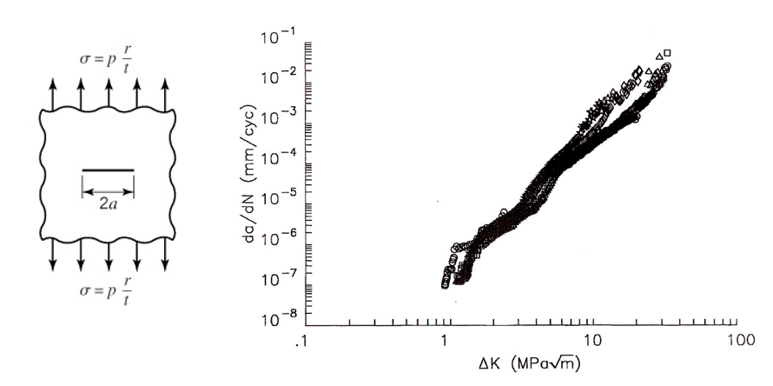

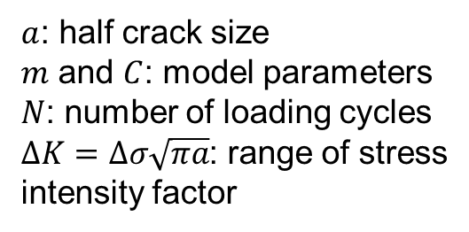
Paris Model for Fatigue Crack Growth
the rate of crack growth under constant amplitude cyclic mode I loading of an infinite plate
Ex) a fatigue crack growth in fuselage panel of airplanes due to repeated pressurizations
Incremental form:
$a$: half crack size
$m$ and $C$: model parameters
$N$: number of loading cycles
$ΔK=Δσ\sqrt{πa}$: range of stress intensity factor
$$\frac{da}{dN}=C{\left(Δσ\sqrt{πa}\right)}^{m}$$

Slide 9
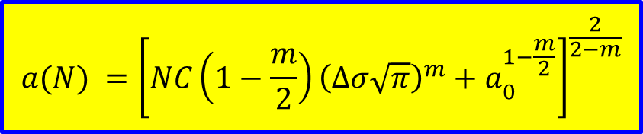
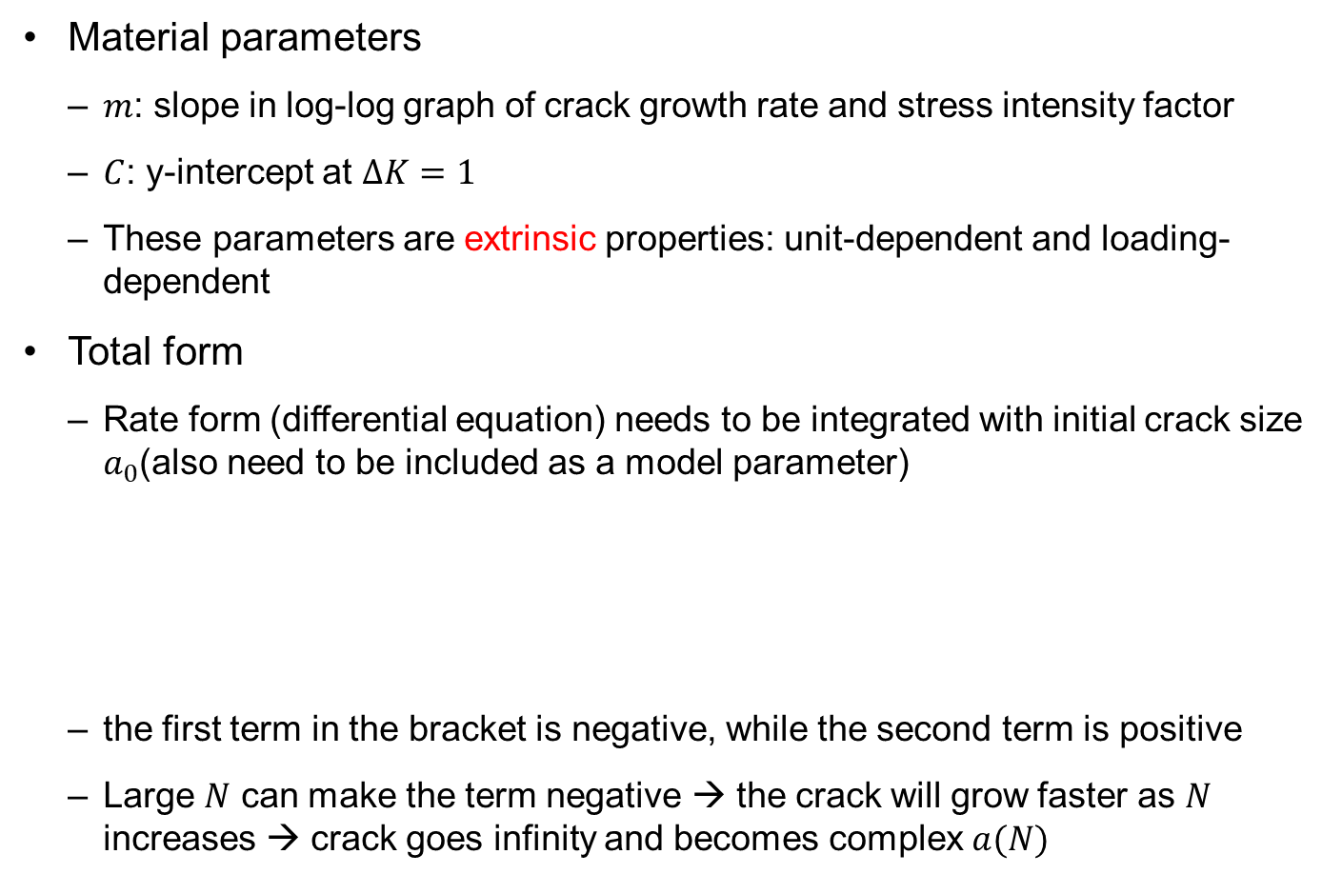
Paris Model for Fatigue Crack Growth cont.
Material parameters
$m$: slope in log-log graph of crack growth rate and stress intensity factor
$C$: y-intercept at $ΔK=1$
These parameters are extrinsic properties: unit-dependent and loading-dependent
Total form
Rate form (differential equation) needs to be integrated with initial crack size $a_{0}$(also need to be included as a model parameter)
the first term in the bracket is negative, while the second term is positive
Large $N$ can make the term negative → the crack will grow faster as $N$ increases → crack goes infinity and becomes complex $a(N)$
$$a(N) ={\left[NC\left(1−\frac{m}{2}\right){\left(Δσ\sqrt{π}\right)}^{m}+a_{0}^{1−\frac{m}{2}}\right]}^{\frac{2}{2−m}}$$

Slide 10

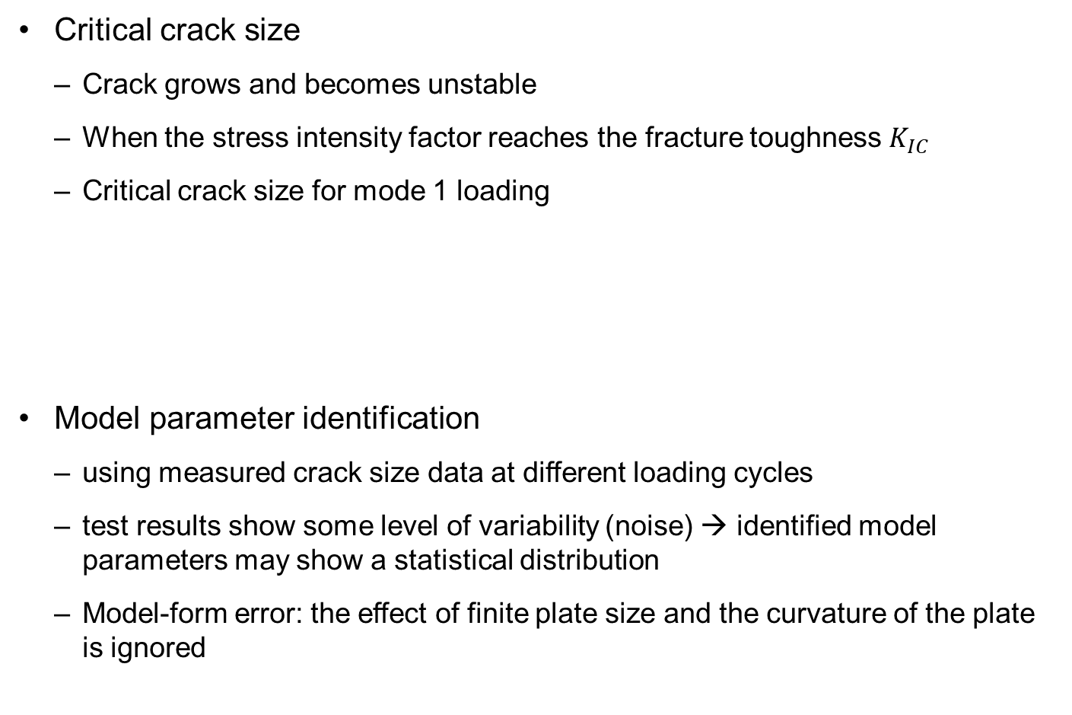

Paris Model for Fatigue Crack Growth cont.
Critical crack size
Crack grows and becomes unstable
When the stress intensity factor reaches the fracture toughness $K_{IC}$
Critical crack size for mode 1 loading
Model parameter identification
using measured crack size data at different loading cycles
test results show some level of variability (noise) → identified model parameters may show a statistical distribution
Model-form error: the effect of finite plate size and the curvature of the plate is ignored
$$a_{C}={\left(\frac{K_{IC}}{Δσ\sqrt{π}}\right)}^{2}$$
Maintenance is required before $a_{C}$

Slide 11
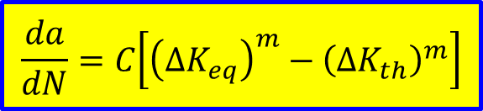
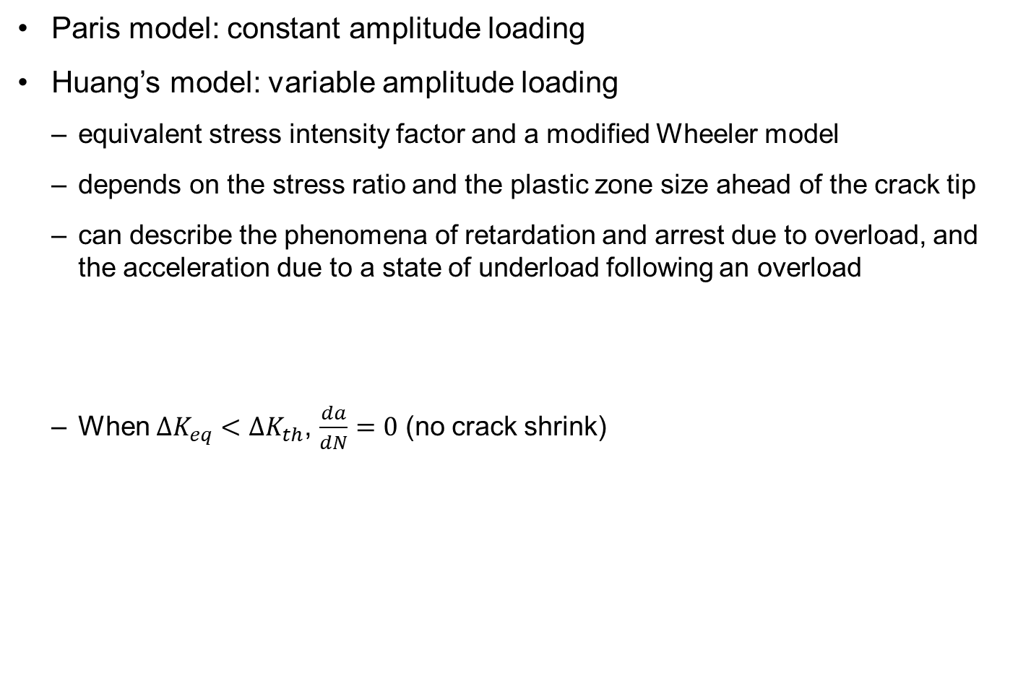
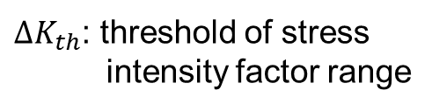
Huang’s Model for Fatigue Crack Growth
Paris model: constant amplitude loading
Huang’s model: variable amplitude loading
equivalent stress intensity factor and a modified Wheeler model
depends on the stress ratio and the plastic zone size ahead of the crack tip
can describe the phenomena of retardation and arrest due to overload, and the acceleration due to a state of underload following an overload
When $ΔK_{eq}<ΔK_{th}$, $\frac{da}{dN}=0$ (no crack shrink)
$$\frac{da}{dN}=C\left[{\left(ΔK_{eq}\right)}^{m}−{\left(ΔK_{th}\right)}^{m}\right]$$
$ΔK_{th}$: threshold of stress intensity factor range

Slide 12
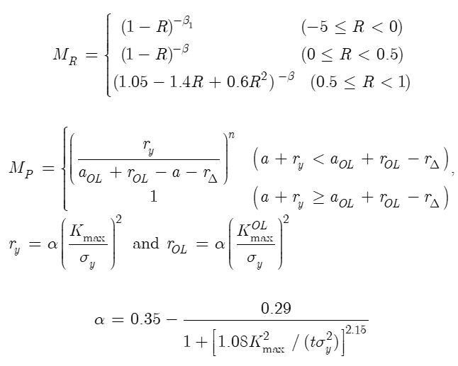


Huang’s Model for Fatigue Crack Growth cont.
$ΔK_{eq}$ includes crack tip plasticity and crack closure after overloading
$Y$: geometric factor
$M_{R}$:scaling factor for the loading ratio
$M_{P}$: correction factor for the loading sequence interaction
$$ΔK_{eq}=M_{R}M_{P}ΔK, ΔK=YΔσ\sqrt{πa}$$
$R=\frac{σ_{min}}{σ_{max}}$: Load ratio
$β, β_{1}$: shaping exponents
$r_{y}$: plastic zone size
$r_{Δ}$: increment of the plastic zone size
$n$: shaping exponent
$α$: plastic zone size factor
$K_{max}$: maximum stress intensity factor
$σ_{y}$: tensile yield strength
Subscript OL: overload

Slide 13
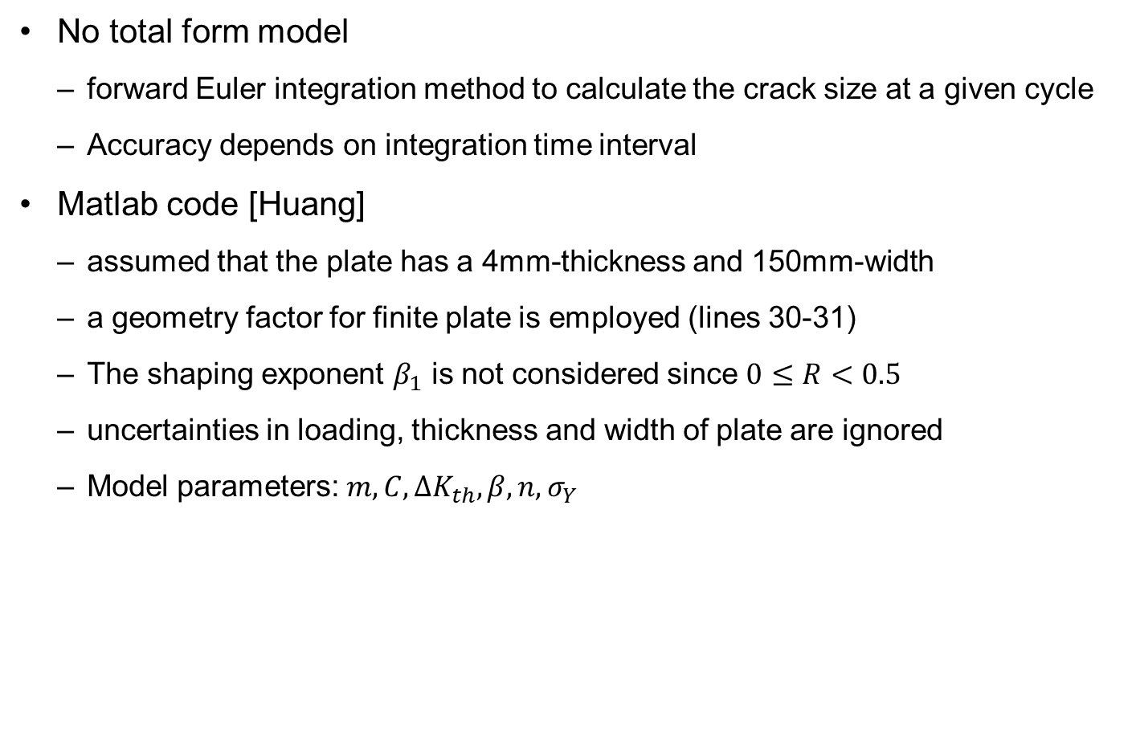
Huang’s Model for Fatigue Crack Growth cont.
No total form model
forward Euler integration method to calculate the crack size at a given cycle
Accuracy depends on integration time interval
Matlab code [Huang]
assumed that the plate has a 4mm-thickness and 150mm-width
a geometry factor for finite plate is employed (lines 30-31)
The shaping exponent $β_{1}$ is not considered since $0≤R<0.5$
uncertainties in loading, thickness and width of plate are ignored
Model parameters: $m, C, ΔK_{th}, β, n, σ_{Y}$

Slide 14
Matlab Code Huang
%=== PROBLEM DEFINITION (Loading and Model Parameters) ======
dN=1; % transition cycle interval
dtMeasu=1000; % measurement cycle interval
dSmin=5; % min. load
sNomin=65; % nominal load
sOverl=[125 100 100 125 125]; % overload
cNomin=[5 5 5 5 45]; % num. of cycle in a block: nominal load
cOverl=[45 45 95 95 5]; % num. of cycle in a block: overload
cBlock=[5000 10000 15000 20000 25000];% cycles for each block
a0=0.01; % true model param including initi crack, a0
m=3.1; C=log(5.5e-11); dKth=5.2; beta=0.2; n=2.8; sY=580;
thick=4e-3; width=150e-3/2; % geometry dimension
%============================================================
cycle=[0:dtMeasu:cBlock(end)]';
% % % LOAD RATIO, R
nb=length(cBlock);
cInter(1)=cBlock(1);
if nb>1; for i=2:nb; cInter(i)=cBlock(i)-cBlock(i-1); end;end

Slide 15
Matlab Code Huang cont.
dSmax=[];
for i=1:nb;
B=[sNomin*ones(cNomin(i),1); sOverl(i)*ones(cOverl(i),1)];
dSmax(length(dSmax)+1:cBlock(i),1)= ...
repmat(B,cInter(i)/(cNomin(i)+cOverl(i)),1);
end;
dSmax=dSmax(1:dN:end); R=dSmin./dSmax;
% % % HUANG's MODEL
aCurre(1)=a0; akOL(1)=a0; rOL(1)=0;
for k=1:max(cycle)/dN;
ak=aCurre(k);
Y=(1-ak./(2*width)+0.326.*(ak./width).^2)...%geometry factor
./sqrt(1-ak./width); loca=ak./width>1; Y(loca)=0;
Kmax=Y.*dSmax(k).*sqrt(pi*ak); %SIF from Eq. 6.5
Kmin=Y.*dSmin.*sqrt(pi*ak);
% Scaling factor, Mr (Eq. 6.6)
Mr=(1-R(k)).^(-beta);

Slide 16
Matlab Code Huang cont.
% Correction factor, Mp (Eqs. 6.7 and 6.8)
alpha=0.35-0.29./(1+(1.08.*Kmax.^2./(thick.*sY.^2)).^2.15);
ry=alpha.*(Kmax./sY).^2;
if R(k)~=dSmin/sNomin;
loca=ry>rOL; rOL(loca)=ry(loca); akOL(loca)=ak(loca);
end
Mp=(ry./(akOL+rOL-ak)).^n; loca=ak+ry>=akOL+rOL; Mp(loca)=1;
% Calculate crack size
dKeq=Mr.*Mp.*(Kmax-Kmin); % Eq. 6.5
rate=exp(C).*(dKeq.^m - dKth.^m); % Eq. 6.4
loca=dKeq<=dKth; rate(loca)=0;
aCurre(k+1)=aCurre(k)+rate.*dN;
end;
crackHuang=aCurre(1:dtMeasu/dN:max(cycle)/dN+1);
% % % DATA PLOT
plot(cycle,crackHuang);

Slide 17
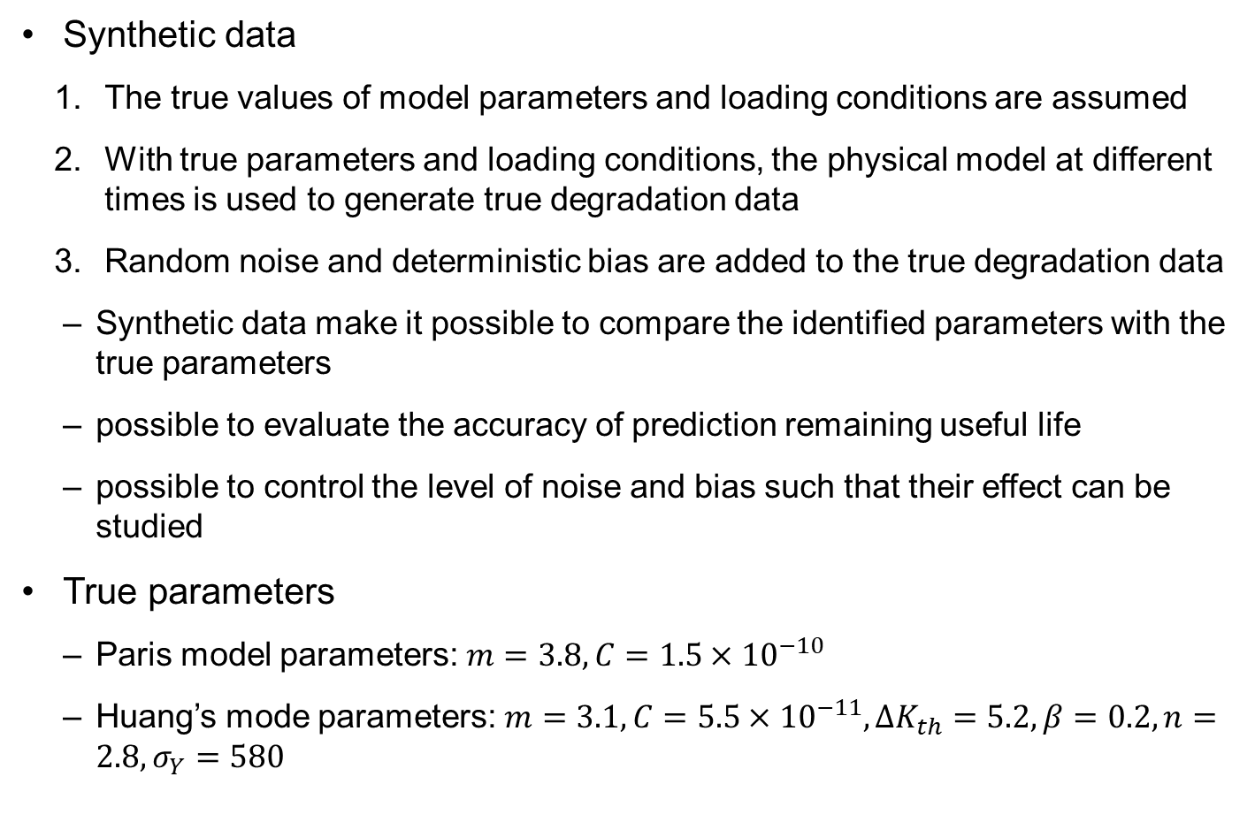
Health Monitoring Data and Loading Conditions
Synthetic data
The true values of model parameters and loading conditions are assumed
With true parameters and loading conditions, the physical model at different times is used to generate true degradation data
Random noise and deterministic bias are added to the true degradation data
Synthetic data make it possible to compare the identified parameters with the true parameters
possible to evaluate the accuracy of prediction remaining useful life
possible to control the level of noise and bias such that their effect can be studied
True parameters
Paris model parameters: $m=3.8, C=1.5×{10}^{−10}$
Huang’s mode parameters: $m=3.1, C=5.5×{10}^{−11}, ΔK_{th}=5.2, β=0.2, n=2.8, σ_{Y}=580$

Slide 18
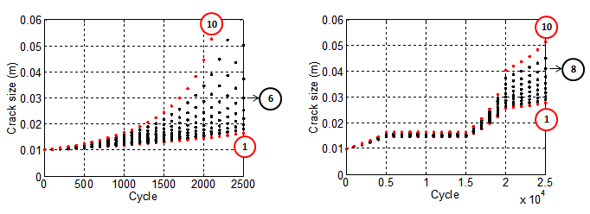

Health Monitoring Data and Loading Conditions
Data for Paris model
10 sets of true data by gradually increasing stress from 65 MPa to 83 MPa
Each set has 26 data until 2500 cycles (every 100 cycles)
Critical crack size $a_{C}=0.05m$

Slide 19
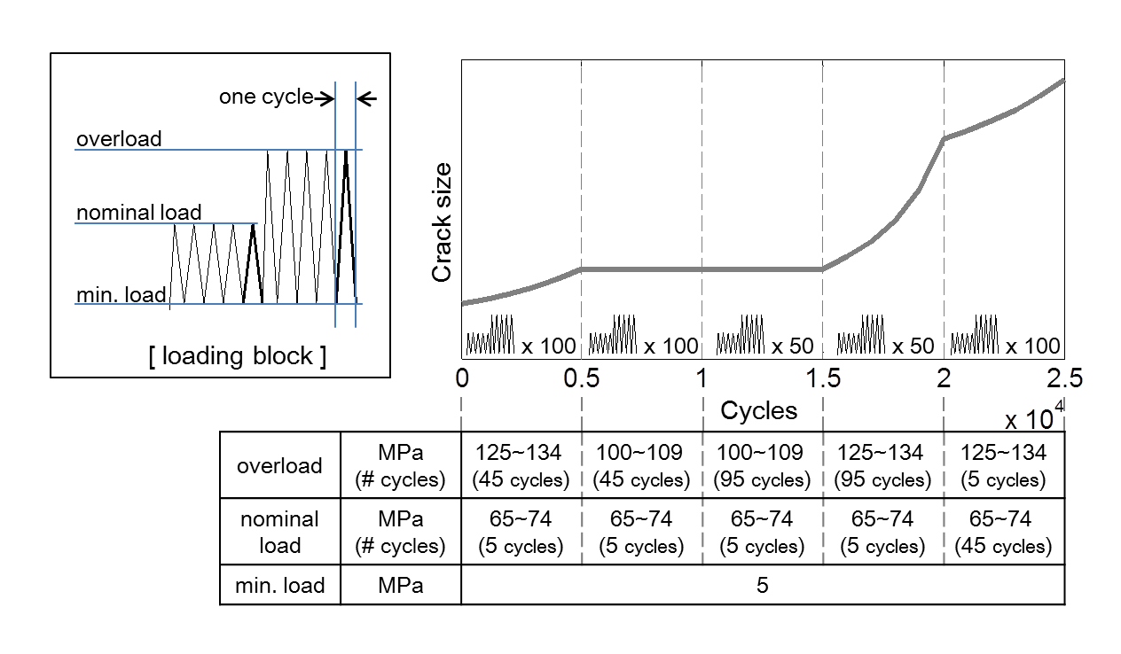
Health Monitoring Data and Loading Conditions
Data for Huang’s model
10 data sets with crack retardation and acceleration due to complex loadings
a loading block: fixed 5 MPa minimum load, two maximum loads (nominal load and overload)
Table shows 5 loading blocks scenario (5,000 cycles for each block)

Slide 20
Health Monitoring Data and Loading Conditions
Data for Huang’s model cont.
10 cases differ by the gradually increasing max loads by 1 MPa
Ex) case 1: nominal load 65 MPa & overload 125 MPa lasting 5 & 45 cycles
Retardation: the crack does not grow at all between 5000 and 15000 cycles
After 15000 cycles, the crack grows fast because underloads followed by overloads
The crack grows slowly after 20000 cycles because the number of cycles for overloads is reduced

Slide 21

Health Monitoring Data and Loading Conditions
Noise and bias
Deterministic bias: $−3$mm
Uniformly distributed random noise: $U[−v,v]$mm, $v=0, 1, 5$mm
Data-driven approaches:
Set 6 is prediction set for Paris model (all others are training set)
Set 8 is prediction set for Huang’s model (all others are training set)
b=-0.003; v=0.001;
crackSimpleMeas=crackSimple + v*(2*rand(10,26)-1) + b;
crackHuangMeas=crackHuang + v*(2*rand(10,26)-1) + b;

Slide 22
3. Physics-based Prognostics

Slide 23
Comparison of Physics-based Algorithms
Comparing physics-based prognostics algorithms for accuracy in parameter and RUL
focus on uncertainty and correlation in model parameters as well as model-form errors
Approaches
likelihood: normal distribution, prior: uniform (see table in the next slide)
Use 5000 samples to represent distributions (NLS, BM, PF)
NLS
Identify mean and covariance → t-distribution to generate 5000 samples
BM
6250 samples from MCMC and 1250 burn-in samples removed
PF
5000 particles from prior distribution → resampled based on weights

Slide 24
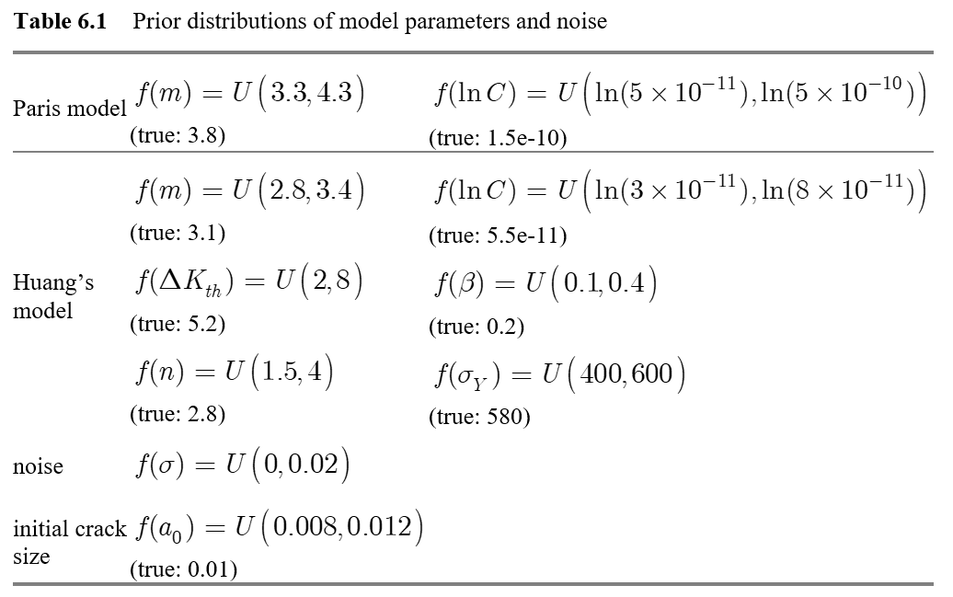
Prior Distributions

Slide 25
Correlation in Prognostics
Performance of different algorithms can be evaluated based on their ability to identify model parameters
Focus on physics-based prognostics is how to identify model parameters accurately with a smaller number of measured data
Correlation between parameters is the most challenging aspects
Probabilistic identification of parameters (due to noise and model-form error)
Marginal PDF is not accurate; Joint PDF (correlation) must be identified
Without properly identifying the correlation, the predicted RUL can be significantly different from the real one
Even if the accurate value of each parameter may not be identified, the RUL prediction can be reliable
all combinations of the correlated parameters can yield the same prediction

Slide 26
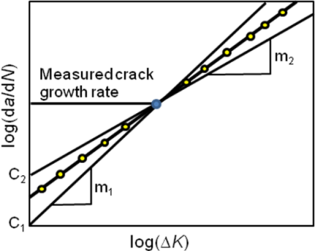
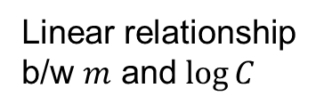


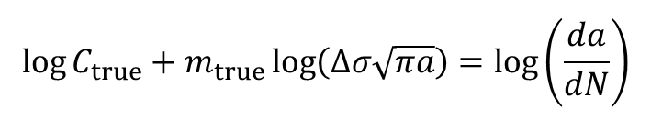
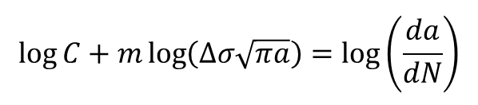
Correlation between Model Parameters
Paris model parameters $m$ and $C$ are strongly correlated
They can be identified with their correlation rather than individual values
For a given $ΔK$, multiple $\left(m,C\right)$ can yield the same growth rate
How can the change in correlation affect predictions
Paris model (logarithm)
$$\log{C}+m\log\left(Δσ\sqrt{πa}\right)=\log\left(\frac{da}{dN}\right)$$
$$\log{C_{true}}+m_{true}\log\left(Δσ\sqrt{πa}\right)=\log\left(\frac{da}{dN}\right)$$
$$\log{C}=\log{C_{true}}+\left(m_{true}−m\right)\log\left(Δσ\sqrt{πa}\right)$$
Linear relationship b/w $m$ and $\log{C}$

Slide 27
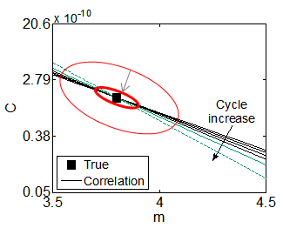


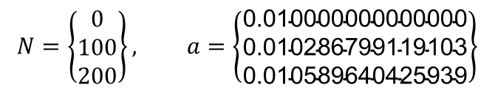

Correlation between Model Parameters cont.
Correlation gradually changes as crack grows
there is no deterministic relationship between parameters, and the relationship evolves as the crack size increases
The slope changes w.r.t. the true value
the true parameters can eventually be identified since the correlation converges to the true value by intersecting many correlation lines
True parameters can be obtained with only three exact degradation data
$\hat{m}=3.8,\log{\hat{C}}=−22.6204$
Very small covariance
$$\log{C}=\log{C_{true}}+\left(m_{true}−m\right)\log\left(Δσ\sqrt{πa}\right)$$
$$N=\left\{\begin{matrix}0 \\ 100 \\ 200\end{matrix}\right\}, a=\left\{\begin{matrix}\text{0.010000000000000} \\ \text{0.010286799119103} \\ \text{0.010589640425939}\end{matrix}\right\}$$
$$Σ_{θ}=\left[\begin{matrix}0.1825 & −0.4746 \\ −0.4746 & 1.2339\end{matrix}\right]×{10}^{−18}$$

Slide 28
Correlation between Model Parameters cont.
When data include noise, the linear relationship cannot be obtained
Measurement at 2 different cycles → 2 different slopes
No noise case:
The intersection of two lines can identify the true model parameters
Noisy data case
Due to uncertainty, line thickness is proportional to the level of noise
Intersection is an area, not a point → uncertainty in the identified parameters
Uncertainty increases when the level of noise is large and when the two slopes are not much different

Slide 29
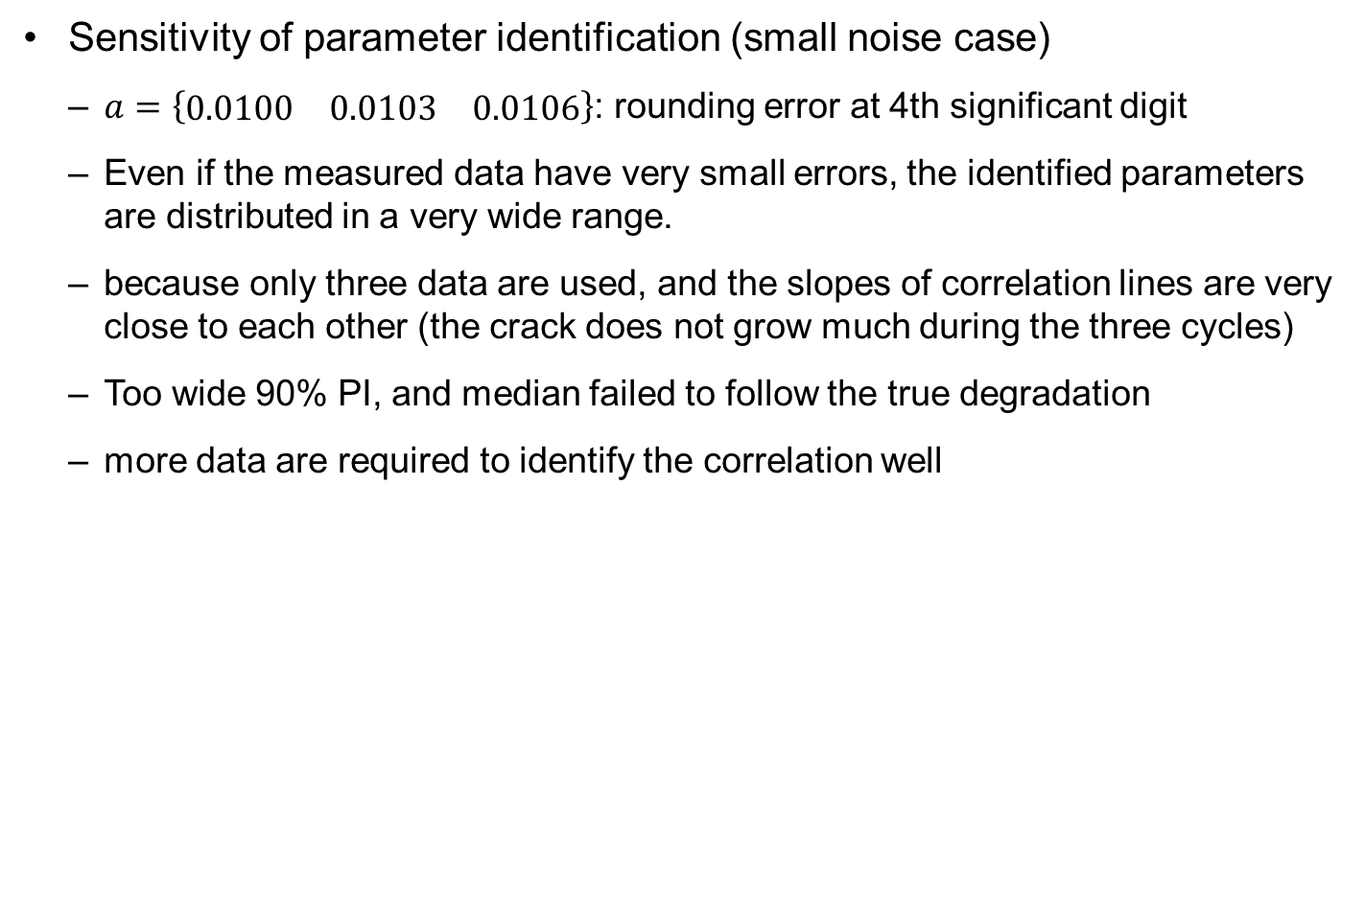
Correlation between Model Parameters cont.
Sensitivity of parameter identification (small noise case)
$a=\left\{\begin{matrix}0.0100 & 0.0103 & 0.0106\end{matrix}\right\}$: rounding error at 4th significant digit
Even if the measured data have very small errors, the identified parameters are distributed in a very wide range.
because only three data are used, and the slopes of correlation lines are very close to each other (the crack does not grow much during the three cycles)
Too wide 90% PI, and median failed to follow the true degradation
more data are required to identify the correlation well

Slide 30
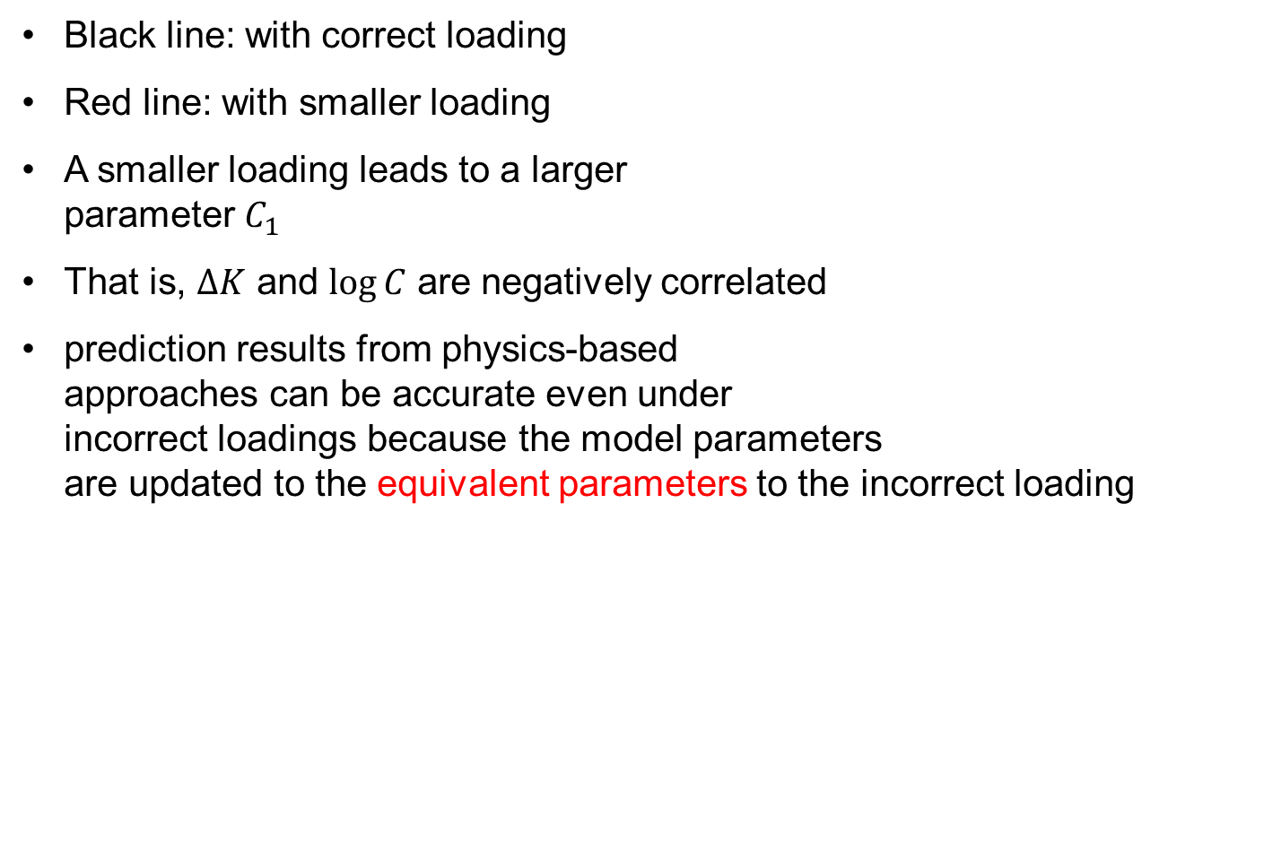
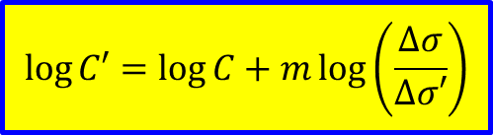
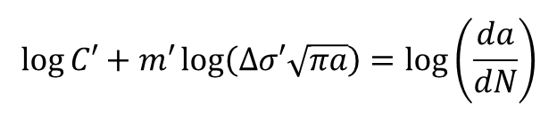
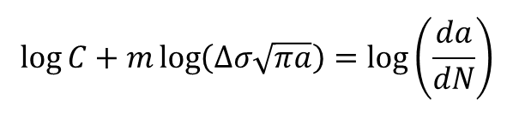
Correlation b/w Parameters and Loading
Black line: with correct loading
Red line: with smaller loading
A smaller loading leads to a larger parameter $C_{1}$
That is, $ΔK$ and $\log{C}$ are negatively correlated
prediction results from physics-based approaches can be accurate even under incorrect loadings because the model parameters are updated to the equivalent parameters to the incorrect loading
$$\log{C}+m\log\left(Δσ\sqrt{πa}\right)=\log\left(\frac{da}{dN}\right)$$
$$\log{C′}=\log{C}+m\log\left(\frac{Δσ}{Δσ′}\right)$$
$$\log{C′}+m′\log\left(Δσ′\sqrt{πa}\right)=\log\left(\frac{da}{dN}\right)$$

Slide 31

Correlation b/w Parameters and Loading cont.
Use dataset 10 $(Δσ_{true}=83MPa)$ with a wrong load of $Δσ=65MPa$
Prognostics using NLS
Overestimating $\log{C}$, but degradation follows the true one

Slide 32

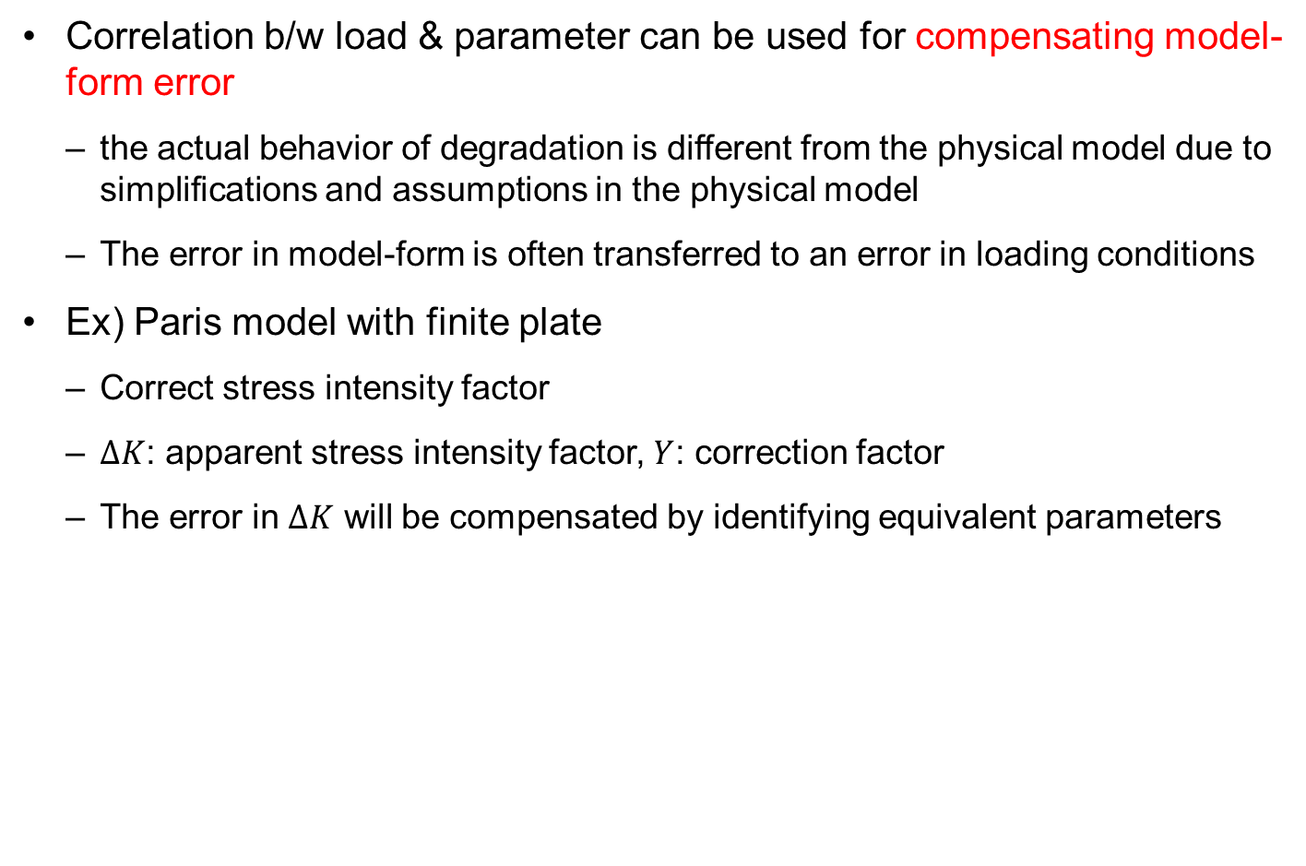
Compensating for Model-Form Error
Correlation b/w load & parameter can be used for compensating model-form error
the actual behavior of degradation is different from the physical model due to simplifications and assumptions in the physical model
The error in model-form is often transferred to an error in loading conditions
Ex) Paris model with finite plate
Correct stress intensity factor
$ΔK$: apparent stress intensity factor, $Y$: correction factor
The error in $ΔK$ will be compensated by identifying equivalent parameters
$$ΔK^{′}=YΔK$$

Slide 33
Correction Factor
The capability of compensating error in loading condition by identifying equivalent model parameters is limited to the case when the correction factor remains constant
the correction factor is a function of crack size, and it will evolve as the crack grows

Slide 34

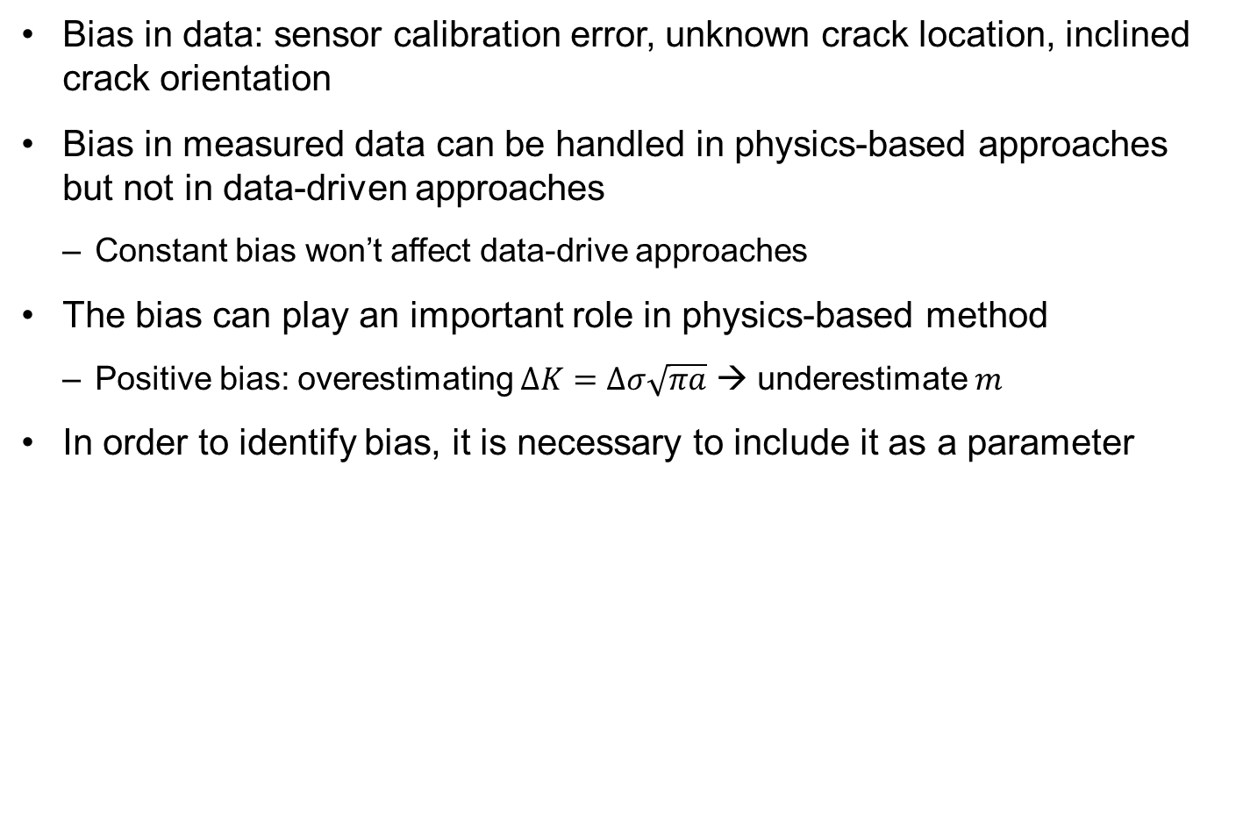
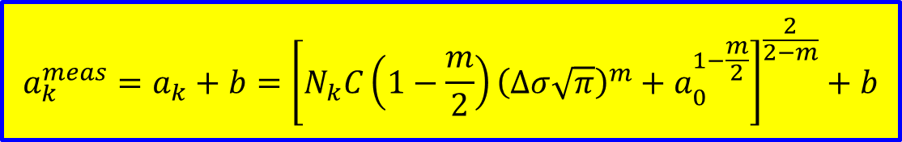
Correlation b/w Initial Crack Size and Bias
Bias in data: sensor calibration error, unknown crack location, inclined crack orientation
Bias in measured data can be handled in physics-based approaches but not in data-driven approaches
Constant bias won’t affect data-drive approaches
The bias can play an important role in physics-based method
Positive bias: overestimating $ΔK=Δσ\sqrt{πa}$ → underestimate $m$
In order to identify bias, it is necessary to include it as a parameter
$$a_{N}^{meas}=a_{N}+b$$
$$a_{k}^{meas}=a_{k}+b={\left[N_{k}C\left(1−\frac{m}{2}\right){\left(Δσ\sqrt{π}\right)}^{m}+a_{0}^{1−\frac{m}{2}}\right]}^{\frac{2}{2−m}}+b$$

Slide 35

Correlation b/w Initial Crack Size and Bias cont.
the bias is correlated with the initial crack size
Assume no noise in data
$a_{0}^{meas}=a_{0}+b$
For a given $a_{0}^{meas}$, infinitely possible combinations of $a_{0}$ and $b$ → linear correlation
Ex) $m$ and $C$ are known, $b=−3mm$, use 2 exact data to find $a_{0}$ and $b$
NLS identified ${\hat{a}}_{0}=0.01m$ and$\hat{b}=−0.003m$
Without bias correction
With bias correction

Slide 36
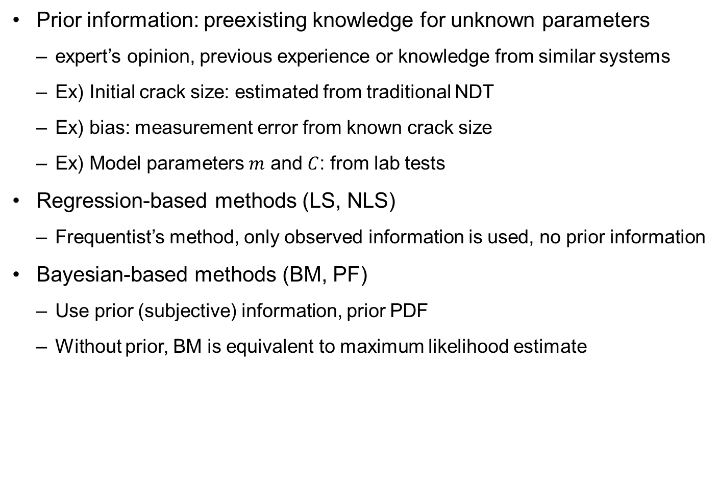
Prior Information
Prior information: preexisting knowledge for unknown parameters
expert’s opinion, previous experience or knowledge from similar systems
Ex) Initial crack size: estimated from traditional NDT
Ex) bias: measurement error from known crack size
Ex) Model parameters $m$ and $C$: from lab tests
Regression-based methods (LS, NLS)
Frequentist’s method, only observed information is used, no prior information
Bayesian-based methods (BM, PF)
Use prior (subjective) information, prior PDF
Without prior, BM is equivalent to maximum likelihood estimate

Slide 37
Prior information for Bayesian Inference
Performance of Bayesian inference
depends on the uncertainty in prior and the variability in measured data
Small uncertainty in the prior: measurement data may not contribute to improving the uncertainty in the posterior distribution (the prior distribution contributes the most to the posterior distribution)
Small variability in measured data: not much use for the prior (the posterior distribution is dominated by measured data)
Effect of the prior distribution
If the uncertainty in prior is small and it covers the true value of parameter, the prior can help accelerating the convergence of the posterior distribution
If the uncertainty in prior distribution is too big, it will not help to reduce uncertainty in the posterior distribution
non-informative prior: infinitely wide prior distribution, unnecessary to consider the prior distribution

Slide 38

Prior information for Bayesian Inference cont.
Incorrect prior
Wrong or inconsistent prior with measured data, it can prevent parameters from being accurately identified or slow down the estimation process
Ex) $m_{true}=3.8$ but $m_{prior}\sim U[3.0, 3.5]$: the posterior will not include the true parameter no matter how many measured data are used
Use dataset 6 with $v=1mm$ up to 1500 cycles
NLS show much larger uncertainty compared to BM and PF
NLS
BM
PF

Slide 39
Prior information for Bayesian Inference cont.
Inferior performance of NLS can be explained by its inability to utilize the prior information
Uniform prior cuts off the posterior distribution of BM and PF (make it narrower)

Slide 40
Prior information for Bayesian Inference cont.
The influence of prior is gradually reduced as more data are used
Increase # of date from 1500 to 2500 cycles
NLS
BM
PF

Slide 41
Sampling Error
the prediction result from PF is worse than the other two
accumulated sampling error during the updating process (particle depletion)
only a few samples remain after 25 updating process for PF (blue dots)
particle depletion has been the major drawback of PF
Possible remedy: add random samples from an arbitrary distribution during the prediction step so that duplicated particles are not generated
can change probabilistic characteristics of parameters and can increase the variance of parameters
BM has sampling error due to the random walk process in MCMC sampling
initial sample locations, the proposal distribution and the acceptance ratio have an effect on the sampling results
marginal density function can be used for the proposal distribution

Slide 42
Uncertainty Representation & Updating Process
NLS
Deterministic parameters (mean) and added linear correlation based on the covariance matrix (use t-distribution)
efficient for a strong linear correlation between unknown parameters
not easy to find accurate relation for many unknown parameters
BM and PF
a joint posterior distribution for unknown parameters (correlation can be well identified)
Posterior distributions are not limited to standard distribution types (represented by samples)
BM is faster when degradation model is given in a total form
BM can be impractical when the degradation model is given in the rate form
PF that is based on sequential updating process is only a practical method for the rate form of degradation model

Slide 43
Results Summary
NLS can be a simple and accurate prediction method when the parameters are linearly correlated
good with Gaussian noise in data and mildly nonlinear model
BM is an efficient method when the degradation model is given as a total form equation
the degradation model has to be computationally inexpensive
Grid approximation method for a small number of parameters
Most practical problems use MCMC to generate samples
Many MCMC samples are required for high-dimensional sampling
Choosing appropriate options in MCMC is a real problem (initial parameter values and the width of proposal distribution)
Too small width: not fully covering the target distribution
Too large width: many duplications in samples by not accepting new samples
the width of proposal distribution depends on the expected uncertainty in un-known parameters

Slide 44
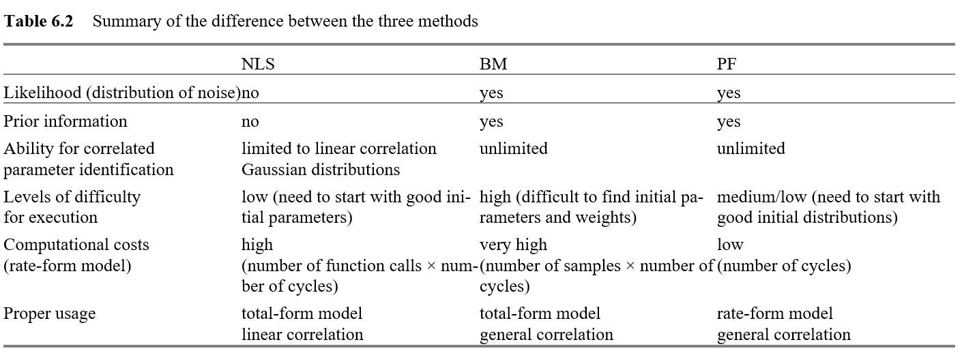
Results Summary cont.
PF is considered easy to use (not many options)
state transition function as a physical model (rate form)
particle depletion problem when many measured data are available

Slide 45
4. Data-driven Prognostics

Slide 46
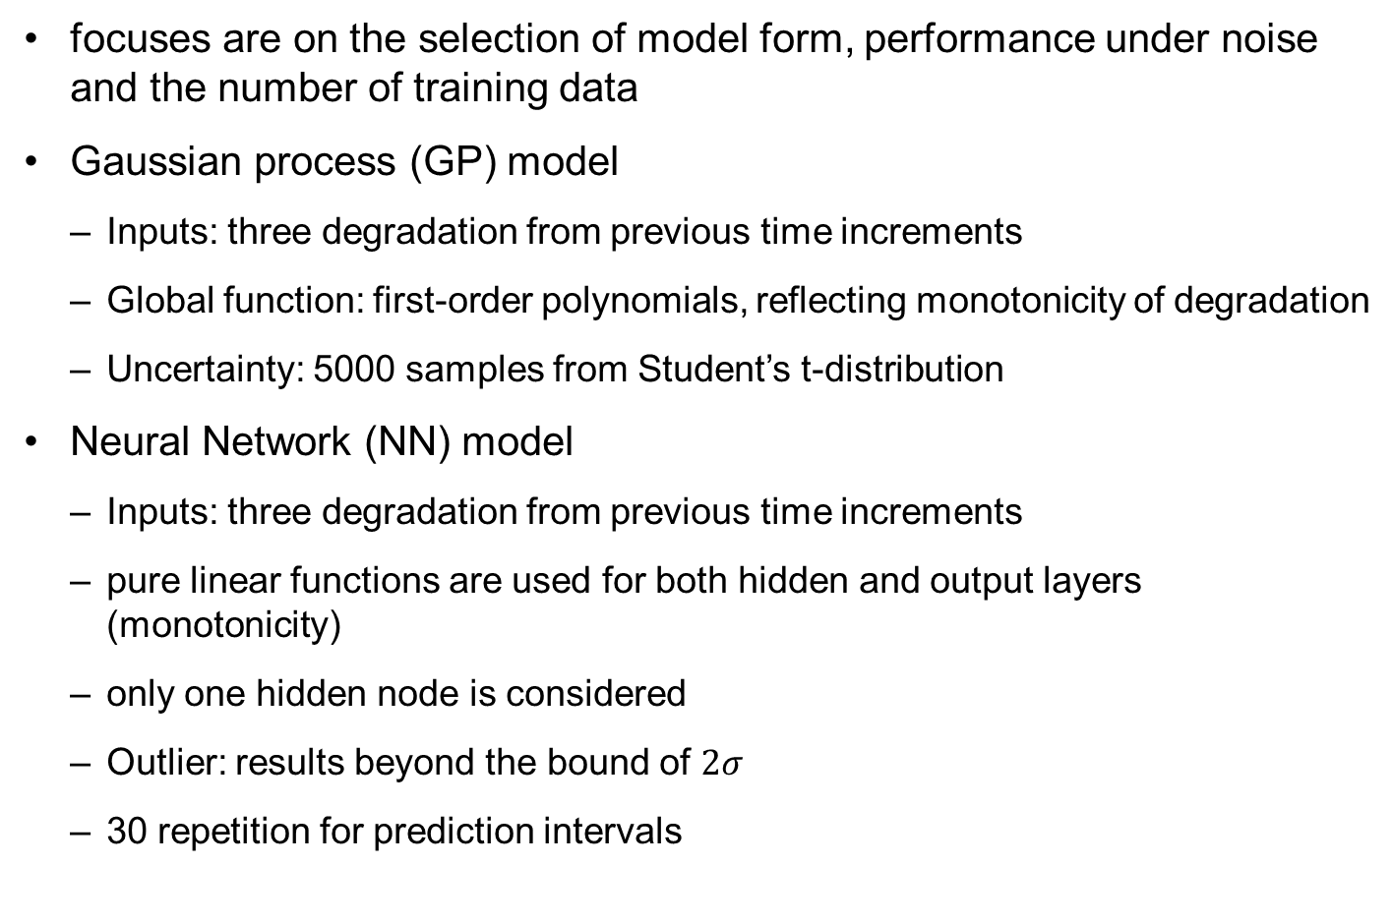
Comparison of Data-driven Algorithms
focuses are on the selection of model form, performance under noise and the number of training data
Gaussian process (GP) model
Inputs: three degradation from previous time increments
Global function: first-order polynomials, reflecting monotonicity of degradation
Uncertainty: 5000 samples from Student’s t-distribution
Neural Network (NN) model
Inputs: three degradation from previous time increments
pure linear functions are used for both hidden and output layers (monotonicity)
only one hidden node is considered
Outlier: results beyond the bound of $2σ$
30 repetition for prediction intervals

Slide 47



Simple Crack Growth Model
No training dataset, prediction dataset 6 up to 1500 cycles
uniformly distributed random noise $U\left(−0.001, 0.001\right)$
GP predicts slightly better than NN
Higher (data/parameter) ratio for GP
v=0.001;
crackSimpleMeas=crackSimple(6,1:16) + v*(2*rand(1,16)-1);
GP with $h_{0}=0.05$
NN with $ns=26$

Slide 48


Simple Crack Growth Model cont.
prediction results using data up to 500 cycles with zero noise + training sets 5 and 7 (up to 2500 cycles)
good prediction results in the interpolation regions
GP works well in the interpolation region with small noise (accurate correlation)
Beyond 2500 cycles, extrapolation and prediction deteriorates quickly
NN works better for extrapolation, but accuracy is worse than GP
GP with $h_{0}=0.05$
NN with $ns=26$

Slide 49



Simple Crack Growth Model cont.
Large noise $U(−0.005, 0.005)$
prediction performance of GP is significantly deteriorated (correlation cannot clearly be identified)
GP performance is improved with $h=0.001$
the optimum value of the hyper-parameter remains the same as the initial value
the prediction results totally depend on the linear global function
GP with $h_{0}=0.05$
GP with $h_{0}=0.001$

Slide 50

Simple Crack Growth Model cont.
NN outperformed GP
When there is a large level of noise in data, having training sets may not help much in improving prediction accuracy
when the level of noise is large, it may help to use time/cycle as an input in NN in-stead of using the previous data as input
NN with $ns=26$
time as input and sigmoid function

Slide 51
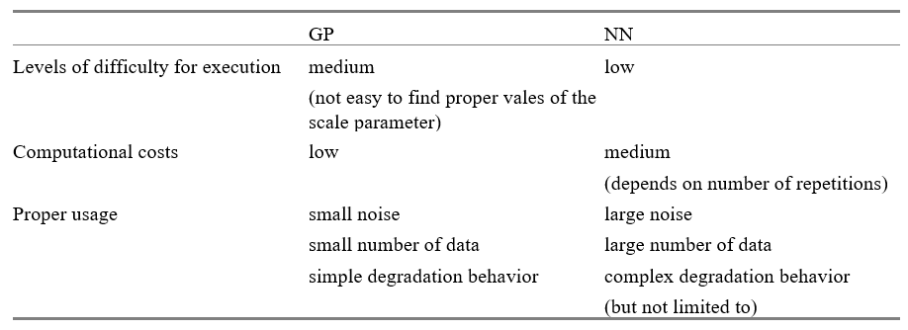
Results Summary
GP is an efficient and accurate prediction method when a small number of data are given with a small level of noise
It is, however, not an easy task to build a proper correlation matrix since not only a large level of noise but also a large number of data adversely affect handling the correlation matrix
NN is less sensitive in the level of noise
a large number of data increase the accuracy in prediction results

Slide 52
5. Comparison between Physics-based and Data-driven Prognostics

Slide 53
Comparison Using Huang’s Model
PF with distributed initial damage size
NN with ns=8 training Sets 2, 7 and 9
PF with true value of initial damage size
NN with ns=23 training Sets 2, 7 and 9 and loading conditions

Slide 54
Comparison Using Huang’s Model cont.
Rate form: NLS and BM are not effective
PF for physics-based model and NN for data-driven model
PF using data up to 16,000 cycles (7 parameters, 5000 particles)
Using accurate initial damage is important for the accuracy
NN using 3 training data sets
Proximity between training data (7, 9) and prediction data set (8)
22 out of 30 repetitions failed to satisfy 2 regulations
Loading information can improve the accuracy
With more training data sets and loading information, data-driven approaches can outperform physics-bade approaches

Slide 55
Summary
Physics-based methods
less affected by the level of noise and model complexity
employed only when a physical model and loading conditions are available
NLS works favorable for a linear correlation case
PF has a wide range of applications
BM is fast when the expression of posterior distribution is available explicitly
Data-driven methods
GP works well when the covariance function is well-defined, such as the case of low noise in data and simple behavior of the damage growth
GP can outperform other algorithms if interpolation conditions can be considered with the given information
GP is easy to implement and quick to calculate, which gives prediction results with interval within around 2 seconds

Slide 56
Summary cont.
Data-driven methods
NN does not require choosing various tuning parameters
the computational cost depends on each training case
NN is advantageous for cases with high levels of noise and complex models with many training data sets
When loading conditions and physical models are not available
prediction can be done by using data-driven approaches with at least three data sets, and loading conditions improve the prediction results
Hybrid approaches or fusion methods that combine the two approaches or prediction results can be considered to improve the prediction performance

