Slide 1
Chapter 7 Applications of Prognostics

Slide 2
1. Introduction

Slide 3
Challenges in Physics-based Approaches
Difficult to accurately identify model parameters due to the correlation between them and a large level of noise and bias in data
Even if accurate values of individual parameters may not be found, the prediction of RUL can still be accurate
Under model-form error, prognostics algorithms can identify equivalent parameters that can compensate for the model-form error
A good prior information can help to reduce uncertainty in the estimated parameters, but inaccurate prior can prevent from converging accurate values

Slide 4
Challenges in Data-driven Approaches
Data-driven approaches are also affected by the level of noise, but obtaining a large number of training data is a challenge
it is possible to utilize the data obtained from accelerated life test during the development of the current system design
Since accelerated life tests are performed much severe operating conditions, it is necessary to convert them corresponding to the nominal operating conditions in order to be used as training data

Slide 5
Indirect CM Data
In many cases, the damage data cannot be measured directly, but system responses that are affected by damage are measured instead
vibration data are often measured to monitor any cracks on bearings and gears, from which the level of damage in bearings is to be predicted
difficult to extract degradation features from indirectly measured data
important to separate signals from noise
signal-to-noise ratio (SNR) becomes an important issue

Slide 6
2. In-situ Monitoring and Prediction of Joint Wear

Slide 7
Prognostics of Wear Volume in a Revolute Joint
Most mechanical joints are under sliding motion, which causes wear
Wear is the gradual removal of material from contacting surfaces in relative motion, which eventually causes failure of the system
important to predict its effects and estimate the service life of the system before failure
Common approaches
(a) estimating wear coefficient from tribometer tests
(b) calculating contact pressure and sliding distance
(c) using a wear model to calculate wear depth as well as wear volume
Challenges
Wear coefficient is a function of contact pressure and surface condition
Variability of wear coefficient is significant even for the same material
In-situ measurement of wear coefficient is preferable

Slide 8
Prognostics of Wear Volume in a Revolute Joint
In-situ measurement
Kinematic information: wear volume and sliding distance
Kinetic information: contact force/pressure
We will use an instrumented slider-crank mechanism
Since in-situ measurements inherently include uncertainty, the statistical distribution of wear coefficient are updated based on the Bayesian method
This application shows how difficult to measure the direct CM data

Slide 9

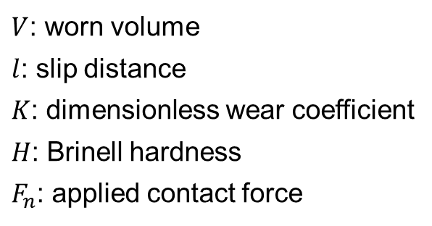
Wear Model and Wear Coefficient
Archard wear model
plastic deformation is a dominant mechanism of material removal
assumes that the volume of material removed is linearly proportional to the product of the sliding distance and the normal load
wear coefficient: slope between the wear volume and sliding distance
$$\frac{V}{l}=K\frac{F_{n}}{H}$$
$V$: worn volume
$l$: slip distance
$K$: dimensionless wear coefficient
$H$: Brinell hardness
$F_{n}$: applied contact force

Slide 10
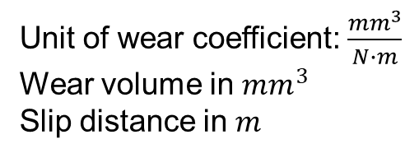


Wear Model and Wear Coefficient cont.
Dimensioned wear coefficient
Objective: identify the wear coefficient for given normal load and slip distance
Variable normal forces
Assumption: wear coefficient is independent of normal force
The wear coefficient is not an intrinsic material property
depends on operating conditions, such as the normal force and slip speed
experimentation does not often represent the real conditions of a machine
Unit of wear coefficient: $\frac{mm^{3}}{N∙m}$
Wear volume in $mm^{3}$
Slip distance in $m$
$$k=\frac{V}{F_{n}∙l}$$
$$k=\frac{V}{\int_{0}^{l}{f_{n}\left(l\right)dl}}$$

Slide 11

In-Situ Measurement for a Slider-Crank
porous carbon air bearings for the revolute joint between the follower link and the slide stage, as well as the prismatic joint for the linear slide
Revolute joint: steel pin + polymer (PTFE) bushing
No wear at steel pin, but considerable wear at bushing
Debris groove to remove worn materials
Debris groove

Slide 12
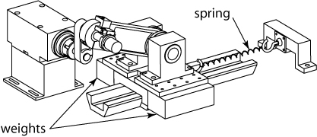
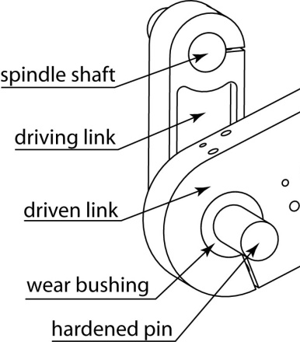
Measurement Instrument
added mass and springs affect the joint force and accelerate wear
Factors to affect wear process
(1) wear coefficient
(2) joint force
(3) relative motion in the interface
Force at joint: load cell measurement
Two full-bridge arrays of strain gages mounted to a necked-down portion of the pin monitor transverse loads while cancelling out bending stresses
Joint of interest

Slide 13
Measurement Instrument cont.
Steel pin load cell
Two full-bridge arrays of strain gages mounted to a necked-down portion of the pin monitor transverse loads while cancelling out bending stresses

Slide 14
Measurement Instrument cont.
two orthogonally-mounted capacitance probes monitor the position of the pin relative to bushing

Slide 15
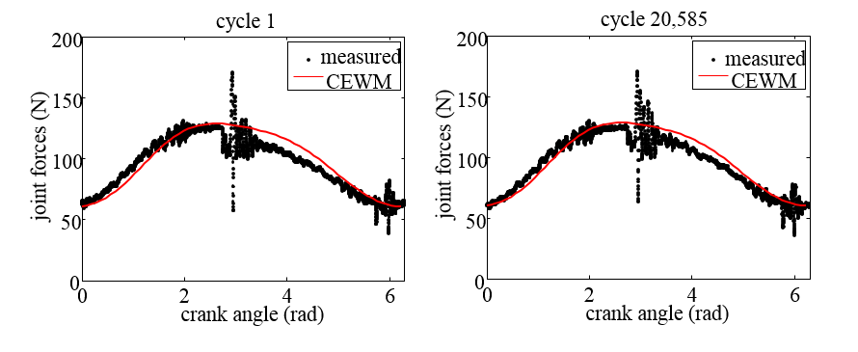
Joint Force Measurement
measured joint force agrees well with the multibody dynamic simulation with the coupled evolution wear model
High frequency oscillation is observed when the slider changes its velocity direction
No significant variation of joint forces between different cycles
the profile of joint forces is fixed throughout all cycles

Slide 16
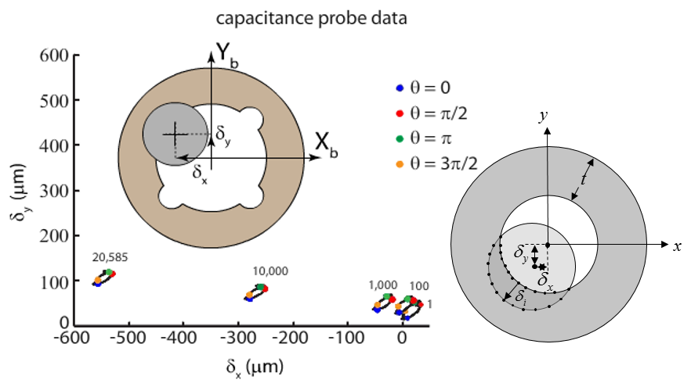

Capacitance Probe Displacement Measurement
measured displacements of the pin center using the capacitance probe
Wear volume can be calculated using $δ_{x}$ and $δ_{y}$
Springs make the contact points located at only one side of the bushing

Slide 17
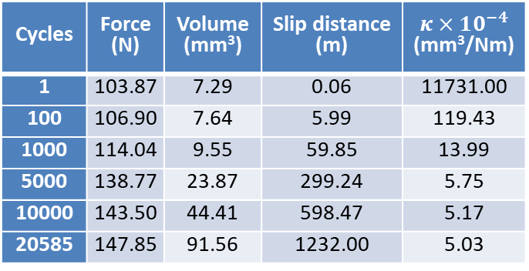
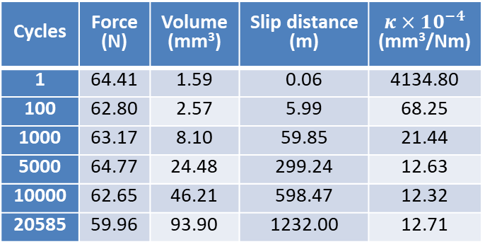

Wear Coefficients
Calculate wear coefficients at different angle positions
Showing convergence but the converged results do not match
because the joint force is not constant with angle and the measured wear volume includes uncertainty
Goal: estimate the wear coefficient using the first five sets and then predict the wear volume in the sixth cycle
Angle location = 0 radian
Angle location = $π$ radian
Cycles | Force (N) | Volume (mm³) | Slip distance (m) | $$κ×10^{−4}$$ (mm³/Nm)
1 | 64.41 | 1.59 | 0.06 | 4134.80
100 | 62.80 | 2.57 | 5.99 | 68.25
1000 | 63.17 | 8.10 | 59.85 | 21.44
5000 | 64.77 | 24.48 | 299.24 | 12.63
10000 | 62.65 | 46.21 | 598.47 | 12.32
20585 | 59.96 | 93.90 | 1232.00 | 12.71
Cycles | Force (N) | Volume (mm³) | Slip distance (m) | $$κ×10^{−4}$$ (mm³/Nm)
1 | 103.87 | 7.29 | 0.06 | 11731.00
100 | 106.90 | 7.64 | 5.99 | 119.43
1000 | 114.04 | 9.55 | 59.85 | 13.99
5000 | 138.77 | 23.87 | 299.24 | 5.75
10000 | 143.50 | 44.41 | 598.47 | 5.17
20585 | 147.85 | 91.56 | 1232.00 | 5.03

Slide 18

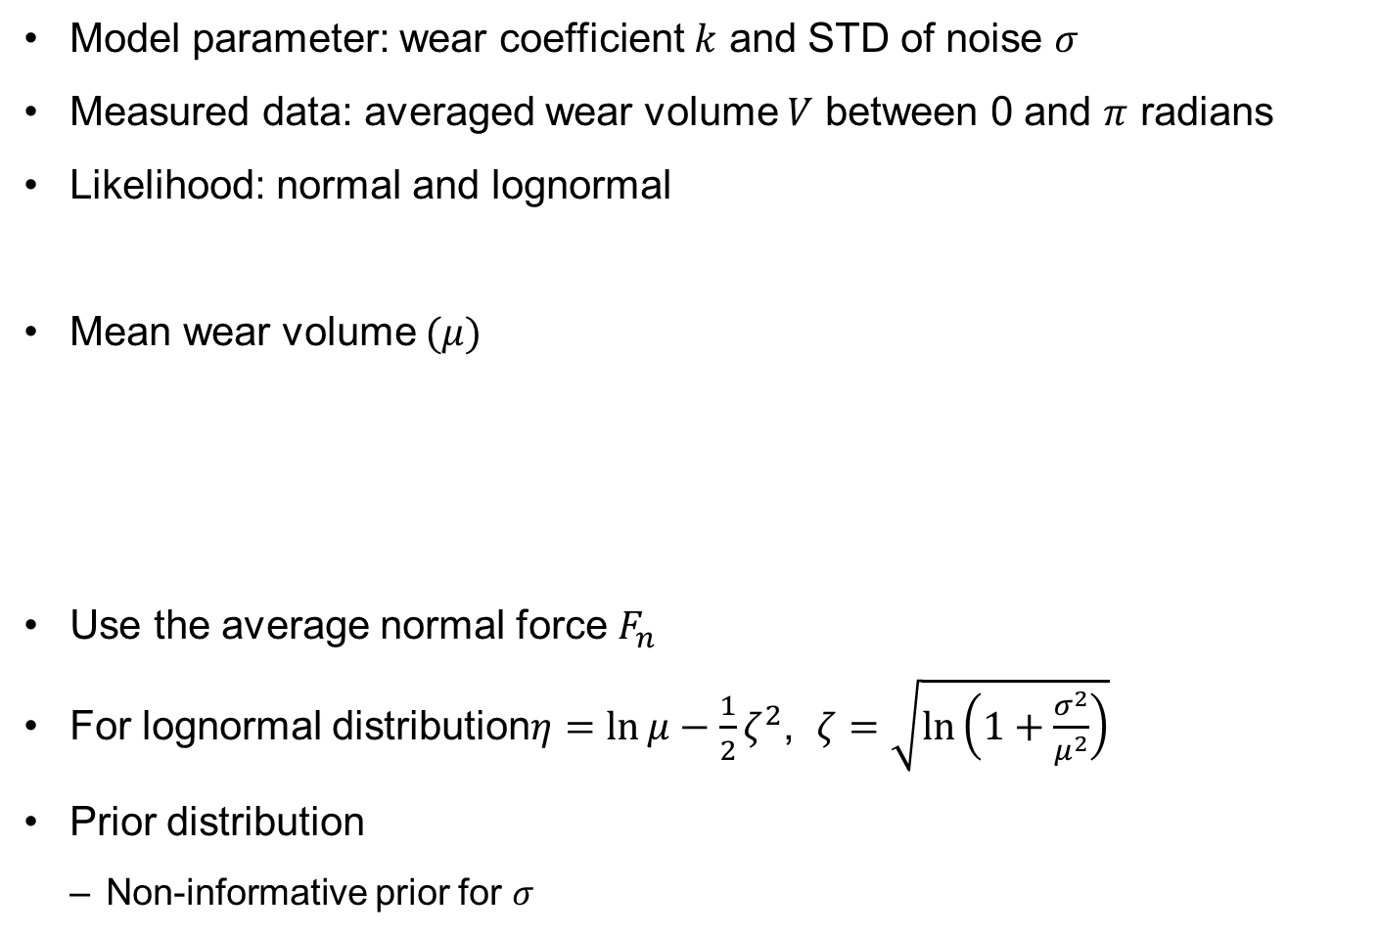

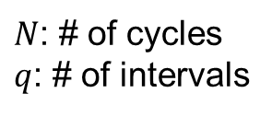
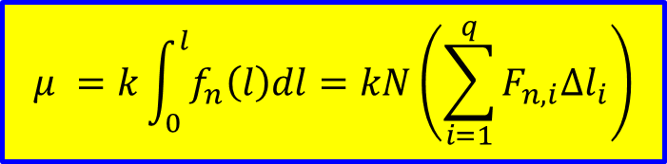
Bayesian Inference
Model parameter: wear coefficient $k$ and STD of noise $σ$
Measured data: averaged wear volume $V$ between 0 and $π$ radians
Likelihood: normal and lognormal
Mean wear volume $(μ)$
Use the average normal force $F_{n}$
For lognormal distribution$η=\ln{μ}−\frac{1}{2}ζ^{2}$, $ζ=\sqrt{\ln\left(1+\frac{σ^{2}}{μ^{2}}\right)}$
Prior distribution
Non-informative prior for $σ$
$$f\left(V\right|k,σ)\sim N\left(μ,σ^{2}\right), f\left(V\right|k,σ)\sim LN\left(η,ζ^{2}\right)$$
$$μ =k\int_{0}^{l}{f_{n}\left(l\right)dl}=kN\left(\sum_{i=1}^{q}{F_{n,i}Δl_{i}}\right)$$
$N$: # of cycles
$q$: # of intervals
$$μ=kF_{n}l$$
$$f\left(k\right)\sim N(5.05,0.74)×{10}^{−4}$$

Slide 19
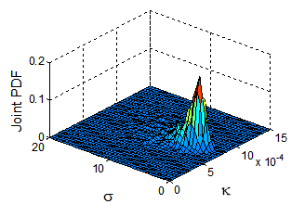

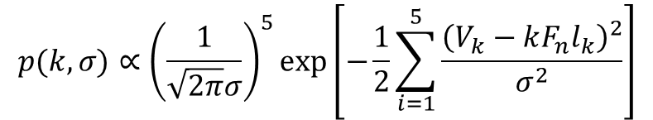
MCMC Simulation
Posterior distribution (non-informative prior)
Measurement model
MCMC sampling results
$$p(k,σ)∝{\left(\frac{1}{\sqrt{2π}σ}\right)}^{5}\exp\left[−\frac{1}{2}\sum_{i=1}^{5}{\frac{{\left(V_{k}−kF_{n}l_{k}\right)}^{2}}{σ^{2}}}\right]$$
$$V_{k}=kF_{n}l_{n}+ε, ε\sim N(0,σ^{2})$$
Burn-in

Slide 20
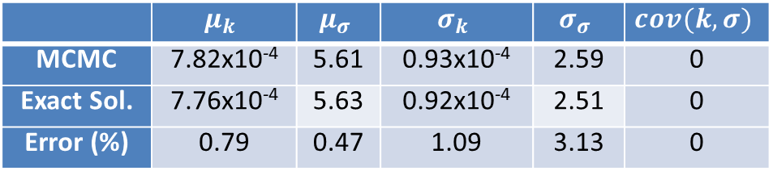
MCMC Simulation cont.
Statistical moments of parameters
 | $$μ_{k}$$ | $$μ_{σ}$$ | $$σ_{k}$$ | $$σ_{σ}$$ | $$cov(k,σ)$$
MCMC | 7.82x10⁻⁴ | 5.61 | 0.93x10⁻⁴ | 2.59 | 0
Exact Sol. | 7.76x10⁻⁴ | 5.63 | 0.92x10⁻⁴ | 2.51 | 0
Error (%) | 0.79 | 0.47 | 1.09 | 3.13 | 0

Slide 21
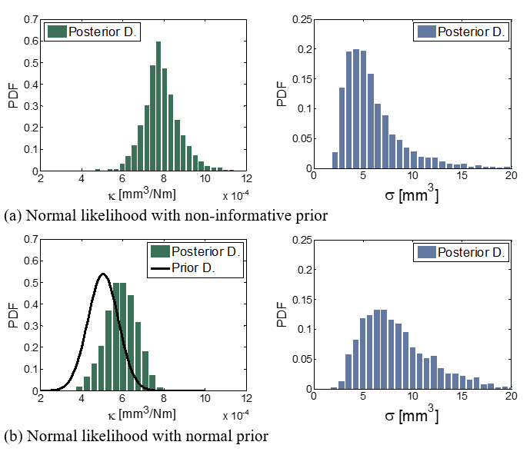
Identification of Wear Coefficient
Posterior distribution (normal likelihood)

Slide 22
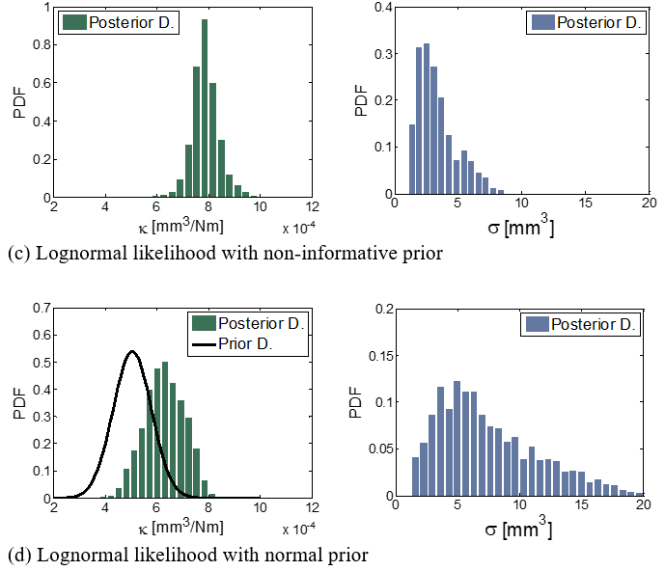
Identification of Wear Coefficient cont.
Posterior distribution (lognormal likelihood)

Slide 23
Identification of Wear Coefficient cont.
Using the first 5 data
STD from lognormal likelihood (0.51) is better than that of normal likelihood (0.90), but the means are nearly identical
Maybe because wear coefficient is non-negative
Likelihood | Prior | Data set No. | 3 | 4 | 5 | 6
normal | non-inform | mean | 17.49 | 8.28 | 7.89 | 7.57
 |  | std. | 10.02 | 2.32 | 0.90 | 0.40
 | prior | mean | 5.11 | 5.42 | 5.93 | 6.89
 |  | std. | 0.73 | 0.73 | 0.76 | 0.57
lognormal | non-inform | mean | 20.81 | 8.89 | 7.88 | 7.64
 |  | std. | 5.82 | 1.17 | 0.51 | 0.25
 | prior | mean | 5.46 | 5.67 | 6.29 | 7.41
 |  | std. | 0.72 | 0.75 | 0.77 | 0.25

Slide 24
Identification of Wear Coefficient cont.
the use of a normal prior leads to underestimation of the mean for k
Due to the inaccurate prior distribution
it can be concluded that the prior contributes significantly to the posterior distribution
the prior information is not consistent with observed data
Non-informative cases are close to Laplace distribution
Normal prior failed to include the target value
Due to erroneous prior
Normal likelihood
Lognormal likelihood

Slide 25
Prediction of Wear Volume
Use the identified wear coefficient, predict wear volume
Predict wear volume at 6th data (20,585 cycles)
the use of selected prior does not predict the wear volume well
the size of the interval of the lognormal likelihood is smaller than that of the normal likelihood
Normal likelihood
Lognormal likelihood

Slide 26
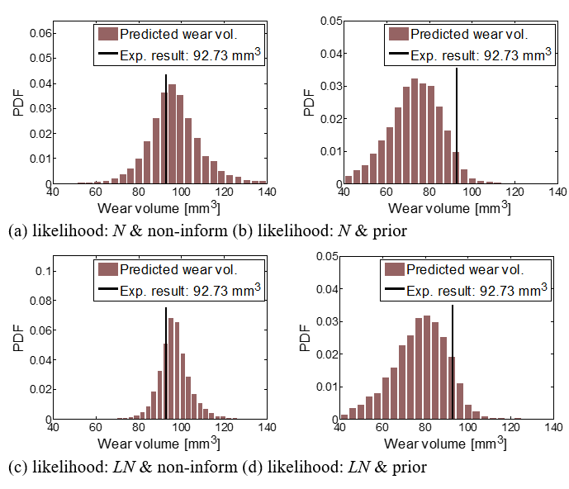
Predicted Distribution of Wear Volume

Slide 27
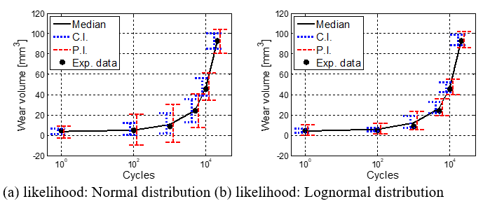
CI and PI of Wear Volume
CI and PI have a tendency to gradually decrease from 1,000 cycles as the cycles increase
CI and PI are small at first stage
Large uncertainty in wear volume, but wear volume itself is very small

Slide 28
CI and PI of Wear Volume cont.
The CIs and PIs of the lognormal case are smaller than that of the normal case, which demonstrates improved accuracy
Data set No. |  |  | 1 | 2 | 3 | 4 | 5 | 6
measured wear V |  |  | 4.44 | 5.105 | 8.825 | 24.175 | 45.31 | 92.73
C.I. | N | 95% | 6.61 | 12.13 | 22.14 | 35.75 | 56.25 | 100.38
 |  | 5% | 0.75 | 0.35 | 2.03 | 12.78 | 38.87 | 85.09
 |  | inter | 5.86 | 11.77 | 20.11 | 22.97 | 17.38 | 15.28
 | LN | 95% | 6.61 | 7.06 | 18.73 | 32.88 | 52.27 | 99.04
 |  | 5% | 2.50 | 3.60 | 7.66 | 21.52 | 42.31 | 88.78
 |  | inter | 4.11 | 3.46 | 11.07 | 11.36 | 9.96 | 10.26
P.I. | N | 95% | 9.19 | 20.32 | 30.96 | 40.34 | 60.64 | 104.04
 |  | 5% | -2.84 | -9.18 | -7.01 | 7.56 | 33.78 | 81.22
 |  | inter | 12.03 | 29.50 | 37.97 | 32.78 | 26.87 | 22.82
 | LN | 95% | 9.90 | 12.22 | 23.72 | 36.06 | 55.18 | 101.86
 |  | 5% | 0.24 | 1.23 | 5.18 | 19.36 | 39.87 | 86.70
 |  | inter | 9.66 | 10.99 | 18.53 | 16.70 | 15.30 | 15.15

Slide 29
3. Correlated Damage Parameters under Noise and Bias

Slide 30
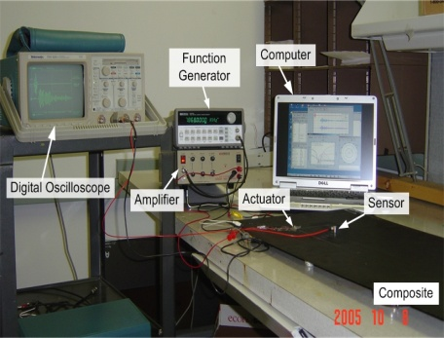
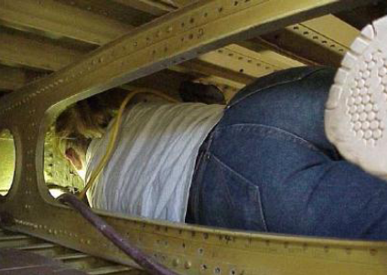

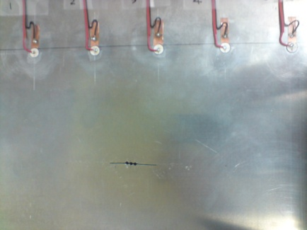
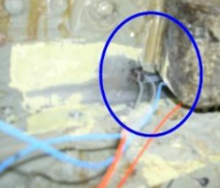
Motivation
Maintenance is essential to keep Airplanes safe
Sensors/actuators
Damage
Preventive Maintenance (PM)
manual inspection with equipment
accurate but can miss large damage
cost and time inefficient
detecting current damage
Condition-based Maintenance (CBM)
Structural Health Monitoring (SHM)
cost and time efficient
predicting the future status and RUL
prognostics

Slide 31
Introduction
Prognostics methods
data-driven approach
model-based approach
hybrid approach
Crack growth
in an aircraft panel
physics model: Paris model
measurement data
identifying model parameters
predicting future status and RUL

Slide 32
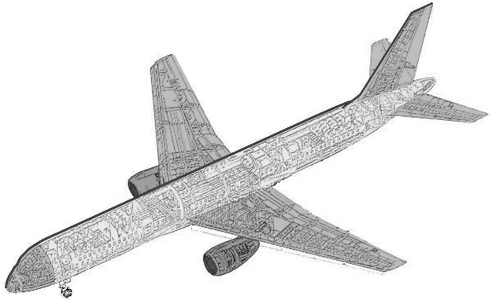


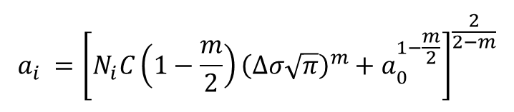


Damage growth and measurement uncertainty models
Damage growth model
Paris model:
$a$ : half crack size
$N$ : number of cycles
$ΔK$ : range of stress intensity factor
$Δσ$ : stress range
$m,C$ : damage parameters
half crack size, $a_{i}$ after $N_{i}$ cycles
critical crack size
$$\frac{da}{dN}=C{\left(ΔK\right)}^{m}$$
$$ΔK=Δσ\sqrt{πa}$$
σ
$$a_{i} ={\left[N_{i}C\left(1−\frac{m}{2}\right){\left(Δσ\sqrt{π}\right)}^{m}+a_{0}^{1−\frac{m}{2}}\right]}^{\frac{2}{2−m}}$$
σ
[ Through-the-thickness crack in a fuselage panel ]
$$a_{C}={\left(\frac{K_{IC}}{Δσ\sqrt{π}}\right)}^{2}$$

Slide 33
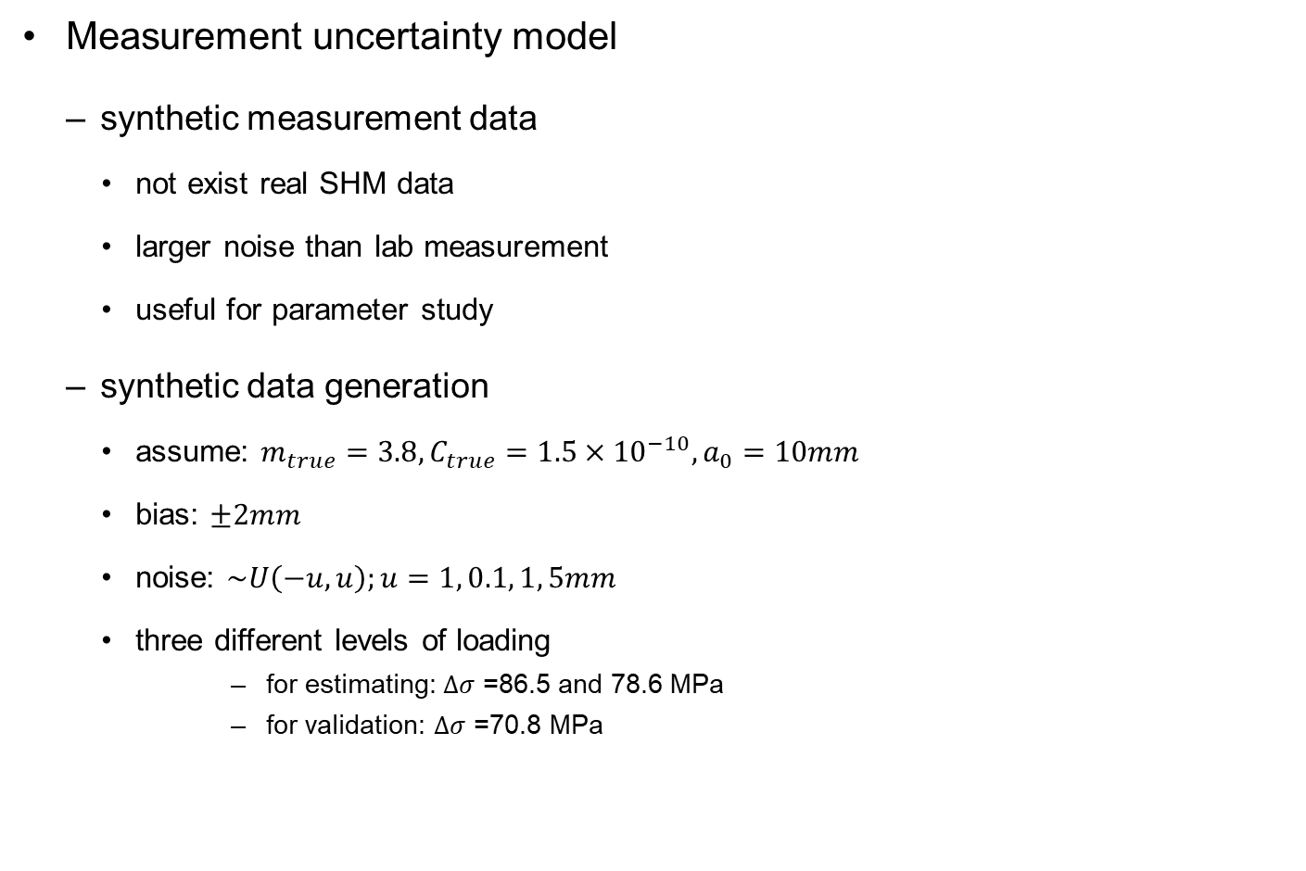
Damage growth and measurement uncertainty models
Measurement uncertainty model
synthetic measurement data
not exist real SHM data
larger noise than lab measurement
useful for parameter study
synthetic data generation
assume: $m_{true}=3.8, C_{true}=1.5×{10}^{−10}, a_{0}=10mm$
bias: $±2mm$
noise: $\sim U\left(−u,u\right);u=1, 0.1, 1, 5mm$
three different levels of loading
for estimating: $Δσ$ =86.5 and 78.6 MPa
for validation: $Δσ$ =70.8 MPa
[ bias = +2mm and noise = 0mm ]
[ bias = +2mm and noise = 5mm ]

Slide 34
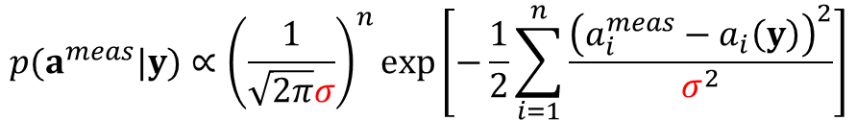

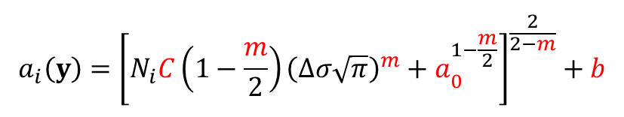
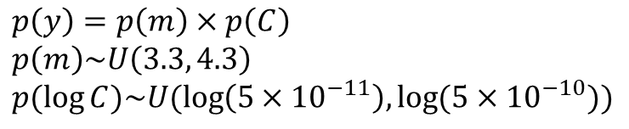


Damage growth parameters estimation
Bayesian inference for identifying parameters
Bayes’ theorem:
likelihood function
prior PDF:
$$p\left(y\left|a^{meas}\right|y\right)∝p\left(a^{meas} | y\right)p(y)$$
$$p(a^{meas}|y)∝{\left(\frac{1}{\sqrt{2π}σ}\right)}^{n}\exp\left[−\frac{1}{2}\sum_{i=1}^{n}{\frac{{\left(a_{i}^{meas}−a_{i}\left(y\right)\right)}^{2}}{σ^{2}}}\right]$$
$$a_{i}\left(y\right)={\left[N_{i}C\left(1−\frac{m}{2}\right){\left(Δσ\sqrt{π}\right)}^{m}+a_{0}^{1−\frac{m}{2}}\right]}^{\frac{2}{2−m}}+b$$
$y$: unknown parameters
$a^{meas}$: observed crack sizes
$p(a^{meas}|y)$: likelihood
$p(y)$: prior PDF of $y$
$p(y|a^{meas}|y)$: posterior PDF
$$p\left(y\right)=p\left(m\right)×p\left(C\right) \\ p\left(m\right)\sim U\left(3.3, 4.3\right) \\ p(\log{C})\sim U(\log\left(5×{10}^{−11}\right),\log{(5×{10}^{−10})})$$
$σ$: STD of noise
$b$: deterministic bias
$y=[m,C,a_{0},b,σ]$

Slide 35
Damage growth parameters estimation
Posterior distributions of correlated parameters with zero noise and bias 2mm
[ n =13 ]
[ n =17 ]

Slide 36
Damage growth parameters estimation
Posterior distributions of correlated parameters with zero noise
[ The median of identified parameters and the errors with the true values ]
 |  | n = 13 |  |  |  | n = 15 |  |  |  | n = 17
 |  | m | log(C) | a₀ | b | m | log(C) | a₀ | b | m | log(C) | a₀ | b
true values |  | 3.8 | -22.6 | 10 | ±2 | 3.8 | -22.6 | 10 | ±2 | 3.8 | -22.6 | 10 | ±2
b=+2mm | median | 3.82 | -22.8 | 10.6 | 1.37 | 3.81 | -22.7 | 10.4 | 1.53 | 3.82 | -22.7 | 10.4 | 1.52
 | error (%) | 0.49 | 0.57 | 5.67 | 31.7 | 0.32 | 0.37 | 4.00 | 23.6 | 0.47 | 0.44 | 3.84 | 24.2
b=-2mm | median | 3.78 | -22.5 | 9.50 | -1.44 | 3.78 | -22.5 | 9.51 | -1.41 | 3.78 | -22.5 | 9.49 | -1.35
 | error (%) | 0.40 | 0.50 | 4.96 | 28.0 | 0.40 | 0.48 | 4.94 | 29.5 | 0.55 | 0.55 | 5.11 | 32.7

Slide 37


Damage growth parameters estimation
Handling correlated parameters
two sets of correlated parameters
$m$ and $C$
$a_{0}$ and $b$
$a_{0}$ and $b$: easy to estimate the correlation
$a_{0}+b={\overline{a}}_{0}=$constant
$b=$ constant $−a_{0}$
the number of parameters and correlation sets decreases:
① ②
①
$$5\left(\overbrace{m,C},\overbrace{a_{0},b},σ\right) → 4\left(\overbrace{m,C},a_{0},σ\right)$$
[ Two sets of correlated parameters ]

Slide 38
Damage growth parameters estimation
Posterior distributions of correlated parameters with three different levels of noise
[ b = +2mm ]
[ b = -2mm ]

Slide 39
Damage propagation and RUL prediction
Prediction of crack growth with bias=+2mm
[ noise = 1mm ]
[ n = 13 ]
[ n = 17 ]
[ noise = 5mm ]
[ n = 13 ]
[ n = 17 ]

Slide 40
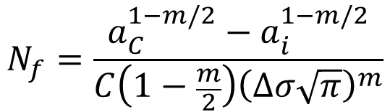
Damage propagation and RUL prediction
Prediction of RUL:
$$N_{f}=\frac{a_{C}^{1−m/2}−a_{i}^{1−m/2}}{C\left(1−\frac{m}{2}\right){\left(Δσ\sqrt{π}\right)}^{m}}$$
[ noise = 0.1mm ]
[ noise = 1mm ]
[ noise = 5mm ]
[ bias = +2mm ]
[ bias =- 2mm ]

Slide 41
Conclusions
Identification of the Paris model parameters that govern the crack growth in an aircraft panel and to predict RUL.
The Bayesian inference was employed for identifying correlated parameters.
The synthetic data including deferent levels of noise and bias were utilized as measured data from SHM systems.
The correlated parameter identification is sensitive to the level of noise.
However, the predicted RUL is relatively accurate

Slide 42
Identification of Model Parameters
Correlated distribution can be reasonably accurate for RUL prediction
However, we still want to identify model parameters
The operating condition may change in the future
It can be used fleet prognostics
Question: How can we identify accurate model parameters under correlation?

Slide 43
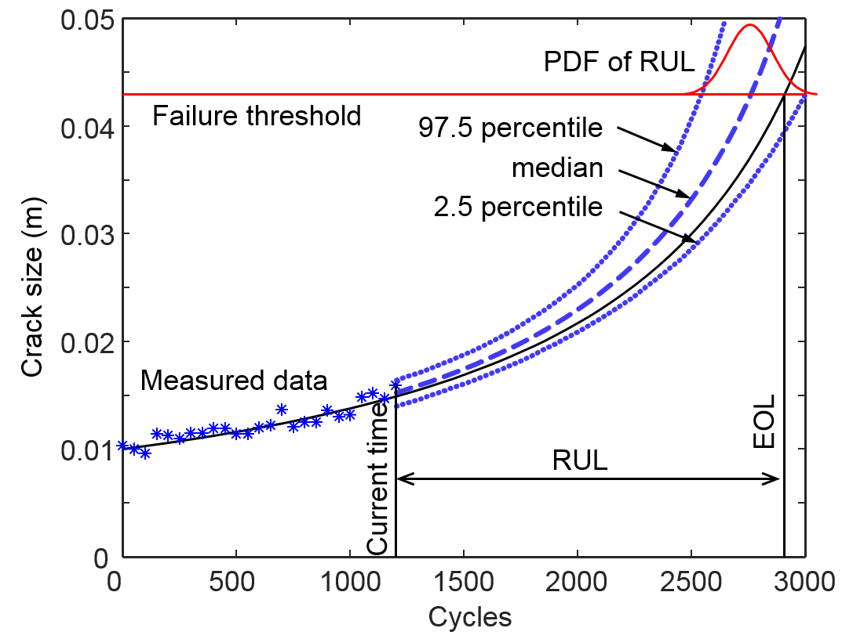
Statistical distribution of crack propagation and RUL

Slide 44
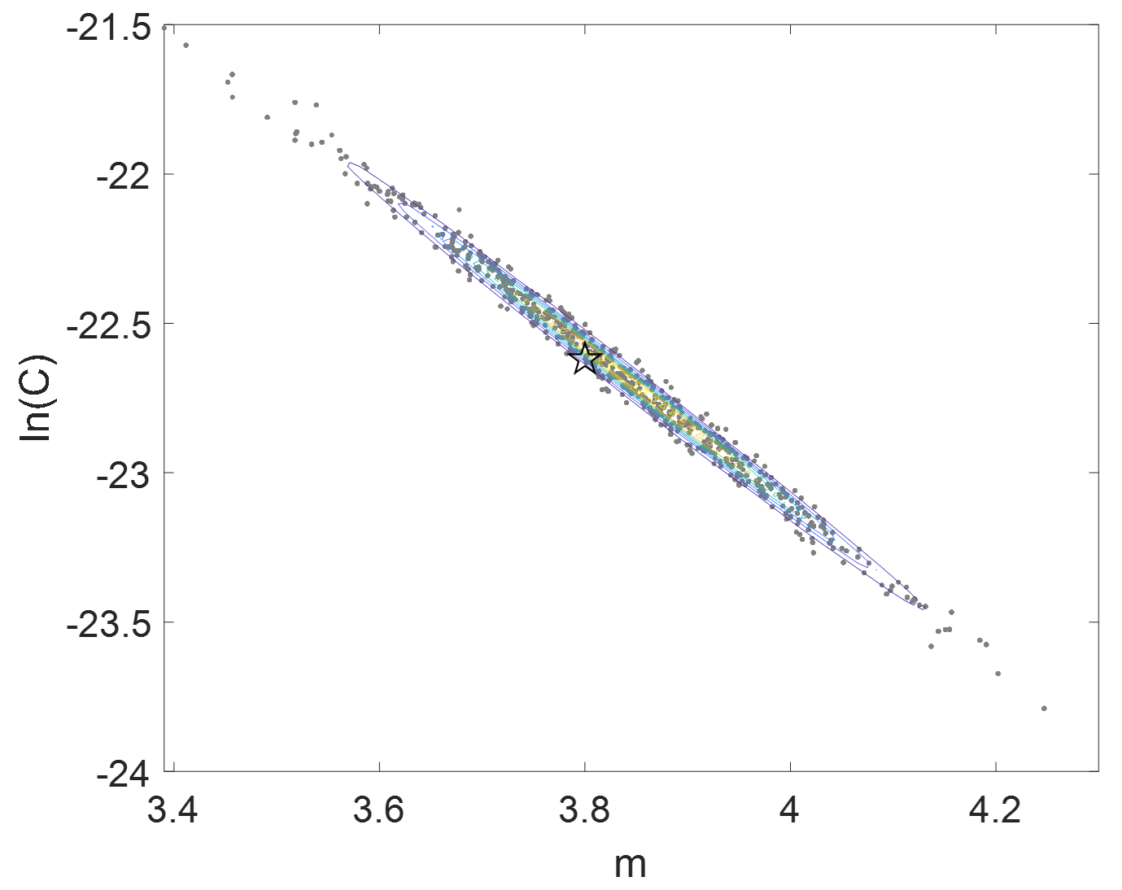
Correlation between two Paris model parameters
Posterior joint PDF of m and C
log(C)

Slide 45
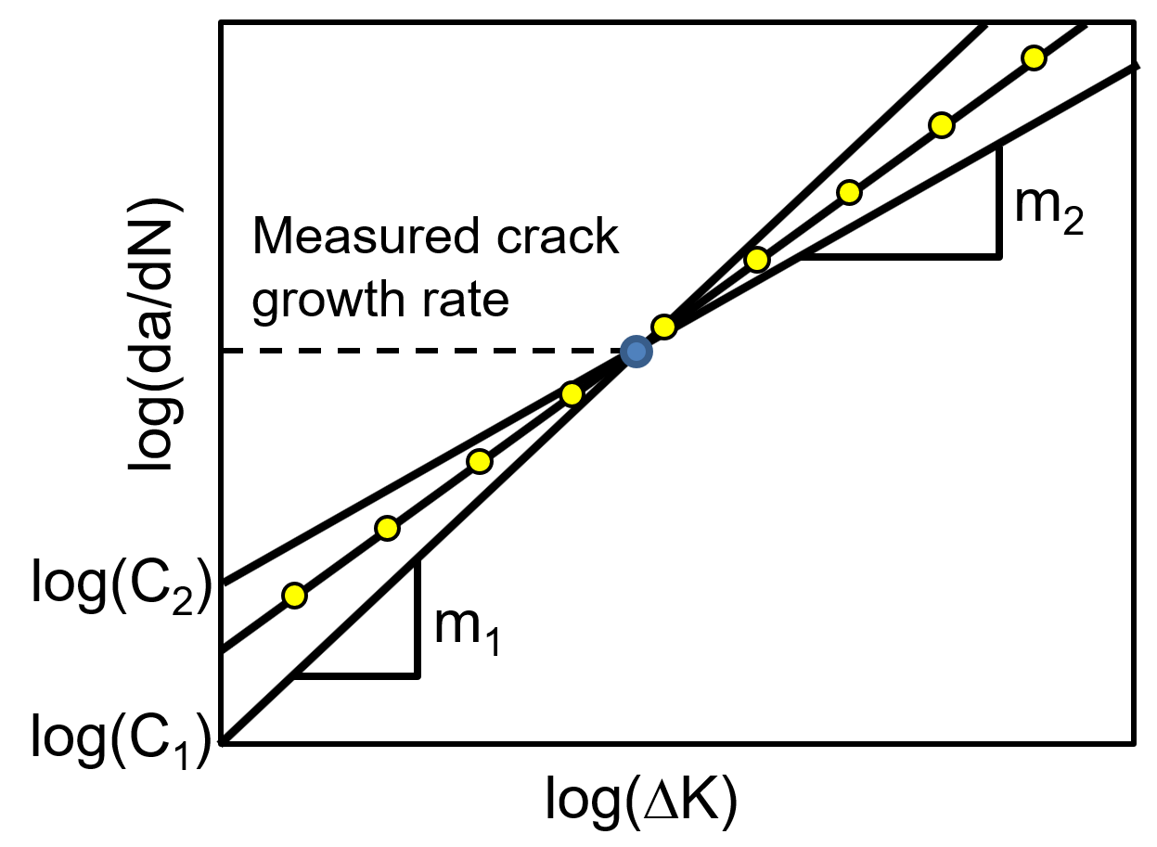
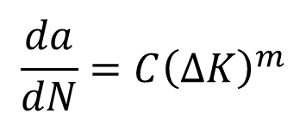
Correlation between Model Parameters
Same crack growth rate with different combinations of parameters
$$\frac{da}{dN}=C{\left(ΔK\right)}^{m}$$

Slide 46
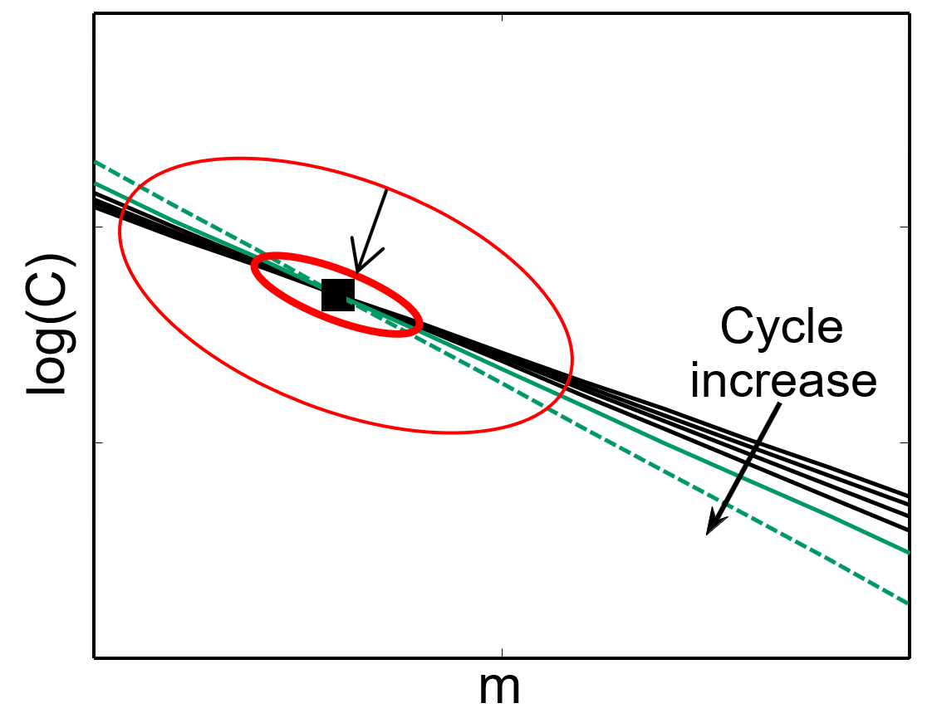
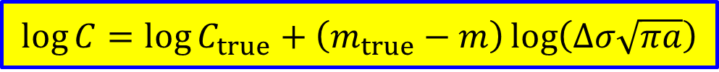
Evolving correlation relationship with respect to cycles
$$\log{C}=\log{C_{true}}+\left(m_{true}−m\right)\log\left(Δσ\sqrt{πa}\right)$$

Slide 47
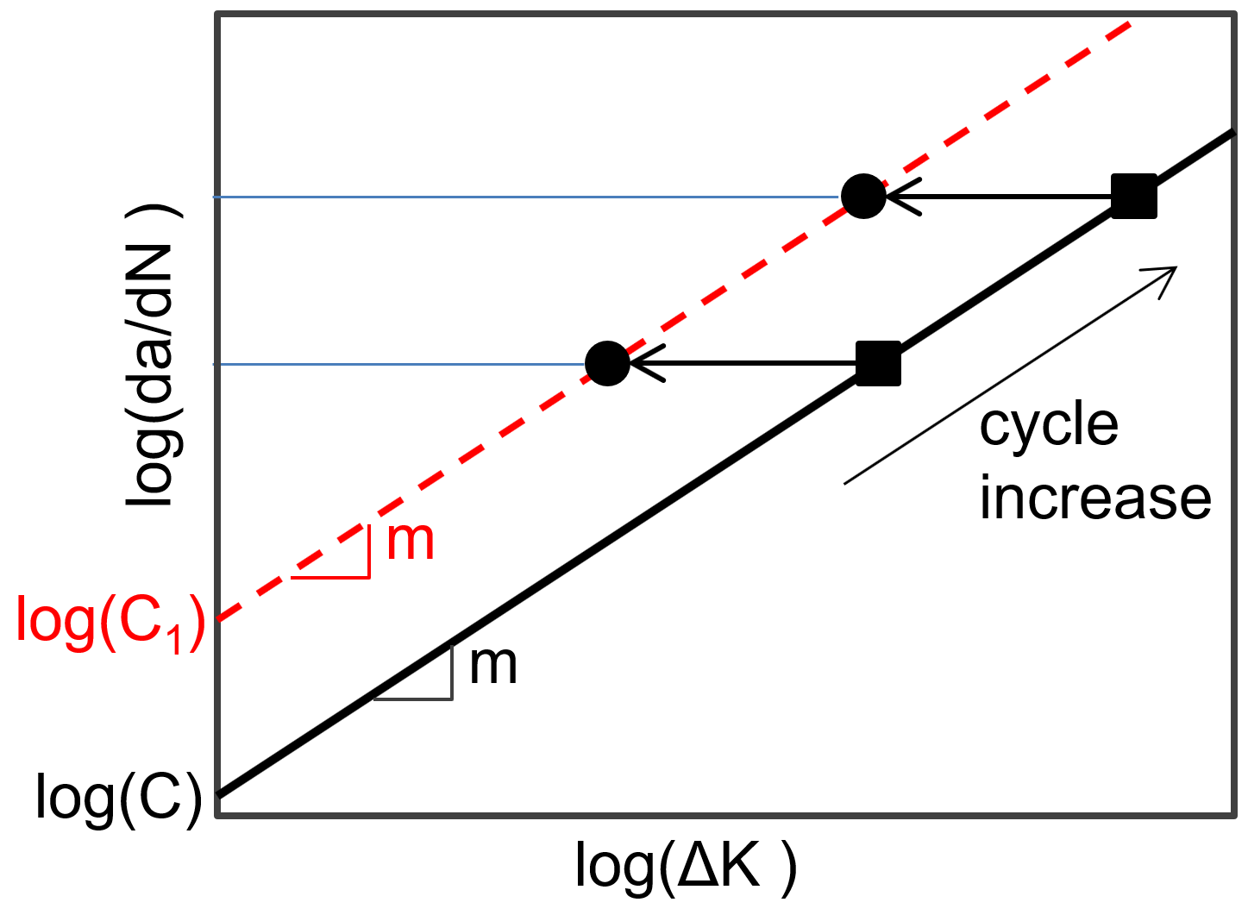
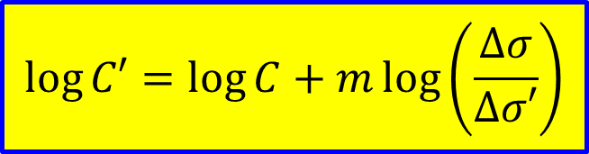
Correlation between load condition & model parameters
Illustration of equivalent parameters to different loadings
$$\log{C′}=\log{C}+m\log\left(\frac{Δσ}{Δσ′}\right)$$

Slide 48

Correlation between initial crack size and bias in data
$$a_{0}^{meas}=a_{0}+b$$

Slide 49
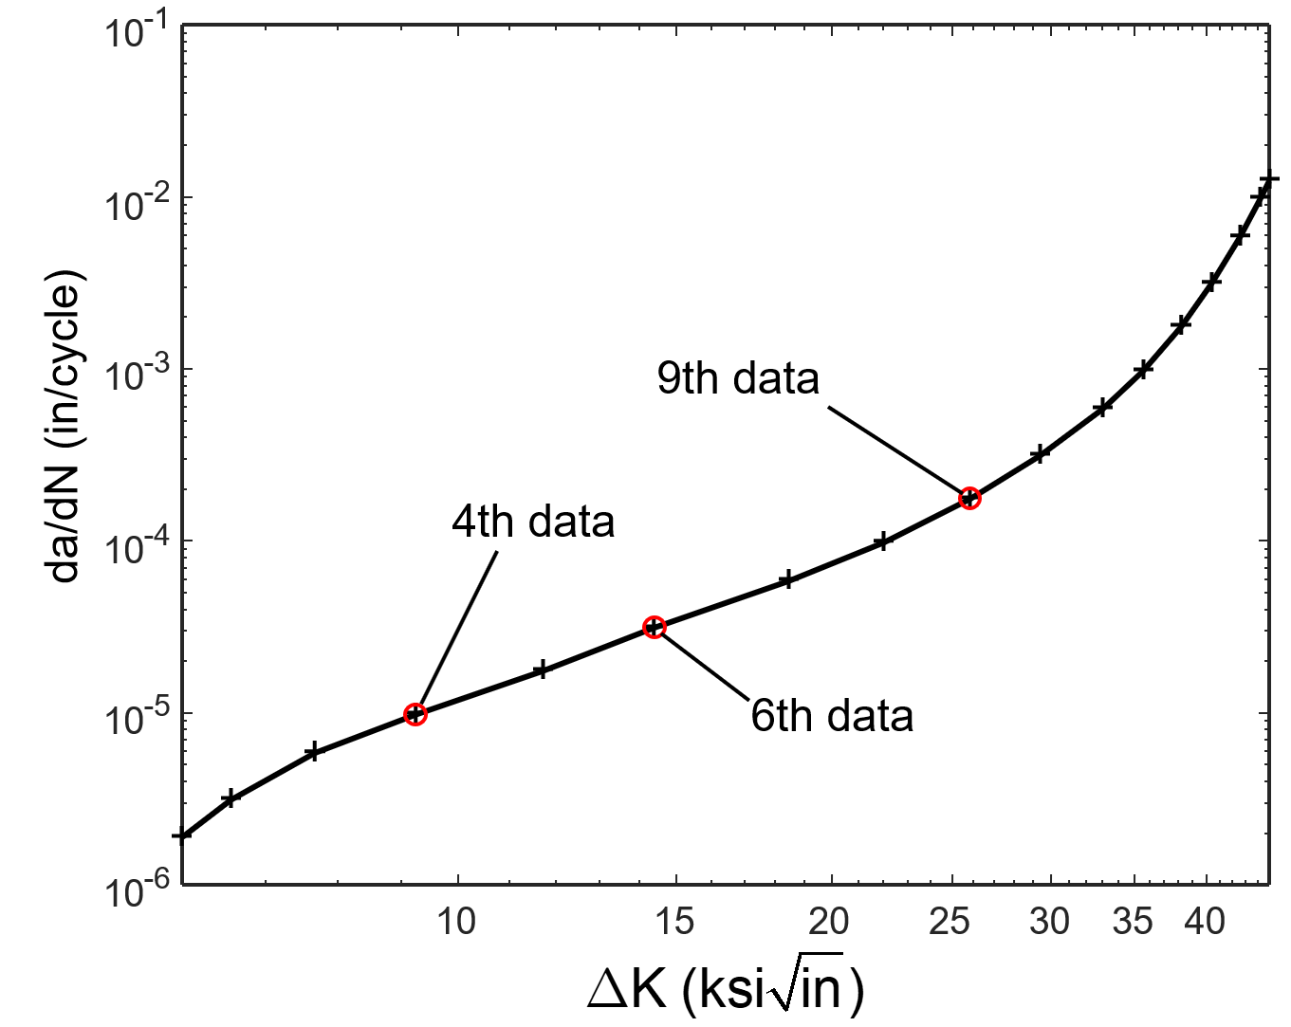
Identifying model parameters using two different stages
Crack propagation on 7075-T651 plate
From fatigue crack growth database for damage tolerance analysis

Slide 50
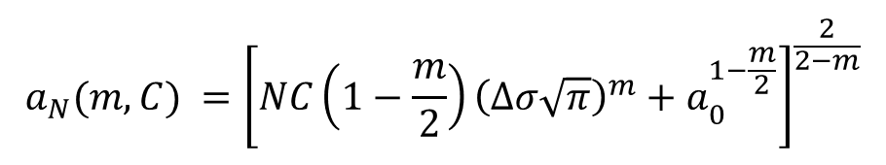
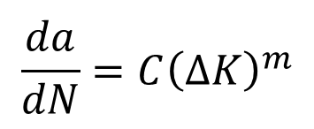


Relationship between model parameters
Relationship between m and C
In terms of crack growth rate
$$\frac{da}{dN}=C{\left(ΔK\right)}^{m}$$
$$\log{C}=−m\log\left(ΔK\right)+\log\left(\frac{da}{dN}\right)$$
(17)
In terms of crack size
$$a_{N}(m,C) ={\left[NC\left(1−\frac{m}{2}\right){\left(Δσ\sqrt{π}\right)}^{m}+a_{0}^{1−\frac{m}{2}}\right]}^{\frac{2}{2−m}}$$
$$\log{C}=−m\log\left(Δσ\sqrt{π}\right)−\log\left(1−\frac{m}{2}\right)$$
$+\log\left(a_{N}^{1−m/2}−a_{0}^{1−m/2}\right)−\log{N}$
(18)

Slide 51

Evolution of correlation at different stages

Slide 52


Identifying model parameters using two different stages
Posterior joint distributions of m and log(C) around N₄ and N₉ cycles
Combined posterior distribution
True model parameters:
m = 2.81
log(C) = -17.77
Identified parameters:
m ~ N(2.81, 0.03²)
log(C) ~N(-17.77, 0.02²)

Slide 53


Identifying model parameters using two different loading conditions
$$\log{C}=−m\log\left(ΔK\right)+\log\left(\frac{da}{dN}\right)$$

Slide 54


Identification of correlated model parameters using two different loading conditions
Posterior joint distributions of m and log(C) under nominal and maximum operating conditions
Combined posterior distribution
True model parameters:
m = 2.81
log(C) = -17.77
Identified parameters:
m ~ N(2.81, 0.05²⁾
log(C) ~N(-17.77, 0.02²)

Slide 55
Conclusions
1. Many model parameters and loading conditions are often correlated and their correlation structures change over the damage growth or loading conditions.
2. We used the evolved correlation structures to identify accurate model parameters
Using two different damage stages
Using two different loading conditions
3. The identified model parameters can be used at similar systems or at different loading conditions.

Slide 56
4. Usage of Accelerated Life Test Data for Prediction RUL at Field Operating Conditions

Slide 57
Motivation
Prognostics is to predict future damage and RUL of in-service systems based on the damage data.
It is expensive to obtain damage data in-service systems.
Instead, it is easy to obtain accelerated test data since companies frequently use them for the purpose of design.

Slide 58
Accelerated Life Test (ALT)
Most companies conduct ALT in the development stage
Using much severe loading/usage conditions
Many sensors are used to monitor degradation over time
So far, accelerated life test (ALT) data are mostly used to estimate the average life of a fleet
Challenges of ALT for prognostics
difficult to use for prognostics because in-service usage conditions are not reflected
too conservative life prediction if the ALT data are directly used
ALT data has been used to build a degradation model when physical models are not available, but the model may not be good for normal loading cond.
ALT data must be converted to the nominal loading conditions

Slide 59
Assumptions
During ALT, sensors are placed in the system or periodic inspections are performed such that the history of damage growth is measured until the damage grows up to a threshold
The threshold is determined at which the system cannot be operated further without maintenance
The time when the damage grows to the threshold is called the end of life (EOL).
The current system in the field has a similar damage data up to the current time
The objective is to predict the EOL of the current system so that maintenance can be ordered before the system reaches inoperable situation
Four different scenarios are considered based on available information, such as physical models and field loading conditions.

Slide 60
Introduction
Prognostics methods can be categorized into three approaches based on the usage of information
Prognostics
Approaches
co-efficient
Neural network,
Gaussian process regression,
Least square regression.
damage data
Extrapolation with
Mathematical model
Algorithms
Data-driven
model
para.
Particle filter,
Bayesian method,
Kalman filter.
damage data
+loading
Physics with
Physical model
parameter
estimation
methods
Physics-based
Algorithms
= +
data-driven
Hybrid approach
physics-based

Slide 61

Physics-based approaches
damage
model para.
Physical model
(unknown parameters)
θ=[m, C]
Paris model
Archard’s wear model
Anand model
cycle
=
loading
update

Slide 62
Data-driven approaches
Mathematical model
damage
(unknown parameters)
w=[β]
polynomial,
transfer function,
covariance function.
y=β₀+β₁x+β₂x²
coefficient
Possible input, x
damage data
loading conditions
time

Slide 63




Crack growth example
Crack growth in a fuselage panel
Paris model:
$a$ : half crack size
$N$ : number of cycles
$ΔK$ : range of stress intensity factor
$Δσ$ : stress range
$m,C$ : damage parameters
Synthetic data generation
assume: $m_{true}=3.5, C_{true}=6.4×{10}^{−11}, a_{0}=10mm$
noise: $\sim U\left(−u,u\right);u=0.7 \left(ALT\right), 1.5mm(field)$
different levels of loading
accelerated operating: $Δσ=135, 140, and 145 MPa$
field operating conditions: $Δσ=68 MPa$
$$\frac{da}{dN}=C{\left(ΔK\right)}^{m}$$
$$ΔK=Δσ\sqrt{πa}$$
σ
σ
[ Through-the-thickness crack
in a fuselage panel ]

Slide 64
Crack growth example
Generated data & different scenarios
[ accelerated operating conditions ]
[ field operating conditions ]
[ four scenarios ]
 | Case 1 | Case 2 | Case 3 | Case 4
Physical model | O | O | X | X
Future loading | O | X | O | X
Available method | Physics-based approaches (Particle Filter) |  | Data-driven approaches (Neural Network)

Slide 65

Case 1: Physics model + loading conditions
the conventional case of physics-based prognostics
accelerated life test data are unnecessary for prognosis
The accelerated test data can be used to provide a better prior
to improve prognostics accuracy and to reduce uncertainty in the early stage
Ex) Paris model for crack growth (Al 7075-T651)
Use material handbook data as a prior: $m \sim U(3.3, 4.3)$ and $log⁡(C) \sim U(log⁡(5x10−11), log⁡(5x10−10))$
5,000 samples from initial distribution
Initial distribution is so large that crack growth prediction is not useful
Incorporate ALT data to reduce the uncertainty in the initial distribution

Slide 66
Case 1: Physics model + loading conditions
Improving the prior distribution using 3 ALT data
Much narrower distribution
Correlation is captured

Slide 67
Case 1: Physics model + loading conditions
Damage & RUL prediction (with priors from literature)
RUL
RUL
RUL
[ 4000 cycles ]
[ 11000 cycles ]
[ 19000 cycles ]
parameters update

Slide 68
Case 1: Physics model + loading conditions
Comparison of RUL prediction results
Utilizing ALT for prior provides fairly accurate and precise results even from an early stage
[ priors from literature ]
[ prior from accelerated test data ]
[ prognostics metrics ]
 | PH ( α=10%) | α-λ accuracy (α=10%, λ=0.5) | RA (λ=0.5) | CRA
prior from literature | 11000 | false (0.2504) | 0.9161 | 0.8479
prior from ALT data | 22000 | True (0.6046) | 0.9240 | 0.9285

Slide 69
Case 2: Physics model, no loading conditions
During ALT, loading conditions are well characterized
In the field, loading conditions are variable and difficult to measure
When future loading is uncertain, it will make sense to assume its range roughly
True loading condition: 68 MPa
Uncertain loading condition: U~(50, 90) MPa
Two ways to predict RUL
Bothe parameters and loading condition are updated
Only loading condition is updated
(Only model parameters are updated)

Slide 70
Case 2: Physics model, no loading conditions
Both parameters and loading conditions updated
ALT data to update the prior distribution of model parameters
Field data to update both the loading and model parameters
[ priors from literature ]
[ prior from accelerated test data ]
[ prognostics metrics ]
 | PH ( α=10%) | α-λ accuracy (α=10%, λ=0.5) | RA (λ=0.5) | CRA
prior from literature | 11000 | false (0.3246) | 0.8739 | 0.8116
prior from test data | 13000 | false (0.4728) | 0.9704 | 0.8643

Slide 71
Case 2: Physics model, no loading conditions
Only loading condition updated
prior information from accelerated life test data are significantly better than ones using the prior information from the literature
[ priors from literature ]
[ prior from accelerated test data ]
[ prognostics metrics ]
 | PH ( α=10%) | α-λ accuracy (α=10%, λ=0.5) | RA (λ=0.5) | CRA
prior from literature | 2000 | false (0.0578) | 0.4627 | 0.4450
prior from test data | 11000 | True (0.5182) | 0.9727 | 0.8751

Slide 72
Case 3: No Physical model + loading conditions
Data-driven method (NN)
Adding loading conditions to input variable
Damage growth prediction at 13,000 and 19,000 cycles
Not using ALT data (only current system’s data)
Long term predictions diverge

Slide 73
Case 3: No Physical model + loading conditions
Use ALT data as training data
Good short term predictions as early as 2,000 cycles
Long term predictions after 19,000 cycles are also close to the true
Even if ALT loading conditions are different from the field loading, ALT data can be used for training data

Slide 74



Case 4: No Physical model, no loading conditions
Data-driven prognostics
Loading cannot be updated as no physical model
Many data similar to the field loading conditions are required
damage data at ALT conditions are mapped into the damage data at the field operating condition so that they can be used as training data
Inverse power method
a linear relation between the logarithm of life and load
$β_{1}$, $β_{2}$: can be found using life data at 2 different loading conditions
$$Life=\frac{β_{1}}{{Load}^{β_{2}}}$$
$$\log\left(Life\right)=\log\left(β_{1}\right)−β_{2}\log{(Load)}$$

Slide 75


Case 4: No Physical model, no loading conditions
Use crack size = $0.05m$ as a threshold
Life = 1,735 (145 MPa), 1,947 (140 MPa), 2,241 (135 MPa)
Plot in log(Load) vs. log(Life) and fit a straight line: $β_{1}$ = slope, $β_{2}$=y-intercept
Life span for other loading conditions can be predicted using
Repeat with different threshold to obtain degradation curve
Uncertain load range is reduced to [65, 75]MPa based on these curves
$$\log\left(Life\right)=\log\left(β_{1}\right)−β_{2}\log{(Load)}$$
[ accelerated test data ]
[ inverse power model ]
[ mapping with estimated life ]

Slide 76
Case 4: No Physical model, no loading conditions
Sources of uncertainty
(1) Uncertainty in regression of accelerated life test data: Approximation of lifespan at given threshold
(2) Uncertainty in the inverse power model: Uncertainty in coefficients
(3) Uncertainty in inverse regression: to estimate the uncertainty in damage size for a given cycle
Median + 1mm noise
We can use mapping data for training
[ mapping uncertainty ]
[ mapping into half-loads ]

Slide 77
Case 4: No Physical model, no loading conditions
Damage growth prediction results at 10000 cycles
using mapped data is much better than not using mapped data in both short-term and long-term predictions
[ only in-service damage data ]
[ with mapping results ]

Slide 78
Conclusions
Practical use of accelerated test data is presented for the prognostics methods to overcome limited number of (in-service) damage data.
Four different cases are considered according to the availability of physical model and future loading conditions.
Using accelerated test data increases prediction accuracy in early stage of physics-based prognostics.
It covers insufficient data problem of data-driven prognostics.

Slide 79
5. Bearing Prognostics Method Based on Entropy Decrease at Specific Frequencies

Slide 80
Bearing Failure
Spall failure in bearing is a common failure in rotating machineries
80~90% of aircraft engine failures
Difficult to measure degradation
Difficult to disassemble, difficult to put sensors in moving parts
vibration signals are used for damage evaluation for several decades
These signals can be used to find the relationship between bearings’ failure mechanism and signal strength at a specific frequency
since the damage grows rapidly in spall, it is difficult to detect the damage early enough to prepare for maintenance

Slide 81
Motivation
Vibration signal are generally measured for bearing fault diagnosis and prognosis.
Red line: threshold of 20g
Unfortunately, it is very challenge to extract damage feature.
Raw data (acceleration) are not consistent in a pattern of signal, life span, and threshold even if they are from the same systems and usage conditions.
There are many efforts to tackle this problem, e.g. methods based on frequency domain and entropy, but not mature yet.
We propose an improved method for bearing prognosis.
based on entropy change in the frequency domain
Notes:
Accelerometers were used to measure the vibration

Slide 82


FEMTO Bearing Data
FEMTO bearing*
Vibration signals are monitored during 0.1 second with a sampling rate of 25.6 kHz every 10 seconds
0.1 second in every 10 seconds is considered as one cycle, and there are 2560 samples in each cycle
[ Experimentation platform: PRONOSTIA ]
*P. Nectoux, R. Gouriveau, K. Medjaher, E. Ramasso, B. Morello, N. Zerhouni, C. Varnier. PRONOSTIA: An Experimental Platform for Bearings Accelerated Life Test. IEEE International Conference on Prognostics and Health Management, Denver, CO, USA, 2012.
Notes:
FEMTO-ST institute: Franche-Comte Electronics, Mechanics, Thermal Processing, Optics - Science and Technology

Slide 83

FEMTO Bearing Data cont.
Data acquisition (Acceleration)
Sampling frequency: 25.6 kHz
2560 samples (during 1/10 secs.) are recorded every 10 secs.
One cycle,
2560 samples
Three different operating conditions
Condition 1: 7 Sets
Condition 2: 7 Sets
Condition 3: 3 Sets
Threshold: 20g

Slide 84
Information Entropy
Entropy: a measure of disorder and randomness of the system
When a system absorbs energy from others, its entropy increases and the counterpart decreases
The total entropy of an isolated system, however, never decreases
Information entropy (Shannon entropy)
entropy increases when uncertainty increases by missing information contained in data
For the bearing problem, the total energy in bearing increases as the work done by external force is consumed by damage initiation/propagation
For bearing degradation, we use vibration signals rather than the total thermodynamic energy

Slide 85



Information Entropy cont.
Entropy
$X$: information source (bins of acceleration data), normalized, 255 intervals
$n$: number of possible outcomes
$f(x_{i})$: probability of each outcome, # of data in the bin/total # of data
$$H\left(X\right)=−\sum_{i=1}^{n}{f\left(x_{i}\right)\log_{2}{f(x_{i})}}$$

Slide 86



Information entropy calculation for bearing data
Assume vibration amplitude linearly increases with cycles
Probability $f(x_{i})$ remains constant
As $n$ increases, entropy increases
Entropy is always calculated from the start to the current cycle (accumulation)
Assume vibration amplitude linearly decreases with cycles
From $k$ to $k+1$ cycles, # of bins are the same, but data at $k+1$ cycles are more located in the middle bins
Entropy decreases
Entropy increase
Entropy decrease

Slide 87
Time Domain Vibration Signals
Raw data for Sets 1 and 2 of Condition 1
entropy increases as the vibration energy increases
it seems that the entropy can be used as a degradation feature
entropy change cannot be observed unless there is a change in vibration signals
many vibration signals from bearing test do not show a significant change until just before failure under large noise (Set 2)
Set 1 of Condition 1
Set 2 of Condition 1

Slide 88

Entropy Change in Frequency Domain
FFT with Nf frequencies: Nf curves of entropy vs cycles
Idea: Among Nf curves, use those frequencies that show a consistent behavior (increase of decrease) for all bearing tests

Slide 89
Entropy May Increase or Decrease
the amplitude increases as the level of damage increases
True for time domain. True for frequency domain with localized damage
vibration characteristics continue to change as degradation progresses
The behavior is more complicated in the frequency domain
The natural frequency changes as the stiffness decreases due to damage
the periodic nature of localized defects can diminish since the motion of rolling elements becomes irregular and disturbed as damage progresses
Ex) frequency changes from 2.4 Hz to 2.2 Hz due to damage growth
Amplitude increases at 2.0 Hz, while decreases at 2.5 Hz

Slide 90
Degradation Feature
amplitude increases at some frequencies, while decreases at other frequencies
After examining 14 FEMTO data sets, it is found that the decreasing trends in entropy are consistent for all data sets
decreasing amplitudes are more stable and consistent than increasing ones
frequencies showing decreasing entropy are around 4 kHz for all data sets
the decreasing entropy in the frequency domain is used as a degradation feature

Slide 91
Summary of feature extraction method
The idea of this method is based on:
In most case, raw data don’t give degradation information.
Multiple/complex damage modes exist in a bearing system.
Certain changes in specific frequencies may contain degradation information.
It is a kind of decomposed signal.
Some of them represent noise part, and some of them catch a damage change.
Procedure
Step 1: Reshape FFT results in frequency-wise
Step 2: Select specific frequencies having degradation information based on entropy decrease

Slide 92
Step 1: Frequency-wise plot
Raw data
…
1 Cycle
…
k Cycle
FFT
…
Frq: 2560/2
Fast Fourier
Transform
.
.
.
Frq: 2
Re-plot
There are 2560 different frequency from 0 Hz to 25.6 kHz.
Take one frequency (Frq: 1).
That frequency has different amplitude value in terms of cycle.
Amplitude
Frq: 1
Frequency-wise
Cycles

Slide 93

Step 2: Select specific frequencies
Entropy (information theory), H
Equation:
Nature
The entropy of an isolated system never decreases.
The entropy of a system (A) decreases only when it interacts with some other system (B) whose entropy increases in the process.
$$H\left(X\right)=−\sum_{i=1}^{n}{f\left(x_{i}\right)\log_{2}{f(x_{i})}}$$
System A
Bearing test system
System B
Microscopic damage in bearing
Without B, entropy of A does not decrease.
After B, entropy of A decreases.
Notes:
The definition of the information entropy is, however, quite general, and is expressed in terms of a discrete set of probabilities p_{i} so that
Irreversible / commonly understood as a measure of disorder
http://electron6.phys.utk.edu/101/CH8/entropy.htm
고립계: 열, 일, 에너지 이동 차단 (교환x)
Entropy ↑: 무질서도 ↑, 에너지는 보존 but 무용에너지 ↑
Entropy ↓: 생물의 생장, 광합성 (유용 에너지가 증가하기 때문에?)

Slide 94
Step 2: Select specific frequencies
Some frequencies show much more clear entropy decrease than raw data.
Frq: 2560/2
Frq: 2560/2
.
.
.
.
.
.
Frq: 2
Frq: 2
Amplitude
Frq: 1
Entropy
Frq: 1
Cycles
Cycles
Those specific frequencies are selected.
Taking a median
n frequencies
Entropy
Cycles

Slide 95
Results of all test sets
[ Condition 1 ]
[ Condition 2 ]
[ Condition 3 ]

Slide 96


Model selection and threshold
Model: $Entropy=β_{1}\exp\left(β_{2}\sqrt{Cycles}\right)$
Estimate beta 1 and beta 2 based on entropy data given up to current time.
Threshold
Degradation rate:
There are two groups for threshold.
Faded by 20% and 45%
$$1−\frac{min. entropy}{max. entropy}$$
Max.
Entropy
Min.
[ Degradation rate
of all sets ]
Cycles
Notes:
Ratio min. entropy to max. entropy

Slide 97
Prediction results of degradation
Threshold: 20%
Threshold: 45%
Max. Entropy is proportional to EOL.
But, several training data are required.
What if
current cycle
is here?
[ Condition 1 ]
[ Condition 2 ]
[ Condition 3 ]
Max. Entropy
EOL

Slide 98
Prediction results RUL
Current cycle
For set 1 and 2: 75% of lifespan
For set 3~set 7: given in challenge problem (IEEE PHM 2012)
 |  | Set 1 | Set 2 | Set 3 | Set 4 | Set 5 | Set 6 | Set 7
Cond#1 | Current cycle | 2101 | 652 | 1801 | 1138 | 2301 | 2301 | 1501
 | RUL_True | 701 | 218 | 573 | 34 | 161 | 146 | 757
 | RUL_Prediction | 87 | 475 | 460 | 34 | 133 | 976 | 442
 | Error (%) | 87.65 | -117.97 | 19.64 | -0.38 | 17.34 | -568.54 | 41.61
Cond#2 | Current Cycle | 682 | 597 | 1201 | 611 | 2001 | 571 | 171
 | RUL_True | 228 | 199 | 753 | 139 | 309 | 129 | 58
 | RUL_Prediction | 98 | 109 | 627 | 21 | 201 | 90 | 44
 | Error (%) | 57.17 | 45.20 | 16.75 | 84.75 | 34.91 | 29.94 | 24.83
Cond#3 | Current cycle | 385 | 1227 | 351
 | RUL_True | 129 | 409 | 82
 | RUL_Prediction | 84 | 388 | 5
 | Error (%) | 34.87 | 5.11 | 94.20
Score based on the competition criterion: 0.3605
(When all prediction results of RUL is the exactly same as true ones, the score=1.)
Notes:
Winner’s sore: 0.1977
Total sets: 0.3440
Test sets: 0.3605

Slide 99

True EOL is unknown
True EOL is unknown in real problems because it should be repaired before failure.
Wasted life by fixing a threshold to 20%
[ FEMTO Bearing failure ]
Ratio of wasted life and true EOL
unit (%) | Set 1 | Set 2 | Set 3 | Set 4 | Set 5 | Set 6 | Set 7
Cond#1 | 84 | 4 | 16 | 6 | 11 | 50 | 5
Cond#2 | 80 | 15 | 64 | 7 | 63 | 29 | 52
Cond#3 | 76 | 84 | 8
Half of bearings represent below 16% waste rate.

Slide 100

Threshold 20% is not an absolute value
IMS bearing*
Degradation feature
By applying the same method,
Damage feature is found.
Max. Entropy is proportional to EOL.
But, the level of threshold is different.
Faded by around 70%
FEMTO: accelerated test
IMS: nominal conditions
Four double row bearings (16 rollers) were installed on a shaft.
Three sets of test data are available.
*J. Lee, H. Qiu, G. Yu, J. Lin, and Rexnord Technical Services (2007). 'Bearing Data Set', IMS, University of Cincinnati. NASA Ames Prognostics Data Repository, [http://ti.arc.nasa.gov/project/prognostic-data-repository], NASA Ames, Moffett Field, CA.

Slide 101
Conclusions
Future work
Apply this method to other bearing problems under different level of (accelerated) loading conditions.
Hope there is a relation between threshold (degradation rate) and level of loading conditions.
Uncertainty caused by taking median of entropy from different frequencies, model parameter estimation, and threshold will be considered.
This method can be widely applicable if certain relation (threshold-loading) is found or if several training data sets are available in each bearing problem.
Procedure summary of the method
Reshape FFT results in frequency-wise
Select specific frequencies showing entropy decrease
Take a median of those entropies as a damage feature
Model selection for prognosis, and estimate model parameters
Setting a threshold (degradation rate based on the max. entropy)

