Slide 1
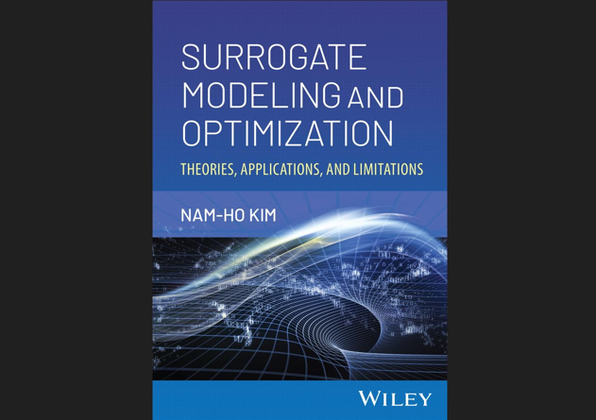

Slide 2
Chap 1 Introduction to Surrogate Models
Overview of surrogate modeling and issues

Slide 3
What Is A Surrogate Model?
An engineering method used when a quantity of interest (QoI) cannot be easily directly measured (calculated) so an approximate (surrogate) of the QoI is used instead
Engineering design problems require experiments and/or simulations to evaluate design objective and constraints as a function of design variables
Ex) To find the optimal airfoil shape, an engineer simulates the airflow around the wing for different shape variables (length, curvature, material, ..)
Single simulation is expensive, and yet, design optimization, design space exploration, sensitivity analysis and what-if analysis require thousands or millions of simulations
Use surrogate!

Slide 4
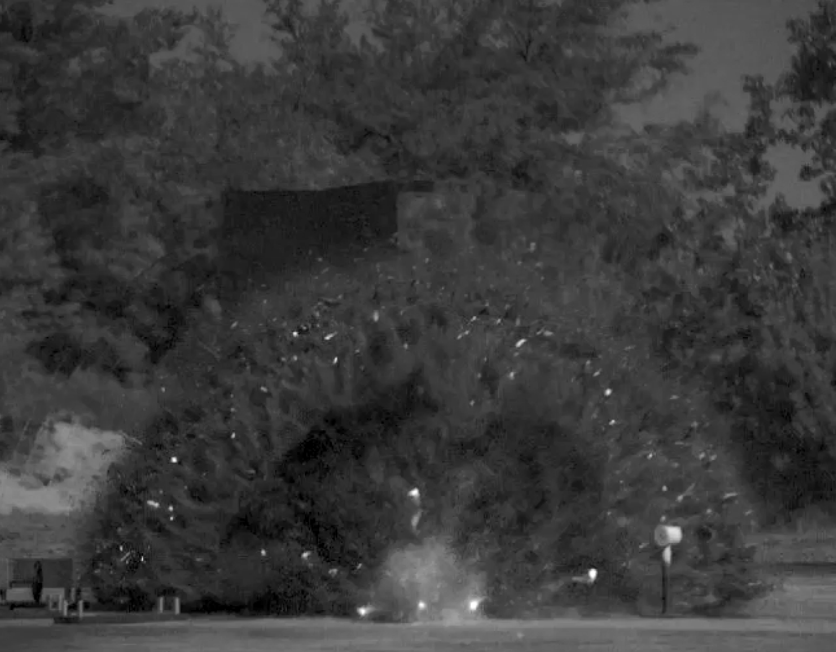
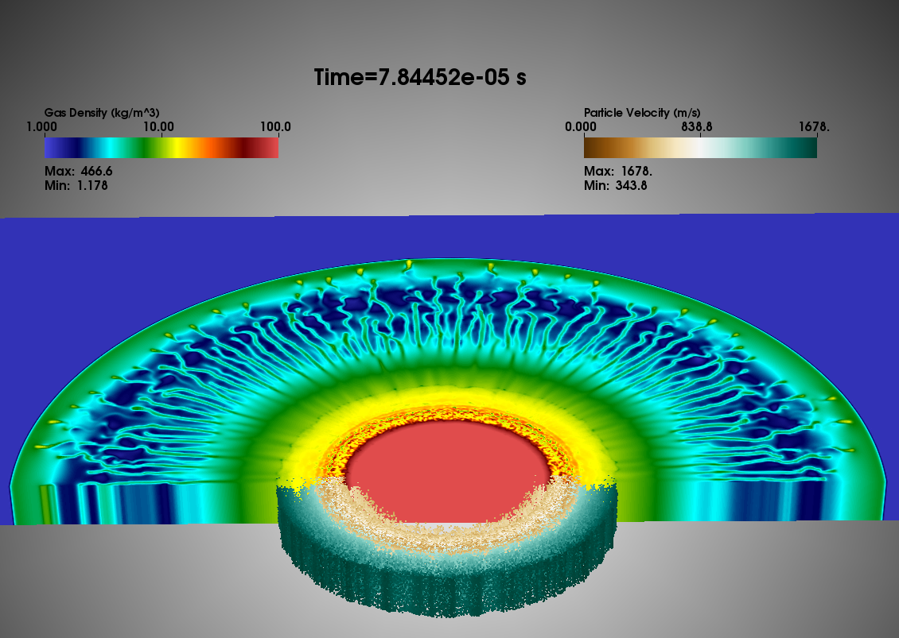
Example of Expensive Computer Simulation
Dispersed multiphase flow, where numerous particles interact with shock waves generated from explosives
Simulation of shock interaction with distributed particles took 15,000 seconds with 2,400 clusters in a high-performance computing facility

Slide 5
What Is A Surrogate Model? cont.
Surrogate models, response surface models, metamodels or emulators
mimic (approximate) the behavior of the simulation model as closely as possible while being computationally cheap(er) to evaluate
Surrogate models does not concern physics or theory in the simulation. It only concerns input-output behavior
A simple mathematical model is constructed based on limited number of input-output pair of data (samples)
This approach is also known as behavioral modeling or black-box modeling
When only a single design variable is involved, the process is known as curve-fitting

Slide 6


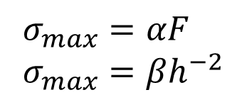
Relationship b/w QoI and Input Variables
Normally QoI is governed by complicated physics and numerical simulation
Relationship b/w QoI and input variables can be simplified
Surrogate model: $σ_{max}=f(F,L,b,h)$
h
b
L
F
$$σ_{max}=\frac{6FL}{bh^{2}}$$
$$σ_{max}=αF \\ σ_{max}=βh^{−2}$$

Slide 7
1.2 Surrogate Models
Different surrogates start with different concepts

Slide 8

Illustration of Surrogate Approximation
Surrogate modeling: to represent the relationship between the QoI and input parameters using known functional forms with unknown coefficients
Generate samples in the input domain (Design of experiments)
Sample location: $x={\left\{x_{1},x_{2},…,x_{N}\right\}}^{T}$
QoI at sample location $x^{\left(k\right)}$: $y^{(k)}$
$k$th sample pair: $(x^{\left(k\right)},y^{(k)})$
Run simulations with input samples → output samples
Fit a surrogate model
Simulation using surrogate
g
x₂
x₁

Slide 9
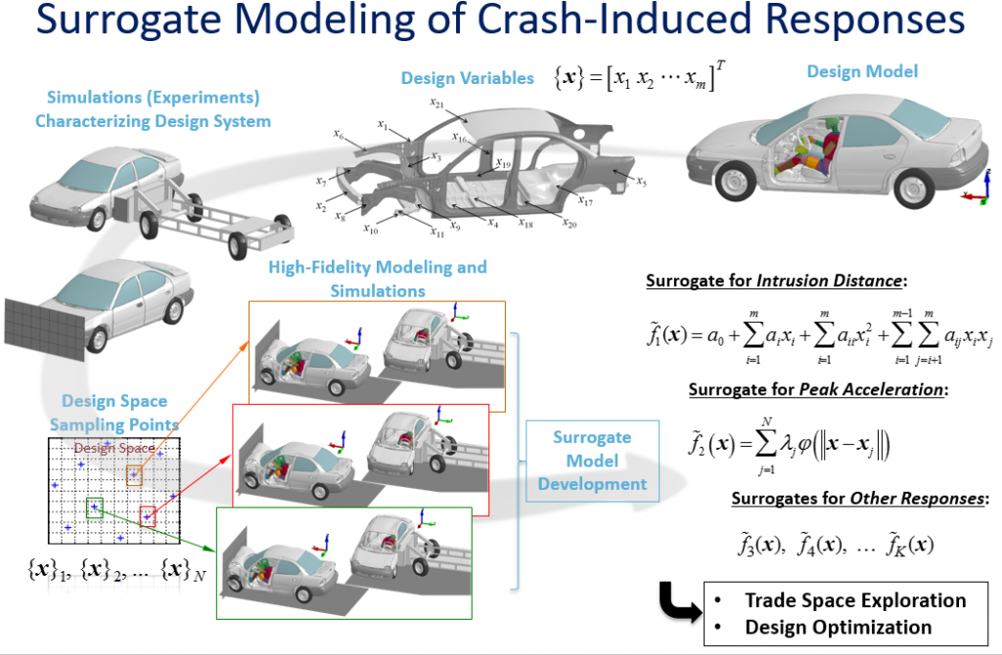
Example of Surrogate Modeling
Notes:
A full-frontal or side impact simulation for estimation of a response function (e.g., peak acceleration, intrusion distance) could take several hours on a computer cluster. Through surrogate modeling, a smooth and computationally efficient representation of each response function can be generated. Such models can be extremely helpful in both trade space exploration and design optimization pursuits.

Slide 10
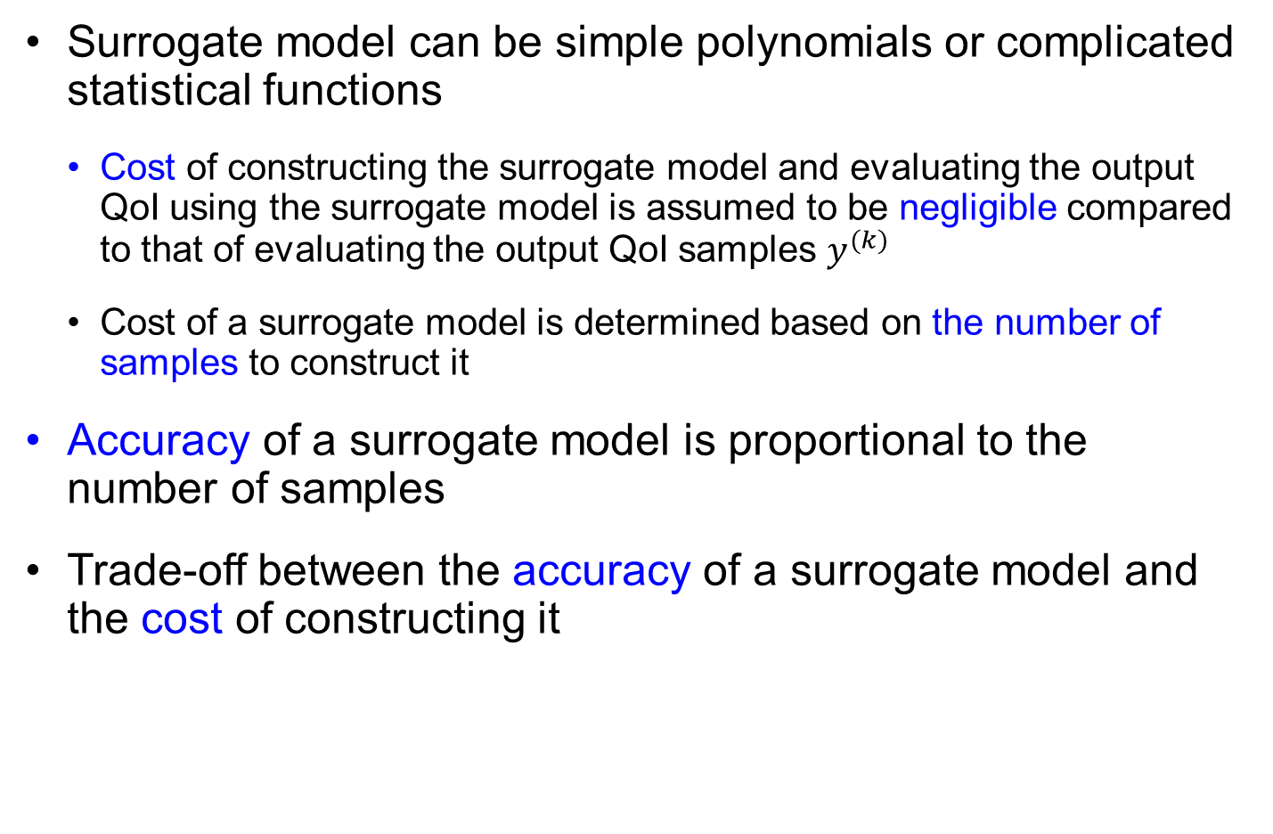
Cost of Surrogate Modeling
Surrogate model can be simple polynomials or complicated statistical functions
Cost of constructing the surrogate model and evaluating the output QoI using the surrogate model is assumed to be negligible compared to that of evaluating the output QoI samples $y^{(k)}$
Cost of a surrogate model is determined based on the number of samples to construct it
Accuracy of a surrogate model is proportional to the number of samples
Trade-off between the accuracy of a surrogate model and the cost of constructing it

Slide 11

Polynomial Response Surface (PRS)
Early surrogate based on experimental data
Linear or quadratic polynomials
Data include noise $⟹$ surrogate filters out noise
Functional form: linear combination of monomial bases
Unknown coefficients are determined to minimize error
PRS does not pass through samples (regression)
Assumption: the surrogate model form is accurate, but the data have random noise
Chapter 2 for PRS
20
C.I.
Samples
15
PRS
10
5
0
-5
0
0.2
0.4
0.6
0.8
1

Slide 12
Kriging (Gaussian Process) Surrogate
Surrogate based on computer simulations
Not much random noise (numerical error), but bias-like predictions
To approximate simulation results, samples are assumed to be exact
Difference b/w surrogate prediction and simulation data is considered prediction error
Assumption: data are exact, but the model form has uncertainty
predicts the simulation data exactly, but the uncertainty increases as a prediction point is farther away from data points
Chapter 7 for Kriging surrogate
20
C.I.
Samples
15
Kriging
10
5
0
0
0.2
0.4
0.6
0.8
1

Slide 13
Which Surrogate Is the Best?
Polynomial response surfaces (PRS), Kriging, Radial basis function, Support vector machines, Space mapping, Artificial neural networks, and Bayesian networks
Different surrogates have different assumptions
When the nature of true function is not known a priori so it is not clear which surrogate model is the most accurate
When the nature of true function is known, physics-based surrogates such as space-mapping based models are the most efficient
There is no consensus on how to obtain the most reliable estimates of the accuracy of a given surrogate
Ensemble of multiple surrogates can be used to reduce the risk of using a bad surrogate

Slide 14
1.3 Design of Experiments: Sampling
Surrogate strongly depends on the number and location of samples

Slide 15
Goals of Surrogate Modeling
To Approximate a QoI as accurate as possible, using as few simulation evaluations as possible
Sample selection (sequential design, optimal experimental design (OED), design of experiments (DOE), or active learning)
Construction of the surrogate model and optimizing the model parameters (bias-variance trade-off)
Appraisal of the accuracy of the surrogate.
The accuracy of the surrogate depends on the number and location of samples (experiments or simulations).
Various design of experiments (DOE) techniques cater to different sources of errors, in particular, errors due to noise in the data or errors due to an improper surrogate model.
DOE in Chapter 3

Slide 16
Design of Experiments (DOE)
Adaptive sampling, sequential design, or active learning
starting from a small number of samples, additional samples can be added sequentially to improve the accuracy of surrogate prediction
require a criterion to determine the next sample locations, such as D-optimal design and minimum bias design
based on a trade-off between minimizing bias (i.e., error) and/or minimizing variance (i.e., uncertainty)
Space-filling design
a better surrogate can be obtained with more samples
locate samples more or less uniformly distributed to the entire sampling space
minimize the maximum distance between samples

Slide 17
1.4 Interpolation vs. Extrapolation
Major challenge of surrogate model is prediction at unsampled region

Slide 18

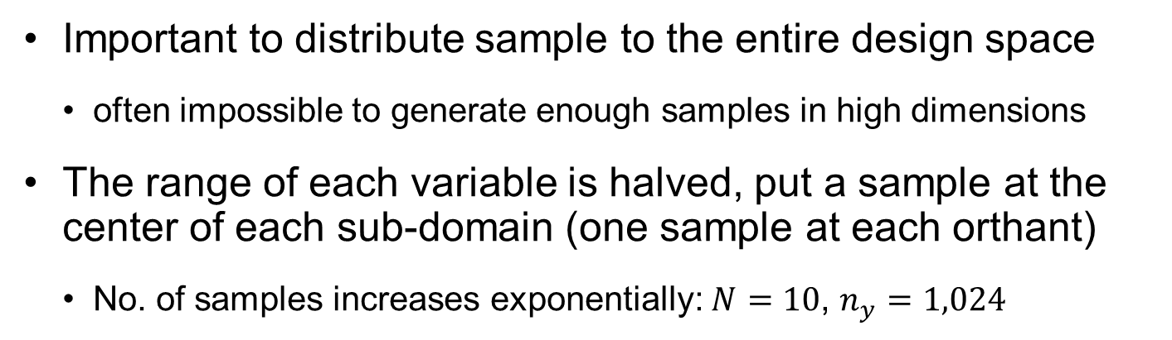



Curse of Dimensionality
Important to distribute sample to the entire design space
often impossible to generate enough samples in high dimensions
The range of each variable is halved, put a sample at the center of each sub-domain (one sample at each orthant)
No. of samples increases exponentially: $N=10$, $n_{y}=1,024$
$$x_{2}$$
Samples
Extrapolation region
Interpolation region
$$x_{3}$$
$$x_{2}$$
$$x_{1}$$
$$x_{1}$$

Slide 19



Interpolation vs. Extrapolation
Interpolation domain is the convex hull of samples
2D: interpolation (25%) vs. extrapolation (75%)
Mostly extrapolation in high-dimensions (10D, extrapolation = 99.9%)
If samples are located at corners, distances b/w samples become too large
Major challenge in surrogate modeling is how to guarantee the accuracy of prediction in the extrapolation region!
$$x_{2}$$
Samples
Extrapolation region
Interpolation region
$$x_{3}$$
$$x_{2}$$
$$x_{1}$$
$$x_{1}$$

Slide 20
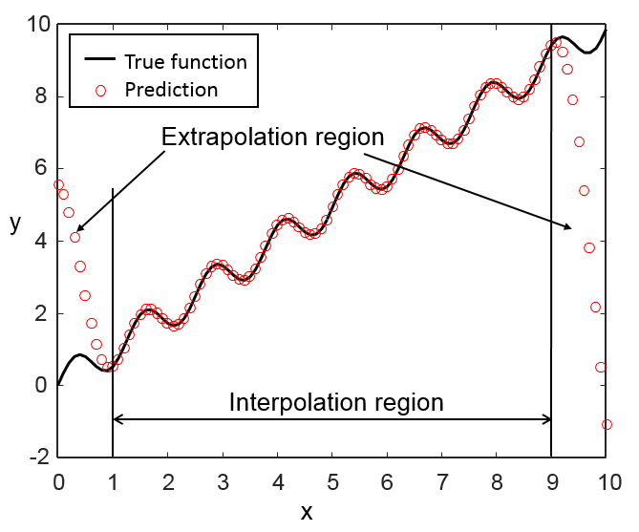

Prediction Accuracy at Interpolation & Extrapolation Regions
21 equal-interval samples at $x∈[1,9]$ from true function $y\left(x\right)=x+0.5sin⁡(5x)$
Use radial-basis function surrogate
Exact at the interpolation region $x∈[1,9]$
Huge error at the extrapolation region $x∈[0,1]$ and $x∈[9,10]$
A surrogate with a good fit in the interpolation region can fail miserably in predicting the extrapolation region!

Slide 21
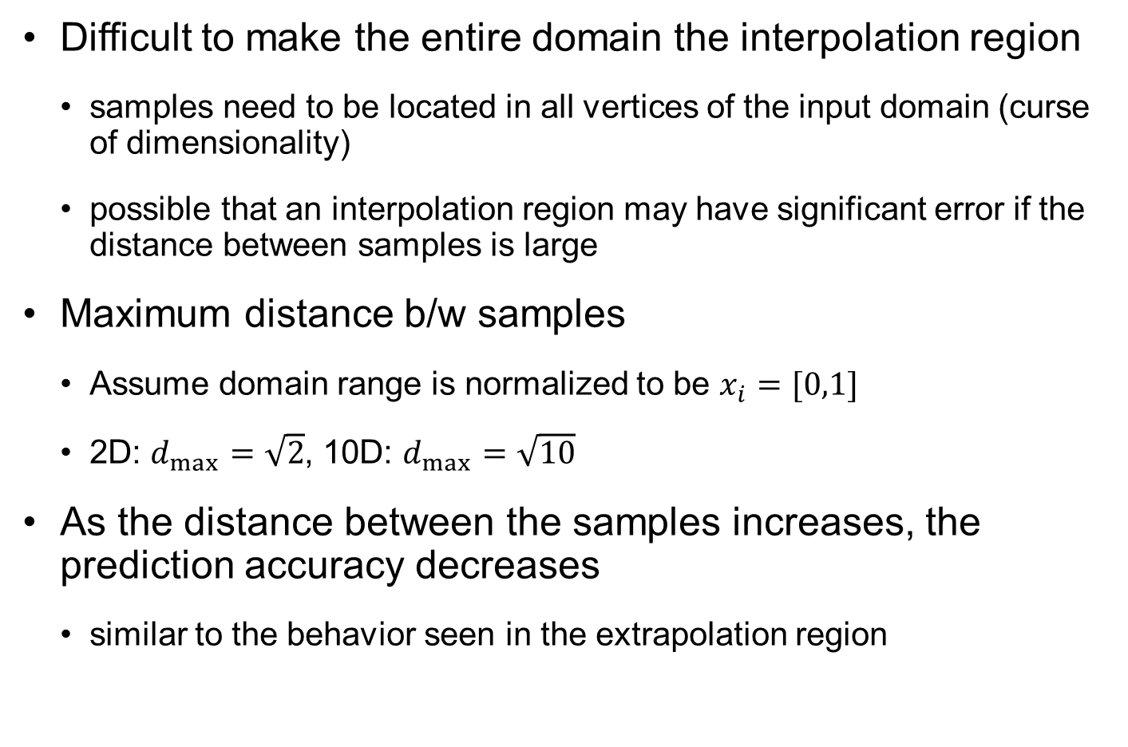
Can We Make the Entire Domain an Interpolation Region?
Difficult to make the entire domain the interpolation region
samples need to be located in all vertices of the input domain (curse of dimensionality)
possible that an interpolation region may have significant error if the distance between samples is large
Maximum distance b/w samples
Assume domain range is normalized to be $x_{i}=[0,1]$
2D: $d_{max}=\sqrt{2}$, 10D: $d_{max}=\sqrt{10}$
As the distance between the samples increases, the prediction accuracy decreases
similar to the behavior seen in the extrapolation region

Slide 22
1.5 Flowchart of Surrogate Modeling
Surrogate needs to be improved based on prediction accuracy

Slide 23
Flowchart of Surrogate Modeling
Four-step surrogate modeling
Design of experiment
If necessary
Numerical simulations at selected locations
Construction of surrogate models (model selection and identification)
Model validation

Slide 24
Flowchart of Surrogate Modeling cont.
Design of experiments (DOE):
Sampling plan in design variable space
The number and location of samples are determined
Usually input variables are normalized: hyper-cube input space
How to assess the goodness of different designs
The number of samples is severely limited by computational cost
Numerical simulations at selected locations
Expensive numerical simulation or experiments
Data may include random noise or error

Slide 25
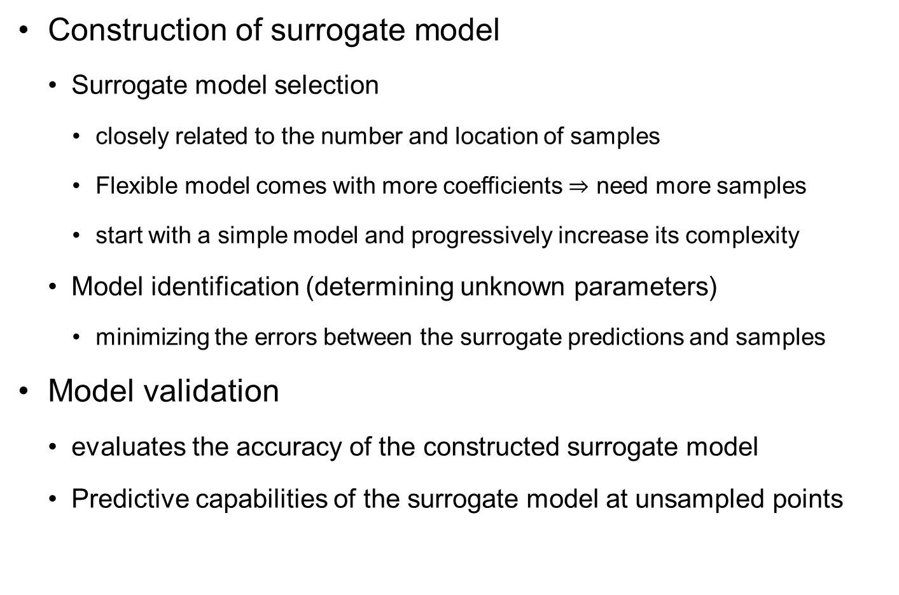
Flowchart of Surrogate Modeling cont.
Construction of surrogate model
Surrogate model selection
closely related to the number and location of samples
Flexible model comes with more coefficients $⇒$ need more samples
start with a simple model and progressively increase its complexity
Model identification (determining unknown parameters)
minimizing the errors between the surrogate predictions and samples
Model validation
evaluates the accuracy of the constructed surrogate model
Predictive capabilities of the surrogate model at unsampled points

Slide 26
Fitting Accuracy vs. Prediction Accuracy
Samples are used to fit the surrogate model
Errors are minimum at sample locations
But surrogate needs to be a good predictor at un-sampled locations
Blue surrogate passes all sample points but has poor prediction capability
Accuracy needs additional samples that were not used in the fitting process
5
5th-order polynomial
true function
data
0
-5
-2
-1
0
1
2

Slide 27
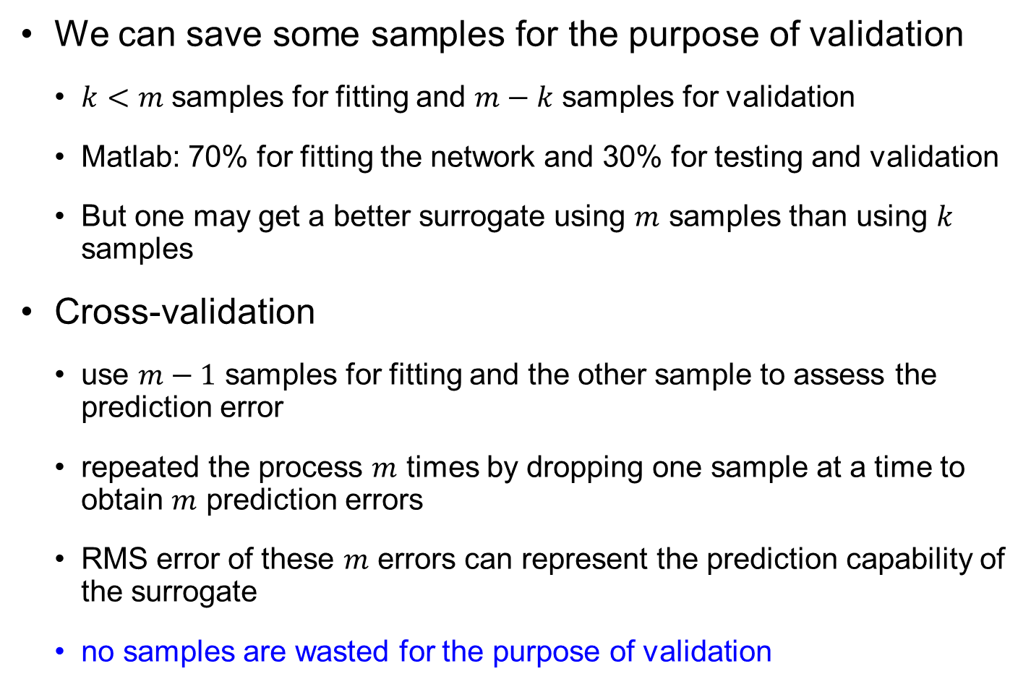
Cross-Validation
We can save some samples for the purpose of validation
$k<m$ samples for fitting and $m−k$ samples for validation
Matlab: 70% for fitting the network and 30% for testing and validation
But one may get a better surrogate using $m$ samples than using $k$ samples
Cross-validation
use $m−1$ samples for fitting and the other sample to assess the prediction error
repeated the process $m$ times by dropping one sample at a time to obtain $m$ prediction errors
RMS error of these $m$ errors can represent the prediction capability of the surrogate
no samples are wasted for the purpose of validation

Slide 28
1.6 Overview of Surrogate Modeling
How to prevent overfitting and how to estimate prediction uncertainty?

Slide 29
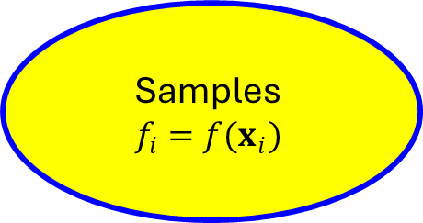
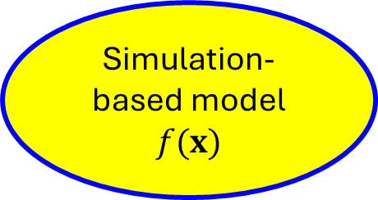
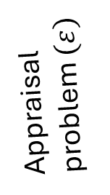
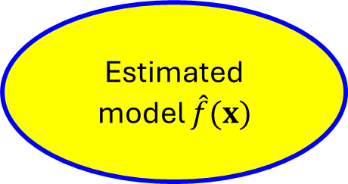
Overview of Surrogate Modeling
Simulation-based model $f(x)$
Analysis problem
Samples $$f_{i}=f(x_{i})$$
Appraisal problem $(ε)$
Estimated model $\hat{f}(x)$
Estimation problem

Slide 30
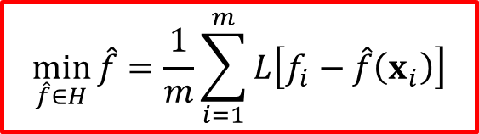
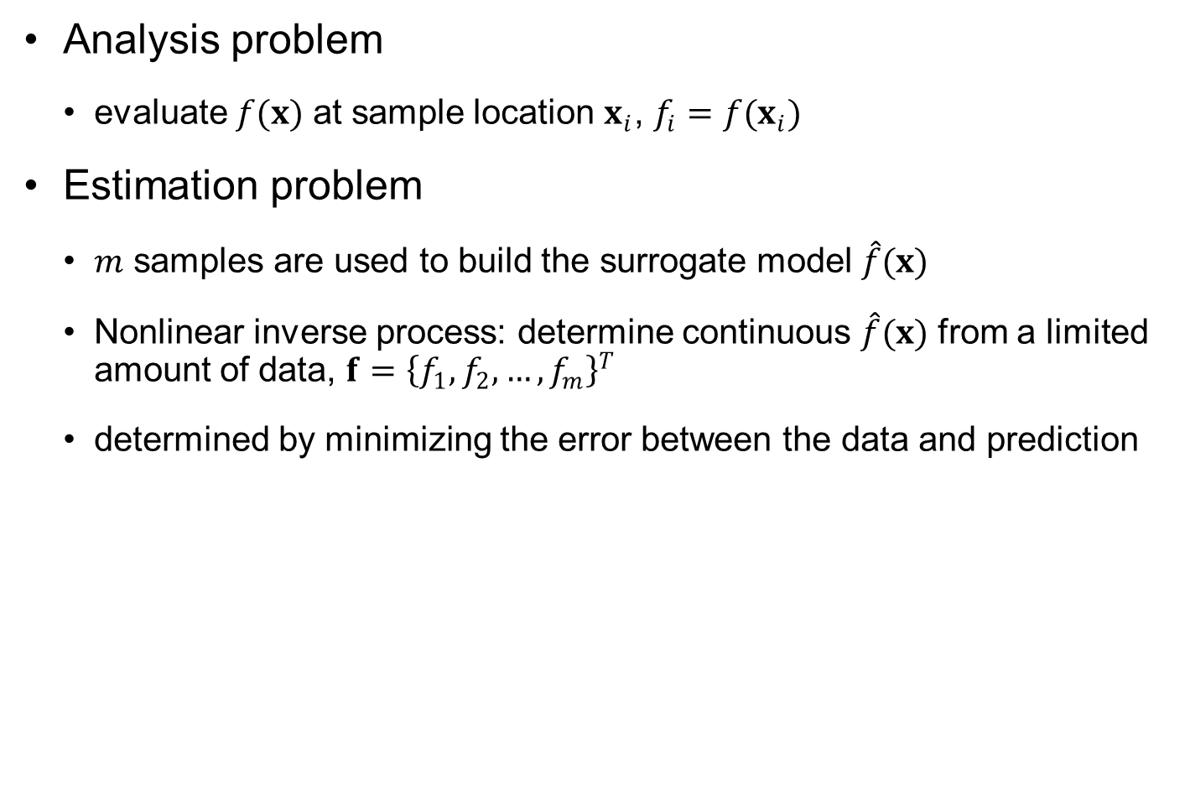
Overview of Surrogate Modeling cont.
Analysis problem
evaluate $f(x)$ at sample location $x_{i}$, $f_{i}=f(x_{i})$
Estimation problem
$m$ samples are used to build the surrogate model $\hat{f}(x)$
Nonlinear inverse process: determine continuous $\hat{f}(x)$ from a limited amount of data, $f={\left\{f_{1}, f_{2}, …,f_{m}\right\}}^{T}$
determined by minimizing the error between the data and prediction
$$\min_{\hat{f}∈H}{\hat{f}}=\frac{1}{m}\sum_{i=1}^{m}{L\left[f_{i}−\hat{f}\left(x_{i}\right)\right]}$$
Loss function

Slide 31




Overview of Surrogate Modeling cont.
Estimation problem cont.
samples may be exact or may include noise
estimation problem usually does not have a unique solution
Prediction uncertainty: multiple estimated models
$$f$$
$${\hat{f}}_{1}$$
$${\hat{f}}_{2}$$
Multiple possibilities of surrogates with given samples
$$x$$

Slide 32
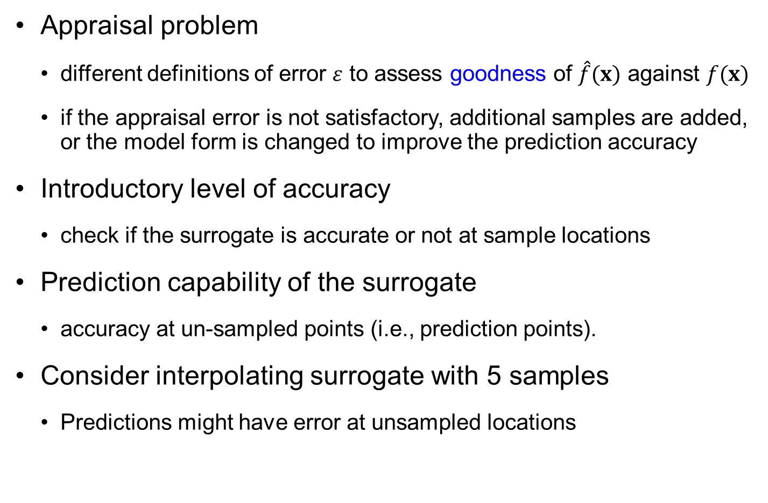
Overview of Surrogate Modeling cont.
Appraisal problem
different definitions of error $ε$ to assess goodness of $\hat{f}(x)$ against $f(x)$
if the appraisal error is not satisfactory, additional samples are added, or the model form is changed to improve the prediction accuracy
Introductory level of accuracy
check if the surrogate is accurate or not at sample locations
Prediction capability of the surrogate
accuracy at un-sampled points (i.e., prediction points).
Consider interpolating surrogate with 5 samples
Predictions might have error at unsampled locations

Slide 33



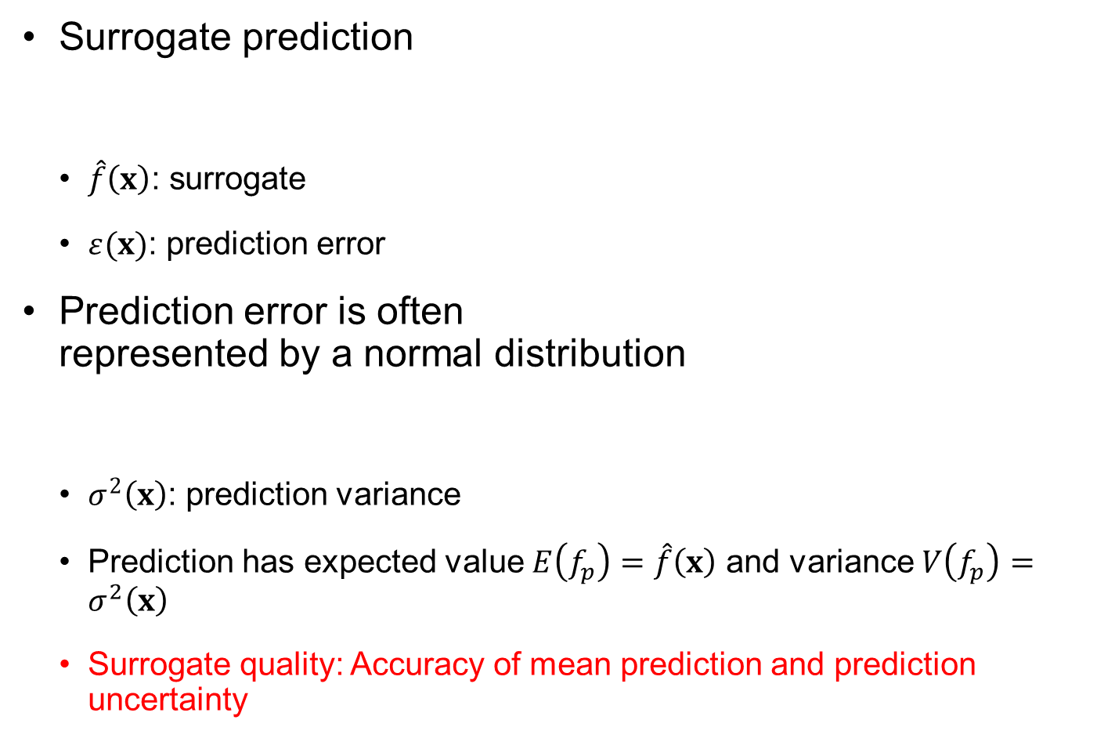



Prediction Uncertainty
$$f$$
Surrogate prediction
$\hat{f}\left(x\right)$: surrogate
$ε(x)$: prediction error
Prediction error is often represented by a normal distribution
$σ^{2}\left(x\right)$: prediction variance
Prediction has expected value $E\left(f_{p}\right)=\hat{f}\left(x\right)$ and variance $V\left(f_{p}\right)=σ^{2}\left(x\right)$
Surrogate quality: Accuracy of mean prediction and prediction uncertainty
$E(f_{p}$)
$$f_{p}\left(x\right)=\hat{f}\left(x\right)+ε(x)$$
$φ(E(f_{p}$), $V(f_{p}$))
$$x$$
$$ε\left(x\right)\sim N\left(0,σ^{2}\left(x\right)\right)$$

Slide 34
1.7 Smoothness and Loss Function
A smoother surrogate is better than a complex one

Slide 35


Quality of Surrogate Fitting
surrogate modeling determines a continuous function using a finite number of samples (nonlinear inverse problem)
Infinitely many surrogates may satisfy the inverse problem
If multiple surrogates have the same fitting error, a smoother one is considered a better one
blue surrogate changes the sign of the slope less than that of the red one
a polynomial function with a smaller number of inflection points is considered smoother
5
5th-order polynomial
2nd-order polynomial
$${\hat{f}}_{1}$$
0
$${\hat{f}}_{2}$$
-5
-2
-1
0
1
2

Slide 36
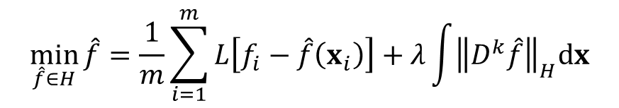
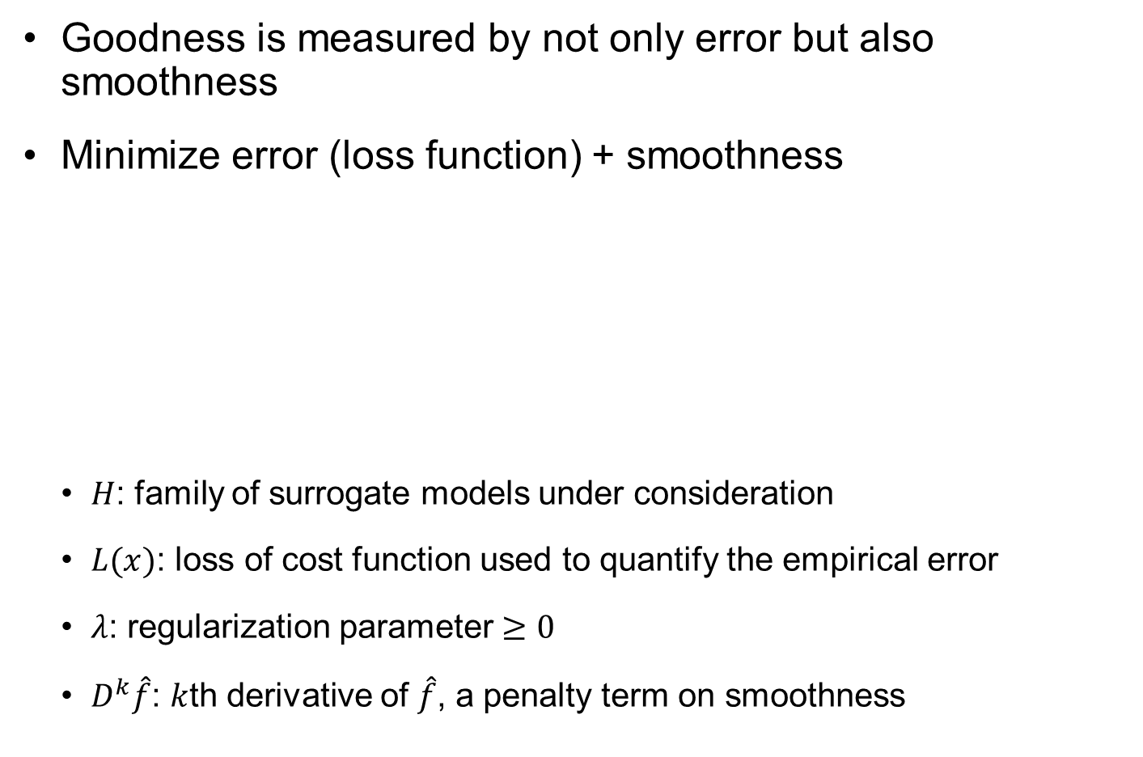
Regularization
Goodness is measured by not only error but also smoothness
Minimize error (loss function) + smoothness
$H$: family of surrogate models under consideration
$L(x)$: loss of cost function used to quantify the empirical error
$λ$: regularization parameter $≥0$
$D^{k}\hat{f}$: $k$th derivative of $\hat{f}$, a penalty term on smoothness
$$\min_{\hat{f}∈H}{\hat{f}}=\frac{1}{m}\sum_{i=1}^{m}{L\left[f_{i}−\hat{f}\left(x_{i}\right)\right]}+λ\int{{\left\|D^{k}\hat{f}\right\|}_{H}dx}$$
Closeness to the data
Smoothness of model

Slide 37
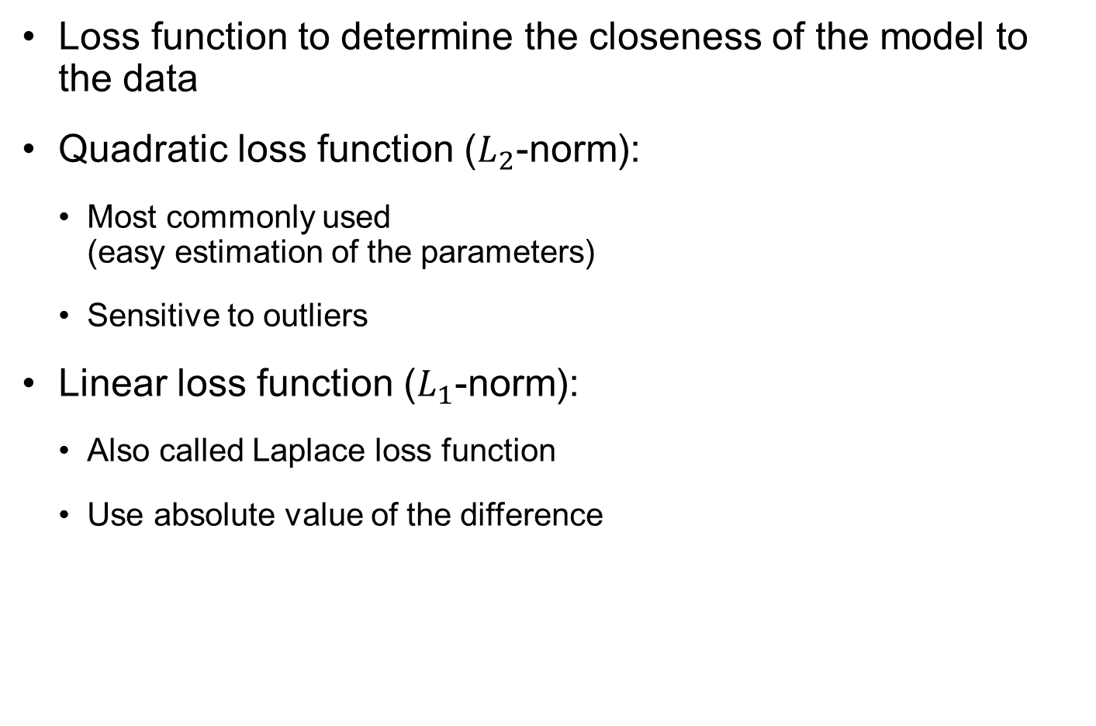
Loss function
Loss function to determine the closeness of the model to the data
Quadratic loss function ($L_{2}$-norm):
Most commonly used (easy estimation of the parameters)
Sensitive to outliers
Linear loss function ($L_{1}$-norm):
Also called Laplace loss function
Use absolute value of the difference
Loss function
Error
Loss function
Error

Slide 38
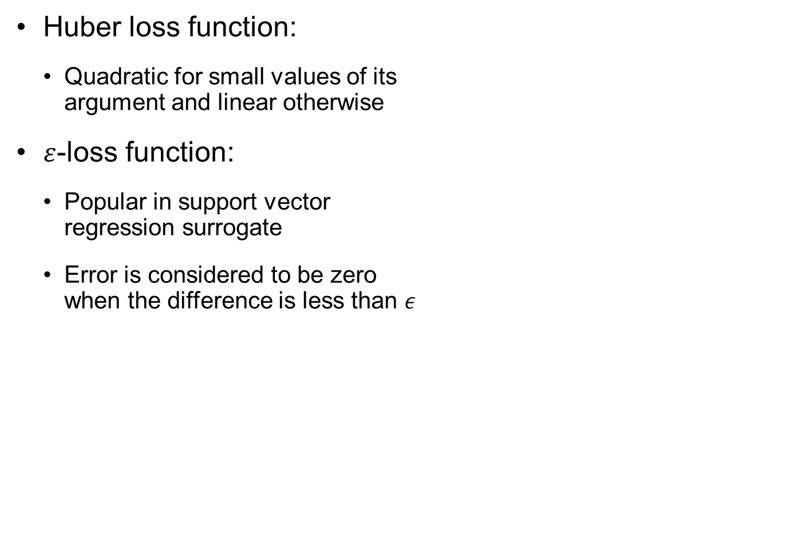
Loss functions cont.
Huber loss function:
Quadratic for small values of its argument and linear otherwise
$ε$-loss function:
Popular in support vector regression surrogate
Error is considered to be zero when the difference is less than $ε$
Loss function
Error
Loss function
Error

