Slide 1
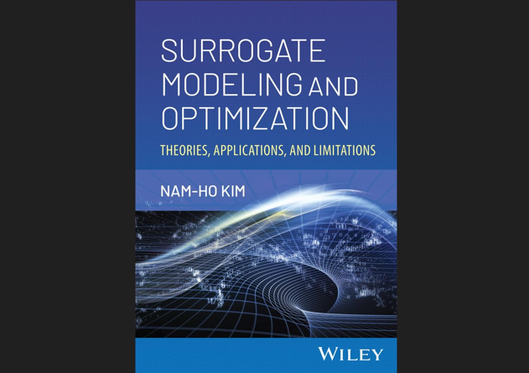

Slide 2
Chap 10 Efficient Global Optimization (EGO)

Slide 3
10.1 Introduction

Slide 4
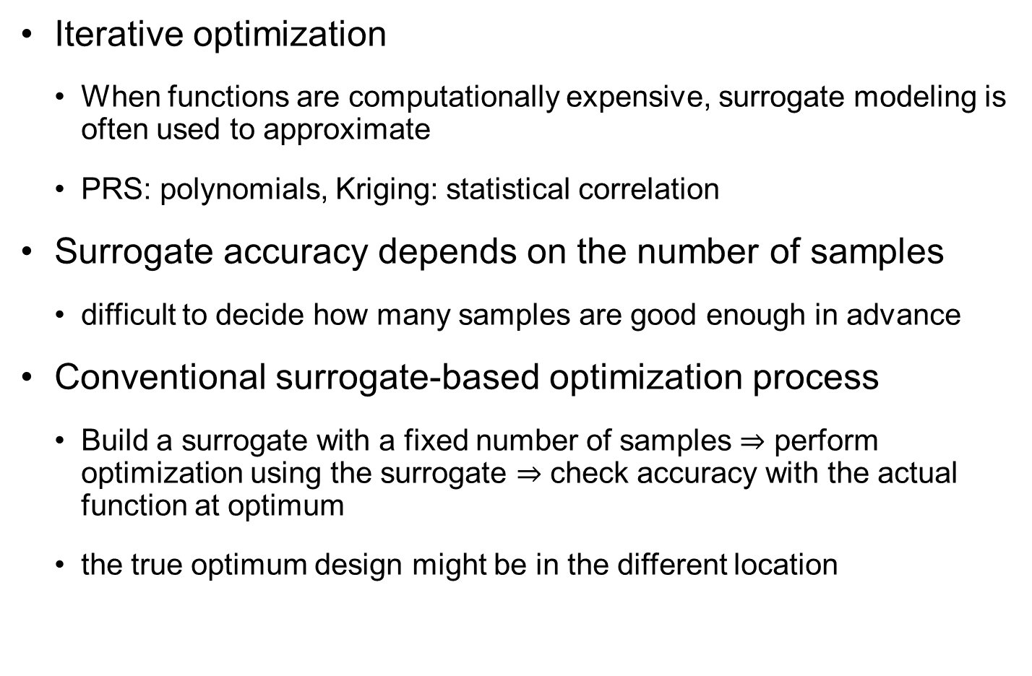
Surrogate-Based Optimization
Iterative optimization
When functions are computationally expensive, surrogate modeling is often used to approximate
PRS: polynomials, Kriging: statistical correlation
Surrogate accuracy depends on the number of samples
difficult to decide how many samples are good enough in advance
Conventional surrogate-based optimization process
Build a surrogate with a fixed number of samples $⇒$ perform optimization using the surrogate $⇒$ check accuracy with the actual function at optimum
the true optimum design might be in the different location

Slide 5
Surrogate-Based Optimization cont.
Unnecessary to be accurate over the entire design domain
accuracy of surrogate model near the optimum design is required
it makes sense to place more samples near the optimum design
Efficient global optimization (EGO) by Jones et al.
make the surrogate model as accurate as possible at optimum design from as few samples as feasible
Adaptive sampling near the possible optimum design such that the prediction accuracy is improved at the optimum design
Add a sample at the surrogate-predicted optimum design
Add a sample at a point, which has a chance to be lower than the current minimum value
Iterate the optimization process with a new surrogate with added samples

Slide 6
EGO – Efficient Global Optimization
Philosophy
balancing the need to exploit the approximating surface (by sampling where it is minimized) with the need to improve the approximation (by sampling where prediction error may be high)
use Kriging predictions and prediction variances to seek the point of maximum expected improvement (EI) as the next simulation for the optimization process
Sequential sampling algorithm to find the best design in the domain using a surrogate model
a trade-off between exploring the design domain and refining the current optimum design by exploiting near the location

Slide 7
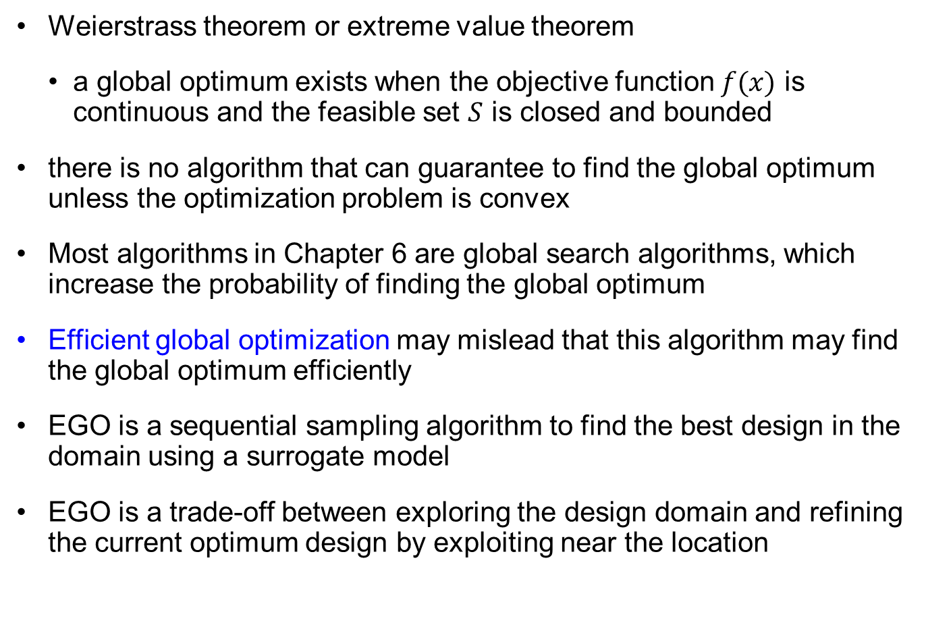
Global Optimization
Weierstrass theorem or extreme value theorem
a global optimum exists when the objective function $f(x)$ is continuous and the feasible set $S$ is closed and bounded
there is no algorithm that can guarantee to find the global optimum unless the optimization problem is convex
Most algorithms in Chapter 6 are global search algorithms, which increase the probability of finding the global optimum
Efficient global optimization may mislead that this algorithm may find the global optimum efficiently
EGO is a sequential sampling algorithm to find the best design in the domain using a surrogate model
EGO is a trade-off between exploring the design domain and refining the current optimum design by exploiting near the location

Slide 8
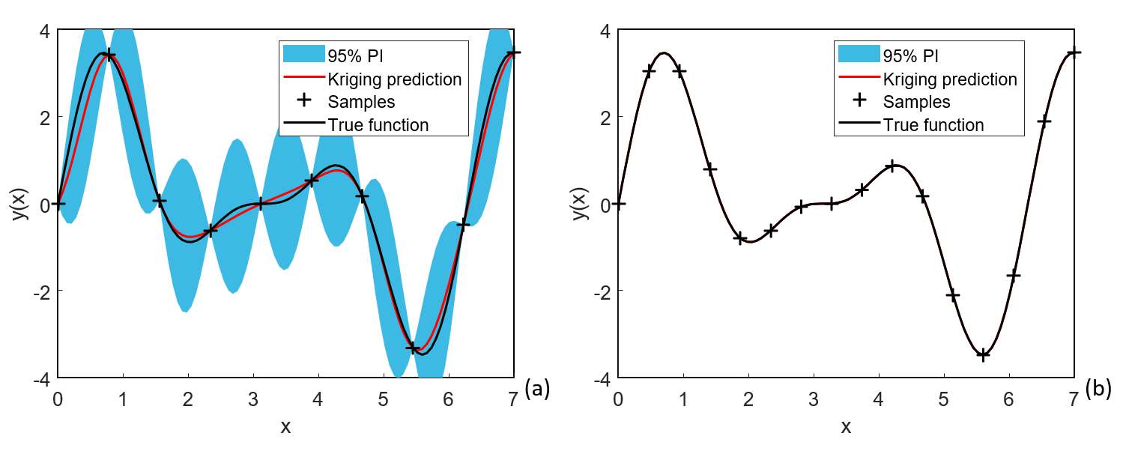
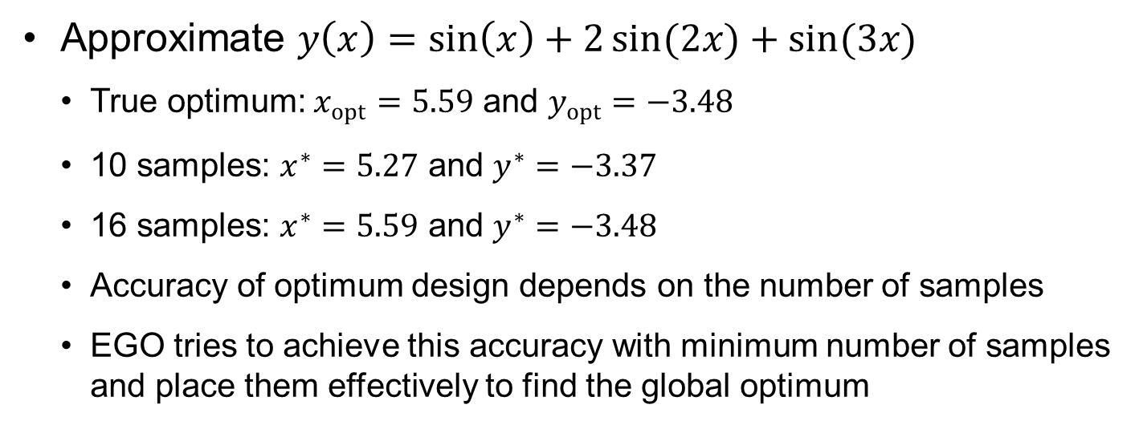
Ex) 1D Kriging Surrogate with Different No. of Samples
Approximate $y\left(x\right)=\sin\left(x\right)+2\sin{(2x)}+sin(3x)$
True optimum: $x_{opt}=5.59$ and $y_{opt}=−3.48$
10 samples: $x^{∗}=5.27$ and $y^{∗}=−3.37$
16 samples: $x^{∗}=5.59$ and $y^{∗}=−3.48$
Accuracy of optimum design depends on the number of samples
EGO tries to achieve this accuracy with minimum number of samples and place them effectively to find the global optimum

Slide 9
10.2 Efficient Global Optimization

Slide 10
EGO
EGO algorithms require surrogate predictions and uncertainty associated with predictions
PRS and Kriging surrogates provide prediction uncertainty
How to select the next sample location
expected improvement (EI)
probability of improvement (PI) with adaptive target improvement
expected feasibility (EF)
Others: Bayesian expected losses, lower confidence bounds, and choosing multiple sample locations simultaneously

Slide 11
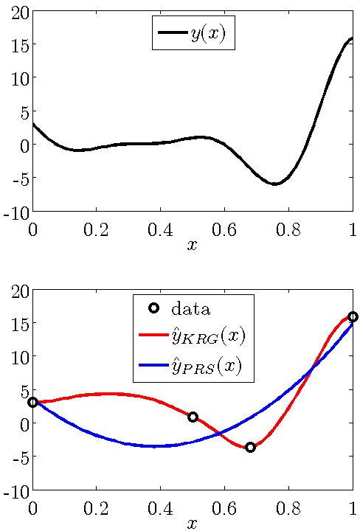

Background: Surrogate Modeling
Surrogates replace expensive simulations by simple algebraic expressions fit to data.
$\hat{y}(x)$ is an estimate of $y(x)$.
Example:
Kriging (KRG)
Polynomial response surface (PRS)
Support vector regression
Radial basis neural networks
Differences are larger in regions of low point density.
Notes:
Surrogates are algebraic expressions fitted to data that approximate an expensive function. Here we denote them with a hat symbol , $\left.\hat{y}(x\right)$ is a surrogate for y(x).
Four common surrogates are kriging, polynomial response surfaces (linear regression), support vector regression, and radial basis neural network. Given the same data different surrogates will provide different approximations. The top figure shows a function y , and the bottom figure shows two surrogates fitted to four data points of function values. The kriging surrogate interpolates the data, while the quadratic polynomial response surface minimizes the sum of the squares of the differences between data and surrogate.
A measure of the uncertainty in the surrogate prediction is the difference between the predictions of different surrogates. In general this uncertainty will be larger when the data points are sparse. In the figure, the distance between points is greater on the left than on the right, and consequently the difference is also larger on the left.
11

Slide 12
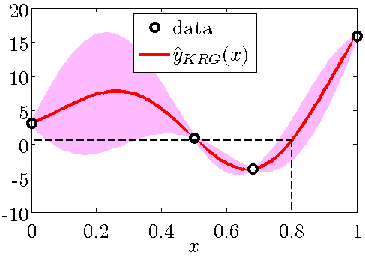
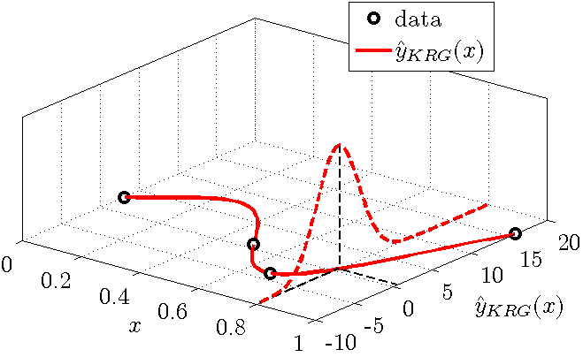
Background: Uncertainty
Some surrogates also provide an uncertainty estimate: standard error, s(x).
Example: Kriging and polynomial response surface.
Both of these are used in EGO.
Notes:
Besides comparing the predictions of multiple surrogates in order to assess the uncertainty, the theory behind many surrogates also permits us to estimate the uncertainty associated with their predictions. The lecture on prediction variance in linear regression and the lecture on kriging may be consulted to see the actual expressions for the uncertainty in the case of polynomial response surfaces and kriging, respectively.
In the upper figure, the kriging surrogate from the previous slide is shown with a shaded region which is one standard error wide. The standard error is the estimate of the standard deviation of the kriging estimate, which is obtained as the square root of the prediction variance. We again see that the uncertainty is larger on the left side, where points are more widely spaced.
Both polynomial response surfaces and linear regression further assume that the uncertainty follows a normal distribution, and this is shown in the bottom figure. The figure shows the distribution at x=0.8, and it allows us to estimate the probability of the true function being below any value. This would be the area of the curve below that value. For example, we have a probability of 50% of the true function being below zero, and a few percent below -5. The upper figure indicates that -5 is about two standard deviation below the mean, and a normally distributed variable has a 2.27% chance of being below the mean minus two standard deviations.
Using the normal distribution for selecting points is a key feature of the EGO algorithm.
12

Slide 13
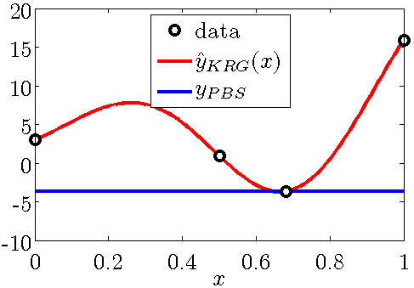
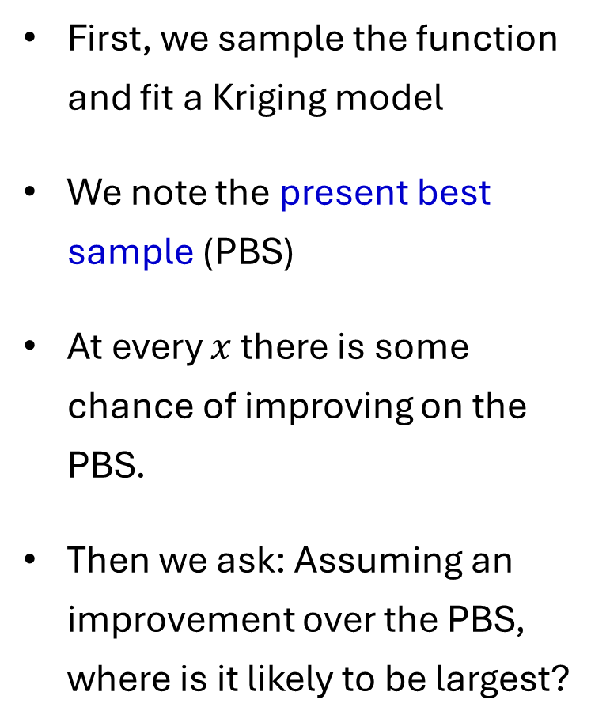
Kriging Fit and Defining Improvement
First, we sample the function and fit a Kriging model
We note the present best sample (PBS)
At every $x$ there is some chance of improving on the PBS.
Then we ask: Assuming an improvement over the PBS, where is it likely to be largest?
Notes:
EGO was developed with kriging, even though it is applicable to any surrogate with an uncertainty model. So in this lecture we will assume that the surrogate is kriging.
So given a sample of function values at data points we fit a kriging model. The first step for EGO is to identify the best sample value, which for minimization is the lowest point. That value is called present best solution (PBS). Note that it is not the lowest points of the surrogate prediction, which can be even lower (though in the figure they are the same).
Note that every point (every value of x) the red curve is the center of a normal distribution that extends from plus to minus infinity. So at every point we have some chance of the function being below the PBS. EGO selects the next point to be sampled by asking the following question: Assuming that at point x we will see improvement on the PBS, at which point will the improvement is likely to be largest.
13

Slide 14
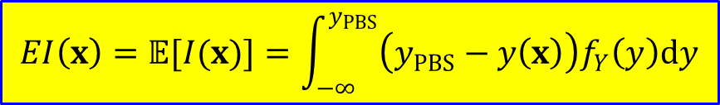
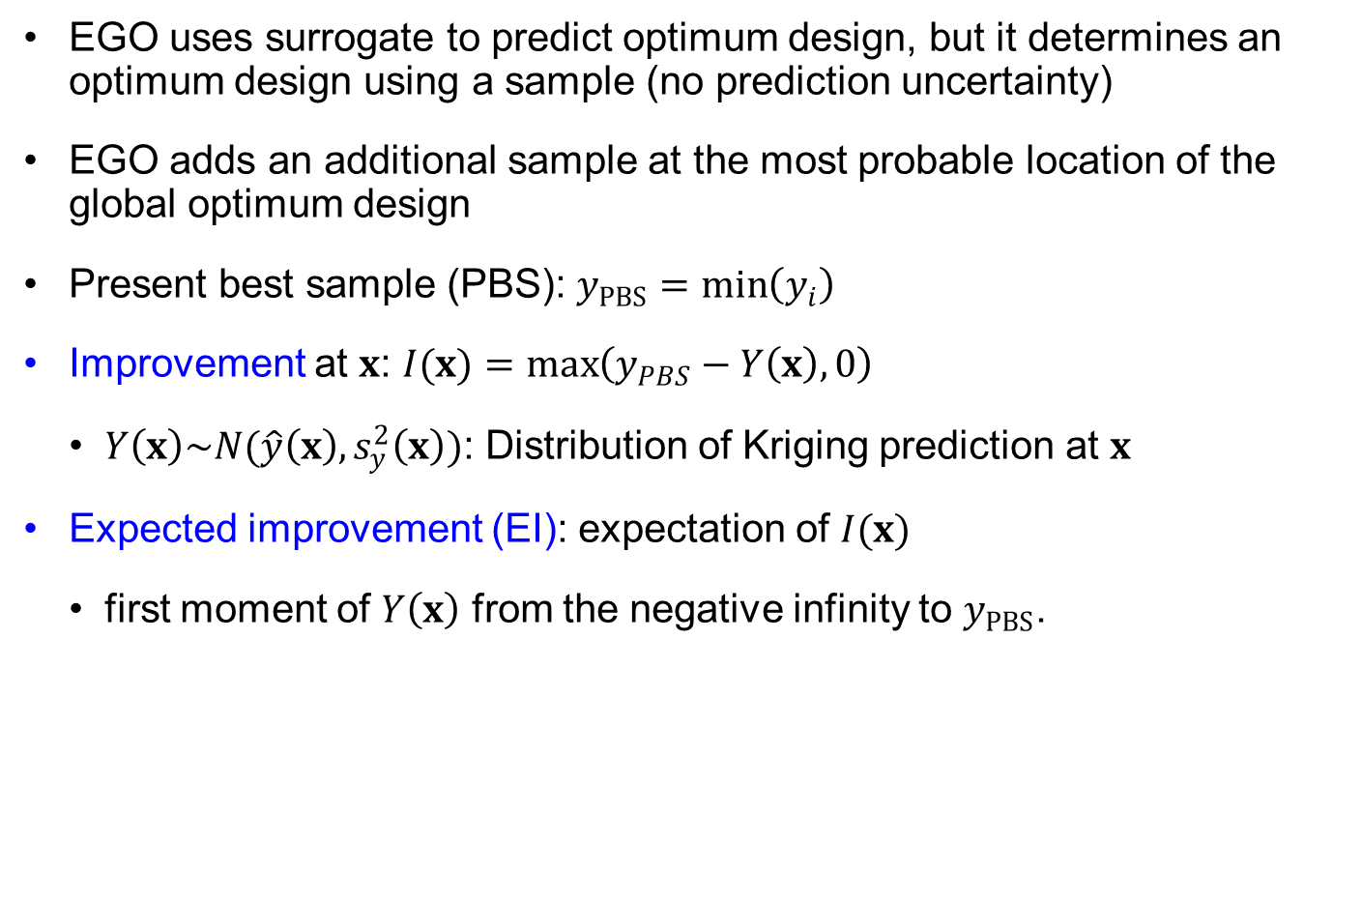
Expected Improvement (EI)
EGO uses surrogate to predict optimum design, but it determines an optimum design using a sample (no prediction uncertainty)
EGO adds an additional sample at the most probable location of the global optimum design
Present best sample (PBS): $y_{PBS}=\min\left(y_{i}\right)$
Improvement at $x$: $I(x)=\max\left(y_{PBS}−Y\left(x\right),0\right)$
$Y\left(x\right)\sim N(\hat{y}\left(x\right), s_{y}^{2}\left(x\right))$: Distribution of Kriging prediction at $x$
Expected improvement (EI): expectation of $I(x)$
first moment of $Y\left(x\right)$ from the negative infinity to $y_{PBS}$.
$$EI\left(x\right)=𝔼[I(x)]=\int_{−∞}^{y_{PBS}}{\left(y_{PBS}−y\left(x\right)\right)f_{Y}\left(y\right)dy}$$

Slide 15
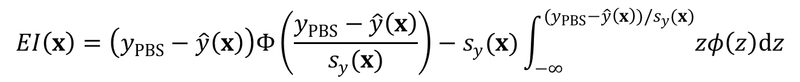


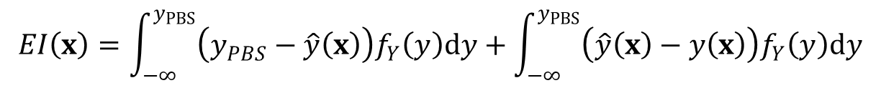
Expected Improvement (EI) cont.
add and subtract mean prediction $\hat{y}\left(x\right)$ and split the integral into two
Normalization: $Z=(Y−\hat{y}\left(x\right))/s_{y}(x)$ (standard normal variable)
The difference $y_{PBS}−\hat{y}\left(x\right)$ is penalized by CDF $⟹$ large when $\hat{y}\left(x\right)$ is small compared to $y_{PBS}$ (exploitation)
Negative of 2nd term becomes large when $s_{y}(x)$ is large (exploration)
Note: $φ^{′}\left(z\right)=−zφ\left(z\right)$, the last integral = $−φ\left((y_{PBS}−\hat{y}\left(x\right))/s_{y}(x)\right)$
New sample location
$$EI\left(x\right)=\int_{−∞}^{y_{PBS}}{\left(y_{PBS}−\hat{y}\left(x\right)\right)f_{Y}\left(y\right)dy}+\int_{−∞}^{y_{PBS}}{\left(\hat{y}\left(x\right)−y\left(x\right)\right)f_{Y}\left(y\right)dy}$$
$$EI\left(x\right)=\left(y_{PBS}−\hat{y}\left(x\right)\right)Φ\left(\frac{y_{PBS}−\hat{y}\left(x\right)}{s_{y}(x)}\right)−s_{y}(x)\int_{−∞}^{(y_{PBS}−\hat{y}\left(x\right))/s_{y}(x)}{zφ\left(z\right)dz}$$
$$EI\left(x\right)=s_{y}\left(x\right)\left[z_{PBS}Φ\left(z_{PBS}\right)+φ\left(z_{PBS}\right)\right], z_{PBS}=(y_{PBS}−\hat{y}(x))/s\left(x\right)$$
$$x_{new}=\arg{\max_{x}{EI\left(x\right)}}$$

Slide 16
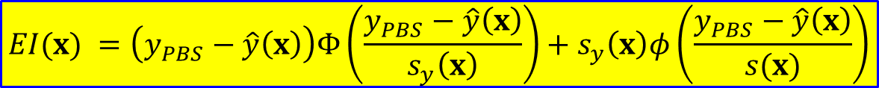
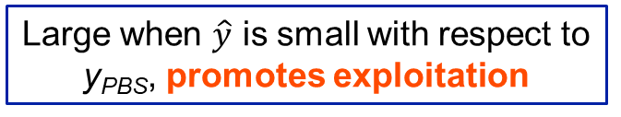

Expected Improvement (EI) cont.
Idea can be found in Mockus’s work as far back as 1978.
Expectation of improving beyond the Present Best Sample (PBS) or current best function value $y_{PBS}$
$$EI(x) =\left(y_{PBS}−\hat{y}\left(x\right)\right)Φ\left(\frac{y_{PBS}−\hat{y}\left(x\right)}{s_{y}\left(x\right)}\right)+s_{y}\left(x\right)φ\left(\frac{y_{PBS}−\hat{y}\left(x\right)}{s(x)}\right)$$
Difference between PBS and prediction at x
Penalized by area under the curve
Large when s(x) is large, promotes exploration
Large when $\hat{y}$ is small with respect to y_{PBS}, promotes exploitation
Balance between seeking promising areas of design space and the uncertainty in the model.
Mockus, J., Tiesis, V. and Zilinskas, A. (1978), The application of Bayesian methods for seeking the extremum, in L.C.W. Dixon and G.P. Szego (eds.), Towards Global Optimisation, Vol.2, pp. 117–129. North Holland, Amsterdam.
Notes:
$Φ$ denotes the CDF of a standard normal distribution and thus represents the area under the curve shown in the previous slide.
y_{PBS}: Present Best Solution
$\hat{y}(x)$: Kriging Prediction
s(x) : Prediction standard deviation $\left(\sqrt{Prediction Variance}\right)$
$Φ$: Cumulative density function of standard normal distribution
$φ$: Probability density function of standard normal distribution
Mockus, J., Tiesis, V. and Zilinskas, A. (1978), The application of Bayesian methods for seeking the extremum, in L.C.W. Dixon and G.P. Szego (eds.), Towards Global Optimisation, Vol.2, pp. 117–129. North Holland, Amsterdam.

Slide 17




Expected Improvement (EI) cont.
Four samples $x_{s}=\{0, 0.5, 0.68, 1.0\}$ from $y\left(x\right)={\left(6x−2\right)}^{2}\sin{(12x−4)}$
$y_{PBS}=y\left(0.68\right)=−3.68$
True optimum: $y\left(x_{opt}=0.757\right)=−6.02$
Prediction PDF: $Y\left(x=0.2\right)\sim N(\hat{y}\left(0.2\right), s_{y}^{2}\left(0.2\right))$
Mean of the area under $y_{PBS}$ is EI
20
20
68% PI
68% PI
15
Kriging prediction
15
Kriging prediction
Samples
Samples
True function
True function
10
10
)
)
x
x
(
5
(
5
y
y
0
0
-5
$$y_{PBS}$$
-5
$$y_{PBS}$$
$$I(0.2)$$
-10
(a)
-10
(b)
0
0.2
0.4
0.6
0.8
1
0
0.2
0.4
0.6
0.8
1
x
x

Slide 18

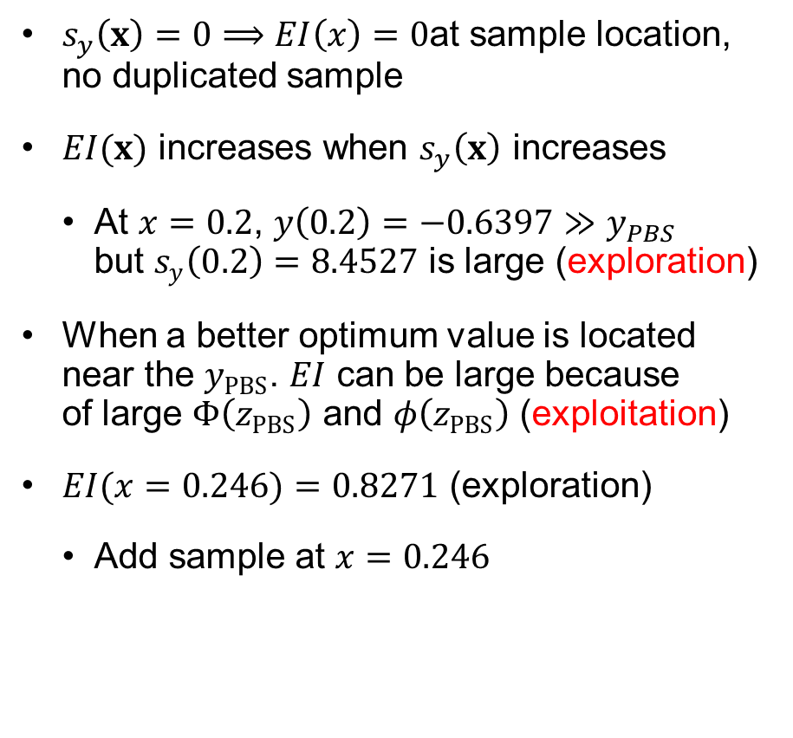


Exploration vs. Exploitation
$$EI\left(x\right)=s_{y}\left(x\right)\left[z_{PBS}Φ\left(z_{PBS}\right)+φ\left(z_{PBS}\right)\right]$$
20
$$z_{PBS}≥0$$
68% PI
15
Kriging prediction
Samples
$s_{y}\left(x\right)=0⟹EI\left(x\right)=0$at sample location, no duplicated sample
$EI(x)$ increases when $s_{y}\left(x\right)$ increases
At $x=0.2$, $y\left(0.2\right)=−0.6397≫y_{PBS}$ but $s_{y}\left(0.2\right)=8.4527$ is large (exploration)
When a better optimum value is located near the $y_{PBS}$. $EI$ can be large because of large $Φ\left(z_{PBS}\right)$ and $φ\left(z_{PBS}\right)$ (exploitation)
$EI(x=0.246)=0.8271$ (exploration)
Add sample at $x=0.246$
True function
10
)
x
(
5
y
0
$$y_{PBS}$$
-5
-10
0
0.2
0.4
0.6
0.8
1
x
1
0.8
)
0.6
x
(
I
E
0.4
0.2
0
0
0.2
0.4
0.6
0.8
1
x

Slide 19
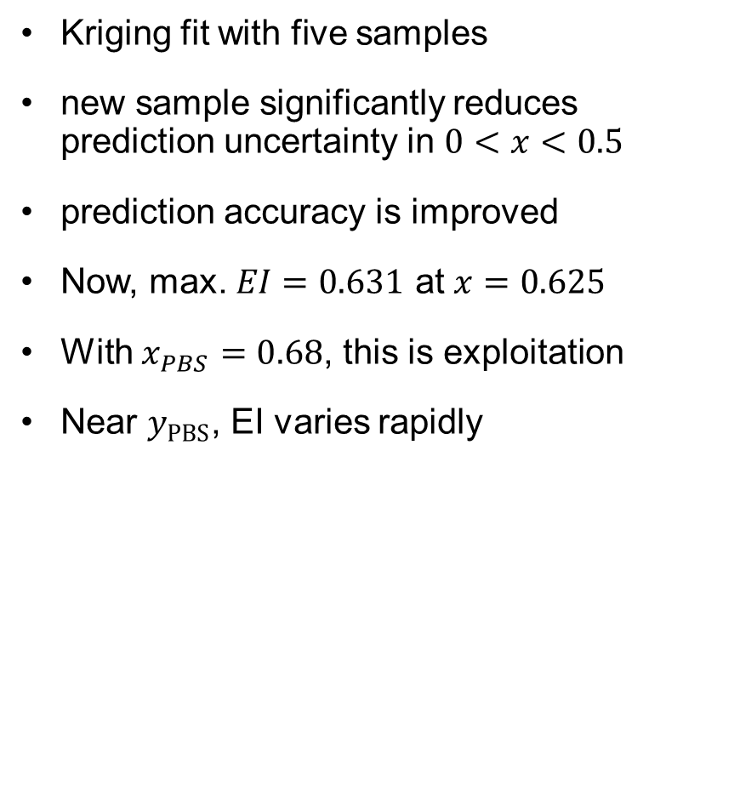
Exploration vs. Exploitation cont.
20
Kriging fit with five samples
new sample significantly reduces prediction uncertainty in $0<x<0.5$
prediction accuracy is improved
Now, max. $EI=0.631$ at $x=0.625$
With $x_{PBS}=0.68$, this is exploitation
Near $y_{PBS}$, EI varies rapidly
68% PI
15
Kriging prediction
Samples
True function
10
)
x
(
5
y
0
-5
-10
0
0.2
0.4
0.6
0.8
1
x
0.7
0.6
0.5
)
0.4
x
(
I
E
0.3
0.2
0.1
0
0
0.2
0.4
0.6
0.8
1
x

Slide 20
Ex10.1) Adding Additional Sample using EI
Perform 3 EGO iteration for $y\left(x\right)={\left(6x−2\right)}^{2}\sin{(12x−4)}$
myfun = @(x) (6*x-2).^2.*sin(12*x-4); % In-line function
xs=[0 0.5 0.68 1]'; % Sample locations
ys=myfun(xs); % output samples
xp=linspace(0,1,501)'; % Prediction points
[yp, ysig, nb]=Kriging(xs,ys,xp,0,0); % Build Kriging surrogate
ny=size(ys,1); % Number of samples
cilb = yp + tinv(0.16,ny-nb)*ysig; % Lower-bounds of prediction intervals
ciub = yp + tinv(0.84,ny-nb)*ysig; % Upper-bounds of prediction intervals
ytrue=myfun(xp); % True function values at prediction points
figure; hold on; % Plotting results
xShaded=[xp;sort(xp,'descend')]; yShaded=[cilb;ciub(end:-1:1)];
patch(xShaded,yShaded,[.24 .73 .89],'EdgeColor','none');
plot(xp,yp,'r-',xs,ys,'k+',xp,ytrue,'k-','Markersize',10,'Linewidth',1.5)
xlabel('x');ylabel('y(x)');
legend('68% PI','Kriging prediction','Samples','True function');
%
[xopt, yopt]=fminsearch(@myfun,0.6); % Optimum of true function
[yPBS,I]=min(ys);xPBS=xs(I); % Present best sample
u=(yPBS-yp)./ysig; % Normalized zPBS
EI=ysig.*(u.*cdf('Normal',u,0,1)+pdf('Normal',u,0,1));%Expected improvement
[EImax, I]=max(EI); xEImax=xp(I); % Maximum expected improvement
fprintf(' xPBS yPBS xEImax EImax\n')
fprintf('%8.3g %8.3g %8.3g %8.3g\n',xPBS,yPBS,xEImax,EImax);
figure;
plot(xp,EI,'k',xEImax,EImax,'pentagram','Markersize',10,'Linewidth',1.5);
xlabel('x');ylabel('EI(x)');
eRMS=sqrt(sum((ytrue-yp).^2)/501); % RMS error at N grid points
eav=sum(abs(ytrue-yp))/501; % Average error at NxN grid points
emax=max(abs(ytrue-yp)); % Maximum error at NxN grid points
fprintf('RMS error:%8.3g\nAve error:%8.3g\nMax error:%8.3g\n',eRMS,eav,emax);

Slide 21
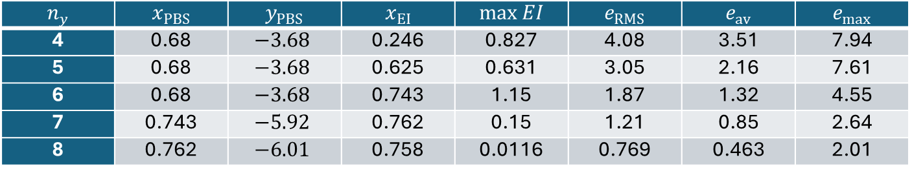

Ex10.1) Adding Additional Sample using EI cont.
Need to add additional sample to xs from xEImax output
$$n_{y}$$ | $$x_{PBS}$$ | $$y_{PBS}$$ | $$x_{EI}$$ | $$\max{EI}$$ | $$e_{RMS}$$ | $$e_{av}$$ | $$e_{max}$$
4 | 0.68 | $$−3.68$$ | 0.246 | 0.827 | 4.08 | 3.51 | 7.94
5 | 0.68 | $$−3.68$$ | 0.625 | 0.631 | 3.05 | 2.16 | 7.61
6 | 0.68 | $$−3.68$$ | 0.743 | 1.15 | 1.87 | 1.32 | 4.55
7 | 0.743 | $$−5.92$$ | 0.762 | 0.15 | 1.21 | 0.85 | 2.64
8 | 0.762 | $$−6.01$$ | 0.758 | 0.0116 | 0.769 | 0.463 | 2.01
$$n_{y}=6$$
20
68% PI
15
Kriging prediction
Samples
10
True function
)
x
(
5
y
0
-5
-10
0
0.2
0.4
0.6
0.8
1
x

Slide 22
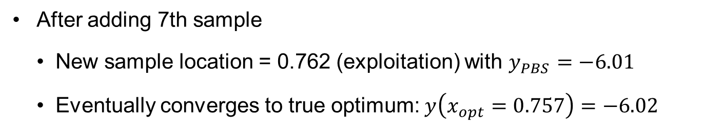
Ex10.1) Adding Additional Sample using EI cont.
After adding 7th sample
New sample location = 0.762 (exploitation) with $y_{PBS}=−6.01$
Eventually converges to true optimum: $y\left(x_{opt}=0.757\right)=−6.02$
20
0.15
68% PI
15
Kriging prediction
Samples
10
True function
0.1
)
)
x
x
(
(
y
5
I
E
0
0.05
-5
-10
0
0.2
0.4
0.6
0.8
1
0
0
0.2
0.4
0.6
0.8
1
x
x

Slide 23
EGO with Probability of Target Improvement (PI)
EGO with EI is expensive to find multiple samples at a time
EGO-PI uses the probability of improvement beyond a given target as the selection criterion
Maximizing PI can balance local and global searches
Performance can be sensitive to the target value
If the target is too ambitious, the search is excessively global and slow to focus on promising areas
If the target is too modest, there is exhaustive search around the PBS before moving to global search
EGO-AT: adapts the target for each cycle according to the success of meeting the target in the previous cycle

Slide 24
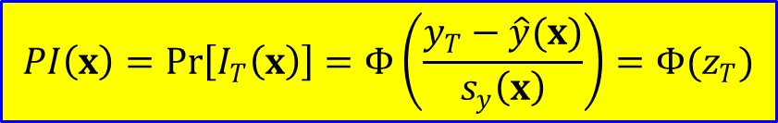
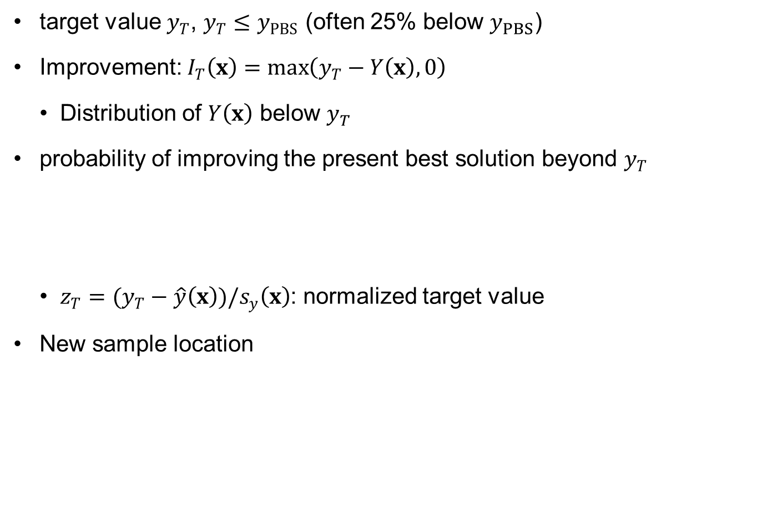

Probability of Improvement (PI)
target value $y_{T}$, $y_{T}≤y_{PBS}$ (often 25% below $y_{PBS}$)
Improvement: $I_{T}\left(x\right)=\max\left(y_{T}−Y\left(x\right),0\right)$
Distribution of $Y\left(x\right)$ below $y_{T}$
probability of improving the present best solution beyond $y_{T}$
$z_{T}=(y_{T}−\hat{y}\left(x\right))/s_{y}\left(x\right)$: normalized target value
New sample location
$$PI\left(x\right)=Pr\left[I_{T}\left(x\right)\right]=Φ\left(\frac{y_{T}−\hat{y}(x)}{s_{y}\left(x\right)}\right)=Φ(z_{T})$$
$$x_{new}=\arg{\max_{x}{PI\left(x\right)}}$$

Slide 25
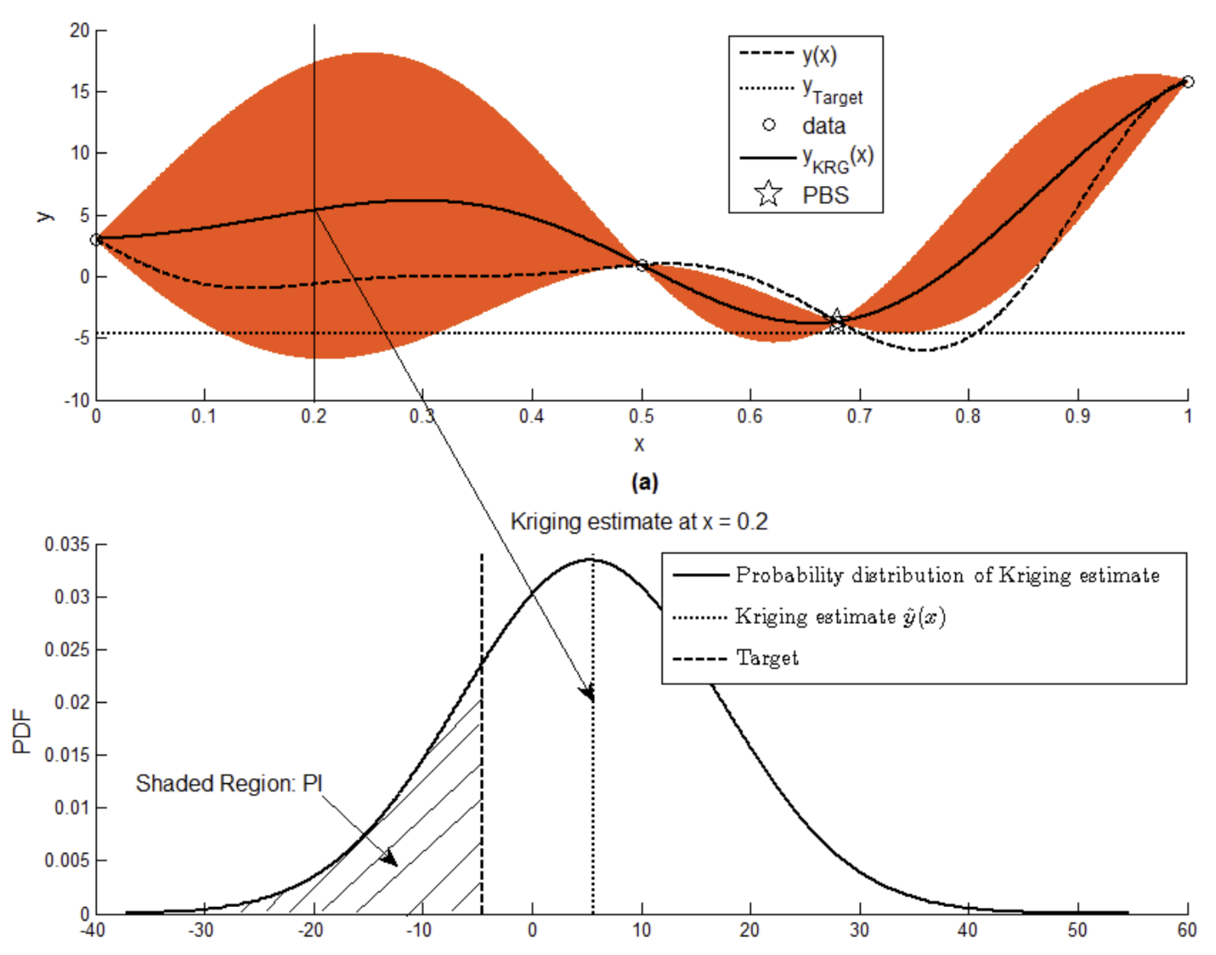
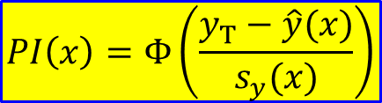

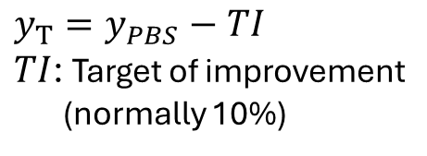
Probability of Improvement (PI) cont.
Probability of improving the target beyond $y_{T}$ at $x$
$$PI\left(x\right)=Φ\left(\frac{y_{T}−\hat{y}(x)}{s_{y}(x)}\right)$$
$y_{T}=y_{PBS}−TI$ $TI$: Target of improvement (normally 10%)

Slide 26
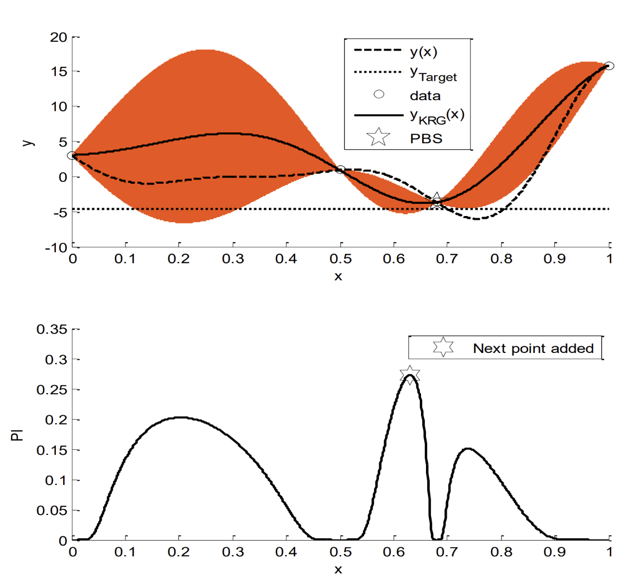

Maximum PI for Adding a Sample
True function: $y\left(x\right)={\left(6x−2\right)}^{2}\sin{(12x−4)}$
Initial sample : x = [0 0.5 0.68 1]
Uncertainty $2×s_{y}(x)$
Maximum $PI$ at $x=0.62$ (exploitation of better PBS)

Slide 27


Probability of Improvement (PI) cont.
20
20
68% PI
68% PI
15
Kriging prediction
15
Kriging prediction
Samples
Samples
True function
True function
10
10
)
)
x
x
(
5
(
5
y
y
0
0
-5
$$y_{T}=−4.6$$
-5
$$y_{T}=−6.5$$
-10
-10
0
0.2
0.4
0.6
0.8
1
0
0.2
0.4
0.6
0.8
1
x
x
exploitation
0.12
exploration
0.1
0.08
)
x
(
I
0.06
P
0.04
0.02
0
0
0.2
0.4
0.6
0.8
1
x

Slide 28
Ex10.2) EGO with PI
Perform 5 EGO iteration with PI
myfun = @(x) (6*x-2).^2.*sin(12*x-4); % In-line function
xs=[0 0.5 0.68 1]'; % Input samples
ys=myfun(xs); % output samples
xp=linspace(0,1,501)'; % Prediction points
[yp, ysig, nb]=Kriging(xs,ys,xp,0,0); % Build Kriging surrogate
ny=size(ys,1); % Number of samples
cilb = yp + tinv(0.16,ny-nb)*ysig; % Lower-bounds of prediction intervals
ciub = yp + tinv(0.84,ny-nb)*ysig; % Upper-bounds of prediction intervals
ytrue=myfun(xp); % True function values at predictio points
figure; hold on; % Plotting results
xShaded=[xp;sort(xp,'descend')]; yShaded=[cilb;ciub(end:-1:1)];
patch(xShaded,yShaded,[.24 .73 .89],'EdgeColor','none');
plot(xp,yp,'r-',xs,ys,'k+',xp,ytrue,'k-','Markersize',10,'Linewidth',1.5)
xlabel('x');ylabel('y(x)');
legend('68% PI','Kriging prediction','Samples','True function');
%
[yPBS,I]=min(ys);xPBS=xs(I); % Present best sample
ytarget=yPBS-0.25*abs(yPBS); % Target value
ztarget=(ytarget-yp)./ysig; % Normalized target value
PI=cdf('Normal',ztarget,0,1); % Probability of improvement
[PImax, I]=max(PI); xPImax=xp(I); % Max. of probability of improvement
fprintf(' xPBS yPBS xPImax PImax ytarget\n')
fprintf('%8.3g %8.3g %8.3g %8.3g %8.3g\n',xPBS,yPBS,xPImax,PImax,ytarget);
figure;
plot(xp,PI,'k',xPImax,PImax,'pentagram','Markersize',10,'Linewidth',1.5);
xlabel('x');ylabel('PI(x)');
eRMS=sqrt(sum((ytrue-yp).^2)/501); % RMS error at N grid points
eav=sum(abs(ytrue-yp))/501; % Average error at NxN grid points
emax=max(abs(ytrue-yp)); % Maximum error at NxN grid points
fprintf('RMS error:%8.3g\nAve error:%8.3g\nMax error:%8.3g\n',eRMS,eav,emax);

Slide 29
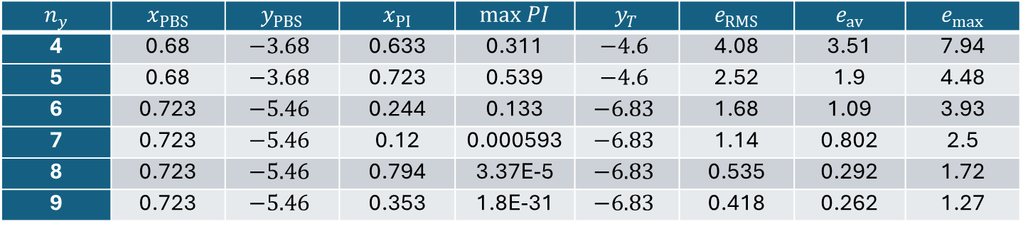

Ex10.2) EGO with PI cont.
Need to add additional sample to xs from xPImax output
$$n_{y}$$ | $$x_{PBS}$$ | $$y_{PBS}$$ | $$x_{PI}$$ | $$\max{PI}$$ | $$y_{T}$$ | $$e_{RMS}$$ | $$e_{av}$$ | $$e_{max}$$
4 | 0.68 | $$−3.68$$ | 0.633 | 0.311 | $$−4.6$$ | 4.08 | 3.51 | 7.94
5 | 0.68 | $$−3.68$$ | 0.723 | 0.539 | $$−4.6$$ | 2.52 | 1.9 | 4.48
6 | 0.723 | $$−5.46$$ | 0.244 | 0.133 | $$−6.83$$ | 1.68 | 1.09 | 3.93
7 | 0.723 | $$−5.46$$ | 0.12 | 0.000593 | $$−6.83$$ | 1.14 | 0.802 | 2.5
8 | 0.723 | $$−5.46$$ | 0.794 | 3.37E-5 | $$−6.83$$ | 0.535 | 0.292 | 1.72
9 | 0.723 | $$−5.46$$ | 0.353 | 1.8E-31 | $$−6.83$$ | 0.418 | 0.262 | 1.27
$$n_{y}=5$$
exploitation

Slide 30



Ex10.2) EGO with PI cont.
After adding 7th sample
$y_{T}=−6.83$ is too ambitious, PI becomes very small
it would be necessary to make the target closer to the present best sample
$$n_{y}=7$$
exploration
Knowing achievable $y_{T}$ is difficult!

Slide 31
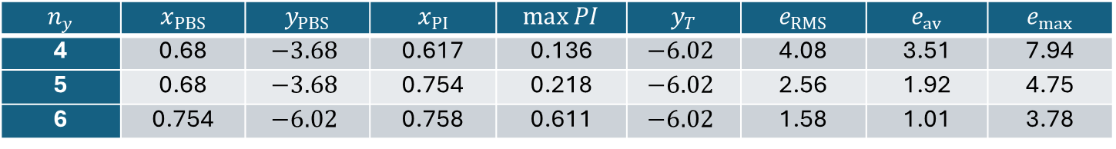
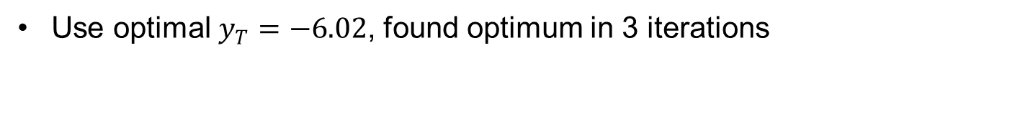
Ex10.3) PI with Optimum Target
Use optimal $y_{T}=−6.02$, found optimum in 3 iterations
$$n_{y}$$ | $$x_{PBS}$$ | $$y_{PBS}$$ | $$x_{PI}$$ | $$\max{PI}$$ | $$y_{T}$$ | $$e_{RMS}$$ | $$e_{av}$$ | $$e_{max}$$
4 | 0.68 | $$−3.68$$ | 0.617 | 0.136 | $$−6.02$$ | 4.08 | 3.51 | 7.94
5 | 0.68 | $$−3.68$$ | 0.754 | 0.218 | $$−6.02$$ | 2.56 | 1.92 | 4.75
6 | 0.754 | $$−6.02$$ | 0.758 | 0.611 | $$−6.02$$ | 1.58 | 1.01 | 3.78

Slide 32
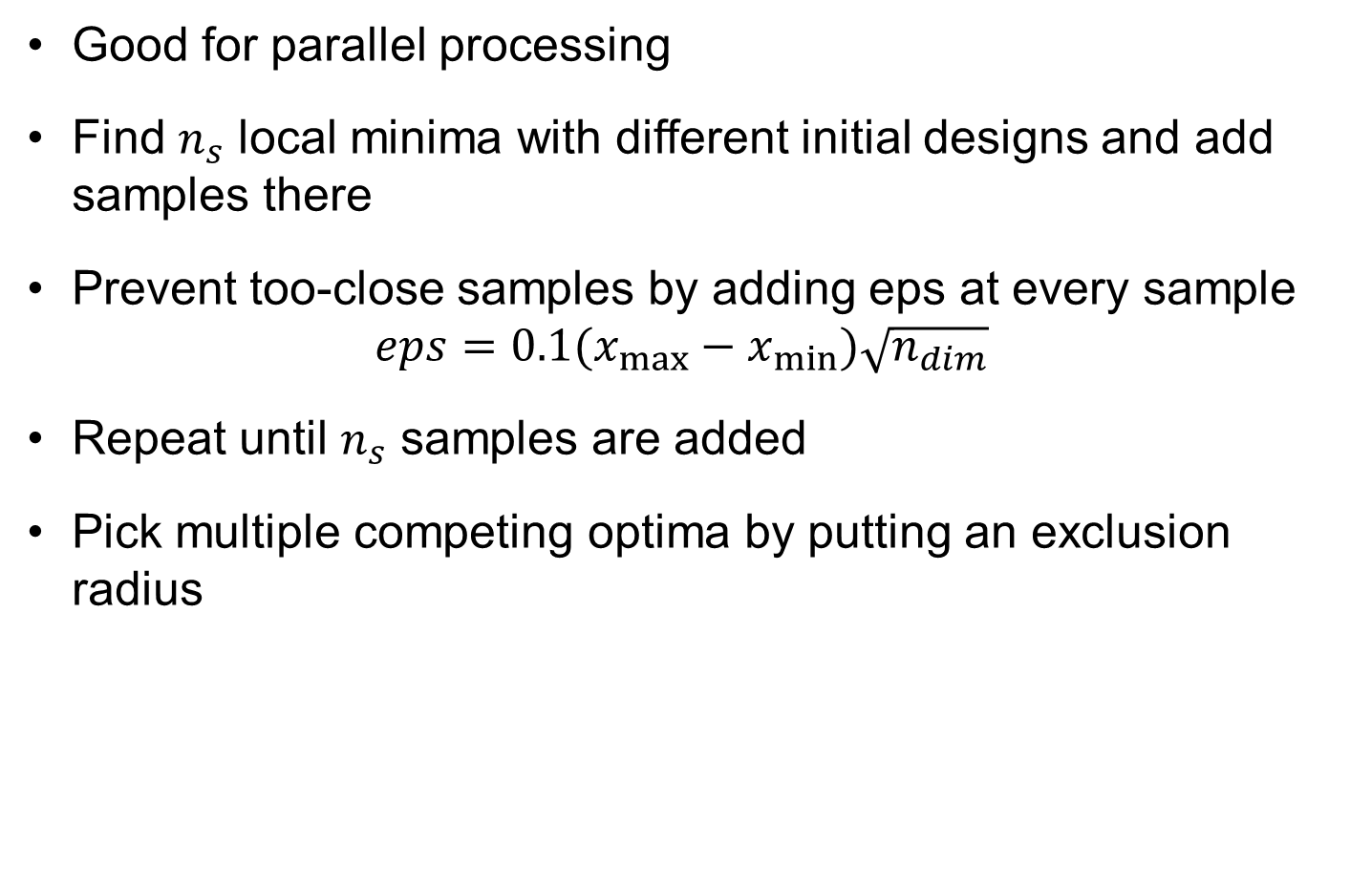
Adding Multiple Samples Simultaneously
Good for parallel processing
Find $n_{s}$ local minima with different initial designs and add samples there
Prevent too-close samples by adding eps at every sample $eps=0.1(x_{max}−x_{min})\sqrt{n_{dim}}$
Repeat until $n_{s}$ samples are added
Pick multiple competing optima by putting an exclusion radius

Slide 33
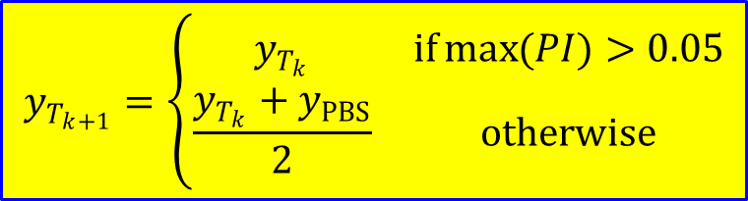
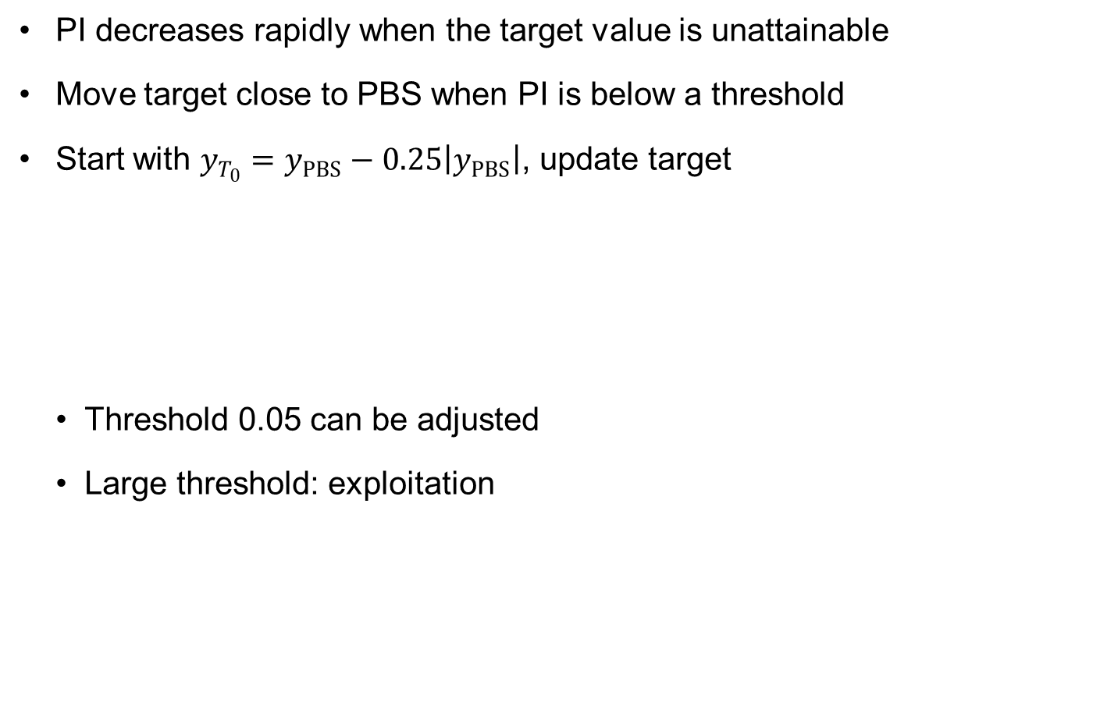
EGO with Adaptive Target (EGO-AT)
PI decreases rapidly when the target value is unattainable
Move target close to PBS when PI is below a threshold
Start with $y_{T_{0}}=y_{PBS}−0.25\left|y_{PBS}\right|$, update target
Threshold 0.05 can be adjusted
Large threshold: exploitation
$$y_{T_{k+1}}=\left\{\begin{matrix}y_{T_{k}} & if\max{(PI)}>0.05 \\ \frac{y_{T_{k}}+y_{PBS}}{2} & otherwise\end{matrix}\right.$$

Slide 34
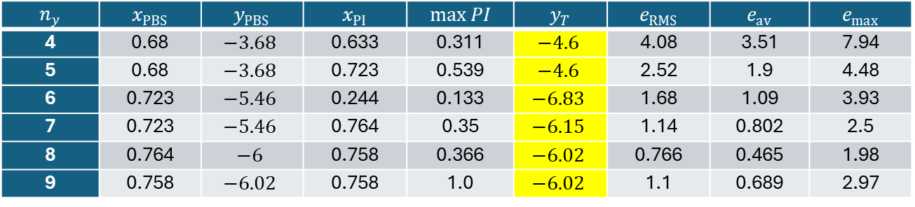
Ex10.4) PI with Adaptive Target
Modify Matlab script for calculating max PI
ytarget=yPBS-0.25*abs(yPBS);
while 1
ztarget=(ytarget-yp)./ysig;
PI=cdf('Normal',ztarget,0,1);
[PImax, I]=max(PI); xPImax=xp(I);
if PImax<0.05, ytarget=(ytarget+yPBS)/2; else, break; end
end
$$n_{y}$$ | $$x_{PBS}$$ | $$y_{PBS}$$ | $$x_{PI}$$ | $$\max{PI}$$ | $$y_{T}$$ | $$e_{RMS}$$ | $$e_{av}$$ | $$e_{max}$$
4 | 0.68 | $$−3.68$$ | 0.633 | 0.311 | $$−4.6$$ | 4.08 | 3.51 | 7.94
5 | 0.68 | $$−3.68$$ | 0.723 | 0.539 | $$−4.6$$ | 2.52 | 1.9 | 4.48
6 | 0.723 | $$−5.46$$ | 0.244 | 0.133 | $$−6.83$$ | 1.68 | 1.09 | 3.93
7 | 0.723 | $$−5.46$$ | 0.764 | 0.35 | $$−6.15$$ | 1.14 | 0.802 | 2.5
8 | 0.764 | $$−6$$ | 0.758 | 0.366 | $$−6.02$$ | 0.766 | 0.465 | 1.98
9 | 0.758 | $$−6.02$$ | 0.758 | 1.0 | $$−6.02$$ | 1.1 | 0.689 | 2.97
20
68% PI
15
Kriging prediction
Samples
10
True function
)
x
(
5
y
0
-5
-10
0
0.2
0.4
0.6
0.8
1
x

Slide 35
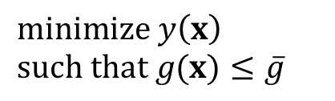
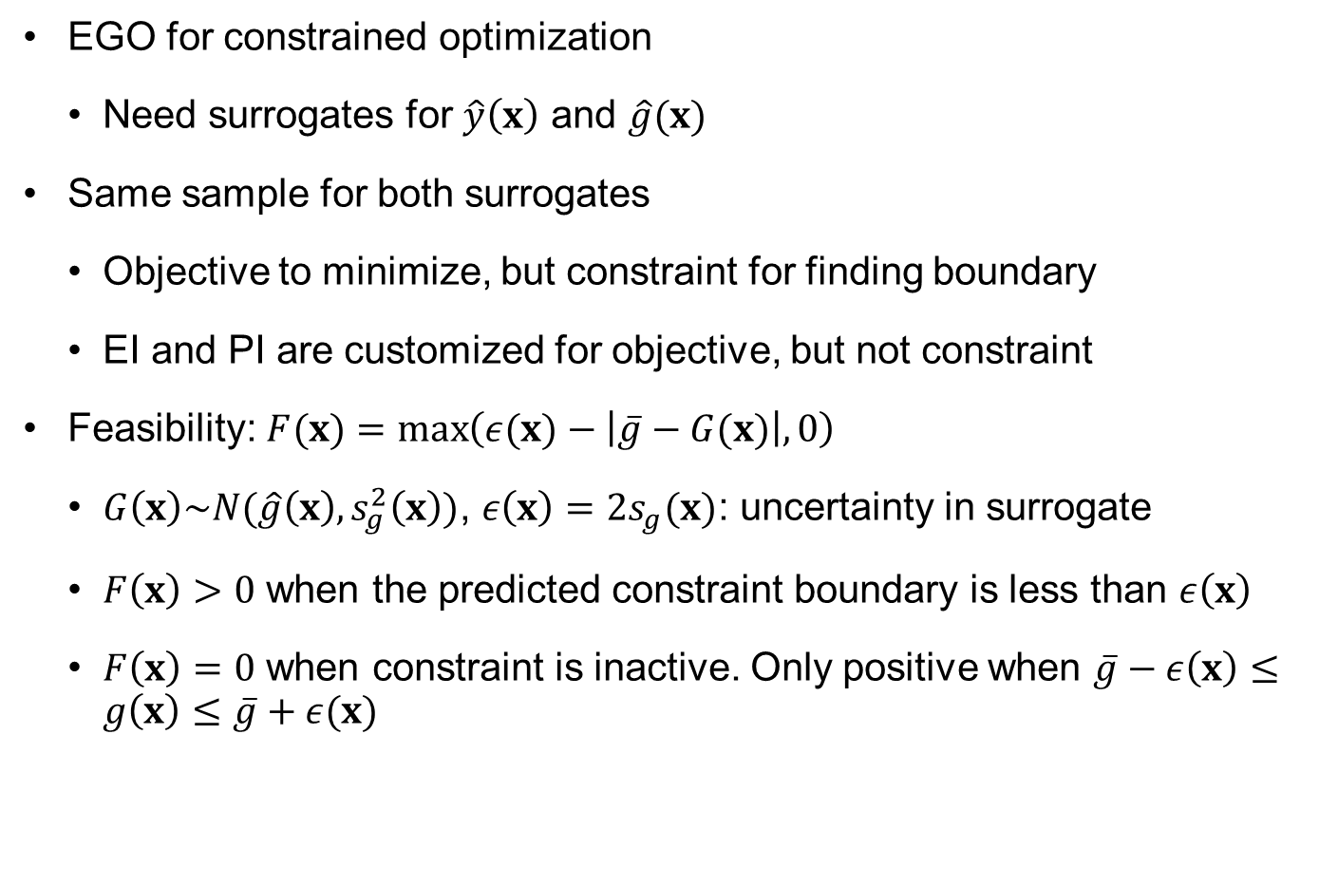
Expected Feasibility (EF)
$$minimize y\left(x\right) \\ such that g(x)≤\overline{g}$$
EGO for constrained optimization
Need surrogates for $\hat{y}\left(x\right)$ and $\hat{g}(x)$
Same sample for both surrogates
Objective to minimize, but constraint for finding boundary
EI and PI are customized for objective, but not constraint
Feasibility: $F(x)=\max\left(ε(x)−\left|\overline{g}−G(x)\right|,0\right)$
$G\left(x\right)\sim N(\hat{g}\left(x\right), s_{g}^{2}\left(x\right))$, $ε\left(x\right)=2s_{g}(x)$: uncertainty in surrogate
$F\left(x\right)>0$ when the predicted constraint boundary is less than $ε\left(x\right)$
$F\left(x\right)=0$ when constraint is inactive. Only positive when $\overline{g}−ε\left(x\right)≤g\left(x\right)≤\overline{g}+ε(x)$

Slide 36
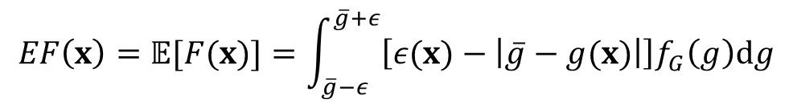
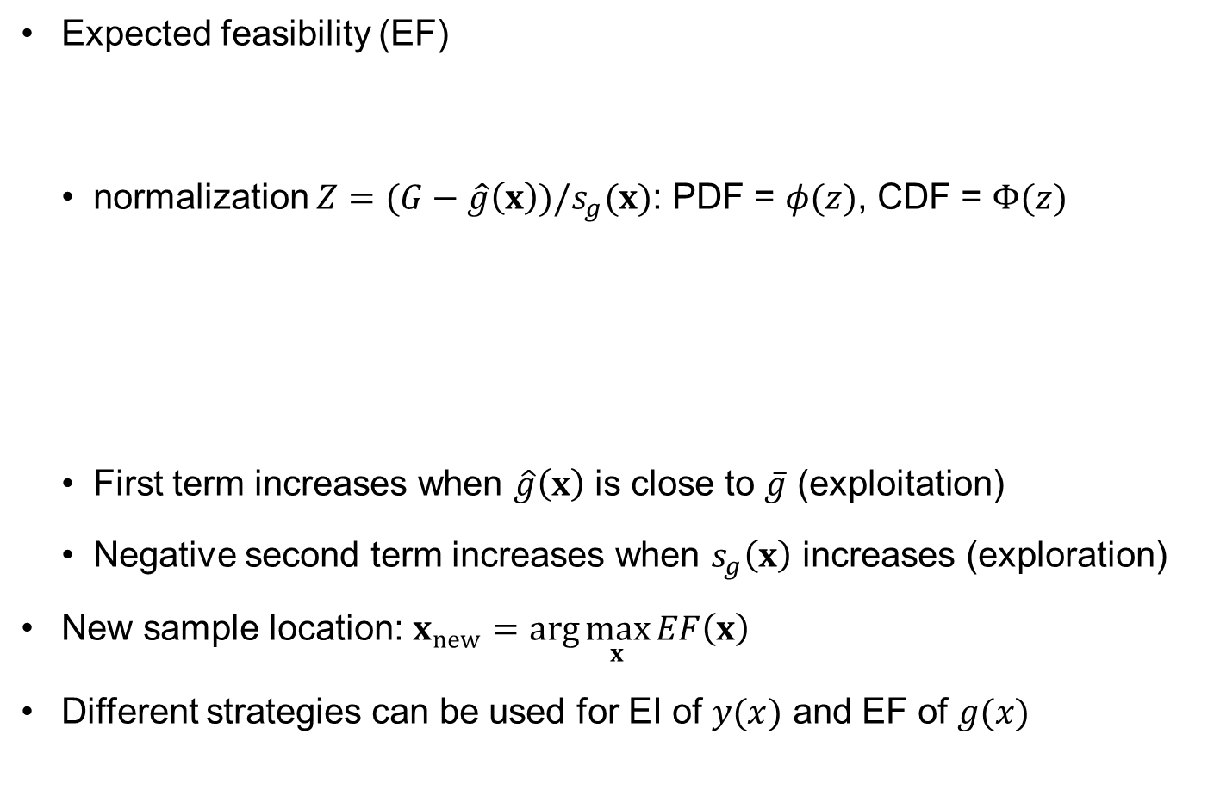
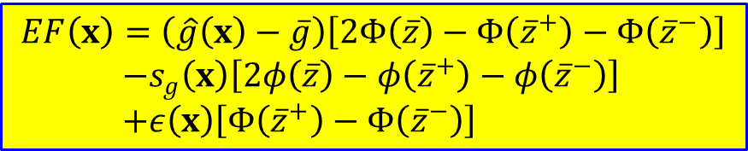

Expected Feasibility (EF) cont.
Expected feasibility (EF)
normalization $Z=(G−\hat{g}\left(x\right))/s_{g}(x)$: PDF = $φ(z)$, CDF = $Φ(z)$
First term increases when $\hat{g}\left(x\right)$ is close to $\overline{g}$ (exploitation)
Negative second term increases when $s_{g}\left(x\right)$ increases (exploration)
New sample location: $x_{new}=\arg{\max_{x}{EF\left(x\right)}}$
Different strategies can be used for EI of $y(x)$ and EF of $g(x)$
$$EF\left(x\right)=𝔼[F(x)]=\int_{\overline{g}−ε}^{\overline{g}+ε}{\left[ε(x)−\left|\overline{g}−g(x)\right|\right]f_{G}\left(g\right)dg}$$
$$EF\left(x\right)=\left(\hat{g}\left(x\right)−\overline{g}\right)\left[2Φ\left(\overline{z}\right)−Φ\left({\overline{z}}^{+}\right)−Φ\left({\overline{z}}^{−}\right)\right] \\ −s_{g}\left(x\right)\left[2φ\left(\overline{z}\right)−φ\left({\overline{z}}^{+}\right)−φ\left({\overline{z}}^{−}\right)\right] \\ +ε\left(x\right)\left[Φ\left({\overline{z}}^{+}\right)−Φ\left({\overline{z}}^{−}\right)\right]$$
$${\overline{z}}^{±}=\frac{\overline{g}±ε−\hat{g}\left(x\right)}{s_{g}}$$

Slide 37
10.3 Efficient Global Optimization Using Polynomial Response Surface

Slide 38
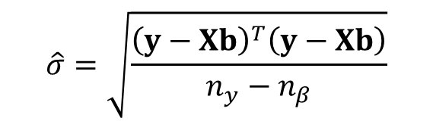
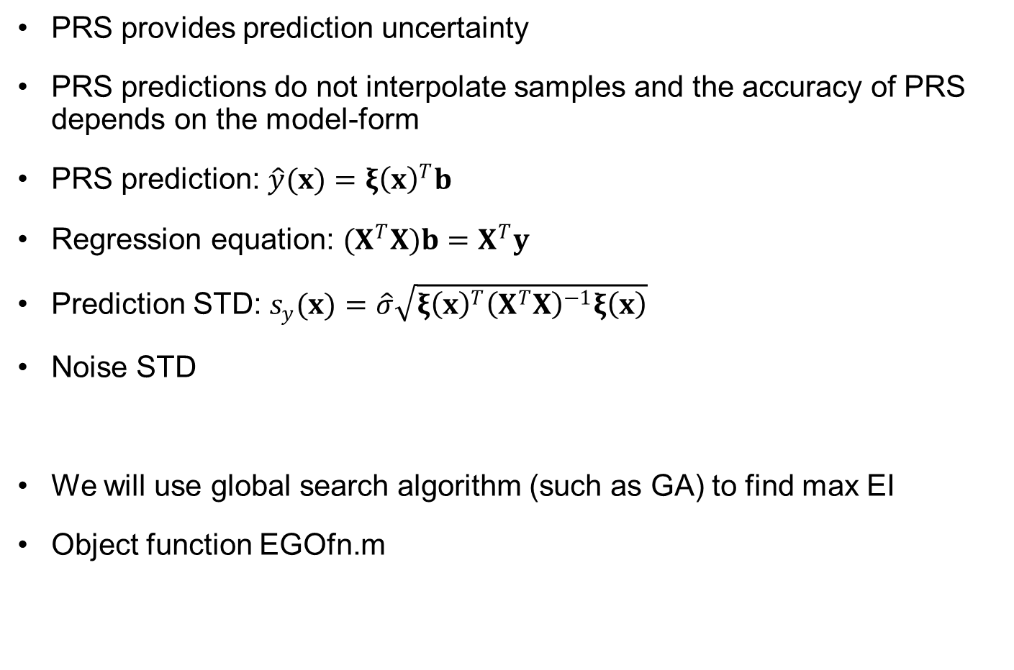
EGO using PRS
PRS provides prediction uncertainty
PRS predictions do not interpolate samples and the accuracy of PRS depends on the model-form
PRS prediction: $\hat{y}(x)={ξ\left(x\right)}^{T}b$
Regression equation: $(X^{T}X)b=X^{T}y$
Prediction STD: $s_{y}(x)=\hat{σ}\sqrt{{ξ\left(x\right)}^{T}{\left(X^{T}X\right)}^{−1}ξ\left(x\right)}$
Noise STD
We will use global search algorithm (such as GA) to find max EI
Object function EGOfn.m
$$\hat{σ}=\sqrt{\frac{{\left(y−Xb\right)}^{T}\left(y−Xb\right)}{n_{y}−n_{β}}}$$
function f=EGOfn(x)
f = sin(x);
end

Slide 39
EGOPRS
1 function [xs, ys, yp, ysig, nb]=EGOPRS(xs,ys,xp,nmax,range,p)
2 % INPUTS (xs, ys): initial sample pairs
3 % xp: np x NDV prediction points
4 % nmax: maximum number of samples
5 % range: range of design domain
6 % p: order or PRS
7 % OUTPUTS (xs, ys): samples pairs included added samples
8 % yp: np x 1 mean predictions
9 % ysig: np x 1 prediction standard deviations
10 % nb: # of coefficients in trend function
11 %
12 [ny,NDV]=size(xs);np=size(xp,1); % Size of samples
13 meanx=mean(xs);stdx=std(xs);xs=(xs-meanx)./stdx;% Scaling sample locations
14 meany=mean(ys); stdy=std(ys);ys=(ys-meany)/stdy; % Scaling samples
15 xp=(xp-meanx)./stdx; % Scaling prediction points
16 range=(range-meanx)./stdx; % Scaling design space
17 nb=factorial(NDV+p)/(factorial(NDV)*factorial(p)); % No. of coefficients
18 %
19 fprintf(" ny yPBS maxEI xNew yNew\n") % Table legend
20 for loop=ny:nmax % EGO loop
21 X=basis(xs,NDV,p); % Design matrix
22 b=(X'*X)\(X'*ys); % Fitting PRS
23 %
24 % Optimization using EI to find a new sample location
25 par=struct('b',b,'nb',nb,'p',p,'sigma2',sum((ys-X*b).^2)/(ny-nb),...
26 'R',inv(X'*X),'yPBS',min(ys)); % Structure of database
27 opts=optimset('Display','off','TolFun',1e-6,'DiffMinChange',0.001);
28 xNew=ga(@(x) exImp(x,par),NDV,[],[],[],[],range(1,:),range(2,:),[],opts);
29 % Stopping criteria
30 if (loop==nmax||max(min(abs(xNew-xs)))<1E-3||exImp(xNew,par)>-1E-3)
31 fprintf('%4d %8.3g\n',loop,par.yPBS.*stdy+meany); break;
32 end

Slide 40
EGOPRS cont.
33 %
34 fprintf('%4d %8.3g %8.3g',loop,par.yPBS.*stdy+meany,-exImp(xNew,par));
35 xs=[xs;xNew]; ny=ny+1; % Adding a new sample
36 yNew=(EGOfn(xNew.*stdx+meanx)-meany)/stdy; ys=[ys;yNew];
37 fprintf(' %8.3g',xNew.*stdx+meanx);fprintf(' %8.3g\n',yNew*stdy+meany);
38 end
39 xi=basis(xp,NDV,p); % Basis vector at prediction points
40 yp=(xi*b)*stdy+meany; % PRS predictions
41 ysig=zeros(np,1); % Prediction STD
42 for i=1:np, ysig(i)=sqrt(par.sigma2.*xi(i,:)*par.R*xi(i,:)')*stdy; end
43 xs=xs.*stdx+meanx;ys=ys*stdy+meany; % Denormalizing samples
44 end
45 %
46 function EI=exImp(x,par)
47 xi = basis(x,size(x,2),par.p); % Basis vector
48 yhat=xi*par.b; % PRS predictions
49 ysig=sqrt(par.sigma2*xi*par.R*xi'); % Prediction STD
50 u = (par.yPBS-yhat)./ysig; % Normalized PBS
51 EI = -(par.yPBS-yhat).*normcdf(u,0,1)-ysig.*normpdf(u,0,1); % Negative EI
52 end
53 %
Refer to the textbook for detailed explanations

Slide 41
Matlab Function basis
54 function X=basis(x, n, p)
55 % Calculating polynomial basis functions with n variables and p orders
56 ny=size(x,1);
57 X(:,1) = ones(ny,1);
58 if p > 0
59 X=[X x];
60 X1=x;
61 n_loc=1:n;
62 n_loc1=1;
63 for i=2:p
64 nc=size(X1,2);
65 X2=[];
66 ctr=1;
67 for k=1:n
68 l_ctr=0;
69 for j=n_loc(k):nc
70 X2(:,ctr)=x(:,k).*X1(:,j);
71 ctr=ctr+1;
72 l_ctr=l_ctr+1;
73 end
74 n_loc1(k+1)=l_ctr+n_loc1(k);
75 end
76 X=[X X2];
77 X1=X2;
78 n_loc=n_loc1;
79 end
80 end
81 end

Slide 42

Ex10.5) EGO with PRS 1D Function
Min of $y\left(x\right)={\left(6x−2\right)}^{2}\sin{(12x−4)}$ using EGO with quadratic PRS
Start with $x_{s}=[0.0 0.25 0.5 0.68 1.0]$
rng('default'); % Initializing random number generator
xs=[0 0.25 0.5 0.68 1]';ys=EGOfn(xs); % Initial sample pairs
N=100;xp=linspace(0,1,N)'; % Prediction points
[xs, ys, yp, ysig, nb]=EGOPRS(xs,ys,xp,20,[0; 1],4); % Calling EGO
ny=size(ys,1); % Number of updated samples
cilb = yp + tinv(0.025,ny-nb)*ysig; % Lower-bounds of prediction intervals
ciub = yp + tinv(0.975,ny-nb)*ysig; % Upper-bounds of prediction intervals
ytrue=EGOfn(xp); % True function values at prediction points
figure; hold on; % Plotting results
xShaded=[xp;sort(xp,'descend')]; yShaded=[cilb;ciub(end:-1:1)];
patch(xShaded,yShaded,[.24 .73 .89],'EdgeColor','none');
plot(xp,yp,'r-',xs,ys,'k+',xp,ytrue,'k-','Markersize',10,'Linewidth',1.5)
xlabel('x');ylabel('y(x)');
legend('95% PI','Kriging prediction','Samples','True function');
[yPBS,I]=min(ys);
fprintf('Opt at x=');fprintf('%8.3g',xs(I,:));fprintf(', yPBS=%8.3g\n',yPBS);
eRMS=sqrt(sum((ytrue-yp).^2)/N); % RMS error at NxN grid points
eav=sum(abs(ytrue-yp))/N; % Average error at NxN grid points
emax=max(abs(ytrue-yp)); % Maximum error at NxN grid points
fprintf('RMS error:%8.3g\nAve error:%8.3g\nMax error:%8.3g\n',eRMS,eav,emax);

Slide 43
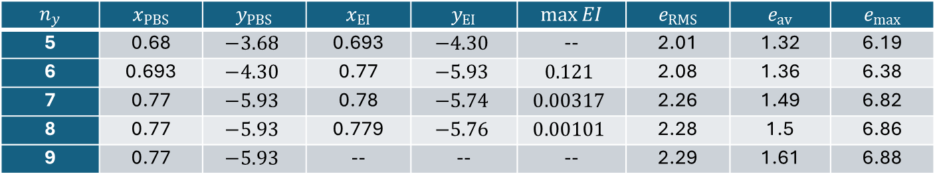
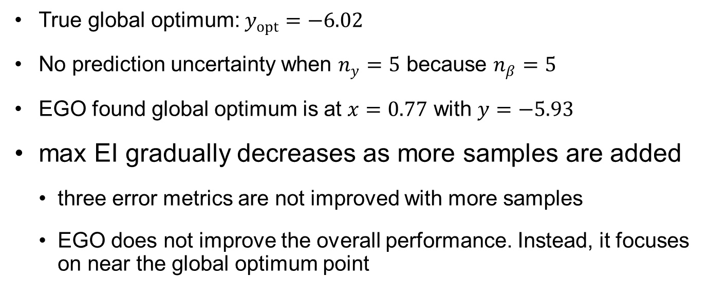
Ex10.5) EGO with PRS 1D Function cont.
True global optimum: $y_{opt}=−6.02$
No prediction uncertainty when $n_{y}=5$ because $n_{β}=5$
EGO found global optimum is at $x=0.77$ with $y=−5.93$
max EI gradually decreases as more samples are added
three error metrics are not improved with more samples
EGO does not improve the overall performance. Instead, it focuses on near the global optimum point
$$n_{y}$$ | $$x_{PBS}$$ | $$y_{PBS}$$ | $$x_{EI}$$ | $$y_{EI}$$ | $$\max{EI}$$ | $$e_{RMS}$$ | $$e_{av}$$ | $$e_{max}$$
5 | 0.68 | $$−3.68$$ | 0.693 | $$−4.30$$ | -- | 2.01 | 1.32 | 6.19
6 | 0.693 | $$−4.30$$ | 0.77 | $$−5.93$$ | $$0.121$$ | 2.08 | 1.36 | 6.38
7 | 0.77 | $$−5.93$$ | 0.78 | $$−5.74$$ | $$0.00317$$ | 2.26 | 1.49 | 6.82
8 | 0.77 | $$−5.93$$ | 0.779 | $$−5.76$$ | $$0.00101$$ | 2.28 | 1.5 | 6.86
9 | 0.77 | $$−5.93$$ | -- | -- | -- | 2.29 | 1.61 | 6.88

Slide 44




Ex10.5) EGO with PRS 1D Function cont.
$$n_{y}=6$$
$$n_{y}=7$$
$$n_{y}=8$$
$$n_{y}=9$$

Slide 45

Ex10.6) EGO with PRS 2D Function
Min $y\left(x_{1},x_{2}\right)=\sin{(x_{1})}\cos{(x_{2})}$ using EGO with cubic PRS
function f=EGOfn(x)
f = sin(x(:,1)).*cos(x(:,2));
end
rng('default'); N=21; dN=2*pi/(N-1); ny=20;
xs=2*pi*lhsdesign(ny,2,'iteration',5000); % 20 LHS samples
ys=EGOfn(xs); % Samples from true function
[XX,YY]=meshgrid(-0:dN:2*pi, 0:dN:2*pi); % NxN grid of predictions
xp=[reshape(XX,N^2,1) reshape(YY,N^2,1)]; % Prediction points
figure(1); scatter(xs(:,1),xs(:,2),'filled');hold on% Plot sample locations
axis([0 2*pi 0 2*pi]); xlabel('x_1');ylabel('x_2');
[xs, ys, yp, ysig, nb]=EGOPRS(xs,ys,xp,40,[0 0; 2*pi 2*pi],3);
YP=reshape(yp,N,N); % Predictions at grid
YT=reshape(EGOfn(xp),N,N); % True function at grid
scatter(xs(ny+1:end,1),xs(ny+1:end,2),'d'); % Plot new sample locations
axis([0 2*pi 0 2*pi]); xlabel('x_1');ylabel('x_2');
figure(2); hold on; surf(XX,YY,YP); % Plot of predictions
plot3(xs(:,1),xs(:,2),ys,'ro'); % Plot of samples
axis([0 2*pi 0 2*pi]); xlabel('x_1');ylabel('x_2');zlabel('y(x)');
figure(3); hold on; surf(XX,YY,YT) % PLot of true function
plot3(xs(:,1),xs(:,2),ys,'ro'); % Plot of samples
axis([0 2*pi 0 2*pi]); xlabel('x_1');ylabel('x_2');zlabel('y(x)');
[yPBS,I]=min(ys);
fprintf('Opt at x=');fprintf('%8.3g',xs(I,:));fprintf(', yPBS=%8.3g\n',yPBS);
eRMS=sqrt(sum(sum((YT-YP).^2))/N^2); % RMS error at NxN grid points
eav=sum(sum(abs(YT-YP)))/N^2; % Average error at NxN grid points
emax=max(max(abs(YT-YP))); % Maximum error at NxN grid points
fprintf('RMS error:%8.3g\nAve error:%8.3g\nMax error:%8.3g\n',eRMS,eav,emax);

Slide 46


Ex10.6) EGO with PRS 2D Function cont.
Initial 20 samples + 10 EGO iterations
4: reduce uncertainty on the boundary (exploration)
6: near the global optimum (exploitation)
global optimum at $(4.55,0)$ with $y_{opt}=−0.987$
true global optimum at $x_{opt}=(4.71,0)$ with $y_{opt}=−1.0$
$$n_{y}$$ | $$y_{PBS}$$ | $$\max{EI}$$ | $$x_{1new}$$ | $$x_{2new}$$ | $$y_{new}$$
20 | $$−0.922$$ | 4.65 | 6.28 | 6.28 | 0.0
21 | $$−0.922$$ | 0.655 | 0.0 | 2.66 | 0.0
22 | $$−0.922$$ | 1.29 | 6.28 | 0.0 | 0.0
23 | $$−0.922$$ | 0.233 | 4.47 | 0.0 | -0.97
24 | $$−0.97$$ | 0.174 | 4.52 | 0.0 | -0.982
25 | $$−0.982$$ | 0.142 | 4.55 | 0.0 | -0.987
26 | $$−0.987$$ | 0.0427 | 0.0 | 4.16 | 0.0
27 | $$−0.987$$ | 0.0969 | 4.51 | 0.0 | -0.98
28 | $$−0.987$$ | 0.0877 | 4.53 | 0.0 | -0.983
29 | $$−0.987$$ | 0.0804 | 4.54 | 0.0 | -0.985
30 | $$−0.987$$ | -- | -- | -- | --

Slide 47


Ex10.6) EGO with PRS 2D Function cont.
6
5
4
x
2
3
2
1
0
(a)
0
1
2
3
4
5
6
x
PRS surrogate
1
True function
(b)
(c)

Slide 48
10.4 Efficient Global Optimization Using Kriging Surrogate

Slide 49
EGO with Kriging
1 function [xs, ys, yp, ysig, nb]=EGO(xs,ys,xp,trPRS,nmax,range,noise)
2 % INPUTS xs: ny x NDV sample points
3 % ys: ny x 1 samples
4 % xp: np x NDV prediction points
5 % trPRS: polynomial order of trend function (0, 1, 2)
6 % nmax: maximum number of samples
7 % range: range of design domain
8 % noise: 1 for noisy samples, 0 for no noise
9 % OUTPUTS (xs, ys): samples pairs included added samples
10 % yp: np x 1 mean predictions
11 % ysig: np x 1 prediction standard deviations
12 % nb: # of coefficients in trend function
13 %
14 [ny,NDV]=size(xs);nvar=NDV+1;np=size(xp,1); % Size of samples
15 meanx=mean(xs);stdx=std(xs);xs=(xs-meanx)./stdx;% Scaling sample locations
16 meany=mean(ys); stdy=std(ys);ys=(ys-meany)/stdy; % Scaling samples
17 xp=(xp-meanx)./stdx; % Scaling prediction points
18 range=(range-meanx)./stdx; % Scaling design space
19 %
20 fprintf(" ny yPBS Theta maxEI xNew yNew\n")
21 for loop=ny:nmax % EGO loop
22 nij=ny*(ny-1)/2; l=0; % # of upper-triangular component of R
23 diff=zeros(nij,NDV); % Distance between samples
24 ij=zeros(nij,2); % Index of correlation matrix
25 for i=1:ny-1
26 l=l(end)+(1:ny-i);
27 ij(l,:)=[repmat(i,ny-i,1),(i+1:ny)'];
28 diff(l,:)=repmat(xs(i,:),ny-i,1)-xs(i+1:ny,:);
29 end
30 %

Slide 50
EGO with Kriging cont.
31 % Estimating hyper-parameters using max. likelihood estimate
32 par=struct('xs',xs,'ys',ys,'d',diff,'ij',ij,'trPRS',min(trPRS,2));
33 hyp0 = [ny^(-1/4)*ones(NDV,1); min(0.1,noise)]; % Initial value
34 lb=[0.01*ones(NDV,1);0];ub=[6*ones(NDV,1);noise]; % Lower- & upper-bound
35 opts=optimset('Display','off','TolFun',1e-6,'DiffMinChange',0.001);
36 %hypOpt=fmincon(@(hyp) fitKRG(hyp,par),hyp0,[],[],[],[],lb,ub,[],opts);
37 hypOpt = ga(@(hyp) fitKRG(hyp,par),nvar,[],[],[],[],lb,ub,[],opts)';
38 %hypOpt = simulannealbnd(@(hyp) fitKRG(hyp,par),hyp0,lb,ub,opts);
39 hypmle=hypOpt(1:size(xs,2)); tau=max(0,hypOpt(end)); % Opt. hypereparam.
40 %
41 par.hyp=hypmle; par.yPBS=min(ys); % Add hyperparameter & PBS to database
42 [~,fit]=fitKRG(hypOpt,par); % Fitting Kriging surrogate
43 %
44 % Optimization using EI to find a new sample location
45 xNew=ga(@(x) exImp(x,fit,par),NDV,[],[],[],[],range(1,:),range(2,:),[],opts);
46 % Stopping criteria
47 if (loop==nmax||max(min(abs(xNew-xs)))<1E-3||exImp(xNew,fit,par)>-1E-3)
48 fprintf('%4d %8.3g\n',loop,par.yPBS.*stdy+meany); break;
49 end
50 %
51 fprintf('%4d %8.3g',loop,par.yPBS.*stdy+meany);
52 fprintf(" %8.3g %8.3g",hypmle,-exImp(xNew,fit,par));
53 xs=[xs;xNew]; ny=ny+1; % Adding a new sample
54 yNew=(EGOfn(xNew.*stdx+meanx)-meany)/stdy; ys=[ys;yNew];
55 fprintf(' %8.3g',xNew.*stdx+meanx); fprintf(' %8.3g\n',yNew*stdy+meany);
56 %
57 end

Slide 51
EGO with Kriging cont.
58 xi = trend(xp,trPRS); nb=size(xi,2); % Trend basis vector at np points
59 xrep=repmat(xp',ny,1); xrep=transpose(reshape(xrep,NDV,np*ny));
60 d=xrep-repmat(xs,np,1); % Distance b/w predictions & samples
61 r = (1-tau)*exp(sum(-(d./hypmle').^2,2));% Correlation b/w preds & samples
62 r = reshape(r,ny,np);
63 yp=(xi*fit.beta + (fit.alpha*r)')*stdy+meany; % Kriging predictions
64 %
65 rt=fit.C\r;
66 q=fit.G\(xi'-fit.Ft'*rt);
67 sigma2=fit.sigma2.*stdy.^2; % Process variance
68 ysig=sqrt(sigma2.*(1-sum(rt.^2,1)+sum(q.^2,1))'); % Prediction STD
69 xs=xs.*stdx+meanx;ys=ys*stdy+meany; % Denormalizing samples
70 end
71 %
72 function EI=exImp(x,fit,par)
73 xi = trend(x,par.trPRS); % Trend basis vector at prediction points
74 d=x-par.xs; % Distance b/w predictions & samples
75 r = exp(sum(-(d./par.hyp').^2,2)); % Correlation b/w preds & samples
76 yhat=xi*fit.beta + (fit.alpha*r)'; % Kriging predictions
77 %
78 rt=fit.C\r;
79 q=fit.G\(xi'-fit.Ft'*rt);
80 sigma2=fit.sigma2; % Process variance
81 ysig=sqrt(sigma2.*(1-sum(rt.^2,1)+sum(q.^2,1))'); % Prediction STD
82 u = (par.yPBS-yhat)./ysig; % Calculating negative expected improvement
83 EI = -(par.yPBS-yhat).*normcdf(u,0,1)-ysig.*normpdf(u,0,1);
84 end
Refer to the textbook for detailed explanations

Slide 52


Ex10.7) EGO with Kriging 1D Function
Same as Ex10.5, Start with four samples: $x_{s}=[0, 0.5, 0.68, 1.0]$
Replace Line 2 and 4 by
initial four samples, $y_{PBS}=−3.68$ at $x_{PBS}=0.68$
Max EI at $x_{new}=0.246$ (exploration)
Next iteration, max EI at $x_{new}=0.626$ (exploitation)
After 7th sample, $x_{new}=0.761$, $y_{PBS}=−6.01$
xs=[0 0.5 0.68 1]';ys=EGOfn(xs); % Initial sample pairs
[xs, ys, yp, ysig, nb]=EGO(xs,ys,xp,0,20,[0; 1],0);
$$n_{y}$$ | $$x_{PBS}$$ | $$y_{PBS}$$ | $$x_{EI}$$ | $$y_{EI}$$ | $$\max{EI}$$ | $$e_{RMS}$$ | $$e_{av}$$ | $$e_{max}$$
4 | 0.68 | $$−3.68$$ | 0.246 | $$−0.238$$ | 0.099 | 4.07 | 3.49 | 7.94
5 | 0.68 | $$−3.68$$ | 0.626 | $$−1.11$$ | $$0.0755$$ | 3.04 | 2.15 | 7.6
6 | 0.68 | $$−3.68$$ | 0.743 | $$−5.92$$ | $$0.138$$ | 1.86 | 1.31 | 4.54
7 | 0.743 | $$−5.92$$ | 0.761 | $$−6.01$$ | $$0.0172$$ | 1.2 | 0.845 | 2.64
8 | 0.761 | $$−6.01$$ | -- | -- | -- | 0.767 | 0.46 | 2.01

Slide 53




Ex10.7) EGO with Kriging 1D Function cont.
$$n_{y}=5$$
$$n_{y}=6$$
$$n_{y}=7$$
$$n_{y}=8$$

Slide 54

Ex10.8) EGO with Kriging 2D Function
Same as Ex10.6
Replace calling EGOPRS line with EGO
EGO converged with 28 samples, one sample for exploration and 7 samples for exploitation
[xs, ys, yp, ysig, nb]=EGO(xs,ys,xp,0,40,[0 0; 2*pi 2*pi],0);
$$n_{y}$$ | $$y_{PBS}$$ | $$\max{EI}$$ | $$x_{1new}$$ | $$x_{2new}$$ | $$y_{new}$$
20 | $$−0.922$$ | 0.155 | 4.5 | 0.0 | $$−0.977$$
21 | $$−0.977$$ | 0.117 | 1.66 | 3.14 | $$−0.996$$
22 | $$−0.996$$ | 0.0836 | 4.58 | 8.28 | $$−0.999$$
23 | $$−0.999$$ | 0.0629 | 6.28 | 6.28 | $$0.0$$
24 | $$−0.999$$ | 0.0075 | 4.76 | 0.0 | $$−0.999$$
25 | $$−0.999$$ | 0.00103 | 1.77 | 3.09 | $$−0.978$$
26 | $$−0.999$$ | 0.0019 | 4.7 | 0.0 | $$−1.0$$
27 | $$−1.0$$ | 0.00611 | 4.53 | 6.28 | $$−0.983$$
28 | $$−1.0$$ | -- | -- | -- | --

Slide 55


Ex10.8) EGO with Kriging 2D Function cont.
6
5
4
x
2
3
2
1
0
(a)
0
1
2
3
4
5
6
Kriging surrogate
x
1
True function
(b)
(c)

Slide 56
Appendix

Slide 57



Expanding EGO to Surrogates Other Than Kriging
Considering the root mean square error, $e_{RMS}$ :
$$e_{RMS}=\sqrt{\int_{0}^{1}{{\left|e\left(x\right)\right|}^{2} dx}}$$
(a) Kriging
We want to run EGO with the most accurate surrogate. But we have no uncertainty model for SVR
(b) Support vector regression
Notes:
EGO was developed for kriging, and it can be used with any surrogate that has an uncertainty model. However, we may be often in a situation where kriging is not the most accurate surrogate for a function, and the most accurate surrogate does not have an implemented uncertainty model.
This is illustrated in the example in this slide. The same data points are fitted with kriging and a support vector regression surrogate (SVR). The RMS error for both is calculated, and it is found that it is 2.2 for the kriging surrogate and 1.3 for the SVR surrogate. In this situation, it would be desirable to use the SVR surrogate for EGO, but what will we do if we do not have an uncertainty model for it?
Note that here we can calculate the RMS error since we have an inexpensive function. In optimization of expensive functions where we need EGO, the determination of which surrogate is the most accurate needs to be done by cross validation or test points.
57

Slide 58



Importation of Uncertainty Model
Notes:
The remedy suggested by Viana and Haftka, in the reference below, is to import the uncertainty model, or more specifically the standard error s from kriging to the most accurate model.
In terms of the spatial variation of s, it is mostly determined by the distance from data points, and as such would be appropriate for any surrogate that interpolate or almost interpolates the data. In terms of magnitude, since the importing surrogate is more accurate, the kriging s may be too high. However, it is well known that the kriging model actually underestimates s.
Viana FAC and Haftka RT, Importing Uncertainty Estimates from One Surrogate to Another, in: 50th AIAA/ASME/ASCE/AHS/ASC Structures, Structural Dynamics, and Materials Conference, Palm Springs, USA, May 4 - 7, 2009. AIAA-2009-2237.
58

Slide 59







Hartmann-3 Example
Hartmann 3 function (initially fitted with 20 points):
After 20 iterations (i.e., total of 40 points), improvement (I) over initial best sample (IBS):
$$I=\frac{y_{IBS}−y_{optim}}{\left|y_{IBS}\right|}$$
$y_{IBS}$: initial best sample
$y_{optim}$: best sample after 20 EGO cycles
Notes:
An example used in the paper by Viana and Haftka is the Hartmann 3 function shown in the slide. It was tested with 100 20-point designs of experiments (DOE), all generated with Latin Hypercube Sampling (LHS, see lecture on space filling designs). Since LHS has some random element, we obtained 100 different DOEs, but with similar characteristics.
For this function with 20 sample points, the radial-basis neural networks surrogate (RBNN) is mostly more accurate than the kriging surrogate.
Cross validation error obtained when one point is left out and the surrogate is fitted to the remaining points and the error at the left out is calculated. When the process is repeated for every point, the root mean square of the cross-validation errors is known as PRESS-RMS. This cross validation error will normally be used to select a surrogate. Here we also calculated the actual RMS error from a dense set of test points.
For one design of experiments, the results, shown in the slide, showed a large advantage to RBNN in terms of PRESS (066 vs. 0.89), but only a minimal advantage in terms of the actual error (0.48 compared to 0.5). The performance of EGO with both surrogates is compared in terms of the normalized improvement is
$$I=\frac{y_{IBS}−y_{optm}}{|y_{IBS}|}$$
Where $y_{IBS}$ is the initial best sample (out of the initial 20 samples for the DOE) and $y_{optm}$ is the best sample after 20 EGO cycles (for a total of 40 points). Here RBNN provided 27% improvement while kriging only 3.5%.
59

Slide 60








Two other Design of Experiments
FIRST:
SECOND:
Notes:
Two other DOEs where importing the uncertainty to the RBNN surrogate worked well are shown here. In these two, the PRESS advantage is smaller than the actual error advantage (unlike the previous example). The normalized improvement is 18% for RBNN compared to 9.8% for kriging for the first DOE and 41% compared to 32% for the second DOE.
60

Slide 61

Summary: Hartmann-3 example
Box plot of the difference between improvement offered by different surrogates after 20 iterations (out of 100 DOEs)
In 34 DOEs (out of 100) KRG outperforms RBNN (in those cases, the difference between the improvements has mean of only 0.8%).
Notes:
To summarize the experience of 100 DOEs, we use a box-plot of the difference in the improvements. The red bar in the box plot shows the median, and the two sides of the box show the 25 percentile and 75 percentile. The red points show outliers.
Positive values indicate RBNN did better than Kriging.
It is clear from the box plot that most of the time RBNN does better, it is actually 66 of the 100 cases. For a few cases the difference is substantial, most of the time it is small. However, the example clearly demonstrate that importing the uncertainty model to RBNN works well for this example.
61

Slide 62

Potential of EGO with Multiple Surrogates
Hartmann 3 function (100 DOEs with 20 points)
Overall, surrogates are comparable in performance.
Notes:
For the Hartman 3 function, three surrogates had similar performance as shown in the box plot of their cross validation PRESS measure for the 100 DOEs discussed before. RBNN was the best, with kriging and SVR not far behind.
62

Slide 63


EGO with Multiple Surrogates (MSEGO)
Traditional EGO uses kriging to generate one point at a time.
We use multiple surrogates to get multiple points.
Notes:
Besides using another surrogate instead of kriging with EGO, we can also use multiple surrogates simultaneously. This will make sense when it is efficient to perform multiple function evaluations simultaneously, because multiple processors are available.
The top two figures show the kriging surrogate with its uncertainty model, and the SVR surrogate with imported uncertainty model. The two uncertainty magnitudes are the same, but because the surrogates are different, the expected improvement (EI)function is different for the two surrogate.
The bottom figures show that the maximum EI for Kriging is on the left (exploration) and the maximum EI for SVR is on the right (exploitation), and so we could use them both if we can perform two function evaluations simultaneously.
63

Slide 64


EGO with Multiple Surrogates (MSEGO)
“krg” runs EGO for 20 iterations adding one point at a time.
“krg-svr” and “krg-rbnn” run 10 iterations adding two points/iteration.
$$I=\frac{y_{IBS}−y_{optim}}{\left|y_{IBS}\right|}$$
Multiple surrogates offer good results in half of the time!!!
Notes:
We compare here running the kriging based EGO for 20 iterations doing one evaluation at a time with running kriging with RBNN or kriging with SVR doing two function evaluations simultaneously. To keep the total number of function evaluations the same, the pairs are run for only 10 iterations.
The box plots show the improvement at the end of the optimization for 100 different DOEs. All three box plots are comparable, but the ones run with pairs would take only half of the time, because they take advantage of parallelism.
64

Slide 65
EGO with Multiple Surrogates and Multiple Sampling Criteria
Multiple sampling (or infill) criteria (each of them also have the capability of adding multiple points per optimization cycle):
EI: Expectation of improvement beyond the present best solution.
Multipoint EI (q-EI), Kriging Believer, Constant Liar
PI: Probability of improving beyond a set target.
Multiple targets, multipoint PI
Multiple sampling criteria with multiple surrogates has very high potential of:
Providing insurance against failed optimal designs.
Providing insurance against inaccurate surrogates.
Leveraging parallel computation capabilities.
Notes:
Adding multiple points using EI:
[1] Ginsbourger, D., Le Riche, R., Carraro, L. : Kriging is well-suited to parallelize optimization. In: Tenne, Y., Goh, C. (eds.) Computational Intelligence in Expensive Optimization Problems, vol. 2, pp. 131–162, Springer, Heidelberg (2010).
Adding multiple points using PI:
[2] Jones, D.R.: A taxonomy of global optimization methods based on response surfaces. J. Glob. Optim. 21(4), 345–383 (2001).
[3] Viana FAC, Haftka RT, “Surrogate-based global optimization with parallel simulations using the probability of improvement,” 13th AIAA/ISSMO Multidisciplinary Analysis and Optimization Conference, Fort Worth, USA, September 13-15, 2010, AIAA 2010-9392.
[4] Chaudhuri A, Haftka RT, and Viana FAC, “Efficient Global Optimization with Adaptive Target for Probability of targeted Improvement,” 8th AIAA Multidisciplinary Design Optimization Specialist Conference, Honolulu, Hawaii, April 23-26, 2012.

