Slide 1
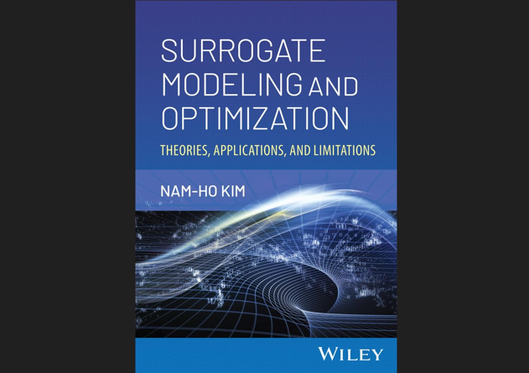

Slide 2
Chap 2 Polynomial Response Surface
How can optimization utilize a batch of experiments?
Build approximation and optimize using it

Slide 3
Sequential vs. Batch Run of Experiments and Simulations
Optimization algorithms require sequential evaluations
Batch run is better for experiments
Due to setup time, planning, facility, assessing errors and noise
Experimental optimization used a batch of experiments
Build approximation and perform optimization using it
If accuracy is not satisfactory, sequential approximate optimization
Computer simulations are similar to experiments
Long setup time, expensive, numerical noise, discretization errors
Parallel processing pushes batch run
Software packages make it difficult to connect directly to optimization

Slide 4
Surrogate (metamodel)
The algebraic function we fit to data is called surrogate, metamodel or approximation
Polynomial surrogates were invented in the 1920s to characterize crop yields in terms of inputs such as water and fertilizer
They were called then “response surface approximations”
The term “surrogate” captures the purpose of the fit: using it instead of the data for prediction
Most important when samples are expensive and noisy, especially for optimization

Slide 5
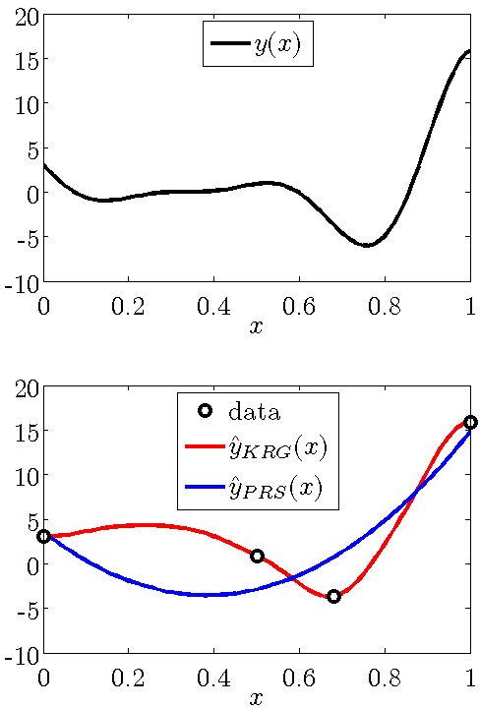
Surrogates for fitting simulations
Great interest now in fitting computer simulations
Computer simulations are also subject to noise (numerical)
Simulations are exactly repeatable, so noise is hidden.
Some surrogates (e.g. polynomial response surfaces) cater mostly to noisy data.
Some (e.g. Kriging) interpolate data.

Slide 6
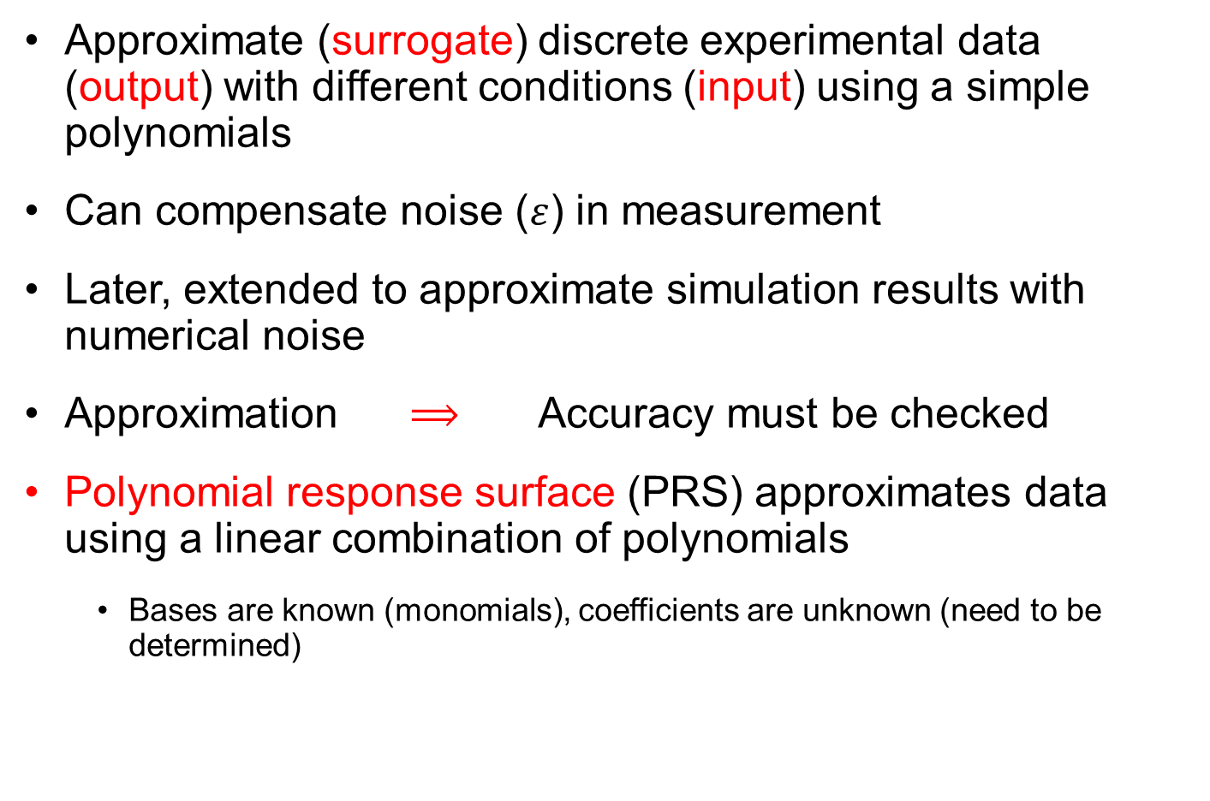
Polynomial Response Surface (PRS)
Approximate (surrogate) discrete experimental data (output) with different conditions (input) using a simple polynomials
Can compensate noise ($ε$) in measurement
Later, extended to approximate simulation results with numerical noise
Approximation $⟹$ Accuracy must be checked
Polynomial response surface (PRS) approximates data using a linear combination of polynomials
Bases are known (monomials), coefficients are unknown (need to be determined)

Slide 7
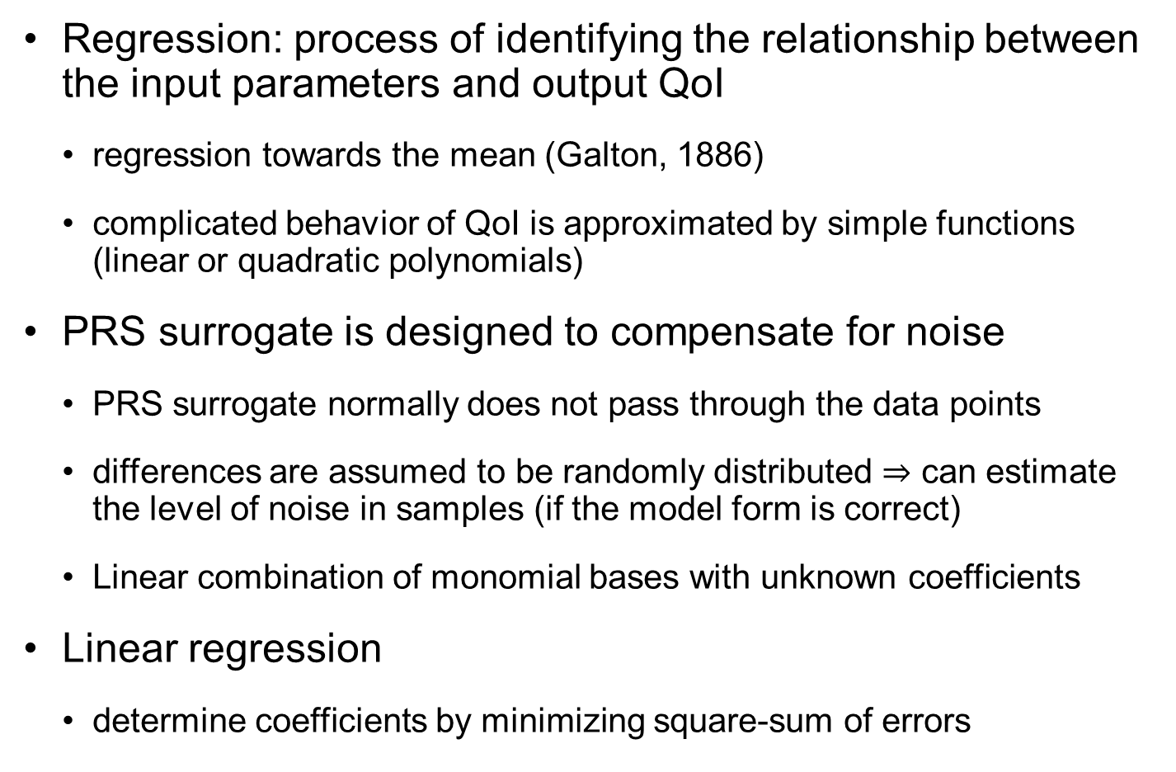
Linear Regression
Regression: process of identifying the relationship between the input parameters and output QoI
regression towards the mean (Galton, 1886)
complicated behavior of QoI is approximated by simple functions (linear or quadratic polynomials)
PRS surrogate is designed to compensate for noise
PRS surrogate normally does not pass through the data points
differences are assumed to be randomly distributed $⇒$ can estimate the level of noise in samples (if the model form is correct)
Linear combination of monomial bases with unknown coefficients
Linear regression
determine coefficients by minimizing square-sum of errors

Slide 8
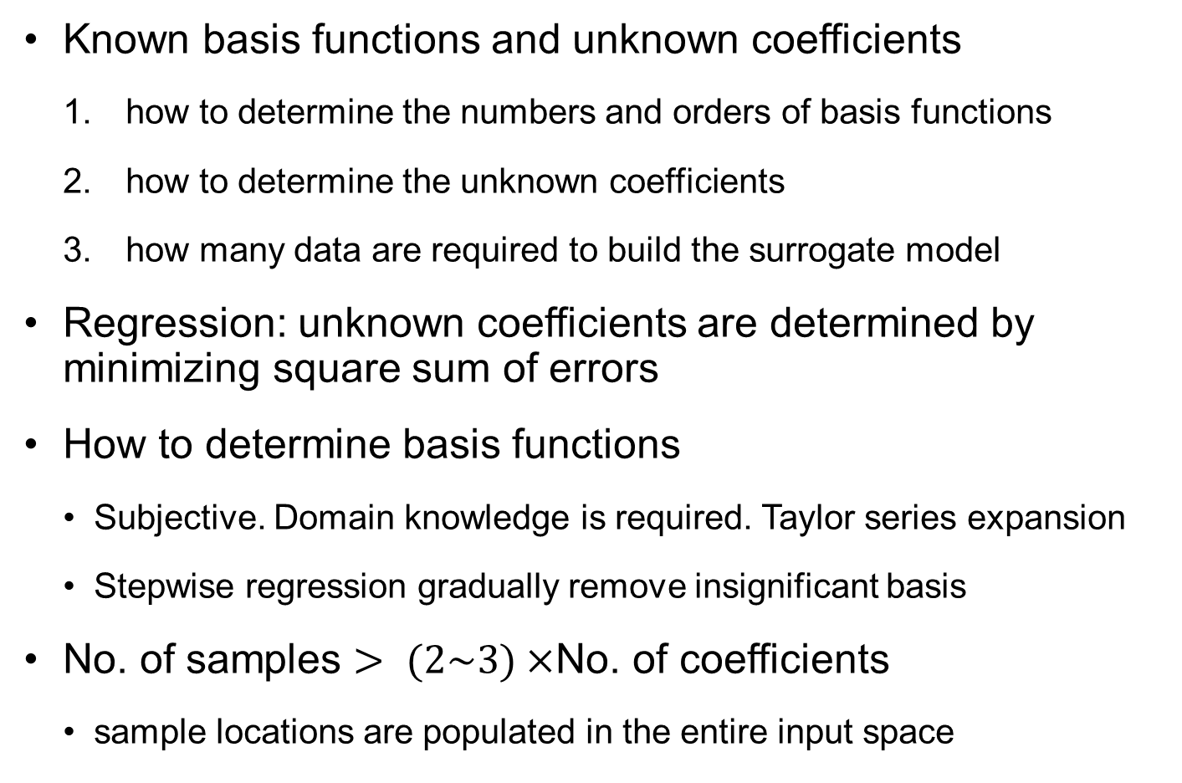
Linear Regression cont.
Known basis functions and unknown coefficients
how to determine the numbers and orders of basis functions
how to determine the unknown coefficients
how many data are required to build the surrogate model
Regression: unknown coefficients are determined by minimizing square sum of errors
How to determine basis functions
Subjective. Domain knowledge is required. Taylor series expansion
Stepwise regression gradually remove insignificant basis
No. of samples $> (2\sim 3)×$No. of coefficients
sample locations are populated in the entire input space

Slide 9
2.2 Curve Fitting
Which one is more accurate? The surrogate or the samples?

Slide 10
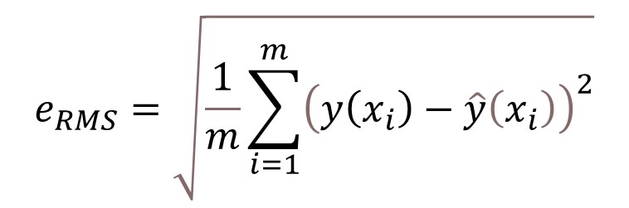
Curve Fit Metrics
This lecture deals with the following case:
The data is noisy
The functional form of the true function is known
The data is dense enough to allow us noise filtering
When we fit a curve to data we ask:
What is the error metric for the best fit?
What is more accurate, the data or the fit?
$$e_{RMS}=\sqrt{\frac{1}{m}\sum_{i=1}^{m}{{\left(y\left(x_{i}\right)−\hat{y}\left(x_{i}\right)\right)}^{2}}}$$

Slide 11
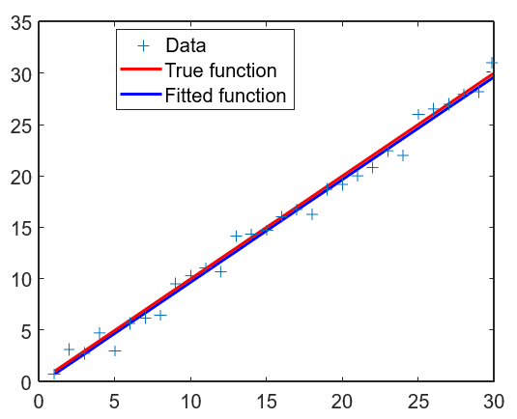
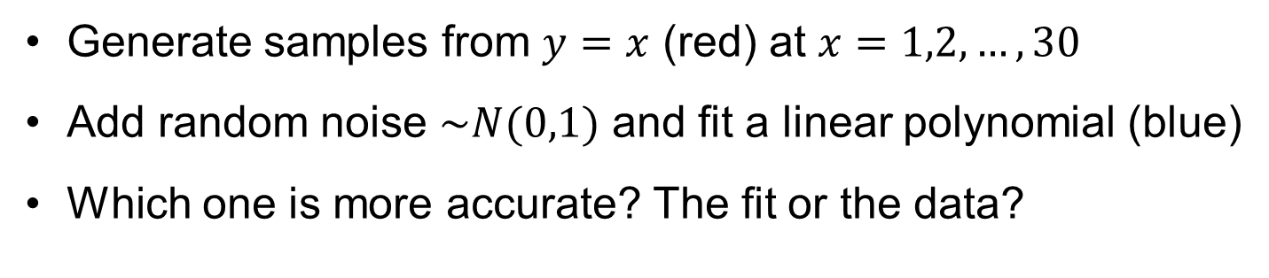
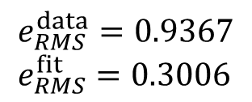

Ex: Curve fitting
Generate samples from $y=x$ (red) at $x=1,2,…,30$
Add random noise $\sim N(0,1)$ and fit a linear polynomial (blue)
Which one is more accurate? The fit or the data?
[p,s]=polyfit(x,y,1);
yfit=polyval(p,x);
plot(x,y,'+',x,x,'r’, x,yfit,'b')
$$e_{RMS}^{data}=0.9367 \\ e_{RMS}^{fit}=0.3006$$
With dense data, functional form is clear. Fit serves to filter out noise
Why $e_{RMS}^{fit}≠0$?
Notes:
We first use an example which satisfies the three assumptions that we stated in the first slide. We know that the true function is a linear polynomial, but the data has some noise. For this example, we take the function y=x , sample it at 30 points with added noise that is normally distributed. The Matlab sequence to generate the data is
noise=randn(1,30); x=1:1:30; y=x+noise
Columns 1 through 10
1.5377 3.8339 0.7412 4.8622 5.3188 4.6923 6.5664 8.3426 12.5784 12.7694
Columns 11 through 20
9.6501 15.0349 13.7254 13.9369 15.7147 15.795 16.8759 19.4897 20.409 21.4172 Columns 21 through 30
21.6715 20.7925 23.7172 25.6302 25.4889 27.0347 27.7269 27.6966 29.2939 29.2127
To fit the data, we use Matlab’s polyfit, and then to evaluate the fitted polynomial we use polyval
[p,s]=polyfit(x,y,1); yfit=polyval(p,x); plot(x,y,'+',x,x,'r',x,yfit,'b')
As seen in the figure, the fitted function is more accurate than the data. This can be checked numerically by calculating the errors of the fit at the data points and comparing the rms or the maximum error.

Slide 12

Fitting Error and Model-Form Error
Fitting process treats the model-form error as if it is noise
31 samples from $y\left(x\right)=x^{2}$ with noise $ε\sim N({0,0.3}^{2})$
Linear polynomial fit: $\hat{y}\left(x\right)=−1.413+2.975x$ (blue curve)
$e_{RMS}^{data}=0.2932$, $e_{RMS}^{fit}=0.7148$
Combined effect of model-form error and noise in data
10
Data
8
True function
Fitted function
6
4
2
0
-2
0
0.5
1
1.5
2
2.5
3

Slide 13
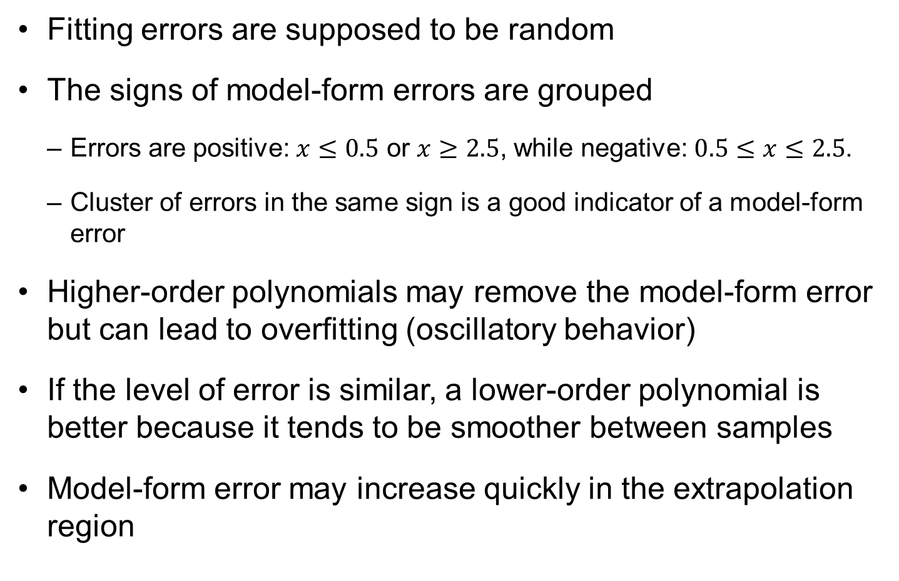
Fitting Error and Model-Form Error cont.
Fitting errors are supposed to be random
The signs of model-form errors are grouped
Errors are positive: $x≤0.5$ or $x≥2.5$, while negative: $0.5≤x≤2.5$.
Cluster of errors in the same sign is a good indicator of a model-form error
Higher-order polynomials may remove the model-form error but can lead to overfitting (oscillatory behavior)
If the level of error is similar, a lower-order polynomial is better because it tends to be smoother between samples
Model-form error may increase quickly in the extrapolation region

Slide 14
2.3 Linear Regression
Regression toward the mean

Slide 15
Regression
The process of fitting data with a curve by minimizing the mean square difference from the data is known as regression
Term originated from first paper to use regression dealt with a phenomenon called regression toward the mean (check Wikipedia)
The polynomial regression on the previous slide is a simple regression, where we know or assume the functional shape and need to determine only the coefficients.
Notes:
The process of fitting data by minimizing the sum of the squares of the differences between data and curve is called regression. The term comes from the first paper where regression was used that happened to be about a phenomenon called regression towards the mean, see Wikipeda. The paper is.
Galton, F. (1886). "Regression towards mediocrity in hereditary stature". The Journal of the Anthropological Institute of Great Britain and Ireland 15: 246–263. It found that children of tall parents tended to be shorter than their parents, while children of short parents tended to be taller than their parents.
There are many forms of regression, and the one we saw on the previous slide is simple because we assumed a functional form (linear polynomial) so that the polyfit function just needed to calculate the coefficients of the polynomial.

Slide 16
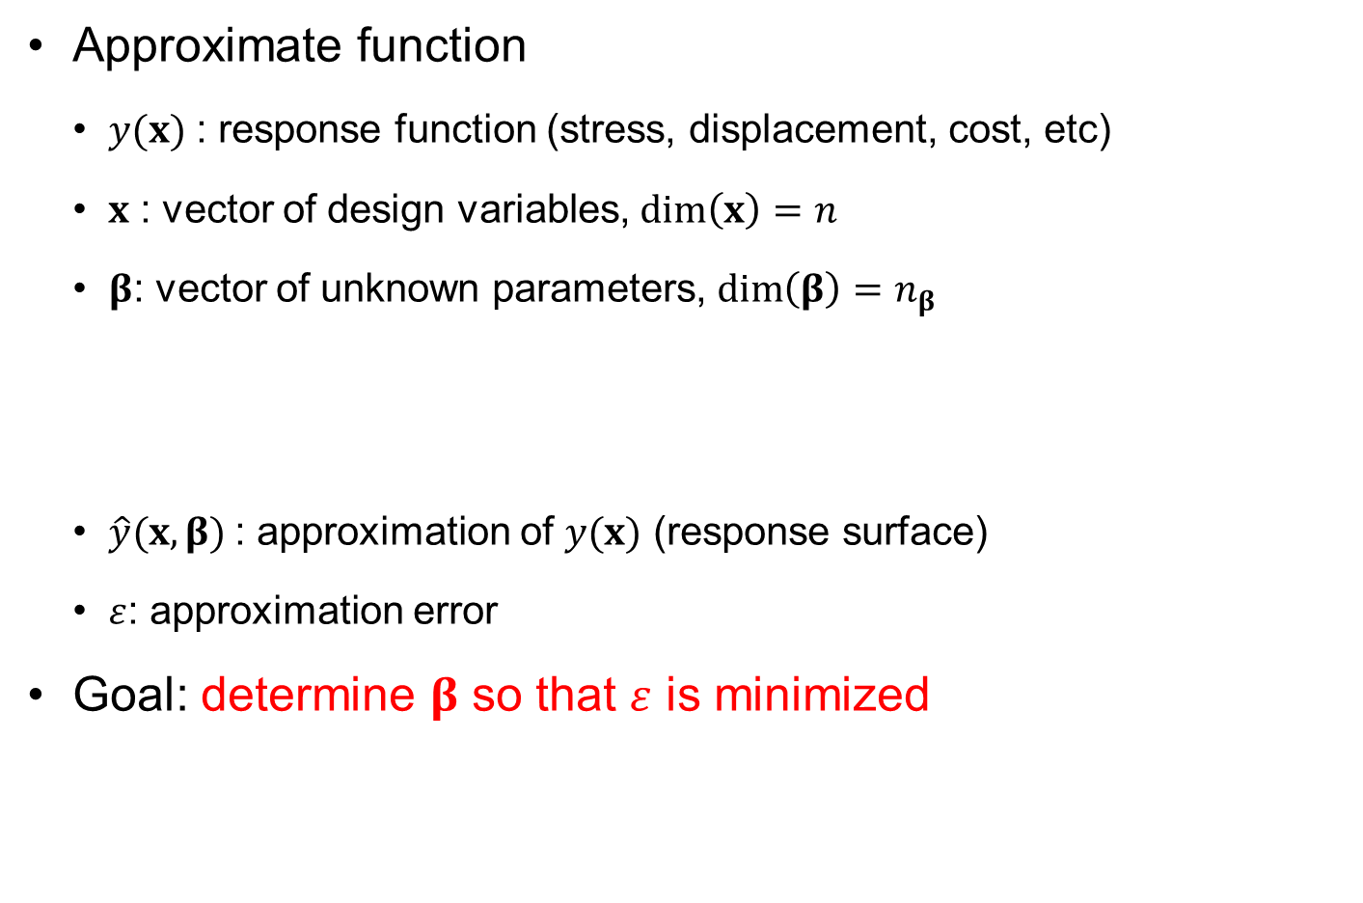
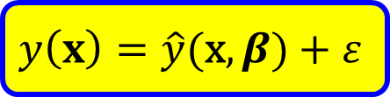
Fitting a function with given data
Approximate function
$y(x)$ : response function (stress, displacement, cost, etc)
$x$ : vector of design variables, $\dim\left(x\right)=n$
$β$: vector of unknown parameters, $\dim\left(β\right)=n_{β}$
$\hat{y}(x,β)$: approximation of $y(x)$ (response surface)
$ε$: approximation error
Goal: determine $β$ so that $ε$ is minimized
$$y\left(x\right)=\hat{y}\text{(}\text{x},β)+ε$$
Question: What is the form of approximate function?
What measure is used to minimize the error?

Slide 17
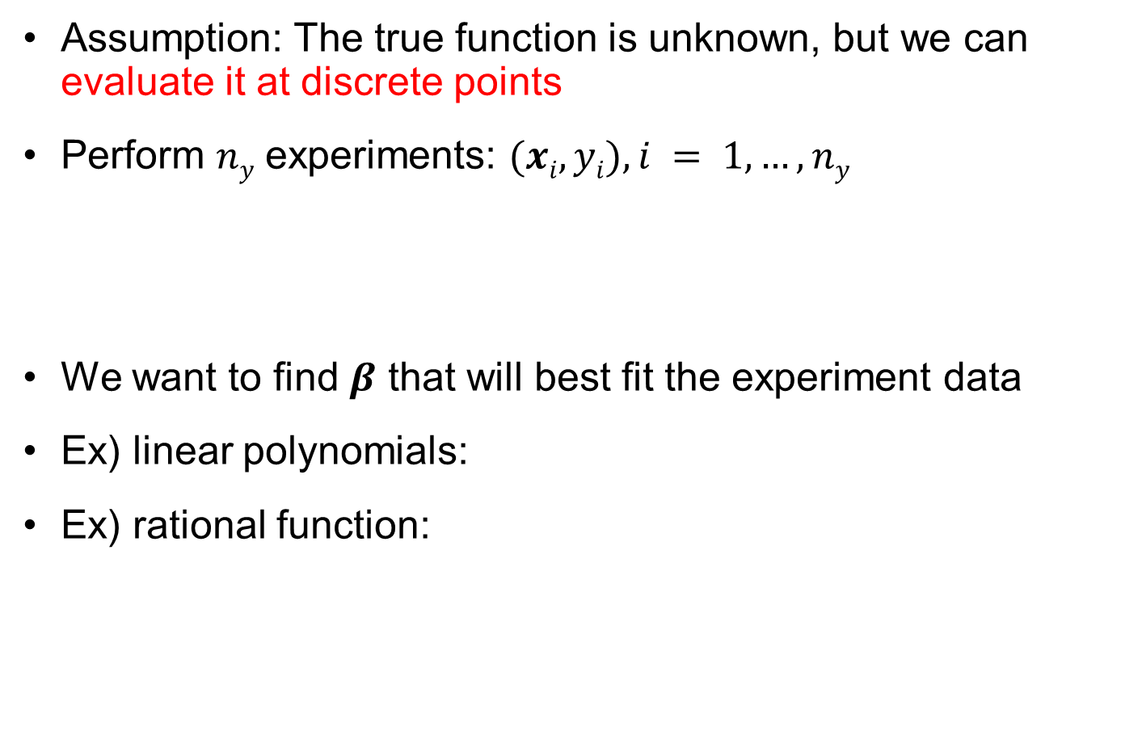


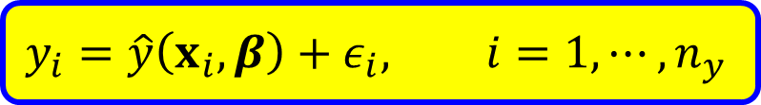
How to determine $β$?
Assumption: The true function is unknown, but we can evaluate it at discrete points
Perform $ny$ experiments: $(xi, yi), i = 1, …, ny$
We want to find $β$ that will best fit the experiment data
Ex) linear polynomials:
Ex) rational function:
$$y_{i}=\hat{y}\left(x_{i},β\right)+ε_{i}, i=1,⋯, n_{y}$$
$$\hat{y}\left(x,β\right)=β_{1}+β_{2}x$$
$$\hat{y}\left(x,β\right)=\frac{β_{1}}{x+β_{2}}$$

Slide 18


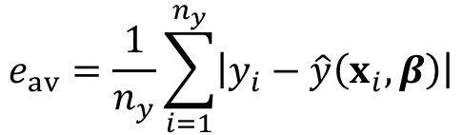




Measures of Errors
Finding $β$ to best fit the data (minimize regression error)
Need to define the regression error first
Root-mean-squared (RMS) error
Average error
Maximum error
$$e_{rms}=\sqrt{\frac{1}{n_{y}}\sum_{i=1}^{n_{y}}{{\left[y_{i}−\hat{y}\left(x_{i},β\right)\right]}^{2}}}$$
$L2$-norm
$$e_{av}=\frac{1}{n_{y}}\sum_{i=1}^{n_{y}}{\left|y_{i}−\hat{y}\left(x_{i},β\right)\right|}$$
$L1$-norm
$$e_{max}=\max_{n_{y}}\left|y_{i}−\hat{y}\left(x_{i},β\right)\right|$$
$L∞$-norm

Slide 19
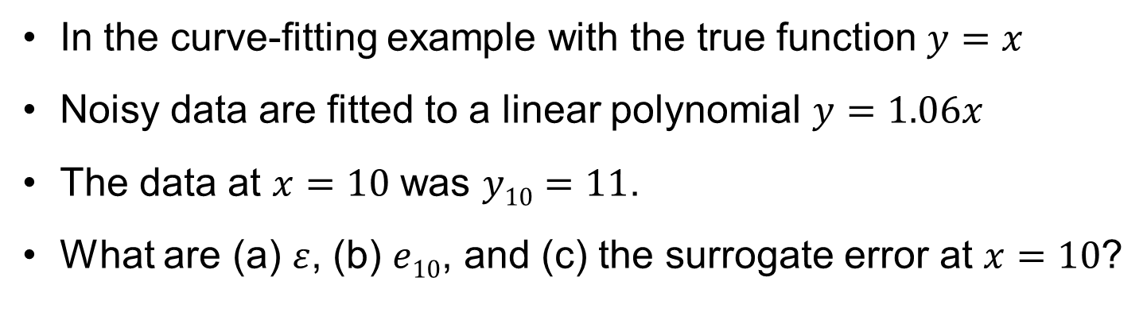
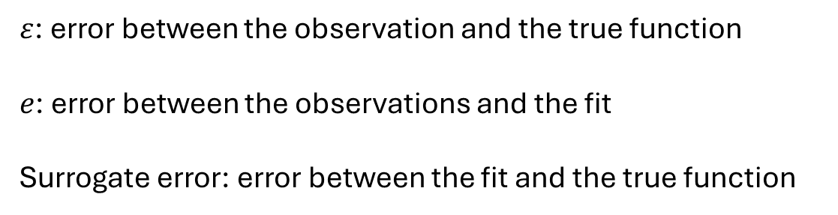
Exercise
In the curve-fitting example with the true function $y=x$
Noisy data are fitted to a linear polynomial $y=1.06x$
The data at $x=10$ was $y10=11$.
What are (a) $ε$, (b) $e10$, and (c) the surrogate error at $x=10$?
$ε$: error between the observation and the true function
$e$: error between the observations and the fit
Surrogate error: error between the fit and the true function
Notes:
The true function is y=x. We fitted noisy data at 10 points. The data at x=10, the last point was y₁₀=11. The fit was y=1.06x.
Provide the values of ε, e₁₀, and the error at x=10.
measures the difference between the observation and the true function, so ε₁₀=11−10=1
e measures the difference between the observations and the fit so e₁₀=11-10.6=0.4
The surrogate error measures the difference between the fit and the true function, so it is 10.6-10=0.6

Slide 20
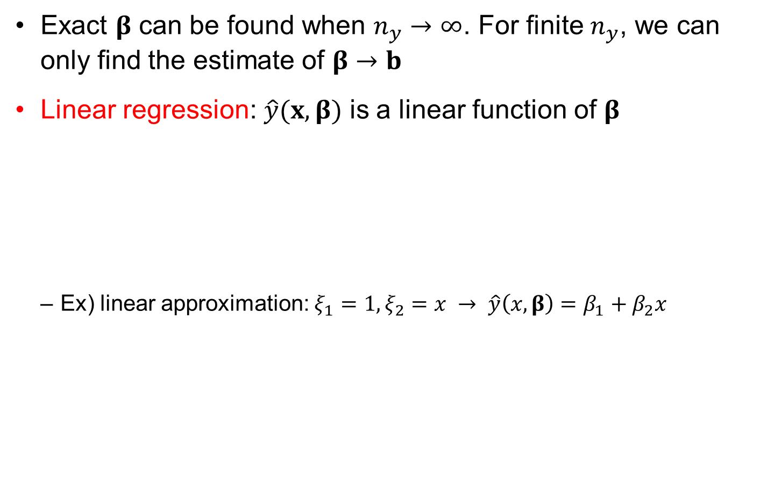


Linear regression
Exact $β$ can be found when $n_{y}→∞$. For finite $n_{y}$, we can only find the estimate of $β→b$
Linear regression: $\hat{y}(x,β)$ is a linear function of $β$
Ex) linear approximation: $ξ_{1}=1,ξ_{2}=x → \hat{y}\left(x,β\right)=β_{1}+β_{2}x$
$$\hat{y}\left(x,β\right)=\sum_{i=1}^{n_{β}}{β_{i}ξ_{i}(x)}$$
given shape function, basis
Only $β$ is unknown

Slide 21


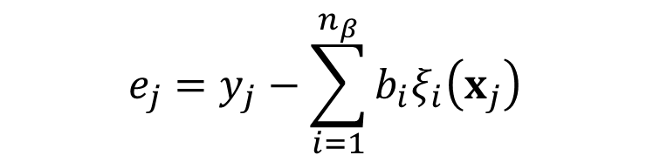

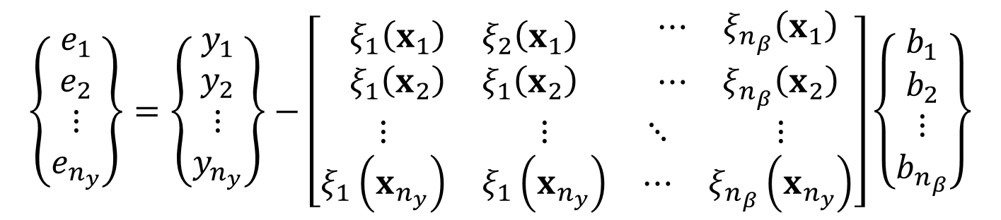
Regress error
Regression error vector
with $n_{y}$ samples $(x_{i}, y_{i})$
In matrix notation
$$e_{j}=y_{j}−\sum_{i=1}^{n_{β}}{b_{i}ξ_{i}\left(x_{j}\right) }$$
$$e=y−Xb$$
Evaluation of basis at sample points
$$\left\{\begin{matrix}\begin{matrix}e_{1} \\ e_{2}\end{matrix} \\ \begin{matrix}⋮ \\ e_{n_{y}}\end{matrix}\end{matrix}\right\}=\left\{\begin{matrix}\begin{matrix}y_{1} \\ y_{2}\end{matrix} \\ \begin{matrix}⋮ \\ y_{n_{y}}\end{matrix}\end{matrix}\right\}−\left[\begin{matrix}\begin{matrix}ξ_{1}\left(x_{1}\right) & ξ_{2}\left(x_{1}\right) \\ ξ_{1}\left(x_{2}\right) & ξ_{1}\left(x_{2}\right)\end{matrix} & \begin{matrix}⋯ & ξ_{n_{β}}\left(x_{1}\right) \\ ⋯ & ξ_{n_{β}}\left(x_{2}\right)\end{matrix} \\ \begin{matrix}⋮ & ⋮ \\ ξ_{1}\left(x_{n_{y}}\right) & ξ_{1}\left(x_{n_{y}}\right)\end{matrix} & \begin{matrix}⋱ & ⋮ \\ ⋯ & ξ_{n_{β}}\left(x_{n_{y}}\right)\end{matrix}\end{matrix}\right]\left\{\begin{matrix}\begin{matrix}b_{1} \\ b_{2}\end{matrix} \\ \begin{matrix}⋮ \\ b_{n_{β}}\end{matrix}\end{matrix}\right\}$$
$X:n_{y}×n_{β}$ design matrix

Slide 22
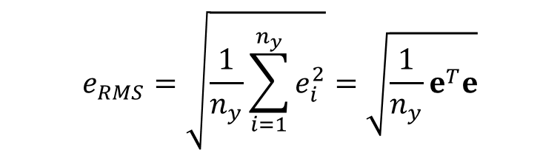


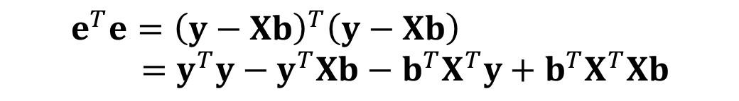
Determining unknown coefficients
We will use RMS error
The magnitude of $e_{rms}$ is not the focus, $b$ that minimizes $e_{rms}$ is
Therefore, it is equivalent to minimize $e^{T}e$
$$e_{RMS}=\sqrt{\frac{1}{n_{y}}\sum_{i=1}^{n_{y}}{e_{i}^{2}}}=\sqrt{\frac{1}{n_{y}}e^{T}e}$$
$$e^{T}e={\left(y−Xb\right)}^{T}\left(y−Xb\right) \\ =y^{T}y−y^{T}Xb−b^{T}X^{T}y+b^{T}X^{T}Xb$$
$$y^{T}Xb=b^{T}X^{T}y$$
Scalar

Slide 23



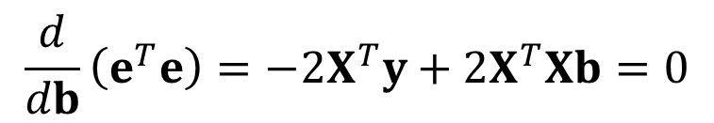

Determining unknown coefficients cont.
Minimum of function = zero derivative
Remedy: Solve $Xb=y$ using QR decomposition
Computationally efficient. Nonlinear regression requires solving an optimization problem to determine $b$
$$\frac{d}{db}\left(e^{T}e\right)=−2X^{T}y+2X^{T}Xb=0$$
Equation of linear regression
Normal equation
$$X^{T}Xb=X^{T}y$$
$$b={\left(X^{T}X\right)}^{−1}X^{T}y$$
$n_{β}×n_{β}$ matrix: ill-conditioned for large $n_{β}$

Slide 24

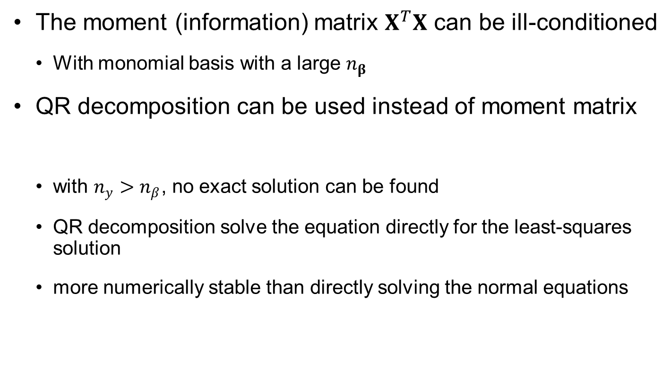
QR Decomposition
The moment (information) matrix $X^{T}X$ can be ill-conditioned
With monomial basis with a large $n_{β}$
QR decomposition can be used instead of moment matrix
with $n_{y}>n_{β}$, no exact solution can be found
QR decomposition solve the equation directly for the least-squares solution
more numerically stable than directly solving the normal equations
$$Xb=y$$
[Q,R]=qr(X);
b=Q\(Q’*y)

Slide 25
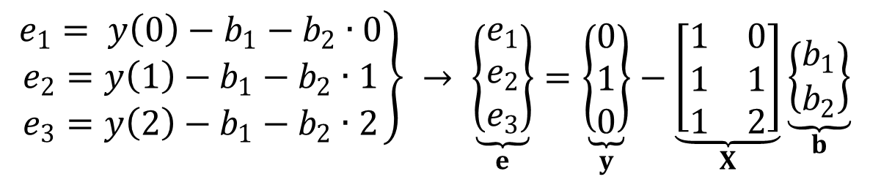

Ex2-1) Linear approximation
Linear function with 3 data
Apply data to the model
$$\hat{y}\left(x , b\right)=b_{1}+b_{2}x, y\left(0\right)=0, y\left(1\right)=1, y\left(2\right)=0$$
$$\left.\begin{matrix}e_{1}= y\left(0\right)−b_{1}−b_{2}∙0 \\ e_{2}=y\left(1\right)−b_{1}−b_{2}∙1 \\ e_{3}=y\left(2\right)−b_{1}−b_{2}∙2\end{matrix}\right\} → \underset{e}{\underbrace{\left\{\begin{matrix}e_{1} \\ e_{2} \\ e_{3}\end{matrix}\right\}}}=\underset{y}{\underbrace{\left\{\begin{matrix}0 \\ 1 \\ 0\end{matrix}\right\}}}−\underset{X}{\underbrace{\left[\begin{matrix}1 & 0 \\ 1 & 1 \\ 1 & 2\end{matrix}\right]}}\underset{b}{\underbrace{\left\{\begin{matrix}b_{1} \\ b_{2}\end{matrix}\right\}}}$$
$$X^{T}X=\left[\begin{matrix}1 & 1 & 1 \\ 0 & 1 & 2\end{matrix}\right]\left[\begin{matrix}1 & 0 \\ 1 & 1 \\ 1 & 2\end{matrix}\right]=\left[\begin{matrix}3 & 3 \\ 3 & 5\end{matrix}\right] \\ X^{T}y=\left[\begin{matrix}1 & 1 & 1 \\ 0 & 1 & 2\end{matrix}\right]\left\{\begin{matrix}0 \\ 1 \\ 0\end{matrix}\right\}=\left\{\begin{matrix}1 \\ 1\end{matrix}\right\}$$

Slide 26
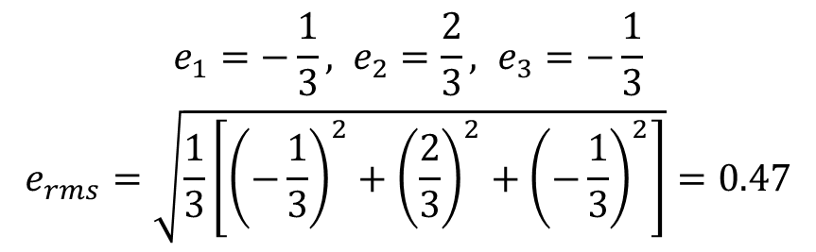



Ex2-1) Linear approximation cont.
Linear regression equation
Errors
$$\left\{\begin{matrix}3b_{1}+3b_{2}=1 \\ 3b_{1}+5b_{2}=1\end{matrix}\right.→ \left\{\begin{matrix}b_{1}=\frac{1}{3} \\ b_{2}=0\end{matrix}\right.$$
$$X^{T}Xb=X^{T}y$$
y
$$\hat{y}\left(x,b\right)=\frac{1}{3}$$
Average value of data
x
0
1
2
$$\begin{matrix}e_{1}=−\frac{1}{3}, e_{2}=\frac{2}{3}, e_{3}=−\frac{1}{3} \\ e_{rms}=\sqrt{\frac{1}{3}\left[{\left(−\frac{1}{3}\right)}^{2}+{\left(\frac{2}{3}\right)}^{2}+{\left(−\frac{1}{3}\right)}^{2}\right]}=0.47\end{matrix}$$

Slide 27
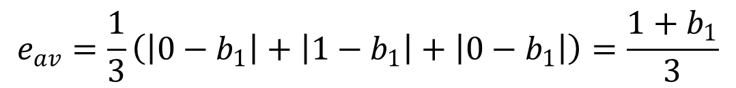

Ex2-1) Linear approximation with other error metrics
Assuming other fits will lead to the form $\hat{y}=b$
For average error minimize
For maximum error minimize
$$e_{av}=\frac{1}{3}\left(\left|0−b_{1}\right|+\left|1−b_{1}\right|+\left|0−b_{1}\right|\right)=\frac{1+b_{1}}{3}$$
$$e_{max}=max\left(\left|0−b_{1}\right|,\left|1−b_{1}\right|,\left|0−b_{1}\right|\right)=0.5$$
y
RMS fit
Max. error fit
Ave. error fit
 | RMS fit | Av. Err. fit | Max err. fit
RMS error | 0.471 | 0.577 | 0.5
Av. error | 0.444 | 0.333 | 0.5
Max error | 0.667 | 1 | 0.5
x
0
1
2

Slide 28

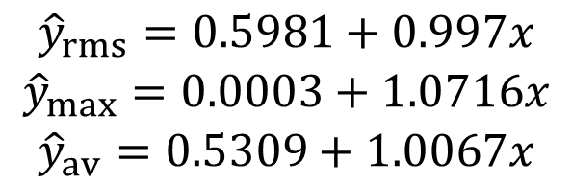
Ex) Curve fit cont.
35
Fitting $y=x$ with noisy data
Use 3 error metrics to fit
With dense data, difference due to metrics is small
Max error:
y
30
y_{av}
y_{rms}
y_{max}
25
20
15
10
5
0
0
5
10
15
20
25
30
f=@(b,x,y) max(abs(b(1)+b(2)*x-y))
B=fminsearch(@(b) f(b,x,y),[0,1])
 | RMS fit | Av. Err. fit | Max err. fit
RMS error | 1.278 | 1.283 | 1.536
Av. error | 0.958 | 0.951 | 1.234
Max error | 3.007 | 2.987 | 2.934
$$\begin{matrix}{\hat{y}}_{rms}=0.5981+0.997x \\ {\hat{y}}_{max}=0.0003+1.0716x \\ {\hat{y}}_{av}=0.5309+1.0067x\end{matrix}$$
Notes:
For the data we had in the first slide, we fit using the maximum error metric by using Matlab fminsearch to minimize the maximum error.
f=@(b,x,y) max(abs(b(1)+b(2)*x-y))
B=fminsearch(@(b) f(b,x,y),[0,1])
B = 0.0003 1.0716
Note that we started the search at the true b vector [0,1], but any good estimate would do.
The solution based on the maximum metric is ymax=0.0003+1.0716x
One can use the same fminsearch to obtain the fit based on the average absolute error and get yav=0.5309+1.0067x.
The rms fit that was obtained by polyfit was yrms=0.5981+0.997x
Note that the there is very small difference between the fit based on rms and the fit based on average absolute error. However, the fit based on the maximum error is significantly different, has substantially larger average and rms errors and only a small improvement in maximum error. The reason is that this fit is much more sensitive to a few outlying points.

Slide 29

Exercises
Find other metrics for a fit besides the three discussed in this section
Redo the 30-point example with the surrogate $y=bx$
Redo the 30-point example using only every third point $(x=3,6,…)$. Compare the accuracy of the fit with regard to the true function. It is enough to use one error metric
Notes:
Other metrics for the goodness of a fit: The three discussed in the lecture correspond to the L1, L2, and L-infinity norms of the vector e. We can use the p-norm, for any other value of p. For example, for p=5
In addition, there are fit metrics that are not based on the error metric alone, but look for fits with small number of terms, or with small coefficients. For example, Ridge regression seeks to minimize
where λ is a parameter selected based on the relative importance of small errors or small coefficients.
Redo the 30-point example with the surrogate y=bx. Use the same data. For this simple case, it is easiest to solve (X’X)b = X’y because here the matrix X has a single column that is equal to the vector of x at the data points. So the Matlab commands are
x=[1:30]’;
y=[ 1.5377 3.8339 0.7412 4.8622 5.3188 4.6923 6.5664 8.3426 12.5784 12.7694 . . .
9.6501 15.0349 13.7254 13.9369 15.7147 15.7950 16.8759 19.4897 20.4090 21.4172 . . .
21.6715 20.7925 23.7172 25.6302 25.4889 27.0347 27.7269 27.6966 29.2939 29.2127]’;
b=x\y
b =1.0264
Here we took advantage of the fact that when you ask Matlab to solve a rectangular system Xb=y, it will do the (X’X)b = X’y.
Note that when we did allow an intercept and used polyfit, we got the following
[p,s]=polyfit(x,y,1);
yfit=polyval(p,x);
(x,y,'+',x,x,'r',x,yfit,'b')
p = 0.9970 0.5981
We got a more accurate slope (0.997 instead of 1.026). This seems to be counter intuitive. We provided a more accurate model of the true function (y=x) and ended up with a less accurate coefficient. This anomaly is due to the fact that with only 30 data points the mean value of y is biased. It is 16.05 instead of 15.5. The intercept term allows the fit to put this bias into the intercept term instead of modeling it with a higher slope.
Redo the 30-point example using only every third point (x=3,6,…). Compare the accuracy of the fit with regard to the true function. It is enough to use one error metric.
x=[3:3:30]’;
y=[0.7412 4.6923 12.5784 15.0349 15.7147...
19.4897 21.6715 25.6302 27.7269 29.2127]’;
[p,s]=polyfit(x,y,1)
p = 1.0231 0.3683
That is yˆ = 1.0231 + 0.3683x compared to the fit obtained with 30 points yˆ = 0.9970 + 0.5981x. With only 10 points the fit is less accurate. For example, the maximum error in the range of the data between the true function and the fit is 0.5981 at x=0 for the 30-point fit and is 1.0613 at x=30 for the 10-point fit.

Slide 30

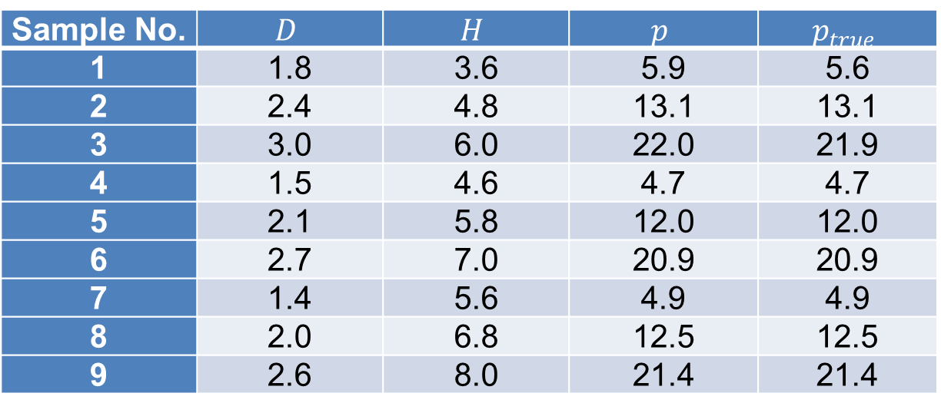
Ex2-2) PRS in Multi-dimension
PRS can be a linear combination of non-monomial bases
Can design with diameter $D∈[1.5, 3.5]$ in, height $H∈[3.0, 7.0]$ in to maximize profit
True profit function:
$$p(D,H)=0.2361πD^{2}H−3.858×{10}^{−4}π^{2}D^{4}H^{2}−0.1π\left(0.5D^{2}+DH\right)$$
Sample No. | $$D$$ | $$H$$ | $$p$$ | $$p_{true}$$
1 | 1.8 | 3.6 | 5.9 | 5.6
2 | 2.4 | 4.8 | 13.1 | 13.1
3 | 3.0 | 6.0 | 22.0 | 21.9
4 | 1.5 | 4.6 | 4.7 | 4.7
5 | 2.1 | 5.8 | 12.0 | 12.0
6 | 2.7 | 7.0 | 20.9 | 20.9
7 | 1.4 | 5.6 | 4.9 | 4.9
8 | 2.0 | 6.8 | 12.5 | 12.5
9 | 2.6 | 8.0 | 21.4 | 21.4

Slide 31
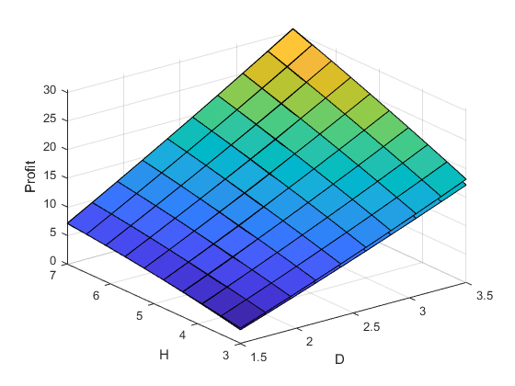

Ex2-2) PRS in Multi-dimension cont.
Quadratic PRS with noisy samples:
Quadratic PRS with exact samples:
Coefficients of $H$ and of $H^{2}$ are quite different, indicating that these coefficients are less important for fitting the samples
$$\hat{p}=−7.1827+2.8835D+0.3022H+0.3576D^{2}+1.0024DH−0.0707H^{2}$$
$${\hat{p}}_{true}=−7.9801+2.5672D+0.6756H+0.2956D^{2}+1.0898DH−0.1150H^{2}$$
Notes:
% Quadratic PRS for profit-per-can
x=[1.8 3.6; 2.4 4.8; 3.0 6.0; 1.5 4.6; 2.1 5.8; 2.7 7.0; 1.4 5.6; 2.0 6.8; 2.6 8.0];
p=[5.9 13.1 22.0 4.7 12.0 20.9 4.9 12.5 21.4]';
D=x(:,1); H=x(:,2);
ptrue=0.2361*pi*D.^2.*H-3.858E-4*pi^2*D.^4.*H.^2-0.1*pi*(0.5*D.^2+D.*H);
%
X=[ones(9,1) D H D.^2 D.*H H.^2];
A=X'*X;
Btrue=X'*ptrue;
B=X'*p;
btrue=A\Btrue;
b=A\B;
%
d=linspace(1.5,3.5,10);
h=linspace(3.0,7.0,10);
[D,H]=meshgrid(d,h);
P=b(1)+b(2)*D+b(3)*H+b(4)*D.^2+b(5)*D.*H+b(6)*H.^2;
Ptrue=btrue(1)+btrue(2)*D+btrue(3)*H+btrue(4)*D.^2+btrue(5)*D.*H+btrue(6)*H.^2;
surf(D, H, P); hold on; surf(D, H, Ptrue);

Slide 32
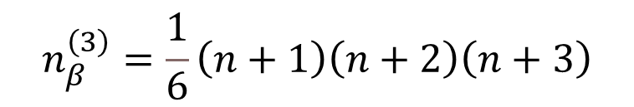
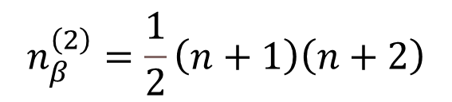
Curse of Dimensionality
The number of coefficients rapidly increases as the order of PRS and the dimension of the input variable increase
Quadratic PRS:
Cubic PRS:
When the dimensionality increases, the volume of the design space increases so fast that the available samples become sparse
samples are sparse and the distances between samples are large
difficult to capture the trend of the function accurately
inevitably causes a large extrapolation region
$$n_{β}^{\left(2\right)}=\frac{1}{2}\left(n+1\right)\left(n+2\right)$$
$$n_{β}^{\left(3\right)}=\frac{1}{6}\left(n+1\right)\left(n+2\right)\left(n+3\right)$$

Slide 33
Remedies for High-Dimensional Surrogate
challenge to build an accurate and reliable surrogate model in 10 dimensions
Needs to reduce the number of variables
Not all variables are critical to QoI.
Identify critical variables that significantly affect the QoI and fix all other variables (sensitivity analysis)
Transform to a low-dimensional space using nondimensionalization, principal component analysis, or proper orthogonal decomposition (POD)

Slide 34
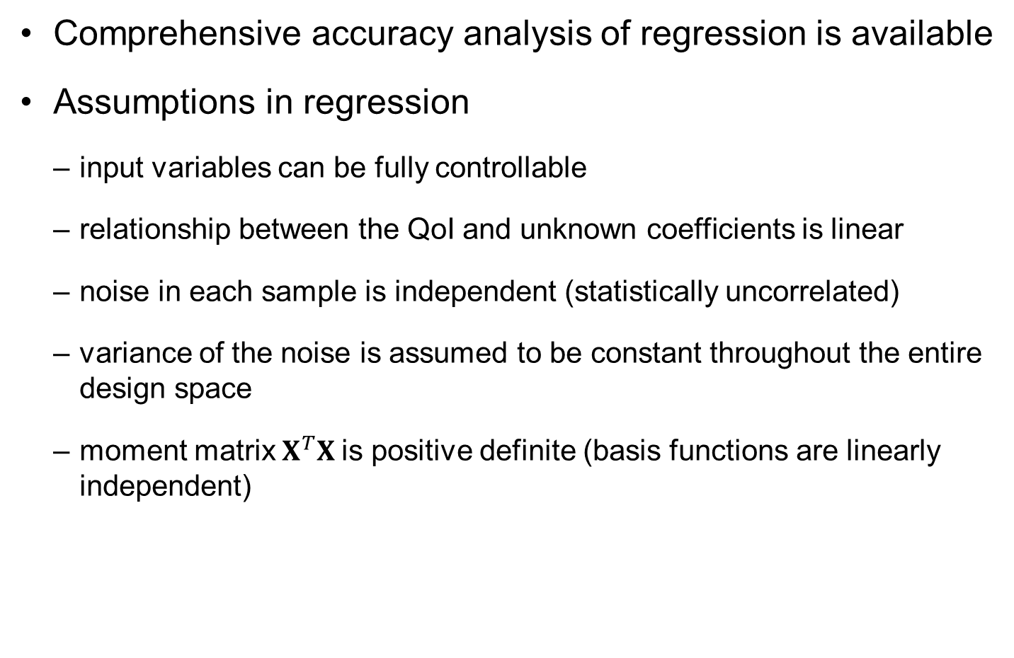
Assumptions in Linear Regression
Comprehensive accuracy analysis of regression is available
Assumptions in regression
input variables can be fully controllable
relationship between the QoI and unknown coefficients is linear
noise in each sample is independent (statistically uncorrelated)
variance of the noise is assumed to be constant throughout the entire design space
moment matrix $X^{T}X$is positive definite (basis functions are linearly independent)

Slide 35
2.4 Goodness of Fit
Accuracy at sample locations vs. accuracy at prediction points

Slide 36
Challenge in Assessing Accuracy of Surrogate Model
We cannot compare the accuracy of the surrogate model against the true function
We do not know the true function and data have random noise
How to evaluate its accuracy without knowing the true function?
Noise is normally distributed (or we assumed), but its variance is unknown
Goodness of fit: possible to evaluate the accuracy of a surrogate model against samples
errors are minimized at sample locations during the fitting process
goodness of fit does not mean simply measuring the error at sample points

Slide 37
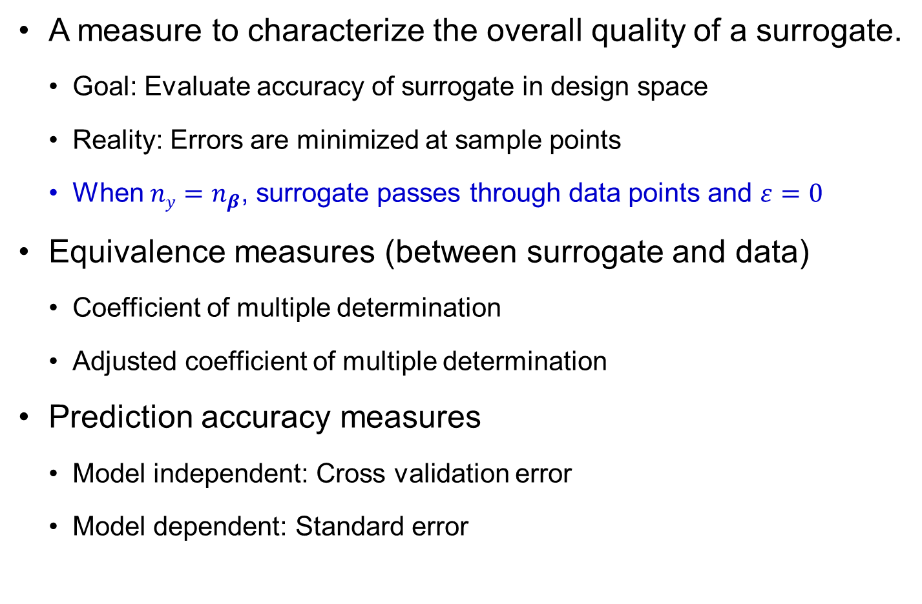
Global predictors of regression fidelity
A measure to characterize the overall quality of a surrogate.
Goal: Evaluate accuracy of surrogate in design space
Reality: Errors are minimized at sample points
When $ny=n_{β}$, surrogate passes through data points and $ε=0$
Equivalence measures (between surrogate and data)
Coefficient of multiple determination
Adjusted coefficient of multiple determination
Prediction accuracy measures
Model independent: Cross validation error
Model dependent: Standard error
Notes:
This lecture is about obtaining measures characterizing the fidelity of the surrogate for predicting the behavior of the future simulations. We will limit ourselves here to global measures, which means we will get a single number that will characterize the overall fidelity.
The coefficient of multiple determination and its adjusted cousin measure the equivalence between the surrogate and the data in terms of variability. The first provides the fraction of the variability in the data captured by the surrogate. The second adjusts it in an attempt to estimate the fraction that will be captured by using the surrogate to predict values at other points. Good fidelity will be reflected in these coefficients being close to 1.
Prediction accuracy measures estimate what will be the rms error in predictions based on the surrogate. Cross validation error is a measure that can be applied to any surrogate, while the standard error applies only to linear regression with specific assumptions on the noise in the data. Good fidelity will be reflected in these errors being small compared to the average values in the data.
There are also measures that estimate the error in the coefficients and the error at a given point that will be discussed in future lectures.

Slide 38




Errors at sample points
After fitting surrogate $\hat{y}\left(x,b\right)=\sum_{i=1}^{n_{β}}{b_{i}ξ_{i}(x)}$, its prediction at data points are $\hat{y}=X∙b$ and the errors are $e=\hat{y}−y$
Average error
Maximum error
RMS error
Square-sum-error
These measures underestimate error at unsampled (prediction) points
Errors are minimized at sample locations
$$e_{av}=\frac{1}{n_{y}}\sum_{i=1}^{n_{y}}{\left|e_{i}\right|}$$
$$e_{max}=\max_{n_{y}}\left|e_{i}\right|$$
$$e_{rms}=\sqrt{SSe/n_{y}}$$
$$SSe=e^{T}e=y^{T}y−2b^{T}X^{T}y+b^{T}X^{T}Xb$$

Slide 39


Estimation of noise in data
PRS assumes that the model $\hat{y}\left(x,b\right)=\sum_{i=1}^{n_{β}}{b_{i}ξ_{i}(x)}$ is accurate but the data have random noise ~ $N(0,σ2)$
Unbiased estimate of $σ$
This is only reasonable when the model form is accurate
The model form error is embedded in the estimated noise
$\hat{σ}$: Standard error of noise
$${\hat{σ}}^{2}=\frac{SSe}{n_{y}−n_{β}}$$

Slide 40

Ex2-3) Fitting noise
Equally spaced 5 samples of y = x with noise $\sim N(0,12)$
Fit the sample using 4-th order polynomials (5 coefficients)
Perfect fit for all data points
The surrogate fits noise, not the trend (no noise canceling)
x = [0, 2.5000, 5.0000, 7.5000, 10.0000]
y = [1.5326, 1.7303, 5.3714, 7.2744, 11.1174]
$$\hat{y}\left(x\right)=1.5326−2.1864x+1.3397x^{2}−0.1970x^{3}+0.0095x^{4}$$
12
Samples
10
True function
Fitted function
8
6
4
2
0
0
2
4
6
8
10
Notes:
x=linspace(0,10,5);
y=x+randn(1,5);
p=polyfit(x,y,4)
xx=linspace(0,10,50);
f = polyval(p,xx);
yy=xx;
plot(x,y,'ko',xx,f,'k-',xx,yy,'b-');
legend('samples','4-th order polynomials','true function');

Slide 41


Ex2-4) Estimated noise vs. model error
PRS assumes that the model is correct, but data has noise
Estimated noise will be reasonable when the model is correct
If the model has an error, it will be included in the estimated noise
Equally spaced 10 samples of $y=x2$with noise $\sim N({0,1}^{2})$
Standard deviation of samples $σ=1.4797$
Fit the samples using linear and quadratic polynomials
x=linspace(0,10,20);
y=x.^2+randn(1,20);
$${\hat{y}}_{L}\left(x\right)=−16.2473+10.0916x$$
$${\hat{y}}_{Q}\left(x\right)=−0.5748+0.1657x+0.9926x^{2}$$
Notes:
x=linspace(0,10,20);
y=x.^2+randn(1,20);
p=polyfit(x,y,1)
e = y - polyval(p,x);
sigma = sqrt(e*e'/18)
%
p2=polyfit(x,y,2)
e = y - polyval(p2,x);
sigma2 = sqrt(e*e'/3)
%
xx=linspace(0,10,50);
f = polyval(p,xx);
f2 = polyval(p2,xx);
yy=xx.^2;
plot(x,y,'ko',xx,f,'k-',xx,f2,'r-',xx,yy,'b-');
legend('samples','linear polynomials','quadratic polynomials','true function');

Slide 42

Ex2-4) Estimated noise versus model error cont.
Estimated noise
$${\hat{σ}}_{L}=\sqrt{\frac{SSe_{L}}{20−2}}=8.7153, {\hat{σ}}_{Q}=\sqrt{\frac{SSe_{Q}}{20−3}}=1.5336$$
Include model error
reasonable
120
20
Samples
e
100
True function
15
L
e
Q
Linear PRS
80
Quadratic PRS
10
60
5
40
0
20
-5
0
-10
-20
-15
0
2
4
6
8
10
0
2
4
6
8
10
Notes:
rng default;
x=linspace(0,10,20);
ytrue=x.^2;
noise=randn(1,20); noise=noise-mean(noise);
y=ytrue+noise;
bL=polyfit(x,y,1);
yL=polyval(bL,x);
sigmaL=sqrt((y-yL)*(y-yL)'/(20-2))
bQ=polyfit(x,y,2);
yQ=polyval(bQ,x);
sigmaQ=sqrt((y-yQ)*(y-yQ)'/(20-3))
plot(x,y,'+',x,x.^2,'r',x,yL,'b',x,yQ,'k');
legend('Samples','True function','Linear PRS','Quadratic PRS');
figure(2);
plot(x,y-yL,'+',x,y-yQ,'o');
legend('e_L','e_Q');

Slide 43






Coefficient of multiple determination
Equivalence of surrogate with data is measured by what fraction of variance in the data is captured by the surrogate.
Coefficient of multiple determination
Adjusted coefficient of multiple determination
Values larger than 0.9 is satisfactory
But not directly related to the magnitude of error
$$SS_{y}=\sum_{i=1}^{n_{y}}{{\left(y_{i}−\overline{y}\right)}^{2}}$$
$$SS_{r}=\sum_{i=1}^{n_{y}}{{\left({\hat{y}}_{i}−\overline{y}\right)}^{2}}$$
$$\overline{y}=\frac{1}{n_{y}}\sum_{i=1}^{n_{y}}{y_{i}}$$
Variation of data
Variation of prediction
Average of data
$$SS_{y}=SS_{r}+SS_{e}$$
$$R^{2}=\frac{SS_{r}}{SS_{y}}=1−\frac{SS_{e}}{SS_{y}}$$
$$R_{a}^{2}=1−(1−R^{2})\frac{n_{y}−1}{n_{y}−n_{β}−1}$$
Penalize the number of coefficients
Notes:
The equivalence between the data and the surrogate is often measured by what fraction of the variance is captured by the surrogate. The coefficient of multiple determination is the ratio of the variance of the data and the variance in the surrogate prediction at the same points. That is, given the average of the data $\overline{y}=\frac{1}{n_{y}}\sum_{i=1}^{n_{y}}{y_{i}}$, the variance of the data is the sum of the squares of the difference from the average$SS_{y}=\sum_{i=1}^{n_{y}}{{\left(y_{i}−\overline{y}\right)}^{2}}$, while the corresponding quantity for the surrogate predictions is $SS_{r}=\sum_{i=1}^{n_{y}}{{\left({\hat{y}}_{i}−\overline{y}\right)}^{2}}$. The ratio of the two is the square of the coefficient of multiple determination.
As the number of coefficients in the surrogate, $n_{b}$, is increased, the surrogate matches more and more the data. That does not mean, however, that it would match it at other points, as we are possibly fitting noise by adding additional terms. So the adjusted coefficient of multiple determination compensates for that by penalizing the number of coefficients $R_{a}^{2}=1−(1−R^{2})\frac{n_{y}−1}{n_{y}−n_{b}}$. Values of these coefficients above 0.9 are generally considered satisfactory. However, they are not directly related to the magnitude of the error, as will be seen in the next slide.

Slide 44

Coefficient of multiple determination cont.
proportion of sample variation “explained” by the model prediction
$R^{2}=1$: the fitted model explains all variability in samples $y$,
$R^{2}=0$: no ‘linear’ relationship between the samples and predictions
$R^{2}<0$: theoretically not possible with constant basis
different sets of samples are used for fitting and testing
surrogate is fitted different methods than the linear regression
the basis functions do not include the constant term such that the condition $y^{T}\overline{y}={\hat{y}}^{T}\overline{y}$ does not satisfy

Slide 45

$R^{2}$ vs. $R_{a}^{2}$
$R^{2}$ monotonically increases as the PRS includes additional basis functions (increasing $n_{β}$)
This does not mean improving goodness (overfitting)
$R_{a}^{2}$ penalizes $R^{2}$ as extra basis functions are included
If $R_{a}^{2}$ decreases as we increase $n_{β}$, we may fit the samples better, but losing predictive capability
$R_{a}^{2}$ can be negative and always less than or equal to $R^{2}$
$R_{a}^{2}$ increases only when the basis contributes to the prediction accuracy

Slide 46




Ex2-5) Example: Linear regression
True function: $y=x$ 5 data: $(−2,−1.5), (−1,−1.5), (1,1.25), (2,1.75), (0,0)$
Linear fit: $y = b1 + b2x$
$$X=\left[\begin{matrix}\begin{matrix}1 \\ 1\end{matrix} & \begin{matrix}−2 \\ −1\end{matrix} \\ \begin{matrix}1 \\ 1\end{matrix} & \begin{matrix}0 \\ 1\end{matrix} \\ 1 & 2\end{matrix}\right], y=\left\{\begin{matrix}\begin{matrix}−1.5 \\ −1.5\end{matrix} \\ \begin{matrix}0 \\ 1.25\end{matrix} \\ 1.75\end{matrix}\right\}, X^{T}X=\left[\begin{matrix}5 & 0 \\ 0 & 10\end{matrix}\right], X^{T}y=\left\{\begin{matrix}0 \\ 9.25\end{matrix}\right\}$$
$${\hat{y}}^{\left(1\right)}\left(x\right)=0.925x, e=\left\{\begin{matrix}\begin{matrix}0.35 \\ −0.575\end{matrix} \\ \begin{matrix}0.0 \\ 0.325\end{matrix} \\ −0.1\end{matrix}\right\}$$
$$SSy=\sum_{i=1}^{5}{{\left(y_{i}−\overline{y}\right)}^{2}}=9.125, SSe=e^{T}e=0.56875$$

Slide 47




Ex2-5) Linear regression cont.
Coefficient of multiple determination
Error measures
Standard deviation of noise
$$R^{2}=1−\frac{SSe}{SSy}=0.9377, R_{a}^{2}=1−\left(1−0.9377\right)\frac{4}{2}=0.8754$$
Linear fit is satisfactory!!
$$\begin{matrix}e_{av}=\frac{1}{5}\sum_{i=1}^{5}{\left|e_{i}\right|}=0.27, e_{max}=max\left|e_{i}\right|=0.575 \\ e_{rms}=\sqrt{\frac{SSe}{5}}=0.337\end{matrix}$$
$$\hat{σ}=\sqrt{\frac{SSe}{n_{y}−n_{β}}}=\sqrt{\frac{0.56875}{5−2}}=0.4354$$
$$σ=0.395$$

Slide 48



Ex2-5) Linear regression cont.
Quadratic fit: $y = b1 + b2x + b3x2$
$$X=\left[\begin{matrix}\begin{matrix}1 \\ 1\end{matrix} & \begin{matrix}−2 \\ −1\end{matrix} & \begin{matrix}4 \\ 1\end{matrix} \\ \begin{matrix}1 \\ 1\end{matrix} & \begin{matrix}0 \\ 1\end{matrix} & \begin{matrix}0 \\ 1\end{matrix} \\ 1 & 2 & 4\end{matrix}\right], y=\left\{\begin{matrix}\begin{matrix}−1.5 \\ −1.5\end{matrix} \\ \begin{matrix}0 \\ 1.25\end{matrix} \\ 1.75\end{matrix}\right\}, X^{T}X=\left[\begin{matrix}5 & 0 & 10 \\ 0 & 10 & 0 \\ 10 & 0 & 34\end{matrix}\right], X^{T}y=\left\{\begin{matrix}0 \\ 9.25 \\ 0.75\end{matrix}\right\}$$
$$\hat{y}=−0.1071+0.925x+0.05357x^{2}$$
$$e=\left\{\begin{matrix}−0.243 & 0.521 & −0.107 & −0.378 & 0.207\end{matrix}\right\}$$
$$SSy=9.125, SSe=0.52857, R^{2}=0.9421, R_{a}^{2}=0.7684$$
Improved
Deteriorated
$$e_{av}=0.291, e_{max}=0.521, e_{rms}=0.325, \hat{σ}=0.5141$$

Slide 49
Ex2-5) Linear regression cont.
we have not gained any predictive capabilities by adding the quadratic terms
2
Samples
Linear PRS
Quadratic PRS
1
0
-1
-2
-2
-1
0
1
2

Slide 50


Ex2-6) $R2$ does not reflect accuracy
Compare $y1=x$to $y2=0.1x$plus noise $\sim N({0,1}^{2})$
Estimate $eav$ and $R2$ between the function (red) and surrogate (blue).
$eav$ is similar, but $R2$ are significantly different because $y1$ varies much faster than $y2$
Notes:
The coefficient of multiple determination does not necessarily reflect the accuracy. For the same level of error, if the function varies fast, R² will be larger than if the function varies slowly. This is illustrated in the two figures in the slide. In both we generate normally distributed random noise at 30 points using Matlab randn(1,30)
noise =
5.3767e-001 1.8339e+000 -2.2588e+000 8.6217e-001 3.1877e-001 -1.3077e+000 -4.3359e-001 3.4262e-001 3.5784e+000 2.7694e+000 -1.3499e+000 3.0349e+000 7.2540e-001 -6.3055e-002 7.1474e-001 -2.0497e-001 -1.2414e-001 1.4897e+000 1.4090e+000 1.4172e+000 6.7150e-001 -1.2075e+000 7.1724e-001 1.6302e+000 4.8889e-001 1.0347e+000 7.2689e-001 -3.0344e-001 2.9387e-001 -7.8728e-001
For the left figure we add the noise to the function y=x at x=1,2,…,30 ,and in the second we add it to y=0.1x at the same points. We fit the data with Matlab regress
xx=[ones(30,1),x']; [B,BINT,R,RINT,STATS] = regress(y',xx);
The fit of the data with y=x gives $\hat{y}$=0.5981+0.9970x with R²=0.9785, while the fit with y=0.1x gives $\hat{y}$=0.5981+0.0970x with R²=0.3016. Note that the errors from the true function (without the noise) are of similar magnitude even though the coefficients of multiple determination are very different. The figure on the right certainly looks much poorer than the one on the left, reflecting the fact that the noise to signal ratio is poor. The function y=0.1x changes by only 3 which is comparable to some of the noise values.

Slide 51
Cross Validation
Validation consists of checking the surrogate at a set of validation points
This may be considered wasteful because we do not use all the points for fitting the best possible surrogate
a resampling method that uses different portions of the samples to train and validate a model on different iterations
wants to estimate how accurately a predictive model will perform in practice
Notes:
The most straight forward method to estimate the accuracy of the surrogate is to compare it to the true function at a number of test points. This process is often called validation. It may be considered wasteful, because the extra points might as well be used to improve the accuracy of the surrogate. To get around this problem we use cross validation.
In simplest form of cross validation we leave one point out , fit the surrogate to the remaining points, and then check the error at the left out point. We repeat for each point, and so we end up with a cross validation error at each data point. The sum of the squares of these error is often called PRESS (prediction error sum of squares) and rms cross validation error is called the PRESS error.
When using linear regression, one can show that the ith cross validation errors $e_{pi}$ is $e_{pi}=\frac{e_{i}}{1−E_{ii}} where E=X{\left(X^{T}X\right)}^{−1}X^{T}$. However, the matrix E may be ill conditioned, in which case the equation for the cross validation errors may not be accurate. For most other surrogates there is no formula for the cross validation errors, and they most be calculated by successive refitting of the surrogate. When this is too expensive, it is possible to take a shortcut by leaving out several points at a time. For example, with 100 data points, we may divide the data into 20 groups of 5 and leave out one group, fitting the other 95 and calculating the errors at the 5 left out points. We then need to repeat the process only 20 times.

Slide 52






$k$-fold Cross-Validation
Cross validation divides data into $k$ groups.
Fit the approximation to $k−1$ groups and use last group to estimate error. Repeat for each group.
When each group consists of one point, error often called PRESS (prediction error sum of squares)
Calculate error at each point and then present RMS error
Training set
Validation set
$${→e}_{p1}$$
$${→e}_{p2}$$
$${→e}_{p3}$$
$${→e}_{p4}$$
$${→e}_{p5}$$

Slide 53






PRESS (prediction error sum of squares)
Leave out data at point $i$
Build surrogate ${\hat{y}}^{\left(i\right)}(x)$ $\hat{y} (x)$:Surrogate with all data
PRESS residual: $e_{pi}=y_{i}−{\hat{y}}_{\left(i\right)}\left(x_{i}\right)$
Error: $e_{i}=y_{i}−\hat{y}\left(x_{i}\right)$
PRESS
This requires fitting $ny$ times. But it turns out that for linear regression
$$=\sum_{i=1}^{n_{y}}{e_{pi}^{2}}=\sum_{i=1}^{n_{y}}{{\left[y_{i}−{\hat{y}}^{\left(i\right)}\left(x_{i}\right)\right]}^{2}}$$
$$e_{pi}=\frac{e_{i}}{1−E_{ii}}$$
$$E=X{\left(X^{T}X\right)}^{−1}X^{T}$$
Idempotent matrix
$$e_{PRESS}=\sqrt{\frac{1}{n_{y}−1}\sum_{i=1}^{n_{y}}{{\left(\frac{e_{i}}{1−E_{ii}}\right)}^{2}}}$$
Scaled error with $1 – Eii$ term
Requires one fitting

Slide 54



PRESS (prediction error sum of squares) cont.
Property of the idempotent matrix $E$
Large $Eii$: large PRESS residual → high influence point
Diagonal term $1−E_{ii}$ represents the importance of sample $y_{i}$ on error $e_{i}$.
Variance of $i$th PRESS
$$\hat{y}=X∙b=X{\left(X^{T}X\right)}^{−1}X^{T}y=E∙y$$
Idempotent matrix E: map y →
$$e=y−\hat{y}=\left[I−X{\left(X^{T}X\right)}^{−1}X^{T}\right]y=\left[I−E\right]y$$
$${V[e}_{pi}]=V\left[\frac{e_{i}}{1−E_{ii}}\right]={\left(\frac{σ}{1−E_{ii}}\right)}^{2}$$

Slide 55



Ex2-8) PRESS Error
Compare $e_{PRESS}$ of Ex2-5) using the formula and repeating fittings
Idempotent matrix
Regression error and prediction error
$$E=X{\left(X^{T}X\right)}^{−1}X^{T}=\left[\begin{matrix}\begin{matrix}0.8857 & 0.2671 \\ 0.2571 & 0.3714\end{matrix} & \begin{matrix}−0.0857 & −0.1429 \\ 0.3429 & 0.1714\end{matrix} & \begin{matrix}0.0857 \\ −0.1429\end{matrix} \\ \begin{matrix}−0.0857 & 0.3429 \\ −0.1429 & 0.1714\end{matrix} & \begin{matrix}0.4857 & 0.3429 \\ 0.3429 & 0.3714\end{matrix} & \begin{matrix}−0.0857 \\ 0.2571\end{matrix} \\ \begin{matrix}0.0857 & −0.1429\end{matrix} & \begin{matrix}−0.0857 & 0.2571\end{matrix} & 0.8857\end{matrix}\right]$$
$$e=\left\{\begin{matrix}\begin{matrix}0.243 \\ −0.521\end{matrix} \\ \begin{matrix}0.107 \\ 0.379\end{matrix} \\ −0.207\end{matrix}\right\}, e_{p}=\left\{\frac{e_{i}}{1−E_{ii}}\right\}=\left\{\begin{matrix}\begin{matrix}2.125 \\ −0.8295\end{matrix} \\ \begin{matrix}0.2083 \\ 0.6023\end{matrix} \\ −1.8125\end{matrix}\right\}$$

Slide 56



Ex2-8) PRESS Error cont.
Consider the case that $y_{3}$ is dropped
$b_{1}=−0.2083,b_{2}=0.925$, and $b_{3}=0.0833$
Prediction error $e_{p3}=y_{3}−{\hat{y}}^{\left(3\right)}\left(0\right)=0+0.2083=0.2083$
Repeat for all points:
$$X=\left[\begin{matrix}1 & −2 & 4 \\ 1 & −1 & 1 \\ \begin{matrix}1 \\ 1\end{matrix} & \begin{matrix}1 \\ 2\end{matrix} & \begin{matrix}1 \\ 4\end{matrix}\end{matrix}\right], y=\left\{\begin{matrix}\begin{matrix}−1.5 \\ −1.5\end{matrix} \\ \begin{matrix}1.25 \\ 1.75\end{matrix}\end{matrix}\right\}, X^{T}X=\left[\begin{matrix}4 & 0 & 10 \\ 0 & 10 & 0 \\ 10 & 0 & 34\end{matrix}\right], X^{T}y=\left\{\begin{matrix}0 \\ 9.25 \\ 0.75\end{matrix}\right\}$$
$${\hat{y}}^{\left(3\right)}\left(x\right)=−0.2083+0.925x+0.0833x^{2}$$
$$e_{p}=\left\{y_{i}−{\hat{y}}^{\left(i\right)}\left(x_{i}\right)\right\}=\left\{\begin{matrix}\begin{matrix}2.125 \\ −0.8295\end{matrix} \\ \begin{matrix}0.2083 \\ 0.6023\end{matrix} \\ −1.8125\end{matrix}\right\}$$

Slide 57



Model based error for linear regression
The common assumptions for linear regression
The true function is described by the functional form of the surrogate.
The data is contaminated with normally distributed error with the same standard deviation at every point.
The errors at different points are not correlated.
Under these assumptions, the noise standard deviation (standard error) is estimated as
$\hat{σ}$ is used as estimate of the prediction error. That is the error between the true function and the surrogate
$$\hat{σ}=\sqrt{\frac{e^{T}e}{n_{y}−n_{β}}}$$
$$n_{y}↑ → \hat{σ}↓$$
Large # of data makes surrogate more accurate than data
Notes:
In linear regression we commonly assume that the form that we select for the surrogate is the true form of the function. When we compare the prediction of the surrogate to future simulations we will have two sources of error, the noise in the simulation and the inaccuracy in the coefficients of the shape functions that is caused by the noise in the data.
The noise is assumed to be Gaussian (normally distributed) with a zero mean and the same standard deviation at all points. Furthermore, the noise at different points in uncorrelated. Under these assumptions, we can show that the estimate of the square of the standard deviation of the noise is ${\hat{σ}}^{2}=\frac{e^{T}e}{n_{y}−n_{b}}$. This standard deviation called the standard error and it is a good measure of the overall accuracy of the surrogate even when the assumptions do not hold.
It is important to note that we are estimating the difference between the surrogate and future simulation. The error, that is the difference between the true function (uncontaminated by the noise) and the surrogate can be substantially smaller when we have an abundance of data compared to the number of coefficients. That is the surrogate is more accurate than the data.

Slide 58


Ex) Model-based error vs. PRESS
30 samples from $y = x$and noise $\sim N({0,1}^{2})$
Fitting linear function
Standard error = 1.3228
mean(noise) = 0.5519, std(noise) = 1.3
x=1:30; noise=randn(1,30); y=x+noise;
$$\hat{y}=0.5981+0.997x$$
X=[ones(30,1),x'];
[B,BINT,R,RINT,STATS] = regress(y',X);
yfit=B(1)+B(2)*x;
error=y-yfit;
sigma=sqrt(error*error'/28)
Similar, due to finite samples
mean(noise)
neutnoise=noise-mean(noise);
nnrms=sqrt(neutnoise*neutnoise'/29)

Slide 59
Ex) Model-based error vs. PRESS cont.
PRESS = 1.3907
Two errors are similar (1.3228 vs 1.3907)
And they are equal to std(noise) = 1.3
The actual error was only about 0.6 because the large amount of data filtered the noise.
With less data, the differences will be larger.
M=X'*X; E=X*inv(M)*X';
d=diag(E);
ep=error'./(1-d);
epress=sqrt(ep'*ep/29)

Slide 60

Exercises
The pairs (0,0), (1,1), (2,1) represent strain (millistrains) and stress (ksi) measurements.
Estimate Young’s modulus using regression.
Calculate the error in Young modulus using cross validation both from the definition and from the formula.
Repeat the example of $y=x$, using only data at $x= 3, 6, 9,…, 30$. Add noise $\sim N({0,1}^{2}).$
Notes:
The first problem can be done by hand, and the blue question mark near it indicates that it is the kind of problem that may appear on an exam. The stress strain relationship is assumed to be $σ=Eε$, where $σ$ is the stress, $E is Young^{′}s modulus and ε$ is the strain.
The objective of the second problem that needs to be done with Matlab or similar software is to explore what happens to the accuracy when we have fewer data.

Slide 61
2.5 Confidence of Coefficients and Backward Elimination
Starting with complex model form and progressively eliminating unimportant basis

Slide 62


Important Basis vs. Unimportant Basis
Importance of basis magnitude of coefficients
Remove those coefficients whose values cannot be estimated accurately for given data
These coefficients do not have much effect on the accuracy of the fit
May reduce prediction quality in the region where these coefficients have a large effect
Good to have a systematic way to determine important basis
$$\hat{y}\left(x_{1},x_{2}\right)=10.5+0.01x_{1}+9.87x_{2}−5x_{1}^{2}+7.6x_{1}x_{2}+0.02x_{2}^{2}$$
Linear $x1$ term is not important
Quadratic $x2$ term is not important
$$\hat{y}\left(x_{1},x_{2}\right)=10.5+9.87x_{2}−5x_{1}^{2}+7.6x_{1}x_{2}$$

Slide 63
Uncertainty in Regression Coefficients
PRS assumes data have random noise
Different realization of noise produce different sample sets, which end up different coefficients
Due to random noise, identified coefficients are also random
If we know the true function and noise STD, we can generate multiple sets of samples to identify the distribution of coefficients, but we only have one set of samples
In linear regression with Gaussian noise, the coefficients are also normally distributed, but they are correlated each other

Slide 64






Confidence in Regression Coefficients
Covariance matrix of coefficient vector $b$
Diagonal of $Σb$: variance of $bi$
Off-diagonal of $Σb$: correlation between $bi$ and $bj$
Random coefficients $\sim N(b,Σ_{b})$
Standard deviation of $b$ (standard error of coefficients)
$$Σ_{b}=\left[b−E\left(b\right)\right]{\left[b−E\left(b\right)\right]}^{T}$$
$E(b)$: expected (average) of $b$
$$Σ_{b}=σ^{2}{\left[X^{T}X\right]}^{−1}$$
Use estimated
$$\hat{σ}$$
$$σ_{b_{i}}=\hat{σ}\sqrt{{\left[{\left(X^{T}X\right)}^{−1}\right]}_{ii}}$$

Slide 65


Importance of Coefficients
Coefficient of variation of $b$
$c_{i}>1$: uncertainty is larger than the coefficient itself
the coefficient has very low confidence
Important basis has a large $\left|b_{i}\right|$and a small $σ_{b_{i}}$
Surrogate prediction strongly depends on the term
The coefficient is well-identified.
t-statistics ($1/c_{i}$)
Backward elimination: eliminate coefficient with the largest c.o.v. as long as $R_{a}^{2}$ or $e_{PRESS}$ is improved
$$c_{i}=\frac{σ_{b_{i}}}{\left|b_{i}\right|}$$

Slide 66




Ex2-9) Backward elimination
Quadratic model of Ex2-5
Coefficient of variation
Eliminate $b1$
Reduced quadratic model $\hat{y}=b_{2}x+b_{3}x^{2}$
$$\begin{matrix}\hat{σ}=0.5141 \\ R_{a}^{2}=0.8841\end{matrix}$$
$$\hat{y}=−0.1071+0.925x+0.05357x^{2}$$
$${\left(X^{T}X\right)}^{−1}=\left[\begin{matrix}\frac{17}{35} & 0 & −\frac{1}{7} \\ 0 & \frac{1}{10} & 0 \\ −\frac{1}{7} & 0 & \frac{1}{14}\end{matrix}\right], Σ_{b}=\left[\begin{matrix}0.1284 & 0 & −0.03776 \\ 0 & 0.02643 & 0 \\ −0.03776 & 0 & 0.01888\end{matrix}\right]$$
$$c_{1}=\frac{\sqrt{0.1284}}{0.1071}=3.35, c_{2}=\frac{\sqrt{0.02643}}{0.925}=0.176, c_{3}=\frac{\sqrt{0.01888}}{0.05357}=2.56$$

Slide 67




Ex2-9) Backward elimination cont.
Reduced quadratic model $\hat{y}=b_{2}x+b_{3}x^{2}$
$$X=\left[\begin{matrix}−2 & 4 \\ −1 & 1 \\ 0 & 0 \\ 1 & 1 \\ 2 & 4\end{matrix}\right], y=\left\{\begin{matrix}−1.5 \\ −1.5 \\ 0 \\ 1.25 \\ 1.75\end{matrix}\right\} ⇒ b=[0.925,0.0221]$$
$$\hat{y}\left(x\right)=0.925x+0.02205x^{2}$$
Improved!
$$e={\left\{−0.262, 0.597, 0.0, −0.3038, 0.188\right\}}^{T}$$
$$SSy=9.125, SSe=0.5522, R^{2}=0.9394, R_{a}^{2}=0.9193$$
$${\hat{σ}}^{2}=\frac{SSe}{n_{y}−n_{β}}=0.1841, \hat{σ}=0.429$$

Slide 68




Ex2-9) Backward elimination cont.
$${\left(X^{T}X\right)}^{−1}=\left[\begin{matrix}\frac{1}{10} & 0 \\ 0 & \frac{1}{34}\end{matrix}\right], Σ_{b}=\left[\begin{matrix}0.0184 & 0 \\ 0 & 0.00541\end{matrix}\right]$$
$$c_{1}=\frac{\sqrt{0.0184}}{0.925}=0.147, c_{2}=3.33$$
Eliminate $b2$
Eliminate $b_{2}$ $\hat{y}=b_{1}x$
Best fit: $\hat{y}\left(x\right)=0.925x+0.02205x^{2}$
$$\hat{y}\left(x\right)=0.925x, \hat{σ}=0.4354, R_{a}^{2}=0.9169$$
Slightly decreased

Slide 69



Ex2-9) Backward elimination cont.
Change (perturb) data $y(1)=1.35$ (8% perturbation)
Quadratic fit
After eliminating b₁
$${\hat{y}}_{original}\left(x\right)=−0.1071+0.925x+0.0536x^{2}$$
$${\hat{y}}_{perturbed}\left(x\right)=−0.0729+0.935x+0.0465x^{2}$$
30% 1% 13% change
$${\hat{y}}_{original}\left(x\right)=0.925x+0.02205x^{2}$$
$${\hat{y}}_{perturbed}\left(x\right)=0.935x+0.025x^{2}$$
1% 13% change

Slide 70
2.6 Prediction Variance
Uncertainty at unsampled locations

Slide 71





Prediction Uncertainty
Noise$\sim N(0,σ^{2})$→coefficient$\sim N(b,Σ_{b})$→prediction uncertainty
Prediction at unsampled point $x_{p}$ $\sim N(\hat{y}(x_{p}),σ_{y}^{2}(x_{p}))$
prediction uncertainty is proportional to the $σ$ of noise
Prediction uncertainty increases as the prediction point moves away from sample locations
$$±3σ_{y}(99.7\%)$$
Probability Density Function
$$±2σ_{y}(95\%)$$
$$±1σ_{y}(68\%)$$
mean
$$\hat{y}(x_{p})$$
Prediction

Slide 72

Prediction variance in linear regression
Assumptions on noise in linear regression allow us to estimate the prediction variance due to the noise at any point.
We distinguish between interpolation, when we are in the convex hull of the data points, and extrapolation where we are outside.
Extrapolation is associated with larger errors, and in high dimensions it usually cannot be avoided.
We display prediction uncertainty in terms of confidence intervals
68% CI: $[\hat{y}\left(x_{p}\right)−σ_{y}\left(x_{p}\right), \hat{y}\left(x_{p}\right)+σ_{y}\left(x_{p}\right)]$
95% CI: $[\hat{y}−2σ_{y}, \hat{y}+2σ_{y}]$
99% CI: $[\hat{y}−3σ_{y}, \hat{y}+3σ_{y}]$
Notes:
When we fit a surrogate to data we typically calculate some measure of the overall accuracy of the fit, such as standard error or cross validation rms. However, when we use the surrogate for prediction, it is helpful to also have an idea of the expected accuracy at the prediction point.
In linear regression we typically assume that the data is contaminated with normally distributed noise. This means that if we generated the data again, we would get different data and a different fit. The assumptions on the noise will allow us to estimate the variance in the prediction of the fit at any given point. This is called prediction variance. The square root of the variance is an estimate of the standard deviation in the prediction at that point. Even if the error in the fit is not due to noise, or only to noise, the prediction variance often gives a good idea of the expected accuracy at a point. This is important because even if the fit is good overall, it may still have large errors at some points, especially at points that are far from data points. In general, we expect that in the convex hull of the data points (we’ll remind you of the definition of convex hull on Slide 5) the predictions will be more accurate than outside, or in other words, interpolation will be more accurate than extrapolation.

Slide 73




Prediction variance
$$\hat{y}\left(x,b\right)=\sum_{i=1}^{n_{β}}{b_{i}ξ_{i}(x)}$$
Linear regression model
Define $x_{i}^{(m)}=ξ_{i}(x)$, then $\hat{y}(x_{p})={ξ(x_{p})}^{T}b$
Ex)
Prediction variance:
Standard error of prediction
$$y=ax, V\left[x\right]=σ^{2} \\ V\left[y\right]=a^{2}V\left[x\right]=a^{2}σ^{2}$$
$$V\left[\hat{y}\left(x_{p}\right)\right]={ξ(x_{p})}^{T}Σ_{b}ξ(x_{p})={\hat{σ}}^{2}{ξ(x_{p})}^{T}{\left(X^{T}X\right)}^{−1}ξ(x_{p})$$
$$σ_{y}=\hat{σ}\sqrt{{ξ(x_{p})}^{T}{\left(X^{T}X\right)}^{−1}ξ(x_{p})}$$
Notes:
To estimate the variability in prediction at a point x we start with the linear regression model $\overset{}{\hat{y}}=\sum_{i=1}^{n_{β}}{b_{i}ξ_{i}(x),}$ and write it in vector form as $\overset{}{\hat{y}}=x^{\left(m)T\right.}b ,$ where the vector of coefficients b multiplies a vector of shape functions $\left.x_{i}^{\left(m\right)}=ξ_{i}(x\right)$.
Since the coefficients are linear functions of the data, and the data is normally distributed, the coefficients b are also normally distributed. From the equation for b (Slide 2) we can show that the covariance matrix of b is $\sum_{b}{}=σ^{2}{\left(X^{T}X\right)}^{−1}$ and then with some algebra it follows that
$$Var[\overset{}{\hat{y}}(x)]=x^{\left(m)T\right.}\sum_{b}{x^{\left(m\right)}}=σ^{2}x^{\left(m)T\right.}{\left(X^{T}X\right)}^{−1}x^{\left(m\right)}$$
Since we do not know the exact value of the noise $σ$ we substitute the estimate. And take the square root to get the standard error, which as usual, is the estimate of the standard deviation
$$s_{y}=\overset{}{\hat{σ}}\sqrt{x^{\left(m)T\right.}{\left(X^{T}X\right)}^{−1}x^{\left(m\right)}}$$

Slide 74


Sample sensitivity
Sample sensitivity: how much the prediction at $x$ will vary due to a change in data $y_{i}$?
Linear regression surrogate
Differentiate $\hat{y}(x_{p})$ with respect to $i$th component of $y$
Sensitivity of prediction with respect to change in data
$$\hat{y}\left(x_{p}\right)={ξ(x_{p})}^{T}b={ξ(x_{p})}^{T}{\left(X^{T}X\right)}^{−1}X^{T}y$$
$$\frac{∂\hat{y}\left(x_{p}\right)}{∂y_{i}}={\left\{{ξ(x_{p})}^{T}{\left(X^{T}X\right)}^{−1}X^{T}\right\}}_{i}$$

Slide 75


Ex2-10) Prediction variance
For a linear PRS $y = b1 + b2x1 + b3x2$, find the prediction variance in the region $−1≤x_{1},x_{2}≤$1
(a) For data at three vertices $\left(x_{1},x_{2}\right)=\left(−1, −1\right), \left(−1,1\right), (1,−1)$
Interpolation region
$$ξ=\left\{\begin{matrix}1 \\ x_{1} \\ x_{2}\end{matrix}\right\}, X=\left[\begin{matrix}1 & −1 & −1 \\ 1 & −1 & 1 \\ 1 & 1 & −1\end{matrix}\right] \\ X^{T}X=\left[\begin{matrix}3 & −1 & −1 \\ −1 & 3 & −1 \\ −1 & −1 & 3\end{matrix}\right], {\left(X^{T}X\right)}^{−1}=\frac{1}{4}\left[\begin{matrix}2 & 1 & 1 \\ 1 & 2 & 1 \\ 1 & 1 & 2\end{matrix}\right]$$
Notes:
As a simple example of the variation of prediction variance from point to point, we take the fit of a linear polynomial to three data points in the plane. The slides shows the values of the vectors and matrices that are needed to calculate the prediction variance and standard error as a function of $x_{1}$ and $x_{2}$. Note that in general the values of the function (y) at the data points determine the estimate of the noise $\overset{}{\hat{σ}}$, but they are not needed to compare the relative magnitude of the errors at different points. For this example, where the number of data points is equal to the number of coefficients we would not be able to estimate $\overset{}{\hat{σ}}$ anyhow (recall that the formula for $\overset{}{\hat{σ}}$ divides by the difference between number of points and number of coefficients). However, in the next slide we will compare the magnitudes of the standard error at different points, and in particular the difference between interpolated points and extrapolated points.

Slide 76



Ex2-10) Prediction variance: Interpolation vs. Extrapolation
Prediction standard error
Prediction error increased at an extrapolation point (1,1)
$$σ_{y}=\hat{σ}\sqrt{ξ^{T}{\left(X^{T}X\right)}^{−1}ξ}=\hat{σ}\sqrt{0.5\left(1+x_{1}+x_{2}+x_{1}^{2}+x_{2}^{2}+x_{1}x_{2}\right)}$$
$$σ_{y}=\sqrt{3}\hat{σ}$$
$$σ_{y}=\frac{\hat{σ}}{\sqrt{2}}$$
$$σ_{y}=\hat{σ}$$
Notes:
One check that we have not made a mistake is that the prediction variance at the vertices is equal to $\hat{σ}$. This is due to the fact that with three data points and three coefficients, the polynomial will pass through the data, and so at the data points the noise in the polynomial will be equal to the noise in the data. Inside the triangle, in the interpolation region, the noise may be lower. So, for example, at the origin it is reduced by about 30% at ${\overset{}{\hat{σ}}}/{\sqrt{2}}$ . On the other hand, when we extrapolate all the way to the vertex (1,1) we find that the noise is amplified to $\sqrt{3}\hat{σ}$ .

Slide 77


Ex2-10) Prediction standard error contour
$$\frac{∂σ_{y}}{∂x_{1}}=\frac{∂σ_{y}}{∂x_{2}}=0$$
Find the minimum error location by
Minimum $σ_{y}=\frac{1}{\sqrt{3}}\hat{σ}$ at $x_{1}=x_{2}=−\frac{1}{3}$
What is special about this point?
Prediction variance contour
1
1
1.4
1.2
1.6
0.8
1
0.6
0.8
0.4
1.4
x=[-1 -1 1]; y=[-1 1 -1];
[X,Y]=meshgrid(-1:.1:1, -1:.1:1);
Z=sqrt(.5*(1+X+Y+X.^2+Y.^2+X.*Y));
v=linspace(0.6,1.8,7)
scatter(x,y,'filled’);
grid on; hold on
[C,h]=contour(X,Y,Z,v);
clabel(C,h)
0.8
1
1.2
0.2
0
0.6
0.6
0.8
-0.2
1
-0.4
-0.6
0.6
-0.8
0.8
0.8
-1
1
-1
-0.8
-0.6
-0.4
-0.2
0
0.2
0.4
0.6
0.8
1
Notes:
We first find the minimum value of the prediction variance by setting to zero the derivative with respect to $x_{1}and x_{2}$. The minimum of $s_{y}=\frac{1}{\sqrt{3}}\hat{σ}$, is found at $x_{1}=x_{2}=−\frac{1}{3}$, which is a special point in the triangle (?). At that point the standard error is reduced by more than 40% compared to the noise in the data. The countours of the prediction variance are sketched with the following Matlab sequence.
x=[-1 -1 1]; y=[-1 1 -1];
[X,Y]=meshgrid(-1:0.1:1, -1:0.1:1);
Z=sqrt(0.5*(1+X+Y+X.^2+Y.^2+X.*Y));
v=linspace(0.6,1.8,7)
scatter(x,y,'filled'); grid on; hold on
[C,h]=contour(X,Y,Z,v); clabel(C,h)

Slide 78



Ex2-10) Samples at four vertices
Add additional data at (1,1)
$\left(x_{1},x_{2}\right)=\left(−1, −1\right), \left(−1,1\right), (1,−1)$
Error at vertices: $σ_{y}=\frac{\sqrt{3}}{2}\hat{σ}$
At the origin minimum is $σ_{y}=\frac{1}{2}\hat{σ}$
$$X=\left[\begin{matrix}1 & −1 & −1 \\ 1 & −1 & 1 \\ \begin{matrix}1 \\ 1\end{matrix} & \begin{matrix}1 \\ 1\end{matrix} & \begin{matrix}−1 \\ 1\end{matrix}\end{matrix}\right], {\left(X^{T}X\right)}^{−1}=\frac{1}{4}\left[\begin{matrix}1 & 0 & 0 \\ 0 & 1 & 0 \\ 0 & 0 & 1\end{matrix}\right]$$
$$σ_{y}=\hat{σ}\sqrt{ξ^{T}{\left(X^{T}X\right)}^{−1}ξ}=\hat{σ}\sqrt{0.25\left(1+x_{1}^{2}+x_{2}^{2}\right)}$$
Surrogate is more accurate than the data
Notes:
We now consider the case where we have data at all four vertices. This time the polynomial will not necessarily fit the data (four data points and only three coefficients), and we will be able to estimate the noise from the data. The calculation now gives us that the prediction variance is equal to $\left.0.25σ^{2}(1+x_{1}^{2}+x_{2}^{2}\right)$. With four data and three coefficients there is some noise filtering even at the data points, with the standard error at the vertices being $s_{y}=\frac{\sqrt{3}}{2}\hat{σ}$. That means that if the assumptions of the linear regression (exact function is linear polynomial, noise is normally distributed and uncorrelated at different data points) then the polynomial will be more accurate than the data at the data points.

Slide 79
Ex2-10) Graphical comparison of standard errors
3 sampling points
4 sampling points
1
1
1.4
1
0.8
0.7
0.8
1.2
1.6
0.8
0.75
0.7
0.75
0.8
1
0.65
0.65
0.6
0.8
0.6
0.7
0.6
0.6
0.4
0.8
1
1.4
0.4
0.55
1.2
0.7
0.7
0.2
0.2
0.65
0.65
0
0
0.6
0.55
0.6
0.6
0.6
0.8
0.55
-0.2
1
-0.2
-0.4
-0.4
0.55
0.7
-0.6
0.6
-0.6
0.7
0.65
0.6
0.6
0.65
-0.8
0.8
0.8
-0.8
0.75
0.65
0.75
1
0.8
0.7
0.7
0.8
-1
-1
-0.8
-0.6
-0.4
-0.2
0
0.2
0.4
0.6
0.8
1
-1
-1
-0.8
-0.6
-0.4
-0.2
0
0.2
0.4
0.6
0.8
1
Additional sample does not improve the low prediction variance, but significantly reduce the large prediction variance in the extrapolation region
Notes:
A graphical comparison of the two cases, shows that the effect of adding the point on the regions with low prediction variance is small. On the other hand, because we avoided extrapolation, the largest standard error was reduced by a factor of two.

Slide 80

Exercise
Redo analytically the four point example, when the data points are not at the corners but inside the domain, at $±0.7$. What does the difference in the results tells you?
For a grid of $3×3$ data points, compare the standard error contours for linear and quadratic fits.

Slide 81



Prediction variance with variable noise
So far, we consider the case when noise of all data points are from an identical random distribution $\sim N(0,σ2)$
In some cases, noises at different locations may have different magnitudes
Data sensitivity can be used to estimate the prediction variance when each data has noise variance $σ_{i}^{2}$
$$V\left[\hat{y}\left(x_{p}\right)\right]=σ^{2}{ξ\left(x_{p}\right)}^{T}{\left(X^{T}X\right)}^{−1}ξ\left(x_{p}\right)$$
$$V\left[\hat{y}\left(x_{p}\right)\right]=\sum_{i=1}^{n_{y}}{{\left(\frac{∂\hat{y}\left(x_{p}\right)}{∂y_{i}}\right)}^{2}}σ_{i}^{2}$$

Slide 82


Ex2-11) Prediction Variance
X | -2 | -1 | 0 | 1 | 2
Y | -1.5 | -1.5 | 0 | 1.25 | 1.75
Linear fit the data
PRS
Sample sensitivity
$$X=\left[\begin{matrix}\begin{matrix}1 \\ 1\end{matrix} & \begin{matrix}−2 \\ −1\end{matrix} \\ \begin{matrix}1 \\ 1\end{matrix} & \begin{matrix}0 \\ 1\end{matrix} \\ 1 & 2\end{matrix}\right], y=\left\{\begin{matrix}\begin{matrix}−1.5 \\ −1.5\end{matrix} \\ \begin{matrix}0 \\ 1.25\end{matrix} \\ 1.75\end{matrix}\right\}, X^{T}X=\left[\begin{matrix}5 & 0 \\ 0 & 10\end{matrix}\right], ξ=\left\{\begin{matrix}1 \\ x\end{matrix}\right\}$$
$$\hat{y}\left(x\right)=ξ^{T}{\left(X^{T}X\right)}^{−1}X^{T}y=0.925x$$
$$\frac{∂\hat{y}}{∂y_{i}}=ξ^{T}{\left(X^{T}X\right)}^{−1}X^{T}=0.1\left[\begin{matrix}\begin{matrix}2−2x & 2−x & 2\end{matrix} & 2+x & 2+2x\end{matrix}\right]$$

Slide 83



Ex2-11) Prediction variance at $x=3$
Prediction variance
Variance of prediction
If all data variances are the same, $V\left[\hat{y}\left(x\right)\right]=1.1σ^{2}$
If not, variance of $y5$ is most important
$y5$ is closest to $x = 3$
$$V\left[\hat{y}\left(x\right)\right]=σ^{2}ξ^{T}{\left(X^{T}X\right)}^{−1}ξ \\ =σ^{2}\left\{1, x\right\}\left[\begin{matrix}0.2 & 0 \\ 0 & 0.1\end{matrix}\right]\left\{\begin{matrix}1 \\ x\end{matrix}\right\}=\left(0.2+0.1x^{2}\right)σ^{2}=1.1σ^{2}$$
$$\frac{∂\hat{y}}{∂y_{i}}=0.1\left[\begin{matrix}\begin{matrix}−4 & −1 & 2\end{matrix} & 5 & 8\end{matrix}\right]$$

Slide 84
Bootstrapping
When we calculate statistics from random data bootstrapping can provide error estimates.
If we had multiple sets of samples, we could use them to estimate the error in the computation.
With bootstrapping we perform the amazing feat of getting the error from a single set of samples.
This is done by resampling with replacement of the same data.
We draw a samples from the original data without removing it so that the new sample may have repetitions.
We repeat for many bootstrap samples to get a distribution of the statistic of interest.

Slide 85
Matlab bootstrp routine
bootstat = bootstrp(nboot,bootfun,d1,...) draws nboot bootstrap data samples, computes statistics on each sample using bootfun, and returns the results in the matrix bootstat. bootfun is a function handle specified with @. Each row of bootstat contains the results of applying bootfun to one bootstrap sample.
[bootstat,bootsam] = bootstrp(...) returns an n-by-nboot matrix of bootstrap indices, bootsam. Each column in bootsam contains indices of the values that were drawn from the original data sets to constitute the corresponding bootstrap sample

Slide 86
Ex) Sample mean
Generate 10 randome samples: x = randn(1,10)
[bootstat,bootsam]=bootstrp(1000,@mean,x);
Generate 1000 bootstrap sets of samples and means
bootsam(:,1:5) shows the first 5 sets of bootstrap samples
x =[0.5377, 1.8339, -2.2588, 0.8622, 0.3188,
-1.3077, -0.4336, 0.3426, 3.5784, 2.7694];
6 3 2 8 1
4 9 10 3 10
10 2 10 2 8
9 3 5 3 5
6 2 2 4 6
7 3 3 5 3
6 5 5 6 5
3 4 6 1 10
4 10 3 3 6
5 5 7 9 6
Each column contains the indices of one set of bootstrap samples. For example, the last column indicates that we drew x(1), x(10), x(8), x(5), x(6), x(3), x(5), x(10), x(6), and x(6). That is, we drew x(6) three times, x(5) and x(10) twice.

Slide 87

Ex) Statistics for sample mean
Histogram of bootstrap means
mean(x) = 0.6243
std(x) = 1.7699
mean(bootstat) = 0.6068
std(bootstat) = 0.5191
Standard deviation of sample mean:
In other cases we may not have a formula. May use bootstrapping to estimate accuracy of probability
$$σ_{μ}=\frac{σ_{x}}{\sqrt{n}}=0.56$$

Slide 88
Ex) Statistics of sample standard deviation
[bootstat,bootsam]=bootstrp(10000,@std,x);
mean(bootstat)=1.6387
std(bootstat)=0.3415
Check ratio
a=randn(10,10000);
s=std(a);
mean(s) = 0.9728
std(s)=0.2302
Bootstrap ratio is 0.208, actual ratio 0.237

Slide 89

Exercise
The variables x and y are normally distributed with $N(0,12)$ marginal distributions and a correlation coefficient of 0.7.
Generate a sample of 10 pairs and use bootstrap to estimate the accuracy of the correlation coefficient you obtain from the sample.
Compare to the accuracy you can get from a formula or by repeating step 1 many times.

Slide 90
2.7 Outliers
Statistical justification of eliminating outliers

Slide 91


Outliers
Due to simulation error or measurement error, some samples have excessively large errors (called outliers)
Such large errors have detrimental effects on the prediction accuracy
Need to detect them and either remove or repair them
Iteratively Reweighted Least Squares (IRLS) procedure: standard tool for detecting outliers
Weighted least squares (WLS) procedure
Each sample has different weight $w_{i}$ (due to different confidences)
Weighted root-mean-squared error
$$e_{wRMS}=\sqrt{\frac{1}{n_{y}}\sum_{i=1}^{n_{y}}{w_{i}e_{i}^{2}}}=\sqrt{\frac{1}{n_{y}}e^{T}We}$$

Slide 92


Iterative Reweighted Least Squares (IRLS)
Minimizing the weighted RMS error:
$$X^{T}WXb=X^{T}Wy$$
IRLS procedures
weigh points with large residuals with small weights
If the point is an outlier, the surrogate model will move away from it, so its residual will increase
Huber’s weighting scheme:
Repeat the procedures until the weight of the outlier decreases enough, or the samples can be removed in the regular regression
$$w_{i}=\left\{\begin{matrix}1 & if {\left|e_{i}\right|}/{\hat{σ}}≤1 \\ {\hat{σ}}/{\left|e_{i}\right|} & otherwise\end{matrix}\right.$$

Slide 93



Ex2-12) Outlier Detection
Model: $Stress=E∙strain$
Initially regular regression with $w_{i}=1$
Residual error $e=y−\hat{y}={\left\{1.567, −0.867, 4.3, −3.267\right\}}^{T}$
Decrease $w_{3}=3.2846/4.3=0.764$
Strain (milistrain) | 1 | 2 | 3 | 4
Stress (ksi) | 9 | 22 | 36 | 39
$$X=\left[\begin{matrix}\begin{matrix}1 \\ 2\end{matrix} \\ \begin{matrix}3 \\ 4\end{matrix}\end{matrix}\right],y=\left\{\begin{matrix}\begin{matrix}9 \\ 22\end{matrix} \\ \begin{matrix}36 \\ 39\end{matrix}\end{matrix}\right\}, X^{T}X=\left[30\right], X^{T}y=\left\{317\right\}, E={\left(X^{T}X\right)}^{−1}X^{T}y=10.569 Msi$$
$$\hat{σ}=\sqrt{\frac{e^{T}e}{4−1}}=3.2846, {\hat{σ}}_{E}=3.2846\sqrt{\frac{1}{30}}=0.6$$

Slide 94


Ex2-12) Outlier Detection cont.
Update weights $W=diag[1.0, 1.0, 0.764, 1.0]$
One more iteration with $e={\left\{1.457, −1.085, 4.628, 2.830\right\}}^{T}$
Decrease $w_{3}=3.037/4.628=0.656$
Either continue or remove $y_{3}$ → $E=9.95 Msi$
$$X^{T}WX=\left[27.88\right], X^{T}Wy=\left\{295.51\right\}, E={\left(X^{T}WX\right)}^{−1}X^{T}Wy=10.46 Msi$$
$$\hat{σ}=\sqrt{\frac{e^{T}We}{4−1}}=3.037, {\hat{σ}}_{E}=3.037\sqrt{\frac{1}{30}}=0.56$$
$$X^{T}WX=\left[26.90\right], X^{T}Wy=\left\{279.85\right\}, E={\left(X^{T}WX\right)}^{−1}X^{T}Wy=10.40 Msi$$

Slide 95
2.8 Statistical View of Linear Regression
How noise (aleatory) in samples transform into error (epistemic) in regression coefficients?

Slide 96




Linear regression
Statistical model
Data model: deterministic part + probabilistic part $ε\sim N(0,σ^{2})$
Measurement $y$ are modeled by a deterministic function of inputs, $f\left(x;b\right)$, which are contaminated by noise or some error defined by$ε$
The noise is assumed to be normally distributed with mean zero and variance $σ^{2}$
Conditional probability distribution of $y$ given $x$ is a normal distribution with mean function $f$ and variance $σ^{2}$
$$y=f\left(x;b\right)+ε$$
$$y|x\sim N(f\left(x;b\right),σ^{2})$$
$$p\left(y | x\right)=N(f\left(x;b\right),σ^{2})$$

Slide 97



Probabilistic method
The principle of likelihood
How likely is it that the samples can be obtained given the input variable $x$ and parameter $β$?
The likelihood of observing the outputs is the conditional probability of making all the observations
We assume that the data are independent and identically distributed (iid)
The joint probability of our measurements takes a factored form
$$p(y_{1},y_{2},⋯,y_{n}|x_{1},x_{2},⋯,x_{n})$$
$$p\left(y | X,b,σ\right)=\prod_{i=1}^{n}{p(y_{i}|x_{i})}=\prod_{i=1}^{n}{N(f\left(x_{i};b\right),σ^{2})}$$

Slide 98

















Conditional Probability vs. Likelihood
Although both have the same expression, the interpretations are different
Conditional PDF $p\left(\left.y\right|X,β,σ\right)$: the PDF value of $y$ for given parameters $X,β,σ$ ($y$ is varied)
Likelihood function $p\left(\left.y\right|X,β,σ\right)$: the probability density value to obtain $y$ for given $X,β,σ$ ($y$ is fixed)
$$A$$
$$A$$
$$B$$
$$B$$
Probability Density Function
Likelihood Function
$$β_{1}$$
$$y_{1}$$
$$C$$
$$C$$
$$β_{2}$$
$$β_{3}$$
$$y_{1}$$
$$y$$
$$β_{1}$$
$$β_{2}$$
$$β_{3}$$
$$β$$

Slide 99

Likelihood Function
Likelihood is our knowledge of the unknown parameter
we can only estimate the unknown parameter probabilistically
For given $y_{1}$, the probability that the parameter is $β_{1}$ is high, while the probability that the parameter is $β_{3}$ is low
If $y_{1}$ is exact with $σ=0$, $β_{1}$ can be determined exactly
Epistemic uncertainty: $β_{1}$ is not random but uncertain
Point A: the probability of $β_{1}$ being the actual parameter is highest
Point C: the probability of $β_{3}$ being the actual parameter is low
Narrow likelihood: information is accurate and uncertainty in the parameter is low
Wide likelihood: the information is vague, and it is difficult to identify accurate parameters

Slide 100

Likelihood Function of Multiple Samples
With multiple samples, the individual likelihood functions are multiplied together
Likelihood function maps $n_{y}$-dim joint PDF to $n_{β}$-dim function
With two samples, $y_{1}$ and $y_{2}$, it becomes 2D joint PDF
But the likelihood function is still 1D function of $β$

Slide 101

Maximum likelihood
The principle of likelihood
The joint probability is likelihood function
Log-likelihood function is defined as
$$L=\log{p\left(y | X,b,σ\right)}=\sum_{i=1}^{n_{y}}{\log{p\left(y_{i} | x_{i},b,σ\right)}} \\ =\sum_{i=1}^{n_{y}}{\log{\frac{1}{\sqrt{2π}σ}exp\left(−\frac{1}{2σ^{2}}{\left|y_{i}−f\left(x_{i};b\right)\right|}^{2}\right)}} \\ =−\frac{1}{2σ^{2}}\sum_{i=1}^{n_{y}}{{\left|y_{i}−f\left(x_{i};b\right)\right|}^{2}}−n_{y}\log{σ\sqrt{2π}} \\ =−\frac{1}{2σ^{2}}{\left(y−Xb\right)}^{T}(y−Xb)−n_{y}\log{σ\sqrt{2π}}$$

Slide 102



Maximum likelihood
Maximum likelihood = the stationary point of the log-likelihood
Determining $b$ is independent of $σ$
Large $σ$ may cause a wide distribution, but the peak is the same
Estimated model parameters
Same with estimated model parameters by minimizing RMS error
Since $y$ is random, $\hat{b}\sim N(b,Σ_{b})$
Aleatory uncertainty in samples is converted into epistemic uncertainty in the regression coefficients
$$\frac{∂L}{∂b}=\frac{1}{σ^{2}}\left(X^{T}y−X^{T}Xb\right)=0$$
$$\hat{b}={\left(X^{T}X\right)}^{−1}X^{T}y$$

Slide 103



Maximum likelihood cont.
Estimated model parameters
Same with estimated model parameters by minimizing RMS error
Hessian matrix (information matrix) of likelihood function
A measure of uncertainty in the estimates
$$\frac{∂L}{∂\hat{σ}}=0$$
$${\hat{σ}}^{2}=\frac{1}{n_{y}}{\left(y−X\hat{b}\right)}^{T}\left(y−X\hat{b}\right)=\frac{SSe}{n_{y}}$$
$$\frac{∂L}{∂b}=\frac{1}{σ^{2}}\left(X^{T}y−X^{T}Xb\right)$$
$$\frac{∂^{2}L}{∂b∂b^{T}}=−\frac{1}{σ^{2}}X^{T}X$$

Slide 104



Uncertainty in estimated parameters
Uncertainty is defined as covariance matrix
Hessian matrix is defined as the information matrix
$$cov\left[\hat{b}\right]=Σ_{b}=E\left[\hat{b}{\hat{b}}^{T}\right]−E\left[\hat{b}\right]E\left[{\hat{b}}^{T}\right] \\ E\left[\hat{b}{\hat{b}}^{T}\right]={\left(X^{T}X\right)}^{−1}{X^{T}E\left[yy^{T}\right]X\left(X^{T}X\right)}^{−1} \\ E\left[yy^{T}\right]=E\left[(Xb−ε){(Xb−ε)}^{T}\right]=Xbb^{T}X^{T}+σ^{2}I \\ E\left[\hat{b}\right]=b \\ Σ_{b}=σ^{2}{\left(X^{T}X\right)}^{−1}$$
$\hat{b}$ is uncertain but $b$ is not.
$$E\left[εε^{T}\right]=σ^{2}I$$
$$Σ_{b}=σ^{2}{\left(X^{T}X\right)}^{−1}=−{\left(\frac{∂^{2}L}{∂b∂b^{T}}\right)}^{−1}$$

Slide 105




Uncertainty in prediction
Prediction
Estimate of the variance of the prediction
95% confidence intervals around the estimate
$$cov\left[\hat{b}\right]=σ^{2}{\left(X^{T}X\right)}^{−1}$$
$$\hat{y}\left(x\right)={ξ(x)}^{T}\hat{b}$$
$$Var\left(\hat{y}\right)={ξ(x)}^{T}Σ_{b}ξ\left(x\right)={ξ(x)}^{T}σ^{2}{\left(X^{T}X\right)}^{−1}ξ\left(x\right) \\ σ_{y}(x)=\sqrt{{ξ(x)}^{T}σ^{2}{\left(X^{T}X\right)}^{−1}ξ\left(x\right)}$$
$$CI_{95}=\hat{y}(x)±1.96σ_{y}(x)$$

Slide 106

Ex2-13) Confidence Intervals of Prediction
Generate 50 equally-spaced samples in $x∈[−5,5]$ from $y\left(x\right)=5x^{3}−x^{2}+x$ and add noise $\sim N({0,100}^{2})$
Fit the samples using 1st, 3rd, 6th, and 10th-order PRS with 95% confidence intervals
Matlab script:
rng default; % Control random number sequence
x=linspace(-5,5,50)'; % Equally spaces sample locations
ytrue=5*x.^3 - x.^2 + x; % True function
noise=100*randn(50,1); noise=noise-mean(noise); % Unbiased random noise
y=ytrue+noise; % Generate samples
%X=[ones(50,1) x];
X=[ones(50,1) x x.^2 x.^3]; % Design matrix
%X=[ones(50,1) x x.^2 x.^3 x.^4 x.^5 x.^6];
%X=[ones(50,1) x x.^2 x.^3 x.^4 x.^5 x.^6 x.^7 x.^8 x.^9 x.^10];
[b,bint,r,rint,stats]=regress(y,X); % Fitting PRS
yfit=X*b; % Prediction at sample points
s=sqrt(r'*r/(50-size(X,2)); % Standard error of noise
sy=s.*diag(sqrt(X*inv(X'*X)*X')); %Standard error of prediction
plot(x,y,'+',x,yfit,'b',x,yfit-2*sy,'k',x,yfit+2*sy,'k'); % Plotting

Slide 107
Ex2-13) Confidence Intervals of Prediction cont.
Linear PRS failed to follow the trend of the true function, and the estimated uncertainty is not consistent (30 samples were out of 95% confidence intervals)
Cubic PRS seems to follow the trend of true function well
(a) 1st-order PRS
(b) 3rd-order PRS

Slide 108
Ex2-13) Confidence Intervals of Prediction cont.
6th-order PRS seems to follow the trend of true function well
10th-order PRS seems overfitting samples
(c) 6th-order PRS
(d) 10th-order PRS

Slide 109

Ex2-13) Confidence Intervals of Prediction cont.
Coefficients of multiple determination
 | 1st-order PRS | 3rd-order PRS | 6th-order PRS | 10th-order PRS
$$\hat{σ}$$ | 186.3 | 120.8 | 123.5 | 122.3
$$R^{2}$$ | 0.57 | 0.8267 | 0.8306 | 0.8494
$$R_{a}^{2}$$ | 0.561 | 0.8154 | 0.8070 | 0.8108
Best surrogate

