Slide 1


Slide 2
Chap 3 Design of Experiments
Use the minimum number of samples to achieve the maximum prediction accuracy

Slide 3
Improving Prediction Accuracy of a Surrogate
How to improve prediction accuracy of a surrogate?
Selection of basis functions
Eliminating unimportant basis functions
Choice of sample locations
Goal: make the surrogate as accurate as possible using as few samples as possible
Tasks
How many samples to use?
Where to locate the samples?

Slide 4
Design of Experiments (DoE)
Given a domain, we can reduce the prediction error by good choice of the sampling points
The choice of sampling locations is called “design of experiments” or DoE
DoE is as important as the surrogate itself because the accuracy depends on the number and location of samples
No single DoE scheme can be the best for all surrogates
Various DoEs cater to different sources of errors
Errors due to noise in samples
Errors due to an improper surrogate model
Notes:
This lecture is about sampling plans that reduce the prediction errors for linear regression where the main source of error is assumed to be noise in the data. We will assume in this lecture that we fit the data with either a linear or quadratic polynomials. When noise is not the main issue, and instead the error is due to fitting an unknown function, we often fit with other surrogates such as Kriging. Then other sampling plans, such as Latin Hypercube sampling (LHS) are used. The choice of sampling locations is called ‘design of experiments’ or DOE. For a given number of samples, the best DOE would be the one that reduced the prediction variance (reviewed in the next slide).
We also mostly discuss sampling points in a box-like domain. In that case the simplest DOE is a grid, where we sample each direction (factor) with a fixed number of levels. This is called full-factorial design. For example, if we have 3 variables in the unit box, $0≤x_{1},x_{2},x_{3}≤1$, we may decide to sample $x_{1}$ at five locations (0, 0.25, 0.5, 0.75, 1) and $x_{2}$ at 2 locations (0,1), and$x_{3}$ at three locations (0,0.5, 1), we will get a total of 30 samples from all possible combinations of $x_{1},x_{2},x_{3},$ with the first one being (0,0,0), the second being (0.25,0, 0), and the last two (#29 and #30) are (1,1,0.5) and (1,1,1), respectively.
Full factorial design is not practical for high dimensions. For example, if we are in 20 dimensional space, even if we have only two points for each factor, we will end up with$2^{20}=1,048,576$ sampling locations, which we can rarely afford.

Slide 5
DoE cont.
Originally developed in agricultural applications to identify the effect of input variables (factors) on the output QoI
Branch of applied statistics that deals with planning, conducting, analyzing, and interpreting controlled tests to evaluate the factors
It is mostly used
to determine if input variables have an effect on QoIs
to determine if multiple inputs interact in their effect on the QoIs
to model the behavior of the QoI as a function of input variables
to optimize the QoI.
Here: used for defining sample locations for the surrogate

Slide 6
DoE Terminology
Input variables (factors)
those variables that can be varied in experiments or simulations
are deterministic and the users have full control of them
include dimensions of test specimens, applied loads, mass, time, etc.
Uncontrollable parameters
Input variables (controllable)
Process (model or experiment)
Output QoI (response)

Slide 7
DoE Terminology cont.
Output QoI
the response of the model or measurement from the experiment
varies depending on input variables
may include measurement error or simulation error
is a continuous and smooth function of input variables
Uncontrollable parameters
cannot be controlled by the user, such as ambient temperature
variation of these parameters causes random noise in the output QoI
their contribution is not modeled as a functional relationship.

Slide 8
DoE Terminology cont.
Process (computer simulations or experiments)
physical experiments or numerical simulations that can produce QoI
is considered a black-box to the user
the user can provide different input variables and obtain output QoI
Surrogate model is considered a data-driven approach as it can be applied to any physical model or process
Uncontrollable parameters
Input variables (controllable)
Process (model or experiment)
Output QoI (response)

Slide 9
Objective of DoE
DoE is inherently a multi-objective optimization problem
select points so that we maximize the accuracy of the information that we get from the experiments
the accuracy can be improved by increasing the number of samples as well
General objective of DoE: to maximize the accuracy of estimating some physical characteristics
Objective of DoE here: to construct a surrogate that could be used to predict the performance at unsampled locations
how to reduce/minimize the prediction variance and/or bias at unsampled locations

Slide 10
Overall vs. Sequential Sampling
Overall sampling: All sample locations are determined simultaneously
Sequential sampling: Starting from a small number of samples, additional samples are added sequentially to improve the accuracy of surrogate prediction
adaptive sampling, sequential design, or active learning
require a criterion to determine the next sample locations
These criteria are often based on a trade-off between minimizing bias (i.e., error) and/or minimizing variance (i.e., uncertainty)

Slide 11
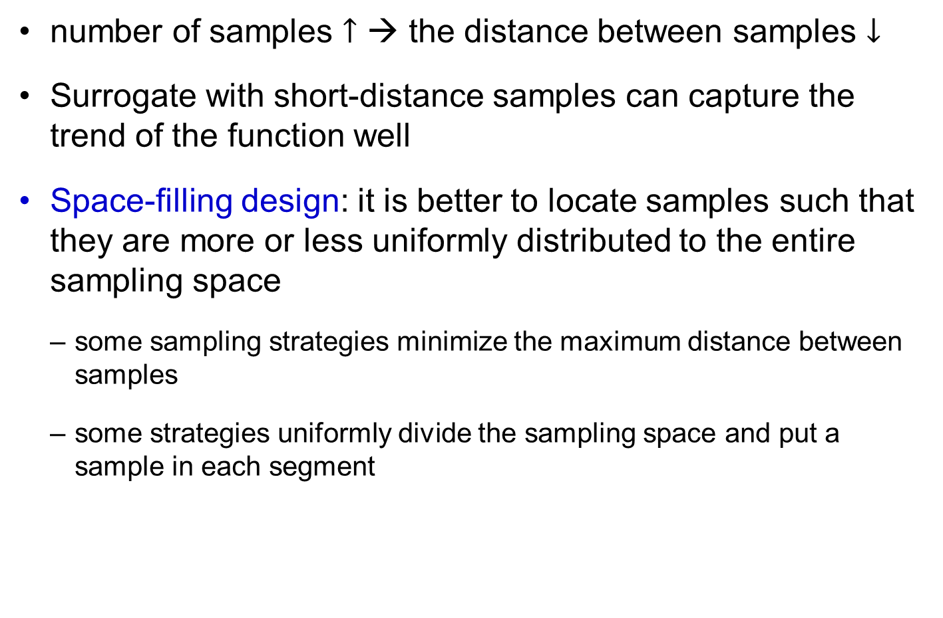
Space-filling Design
number of samples $↑$ → the distance between samples $↓$
Surrogate with short-distance samples can capture the trend of the function well
Space-filling design: it is better to locate samples such that they are more or less uniformly distributed to the entire sampling space
some sampling strategies minimize the maximum distance between samples
some strategies uniformly divide the sampling space and put a sample in each segment

Slide 12
3.2 Design of Experiments in Boxlike Domain
Standard sampling methods for polynomial response surfaces

Slide 13

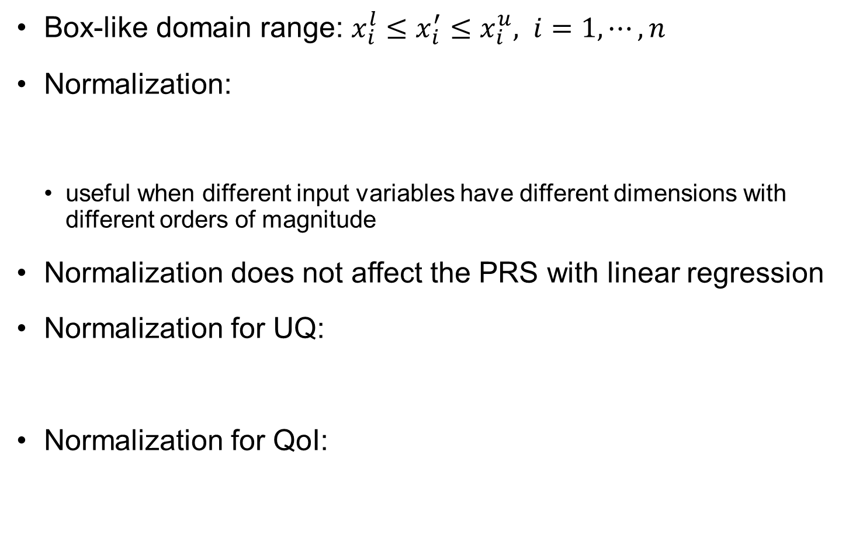
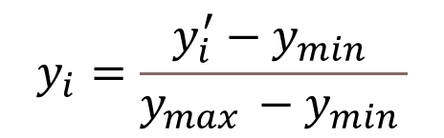
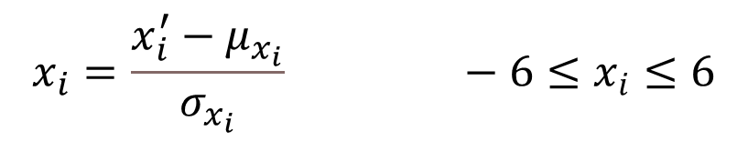

DoE in Box-like Domains
Box-like domain range: $x_{i}^{l}≤x_{i}^{′}≤x_{i}^{u}, i=1,⋯,n$
Normalization:
useful when different input variables have different dimensions with different orders of magnitude
Normalization does not affect the PRS with linear regression
Normalization for UQ:
Normalization for QoI:
$$x_{i}=\frac{2x_{i}^{′}−x_{i}^{l}−x_{i}^{u}}{x_{i}^{u}−x_{i}^{l}}$$
$$−1≤x_{i}≤1$$
$$x_{i}=\frac{x_{i}^{′}−μ_{x_{i}}}{σ_{x_{i}}} −6≤x_{i}≤6$$
$$y_{i}=\frac{y_{i}^{′}−y_{min }}{y_{max }−y_{min }}$$

Slide 14

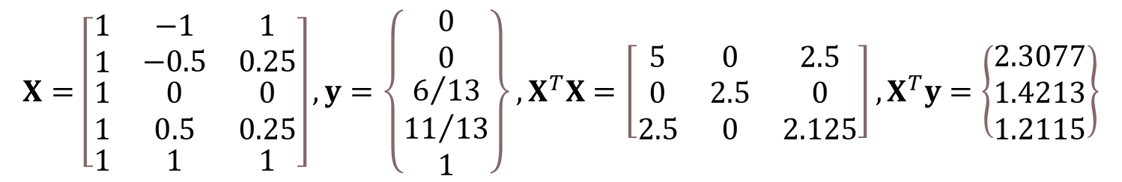
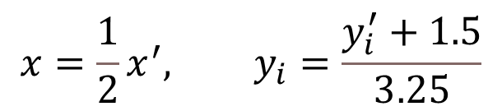
Ex3-1) Regression with Normalized Variables
Quadratic PRS in Ex2-5 with 5 samples (before normalized)
Normalization: $x^{l}=−2, x^{u}=2, y_{min}=−1.5, y_{max}=1.75$
Scaled samples: $\left(−1,0\right), \left(−0.5, 0\right), \left(0, 6/13\right), (0.5, 11/13), (1, 1)$
Linear regression
$${\hat{y}}^{′}\left(x′\right)=−0.1071+0.925x^{′}+0.0536x^{′2}$$
$$x=\frac{1}{2}x^{′}, y_{i}=\frac{y_{i}^{′}+1.5}{3.25}$$
$$X=\left[\begin{matrix}\begin{matrix}1 \\ 1\end{matrix} & \begin{matrix}−1 \\ −0.5\end{matrix} & \begin{matrix}1 \\ 0.25\end{matrix} \\ \begin{matrix}1 \\ 1\end{matrix} & \begin{matrix}0 \\ 0.5\end{matrix} & \begin{matrix}0 \\ 0.25\end{matrix} \\ 1 & 1 & 1\end{matrix}\right], y=\left\{\begin{matrix}\begin{matrix}0 \\ 0\end{matrix} \\ \begin{matrix}6/{13} \\ {11}/{13}\end{matrix} \\ 1\end{matrix}\right\}, X^{T}X=\left[\begin{matrix}5 & 0 & 2.5 \\ 0 & 2.5 & 0 \\ 2.5 & 0 & 2.125\end{matrix}\right], X^{T}y=\left\{\begin{matrix}2.3077 \\ 1.4213 \\ 1.2115\end{matrix}\right\}$$

Slide 15
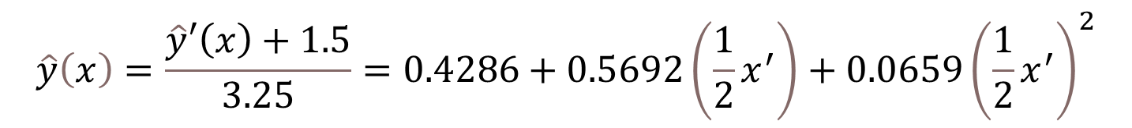
Ex3-1) Regression with Normalized Variables cont.
Quadratic approximation
Un-normalization
Normalization should not affect the PRS with linear regression because of the linear relationship between the original and normalized variables
$$\hat{y}\left(x\right)=0.4286+0.5692x+0.0659x^{2}$$
$$\hat{y}\left(x\right)=\frac{\hat{y}′\left(x\right)+1.5}{3.25}=0.4286+0.5692\left(\frac{1}{2}x^{′}\right)+0.0659{\left(\frac{1}{2}x^{′}\right)}^{2}$$
$${\hat{y}}^{′}\left(x′\right)=−0.1071+0.925x′+0.0536{x′}^{2}$$

Slide 16
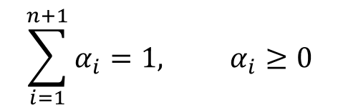

Interpolation vs. Extrapolation
a surrogate will interpolate the function at a point if that point is ‘completely surrounded’ by sample points
Interpolation: within the convex hull of data points
n-dimension simplex (n+1 vertices)
Convex hull: union of all simplices
1D
2D
Data points
Interpolation
extrapolation
$$x=\sum_{i=1}^{n+1}{α_{i}x_{i}}$$
$$\sum_{i=1}^{n+1}{α_{i}}=1, α_{i}≥0$$

Slide 17

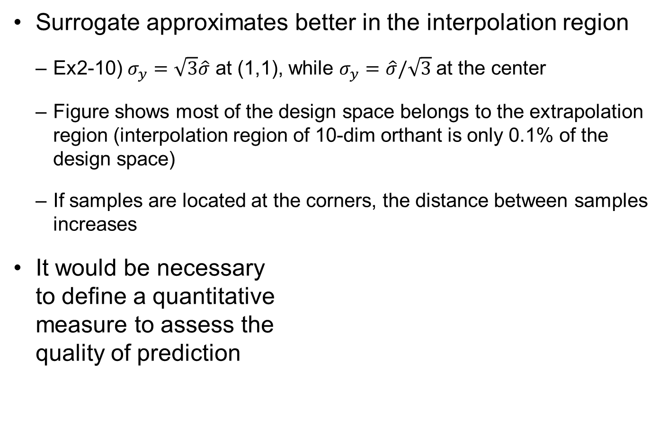



Interpolation vs. Extrapolation cont.
Surrogate approximates better in the interpolation region
Ex2-10) $σ_{y}=\sqrt{3}\hat{σ}$ at (1,1), while $σ_{y}=\hat{σ}/\sqrt{3}$ at the center
Figure shows most of the design space belongs to the extrapolation region (interpolation region of 10-dim orthant is only 0.1% of the design space)
If samples are located at the corners, the distance between samples increases
It would be necessary to define a quantitative measure to assess the quality of prediction
$$x_{2}$$
Samples
Extrapolation region
Interpolation region
$$x_{3}$$
$$x_{2}$$
$$x_{1}$$
$$x_{1}$$

Slide 18
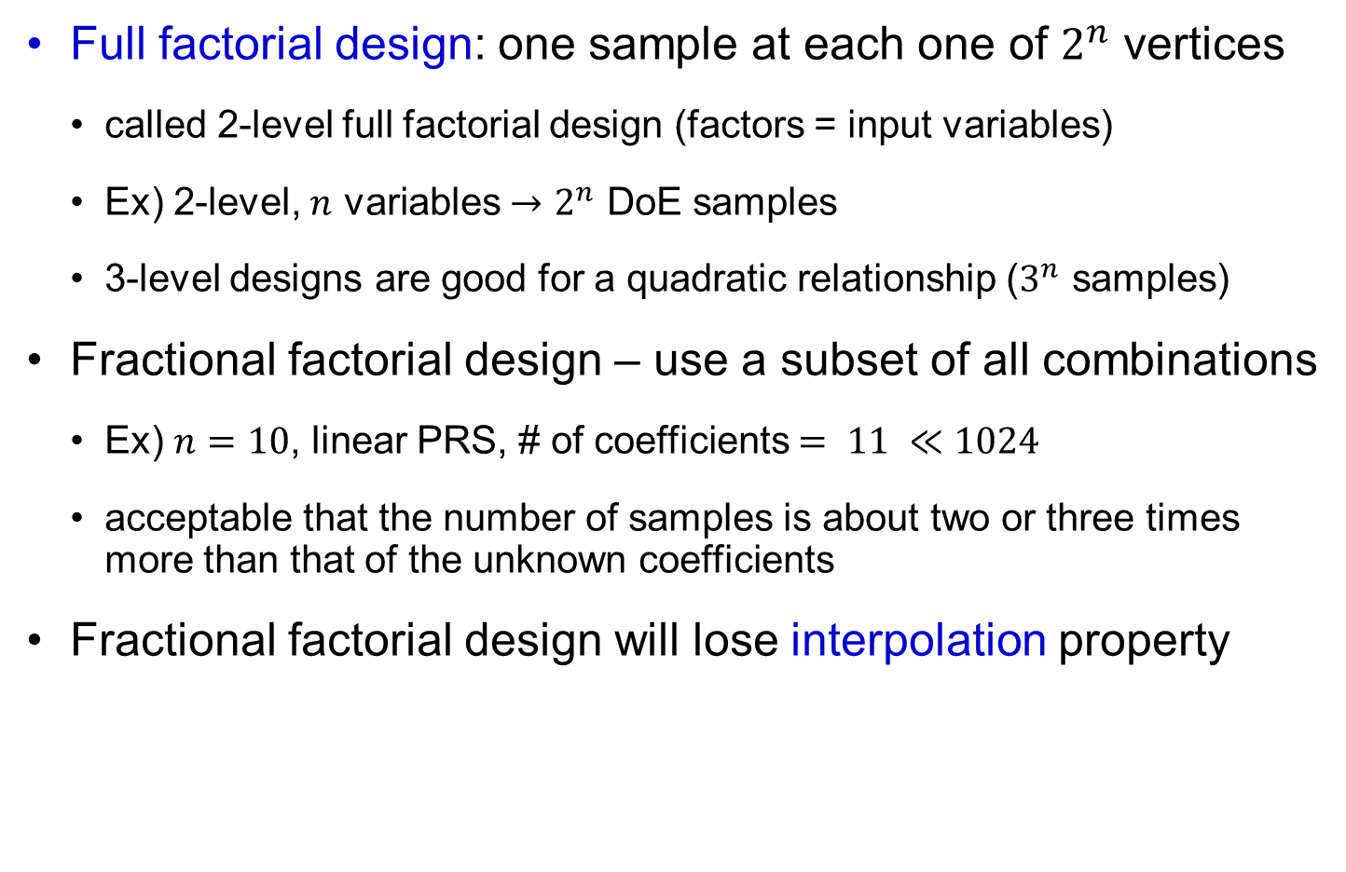
Full Factorial Design for Linear Relationship
Full factorial design: one sample at each one of $2^{n}$ vertices
called 2-level full factorial design (factors = input variables)
Ex) 2-level, $n$ variables $→2^{n}$ DoE samples
3-level designs are good for a quadratic relationship ($3^{n}$ samples)
Fractional factorial design – use a subset of all combinations
Ex) $n=10$, linear PRS, # of coefficients $= 11 ≪1024$
acceptable that the number of samples is about two or three times more than that of the unknown coefficients
Fractional factorial design will lose interpolation property

Slide 19
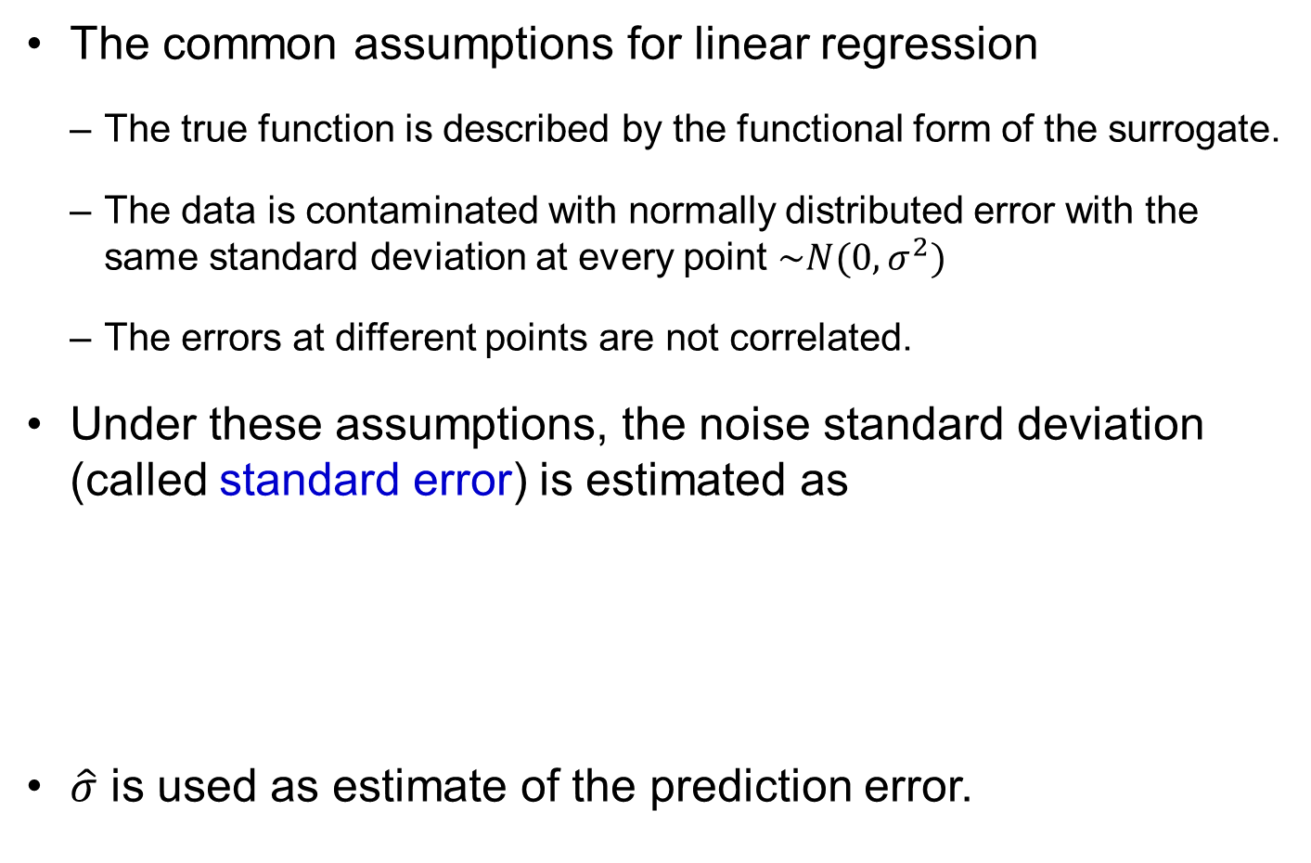

Model based error for linear regression
The common assumptions for linear regression
The true function is described by the functional form of the surrogate.
The data is contaminated with normally distributed error with the same standard deviation at every point $\sim N(0,σ^{2})$
The errors at different points are not correlated.
Under these assumptions, the noise standard deviation (called standard error) is estimated as
$\hat{σ}$ is used as estimate of the prediction error.
$$\hat{σ}=\sqrt{\frac{e^{T}e}{n_{y}−n_{β}}}$$
Notes:
In linear regression we commonly assume that the form that we select for the surrogate is the true form of the function. When we compare the prediction of the surrogate to future simulations we will have two sources of error, the noise in the simulation and the inaccuracy in the coefficients of the shape functions that is caused by the noise in the data.
The noise is assumed to be Gaussian (normally distributed) with a zero mean and the same standard deviation at all points. Furthermore, the noise at different points in uncorrelated. Under these assumptions, we can show that the estimate of the square of the standard deviation of the noise is ${\hat{σ}}^{2}=\frac{e^{T}e}{n_{y}−n_{b}}$. This standard deviation called the standard error and it is a good measure of the overall accuracy of the surrogate even when the assumptions do not hold.

Slide 20

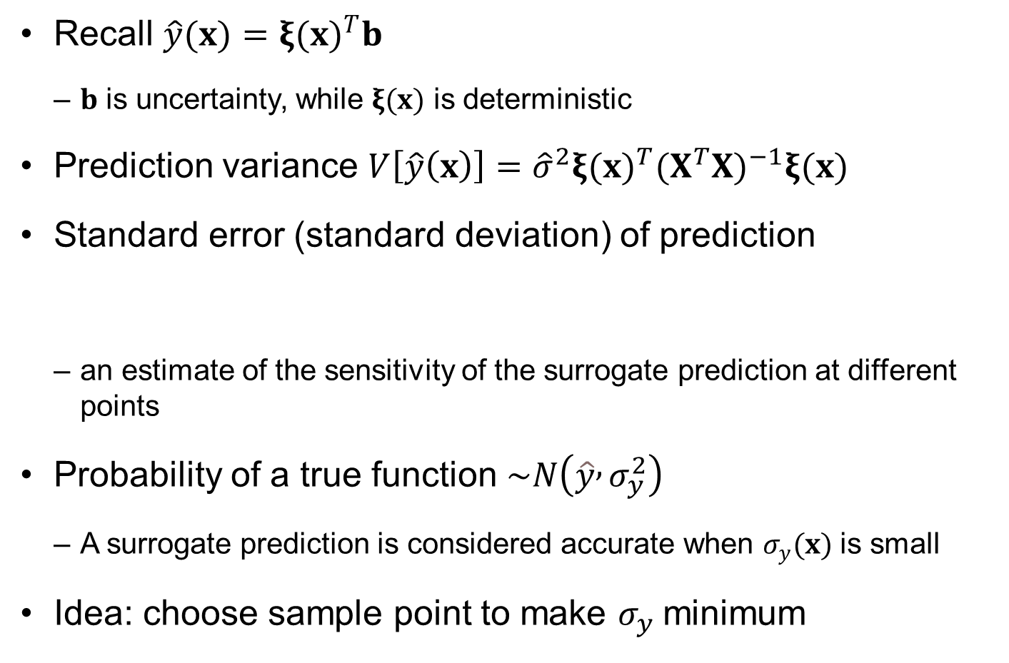
Prediction Variance
Recall $\hat{y}(x)={ξ(x)}^{T}b$
$b$ is uncertainty, while $ξ(x)$ is deterministic
Prediction variance $V\left[\hat{y}\left(x\right)\right]={\hat{σ}}^{2}{ξ(x)}^{T}{(X^{T}X)}^{−1}ξ(x)$
Standard error (standard deviation) of prediction
an estimate of the sensitivity of the surrogate prediction at different points
Probability of a true function $\sim N\left(\hat{y} , σ_{y}^{2}\right)$
A surrogate prediction is considered accurate when $σ_{y}(x)$ is small
Idea: choose sample point to make $σ_{y}$minimum
$$σ_{y}\left(x\right)=\hat{σ}\sqrt{{ξ\left(x\right)}^{T}{\left(X^{T}X\right)}^{−1}ξ\left(x\right)}$$

Slide 21
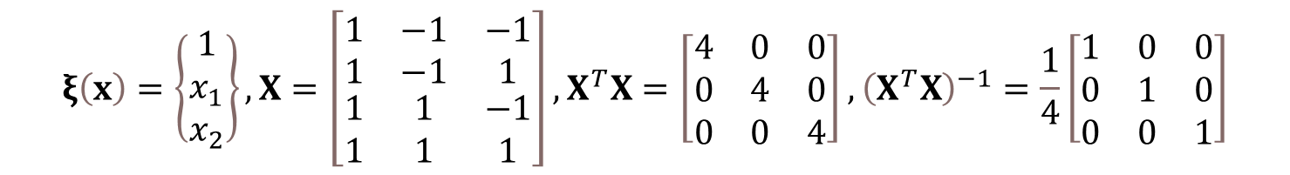


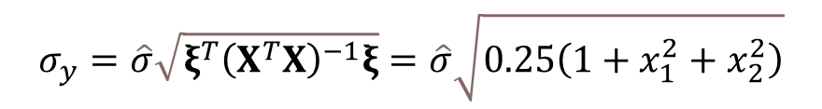
Ex3-2) Full factorial design
$\hat{y}\left(x_{1},x_{2}\right)=b_{1}+b_{2}x_{1}+b_{3}x_{2}$, $−1≤x_{1},x_{2}≤1$
Data: $\left(−1,−1,y_{1}\right), \left(−1,1,y_{2}\right), \left(1,−1,y_{3}\right), (1,1,y_{4})$
Minimum at $(0,0)$, $σ_{y,min}=\frac{\hat{σ}}{2}$
Maximum at $(±1,±1)$, $σ_{y,max}=\frac{\sqrt{3}\hat{σ}}{2}$
$$ξ\left(x\right)=\left\{\begin{matrix}1 \\ x_{1} \\ x_{2}\end{matrix}\right\}, X=\left[\begin{matrix}1 & −1 & −1 \\ 1 & −1 & 1 \\ \begin{matrix}1 \\ 1\end{matrix} & \begin{matrix}1 \\ 1\end{matrix} & \begin{matrix}−1 \\ 1\end{matrix}\end{matrix}\right], X^{T}X=\left[\begin{matrix}4 & 0 & 0 \\ 0 & 4 & 0 \\ 0 & 0 & 4\end{matrix}\right], {\left(X^{T}X\right)}^{−1}=\frac{1}{4}\left[\begin{matrix}1 & 0 & 0 \\ 0 & 1 & 0 \\ 0 & 0 & 1\end{matrix}\right]$$
$$σ_{y}=\hat{σ}\sqrt{ξ^{T}{\left(X^{T}X\right)}^{−1}ξ}=\hat{σ}\sqrt{0.25\left(1+x_{1}^{2}+x_{2}^{2}\right)}$$
$$\frac{σ_{y,max}}{σ_{y,min}}=\frac{\frac{\sqrt{3}\hat{σ}}{2}}{\frac{\hat{σ}}{2}}=\sqrt{3}$$

Slide 22
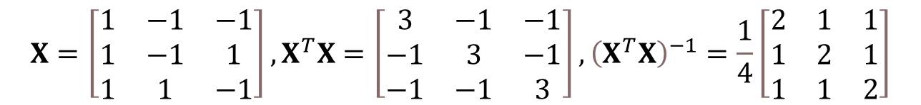



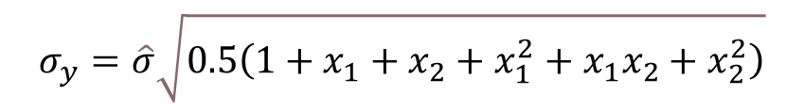
Ex3-2) Fractional factorial design
$\hat{y}\left(x_{1},x_{2}\right)=b_{1}+b_{2}x_{1}+b_{3}x_{2}$, $−1≤x_{1},x_{2}≤1$
Data: $\left(−1,−1,y_{1}\right), \left(−1,1,y_{2}\right), \left(1,−1,y_{3}\right)$
At $(0,0)$: $σ_{y}=\frac{\hat{σ}}{\sqrt{2}}$, $\left(−1,−1\right), (−1,1), (1,−1)$: $σ_{y}=\hat{σ}$, $(1,1)$: $σ_{y}=\sqrt{3}\hat{σ}$
Minimum at $(−\frac{1}{3},−\frac{1}{3})$: $σ_{y,min}=\frac{\hat{σ}}{3}$
$$X=\left[\begin{matrix}1 & −1 & −1 \\ 1 & −1 & 1 \\ 1 & 1 & −1\end{matrix}\right], X^{T}X=\left[\begin{matrix}3 & −1 & −1 \\ −1 & 3 & −1 \\ −1 & −1 & 3\end{matrix}\right], {\left(X^{T}X\right)}^{−1}=\frac{1}{4}\left[\begin{matrix}2 & 1 & 1 \\ 1 & 2 & 1 \\ 1 & 1 & 2\end{matrix}\right]$$
$$σ_{y}=\hat{σ}\sqrt{0.5\left(1+x_{1}+x_{2}+x_{1}^{2}+x_{1}x_{2}+x_{2}^{2}\right)}$$
$$\frac{∂σ_{y}}{∂x_{1}}=\frac{∂σ_{y}}{∂x_{2}}=0$$
$$\frac{σ_{y,max}}{σ_{y,min}}=\frac{\sqrt{3}\hat{σ}}{\frac{\hat{σ}}{3}}=3\sqrt{3}$$

Slide 23


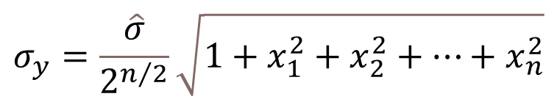
Prediction variance for full factorial design
Recall that prediction standard error
For full factorial design, the domain is normally a box.
Cheapest full factorial design: two levels (not good for quadratic polynomials).
For a linear polynomial standard error is then
Maximum error at vertices
What does the ratio in the square root represent?
$$σ_{y}=\hat{σ}\sqrt{ξ^{T}{\left(X^{T}X\right)}^{−1}ξ}$$
$$σ_{y}=\frac{\hat{σ}}{2^{n/2}}\sqrt{1+x_{1}^{2}+x_{2}^{2}+⋯+x_{n}^{2}}$$
$$σ_{y,max}=\hat{σ}\sqrt{\frac{n+1}{2^{n}}}$$
Notes:
We consider first the unit box where all the variables are in [-1,1]. For a linear polynomial we can make do with two levels for each variable, that is include only the vertices. For example in two dimension the surrogate is $\hat{y}=b_{1}+b_{2}x_{1}+b_{3}x_{2}$. Then the vector of shape functions $x^{\left(m\right)}={\left[\begin{matrix}1 & x_{1} & x_{2}\end{matrix}\right]}^{T}$, and the matrix X which is the shape functions evaluated at the data points is
$$X=\left[\begin{matrix}1 & −1 & −1 \\ \begin{matrix}1 \\ 1\end{matrix} & \begin{matrix}−1 \\ 1\end{matrix} & \begin{matrix}1 \\ −1\end{matrix} \\ 1 & 1 & 1\end{matrix}\right]{ X}^{T}X=\left[\begin{matrix}4 & 0 & 0 \\ 0 & 4 & 0 \\ 0 & 0 & 4\end{matrix}\right]$$
Then we get that $s_{y}=0.5\hat{σ}\sqrt{1+x_{1}^{2}+x_{2}^{2}}$ . For the a linear polynomial in n dimensions we similarly get $s_{y}=\frac{\overset{}{\hat{σ}}}{2^{n/2}}\sqrt{1+x_{1}^{2}+x_{2}^{2}+....+x_{n}^{2}}$ . The minimum error at the origin is substantially smaller than the noise. However, even the maximum error (at the vertices) $s_{y}=\hat{σ}\sqrt{\frac{n+1}{2^{n}}}$, is much smaller than the noise. Notice that the noise there is reduced by the square root of the ratio between the number of coefficients in the polynomial and the number of data points. This ratio is in general a good estimate to the effect of having a surplus of data over coefficients for filtering out noise. If the noise is the only source of error (that is the true function is a linear polynomial) then the fit will be more accurate than the data.

Slide 24
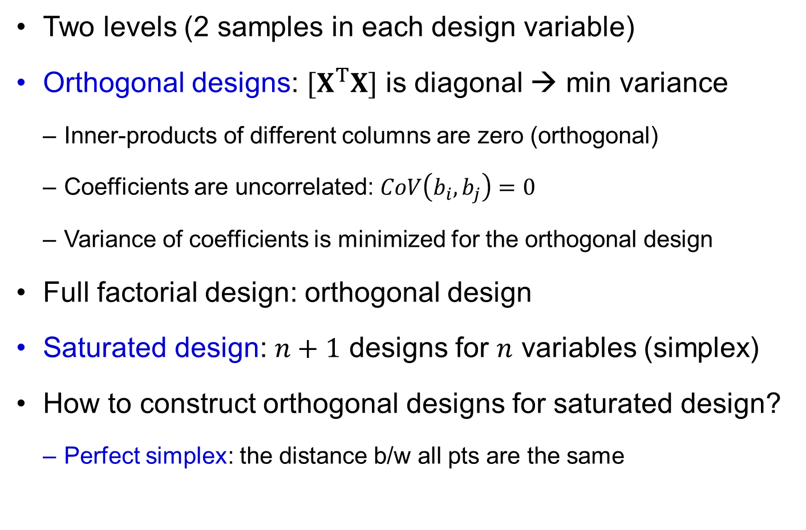
DoE for Linear PRS
Two levels (2 samples in each design variable)
Orthogonal designs: $[X^{T}X]$ is diagonal → min variance
Inner-products of different columns are zero (orthogonal)
Coefficients are uncorrelated: $CoV\left(b_{i},b_{j}\right)=0$
Variance of coefficients is minimized for the orthogonal design
Full factorial design: orthogonal design
Saturated design: $n+1$ designs for $n$ variables (simplex)
How to construct orthogonal designs for saturated design?
Perfect simplex: the distance b/w all pts are the same

Slide 25
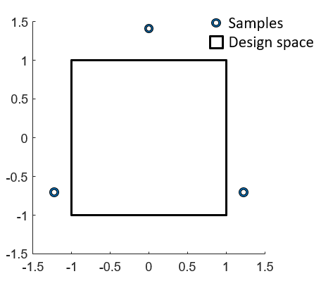


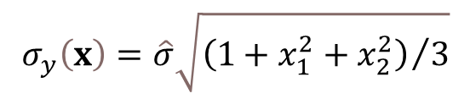
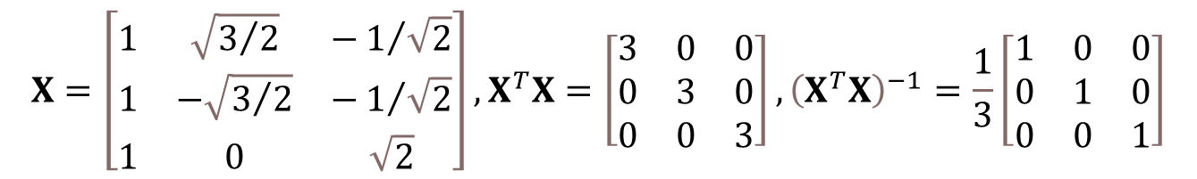
Ex3-3) Orthogonal Design with a Simplex
3 points linear PRS $\hat{y}=b_{1}+b_{2}x_{1}+b_{3}x_{2}$
Select
Standard error of prediction
At (0,0), $σ_{y}=\hat{σ}/\sqrt{3}$
At $(±1,±1)$, $σ_{y}=\hat{σ}$
But will increase “bias error” (modeling error) and samples are outside of domain
$$X=\left[\begin{matrix}1 & \sqrt{3/2} & −1/{\sqrt{2}} \\ 1 & −\sqrt{3/2} & −1/{\sqrt{2}} \\ 1 & 0 & \sqrt{2}\end{matrix}\right], X^{T}X=\left[\begin{matrix}3 & 0 & 0 \\ 0 & 3 & 0 \\ 0 & 0 & 3\end{matrix}\right], {\left(X^{T}X\right)}^{−1}=\frac{1}{3}\left[\begin{matrix}1 & 0 & 0 \\ 0 & 1 & 0 \\ 0 & 0 & 1\end{matrix}\right]$$
$$σ_{y}\left(x\right)=\hat{σ}\sqrt{{\left(1+x_{1}^{2}+x_{2}^{2}\right)}/3}$$
$$\frac{σ_{y,max}}{σ_{y,min}}=\sqrt{3}$$
Improved!

Slide 26
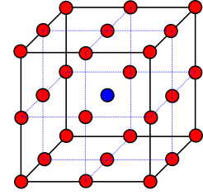
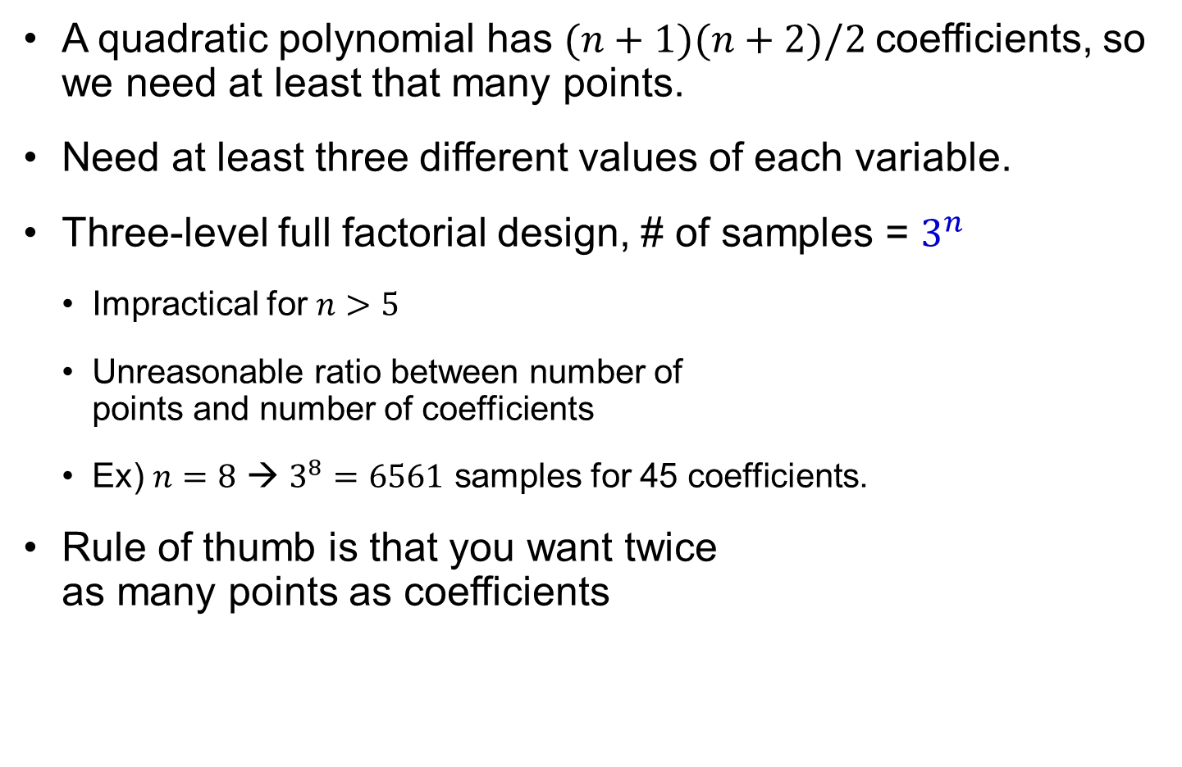
DoE for Quadratic PRS
A quadratic polynomial has $(n+1)(n+2)/2$coefficients, so we need at least that many points.
Need at least three different values of each variable.
Three-level full factorial design, # of samples = $3^{n}$
Impractical for $n>5$
Unreasonable ratio between number of points and number of coefficients
Ex) $n=8$ → $3^{8}=6561$ samples for 45 coefficients.
Rule of thumb is that you want twice as many points as coefficients
Notes:
A quadratic polynomial in n variables has (n+1)(n+2)/2 coefficients, so you need at least that many data points. You also need three different values of each variable. We can achieve both requirements with a full factorial design with three levels. However for n>5 this will normally give more points than we can afford to evaluate. In addition, for n>3 we will get unreasonable ratio between the number of points and number of coefficients. This ratio is normally around 2. For n=4 we have 15 coefficients and 81 points, and for n=8 we have 45 coefficients and 6561 points.

Slide 27
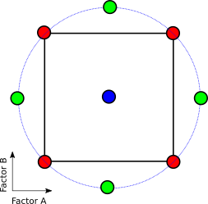
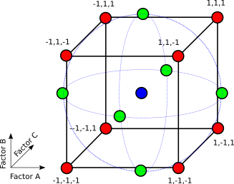
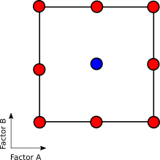

Central Composite Design
Includes $2^{n}$ vertices, $2n$ face points plus $nc$ repetitions of central point
# of samples = $2^{n}+2n+n_{c}$
Can choose $α=2^{n/4}$
achieve spherical design, achieve rotatability (prediction variance is spherical)
Stay in box (face centered) FCCCD, $α=1$
Still impractical for $n>8$
Notes:
The central composite design takes the two-level full-factorial design and adds to it the minimum number of points needed to provide three levels for each variable, so that a quadratic polynomial can be fitted. This is done by adding points along the axes, in both the positive and negative directions, at a distance $α$ from the origin. The figure showing the central composite design for n=3 is taken from Myers and Montgomery’s Response Surface Methodology, Figure 7.5 in 1995 edition. The value of $α$ can be chosen to achieve a spherical design, where all the points are at the same distance from the origin ($α$=$\sqrt{3}$), or to achieve “rotatibility” which is when the prediction variance is a spherical function. Myers and Montgomery show that this requires that $α=\sqrt[4]{V}$where V is the number of vertices. So for n=3, $α=\sqrt[4]{8}=1.682$. Of course, if the sample points must stay in the box, we have to chose $α$=1. This design is called face-centered, central composite design (FCCCD).
Central composite design is popular for 3$≤$n$≤$6, when it gives reasonable ratios between the number of points and the number of coefficients of a quadratic polynomial. For n=7, we already require at least 143 data points (without repetitions at the center) for 36 coefficients, and for n=9, 531 points for 55 coefficients.

Slide 28
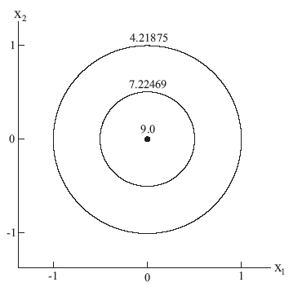
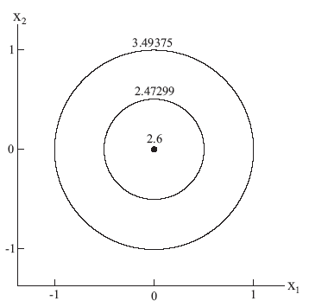
Repeated observations at origin
Unlike linear PRS, prediction variance is high at origin.
Repetition at origin decreases variance and improves stability (uniformity).
Repetition also gives an independent measure of magnitude of noise.
Contours of prediction variance for spherical CCD design (no repetition)
With five repetitions, the max prediction variance is significantly reduced and greatly improve the uniformity.
Notes:
Central Composite Designs without repetition at the origin have high prediction variance there. This is in contrast to the linear designs that we discussed earlier in the lecture where the prediction variance was the lowest at the origin. Repetition at the origin decreases variance there, and so it improves stability. There is also another obvious reason for choosing the origin for repetition rather than any other point. What is it? Repetition also gives an independent measure of the magnitude of the noise, and if that noise is substantially smaller than the value of $\overset{}{\hat{σ}}$, it indicates that there lack-of-fit, that is, the function we chose for the regression is different in form from the true function.
Repeated observations make sense in the case of noisy measurements. Numerical simulations can also be noisy due to discretization error as remeshing occurs. However, repeating a simulation will usually give the same results, not showing the numerical noise. In that case, it is advisable to repeat them at a small distance from the origin, such as 0.01 if the box is normalized to the range [-1,1].

Slide 29


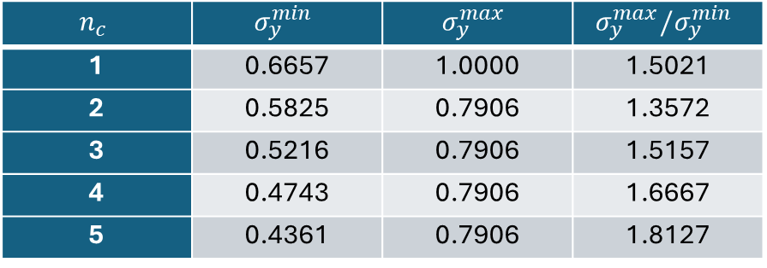
Ex3-5) Effect of Repeating Central Samples
2D CCD: 4 corners + 4 axial points + $n_{c}$ repetition of center
$\left(−1,−1\right), \left(1,−1\right), \left(1, 1\right), \left(−1,1\right),\left(−\sqrt{2},0\right), \left(\sqrt{2},0\right), \left(0,−\sqrt{2}\right), \left(0,\sqrt{2}\right),$ $n_{c}×(0,0)$
Plot $σ_{y}(x_{1},x_{2})$ at $21×21$ grid points
$$X^{T}X=\left[\begin{matrix}\begin{matrix}8+n_{c} & 0 \\ 0 & 8\end{matrix} & \begin{matrix}0 & 8 \\ 0 & 0\end{matrix} & \begin{matrix}0 & 0 \\ 0 & 0\end{matrix} \\ \begin{matrix}0 & 0 \\ 8 & 0\end{matrix} & \begin{matrix}8 & 0 \\ 0 & 12\end{matrix} & \begin{matrix}0 & 0 \\ 0 & 4\end{matrix} \\ \begin{matrix}0 & 0 \\ 8 & 0\end{matrix} & \begin{matrix}0 & 0 \\ 0 & 4\end{matrix} & \begin{matrix}4 & 0 \\ 0 & 12\end{matrix}\end{matrix}\right]$$
$$n_{c}$$ | $$σ_{y}^{min}$$ | $$σ_{y}^{max}$$ | $$σ_{y}^{max}/σ_{y}^{min}$$
1 | 0.6657 | 1.0000 | 1.5021
2 | 0.5825 | 0.7906 | 1.3572
3 | 0.5216 | 0.7906 | 1.5157
4 | 0.4743 | 0.7906 | 1.6667
5 | 0.4361 | 0.7906 | 1.8127

Slide 30


Ex3-5) Effect of Repeating Central Samples cont.
(a) $n_{c}=1$
(b) $n_{c}=5$

Slide 31

Face-Center Central Composite (FCCCD) Design
No need to repeat centers
All samples are within the design space
2D FCCCD = 3-level full factorial design
$σ_{y}\left(0,0\right)=0.7454$
$σ_{y}\left(±1,±1\right)=0.8975$ (maximum)
$σ_{y}\left(±\sqrt{0.4},±\sqrt{0.4}\right)=0.5980$ (minimum)
$σ_{y}^{max}/σ_{y}^{min}=1.50$
Better than CCD with $n_{c}=1$
1
3
1
0
.
1
1
7
8
2
7
1
6
9
7
8
2
.
3
0
6
9
.
7
0
0
.
.
0
6
6
4
5
3
0
0
.
6
6
4
5
.
3
7
3
1
0
1
4
.
2
6
1
3
3
1
0
2
.
0
6
3
4
6
0.5
.
.
4
5
9
0
6
0
6
6
0
7
.
.
.
3
0
6
6
1
2
3
8
6
9
7
8
1
6
2
0
.
2
4
2
4
4
5
0
3
.
3
0
6
5
0
.
1
6
.
6
1
4
4
7
9
3
5
6
3
7
7
3
6
0
1
8
.
.
0
1
2
0
0
.
7
3
1
2
1
8
0
7
.
9
6
6
6
.
4
0
5
3
4
2
-0.5
0
2
8
.
5
3
1
7
6
6
6
4
3
.
0
3
0
6
9
.
1
.
6
6
2
0
.
6
0
4
0
0
4
.
.
6
6
3
0
5
3
1
1
.
3
2
4
5
3
2
3
7
4
6
6
4
5
.
0
0
4
3
.
6
1
1
6
6
1
9
.
1
7
0
.
0
3
8
6
9
7
8
2
7
2
.
.
1
0
-1
0
7
3
1
-1
-0.5
0
0.5
1

Slide 32

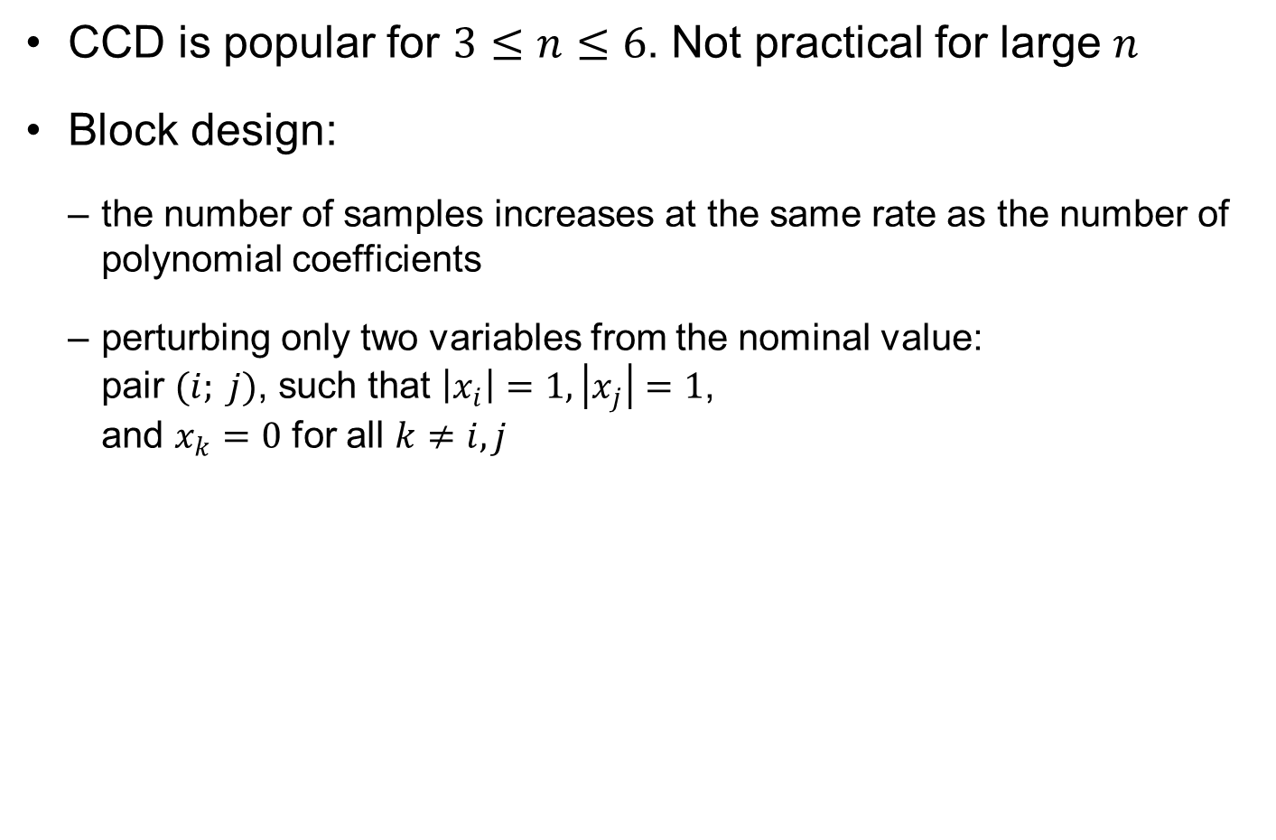



Block Design
CCD is popular for $3≤n≤6$. Not practical for large $n$
Block design:
the number of samples increases at the same rate as the number of polynomial coefficients
perturbing only two variables from the nominal value: pair $(i; j)$, such that $\left|x_{i}\right|=1, \left|x_{j}\right|=1$, and $x_{k}=0$ for all $k≠i,j$
$$\begin{matrix}\begin{matrix}x_{1} \\ −1 \\ −1\end{matrix} & \begin{matrix}x_{2} \\ −1 \\ 1\end{matrix} & \begin{matrix}x_{3} \\ 0 \\ 0\end{matrix} \\ \begin{matrix}1 \\ 1 \\ −1\end{matrix} & \begin{matrix}−1 \\ 1 \\ 0\end{matrix} & \begin{matrix}0 \\ 0 \\ −1\end{matrix} \\ \begin{matrix}−1 \\ \begin{matrix}1 \\ 1 \\ 0\end{matrix} \\ \begin{matrix}0 \\ 0 \\ \begin{matrix}0 \\ 0\end{matrix}\end{matrix}\end{matrix} & \begin{matrix}0 \\ \begin{matrix}0 \\ 0 \\ −1\end{matrix} \\ \begin{matrix}−1 \\ 1 \\ \begin{matrix}1 \\ 0\end{matrix}\end{matrix}\end{matrix} & \begin{matrix}1 \\ \begin{matrix}−1 \\ 1 \\ −1\end{matrix} \\ \begin{matrix}1 \\ −1 \\ \begin{matrix}1 \\ 0\end{matrix}\end{matrix}\end{matrix}\end{matrix}$$
$$x_{2}$$
$$x_{1}$$
$$x_{3}$$

Slide 33
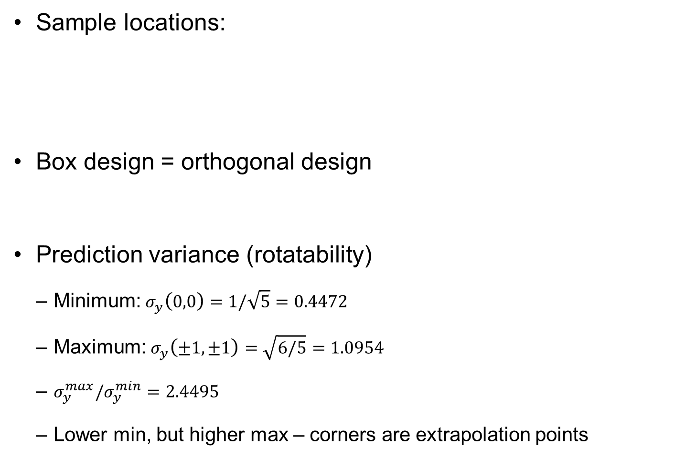
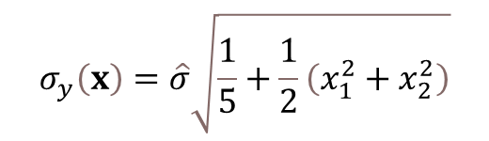
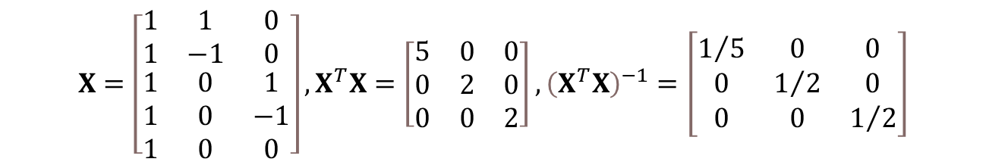
Ex3-6) 2D Block Design
Sample locations:
Box design = orthogonal design
Prediction variance (rotatability)
Minimum: $σ_{y}\left(0,0\right)=1/\sqrt{5}=0.4472$
Maximum: $σ_{y}\left(±1,±1\right)=\sqrt{6/5}=1.0954$
$σ_{y}^{max}/σ_{y}^{min}=2.4495$
Lower min, but higher max – corners are extrapolation points
$$x_{1}=\left(−1,0\right), x_{2}=\left(1,0\right), x_{3}=\left(0,−1\right), x_{4}=\left(0,1\right), x_{5}=\left(0,0\right)$$
$$X=\left[\begin{matrix}1 & 1 & 0 \\ 1 & −1 & 0 \\ \begin{matrix}1 \\ 1 \\ 1\end{matrix} & \begin{matrix}0 \\ 0 \\ 0\end{matrix} & \begin{matrix}1 \\ −1 \\ 0\end{matrix}\end{matrix}\right], X^{T}X=\left[\begin{matrix}5 & 0 & 0 \\ 0 & 2 & 0 \\ 0 & 0 & 2\end{matrix}\right], {\left(X^{T}X\right)}^{−1}=\left[\begin{matrix}1/5 & 0 & 0 \\ 0 & 1/2 & 0 \\ 0 & 0 & 1/2\end{matrix}\right]$$
$$σ_{y}\left(x\right)=\hat{σ}\sqrt{\frac{1}{5}+\frac{1}{2}\left(x_{1}^{2}+x_{2}^{2}\right)}$$

Slide 34

Matlab Functions for DoE
ff2n(n): two-level full factorial design of $n$ input variables
fullfact([l1…ln]): full factorial design with different levels
ccdesign(n,‘Name’,value): CCD with different options
‘center’, $n_{c}$: number of repetition
‘circumscribed’, ‘inscribed’, and ‘faced’
bbdesign(n, ‘Name’, value): Block design
0
(a) Circumscribed
(b) Inscribed
(c) Faced

Slide 35
3.3 Optimal Design of Experiments
Best sample locations depend on criteria

Slide 36

Optimal Design of Experiments
Standard DoEs are good for box-like design space
Feasible design – irregular design space due to constraints
Also, arbitrary # of samples in the box-like design space
Goal: select the best set of sample locations for the given design space and the number of samples
Optimal DoE: minimizing a criterion by changing locations
Model-dependent: optimum for the given PRS model
Challenge due to large # of variables: $n×n_{y}$ variables
Often combinatorial problems
Select the best $n_{y}$ points out of large candidates that minimize variance or modeling error

Slide 37




Variance-based Optimal Design
Noise in data → Uncertainty in $b$ → Prediction variance $σ_{y}$
Minimizing $σ_{y}$ directly or indirectly
$\hat{σ}$depends on samples (aleatory), $ξ(x)$ is deterministic basis
Therefore, most optimal designs are related to ${(X^{T}X)}^{−1}$
Variance-based optimal design
D-optimality: minimum coefficient variance by maximizing $\left|X^{T}X \right|$
A-optimality: minimum sum of individual variance $\sum_{i=1}^{n_{β}}{{\left(X^{T}X\right)}_{ii}^{−1}}$
G-optimality: minimum prediction variance
$$\hat{σ}$$
$$Σ_{b}={\hat{σ}}^{2}{\left[X^{T}X\right]}^{−1}$$
$$σ_{y}\left(x\right)=\hat{σ}\sqrt{{ξ\left(x\right)}^{T}{\left(X^{T}X\right)}^{−1}ξ\left(x\right)}$$

Slide 38

D-optimal Design
Since the model form is accurate, if there is no uncertainty in the regression coefficients, the prediction will be accurate
Good design makes $Σ_{b}$ small → make ${(X^{T}X)}^{−1}$ small → make $X^{T}X$ large → $maximize D=\left|X^{T}X \right|$
Recall $Σ_{b}={\hat{σ}}^{2}{\left(X^{T}X\right)}^{−1}={\hat{σ}}^{2}\frac{1}{\left|X^{T}X\right|}adj\left(X^{T}X\right)$ $Σ_{b}\sim \frac{1}{\left|X^{T}X\right|}$
Moment matrix $M=\frac{1}{n_{y}}X^{T}X$, $\left|M\right|=\frac{1}{{\left(n_{y}\right)}^{n_{β}}}\left|X^{T}X\right|$
Maximize $\left|M\right|$ → combinatorial optimization problem
Finding D-optimal design in higher dimensions is a difficult optimization problem often solved heuristically

Slide 39

Algorithm for D-optimal Design
Model-dependent → need to determine model form first
generate a set of possible candidate points
select the subset that maximizes $\left|X^{T}X \right|$
begins with a randomly selected set of points
Points in and out of the current design are exchanged until no exchange can be found that increases $\left|X^{T}X \right|$
No guarantee the global D-optimal → repetition may help
Difficult combinatorial problem
10 D-optimal points out of 50 sample locations: ${}_{10}^{ }{C_{50}}≈{10}^{10}$ possible combinations

Slide 40


Ex3-7) D-optimal Design
For $\hat{y}=b_{1}x_{1}+b_{2}x_{2}$ with 2 data points (0,0) and (1,0), find the optimum third data point $(p,q)$ in the unit square.
We have
arg max $\left|X^{T}X\right|$ → $q=1$
So that the third point is $(p,1)$, for any value of $p$
D-optimal design permits any number of points
Leads to asymmetrical designs
Time consuming and not converge well for large $n_{y}$
$$X=\left[\begin{matrix}0 & 0 \\ 1 & 0 \\ p & q\end{matrix}\right], X^{T}X=\left[\begin{matrix}1+p^{2} & pq \\ pq & q^{2}\end{matrix}\right], \left|X^{T}X\right|=q^{2}$$

Slide 41

Matlab Functions for D-optimal Design
Available functional forms: ‘linear’, ‘interaction’, ‘quadratic’, ‘purequadratic’
rlist = candexch(C,nrows): uses a row-exchange algorithm to select nrows number of D-optimal designs from the candidate set matrix C
[dRE,X] = rowexch(n,ny,model): uses a row-exchange algorithm to generate a D-optimal design with $n_{y}$ samples for a linear additive model with n design variables
[dCE,X] = cordexch(n,ny,'model’): starts with $n_{y}$ initial random sample locations and moves the locations to increase the determinant of the moment matrix

Slide 42
Ex3-8) Matlab D-optimal Design
Use cordexch to generate 6 and 12 samples for 2D quadratic PRS using D-optimal design
All samples are on the edge, except for the center
Some samples are overlapped
ny=6; %With 6 samples:
[dce,X]=cordexch(2,ny,'quadratic');
scatter(dce(:,1),dce(:,2),200,'filled')
D6=det(X'*X)
1
1
0.5
0.5
0
0
-0.5
-0.5
-1
-1
-0.5
0
0.5
1
-1
-1
-0.5
0
0.5
1
(a) Six samples
(b) Twelve samples

Slide 43


A-optimal Design
Also, focus on the variance of regression coefficients
tries to reduce the variance of individual coefficients
A-optimal design: find $(x_{1}, x_{2}, ⋯, x_{n_{y}})$, such that
more consistent with the screening objective than the D-optimal design
A-optimal designs tend to have better statistical properties than D-optimal designs
$$minimize \sum_{i=1}^{n_{β}}{{\left(X^{T}X\right)}_{ii}^{−1}}$$

Slide 44


Ex3-9) A-optimal Design
Repeat the previous example with A-optimality design
Minimize $\sum{\left|M_{ii}^{−1}\right|}$ at $p^{2}=0$ and $q^{2}=1$
→ $\left(p,q\right)=(0,1)$
$$M^{−1}=\frac{9}{q^{2}}\left[\begin{matrix}q^{2} & −pq \\ −pq & 1+p^{2}\end{matrix}\right], \sum_{i=1}^{2}{\left|M_{ii}^{−1}\right|}=9\left(1+\frac{1+p^{2}}{q^{2}}\right)$$

Slide 45


G-optimal Design
tries to reduce prediction variance directly
$\max{v\left(x\right)}≤n_{β}/n_{y}$ (Target goal)
For 2-level full-factorial design of linear PRS,
Two-level optimization problem
Inner-level: find $\max{v\left(x\right)}$ for given samples
Outer-level: find sample locations to minimize $\max{v\left(x\right)}$
Difficult to solve (non-smooth inner-level solution)
$$minimize \max{v\left(x\right)}={ξ\left(x\right)}^{T}{\left(X^{T}X\right)}^{−1}ξ\left(x\right)$$
$$σ_{y,max}^{2}={\hat{σ}}^{2}\frac{n+1}{2^{n}}={\hat{σ}}^{2}\frac{n_{β}}{n_{y}}$$
$$\min{f\left(x\right)}=−{ξ\left(x\right)}^{T}{\left(X^{T}X\right)}^{−1}ξ\left(x\right),such that −1≤x≤1$$
Avoid repeating points
$$\min{g\left(x^{\left(1\right)}, x^{\left(2\right)}, ⋯,x^{\left(n_{y}\right)}\right)}=max\left(−ξ^{T}{\left(X^{T}X\right)}^{−1}ξ\right), such that \left|X^{T}X\right|>0$$

Slide 46


Ex3-10) G-optimal Design
Repeat Ex3-7 with G-optimal design
Prediction variance
Heuristically determine $q=1$
At 4 corners: $v\left(0,0\right)=0$, $v\left(1,0\right)=1$, $v\left(0,1\right)=1+p^{2}$, $v\left(1,1\right)=2−2p+p^{2}$
$p≥0.5$: maximum at $(0,1)$, min of max occurs at $p=0.5$
$p≤0.5$, maximum at $(1,1)$, min of max occurs at $p=0.5$
G-optimal design: $\left(p,q\right)=(0.5,1)$ (middle of upper bound)
$$v\left(x\right)={ξ\left(x\right)}^{T}{\left(X^{T}X\right)}^{−1}ξ\left(x\right)={\left(x_{1}−2\frac{p}{q}x_{2}\right)}^{2}+\frac{1+p^{2}}{q^{2}}x_{2}^{2}$$
$$v\left(x\right)={\left(x_{1}−2px_{2}\right)}^{2}+\left(1+p^{2}\right)x_{2}^{2}$$

Slide 47






Ex3-10) Comparison of D-, A-, and G-optimal Designs
A-optimal design
D-optimal design
1
G-optimal design
$$σ_{y}^{max}=\sqrt{2}\hat{σ}$$
0.5
Pre-existing samples
0
0
0.5
1
(a) Sample locations
(b) $σ_{y}$ of D-optimal design
$$σ_{y}^{max}=\sqrt{2}\hat{σ}$$
$$σ_{y}^{max}=\sqrt{5}{\hat{σ}}/2$$
(c) $σ_{y}$ of A-optimal design
(b) $σ_{y}$ of G-optimal design

Slide 48

Ex3-10) Covariance of D-, A-, and G-optimal Designs
Covariance matrix of coefficients
A-optimal design shows smallest variance and uncorrelated coefficients
D-optimal design shows the largest variance
G-optimal design is good for max prediction variance, but it has a relatively large variance and correlation
Designs | D-optimal | A-optimal | G-optimal
Covariance matrix | $$Σ_{b}=\hat{σ}\left[\begin{matrix}1 & −1 \\ −1 & 2\end{matrix}\right]$$ | $$Σ_{b}=\hat{σ}\left[\begin{matrix}1 & 0 \\ 0 & 1\end{matrix}\right]$$ | $$Σ_{b}=\hat{σ}\left[\begin{matrix}1 & −0.5 \\ −0.5 & 1.25\end{matrix}\right]$$

Slide 49
Variance-based vs. Bias-based Optimal Design
Variance-based optimal design
Reducing uncertainty in coefficients or prediction
Reducing uncertainty does not always guarantee prediction accuracy
Model form error → inaccurate coefficients → error in prediction (bias error)
Variance and bias are competing objectives in DoE
Fitting surrogate close to samples reduces bias error but causes large variance
Smoothing surrogate model reduces variance but increases bias error
Necessary to balance the bias and variance errors by a trade-off

Slide 50





Minimum Bias Design
1st design moment 2nd design moment
Discrete moment
Min bias design: equivalence of the discrete moments with the continuous moments
Surrogate model: $\hat{y}\left(x\right)={{ξ(x)}^{\left(1\right)}}^{T}b^{(1)}$
True model: $y\left(x\right)={{ξ(x)}^{\left(1\right)}}^{T}b^{(1)}+{{ξ(x)}^{\left(2\right)}}^{T}b^{(2)}$
At samples: $y=X^{(1)}b^{(1)}+X^{(2)}b^{(2)}$
$$μ_{i}=\frac{1}{V}\int_{R}^{ }{x_{i} dR}, i=1,⋯, n$$
$$μ_{ij}=\frac{1}{V}\int_{R}^{ }{x_{i}x_{j} dR}, i,j=1,⋯, n$$
$$m_{i}=\frac{1}{n_{y}}\sum_{k=1}^{n_{y}}{x_{ik}}, i=1,⋯, n$$
$x_{ik}$: $i$th component of $k$th sample
linear
Bias error term
quadratic

Slide 51


Minimum Bias Design cont.
Continuous moment matrix
Average moment matrix
approximating the integral of basis functions by a sum over samples
choose sample locations such that the mean-squared-bias error of PRS is minimized (discrete moment = continuous moment)
$$μ=\left[\begin{matrix}μ_{11} & \left.\left. \right.\right| & μ_{12} \\ −− & \left.\left. \right.\right| & −− \\ μ_{21} & \left.\left. \right.\right| & μ_{22}\end{matrix}\right]=\frac{1}{V}\left[\begin{matrix}\int_{R}^{ }{{ξ\left(x\right)}^{\left(1\right)}{{ξ\left(x\right)}^{\left(1\right)}}^{T}dR} & \left.\left. \right.\right| & \int_{R}^{ }{{ξ\left(x\right)}^{\left(1\right)}{{ξ\left(x\right)}^{\left(2\right)}}^{T}dR} \\ −−−−−−− & \left.\left. \right.\right| & −−−−−−− \\ \int_{R}^{ }{{ξ\left(x\right)}^{\left(2\right)}{{ξ\left(x\right)}^{\left(1\right)}}^{T}dR} & \left.\left. \right.\right| & \int_{R}^{ }{{ξ\left(x\right)}^{\left(2\right)}{{ξ\left(x\right)}^{\left(2\right)}}^{T}dR}\end{matrix}\right]$$
$$M=\left[\begin{matrix}M_{11} & \left.\left. \right.\right| & M_{12} \\ −− & \left.\left. \right.\right| & −− \\ M_{21} & \left.\left. \right.\right| & M_{22}\end{matrix}\right]=\frac{1}{n_{y}}\left[\begin{matrix}{X^{\left(1\right)}}^{T}X^{\left(1\right)} & \left.\left. \right.\right| & {X^{\left(1\right)}}^{T}X^{\left(2\right)} \\ −−−−−− & \left.\left. \right.\right| & −−−−−− \\ {X^{\left(2\right)}}^{T}X^{\left(1\right)} & \left.\left. \right.\right| & {X^{\left(2\right)}}^{T}X^{\left(2\right)}\end{matrix}\right]$$

Slide 52


Minimum Bias Design cont.
Min bias designs satisfy $M_{11}^{−1}M_{12}=μ_{11}^{−1}μ_{12}$
Without knowing true function, $M_{12}=μ_{12}$ cannot be imposed
$M_{11}=μ_{11}$ is used to define sample locations
Min variance design: pts toward boundary, may not low bias
Min bias design: pts toward centroid, lower variance
$$M_{11}=μ_{11}, M_{12}=μ_{12}$$
sufficient

Slide 53



Ex3-11) Minimum Bias Design
Select 4 pts for $y=x_{1}^{2}+x_{2}^{2}$ using linear PRS $ξ={\left\{1,x_{1},x_{2}\right\}}^{T}$
Discrete moment $M_{11}$
$$μ_{11}=\frac{1}{V}\int_{−1}^{1}{\int_{−1}^{1}{\left[\begin{matrix}1 & x_{1} & x_{2} \\ x_{1} & x_{1}^{2} & x_{1}x_{2} \\ x_{2} & x_{1}x_{2} & x_{2}^{2}\end{matrix}\right]dx_{1}dx_{2}}}=\left[\begin{matrix}1 & 0 & 0 \\ 0 & \frac{1}{3} & 0 \\ 0 & 0 & \frac{1}{3}\end{matrix}\right]$$
$$M_{11}=\frac{1}{n_{y}}{X^{\left(1\right)}}^{T}X^{\left(1\right)}=\frac{1}{n_{y}}\left[\begin{matrix}\sum_{k=1}^{n_{y}}{1} & \sum_{k=1}^{n_{y}}{x_{1k}} & \sum_{k=1}^{n_{y}}{x_{2k}} \\ \sum_{k=1}^{n_{y}}{x_{1k}} & \sum_{k=1}^{n_{y}}{x_{1k}^{2}} & \sum_{k=1}^{n_{y}}{x_{1k}x_{2k}} \\ \sum_{k=1}^{n_{y}}{x_{2k}} & \sum_{k=1}^{n_{y}}{x_{1k}x_{2k}} & \sum_{k=1}^{n_{y}}{x_{2k}^{2}}\end{matrix}\right]$$

Slide 54





Ex3-11) Minimum Bias Design cont.
Select 4 samples symmetric (off-diagonal terms are all zero)
Case 1: $\left(±α,0\right), (0,±α)$
$$\frac{1}{4}\sum_{k=1}^{4}{1}=1, \frac{1}{4}\sum_{k=1}^{4}{x_{1k}^{2}}=\frac{1}{3}, \frac{1}{4}\sum_{k=1}^{4}{x_{2k}^{2}}=\frac{1}{3}$$
$$\frac{1}{4}\left(α^{2}+α^{2}\right)=\frac{1}{3} α=\sqrt{\frac{2}{3}}=0.8165$$
$$X=\left[\begin{aligned}&\begin{matrix}1 & −α & 0 \\ 1 & α & 0\end{matrix} \\ &\begin{matrix}1 & 0 & −α \\ 1 & 0 & α\end{matrix}\end{aligned}\right], y=\left\{\begin{aligned}&\begin{matrix}α^{2} \\ α^{2}\end{matrix} \\ &α^{2} \\ &α^{2}\end{aligned}\right\}, b={\left(X^{T}X\right)}^{−1}X^{T}y=\left\{\begin{aligned}&α^{2} \\ &0 \\ &0\end{aligned}\right\}$$
$$\hat{y}\left(x\right)=b_{1}+b_{2}x_{1}+b_{3}x_{2}=α^{2}=\frac{2}{3}$$

Slide 55








Ex3-11) Minimum Bias Design cont.
Case 2: $(±β,±β)$
Full factorial design $(±1,±1)$
Min bias design is better than full factorial design
$$\frac{1}{4}\left(β^{2}+β^{2}+β^{2}+β^{2}\right)=\frac{1}{3} β=\sqrt{\frac{1}{3}}=0.5774$$
$$X=\left[\begin{aligned}&\begin{matrix}1 & −β & −β \\ 1 & −β & β\end{matrix} \\ &\begin{matrix}1 & β & −β \\ 1 & β & β\end{matrix}\end{aligned}\right], y=\left\{\begin{aligned}&\begin{matrix}2β^{2} \\ 2β^{2}\end{matrix} \\ &2β^{2} \\ &2β^{2}\end{aligned}\right\}, b={\left(X^{T}X\right)}^{−1}X^{T}y=\left\{\begin{aligned}&2β^{2} \\ &0 \\ &0\end{aligned}\right\}$$
$$x_{2}$$
1
$$\hat{y}\left(x\right)=b_{1}+b_{2}x_{1}+b_{3}x_{2}=2β^{2}=\frac{2}{3}$$
$$x_{1}$$
-1
-1
1
$$X=\left[\begin{aligned}&\begin{matrix}1 & −1 & −1 \\ 1 & −1 & 1\end{matrix} \\ &\begin{matrix}1 & 1 & −1 \\ 1 & 1 & 1\end{matrix}\end{aligned}\right], y=\left\{\begin{aligned}&\begin{matrix}2 \\ 2\end{matrix} \\ &2 \\ &2\end{aligned}\right\}, b={\left(X^{T}X\right)}^{−1}X^{T}y=\left\{\begin{aligned}&2 \\ &0 \\ &0\end{aligned}\right\}$$
$$\hat{y}\left(x\right)=2$$

Slide 56


Ex3-11) Minimum bias design cont.
$\hat{y}\left(x\right)=b_{1}$, mean square error:
Min bias design: $e_{RMS}^{2}=8/45$
Full factorial design: $e_{RMS}^{2}=88/45$
No noise data favors min bias design
$$e_{RMS}^{2}=\frac{1}{4}\int_{−1}^{1}{\int_{−1}^{1}{{\left(x_{1}^{2}+x_{2}^{2}−b_{1}\right)}^{2}dx_{1}dx_{2}}}=\frac{28}{45}−\frac{4}{3}b_{1}+b_{1}^{2}$$

Slide 57
Pros and Cons of Optimal Design
Pros
finding locations that minimize prediction uncertainty and/or bias error
useful for adaptive sampling
Cons
computationally challenge for high dimension with large samples
Depends on specific surrogate model (PRS)
Difficult to generalize for a general surrogate model with an arbitrary number of samples

Slide 58
3.4 Space-Filling Design of Experiments
Model independent sampling scheme to fill the design space

Slide 59
Space-Filling DoE
Model-independent DoE
predictions are accurate when the prediction point is close to the sample location
distribute samples regularly in the design space
either maximizing the minimum distance or minimizing correlation among samples
Space-filling DoE: filling the design space as much as possible for a given number of samples
beneficial if samples are randomly distributed
inevitable to anticipate a large extrapolation region in a high-dimensional design space
tends to put samples inside the domain instead of at boundaries

Slide 60
Space-Filling DoE cont.
DOE for noisy data tend to place points on the boundary
When the error in the surrogate is due to unknown functional form, space filling designs are more popular.
use values of variables inside range instead of at boundaries
Space-filling DOE is appropriate only for low-dimension
For 10-dimensional space, need 1024 points to have one per orthant.
Space-filling DOEs
Monte Carlo sampling (MCS)
Latin hypercube sampling (LHS) uses as many levels as points
Orthogonal arrays (OA)
Notes:
When we fit a surrogate, the set of points where we sample the data is called sampling plan, or design of experiments (DOE). When the data is very noisy, so that noise is the main reason for errors in the surrogate, sampling plans for linear regression (see lecture on that topic) are most appropriate. These DOEs tend to favor points on the boundary of the domain. When the error in the surrogate is mostly due to the unknown shape of the true function, there is a preference for DOEs that spread the points more evenly in the domain.
Latin hypercube sampling (LHS), a very popular sampling plan, has as many levels (different values) for each variable as the number of points. That is, no two points have the same value for even a single variable. For this reason, LHS and similar DOEs are called “space filling.” While it is true that they produce a space filling DOE for any single variable, this is not true for the entire domain when the number of variable is not low. For example, in 10 dimensional space, we will need 1024 points to have one point in each orthant. Since we normally cannot even afford 1024 points, there will be orthants lacking a single point. For example, if we operate in the box where all variables are in [-1,1], there may not be even a single point where all the variables are positive.

Slide 61

Monte Carlo sampling (MCS)
Regular, grid-like DOE runs the risk of deceptively accurate fit, so randomness appeals.
Given a region in design space, we can assign a uniform distribution to the region and generate sample points
MSC ~ Sampling according to probability distribution
It is likely, though, that some regions will be poorly sampled
In 5-dimensional space, with 32 sample points, what is the chance that all orthants will be occupied?
$$\frac{31}{32}×\frac{30}{32}×⋯\frac{1}{32}=1.8×{10}^{−13}$$
-1
1
x
Notes:
A certain amount of randomness is desirable in a DOE, because a regular grid may just happen to cater to some special feature of the function and lead to a surrogate that fits the data very well, but makes poor predictions. An example is when the function has periodicity with a wave length that is equal or very near to the periodicity of the grid.
Monte Carlo sampling assigns a uniform distribution to all points in the design domain and samples points completely randomly. For example, the points in a box may be generate by using the rand function in Matlab. The problem with Monte Carlo sampling is that there is a high probability that certain regions will not be sampled at all. For example, with 32 points in five dimensional space, the chances that all 32 orthants will have one point each is ${31!/32}^{31}$=1.8$×$ ${10}^{−13}$.

Slide 62



Ex3-12) MCS
General 20 samples of $(x_{1},x_{2})∈(0,1)$ and plot marginal histogram
rng default;
x=rand(20,2);
subplot(2,2,1); plot(x(:,1), x(:,2), 'o');
subplot(2,2,2); hist(x(:,2),20);
subplot(2,2,3); hist(x(:,1),20);
(a) Sample location
(b) Histogram of $x_{2}$
With 20 points there is evidence of both clamping and holes
The histogram of x₁ (left) and x₂ (above) are not that good either.
(c) Histogram of $x_{1}$
Notes:
An example of a DOE with 20 points using Monte Carlo sampling was generated with Matlab by: x=rand(20,2);
The plot and histogram of the x₁ and x₂ coordinates were obtained with
subplot(2,2,1); plot(x(:,1), x(:,2), 'o');
subplot(2,2,2); hist(x(:,2));
subplot(2,2,3); hist(x(:,1));
The distribution of points shows both clamping on the right and a hole in the middle. This is evidenced also in the histograms of the x₁ and x₂ densities. For example, The histogram of x₁ (bottom left) has 6 points in the rightmost tenth, and zero in the third tenth.

Slide 63

Latin Hypercube Sampling (LHS)
semi-random sampling scheme
design space is divided by $n_{y}$ equal probability intervals, and samples are randomly located within the grid
PDF
x
x
Equal interval
CDF
Equal probability
(a) LHS of uniform distribution
(b) LHS of normal distribution

Slide 64


LHS procedure
$m$ designs, $n$ samples (intervals)
Create $n×m$ matrix
Each column: permutation of 1, 2, …, n
Ex) 2 designs, 3 samples (levels)
Choose location randomly within an interval
This is the major source of randomness
X
$$\left[\begin{matrix}1 & 3 \\ 2 & 1 \\ 3 & 2\end{matrix}\right]$$
X
X

Slide 65



Ex) LHS
$x_{1}$: normal distribution, $x_{2}$: uniform distribution
Choose 5 sample using LHS
Chosen intervals
$$x_{1}$$ | $$x_{2}$$
1 | 2
2 | 3
3 | 4
4 | 1
5 | 5
Notes:
Latin Hypercube sampling is semi-random sampling. We start by dividing the range of each variable to as many intervals as we have points, 5 in the example of the figure. The intervals are of equal probability. That is, if we fit a surrogate for the purpose of propagating uncertainty from input to output, it makes sense to sample according to the distribution of the input variables. If on the other hand the surrogate is intended for optimization, and we do not have any information that favors certain areas, we will use uniform distribution.
The principle of LHS is that each variable will be sampled at each interval. The way we allocate points to the boxes formed by the intervals as well as the location of the point in the box are the random elements. In the example in the slide, the distribution of points is defined by the table. The first column defines the intervals for x₁, the second column defines the intervals for x₂ and is a random permutation of the sequence 1,2,3,4,5. If we had a third variable, we will have another random permutation of the five numbers.

Slide 66

Latin Hypercube definition matrix
For n points with m variables: m by n matrix, with each column a permutation of 1,…,n
Examples
Points are better distributed for each variable, but can still have holes in m-dimensional space
$$\left[\begin{matrix}\begin{matrix}1 \\ 2 \\ 3\end{matrix} & \begin{matrix}3 \\ 1 \\ 2\end{matrix}\end{matrix}\right] \left[\begin{matrix}\begin{matrix}1 \\ 4 \\ 3 \\ 2\end{matrix} & \begin{matrix}2 \\ 1 \\ 3 \\ 4\end{matrix} & \begin{matrix}4 \\ 2 \\ 3 \\ 1\end{matrix}\end{matrix}\right]$$
Notes:
In general, for n points in m variables the location of the points will be defined by an $m×n$ matrix, with each column a permutation of 1,2,…,n. The points will be better distributed for each individual variable than simple Monte Carlo, but there could be still large holes. For example, if all the permutations happen to be the same, the points will all be aligned on one of the diagonals in the box.

Slide 67

Improved LHS
Since some LHS designs are better than others, it is possible to try many permutations. What criterion to use for choice?
One popular criterion is minimum distance between points (maximize). Another is correlation between variables (minimize).
Matlab lhsdesign uses by default 5 iterations to look for “best” design.
The blue circles were obtained with the minimum distance criterion. Correlation coefficient is $−0.7$.
The red crosses were obtained with correlation criterion, the coefficient is $−0.055$.
Notes:
Since there are many possible LHS design, it is possible to generate many and pick the best. The desirable features are absence of holes and low correlations between variables. Unfortunately, calculating the maximum size hole is tricky, and so instead a surrogate criterion that is easy and cheap to calculate is the minimum distance between points.
Matlab lhsdesign can either maximize minimum distance (default0 or minimize correlation. The blue circles were generated with the default, and have a correlation of -0.7 (I have to admit that I ran lhsdesign many times until I obtained such high correlation). The red crosses were obtained by minimizing the correlation, and it is -0.0545. Note that even though the minimum distance between the circles is larger than between the crosses, the circles have a much larger hole in the bottom left corner. This is because Matlab uses only 5 iterations as default for optimizing the design.
The Matlab sequence was
x=lhsdesign(10,2); plot(x(:,1), x(:,2), 'o‘,’MarkerSize’,12);
xr=lhsdesign(10,2,'criterion','correlation');
hold on; plot(xr(:,1), xr(:,2), 'r+‘,’MarkerSize’,12);
r=corrcoef(x)
r = 1.0000 -0.6999
-0.6999 1.0000
r=corrcoef(xr)
r = 1.0000 -0.0545
-0.0545 1.0000

Slide 68
More iterations
With 5,000 iterations the two sets of designs improve.
The blue circles, maximizing minimum distance, still have a correlation coefficient of 0.236 compared to 0.042 for the red crosses.
With more iterations, maximizing the minimum distance also reduces the size of the holes better.
Note the large holes for the crosses around (0.45,0.75) and around the two left corners.
Notes:
Since the 5 default iterations in Matlab often do a poor job, it makes sense to use more. The figure shows the results with 5,000 iterations. Maximizing the maximum distance (blue circles) actually reduces also the correlation. Here the correlation dropped to 0.236, and I had to run several cases to get such a high value (0.1 was more typical). Of course, minimizing the correlation leads to lower correlation of 0.042.
Also with more iterations, maximizing the minimum distance eliminated the large holes we saw for the blue circles in the previous slide. On the other hand, even with more iterations, minimizing the correlation, did not change much the minimum distance or eliminated holes. So for the red crosses we still have large holes near (0.45, 0.75), (0,0) and (0,1).
This explains why the minimum distance is the default criterion in Matlab.

Slide 69
Reducing randomness further
We can reduce randomness further by putting the point at the center of the box.
x=lhsdesign(10, 2, 'iterations',5000,'smooth','off')
With 10 points, all will be at 0.05, 0.15, 0.25, and so on.
Notes:
If we are not worried about stumbling on some periodicity in the function, we can reduce the randomness of LHS further by putting the points at the center of the intervals instead of at random positions in these intervals. This is done by using the ‘smooth’ parameter in lhs design. So the blue circles in the figure were generated by x=lhsdesign(10,2,'iterations',5000,'smooth','off');
With 10 points, each variable is divided into 10 intervals, and the center of these intervals are 0.05, 0.15, 0.25, and so on. So in the figure, the circles (max minimum distance) and crosses (minimum correlation) are aligned, and one point even overlaps.

Slide 70



Orthogonal Arrays
A type of general fractional factorial designs
allows an arbitrary # of variables with an arbitrary # of levels
${OA}_{n_{y}}(s^{n})$: $s$ levels, $n$ variables, $n_{y}$ samples
Experiment No. | Design variable
 | 1 | 2 | 3
1 | -1 | -1 | -1
2 | -1 | 1 | 1
3 | 1 | -1 | 1
4 | 1 | 1 | -1
Experiment No. | Design variable
 | 1 | 2 | 3
1 | -1 | -1 | -1
2 | -1 | 0 | 0
3 | -1 | 1 | 1
4 | 0 | -1 | 1
5 | 0 | 0 | -1
6 | 0 | 1 | 0
7 | 1 | -1 | 0
8 | 1 | 0 | 1
9 | 1 | 1 | -1
(a) ${OA}_{4}(2^{3})$
(b) ${OA}_{9}(3^{3})$

Slide 71

Orthogonal Arrays cont.
balanced to ensure that all levels of all variables are considered equally
every pair of columns each of the possible ordered pairs of elements appears the same number of times
the ratio $(n_{y}/s^{n})$ is the fraction of full factorial design
A sub-matrix formed by deleting some columns of an orthogonal array is also an orthogonal array
Orthogonal arrays are orthogonal design (uncorrelated coeff.)
$n_{y}$ cannot be arbitrary
samples in some orthogonal arrays can be repeated

Slide 72



Ex3-13) Orthogonal Array
Use ${OA}_{4}(2^{3})$, calculate $σ_{y}$ for $\hat{y}\left(x\right)=b_{1}+b_{2}x_{1}+b_{3}x_{2}+b_{4}x_{3}$
standard error of prediction
$σ_{y}^{min}=\hat{σ}/2$ at (0,0)
$σ_{y}^{max}=\hat{σ}$ at corners
$σ_{y}$ is the same for both sampled or unsampled corners
orthogonal array captures the behavior of an individual variable while fixing other variables
$$X=\left[\begin{matrix}\begin{matrix}1 & −1 \\ 1 & −1\end{matrix} & \begin{matrix}−1 & −1 \\ 1 & 1\end{matrix} \\ \begin{matrix}1 & 1 \\ 1 & 1\end{matrix} & \begin{matrix}−1 & 1 \\ 1 & −1\end{matrix}\end{matrix}\right], X^{T}X=\left[\begin{matrix}\begin{matrix}4 & 0 \\ 0 & 4\end{matrix} & \begin{matrix}0 & 0 \\ 0 & 0\end{matrix} \\ \begin{matrix}0 & 0 \\ 0 & 0\end{matrix} & \begin{matrix}4 & 0 \\ 0 & 4\end{matrix}\end{matrix}\right]$$
Orthogonal design
$$σ_{y}\left(x\right)=\hat{σ}\sqrt{ξ{\left(x\right)}^{T}{\left(X^{T}X\right)}^{−1}ξ\left(x\right)}=\frac{\hat{σ}}{2}\sqrt{1+x_{1}^{2}+x_{2}^{2}+x_{3}^{3}}$$

Slide 73
3.5 Review of Various Design of Experiments
The choice of DoE under different simulation environments

Slide 74

Review of various DOWs
Questions before DOE
Level of noise
# of variables ($n$)
# of regression coefficients ($n_{β}$)
# of samples ($ny$)
All the simulations at once or adaptive sampling
DOE recommendations
Low dimension with large noise
Full factorial design or CCD (box domain)
D- or A-optimal design (irregular domain) + adaptive sampling

Slide 75
Review of various DOWs
Low dimension + small noise
Minimum bias, LHS, orthogonal arrays (box domain)
MCS, optimized distance design (irregular domain)
High dimension + large noise
Block design, fractional factorial design, CCD (box domain)
D- or A-optimal design (irregular domain)
High dimension + small noise
LHS, optimized distance design

Slide 76

Good Practices of DoE
always good to normalize the design space to $−1≤x_{k}≤1$
normalize QoI
Use logarithmic scale when the orders of magnitudes change
For box-like domain, it would be better to use a well-known pattern of sampling methods (CCD)
reduce the dimension as much as possible
# of samples should be at least two- or three times more than that of unknown model parameters
Use domain knowledge to find the correct model form. Otherwise use backward elimination to find the best form

