Slide 1
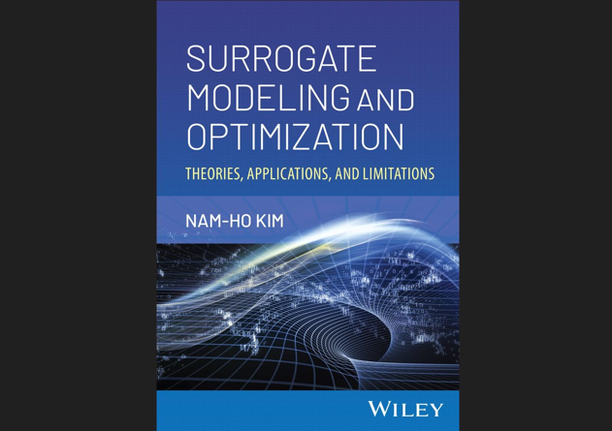

Slide 2
PART II DESIGN OPTIMIZATION

Slide 3
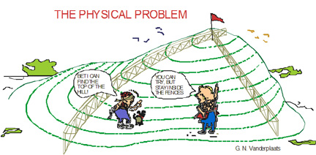
Chapter 4 Optimization Definition and Formulation

Slide 4
4.2 Design Optimization Definition
We need a goal to optimize under constraints by changing design variables

Slide 5
Optimization
Optimization methods help us find solutions to problems where we seek to find the best of something
Curve-fitting by minimizing error between the curve and data is an example of optimization
This section is about how we formulate/solve the problem mathematically.
Gradient-based methods
Searching for local minima
Function must be continuous and smooth
Gradient-free methods
Direct search
Genetic algorithm, simulated annealing, etc.
Maximize
Minimize
Notes:
Optimization is the process of finding the best alternative from all possible available alternatives. This lecture is about formulating optimization mathematically. In this lecture we assume that we can attach a numerical value to the ‘goodness’ of each alternative. This is not always the case. For example, in looking for the piece of jewelry we like best, we may be able to compare any two pieces on their appeal without being able to assign a numerical value to that appeal.

Slide 6


Quantitative Measures
Optimization assumes that we have choices and that we can attach numerical values to the ‘goodness’ of each alternative.
This is not always the case. We may have problems where the only thing we can do is compare pairs of alternatives and tell which one is better, but not by how much.
Notes:
The requirement of a numerical value that is attached to each alternative allows us to pose the optimization problem as a maximization problem or a minimization problem. For example, going back to the problem of looking for the best piece of jewelry, we may seek the cheapest jewelry that we still like well. In this case we seek to minimize the price considering attractiveness as a requirement to define the acceptable alternatives.
I often go through the process of optimization like this when I am tested by an optometrist or an ophthalmologist for eyeglasses. I get presented a series of requests to compare option A to option B, in terms of which one is better, and the optimum prescription for the glasses is obtained without any objective function value.

Slide 7
Design Optimization
What Is Design Optimization?
To find the best design parameters that meet the design goal and satisfies constraints.
Design Variables: Anything the Designer Can Change
Thickness of a plate, Cross-sectional geometry of a beam or truss, Geometric dimensions
Design Goal: Objective Function, Cost Function
Design criterion that will be minimized (or maximized)
Mass, Stress, Displacement, Natural Frequency, ETC
Constraint: Conditions that the system must satisfy
Stress, Displacement, ETC
Note: Design variables must affect the goal and constraints

Slide 8
Design Optimization Flow Chart
Physical engineering problem
Structural modeling
Design parameterization
Performance definition (cost, constraints)
Structural analysis (FEM, BEM, CFD…)
Structural model update
Design sensitivity analysis
Optimized?
No
Yes
Stop

Slide 9
Design Optimization Process
Simplify physical problem into mathematical model
Math model parameters are related to the physical parameters
Design parameterization
define the system parameters that characterize the system model and to collect a subset of the parameters as design variables
proper design parameterization will yield a good optimum design
Simulation often means numerical models (FEA, CFD)
Surrogate model is used to replace expensive numerical simulation
Design space and simulation are selected carefully for accuracy and efficiency

Slide 10
Design Optimization Process cont.
Performance measures
result of numerical simulations, stress, displacement, mass, etc.
Cost and constraints can be defined using performances
cost (objective) function, is minimized during optimization
cost function has to be influenced by the design variables
Constraints are the criteria that the system has to satisfy
as long as the constraint is less than the limit, the constraint level is not important
Optimization algorithm change design variables to find the best cost function that satisfies all constraints
iterative process, requires numerous evaluations of functions
Surrogate models can play a critical role to reduce computational cost

Slide 11
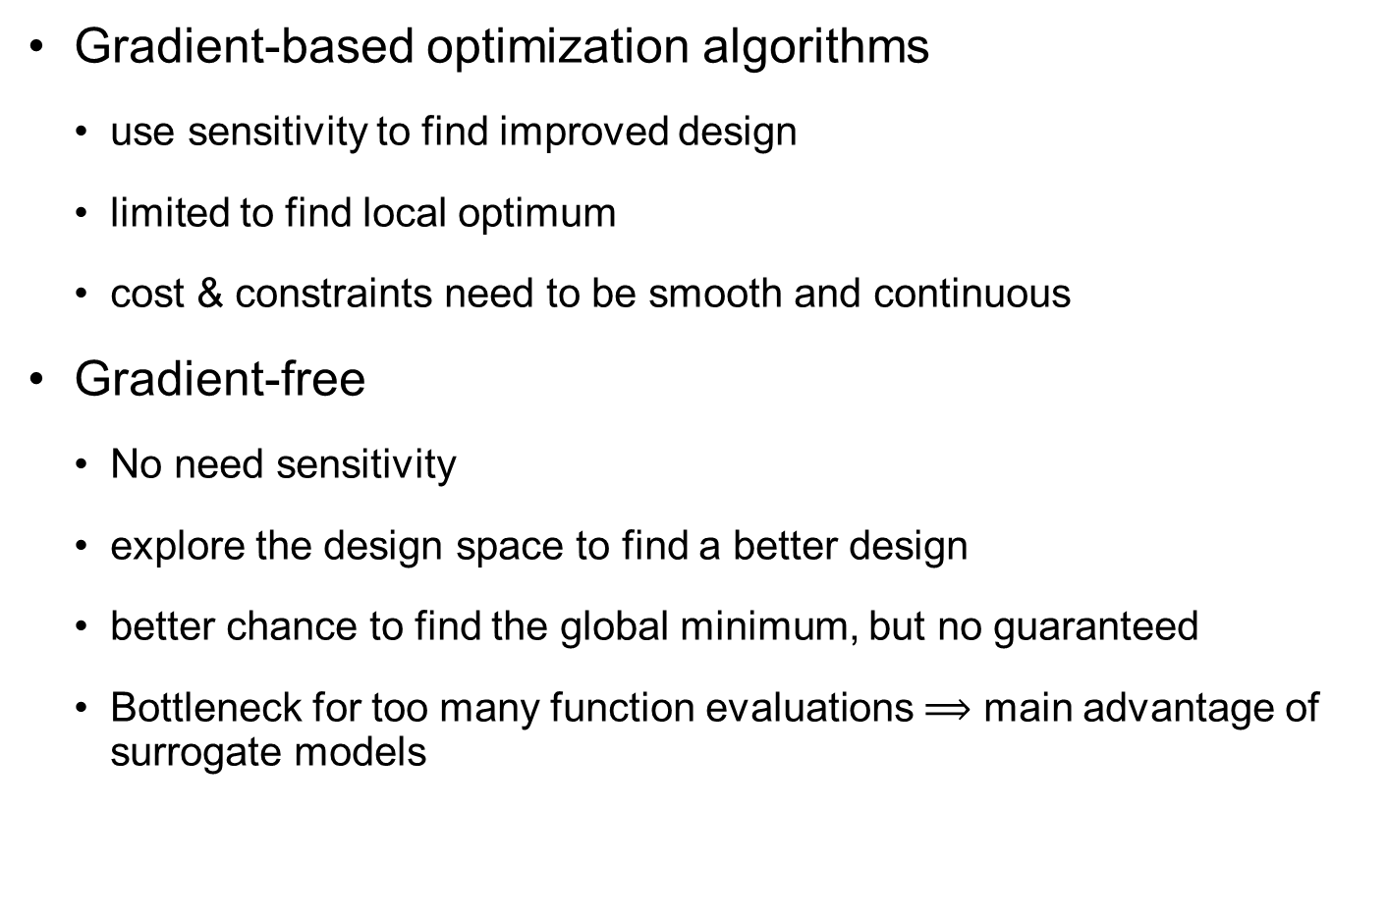
Design Optimization Process cont.
Gradient-based optimization algorithms
use sensitivity to find improved design
limited to find local optimum
cost & constraints need to be smooth and continuous
Gradient-free
No need sensitivity
explore the design space to find a better design
better chance to find the global minimum, but no guaranteed
Bottleneck for too many function evaluations $⟹$ main advantage of surrogate models

Slide 12
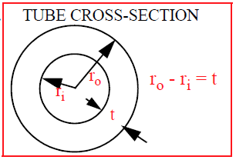

Design Variables
Design variables: Parameters that change during optimization
Material properties
Sizing (parameter): thickness, cross-section
Shape: domain
Topology: birth or death
Continuous vs. discrete
Independent
Feasible design
A set (subdomain) of design variables that satisfies all constraints
$$S=\left\{\text{feasible} \text{designs}\right\}$$

Slide 13
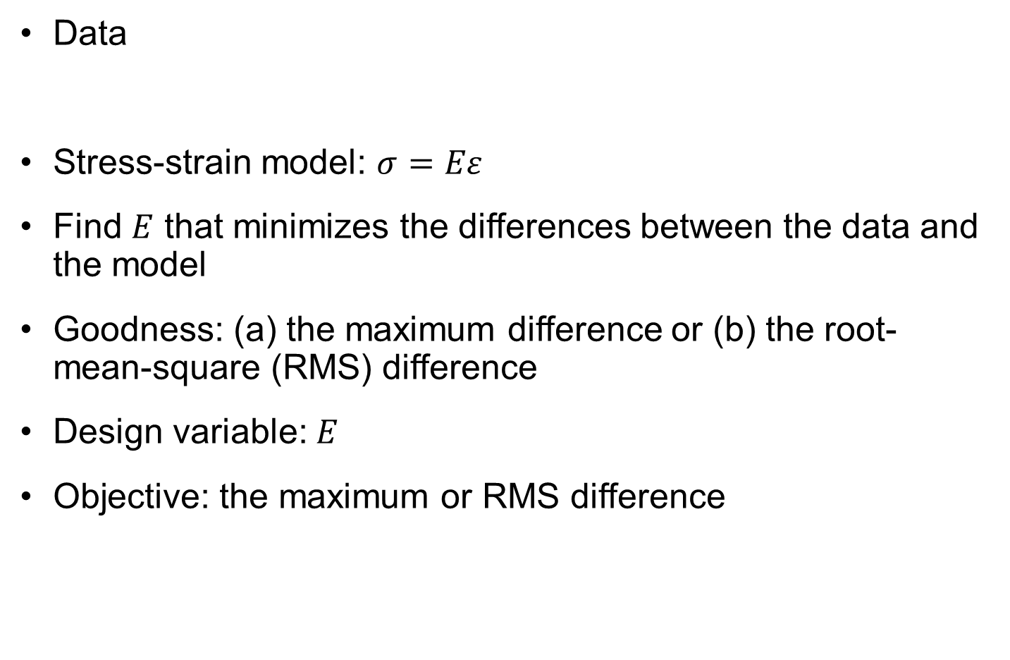
Ex4.1) Least-squares Fitting of Young Modulus
Strain (me) | 1 | 2 | 4
Stress (ksi) | 1 | 2 | 3
Data
Stress-strain model: $σ=Eε$
Find $E$ that minimizes the differences between the data and the model
Goodness: (a) the maximum difference or (b) the root-mean-square (RMS) difference
Design variable: $E$
Objective: the maximum or RMS difference
Notes:
A common problem where we use optimization is to fit a curve to data, looking for the “best fit.” Here we assume that we conducted a stress-strain test, and we measured the following pairs of stress (in ksi) and strain (in milistrains): (1,1), (2,2), (4,3).
We assume that the material we test is linearly elastic, so that the stress strain relation is given as $σ=Eε$, where $σ$ is the stress, $ε$ is the strain and E is Young’s modulus. We seek the Young modulus that will fit the data best. This could be viewed as a curve fit problem, or it could be viewed as the best estimate of a physical property: Young’s modulus.
When we try a value of E, we will obtain three errors between the data and the curve at the three data points. It is clear that when we say best fit, we want all three errors to be small. However, if we want a single measure of goodness we need to obtain a single measure of the smallness of the three errors.
Here we will select the maximum of the three errors as our measure of smallness. We call this measure our objective function. The variable that we can change to achieve good objective function, E, is an example of a design variable. A different popular measure combining the three error is the root mean square error. The choice of the error measure would lead to alternate formulations of the optimization problem.

Slide 14
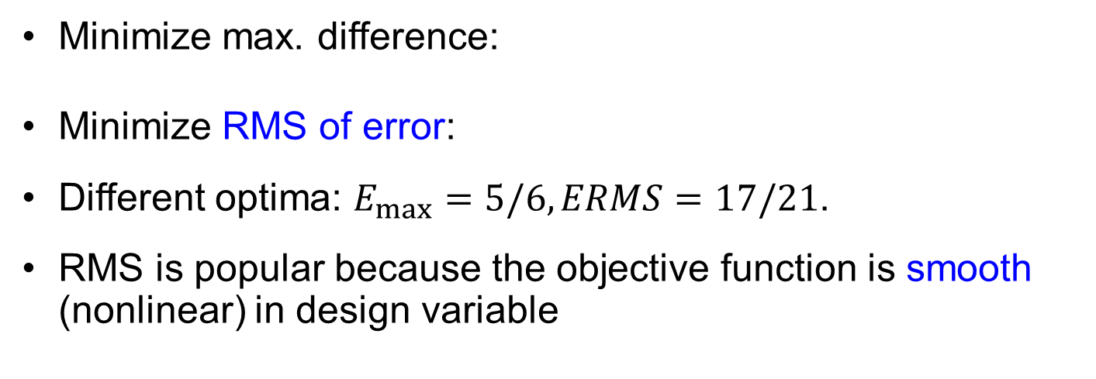
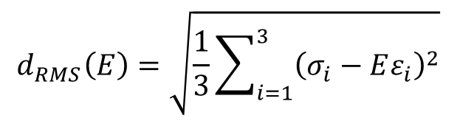

Unconstrained Formulations
$$d_{max}\left(E\right)=\max_{i=1,2,3}\left|σ_{i}−Eε_{i}\right|$$
Minimize max. difference:
Minimize RMS of error:
Different optima: $E_{max}=5/6, ERMS=17/21$.
RMS is popular because the objective function is smooth (nonlinear) in design variable
$$d_{RMS}\left(E\right)=\sqrt{\frac{1}{3}\sum_{i=1}^{3}{{\left(σ_{i}−Eε_{i}\right)}^{2}}}$$
Notes:
We first compare two formulations that minimize an objective functions without constraints. The maximum difference between the fit and the data may be written as
$$d_{max}(E)=\max_{i=1,2,3}|σ_{i}−Eε_{i}|$$
Similarly, the root mean square of the differences may be written as
$$d_{rms}(E)=\sqrt{\frac{1}{3}\sum_{i=1}^{3}{{\left(σ_{i}−Eε_{i}\right)}^{2}}}$$
With only one design variable, E, we can perform the optimization by plotting the two functions versus E. The right figure shows that the minimum of the maximum difference is about 0.33 at E=0.83, while the minimum rms is about 0.28 at E=0.81. The rms is a smooth function of E, while the maximum difference is not, which makes rms formulations more popular.
The Matlab sequence used to generate the data and right figure is
eps=[1 2 4]; sig=[1 2 3]
e=linspace(0.5,1,101);
sigmodel=e'*eps;
sigr=ones(101,1)*sig;
diff=abs(sigr-sigmodel); maxdiff=max(diff');
sumsquares=diag(diff*diff'); rms=sqrt(sumsquares/3)
plot(e,maxdiff); xlabel('E'); ylabel('objective function')
hold on; plot(e,rms,'r-'); legend('max error','rms error','Location','North')

Slide 15
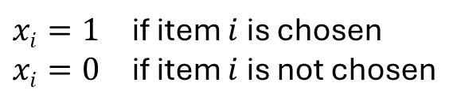
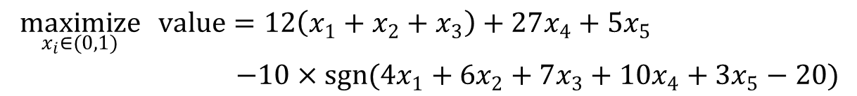
Ex4.2) Knapsack Problem
Put five items in the knapsack to maximize the total value while the total weight is less than 20 lbs
Design variables: binary design
Objective: Total value minus $10 if weight exceeds 20 lb
Item | 1 | 2 | 3 | 4 | 5
Weight (lb) | 4 | 6 | 7 | 10 | 3
Value ($) | 12 | 12 | 12 | 27 | 5
$xi=1$ if item $i$ is chosen
$xi=0$ if item $i$ is not chosen
$$\begin{matrix}\underset{x_{i}∈(0,1)}{maximize}{ value=12\left(x_{1}+x_{2}+x_{3}\right)+27x_{4}+5x_{5}} \\ −10×sgn(4x_{1}+6x_{2}+7x_{3}+10x_{4}+3x_{5}−20)\end{matrix}$$
Notes:
The knapsack problem is a well known optimization problem (see Wikipedia). Here is a special case of wanting to choose from five possible items so as to maximize their value without exceeding a total weight of 20 pounds.
When it comes to formulating a problem of choosing between items, a common approach is to assign each item a binary design variable that is equal to one if the item is chosen and equal to zero if it is not. Then we can write the total value and total weight as a sum of the variables times the individual values, and weights, respectively, as shown in the formulation.
This is really a constrained problem, since we have a constraint on the weight. However, we can replace the constraint with a penalty of $10 if it is violated and a bonus of $10 if it is satisfied.
If we solve the problem formulated in the slide, the design variables will tell us which items to choose to maximize the value plus $10. The bonus will affect the objective function but not the choice of design variables.

Slide 16
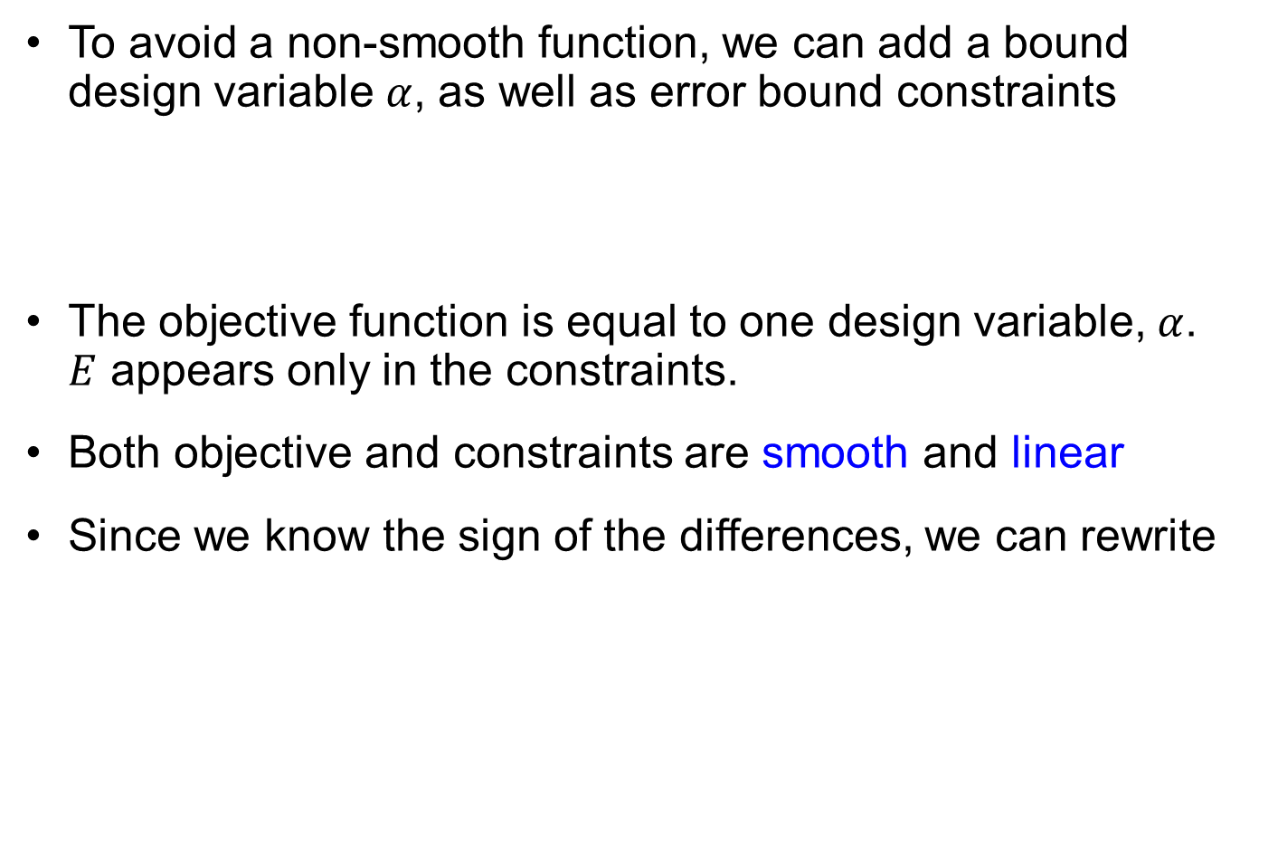
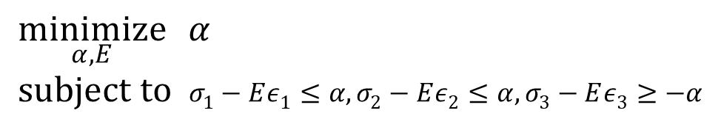
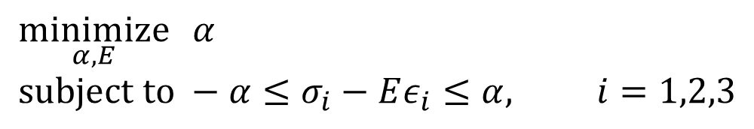
Constrained Optimization Formulation
To avoid a non-smooth function, we can add a bound design variable $α$, as well as error bound constraints
The objective function is equal to one design variable, $α$. $E$ appears only in the constraints.
Both objective and constraints are smooth and linear
Since we know the sign of the differences, we can rewrite
$$\underset{α,E}{minimize}{ α} \\ subject to −α≤σ_{i}−Eε_{i}≤α, i=1,2,3$$
$$\underset{α,E}{minimize}{ α} \\ subject to σ_{1}−Eε_{1}≤α, σ_{2}−Eε_{2}≤α, σ_{3}−Eε_{3}≥−α$$
Notes:
Even if we limit ourselves to minimizing the maximum error, we can have more than one formulation. In particular we can get rid of the non-smooth problem by adding one design variable b and constraints that the three errors are smaller than b.
$$\begin{matrix}\underset{b,E}{Minimize} b \\ Such that d_{i}=|σ_{i}−Eε|≤bi=1,2,3\end{matrix}$$
Since the absolute value is still not a smooth function, we can replace the bounds on the absolute value with upper and lower bounds on the differences as
$$\begin{matrix}\underset{b,E}{Minimize} b \\ Such that −b≤σ_{i}−Eε_{i}≤b\end{matrix}$$
This gives us a problem where the objective function and constraints are linear in the two design variables, and such problems are easy to solve.
In our case (see left figure on previous slide), it is clear that for minimizing the differences we need a larger E for the first two points than for the third one. So the optimal E, which is a compromise will underestimate the stress in the first two points and over estimate it in the third one. If we use this knowledge, the optimization problem becomes
$$\begin{matrix}\underset{b,E}{Minimize} b \\ Such that{ σ}_{1}−Eε_{1}≤b, σ_{2}−Eε_{2}≤b, −b≤σ_{3}−Eε_{3}\end{matrix}$$

Slide 17
Graphical Optimization
Graphical methods can be used to solve the optimization problem when it has only one or two design variables
Graphical methods are expensive but help to visualize the design space and to understand the nature of design problem
Procedure
Draw the design space (lower- & upper-bounds of DVs)
Plot constraints on the graph (feasible set)
Plot contour lines of objective function
Find the optimum point (the objective function has the lowest value within the feasible set)

Slide 18

Graphical Optimization cont.
$$\underset{α,E}{minimize}{ α} \\ subject to σ_{1}−Eε_{1}≤α$$
$σ_{2}−Eε_{2}≤α$
$−α≤σ_{3}−Eε_{3}$
1
s₁ – Ee₁ = a
s₂ – Ee₂ = a
0.8
s₃ – Ee₃ = – a
Feasible set S
0.6
a
0.4
A
0.2
0
0.75
0.8
0.85
0.9
0.95
1
E
Notes:
We have seen that with one variable, we can find the optimum by just plotting the function. With two design variables, the optimization can also be solved graphically, by plotting the constraint boundaries and the objective function contours.
The figure shows the constraint boundaries with hatching marking the region where the constraint is violated, which is a standard way of marking an inequality. The marking were created with a Matlab routine crosshatch_poly available from Matlab Central. Matlab’s gtext may be used instead to add slashes by clicking on the figure.
Since the objective function is equal to b, there is no need for objective function contours, we simply look for the lowest point in the region where no constraints are violated (called the feasible domain).
It is seen that there two active constraints on the differences at point 2(red) and point 3 (green). It is easy to check that the difference at point 1 is half of that at point 2 for any value of E, so that constraint is not binding. The optimum is found therefore at the intersection, where the differences between the model and the data at point 2 and point 3 have same magnitude and opposite signs.

Slide 19

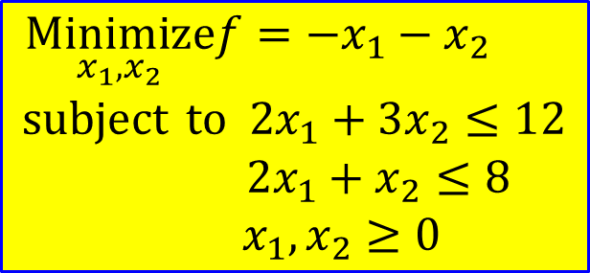




Example: Graphical Optimization
$$\begin{matrix}\underset{x_{1},x_{2}}{Minimize}f=−x_{1}−x_{2} \\ subject to 2x_{1}+3x_{2}≤12 \\ 2x_{1}+x_{2}≤8 \\ x_{1},x_{2}≥0\end{matrix}$$
$$x2$$
Minimum at $(3,2)$ with $f=−5$
Optimum point
Feasible region
$$x1$$
$$f=−5$$
$$f=0$$

Slide 20








POSSIBLE DIFFICULTIES
Unbounded problems
Problems with multiple optima
Problems with zero feasible regions
Problems with no active constraints
$$x_{2}$$
Unbounded solution
$$x_{2}$$
No feasible solution
$$x_{2}$$
Multiple optimal solutions
$$Δf<0$$
P
$$Δf<0$$
Q
$$x_{1}$$
$$x_{1}$$
$$x_{1}$$
(a)
(b)
(c)

Slide 21
4.3 Optimization Problem Formulation
We need a standard form so that everyone can understand the optimization problem correctly

Slide 22
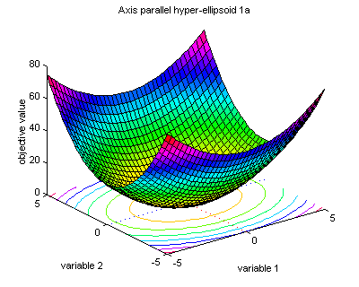
Three-step Problem Formulation
w
Design Parameterization
Clear identification
Independence of designs
Objective Function
Must be a function of design parameters
Minimization ( –Maximization)
Constraint Functions
Inequality constraints
Equality constraints
Equality constraints + active constraints must be less than the number of design parameters
t₁
t₂
h

Slide 23
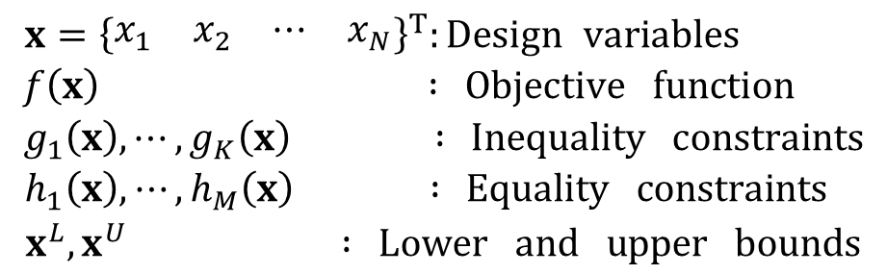
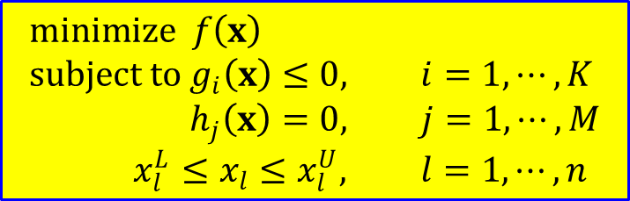
Standard Form
Standard form of design optimization
Feasible set: the set of designs that satisfy constraints
$$minimize f\left(x\right) \\ subject to g_{i}\left(x\right)≤0, i=1,⋯,K \\ h_{j}\left(x\right)=0, j=1,⋯,M \\ x_{l}^{L}≤x_{l}≤x_{l}^{U}, l=1,⋯,n$$
$$\begin{matrix}x={\left\{\begin{matrix}x_{1} & x_{2} & ⋯ & x_{N}\end{matrix}\right\}}^{T}:Design variables \\ f\left(x\right) : Objective function \\ g_{1}\left(x\right),⋯,g_{K}\left(x\right) : Inequality constraints \\ h_{1}\left(x\right),⋯,h_{M}\left(x\right) : Equality constraints \\ x^{L},x^{U} : Lower and upper bounds\end{matrix}$$
$$S=\left\{x| g_{i}\left(x\right)≤0,i=1,⋯,K;h_{j}\left(x\right)=0,j=1,⋯,M\right\}$$

Slide 24
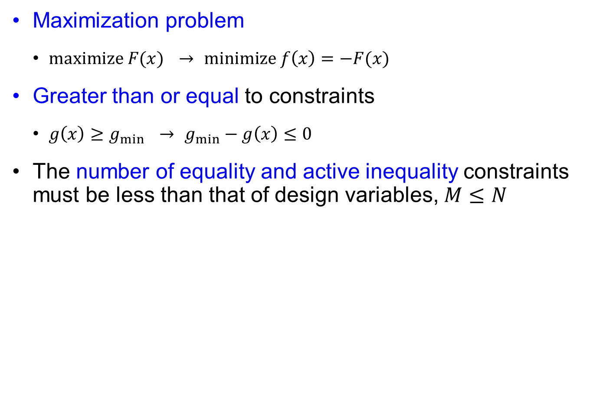
Standard Form cont.
Maximization problem
$maximize F(x)$ $→$ $minimize f\left(x\right)=−F(x)$
Greater than or equal to constraints
$g\left(x\right)≥g_{min}$ $→$ $g_{min}−g\left(x\right)≤0$
The number of equality and active inequality constraints must be less than that of design variables, $M≤N$

Slide 25
Standard Types of Optimization Problems
Linear programming (LP) problem
Both objective and constraints are linear functions of designs
Many specialized numerical algorithms are available
An optimum design is the global optimum
Quadratic programming (QP) problem
The objective is a quadratic function of designs, while all constraints are linear functions of designs.
Nonlinear programming (NLP) problems
Both objective and constraints are nonlinear functions of designs
Most general but most difficult to solve

Slide 26


Ex4.4) Standard Form
Standard form of Young’s modulus fit
$$\underset{α,E}{minimize}{ α} \\ subject to σ_{1}−Eε_{1}≤α$$
$σ_{2}−Eε_{2}≤α$
$−α≤σ_{3}−Eε_{3}$
$$\underset{α,E}{minimize}{ α} \\ subject to σ_{1}−Eε_{1}−α≤0 \\ σ_{2}−Eε_{2}−α≤0 \\ −σ_{3}+Eε_{3}−α≤0 \\ 0.5≤E≤1$$
Notes:
To facilitate the description of algorithms for solving optimization problems, there is a fairly standard notation for writing them. The letter f is typically used for objective functions, g for inequality constraints, and h for equality constraints. Lower and upper bounds on design variables, are often called side constraints and are written separately in a different form.
Given an optimization problem that is not in standard form, we often have to do the following in order to convert it to standard form
If the objective function is to be maximized, we change the sign and minimize the negative of the function.
We rewrite constraints so that the right hand side is zero.
If the inequality is g$≥$0 we replace it by -g$≤0$.
So for example, an inequality of the form x+y $≥3,$ will be first replaced by x+y-3 $≥0,$ and then multiplied by -1 to get 3-(x+y) $≤0,$

Slide 27
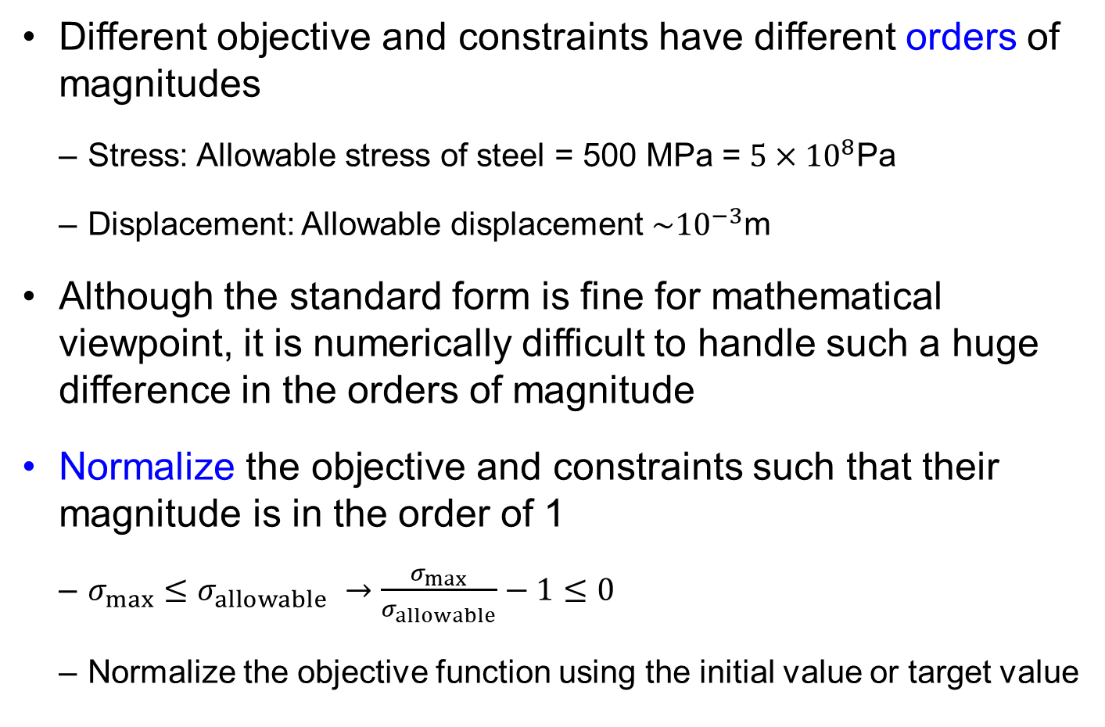
Normalization
Different objective and constraints have different orders of magnitudes
Stress: Allowable stress of steel = 500 MPa = $5×{10}^{8}$Pa
Displacement: Allowable displacement $\sim {10}^{−3}$m
Although the standard form is fine for mathematical viewpoint, it is numerically difficult to handle such a huge difference in the orders of magnitude
Normalize the objective and constraints such that their magnitude is in the order of 1
$σ_{max}≤σ_{allowable}$ $→$ $\frac{σ_{max}}{σ_{allowable}}−1≤0$
Normalize the objective function using the initial value or target value

Slide 28
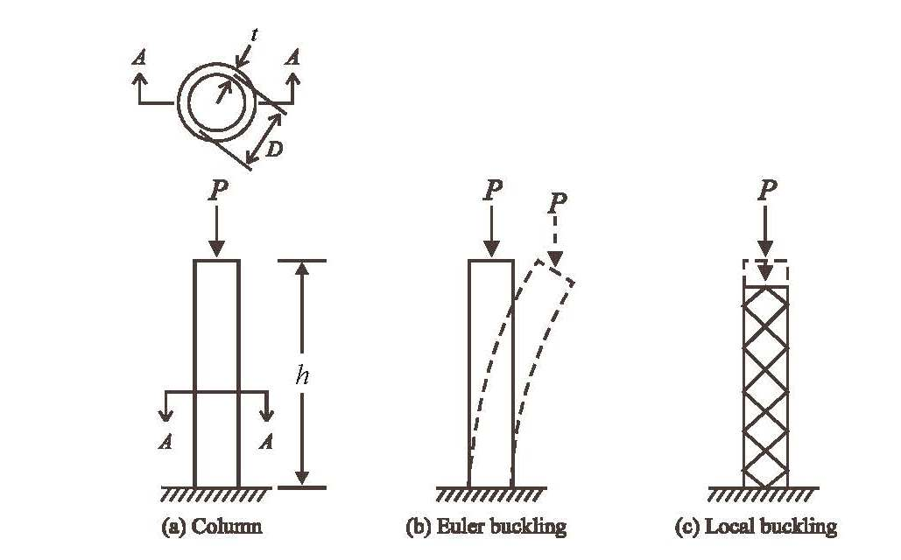
Ex4.5) Column Design
Height is fixed, design variables are R and t
Objective function is cross-sectional area
Three failure modes
Notes:
As another example of writing constraints well we take a problem from Vanderplaats, Numerical optimization techniques for engineering design, 3rd edition, Example 1-2. It involves the minimum weight design of a tubular column under compressive load where failure may occur in three modes shown in the figure. The two design variables are the diameter D and the thickness t of the tube. The weight, which is the objective function is proportional to the cross sectional area, so in the optimization formulation we will use the area as the objective function.
The three modes of failure are stress failure, global buckling also called Euler buckling, and local buckling where the tube wrinkles into a diamond pattern.

Slide 29
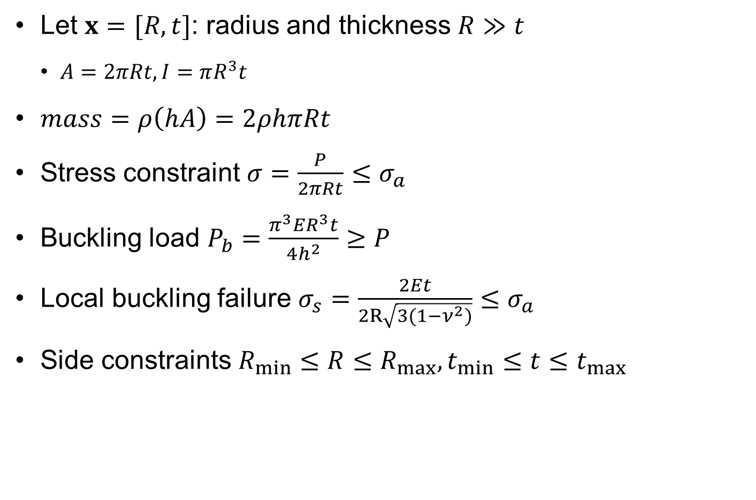
Ex4.5) Column Design Formulation 1
Let $x=[R, t]$: radius and thickness $R≫t$
$A=2πRt, I=πR^{3}t$
$mass=ρ\left(hA\right)=2ρhπRt$
Stress constraint $σ=\frac{P}{2πRt}≤σ_{a}$
Buckling load $P_{b}=\frac{π^{3}ER^{3}t}{4h^{2}}≥P$
Local buckling failure $σ_{s}=\frac{2Et}{2R\sqrt{3(1−ν^{2})}}≤σ_{a}$
Side constraints $R_{min}≤R≤R_{max},t_{min}≤t≤t_{max}$
Notes:
The equations for the three failure modes are given in the slide. Each failure mode provides for different importance of the diameter and the thickness. The stress depends only on the area, which is also the objective function, and the area depends only on the product of the thickness and the diameter. This means that with a stress constraint only, any combination of the diameter and thickness that is at the stress limit $\overline{σ}$ will have the same weight.
The global buckling load depends on the Moment of inertia I that depends on D more strongly than on t. So it will drive the design towards a thin tube. Local buckling pushes in the other direction in that it benefits from large t and small D. This indicates that if buckling is critical (happens if the column is slender enough, i.e. h is large), both failure modes will happen simultaneously.

Slide 30
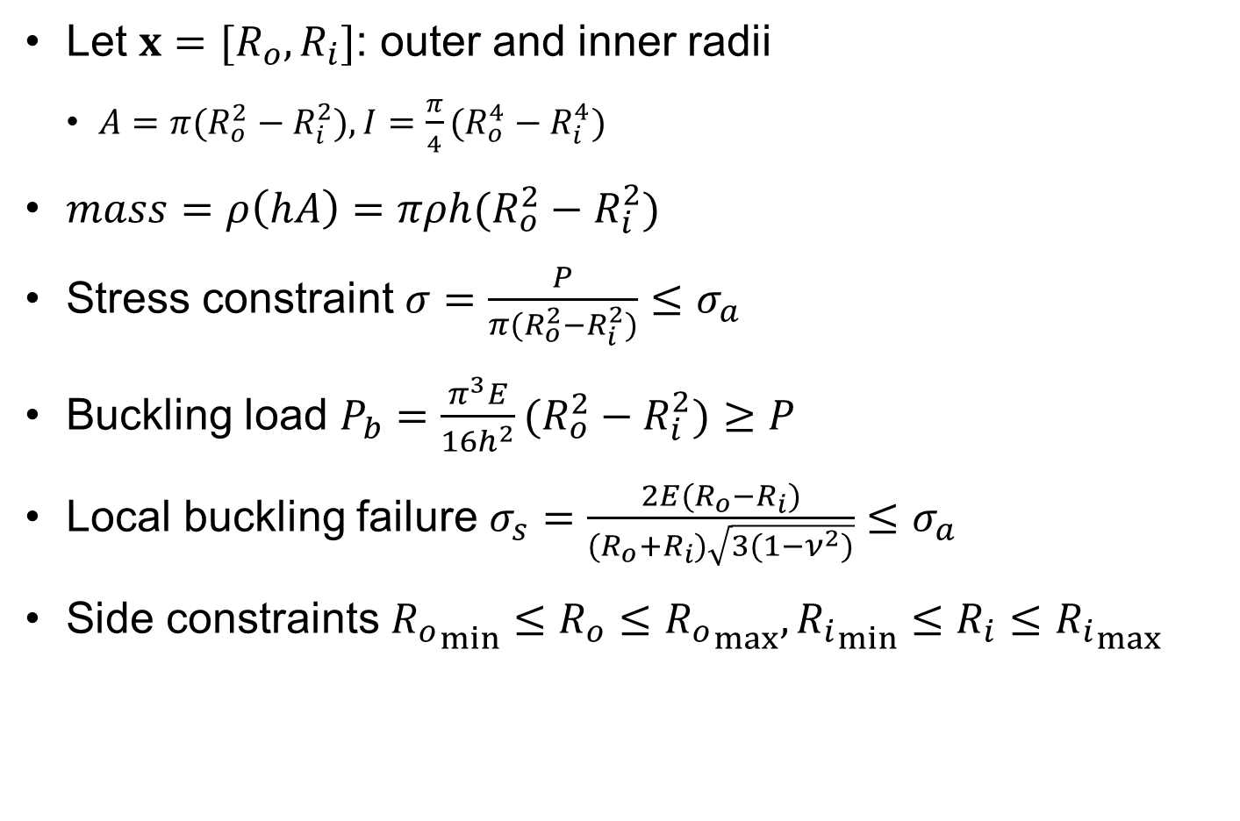
Ex4.5) Column Design Formulation 2
Let $x=[R_{o}, R_{i}]$: outer and inner radii
$A=π(R_{o}^{2}−R_{i}^{2}), I=\frac{π}{4}(R_{o}^{4}−R_{i}^{4})$
$mass=ρ\left(hA\right)=πρh(R_{o}^{2}−R_{i}^{2})$
Stress constraint $σ=\frac{P}{π(R_{o}^{2}−R_{i}^{2})}≤σ_{a}$
Buckling load $P_{b}=\frac{π^{3}E}{16h^{2}}(R_{o}^{2}−R_{i}^{2})≥P$
Local buckling failure $σ_{s}=\frac{2E(R_{o}−R_{i})}{(R_{o}+R_{i})\sqrt{3(1−ν^{2})}}≤σ_{a}$
Side constraints ${R_{o}}_{min}≤R_{o}≤{R_{o}}_{max},{R_{i}}_{min}≤R_{i}≤{R_{i}}_{max}$

Slide 31

Ex4.5) Column Design Standard Form
Dimensionless form
Normalized constraints are better both numerically and for communicating degree of satisfaction.
$$\underset{R,t}{minimize}{ 2πρhRt} \\ subject to g_{1}\left(R,t\right)=\frac{σ}{σ_{a}}−1≤0 \\ g_{2}\left(R,t\right)=1−\frac{P}{P_{cr}}≤0 \\ g_{3}\left(R,t\right)=\frac{σ_{s}}{σ_{a}}−1≤0 \\ R_{min}≤R≤R_{max}, t_{min}≤t≤t_{max}$$
Notes:
The standard formulation requires us to write the failure constraints so that all are of the form g(D,t) $≤$0. In the slide they are also written as ratios of response to allowable limit minus one. This provides a handy measure of constraint satisfaction. For example, if the constraint is equal to -0.1, it tells us that we have a 10% margin between the response and the allowable response. If the constraint is equal to 0.05, it means we exceed the allowable by 5%.
This normalized and non-dimensional formulation of constraints is also typically better for the numerical performance of optimization algorithms. That is, using an optimization routine, it is likely to lead to faster convergence and increase the chance that we will find the true optimum.

Slide 32


Ex) Two-Bar Truss
Design: $A1, A2, L, h$
Objective: weight
Constraints:
$σ_{i}≤σ_{Y}, u_{i}≤u_{igiven}, σ_{C}≤σ_{buckling}$
Standard form
A₂
h
A₁, L
w
$$\begin{matrix}Minimize ρ\left(A_{1}L+A_{2}\sqrt{L^{2}+h^{2}}\right) \\ subject to \frac{σ_{i}}{σ_{Y}}−1≤0 \\ \frac{u_{i}}{u_{i given}}−1≤0 \\ \frac{σ_{C}}{σ_{buckling}}−1≤0 \\ A^{L}≤A_{i}≤A^{u}, L^{L}≤L≤L^{u}, h^{L}≤h≤h^{u}\end{matrix}$$

Slide 33
Ex4.6) Beer Can Design
Design the beer can size so that the minimum amount of sheet metal can be used (minimize manufacturing cost)
Constraints
It is required to hold at least 400 ml of fluid.
The diameter of the can should be no more than 8 cm. In addition, it should not be less than 3.5 cm (shipping & handling).
The height of the can should be no more than 18 cm and no less than 8 cm.
D
H

Slide 34
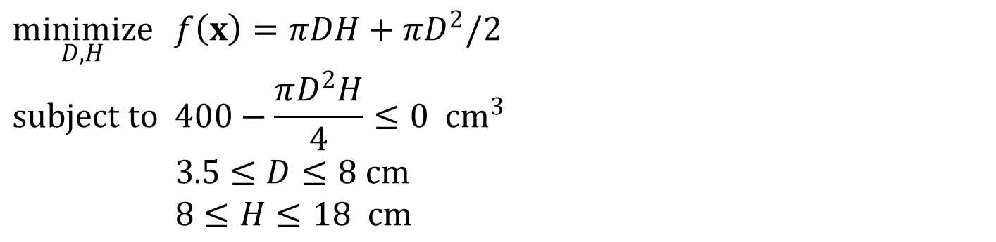
Ex4.6) Beer Can Design cont.
Standard form
Feasible domain
$$\underset{D,H}{minimize}{ f\left(x\right)=πDH+πD^{2}/2} \\ subject to 400−\frac{πD^{2}H}{4}≤0 cm^{3} \\ 3.5≤D≤8 cm \\ 8≤H≤18 cm$$
20
15
S
H
10
5
3
4
5
D
6
7
8
9
Notes:
figure;
x=[3.5 8 8 3.5 3.5];
y=[8 8 18 18 8];
plot(x,y); hold on;
axis([3 9 5 20])
x=4:0.1:9;
y=400./(0.25*pi*x.^2);
plot(x,y);

Slide 35
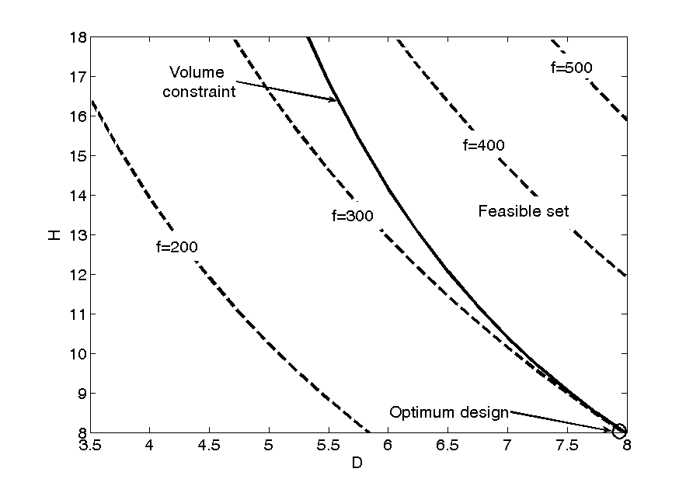
Ex4.6) Beer Can Design cont.

Slide 36

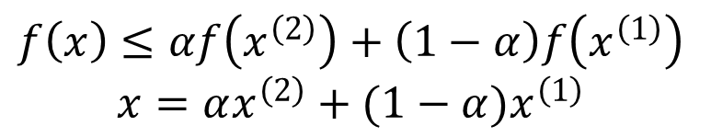



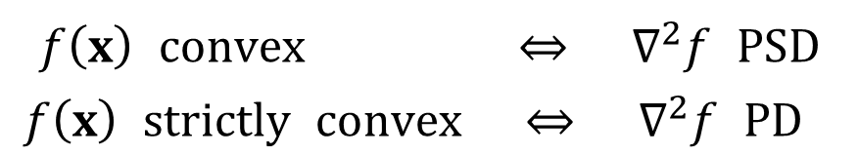

Convex Function
A straight line connecting two points will not dip below the function graph
Convexity of a function
Convex function will have a single minimum
$$f\left(x\right)≤αf\left(x^{\left(2\right)}\right)+\left(1−α\right)f\left(x^{\left(1\right)}\right) \\ x=αx^{\left(2\right)}+(1−α)x^{\left(1\right)}$$
$$\left(x_{2},f\left(x_{2}\right)\right)$$
$$\left(x_{1},f\left(x_{1}\right)\right)$$
$$x_{1}$$
$$x$$
$$x_{2}$$
$$\begin{matrix}f\left(x\right) convex ⇔ ∇^{2}f PSD \\ f\left(x\right) strictly convex ⇔ ∇^{2}f PD \end{matrix}$$
Sufficient condition: Positive semi-definite Hessian everywhere.
Notes:
A function is convex if a straight line connecting two points on its graph will not dip below the function values in between. This applies to n-dimensional function rather than just to a function of a single variable as shown in the figure. This statement is encapsulated in the equation
The weighted sum of a number of quantities, where the sum of the weights is equal to one and all the weights are positive is called a convex combination. So the equation above says that the value of the function at a convex combination of two points cannot be larger than the convex combination with the same weights of the function values at these two points.
It is not difficult to show that if a function is convex, the statement above will apply to a convex combination of any number of points.

Slide 37
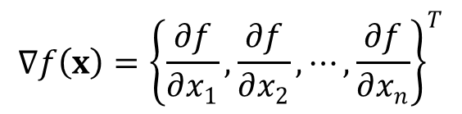

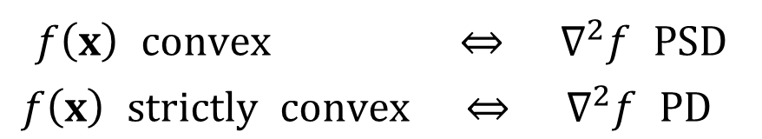

Convex Function cont.
$$∇f\left(x\right)={\left\{\frac{∂f}{∂x_{1}}, \frac{∂f}{∂x_{2}}, ⋯, \frac{∂f}{∂x_{n}}\right\}}^{T}$$
Gradient
Hessian
positive definite matrix $H$ if $x^{T}Hx>0$ for all $x≠0$
positive semi-definite matrix $H$ if $x^{T}Hx≥0$ for all $x≠0$
$$H≡∇^{2}f\left(x\right)=\left[\begin{matrix}\frac{∂^{2}f}{∂x_{1}^{2}} & ⋯ & \frac{∂^{2}f}{∂x_{1}∂x_{n}} \\ ⋮ & ⋱ & ⋮ \\ \frac{∂^{2}f}{∂x_{1}∂x_{n}} & ⋯ & \frac{∂^{2}f}{∂x_{n}^{2}}\end{matrix}\right]$$
$$\begin{matrix}f\left(x\right) convex ⇔ ∇^{2}f PSD \\ f\left(x\right) strictly convex ⇔ ∇^{2}f PD \end{matrix}$$

Slide 38

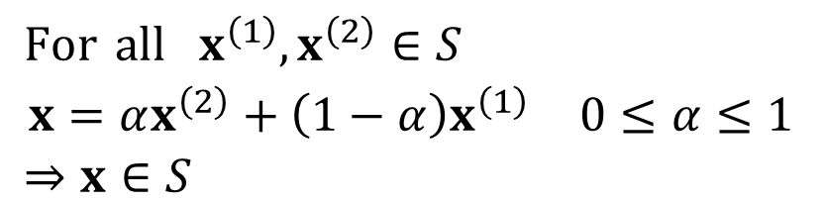
Convex Problem cont.
Convex Problem: $f(x)$ is a convex function over a convex feasible set $S$
If a problem is convex, KKT condition is necessary as well as sufficient
Any local minimum is also a global minimum
Convex set:
$$\begin{matrix}For all x^{\left(1\right)},x^{\left(2\right)}∈S \\ x=αx^{\left(2\right)}+\left(1−α\right)x^{\left(1\right)} 0≤α≤1 \\ ⇒x∈S \end{matrix}$$
Convex set
Non-convex set
Notes:
As in the unconstrained case, if we have a convex problem we will have only one local optimum, which is then the global optimum. Only convexity is more complicated. We need to have a convex objective function and a convex feasible domain. The feasible domain is convex if the line segment connecting any two feasible points is entirely feasible. This will happen if all the inequality constraints are convex and all the equality constraints are linear. If an equality constraint is nonlinear, then it is curved, and if we connect two points on the line by a straight segment, the interior of the segment will not satisfy the equality constraint, and this will violate the convexity requirement.
Then the KKT conditions are also sufficient for a global optimum.

Slide 39
4.4 Optimality Criteria
How do you know if a design is optimum or not?

Slide 40


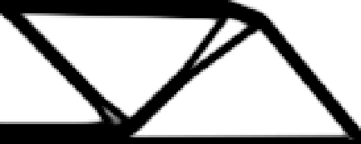
Global vs. Local Minimum
Optimization algorithm searches for local minimum…global minimum is not guaranteed
Starting with different initial designs will result in different designs
Objective
Local optimum
Global optimum
Global optimum
Design

Slide 41
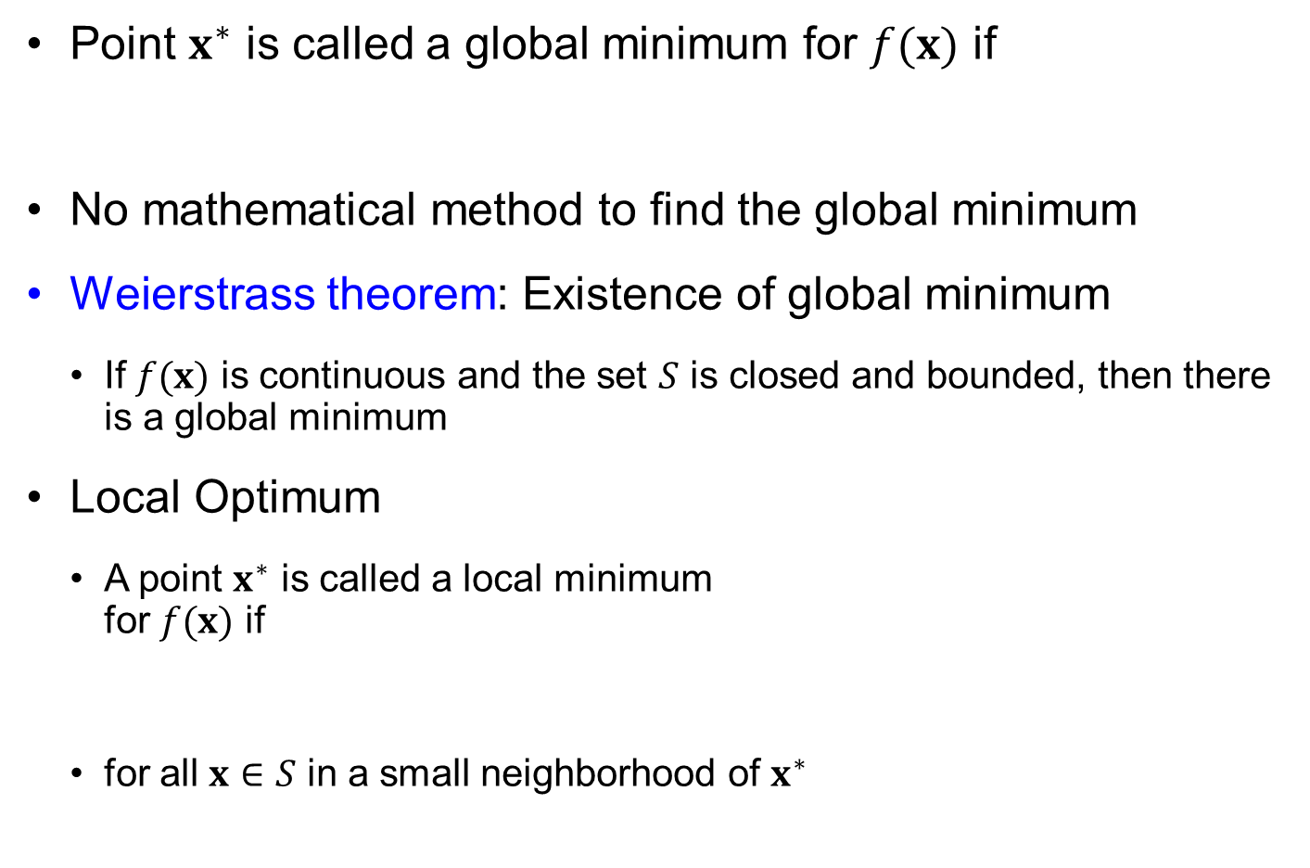


Global Optimization
Point $x^{∗}$ is called a global minimum for $f(x)$ if
No mathematical method to find the global minimum
Weierstrass theorem: Existence of global minimum
If $f(x)$ is continuous and the set $S$ is closed and bounded, then there is a global minimum
Local Optimum
A point $x^{∗}$ is called a local minimum for $f(x)$ if
for all $x∈S$ in a small neighborhood of $x^{∗}$
$$f\left(x^{∗}\right)≤f\left(x\right), for all x∈S$$
Local min
$$f\left(x^{∗}\right)≤f\left(x\right)$$
Global min

Slide 42

Global Optimization
Normally no functional expression available
For a given design, we can calculate objective & constraints
We find optima using numerical search
We know that there is no better design in the immediate neighborhood
But, we don’t know if that is the global optimum
We can only guarantee a local optimum
$$f=x+sin⁡(2x)$$
Notes:
For most functions that we need to optimize in engineering applications, we do not have simple expressions, and we find optima by numerical search techniques. Once we find a minimum that satisfies the optimality conditions, we know that there are no better designs in the immediate neighborhood. However, we do not know whether there might be a better solution further away.
The function x+sin(2x) is a simple example of a function that has several local minima and several local maxima, the number depends on the range. There are, however, functions for which there is only one minimum, as we will see on the next slide.

Slide 43
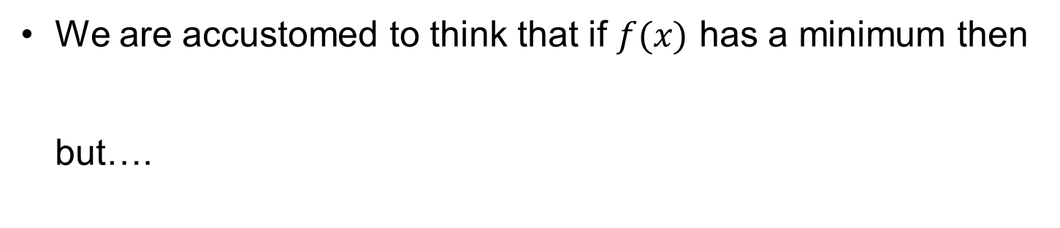


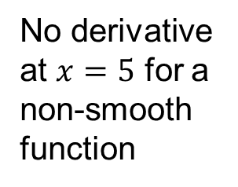
One Dimensional Optimization
We are accustomed to think that if $f(x)$ has a minimum then but….
$$\frac{df\left(x\right)}{dx}=0$$
Optimality criteria only consider smooth functions
5
$$\left|x−5\right| \\ 0.2{\left(x−5\right)}^{2}$$
4
3
2
1
No derivative at $x=5$ for a non-smooth function
0
0
1
2
3
4
5
6
7
8
9
10
$$x$$
Notes:
From Calculus we are accustomed to associate a minimum or a maximum with the vanishing of the first derivative. However, that applies only to differentiable functions with continuous derivatives as is illustrated in the figure.
b=0:0.5:10;
y1=abs(b-5);
y2=0.2*(b-5).^2;
plot(b, y1); hold on;
plot(b, y2);
legend('|b-5|', '0.2*(b-5)^2');
xlabel('b');

Slide 44





1d Optimization Jargon
A point with zero derivative is a stationary point
$x=5$ can be
a minimum
a maximum
an inflection point
20
$$f\left(x\right)={\left(x−5\right)}^{2}$$
10
0
$$f\left(x\right)=10x−x^{2}$$
-10
$${\left(x−5\right)}^{2} \\ 10x−x^{2} \\ 0.2{\left(x−5\right)}^{3}$$
$$f\left(x\right)={0.2\left(x−5\right)}^{3}$$
-20
0
1
2
3
4
5
6
7
8
9
10
$$x$$
Notes:
For one dimensional functions stationary points are points where the derivative vanishes. We consider three functions that have a stationary point at x=5. One has a minimum ( Y=(x-5)², the green curve), one has a maximum (y=10x-x², the red curve), and one has an inflection point ( y=0.2(x-5)³, the blue curve).

Slide 45
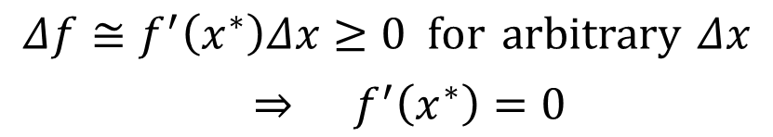



Optimality Conditions
Unconstrained problems (one variable)
Necessary condition for $x^{∗}$ to be a local min
For $x^{∗}$ to be minimum, $∆f≥0$
$$\underset{x}{minimize}{ f\left(x\right)}$$
$$f^{′}\left(x^{∗}\right)=0$$
Kuhn-Tucker (KT) condition
1st-order necessary condition
$$f\left(x\right)=f\left(x^{∗}+Δx\right)=f\left(x^{∗}\right)+f^{′}\left(x^{∗}\right)Δx+\frac{1}{2}f^{′′}\left(x^{∗}\right)Δx^{2}+H.O.T.$$
$$Δf=f\left(x\right)−f\left(x^{∗}\right)=f^{′}\left(x^{∗}\right)Δx+\frac{1}{2}f^{′′}\left(x^{∗}\right)Δx^{2}+H.O.T.$$
Dx
$$\begin{matrix}Δf≅f^{′}\left(x^{∗}\right)Δx≥0 for arbitrary Δx \\ ⇒ f^{′}\left(x^{∗}\right)=0\end{matrix}$$
x*
x
Notes:
For a function of one variable f(x) to have a minimum or a maximum at x*, it has to be stationary, so the vanishing of the first derivative, f’(x*)=0, is a necessary condition for either. From a Taylor series expansion about x*
f(x*+h)=f(x*)+hf’(x*)+0.5h²f”(x*)+higher order terms in h
it is clear that f”(x*)>0 is a sufficient condition for a minimum, because it guarantees that close enough to x* (h sufficiently small), f(x)>f*(x). Similarly, f”(x*)<0 is a sufficient condition for a maximum.
When f”(x)=0 at a stationary point, it is the higher derivatives that determine whether it is a minimum. First the third derivative has to vanish in order to avoid an inflexion point. Then if the fourth derivative is positive we have a minimum. For example f(x)=x⁴ has a minimum at x=0.

Slide 46


Optimality Conditions cont.
Now,
Sufficient condition
$$Δf=\frac{1}{2}f^{′′}\left(x^{∗}\right)Δx^{2}+H.O.T.≥0 ⟹ f^{′′}\left(x^{∗}\right)≥0$$
$$f^{′′}\left(x^{∗}\right)≥0$$
2nd-order necessary condition
$$f^{′′}\left(x^{∗}\right)>0$$

Slide 47

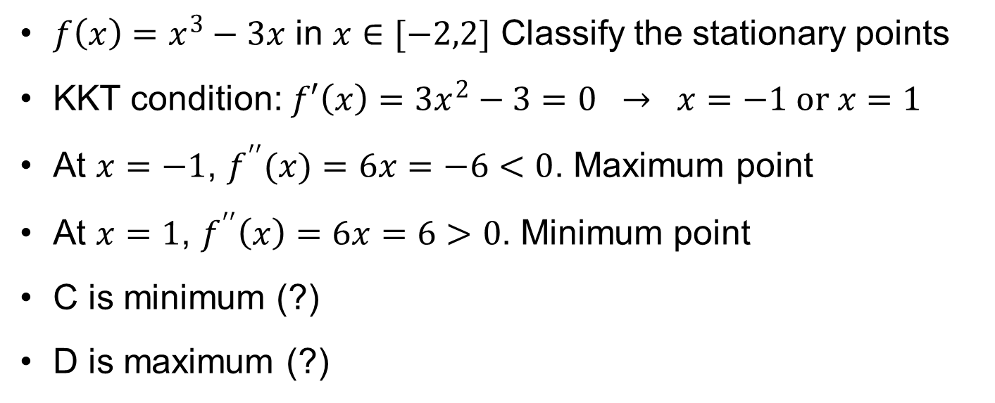

Ex4.7) Optimality Condition
$f\left(x\right)=x^{3}−3x$ in $x∈[−2,2]$ Classify the stationary points
KKT condition: $f′\left(x\right)=3x^{2}−3=0 → x=−1 or x=1$
At $x=−1$, $f^{′′}(x)=6x=−6<0$. Maximum point
At $x=1$, $f^{′′}\left(x\right)=6x=6>0$. Minimum point
C is minimum (?)
D is maximum (?)
10
8
6
4
A
2
D
$$f(x)$$
0
-2
C
B
-4
-6
-8
-10
-2.5
-2
-1.5
-1
-0.5
0
0.5
1
1.5
2
2.5
$$x$$

Slide 48
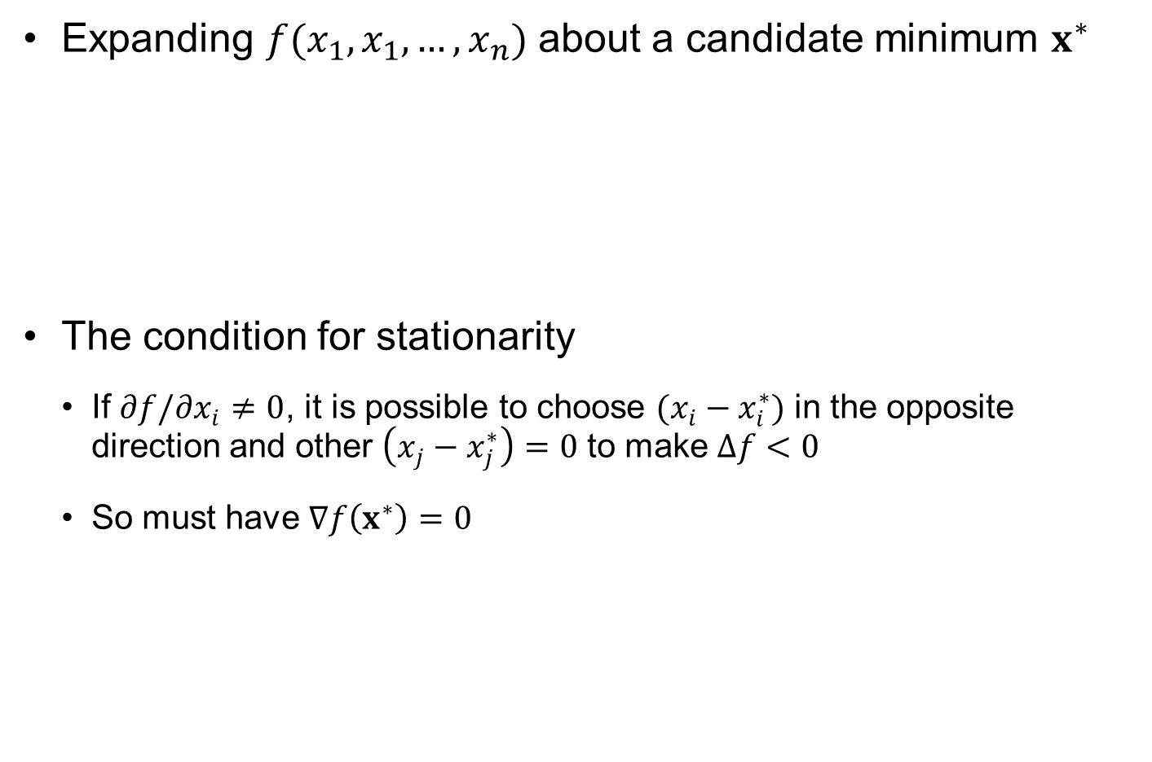
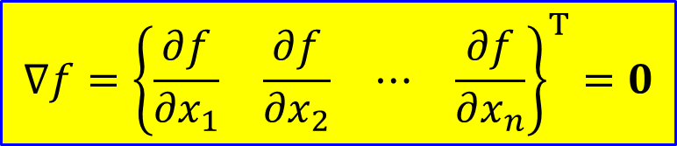
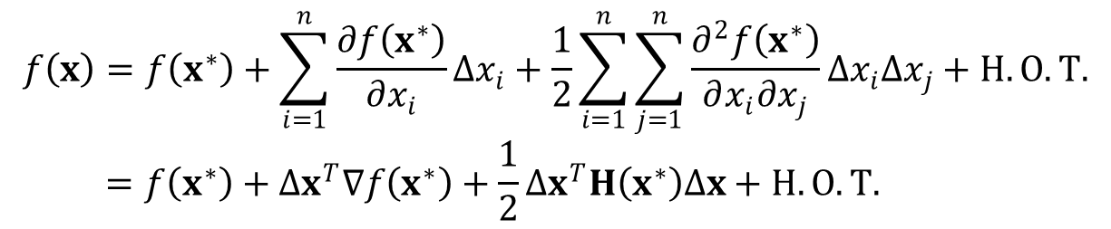
Taylor Series Expansion in $n$ Dimensions
Expanding $f(x_{1},x_{1}, …,x_{n})$ about a candidate minimum $x^{∗}$
The condition for stationarity
If $∂f/∂x_{i}≠0$, it is possible to choose $(x_{i}−x_{i}^{∗})$ in the opposite direction and other $\left(x_{j}−x_{j}^{∗}\right)=0$ to make $Δf<0$
So must have $∇f\left(x^{∗}\right)=0$
$$f\left(x\right)=f\left(x^{∗}\right)+\sum_{i=1}^{n}{\frac{∂f\left(x^{∗}\right)}{∂x_{i}}Δx_{i}}+\frac{1}{2}\sum_{i=1}^{n}{\sum_{j=1}^{n}{\frac{∂^{2}f\left(x^{∗}\right)}{∂x_{i}∂x_{j}}Δx_{i}Δx_{j}}}+H.O.T. \\ =f\left(x^{∗}\right)+Δx^{T}∇f\left(x^{∗}\right)+\frac{1}{2}Δx^{T}H\left(x^{∗}\right)Δx+H.O.T.$$
$$∇f={\left\{\begin{matrix}\frac{∂f}{∂x_{1}} & \frac{∂f}{∂x_{2}} & ⋯ & \frac{∂f}{∂x_{n}}\end{matrix}\right\}}^{T}=0$$
Notes:
For an n-dimensional function we again use the Taylor series to derive the optimality conditions. The Taylor series here is also useful in order to define some terminology that we will use later. The vector of first derivatives is called the gradient vector, and the matrix of second derivatives is called the Hessian matrix (after Ludwig Otto Hesse, German mathematician, 1811-1874). Using this vector and matrix, it is possible to write the Taylor series expansion in a more compact form.
The fact that a necessary condition for a minimum is that all the first derivatives are zero is easy to derive. If any first derivative is non zero, the slope in that direction is non-zero, and we will move in the direction that will reduce the function. For example if the derivative with respect to x8 is positive, we will reduce x8 a bit without changing any of the other variables. If the change in x8 is small enough, the quadratic and higher terms will be negligible compare to the first derivative times the change in x8, and we will find a nearby point where f(x)<f(x*), so that x* is not a local minimum.
This condition of all the first derivatives being zero, is the condition for stationarity. It is also a necessary condition for a maximum, using the same kind of logic.

Slide 49


Conditions for Minimum
$$f\left(x\right)=f\left(x^{∗}\right)+Δx^{T}∇f\left(x^{∗}\right)+\frac{1}{2}Δx^{T}H\left(x^{∗}\right)Δx+H.O.T.$$
Sufficient condition for a minimum is that
That is, the matrix of second derivatives (Hessian) is positive definite
Simplest way to check positive definiteness is eigenvalues: All eigenvalues need to be positive
Necessary conditions: Hessian matrix is positive-semi definite, i.e., all eigenvalues are non-negative
$$Δx^{T}H\left(x^{∗}\right)Δx>0 for all Δx≠0$$
Notes:
The conditions for a minimum are now derived in a similar way to a one-dimensional function. A sufficient condition for a minimum is to have a Hessian matrix that has the property of v^{T}Hv>0 for any vector v. Such a property for a symmetric matrix is called positive definiteness.
If v is selected to be a unit length eigenvector of H, then the product v^{T}Hv is equal to the corresponding eigenvalue, which shows that all eigenvalues of a positive definite matrix must be positive. It is not difficult to show the reverse, that if all the eigenvalues are positive the matrix is positive definite. The eigenvalues of the Hessian matrix are the curvatures of f in the direction of the eigenvectors. So a a matrix is positive definite if it has positive curvature in the direction of every eigenvector. That turns out to be enough to guarantee that it is positive in any other direction.
So positive definiteness is a sufficient condition for a minimum at a stationary point. However, it is not necessary. If there are directions where the second derivative is zero, that is v^{T}Hv=0, we could still have a minimum there depending on the higher order derivatives. A matrix H with v^{T}Hv>=0 is called semi-positive definite, and all its eigenvalues are non-negative.

Slide 50





Optimality Condition for Unconstrained Problem
Multi-variable case
KKT condition
Second-order necessary condition
Sufficient condition
$$∇f=\left\{\frac{∂f}{∂b_{i}}\right\} i=1,...,n$$
Column vector
$$∇f\left(x^{∗}\right)=0$$
$$H=\left[\frac{∂^{2}f}{∂b_{i}∂b_{j}}\right] i,j=1,...,n$$
$$Δx^{T}H\left(x^{∗}\right)Δx≥0 for all Δx≠0$$
Hessian matrix
$$Δx^{T}H\left(x^{∗}\right)Δx>0 for all Δx≠0$$

Slide 51

Types Of Stationary Points
Quadratic form: $q=Δx^{T}H\left(x^{∗}\right)Δx$
Quadratic form | Hessian matrix | Extreme
$$q>0$$ | Positive definite | Minimum
$$q≥0$$ | Positive semi-definite | Possibly minimum
$$q<0$$ | Negative definite | Maximum
$$q≤0$$ | Negative semi-definite | Possibly maximum
$$q≥0 or q≤0$$ | Indefinite | Saddle point
Notes:
So we can now offer a complete classification of stationary points for n-dimensional functions depending on the definiteness of the Hessian matrix. If the matrix is positive definite we have sufficient conditions for a minimum, and similarly if the matrix is negative definite (v^{T}Hv<0 for all v) we must have a maximum.
The necessary conditions are milder, v^{T}Hv>=0 for a minimum. In that case the matrix is called positive simi-definite, all the eigenvalues are non-negative, and if one ore more is zero, higher derivatives will determine whether we have a minimum.
Similarly, the necessary condition for a maximum, is that the matrix is negative semi-definite, which leads to the eigenvalues being non-positive.
Finally, if the matrix has v^{T}Hv>0 for some vectors v, and v^{T}Hv<0 for others, it is called indefinite. In this case some of the eigenvalues are positive and some are negative, and the stationary point is called a saddle point. This is because the shape of a saddle is an example of such a function. It has positive curvature from front to back, and negative curvature side to side.

Slide 52





Ex4.8) Stationary Points
$f_{1}\left(x_{1},x_{2}\right)=x_{1}^{2}+x_{1}x_{2}+x_{2}^{2}$
Stationary point $\left\{x_{1},x_{2}\right\}=\{0, 0\}$
Eigenvalues $λ_{1,2}=1,3⟹$ minimum
$f_{2}\left(x_{1},x_{2}\right)=x_{1}^{2}+3x_{1}x_{2}+x_{2}^{2}$
Stationary point $\left\{x_{1},x_{2}\right\}=\{0, 0\}$
Eigenvalues $λ_{1,2}=−1,5⟹$ saddle point
$$∇f_{1}=\left\{\begin{matrix}2x_{1}+x_{2} \\ x_{1}+2x_{2}\end{matrix}\right\}=0$$
$$H=\left[\begin{matrix}2 & 1 \\ 1 & 2\end{matrix}\right]$$
$$∇f_{2}=\left\{\begin{matrix}2x_{1}+3x_{2} \\ 3x_{1}+2x_{2}\end{matrix}\right\}=0$$
$$H=\left[\begin{matrix}2 & 3 \\ 3 & 2\end{matrix}\right]$$
Notes:
To illustrate the procedure we start with the function f=x₁²+x₁x₂+x₂². Setting the first derivative to zero we get that (0,0) is the only stationary point. The Hessian matrix is a constant matrix
and its eigenvalues are 1 and 3, both positive so the stationary point is a minimum.
Nest we alter the function to f=x₁²+3x₁x₂+x₂². It has the same stationary point, but the Hessian matrix is now
The eigenvalues are -1 and 5
So the stationary point is a saddle point. The two functions are plotted in order to verify these conclusion using the Matlab sequence:
x1=linspace(-2,2,40); x2=linspace(-2,2,40);
[X1,X2]=meshgrid(x1,x2);
Z=X1.^2+X1.*X2+X2.^2;
cs=surfc(X1,X2,Z); xlabel('x1'); ylabel('x2')
Z=Z+2*X1.*X2;
cs=surfc(X1,X2,Z); xlabel('x1'); ylabel('x2')
$$\left[\begin{matrix}2 & 1 \\ 1 & 2\end{matrix}\right]$$
$$\left[\begin{matrix}2 & 3 \\ 3 & 2\end{matrix}\right]$$

Slide 53


Review of Linear Algebra
Set of vectors: $a^{(1)},⋯,a^{\left(k\right)} → a^{\left(i\right)}∈R^{n}$ has $n$ components
Linear combination $b=\sum_{i=1}^{k}{x_{i}a^{\left(i\right)}}$
Linear independence
From linear combination and set it to zero, $Ax=0$, if $x=0$ is the only solution, then columns of $A$ are linear independent
Non-trivial solutions $(x≠0)$ exist if $A$ is rank deficient
If it has only $x=0$ unique solution, $rank\left(A\right)=k$
$Ax=b$, $A={\left[a^{\left(1\right)},⋯,a^{\left(k\right)}\right]}_{n×k}$

Slide 54


Vector Space
Set of vectors must be closed under addition and scalar multiplication
Let $S=\left\{x∈R^{3}|x_{1}=1\right\}$, let $x^{1}={\left[1, a, b\right]}^{T}, x^{2}={\left[1, c, d\right]}^{T}$, then $x^{1}+x^{2}={\left[2, a+c, b+d\right]}^{T}$ does not belong to $S$. Therefore, $S$ is not a vector space
No. of linearly independent vectors in a set is called dimension of the vector space
Linear independent vectors form the basis of the vector space
$$\left(\begin{matrix}x,y∈S → x+y∈S \\ α∈R → αy∈S\end{matrix}\right.$$

Slide 55

Orthogonality of Vectors
Orthogonal: ${a^{(i)}}^{T}a^{(j)}=0$
If $\left(a^{\left(i\right)},a^{\left(j\right)}\right)=0 for ∀i≠j$, then the set is called an orthogonal set
If $\left\|a^{(i)}\right\|=1$, then the set is called an orthonormal set
In $Ax=b$, columns of $A$ form a basis for k-dim subspace
Null space: $A^{T}y=0$
Collection of all $y_{(n×1)}$ such that $A^{T}y=0$ is called the null space
No. of independent vector of null space $=n−k$
y
a₂
j
i
x
k
a₁
z
a₃

Slide 56

Hyperplane
3D plane: $ax+ay+az=d$
n-dimension hyperplane: $a_{1}x_{1}+a_{2}x_{2}+⋯a_{n}x_{n}=c$
Vector notation: $a^{T}x=c$ or $\left(a,x\right)=c$
Vector $a$ is normal to the plane
Let $f\left(x\right)=\left(a,x\right)−c$, then $∇f=a$: gradient is normal to the surface
If $\left|a\right|=1$, then $c$ is the least distance from the origin to the hyperplane
If $a$ is not a unit vector, then the distance $=\frac{c}{\left\|a\right\|}$
If two points $x,y$ are on the plane, then
$\left(a,x\right)=c, \left(a,y\right)=c, \left(a,\left(x−y\right)\right)=0 → a$ is normal to $x−y$

Slide 57

Hyperplane cont.
A set of vectors satisfying $\left(a,x\right)=c$ is not a subspace
$\left(a,x\right)=c, \left(a,y\right)=c, \left(a,\left(x+y\right)\right)=2c →$ not a subspace
If $c=0$ (hyperplane passes through the origin), then vectors satisfying $\left(a,x\right)=0$ form a subspace
$\left(a,x\right)=0$: vector $a$ forms a basis for subspace of dimension one
Null space of vector $a$ has dimension $n−1$
Reisz representation
Given a vector $x∈R^{n}$, $x$ can be decomposed into sum of two vectors $y,z → x=y+z$ when $y∈F$ and $z∈F^{⊥}$
$F$: subspace of m (<n) dim. $F^{⊥}$: Null space of F dim($n−m$)

Slide 58



Constrained Problem (Inactive Constraint)
Inequality constraint example
Constraint is not active → ignore
Hessian is positive definite (sufficient)
x₂
$$minimize f\left(x\right)={\left(x_{1}−1\right)}^{2}+{\left(x_{2}−1\right)}^{2} \\ subject to g\left(x\right)=x_{1}+x_{2}−4≤0$$
feasible
optimum
x₁
$$\begin{matrix}\frac{∂f}{∂b_{1}}=2\left(b_{1}−1\right)=0b_{1}=1 \\ \frac{∂f}{∂b_{2}}=2\left(b_{2}−1\right)=0b_{2}=1\end{matrix}$$
Inactive constraints do not affect optimum
$$H=\left[\begin{matrix}2 & 0 \\ 0 & 2\end{matrix}\right]$$
Notes:
Today’s lecture is on optimality conditions for local constrained optima. An important by product of these conditions are Lagrange multipliers. These are sometimes called “shadow prices’ because they can be used to assess the price of constraints. More generally, they allow us to estimate the derivative of the optimum objective with respect to changes in problem parameters.
Much of the material in this lecture is from Chapter 5 of Haftka and Gurdal’s Elements of Structural Optimization.
From Wikipedia:
Joseph-Louis Lagrange (born Giuseppe Lodovico Lagrangia ^{[1][2][3]} (also reported as Giuseppe Luigi Lagrangia ^{[4]}), 25 January 1736 in Turin, Piedmont; died 10 April 1813 in Paris) was an Italian Enlightenment Era mathematician and astronomer. He made significant contributions to all fields of analysis, number theory, and both classical and celestial mechanics.

Slide 59



Constrained Problem (Active Constraint)
Inequality constraint example
Constraint is active
At $(3,3), f=0, g=3+3−4=2>0$ (infeasible)
At $(2,2), f=2, g=0$ (constraint is active)
x₂
$$minimize f\left(x\right)={\left(x_{1}−3\right)}^{2}+{\left(x_{2}−3\right)}^{2} \\ subject to g\left(x\right)=x_{1}+x_{2}−4≤0$$
feasible
optimum
x₁
Optimum design is located on the boundary of active constraints
At optimum design, $g\left(x\right)=x_{1}+x_{2}=4$. Inequality becomes equality
Notes:
Consider first the case of only inequality constraints. The figure shows the contours of the objective function and the boundaries of two constraints that are depicted linear for simplicity.
Three of the four regions defined by the constraint boundaries are infeasible. Two correspond to one constraint being violated and one region where both are violated. In the feasible domain, it is clear that the optimum is found at the intersection of two constraints.
Indeed as we saw in linear programming, for a problem of n variables, the optimum is at a vertex where n constraints intersect. When the problem is nonlinear, this does not necessarily happen, but it often does.

Slide 60


Constrained Problem (Equality Constraint)
Equality constraint example
Equality constraint is always active
Let $x_{2}=4−b_{1}$, then the original constrained problem becomes unconstrained problem with $f\left(x_{1}\right)={\left(x_{1}−1\right)}^{2}+{\left(4−x_{1}\right)}^{2}$
Equality constraint can reduce design variables
If constraints are implicit, we cannot reduce design variables
x₂
$$minimize f\left(x\right)={\left(x_{1}−1\right)}^{2}+{\left(x_{2}−1\right)}^{2} \\ subject to h\left(x\right)=x_{1}+x_{2}−4=0$$
feasible
optimum
x₁

Slide 61



Optimality Condition (Equality Constraint)
$$minimize f\left(x\right) \\ subject to h\left(x\right)=0$$
With an equality constraint:
Lagrange function: $minimize L\left(x,λ\right)=f\left(x\right)+λh\left(x\right)$
1st-order necessary condition:
At optimum: $∇f\left(x\right)=−λ∇h\left(x\right)$
$λ$: Lagrange multiplier (shadow price)
Lagrange function transforms to unconstrained optimization by introducing additional variable (Lagrange multiplier)
$$∇L\left(x,λ\right)=0 ⟹ \left\{\begin{aligned}\frac{∂f\left(x\right)}{∂x}+λ\frac{∂h\left(x\right)}{∂x}=0 \\ h\left(x\right)=0\end{aligned}\right.$$
Notes:
The trick for obtaining the optimality conditions is to add to the objective function a linear combination of the equality constraints, with the coefficients known as Lagrange multipliers. The combined function is called the Lagrangian.
Then necessary conditions for stationarity are that the derivatives of the Lagrangian with respect to the design variables are equal to zero. The derivatives with resepct to the Lagrange multipliers are also zero, because they are the equality constraints.
Altogether this gives us n+n_{e} equations for n+n_{e} unknowns.

Slide 62



Optimality Condition (Equality Constraint) cont.
Multiple constraints:
KKT condition
KKT conditions have $n+M$ variables and $n+M$ equations
$$L\left(x,λ\right)=f\left(x\right)+\sum_{j=1}^{M}{λ_{j}h_{j}\left(x\right)}$$
$$∇L\left(x,λ\right)=0 → \left\{\begin{aligned}\frac{∂f\left(x\right)}{∂x}+\sum_{j=1}^{M}{λ_{j}\frac{∂h_{j}\left(x\right)}{∂x}}=0 \\ h_{j}\left(x\right)=0, j=1,⋯, M\end{aligned}\right.$$

Slide 63



Ex4.10) Equality Constraint
$$minimize f\left(x\right)={\left(x_{1}−1\right)}^{2}+{\left(x_{2}−1\right)}^{2} \\ subject to h\left(x\right)=x_{1}+x_{2}−4=0$$
Lagrange function
KKT conditions
$$L\left(x,λ\right)={\left(x_{1}−1\right)}^{2}+{\left(x_{2}−1\right)}^{2}+λ(x_{1}+x_{2}−4)$$
$$\frac{∂L}{∂x_{1}}=2\left(x_{1}−1\right)+λ=0 \\ \frac{∂L}{∂x_{2}}=2\left(x_{2}−1\right)+λ=0 \\ \frac{∂L}{∂λ}=x_{1}+x_{2}−4=0$$
$$\begin{matrix}x_{1}=2 \\ x_{2}=2 \\ λ=−2\end{matrix}$$

Slide 64




Ex4.11) Quadratic Function
Quadratic objective and constraint
Lagrangian: $L\left(x,λ\right)=x_{1}^{2}+10x_{2}^{2}+λ(100−x_{1}^{2}−x_{2}^{2})$
Stationarity conditions
Four stationary points
$$minimize f\left(x\right)=x_{1}^{2}+10x_{2}^{2} \\ subject to h\left(x\right)=100−\left(x_{1}^{2}+x_{2}^{2}\right)=0$$
$$\frac{∂L}{∂x_{1}}=2x_{1}−2λx_{1}=0, \frac{∂L}{∂x_{2}}=20x_{2}−2λx_{2}=0 \\ \frac{∂L}{∂λ}=100−x_{1}^{2}−x_{2}^{2}=0$$
$$x_{1}=0, x_{2}=±10 \left(f=1,000, maxima\right) \\ x_{1}=±10, x_{2}=0 \left(f=100, minima\right)$$
Notes:
As an example we will use a quadratic objective function and a quadratic constraint that requires the design to be on a circle with radius 10 and center at the origin. Since the objective function prefers x₁ to x₂, the minimum may be expected for high x₁ and low x₂.
Creating the Lagrangian and taking the derivatives with respect to x₁, x₂, and lambda, we get three equations, with the last being the constraint equations. The first two equations will produce contradictory values for lambda if both x₁ and x₂ are non-zero. That indicates that a minimum will be obtained when x₂=0 and a maximum when x₁=0.
Since all the terms are quadratic, we can change the sign of x₁ or x₂ without changing the results. These correspond to moving 180-deg around the circle.

Slide 65
Ex4.11) Quadratic Function cont.
15
10
5
x₂
Minimum
0
-5
-10
Maximum
-15
-15
-10
-5
0
5
10
15
x₁

Slide 66





Inequality Constraints
Optimization with inequality constraints
Introducing a slack variable (convert to equality constraint)
Lagrange function
$$minimize f\left(x\right) \\ subject to g_{i}\left(x\right)≤0, i=1,⋯,K$$
$$g_{i}\left(x\right)≤0→ g_{i}\left(x\right)+s_{i}^{2}=0$$
$s_{i}^{2}≥0$ slack variable
$$minimize L\left(x,λ,s\right)=f\left(x\right)+\sum_{i=1}^{K}{λ_{i}(g_{i}\left(x\right)+s_{i}^{2})}$$
unknown:$x,λ,s \left(n+K+K\right)$
Notes:
To deal with inequality constraints we convert them to equality constraints by adding a slack tj and squaring it. If we did not square it, we would have needed to add a constraint that it is positive, which would add another inequality constraint. The square guarantees that the original constraint is satisfied.
Now the Lagrangian function has n+2n_{g} variables, since each constraint has a Langrange multiplier and a slack variable.

Slide 67



Inequality Constraints cont.
KKT condition
$λ_{i}s_{i}=0⟹λ_{i}g_{i}=0$: Complementary slackness (switching condition)
Slack variable
$$∇L\left(x,λ,s\right)=0 → \left\{\begin{aligned}\frac{∂f\left(x\right)}{∂x}+\sum_{i=1}^{K}{λ_{i}\frac{∂g_{i}\left(x\right)}{∂x}}=0 \\ g_{i}\left(x\right)+s_{i}^{2}=0, i=1,⋯, K \\ 2λ_{i}s_{i}=0, i=1,⋯, K\end{aligned}\right.$$
Nonlinear equation
$$λ_{i}=0 → g_{i}<0 inactive constraint \\ λ_{i}>0 → g_{i}=0 active constraint$$
Notes:
The conditions for a minimum obtained by differentiating the Lagrangian were first published in 1951 by two Princeton math professors, Harold Kahn and Albert Tucker. Later it was found that Wiliam Karush who became professor at Cal State Northridge had them in his MS thesis in 1939.
Differentiating with respect to the design variables and the Lagrange multipliers yields similar results to the case of equality constraints. However differentiating with respect to the slack variables yields the important result that if the Lagrange multiplier is non zero the slack variable must be zero, hence the constraint must be active. This conditions is often called the constraint qualification condition.
Later on we will see that the Lagrange multipliers are the price of the constraints. That is they give you the cost in the objective function of making the constraint more demanding by one unit. For a minimum, making the constraint more demanding cannot decrease the objective function, so the Lagrange multiplier must be non-negative.

Slide 68



Ex4.12) Inequality Constraint
Optimization Problem
Lagrange Function
KKT condition
$$minimize f\left(x\right)={\left(x_{1}−3\right)}^{2}+{\left(x_{2}−3\right)}^{2} \\ subject to h\left(x\right)=x_{1}−3x_{2}−1=0 \\ g\left(x\right)=x_{1}+x_{2}−4≤0$$
$$L\left(x,λ,s\right)={\left(x_{1}−3\right)}^{2}+{\left(x_{2}−3\right)}^{2}+λ_{1}\left(x_{1}−3x_{2}−1\right)$$
$$+λ_{2}(x_{1}+x_{2}−4+s^{2})$$
$$∇L\left(x,λ,s\right)=0 → \left\{\begin{aligned}2\left(x_{1}−3\right)+λ_{1}+λ_{2}=0 \\ 2\left(x_{2}−3\right)−3λ_{1}+λ_{2}=0 \\ x_{1}−3x_{2}−1=0 \\ x_{1}+x_{2}−4+s^{2}=0 \\ sλ_{2}=0\end{aligned}\right.$$

Slide 69







Ex4.12) Inequality Constraint cont.
$$\left\{\begin{aligned}2\left(x_{1}−3\right)+λ_{1}=0 \\ 2\left(x_{2}−3\right)−3λ_{1}=0 \\ x_{1}−3x_{2}−1=0 \\ x_{1}+x_{2}−4+s^{2}=0\end{aligned}\right.$$
$$x_{1}=3.7$$
$$x_{2}=0.9$$
$$λ_{1}=−1.4$$
$$s^{2}=−0.6<0$$
Case 1: $λ_{2}=0$
Case 2: $s=0$
Violate constraint
$$\left\{\begin{aligned}2\left(x_{1}−3\right)+λ_{1}+λ_{2}=0 \\ 2\left(x_{2}−3\right)−3λ_{1}+λ_{2}=0 \\ x_{1}−3x_{2}−1=0 \\ x_{1}+x_{2}−4=0\end{aligned}\right.$$
$$x_{1}=3.25$$
$$x_{2}=0.75$$
$$λ_{1}=−1.875$$
$$λ_{2}=1.125>0$$
Satisfy constraint
x₂
$$g\left(x\right)=0$$
$$h\left(x\right)=0$$
Feasible set
Case 1
Case 2
x₁

Slide 70


Lagrange Multiplier
Observation (Assume all $g_{i}$ are active, i.e., $s_{i}=0$)
$−∇_{x}f\left(x\right)$ is a positive linear combination of $∇_{x}g_{i}\left(x\right)$
Only with active constraints!
$$∇_{x}L\left(x,λ,s\right)=0 → \frac{∂f\left(x\right)}{∂x}=−\sum_{i=1}^{K}{λ_{i}\frac{∂g_{i}\left(x\right)}{∂x}}$$
g₂=0
g₁=0
Feasible region
Optimum design
$$λ_{1}∇g_{1}$$
$$λ_{2}∇g_{2}$$
$$−∇f$$

Slide 71



Second-order Conditions
Lagrange function
First-order condition: $∇L\left(x,μ,λ,s\right)=0$
Sufficient condition (unconstrained): $∇^{2}f$ P.D.
Sufficient condition (constrained): $∇_{xx}L$ P.D. for all feasible directions
$$L\left(x,μ,λ,s\right)=f\left(x\right)+\sum_{j=1}^{M}{μ_{j}h_{j}\left(x\right)}+\sum_{i=1}^{K}{λ_{i}(g_{i}\left(x\right)+s_{i}^{2})}$$
Equality: $∇h_{j}∙∆x=0$
Inequality: $∇g_{i}∙∆x≤0$
But, $∇g_{i}∙∆x<0$ direction becomes inactive
d
feasible set
Assume that small feasible move keeps the constraint active

Slide 72

Second-order Conditions cont.
Second-order necessary condition
Second-order sufficient condition
$$q=Δx^{T}\left[∇_{xx}L\right]Δx≥0 for all Δx≠0 satisfying$$
$$\left\{\begin{aligned}∇g_{i}^{T}∆x=0 for all active inequalities \\ ∇h_{j}^{T}∆x=0 for all equalities \end{aligned}\right.$$
(1)
$$q=Δx^{T}\left[∇_{xx}L\right]Δx>0 for all Δx≠0 satisfying (1)$$

Slide 73






Effect Of Constraint Limit
Let’s work with non-standard form for the moment
Optimum design: $x^{∗}=x^{∗}(a, b)$
Optimum objective: $f=f(a,b)$
Optimum Lagrange multipliers: $μ_{j}^{∗}$ and $λ_{i}^{∗}$
How much will $f$ change due to $Δa$ and $Δb$?
$$h_{i}\left(x\right)=a_{i}, g_{j}\left(x\right)≤b_{j}$$
$a_{i},b_{j}$: constraint bounds
$$\frac{∂f}{∂a_{j}}=−μ_{j}^{∗}, \frac{∂f}{∂b_{i}}=−λ_{i}^{∗}$$
$$f^{∗}\left(a_{j}+Δa_{j},b_{i}+Δb_{i}\right)=f^{∗}\left(a_{j},b_{i}\right)+\frac{∂f^{∗}}{∂a_{j}}Δa_{j}+\frac{∂f^{∗}}{∂b_{i}}Δb_{i}+H.O.T.$$
$$Δf^{∗}=−\sum_{j=1}^{M}{μ_{j}^{∗}Δa_{j}}−\sum_{i=1}^{K}{λ_{i}^{∗}Δb_{i}}$$

Slide 74







Effect Of Constraint Limit cont.
Change in optimal objective ($Δf^{∗}$) due to change in constraint bound ($Δb_{2}$)
$$g_{2}≤b_{2}$$
$$g_{1}≤b_{1}$$
$$g_{2}≤b_{2}+Δb_{2}$$
Feasible domain
A
$$Δf$$
C
B
$$−λ_{2}^{∗}Δb_{2}$$
$$Δf^{∗}=−\sum_{j=1}^{M}{μ_{j}^{∗}Δa_{j}}−\sum_{i=1}^{K}{λ_{i}^{∗}Δb_{i}}$$

Slide 75


Ex4.13) Optimization of Top-Open Container Box
Side panels ($10/ft²), ends & floor ($15/ft²), volume >= 125ft³
Optimization problem (cost)
Lagrange function
Optimum design: $x_{1}^{∗}=4.8075$, $x_{2}^{∗}=7.2112$, $x_{3}^{∗}=3.6056$
$f^{∗}=1560$, $λ^{∗}=8.320$
Increase volume to 130ft³: $Δf=−λΔb=−8.320×−5=41.6$
Actual optimum: $f^{∗}=1601.3$, $Δf=41.3$
$$minimize f\left(x\right)=20x_{2}x_{3}+30x_{1}x_{3}+15x_{1}x_{2} \\ subject to g\left(x\right)=125−x_{1}x_{2}x_{3}≤0$$
b₃
b₂
b₁
$$L\left(x,λ,s\right)=20x_{2}x_{3}+30x_{1}x_{3}+15x_{1}x_{2}+λ\left(125−x_{1}x_{2}x_{3}+s^{2}\right)$$

Slide 76



Sensitivity of Optimum Solution to Parameters
Objective and constraints depend on parameter $p$
Optimum solution: $x^{∗}(p)$
Optimum objective: $f^{∗}\left(p\right)=f(x^{∗}\left(p\right), p)$
Sensitivity of $f^{∗}\left(p\right)$ w.r.t. $p$
Lagrange multipliers are called “shadow prices” because they provide the price of imposing constraints
$$minimize f\left(x,p\right) \\ subject to g\left(x,p\right)≤0$$
$$\frac{df}{dp}=\frac{∂f}{∂p}+{\frac{∂f}{∂x}}^{T}\frac{dx}{∂p}=\frac{∂f}{∂p}−λ{\frac{∂g}{∂x}}^{T}\frac{dx}{∂p}=\frac{∂f}{∂p}+λ\frac{∂g}{∂p}$$
Notes:
The Lagrange multipliers are useful when we want to estimate how a change in a problem parameter will affect the result of the objective function. So, for example, if we minimize the weight of a structure subject to stress constraints, we may want to get an estimate of how much weight we will save if we increase the stress limit by going to a better grade of material.
So we now formulate an optimization problem that depends on some input parameter p, so that the optimum design x* is a function of p and the function value at the optimum f* is also a function of p. We want to calculate the derivative of f* with respect to p.
Doing a bit of algebra one can show that the derivative of the optimum objective f* with respect to the parameter obeys the equation in the slide. There are two special cases that are worth noting.
When only the objective function depends on the parameter, it is remarkable that the derivative is equal to the partial derivative. That means, that the effect of the optimum position x* is also a function of p can be neglected.
When p is the bound on a single constraint. That is when the constraint can be written as g(x)-p<=0. In that case, the derivative of f* with respect to p is equal to the Lagrange multiplier of that constraint, which is why the Lagrange multipliers are called shadow prices.
Note that f* is a function of a single variable, p, while g_{a} is a function of both x and p, hence the partial derivative.

Slide 77




Ex4.14) Quadratic Objective inside A Circle
Optimization problem
For $p=100$ we found $λ=1$
Which agrees with
$$minimize f\left(x\right)=x_{1}^{2}+10x_{2}^{2} \\ subject to g\left(x,p\right)=p−(x_{1}^{2}+x_{2}^{2})≤0$$
$$x_{1}^{∗}=\sqrt{p}, x_{2}^{∗}=0, f^{∗}\left(p\right)=p, \frac{df^{∗}}{dp}=1$$
$$\frac{df}{dp}=\frac{∂f}{∂p}+λ\frac{∂g}{∂p}=0+1×1=1$$
Notes:
Since the outer circle constraint was not active for the ring problem, we drop it for this example. If we make p be the square of the radius of the circle, then we calculated that for p=100 the Lagrange multiplier was equal to 1. This means that the derivative of the optimum objective with respect to p is equal to 1.
This is easily verified, since for any value of p we get that the optimum is at x*₂=0 and x*₁=sqrt(p), so f*(p)=p.

