Slide 1
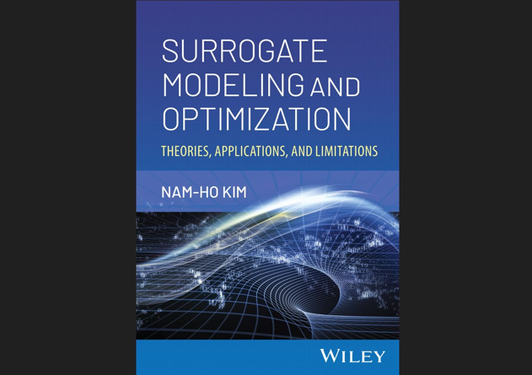

Slide 2
Chapter 5 Numerical Optimization Algorithms

Slide 3
Numerical Optimization Algorithms
Optimality criteria are only applicable for limited cases
When the expressions of obj and constraints are known
Compliance objective in topology optimization
Most other cases, numerical methods are used to find optimum design
Some numerical algorithms start from a design and find a new design that can improve the objective function
Other algorithms populate designs until they cannot find a design that can improve the objective function

Slide 4
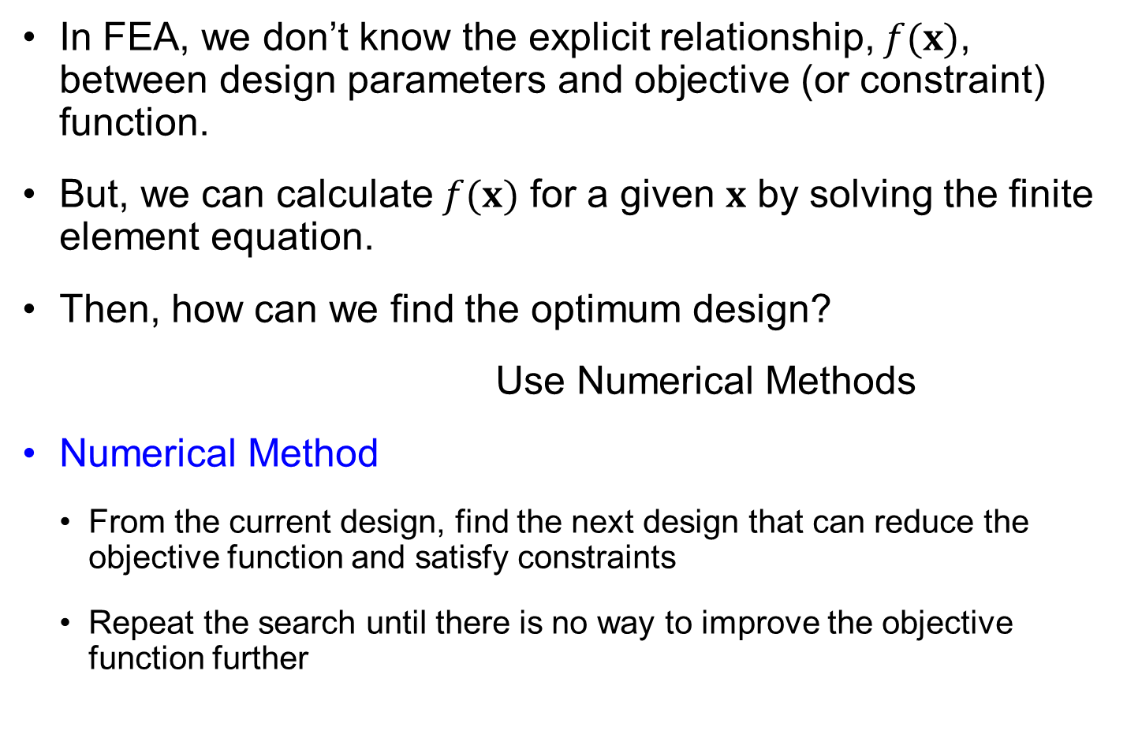
Numerical Methods
In FEA, we don’t know the explicit relationship, $f(x)$, between design parameters and objective (or constraint) function.
But, we can calculate $f(x)$ for a given $x$ by solving the finite element equation.
Then, how can we find the optimum design?
Use Numerical Methods
Numerical Method
From the current design, find the next design that can reduce the objective function and satisfy constraints
Repeat the search until there is no way to improve the objective function further

Slide 5
Gradient-based Methods
We do not know the function before optimization
We can only evaluate the function and gradient at a given design
Objective
Start
Gradient
Move
Check Gradient = 0
Stop
Optimum solution
Design

Slide 6
5.2 Overview of Numerical Optimization Process
From a given design point, move to next design point that will improve the objective function while satisfying constraints

Slide 7
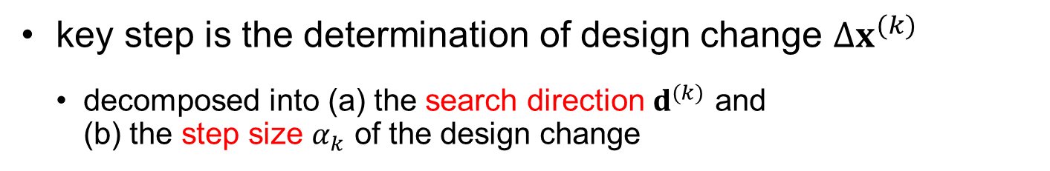
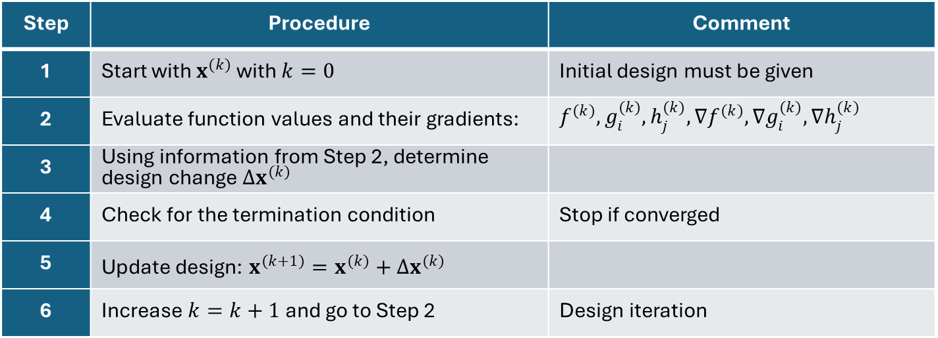

Numerical Optimization Process
Step | Procedure | Comment
1 | Start with $x^{(k)}$ with $k=0$ | Initial design must be given
2 | Evaluate function values and their gradients: | $f^{(k)}, g_{i}^{(k)}, h_{j}^{(k)},∇f^{(k)}, ∇g_{i}^{(k)}, ∇h_{j}^{(k)}$
3 | Using information from Step 2, determine design change $Δx^{(k)}$
4 | Check for the termination condition | Stop if converged
5 | Update design: $x^{(k+1)}=x^{(k)}+Δx^{(k)}$
6 | Increase $k=k+1$ and go to Step 2 | Design iteration
key step is the determination of design change $Δx^{(k)}$
decomposed into (a) the search direction $d^{(k)}$ and (b) the step size $α_{k}$ of the design change
d^{(k)}
α_{k}
$$Δx^{(k)}=α_{k}d^{(k)}$$
x^{(k)}

Slide 8
5.3 Determination of Step Size
For a given search direction, how far the design should change

Slide 9
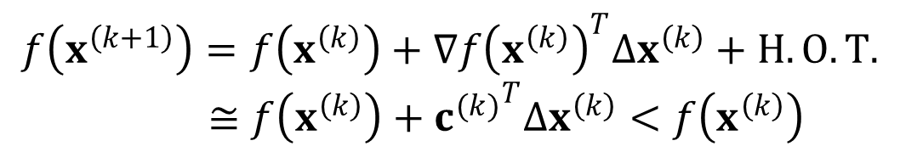
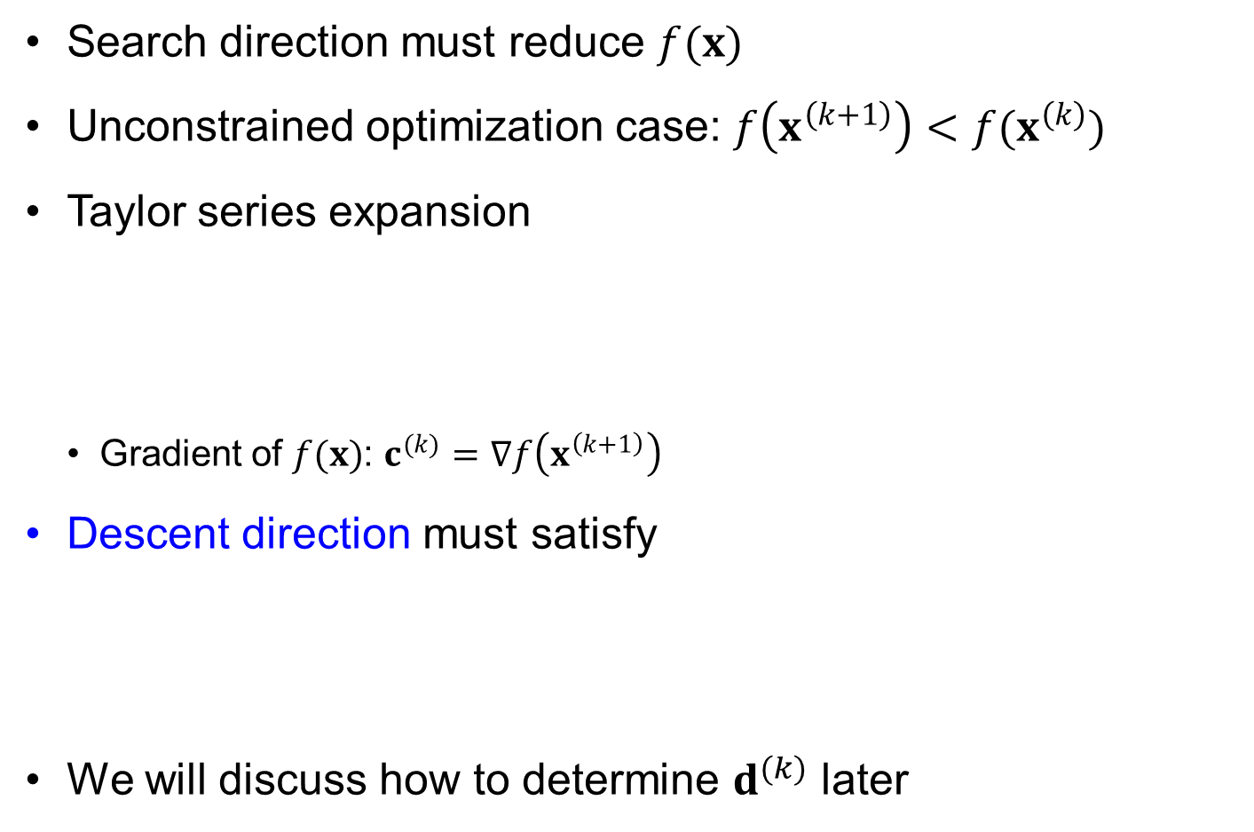

Descent Direction
Search direction must reduce $f(x)$
Unconstrained optimization case: $f\left(x^{\left(k+1\right)}\right)<f(x^{\left(k\right)})$
Taylor series expansion
Gradient of $f(x)$: $c^{(k)}=∇f\left(x^{\left(k+1\right)}\right)$
Descent direction must satisfy
We will discuss how to determine $d^{(k)}$ later
$$f\left(x^{\left(k+1\right)}\right)=f\left(x^{\left(k\right)}\right)+∇f{\left(x^{\left(k\right)}\right)}^{T}Δx^{\left(k\right)}+H.O.T. \\ ≅f\left(x^{\left(k\right)}\right)+{c^{(k)}}^{T}Δx^{\left(k\right)}<f\left(x^{\left(k\right)}\right)$$
c^{(k)}
$${c^{\left(k\right)}}^{T}Δx^{\left(k\right)}<0 \\ α_{k}{c^{\left(k\right)}}^{T}d^{(k)}<0$$
d^{(k)}

Slide 10

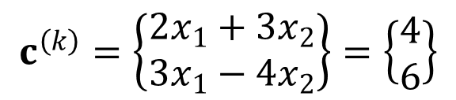

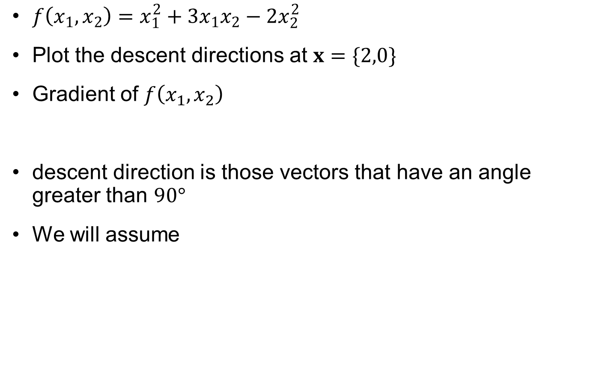



Ex5.1) Descent Direction
$f\left(x_{1},x_{2}\right)=x_{1}^{2}+3x_{1}x_{2}−2x_{2}^{2}$
Plot the descent directions at $x=\{2,0\}$
Gradient of $f\left(x_{1},x_{2}\right)$
descent direction is those vectors that have an angle greater than $90°$
We will assume
$$c^{\left(k\right)}=\left\{\begin{aligned}2x_{1}+3x_{2} \\ 3x_{1}−4x_{2}\end{aligned}\right\}=\left\{\begin{aligned}4 \\ 6\end{aligned}\right\}$$
$$x_{2}$$
$$c^{(k)}$$
$$x_{1}$$
Tangent plane
$$d^{(k)}$$
$$f=4$$

Slide 11




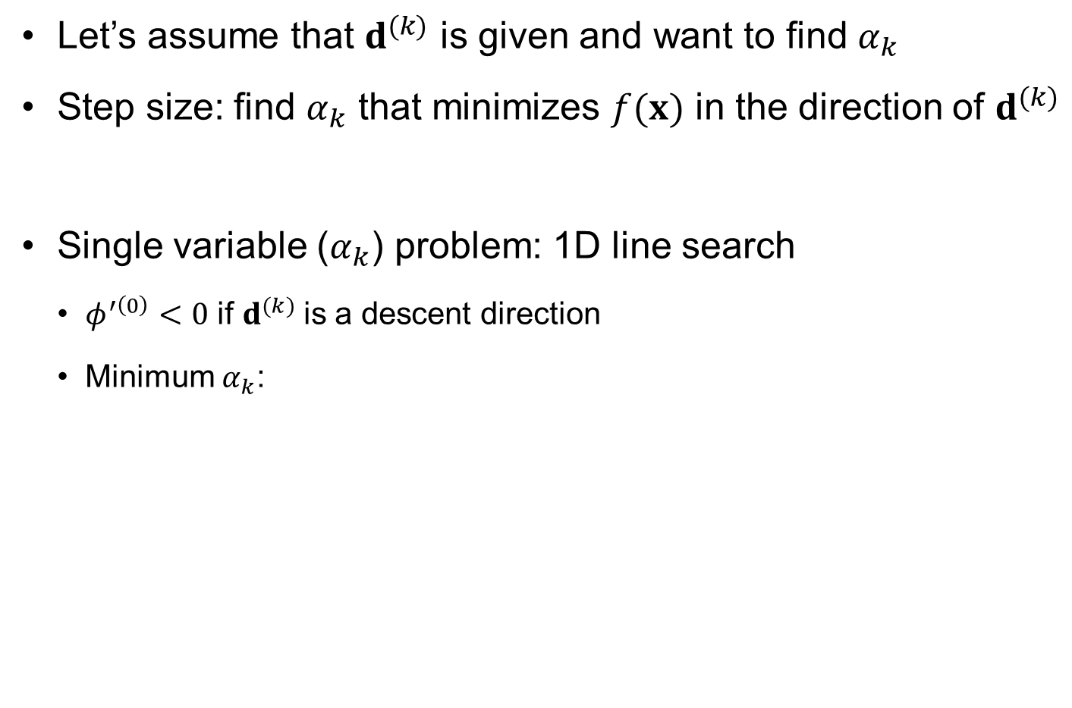




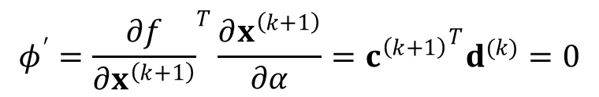

Step Size Termination Criterion
Let’s assume that $d^{(k)}$ is given and want to find $α_{k}$
Step size: find $α_{k}$ that minimizes $f(x)$ in the direction of $d^{(k)}$
Single variable ($α_{k}$) problem: 1D line search
$φ^{′\left(0\right)}<0$ if $d^{(k)}$is a descent direction
Minimum $α_{k}$:
$$minimize φ\left(α_{k}\right)≡f(x^{\left(k\right)}+α_{k}d^{\left(k\right)})$$
step size termination criterion
$$φ^{′}={\frac{∂f}{∂x^{\left(k+1\right)}}}^{T}\frac{∂x^{\left(k+1\right)}}{∂α}={c^{\left(k+1\right)}}^{T}d^{(k)}=0$$
$$φ(α)$$
$$x_{2}$$
$$d^{(k)}$$
Negative initial slope
$$φ(0)$$
$$α_{k}$$
$$x^{(k)}$$
$$α_{k}$$
$$α$$
$$x_{1}$$

Slide 12
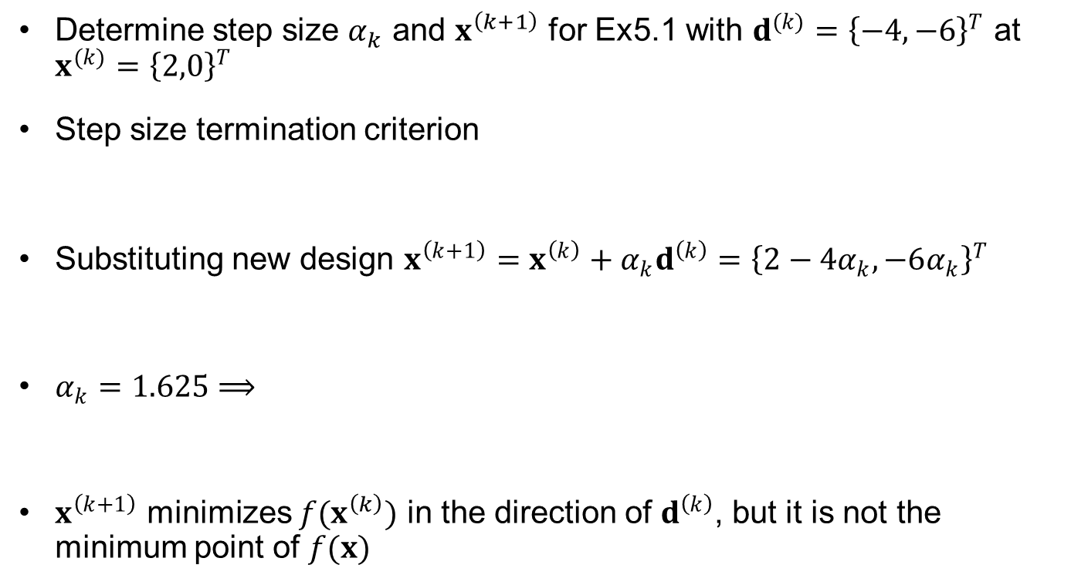
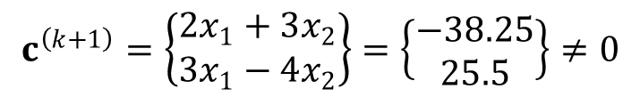
Ex5.2) Step Size Determination
Determine step size $α_{k}$ and $x^{\left(k+1\right)}$ for Ex5.1 with $d^{(k)}={\left\{−4, −6\right\}}^{T}$ at $x^{(k)}={\left\{2,0\right\}}^{T}$
Step size termination criterion
Substituting new design $x^{\left(k+1\right)}=x^{\left(k\right)}+α_{k}d^{\left(k\right)}={\left\{2−4α_{k}, −6α_{k}\right\}}^{T}$
$α_{k}=1.625⟹$
$x^{\left(k+1\right)}$ minimizes $f(x^{\left(k\right)})$ in the direction of $d^{\left(k\right)}$, but it is not the minimum point of $f(x)$
$${c^{\left(k+1\right)}}^{T}d^{(k)}=−4\left(2x_{1}+3x_{2}\right)−6(3x_{1}−4x_{2})=0$$
$${c^{\left(k+1\right)}}^{T}d^{(k)}=−4\left(2\left(2−4α_{k}\right)+3\left(−6α_{k}\right)\right)−6(3(2−4α_{k})−4(−6α_{k}))=0$$
$$x^{\left(k+1\right)}=x^{\left(k\right)}+α_{k}d^{\left(k\right)}={\left\{2−4α_{k}, −6α_{k}\right\}}^{T}={\left\{−4.5, −9.75\right\}}^{T}$$
$$c^{\left(k+1\right)}=\left\{\begin{aligned}2x_{1}+3x_{2} \\ 3x_{1}−4x_{2}\end{aligned}\right\}=\left\{\begin{aligned}−38.25 \\ 25.5\end{aligned}\right\}≠0$$

Slide 13
Numerical Line Search
0th-order methods: Bracketing, Quad. Interpolation, Fibonacci & golden section search
1st-order methods: Bisection, cubic interpolation
2nd-order methods: Newton’s method
Fibonacci & golden section method
Reducing interval based on function value
Maintain the reduction ratio constant
φ(α)
a₀ α₁ α₃ α₄ α₂ b₀
α

Slide 14





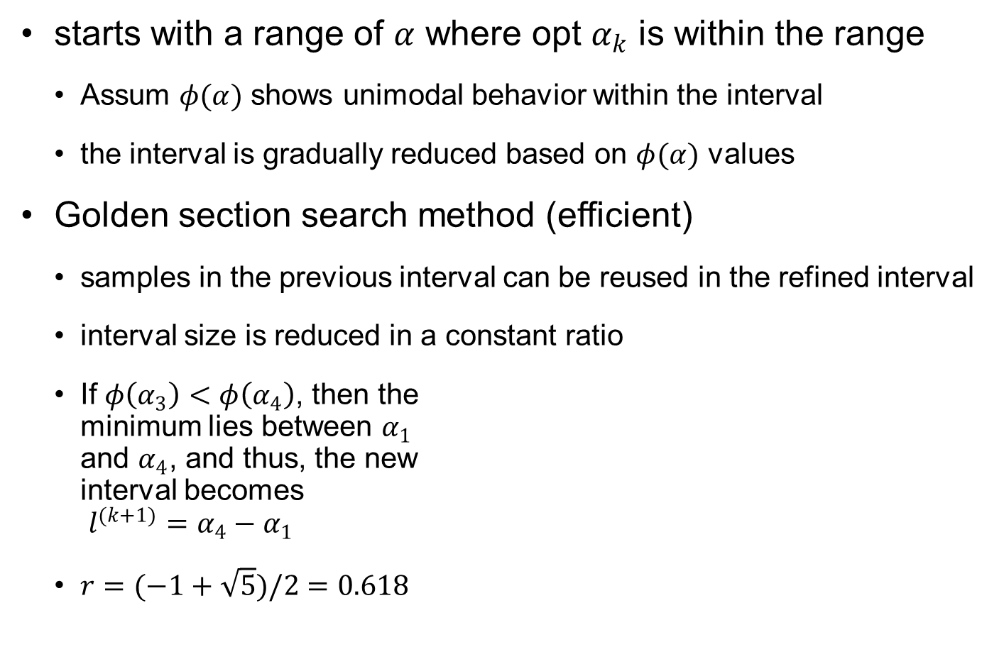








Interval Reduction Method
starts with a range of $α$ where opt $α_{k}$ is within the range
Assum $φ(α)$ shows unimodal behavior within the interval
the interval is gradually reduced based on $φ(α)$ values
Golden section search method (efficient)
samples in the previous interval can be reused in the refined interval
interval size is reduced in a constant ratio
If $φ\left(α_{3}\right)<φ\left(α_{4}\right)$, then the minimum lies between $α_{1}$ and $α_{4}$, and thus, the new interval becomes $l^{(k+1)}=α_{4}−α_{1}$
$r=(−1+\sqrt{5})/2=0.618$
$$l^{(k)}$$
$$rl^{(k)}$$
$$(1−r)l^{(k)}$$
$$α_{1}$$
$$α_{3}$$
$$α_{4}$$
$$α_{2}$$
$k$th iteration
$$l^{(k+1)}$$
$$α_{5}$$
($k+1)$th iteration
$$rl^{(k+1)}$$
$$(1−r)l^{(k+1)}$$

Slide 15

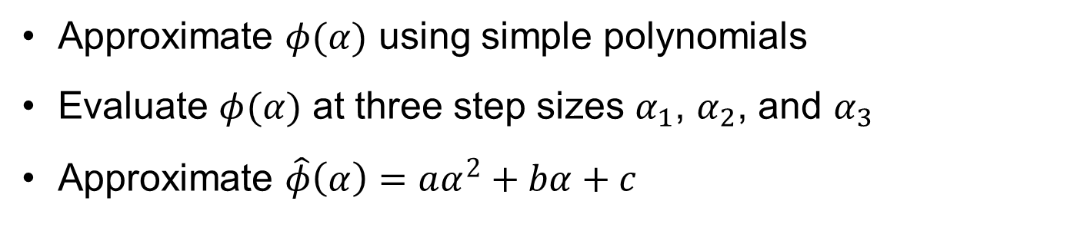
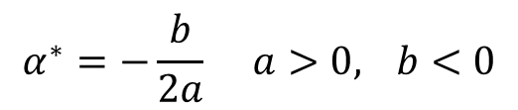
Quadratic Interpolation Method
Approximate $φ(α)$ using simple polynomials
Evaluate $φ(α)$ at three step sizes $α_{1}$, $α_{2}$, and $α_{3}$
Approximate $\hat{φ}\left(α\right)=aα^{2}+bα+c$
$$\begin{matrix}φ\left(α\right)=aα^{2}+bα+c \\ φ^{′}\left(α\right)=2aα+b=0 \\ φ^{″}\left(α\right)=2a>0\end{matrix}$$
φ(α)
True function
Quad. approx.
$$α^{∗}=−\frac{b}{2a} a>0, b<0$$
optimum step size
α₁ α₂ α* α₃
α

Slide 16
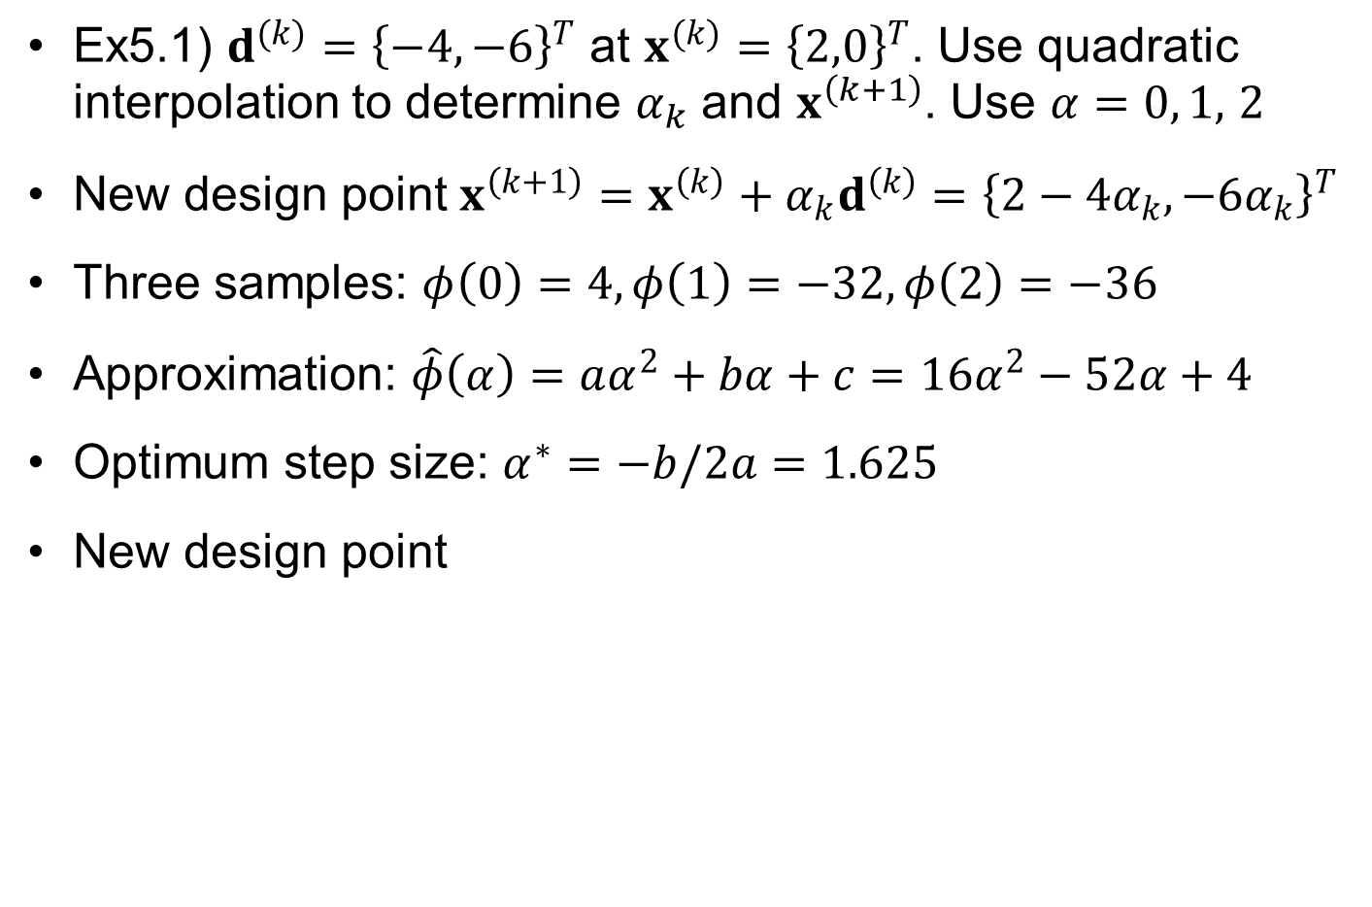
Ex5.3) Quadratic Interpolation
Ex5.1) $d^{(k)}={\left\{−4, −6\right\}}^{T}$ at $x^{(k)}={\left\{2,0\right\}}^{T}$. Use quadratic interpolation to determine $α_{k}$ and $x^{\left(k+1\right)}$. Use $α=0, 1,$ $2$
New design point $x^{\left(k+1\right)}=x^{\left(k\right)}+α_{k}d^{\left(k\right)}={\left\{2−4α_{k}, −6α_{k}\right\}}^{T}$
Three samples: $φ\left(0\right)=4, φ\left(1\right)=−32, φ\left(2\right)=−36$
Approximation: $\hat{φ}\left(α\right)=aα^{2}+bα+c=16α^{2}−52α+4$
Optimum step size: $α^{∗}=−b/2a=1.625$
New design point
$$x^{\left(k+1\right)}=x^{\left(k\right)}+α_{k}d^{\left(k\right)}={\left\{2−4α_{k}, −6α_{k}\right\}}^{T}={\left\{−4.5, −9.75\right\}}^{T}$$

Slide 17
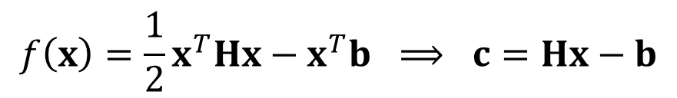
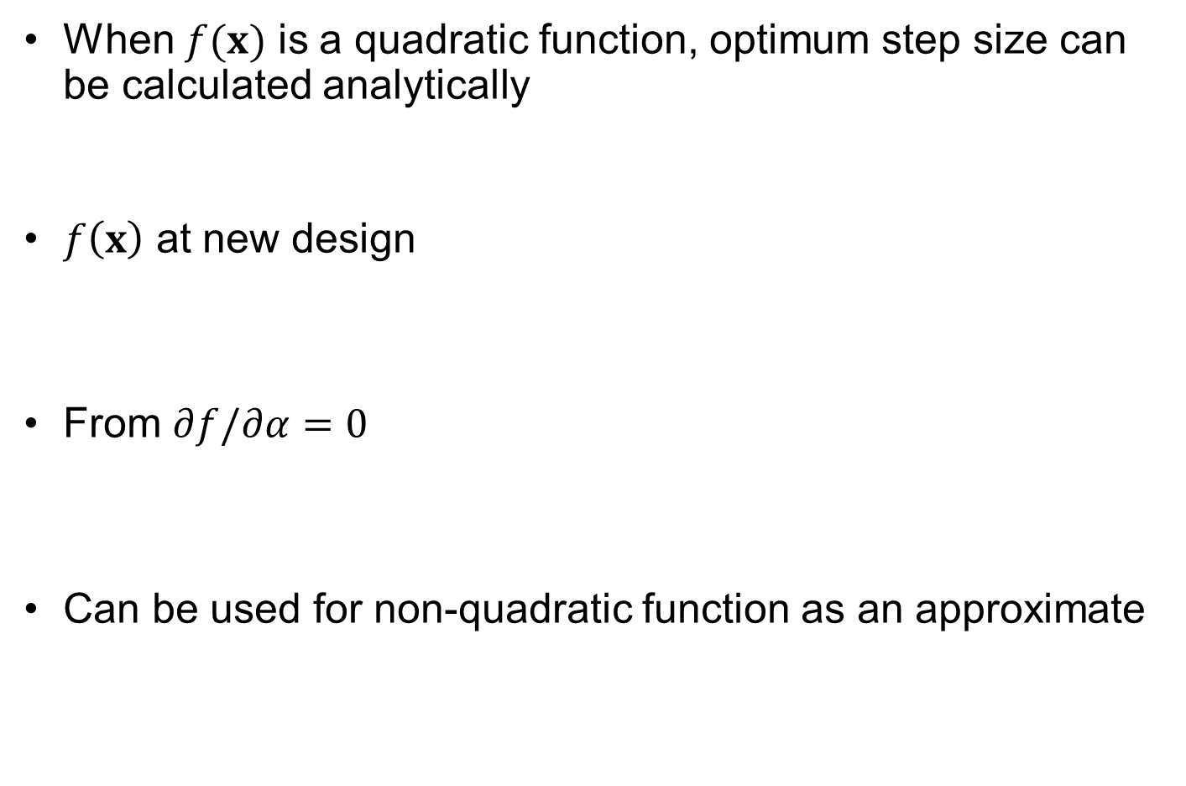

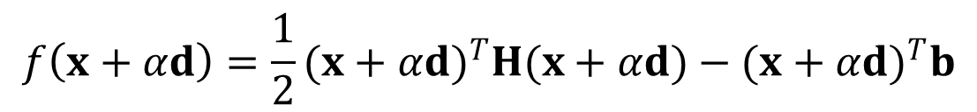
Optimum Step Size for Quadratic Function
When $f(x)$ is a quadratic function, optimum step size can be calculated analytically
$f\left(x\right)$ at new design
From $∂f/∂α=0$
Can be used for non-quadratic function as an approximate
$$f\left(x\right)=\frac{1}{2}x^{T}Hx−x^{T}b ⟹ c=Hx−b$$
$$f\left(x+αd\right)=\frac{1}{2}{(x+αd)}^{T}H(x+αd)−{(x+αd)}^{T}b$$
$$α=−\frac{d^{T}c}{d^{T}Hd}>0$$

Slide 18
5.4 Unconstrained Optimization Algorithms
Optimization problem without constraint is to find the stationary point of the objective function

Slide 19

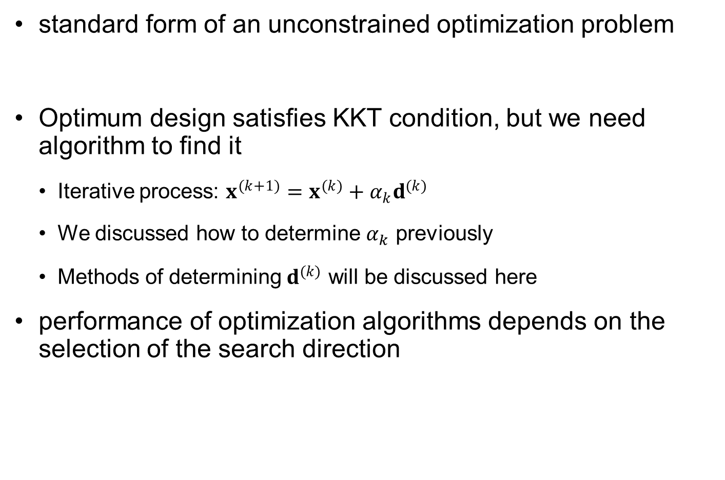
Unconstrained Optimization Algorithms
standard form of an unconstrained optimization problem
Optimum design satisfies KKT condition, but we need algorithm to find it
Iterative process: $x^{(k+1)}=x^{(k)}+α_{k}d^{(k)}$
We discussed how to determine $α_{k}$ previously
Methods of determining $d^{(k)}$ will be discussed here
performance of optimization algorithms depends on the selection of the search direction
$$minimize f(x)$$

Slide 20


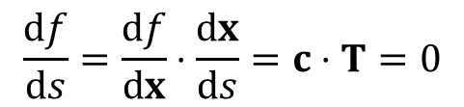
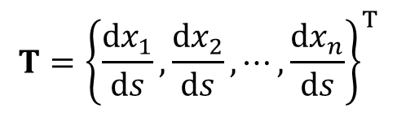
Search (Descent) Direction
Properties of $c^{\left(k\right)}=∇f^{\left(k\right)}$
Normal to the surface $f=constant$
$f(x)$ increases in the direction of $c^{\left(k\right)}$
Increasing ratio is max in the direction of $c^{\left(k\right)}$
c
$$T={\left\{\frac{dx_{1}}{ds},\frac{dx_{2}}{ds},⋯,\frac{dx_{n}}{ds}\right\}}^{T}$$
T
$$\frac{df}{ds}=\frac{df}{dx}⋅\frac{dx}{ds}=c⋅T=0$$
s
f = constant
$$∴c⊥T$$
T: Tangent vector

Slide 21
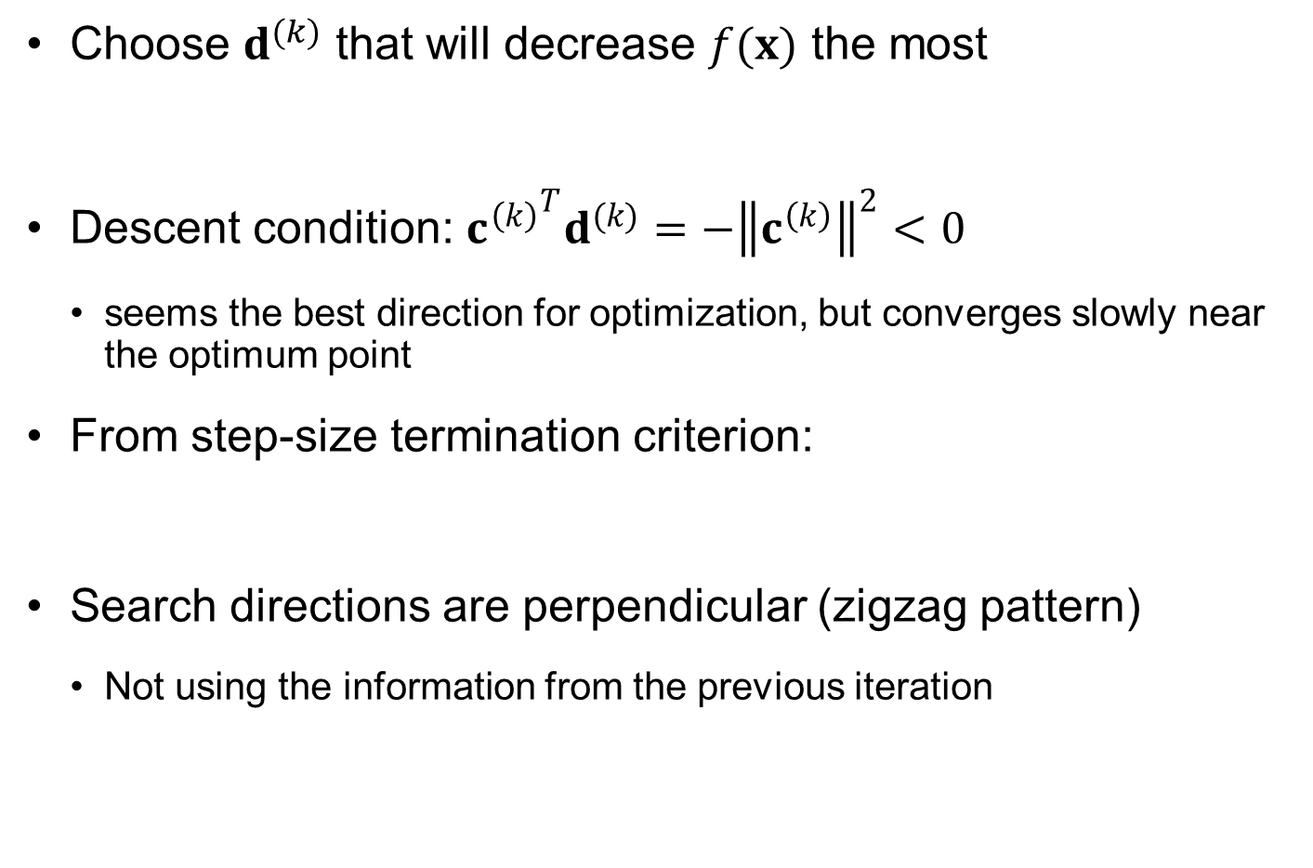

Steepest Descent Method (SDM)
Choose $d^{(k)}$ that will decrease $f(x)$ the most
Descent condition: ${c^{\left(k\right)}}^{T}d^{(k)}=−{\left\|c^{\left(k\right)}\right\|}^{2}<0$
seems the best direction for optimization, but converges slowly near the optimum point
From step-size termination criterion:
Search directions are perpendicular (zigzag pattern)
Not using the information from the previous iteration
$$d^{(k)}=−c^{(k)}$$
$${c^{\left(k+1\right)}}^{T}d^{(k)}=−{c^{\left(k+1\right)}}^{T}c^{\left(k\right)}=0 ∴c^{\left(k+1\right)}⊥c^{\left(k\right)}$$
Notes:
Gradient based optimization algorithms assume that gradient calculations are expensive. Therefore, once the gradient is calculated and a search direction selected, it pays to go in that direction for a while, rather than stop soon and update the direction based on another gradient calculation. The move is described by
Which indicates that the (k+1)-th position is found by moving a distance alpha in the direction s_{k}. The distance alpha is usually based on one-dimensional minimization of the function in that direction.
The most intuitive direction is in the direction of steepest descent (negative of the gradient direction), the way water moves on a terrain. However, water can continually change direction, while we want to stick to a single direction as long as possible. This makes the steepest descent direction a poor choice.
Instead, methods for choosing a better direction are based on the idea that close enough to a minimum the function behaves like a quadratic.

Slide 22
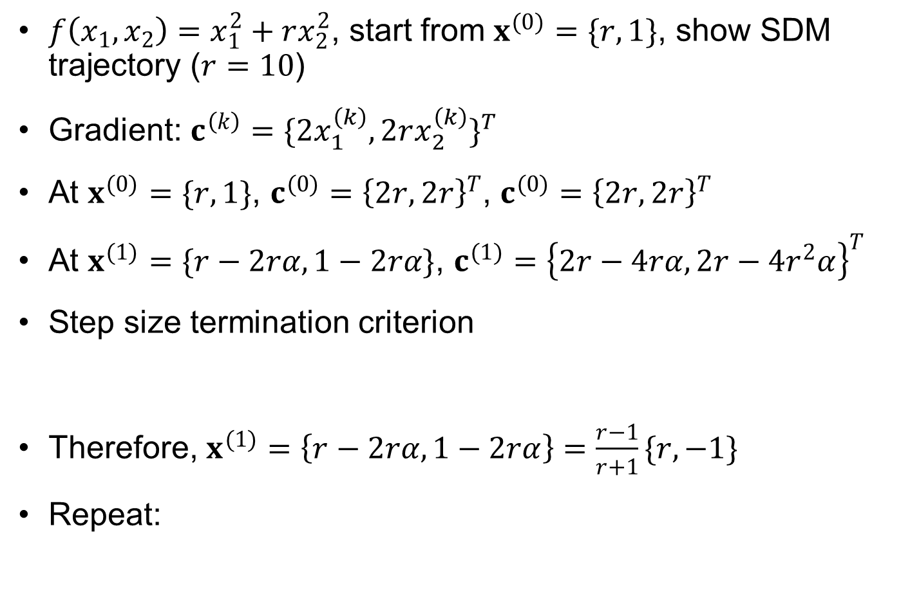
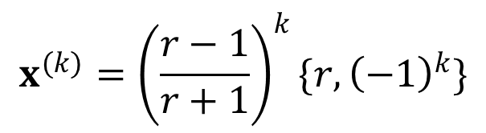
Ex5.4) Steepest Descent Method
$f\left(x_{1},x_{2}\right)=x_{1}^{2}+rx_{2}^{2}$, start from $x^{(0)}=\{r,1\}$, show SDM trajectory ($r=10$)
Gradient: $c^{\left(k\right)}={\{2x_{1}^{\left(k\right)}, 2rx_{2}^{\left(k\right)}\}}^{T}$
At $x^{(0)}=\{r,1\}$, $c^{(0)}={\left\{2r,2r\right\}}^{T}$, $c^{(0)}={\left\{2r,2r\right\}}^{T}$
At $x^{(1)}=\{r−2rα,1−2rα\}$, $c^{(1)}={\left\{2r−4rα,2r−4r^{2}α\right\}}^{T}$
Step size termination criterion
Therefore, $x^{(1)}=\left\{r−2rα,1−2rα\right\}=\frac{r−1}{r+1}\{r,−1\}$
Repeat:
$${c^{\left(1\right)}}^{T}d^{(0)}=2r\left(2r−4rα\right)+2r\left(2r−4r^{2}α\right)=0 → α_{0}=\frac{1}{r+1}$$
$$x^{(k)}={\left(\frac{r−1}{r+1}\right)}^{k}\{r,{\left(−1\right)}^{k}\}$$

Slide 23
Ex5.4) Steepest Descent Method cont.
r=10; x0=[r 1];
for k=1:10
x(k,:)=((r-1)/(r+1))^k*[r (-1)^k];
end
x = [x0; x];
figure(1);hold on; axis equal;
line(x(:,1),x(:,2),'marker','o')
%
x = linspace(-12,12);
y = linspace(-5,5);
[X,Y] = meshgrid(x,y);
Z = X.^2 + r*Y.^2;
contour(X,Y,Z,[0.1 0.5 1 2 5 10 20 30 50 70 100])
3
2
1
0
-1
-2
-3
-10
-5
0
5
10

Slide 24



Conjugate Gradient Method
Use gradient information from the previous iteration to move in the diagonal direction of two gradients
converge to the minimum of an $n$-dimensional quadratic function in no more than $n$ iterations
Let $d^{(0)}=−c^{(0)}$ (SDM)
$d^{(k)}=−c^{\left(k\right)}+β_{k}d^{(k−1)}$
$$β_{k}={\left(\frac{\left\|c^{\left(k\right)}\right\|}{\left\|c^{\left(k−1\right)}\right\|}\right)}^{2}>0$$
At optimum, $β_{k}=0$
Notes:
Conjugate gradient methods select a direction which takes into account not only the gradient direction but also the search direction in the previous iteration. By doing that, we can develop algorithms that are guaranteed to converge to the minimum of an n-dimensional quadratic function in no more than n iterations.
The equation at the top of the slide gives the recipe for the Fletcher Reeves conjugate gradient method, and the figure compares it to the steepest descent method for a quadratic function
The two methods start the same in the negative gradient direction. However, the steepest descent methods zig-zags around, while the conjugate directions methods homes on the minimum in the second move.
Note that each move ends being tangent to the function contour, because we minimize the function in the search direction. Most implementations approximate the function as a quadratic along the search direction, so that if the function is a quadratic the search will end at the minimum in that direction. However, if the function is not quadratic we are likely to stop at a distance from where the direction is tangent to the contour.

Slide 25
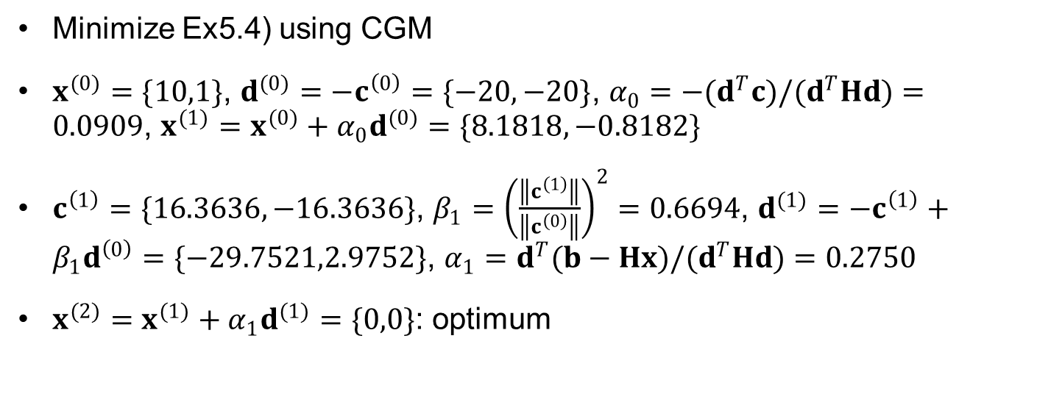
Ex5.5) Conjugate Gradient Method
Minimize Ex5.4) using CGM
$x^{(0)}=\{10,1\}$, $d^{(0)}=−c^{\left(0\right)}=\{−20,−20\}$, $α_{0}=−(d^{T}c)/(d^{T}Hd)=0.0909$, $x^{(1)}=x^{(0)}+α_{0}d^{(0)}=\{8.1818,−0.8182\}$
$c^{\left(1\right)}=\{16.3636,−16.3636\}$, $β_{1}={\left(\frac{\left\|c^{\left(1\right)}\right\|}{\left\|c^{\left(0\right)}\right\|}\right)}^{2}=0.6694$, $d^{(1)}=−c^{\left(1\right)}+β_{1}d^{\left(0\right)}=\{−29.7521,2.9752\}$, $α_{1}=d^{T}(b−Hx)/(d^{T}Hd)=0.2750$
$x^{(2)}=x^{(1)}+α_{1}d^{(1)}=\{0,0\}$: optimum
3
2
1
0
-1
-2
-3
-10
-5
0
5
10

Slide 26
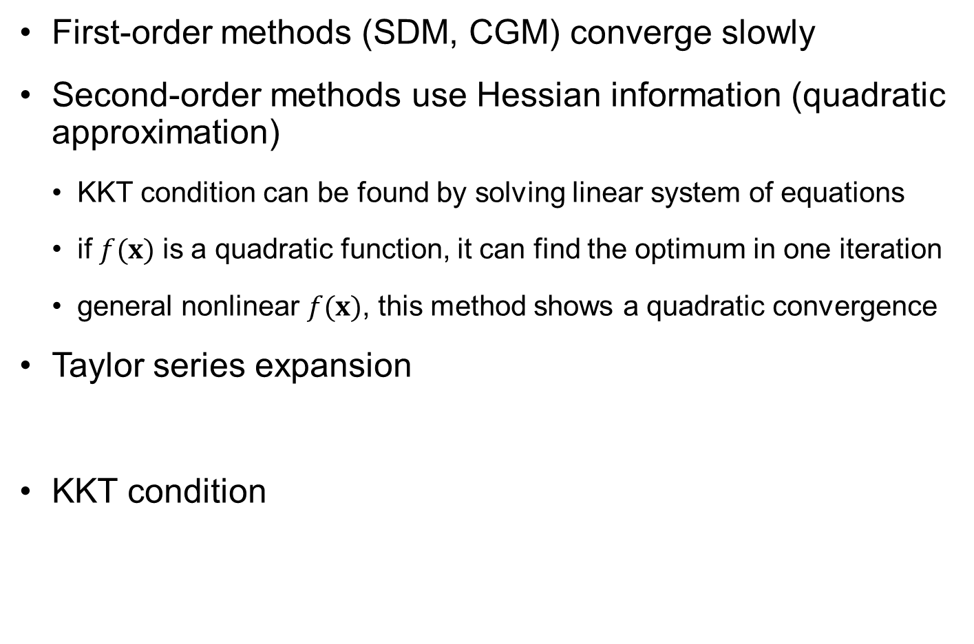

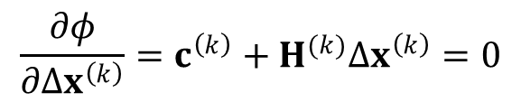
Newton’s Method
First-order methods (SDM, CGM) converge slowly
Second-order methods use Hessian information (quadratic approximation)
KKT condition can be found by solving linear system of equations
if $f(x)$ is a quadratic function, it can find the optimum in one iteration
general nonlinear $f(x)$, this method shows a quadratic convergence
Taylor series expansion
KKT condition
$$φ\left(Δx^{\left(k\right)}\right)=f\left(x^{(k)}+Δx^{(k)}\right)≈f\left(x^{\left(k\right)}\right)+{c^{\left(k\right)}}^{T}Δx^{\left(k\right)}+\frac{1}{2}Δ{x^{\left(k\right)}}^{T}H^{(k)}Δx^{\left(k\right)}$$
$$\frac{∂φ}{∂Δx^{\left(k\right)}}=c^{\left(k\right)}+H^{(k)}Δx^{\left(k\right)}=0$$
$$Δx^{\left(k\right)}=−{H^{(k)}}^{−1}c^{\left(k\right)}$$

Slide 27

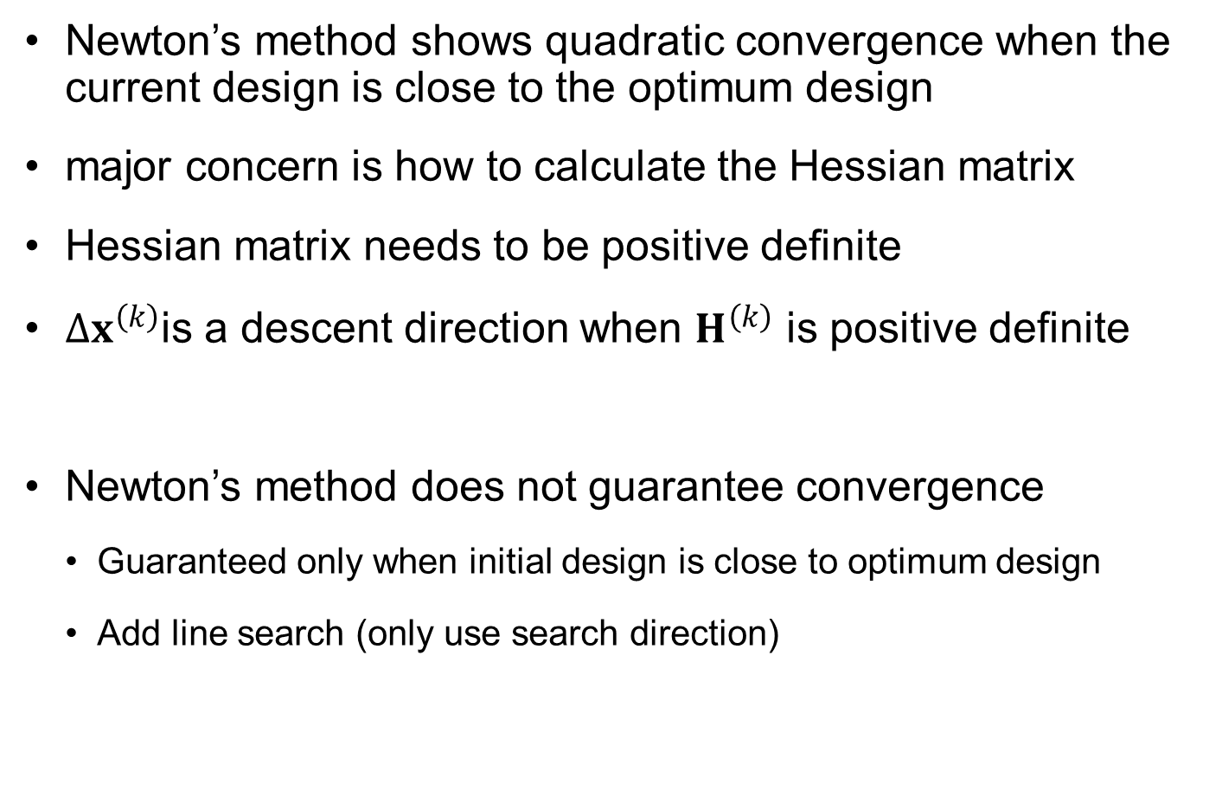
Newton’s Method cont.
Newton’s method shows quadratic convergence when the current design is close to the optimum design
major concern is how to calculate the Hessian matrix
Hessian matrix needs to be positive definite
$Δx^{\left(k\right)}$is a descent direction when $H^{\left(k\right)}$ is positive definite
Newton’s method does not guarantee convergence
Guaranteed only when initial design is close to optimum design
Add line search (only use search direction)
$${c^{\left(k\right)}}^{T}Δx^{\left(k\right)}=−c^{\left(k\right)}H^{\left(k\right)}c^{\left(k\right)}<0$$
$$Δd^{\left(k\right)}=−{H^{(k)}}^{−1}c^{\left(k\right)}⟹x^{(k+1)}=x^{(k)}+α_{k}Δd^{\left(k\right)}$$

Slide 28
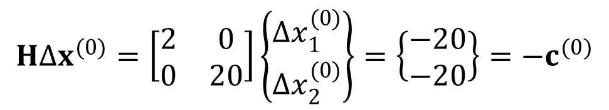
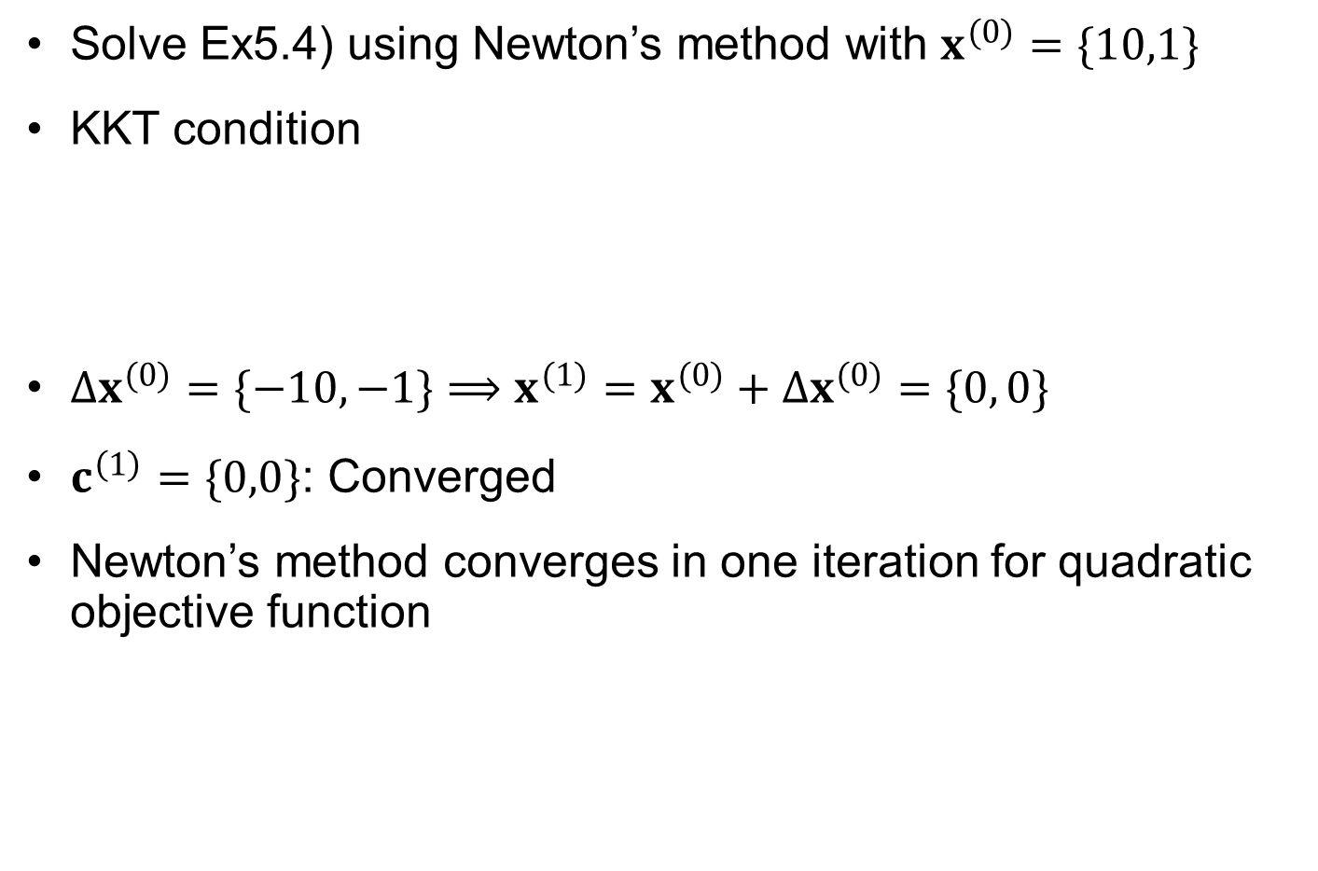
Ex) Newton’s Method
Solve Ex5.4) using Newton’s method with $x^{(0)}=\{10,1\}$
KKT condition
$Δx^{(0)}=\{−10, −1\}⟹x^{(1)}=x^{(0)}+Δx^{(0)}=\{0, 0\}$
$c^{\left(1\right)}=\{0,0\}$: Converged
Newton’s method converges in one iteration for quadratic objective function
$$HΔx^{(0)}=\left[\begin{matrix}2 & 0 \\ 0 & 20\end{matrix}\right]\left\{\begin{matrix}Δx_{1}^{(0)} \\ Δx_{2}^{(0)}\end{matrix}\right\}=\left\{\begin{matrix}−20 \\ −20\end{matrix}\right\}=−c^{(0)}$$

Slide 29
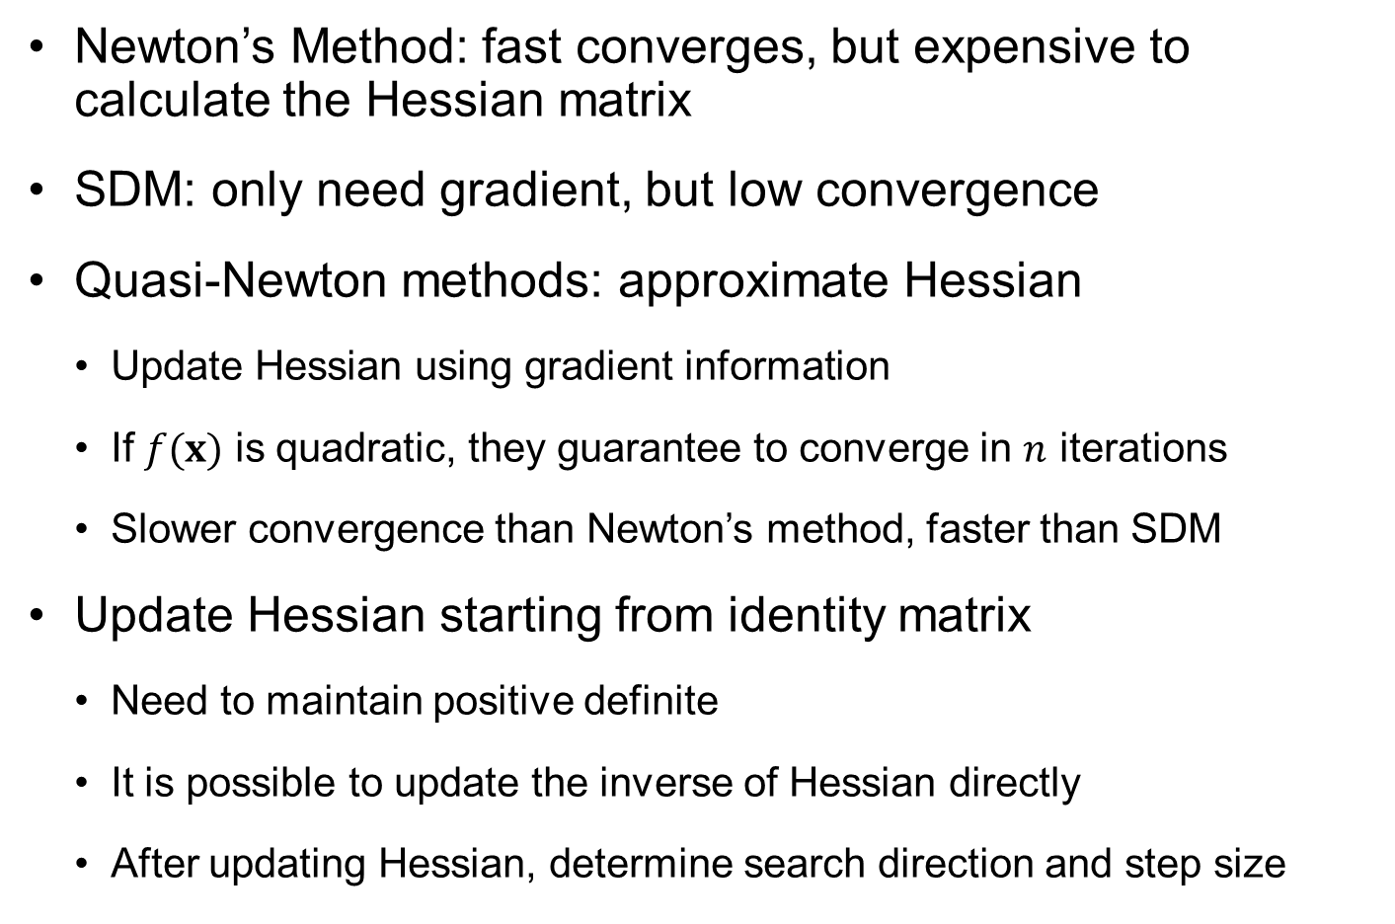
Quasi-Newton Method
Newton’s Method: fast converges, but expensive to calculate the Hessian matrix
SDM: only need gradient, but low convergence
Quasi-Newton methods: approximate Hessian
Update Hessian using gradient information
If $f(x)$ is quadratic, they guarantee to converge in $n$ iterations
Slower convergence than Newton’s method, faster than SDM
Update Hessian starting from identity matrix
Need to maintain positive definite
It is possible to update the inverse of Hessian directly
After updating Hessian, determine search direction and step size

Slide 30
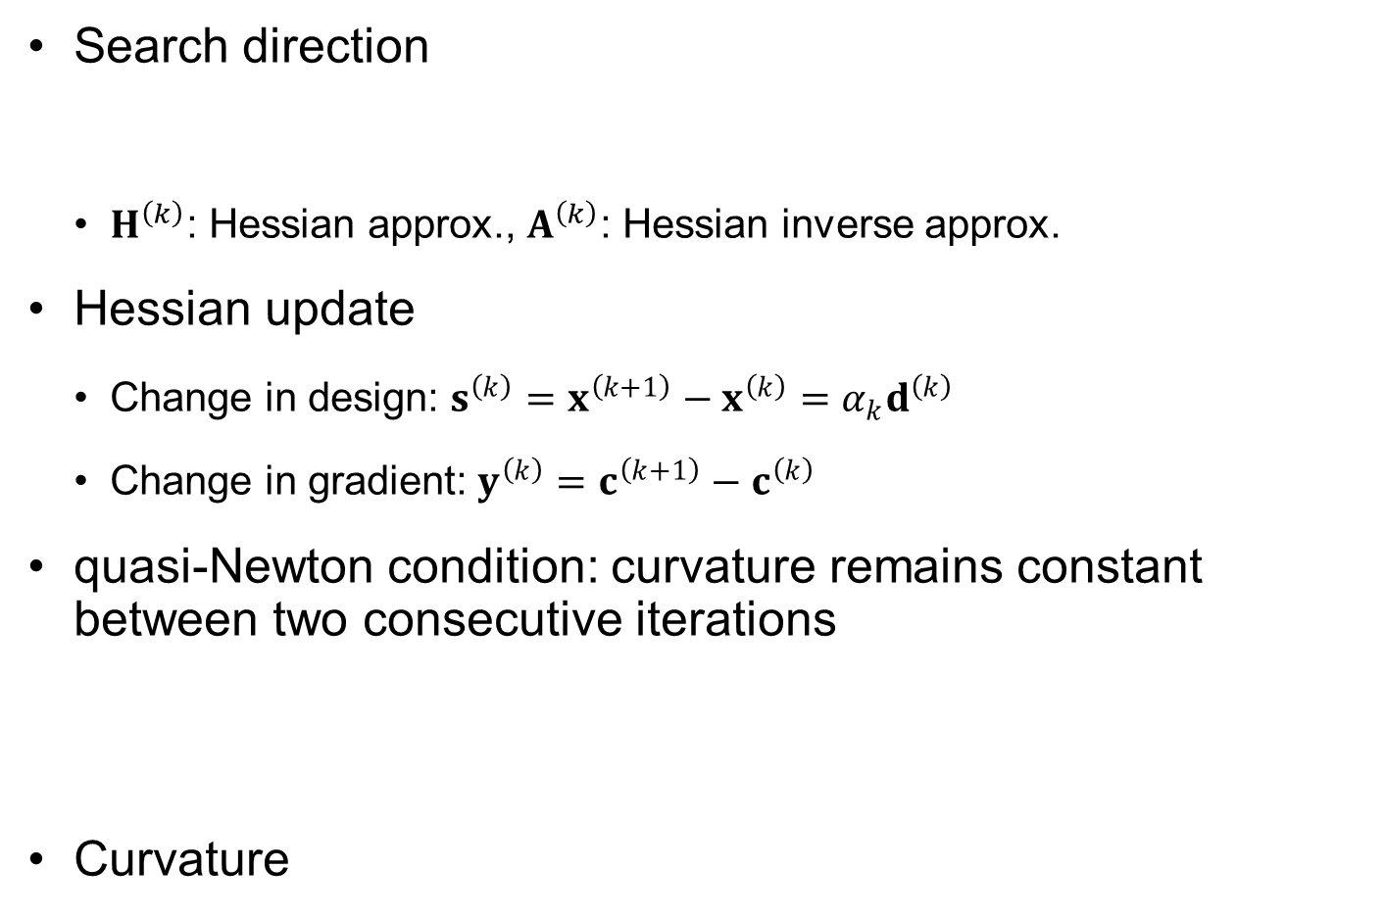


Quasi-Newton Method cont.
Search direction
$H^{\left(k\right)}$: Hessian approx., $A^{\left(k\right)}$: Hessian inverse approx.
Hessian update
Change in design: $s^{\left(k\right)}=x^{\left(k+1\right)}−x^{\left(k\right)}=α_{k}d^{\left(k\right)}$
Change in gradient: $y^{\left(k\right)}=c^{\left(k+1\right)}−c^{\left(k\right)}$
quasi-Newton condition: curvature remains constant between two consecutive iterations
Curvature
$$d^{\left(k\right)}=−{H^{\left(k\right)}}^{−1}c^{\left(k\right)} or d^{\left(k\right)}=−A^{\left(k\right)}c^{\left(k\right)}$$
+ line search
$$c^{\left(k+1\right)}=c\left(x^{\left(k\right)}+s^{\left(k\right)}\right)=c^{\left(k\right)}+H^{\left(k\right)}s^{\left(k\right)}+H.O.T.$$
$$y^{\left(k\right)}=c^{\left(k+1\right)}−c^{\left(k\right)}≈H^{\left(k\right)}s^{\left(k\right)}$$
$${s^{\left(k\right)}}^{T} y^{\left(k\right)}={s^{\left(k\right)}}^{T}H^{\left(k\right)}s^{\left(k\right)}$$

Slide 31
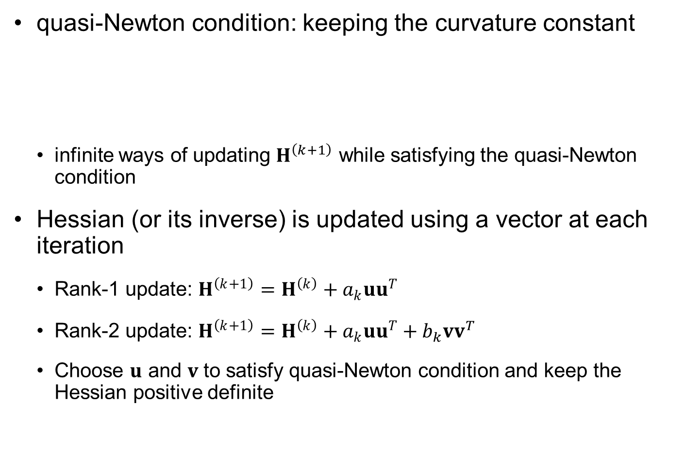
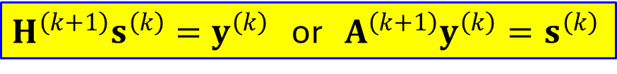
Quasi-Newton Method cont.
quasi-Newton condition: keeping the curvature constant
infinite ways of updating $H^{\left(k+1\right)}$ while satisfying the quasi-Newton condition
Hessian (or its inverse) is updated using a vector at each iteration
Rank-1 update: $H^{\left(k+1\right)}=H^{\left(k\right)}+a_{k}uu^{T}$
Rank-2 update: $H^{\left(k+1\right)}=H^{\left(k\right)}+a_{k}uu^{T}+b_{k}vv^{T}$
Choose $u$ and $v$ to satisfy quasi-Newton condition and keep the Hessian positive definite
$${s^{\left(k\right)}}^{T}H^{\left(k+1\right)}s^{\left(k\right)}={s^{\left(k\right)}}^{T}H^{\left(k\right)}s^{\left(k\right)}={s^{\left(k\right)}}^{T} y^{\left(k\right)}$$
$H^{\left(k+1\right)}s^{\left(k\right)}=y^{\left(k\right)}$ or $A^{\left(k+1\right)}y^{\left(k\right)}=s^{\left(k\right)}$

Slide 32

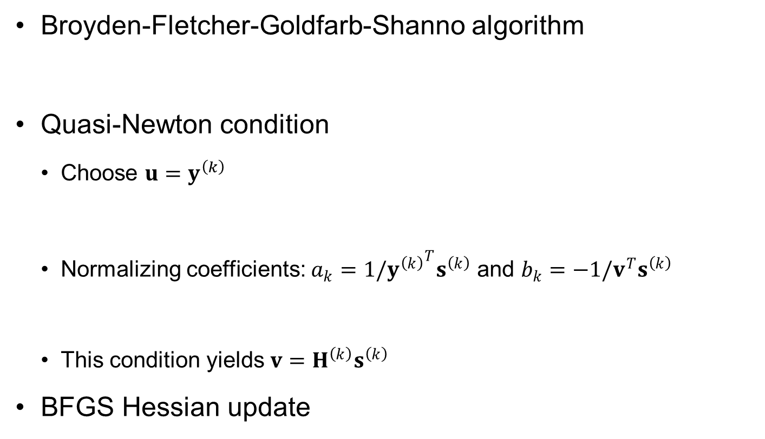
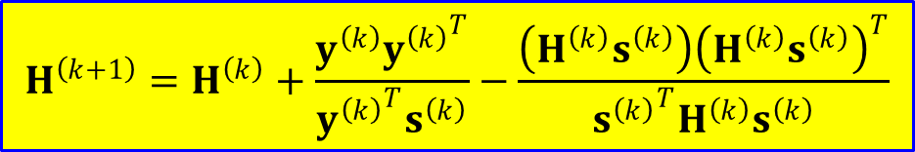

Rank-2 Update (BFGS)
Broyden-Fletcher-Goldfarb-Shanno algorithm
Quasi-Newton condition
Choose $u=y^{\left(k\right)}$
Normalizing coefficients: $a_{k}=1/{y^{\left(k\right)}}^{T}s^{\left(k\right)}$ and $b_{k}=−1/v^{T}s^{\left(k\right)}$
This condition yields $v=H^{\left(k\right)}s^{\left(k\right)}$
BFGS Hessian update
$$H^{\left(k+1\right)}=H^{\left(k\right)}+a_{k}uu^{T}+b_{k}vv^{T}$$
$$H^{\left(k+1\right)}s^{\left(k\right)}=H^{\left(k\right)}s^{\left(k\right)}+a_{k}y^{\left(k\right)}\left({y^{\left(k\right)}}^{T}s^{\left(k\right)}\right)+b_{k}v\left(v^{T}s^{\left(k\right)}\right)=y^{\left(k\right)}$$
$$H^{\left(k+1\right)}s^{\left(k\right)}=H^{\left(k\right)}s^{\left(k\right)}+y^{\left(k\right)}−v=y^{\left(k\right)}$$
$$H^{\left(k+1\right)}=H^{\left(k\right)}+\frac{y^{\left(k\right)}{y^{\left(k\right)}}^{T}}{{y^{\left(k\right)}}^{T}s^{\left(k\right)}}−\frac{\left(H^{\left(k\right)}s^{\left(k\right)}\right){\left(H^{\left(k\right)}s^{\left(k\right)}\right)}^{T}}{{{s^{\left(k\right)}}^{T}H}^{\left(k\right)}s^{\left(k\right)}}$$

Slide 33


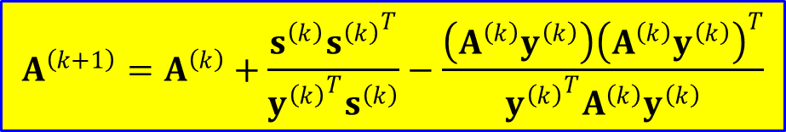
Rank-2 Update (DFP)
Davidon-Fletcher-Powell algorithm
Updating the inverse of Hessian matrix
Choose $u=s^{\left(k\right)}$ and $v=A^{\left(k\right)}y^{\left(k\right)}$
$$A^{\left(k+1\right)}=A^{\left(k\right)}+a_{k}uu^{T}+b_{k}vv^{T}$$
$$A^{\left(k+1\right)}=A^{\left(k\right)}+\frac{s^{\left(k\right)}{s^{\left(k\right)}}^{T}}{{y^{\left(k\right)}}^{T}s^{\left(k\right)}}−\frac{\left(A^{\left(k\right)}y^{\left(k\right)}\right){\left(A^{\left(k\right)}y^{\left(k\right)}\right)}^{T}}{{{y^{\left(k\right)}}^{T}A}^{\left(k\right)}y^{\left(k\right)}}$$

Slide 34
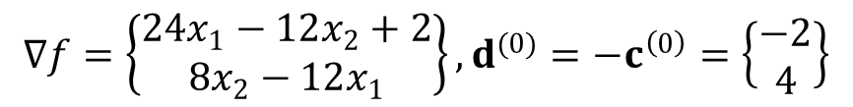
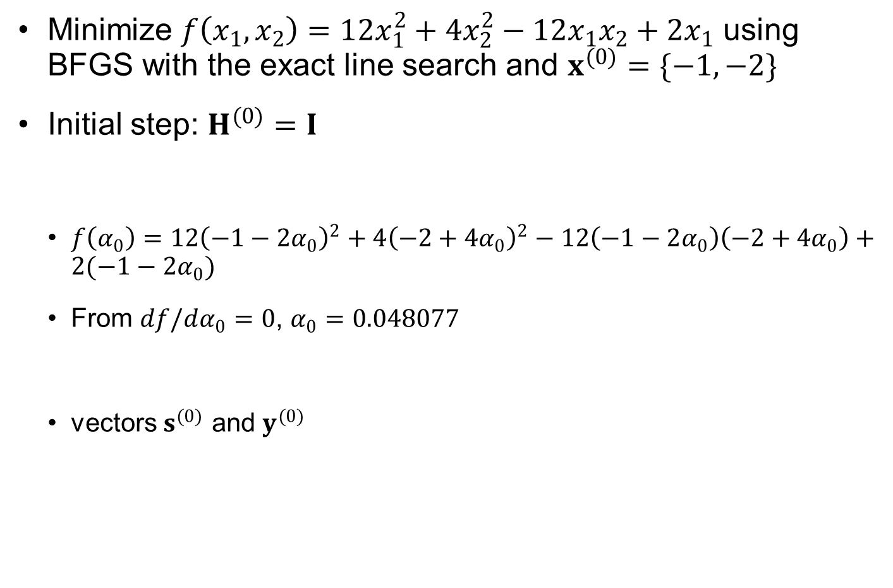
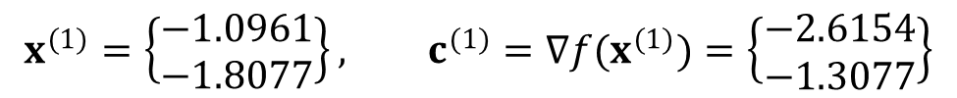

Ex5.7) BFGS Algorithm
Minimize $f\left(x_{1},x_{2}\right)=12x_{1}^{2}+4x_{2}^{2}−12x_{1}x_{2}+2x_{1}$ using BFGS with the exact line search and $x^{(0)}=\{−1,−2\}$
Initial step: $H^{(0)}=I$
$f\left(α_{0}\right)=12{\left(−1−2α_{0}\right)}^{2}+4{\left(−2+4α_{0}\right)}^{2}−12\left(−1−2α_{0}\right)\left(−2+4α_{0}\right)+2(−1−2α_{0})$
From $df/dα_{0}=0$, $α_{0}=0.048077$
vectors $s^{(0)}$ and $y^{(0)}$
$$∇f=\left\{\begin{matrix}24x_{1}−12x_{2}+2 \\ 8x_{2}−12x_{1}\end{matrix}\right\}, d^{(0)}=−c^{\left(0\right)}=\left\{\begin{matrix}−2 \\ 4\end{matrix}\right\}$$
$$x^{(1)}=\left\{\begin{matrix}−1 \\ −2\end{matrix}\right\}+α_{0}\left\{\begin{matrix}−2 \\ 4\end{matrix}\right\}$$
$$x^{(1)}=\left\{\begin{matrix}−1.0961 \\ −1.8077\end{matrix}\right\}, c^{(1)}=∇f(x^{(1)})=\left\{\begin{matrix}−2.6154 \\ −1.3077\end{matrix}\right\}$$
$$s^{(0)}=x^{(1)}−x^{\left(0\right)}=\left\{\begin{matrix}−0.0961 \\ 0.1923\end{matrix}\right\}, y^{\left(0\right)}=c^{\left(1\right)}−c^{(0)}=\left\{\begin{matrix}−4.6154 \\ 2.6923\end{matrix}\right\}$$

Slide 35
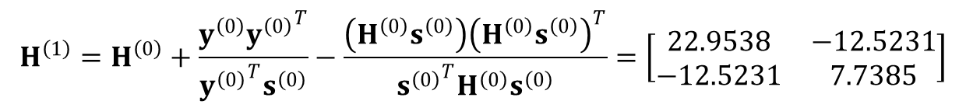




Ex5.7) BFGS Algorithm cont.
Update Hessian
Search direction
Design at next iteration
from $df/dα_{1}=0$, $α_{1}=0.4332$
$$H^{\left(1\right)}=H^{\left(0\right)}+\frac{y^{\left(0\right)}{y^{\left(0\right)}}^{T}}{{y^{\left(0\right)}}^{T}s^{\left(0\right)}}−\frac{\left(H^{\left(0\right)}s^{\left(0\right)}\right){\left(H^{\left(0\right)}s^{\left(0\right)}\right)}^{T}}{{{s^{\left(0\right)}}^{T}H}^{\left(0\right)}s^{\left(0\right)}}=\left[\begin{matrix}22.9538 & −12.5231 \\ −12.5231 & 7.7385\end{matrix}\right]$$
$$d^{\left(k\right)}=−{H^{\left(k\right)}}^{−1}c^{\left(k\right)}=\left\{\begin{matrix}1.7608 \\ 3.0186\end{matrix}\right\}$$
$$x^{(2)}=\left\{\begin{matrix}−1.0961 \\ −1.8077\end{matrix}\right\}+α_{1}\left\{\begin{matrix}1.7608 \\ 3.0186\end{matrix}\right\}$$
$$x^{(2)}=\left\{\begin{matrix}−0.3333 \\ −0.500\end{matrix}\right\}, c^{(2)}=∇f(x^{(2)})≈\left\{\begin{matrix}0 \\ 0\end{matrix}\right\}$$
Converged to the optimum

Slide 36



Rate of Convergence
Convergence ratio, $β$, indicates how fast the algorithm converges to the optimum solution
Sequence of solution $\{x^{(k)}\}→x^{∗}$
Order of convergence
A sequence $\{x^{(k)}\}$ is said to converge to $x^{∗}$ with order $p$ where $p$ is the largest number such that
Convergence ratio
$$0≤\lim_{k→∞}{\frac{\left\|x^{(k+1)}−x^{∗}\right\|}{{\left\|x^{\left(k\right)}−x^{∗}\right\|}^{p}}}<∞$$
$$β=\lim_{k→∞}{\frac{\left\|x^{(k+1)}−x^{∗}\right\|}{{\left\|x^{\left(k\right)}−x^{∗}\right\|}^{p}}}$$

Slide 37

Rate of Convergence cont.
If $p=1$, the sequence displays linear convergence, and $β$ must be $<1$ for the sequence to converge
$p=2$: quadratic convergence
If $β=0$ when $p=1$, then the convergence is super-linear
Ex) $x^{(k)}=a^{k}, a<1, x^{∗}=0$
$p=1$: $\frac{\left\|x^{(k+1)}−x^{∗}\right\|}{{\left\|x^{\left(k\right)}−x^{∗}\right\|}^{1}}=\frac{a^{k+1}}{a^{k}}=a<∞$
$p=2$: $\frac{\left\|x^{(k+1)}−x^{∗}\right\|}{{\left\|x^{\left(k\right)}−x^{∗}\right\|}^{2}}=\frac{a^{k+1}}{a^{2k}}=\frac{1}{a^{k−1}}→∞$
With $p=1$, $β=\frac{a^{k+1}}{a^{k}}=a$
Therefore, linear convergence with convergence ratio $β=a$
Order of convergence = 1

Slide 38

Rate of Convergence cont.
Ex) $x^{(k)}=\frac{1}{k}, x^{∗}=0$
$p=1$: $\frac{\left\|x^{(k+1)}−x^{∗}\right\|}{{\left\|x^{\left(k\right)}−x^{∗}\right\|}^{1}}=\frac{k}{k+1}=\frac{1}{1+1/k}→1<∞$
$p=2$: $\frac{\left\|x^{(k+1)}−x^{∗}\right\|}{{\left\|x^{\left(k\right)}−x^{∗}\right\|}^{2}}=\frac{k^{2}}{k+1}→∞$
Therefore, the order of convergence $p=1$
$β=\frac{k}{k+1}=\frac{1}{1+1/k}→1$
Therefore, linear convergence with convergence ratio=1

Slide 39
5.5 Constrained Optimization Using Unconstrained Algorithms
Constrained optimization problem can be converted into unconstrained one

Slide 40




How Constraints Play in Optimization?
Most cases, constraints determine optimal design
constraints play a critical role in determining the optimum
Only active constraints contribute to the optimum design
Objective
Constraint satisfied
Constraint violated
$$x_{2}$$
$$g_{2}=0$$
Start
Objective decreased
$$g_{1}=0$$
Move
Constraint violated
Constraint violated
Optimum solution
Design
Optimum solution
$$x_{1}$$
Single constraint example
Two constraints example

Slide 41



Lagrange Multiplier Method
Transform constrained optimization into unconstrained one
$L$: No. of active inequality constraint
Lagrange multiplier method
Unknown variables: $n$ design variables + $M+L$ Lagrange multipliers
Unconstrained optimization algorithms can be used
$$minimize f\left(x\right) \\ subject to g_{i}\left(x\right)≤0, i=1,⋯,K \\ h_{j}\left(x\right)=0, j=1,⋯,M \\ x_{l}^{L}≤x_{l}≤x_{l}^{U}, l=1,⋯,n$$
$$minimize L\left(x,μ,λ\right)=f\left(x\right)+\sum_{j=1}^{M}{μ_{j}h_{j}\left(x\right)}+\sum_{i=1}^{L}{λ_{i}g_{i}\left(x\right)}$$

Slide 42
Challenges in Lagrange Multiplier Method
the number of active constraints varies during design iterations
some Lagrange multipliers may disappear while others are introduced in the middle of design iterations, which causes difficulty in initializing and updating them
can cause a problem especially when some constraints oscillate between active and inactive states
positive definite property of the Hessian matrix
second-order derivatives of the Lagrange multiplier are zero
the diagonal terms of the Hessian matrix are zero
Hessian matrix positive semi-definite
Because of these two difficulties, Lagrange multiplier method is not popular in practice

Slide 43


Penalty Method
Add a quadratic penalty for violated constraints
Loss function
$ω$: penalty parameter, $g_{i}^{+}\left(x\right)=\max{(0,g_{i}\left(x\right))}$
Quadratic penalty
Very small for small violation; tends to violate some constraints
large parameter $ω$ makes the problem numerically ill-conditioned
Sequential unconstrained minimization technique (SUMT): gradually increase $ω$ as one gets closer to the solution
No additional variables, but ill-conditioning of the Hessian matrix
$$Φ\left(x,ω\right)=f\left(x\right)+P\left(h,g,ω\right)=f\left(x\right)+ω\left\{\sum_{j=1}^{M}{{\left(h_{j}\left(x\right)\right)}^{2}}+\sum_{i=1}^{L}{{\left(g_{i}^{+}\left(x\right)\right)}^{2}}\right\}$$

Slide 44



Ex5.9) Penalty Method SUMT
$$minimize f\left(x\right)=x_{1}^{2}+10x_{2}^{2} \\ subject to h\left(x\right)={4−x}_{1}−x_{2}=0$$
Opt problem:
Loss function
KKT condition
$$Φ\left(x,ω\right)=x_{1}^{2}+10x_{2}^{2}+ω\left({4−x}_{1}−x_{2}\right)$$
$$x_{1}=\frac{40ω}{10+11ω}, x_{2}=\frac{4ω}{10+11ω}$$
$$ω$$ | $$x_{1}$$ | $$x_{2}$$ | $$f$$ | $$Φ$$
$$1$$ | $$1.905$$ | $$0.1905$$ | $$3.992$$ | $$7.619$$
$$10$$ | $$3.333$$ | $$0.3333$$ | $$12.220$$ | $$13.333$$
$$100$$ | $$3.604$$ | $$0.3604$$ | $$14.288$$ | $$14.144$$
$$1,000$$ | $$3.633$$ | $$0.3633$$ | $$14.518$$ | $$14.532$$

Slide 45
Ex5.9) Penalty Method SUMT cont.
numerical optimization with a large value of the penalty parameter may experience difficulty in convergence
For non-derivative methods can avoid this by having penalty proportional to absolute value of violation instead of its square!
0.5
0.5
10
14
18
22
26
0.4
0.4
28
0.3
0.3
8
0.2
0.2
12
16
20
24
0.1
1
1.5
2
2.5
3
3.5
4
4.5
5
0.1
1
1.5
2
2.5
3
3.5
4
4.5
5
(a) w = 1
(b) w = 1000
Notes:
The contours of the augmented function for r=1 are well behaved so that optimizing the function numerically would be easy. The contours were obtained with the following Matlab script
r=1;
x=linspace(1,5,41); y=linspace(0.1,0.5,41);
[X,Y]=meshgrid(x,y);
Z=X.^2+10*Y.^2+r*(4-X-Y).^2;
cs=contour(X,Y,Z); clabel(cs);
On the other hand, for r=1000, the contours show that we have a canyon at the constraint boundary. For a linear constraint this may not be much of a problem, but if the constraint is curved, an optimization algorithm that moves in straight lines would require large number of iterations and may get stuck.
For non gradient algorithm we may avoid this problem by using a penalty that is proportional to the violation instead of its square, so that the penalty parameter would not need to be very high.

Slide 46
5.6 Constrained Optimization Using Direct Methods
Constraints play a critical role in locating and finding the optimum design

Slide 47
Constrained Optimization Using Direct Methods
Popular to solve constrained optimization directly instead of transforming to unconstrained optimization
calculate a search direction based on the gradients of both the objective function and the constraints
Function values and their gradients are local information
All algorithms try to find a local optimum
Can increase the change of finding global optimum by repetition with different initial designs

Slide 48



Direct Methods for Constrained Optimization
$$\begin{matrix}Minimize f\left(b\right) \\ subject to h\left(b\right)=0 \\ g\left(b\right)≤0\end{matrix}$$
Constrained optimization (Direct solution method)
Optimum point is on the boundary of the feasible set
Follow the boundary
Move into the feasible domain
Descent function (merit function)
Must be reduced from iteration to iteration
Should be the same with f(b) at opt
$ε$-active constraint set
$$I_{ε}=\left\{\left.i\right| g_{i}+ε≥0\right\}$$
Active or violated constraints
Notes:
As for unconstrained gradient based algorithms the basic idea is to calculate a direction based on the gradients, but here they include the gradient of both the objective function and the constraints (possibly only the active ones). Then because gradient calculation is expensive, we move in that direction as far as we can.
It can be likened to a person with a flashlight with very limited battery trying to go down hill in a terrain with fenced areas. Shining the flashlight is the equivalent of calculating the gradients, and you use it to select a direction. Then you move until you either go up or bump into a constraint.
Some algorithms move mostly away from constraints and some inch along the constraint boundaries.
The gradient projection algorithm starts with a point on the boundary of the feasible domain and moves in the plane tangent to all the active constraints there. The direction is the projection of the gradient on that plane.
This move will end either when a new constraint is encountered or when the move will take it too far from the constraints boundary due to their nonlinearity. Then there is a restoration move that brings it back to the constraint boundary.

Slide 49




Sequential Linear Programming (SLP)
Approximate nonlinear problem as a sequence of linear one
Linearize the problem at the current point using gradient
Solve $Δx$ using a simplex method ${⟹x}^{(k+1)}=x^{(k)}+Δx$
$$f\left(x^{\left(k+1\right)}\right)≈f\left(x^{\left(k\right)}\right)+c^{T}Δx \\ h_{i}\left(x^{\left(k+1\right)}\right)≈h_{i}\left(x^{\left(k\right)}\right)+∇h_{i}^{T}Δx \\ g_{j}\left(x^{\left(k+1\right)}\right)≈g_{j}\left(x^{\left(k\right)}\right)+∇g_{j}^{T}Δx$$
$$\begin{matrix}n_{i}=∇h_{i} N=\left[n_{i}\right] \\ a_{i}=∇g_{j} A=\left[a_{j}\right]\end{matrix}$$
$$minimize c^{T}Δx \\ subject to n_{i}^{T}Δx+h_{i}=0, i=1,⋯,M \\ a_{j}^{T}Δx+g_{i}≤0, j=1,⋯,K \\ Δx_{l}^{L}≤Δx_{l}≤Δx_{l}^{U} l=1,⋯,n$$

Slide 50



Quadratic Programming (QP) Subproblem
In SLP, $Δx$ tends to move to the corner of move limits
The length is large
It would be necessary to use spherical move limits to prevent bias
Add move limit constraint
The last constraint is nonlinear (quadratic)
Equivalent QP
More likely
Equal size
Move limit
$$minimize c^{T}d \\ subject to N^{T}d=−h \\ A^{T}d≤−g \\ \frac{1}{2}d^{T}d≤ξ^{2}$$
(1)
$$minimize c^{T}d+\frac{1}{2}d^{T}d \\ subject to N^{T}d=−h \\ A^{T}d≤−g$$
Convex objective function
+ convex feasible set
→ Global optimum
(2)

Slide 51



Constrained SDM
Descent function with violated constraints
$$Φ(x,ω,h,g)=f(x)+ω_{k}V(h,g)$$
Max. violation
$$V\left(h,g\right)=\max\left\{0,\left|h_{i}\right|, g_{j}, j∈I_{ε}\right\}$$
Step | Procedure | Comment
1 | Set $x^{(0)}, k=0, ω_{0}=1$ | Initial design must be given
2 | Compute $f\left(x^{\left(k\right)}\right), h_{i}\left(x^{\left(k\right)}\right), g_{j}\left(x^{\left(k\right)}\right), c, N, A, V$
3 | Using QP subproblem, solve for $d^{\left(k\right)}$
4 | Check for convergence $\left\|d^{\left(k\right)}\right\|<ε_{2}$ and $V<ε_{1}$ | Stop if converged
5 | Update $ω_{k}$
6 | Line search: $x^{\left(k+1\right)}=x^{\left(k\right)}+α_{k}d^{\left(k\right)}$
7 | Increase $k=k+1$, go to step 2 | Design iteration

Slide 52





Feasible Direction Method
$$\begin{matrix}Minimizef\left(b\right) \\ subject tog\left(b\right)≤0\end{matrix}$$
Good for inequality constraints
Linearization:
Feasible direction: $a_{j}^{T}d≤0$
Usable-feasible direction: $c^{T}d≤0$
Define $β=\max\left\{c^{T}d, a_{j}^{T}d\right\}$
$$minimize \overline{f}=f_{0}+c^{T}d \\ subject to {\overline{g}}_{j}=g_{j0}+a_{j}^{T}d≤0$$
$$g_{j0}≤0$$
$$minimize β\left(d\right) \\ subject to a_{j}^{T}d≤β \\ c^{T}d≤β \\ −1≤\left\|d\right\|≤1$$

Slide 53






Sequential Quadratic Programming (SQP)
Equality constraint case
Optimality condition (KKT) with $y={\left\{x,λ\right\}}^{T}$
Solve nonlinear equations using Newton’s method
From Taylor series expansion $F\left(y^{\left(k+1\right)}\right)=F\left(y^{\left(k\right)}\right)+{\left(∇_{y}F\right)}^{T}Δy^{(k)}=0$
$k$th iteration to find the search direction and Lagrange multiplier for the KKT condition
$$minimize f\left(x\right) \\ subject to h_{i}\left(x\right)=0$$
$$L\left(x,λ\right)=f\left(x\right)+\sum{λ_{i}h_{i}(x)}$$
$$\begin{matrix}\left\{\begin{aligned}∇_{x}L=∇_{x}f+Nλ=0 \\ ∇_{λ}L=h=0 \end{aligned}\right. & ⟹ & F\left(y\right)=\left\{\begin{aligned}∇_{x}f+Nλ \\ h\end{aligned}\right\}=0\end{matrix}$$
$$\left[\begin{matrix}∇_{xx}L & N \\ N^{T} & 0\end{matrix}\right]\left\{\begin{matrix}d^{(k)} \\ λ^{(k+1)}\end{matrix}\right\}=−\left\{\begin{matrix}∇_{x}f \\ h\end{matrix}\right\}$$
$$Δy={\left\{d,Δλ\right\}}^{T}$$
$$Δλ^{(k)}=λ^{(k+1)}−λ^{(k)}$$
(1)

Slide 54





SQP cont.
Instead of solving (1), equivalent QP problem is solved
Since Hessian is expensive, BFGS is used to approximate it
Inequality constraint
$$minimize c^{T}d+\frac{1}{2}d^{T}\left[∇_{xx}L\right]d \\ subject to N^{T}d=−h$$
(2)
$$\tilde{L}=c^{T}d+\frac{1}{2}d^{T}\left(∇_{bb}L\right)d+λ^{T}\left(N^{T}d+h\right)$$
$$∇\tilde{L}=\left\{\begin{matrix}c+\left(∇_{bb}L\right)d+Nλ \\ N^{T}d+h\end{matrix}\right\}=0$$
Same as (1)
$$minimize c^{T}d+\frac{1}{2}d^{T}\left[∇_{xx}L\right]d \\ subject to N^{T}d=−h \\ A^{T}d≤−g$$
With $d^{(k)}$, line search to find $α_{k}$
$$⟹x^{(k+1)}=x^{(k)}+α_{k}d^{(k)}$$

Slide 55
5.7 Matlab Optimization Toolbox
Matlab provides a suit of optimization functions

Slide 56
Matlab Optimization Toolbox
Matlab has many optimization functions
fmincon is most commonly used – nonlinear obj & const. (read Matlab fmincon manual)
Type | Function
Scalar min | fminbnd
Unconstrained min | fminunc, fminsearch
Linear programming | linprog
Quadratic programming | quadprog
Constrained min | fmincon
Goal attainment | fgoalattain
Minmax | fminmax
Semi-inf min | fseminf
Binary integer prog | bintprog

Slide 57

Ex5.10) Matlab fmincon Function
$$minimize f\left(x\right)=e^{x_{1}}\left(4x_{1}^{2}+2x_{2}^{2}+4x_{1}x_{2}+2x_{2}+1\right) \\ subject to g_{1}\left(x\right)=x_{1}x_{2}−x_{1}−x_{2}+1.5≤0 \\ g_{2}\left(x\right)=−x_{1}x_{2}−10≤0$$
Example
Create m-file objfun.m
Create m-file confun.m
function f = objfun(x)
f = exp(x(1))*(4*x(2)^2 + 2*x(2)^2 + 4*x(1)*x(2) + 2*x(2) + 1);
function [c, ceq] = confun(x)
% Nonlinear inequality constraint
c = [1.5 + x(1)*x(2) – x(1) – x(2);
– x(1)*x(2) – 10];
% Nonlinear equality constraints
ceq = [];

Slide 58
Ex5.10) Matlab fmincon Function cont.
Invoke constrained optimization routine
x contains optimum design variable
fval contains optimum objective
You can evaluate constraints at optimum
[c, ceq] = confun(x)
x0 = [-1,1]; % Make a starting guess at the solution
options = optimset('LargeScale','off');
[x, fval, exitflag, output, lambda, grad, hessian] = ...
fmincon(@objfun,x0,[],[],[],[],[],[],@confun, options)

Slide 59
Ex5.10) Matlab fmincon Function cont.
Possible to provide lower- & upper-bounds of design variable
Possible to provide gradients of objective and constraints
optimset controls algorithm, convergence criteria, results display, etc
Refer to fmincon manual page

Slide 60
Ex5.10) Matlab fmincon Function cont.
x = -3.4049 1.1135
fval = -0.1494
exitflag = 1
output = iterations: 13
funcCount: 45
constrviolation: 0
stepsize: 1.2743e-05
algorithm: 'interior-point'
firstorderopt: 4.0000e-07
cgiterations: 0
message: 'Local minimum found that satisfies the constraints. Optimization completed because the objective function is non-decreasing in ↵feasible directions, to within the value of the optimality tolerance, and constraints are satisfied to within the value of the constraint tolerance. <stopping criteria details> Optimization completed: The relative first-order optimality measure, 4.000016e-07, is less than options.OptimalityTolerance = 1.000000e-06, and the relative maximum constraint violation, 0.000000e+00, is less than options.ConstraintTolerance = 1.000000e-06.'
lambda = eqlin: [0×1 double]
eqnonlin: [0×1 double]
ineqlin: [0×1 double]
lower: [2×1 double]
upper: [2×1 double]
ineqnonlin: [2×1 double]
grad =
-0.0015
0.0579
hessian =
0.1464 0.2038
0.2038 0.3980

Slide 61
Ex5.10) Matlab fmincon Function cont.
exitflag
exitflag | Meaning
1 | First-order optimality measure was less than options.TolFun and maximum constraint violation was less than options.TolCon.
2 | Change in x was less than options.TolX.
3 | Change in the objective function value was less than options.TolFun.
4 | Magnitude of the search direction was less than 2*options.TolX and constraint violation was less than options.TolCon.
5 | Magnitude of directional derivative in search direction was less than 2*options.TolFun and maximum constraint violation was less than options.TolCon.
0 | Number of iterations exceeded options.MaxIter or number of function evaluations exceeded options.FunEvals.
-1 | Algorithm was terminated by the output function.
-2 | No feasible point was found.

Slide 62
Ex5.10) Matlab fmincon Function cont.
optimset
Option | Data | Meaning
Display | ‘off’ ‘iter’ ‘final’ ‘notify’ | Level of display
GradObj | ‘on’ ‘off’ | Obj gradient
Jacobian | ‘on’ ‘off’ | Cons gradient
LargeScale | ‘on’ ‘off’ | Algorithm
MaxFunEvals | Integer
MaxIter | Integer
TolFun | Real
TolX | Real

Slide 63

Ex5.11) Quadratic Function And Constraint
Define obj and constraint functions
function f=quad2(x)
global a
f=x(1)^2+a*x(2)^2;
end
%
function [c,ceq]=ring(x)
c(1)=10^2-x(1)^2-x(2)^2;
c(2)=x(1)^2+x(2)^2-20^2;
ceq=[];
end
Matlab script
global a
x0=[1,10];a=10;
[x,fval,exitflag,output,lambda]=fmincon(@quad2,x0,[],[],[],[],[],[],@ring)
Matlab output
x = 10.0000 0.0000
fval = 100.0000
exitflag = 1
output =
iterations: 9
funcCount: 36
constrviolation: 0
stepsize: 9.9662e-06
algorithm: 'interior-point'
firstorderopt: 2.0004e-06
cgiterations: 2
$$minimize f\left(x\right)=x_{1}^{2}+ax_{2}^{2} \\ subject to {10}^{2}≤x_{1}^{2}+x_{2}^{2}≤{20}^{2}$$
Notes:
We will examine the behavior of fmincon for a simple example of minimizing a quadratic function in a ring. The objective is f=x₁²+ax₂², and this means that the outer ring constraint will not be active, but it may slow down convergence by limiting the straight-line moves.
As long as a>1, no matter what its value is, the optimum on the inner circle will go to x₂=0. For the first example we choose a=10, which would make it easy for fmincon to find the optimum, even if we start far away at (1,10).
The matlab script shows the quad2 function for the objective, the ring function for the constraints and an abbreviated call to fmincon, which just gives x* and f*. On the next slide we will examine a fuller call to fmincon. The output shows that fimincon found the optimum.

Slide 64
Ex5.11) Making It Harder for fmincon
a=1.1;
[x,fval,flag,output,lambda]=fmincon(@quad2,x0,[],[],[],[],[],[],@ring)
Maximum number of function evaluations exceeded;
increase OPTIONS.MaxFunEvals.
x =4.6355 8.9430 fval =109.4628 flag=0
iterations: 14
funcCount: 202
lssteplength: 9.7656e-04
stepsize: 2.2830
algorithm: 'medium-scale: SQP, Quasi-Newton, line-search'
firstorderopt: 5.7174
constrviolation: -6.6754
Notes:
Setting a=1.1, we make the advantage of reducing x2 and increasing x1 much smaller. This causes fmincon to slow down a lot. After 14 iterations it runs out of the default maximum function evaluations (100 times the number of variables). Note that each iterations now takes about 14 function evaluations!
It terminates far from the optimum, in that it is still closer to the initial point than the optimum.

Slide 65
Restart Sometimes Helps
x0=x
x0 = 4.6355 8.9430
[x,fval,flag,output,lambda]=fmincon(@quad2,x0,[],[],[],[],[],[],@ring)
x =10.0000 0.0000 fval =100.0000
flag = 1
iterations: 15
funcCount: 108
lssteplength: 1
stepsize: 4.6293e-04
algorithm: 'medium-scale: SQP, Quasi-Newton, line-search'
firstorderopt: 2.2765e-07
constrviolation: -2.1443e-07
Notes:
Since we ran out of function values, we might as well restart, and after 100 more function evaluations we reach the optimum

Slide 66






Exercise: Ten-bar Truss
Minimize the weight of ten-bar truss. Design variables are cross-sectional areas (A₁ ~ A₁₀)
Minimum area = 0.1in², b = 360 in., P₁ = P₂ = 66.67 kips.
All members has stress allowables (25ksi), except for member 9 (75 ksi)
P1 = P2 = 100kip
$$a_{11}=\left(\frac{1}{A_{1}}+\frac{1}{A_{3}}+\frac{1}{A_{5}}+\frac{2\sqrt{2}}{A_{7}}+\frac{2\sqrt{2}}{A_{8}}\right)$$
$$a_{12}=a_{21}=\frac{1}{A_{5}}$$
$$a_{22}=\left(\frac{1}{A_{2}}+\frac{1}{A_{4}}+\frac{1}{A_{5}}+\frac{1}{A_{6}}+\frac{2\sqrt{2}}{A_{9}}+\frac{2\sqrt{2}}{A_{10}}\right)$$
$$b_{1}=\sqrt{2}\left[\frac{P_{2}}{A_{1}}−\frac{P_{1}+2P_{2}}{A_{3}}−\frac{P_{2}}{A_{5}}−\frac{2\sqrt{2}\left(P_{1}+P_{2}\right)}{A_{7}}\right]$$
$$b_{2}=\left[\frac{−\sqrt{2}P_{2}}{A_{4}}−\frac{\sqrt{2}P_{2}}{A_{5}}−\frac{4P_{2}}{A_{9}}\right]$$

Slide 67










Exercise: Ten-bar Truss cont.
Analytical method of calculating member forces
Stresses by dividing by cross-sectional area
We will practice FEA version later
$$N_{8}=\frac{b_{1}a_{22}−a_{12}b_{2}}{a_{11}a_{22}−a_{12}a_{21}}$$
$$N_{4}=−P_{2}−\frac{1}{\sqrt{2}}N_{10}$$
$$N_{10}=\frac{a_{11}b_{2}−a_{21}b_{1}}{a_{11}a_{22}−a_{12}a_{21}}$$
$$N_{5}=−P_{2}−\frac{1}{\sqrt{2}}N_{8}−\frac{1}{\sqrt{2}}N_{10}$$
$$N_{1}=P_{2}−\frac{1}{\sqrt{2}}N_{8}$$
$$N_{6}=−\frac{1}{\sqrt{2}}N_{10}$$
$$N_{2}=−\frac{1}{\sqrt{2}}N_{10}$$
$$N_{7}=\sqrt{2}\left(P_{1}+P_{2}\right)+N_{8}$$
$$N_{3}=−P_{1}−2P_{2}−\frac{1}{\sqrt{2}}N_{8}$$
$$N_{9}=\sqrt{2}P_{2}+N_{10}$$

Slide 68
Exercise: Ten-bar Truss cont.
Make Matlab codes for objfun and confun for ten-bar truss
Objective: minimize weight (volume) of truss
Constraints: member stress(i) ≤ allowable stress(i)
Make Matlab code to optimize the ten-bar truss using fmincon
Use initial cross-sectional area A_{i} = 0.5in²
Plot objective history (objective value versus iteration)
Discuss about EXITFLAG
Discuss why some members have minimum area
Bonus points: Study the difference between statically determinant and indeterminant systems and discuss how this can affect optimization
Notes:
function f=tenbarobj(x)
f=12*(sum(x(1:6))+sqrt(2)*sum(x(7:10)));
end
function [c, ceq]=tenbarcnstr(x)
sallowable = 25000*ones(10,1); sallowable(9) = 75000;
P1=1E5; P2=1E5;
%
a11=1/x(1) +1/x(3) +1/x(5) +2*sqrt(2.)/x(7) +2*sqrt(2.)/x(8);
a12=1/x(5);
a21=a12;
a22=1/x(2) +1/x(4) +1/x(5) +1/x(6) +2*sqrt(2.)/x(9) +2*sqrt(2.)/x(10);
deter=a11*a22-a12*a12;
b1=sqrt(2.)*(P2/x(1)-(P1+2*P2)/x(3) -P2/x(5) -2*sqrt(2.)*(P1+P2)/x(7));
b2=sqrt(2.)*(-P2)/x(4) -sqrt(2.)*P2/x(5) -4*P2/x(9);
%
%Member forces
F=zeros(10,1);
F(8)= (b1*a22-a12*b2)/deter;
F(1)= P2-1/sqrt(2.)*F(8);
F(10)= (a11*b2-a21*b1)/deter;
F(2)= -1/sqrt(2.)*F(10);
F(3)= -P1-2*P2-1/sqrt(2.)*F(8);
F(4)= -P2-1/sqrt(2.)*F(10);
F(5)= -P2-1/sqrt(2.)*F(8)-1/sqrt(2.)*F(10);
F(6)= -1/sqrt(2.)*F(10);
F(7)= sqrt(2.)*(P1+P2)+F(8);
F(9)= sqrt(2.)*P2 + F(10);
stress = abs(F./x);
c=stress./sallowable - 1;
ceq=[];
end
x0=0.5*ones(10,1);
lb=0.1*ones(10,1);
option=optimset('Display','iter');
[x, fval, exitflag]=fmincon(@tenbarobj,x0,[],[],[],[],lb,[],@tenbarcnstr,option)
Max Line search Directional First-order
Iter F-count f(x) constraint steplength derivative optimality
0 11 69.9411 15.37
1 22 101.882 7.467 1 18.4 21.4
2 33 174.259 3.502 1 35 30.2
3 44 275.756 1.535 1 33.5 64.8
4 55 387.776 0.577 1 32.2 46.7
5 66 467.178 0.1543 1 27.5 22
6 77 495.874 0.01821 1 22.5 3.83
7 88 499.153 0.0003203 1 18.8 0.183
8 99 499.2 1.023e-07 1 16.4 0.00123
x = [ 7.90, 0.10, 8.10, 3.90, 0.10, 0.10, 5.80, 5.52, 3.68, 0.14]
fval = 499.2000
exitflag = 4
c=tenbarcnstr(x);
c = [0.00, ,-0.00, 0.00, 0.00, -1.00, -0.00, -0.00, 0.00, -0.50, -0.00]
stress = (c+1).*sallowable
stress = 1.0e+04*[2.50, 2.50, 2.50, 2.50, 0.00, 2.50, 2.50, 2.50, 3.75, 2.50]
EXITFLAG = 4 means that the magnitude of the search direction was less than 2*options.TolX and constraint violation was less than options.TolCon Members 2, 5 and 6 have minimum gage areas. Among which member 5 is zero-force member.
Difference between statically determinant system and statically indeterminant system: In statically determinant system, the member forces are independent of member areas. Therefore, the optimum member areas can be obtained in one iteration. On the other hand, in statically indeterminant system, member forces vary according to member areas. Therefore, the optimization requires several iterations to find the optimum distribution of member areas.

Slide 69
5.8 Practical Suggestions for Numerical Optimization
There are different ways of formulating/solving optimization. Some expedite the process, while others hinder it

Slide 70



Practical Suggestions
to normalize the design space to $0≤x_{k}≤1$
to normalize constraints $c(x)≤c_{limit}$
choose an optimization algorithm that computes Lagrange multipliers
useful to understand the role of constraints on the optimum design
design sensitivity analysis
Systematic way of calculating gradients, but requires more computer programs
$$\hat{x}=\frac{x−x_{min}}{x_{max}−x_{min}}$$
$$g\left(x\right)=\frac{c\left(x\right)}{c_{limit}}−1≤0$$

Slide 71


Practical Suggestions cont.
design sensitivity analysis cont.
Forward finite difference:
computationally expensive because each design variable is perturbed one at a time and the response is calculated again
Central finite difference:
Lack of accuracy in iterative numerical analysis
Can cause problem in gradient calculation using finite difference
use extra stringent convergence criterion
Analysis failure at some design
Carefully check optimization results
Artificial high obj and constraint values at failed design
$$∇g\left(x\right)≈\frac{g\left(x+∆x\right)−g\left(x\right)}{∆x}$$
$$∇g\left(x\right)≈\frac{g\left(x+∆x\right)−g\left(x−∆x\right)}{2∆x}$$

Slide 72
Practical Suggestions cont.
Intuition before solving optimization problem
crucial to gain some insight into the problem by studying carefully the results of an analysis of a representative or intuitive design
Do not use nonlinear opt algorithm to solve linear problem
Opt algorithms can stop iterations for many reasons
Max. No. of function evaluations, max. No. of iterations
Check EXITFLAG for Matlab
Check KKT condition

