Slide 1
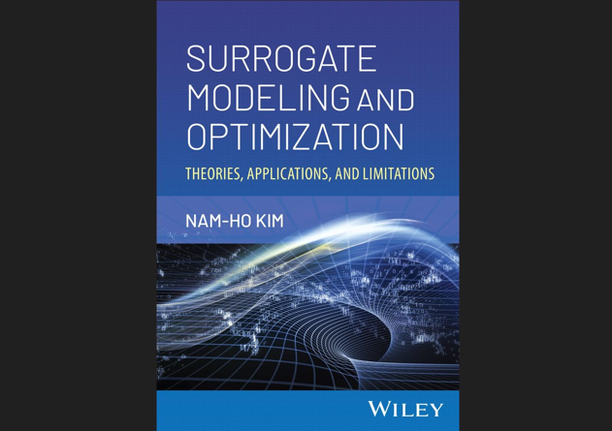

Slide 2
Chapter 6 Global Search Optimization Algorithms

Slide 3
Local Search Algorithms
Most local search algorithms are based on derivatives to guide the search.
For differentiable function it has been shown that even if you need to calculate derivatives by finite differences, derivative-based algorithms are better than ones that do not use derivatives.
However, functions are not smooth or discontinuous, we have to rely on gradient-free optimization algorithms
Local search algorithms often converge to local optima
Multiple runs with different initial designs may increase change
lack of capability in exploring the entire design space
Notes:
Later in the semester we will describe algorithms for unconstrained optimization that are based on derivatives. For continuously differentiable functions these algorithms are very effective for finding local minima.
In this lecture we will introduce instead an algorithm that does not need differentiability or even continuity, which is the Nelder-Mead sequential simplex algorithm.

Slide 4
Gradient-Free Methods
Easy to implement, better chance to find global optimum
Computationally expensive (~1,000 function calls)
Many parameters to be tuned, the performance strongly depends on them
developed based on some physical phenomena
genetic algorithms, simulated annealing, and particle swarm
global optimization algorithms, but global search algorithms
no guarantee to find the global optimum design
structured random search: increase the chance of finding global or near global optimum designs
can provide many good designs instead of a single optimum design

Slide 5
Global Search Algorithms
Some are deterministic, while most others are probabilistic
Deterministic: Nelder-Mead and DIRECT algorithms
Probabilistic algorithms
Random search: hill-climbing, taboo search, jumping around the design space and accept design with probability
Evolutionary: genetic algorithm, imitating biological evolution
Imitating swarm intelligence: particle swarm optimization (birds, bees), ant colony optimization (ants)
Major bottleneck is computational cost
NP-hard: as the dimension of a problem increases, the cost of solving it increases faster than any polynomial orders

Slide 6
Global Search Algorithms cont.
No-free-lunch theorem
computational cost of finding a solution is the same for any solution method
no single algorithm will perform well on all problems
performance of global search algorithms changes significantly by changing their parameters
possible to make an algorithm perform well for a specific problem, but it may not work efficiently for other problems

Slide 7








Complexity of a Function
benign: most local algorithms may be able to find the global min.
many significant local optima
Challenging, most algorithms may trap in the wide flat region
Hidden global minimum
$$f(x)$$
$$f(x)$$
$$x$$
$$x$$
$$f(x)$$
$$f(x)$$
$$x$$
$$x$$

Slide 8
6.2 Nelder-Mead Sequential Simplex Algorithm
Move/modify a simplex toward optimum design

Slide 9
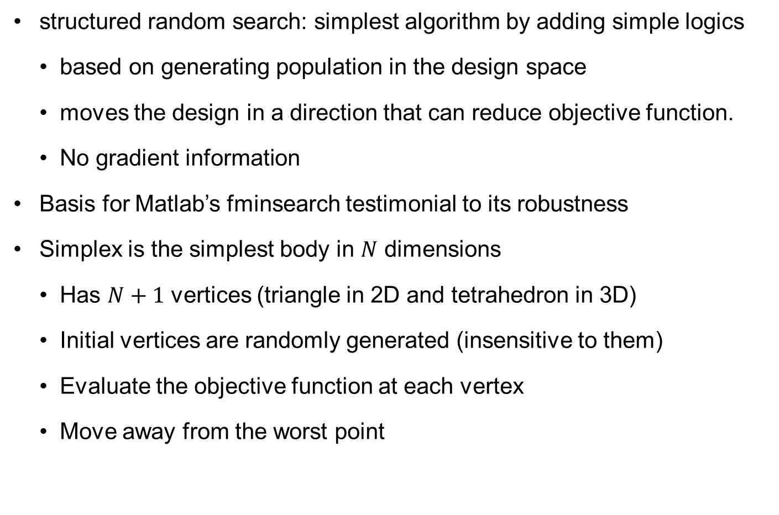
Nelder-Mead Sequential Simplex Algorithm
structured random search: simplest algorithm by adding simple logics
based on generating population in the design space
moves the design in a direction that can reduce objective function.
No gradient information
Basis for Matlab’s fminsearch testimonial to its robustness
Simplex is the simplest body in $N$ dimensions
Has $N+1$ vertices (triangle in 2D and tetrahedron in 3D)
Initial vertices are randomly generated (insensitive to them)
Evaluate the objective function at each vertex
Move away from the worst point
Notes:
The algorithm was actually invented by Spendley, Hext and Himsworth:
(Spendley, W., Hext, G. R., and Himsworth, F. R., “Sequential Application of
Simplex Designs in Optimisation and Evolutionary Operation,” Technometrics,
4 (4), pp. 441–461, 1962.)
I was then refined by British Mathematicians Nelder and Mead: (Nelder, J. A. and Mead, R., “A Simplex Method for Function Minimization,” Computer J., 7, pp. 308–313, 1965.)
Matlab refers instead to a paper on its convergence properties in one or two dimensions
Lagarias, J.C., J. A. Reeds, M. H. Wright, and P. E. Wright, "Convergence Properties of the Nelder-Mead Simplex Method in Low Dimensions," SIAM Journal of Optimization, Vol. 9 Number 1, pp. 112-147, 1998.
So it is an old algorithm, but it embodies three properties that are characteristic of modern search techniques that may be responsible for its longevity: (i) it does not use derivatives; (ii) it is population based; (iii) it uses a simple idea and does not require much mathematics.
The basic unit is a simplex, which is the simplest body in n-dimensional space. It is bounded by n+1 vertices, where we evaluate the objective functions. In two dimensions a simplex is a triangle, and in three dimensions it is a tetrahedron.

Slide 10
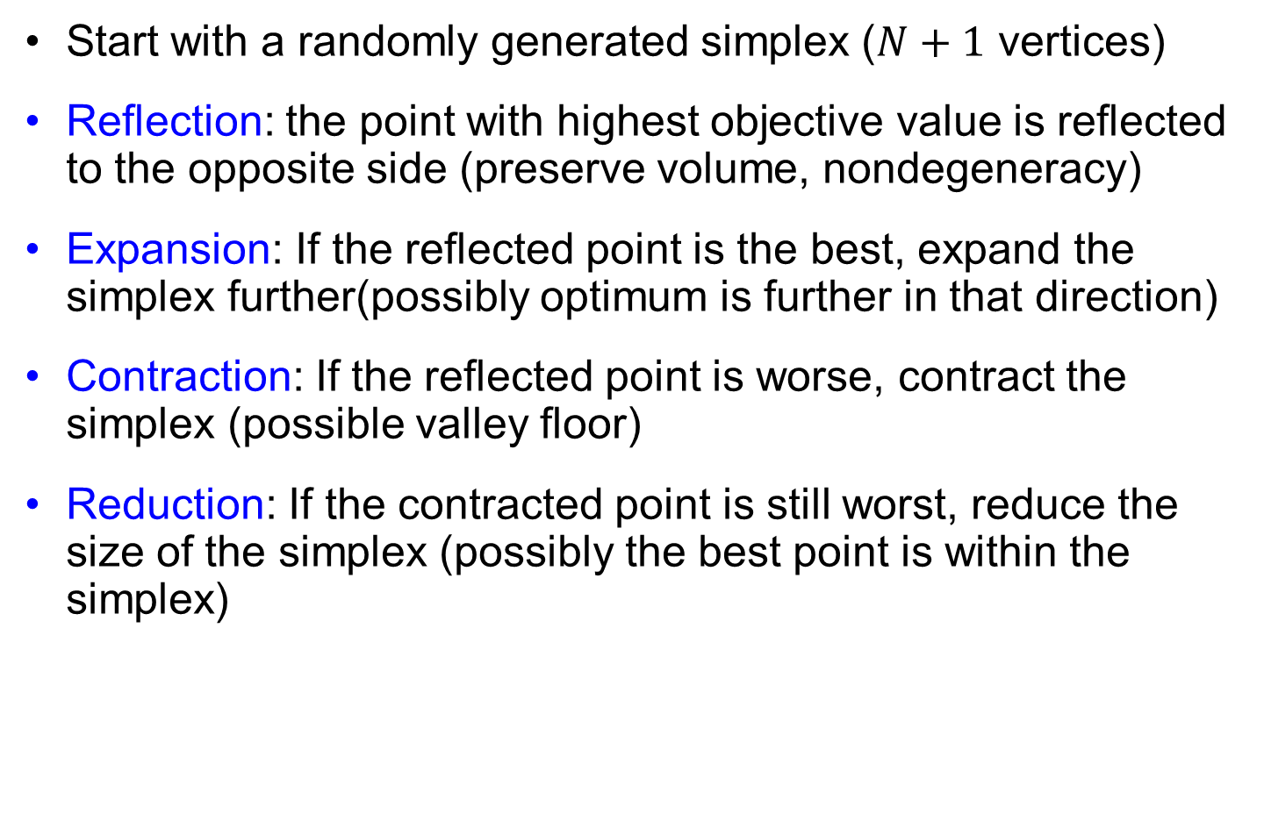
NM Simplex Algorithm
Start with a randomly generated simplex ($N+1$ vertices)
Reflection: the point with highest objective value is reflected to the opposite side (preserve volume, nondegeneracy)
Expansion: If the reflected point is the best, expand the simplex further(possibly optimum is further in that direction)
Contraction: If the reflected point is worse, contract the simplex (possible valley floor)
Reduction: If the contracted point is still worst, reduce the size of the simplex (possibly the best point is within the simplex)

Slide 11


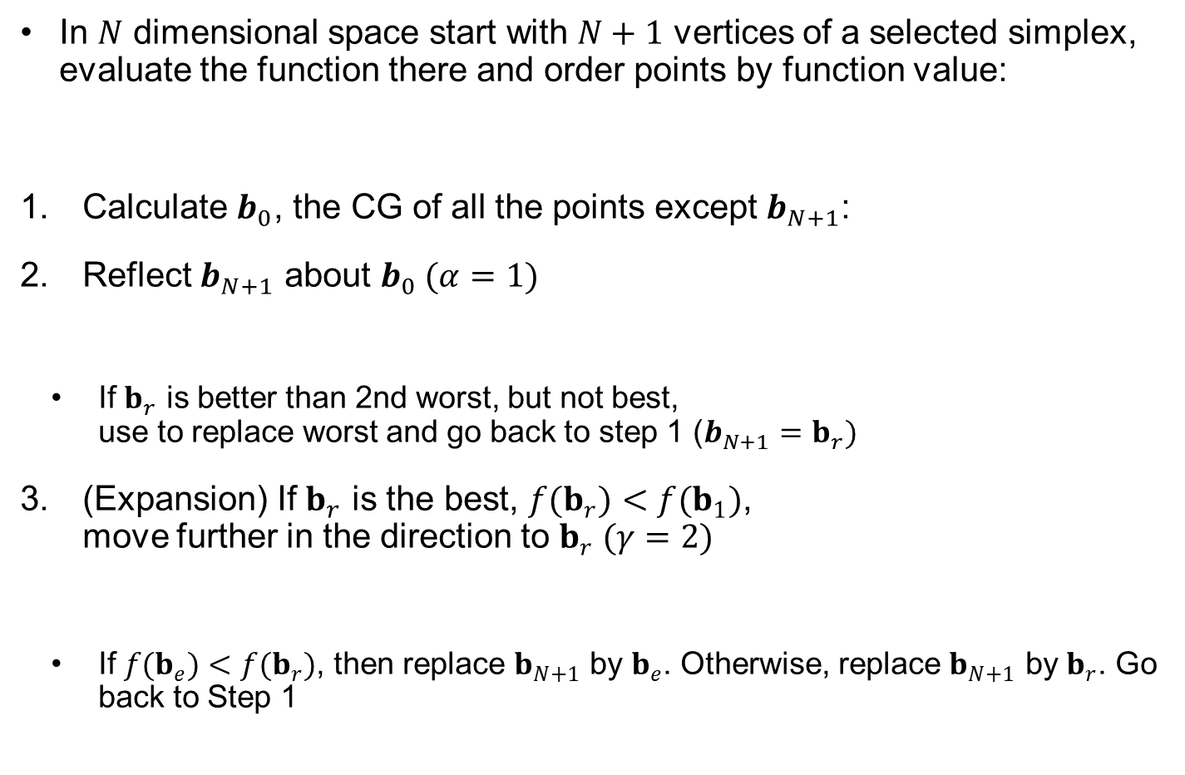








Sequential Simplex Method
In $N$ dimensional space start with $N+1$ vertices of a selected simplex, evaluate the function there and order points by function value:
Calculate $b_{0}$, the CG of all the points except $b_{N+1}$:
Reflect $b_{N+1}$ about $b_{0}$ $(α=1)$
If $b_{r}$ is better than 2nd worst, but not best, use to replace worst and go back to step 1 ($b_{N+1}=b_{r})$
(Expansion) If $b_{r}$ is the best, $f(b_{r})<f(b_{1})$, move further in the direction to $b_{r} (γ=2)$
If $f(b_{e})<f(b_{r})$, then replace $b_{N+1}$ by $b_{e}$. Otherwise, replace $b_{N+1}$ by $b_{r}$. Go back to Step 1
$$f(b_{1})≤f(b_{2})≤⋯≤f(b_{N+1})$$
$$b_{0}=\frac{1}{N}\sum_{i=1}^{N}{b_{i}}$$
$$b_{r}=b_{0}+α(b_{0}−b_{N+1})$$
$$b_{r}$$
$$b_{1}$$
$$b_{c}$$
$$b_{0}$$
$$b_{3}$$
$$b_{2}$$
$$b_{e}=b_{0}+γ(b_{0}−b_{N+1})$$
Notes:
The basic idea of the Nelder-Mead algorithm is movement away from the worst point in the directions of the other points. Specifically, one moves in the direction of the center of gravity of the other points. The move is called reflection, because in its simplest form one goes to the point that is the mirror image of the worst point on the other side (α=1).
There are three possibilities for the value of the function at the reflection point b_{r.} Most of the time it will be an improvement on the worst point, but not on the best point. In that case, we will replace b_{n+1} by b_{r.}.
The second possibility is that the new point is better than all the points in the current simplex. This means that the reflection direction is very promising and we should go further along in that direction, something called expansion.
The third possibility is that the new point is worst than all the existing points. This means that we have possibly gone too far, and we should retract in a process called contraction.
Expansion and contraction are discussed in the next slide.

Slide 12

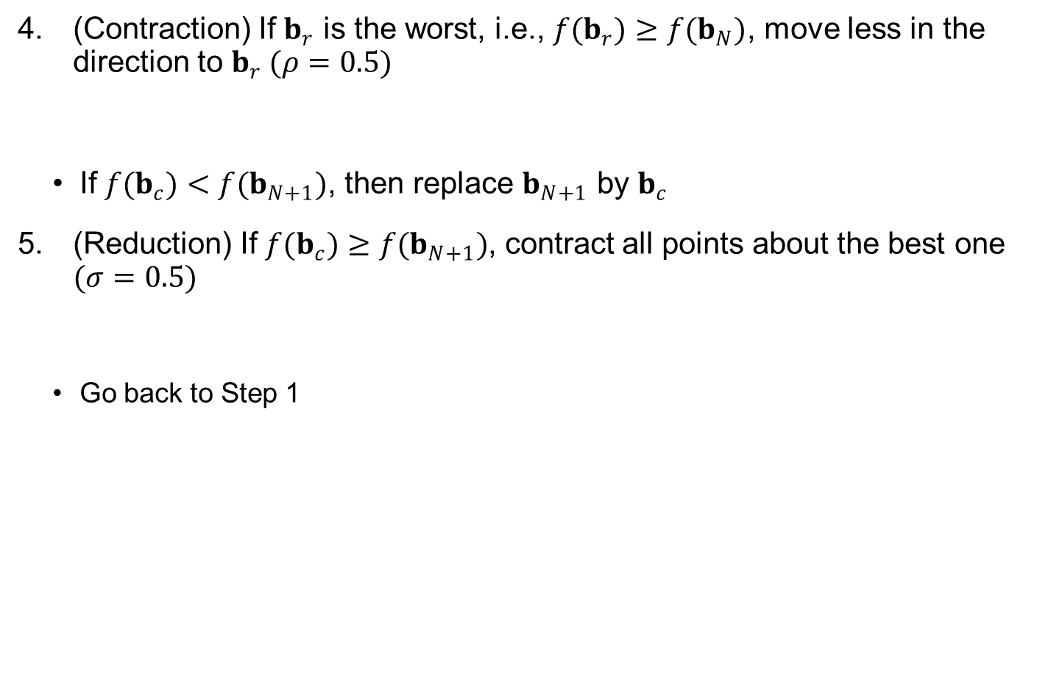
Sequential Simplex Method cont.
(Contraction) If $b_{r}$ is the worst, i.e., $f(b_{r})≥f(b_{N})$, move less in the direction to $b_{r} (ρ=0.5)$
If $f(b_{c})<f(b_{N+1})$, then replace $b_{N+1}$ by $b_{c}$
(Reduction) If $f(b_{c})≥f(b_{N+1})$, contract all points about the best one $(σ=0.5)$
Go back to Step 1
$$b_{c}=b_{0}+ρ\left(b_{0}−b_{N+1}\right)$$
$$b_{i}=b_{1}+σ\left(b_{i}−b_{1}\right), i=2,⋯,N+1$$

Slide 13
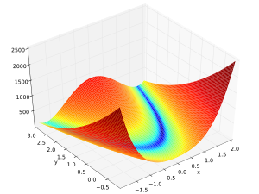
Ex6.1) Rosenbrock Function (Banana Function)
Commonly called a banana function
Many versions of Rosenbrock function exists, we use the one from Wikeipedia (minimum at (1,1))
Notes:
The Rosenbrock Banana function was invented by Howard Rosenbrock (British statistician, 1920-2010). It is popular for testing optimization algorithms, and here we will use a version of the function from Wikipedia.

Slide 14
MATLAB fminsearch for BANANA FUNCTION
Matlab code for 20 optimization iterations
global z1 z2 yg count
count =1;
options=optimset('MaxFunEvals',20)
[b,fval] = fminsearch(@banana,[-1.2, 1],options)
mat=[z1;z2;yg]
function [y]=banana(b)
global z1 z2 yg count
y=100*(b(2)-b(1)^2)^2+(1-b(1))^2;
z1(count)=b(1); z2(count)=b(2);
yg(count)=y;
count=count+1;
mat =
Columns 1 through 8
-1.200 -1.260 -1.200 -1.140 -1.080 -1.080 -1.020 -0.960
1.000 1.000 1.050 1.050 1.075 1.125 1.1875 1.150
24.20 39.64 20.05 10.81 5.16 4.498 6.244 9.058
Columns 9 through 16
-1.020 -1.020 -1.065 -1.125 -1.046 -1.031 -1.007 -1.013
1.125 1.175 1.100 1.100 1.119 1.094 1.078 1.113
4.796 5.892 4.381 7.259 4.245 4.218 4.441 4.813
Notes:
The banana function shown on the left, does not only codes the Banana function, but it also stores the coordinates and the function values every time it is called. That allows us to use these on the next slide in order to visualize the progress of the algorithm. The matlab segment on the right shows how we use fminsearch with a limit on the number of function evaluation set at 20, and the bottom frame shows the first 16 points.
The first three are the initial simplex. The first point is specified in the calling sequence, and fminsearch generates the other two points by 5% perturbation to the coordinate of the first point.

Slide 15
REFLECTION AND EXPANSION
1.2
6.24
1.18
7
1.16
1.14
6
4.49
1.12
b₂
1.1
5
1.08
5.16
3
4
1.06
20.05
10.81
1.04
1.02
2
1
1
-1.3
-1.25
-1.2
-1.15
-1.1
-1.05
-1
-0.95
39.6
24.2
b₁
Notes:
Here the first reflection is very successful, in that the value of the function, at 10.81, is better than any of the previous points, so we double the distance and get an even better result of 5.16
The second iteration again starts with reflection of the worst point (24.2) about the middle of the line connecting the other two points. This gives us an improvement to 4.49, so we try expansion again. However, this time we do not get an improvement, so the simplex for the next iteration will include the 20.05, 5.16, and 4.49 points.

Slide 16
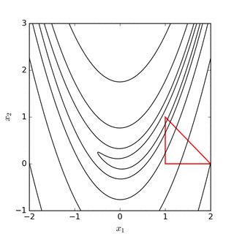
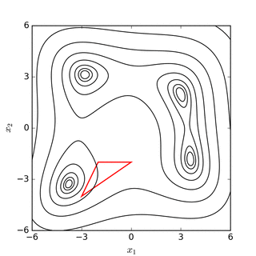
COMPLETE SEARCH EXAMPLES FROM WIKIPEDIA
http://en.wikipedia.org/wiki/Nelder-Mead_method
Shows progress for the Banana function as well as for Himmelblau’s function.
Banana function
Himmelblau’s function

Slide 17
6.3 DIRECT Algorithm
Convex hull of box sizes to balance exploitation vs. exploration

Slide 18

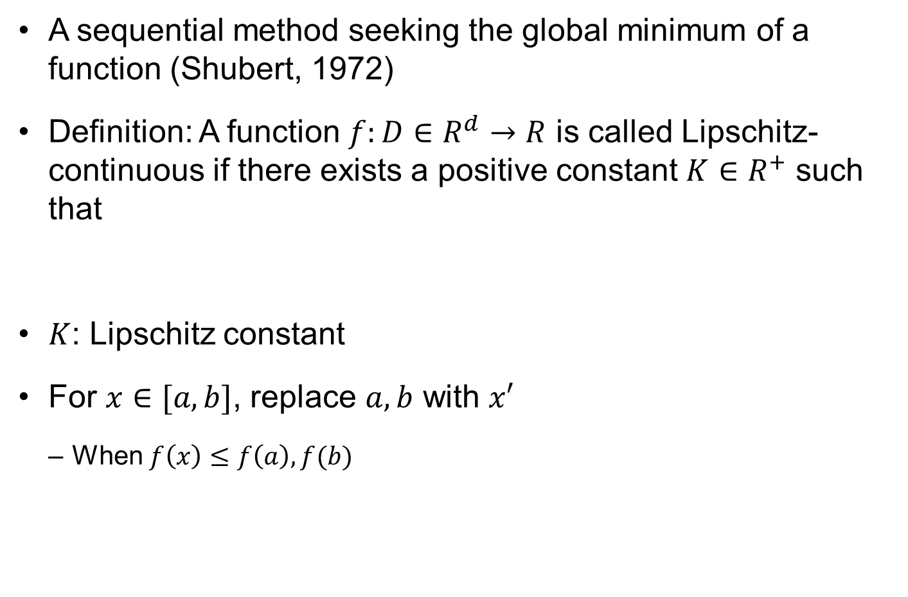



Lipschitzian Optimization
A sequential method seeking the global minimum of a function (Shubert, 1972)
Definition: A function $f:D∈R^{d}→R$ is called Lipschitz-continuous if there exists a positive constant $K∈R^{+}$ such that
$K$: Lipschitz constant
For $x∈[a,b]$, replace $a,b$ with $x′$
When $f\left(x\right)≤f\left(a\right), f(b)$
$$\left|f\left(x\right)−f(x^{′})\right|≤K\left|x−x^{′}\right|, ∀x,x′∈D$$
$$f(x)$$
$$f\left(x\right)≥f\left(a\right)−K\left(x−a\right) \\ f\left(x\right)≥f\left(b\right)+K(x−b)$$
$$a$$
$$b$$

Slide 19
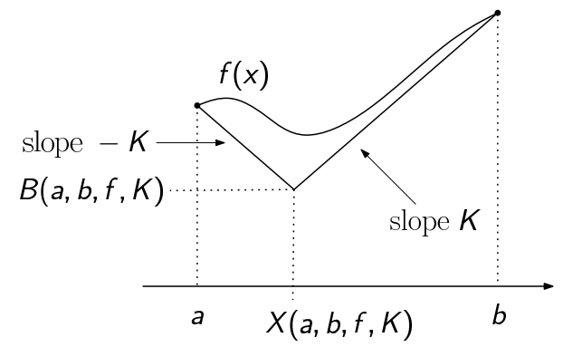


Lipschitzian Optimization cont.
Straight lines from $a$ and $b$ with slope $K$ and find intersection ($x_{1}$, the possible lowest point)
$$X\left(a,b,f,K\right)=\frac{a+b}{2}+\frac{f\left(a\right)−f(b)}{2K} \\ B\left(a,b,f,K\right)=\frac{f(a)+f(b)}{2}−\frac{K(b−a)}{2}$$

Slide 20
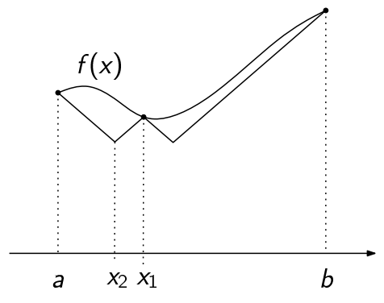

Lipschitzian Optimization cont.
Evaluate actual function at $x_{1}$
Repeat the process at the two intervals that were created by adding $x_{1}$, that is $(a,x_{1})$ and $(x_{1},b)$
Between two intersection points, choose the lowest one as $x_{2}$

Slide 21
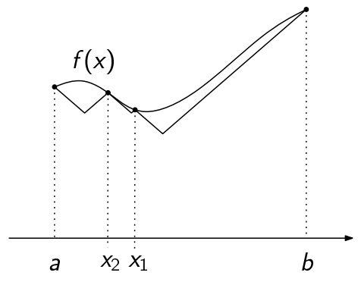
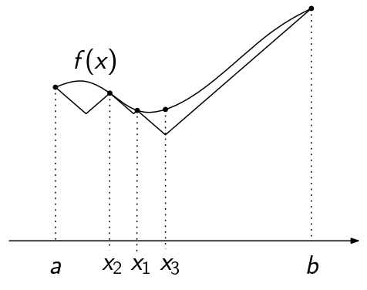

Lipschitzian Optimization cont.
Evaluate actual function at $x_{2}$
Repeat the process at the additional two intervals that were created by adding $x_{2}$, that is $(a,x_{2})$ and $(x_{2},x_{1})$
Among all intersection points, choose the lowest one as $x_{3}$

Slide 22
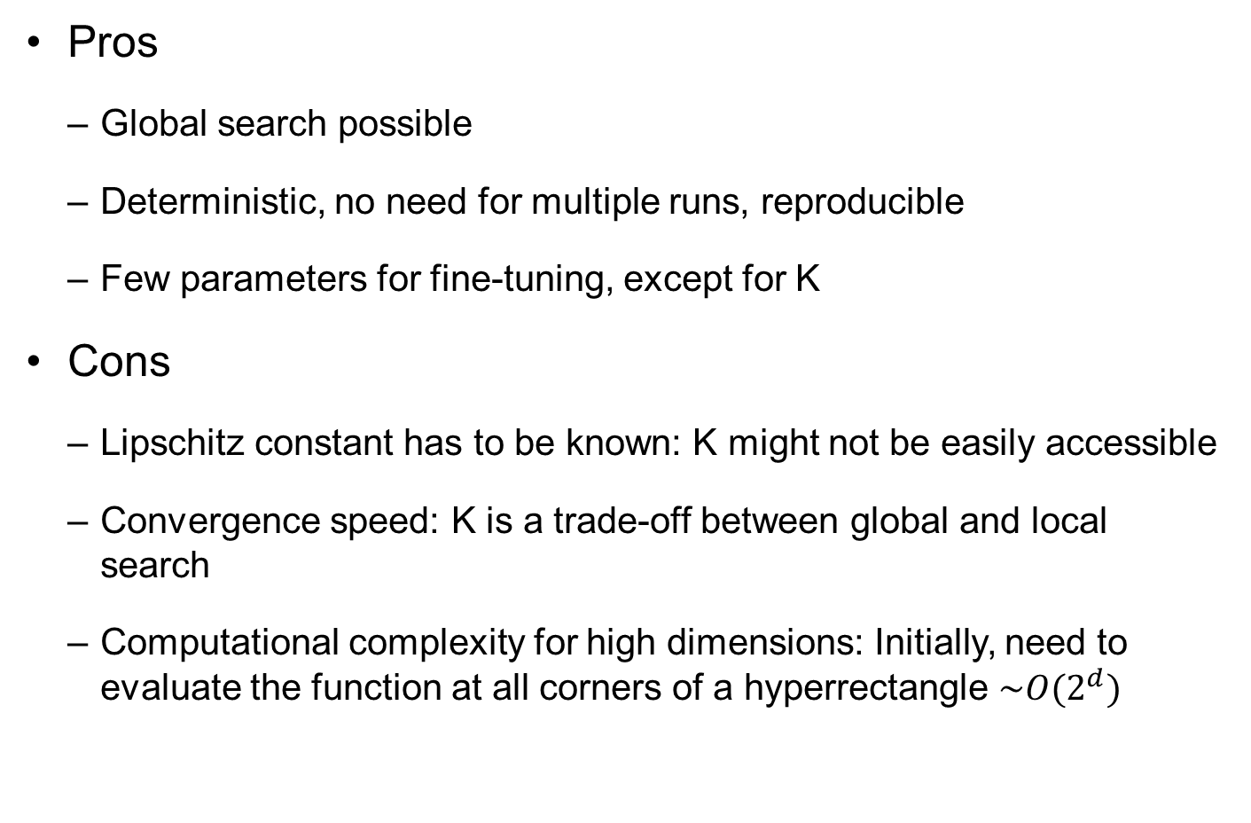
Lipschitzian Optimization cont.
Pros
Global search possible
Deterministic, no need for multiple runs, reproducible
Few parameters for fine-tuning, except for K
Cons
Lipschitz constant has to be known: K might not be easily accessible
Convergence speed: K is a trade-off between global and local search
Computational complexity for high dimensions: Initially, need to evaluate the function at all corners of a hyperrectangle $\sim O(2^{d})$
Notes:
Lipschitzian optimization is a predecessor of DIRECT that divides the space into boxes, samples at the vertices and divides boxes further based on the function’s Lipschitz constant. The Lipschitz constant is an upper bound on the rate of change of the function, and it can be used even for functions that are not even differentiable (just Lipschitz continuous). It is named after Rudolf Otto Sigismund Lipschitz (14 May 1832 – 7 October 1903) was a German mathematician and professor at the University of Bonn from 1864.
The process is illustrated in the figures on the right. In the top left figure we have the value of the functions and the two ends. Based on the Lipschitz constant K we find the point x1, where the function could be at its lowest if it decreased by a rate of K from both ends. Note that given K the function cannot be possibly lower than the intersection value at x1.
We now repeat the process at the two intervals that were created by adding x1, that is (a,x1) and (x1,b). The second figure shows that the process predicts a lower bound on the function in (a,x1) that is better than the one in (x1,b), so we select the intersection there and get x2. And so we continue.

Slide 23
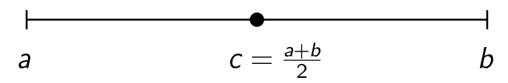
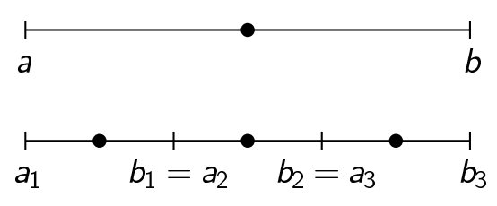
DIRECT in 1D
Jones, Perttunen, Stuckman (1993), Lipschitzian optimization without the Lipschitz constant
DIviding RECTangles
DIRECT was inspired by Lipschitzian optimization.
Optimizer divides space into boxes and sample the function at the center of rectangles
When dividing a box, use trisection so that previous point is useful

Slide 24
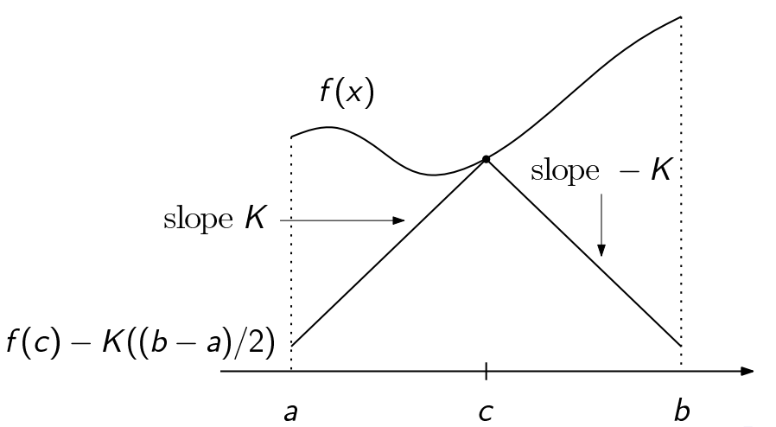
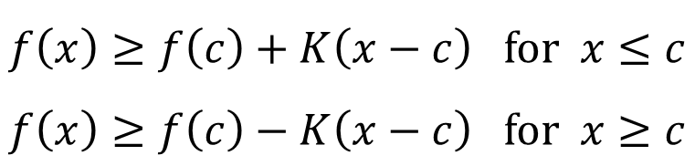
Lipschitz Bound
DIRECT uses the following Lipschitz bound
$$f\left(x\right)≥f\left(c\right)+K\left(x−c\right) for x≤c \\ f\left(x\right)≥f\left(c\right)−K\left(x−c\right) for x≥c$$

Slide 25
Direct Algorithm
At a given iteration the design space is divided into boxes, and we have the value of the function at the center of each box
We then look at a plot of box sizes (determined by the largest dimension of the box) vs. function value and look for boxes that should be divided
Objective function
Large-sized box but can be reduced further by dividing box (exploration)
Small-sized box and good design (exploitation)
Box size

Slide 26

Direct Algorithm cont.
This can be seen as a Pareto front of multi-objective optimization problem.
Those points on the Pareto front correspond to Lipschitzian optimization for all possible Lipschitz constants
$$Slope K$$
Objective function
Box size

Slide 27
Direct Algorithm cont.
Sample at all the points that are on the Pareto front of size and function value, which includes all the points that are on the bottom part of the convex hull
Objective function
Divide these boxes
Box size

Slide 28
DIRECT Box Division
Start with a center point of the entire domain
Yellow box is potential optimum
Since the domain is square, divide it in the vertical and horizontal directions (bottom box is the best)
Divide the bottom box (top and bottom center box are the best)
Divide the top box and bottom center box (top center, bottom right, bottom center right boxes are the best)

Slide 29
Exploration vs. Exploitation
DIRECT uses convex hull of box sizes to balance exploitation vs. exploration
With enough function evaluations every region in design space will be explored
This is clearly not feasible for high-dimensional spaces
Cox’s paper compares DIRECT to repeated local optimization with random start
Notes:
DIRECT uses the convex hull of box sizes to generate the Pareto front of function value versus size. Low function values are associated with exploitation, large boxes with exploration.
If we wait long enough, every region in design space will be eventually divided into a small box, so the algorithm is guaranteed to find the global optimum even if the problem is of the nightmare variety. However, practically we will run out of computer time.
Since the number of boxes increases exponentially with dimension, there is a serious question as to how practical is DIRECT for high dimensional problem. The following paper probed this question;
S. E. COX, R. T. HAFTKA, C. A. BAKER, B. GROSSMAN, W. H. MASON and L. T. WATSON A Comparison of Global Optimization Methods for the Design of a High-speed Civil Transport, Journal of Global Optimization 21: 415–433, 2001.

Slide 30
MATLAB CODE direct.m
function [ret_minval,final_xatmin,history] = Direct...
(Problem,bounds,opts,varargin)
% Written by : Dan Finkel (definkel@unity.ncsu.edu)
% Parameters:
% Problem.f = Objective function handle
% Problem.numconstraints = number of constraints
% Problem.constraint(i).func = i-th constraint handle
% Problem.constraint(i).penalty = penalty parameter for
% bounds - an n x 2 vector of the lower and upper bounds.
% opts - (optional) MATLAB structure.
% opts.ep = Jones factor (default is 1e-4)
% opts.maxevals = max. number of function evals (default is 20)
% opts.maxits = max. number of iterations (default is 10)
% opts.maxdeep = max. number of rect. divisions(default is 100)
% opts.showits = 1 if disp. stats shown, 0 oth.(default is 1)
% opts.tol = tolerance for term. if tflag=1(default is 0.01)
%OUT: minval - minimum value found
% xatmin - (optional) location of minimal value
% history - (optional) array of iteration historyory, useful for tables and plots. The three columns are iteration, fcn evals, and min value found.

Slide 31

Ex6.2) DIRECT Optimization of Goldstein-Price function
Define function (global minimum at $\left(x_{1},x_{2}\right)=(0,−1)$)
Matlab script
Optimum: $x_{min}= (0,−1.0005)$, $f_{min}=3.0001$
Converged after 14 iteration with 191 function evaluations
function value = gp(x)
x1 = x(1); x2 = x(2);
value =(1+(x1+x2+1).^2.*(19-14.*x1+3.*x1.^2-14.*x2+6.*x1.*x2+3.*x2.^2))...
.*(30+(2.*x1-3.*x2).^2.*(18-32.*x1+12.*x1.^2+48.*x2-36.*x1.*x2+27.*x2.^2));
bounds = [-2 2;-2 2]; % lower- and upper-bounds of design
options.testflag = 1; % Global minimum is known
options.globalmin = 3; % The value of known global min
options.showits = 1; % Show iteration history
options.tol = 0.01; % Stopping criterion
Problem.f = 'gp'; % Objective function name
[fmin,xmin,hist] = Direct(Problem,bounds,options);% Calling DIRECT algorithm
plot(hist(:,2),hist(:,3)) % Plot iteration statistics
xlabel('Fcn Evals'); ylabel('f_{min}');

Slide 32
Ex6.2) DIRECT Optimization of Goldstein-Price function
2
1
0
0
0
0
0
200
5
0
0
0
0
0
180
1.5
1
0
0
0
0
0
0
0
0
0
5
0
0
1
0
0
0
0
5
0
160
1
5
0
0
0
0
1
0
0
0
0
0
0
140
0
1
0
0
0
0
0
0
0.5
0
5
1
0
0
0
0
5
5
0
1
0
0
5
0
120
0
0
0
0
0
n
0
1
i
0
0
0
0
0
f
m
100
0
5
0
0
1
-0.5
5
5
0
5
0
0
0
0
80
0
0
5
0
1
0
0
1
0
60
1
5
1
0
0
-1
0
5
0
0
0
5
1
0
0
0
40
0
0
5
0
0
0
0
0
0
0
0
0
0
-1.5
0
0
1
0
0
1
0
0
0
0
0
20
0
5
0
1
0
0
1
0
0
0
0
5
0
1
-2
5
0
5
0
0
0
0
0
0
0
-2
-1.5
-1
-0.5
0
0.5
1
1.5
2
0
20
40
60
80
100
120
140
160
180
200
Fcn Evals

Slide 33
6.4 Genetic Algorithm
Move from parents to children to probabilistically create fitter individuals through selection and recombination of good characters

Slide 34
Genetic Algorithms
Genetic algorithms imitate a natural optimization process: natural selection in evolution.
Developed by John Holland at the University of Michigan for machine learning in 1975.
Similar algorithms developed in Europe in the 1970s under the name evolutionary strategies
Main difference has been in the nature of the variables: Discrete vs. continuous
Key components are population, parent and child designs, and randomness (e.g. mutation)
Notes:
Genetic algorithms imitate natural selection In evolution. The key ideas that distinguish genetic algorithms from traditional search algorithms are the use of population of designs, the mating of pairs of design to create child designs in a process called crossover, and the use of mutations to enhance exploration. Together it creates an optimization process that has a strong random component, so every time you run it you may get a different answer.
Genetic algorithms were developed in 1975 by John Holland from the University of Michigan. However, similar algorithms were developed in Europe around the same time with the name of evolutionary strategies. GAs are usually associated with discrete variables, while evolutionary strategies with continuous ones.

Slide 35
Basic Scheme
Coding: replace design variables with a continuous string of digits or “genes”
Binary
Integer
Real
Population: Create population of design points
Selection: Select parents based on fitness
Crossover: Create child designs
Mutation: Mutate child designs
Notes:
In order to use a genetic algorithm we have to first start by coding the design variables as a string that imitates DNA. There is information on different ways to do that in Section 4.4 of Elements of Structural Optimization, with the three choices is whether to use binary, integer, or real variables. We will discuss that in the context of composite laminate design.
A key factor is working with a population of designs that can mate and create child designs. Then we need a method to select parents based on their objective function value that we translate to fitness as described later.
Child designs are created by crossing over the strings of the parents, that is taking some genes from one parent and some from a second parent. Selection plus crossover form together an exploitation mechanisms that looks for combination of good designs. Mutation adds an element of exploration.

Slide 36
Outline of algorithm
Create random initial population
Generate next population based on the following steps
Scores each member of the current population based on its fitness
Selects members, called parents, based on their fitness
Choose lower/higher fitness members as elite. These elite members are passed to the next population
Produces children from the parents using genetic operations
Replaces the current population with the children to form the next generation
Repeat the process until stopping criteria are satisfied

Slide 37
Procedure of Genetic Algorithms
Create a random initial population
Generate the next population based on the following steps
Scores each design of the current population based on its fitness
Selects members, called parents, based on their fitness
Choose lower/higher fitness members as elite. These elite members are passed to the next population
Produces children from the parents using genetic operations
Replaces the current population with children to form the next generation
Repeat the process until the stopping criteria are satisfied

Slide 38
Procedure of Genetic Algorithms cont.
fitness
40
100
30
70
Create initial population
Calculate fitness
Select parents
Create children
Notes:
This illustrates how the basic operators work. You start with a population of designs and you calculate the fitness of each design based on its objective function and possibly constraint satisfaction.
Then you select parent designs based on their fitness but with randomness thrown in. From the figure we see that the best (green) design was selected three times, as was the second best (red). The third best design (blue) was selected twice and the worst design (orange) not at all.
Finally you create children by crossover and mutation. Here only crossover is illustrated.

Slide 39
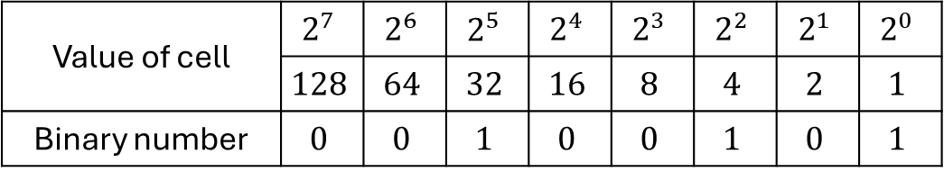
Representation of Design (Coding)
Design variable is stored in the chain of DNA, often using binary digits
A design variable is represented in the form of a string of binary numbers (0 or 1)
Coding: the mapping between binary numbers and the state of design variable
binary number 100101
Value of cell | $$2^{7}$$ | $$2^{6}$$ | $$2^{5}$$ | $$2^{4}$$ | $$2^{3}$$ | $$2^{2}$$ | $$2^{1}$$ | $$2^{0}$$
 | $$128$$ | $$64$$ | $$32$$ | $$16$$ | $$8$$ | $$4$$ | $$2$$ | $$1$$
Binary number | $$0$$ | $$0$$ | $$1$$ | $$0$$ | $$0$$ | $$1$$ | $$0$$ | $$1$$
$${100101}_{2}=\left(1×2^{5}\right)+\left(0×2^{4}\right)+\left(0×2^{3}\right)+\left(1×2^{2}\right)+\left(0×2^{1}\right)+\left(1×2^{0}\right)=37$$

Slide 40
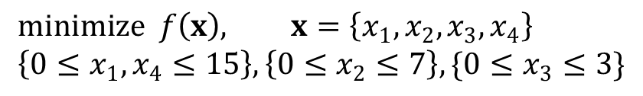





Ex6.3) Design Representation
When $x_{1}=6, x_{2}=5, x_{3}=3, x_{4}=11$, represent the integer design variables using binary coding
$x_{1}$ and $x_{4}$ need four bits, $x_{2}$ and $x_{3}$ need two bits
$$minimize f\left(x\right), x=\left\{x_{1}, x_{2}, x_{3}, x_{4}\right\} \\ \left\{0≤x_{1}, x_{4}≤15\right\}, \left\{0≤x_{2}≤7\right\}, \{0≤x_{3}≤3\}$$
0 | 1 | 1 | 0 | 1 | 0 | 1 | 1 | 1 | 1 | 0 | 1 | 1
$$x_{1}$$
$$x_{2}$$
$$x_{3}$$
$$x_{4}$$

Slide 41
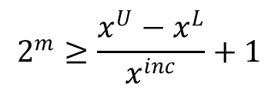
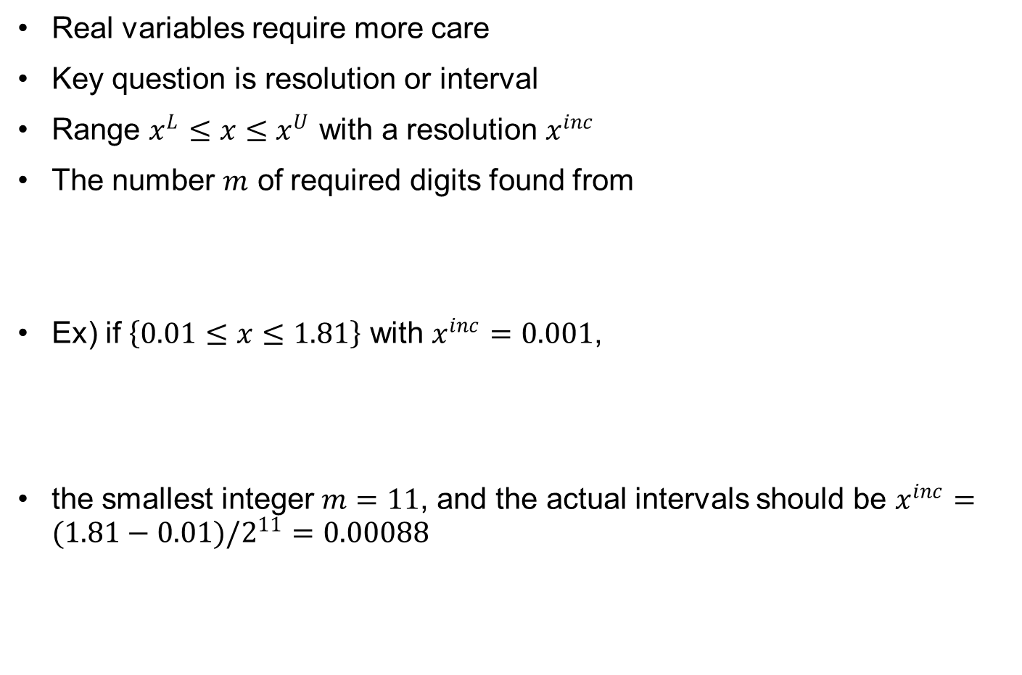
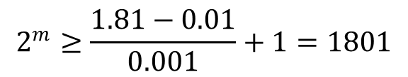
Coding
Real variables require more care
Key question is resolution or interval
Range $x^{L}≤x≤x^{U}$ with a resolution $x^{inc}$
The number $m$ of required digits found from
Ex) if $\left\{0.01≤x≤1.81\right\}$ with $x^{inc}=0.001$,
the smallest integer $m=11$, and the actual intervals should be $x^{inc}=(1.81−0.01)/2^{11}=0.00088$
$$2^{m}≥\frac{x^{U}−x^{L}}{x^{inc}}+1$$
$$2^{m}≥\frac{1.81−0.01}{0.001}+1=1801$$

Slide 42
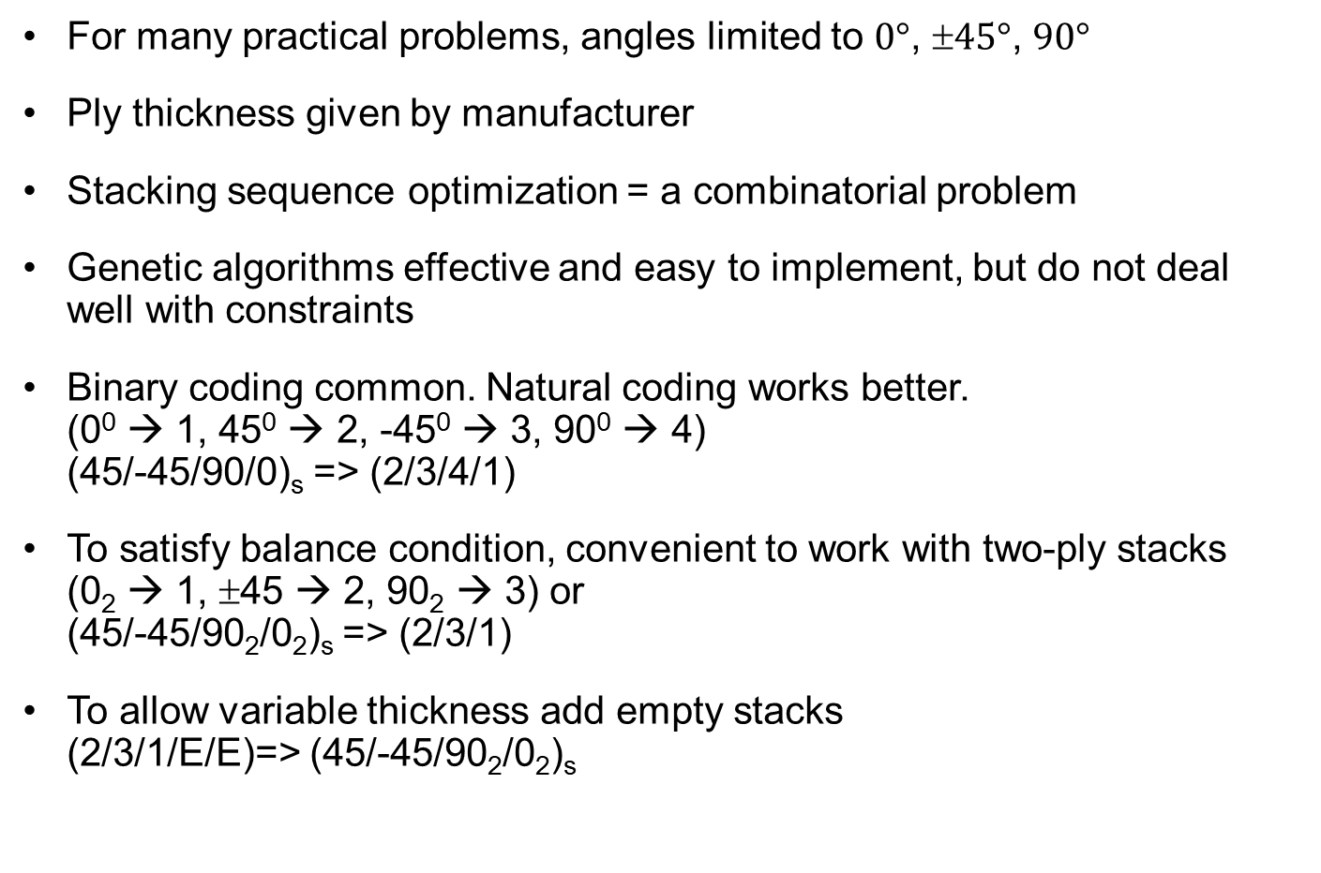
Stacking Sequence Optimization of Composite Materials
For many practical problems, angles limited to $0°$, $45°$, $90°$
Ply thickness given by manufacturer
Stacking sequence optimization = a combinatorial problem
Genetic algorithms effective and easy to implement, but do not deal well with constraints
Binary coding common. Natural coding works better. (0⁰ → 1, 45⁰ → 2, -45⁰ → 3, 90⁰ → 4) (45/-45/90/0)_{s} => (2/3/4/1)
To satisfy balance condition, convenient to work with two-ply stacks (0₂ → 1, ±45 → 2, 90₂ → 3) or (45/-45/90₂/0₂)_{s} => (2/3/1)
To allow variable thickness add empty stacks (2/3/1/E/E)=> (45/-45/90₂/0₂)_{s}
Notes:
We will use stacking sequence optimization to illustrate the implementation of a genetic algorithm. In particular for the case where the ply angles are limited to 0, +-45 or 90 degrees. Ply thickness is given by the manufacturer, so the design problem is to select the number of plies you need and select the ply angles for each ply from the four choices.
Genetic algorithms do not deal well with constraints, and so it is common to use a penalty function to transform to an unconstrained problem.
Coding the stacking sequence of a composite laminate that has a finite number of possible angles is typically done by assigning a number to each angle, or even just using the angle itself. When the laminate is symmetric, we need to code only one half.
There is often also a balance condition that requires that the laminate has equal number of positive and negative angles. In our case, this means that the number of 45-deg plies needs to be equal to the number of -45-deg plies. This is tough to enforce, and an easy way out is to require that plies come in groups of two. This, however, may mean wasted plies for the zero or 90 directions.
To allow variable number of plies, we also introduce an empty ply gene. Finally, if

Slide 43
Coding cont.
Binary coding most common. Real number coding possible but requires special treatment.
Genetic algorithm not effective for getting high precision. It is better to go for coarse grid of real values. With n binary digits get 2^{n} values.
Segregate stacking sequence and geometry chromosomes.
Notes:
For dimensions, such as stiffener height, it is common to use binary coding. Genetic algorithms like most global algorithms, are not good for zooming on a solution, so it is best to have a course grid. With n binary digits you can get 2n possibilities.
For example, if you have a stiffener whose height can vary from 1inch to 2 inches, and you care to determine it to 0.1 inch precision, you have 11 possible values. With four binary digits you actually get 16 values, so you can divide the range to 15 intervals, each 1/15 inch wide. So
0000 denotes 1” 0001 denotes 16/15 “,……1111 denotes 2”.
It is recommended to have separate strings or chromosomes for stacking sequence and dimensions, with possibly different mutations or crossover ruels.

Slide 44
Genetic Operators
Crossover: portions of strings of the two parents are exchanged
Mutation: the value of one bit (gene) is changed at random
Permutation: the order of a portion of the chromosome is reversed
Addition/deletion: one gene is added to/removed from the chromosome
Notes:
The slide illustrates the two basic genetic operators of crossover and mutation that are used in practically every genetic algorithm, plus two others that are useful for designing composite laminates.
Permutation changes the order of the genes, and for laminates it preserves the in-plane properties and changes only the bending properties.
Addition/deletion is important if we have laminates with each play assigned a gene and we do not know ahead of time the number of genes.

Slide 45
Other Kinds of Crossover
Multiple point crossover
Uniform crossover
Bell-curve crossover for real numbers
Multi-parent crossover
Notes:
Other kind of crossovers include multiple point crossover, including the extreme version where we randomly assign each gene to one parent or the other. For real numbers we may do the crossover by generating a normal random number r and using rand (1-r) as the weighted combination of the two parents.
I tried three parent crossover, did not seem to make a difference.

Slide 46



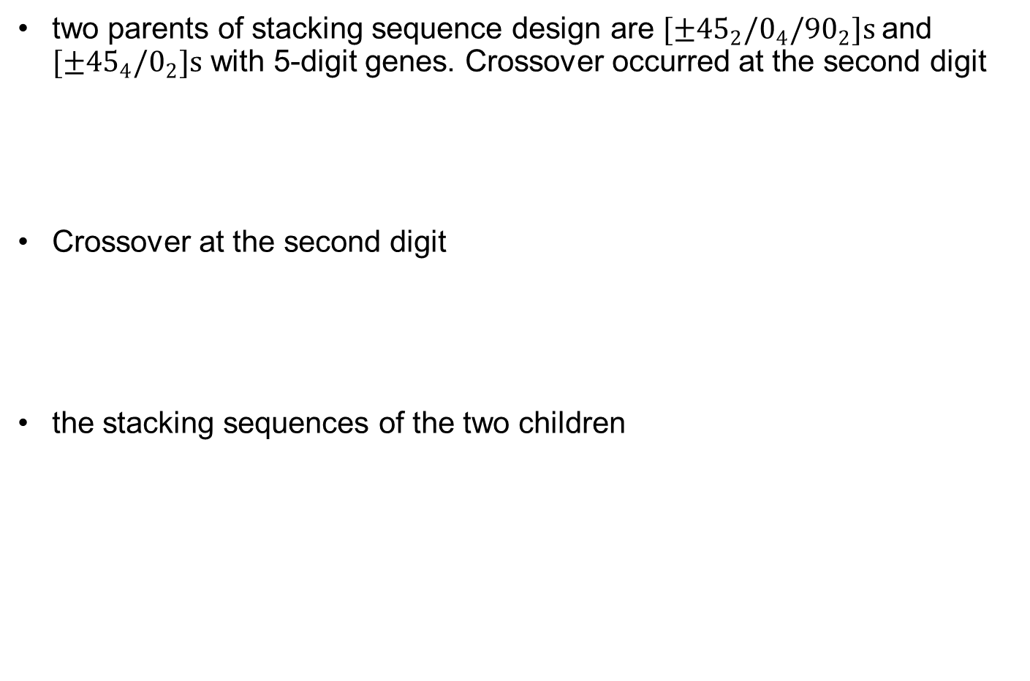



Ex6.4) Crossover Operator
two parents of stacking sequence design are $[±{45}_{2}/0_{4}/{90}_{2}]s$and $[±{45}_{4}/0_{2}]s$ with 5-digit genes. Crossover occurred at the second digit
Crossover at the second digit
the stacking sequences of the two children
$$Parent 1 : [2/2/1/1/3]$$
$$Parent 2 : [2/2/2/2/1]$$
$$Child 1 : [2/2/1/2/1]$$
$$Child 2 : [2/2/1/1/3]$$
$$Child 1 :[±{45}_{2}/0_{2}/±45/0_{2}]s$$
$$Child 2 :[±{45}_{2}/0_{4}/{90}_{2}]s$$

Slide 47
Mutation and Stack Swap
[1/1/2/2/3]=> [1/1/2/3/3]
[0₄/±45₂/90₂]_{s} => [0₄/±45/90₄]_{s}
[1/1/2/2/3]=> [1/2/1/2/3]
[0₄/±45₂/90₂]_{s} => [(0₂/±45)₂/90₂]_{s}
Notes:
Mutation is a common genetic operator, and here it is illustrated for a laminate where we select a gene at random (here the fourth) and replace it randomly with another allele (here 2 becomes 3).
For laminates there is also permutation or swap. Here we select a pair of genes and switch their positions (1/2 becoming 2/1).

Slide 48
Initial Population
Random number generator used
Typical function call is rand(seed)
In Matlab rand(n) generates nxn matrix of uniformly distributed (0,1) random numbers
Seed updated after call to avoid repeating the same number. See Matlab help on how to change seed (state).
If we want repeatable runs must control seed.
Need to transform random numbers to values of possible gene values.
Notes:
Initial population is usually random. With Matlab we typically use the rand function. Need to transform to possible values of alleles (gene values). For example, if for stacking sequence design we have four angles, we will assign values in [0,0.25) to first angle, [0.25,0.5) to second angle, and so forth.
The random number generator uses a seed to select the first number and then updates it for the second, and so forth. The initial seed may reflect some internal computer state, time of day, or some other data available to the generator. It is selected so that it is practically random, and that means that every time you run a genetic algorithm you will bet a different result. If you want runs to be repeatable, you have to set the seed yourself.

Slide 49
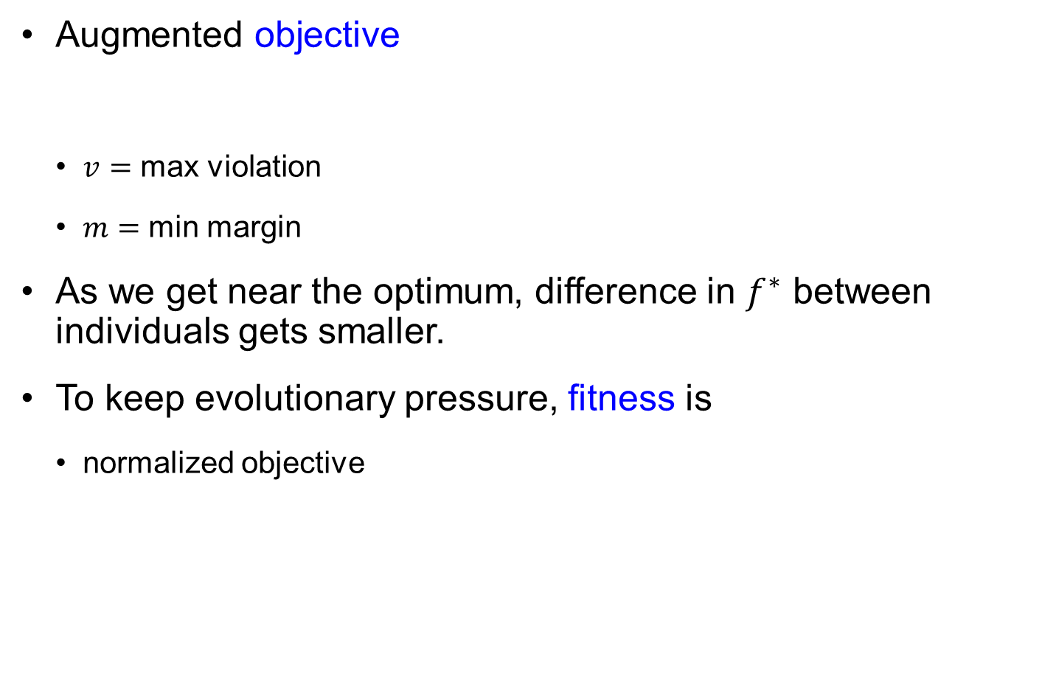
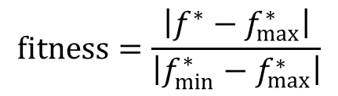

Fitness with Constraint Violation
Augmented objective
$v=$ max violation
$m=$ min margin
As we get near the optimum, difference in $f^{∗}$ between individuals gets smaller.
To keep evolutionary pressure, fitness is
normalized objective
$$f^{∗}=f+pv−bm+sign\left(v\right)Δ$$
$$fitness=\frac{\left|f^{∗}−f_{max}^{∗}\right|}{\left|f_{min}^{∗}−f_{max}^{∗}\right|}$$
Notes:
The penalty function that is commonly used for genetic algorithms typically consists of three terms as shown in the equation. First there is penalty proportional to a measure of the constraint violation, which is often selected to be the maximum violation. This does most of the work. Then there is a small penalty (delta) if there is any violation, to give preference to designs that satisfy the constraints over those that have very small violations.
Finally there is a term that rewards margin with respect the constraint with a bonus. This is important when there are multiple designs that have the same objective function, but some satisfy the constraint with a larger margin. This is common in laminate design optimization. The objective function is often the weight, and all laminates with the same number of plies may have the same weight, if the geometry is fixed.
The augmented objective is not the same as the fitness. The fitness is often selected so that the difference between the best design and poorest design is large even if their objective function values are close. This prevents stagnation in the evolution as we near the optimum.
Accentuating the difference may be done by normalizing. For example, if we subtract the value of poor

Slide 50
Selection Operator
Roulette wheel selection
Tournament selection
Randomly select two individuals and pick the best one as one parent
Elitist strategies
Select the best fitness individual of the current population
Selection pressures versus exploration
No twin rule
Notes:
The two most common ways of selecting parents are roulette wheel and tournament. The roulette wheel approach will be shown in the next slide. Tournament selection is based on selecting randomly two individuals from the population and picking the best one as one parent, then repeating to select the second parent.
Some genetic algorithms pursue elitist strategies, where the top design in a generation is always selected to be moved to the next generation. This guarantees monotonic progress, but it has not been proven to lead to faster convergence.
When we intensify selection pressures we favor exploitation versus exploration, so one has to be careful not to do that too early.
Finally, often genetic algorithms have a no twin rule, in that both parents cannot be identical.

Slide 51
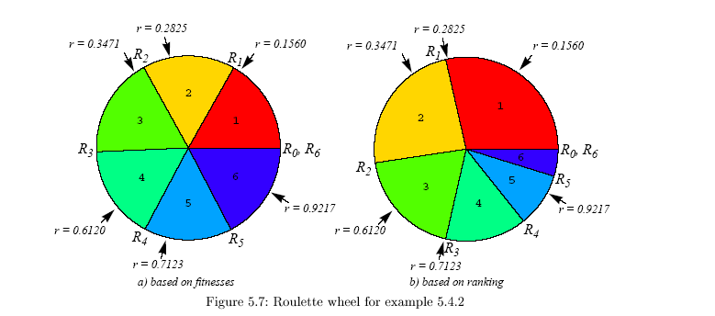
Roulette Wheel Selection Method
Slice of the roulette wheel proportional to its fitness
Example fitness {0.62, 0.60, 0.65, 0.61, 0.57, 0.64}
Example reverse rank {4/21, 2/21, 6/21, 3/21, 1/21, 5/21}
Notes:
In a roulette wheel approach, each individual gets a slice of the roulette wheel that is proportional to its fitness. Spinning the roulette wheel is simulated by generating a random number in [0,1].
In the example we see a set of six fitnesses that are based directly on the augmented objective without normalization and they are very close. Consequently, the slices allocated to the six designs are close in size.
If, on the other hand, the fitness is made proportional to the reverse rank, then the top design will get a slice of 6/21 of the wheel, the second best 5/21, and the poorest design 1/21.
The figure also shows the effect of generating 6 random numbers and selecting individuals based on these numbers. With the original fitnesses, each design is selected once. With the rank based fitness, the first and third best designs get selected twice, while the fourth and sixth not once.

Slide 52
Stopping Criteria
Stop when the maximum number of generations reaches
Stop after running for the maximum computational time reaches
Stop when the best fitness becomes less than or equal to the limit
Stop when the relative change in the fitness is less than the tolerance
Stop if there is no improvement during an interval of time
Stop if the average relative change in the fitness is less than the tolerance.

Slide 53
Genetic Algorithm in Matlab
[x,fval,exitflag,output,population,scores] = ga(fun,nvars,A,b,[],[],lb,ub,nonlcon,IntCon,options)
Outputs
x: the best location
fval: objective function value at x
exitflag: >0 normal stop, <0 erroneous stop
output: opt process information
population: final population
scores: fitness function values of the population

Slide 54
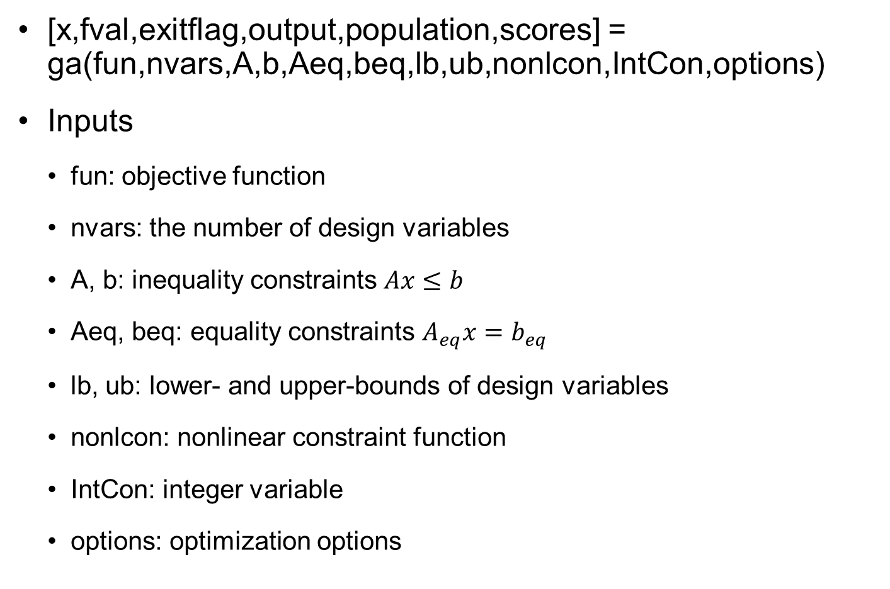
Genetic Algorithm in Matlab cont.
[x,fval,exitflag,output,population,scores] = ga(fun,nvars,A,b,Aeq,beq,lb,ub,nonlcon,IntCon,options)
Inputs
fun: objective function
nvars: the number of design variables
A, b: inequality constraints $Ax≤b$
Aeq, beq: equality constraints $A_{eq}x=b_{eq}$
lb, ub: lower- and upper-bounds of design variables
nonlcon: nonlinear constraint function
IntCon: integer variable
options: optimization options

Slide 55
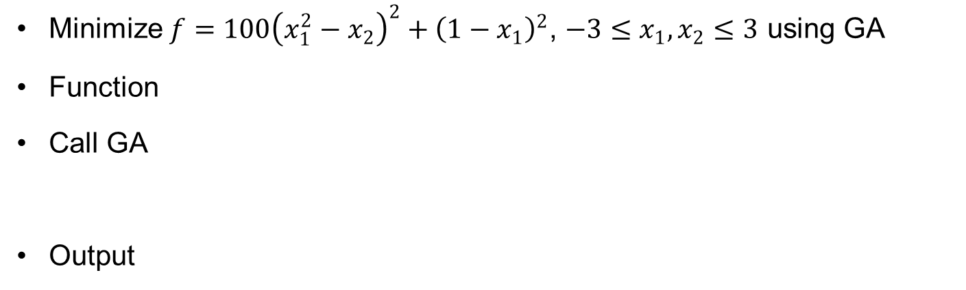
Ex6.6) Optimization of Rosenbrock Function using GA
Minimize $f=100{\left(x_{1}^{2}−x_{2}\right)}^{2}+{\left(1−x_{1}\right)}^{2}$, $−3≤x_{1}, x_{2}≤3$ using GA
Function
Call GA
Output
function y = Rosenbrock(x)
y = 100 * (x(1)^2 - x(2))^2 + (1 - x(1))^2;
rng default % For reproducibility
ndv = 2; lb = [-3,-3]; ub = [3,3];
options = optimoptions('ga','MaxGenerations',10000);
[x,fval] = ga(@Rosenbrock,ndv,[],[],[],[],lb,ub,[],[],options)
Optimization terminated: average change in the fitness value less than options.FunctionTolerance.
x = 1.0354 1.0721
fval = 0.0013

Slide 56
When To Use Genetic Algorithms?
Genetic algorithms do not require continuity or differentiability of the objective function. They do not need gradients;
They are robust: they are very insensitive to noise;
They are modular and therefore portable; because the evolutionary mechanism is separate from the problem representation, they can be transferred from problem to problem;
They are particularly efficient in discrete and combinatorial problems, which are typically difficult to solve by conventional algorithms; they can be used for problems involving both discrete and continuous variables;
Because they explore the design space with populations, genetic algorithms are “naturally” amenable to parallelization.

Slide 57


Reliability
Genetic algorithm is random search with random outcome.
Reliability can be estimated from multiple runs for similar problems with known solution
Variance of reliability, $r$, from $n$ runs
$$σ_{r}=\sqrt{\frac{r\left(1−r\right)}{n}}$$
Notes:
When we want to compare algorithms that have random component this is difficult because each time they may have a different outcome. We often compare them by running n times and comparing what fraction of the time they ended up close enough to the global optimum.
However, because of the randomness even r is a matter of chance. The equation gives the standard deviation of the observed r from n runs. So for example, if we observe that 80 out of 100 runs were successful, the standard deviation is sqrt(0.8*0.2/100)=0.04, which is 5% of the observed value.
Here is a comparison between four global search algorithm that shows their reliabilities as a function of the number of function evaluations (analyses).. The curves were generated on the basis of 100 runs of each algorithms.
We ask ourselves whether the differences between these algorithms are meaningful or not. So for example, after 200 analyses, the four reliabilities are 0.2 (blue), 0.6 (yellow), 0.75(aqua) and 0.85 (magenta). If we use the equation for the standard deviation on the previous slide we get for the standard deviations 0.04, 0.049, 0.043, and 0.036. This tells us that the blue is certainly inferior to the others, and the magenta is better than the yellow, but for comparing the aqua to the yellow and magenta the difference may still be a matter of chance.

Slide 58
6.5 Particle Swarm Algorithm
swarm of bees seeking food
Moves based on personal and group memory of good locations

Slide 59
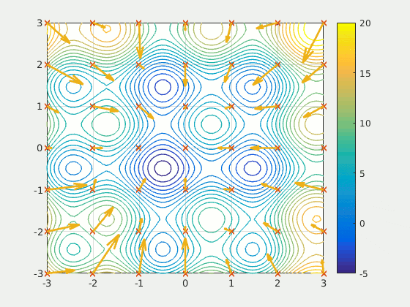
Particle Swarm Optimization
Mimicking social behavior of insects or birds

Slide 60
Particle Swarm Optimization cont.
introduced by Kennedy and Eberhart in 1995
imitates the basic strategy of swarm of bees seeking food
search direction relies on remembered good locations from the past
search direction is a compromise between the best point visited by the swarm and the best point visited by the individual
based on a population of designs
moves the existing designs to better ones
this algorithm has an advantage of handling continuous design variables
stochastic property in search
Insensitive to tuning parameters, suitable for parallel computing

Slide 61
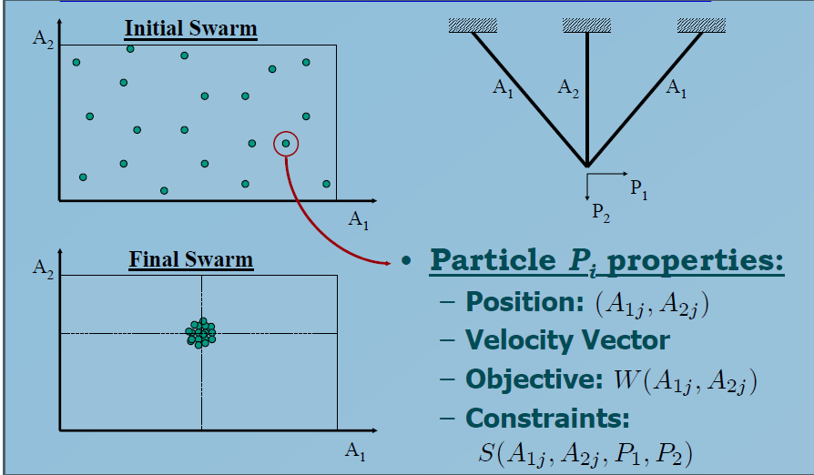
Algorithm Overview
Notes:
If we applied the algorithm to a three bar truss with two cross-sectional area design variables, we will need to define objective function and constraints. Here they are the weight and stress constraints, respectively.
we will start with a randomly distributed set of particles. Each particle will have a position, which are the values of the design variables, and a velocity vector that indicates its motion. As the search progresses, the swarm coalesces at the presumed optimum as is shown in the bottom left figure.

Slide 62
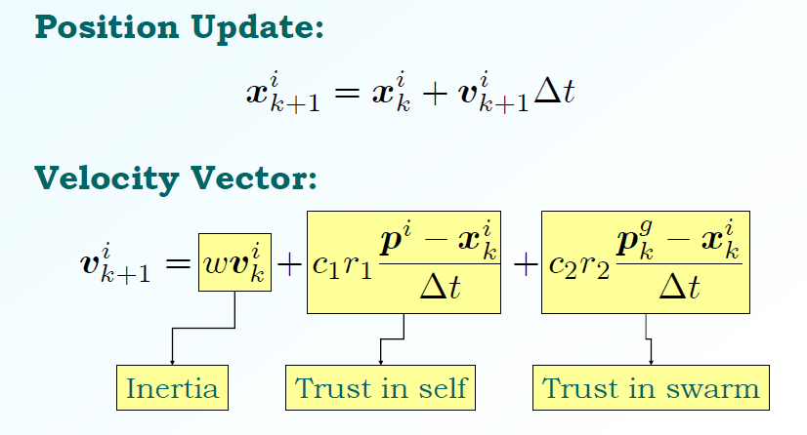
Moving Towards Personal Best And Group Best
YouTube visualization www.youtube.com/watch?v=_Y4A8Q2j0wA
Notes:
The velocity vector defines the motion of the particle. The $Δt$ is usually set to 1. The velocity of the particle at the k+1th generation is composed of three terms. The first is an inertia term that is a fraction of the velocity in the previous generation. A typical value of w (the inertia fraction) is 0.5.
The second term is based on moving towards p^{i}, the best past position of the ith particle. The size of the move is random, controlled by the random number r₁, uniformly distributed in [0,1]. The multiplier c₁ is used to control the mean of the move distance. A typical value is c₁=2, in which case the mean of the move is at p^{i}, and there is 50% chance of overshooting it or undershooting it.
The third term is exactly of the same structure as the second term, but the target is p^{g}, which is the group (swarm) best. Again, a typical value for c₂ is also 2. With all three terms present, we get motion in an intermediate direction between the three directions of the three terms.
Some PSO algorithms, including the one in this paper also add mutation. Here there is 10% chance that the particle will be moved to a random position in design space.

Slide 63
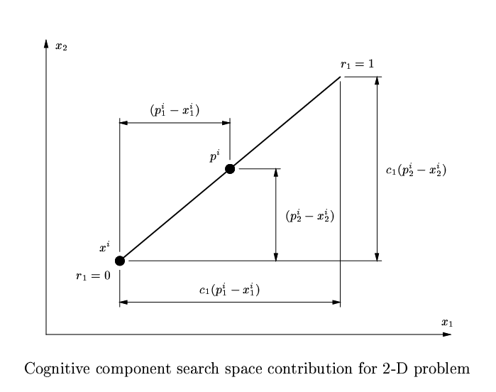
Cognitive Component Search

Slide 64
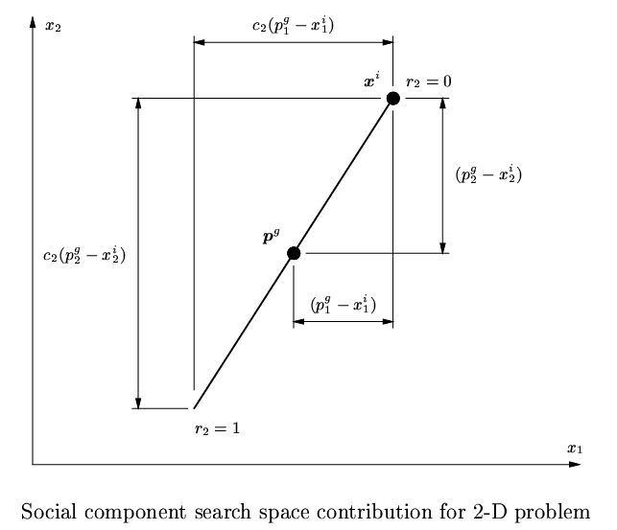
Social Component Search

Slide 65
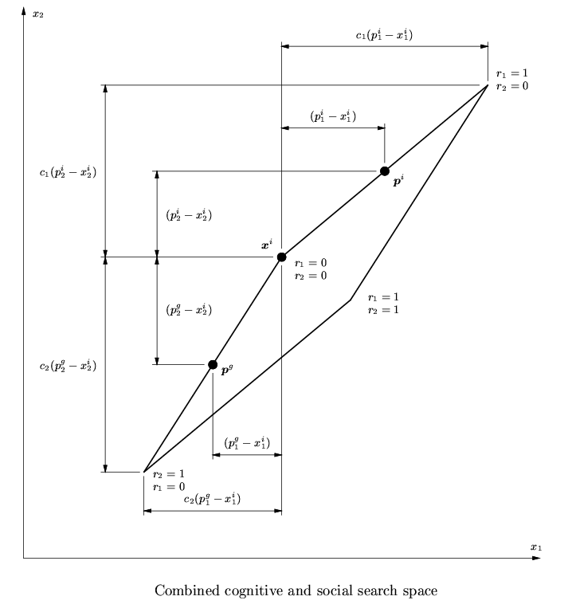
Combined Cognitive and Social Search

Slide 66
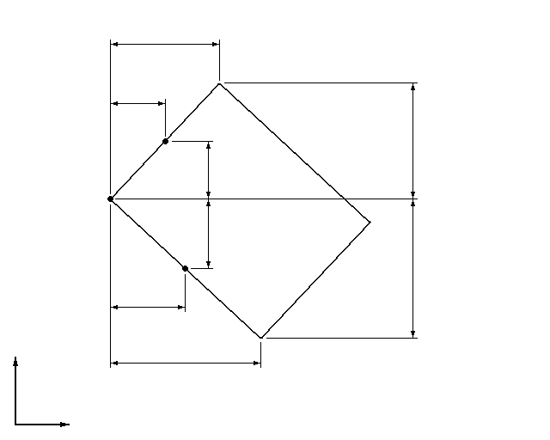
Alternative Case of Combined Search

Slide 67
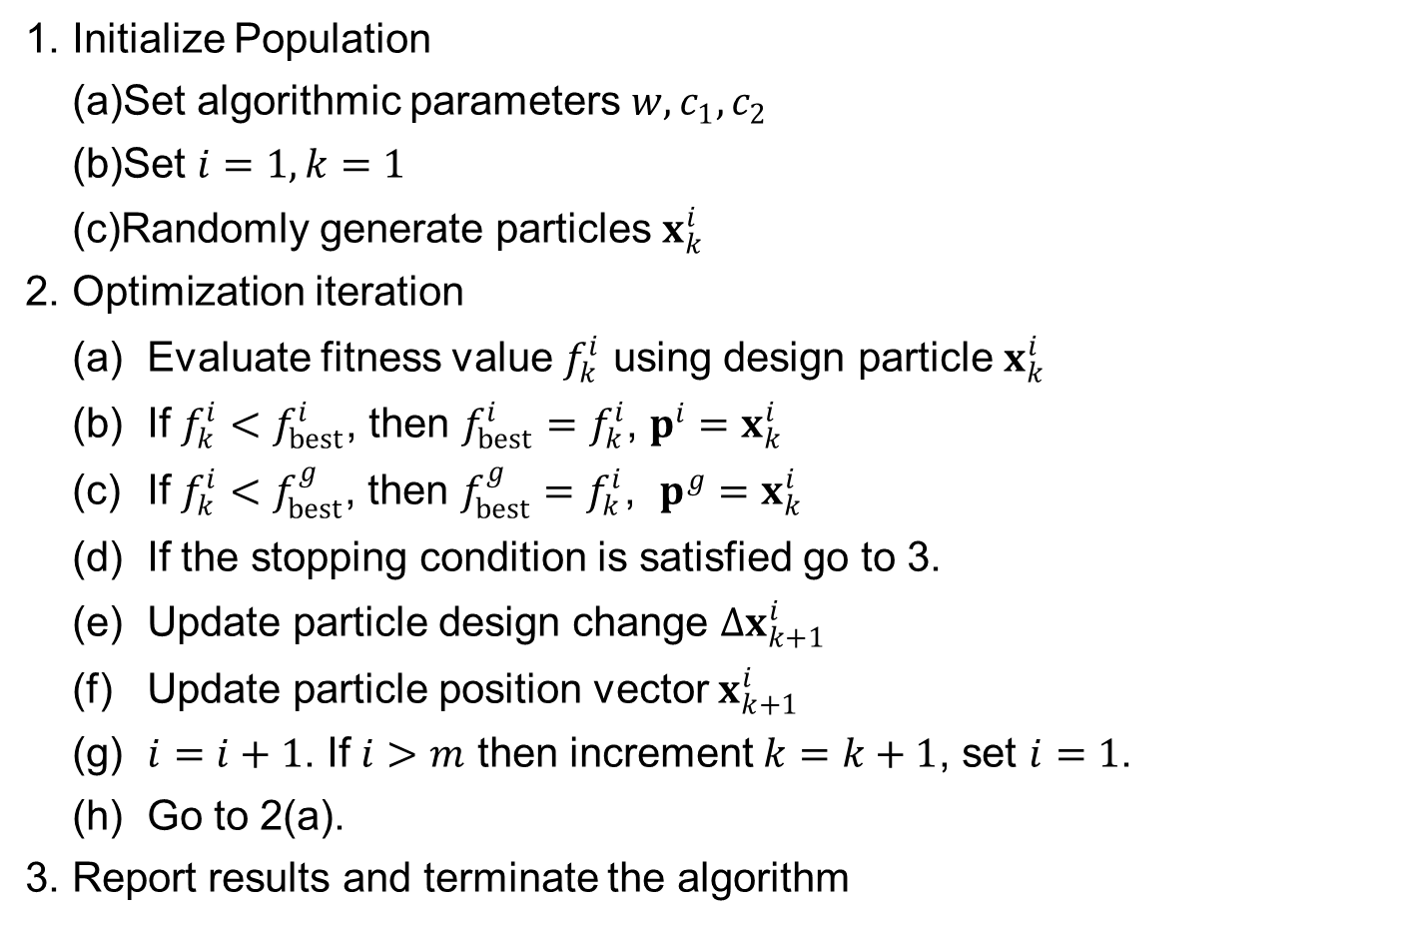
PSO Flowchart
1. Initialize Population
Set algorithmic parameters $w, c_{1}, c_{2}$
Set $i=1, k=1$
Randomly generate particles $x_{k}^{i}$
2. Optimization iteration
(a) Evaluate fitness value $f_{k}^{i}$ using design particle $x_{k}^{i}$
(b) If $f_{k}^{i}<f_{best}^{i}$, then $f_{best}^{i}=f_{k}^{i}$, $p^{i}=x_{k}^{i}$
(c) If $f_{k}^{i}<f_{best}^{g}$, then $f_{best}^{g}=f_{k}^{i}$, $p^{g}=x_{k}^{i}$
(d) If the stopping condition is satisfied go to 3.
(e) Update particle design change $Δx_{k+1}^{i}$
(f) Update particle position vector $x_{k+1}^{i}$
(g) $i=i+1$. If $i>m$ then increment $k=k+1$, set $i=1$.
(h) Go to 2(a).
3. Report results and terminate the algorithm

Slide 68

Stopping Criteria
the convergence of the particle swarm optimization algorithm can be defined in two different ways.
All particles converged to a point in the design space, which may or may not be the optimum design $→$ the design change is less than a threshold
the individual optimum $p^{i}$ and the swarm’s best-known position $p^{g}$ does not change for many iterations, regardless of how the swarm behaves $→$ change of the objective function is less than a threshold

Slide 69
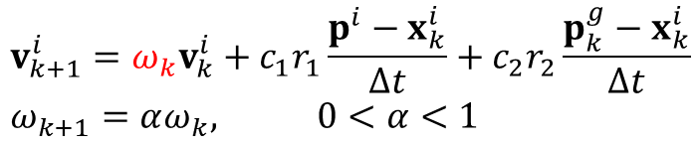


Particle Swarm Optimization Variations
Constant inertia weight
Linear reduction of inertia weight
Constriction factor
$$v_{k+1}^{i}={ωv}_{k}^{i}+c_{1}r_{1}\frac{p^{i}−x_{k}^{i}}{Δt}+c_{2}r_{2}\frac{p_{k}^{g}−x_{k}^{i}}{Δt}$$
$$v_{k+1}^{i}={ω_{k}v}_{k}^{i}+c_{1}r_{1}\frac{p^{i}−x_{k}^{i}}{Δt}+c_{2}r_{2}\frac{p_{k}^{g}−x_{k}^{i}}{Δt} \\ ω_{k+1}=αω_{k}, 0<α<1$$
$$v_{k+1}^{i}=K\left[v_{k}^{i}+c_{1}r_{1}\frac{p^{i}−x_{k}^{i}}{Δt}+c_{2}r_{2}\frac{p_{k}^{g}−x_{k}^{i}}{Δt}\right] \\ K=\frac{2}{\left|2−φ−\sqrt{φ^{2}−4φ}\right|},φ=c_{1}+c_{2},φ>4$$

Slide 70

Particle Swarm Optimization Variations cont.
Dynamic inertia and maximum velocity reduction
Maximum velocity limit:
Tracking of time dependent minima
Discrete optimization
$$v_{k+1}^{i}={ω_{k}v}_{k}^{i}+c_{1}r_{1}\frac{p^{i}−x_{k}^{i}}{Δt}+c_{2}r_{2}\frac{p_{k}^{g}−x_{k}^{i}}{Δt}$$
$$v^{max}=γ\left(x_{UB}−x_{LB}\right) \\ If f\left(p_{k}^{g}\right)≥f\left(p_{k−h}^{g}\right), then ω_{k+1}=αω_{k},v_{ }^{max}=βv_{ }^{max}, 0<α,β<1$$
Notes:
Alpha = beta = 0.99 and a wait period h = 10 were typical values used during the optimization

Slide 71



Performance Comparison for Variations

Slide 72
Matlab Function particleswarm.m
function [x,fval,exitflag,output] = particleswarm(fun,nvars,lb,ub,options)
INPUTS:
fun : Function
nvars : number of variables
lb, ub : Lower- and Upper-bounds of design variables
options : Control option structure (see optimoptions function)
OUTPUTS:
x : Design variables at optimum design
fval : Objective function values at optimum design
exitflag : 0 - Maximum number of function evaluations or iterations reached.
1 - Design changes are less than the tolerance
2 - Objective change is less than the tolerance
3 - Particle distances are less than the tolerance
4 - The maximum time specified in OPTIONS was reached.
output : Solution process summary structure
options = optimoptions('particleswarm','SwarmSize',50);

Slide 73





Ex6.7) Optimization of Rosenbrock Function using PSO
Minimize $f=100{\left(x_{1}^{2}−x_{2}\right)}^{2}+{\left(1−x_{1}\right)}^{2}$, $−3≤x_{1}, x_{2}≤3$ using GA
Function
Call PSO
Output
function y = Rosenbrock(x)
y = 100 * (x(1)^2 - x(2))^2 + (1 - x(1))^2;
rng default % For reproducibility
ndv = 2; lb = [-3,-3]; ub = [3,3];
options = optimoptions('particleswarm','SwarmSize',10);
[x,fval,exitflag,output] = particleswarm(@Rosenbrock,nvars,lb,ub,options)
x = 0.9683 0.9375
fval = 0.0010
exitflag = 1
output =
iterations: 67
funccount: 680
$$x_{2}$$
$$x_{2}$$
Initial particles
$$x_{1}$$
Optimum particles
$$x_{1}$$

Slide 74
Constrained Particle Swarm Optimization
Based on Venter, G. and Haftka, R.T., (2010), Structural and Multidisciplinary Optimization, Vol. 40(1-6), 65-76.
Constraints are treated using a bi-objective approach that minimizes both the objective function and a measure of the violation of the constraints.
Notes:
Particle swarm optimization (PSO) is one of the more recent nature based global optimization algorithms ( Kennedy, J.; Eberhart, R. (1995). "Particle Swarm Optimization". Proceedings of IEEE International Conference on Neural Networks IV. pp. 1942–1948. doi:10.1109/ICNN.1995.488968). My experience is very favorable with it when the design variables are continuous. So the first part of this lecture will cover the basic algorithm.
Like most other global optimization algorithms, PSO is for unconstrained problems. When we need to apply it to constrained problems, we typically use a penalty function to transform it to an unconstrained problem.
An alternative that was explored in my paper with Venter is to turn it into a bi-objective optimization, where we seek to minimize both the objective function and a measure of the constraint violation. The second part of the lecture will thus present a multi-objective PSO.
Finally, we will discuss a modification of the standard multi-objective PSO that is good for the constrained single objective problem.

Slide 75



What Is Best When Constraints Are Present?
Constrained optimization problem
Penalty function approach
Not easy to pick good $ω$
Creates canyons in design space that can trap swarm
$$\begin{matrix}Minimize f\left(b\right) \\ subject to g_{j}\left(x\right)≤0, j=1,…,K\end{matrix}$$
$$\overline{f}\left(b\right)=f\left(b\right)+ω\sum_{j=1}^{K}{max(0,g_{j}(b)) }$$
Notes:
When we have constraints, we need to transform the problem somehow in order to be able to apply an algorithm that is designed for unconstrained problem. The common approach is to add a penalty for each constraint violation. When we deal with gradient based optimizers, the penalty is usually proportional to the square of the constraint violation in order for the augmented objective to be differentiable.
For an algorithm that does not use derivative, a penalty proportional to the violation is better because it can prevent any violation. The square penalty is so small for small violations, that we normally end up with small constraint violations.
The drawback of a penalty function approach is that it is difficult to pick a good penalty multiplier r_{p}. If r_{p} is too small, we will not satisfy the constraints. If it is too large, we create such steep canyons in design space, that it is difficult for the swarm to move.

Slide 76


Bi-objective Or Filter Approach
Replace
By
Fletcher R., Leyffer, S. (2002) Nonlinear programming without a penalty function, Math Program 91(2);239-269
Advantage is in allowing less constrained search in design space.
$$\overline{f}\left(b\right)=f\left(b\right)+ω\sum_{j=1}^{K}{max(0,g_{j}(b)) }$$
$$\begin{matrix}Minimize f\left(b\right) \\ Minimize h\left(b\right)=\sum_{j=1}^{K}{max(0,g_{j}(b))}\end{matrix}$$
Notes:
The bi-objective approach merely take the penalty term and makes it a second objective. One has to keep in mind, though, that we are not really interested in points on the Pareto front where there are large violations, but in points where the violations are small or zero.
The key idea of the filter method is that by allowing violation of the constraints, you make the search for the optimum easier, since you have more freedom to cut through regions where constraints are violated.
In the context of PSO, we will then look first at how do you do a multi-objective PSO, and then how you bias it to look for only part of the Pareto front.

Slide 77
Multi-Objective PSO
The bi-objective formulation requires a multi-objective PSO (MOPSO)
Each iteration has multiple equally good “leaders”, non-dominated solutions
Based on general algorithm by Reyes-Sierra and Coello Coello (2005)
Create archive of non-dominated solutions
Select leader for each particle based on a binary tournament
Makes use of the crowding distance to maintain and select leaders
Notes:
The multi-objective PSO (MOPSO) used for this work was developed by Reyes-Sierra and Coello-Coello. (Reyes-Sierra M, Coello Coello C (2005) Improving PSO-based
multi-objective optimization using crowding, mutation and -dominance. In: Third international conference on evolutionary multi-criterion optimization, Guanajuato, 9–11 March 2005, pp 505–519)
One maintain an archive of non-dominated solutions. That is, when a new point is evaluated it is compared to the archive, added if no point there dominates it, points it dominates are removed from the archive.
From that archive we select a group of leaders by limiting their number and selection based on the crowding distance. The rest are discarded. Crowding distance will be explained on next slide.
Instead of swarm best position, used in the case of regular PSO, each particle is given a leader, selected from the group of stored leaders. This is done with a binary tournament, which means picking two members of the archive at random, and selecting the one that has the largest crowding distance from the leaders selected so far.

Slide 78

Crowding Distance
First sort non-dominated points by objective function values.
Crowding distance of point i is the distance between two nearest neighbors ($i−1$ to $i+1$)
Notes:
The crowding distance of points at the two ends of the Pareto front is infinity, while for internal points it is the sum of the absolute differences in the function values. So referring the figure in the slide, the crowding distance of point I is

Slide 79

Example: MOPSO
MOPSO with two objective functions
$$f_{1}\left(b\right)=b^{2}, f_{2}\left(b\right)={\left(b−2\right)}^{2}, b∈\left[−100,100\right]$$
With this large range of b, how come the two objectives have such small values?
Notes:
This is an illustrative example of the use of the algorithm. It is a one dimensional problem, but with very large range for b, the twenty particles will be distributed with mostly very large values of both f1 and f2. However, if b<0 or b>2, both objectives suffer, and therefore the Pareto front will be in the range of x in [0,2]. In that range both functions vary between zero and four.
We see that the Pareto front is well defined with the crowding distance approach resulting in fairly even distribution of points along the front.

Slide 80
Constraint Specialized Bi-objective PSO
We are not interested in complete Pareto front, but mostly in part that has low constraint violations.
Bias algorithm to such points
Select leaders based on both constraint violation and crowding distance
Binary tournament based on constraint violation
Goal is to place more particles near feasible domain
Notes:
Since we are not interested in parts of the Pareto front that represent large constraint violation, we want to bias the selection of leaders to low values of constraint violation. This is done by selecting the leaders based on both crowding distance and value of the penalty.
In addition, to select a leader for a given particle, we base the winner in the binary tournament on the value of the penalty function instead of the crowding distance.

Slide 81

Example
Composite laminate design $(θ1/θ2/θ3)s$, with three angles and three thicknesses as design variables.
Maximize the transverse in-plane stiffness $A22$
Constraints on ply angles and effective Poisson’s ratio
Methods compared
Standard PSO with penalty function
MOPSO algorithm of Reyes-Sierra and Coello-Coello
Modified MOPSO algorithm
100 runs, each with 30 particles and 100 generations.
10% probability of mutation, $w=0.5, c1=1.75, c2=2.25$
Notes:
The optimization problem used in the paper to demonstrate the effectiveness of the approach is the design of composite laminate made of three plies with the thickness of the plies and their angles being the design variables. The objective function is the transverse stiffness with constraints on ply angles and the effective Poisson ratio. The formulation is written out on the next slide.
The method is solved with a standard PSO algorithm with a penalty function, the MOPSO algorithm described before, and the specialized MOPSO algorithm. Each optimization was done with 30 particles and 100 generations, that is 3,000 function evaluations. However, because of the randomness of the algorithm, each of the three methods was run 100 times.
The parameters of the PSO are given in the slide. They were chosen based on experience with other problems.

Slide 82

Optimization Formulation
See relation between stiffness and Poisson’s ratio and design variables in the paper.
$$\begin{matrix}Maximize{ A}_{22} \\ subject to 0.48≤ν_{eff}≤0.52 \\ −5^{o}≤θ_{k}≤5^{o}or \\ {40}^{o}≤θ_{k}≤{50}^{o}or \\ {85}^{o}≤θ_{k}≤{95}^{o} \\ 0.001≤t_{k}≤0.05"\end{matrix}$$
Notes:
This is the formulation of the optimization problem. The objective function A22 is the transverse stiffness, which is approximately the transverse Young modulus times the thickness of the laminate. There is a constraint on the effective Poisson’s ratio. The equations for the transverse stiffness and Poisson’s ratio in terms of the angles and the thicknesses are given in the paper.
In addition there are constraints on the angles that confine them to be near zero, near 45-deg or near 90-deg. The thicknesses have limited range too. In a more realistic problem, the thicknesses would need to be a multiple of a commercially available ply thickness rather than continuous. The thickness range shown here corresponds to about 10 plies.

Slide 83
Results: Penalty Function
$108$ is the best penalty multiplier
Notes:
The figure shows the distribution of the final objective function in each of the 100 runs for the standard PSO with penalty function. Instead of showing the runs in the order that they were run, they are arranged by the value of the objective function.
We see that for low value of the penalty parameter of 10⁴, only about 10% of the runs reached near the global optimum, while for the best value of 10⁸, more than 40% did. However, increasing the penalty parameter further was counter productive.

Slide 84
Results: Bi-objective Formulation
Without focus of the Pareto front on the near feasible designs, there are many wasted evaluations on deeply infeasible designs.
Notes:
This is now compared to the two MOPSO algorithms. The standard MOPSO has very poor performance, because most of the runs do not end up with any particles that satisfy the constraints. However, the MOPSO biased towards low penalty, has about 80% of the runs nearing the global optimum.

Slide 85
6.6 Simulated Annealing Optimization
By gradually lowering temperature, atoms can find a better equilibrium

Slide 86

Simulated Annealing Algorithm
motivated by statistical mechanics: equilibrium of atoms in solids by gradually decreasing temperature
to reach a more stable, globally minimum energy state, the metal is reheated to a high temperature and cooled slowly
Simulated annealing (Metropolis)
predicts the behavior of atoms in equilibrium at a given temperature
At a given $T$, atom’s position is randomly perturbed and computes $ΔE$ of the system
If $ΔE<0$, then the new position of the atom is accepted
If $ΔE≥0$, the new position is accepted with a probability inversely proportional to the energy increase (exploration of design space)

Slide 87


Simulated Annealing Algorithm cont.
positive energy change: $ΔE_{+}=\max\left(0, ΔE\right)$
probability of acceptance
when $ΔE<0$, $P\left(ΔE\right)=e^{0}=1$. the probability is $0<P\left(ΔE\right)≤1$
If $ΔE<0$, it will be accepted always
if $ΔE>0$, it will be accepted with a probability of $P\left(ΔE\right)$
If $T$ is high, prob. of acceptance of a higher energy state increase
If $T$ is low, the probability of acceptance becomes small
$$P\left(ΔE\right)=e^{\left(−\frac{ΔE_{+}}{T}\right)}$$

Slide 88

Simulated Annealing Algorithm cont.
$T$ becomes a control parameter
first “melt” the system at a high temperature
Randomly perturb design to make thermal equilibrium (iteration)
Once thermal equilibrium, then lower temperature
Annealing schedule: temperature reduction sequence and No. of iterations
Objective function $f$ = energy state
Moving from $x^{i}$ to $x^{j}$ causes $Δf^{ij}$
Temperature $T$ regulates the convergence of the process
How to choose initial $T_{0}$ and how to update it are important, as well as No. of iterations before thermal equilibrium (cooling schedule)

Slide 89

Simulated Annealing Algorithm Flowchart
Set initial design $x=x_{0}$, objective function $f(x)$, the maximum number of iterations $M$, and initial temperature $T_{0}$
Loop for cooling schedule
Calculate $T$ from the cooling schedule
Loop for thermal equilibrium
Generate a new candidate design $x_{new}$ randomly near the current design $x$
Calculate objective function $f(x_{new})$, and $Δf$=$f\left(x_{new}\right)−f(x)$
Calculate the probability of acceptance $P\left(Δf\right)=e(−Δf_{+}/T)$ with $Δf_{+}=\max\left(0,Δf\right)$ and generate a random sample $u\sim U(0,1)$
If $P\left(Δf\right)≥u$, set $x=x_{new}$
End of the thermal equilibrium loop
End of the cooling schedule loop
Finish the algorithm with optimum design $x$ and optimum objective function $f(x)$.

Slide 90




Cooling Schedule
selection of the initial temperature $T_{0}$
Low $T_{0}$ has a low probability of reaching a global minimum
High $T_{0}$ permits virtually all moves to be accepted (exploration)
Typically $T_{0}$ is selected to make the acceptance ratio $X_{0}=0.95$
Max. No. of iterations
Needs to be large enough to escape from local minima
Ex) No change of $f$ for $M$ iterations
For $S$ neighboring designs,
$$X_{0}=e^{\left(−\frac{{\overline{Δf}}^{(+)}}{T_{0}}\right)}⟹T_{0}=\frac{{\overline{Δf}}^{(+)}}{\ln{(X_{0}^{−1})}}$$
${\overline{Δf}}^{(+)}$: average increase in $f$
$$M=S\ln\left(\frac{1}{1−P}\right)$$

Slide 91


Cooling Schedule cont.
Cooling schedule (updating temperature)
Constant cooling update: $T_{k+1}=αT_{k}, k=0, 1, ⋯, K,0.5≤α≤0.95$
Or
Pros
transitions out of a local optimum is always possible
relatively insensitive to noise and no need gradient information
Cons
problem dependency of algorithm parameters
$$T_{k}=\frac{K−k}{K}T_{0}, k=0, 1, ⋯, K$$

Slide 92

Ex6.8) Matlab Function simulannealbnd
Find minimum of $f(x)=\left(4−2.1x_{1}^{2}+x_{1}^{4}/3\right)x_{1}^{2}+x_{1}x_{2}+\left(−4+4x_{2}^{2}\right)x_{2}^{2}$ in $−64≤x_{1},x_{2}≤64$
Define objective function
Call optimization
Output
function f = objfun(x)
x1 = x(1); x2 = x(2);
f = (4-2.1.*x1.^2+x1.^4./3).*x1.^2+x1.*x2+(-4+4.*x2.^2).*x2.^2;
rng default % For reproducibility
x0 = [0.5 0.5]; % Starting point
lb = [-64 -64]; ub = [64 64];
[x,fval,exitFlag,output] = simulannealbnd(@objfun,x0,lb,ub)
x = -0.0896 0.7127
fval = -1.0316
exitFlag = 1
output =
iterations: 2465
funccount: 2484
message: 'Optimization terminated: change in best function value
less than options.FunctionTolerance.'
rngstate: [1×1 struct]
problemtype: 'boundconstraints'
temperature: [2×1 double]
totaltime: 0.5566

