Slide 1


Slide 2
Chap 8 Neural Network Model

Slide 3
Can Neural Network Be a Surrogate?
neural network is a surrogate for the prediction of QoI
no need a physics-based model to predict physical phenomena
uses samples to fit a mathematical model
fitting process determines unknown parameters (weights and biases)
Different terminology
training in neural network vs. fitting in surrogate
learning or training data in neural network vs. samples in surrogate
Due to many layers and nodes, neural networks have much more parameters than other surrogates
Need a lot of data
Prevent overfitting

Slide 4
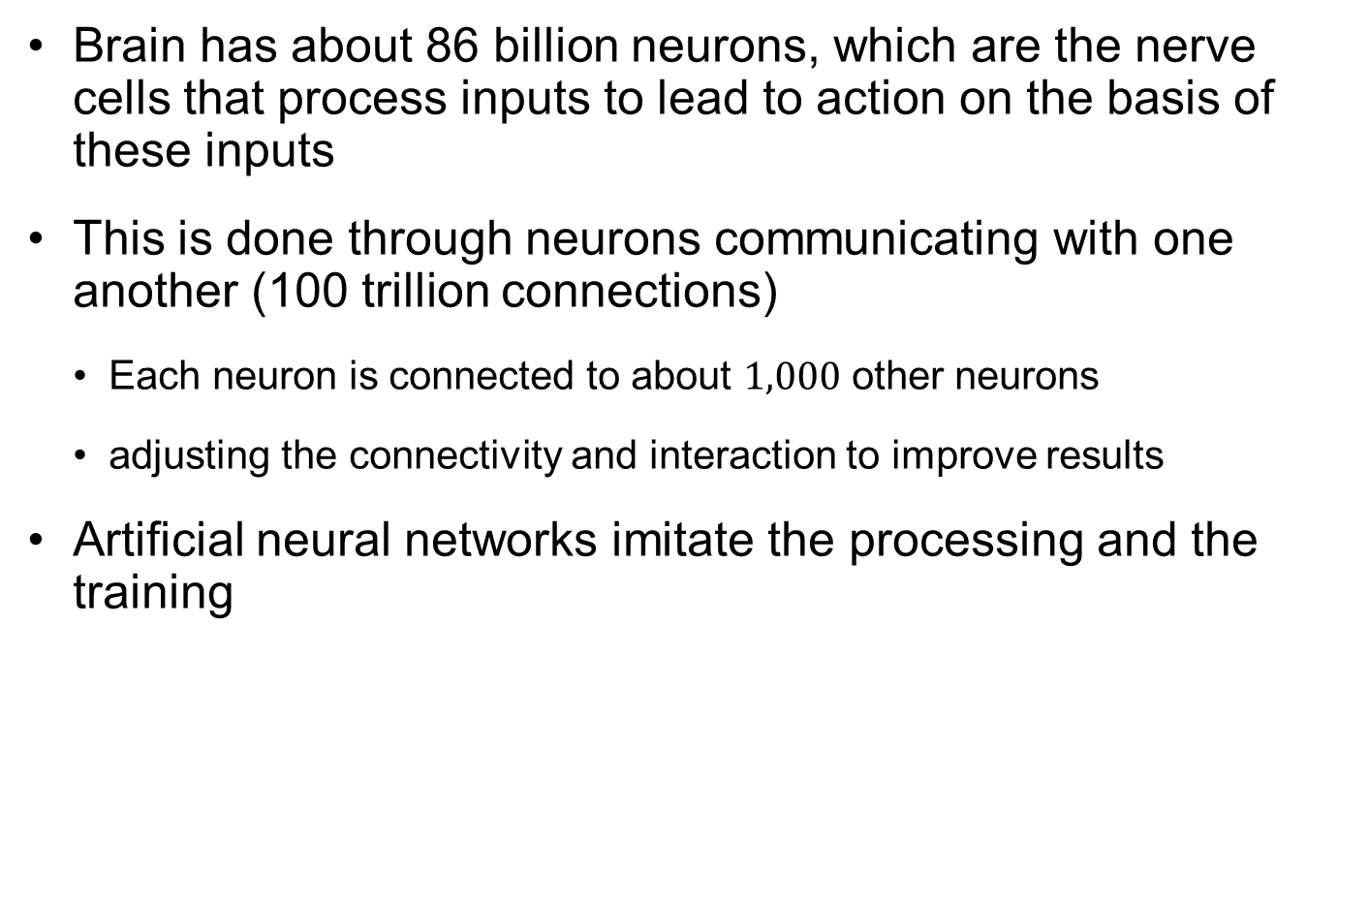
What We Try to Imitate
Brain has about 86 billion neurons, which are the nerve cells that process inputs to lead to action on the basis of these inputs
This is done through neurons communicating with one another (100 trillion connections)
Each neuron is connected to about $1,000$ other neurons
adjusting the connectivity and interaction to improve results
Artificial neural networks imitate the processing and the training

Slide 5
Artificial Neural Network
Computing systems vaguely inspired by the biological neural networks that constitute animal brains
The data structures and functionality of neural nets are designed to simulate associative memory
Learn by processing input and output data (samples)
After learn by enough data, neural nets can predict results from inputs
Relationship between the number and diversity of samples processed by a neural net and the prediction accuracy
Fancy description, but basically neural network is a kind of surrogate model
Determine (train) unknown parameters using samples and predict

Slide 6
Artificial Neural Network cont.
based on a collection of connected units or nodes called artificial neurons
loosely model the neurons in a biological brain
Each connection can transmit a signal to other neurons
A neuron receives a signal then processes it and sends the signal to the neurons connected to it
Implementation
"signal" at a connection is a real number, and the output of each neuron is computed by a nonlinear function of the sum of its inputs
Neurons typically have a weight that adjusts as learning proceeds
Input layer (inputs), hidden layer (not shown), and output layer (prediction)

Slide 7
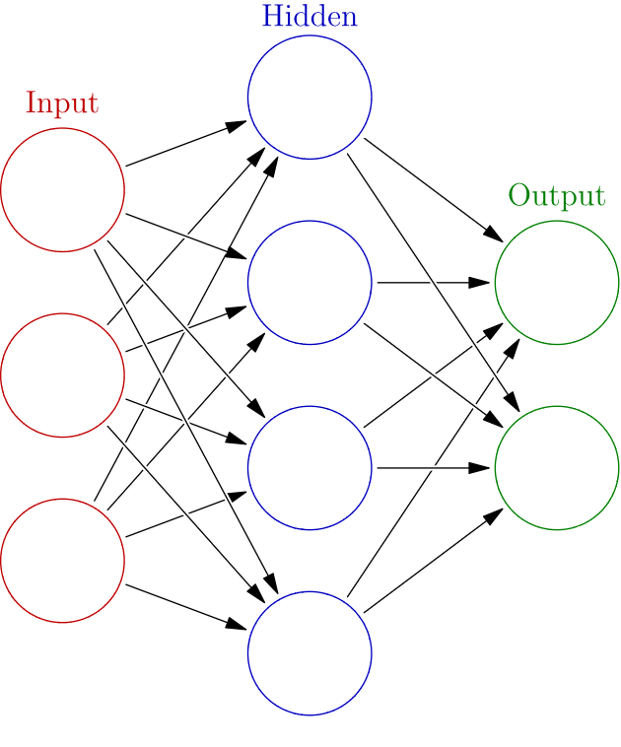
Deep Learning
part of a broader family of machine learning methods based on artificial neural networks with representation learning
Learning can be supervised, semi-supervised or unsupervised
The adjective "deep" comes from the use of multiple layers in the network
Deep learning is a modern variation which is concerned with an unbounded number of layers of bounded size
permits practical application and optimized implementation

Slide 8
History of Neural Network
first introduced in 1943 by Warren McCulloch, a neurophysiologist, and a mathematician Walter Pitts
In 1949, Donald Hebb published a book, “The Organization of Behavior,” where he formulated the classical Hebbian rule, which is proved to be the basis of almost all neural learning procedures
John Hopfield invented associative neural network in 1982, which is now more commonly known as Hopfield Network
backpropagation algorithm, a generalization of Widrow-Hoff learning algorithm, was invented by Rumelhart, Hinton and Williams → renaissance of research in neural network

Slide 9
Types of NN
Feedforward NN (Svozil et al. 1997): conveys the information in one direction
Radial basis function network (Orr 1996): uses the Gaussian radial basis function
Recurrent NN (Bodén 2001): local feedback connections between the input and outputs, and so forth
Fuzzy-neural (Liu and Li 2004), wavelet (He et al. 2004), associative-memory (Bicciato et al. 2001), modular (Happel and Murre 1994) and hybrid (Zhang and Yuen 2013, Rovithakis et al. 2004) neural networks

Slide 10
8.2 Feedforward Neural Network Model
information only moves in forward direction from input layer, through hidden layer and to output layer

Slide 11
Feedforward NN Model
Neurons or nodes: basic processing units in NN
they can be grouped into different layers such as input layer, output layer and hidden layer
Input layer: receiving input data from outside
Output layer: send processed data out of the NN (prediction)
Hidden layer: between input and output layers, no interaction with outside (not shown to users)
Feedforward NN
information only moves in forward direction from input layer, through hidden layer and to output layer
no feedback or flow within layers

Slide 12

Illustration of Feedforward NN Model
$$\hat{y}$$

Slide 13
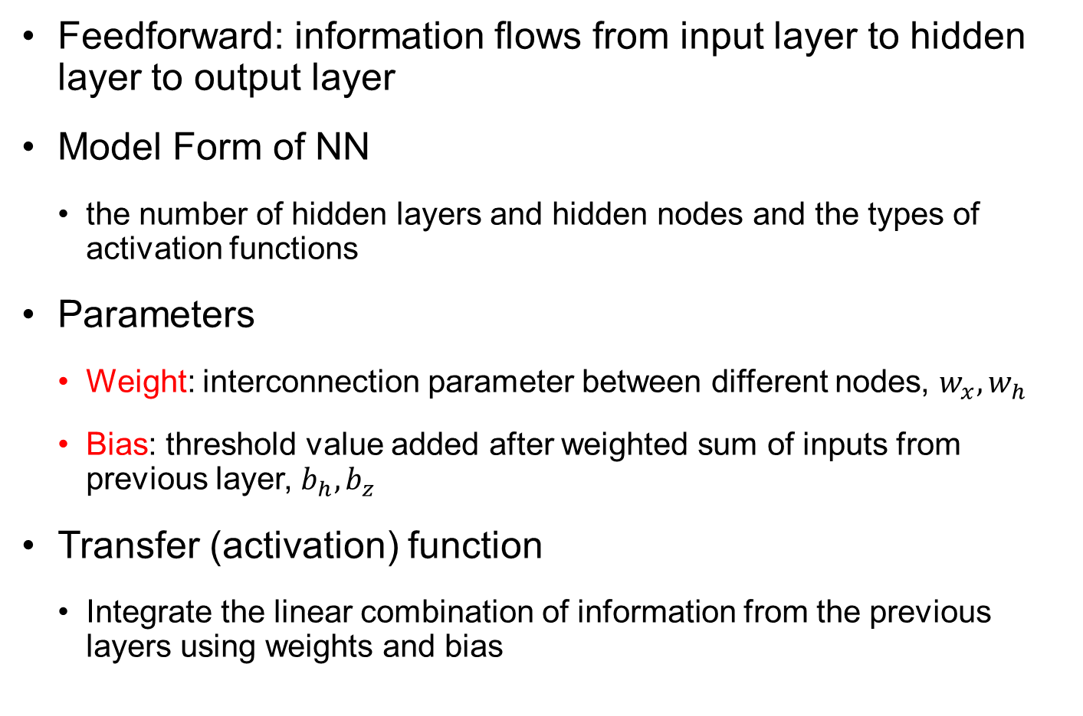
Illustration of Feedforward NN Model cont.
Feedforward: information flows from input layer to hidden layer to output layer
Model Form of NN
the number of hidden layers and hidden nodes and the types of activation functions
Parameters
Weight: interconnection parameter between different nodes, $w_{x}, w_{h}$
Bias: threshold value added after weighted sum of inputs from previous layer, $b_{h}, b_{z}$
Transfer (activation) function
Integrate the linear combination of information from the previous layers using weights and bias

Slide 14
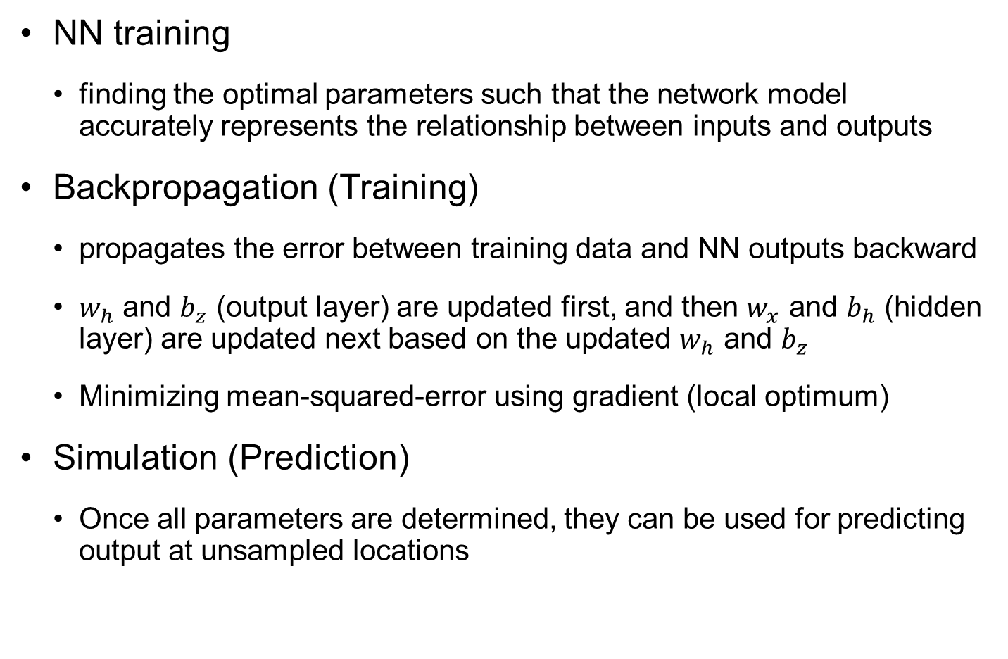
Backpropagation
NN training
finding the optimal parameters such that the network model accurately represents the relationship between inputs and outputs
Backpropagation (Training)
propagates the error between training data and NN outputs backward
$w_{h}$ and $b_{z}$ (output layer) are updated first, and then $w_{x}$ and $b_{h}$ (hidden layer) are updated next based on the updated $w_{h}$ and $b_{z}$
Minimizing mean-squared-error using gradient (local optimum)
Simulation (Prediction)
Once all parameters are determined, they can be used for predicting output at unsampled locations

Slide 15














Model a Single Neuron
The model of ANN neuron combines three principles:
Output of a neuron is a function of input from the connected neurons
Neuron favors input from some connections over others
Neuron saturates if it gets too much input
Neuron generates linear combination of all connected inputs
Activation function models saturation
describes nonlinear behaviors
$$u=w_{1}x_{1}+w_{2}x_{2}+⋯+w_{n}x_{n}$$
$$x_{1}$$
$$w_{1}$$
$$b$$
Activation function
$$y=Φ\left(u\right)$$
$$x_{2}$$
$$w_{2}$$
$$Σ$$
$$u$$
$$Φ(u)$$
Output $z$
$$⋮$$
Summation operator
$$x_{n_{x}}$$
$$w_{n_{x}}$$

Slide 16
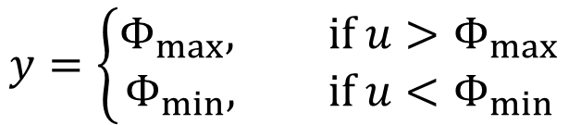
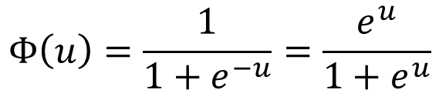

Saturation Effect of Activation Function
The output cannot exceed a lower and upper limit (non-smooth)
Sigmoid (logistic) function is often used (monotonic, differentiable)
Hyperbolic tangent function
Arctangent function
Error function, etc.
$$y=\left\{\begin{aligned}Φ_{max}, if u>Φ_{max} \\ Φ_{min}, if u<Φ_{min}\end{aligned}\right.$$
$$Φ\left(u\right)=\frac{1}{1+e^{−u}}=\frac{e^{u}}{1+e^{u}}$$
1
Linear region
$$Φ(u)$$
0.5
Saturation region
0
-6
-4
-2
0
2
4
6
$$u$$

Slide 17
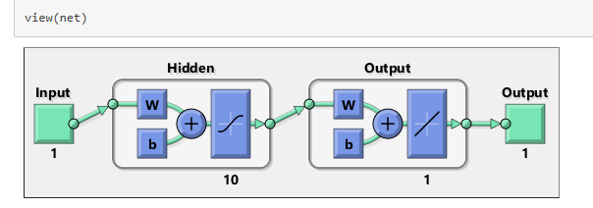
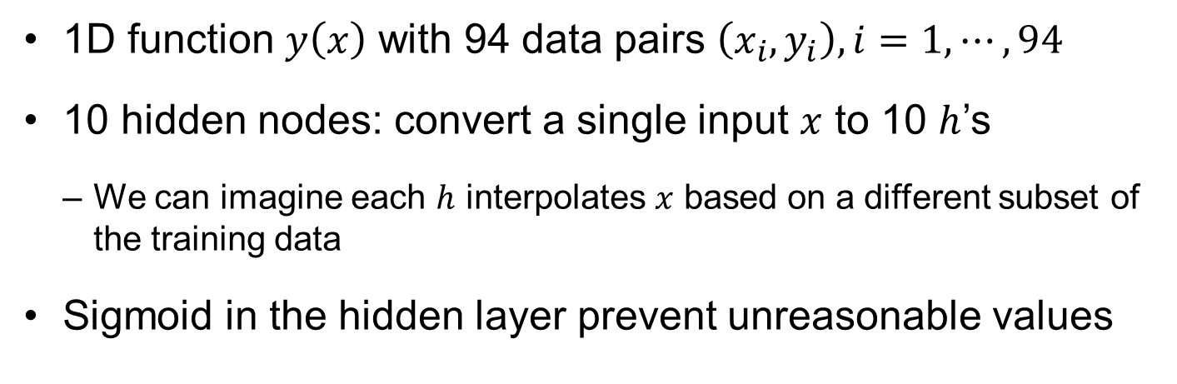
Example from Matlab
1D function $y\left(x\right)$ with 94 data pairs $\left(x_{i},y_{i}\right), i=1,⋯,94$
10 hidden nodes: convert a single input $x$ to 10 $h$’s
We can imagine each $h$ interpolates $x$ based on a different subset of the training data
Sigmoid in the hidden layer prevent unreasonable values

Slide 18


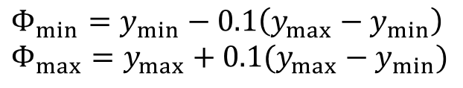

Example from Matlab cont.
Let $h_{1}$ is interpolation based on two data $(x_{1},y_{1})$ and $(x_{2},y_{2})$
Other hidden nodes can be written similarly
Lower- and upper-saturation limits
Output prediction
$$h_{1p}=\frac{x_{2}−x}{x_{2}−x_{1}}y_{1}+\frac{x−x_{1}}{x_{2}−x_{1}}y_{2}=\frac{x(y_{2}−y_{1})}{x_{2}−x_{1}}+\frac{x_{2}y_{1}−x_{1}y_{2}}{x_{2}−x_{1}}=w^{(1)}x+b_{1}$$
$$h_{1}=Φ(h_{1p})$$
$$h_{ip}=w^{(i)}x+b_{i}, h_{i}=Φ\left(h_{ip}\right), i=1,⋯,10$$
$$Φ_{min}=y_{min}−0.1\left(y_{max}−y_{min}\right) \\ Φ_{max}=y_{max}+0.1(y_{max}−y_{min})$$
$$y=b_{o}+\sum_{i=1}^{10}{w_{i}h_{i}}$$

Slide 19
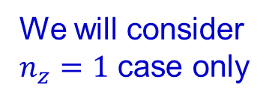
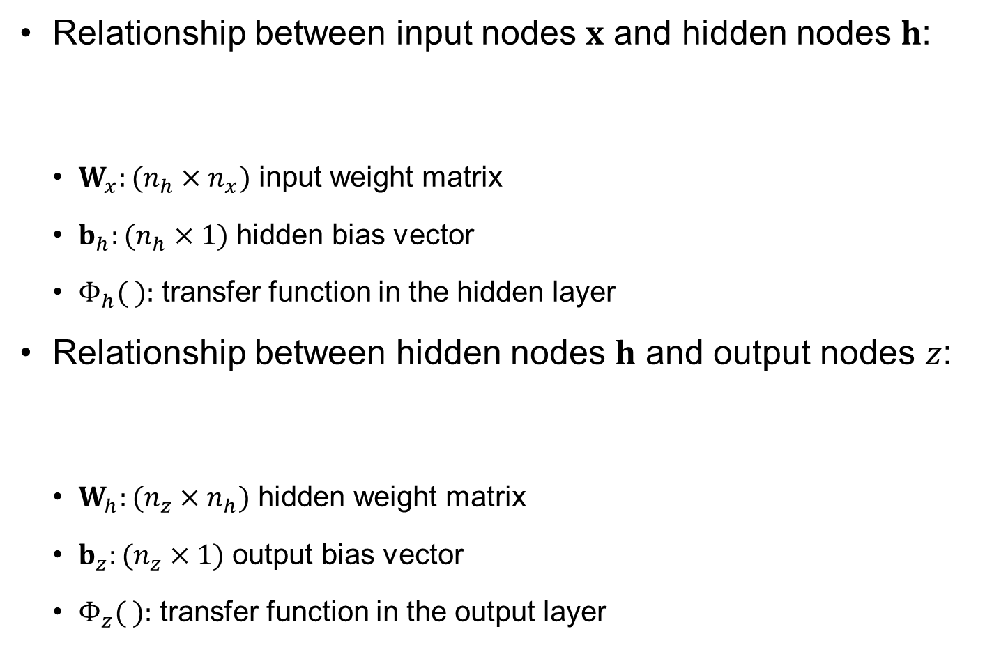


Feedforward Mechanism
Relationship between input nodes $x$ and hidden nodes $h$:
$W_{x}:(n_{h}×n_{x})$ input weight matrix
$b_{h}:(n_{h}×1)$ hidden bias vector
$Φ_{h}( ):$ transfer function in the hidden layer
Relationship between hidden nodes $h$ and output nodes $z$:
$W_{h}:(n_{z}×n_{h})$ hidden weight matrix
$b_{z}:(n_{z}×1)$ output bias vector
$Φ_{z}( ):$ transfer function in the output layer
$$h=Φ_{h}\left(W_{x}x+b_{h}\right)$$
$$z=Φ_{z}(w_{h}h+b_{z})$$
We will consider $n_{z}=1$ case only

Slide 20






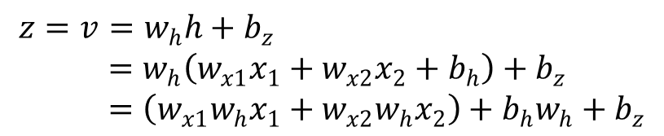
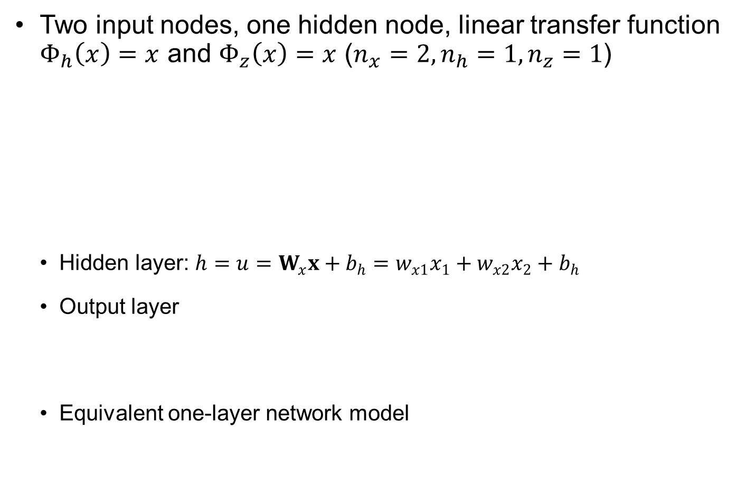








Ex8.1) FFNN with Linear Transfer Function
Two input nodes, one hidden node, linear transfer function $Φ_{h}\left(x\right)=x$ and $Φ_{z}\left(x\right)=x$ ($n_{x}=2, n_{h}=1, n_{z}=1$)
Hidden layer: $h=u=W_{x}x+b_{h}=w_{x1}x_{1}+w_{x2}x_{2}+b_{h}$
Output layer
Equivalent one-layer network model
$${ b}_{h}$$
Activation function
$${ b}_{z}$$
$$x_{1}$$
$$w_{x1}$$
$$Σ$$
$$u$$
$$h$$
$$w_{h}$$
$$Σ$$
$$v$$
Output $z$
$$x_{2}$$
$$w_{x2}$$
$$x=\left\{\begin{matrix}x_{1} \\ x_{2}\end{matrix}\right\}, W_{x}=\left[w_{x1}, w_{x2}\right], b_{h}=b_{h}$$
$$z=v=w_{h}h+b_{z} \\ =w_{h}\left(w_{x1}x_{1}+w_{x2}x_{2}+b_{h}\right)+b_{z} \\ =\left(w_{x1}{w_{h}x}_{1}+w_{x2}w_{h}x_{2}\right)+b_{h}w_{h}+b_{z}$$
$$w_{x1}^{∗}=w_{x1}w_{h}$$
$$w_{x2}^{∗}=w_{x2}w_{h}$$
$$b_{z}^{∗}=b_{h}w_{h}+b_{z}$$
$$z=w_{x1}^{∗}x_{1}+w_{x2}^{∗}x_{2}+b_{z}^{∗}$$

Slide 21

Ex) FFNN with Linear Transfer Function cont.
When $Φ_{h}\left(x\right)=x$ and $Φ_{z}\left(x\right)=x$
One-layer NN model with ${\left(w_{h}W_{x}\right)}_{1×n_{x}}$ being input weights and ${\left(w_{h}B_{h}+b_{z}\right)}_{1×n_{y}}$ being the output bias
Multi-layer NN model with pure linear transfer function can be converted into a single-layer NN model
$$z=w_{h}\left(W_{x}x+b_{h}\right)+b_{z}=(w_{h}W_{x})x+(w_{h}b_{h}+b_{z})$$

Slide 22
Activation (Transfer) Functions
Significant role in predicting nonlinear behavior
should be differentiable: the gradient of MSE is needed in backpropagation training process
Examples: Sigmoid, logistics, hyperbolic tangent, rectified linear unit (ReLU), inverse and linear functions
choice depends on the complexity and performance of NN models
Each activation function has its own unique properties and is suitable for certain use cases
Sigmoid: ideal for binary classification problems
ReLU: helps overcome the vanishing gradient problem

Slide 23




Activation (Transfer) Functions cont.
Pure linear
Sigmoid
3
1
$$Φ\left(u\right)=u$$
$$Φ\left(u\right)=\frac{e^{u}}{1+e^{u}}$$
2
1
0
0.5
-1
-2
(a)
(b)
-3
-3
-2
-1
0
1
2
3
0
-3
-2
-1
0
1
2
3
Hyperbolic tangent
Rectified linear unit
1
$$Φ\left(u\right)=\frac{e^{u}−e^{−u}}{e^{u}+e^{−u}}$$
3
$$Φ\left(u\right)=\max{(0,u)}$$
2
0
1
(c)
(d)
-1
-3
-2
-1
0
1
2
3
0
-3
-2
-1
0
1
2
3

Slide 24

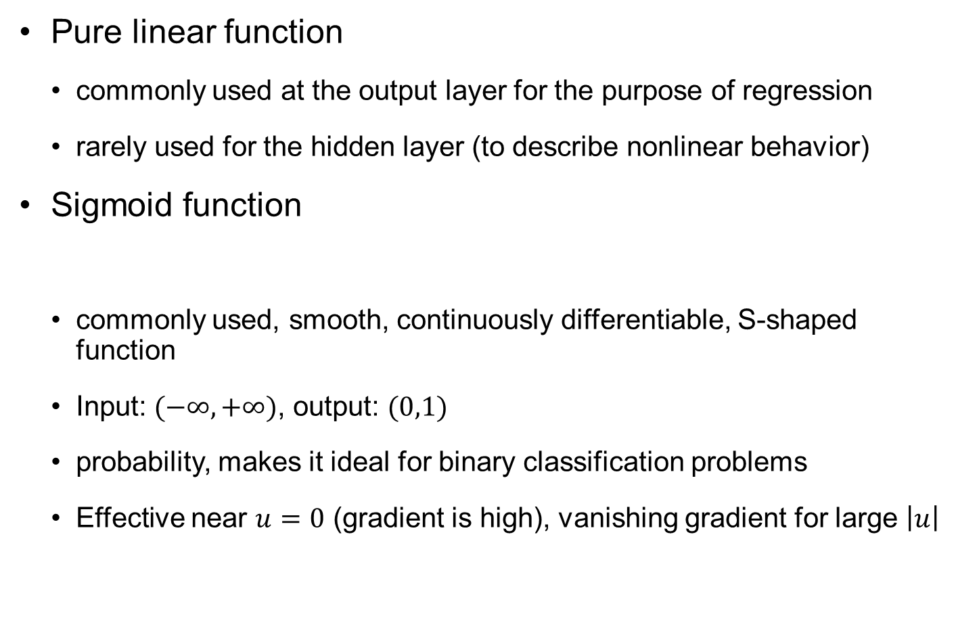

Activation (Transfer) Functions cont.
Pure linear function
commonly used at the output layer for the purpose of regression
rarely used for the hidden layer (to describe nonlinear behavior)
Sigmoid function
commonly used, smooth, continuously differentiable, S-shaped function
Input: $(−∞,+∞)$, output: $(0,1)$
probability, makes it ideal for binary classification problems
Effective near $u=0$ (gradient is high), vanishing gradient for large $\left|u\right|$
$$Φ(u)=u$$
$$Φ\left(u\right)=\frac{e^{u}}{1+e^{u}}$$

Slide 25
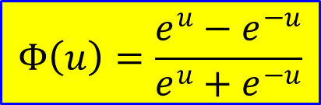
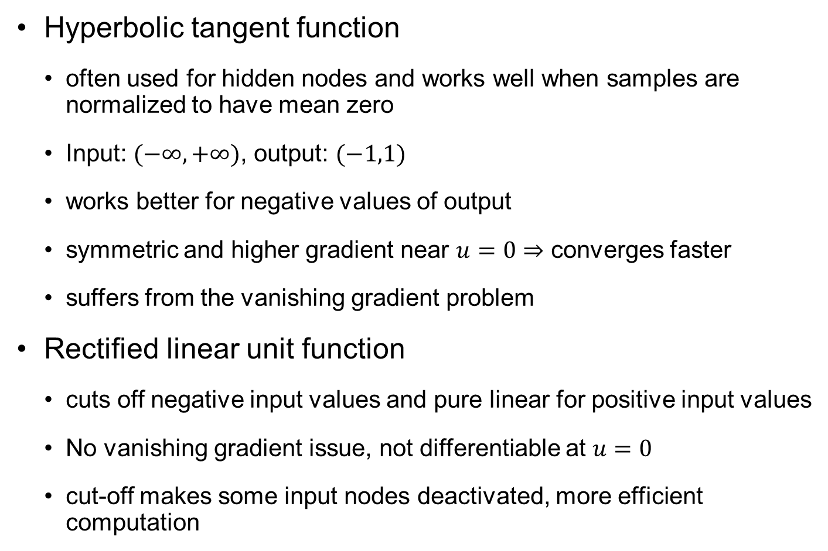

Activation (Transfer) Functions cont.
$$Φ\left(u\right)=\frac{e^{u}−e^{−u}}{e^{u}+e^{−u}}$$
Hyperbolic tangent function
often used for hidden nodes and works well when samples are normalized to have mean zero
Input: $(−∞,+∞)$, output: $(−1,1)$
works better for negative values of output
symmetric and higher gradient near $u=0⇒$ converges faster
suffers from the vanishing gradient problem
Rectified linear unit function
cuts off negative input values and pure linear for positive input values
No vanishing gradient issue, not differentiable at $u=0$
cut-off makes some input nodes deactivated, more efficient computation
$$Φ\left(u\right)=\max{(0, u)}$$

Slide 26
Activation (Transfer) Functions cont.
Activation function | Characteristics
Sigmoid | Mainly used in one-class classification problems within output layer Vanishing gradient problem
Tanh | Compensating for shortcomings of sigmoid function (zero-centered; faster convergence) Still vanishing gradient problem
ReLU | Compensating for vanishing gradient problem Mainly used for hidden layer Simple and fast Dying ReLU problem
Leaky ReLU | Compensating for shortcomings of ReLU function (dying ReLU problem)
Softmax | Mainly used in multiclass classification problems within output layer
Pure linear | Mainly used in regression analysis problems within output layer Linear activation function problems

Slide 27





Ex) Complexity of NN model
2-layer NN model: 1 input node, 1 (or 5) hidden node, and 1 output node
Generate random weights and biases from $\sim U(−5,5)$
Repeat 5 times:
$$h=Φ_{h}\left(W_{x}x+b_{h}\right)$$
$$z=Φ_{z}\left(W_{h}h+b_{z}\right)$$
1-hidden node
5-hidden nodes
$$\hat{y}$$
$$\hat{y}$$

Slide 28


















Ex8.2) Activation Functions
Design FFNN model to predict $z\left(x\right)=5x^{4}+2x^{3}−x^{2}+3x−2$ exactly
4 activation functions: $Φ_{h1}\left(u\right)=u$, $Φ_{h2}\left(u\right)=u^{2}$, $Φ_{h3}\left(u\right)=u^{3}$, $Φ_{h4}\left(u\right)=u^{4}$
one input node, four hidden nodes, and one output node
All weights in hidden layers are one, and all hidden biases are zero
$$W_{xi}=1, b_{hi}=0, i=1,⋯, 4$$
$$w_{h1}=3, w_{h2}=−1, w_{h3}=2, w_{h4}=5, b_{z}=−2$$
$$h_{1}$$
$${ b}_{z}$$
$$w_{x1}$$
$$w_{h1}$$
$$w_{x2}$$
$$h_{2}$$
$$w_{h2}$$
$$x$$
$$w_{x3}$$
$$Σ$$
Output $z$
$$w_{x4}$$
$$h_{3}$$
$$w_{h3}$$
$$h_{4}$$
$$w_{h4}$$

Slide 29
Backpropagation Process
finding the optimal parameters, weights and biases, such that the network model accurately represents the relationship between inputs and outputs
backpropagation: propagates the error between training data and the network outputs backward
optimization process to find the best weights and biases to minimize the mean square error between network predictions and training data
parameters (gradient or Jacobian) for hidden weights and output bias (output layer) are updated first
then, parameters for input weights and hidden biases (hidden layer) are updated next based on the updated parameters in the output layer

Slide 30
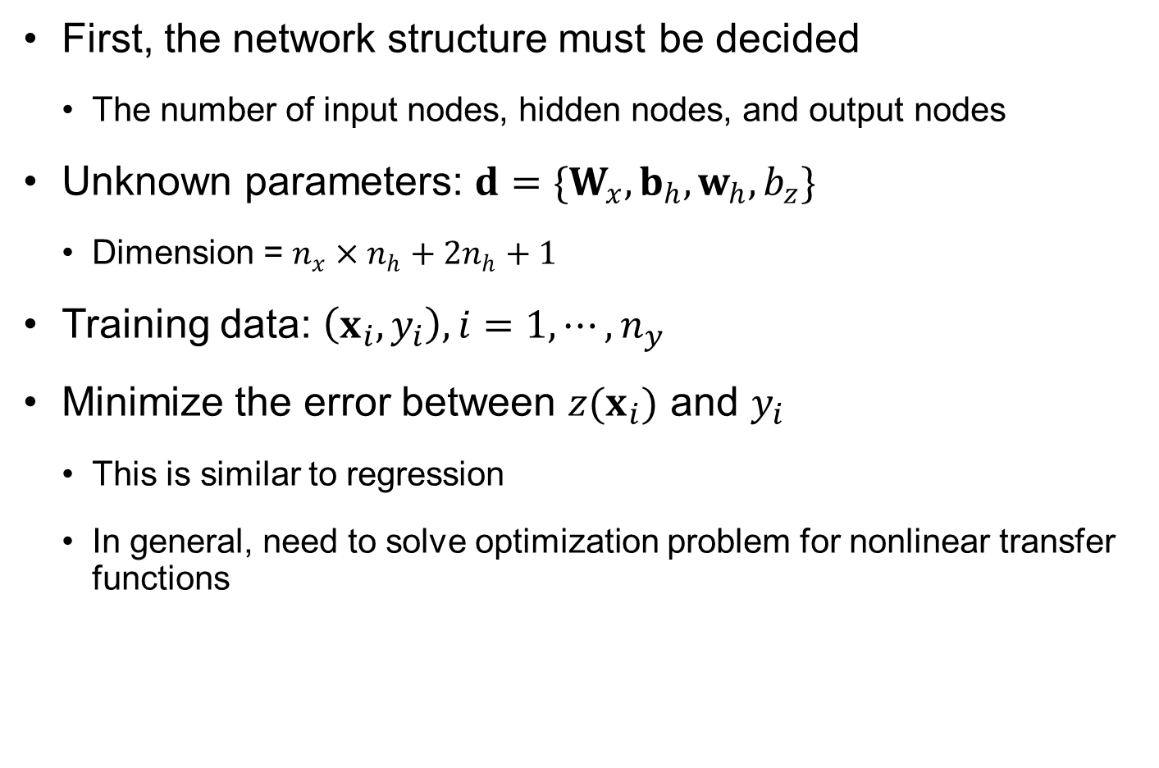
Backpropagation Process cont.
First, the network structure must be decided
The number of input nodes, hidden nodes, and output nodes
Unknown parameters: $d=\{W_{x},b_{h},w_{h},b_{z}\}$
Dimension = $n_{x}×n_{h}+2n_{h}+1$
Training data: $\left(x_{i},y_{i}\right), i=1,⋯,n_{y}$
Minimize the error between $z(x_{i})$ and $y_{i}$
This is similar to regression
In general, need to solve optimization problem for nonlinear transfer functions

Slide 31
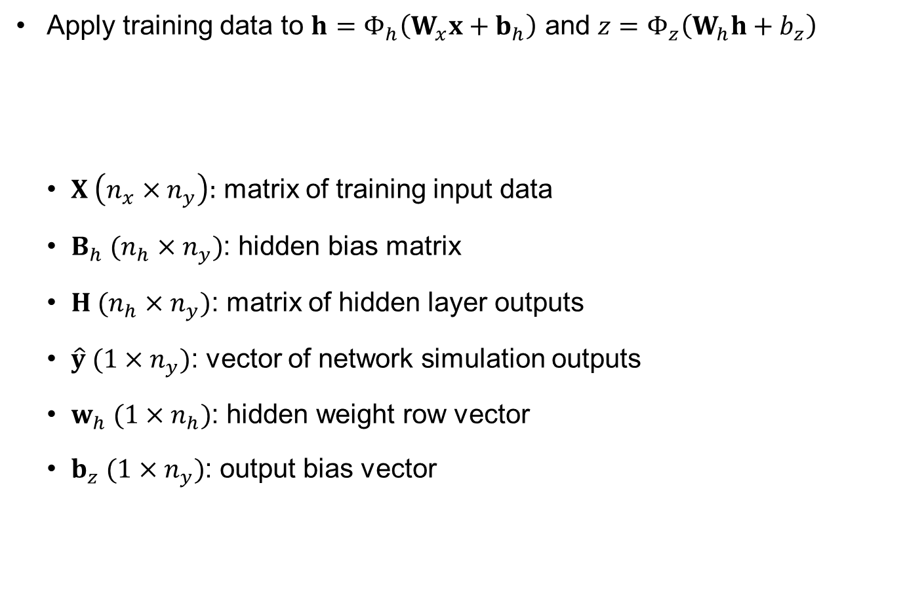
Backpropagation Process cont.
Apply training data to $h=Φ_{h}\left(W_{x}x+b_{h}\right)$ and $z=Φ_{z}\left(W_{h}h+b_{z}\right)$
$X \left(n_{x}×n_{y}\right):$ matrix of training input data
$B_{h} (n_{h}×n_{y})$: hidden bias matrix
$H (n_{h}×n_{y})$: matrix of hidden layer outputs
$\hat{y} (1×n_{y})$: vector of network simulation outputs
$w_{h} (1×n_{h})$: hidden weight row vector
$b_{z} (1×n_{y})$: output bias vector
$$H=Φ_{h}\left(W_{x}X+B_{h}\right), z=Φ_{z}\left(w_{h}H+b_{z}\right)$$

Slide 32
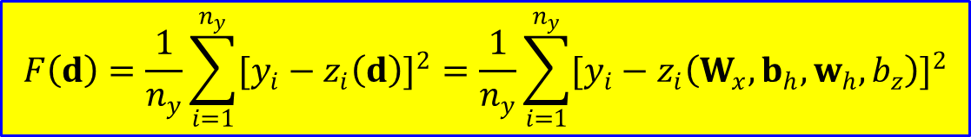
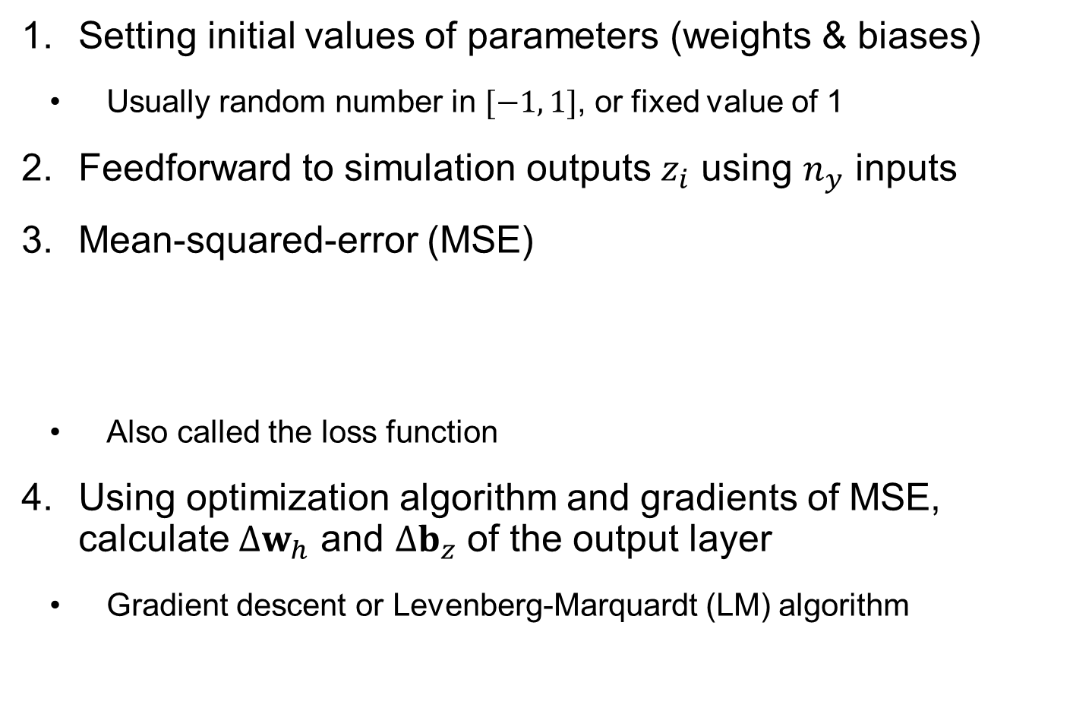
Backpropagation Process cont.
Setting initial values of parameters (weights & biases)
Usually random number in $[−1, 1]$, or fixed value of 1
Feedforward to simulation outputs $z_{i}$ using $n_{y}$ inputs
Mean-squared-error (MSE)
Also called the loss function
Using optimization algorithm and gradients of MSE, calculate $Δw_{h}$ and $Δb_{z}$ of the output layer
Gradient descent or Levenberg-Marquardt (LM) algorithm
$$F\left(d\right)=\frac{1}{n_{y}}\sum_{i=1}^{n_{y}}{{[y_{i}−z_{i}\left(d\right)]}^{2}}=\frac{1}{n_{y}}\sum_{i=1}^{n_{y}}{{[y_{i}−z_{i}\left(W_{x},b_{h},w_{h},b_{z}\right)]}^{2}}$$

Slide 33

Backpropagation process cont.
Calculate $ΔW_{x}$ and $ΔB_{h}$ of the hidden layer
$ΔW_{x}$ and $ΔB_{h}$ depend on $Δw_{h}$ and $Δb_{z}$
Update the weights and biases of NN model
Repeat Steps 1 ~ 6 until satisfying a stopping criterion

Slide 34
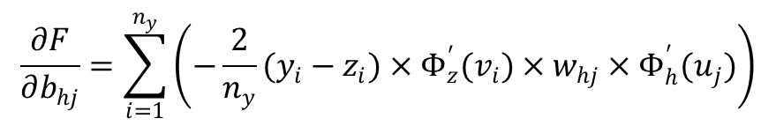
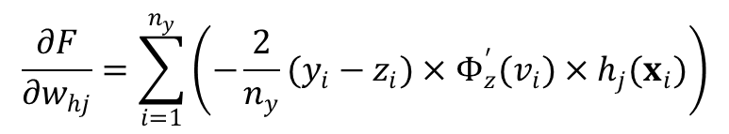
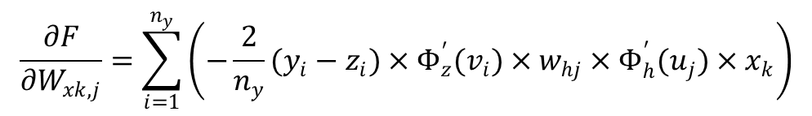


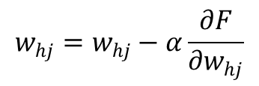
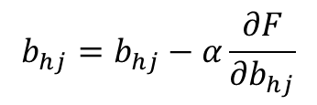
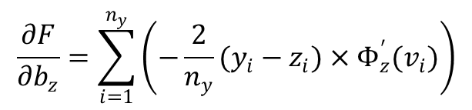
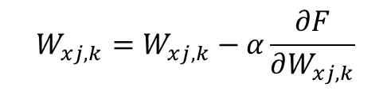
One Cycle (Epoch) of Parameter Update
Gradient of $F$ w.r.t. $w_{h}$ and $b_{z}$
$α$: learning rate
Gradient of $F$ w.r.t. $w_{x}$ and $b_{h}$
$$\frac{∂F}{∂w_{hj}}=\sum_{i=1}^{n_{y}}{\left(−\frac{2}{n_{y}}(y_{i}−z_{i})×Φ_{z}^{′}(v_{i})×h_{j}(x_{i})\right)}$$
$$w_{hj}=w_{hj}−α\frac{∂F}{∂w_{hj}}$$
$$\frac{∂F}{∂b_{z}}=\sum_{i=1}^{n_{y}}{\left(−\frac{2}{n_{y}}(y_{i}−z_{i})×Φ_{z}^{′}(v_{i})\right)}$$
$$b_{z}=b_{z}−α\frac{∂F}{∂b_{z}}$$
$$\frac{∂F}{∂W_{xk,j}}=\sum_{i=1}^{n_{y}}{\left(−\frac{2}{n_{y}}(y_{i}−z_{i})×Φ_{z}^{′}(v_{i})×w_{hj}×Φ_{h}^{′}(u_{j})×x_{k}\right)}$$
$$W_{xj,k}=W_{xj,k}−α\frac{∂F}{∂W_{xj,k}}$$
$$\frac{∂F}{∂b_{hj}}=\sum_{i=1}^{n_{y}}{\left(−\frac{2}{n_{y}}(y_{i}−z_{i})×Φ_{z}^{′}(v_{i})×w_{hj}×Φ_{h}^{′}(u_{j})\right)}$$
$$b_{hj}=b_{hj}−α\frac{∂F}{∂b_{hj}}$$

Slide 35

Ex8.3) Backpropagation
Two samples $\left(x_{i},y_{i}\right)=\left(0,−1\right), (1,1)$ from $y\left(x\right)=2x−1$
Fit FFNN model with $α=0.2$ and $α=0.5$
clear;
x=[0 1]; y=[-1 1];
alpha=0.2; %alpha=0.5;
wx=1; wh=1; bh=0; bz=0;
for i=1:50
h=wx*x+bh;
z=wh*h+bz;
MSE(i)=sum((y-z).^2)/2;
if MSE(i) < 1E-6, break, end
dwh = -(y(1)-z(1))*h(1) - (y(2)-z(2))*h(2);
dbz = -(y(1)-z(1)) - (y(2)-z(2));
wh = wh -alpha*dwh;
bz = bz -alpha*dbz;
dwx = -(y(1)-z(1))*wh*x(1) - (y(2)-z(2))*wh*x(2);
dbh = -(y(1)-z(1))*wh - (y(2)-z(2))*wh;
wx = wx -alpha*dwx;
bh = bh -alpha*dbh;
end
epoch=1:i; plot(epoch,MSE)

Slide 36
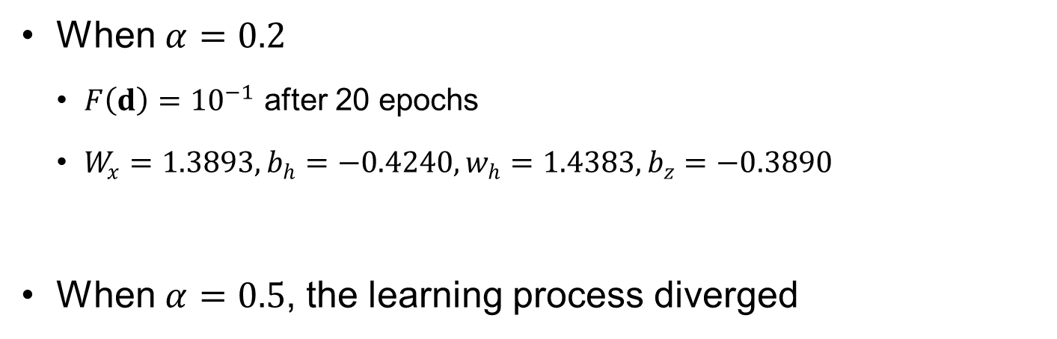


Ex8.3) Backpropagation cont.
When $α=0.2$
$F\left(d\right)={10}^{−1}$ after 20 epochs
$W_{x}=1.3893, b_{h}=−0.4240, w_{h}=1.4383, b_{z}=−0.3890$
When $α=0.5$, the learning process diverged
$$z\left(x\right)=w_{h}W_{x}x+w_{h}b_{h}+b_{z}=2x−1$$
0.5
10
10
121
$$α=0.2$$
$$α=0.5$$
0.4
8
0.3
6
0.2
4
0.1
2
0
0
4
8
12
16
20
(a)
0
1
2
3
4
5
6
7
8
(b)
epochs
epochs

Slide 37
8.3 Matlab Functions for Feedforward Neural Network
With given samples and network structure, Matlab can train and predict NN model

Slide 38
Matlab Functions for Feedforward NN
define a network model → set up configurations → train the network model → prediction with different inputs
feedforwardnet: creates a two-layer network model with user-defined number of hidden nodes
configure: Optional step to normalize input and output data and assigns them to each node
train: trains the network model with the LM backpropagation for training method and the MSE for the error function
sim: simulates/predicts the network outputs at new inputs based on the identified weights and biases during the training process

Slide 39
Matlab fitnet
net=fitnet(hiddenSizes,trainFcn)
Defining the structure of the network and the training function
hiddenSizes=[10, 4]: 2 hidden layers with 10 and 4 nodes, respectively
trainFcn
Two hidden layers (example)
1st-layer: a different estimate of the desired final y
2nd-layer: different weighted averages of the estimate
Training function | Algorithm
'trainlm' | Levenberg-Marquardt
'trainbr' | Bayesian regularization
'trainbfg' | BFGS quasi-Newton
… | …

Slide 40
Stopping Criterion Based on Validation Error
Randomly divide data: training (70%), validation (15%), test (15%)
use training set to update the weights and biases based on their error
The error of the training set keeps decreasing, and the error in the validation set also decreases: the training process goes well
The error in the validation set starts increasing after some phase of training process, i.e., good performance at the training set but bad performance at the validation set (new points, prediction points): the network model overfits the training data
Therefore, the training process stops when the validation error starts increasing
The test data sets are not used during the training process but used for testing the prediction accuracy with trained parameters

Slide 41



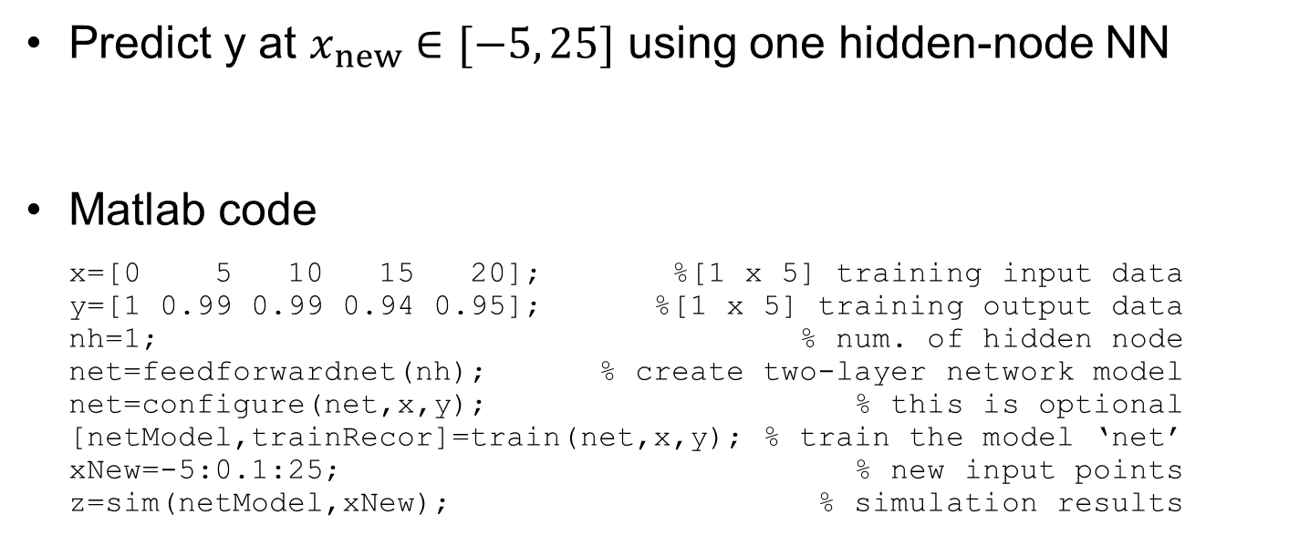






Ex8.4) Feedforward NN Model
Predict y at $x_{new}∈[−5, 25]$ using one hidden-node NN
Matlab code
x=[0 5 10 15 20]; %[1 x 5] training input data
y=[1 0.99 0.99 0.94 0.95]; %[1 x 5] training output data
nh=1; % num. of hidden node
net=feedforwardnet(nh); % create two-layer network model
net=configure(net,x,y); % this is optional
[netModel,trainRecor]=train(net,x,y); % train the model ‘net’
xNew=-5:0.1:25; % new input points
z=sim(netModel,xNew); % simulation results
$$x \left(=t\right)={\left[\begin{matrix}0 & 5 & 10 & 15 & 20\end{matrix}\right]}^{T}, y={\left[\begin{matrix}1 & 0.99 & 0.99 & 0.94 & 0.95\end{matrix}\right]}^{T}$$
Initial 1.40 0.0 -0.13 0.02
$${ b}_{h}$$
Activation function
$${ b}_{z}$$
$$x$$
$$w_{x}$$
$$Σ$$
$$h$$
$$w_{h}$$
$$Σ$$
Output $z$
Optimum 1.54 -0.22 -1.04 0.05

Slide 42
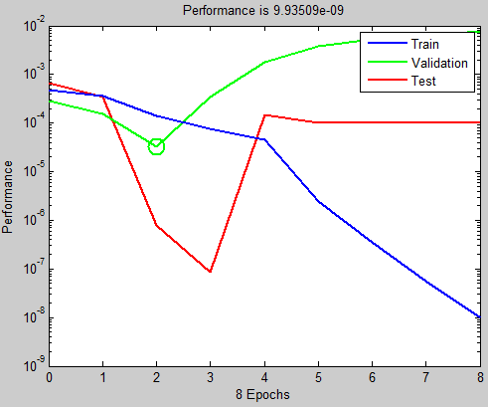
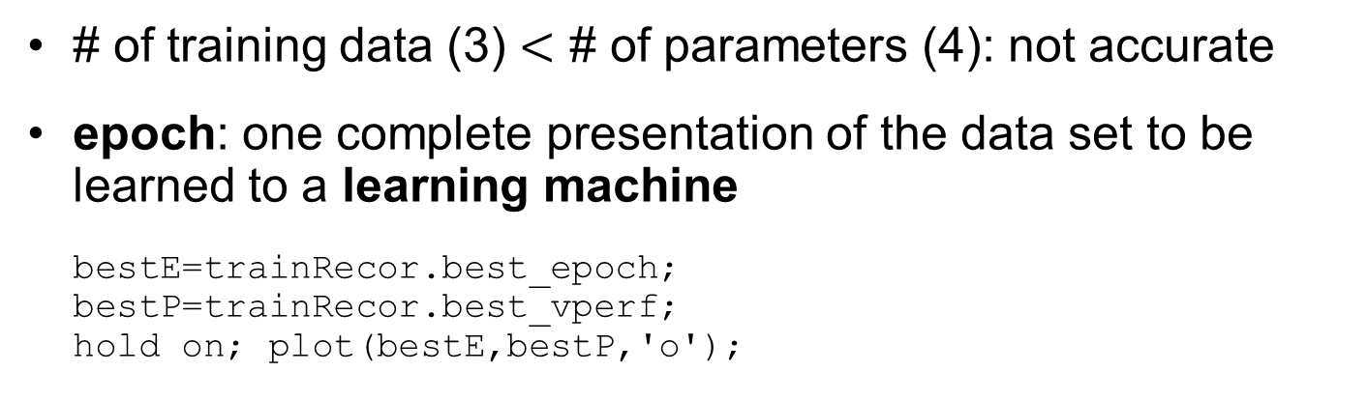

Ex8.4) Feedforward NN Model cont.
# of training data (3) $<$ # of parameters (4): not accurate
epoch: one complete presentation of the data set to be learned to a learning machine
bestE=trainRecor.best_epoch;
bestP=trainRecor.best_vperf;
hold on; plot(bestE,bestP,'o');
$$\hat{y}$$

Slide 43
Ex8.5) Feedforwardnet of Rosenbrock Function
Fit the banana function using NN in $x_{1},x_{2}∈[0.5,1.5]$ with 20 LHS samples. Calculate the $e_{RMS}$ using $51×51$ equally spaced grid points
%Plotting the actual function at grid points
clear; n=51;
x=linspace(0.5,1.5,n); y=linspace(0.5,1.5,n);
[X,Y]=meshgrid(x,y);
Z=zeros(n);
for i=1:n, for j=1:n
Z(i,j)=Rosenbrock([y(j) x(i)]);
end, end
figure(1); cs=surface(X,Y,Z); hold on;
%
%LHS samples
rng default;
xx=0.5+lhsdesign(20, 2,'iterations',5000,'smooth','off');
yy=Rosenbrock(xx);
plot3(xx(:,1), xx(:,2), yy,'or'); hold off
%
% FFNN
nh=5; % num. of hidden node
net=feedforwardnet(nh); % create two-layer network model
net=configure(net,xx',yy'); % this is optional
[netModel,trainRecor]=train(net,xx',yy'); % train the model 'net'
ZNN=zeros(n);
for i=1:n, for j=1:n
ZNN(i,j)=sim(netModel,[y(j) x(i)]');
end, end
figure(2); cs=surface(X,Y,ZNN); hold on;
plot3(xx(:,1), xx(:,2), yy,'or'); hold off
RMSE=sqrt(sum(sum(abs(Z-ZNN)))/(n*n))

Slide 44
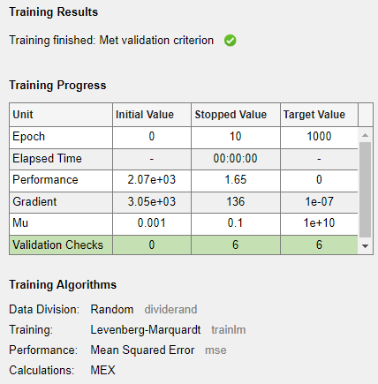




Ex8.5) Feedforwardnet of Rosenbrock Function cont.
$e_{RMSE}=4.4287$, range of function $[0, 306.5]$
$$x_{2}$$
$$x_{2}$$
$$x_{1}$$
$$x_{1}$$
(a) Actual function with 20 samples
(b) FFNN approximation
(c) Training history
(d) Training results

Slide 45
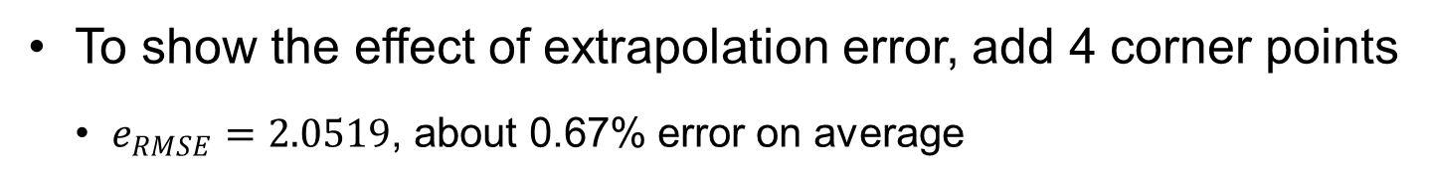
Ex8.5) Feedforwardnet of Rosenbrock Function cont.
To show the effect of extrapolation error, add 4 corner points
$e_{RMSE}=2.0519$, about 0.67% error on average
$$x_{2}$$
$$x_{1}$$

Slide 46
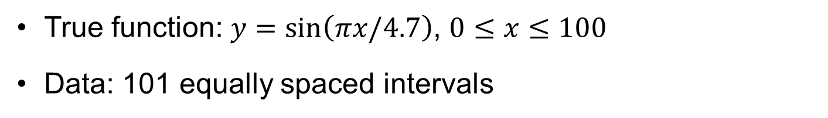
Ex) Fitting Periodic Function
True function: $y=\sin\left(πx/4.7\right)$, $0≤x≤100$
Data: 101 equally spaced intervals
mse=1; % The results are random, so we run multiple times
x=0:1:100; y=sin(pi*x/4.7); % The 4.7 was selected so that the points are not periodic
while mse>0.001 % We will stop only after the mean square error is smaller than 0.001
net.performFcn = 'mse';
net=fitnet([12,10,8,6,4,2]);
net=train(net,x,y);
%% testing performance
yfit_test=net(x);
mse=perform(net,y,yfit_test);
%%%%%%%%%%%%%%%%%%%%%%
end
view(net)
%% plotting
xplot=0:0.1:100; yplot=sin(pi*xplot/4.7); %The plotting points are 10 denser than the training points
yfit=net(xplot); % making predictions
plot(xplot,yfit,'b',x,y,'*',xplot,yplot,'--r')

Slide 47
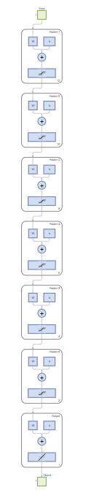
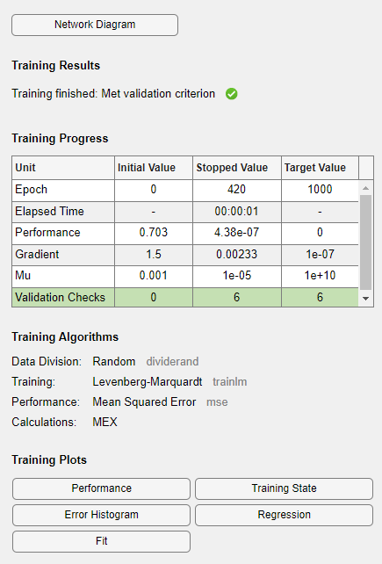
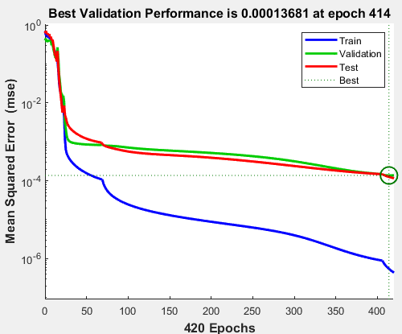
Ex) Network Model and Fitting Results

Slide 48
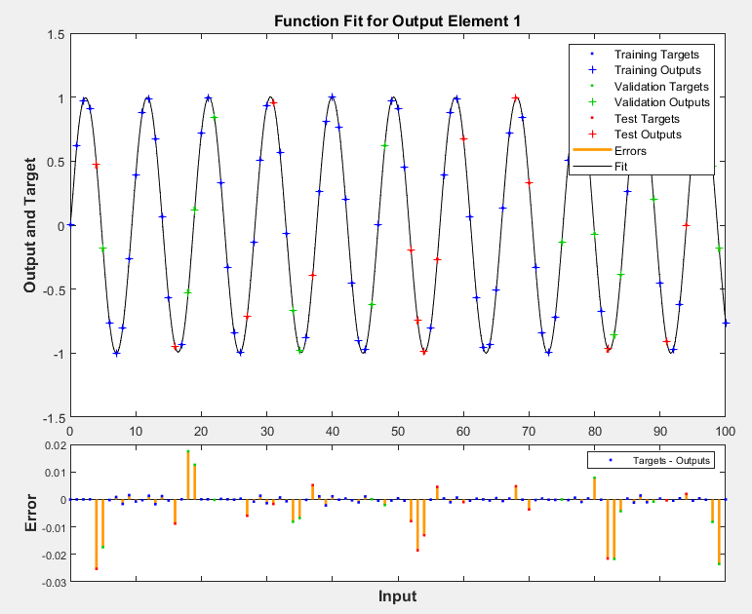
Ex) Network Model and Fitting Results cont.

Slide 49
8.4 Uncertainty Quantification in Neural Network Models
Training uncertainty = uncertainty in samples + uncertainty in model form + uncertainty in training process

Slide 50
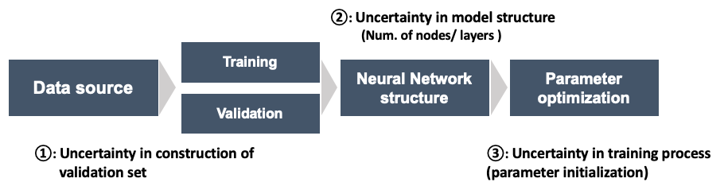
Sources of Uncertainty in the Training Process of NN
early stopping criterion
Uncertainty due to randomly chosen training and validation sets
model-form uncertainty of NN
network structure, including the number of nodes and layers and types of activation functions
optimization algorithms
local optima based on randomly chosen initial values of parameters

Slide 51
Training Uncertainty
Aleatory: random by nature, noise in data, uncontrollable, conservatism
Epistemic: may not random, but unknown, model error, sampling uncertainty, controllable, reducible,
Training uncertainty: mixture of aleatory and epistemic
Aleatory: random selection of validation set
Epistemic: network structure and type of activation function, gradient-based optimization algorithm
Important to quantify training uncertainty
If training uncertainty is in the level of noise in data, it is acceptable

Slide 52
Sources of Training Uncertainty
$z\left(x\right)=0.2x+\sin{x}$, $x∈[0,4π]$, activate different uncertainty
2: clear; close all; rng default
3: a=0; b=4*pi; n=51; ns=15; nh=5;
4: x=linspace(a,b,n); % Test grid points
5: z=0.2*x+sin(x); % True function
6: %
7: xx=linspace(a,b,ns); % Equally spaced samples
8: yy=0.2*xx+sin(xx);
9: %
10: figure(1); hold on
11: for i=1:20 % Repetition of FFNN
12: net=feedforwardnet(nh); % create two-layer network model
13: net=configure(net,xx,yy);
14: if i==1, wb=getwb(net); end
15: net = setwb(net,wb); % Fix initial parameters
16: %
17: net.divideFcn = 'divideind'; % Fixed datasets
18: net.divideParam.trainInd=[1 2 3 4 6 7 9 11 12 14 15];
19: net.divideParam.valInd=[5 10];
20: net.divideParam.testInd=[8 13];
21: %
22: [netModel,trainRecor]=train(net,xx,yy); % train the model 'net'
23: zNN=sim(netModel,x); % FFNN model predictions
24: plot(x,zNN,'k');
25: %
26: RMSE(i)=sqrt((z-zNN)*(z-zNN)'/n); % RMSE at test grid
27: end
28: plot(x,z,'r',xx, yy,'or'); hold off
29: m=mean(RMSE), s=std(RMSE) % Mean and standard deviation of RMSE

Slide 53


Sources of Training Uncertainty cont.
$n=51$ grid points, $n=15$ samples, $nh=5$ hidden nodes
Lines 14~15 fix the initial parameter values
Lines 17~20 fix the training, validation, and test datasets
repeats 20 times to calculate $e_{RMS}$ between the true function and network prediction at grid points
Source of uncertainty | Mean of $e_{RMSE}$ | STD of $e_{RMSE}$
No uncertainty | $$0.2798$$ | $$0.0$$
Initialization uncertainty | $$0.1900$$ | $$0.1216$$
Selecting training set uncertainty | $$0.1888$$ | $$0.1106$$
Both uncertainties | $$0.1930$$ | $$0.2258$$

Slide 54
Sources of Training Uncertainty cont.
3
3
2
2
1
1
0
0
-1
0
2
4
6
8
10
12
14
0
2
4
6
8
10
12
14
(a) no training uncertainty
(b) uncertainty with parameter initialization
3
3
2
2
1
1
0
0
0
2
4
6
8
10
12
14
-1
0
2
4
6
8
10
12
14
(c) uncertainty with selecting training dataset
(d) uncertainty with both parameter initialization and selecting training dataset

Slide 55




Model Form Uncertainty
Vary $1≤n_{h}≤10$
$e_{RMSE}$ decreases significantly after $n_{h}=5$
needs at least 5 hidden nodes to approximate the complex behavior
STD of $e_{RMSE}$ also decreases significantly after $n_{h}=5$
having more hidden nodes than necessary may not help improve prediction accuracy
0.7
0.6
0.2
0.5
0.16
0.4
STD of $e_{RMSE}$
Mean of $e_{RMSE}$
0.12
0.3
0.2
0.08
0.1
0.04
0
1
2
3
4
5
6
7
8
9
10
1
2
3
4
5
6
7
8
9
10
$$n_{h}$$
$$n_{h}$$

Slide 56

Sampling Uncertainty
number of samples (epistemic) and random noise in samples (aleatory)
Test $15≤n_{y}≤30$
$e_{RMSE}$ decreases until $n_{y}=22$, similar trend for STD
prediction accuracy can be improved with more samples
After $n_{y}=22$, model-form uncertainty dominated
0.25
0.18
0.2
0.14
0.15
Mean of $e_{RMSE}$
STD of $e_{RMSE}$
0.1
0.1
0.06
0.05
0.02
15
20
25
30
0
15
20
25
30
Number of samples
Number of samples

Slide 57


Sampling Uncertainty cont.
Level of noise, $z\left(x\right)=0.2x+\sin{x}$ add noise$\sim N(0,{0.3}^{2})$
The sample distribution is exactly $\sim N(0,{0.3}^{2})$
effect of sampling uncertainty is on prediction accuracy not on prediction uncertainty
v=randn(1,ns); v=0.3*(v-mean(v))/std(v);
yy=0.2*xx+sin(xx)+v; % Add random noise
Source of uncertainty | Mean of $e_{RMSE}$ | STD of $e_{RMSE}$
Sampling uncertainty only | $$0.3312$$ | $$0.0684$$
Sampling uncertainty + initialization uncertainty | $$0.4374$$ | $$0.1909$$
Sampling uncertainty + selecting training set uncertainty | $$0.4600$$ | $$0.2723$$
All three uncertainties | $$0.4413$$ | $$0.2588$$

Slide 58
Sampling Uncertainty cont.
4
3
3
2
2
z
z
1
1
0
0
-1
-1
x
-2
0
2
4
6
8
10
12
14
0
2
4
6
8
10
12
14
x
(a) only sampling uncertainty
(b) sampling uncertainty + random initialization uncertainty
6
5
5
4
4
3
z
3
z
2
2
1
1
0
0
-1
-1
0
2
4
6
x
8
10
12
14
-2
0
2
4
x
6
8
10
12
14
(c) sampling uncertainty + random training set
(d) all three sources of uncertainty

Slide 59


Confidence Intervals and Prediction Intervals
Estimate prediction uncertainty using $n$ repetition
Let mean ($\overline{z}$) and standard deviation ($s$)
two-sided confidence intervals
$t_{α/2,n−1}$: $100(1−α⁄2)$ percentile of the student’s $t$ distribution with $n−1$ DOF. Confidence level of $1−α$
Prediction intervals: additional sample of prediction
$\sqrt{s^{2}+s^{2}/n}$ represents the standard error of the prediction
$${CI}_{z}=\left[\overline{z}−t_{α/2,n−1}×\frac{s}{\sqrt{n}}, \overline{z}+t_{α/2,n−1}×\frac{s}{\sqrt{n}}\right]$$
$${PI}_{z}=\left[\overline{z}−t_{α/2,n−1}×\sqrt{s^{2}+s^{2}/n}, \overline{z}+t_{α/2,n−1}×\sqrt{s^{2}+s^{2}/n}\right]$$

Slide 60



Ex8.6) Uncertainty in NN Simulation
Uncertainty
the initial values of parameters are assigned differently. Also, the train, validation, and test sets change when the training is re-started. These two are the sources of uncertainty in the neural network process and make different results
Simulation #5
$$\hat{y}$$

Slide 61
8.5 Issues in Feedforward Neural Network
With scarce samples, it is important to prevent overfitting the NN model

Slide 62

Adaptive Learning Rate
Learning rate $w_{hj}=w_{hj}−α∂F/∂w_{hj}$
Too-small $α$ slows training speed
Too-large $α$ can fail the optimization
Adaptive learning rate (learn rate decay)
Gradually reduces $α$ from a large initial
Bold driver algorithm: $MSE↓⇒α↑$, $MSE↑⇒α↓$
Too small
Just right
Too big
MSE
MSE
MSE
Too small learning rate requires many updates before reaching the minimum point
$$α$$
The optimal learning rate swiftly reaches the minimum point
$$α$$
$$α$$
Too big learning rate cause drastic updates which lead to divergence

Slide 63

Scaling Input Data
efficient learning with similar magnitudes of gradients
gradients are large near the origin and diminish quickly
the training speed is faster when $−1≤X≤1$
Sigmoid function
Gradient of sigmoid function
1
0.25
0.8
0.2
0.6
0.15
Vanishing gradient
Vanishing gradient
0.4
0.1
Efficient learning range
0.2
0.05
0
-6
-4
-2
0
2
4
6
0
-6
-4
-2
0
2
4
6
u
u

Slide 64

Scaling Input Data cont.
Min-max normalization: ${\tilde{X}}_{i}=\frac{X_{i}−X_{min}}{X_{max}−X_{min}}×\left(t_{max}−t_{min}\right)+t_{min}$
$t_{min}$ and $t_{max}$ are the min. and max. target scaling values
Descaling: $X_{i}=\frac{{\tilde{X}}_{i}−t_{min}}{t_{max}−t_{min}}×\left(X_{max}−X_{min}\right)+X_{min}$
Scaling of output: ${\tilde{y}}_{i}=\frac{y_{i}−y_{min}}{y_{max}−y_{min}}$

Slide 65
Underfitting and Overfitting
Underfitting and overfitting are representative problems that reduce the performance of training
underfitting occurs when the training data is not sufficiently learned (high bias and low variance)
overfitting occurs when the training data is learned too much (low bias and high variance)
overfitting fits noise rather than the trend of a function
Generalization: appropriately learns from the training data and provides meaningful predictions for new inputs
y
y
y
x
x
x
Underfitted
Good fit
Overfitted

Slide 66

Underfitting and Overfitting cont.
Resolving underfitting
Add more samples, add more layers and/or nodes, restart the learning process
Resolving overfitting
(1) reduce the complexity by reducing the number of hidden nodes
5
Network prediction
True function
15 samples from $z\left(x\right)=0.2x+\sin{x}$
Add random noise $\sim N\left({0,0.3}^{2}\right)$ Use all 15 samples for training
Use 10 hidden nodes
69 epochs with $MSE=9.97×{10}^{−20}$
4
3
z
2
1
0
-1
0
2
4
6
8
10
12
14
x

Slide 67


Overfitting (2) $L_{2}$ Regularization
Goal: Good model for both training and prediction points
Regularization: modify the learning process to prevent overfitting
predictions vary slowly when input variable changes, not fluctuating
weights affect generalization more than biases
Large weights lead to a large change in output $⇒$ overfit
helpful to reduce the magnitudes of weights
MSE
Reducing weight
A
Increasing weight
$$w$$

Slide 68





Overfitting (2) $L_{2}$ Regularization cont.
Penalize the loss function with weights
Gradient of $L_{2}$
Updating parameters
$$\tilde{F}=(1−γ)F+γL_{2}=\frac{1−γ}{n_{y}}\sum_{i=1}^{n_{y}}{{[y_{i}−z_{i}\left(d\right)]}^{2}}+\frac{γ}{n_{w}}\sum_{j=1}^{n_{w}}{w_{j}^{2}}$$
$$\frac{∂L_{2}}{∂w_{h}}=\frac{∂}{∂w_{h}}\left(\frac{1}{n_{w}}\sum_{j=1}^{n_{w}}{w_{j}^{2}}\right)=\frac{2}{n_{w}}w_{h}$$
$$w_{hj}=w_{hj}−α\left((1−γ)\frac{∂F}{∂w_{hj}}+γ\frac{∂L_{2}}{∂w_{hj}}\right)$$
$$W_{xj,k}=W_{xj,k}−α\left((1−γ)\frac{∂F}{∂W_{xj,k}}+γ\frac{∂L_{2}}{∂W_{xj,k}}\right)$$

Slide 69





Overfitting (2) $L_{2}$ Regularization cont.
Too-small $γ$: no regularization
The overfitting effect becomes significant in the extrapolation region
Too-large $γ$: regularization dominates MSE
trained model loses its prediction capability
Too-small $γ$
Too-large $γ$

Slide 70






How to Improve Learning Speed?
Adaptive learning rate improves convergence near optimal parameters
Normalization prevents vanishing gradient issue in activation functions
$L_{2}$-norm regularization prevents large weights
Unregularized: 100 epochs
$L_{2}$ Regularized: 17 epochs
5
$$w_{2}$$
0
0
$$w_{1}$$
5
0
$$w_{1}$$
5

Slide 71
Ex8.8) Using Regularization Instead of Validation Set
Use all data for training regularization
clear; close all; rng default
a=0; b=4*pi; n=51; ns=15; nh=10;
x=linspace(a,b,n); % Test grid points
z=0.2*x+sin(x); % True function
xx=linspace(a,b,ns); % Equally spaced samples
yy=0.2*xx+sin(xx);
%
figure(1); hold on
for i=1:20 % Repetition of FFNN
v=randn(1,ns); v=0.3*(v-mean(v))/std(v);
yy=0.2*xx+sin(xx)+v; % Add random noise
%
net=feedforwardnet(nh,'traincgf');% create two-layer network model
net=configure(net,xx,yy);
net.performParam.regularization=0.01;
%
all=1:ns; valInd=[]; testInd=[];
net.divideFcn = 'divideind'; % Fixed datasets
net.divideParam.valInd=valInd;
net.divideParam.testInd=testInd;
net.divideParam.trainInd=setdiff(setdiff(all,valInd),testInd);
%
[netModel,trainRecor]=train(net,xx,yy); % train the model 'net'
zNN=sim(netModel,x); % FFNN model predictions
plot(x,zNN,'k');
%
RMSE(i)=sqrt((z-zNN)*(z-zNN)'/n); % RMSE at test grid
end
plot(x,z,'r',xx, yy,'or'); hold off
m=mean(RMSE), s=std(RMSE) % Mean and standard deviation of RMSE

Slide 72




Ex8.8) Using Regularization Instead of Validation Set cont.
4
(a) $γ=0$
(b) $γ=0.01$
3
3
2
2
z
z
1
1
0
0
-1
0
2
4
6
x
8
10
12
14
-1
0
2
4
6
x
8
10
12
14
3
(c) $γ=0.1$
3
(d) $γ=0.5$
2
2
z
z
1
1
0
0
0
2
4
6
8
10
12
14
-1
0
2
4
6
8
10
12
14
x
x

Slide 73


Ex8.8) Using Regularization Instead of Validation Set cont.
Need to use Fletcher-Powell conjugate gradient method ('traincgf’)
10 hidden nodes, 31 parameters, 15 samples
$γ=0$: not smooth, do not follow the trend of the true function
$γ=0.01$: follows the trend, low mean and std of $e_{RMS}$
$γ=0.1$: smoother, prediction errors increase
$γ=0.5$: MSE is equally weighted with $e_{RMS}$, almost straight prediction, significant $e_{RMS}$, regularization dominates the fitting error
Regularization param $γ$ | Mean of $e_{RMSE}$ | STD of $e_{RMSE}$
$$0.0$$ | $$0.3052$$ | $$0.0373$$
$$0.01$$ | $$0.2132$$ | $$0.0245$$
$$0.1$$ | $$0.2503$$ | $$0.0884$$
$$0.5$$ | $$0.6549$$ | $$0.0437$$

Slide 74

Overfitting (3) Early Termination of Learning
insufficient epochs: underfit data and fail to follow the trend of data
Too many epochs: overfit data and inferior performance on prediction
Better to stop the process when it satisfies some stopping criteria
Use magnitudes of parameters as early stopping criterion
$$\left|Δw_{h}\right|=\left|α\frac{∂F}{∂w_{h}}\right|≤β, \left|Δb_{z}\right|=\left|α\frac{∂F}{∂b_{z}}\right|≤β \\ \left|ΔW_{xj,k}\right|=\left|α\frac{∂F}{∂W_{xj,k}}\right|≤β, \left|Δb_{hj}\right|=\left|α\frac{∂F}{∂b_{hj}}\right|≤β$$

Slide 75

Overfitting (3) Early Termination of Learning cont.
How to use early stopping to prevent overfitting?
Divide data to validation set (20%) and training set (80%)
backpropagation process is performed only using training data set
MSE of the training set = performance of training MSE of the validation set = performance of generalization
When MSE of training$↓$ but MSE of the validation$↑$, starts overfitting
Training set
Validation set
MSE
Overfitting starts
epochs

Slide 76

Appendix Radial Basis Neural Network

Slide 77



Radial Basis Function (RBF)
Real-valued function whose value depends only on the distance from its origin to the evaluation point
It is also called radial kernel function
Use $r=\left\|x−c_{i}\right\|$ as a distance and $ε$ as a spread parameter
Gaussian: $φ\left(r\right)=e^{−εr^{2}}$
Multiquadric: $φ\left(r\right)=\sqrt{1+εr^{2}}$
Inverse quadratic: $φ\left(r\right)=\frac{1}{1+εr^{2}}$
$$φ_{i}\left(x\right)=φ\left(\left\|x−c_{i}\right\|\right)$$
$c_{i}$: center

Slide 78





Parameters in Radial Basis Function
Spread parameter $ε$ determines the influence range of the radial basis function
Center $c_{i}$ shifts the basis function
Effect of spread parameter
Effect of center
$$φ\left(x−c_{1}\right)$$
$$φ\left(x−c_{2}\right)$$
c₁
c₂

Slide 79

Ex) Matlab Radial Basis Function
Radial basis as a transfer function
x = -3:.1:3; a = radbas(x);
plot(x,a); title('Radial Basis Function');
xlabel('X'); ylabel('\phi (x) ');
Weight = center position, bias = width of RBF (spread)
Linear combination of 3 RBFs
a2 = radbas(x-1.5); a3 = radbas(x+2);
a4 = a + a2*1 + a3*0.5;
plot(x,a,'b-',x,a2,'b--',x,a3,'b--',x,a4,'m-')
title('Weighted Sum of RBFs');
xlabel('X'); ylabel('\phi (x)');
$$φ(x,w,ε) =e^{−ε{\left\|x−w\right\|}^{2}}$$

Slide 80
Ex) Matlab Radial Basis Function cont.
Radial Basis Function
Weighted Sum of RBFs
1
1.2
1
0.8
0.8
0.6
)
)
x
x
(
0.6
(
0.4
0.4
0.2
0.2
0
0
-3
-2
-1
0
1
2
3
-3
-2
-1
0
1
2
3
X
X
0.8326
RBF = 0.5 at distance = 0.8326

Slide 81


Approximation Using Radial Basis Functions
Radial basis function (RBF) model
Linear combination of radial basis functions
Model parameters: coefficient $b_{i}$, center $c_{i}$, spread parameter $ε_{i}$
When the centers and spread parameters are fixed, linear regression can be used to determine unknown coefficients $b_{i}$
$$\hat{y}\left(x\right)=\sum_{i=1}^{N_{RBF}}{b_{i}φ_{i}\left(x\right)}$$

Slide 82


Radial Basis Neural Network (RBNN) Model
NN model with input, hidden, and output layer
Hidden nodes have RBF as a transfer function
Use the weight as a center point and bias as a spread
$$φ(x,w,ε) =e^{−ε{\left\|x−w\right\|}^{2}}$$

Slide 83


Matlab Radial Basis Neural Network newrbe
Exact design (newrbe)
produce a network with zero error on training vectors (interpolation)
net = newrbe(x,y,spread)
Generate same number of hidden nodes with the input samples with the weights being the location of input samples
User provides bias (spread): $ε=0.8326/spread$
Determine output weights $(n_{y})$ and output bias (1) using linear regression
$$\hat{y}=b_{z}+\sum_{i=1}^{n_{y}}{w_{hi}φ_{i}\left(x\right)}$$

Slide 84




Regress for RBNN
Regression error vector
with $n_{y}$ samples $(x_{i}, y_{i})$
In matrix notation
$$e=y−X⋅w_{h}−b_{z} e_{j}=y_{j}−\sum_{i=1}^{n_{y}}{w_{hi}φ_{i}\left(x_{j}\right)−b_{z}}$$
Evaluation of basis at sample points
$$\left\{\begin{matrix}e_{1} \\ e_{2} \\ ⋮ \\ e_{n_{y}}\end{matrix}\right\}=\left\{\begin{matrix}y_{1} \\ y_{2} \\ ⋮ \\ y_{n_{y}}\end{matrix}\right\}−\left[\begin{matrix}φ_{1}\left(x_{1}\right) & φ_{2}\left(x_{1}\right) & ⋯ & φ_{n_{y}}\left(x_{1}\right) & 1 \\ φ_{1}\left(x_{2}\right) & φ_{2}\left(x_{2}\right) & ⋯ & φ_{n_{y}}\left(x_{2}\right) & 1 \\ ⋮ & ⋮ & ⋱ & ⋮ & ⋮ \\ φ_{1}\left(x_{n_{y}}\right) & φ_{2}\left(x_{n_{y}}\right) & ⋯ & φ_{n_{y}}\left(x_{n_{y}}\right) & 1\end{matrix}\right]\left\{\begin{matrix}w_{h1} \\ w_{h2} \\ ⋮ \\ w_{n_{y}} \\ b_{z}\end{matrix}\right\}$$
$X:n_{y}×(n_{y}+1)$ design matrix

Slide 85





Regression for RBNN cont.
Minimum of function = zero derivative
Remedy: Solve $Xw=y$ using QR decomposition
$$\frac{d}{db}\left(e^{T}e\right)=−2X^{T}y+2X^{T}Xw=0$$
$$X^{T}Xw=X^{T}y$$
Equation of linear regression
Normal equation
$$w={\left(X^{T}X\right)}^{−1}X^{T}y$$
$n_{y}×n_{y}$matrix: ill-conditioned for large$n_{y}$

Slide 86
Ex) Matlab Radial Basis Approximation
21 training samples
x = -1:.1:1;
y = [-.9602 -.5770 -.0729 .3771 .6405 .6600 .4609 ...
.1336 -.2013 -.4344 -.5000 -.3930 -.1647 .0988 ...
.3072 .3960 .3449 .1816 -.0312 -.2189 -.3201];
plot(x,y, '+'); title('Training samples');
xlabel('x'); ylabel('y(x)');
Training samples
1
0.5
)
x
(
0
y
-0.5
-1
-1
-0.5
0
0.5
1
x

Slide 87
Ex) Effect of Spread (Exact Design newrbe)
Three different spreads (0.01, 1.0, 100.0)
sc = 0.01; net1 = newrbe(x,y,sc); Y1 = net1(X);
sc = 1.0; net2 = newrbe(x,y,sc); Y2 = net2(X);
sc = 100.0; net3 = newrbe(x,y,sc); Y3 = net3(X);
plot(x,y,'+b',X,Y1,'-k',X,Y2,'-r',X,Y3,'-b'); hold on;
xlabel('x'); ylabel('y(x)');
legend({'samples','spread=0.01','spread=1.0','spread=100.0'});
1
samples
Even if newrbe is designed to interpolate all samples, it may not pass samples when the spread is too large
When the spread is too small, most points predict the minimum sample values, except for actual sample points
spread=0.01
0.5
spread=1.0
spread=100.0
)
0
x
(
y
-0.5
-1
-1.5
-1
-0.5
0
0.5
1
x

Slide 88

Matlab Radial Basis Neural Network newrb
Efficient design (newrb)
iteratively creates a radial basis network one neuron at a time
net = newrb(x,y,goal,spread)
Neurons are added until MSE become less than GOAL or the max # of neurons has been reached
Iteration $i$, $x_{i}$ that lowers MSE the most is used to create a neuron
Compared with NN, RBNN requires more neurons
RBF are local, while linear or sigmoid transfer functions are global
But RBNN training is more efficient

Slide 89

Ex) Matlab RBNN Approximation cont.
1
RBNN fit
eg = 0.02; % sum-squared error goal
sc = 1; % spread constant
net = newrb(x,y,eg,sc);
X = -1:.01:1; Y = net(X);
plot(x,y,'+b',X,Y,'-r'); hold on;
xlabel('x'); ylabel('y(x)');
legend({'Samples','RBNN'});
How to choose spread?
larger than the distance between adjacent input samples
smaller than the distance across the whole input space
Samples
RBNN
0.5
)
x
(
0
y
-0.5
-1
-1
-0.5
0
0.5
1
x
$$φ(x,w,b) =e^{−b{\left\|x−w\right\|}^{2}}$$

Slide 90
Ex) Matlab RBNN Approximation cont.
Repeat with spread = 0.01
sc = 0.01; % spread constant
Too small spread constant (underlapping neurons)
No two radial basis neurons cover the same point
1
Samples
RBNN
0.5
)
x
(
0
y
-0.5
-1
-1
-0.5
0
0.5
1
x

Slide 91
Ex) Matlab RBNN Approximation cont.
Repeat with spread = 100
sc = 100; % spread constant
Too large spread constant (overlapping neurons)
All radial basis neurons are 1 at any point
1
Samples
RBNN
0.5
)
0
x
(
y
-0.5
-1
-1.5
-1
-0.5
0
0.5
1
x

Slide 92


Interpolation vs Extrapolation
Surrogate behaves quite different between interpolation and extrapolation region
A surrogate with a good fit in interpolation region can miserably fail in predicting in the extrapolation region
Ex) $\hat{y}\left(x\right)=x+0.5\sin\left(5x\right)$
21 equally spaces sample
x=linspace(1,9,21);
y=x+0.5*sin(5*x);
net=newrb(x,y);
xf=linspace(0,10,101);
yf=xf+0.5*sin(5*xf);
ysim=sim(net,xf);
plot(xf,yf); hold on;
plot(xf,ysim,'ro’)

