Slide 1
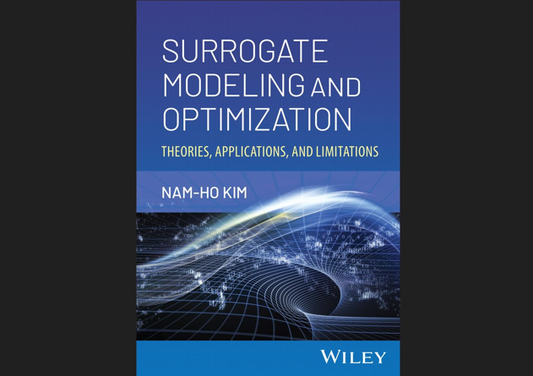

Slide 2
Chap 9 Multi-fidelity surrogate model

Slide 3
Accuracy of Surrogate Model and Fidelity
Prediction accuracy of a surrogate model depends on
the functional form of the surrogate model
the number and locations of samples
the accuracy of samples
We have discussed 1 and 2 in the previous chapters. This chapter addresses accuracy or fidelity of samples
Increasing computing power raises fidelity in simulation
Optimization and UQ requires thousands of simulations
High-fidelity models are accurate but expensive
Low-fidelity models are cheap but not satisfactory
Too expensive to build reliable surrogate using HF samples

Slide 4
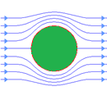
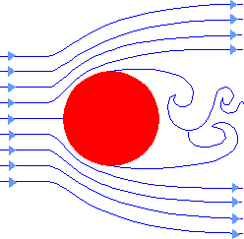
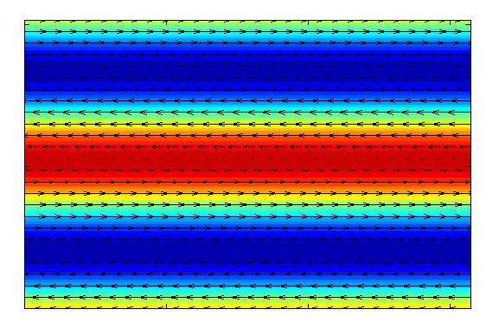
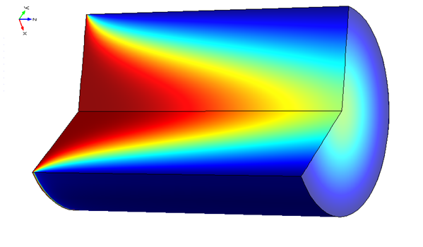
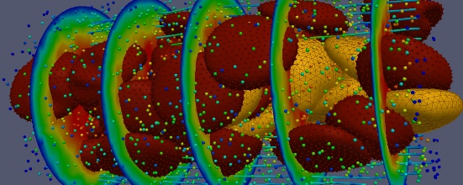
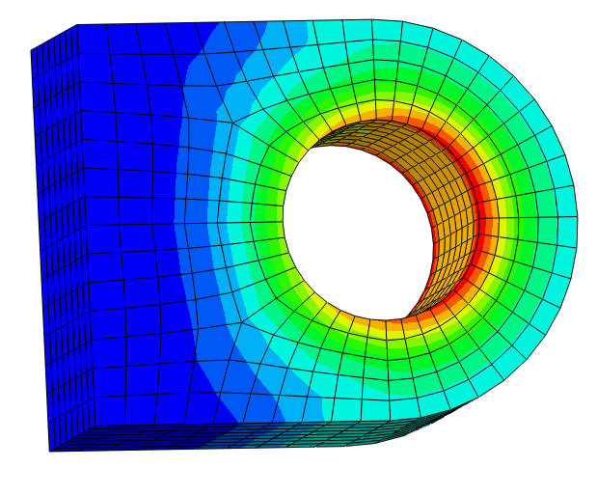
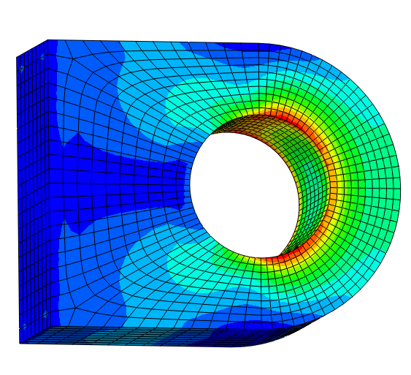
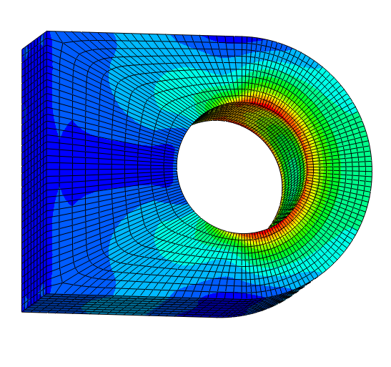
Fidelity in Computer Simulations
Fidelity in mathematical models
Fidelity in dimensions
Fidelity in mesh
Inviscid
Viscous
1D
2D (Axisymmetric)
3D
Coarse mesh
Intermediate mesh
Fine mesh

Slide 5
Multi-Fidelity (MF) Surrogate
Assumption: We can afford many LF simulations but only a small number of HF simulations
small HF samples cannot predict QoI accurately
most predictions are extrapolation in high-dimensions
surrogate predictions using LF samples is not accurate or mislead
MF surrogate integrates LF and HF samples and trade-off between prediction accuracy and computational cost
take advantages of HF accuracy and LF efficiency
works well usually when the correlations between the two are high
LF model should capture the overall trend of the responses from the HF model
Multi-fidelity surrogate
Fast simulation
High accuracy
Low-fidelity simulation
High-fidelity simulation
Fast computation time
Low accuracy
Long computation time
High accuracy

Slide 6



Example of MF Surrogate
HF model: $y_{H}\left(x\right)={\left(6x−2.5\right)}^{2}\sin{(12x−4)}$, 4 samples
LF model: $y_{L}\left(x\right)=0.5y_{H}\left(x\right)+10\left(x−0.5\right)+5$, 8 samples
LF is well correlated to the HF, correlation coefficient is 0.71
Good prediction with 4 HF samples
20
20
$$y_{L}\left(x\right)=0.5y_{H}\left(x\right)+10\left(x−0.5\right)+5$$
CI
$y_{M}(x)$
HF samples
$y_{H}(x)$
15
$$y_{H}\left(x\right)={\left(6x−2.5\right)}^{2}\sin{(12x−4)}$$
15
Extrapolation region
10
Low fidelity function
10
5
5
0
0
High fidelity function
Mult-fidelity surrogate
-5
-5
-10
-10
0
0.2
0.4
0.6
0.8
1
0
0.2
0.4
0.6
0.8
1
x
x

Slide 7
Questions Related To MF Surrogate Models
How much cost can be saved by using MF surrogate models for the same level of accuracy?
How much accuracy can be improved by using MF surrogate models for the same computational cost?
When should we use MF surrogate models rather than HF surrogate models based on sparser samples?
When MF surrogate models perform worse than HF surrogate models?

Slide 8
9.2 Multi-Fidelity Surrogate Models
Use many low-fidelity samples with scarce high-fidelity samples to make a good prediction

Slide 9

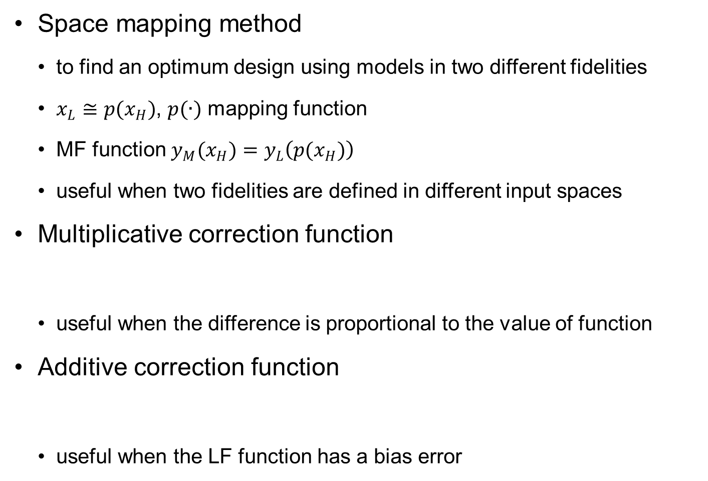



Types of Multi-Fidelity Models
Space mapping method
to find an optimum design using models in two different fidelities
$x_{L}≅p(x_{H})$, $p(∙)$ mapping function
MF function $y_{M}(x_{H})=y_{L}\left(p(x_{H})\right)$
useful when two fidelities are defined in different input spaces
Multiplicative correction function
useful when the difference is proportional to the value of function
Additive correction function
useful when the LF function has a bias error
$$y_{M}\left(x\right)=ρ\left(x\right)y_{L}\left(x\right)$$
$ρ\left(x\right)$: correction function
$$y_{M}\left(x\right)=y_{L}\left(x\right)+δ\left(x\right)$$
$δ\left(x\right)$: discrepancy function

Slide 10


Types of Multi-Fidelity Models cont.
Comprehensive form: use both multiplicative and additive correction function
Usage of multiple LF functions
possible to use more than two fidelities
We will mostly consider the comprehensive form of MF surrogate in this chapter
$$y_{M}\left(x\right)=ρy_{L}\left(x\right)+δ(x)$$
$ρ$: LF scale factor
$$y_{L}\left(x\right)=b_{1}y_{L1}\left(x\right)+b_{2}y_{L2}\left(x\right)+⋯+b_{m}y_{Lm}\left(x\right)$$

Slide 11
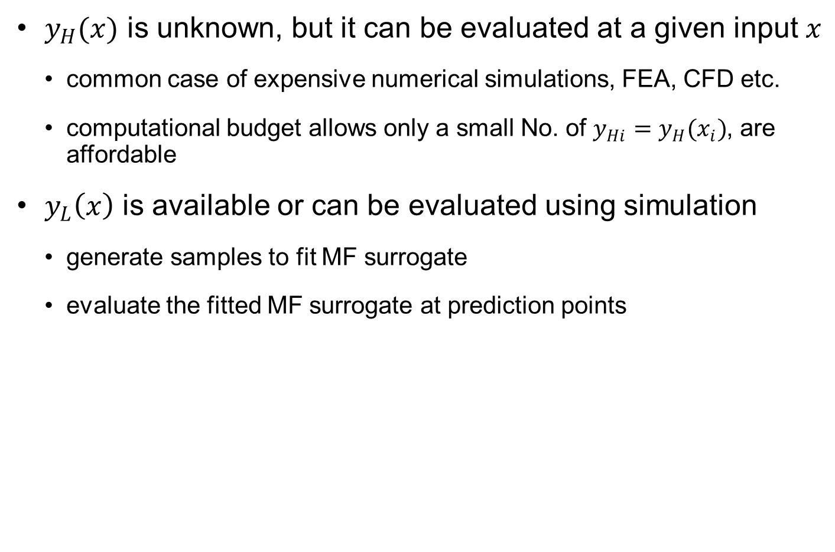
Assumptions of MF Surrogate Modeling
$y_{H}(x)$ is unknown, but it can be evaluated at a given input $x$
common case of expensive numerical simulations, FEA, CFD etc.
computational budget allows only a small No. of $y_{Hi}=y_{H}(x_{i})$, are affordable
$y_{L}\left(x\right)$ is available or can be evaluated using simulation
generate samples to fit MF surrogate
evaluate the fitted MF surrogate at prediction points

Slide 12
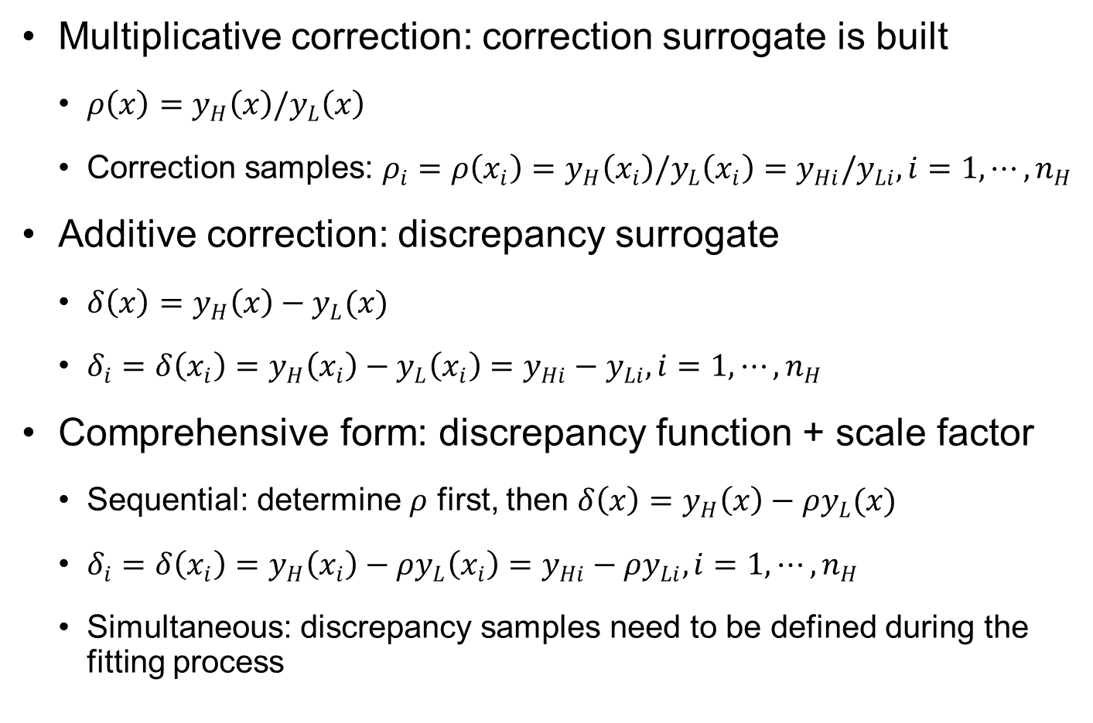
What to Fit in MF Surrogates?
Multiplicative correction: correction surrogate is built
$ρ\left(x\right)=y_{H}\left(x\right)/y_{L}\left(x\right)$
Correction samples: $ρ_{i}=ρ\left(x_{i}\right)=y_{H}\left(x_{i}\right)/y_{L}\left(x_{i}\right)=y_{Hi}/y_{Li}, i=1,⋯,n_{H}$
Additive correction: discrepancy surrogate
$δ\left(x\right)=y_{H}\left(x\right)−y_{L}(x)$
$δ_{i}=δ\left(x_{i}\right)=y_{H}\left(x_{i}\right)−y_{L}\left(x_{i}\right)=y_{Hi}−y_{Li}, i=1,⋯,n_{H}$
Comprehensive form: discrepancy function + scale factor
Sequential: determine $ρ$ first, then $δ\left(x\right)=y_{H}\left(x\right)−ρy_{L}(x)$
$δ_{i}=δ\left(x_{i}\right)=y_{H}\left(x_{i}\right)−{ρy}_{L}\left(x_{i}\right)=y_{Hi}−ρy_{Li}, i=1,⋯,n_{H}$
Simultaneous: discrepancy samples need to be defined during the fitting process

Slide 13
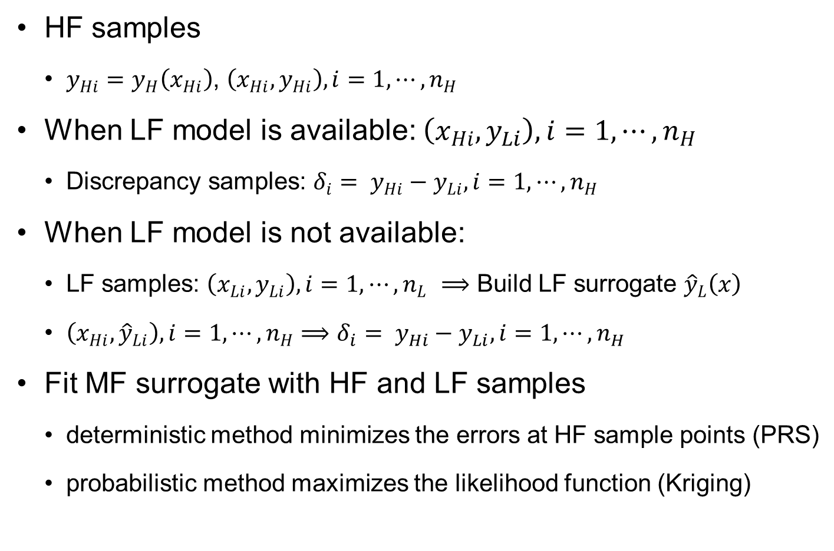
Samples to Fit MF Surrogate
HF samples
$y_{Hi}=y_{H}\left(x_{Hi}\right)$, $\left(x_{Hi}, y_{Hi}\right), i=1,⋯,n_{H}$
When LF model is available: $\left(x_{Hi}, y_{Li}\right), i=1,⋯,n_{H}$
Discrepancy samples: $δ_{i}= y_{Hi}−y_{Li}, i=1,⋯,n_{H}$
When LF model is not available:
LF samples: $\left(x_{Li}, y_{Li}\right), i=1,⋯,n_{L}$ $⟹$ Build LF surrogate ${\hat{y}}_{L}\left(x\right)$
$\left(x_{Hi}, {\hat{y}}_{Li}\right), i=1,⋯,n_{H}$ $⟹$ $δ_{i}= y_{Hi}−y_{Li}, i=1,⋯,n_{H}$
Fit MF surrogate with HF and LF samples
deterministic method minimizes the errors at HF sample points (PRS)
probabilistic method maximizes the likelihood function (Kriging)

Slide 14
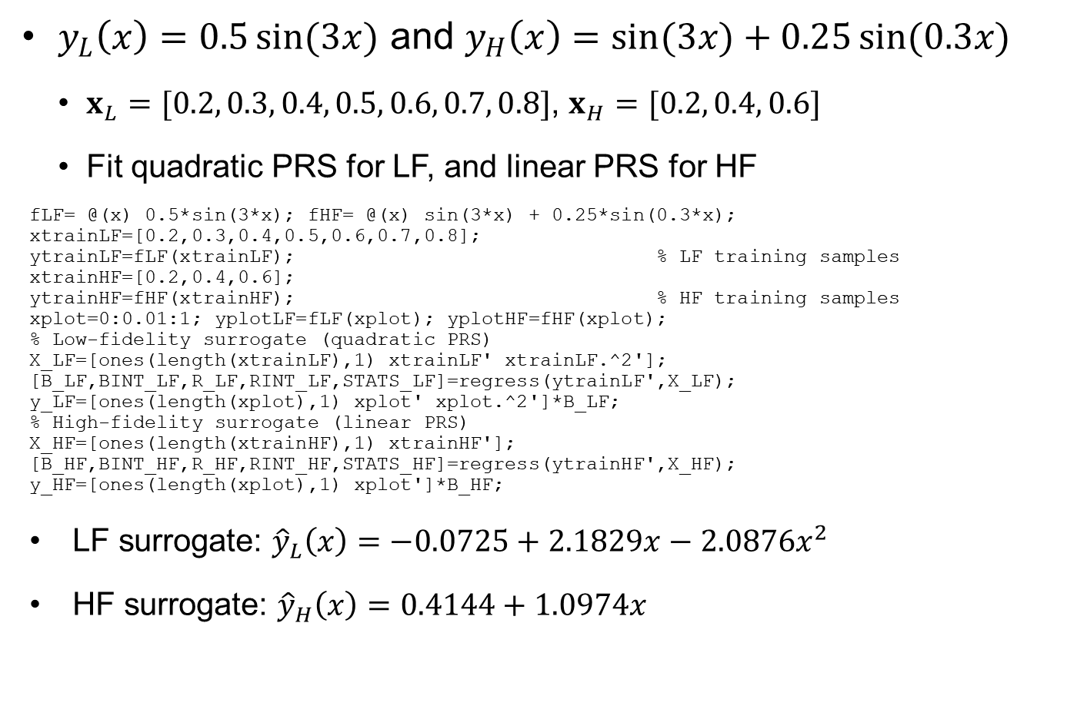
Ex9.1) MF Surrogate Using Discrepancy Function
$y_{L}\left(x\right)=0.5\sin{(3x)}$ and $y_{H}\left(x\right)=\sin{(3x)}+0.25\sin{(0.3x)}$
$x_{L}=[0.2, 0.3, 0.4, 0.5, 0.6, 0.7, 0.8]$, $x_{H}=[0.2, 0.4, 0.6]$
Fit quadratic PRS for LF, and linear PRS for HF
fLF= @(x) 0.5*sin(3*x); fHF= @(x) sin(3*x) + 0.25*sin(0.3*x);
xtrainLF=[0.2,0.3,0.4,0.5,0.6,0.7,0.8];
ytrainLF=fLF(xtrainLF); % LF training samples
xtrainHF=[0.2,0.4,0.6];
ytrainHF=fHF(xtrainHF); % HF training samples
xplot=0:0.01:1; yplotLF=fLF(xplot); yplotHF=fHF(xplot);
% Low-fidelity surrogate (quadratic PRS)
X_LF=[ones(length(xtrainLF),1) xtrainLF' xtrainLF.^2'];
[B_LF,BINT_LF,R_LF,RINT_LF,STATS_LF]=regress(ytrainLF',X_LF);
y_LF=[ones(length(xplot),1) xplot' xplot.^2']*B_LF;
% High-fidelity surrogate (linear PRS)
X_HF=[ones(length(xtrainHF),1) xtrainHF'];
[B_HF,BINT_HF,R_HF,RINT_HF,STATS_HF]=regress(ytrainHF',X_HF);
y_HF=[ones(length(xplot),1) xplot']*B_HF;
LF surrogate: ${\hat{y}}_{L}\left(x\right)=−0.0725+2.1829x−2.0876x^{2}$
HF surrogate: ${\hat{y}}_{H}\left(x\right)=0.4144+1.0974x$

Slide 15
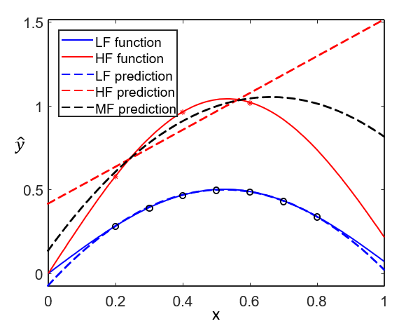
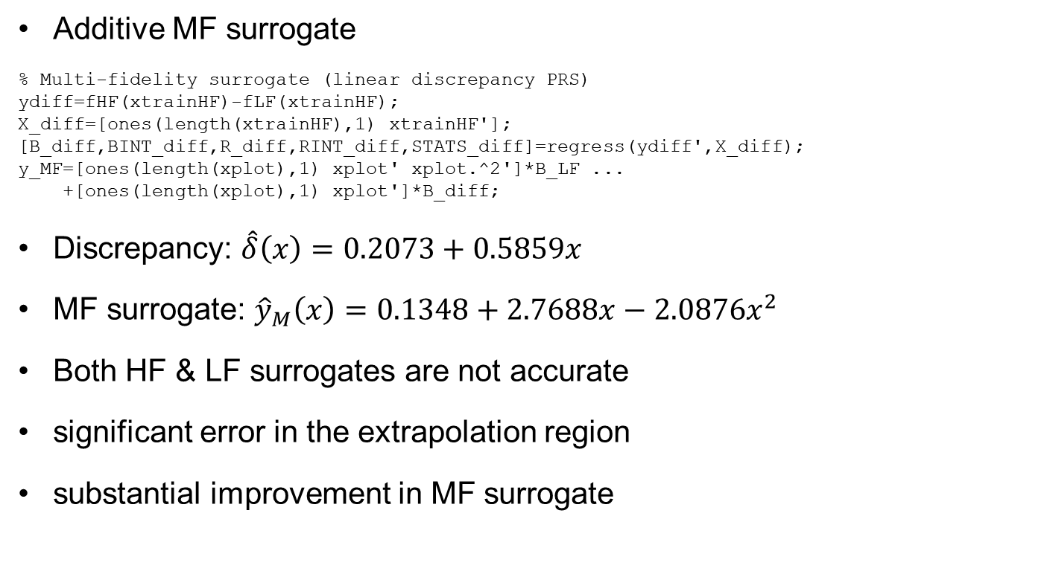
Ex9.1) MF Surrogate Using Discrepancy Function cont.
Additive MF surrogate
% Multi-fidelity surrogate (linear discrepancy PRS)
ydiff=fHF(xtrainHF)-fLF(xtrainHF);
X_diff=[ones(length(xtrainHF),1) xtrainHF'];
[B_diff,BINT_diff,R_diff,RINT_diff,STATS_diff]=regress(ydiff',X_diff);
y_MF=[ones(length(xplot),1) xplot' xplot.^2']*B_LF ...
+[ones(length(xplot),1) xplot']*B_diff;
Discrepancy: $\hat{δ}\left(x\right)=0.2073+0.5859x$
MF surrogate: ${\hat{y}}_{M}\left(x\right)=0.1348+2.7688x−2.0876x^{2}$
Both HF & LF surrogates are not accurate
significant error in the extrapolation region
substantial improvement in MF surrogate

Slide 16
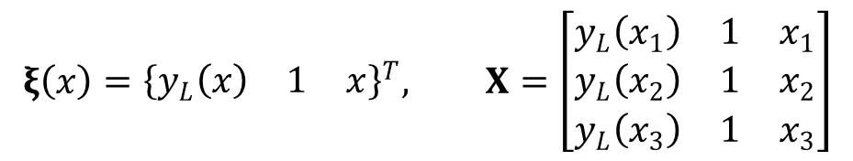
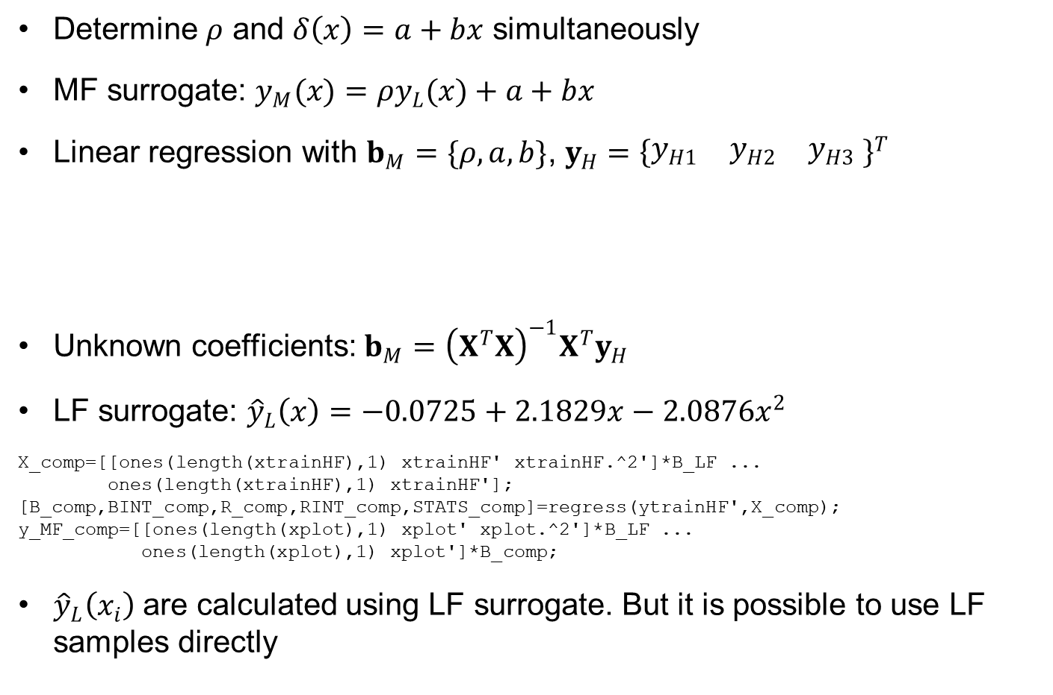
Ex9.2) Comprehensive MF Surrogate
Determine $ρ$ and $δ\left(x\right)=a+bx$ simultaneously
MF surrogate: $y_{M}(x)=ρy_{L}(x)+a+bx$
Linear regression with $b_{M}=\{ρ, a, b\}$, $y_{H}={\left\{\begin{matrix}y_{H1} & y_{H2} & y_{H3}\end{matrix} \right\}}^{T}$
Unknown coefficients: $b_{M}={\left(X^{T}X\right)}^{−1}X^{T}y_{H}$
LF surrogate: ${\hat{y}}_{L}\left(x\right)=−0.0725+2.1829x−2.0876x^{2}$
X_comp=[[ones(length(xtrainHF),1) xtrainHF' xtrainHF.^2']*B_LF ...
ones(length(xtrainHF),1) xtrainHF'];
[B_comp,BINT_comp,R_comp,RINT_comp,STATS_comp]=regress(ytrainHF',X_comp);
y_MF_comp=[[ones(length(xplot),1) xplot' xplot.^2']*B_LF ...
ones(length(xplot),1) xplot']*B_comp;
${\hat{y}}_{L}\left(x_{i}\right)$ are calculated using LF surrogate. But it is possible to use LF samples directly
$$ξ\left(x\right)={\left\{\begin{matrix}y_{L}\left(x\right) & 1 & x\end{matrix}\right\}}^{T}, X=\left[\begin{matrix}y_{L}\left(x_{1}\right) & 1 & x_{1} \\ y_{L}\left(x_{2}\right) & 1 & x_{2} \\ y_{L}\left(x_{3}\right) & 1 & x_{3}\end{matrix}\right]$$

Slide 17
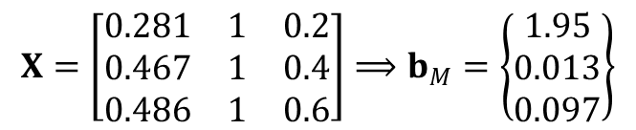


Ex9.2) Comprehensive MF Surrogate cont.
Linear regression
$$X=\left[\begin{matrix}0.281 & 1 & 0.2 \\ 0.467 & 1 & 0.4 \\ 0.486 & 1 & 0.6\end{matrix}\right]⟹b_{M}=\left\{\begin{matrix}1.95 \\ 0.013 \\ 0.097\end{matrix}\right\}$$
$ρ=1.95$: significantly improve MF surrogate
1.5
1
$$\hat{y}$$
0.5
LF function
0
HF function
LF prediction
HF prediction
MF prediction
-0.5
0
0.2
0.4
x
0.6
0.8
1

Slide 18
9.3 Regression-based Multi-fidelity Surrogate
PRS can use multiple LF surrogates/models

Slide 19
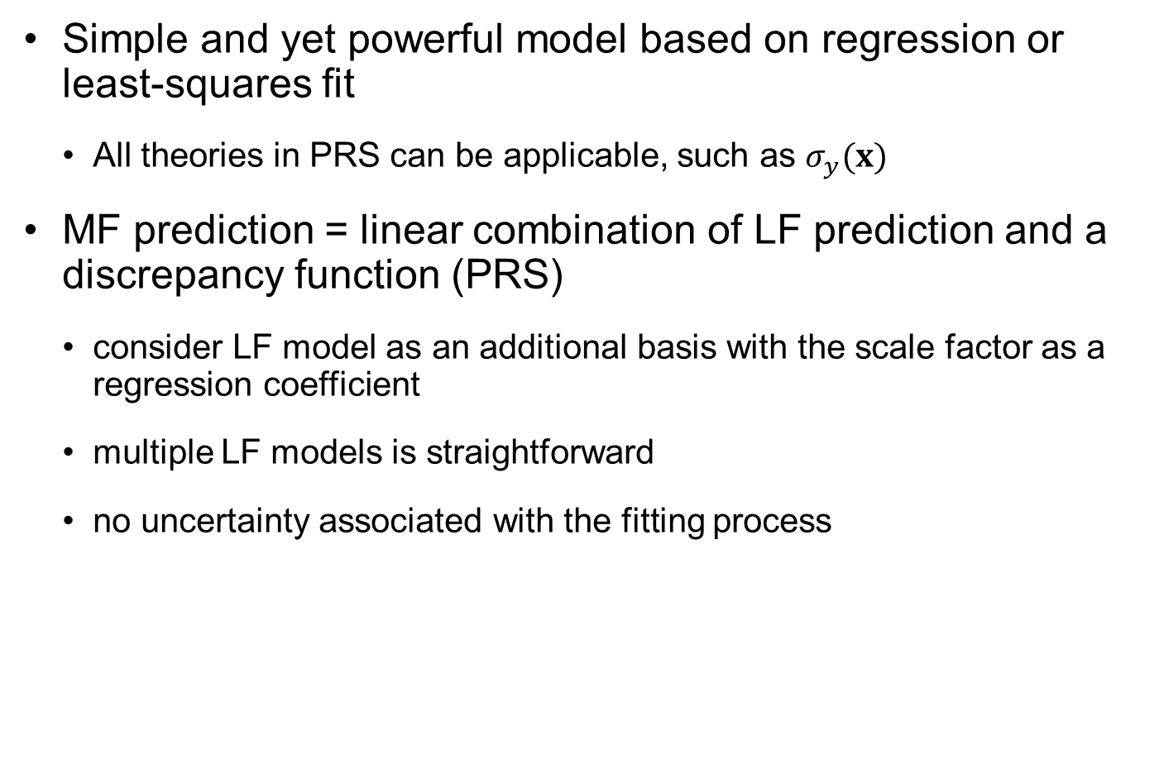
Regression-Based MF Surrogate
Simple and yet powerful model based on regression or least-squares fit
All theories in PRS can be applicable, such as $σ_{y}(x)$
MF prediction = linear combination of LF prediction and a discrepancy function (PRS)
consider LF model as an additional basis with the scale factor as a regression coefficient
multiple LF models is straightforward
no uncertainty associated with the fitting process

Slide 20
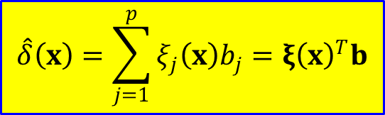
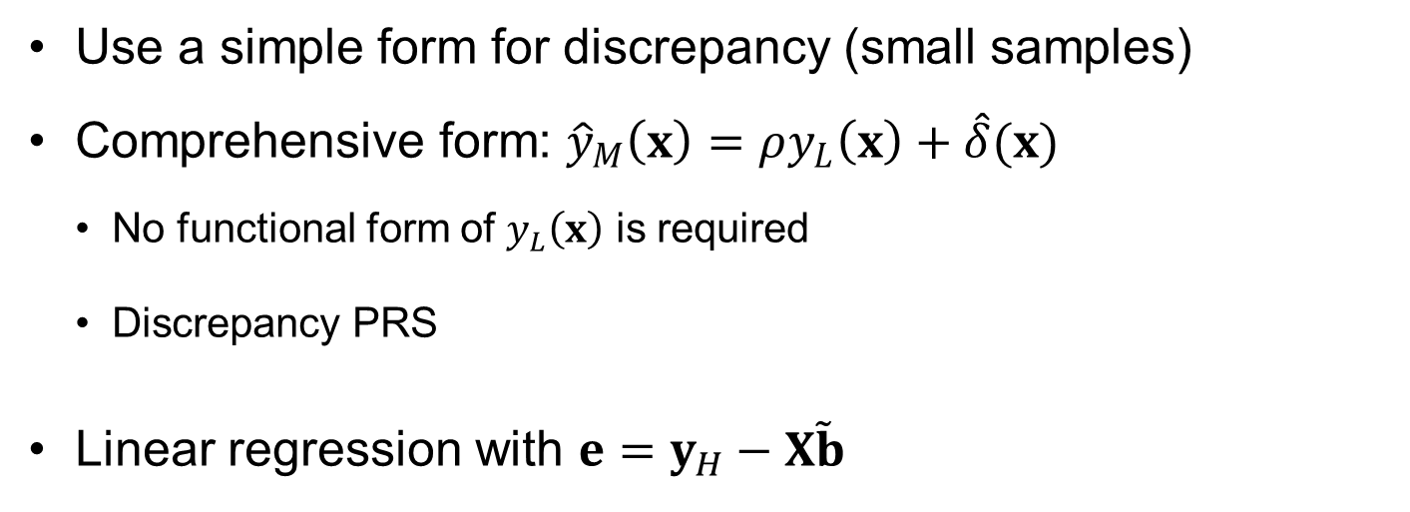
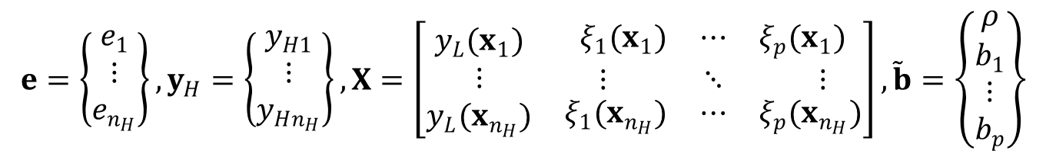
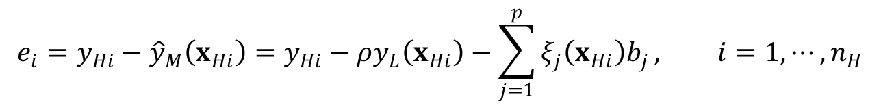
Regression-Based MF Surrogate cont.
Use a simple form for discrepancy (small samples)
Comprehensive form: ${\hat{y}}_{M}\left(x\right)=ρy_{L}\left(x\right)+\hat{δ}(x)$
No functional form of $y_{L}\left(x\right)$ is required
Discrepancy PRS
Linear regression with $e=y_{H}−X\tilde{b}$
$$\hat{δ}\left(x\right)=\sum_{j=1}^{p}{ξ_{j}\left(x\right)b_{j}}=ξ{\left(x\right)}^{T}b$$
$$e_{i}=y_{Hi}−{\hat{y}}_{M}\left(x_{Hi}\right)=y_{Hi}−ρy_{L}\left(x_{Hi}\right)−\sum_{j=1}^{p}{ξ_{j}\left(x_{Hi}\right)b_{j}}, i=1,⋯,n_{H}$$
$$e=\left\{\begin{matrix}e_{1} \\ ⋮ \\ e_{n_{H}}\end{matrix}\right\}, y_{H}=\left\{\begin{matrix}y_{H1} \\ ⋮ \\ y_{Hn_{H}}\end{matrix}\right\}, X=\left[\begin{matrix}y_{L}(x_{1}) & \begin{matrix}ξ_{1}(x_{1}) & ⋯ & ξ_{p}(x_{1})\end{matrix} \\ ⋮ & \begin{matrix}⋮ & ⋱ & ⋮\end{matrix} \\ y_{L}(x_{n_{H}}) & \begin{matrix}ξ_{1}(x_{n_{H}}) & ⋯ & ξ_{p}(x_{n_{H}})\end{matrix}\end{matrix}\right], \tilde{b}=\left\{\begin{matrix}\begin{matrix}ρ \\ b_{1}\end{matrix} \\ \begin{matrix}⋮ \\ b_{p}\end{matrix}\end{matrix}\right\}$$

Slide 21
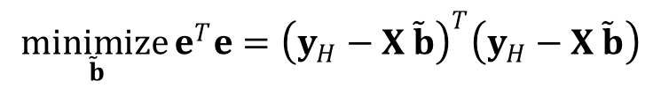
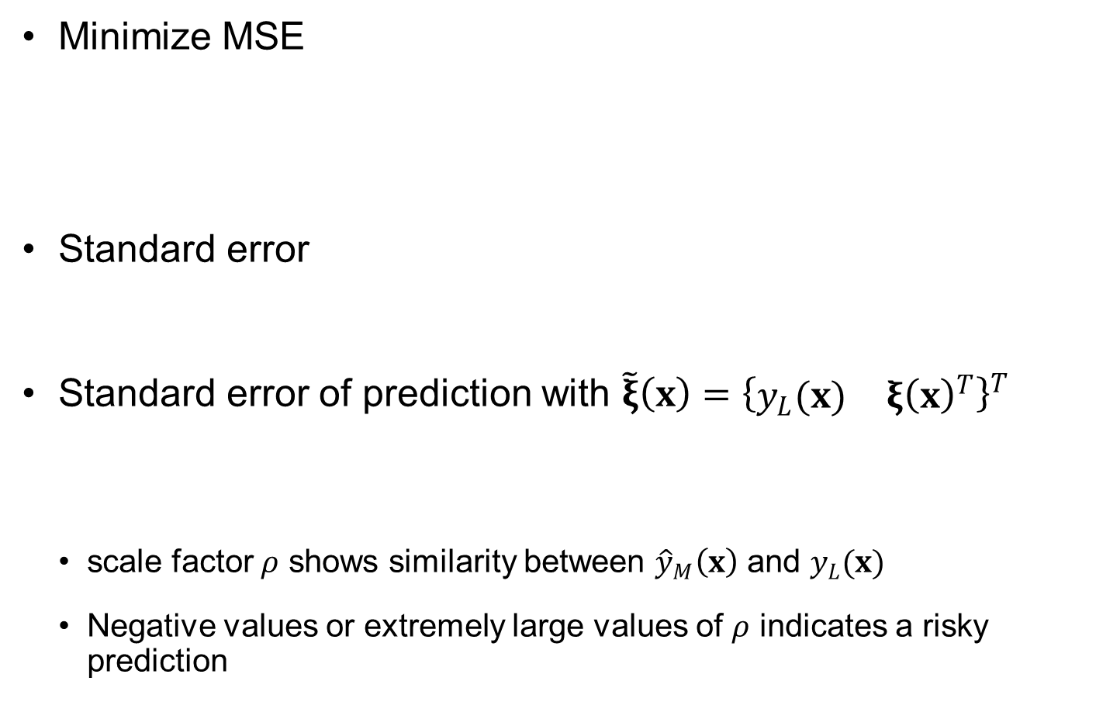
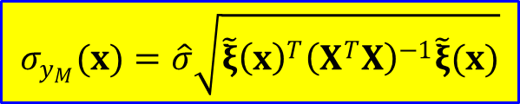

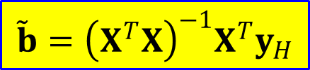
Linear Regression for MF Surrogate
$$\underset{ \tilde{b}}{minimize}{e^{T}e={\left(y_{H}−X \tilde{b}\right)}^{T}\left(y_{H}−X \tilde{b}\right)}$$
Minimize MSE
Standard error
Standard error of prediction with $\tilde{ξ}\left(x\right)={\left\{\begin{matrix}y_{L}(x) & ξ{\left(x\right)}^{T}\end{matrix}\right\}}^{T}$
scale factor $ρ$ shows similarity between ${\hat{y}}_{M}\left(x\right)$ and $y_{L}(x)$
Negative values or extremely large values of $ρ$ indicates a risky prediction
$$\tilde{b}={\left(X^{T}X\right)}^{−1}X^{T}y_{H}$$
$$\hat{σ}=\sqrt{\frac{e^{T}e}{n_{H}−(p+1)}}$$
$$σ_{y_{M}}(x)=\hat{σ}\sqrt{\tilde{ξ}{\left(x\right)}^{T}{\left(X^{T}X\right)}^{−1}\tilde{ξ}(x)}$$

Slide 22
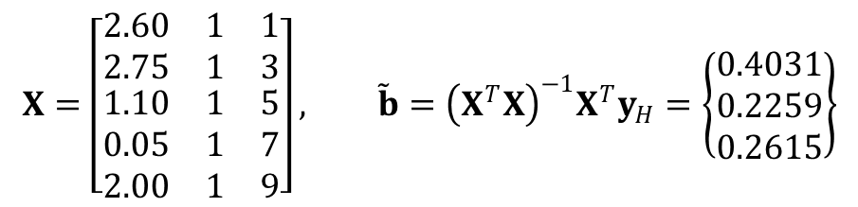


Ex9.3) Accuracy of MF Surrogate
HF $y_{H}\left(x\right)=\sin\left(x\right)+0.2x+{\left(x−5\right)}^{2}/16+0.6$ with $x_{H}={\left\{1 3 5 7 9\right\}}^{T}$ and $y_{H}={\left\{2.54, 1.49, 0.54, 2.81, 3.71\right\}}^{T}$
${\hat{y}}_{M}\left(x\right)=ρy_{L1}\left(x\right)+b_{1}+b_{2}x$, $y_{L1}\left(x\right)=\left(x−5\right)\left(x−4\right)\left(x−9\right)/20+2$
MF surrogate: ${\hat{y}}_{M}\left(x\right)=0.4031y_{L1}\left(x\right)+0.2259+0.2615x$
Large error $e_{RMSE}=0.9696$ due to low correlation between $y_{L1}$ and $y_{H}$
Correlation coefficient = 0.0833
$e_{RMSE}=0.6644$ for cubic PRS better than MF surrogate
$$X=\left[\begin{matrix}2.60 & 1 & 1 \\ 2.75 & 1 & 3 \\ \begin{matrix}1.10 \\ 0.05 \\ 2.00\end{matrix} & \begin{matrix}1 \\ 1 \\ 1\end{matrix} & \begin{matrix}5 \\ 7 \\ 9\end{matrix}\end{matrix}\right], \tilde{b}={\left(X^{T}X\right)}^{−1}X^{T}y_{H}=\left\{\begin{matrix}0.4031 \\ 0.2259 \\ 0.2615\end{matrix}\right\}$$
5
HF function
LF function
4
MF surrogate
3
2
1
0
0
2
4
$$x$$
6
8
10

Slide 23
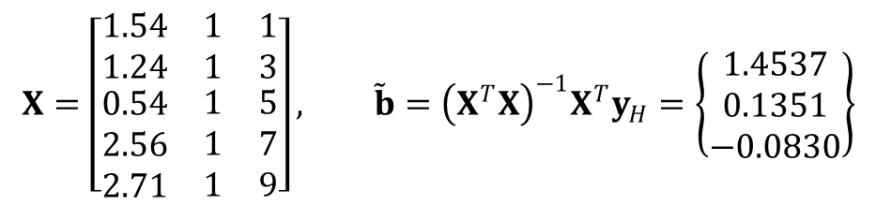


Ex9.3) Accuracy of MF Surrogate cont.
${\hat{y}}_{M}\left(x\right)=ρy_{L2}\left(x\right)+b_{1}+b_{2}x$, $y_{L2}\left(x\right)=\sin\left(x\right)+0.2x+0.5$
MF surrogate: ${\hat{y}}_{M}\left(x\right)=1.4537y_{L2}\left(x\right)+0.1351−0.083x$
Acceptable error $e_{RMSE}=0.4665$ due to low correlation between $y_{L1}$ and $y_{H}$
Most errors are extrapolation region
$e_{RMSE}=0.2450$ for interpolation region
Correlation coefficient = 0.9067
$$X=\left[\begin{matrix}1.54 & 1 & 1 \\ 1.24 & 1 & 3 \\ \begin{matrix}0.54 \\ 2.56 \\ 2.71\end{matrix} & \begin{matrix}1 \\ 1 \\ 1\end{matrix} & \begin{matrix}5 \\ 7 \\ 9\end{matrix}\end{matrix}\right], \tilde{b}={\left(X^{T}X\right)}^{−1}X^{T}y_{H}=\left\{\begin{matrix}1.4537 \\ 0.1351 \\ −0.0830\end{matrix}\right\}$$
4
HF function
LF function
MF surrogate
3
2
1
0
0
2
4
$$x$$
6
8
10

Slide 24



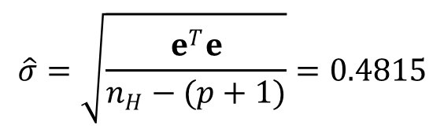
Ex9.4) Prediction Intervals using $y_{L2}(x)$
$$\hat{σ}=\sqrt{\frac{e^{T}e}{n_{H}−(p+1)}}=0.4815$$
Standard error
Standard error of prediction: $σ_{y_{M}}(x)=\hat{σ}\sqrt{\tilde{ξ}{\left(x\right)}^{T}{\left(X^{T}X\right)}^{−1}\tilde{ξ}(x)}$
Prediction intervals $PI=[−2.13σ_{y_{M}}\left(x\right), 2.13σ_{y_{M}}(x)]$
5
4
3
$${\hat{y}}_{M}(x)$$
2
1
0
-1
0
2
4
$$x$$
6
8
10

Slide 25
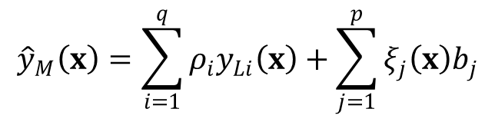
Multiple LF models
$${\hat{y}}_{M}\left(x\right)=\sum_{i=1}^{q}{ρ_{i}y_{Li}\left(x\right)}+\sum_{j=1}^{p}{ξ_{j}\left(x\right)b_{j}}$$
Multiple LF models
Can use non-monomial basis
Other advantages
Handling noise from different distributions
estimating confidence intervals, prediction intervals and tolerance limits
reducing model-form uncertainty via stepwise regression
obtaining optimal design of experiments, e.g., D-optimal designs
important to identify the importance of individual LF functions toward the prediction accuracy of MF surrogate
estimate the confidence of each coefficient and to identify unimportant basis functions

Slide 26
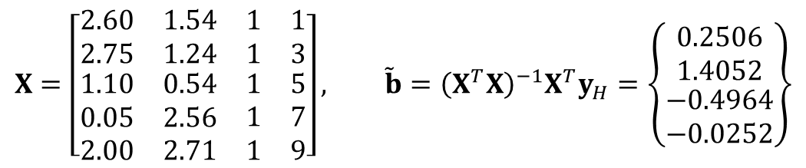



Ex9.5) Backward Elimination of LF Functions
MF surrogate: ${\hat{y}}_{M}\left(x\right)=ρ_{1}y_{L1}\left(x\right)+ρ_{2}y_{L2}\left(x\right)+b_{1}+b_{2}x$
$⇒{\hat{y}}_{M}\left(x\right)=0.2506y_{L1}\left(x\right)+1.4052y_{L2}\left(x\right)−0.4964−0.0252x$
$e_{RMSE}=0.3915$ (improved), $\hat{σ}=0.4944$ (worse)
$$X=\left[\begin{matrix}\begin{matrix}2.60 & 1.54\end{matrix} & \begin{matrix}1 & 1\end{matrix} \\ \begin{matrix}2.75 & 1.24\end{matrix} & \begin{matrix}1 & 3\end{matrix} \\ \begin{matrix}\begin{matrix}1.10 & 0.54\end{matrix} \\ \begin{matrix}0.05 & 2.56\end{matrix} \\ \begin{matrix}2.00 & 2.71\end{matrix}\end{matrix} & \begin{matrix}\begin{matrix}1 & 5\end{matrix} \\ \begin{matrix}1 & 7\end{matrix} \\ \begin{matrix}1 & 9\end{matrix}\end{matrix}\end{matrix}\right], \tilde{b}={\left(X^{T}X\right)}^{−1}X^{T}y_{H}=\left\{\begin{matrix}\begin{matrix}0.2506 \\ 1.4052\end{matrix} \\ \begin{matrix}−0.4964 \\ −0.0252\end{matrix}\end{matrix}\right\}$$
5
6
HF function
LF1 function
5
4
LF2 function
MF surrogate
4
3
3
2
2
1
1
0
0
0
2
4
6
8
10
-1
0
2
4
6
8
10
$$x$$
$$x$$

Slide 27
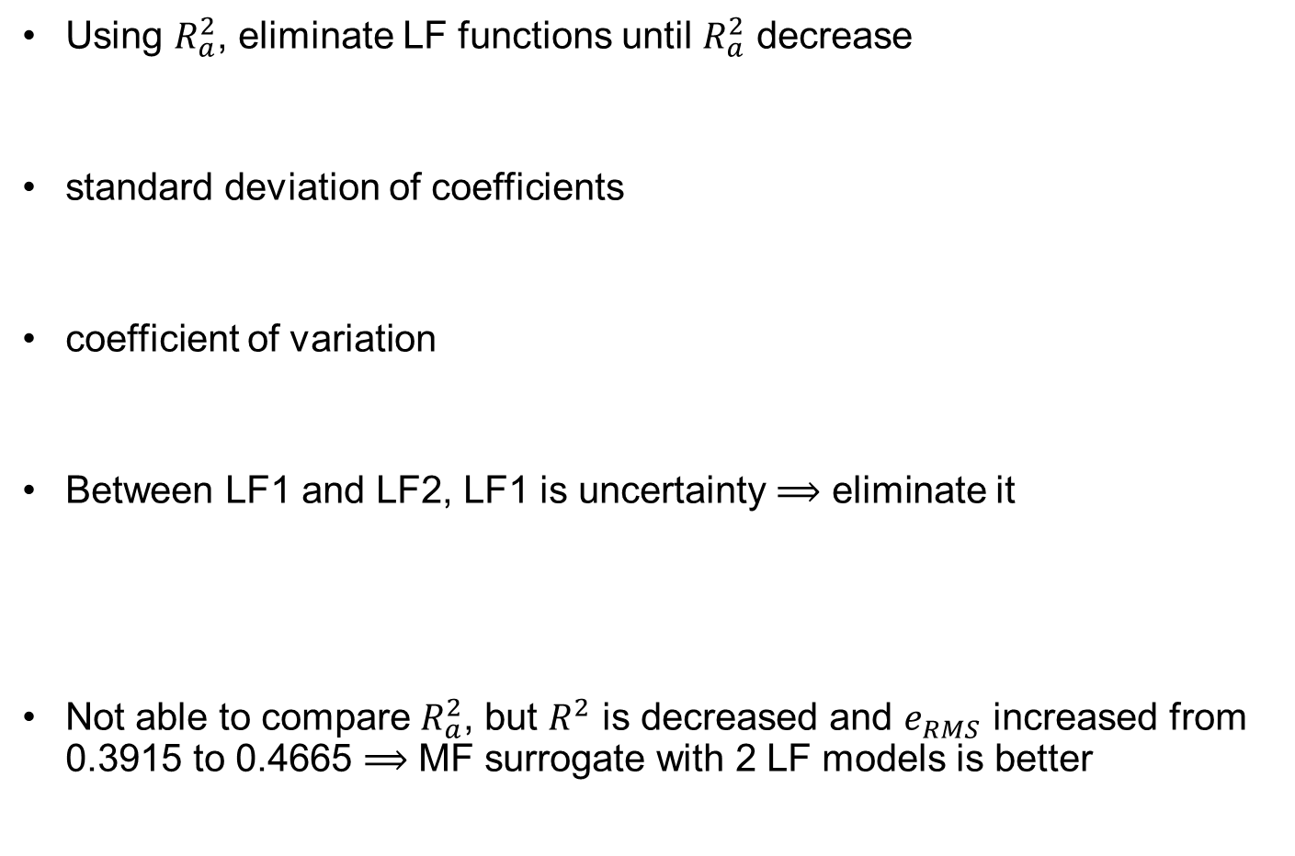
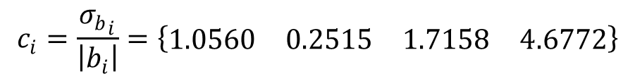
Ex9.5) Backward Elimination of LF Functions cont.
Using $R_{a}^{2}$, eliminate LF functions until $R_{a}^{2}$ decrease
standard deviation of coefficients
coefficient of variation
Between LF1 and LF2, LF1 is uncertainty $⟹$ eliminate it
Not able to compare $R_{a}^{2}$, but $R^{2}$ is decreased and $e_{RMS}$ increased from 0.3915 to 0.4665 $⟹$ MF surrogate with 2 LF models is better
$${\overline{y}}_{H}=2.2186, SS_{y}=6.0244, SS_{r}=5.78, R^{2}=0.9594, R_{a}^{2}=∞$$
$${σ_{b}}_{i}=\hat{σ}\sqrt{{\left[{\left(X^{T}X\right)}^{−1}\right]}_{ii}}=\left\{\begin{matrix}\begin{matrix}0.2647 & 0.3534\end{matrix} & \begin{matrix}0.8517 & 0.1180\end{matrix}\end{matrix}\right\}$$
$$c_{i}=\frac{{σ_{b}}_{i}}{\left|b_{i}\right|}=\left\{\begin{matrix}\begin{matrix}1.0560 & 0.2515\end{matrix} & \begin{matrix}1.7158 & 4.6772\end{matrix}\end{matrix}\right\}$$
$$⟹ {\hat{y}}_{M}\left(x\right)=1.4537y_{L2}\left(x\right)+0.1351−0.083x$$
$${\overline{y}}_{H}=2.2186, SS_{y}=6.0244, SS_{r}=5.5608, R^{2}=0.9230, R_{a}^{2}=0.6922$$

Slide 28
9.4 Kriging-based Multi-fidelity Surrogate
Low-fidelity scale factor plays important role in reducing uncertainty in the discrepancy prediction

Slide 29
Availability of LF Function
Bayesian multi-fidelity surrogate developed by Kennedy and O’Hagan
correlation between multi-fidelity datasets
provide prediction uncertainty at unsampled points
When LF functional form is available
computational cost of evaluating the LF function is ignorable
discrepancy surrogate needs to be built using HF samples
LF function does not cause any error and uncertainty
When no LF function but samples are available
LF surrogate is used to build MF surrogate and evaluate predictions
LF & discrepancy surrogates cause prediction uncertainty
Prefer to HF sample locations being a subset of LF sample locations

Slide 30

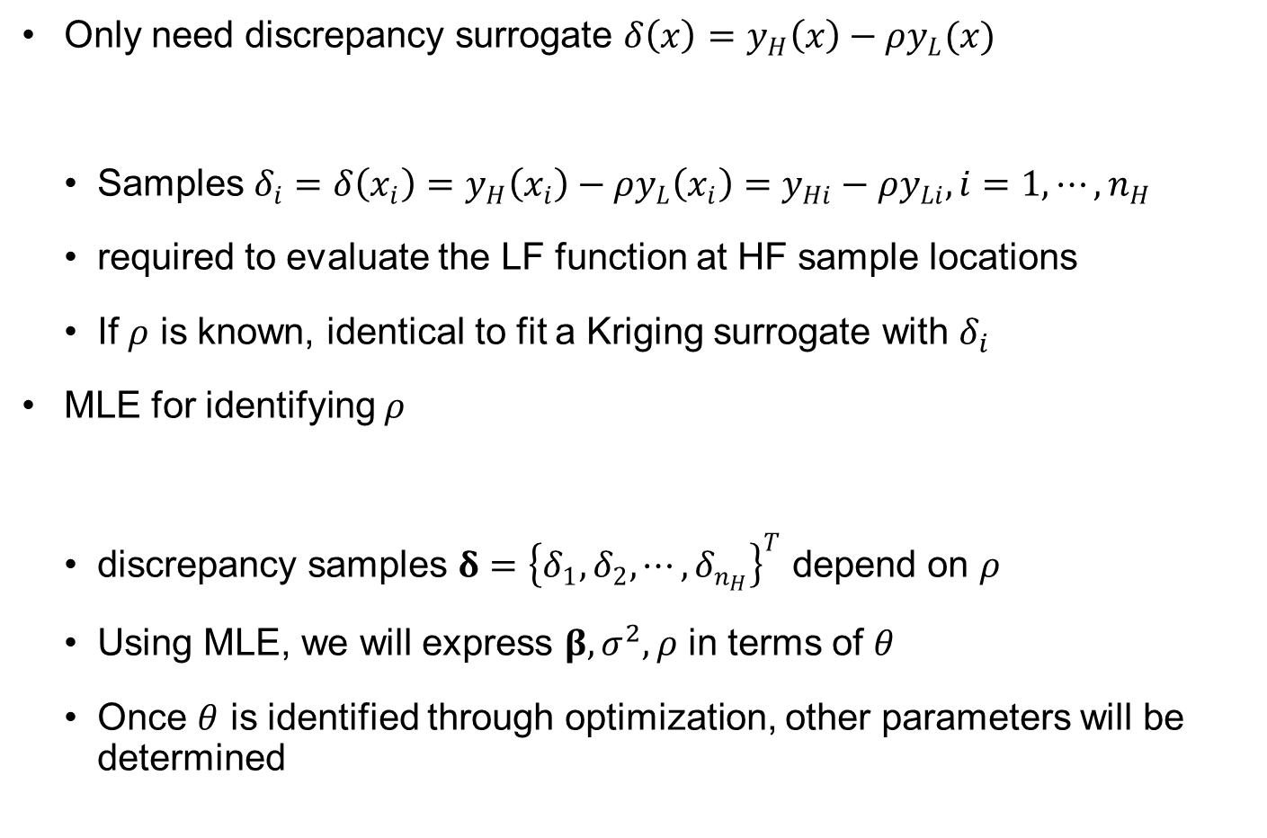
MF Surrogate with LF Function
Only need discrepancy surrogate $δ\left(x\right)=y_{H}\left(x\right)−ρy_{L}(x)$
Samples $δ_{i}=δ\left(x_{i}\right)=y_{H}\left(x_{i}\right)−{ρy}_{L}\left(x_{i}\right)=y_{Hi}−ρy_{Li}, i=1,⋯,n_{H}$
required to evaluate the LF function at HF sample locations
If $ρ$ is known, identical to fit a Kriging surrogate with $δ_{i}$
MLE for identifying $ρ$
discrepancy samples $δ={\left\{δ_{1}, δ_{2},⋯,δ_{n_{H}}\right\}}^{T}$ depend on $ρ$
Using MLE, we will express $β,σ^{2},ρ$ in terms of $θ$
Once $θ$ is identified through optimization, other parameters will be determined
$$\hat{δ}\left(x\right)=ξ{\left(x\right)}^{T}β+s(x)$$
$$\ln\left[f(y|β,σ^{2},θ,ρ)\right]=−\frac{n_{y}}{2}\ln\left(2π\right)−\frac{n_{y}}{2}\ln\left(σ^{2}\right)−\frac{1}{2}\ln\left|R\right|−\frac{{\left(δ−Xβ\right)}^{T}R^{−1}\left(δ−Xβ\right)}{2σ^{2}}$$

Slide 31
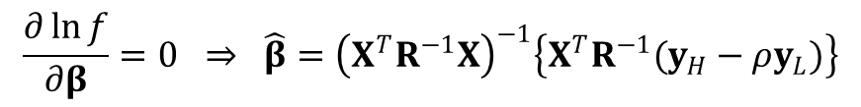
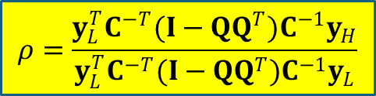
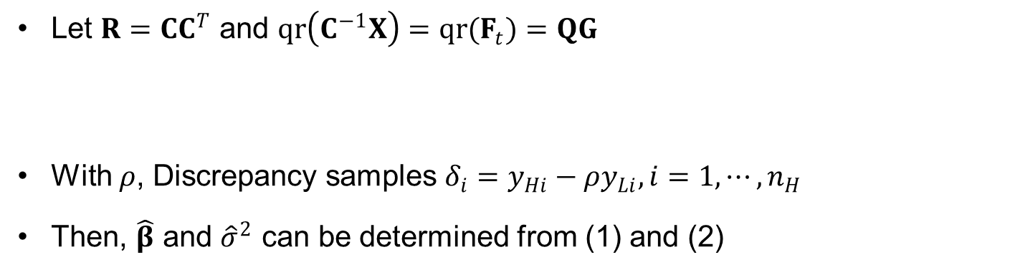
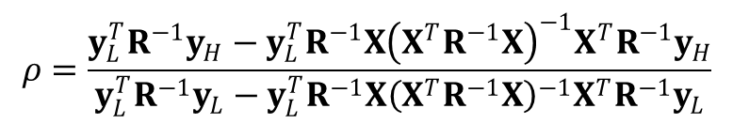
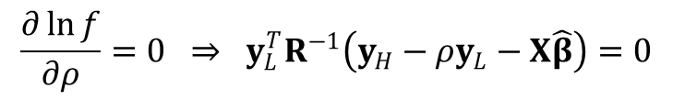
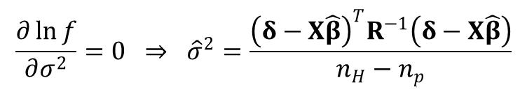
MLE of Discrepancy Parameters
$$\frac{∂\ln{f}}{∂β}=0 ⇒ \hat{β}={\left(X^{T}R^{−1}X\right)}^{−1}\left\{X^{T}R^{−1}(y_{H}−ρy_{L})\right\}$$
(1)
$${\frac{∂\ln{f}}{∂σ^{2}}=0 ⇒ \hat{σ}}^{2}=\frac{{\left(δ−X\hat{β}\right)}^{T}R^{−1}\left(δ−X\hat{β}\right)}{n_{H}−n_{p}}$$
(2)
$$\frac{∂\ln{f}}{∂ρ}=0 ⇒ y_{L}^{T}R^{−1}\left(y_{H}−ρy_{L}−X\hat{β}\right)=0$$
(3)
$$ρ=\frac{y_{L}^{T}R^{−1}y_{H}−y_{L}^{T}R^{−1}X{\left(X^{T}R^{−1}X\right)}^{−1}X^{T}R^{−1}y_{H}}{y_{L}^{T}R^{−1}y_{L}−y_{L}^{T}R^{−1}X{\left(X^{T}R^{−1}X\right)}^{−1}X^{T}R^{−1}y_{L}}$$
Let $R=CC^{T}$ and $qr\left(C^{−1}X\right)=qr(F_{t})=QG$
With $ρ$, Discrepancy samples $δ_{i}=y_{Hi}−ρy_{Li}, i=1,⋯,n_{H}$
Then, $\hat{β}$ and ${\hat{σ}}^{2}$ can be determined from (1) and (2)
$$ρ=\frac{y_{L}^{T}C^{−T}(I−QQ^{T})C^{−1}y_{H}}{y_{L}^{T}C^{−T}(I−QQ^{T})C^{−1}y_{L}}$$

Slide 32
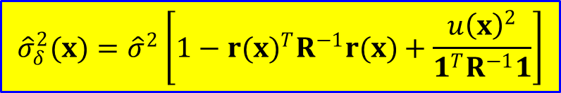



Optimization to Determine Hyperparameter $θ$
Minimizing negative log-likelihood with ${\hat{σ}}^{2}$ in (2)
Discrepancy Kriging surrogate
Prediction variance with $u\left(x\right)=ξ\left(x\right)−X^{T}R^{−1}r\left(x\right)$
Ex) Ordinary Kriging $X≡1={\left[1, 1, ⋯, 1\right]}^{T}$, $ξ\left(x\right)=1$
$$θ=\arg{\min\left[\ln\left({\hat{σ}}^{2(n_{H}−n_{p})}\left|R\right|\right)\right]}$$
$$\hat{δ}\left(x\right)=ξ{\left(x\right)}^{T}\hat{β}+{r\left(x\right)}^{T}R^{−1}\left(δ−X\hat{β}\right) \\ =ξ{\left(x\right)}^{T}\hat{β}+{r\left(x\right)}^{T}α$$
$${\hat{σ}}_{δ}^{2}(x)={\hat{σ}}^{2}\left[1−{r\left(x\right)}^{T}R^{−1}r(x)+u{\left(x\right)}^{T}{\left(X^{T}R^{−1}X\right)}^{−1}u(x)\right]$$
$${\hat{σ}}_{δ}^{2}(x)={\hat{σ}}^{2}\left[1−{r(x)}^{T}R^{−1}r(x)+\frac{u{\left(x\right)}^{2}}{1^{T}R^{−1}1}\right]$$

Slide 33
100-Line Matlab Function MFSLF
1 function [yDp,yDsig2,rho,nbD]=MFSLF(xs,ys,yLs,xp,trD,noise)
2 % Fit Bayesian multi-fidelity surrogate with LF function
3 % INPITS: xs: High-fidelity sample locations
4 % ys: High-fidelity samples
5 % yLs: Low-fidelity samples
6 % xp: Prediction points
7 % trD: Order of discrepancy function (0, 1, 2)
8 % noise: 0~no noise samples, 1~noisy samples
9 % OUTPUTS: yDp: Discrepancy predictions
10 % yDsig2: Discrepancy prediction variance
11 % rho: LF scale factor
12 % nbD: # of coefficients in discrepancy function
13 %
14 [ny,ndim]=size(xs);nvar=ndim+1;np=size(xp,1); % Scaling samples
15 meanx=mean(xs);stdx=std(xs); % Mean and STD of sample locations
16 xs=(xs-meanx)./stdx; % Scaling sample locations
17 meany=mean(ys);stdy=std(ys); % Mean and STD of samples
18 ys=(ys-meany)/stdy;yLs=(yLs-meany)/stdy; % Scaling samples
19 xp=(xp-meanx)./stdx; % Scaling of prediction points
20 %
21 nij=ny*(ny-1)/2; l=0; % # of upper-triangular components of RD
22 dH=zeros(nij,ndim); % Distance between HF samples
23 ijH=zeros(nij,2); % Index of correlation matrix
24 for i=1:ny-1
25 l=l(end)+(1:ny-i);
26 ijH(l,:)=[repmat(i,ny-i,1),(i+1:ny)'];
27 dH(l,:)=repmat(xs(i,:),ny-i,1)-xs(i+1:ny,:);
28 end
Detailed explanations can be found in the textbook!

Slide 34
29 %
30 % Estimating discrepancy hyper-parameters
31 parD=struct('xs',xs,'ys',ys,'yLs',yLs,'d',dH,'ij',ijH,'trPRS',min(trD,2));
32 hyp0 = [ny^(-1/4)*ones(ndim,1); min(0.1,noise)];
33 lb=[0.01*ones(ndim,1);0];ub=[6*ones(ndim,1);noise];% Lower- & upper-bounds
34 options=optimset('Display','off','TolFun',1e-6,'DiffMinChange',0.001);
35 %hypOpt=fmincon(@(hyp) fitDIS(hyp,parD),hyp0,[],[],[],[],lb,ub,[],options);
36 hypOpt = ga(@(hyp) fitDIS(hyp,parD),nvar,[],[],[],[],lb,ub,[],options)';
37 %hypOpt = simulannealbnd(@(hyp) fitDIS(hyp,parD),hyp0,lb,ub,options);
38 hypD=hypOpt(1:size(xs,2)); tau=max(0,hypOpt(end));
39 fprintf('Discrepancy hyperparam:%8.3g\n',hypD.*stdx');
40 if noise ~= 0, fprintf('Discrepancy noise fraction:%8.3g\n',tau); end
41 %
42 [~,fitD]=fitDIS(hypOpt,parD); % Fitting Kriging surrogate
43 rho=fitD.rho; fprintf('LF scale factor:%8.3g\n',rho);
44 %
45 % Evaluating discrepancy surrogate at prediction points
46 xi = trend(xp,trD); nbD=size(xi,2); % Trend basis vector at np points
47 xrep=repmat(xp',ny,1); xrep=transpose(reshape(xrep,ndim,np*ny));
48 d=xrep-repmat(xs,np,1); % Distance b/w predictions & samples
49 r = (1-tau)*exp(sum(-(d./hypD').^2,2)); % Correlation b/w preds & samples
50 r = reshape(r,ny,np);
51 yDp=xi*fitD.beta + (fitD.alpha*r)'; % Kriging predictions
52 yDp=yDp*stdy+(1-rho)*meany; % Unscaling predictions
53 %
54 % Prediction variance of discreepancy surrogate
55 rt=fitD.C\r;
56 q=fitD.G\(xi'-fitD.Ft'*rt);
57 sigma2=fitD.sigma2.*stdy.^2; % Process variance
58 yDsig2=sigma2.*(1-sum(rt.^2,1)+sum(q.^2,1))'; % Prediction variance
59 fprintf('Disc. process std :%8.3g\n',sqrt(sigma2)*stdy);
60 if noise~=0, fprintf('Disc. Noise std :%8.3g\n',sqrt(tau*sigma2)*stdy);end
61 end
62 %
63 %

Slide 35
64 function [negLogLK,fit]=fitDIS(xvar,par)
65 % Negative log-likelihood estimate for given hyper-parameter
66 % INPUTS xvar : Hyper-parameter (hyp) & noise (tau)
67 % par : Model parameters structure
68 % OUTPUTS negLogLK : Negative log-likelihood function
69 % fit : Necessary parameters for function evaluation
70 %
71 hyp=xvar(1:size(par.xs,2)); tau=xvar(end);
72 H = trend(par.xs,par.trPRS); % Design matrix
73 ny=size(par.ys,1); nb=size(H,2); % ny: # of samples, nb: # of coeff.
74 r = (1-tau)*exp(sum(-(par.d./hyp(:)').^2, 2)); % Correlation b/w samples
75 idx=find(r>0); % Index of nonzero components in sparse matrix
76 ii=(1:ny)'; % Diagonal index
77 mu=ones(ny,1)+(10+ny)*eps; % Small diagonal to prevent singularity
78 R=sparse([par.ij(idx,1);ii],[par.ij(idx,2);ii],[r(idx);mu]); % Correlation
79 [C,~]=chol(R); % Cholesky decomposition R = C'*C
80 C=C'; % Transpose: R = C*C'
81 Ft=C\H; % Ft=[C^1][X]
82 [Q,G]=qr(Ft,0); % qr-factorization, Ft = Q*G
83 %
84 Ylt=C\par.yLs; % Maximum likelihood estimate of LF scale factor
85 Yht=C\par.ys;
86 taul=(eye(ny)-Q*Q')*Ylt;
87 tauh=(eye(ny)-Q*Q')*Yht;
88 rhol=max(0.1,min(3,taul'*tauh/(taul'*taul))); % LF scale factor
89 %
90 dis=par.ys-rhol*par.yLs; % Discrepancy samples
91 Yt=C\dis;
92 b=G\(Q'*Yt); % Coefficients of trend function
93 rho=(Yt-Ft*b); % rho = Cinv*(y-Xb)
94 alpha=rho'/C; % alpha = (y-Xb)'*Rinv
95 detR = sum(log(full(diag(C)).^2)); % Determinant of correlation matrix
96 sigma2=sum(rho.^2)/(ny-nb); % Process variance
97 negLogLK=detR + (ny-nb)*log(sigma2); % Negative log-likelihood
98 fit = struct('sigma2',sigma2,'beta',b,'alpha',alpha,'C',C,'Ft',Ft,...
99 'G',G','rho',rhol);
100 end

Slide 36

Ex9.6) MF Surrogate with LF Function
HF samples: $x_{s}={\left\{0.5862, 0.3638, 0.8198\right\}}^{T}$
HF function $y_{H}(x)={\left(6x−2\right)}^{2}\sin{(12x−4)}$
LF function $y_{L}\left(x\right)=0.5\left[{\left(6x−2\right)}^{2}\sin\left(12x−4\right)\right]+10\left(x−0.5\right)+5$
Correlation between HF and LF is medium (corr. coef. = 0.74)
Genetic algorithm $θ=1.37$
discrepancy function does not fluctuate much over the design space
$\hat{σ}=29.8$ but ${\hat{σ}}_{δ}^{2}(x)≈0$ in interpolation region
$ρ=1.76$: separate the LF function from HF function further
discrepancy function can have a simpler form with less fluctuation
40
y
L
(x) true
30
y
L
(x)
y
H
(x) true
y
H
(x) samples
20
10
0
-10
0
0.2
0.4
0.6
0.8
1
x

Slide 37
Ex9.6) MF Surrogate with LF Function cont.
1 lowfun = @(x) 0.5*((6*x-2).^2.*sin(12*x-4))+10*(x-0.5)+5;
2 highfun = @(x) (6*x-2).^2.*sin(12*x-4);
3 xs=[0.5862,0.3638,0.8198]';nHy=size(xs,1); % HF sample locations & size
4 yLs=lowfun(xs);yHs=highfun(xs); % LF & HF samples
5 x=(0:0.01:1)';N=size(x,1); % Prediction points
6 yLtrue=lowfun(x);yHtrue=highfun(x); % True LF & HF functions
7 [yDp,yDsig2,rho,nbD] = MFSLF(xs,yHs,yLs,x,0,0); % fitting Bayesian MFS
8 %
9 yHp=rho*yLtrue+yDp; % Multi-fidelity predictions
10 yHsig=rho*sqrt(yDsig2); % Prediction STD
11 PI = yHp + tinv([0.025 0.975],nHy-nbD).*yHsig; % Prediction intervals
12 figure(1); hold on; % Plotting result MF surrogate
13 xShaded=[x;sort(x,'descend')]; yShaded=[PI(:,1);PI(end:-1:1,2)];
14 patch(xShaded,yShaded,[.24 .73 .89],'EdgeColor','none');
15 plot(x,yHp,'r-',xs,yHs,'k+',x,yHtrue,'k-','LineWidth',2,'Markersize',10);
16 legend('95% PI','y_M(x) prediction','y_H(x) samples','y_H(x) true');
17 xlabel('x'); set(gca,'Fontsize',14)
18 %
19 yDsig=sqrt(yDsig2); yDtrue=yHtrue-rho*yLtrue;% Discrepancy STD & prediction
20 PI = yDp + tinv([0.025 0.975],nHy-nbD).*yDsig; % Prediction intervals
21 figure(2); hold on; % Plotting discrepancy surrogate
22 xShaded=[x;sort(x,'descend')]; yShaded=[PI(:,1);PI(end:-1:1,2)];
23 patch(xShaded,yShaded,[.24 .73 .89],'EdgeColor','none');
24 plot(x,yDp,'r-',xs,yHs-rho*yLs,'k+',x,yDtrue,'k-','LineWidth',2,'Markersize',10)
25 legend('95% PI','y_D(x) prediction','y_D(x) samples','y_D(x) true');
26 xlabel('x'); set(gca,'Fontsize',14)
27 %
28 eRMS=sqrt(sum((yHtrue-yHp).^2)/N); % RMS error at N grid points
29 eav=sum(abs(yHtrue-yHp))/N; % Average error at NxN grid points
30 emax=max(abs(yHtrue-yHp)); % Maximum error at NxN grid points
31 fprintf('RMS error:%8.3g\nAve error:%8.3g\nMax error:%8.3g\n',eRMS,eav,emax);

Slide 38

Ex9.6) MF Surrogate with LF Function cont.
most errors in predictions and prediction variance follow the same trend with the discrepancy function
$e_{RMS}=1.03$, $e_{av}=0.664$, $e_{max}=2.77$
accuracy of surrogate is good
most errors occur in the extrapolation region
MF surrogate
Discrepancy surrogate
20
5
95% PI
95% PI
15
y
M
(x) prediction
y
D
(x) prediction
y
H
(x) samples
0
y
(x) samples
y
(x) true
y
D
(x) true
10
H
D
-5
5
-10
0
-5
-15
-10
0
0.2
0.4
0.6
0.8
1
-20
0
0.2
0.4
0.6
0.8
1
x
x

Slide 39

Effect of LF Scale Factor
What if we fix $ρ=1$?
predictions show clear difference from the true HF function even within the interpolation region
$θ=0.865$: Discrepancy surrogate varies rapidly
$e_{RMS}=3.63$, $e_{av}=2.23$, $e_{max}=11.6$
Performance is deteriorated
20
5
95% PI
95% PI
15
y
M
(x) prediction
y
(x) prediction
y
(x) samples
0
D
10
H
y
(x) samples
y
(x) true
D
H
y
(x) true
5
D
-5
0
-10
-5
-10
-15
-15
0
0.2
0.4
0.6
0.8
1
-20
x
0
0.2
0.4
0.6
0.8
1
x

Slide 40
MF Surrogate with LF Samples: Matlab Function MFS
Need to build LF surrogate before building the discrepancy surrogate
No. of LF samples is much larger than that of HF samples
HF samples are co-located with LF samples
If not, LF surrogate is used to predict, added additional uncertainty
1 function [yLp,yLsig2,yDp,yDsig2,rho,nbL,nbD]=MFS(xLs,yLs,xs,ys,xp,trL,trD,noise)
2 % Fit Bayesian multi-fidelity surrogate
3 % INPITS: xLs: Low-fidelity sample locations
4 % yLs: Low-fidelity samples
5 % xs: High-fidelity sample locations
6 % ys: High-fidelity samples
7 % xp: Prediction points
8 % trL: Order of LF trend function (0, 1, 2)
9 % trD: Order of discrepancy function (0, 1, 2)
10 % noise: 0~no noise samples, 1~noisy samples
11 % OUTPUTS: yLp: LF predictions
12 % yLsig2: LF prediction variance
13 % yDp: Discrepancy predictions
14 % yDsig2: Discrepancy prediction variance
15 % rho: LF scale factor
16 % nbL: # of coefficients in LF trend function
17 % nbD: # of coefficients in discrepancy function
18 %

Slide 41
19 % Scaling samples
20 [nLy,ndim]=size(xLs);nvar=ndim+1;ny=size(xs,1);np=size(xp,1);
21 meanx=mean(xLs);stdx=std(xLs); % Mean and STD of sample locations
22 xLs=(xLs-meanx)./stdx;xs=(xs-meanx)./stdx; % Scaling sample locations
23 meany=mean(yLs);stdy=std(yLs); % Mean and STD of samples
24 yLs=(yLs-meany)/stdy;ys=(ys-meany)/stdy; % Scaling samples
25 xp=(xp-meanx)./stdx; % Scaling of prediction points
26 %
27 nij=nLy*(nLy-1)/2; l=0; % # of upper-triangular components of RL
28 dL=zeros(nij,ndim); % Distance between LF samples
29 ijL=zeros(nij,2); % Index of correlation matrix
30 for i=1:nLy-1
31 l=l(end)+(1:nLy-i);
32 ijL(l,:)=[repmat(i,nLy-i,1),(i+1:nLy)'];
33 dL(l,:)=repmat(xLs(i,:),nLy-i,1)-xLs(i+1:nLy,:);
34 end
35 %
36 nij=ny*(ny-1)/2; l=0; % # of upper-triangular components of RD
37 dH=zeros(nij,ndim); % Distance between HF samples
38 ijH=zeros(nij,2); % Index of correlation matrix
39 for i=1:ny-1
40 l=l(end)+(1:ny-i);
41 ijH(l,:)=[repmat(i,ny-i,1),(i+1:ny)'];
42 dH(l,:)=repmat(xs(i,:),ny-i,1)-xs(i+1:ny,:);
43 end
44 %
45 % Estimating LF hyper-parameters
46 parL=struct('xs',xLs,'ys',yLs,'d',dL,'ij',ijL,'trPRS',min(trL,2));
47 hyp0 = [ny^(-1/4)*ones(ndim,1); min(0.1,noise)]; % Initial values
48 lb=[0.01*ones(ndim,1);0];ub=[6*ones(ndim,1);noise];% Lower- & upper-bounds
49 options=optimset('Display','off','TolFun',1e-6,'DiffMinChange',0.001);
50 %hypOpt=fmincon(@(hyp) fitKRG(hyp,parL),hyp0,[],[],[],[],lb,ub,[],options);
51 hypOpt = ga(@(hyp) fitKRG(hyp,parL),nvar,[],[],[],[],lb,ub,[],options)';
52 %hypOpt = simulannealbnd(@(hyp) fitKRG(hyp,parL),hyp0,lb,ub,options);
53 hypL=hypOpt(1:size(xLs,2)); tau=max(0,hypOpt(end));
54 fprintf('LF Hyperparameters:%8.3g\n',hypL.*stdx');
55 if noise ~= 0, fprintf('LF Noise fraction:%8.3g\n',tau); end

Slide 42
57 [~,fitL]=fitKRG(hypOpt,parL); % Fitting LF Kriging surrogate
58 %
59 % Evaluating LF surrogate at prediction points
60 xi = trend(xp,trL); nbL=size(xi,2); % Trend basis vector at np points
61 xrep=repmat(xp',nLy,1); xrep=transpose(reshape(xrep,ndim,np*nLy));
62 d=xrep-repmat(xLs,np,1); % Distance b/w predictions & samples
63 r = (1-tau)*exp(sum(-(d./hypL').^2,2));% Correlation b/w preds & samples
64 r = reshape(r,nLy,np);
65 yLp=meany+stdy*(xi*fitL.beta + (fitL.alpha*r)'); % LF Kriging predictions
66 %
67 % Prediction variance of LF surrogate
68 rt=fitL.C\r;
69 q=fitL.G\(xi'-fitL.Ft'*rt);
70 sigma2=fitL.sigma2.*stdy.^2; % Process variance
71 yLsig2=sigma2.*(1-sum(rt.^2,1)+sum(q.^2,1))'; % Prediction variace
72 fprintf('LF process std :%8.3g\n',sqrt(sigma2)*stdy);
73 if noise~=0, fprintf('LF Noise std :%8.3g\n',sqrt(tau*sigma2)*stdy); end
74 %
75 % Generating LF samples at HF sample locations
76 xi = trend(xs,trL); % Trend basis vector at ny points
77 xrep=repmat(xs',nLy,1); xrep=transpose(reshape(xrep,ndim,ny*nLy));
78 d=xrep-repmat(xLs,ny,1); % Distance b/w predictions & samples
79 r = (1-tau)*exp(sum(-(d./hypL').^2,2)); % Correlation b/w preds & samples
80 r = reshape(r,nLy,ny);
81 yLs=xi*fitL.beta + (fitL.alpha*r)'; % Kriging predictions
82 %
83 % Estimating discrepancy hyper-parameters
84 parD=struct('xs',xs,'ys',ys,'yLs',yLs,'d',dH,'ij',ijH,'trPRS',min(trD,2));
85 hyp0 = [ny^(-1/4)*ones(ndim,1); min(0.1,noise)];
86 lb=[0.01*ones(ndim,1);0];ub=[6*ones(ndim,1);noise];% Lower- & upper-bounds
87 options=optimset('Display','off','TolFun',1e-6,'DiffMinChange',0.001);
88 %hypOpt=fmincon(@(hyp) fitDIS(hyp,parD),hyp0,[],[],[],[],lb,ub,[],options);
89 hypOpt = ga(@(hyp) fitDIS(hyp,parD),nvar,[],[],[],[],lb,ub,[],options)';
90 %hypOpt = simulannealbnd(@(hyp) fitDIS(hyp,parD),hyp0,lb,ub,options);
91 hypD=hypOpt(1:size(xs,2)); tau=max(0,hypOpt(end));
92 fprintf('Discrepancy hyperparam:%8.3g\n',hypD.*stdx');
93 if noise ~= 0, fprintf('Discrepancy noise fraction:%8.3g\n',tau); end

Slide 43
94 %
95 [~,fitD]=fitDIS(hypOpt,parD); % Fitting Kriging surrogate
96 rho=fitD.rho;
97 fprintf('LF scale factor:%8.3g\n',rho);
98 %
99 % Evaluating discrepancy surrogate at prediction points
100 xi = trend(xp,trD); nbD=size(xi,2); % Trend basis vector at np points
101 xrep=repmat(xp',ny,1); xrep=transpose(reshape(xrep,ndim,np*ny));
102 d=xrep-repmat(xs,np,1); % Distance b/w predictions & samples
103 r = (1-tau)*exp(sum(-(d./hypD').^2,2)); % Correlation b/w preds & samples
104 r = reshape(r,ny,np);
105 yDp=xi*fitD.beta + (fitD.alpha*r)'; % Kriging predictions
106 yDp=yDp*stdy+(1-rho)*meany; % Unscaling predictions
107 %
108 % Prediction variance of discreepancy surrogate
109 rt=fitD.C\r;
110 q=fitD.G\(xi'-fitD.Ft'*rt);
111 sigma2=fitD.sigma2.*stdy.^2; % Process variance
112 yDsig2=sigma2.*(1-sum(rt.^2,1)+sum(q.^2,1))'; % Prediction variance
113 fprintf('Disc. process std :%8.3g\n',sqrt(sigma2)*stdy);
114 if noise~=0, fprintf('Disc. Noise std :%8.3g\n',sqrt(tau*sigma2)*stdy);end
115 end
Refer to the textbook for detailed explanations!

Slide 44

Ex9.7) MF Surrogate with LF Samples
4 HF samples $x_{H}={\left\{0.5862, 0.0007, 0.3638, 0.8198\right\}}^{T}$
$x_{L}={\left\{0.1548,0.7148,0.4934,0.9932,0.5862,0.0007,0.3638,0.8198\right\}}^{T}$
HF function $y_{H}(x)={\left(6x−2\right)}^{2}\sin{(12x−4)}$
LF function $y_{L}\left(x\right)=0.5\left[{\left(6x−2\right)}^{2}\sin\left(12x−4\right)\right]+10\left(x−0.5\right)+5$
1 lowfun = @(x) 0.5*((6*x-2).^2.*sin(12*x-4))+10*(x-0.5)+5;
2 highfun = @(x) (6*x-2).^2.*sin(12*x-4);
3 xLs=[0.1548,0.7148,0.4934,0.9932,0.5862,0.0007,0.3638,0.8198]'; % LF inputs
4 xHs=[0.5862,0.0007,0.3638,0.8198]'; % HF inputs
5 yLs=lowfun(xLs); % low-fidelity outputs
6 yHs=highfun(xHs); % high-fidelity outputs
7 trL=0; % LF trend function order (0, 1, 2)
8 trD=0; % Discrepancy trend function order (0, 1, 2)
9 x=(0:0.01:1)';
10 nHy=size(yHs,1);nLy=size(yLs,1);
11 % fitting Bayesian MFS
12 [yLp,yLsig2,yDp,yDsig2,rho,nbL,nbH] = MFS(xLs,yLs,xHs,yHs,x,trL,trD,0);
13 yHp=rho*yLp+yDp;
14 yHsig=sqrt(rho^2*yLsig2+yDsig2);
15 cilb = yHp + tinv(0.025,nHy-nbH)*yHsig; % Lower-bounds of PI
16 ciub = yHp + tinv(0.975,nHy-nbH)*yHsig; % Upper-bounds of PI
17 yHtrue=highfun(x);
18 % plotting result
19 figure(1); hold on;
20 xShaded=[x;sort(x,'descend')]; yShaded=[cilb;ciub(end:-1:1)];

Slide 45
Ex9.7) MF Surrogate with LF Samples cont.
21 patch(xShaded,yShaded,[.24 .73 .89],'EdgeColor','none');
22 plot(x,yHp,'r-','LineWidth',2)
23 plot(xHs,yHs,'k+','LineWidth',2,'Markersize',10)
24 plot(x,yHtrue,'k-','lineWidth',2)
25 legend('95% CI','y_M(x) prediction','y_H(x) samples','y_H(x) true');
26 xlabel('x'); set(gca,'Fontsize',14)
27 %
28 yLtrue=lowfun(x); yLsig=sqrt(yLsig2);
29 cilb = yLp + tinv(0.025,nLy-nbL)*yLsig; % Lower-bounds of PI
30 ciub = yLp + tinv(0.975,nLy-nbL)*yLsig; % Upper-bounds of PI
31 figure(2); hold on;
32 xShaded=[x;sort(x,'descend')]; yShaded=[cilb;ciub(end:-1:1)];
33 patch(xShaded,yShaded,[.24 .73 .89],'EdgeColor','none');
34 plot(x,yLp,'r-','LineWidth',2)
35 plot(xLs,yLs,'k+','LineWidth',2,'Markersize',10)
36 plot(x,yLtrue,'k-','lineWidth',2)
37 legend('95% CI','y_L(x) prediction','y_L(x) samples','y_L(x) true');
38 xlabel('x'); set(gca,'Fontsize',14)
39 %
40 figure(3); hold on;
41 yDsig=sqrt(yDsig2); yDtrue=yHtrue-rho*yLtrue;
42 cilb = yDp + tinv(0.025,nHy-nbH)*yDsig; % Lower-bounds of PI
43 ciub = yDp + tinv(0.975,nHy-nbH)*yDsig; % Upper-bounds of PI
44 xShaded=[x;sort(x,'descend')]; yShaded=[cilb;ciub(end:-1:1)];
45 patch(xShaded,yShaded,[.24 .73 .89],'EdgeColor','none');
46 plot(x,yDp,'r-','LineWidth',2)
47 plot(xHs,yHs-rho*lowfun(xHs),'k+','LineWidth',2,'Markersize',10)
48 plot(x,yDtrue,'k-','lineWidth',2)
49 legend('95% CI','y_D(x) prediction','y_D(x) samples','y_D(x) true');
50 xlabel('x'); set(gca,'Fontsize',14)

Slide 46
Ex9.7) MF Surrogate with LF Samples cont.
20
20
LF samples
95% PI
LF function
y
(x) prediction
15
HF samples
L
15
y
(x) samples
HF function
L
10
y
(x) true
L
5
10
0
5
-5
-10
0
0
0.2
0.4
0.6
0.8
1
0
0.2
0.4
0.6
0.8
1
x
x
0
20
95% PI
95% PI
y
(x) prediction
y
(x) prediction
-5
D
15
M
y
(x) samples
y
(x) samples
D
H
y
(x) true
10
y
(x) true
D
H
-10
5
-15
0
-20
-5
-25
0
0.2
0.4
0.6
0.8
1
-10
0
0.2
0.4
0.6
0.8
1
x
x

Slide 47

Ex9.7) MF Surrogate with LF Samples cont.
LF surrogate
correlation coefficient between the LF and HF is 0.74
$θ=0.272$: LF function fluctuates within the range of the input variable
$e_{RMS}=0.171$, $e_{av}=0.078$, and $e_{max}=0.613$
Discrepancy surrogate
almost a straight line with minimal prediction intervals, $θ=2.01$
$e_{RMS}=0.557$, $e_{av}=0.266$, and $e_{max}=2.09$
Simplicity is achieved by LF scale factor $ρ=2.15$, which has more errors, but make the discrepancy simpler
MF surrogate
$e_{RMS}=0.375$, $e_{av}=0.159$, and $e_{max}=2.49$
Most error from discrepancy, most uncertainty from LF surrogate

Slide 48

Effect of LF Scale Factor
What if we fix $ρ=1$?
predictions show clear difference from the true HF function even within the interpolation region
$θ=0.495$: Discrepancy surrogate varies rapidly
$e_{RMS}=3.16$, $e_{av}=1.63$, $e_{max}=10.4$: about 5 times more than before
Performance is deteriorated
20
5
95% PI
95% PI
15
y
M
(x) prediction
y
(x) prediction
y
(x) samples
0
D
H
y
(x) samples
y
(x) true
D
10
H
y
(x) true
D
-5
5
-10
0
-5
-15
-10
0
0.2
0.4
0.6
0.8
(a)
-20
(b)
1
0
0.2
0.4
0.6
0.8
1
x
x

Slide 49
9.5 Sampling Strategy for MF Surrogates
High-fidelity samples are a subset of low-fidelity samples

Slide 50
Sampling Issues in MF Surrogate
quality of approximation depends on the number and location of samples
space-filling sampling (LHS) is good for general purpose surrogate models
sampling strategy becomes complicated because multi-levels of samples need to be generated
how many samples should be for LF and HF surrogate?
how should they be located in the design space?
to obtain the required level of accuracy in the surrogate model with the least numbers of samples
how to allocate the number of samples between LF and HF surrogates
High cost ratio, it would be better to have many LF samples
Low cost ratio, a tradeoff between LF & HF samples would be important

Slide 51

Selecting Locations For LF And HF Samples
Once No. of LF and HF samples are determined, the next question is how to distribute them in the design space
Discrepancy is defined using the difference b/w two sets of samples
It would be better that HF sample set is a subset of the LF sample set
two sampling strategies: (a) nearest neighbor sampling and (b) nested design sampling
nearest neighbor sampling strategy
generates independent initial LF and HF sampling points using LHS
each HF sample point is moved to the nearest LF sampling point
nested design sampling
LHS is used to generate $n_{L}−n_{H}$ samples first
additional $n_{H}$ samples are generated by maximizing the min distance

Slide 52
Selecting Locations For LF And HF Samples cont.
(a) 40 LF (blue and green crosses) and 10 HF (red circles) samples
(b) Updated 40 LF samples (blue crosses) and 10 HF samples (red circles)
1
1
0.8
0.8
0.6
0.6
x
2
x
2
0.4
0.4
0.2
0.2
0
0
0.2
0.4
0.6
0.8
(a)
0
(b)
1
0
0.2
0.4
0.6
0.8
1
x
1
x
1

Slide 53

Allocating LF And HF Samples
examine MF surrogates with three factors that affect the performance:
total computational budget
high-to-low sample evaluation cost ratio
high-to-low sample size ratio
Test using Hartman-6 function
Budget | Cost ratio | Sample size ratio $n_{H}/n_{L}$
56H | 4 | 36/80, 26/120, 16/160, 6/200
 | 10 | 49/70, 46/100, 42/140, 35/210, 28/280, 21/350, 14/420, 7/490
 | 30 | 48/240, 46/300, 44/360, 42/420, 40/480, 38/540, 28/840, 18/1140
28H | 4 | 18/40, 13/60, 8/80, 3/100
 | 10 | 22/60, 19/90, 16/120, 13/150, 10/180, 7/210, 4/240
 | 30 | 24/120, 22/180, 20/240, 18/300, 16/360, 14/420, 10/540, 6/660, 4/720

Slide 54


MF Surrogate of Hartman-6 Function
Effect of sample ratio on the median of $e_{RMS}$ with cost ratio of 30
with such a high cost-ratio, LF surrogates yield better accuracy than HF surrogates
MF surrogates perform better in terms of median $e_{RMS}$ than the Kriging surrogates using only LF and HF samples
MF surrogates seem to have an optimal sample size ratio
0.14
Budge = 56H
0.17
0.13
LF
0.16
Budge = 28H
0.12
HF
0.15
LF
MF Disc
HF
0.11
MF Comp
0.14
MF Disc
0.1
0.13
MF Comp
Median RMSE
Median RMSE
0.09
0.12
0.08
0.11
0.07
0.1
0.06
0.09
0.05
0.08
0.04
0
0.05
0.1
0.15
0.2
0
0.05
0.1
0.15
0.2
(a)
(b)
Sample size ratio $n_{H}/n_{L}$
Sample size ratio $n_{H}/n_{L}$

Slide 55


MF Surrogate of Borehole Example
borehole function, which models the flow of water through a borehole penetrating two aquifers
Budget | Cost ratio | Sample size ratio
5H | 10 | 4/10, 3/20, 2/30
 | 30 | 4/30, 3/60, 2/90
10H | 10 | 8/20, 7/30, 6/40, 5/50, 4/60, 3/70, 2/80
 | 30 | 9/30, 8/60, 7/90, 6/120, 5/150, 4/180, 3/210, 2/240
16
25
14
LF
12
LF
20
HF
HF
MF Disc
10
MF Disc
MF Comp
MF Comp
15
Median RMSE
Median RMSE
8
6
10
4
5
2
0
0
0.05
0.1
0.15
0.2
0.25
0.3
0.35
(a)
0
(b)
0.02
0.04
0.06
0.08
0.1
0.12
0.14
Sample size ratio $n_{H}/n_{L}$
Sample size ratio $n_{H}/n_{L}$

Slide 56
9.6 Challenges and Recommendations
To take advantage of multi-fidelity surrogate, low-fidelity model has to be correlated with high-fidelity model

Slide 57

Deciding Whether To Use LF Samples
MF surrogates are not always better than single-fidelity (SF) surrogates
Need a criterion when to use MF surrogate instead of SF
use the comprehensive form and identify the LF scale factor $ρ$
If $ρ$ were very small, LF surrogate may not useful
MLE tends to give a preferrable choice to MF surrogates
MLE is not reliable to determine whether LF samples are useful or not
Lack of dependable criterion to determine the usage of LF surrogate

Slide 58
Choosing Between Multiple LF Datasets
LF mode that is more correlated with HF model is useful
performance of MF surrogate depends on DoEs in addition to the quality of LF samples
MLE and cross-validation estimations were not good at choosing a better LF model for a given DoE
choice between multiple LF models may be a challenge

Slide 59

Selecting $ρ$ for Other Surrogates
$ρ$ significantly improved the performance of MF surrogates by simplifying the model form of discrepancy surrogate
Finding $ρ$ by minimizing error between LF and HF doesn’t work well
MLE in Kriging is similar to reducing fluctuation in the discrepancy
But not all surrogates provide the uncertainty model as in Kriging
When non-Kriging surrogate is used for MF, use Kriging model to obtain $ρ$, and then, switch to a different surrogate for fitting a MF surrogate

Slide 60

Recommendations on Using MF Surrogates
Creating an MF surrogate usually involves a substantial investment of time and effort. should be used when a single-fidelity surrogate is not an option because one cannot afford enough samples for an adequately accurate single-fidelity surrogate.
Adding $ρ$ that transforms the additive correction to the comprehensive one often results in substantial improvement in accuracy
When the number of HF simulations is severely limited, there is an advantage of using the LF simulations for identifying the most important variables and having the discrepancy function $δ$ include only these variables. The dependence on the other variables may be still adequately captured through the scaled LF function or surrogate
When there are multiple LF simulations, those simulations that were considered adequate in the past have been the most promising candidates for our applications
In choosing between candidates LF simulations, high correlation between LF and HF samples is the most important consideration
Selecting an LF simulation that is cheap enough to avoid the need for LF surrogate has two important advantages: (i) it often substantially reduces the implementation effort; (ii) it often avoids a substantial loss of accuracy

